Slide 1
TAXES
Chapter 7

Slide 2
Benjamin Franklin wrote that
“nothing can be said to be certain except death and taxes.”
(In Indonesian: Tak ada yang dapat dikatakan pasti, kecuali mati dan pajak)

Slide 3
Definition
Taxation. The imposition of a mandatory levy or charge by a government unit to provide financing for public services.
Sales Tax. A tax based on the retail selling or rental price of tangible personal property, collected by the retailer at the time of purchase, and paid to the state or local government.

Slide 4
Definition
Sales Tax Rate. Sales tax expressed in its most common form, as a percent of the retail price of an item.
Excise Tax (Cukai) A tax levied by federal, state, and local governments on certain luxury or nonessential products and services such as alcoholic beverages, furs, tobacco products, telephone service, and airline and cruise ship tickets.

Slide 5
SALES TAX

Slide 6
DETERMINING SALES TAX BY USING SALES TAX TABLES

Slide 7
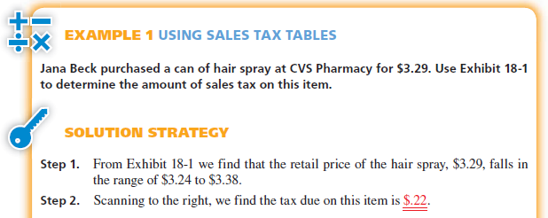

Slide 8
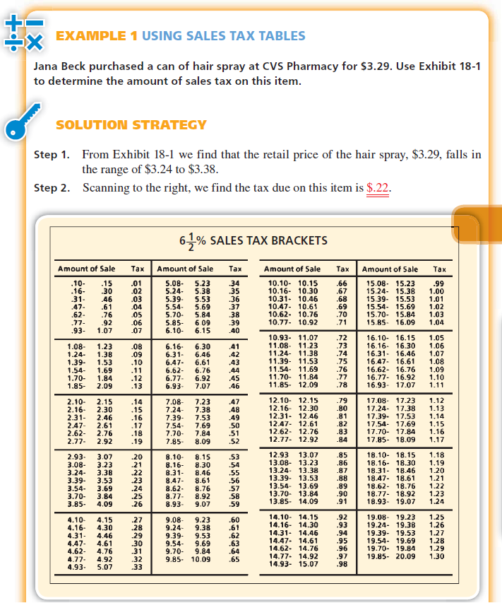

Slide 10
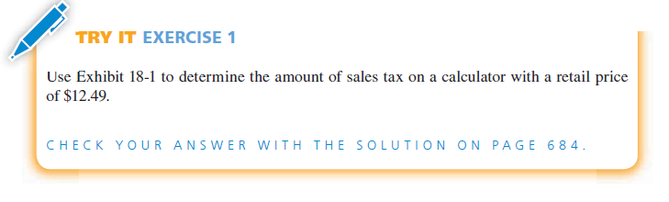

Slide 11
CALCULATING SALES TAX BY USING THE PERCENT METHOD
When sales tax tables are not available, the percent method may be used to calculate the sales tax on an item or service. Other nontaxable charges, such as packing, delivery, handling, or setup, are added after the sales tax has been computed.

Slide 12
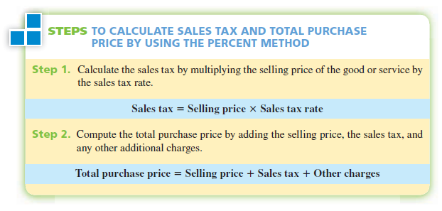

Slide 13
EXAMPLE: CALCULATING SALES TAX
Ryan Miller purchased a riding lawnmower for $488.95 at a Wal-Mart store in Atlanta, Georgia. The store charges $25 for delivery and $15 for assembly. If the state sales tax in Georgia is 5%, and Atlanta has a 1.5% city tax, what is the amount of sales tax on the lawnmower and what is the total purchase price?

Slide 14
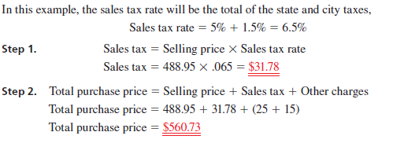
Solution Strategy

Slide 15
Exercise
Tim Meekma purchased a car for $38,600 at Auto City in Milwaukee, Wisconsin. If the dealer preparation charges are $240 and the sales tax rate in Wisconsin is 5%, what is the amount of sales tax on the car, and what is the total purchase price?

Slide 16
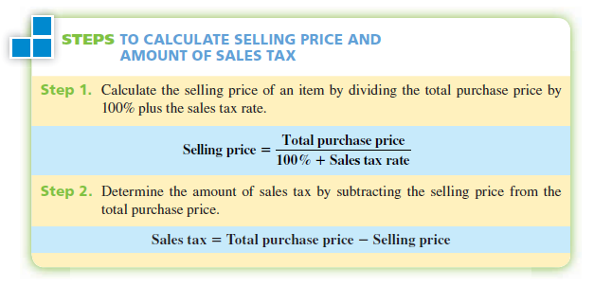
CALCULATING SELLING PRICE AND AMOUNT OF
SALES TAX WHEN TOTAL PURCHASE PRICE IS KNOWN

Slide 17
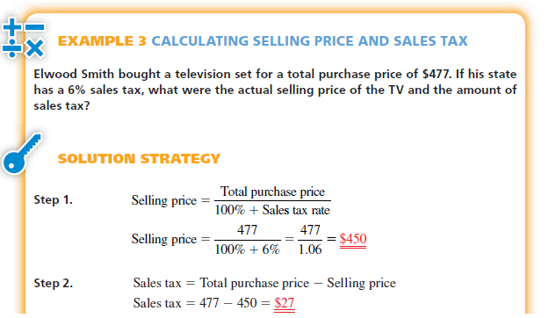

Slide 18
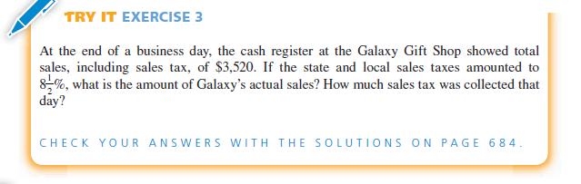

Slide 19
EXCISE TAX

Slide 20
CALCULATING EXCISE TAX

Slide 21
Description
As with the sales tax, an excise tax is usually expressed as a percentage of the purchase price. In certain cases, however, the excise tax may be expressed as a fixed amount per unit purchased, such as $5 per passenger on a cruise ship, or $.15 per gallon of gasoline.
When both sales tax and excise tax are imposed on merchandise at the retail level, the excise taxes are not included in the selling price when computing the sales tax. Each tax should be calculated independently on the actual selling price.

Slide 22
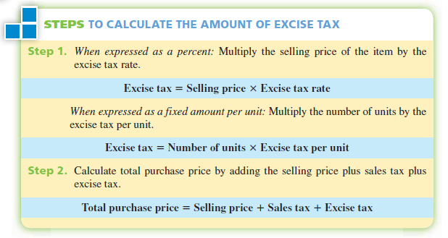

Slide 23
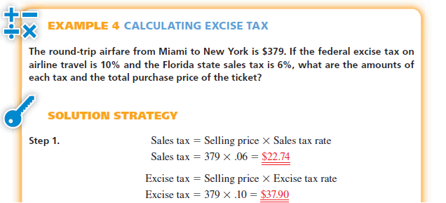

Slide 24
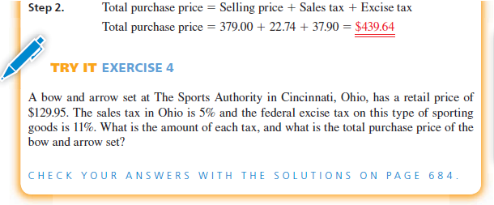

Slide 25
PROPERTY TAX

Slide 26
Definition
Ad Valorem or Property Tax A tax based on the assessed value of property, generally collected at the city or county level as the primary source of revenue for counties, municipalities, school districts, and special taxing districts.
Real Estate, or Real Property Land, buildings, and all other permanent improvements situated thereon.

Slide 27
Definition
Personal Property For ad valorem tax purposes, divided into tangible personal property such as business equipment, fixtures, and supplies and household goods such as clothing, furniture, and appliances.

Slide 28
Definition
Assessed Value The value of property for tax purposes, generally a percentage of the fair market value.
Fair Market Value The value of property based on location, size, cost, replacement value, condition, and income derived from its use.
Tax Assessor, or Property Appraiser The city or county official designated to determine assessed values of property.

Slide 29
CALCULATING THE AMOUNT OF PROPERTY TAX

Slide 30
Description
On the basis of the fair market value, less all applicable exemptions, the property tax due is computed by applying the tax rates established by the taxing authorities within that area to the assessed value of the property.
Property tax = Assessed value of property X Tax rate

Slide 31
Expression
Property tax rates may be expressed in the following ways:
• Decimal or percent of assessed value—for example, .035 or 3.5%
• Per $100 of assessed value—for example, $3.50 per $100
• Per $1,000 of assessed value—for example, $35.00 per $1,000
• Mills (one one-thousandth of a dollar)—for example, 35 mills

Slide 32
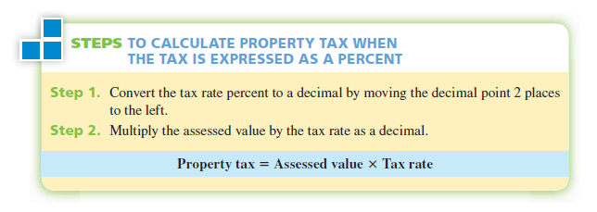

Slide 33
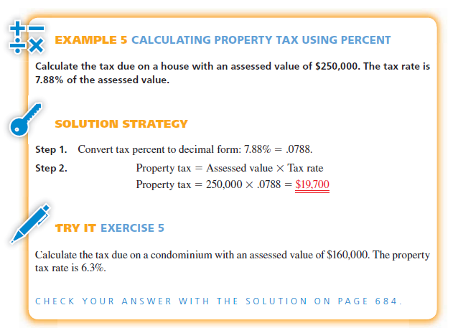

Slide 35
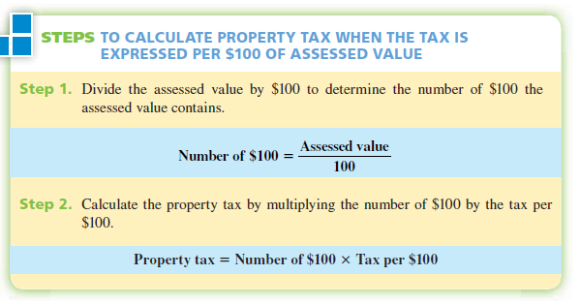
TO CALCULATE PROPERTY TAX WHEN THE TAX IS
EXPRESSED PER $100 OF ASSESSED VALUE

Slide 36
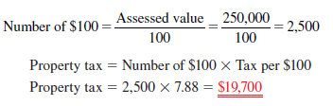
CALCULATING PROPERTY TAX USING
TAX PER $100 OF ASSESSED VALUE
Calculate the tax due on a house with an assessed value of $250,000. The tax rate is $7.88 per $100 of assessed value.

Slide 37
Exercise
Calculate the tax due on a three-acre parcel of land with an assessed value of $50,800. The property tax rate is $3.60 per $100 of assessed value.

Slide 38
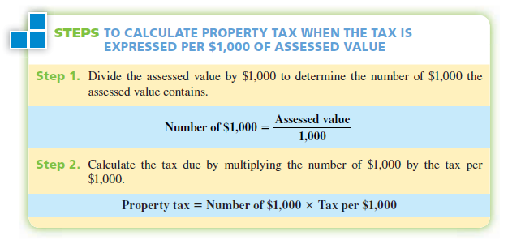
TO CALCULATE PROPERTY TAX WHEN THE TAX IS
EXPRESSED PER $1,000 OF ASSESSED VALUE

Slide 39
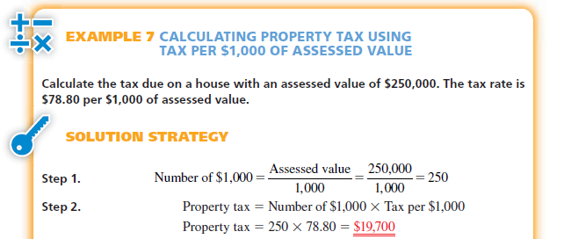
CALCULATING PROPERTY TAX USING
TAX PER $1,000 OF ASSESSED VALUE

Slide 40
Exercise
Calculate the tax due on a warehouse with an assessed value of $325,400. The property tax rate is $88.16 per $1,000 of assessed value.

Slide 41
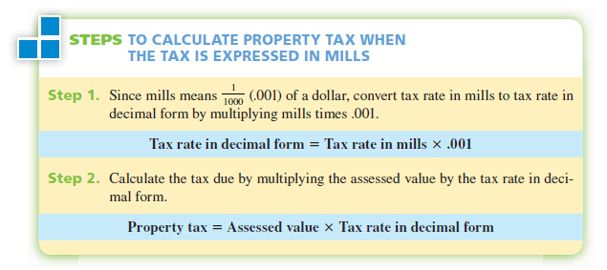
TO CALCULATE PROPERTY TAX WHEN
THE TAX IS EXPRESSED IN MILLS

Slide 42
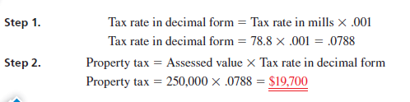
CALCULATING PROPERTY TAX USING MILLS
Calculate the tax due on a house with an assessed value of $250,000. The tax rate is 78.8 mills.

Slide 43
Exercise
Calculate the tax due on a farm with an assessed value of $85,300. The property tax rate is 54.1 mills.

Slide 44
CALCULATING TAX RATE NECESSARY IN A COMMUNITY TO MEET BUDGETARY DEMANDS

Slide 45

Description
Each year local taxing units such as counties and cities must estimate the amount of tax dollars required to pay for all governmental services provided. Typical examples include public schools, law enforcement, fire protection, hospitals, publ ic parks and recreation, roads and highways, sanitation services, and many others. The tax rate necessary to meet these budgetary demands is determined by two factors: (1) the total taxes required, and (2) the total assessed value of the property in the taxing unit. The tax rate is computed by the following formula:
As before, the tax rate may be expressed as a percent, per $100 of assessed value, per $1,000 of assessed value, or in mills.

Slide 46
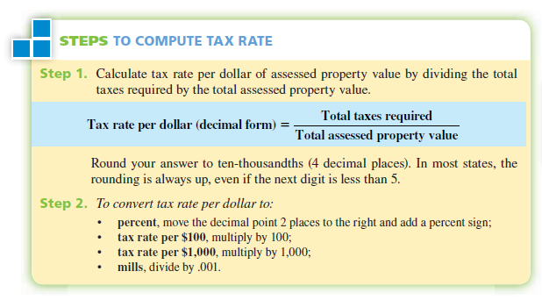

Slide 47
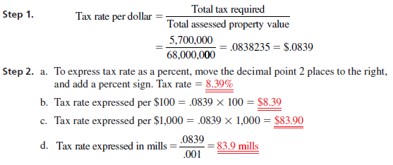
Example
The budget planners for the town of Silvertip have determined that $5,700,000 will be needed to provide all government services for next year. If the total assessed property value in Silvertip is $68,000,000, what tax rate is required to meet the budgetary demands? Express your answer in each of the four ways.

Slide 48
Exercise
The budget planners for Cherry Hill have determined that $3,435,000 will be needed to provide governmental services for next year. The total assessed property value in Cherry Hill is $71,800,000. As the tax assessor, you have been asked by the city council to determine what tax rate will need to be imposed to meet these budgetary demands. Express your answer in each of the four ways.

Slide 49
INCOME TAX

Slide 50
Definition
Income Tax A pay-as-you-go tax based on the amount of income of an individual or corporation.
Tax Return The official Internal Revenue Service forms used to report and pay income tax for income earned during the previous calendar year.
Taxable Income The amount of income that tax rates are applied to in order to calculate the amount of tax owed for the year.

Slide 51
CALCULATING TAXABLE INCOME FOR INDIVIDUALS
Taxable income is the amount of income that tax rates are applied to in order to calculate the amount of tax owed for the year. Exhibit 18-2 is a schematic diagram of the procedure used to calculate taxable income. Look it over carefully, and then use the following steps to calculate taxable income.

Slide 52
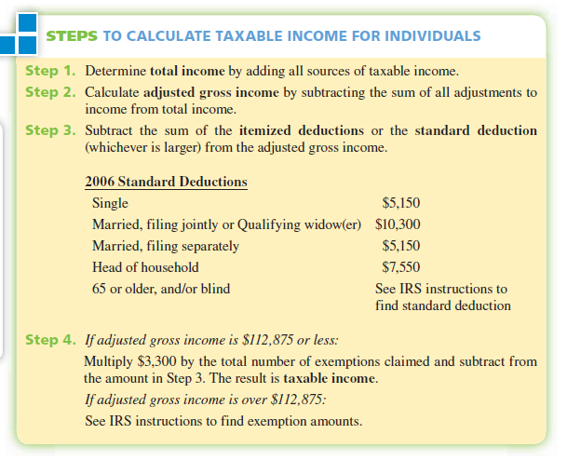

Slide 53
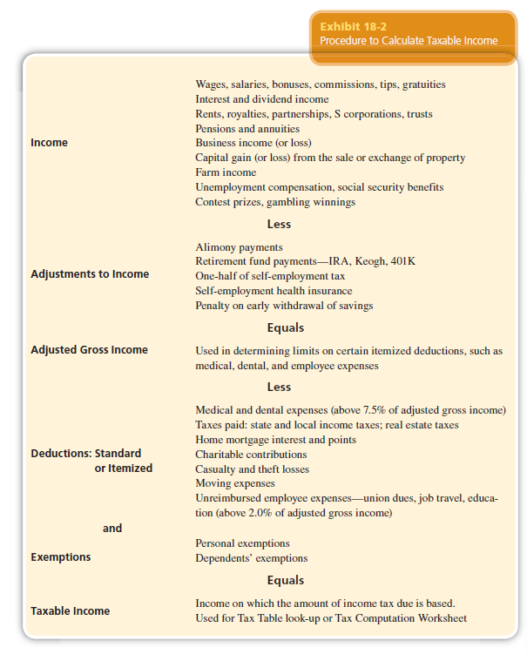

Slide 55
CALCULATING TAXABLE INCOME
Doug and Beth Nelson are married and file a joint tax return. Doug is a manager and earned $43,500 last year. Beth worked as a secretary and earned $24,660. In addition, they earned $540 interest on their savings account. They each contributed $2,500 to a retirement account, and Doug paid alimony of $4,700 to his first wife. Itemized deductions were as follows: $2,340 in real estate taxes, $4,590 in mortgage interest, $325 in charitable contributions, and $120 in unreimbursed employee expenses (above 2% of adjusted gross income). The Nelsons claim three exemptions: one each for themselves and one for their dependent son Michael. From this information, calculate the Nelsons’ taxable income.

Slide 56
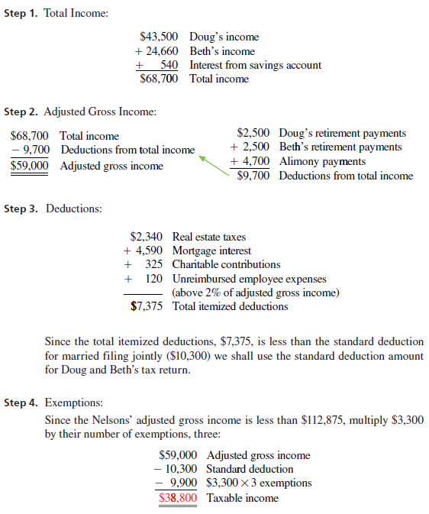
S
Solution Strategy

Slide 59
Exercise
Nick Bontempo is single, claiming two exemptions. He is a welder, earning $35,000 in wages per year. Last year, he also earned $1,200 in cash dividends from his investments portfolio. Nick contributed $1,500 to his individual retirement account and gained $5,000 from the sale of 100 shares of Consolidated Widget stock. His itemized deductions amounted to medical expenses of $1,000 in excess of IRS exclusions; $1,945 in real estate taxes; $2,500 in mortgage interest; and $300 in charitable contributions. From this information, calculate Nick's taxable income.

Slide 60
USING THE TAX TABLE TO DETERMINE TAX LIABILITY

Slide 61
Description
If taxable income is less than $100,000, the Tax Table must be used to figure the tax liability. When the taxable income is $100,000 or more, the Tax Rate Schedule for the appropriate filing status must be used. Exhibit 18-3 illustrates a portion of the 2006 Tax Table and Exhibit 18-4 shows the 2006 Tax Computation Worksheet. The most current version of these may be found in Instructions for Form 1040, published by the IRS.

Slide 62
Definition
Tax Table The IRS chart used to find the amount of income tax due for individuals with taxable income of under $100,000.
Tax Computation Worksheet The IRS chart used to calculate the amount of income tax due for individuals with taxable income of $100,000 or more.

Slide 63
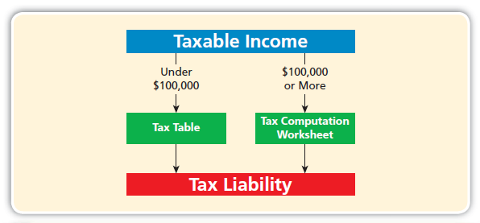

Slide 64
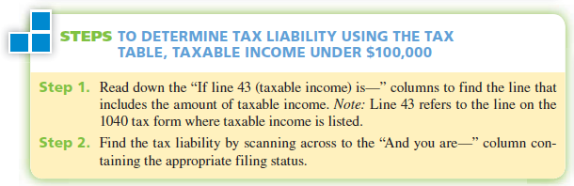
TO DETERMINE TAX LIABILITY USING THE TAX TABLE, TAXABLE INCOME UNDER $100,000

Slide 65
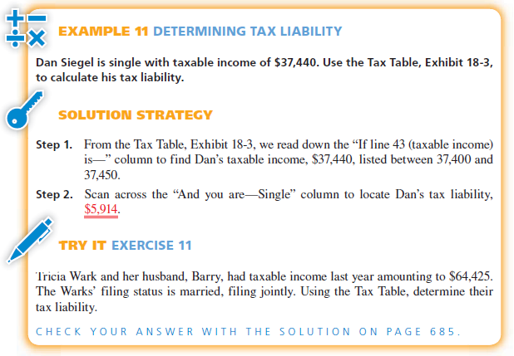

Slide 67
USING THE TAX COMPUTATION WORKSHEET TO CALCULATE
TAX LIABILITY

Slide 68
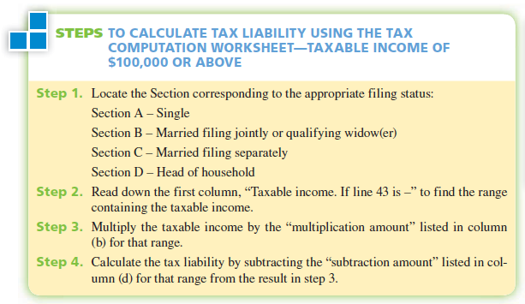
USING THE TAX COMPUTATION WORKSHEET TO
CALCULATE TAX LIABILITY

Slide 69
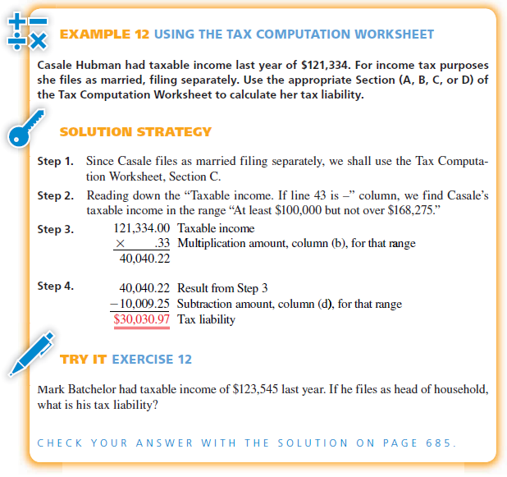

Slide 71
CALCULATING AN INDIVIDUAL’S TAX
REFUND OR AMOUNT OF TAX OWED

Slide 72
CALCULATING AN INDIVIDUAL’S TAX
REFUND OR AMOUNT OF TAX OWED
Once the tax liability has been determined, we must consider the final three items in income tax preparation: tax credits, other taxes, and payments. The following formula is used to complete the tax preparation process. Note: When the result is a positive number, it is the amount of tax owed. When the result is a negative number, it indicates a tax overpayment by that amount. When an overpayment occurs, the taxpayer has the option of receiving a refund or applying the amount of the overpayment to next year’s estimated tax.

Slide 73
Definition
Tax Credits. Tax credits are a dollar-for-dollar subtraction from the tax liability. A tax credit of one dollar saves a full dollar in taxes, whereas a tax deduction of one dollar results in less than a dollar in tax savings (the amount depends on the tax rate). Some examples are credit for child and dependent care expenses, credit for the elderly or disabled, and the foreign tax credit.
Other Taxes. In addition to the tax liability from the Tax Table or Tax Rate Schedules, other taxes may also be due. These taxes are added to the tax liability. Some examples would be self-employment taxes and Social Security and Medicare taxes on tip income.

Slide 74
Definition
Payments. This calculation involves subtracting payments such as employees’ federal income tax withheld by employers, estimated tax payments made quarterly, excess Social Security and Medicare paid, and the Earned Income Credit (considered a payment). The Earned Income Credit is available to married taxpayers filing jointly with a child and adjusted gross income of less than $34,001.

Slide 75
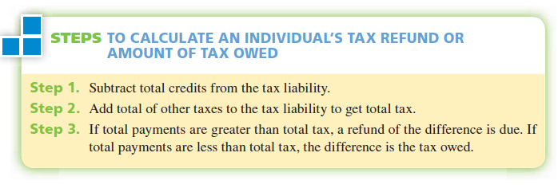
Definition

Slide 76
CALCULATING TAX REFUND OR
AMOUNT OWED
EXAMPLE
After preparing her taxes for last year, Linda Ryan determined that she had a tax liability of $5,326. In addition, she owed other taxes of $575. Because of her mother, Linda was entitled to a credit for the elderly of $1,412. If her employer withheld $510 from her paycheck each month, is Linda entitled to a refund or does she owe additional taxes? How much?

Slide 77

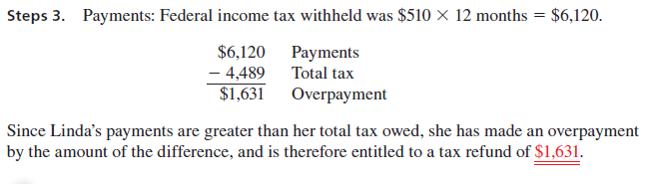
Solution Strategy

Slide 78
Exercise
Jill Carson had a tax liability of $14,600 last year. In addition, she owed other taxes of $2,336. She was entitled to a credit for child care of $668 and a foreign tax credit of $1,719. If her employer withheld $270 per week for 52 weeks, does Jill qualify for a refund or owe more taxes? How much?

Slide 79
CALCULATING CORPORATE INCOME TAX AND NET INCOME AFTER TAXES

Slide 80
Definition
Corporate Tax Rate Schedule The IRS chart used to calculate the amount of income tax due from corporations.

Slide 81

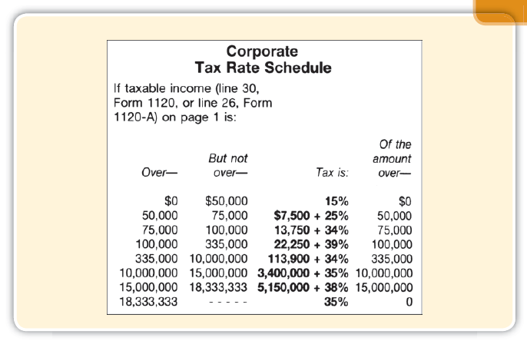

Slide 82
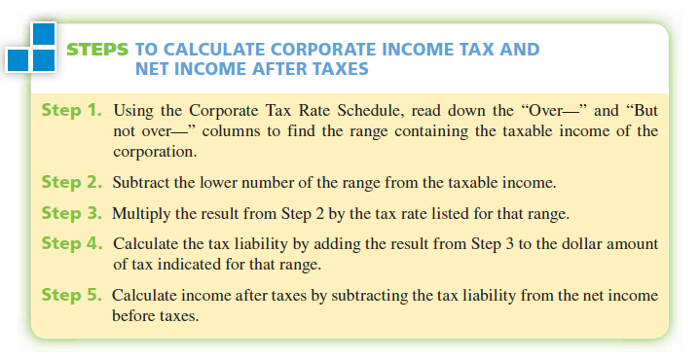

Slide 83
