Slide 1
Mathematics of Buying
Chapter 9

Slide 2
Invoice and Trade Discount
An invoice is a document issued by a seller to a buyer as a record of a transaction. For a seller, the invoice is a sales invoice that records a sale. For a buyer, an invoice is a purchase invoice that records a purchase.
An invoice shows the seller, buyer, items purchased, quantity, price, and any discounts.
It shows the extension total, which is the number of items purchased times the price per unit. It also shows any discounts applied, the shipping and insurance charges, and the invoice total, which is the sum of the extension totals.

Slide 3
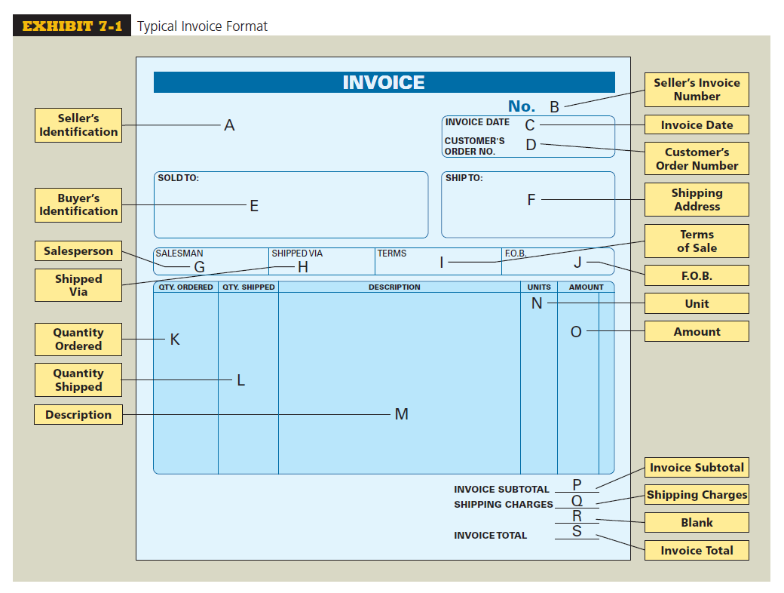

Slide 4
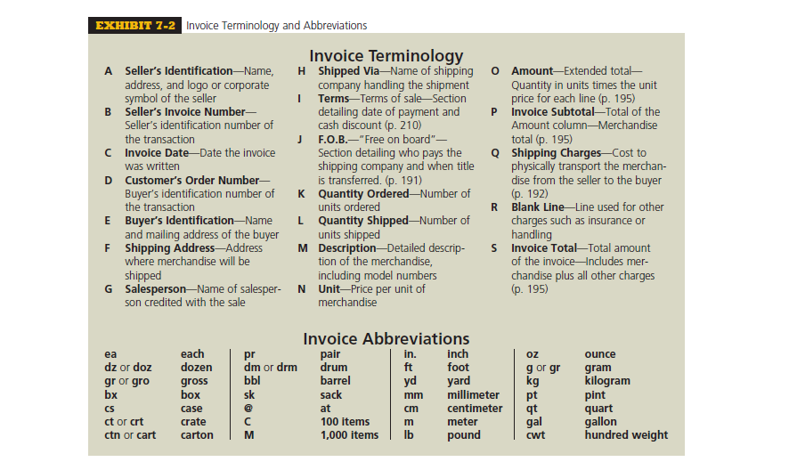

Slide 5
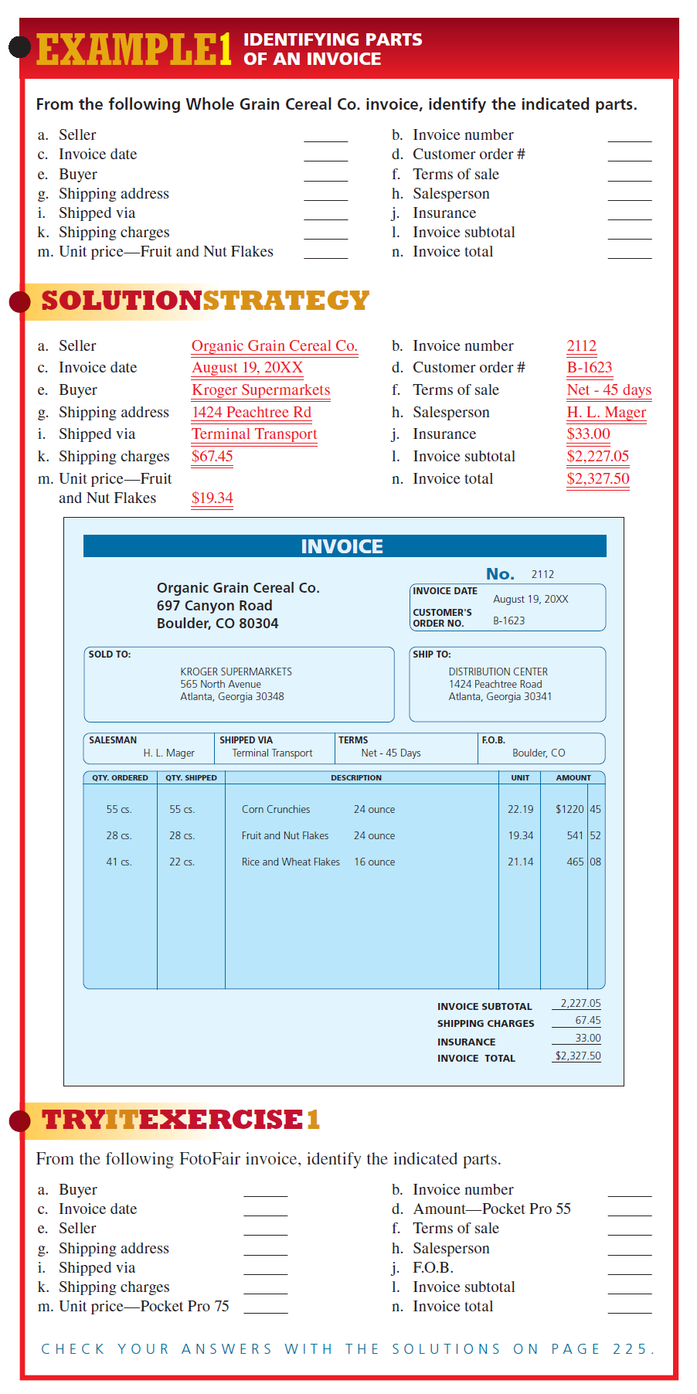

Slide 11
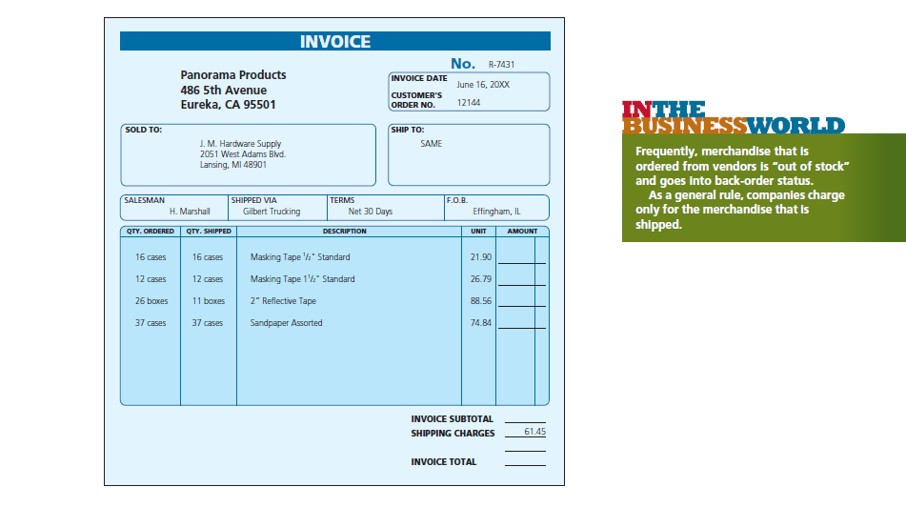

Slide 12
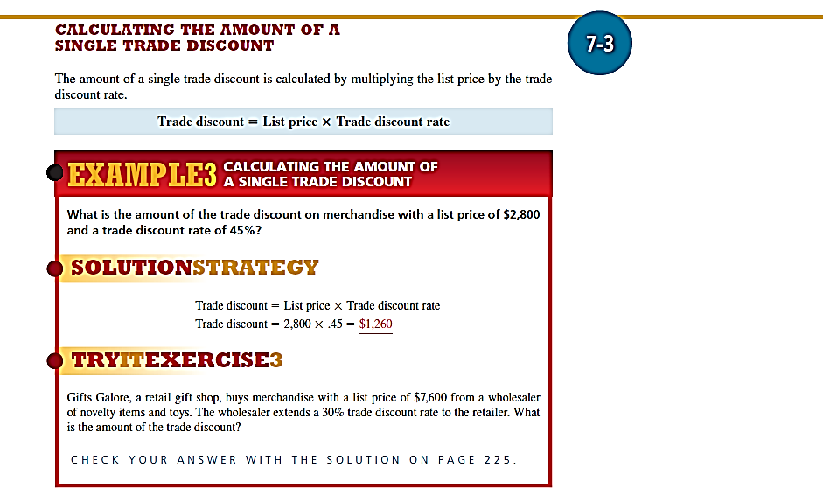


Slide 13
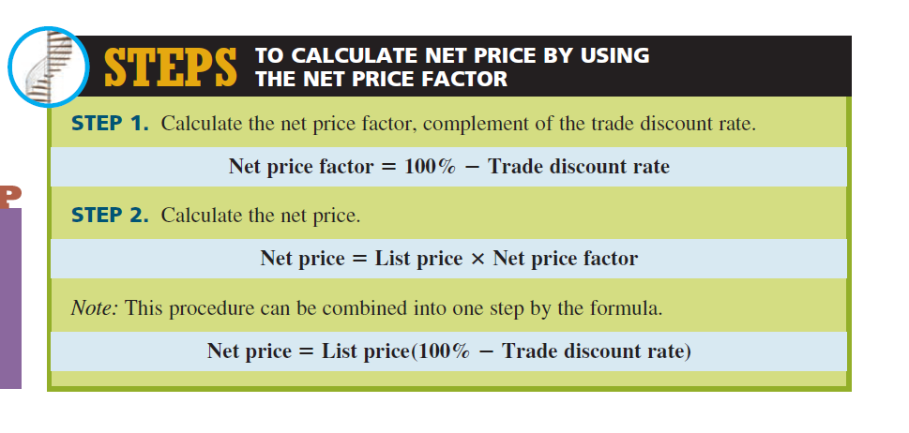

Slide 14
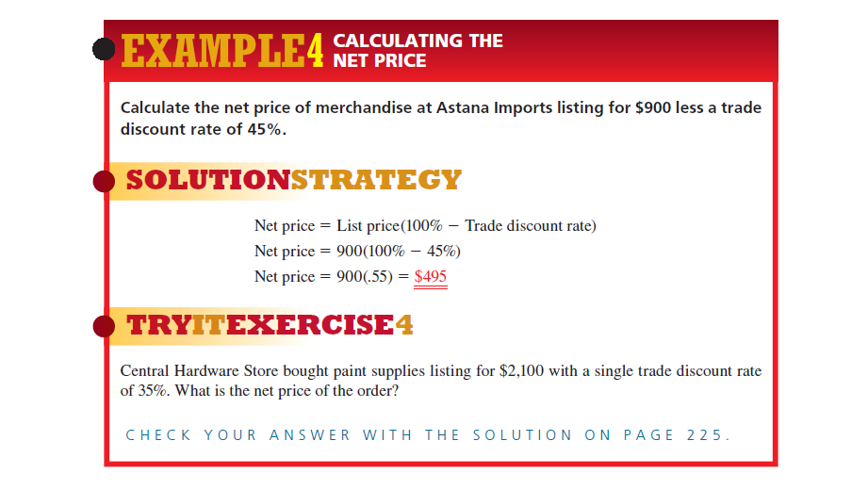

Slide 15
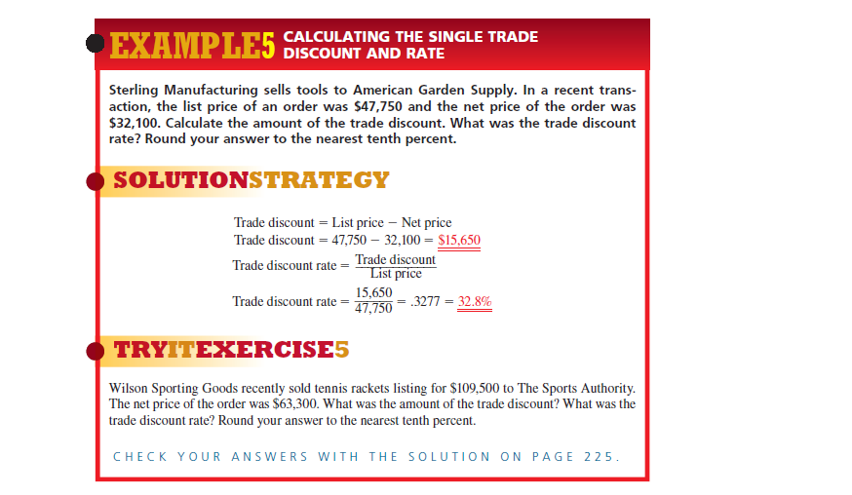

Slide 16
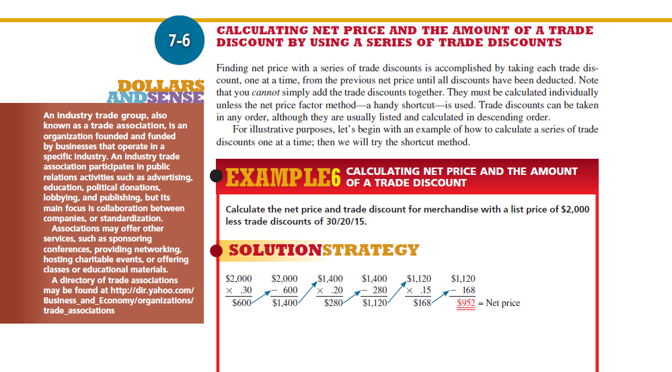

Slide 17
Calculating The Amount Of A Trade Discount By Using A Single Equivalent Discount
Sometimes retailers and wholesalers want to know the one single discount rate that equates to a series of trade discounts. This is known as the single equivalent discount. We have already learned that the trade discounts cannot simply be added together.
Here is the logic: The list price of the merchandise is 100%. If the net price factor is the part of the list price that is paid, then 100% minus the net price factor is the part of the list price that is the trade discount.
The single equivalent discount, therefore, is the complement of the net price factor (100% - Net price factor percent).

Slide 18
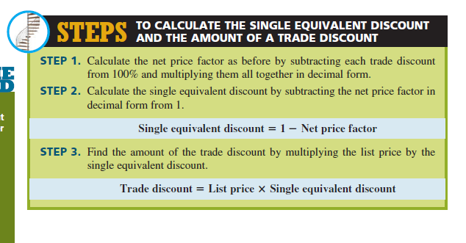

Slide 19
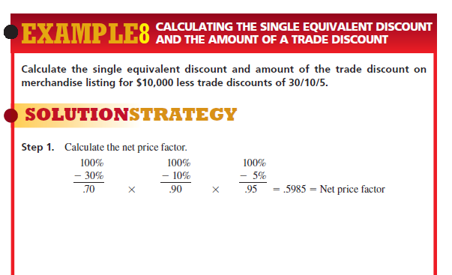

Slide 20
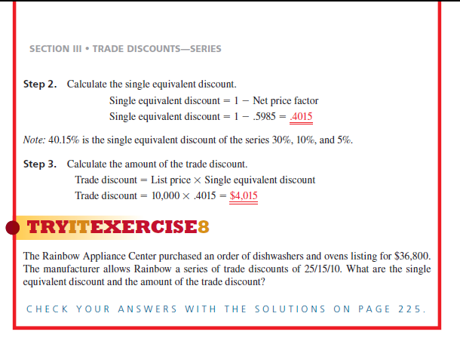

Slide 21
CASH DISCOUNTS AND TERMS OF SALE

Slide 22
Terminology
Terms of sale the details of when an invoice must be paid and if a cash discount is being offered.
Credit period the time period that the seller allows the buyer to pay an invoice.
Net date, or due date the last day of the credit period.
Cash discount an extra discount offered by the seller as an incentive for early payment of an invoice.

Slide 23
Terminology
Invoice date the date an invoice is written. The beginning of the discount and credit periods when ordinary dating is used.
Cash discount period the time period in which a buyer can take advantage of the cash discount.
Discount date the last day of the discount period.

Slide 24
THE IMPORTANCE OF CASH DISCOUNTS
Both buyers and sellers benefit from cash discounts. Sellers get their money much sooner, which improves their cash flow, whereas buyers get an additional discount, which lowers their merchandise cost, thereby raising their margin or gross profit.
Cash discounts generally range from an extra 1% to 5% off the net price of the merchandise. A 1% to 5% discount may not seem significant, but it is. Let’s say that an invoice is due in 30 days; however, a distributor would like payment sooner. It might offer the retailer a cash discount of 2% if the bill is paid within 10 days rather than 30 days.

Slide 25
THE IMPORTANCE OF CASH DISCOUNTS
If the retailer chooses to take the cash discount, he or she must pay the bill by the 10th day after the date of the invoice. Note that this is 20 days earlier than the due date. The retailer is therefore receiving a 2% discount for paying the bill 20 days early.
The logic: There are 18.25 twenty-day periods in a year (365 days divided by 20 days). By multiplying the 2% discount by the 18.25 periods, we see that on a yearly basis, 2% cash discounts can theoretically amount to 36.5%. Very significant!

Slide 26
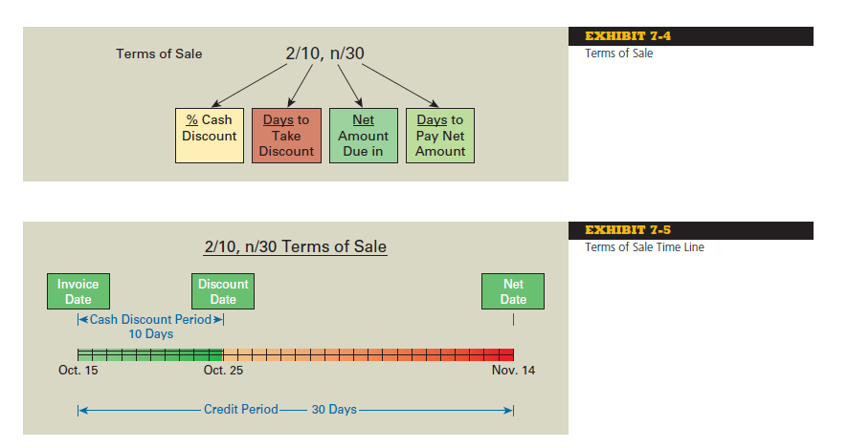

Slide 27
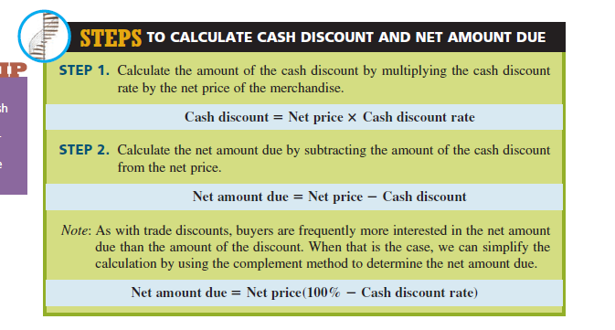

Slide 28
CALCULATING NET AMOUNT DUE, WITH CREDIT
GIVEN FOR PARTIAL PAYMENT
Sometimes buyers do not have all the money needed to take advantage of the cash discount. Manufacturers and suppliers usually allow them to pay part of the invoice by the discount date and the balance by the end of the credit period. This partial payment earns partial cash discount credit. In this situation, we must calculate how much partial payment credit is given.

Slide 29
CALCULATING NET AMOUNT DUE, WITH CREDIT
GIVEN FOR PARTIAL PAYMENT
Here is how it works: Assume a cash discount of 4/15, n/45 is offered to a retailer. A 4% cash discount means that the retailer will pay 96% of the bill (100% 2 4%) and receive 100% credit. Another way to look at it is that every $0.96 paid toward the invoice earns $1.00 credit. We must determine how many $0.96s are in the partial payment. This will tell us how many $1.00s of credit we receive.

Slide 30
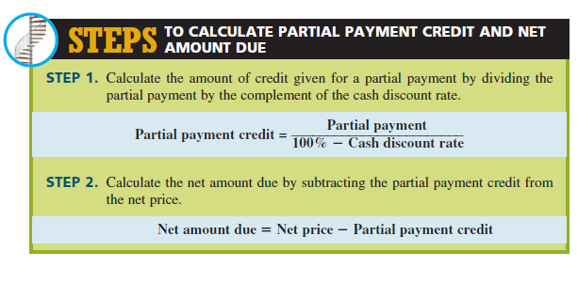

Slide 31
DETERMINING DISCOUNT DATE AND NET DATE BY USING VARIOUS TERMS OF SALE DATING METHODS

Slide 32
DETERMINING DISCOUNT DATE
To determine the discount date and net date of an invoice, you must know how many days are in each month or use a calendar.
Following are two commonly used memory devices to help you remember how many days are in each month. Remember, in a leap year, February has 29 days. Leap years fall every four years. They are the only years evenly divisible by 4 and are the years of our next presidential elections (2012, 2016).

Slide 33
