Slide 1
Business and Consumer Loans
Chapter 16

Slide 2
INTRODUCTION
“Buy now, pay later” is a concept that has become an everyday part of the way individuals and businesses purchase goods and services. Merchants in all categories, as well as lending institutions, encourage us to just say “charge it!”

Slide 3
OPEN-END CREDIT
Charge Account
Credit Card
Lines of Credit

Slide 4
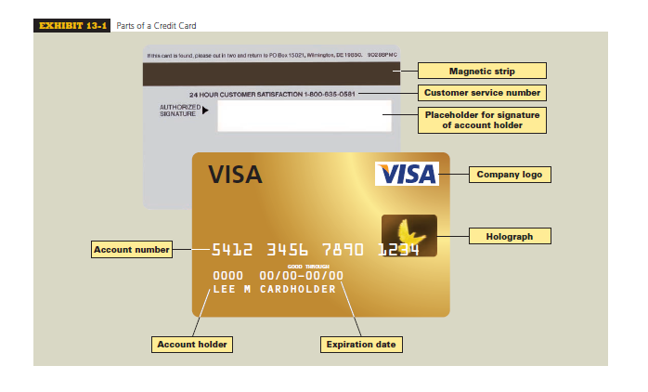

Slide 5
DEFINITION
Open-end Credit. A loan arrangement in which there is no set number of payments. As the balance of the loan is reduced, the borrower can renew the amount of the loan up to a pre-approved credit limit. A form of revolving credit.
A common way of buying on credit, called open-end credit, has no fixed payments. The customer continues making payments until no outstanding balance is owed. Wiht open-end credit, additional credit is ofter extended before the initial amount is paid off.
Examples of open-end credit include most department store credit accounts and credit cards, as well as MasterCard and Visa. Individuals are given a credit limit on these accounts based on their income and other factors. They are then allowed to charge up to this amount.

Slide 6
DEFINITION
Finance Charge. Dollar amount that is paid for credit. Total of installment payments for an item less the cost of that item. Jumlah rupiah yang dibayar untuk kredit. Total pembayaran angsuran untuk item kurang dari harga barang tersebut.
Annual Percentage Rate (APR) Effective or true annual interest rate being charged for credit. Must be revealed to borrowers under the Truth in Lending Act. Suku bunga tahunan efektif (atau suku bunga sebenarnya) dikenakan untuk kredit. Harus diungkapkan kepada peminjam di dalam akad kredit.

Slide 7
DEFINITION
Revolving credit is the most popular type of open-end credit. Under this agreement, the consumer has a prearranged credit limit and two payment options. The first option is to use the account as a regular charge account, whereby the balance is paid off at the end of the month with no finance charge. The second option is to make a minimum payment or portion of the payment but less than the full balance. This option leaves a carryover balance, which accrues finance charges by using the simple interest formula
Interest = Principal x Rate x Time
The name revolving credit comes from the fact that there is no set number of payments as with installment credit. The account revolves month to month, year to year—technically never being paid off as long as minimum monthly payments are made. Exhibit 13-3 illustrates a typical revolving credit monthly statement.

Slide 8
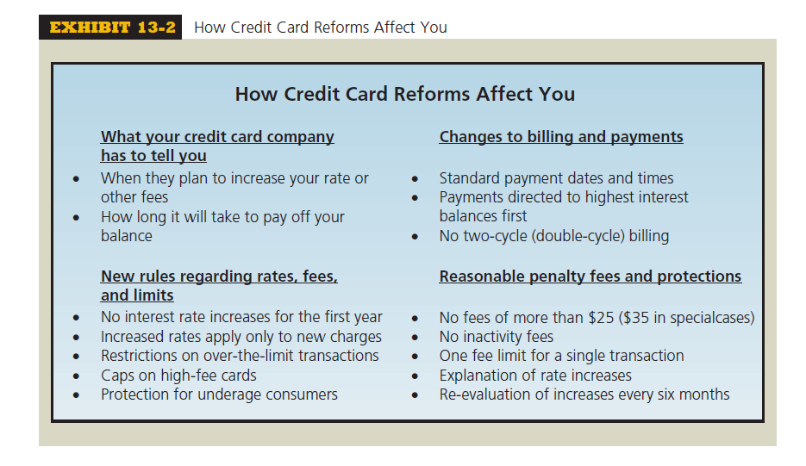
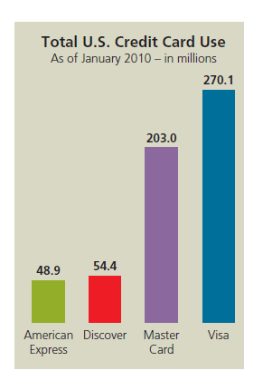

Slide 9
CALCULATING THE FINANCE CHARGE AND NEW BALANCE
BY USING
THE UNPAID OR PREVIOUS MONTH’S BALANCE METHOD

Slide 10
Billing Cycles
Billing Cycles. Time periods, usually 28 to 31 days, used in billing revolving credit accounts. Account statements are sent to the borrower after each billing cycle.

Slide 11
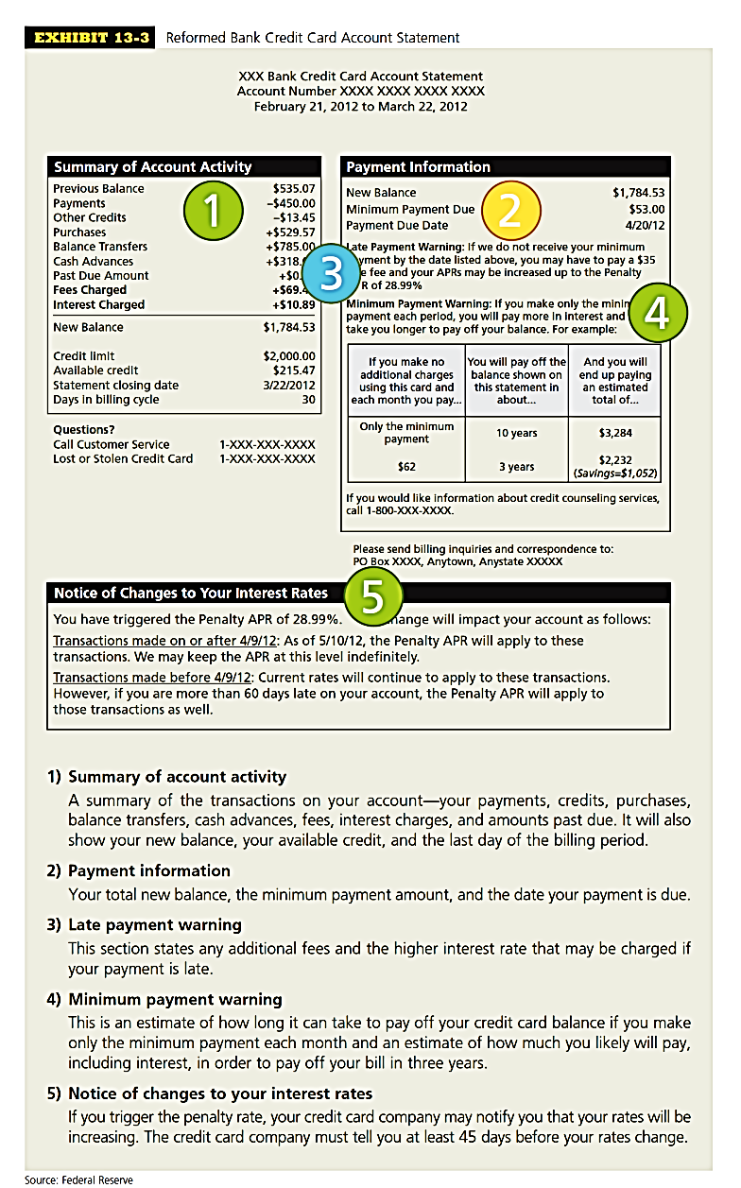
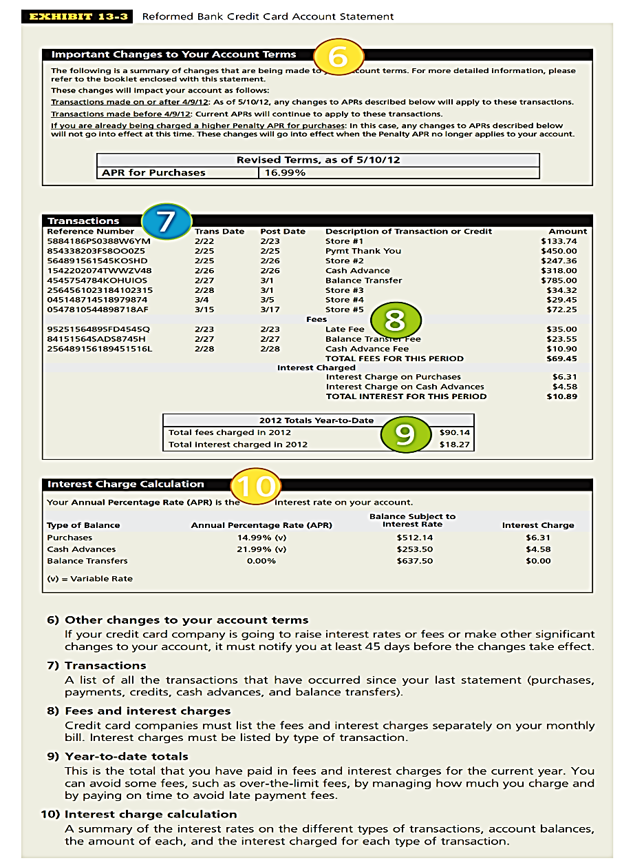

Slide 12
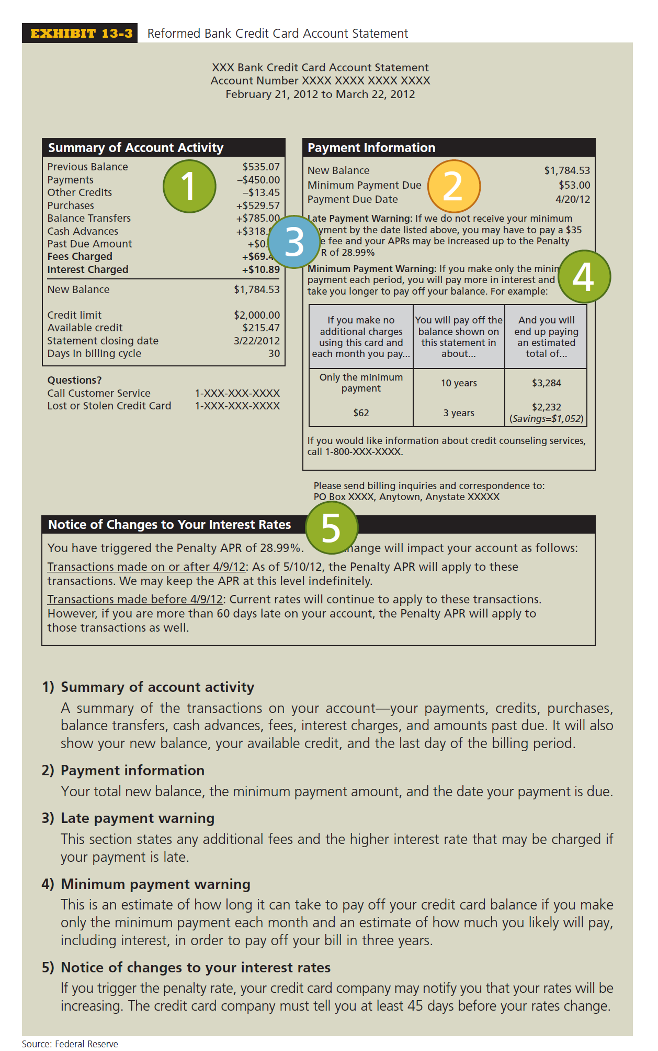

Slide 14
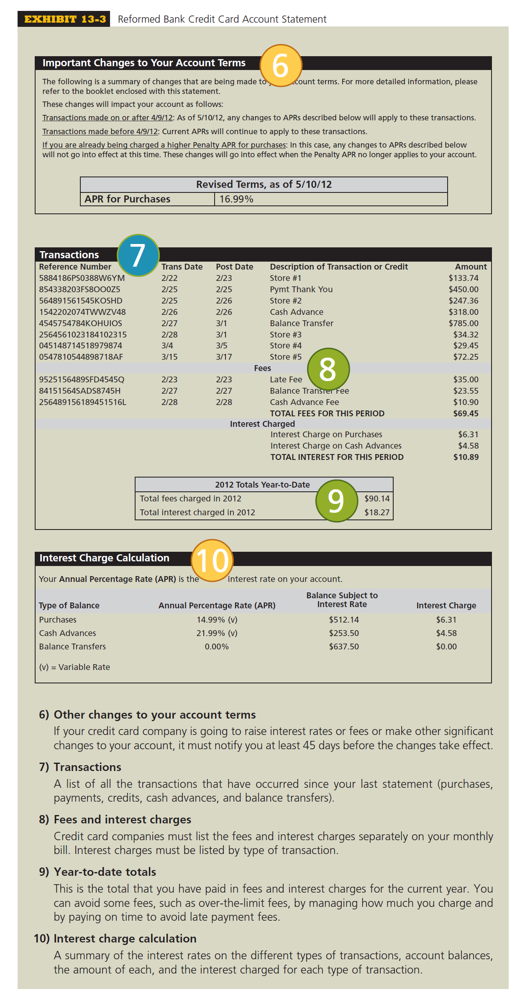

Slide 19
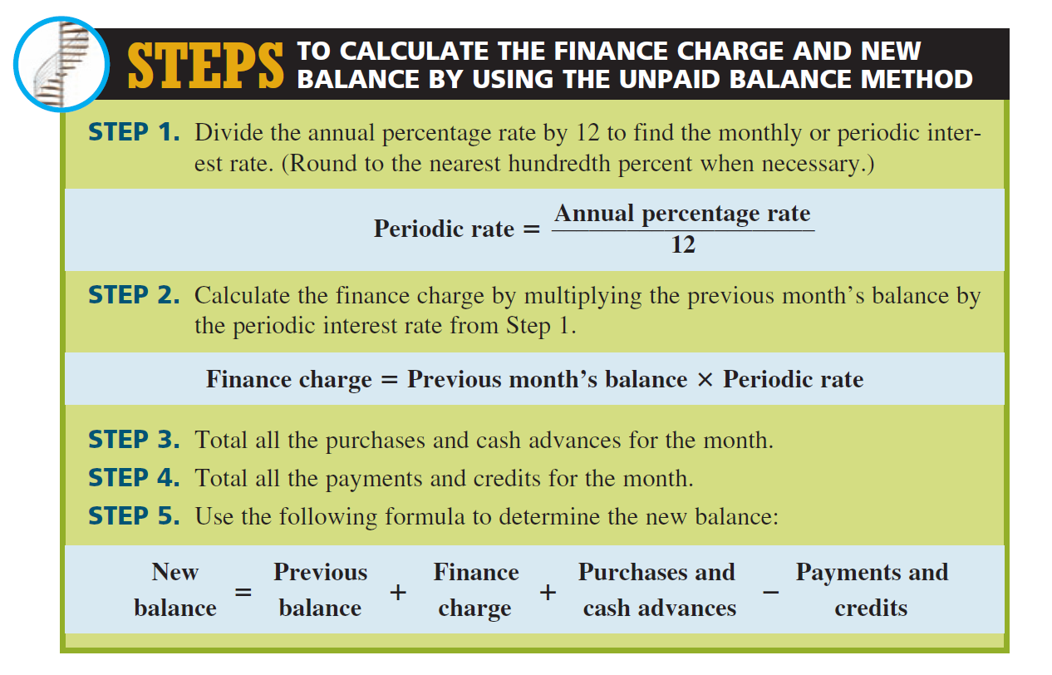

Slide 20
EXAMPLE 1
Jake Morrison has a revolving department store credit account with an annual percentage rate of 18%. His balance from last month is $322.40. During the month, he purchased shirts for $65.60 and a baseball bat for $43.25. He returned a tie for a credit of $22.95 and made a $50 payment. If the department store uses the unpaid balance method, what is the finance charge on the account and what is Jake’s new balance?
Jake Morrison memiliki rekening kredit bergulir department store dengan tingkat bunga tahunan sebesar 18%. Saldo bulan lalu adalah $322,40. Selama satu bulan, ia membeli kemeja seharga $65,60 dan tongkat baseball seharga $43,25. Ia kembalikan dasi seharga $22,95 untuk dikredit dan melakukan pembayaran $50. Jika department store menggunakan metode unpaid balance, berapa beban keuangan pada akun tersebut dan berapa saldo baru akun milik Jake?

Slide 21
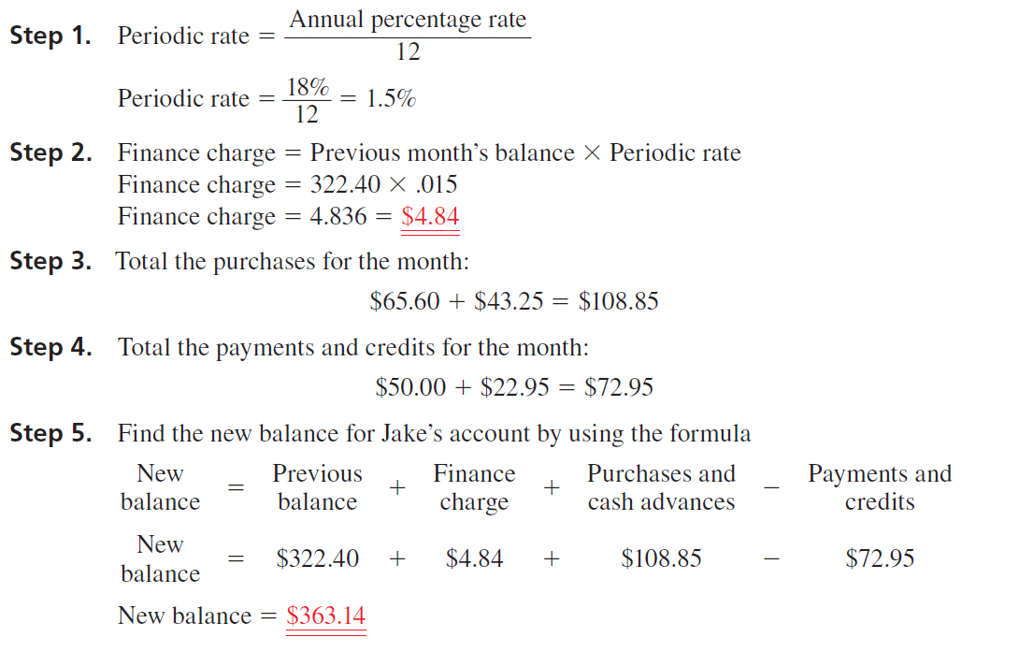

Slide 22
CALCULATING THE FINANCE CHARGE AND NEW BALANCE
BY USING
THE AVERAGE DAILY BALANCE METHOD

Slide 23
CALCULATING THE FINANCE CHARGE AND NEW BALANCE BY USING THE AVERAGE DAILY BALANCE METHOD
In business today, the method most widely used to calculate the finance charge on a revolving credit account is known as the average daily balance. This method precisely tracks the activity in an account on a daily basis. Each day’s balance of a billing cycle is totaled and then divided by the number of days in that cycle.
This gives an average of all the daily balances. For accounts in which many charges are made each month, the average daily balance method results in much higher interest than the unpaid balance method because interest starts accruing on the day purchases are made or cash advances are taken.

Slide 24
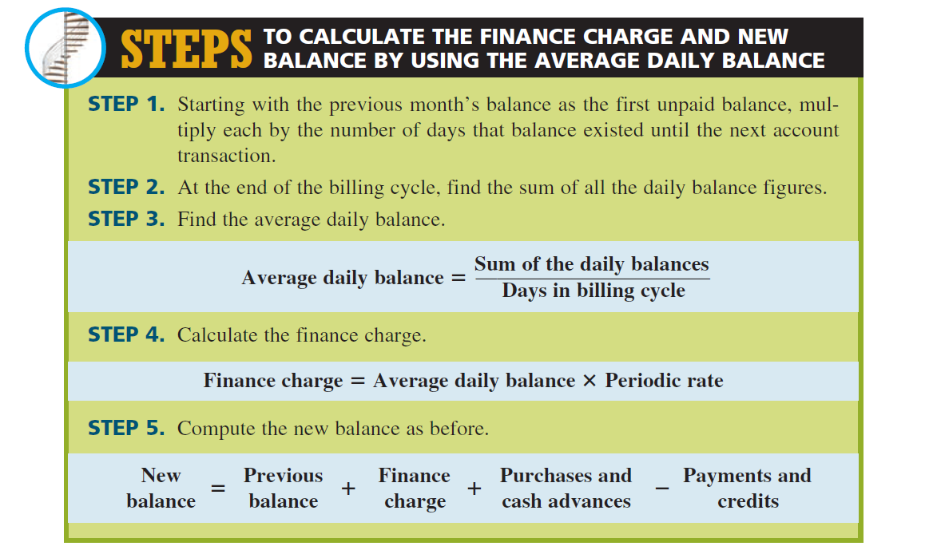

Slide 25
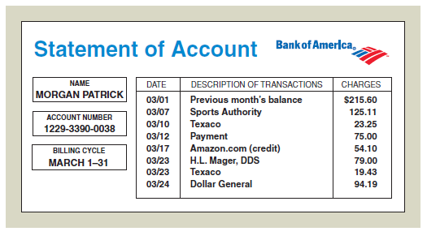
EXAMPLE 2
Morgan Patrick has a Bank of America revolving credit account with a 15% annual percentage rate. The finance charge is calculated by using the average daily balance method. The billing date is the first day of each month, and the billing cycle is the number of days in that month. During the month of March, Morgan’s account showed the following activity.
What is the finance charge for March,
and what is Morgan’s new balance?

Slide 26
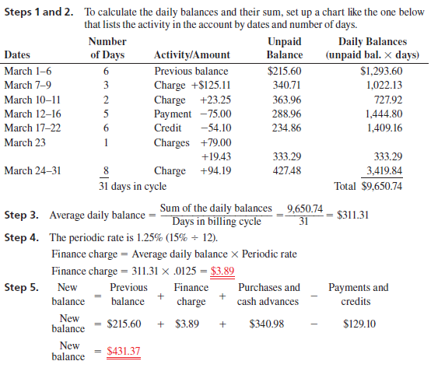

Slide 27
CALCULATING THE FINANCE CHARGE AND NEW BALANCE OF BUSINESS AND PERSONAL LINES OF CREDIT

Slide 28
CALCULATING NEW BALANCE
Like the calculation of finance charges and new balances on credit cards, the finance charge on a line of credit is based on average daily balance and is calculated by
Finance charge = Average daily balance X Periodic rate

Slide 29
CALCULATING NEW BALANCE
This means that interest begins as soon as you write a check for a loan. Typically, the loan is paid back on a flexible schedule. In most cases, balances of $100 or less must be paid in full. Larger balances require minimum monthly payments of $100 or 2% of the outstanding balance, whichever is greater. As you repay, the line of credit renews itself. The new balance of the line of credit is calculated by
New balance = Previous balance + Finance charge + Loans - Payments

Slide 30
EXAMPLE 3
Shari’s Chocolate Shop has a $20,000 line of credit with the Shangri-La National Bank. The annual percentage rate charged on the account is the current prime rate plus 4%. There is a minimum APR on the account of 10%. The starting balance on April 1 was $2,350. On April 9, Shari borrowed $1,500 to pay for a shipment of assorted gift items. On April 20, she made a $3,000 payment on the account. On April 26, she borrowed another $2,500 to pay for air conditioning repairs. The billing cycle for April has 30 days. If the current prime rate is 8%, what is the finance charge on the account and what is Shari’s new balance?

Slide 31
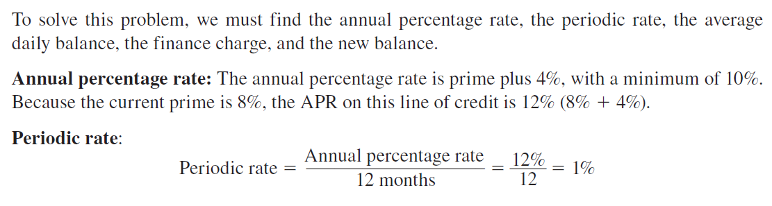
EXAMPLE 3
Shari’s Chocolate Shop has a $20,000 line of credit with the Shangri-La National Bank. The annual percentage rate charged on the account is the current prime rate plus 4%. There is a minimum APR on the account of 10%. The starting balance on April 1 was $2,350. On April 9, Shari borrowed $1,500 to pay for a shipment of assorted gift items. On April 20, she made a $3,000 payment on the account. On April 26, she borrowed another $2,500 to pay for air conditioning repairs. The billing cycle for April has 30 days. If the current prime rate is 8%, what is the finance charge on the account and what is Shari’s new balance?

Slide 32
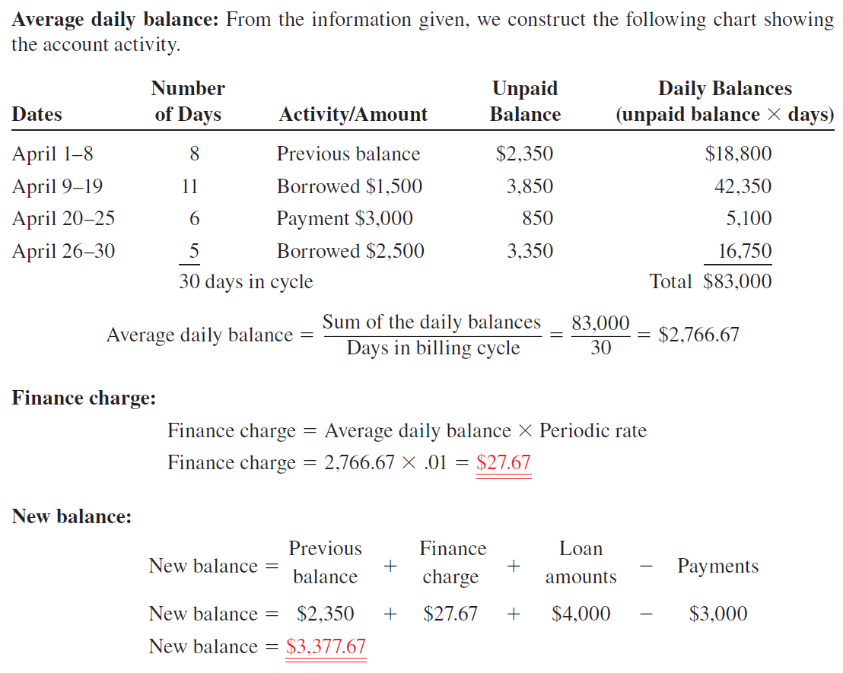

Slide 33
TRY IT EXERCISE 3
Angler Marine has a $75,000 line of credit with Harborside Bank. The annual percentage rate is the current prime rate plus 4.5%. The balance on November 1 was $12,300. On November 7, Angler borrowed $16,700 to pay for a shipment of fishing equipment, and on November 21, it borrowed another $8,800. On November 26, a $20,000 payment was made on the account. The billing cycle for November has 30 days. If the current prime rate is 8.5%, what is the finance charge on the account and what is Angler’s new balance?

Slide 34
CLOSED-END CREDIT—INSTALLMENT LOANS

Slide 35
INSTALLMENT LOANS
Closed-end credit in the form of installment loans is used extensively today for the purchase of durable goods such as cars, boats, electronic equipment, furniture, and appliances, as well as services such as vacations and home improvements.
An installment loan is a lump-sum loan whereby the borrower repays the principal plus interest in a specified number of equal monthly payments. These loans generally range from 6 months to 10 years depending on what is being financed.
When a home or another real estate property is financed, the installment loan is known as a mortgage. A mortgage may be for as long as 30 years on a home and even longer on commercial property such as an office building or a factory.

Slide 36
INSTALLMENT LOANS
An additional form of security for the lending institution is that borrowers are often asked to make a down payment as part of the loan agreement.
A down payment is a percentage of the purchase price that the buyer must pay in a lump sum at the time of purchase.
Down payments on installment loans vary by category of merchandise and generally range from between 0% to 30% of the price of the item.
Sometimes the amount of the down payment is based on the credit rating of the borrower. Usually, the better the credit, the lower the down payment.

Slide 37

Until the loan on this vehicle is repaid, the
lending institution is technically the owner.

Slide 38
CALCULATING THE TOTAL DEFERRED PAYMENT PRICE AND THE AMOUNT OF THE FINANCE CHARGE OF AN INSTALLMENT LOAN

Slide 39
FORMULA
Let’s take a look at some of the terminology of installment loans. When a consumer buys goods or services without any financing, the price paid is known as the cash price or purchase price. When financing is involved, the amount financed is found by subtracting the down payment from the cash or purchase price. Sometimes the down payment will be listed as a dollar amount, and other times it will be expressed as a percent of the purchase price.
Amount financed = Purchase price - Down payment

Slide 40
FORMULA
When the down payment is listed as a percent of the purchase price, it can be found by using
Total amount of installment payments =Amount financed + Finance charge
The finance charge can be found by subtracting the amount financed from the total amount of installment payments.
Finance charge = Total amount of installment payments - Amount financed

Slide 41
FORMULA
When the amount of the monthly payments is known, the total amount of installment payments can be found by multiplying the monthly payment amount by the number of payments.
The total deferred payment price is the total amount of installment payments plus the down payment. This represents the total out-of-pocket expenses incurred by the buyer for an installment purchase.
Total deferred payment price = Total of installment payments + Down payment
Total amount of installment payment
Monthly Payment Amount
Number of Montly Payment
=
x

Slide 42
EXAMPLE 4
Tracy Hall is interested in buying a computer. At Radio Shack, she picks out a computer and a printer for a total cash price of $2,550. The salesperson informs her that if she qualifies for an installment loan, she may pay 20% now as a down payment and finance the balance with payments of $110 per month for 24 months.
a. What is the finance charge on this loan?
b. What is the total deferred payment price of Tracy’s computer?

Slide 43
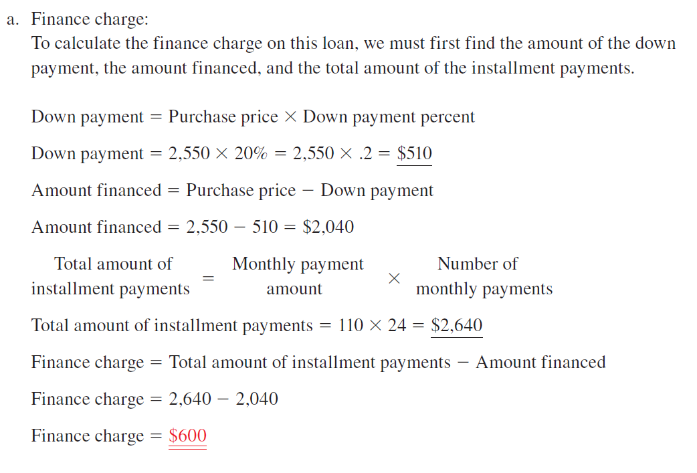

Slide 44
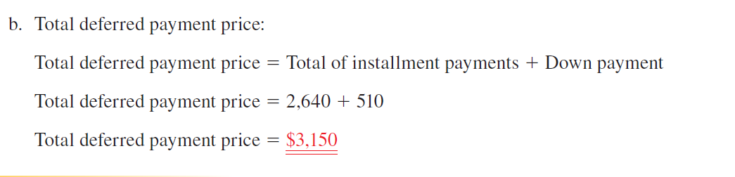

Slide 45
CALCULATING THE AMOUNT OF THE REGULAR
MONTHLY PAYMENTS OF AN INSTALLMENT
LOAN BY THE ADD-ON INTEREST METHOD

Slide 46
One of the most common methods of calculating the finance charge on an installment loan is known as add-on
The term gets its name from the fact that the simple interest is computed and then added on to the amount financed to get the total of installment payments. The interest or finance charge is computed by using the simple interest formulainterest.

Slide 47
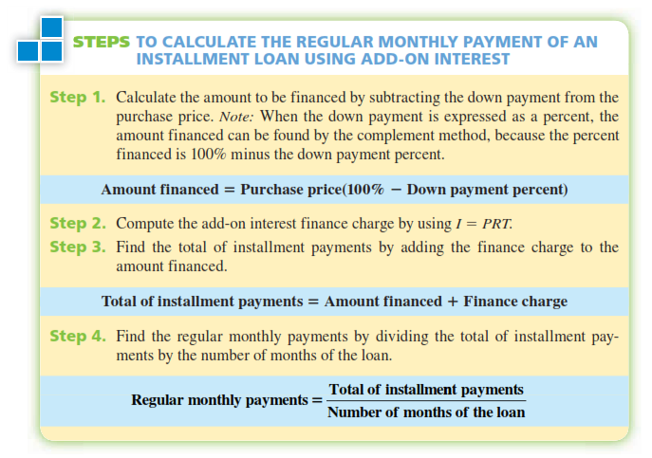

Slide 48
CONTOH
Lee Childs bought a new boat with a 7% add-on interest installment loan from his credit union. The purchase price of the boat was $19,500. The credit union required a 20% down payment and equal monthly payments for 5 years (60 months). How much are Lee’s monthly payments?
Lee Childs membeli kapal baru dengan pinjaman angsuran add-on interest 7% dari serikat kredit. Harga beli perahu adalah $ 19.500. Serikat kredit mensyaratkan uang muka 20% dan pembayaran bulanan selama 5 tahun (60 bulan). Berapa banyak pembayaran bulanan Lee?

Slide 49
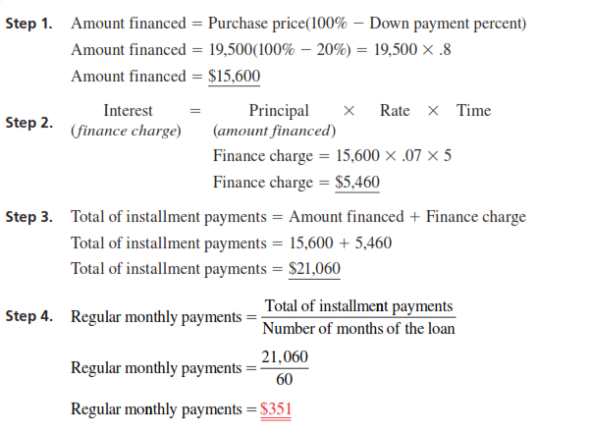

Slide 50
CALCULATING THE ANNUAL PERCENTAGE
RATE OF AN INSTALLMENT LOAN BY
APR TABLES AND BY FORMULA

Slide 51
Description
As we learned in Objective 13-5, the add-on interest calculation for an installment loan is the same as the procedure we used on the simple interest promissory note. Although the interest is calculated the same way, the manner in which the loans are repaid is different. With promissory notes, the principal plus interest is repaid at the end of the loan period. The borrower has the use of the principal for the full time period of the loan. With an installment loan, the principal plus interest is repaid in equal regular payments. Each month in which a payment is made, the borrower has less and less use of the principal. For this reason, the effective or true interest rate on an installment loan is considerably higher than the simple add-on rate. As we learned in Section I of this chapter, the effective or true annual interest rate being charged on open- and closed-end credit is known as the APR.

Slide 52
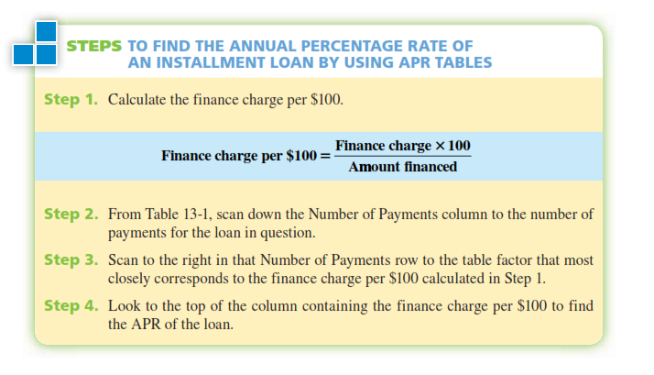

Slide 53
EXAMPLE 6
Jeff Gordon purchased a used motorcycle for $7,000. He made a down payment of $1,000 and financed the remaining $6,000 for 36 months. With monthly payments of $200 each, the total finance charge on the loan was $1,200 ($200 X 36 = $7,200 - $6,000 = $1,200). Use Table 13-1 to find what annual percentage rate was charged on Jeff’s loan.
Jeff Gordon membeli sepeda motor bekas seharga $7.000. Dia melakukan pembayaran uang muka sebesar $1.000 dan sisa $6.000 diangsur untuk 36 bulan. Dengan pembayaran bulanan sebesar $200 masing-masing, biaya total pembiayaan pinjaman adalah $1.200 ($ 200 x 36 = $ 7200 - $ 6000 = $ 1200). Gunakan Tabel 13-1 untuk mencari berapa tingkat bunga tahunan yang dikenakan pada pinjaman Jeff.

Slide 54
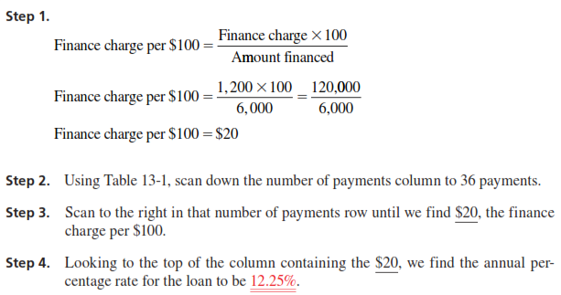

Slide 55
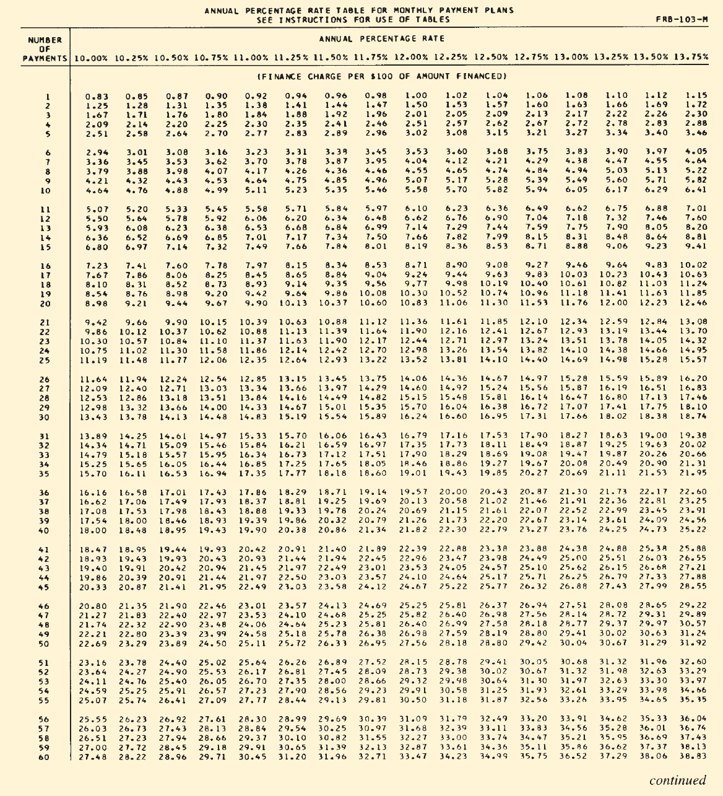

Slide 56
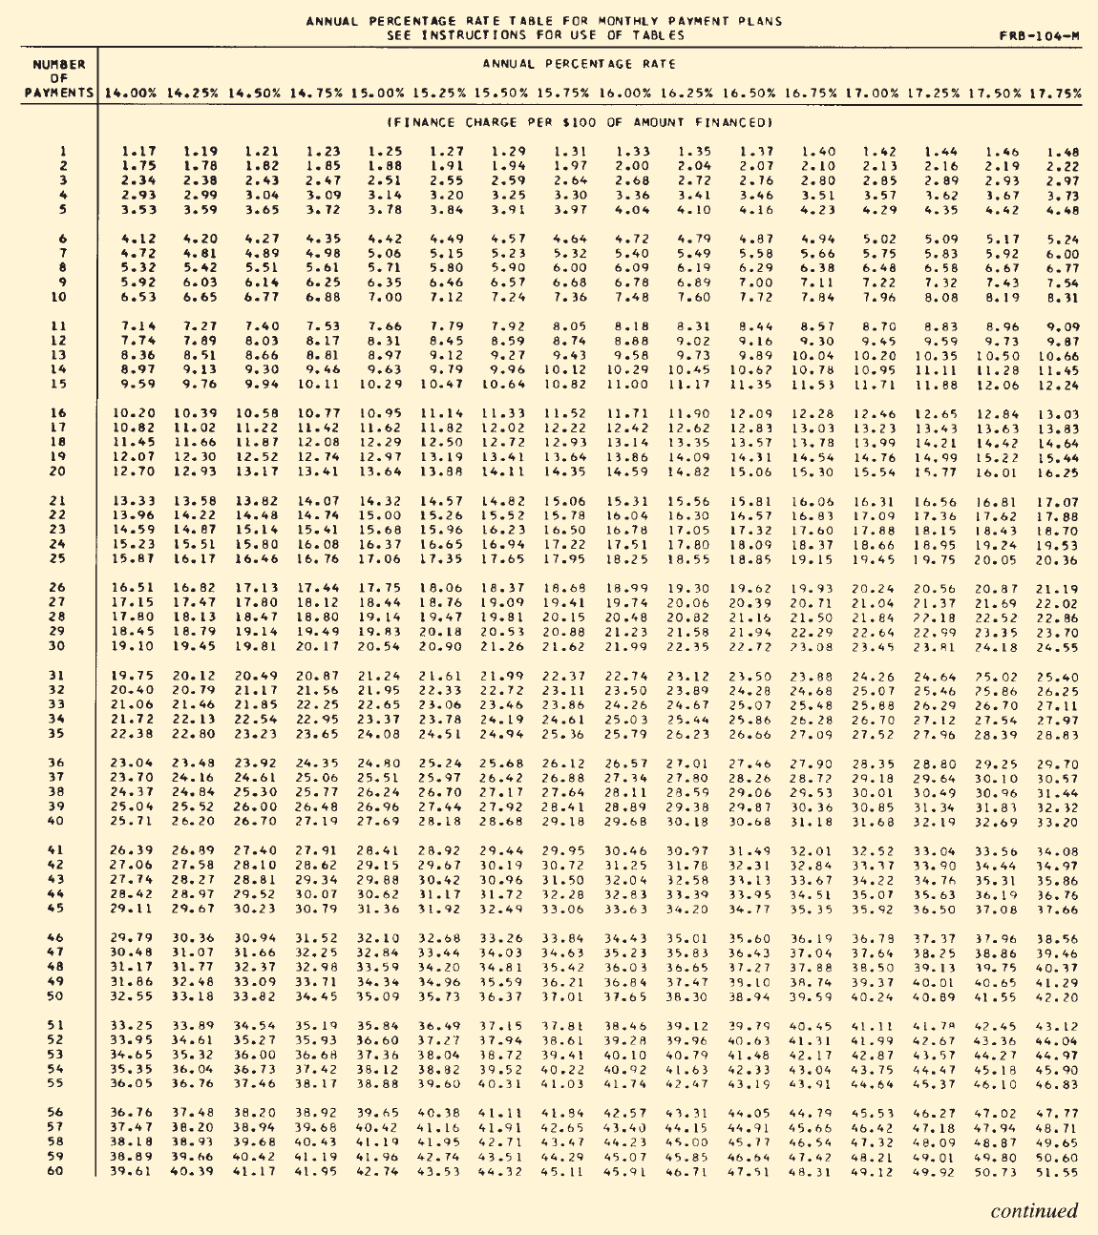

Slide 57
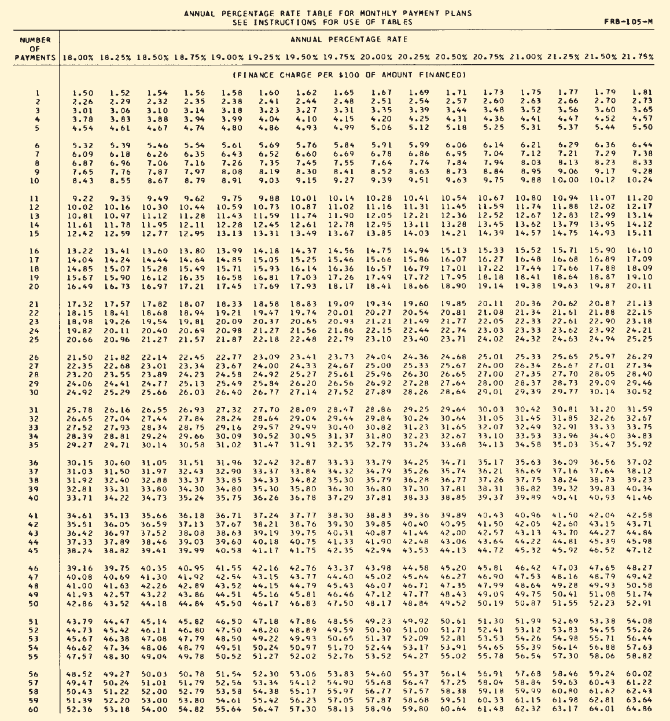

Slide 58
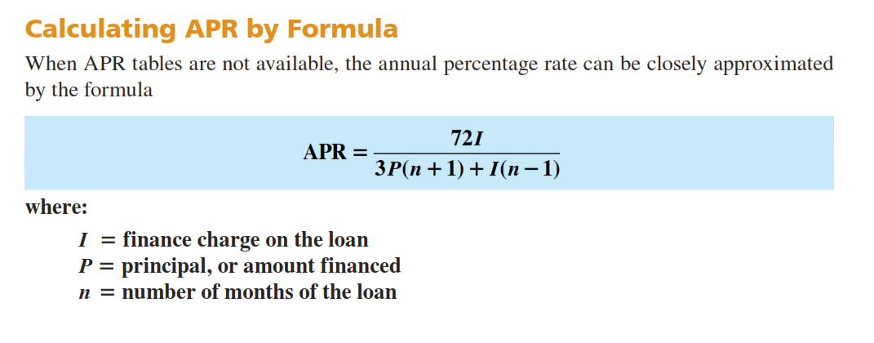

Slide 59
EXAMPLE 7
Refer to Example 6, Jeff Gordon’s motorcycle purchase. This time use the APR formula to find the annual percentage rate. How does it compare with the APR from the table?

Slide 60
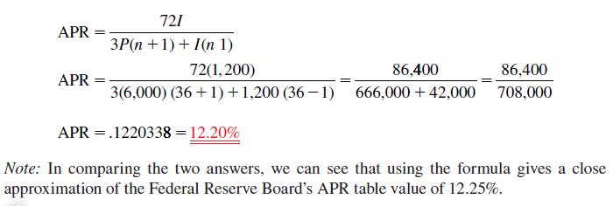

Slide 61
CALCULATING THE FINANCE CHARGE AND
MONTHLY PAYMENT OF AN INSTALLMENT
LOAN BY USING THE APR TABLES

Slide 62
When the annual percentage rate and number of months of an installment loan are known, the APR tables can be used in reverse to find the amount of the finance charge. Once the finance charge is known, the monthly payment required to amortize the loan can be calculated as before.

Slide 63
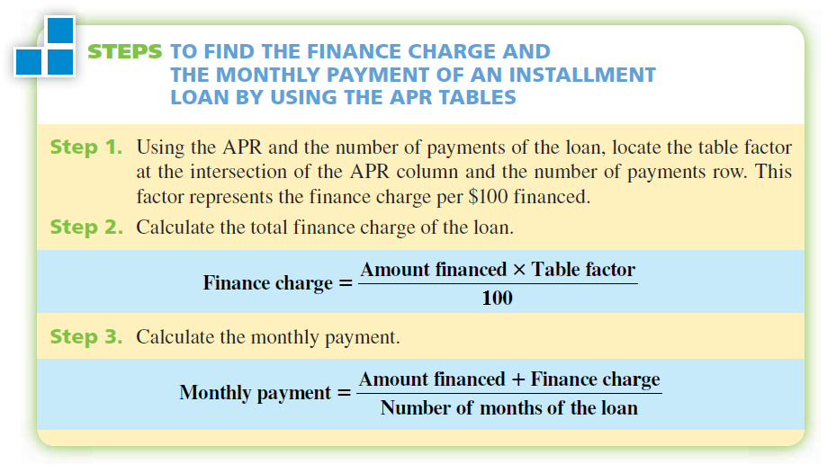

Slide 64
EXAMPLE 8
Classic Motors uses Regal Bank to finance automobile and truck sales. This month Regal is offering up to 48-month installment loans with an APR of 15.5%. For qualified buyers, no down payment is required. If Ron Wiser wants to finance a new truck for $17,500, what are the finance charge and the amount of the monthly payment on Ron’s loan?
Klasik Motors menggunakan fasilitas dari Regal Bank untuk membiayai mobil dan truk penjualan. Bulan ini Regal menawarkan hingga 48 bulan angsuran pinjaman dengan APR sebesar 15,5%. Untuk pembeli yang memenuhi syarat, tidak ada uang muka yang diperlukan. Jika Ron Wiser ingin membiayai sebuah truk baru seharga $ 17.500, berapakah finance charge dan jumlah pembayaran bulanan pinjaman Ron?

Slide 65
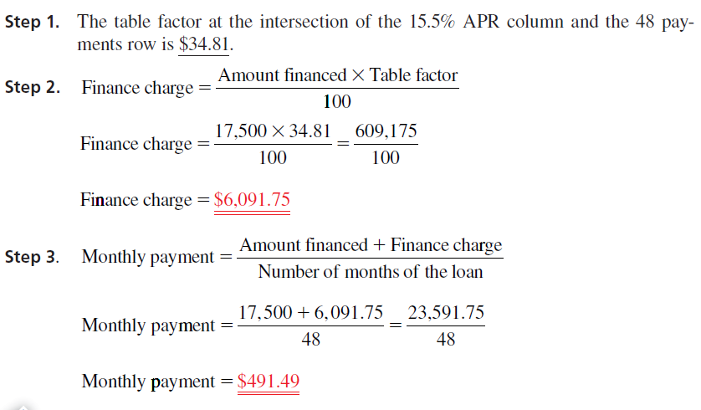

Slide 66
CALCULATING THE FINANCE CHARGE REBATE AND
THE AMOUNT OF THE PAYOFF WHEN A LOAN IS PAID OFF
EARLY BY USING THE SUM-OF-THE-DIGITS METHOD

Slide 67
Description
Frequently, borrowers choose to repay installment loans before the full time period of the loan has elapsed. When loans are paid off early, the borrower is entitled to a finance charge rebate, because the principal was not kept for the full amount of time on which the finance charge was calculated. At payoff, the lender must return or rebate to the borrower any unearned portion of the finance charge.
A widely accepted method for calculating the finance charge rebate is known as the sumof-the-digits method, or Rule of 78.

Slide 68
Description
This method is based on the assumption that the lender earns more interest in the early months of a loan, when the borrower has the use of much of theprincipal, than in the later months, when most of the principal has already been paid back.
When using this method, the finance charge is assumed to be divided in parts equal to the sum of the digits of the months of the loan. Because the sum of the digits of a 12-month loan is 78, the technique has become known as the Rule of 78.

Slide 69
Description
This method is based on the assumption that the lender earns more interest in the early months of a loan, when the borrower has the use of much of theprincipal, than in the later months, when most of the principal has already been paid back.
When using this method, the finance charge is assumed to be divided in parts equal to the sum of the digits of the months of the loan. Because the sum of the digits of a 12-month loan is 78, the technique has become known as the Rule of 78.
Sum of the digits of 12 = 1 + 2 + 3 + 4 + 5 + 6 + 7 + 8 + 9 + 10 + 11 + 12 = 78

Slide 70
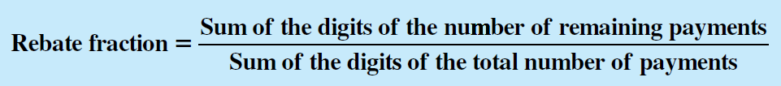
Description
With the sum-of-the-digits method, a rebate fraction is established based on when a loan is paid off. The numerator of the rebate fraction is the sum-of-the-digits of the number of remaining payments and the denominator is the sum of the digits of the total number of payments.

Slide 71

Description
Although the sum of the digits is easily calculated by addition, it can become tedious for loans of 24, 36, or 48 months. For this reason, we shall use the sum-of-the-digits formula to find the numerator and denominator of the rebate fraction. In the formula, n represents the number of payments.

Slide 72
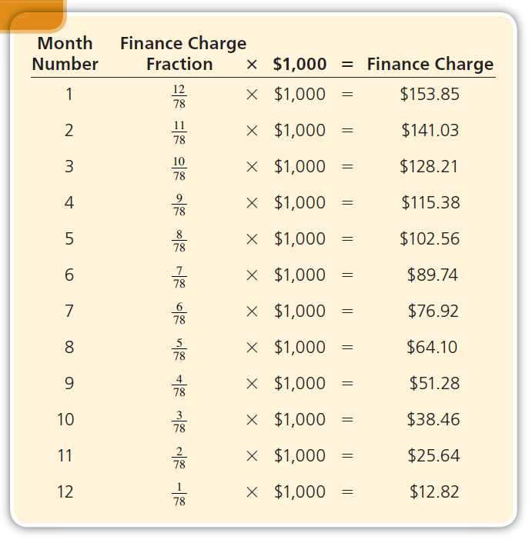

Slide 73
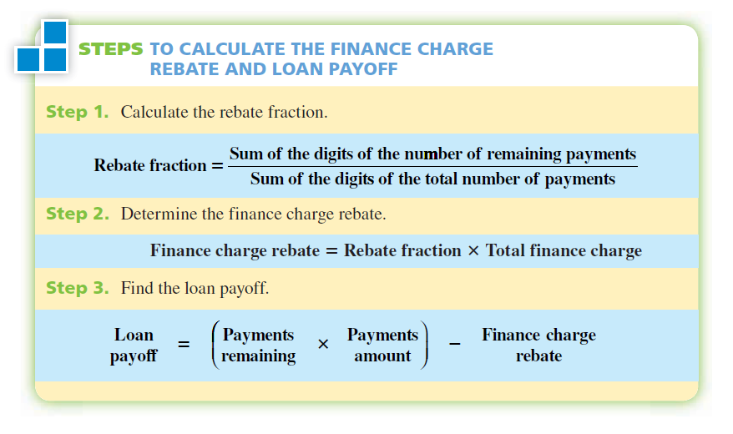

Slide 74
EXAMPLE 9
Sandy Lane financed a $1,500 health club membership with an installment loan for 12 months. The payments were $145 per month, and the total finance charge was $240. After 8 months, she decided to pay off the loan. How much is the finance charge rebate and what is her loan payoff?
Sandy Lane membiayai $1.500 keanggotaan klub kesehatan dengan pinjaman angsuran selama 12 bulan. Pembayaran adalah $145 per bulan, dan biaya keuangan total adalah $240. Setelah 8 bulan, ia memutuskan untuk melunasi pinjaman. Berapa rebate biaya keuangan dan berapa pelunasan pinjamannya?

Slide 75
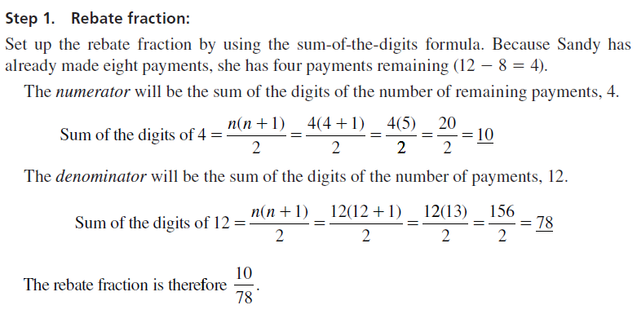

Slide 76
