Slide 1
Equation and Formula
Chapter 2 Salzman
Chapter 5 Brenchner

Slide 2
Definition
Formula A mathematical statement describing a real-world situation in which letters represent number quantities. An example is the simple interest formula, I = PRT, where interest equals principal times rate times time.
Equations Mathematical statements expressing a relationship of equality; usually written as a series of symbols that are separated into left and right sides and joined by an equal sign.
X+7 = 10 is an equation.

Slide 3
Definition
Expression A mathematical operation or a quantity stated in symbolic form, not containing an equal sign. X + 7 is an expression.
Variables (unknowns) The part of an equation that is not given. In equations, the unknowns are variables (letters of the alphabet), which are quantities having no fixed value. In the equation X + 7 = 10, X is the unknown or variable.

Slide 4
Definition
Constants (knowns) The parts of an equation that are given. In equations, the knowns are constants (numbers), which are quantities having a fixed value. In the equation X + 7 = 10, 7 and 10 are the knowns or constants.
Terms The knowns (constants) and unknowns (variables) of an equation. In the equation X + 7 = 10, the terms are X, 7, and 10.
Solve an equation The process of finding the numerical value of the unknown in an equation.

Slide 5
Definition
Solution, or root The numerical value of the unknown that makes the equation true. In the equation X + 7 = 10, for example, 3 is the solution, because 3 + 7 = 10.
Coefficient A number or quantity placed before another quantity, indicating multiplication. For example, 4 is the coefficient in the expression 4C. This indicates 4 multiplied by C.
Transpose To bring a term from one side of an equation to the other, with a corresponding change of sign.

Slide 6
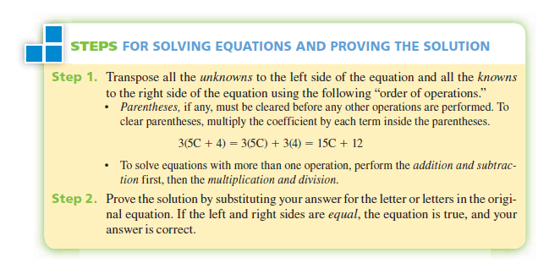
Solving Equation

Slide 7
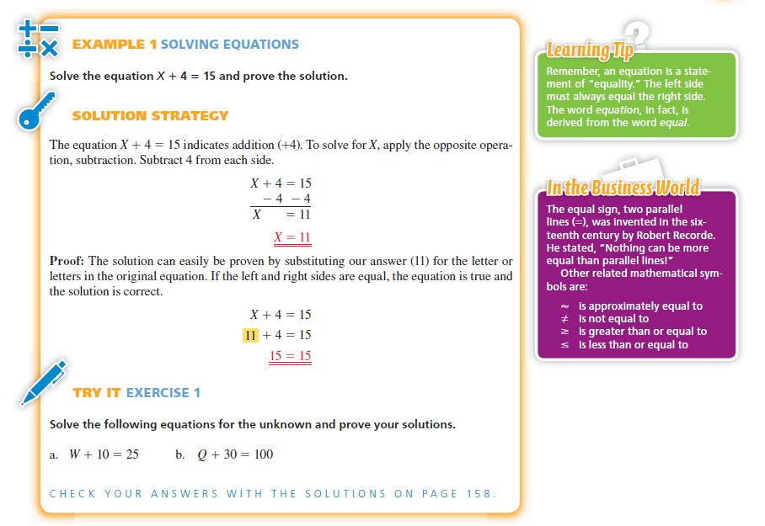

Slide 8
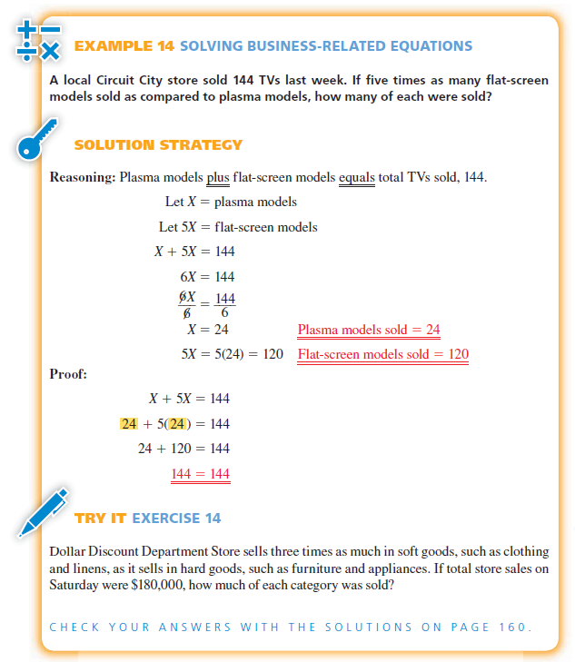
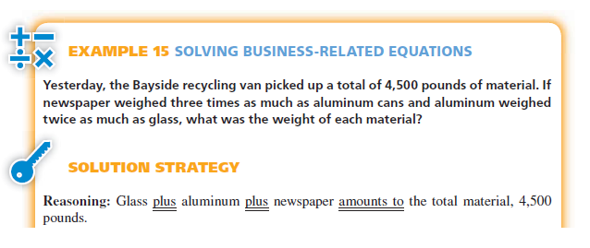
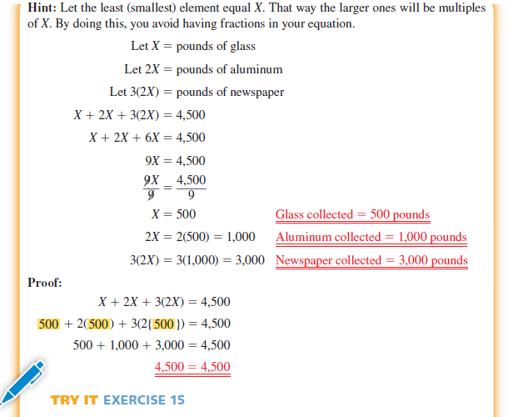

Slide 9
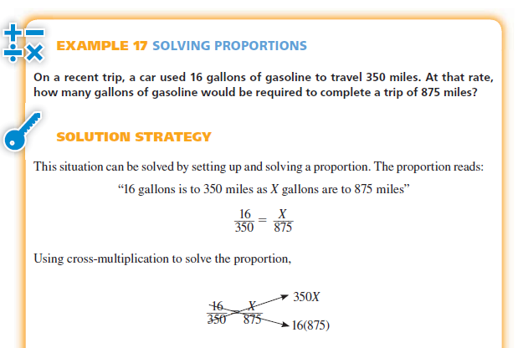

Slide 10

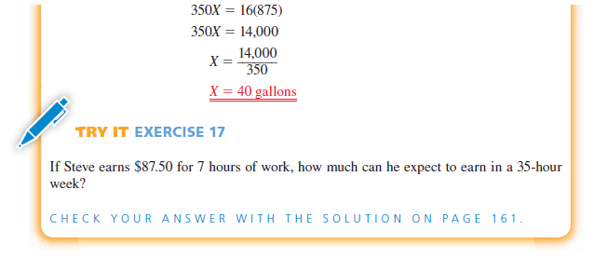

Slide 11
EXERCISES

Slide 12
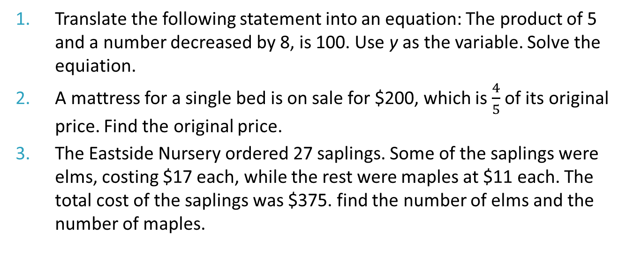
Exercises
Translate the following statement into an equation: The product of 5 and a number decreased by 8, is 100. Use y as the variable. Solve the equiation.
A mattress for a single bed is on sale for $200, which is $\frac{4}{5}$ of its original price. Find the original price.
The Eastside Nursery ordered 27 saplings. Some of the saplings were elms, costing $17 each, while the rest were maples at $11 each. The total cost of the saplings was $375. find the number of elms and the number of maples.

Slide 13
Excercises
Laurie Zimmerman has $15,000 to invest. She places a portion of the funds in a savings account and $3,000 more than twice this amount in a retirement account. How much is put into the savings account? How much is placed in the retirement account?
An employee earns $9 per hour plus $0.45 for each circuit board she assembles. (a) Write an equation for her total income (T) in terms of hours (H) and number of circuit boards assembled (C). (b) Solve for the variable C. (c) Use this to find the number of circuit boards she must assemble in a 40-hour week in order to earn $450.

Slide 14
Excercises
Trinity Home Furnishings has found that total monthly sales for its small chain of stores can be estimated as follows.
Sales = $148,500 + 0.48A²
Where A = amount spent on advertising. Estimate sales for a month when $500 is spent for advertising.
A firm in Hong Kong and one in Thailand agree to jointly develop a controller chip to be sold to North American auto manufacturers. They agree to split the development costs in a ratio of 8:3 (Hong Kong firm to Thailand firm), resulting in a cost of $9,400,000 to the Hong Kong firm. Find the cost to the Thailand firm.

Slide 15
Excercises
Bill Thomas wishes to estimate the amount of timber on some forested land that he owns. One value he needs to estimate is the average height of the trees. One morning, Thomas notices that his own 6-foot body casts an 8-foot shadow at the same time that a tree casts a 34-foot shadow. Find the height of the tree.
The two partners in Alamo Energy agreed to split profits in a ratio of 3:8. If the first partner received $48,000 in profits one year, find the profit earned by the second partner.

