Slide 1
What Do Your Customers Really Want?
Chapter 4

Slide 2
Chapter 4 Outline
Looking over the customer visit process
Laying the groundwork for your customer visit project
Boning up on interview skills before you go live
Visiting with customers to gather information
Organizing the information you gather

Slide 3
INTRO
You don’t have to be a dummy to fail at new product development. In fact, around 50 percent of new products fail in the marketplace. And the biggest reason for failure is that the products don’t fill the needs of customers.
We walk you through the customer visit process. This process gets you right into your customers’ worlds — past, present, and future.
We begin with preparing for the visits, move on to how you’ll gather customer information, and end with the all-important topic of how you can use the information to jump-start and sustain your product development efforts.

Slide 4
4.1 Dissecting the Customer Visit Process

Slide 5
Intro
The customer visit process is a qualitative market research program that companies have used to develop thousands of products and services in every industry imaginable—from blood analyzers to insurances policies; from software products to custom homes; from air conditioners to semi-conductor chips to chocolate-chip cookies.

Slide 6
Intro
The following list presents the customer visit process in a nutshell:
Focus the development team on an opportunity.
Prepare for the customer visits.
Execute the process.
Distill the results.
Quantify the results.

Slide 7
4.2 Building the Foundation for the Customer Visit Program

Slide 8
Intro
You’re about to take a dip in the “ocean of opportunity”. The ocean of opportunity is vast; it includes everything you might do to please your customers, all the technologies you could use, and all the information you could gather about markets and competitors.
One of the most important things you can learn as you swim about in the ocean is what your customers really want.
In this first step of the customer visit process, we walk you through how to choose an opportunity, how to assemble a visit team, and how to select a small group of customers to visit.
Notes:
Anda bagai berenang di “lautan peluang”

Slide 9
Identifying an opportunity

Slide 10
Identifying Opportunity
A customer visit program allows your company to explore NPD opportunities and come up with plenty of ideas for new and different products or services. Before launching a customer visit project, however, you need to identify a valid and important opportunity on which to focus.

Slide 11
Identifying Opportunity
The following list presents some different opportunities to look for, along with examples that show how several different companies chose a focus for their projects:
Technology opportunity: Successful customer visit programs are often based on technology opportunities.
Market opportunity: Changes in the market also can provide direction for a customer visit project.
Regulation change opportunity: Regulations —which can be local, state, or federal government regulations; legal statutes; or industry codes and agreements— have a huge impact on customer needs and provide interesting opportunities for new products or services.

Slide 12
Assembling your customer visit team

Slide 13
Intro
In order to get a project off the ground, you need to have a customer visit team. The team should consist of 8 to 12 members from different business functions. The team needs a sponsor and a team leader.
If your company has carried out customer visits before, it’s a good idea for the team leader, and also several of the team members, to have experience working on customer visit projects.

Slide 14
Intro
The team’s responsibility is to gather customer information and to shape it so that the members or others can use it to generate new product ideas, to develop new products, and to make improvements to existing ones.

Slide 15
First things first: Getting a sponsor and charter
Customer visit programs take time and money, and customer visit teams require resources, which fall under the control of many different people: the head of R&D, the head of marketing, the head of manufacturing, and so on.
Every customer visit project should have a sponsor who can negotiate with the different department heads to acquire the needed resources. The sponsor might be a director, an executive, or the head of a business unit or functional department.

Slide 16
First things first: Getting a sponsor and charter
At the beginning of the customer visit project, you should draw up a project charter that acts as a contract between the visit team and management. We emphasize this because customer visits are often “out of the ordinary”
The project charter should include the following information:
The number of customers the team plans to visit.
The opportunity the team is exploring.
The planned project outcomes and time frame.
Formal chartering assures that a customer visit team will have adequate sup- port and resources, clear goals, and defined deliverables.

Slide 17
Deciding who should make up the team
A customer visit team should have 8 to 12 members who come from different business functions. The team sponsor and the team leader should select team members with an eye to experience and diversity; however, the final say about who will make up the team is usually up to the functional heads.
It’s important to include people with different experiences and perspectives. For example, a marketing member and a manufacturing member will each come away from a customer visit with very different experiences and observations, and they’ll interpret the information the team gathers differently.

Slide 18
Creating and choosing from a customer pool

Slide 19
Intro
You can’t visit all your customers for a customer visit project, and you certainly don’t need to. In the following sections, we help you create a list of the customers you may want to visit and construct a matrix to narrow down your choices.

Slide 20
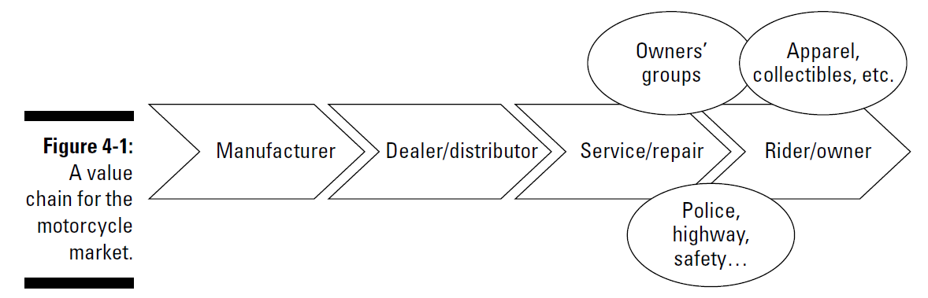
Tagging the most desirable customers
The following steps show you how to identify the many different customers who may be relevant to your opportunity (the section after this one shows you how to narrow the field to a manageable number):
Brainstorm a list of the people and organizations that together would provide the product, service, or solution that the end-user would buy.
List any other segments of the customer population that you may con- sider important.

Slide 21
Creating a customer visit matrix to focus your efforts
But wait! Your team now has lists that highlight everyone you can think of who may relate to your development opportunity, and we say earlier you should visit 10 to 20 customers.
Exactly right. Your team must now decide where to focus its efforts. This can be kind of like making sausage: a messy process. One expert calls it “part art, part science.”

Slide 22
Setting up the matrix
You start by making a customer visit matrix by drawing rows and columns on a large sheet of paper. The headings for the columns should list the stake- holders you’ve brainstormed, and the headings for the rows should list the important customer segments you’ve identified.
Each box you highlight on the matrix includes many customers —possibly even hundreds. For example, your team could locate hundreds of motorcycle dealers, repair shops, and owners groups. You also could contact thousands of riders. With the matrix, you’ve decided which categories are most important to your project; now you have to identify one or several customers in each box that you’ll actually visit.
Selecting your customers

Slide 23
Just selecting the customer
The following list presents a way to go about selecting who you’ll visit from your many options:
Decide which geographic areas you want to visit.
Within each geographic area, identify which kinds of customers each team will visit.
Identify customers in each area who represent the segments each team will visit.
Here’s where a list of other “dimensions” can come in handy. If the Massachusetts team sets up a visit with a 40-year-old woman who uses her motorcycle for transportation, the team that goes to Indianapolis could visit a 20-year-old woman who rides as part of a couple or group.

Slide 24
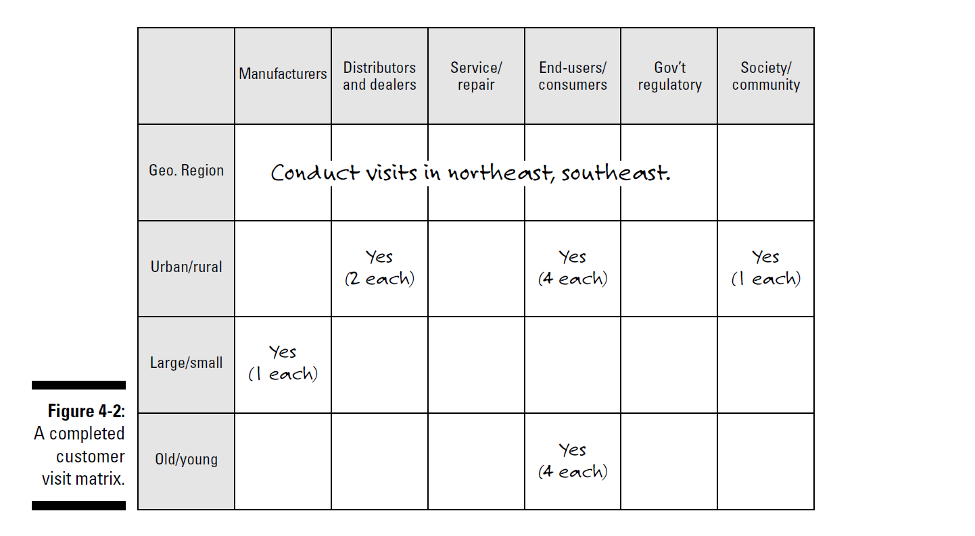

Slide 25
Scheduling the customer visits

Slide 26
Intro
As soon as you decide which customers to visit (see the previous section), you should start scheduling the visits. We recommend that you visit customers in pairs (you can read more about the roles team members play in the section “Setting up a practice interview”). Your team members may know some customers or know someone who does, which makes contacting them much easier. If you don’t have many connections, consider doing some cold-calling —calling current customers and potential customers you find on the Internet or in the phone book— to set up some of the visits.

Slide 27
The following list presents some tips to keep in mind when you begin scheduling customer visits:
Schedule a 1.5 to 2.0 hour interview with each customer.
Don’t schedule more than two visits in one day.
Don’t underestimate the difficulty of getting visits scheduled.
After you schedule a visit, send a letter thanking the customer and briefly explaining the purpose of the upcoming visit.

Slide 28
4.3 Dipping Your Toes into the Visiting Process

Slide 29
Intro
Before your teams of two actually go out to visit your customers, you need to do some preparatory work. You don’t go into a job interview without a résumé and some prepared answers, do you? For starters, your team should prepare a visit guide. When you have the guide drafted, you can start practice interviewing.
For most people, really listening and asking good questions are new skills. You also practice collecting information. With all this prep work under your teams’ belts, you can unleash them into the world of interviewing — allowing a bit of time to make necessary adjustments along the way.

Slide 30
Preparing a visit guide
A visit guide includes a list of themes and topics that each visit pair should cover with each customer. Although each customer visit has a flavor and a character all its own, you want your teams to cover the important points with every customer. A visit guide ensures that this happens.
Your team should follow these steps to create a useful visit guide:
  Brainstorm a list of all the information you want to gather during the customer visit.
  Group the items into categories, and give each category a title.
  Choose the most important categories.
  Use the items in each selected category to develop probe questions.
  Put the important categories (themes) and the probe questions into a logical flow on a visit guide.

Slide 31
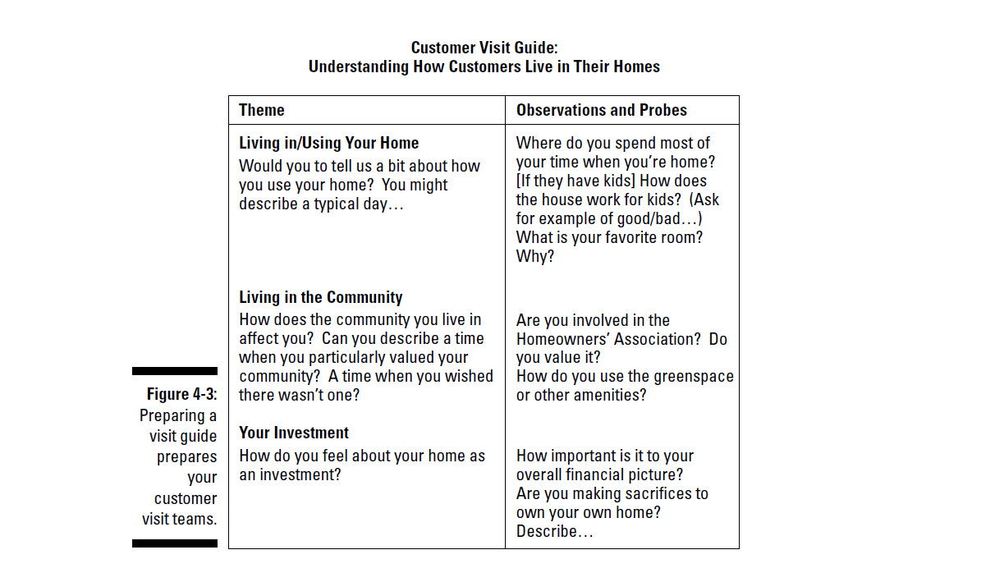

Slide 32
Conducting practice interviews
An interview with a customer isn’t just an ordinary conversation. In fact, it may be quite unlike any conversation you’ve had before. The visit team has a complex task to perform. The pair has to
Make the customer feel comfortable and encourage her to talk frankly about her work, her life, her experiences, and so on.
Follow the outline of the visit guide (see the previous section) so that they cover the points your team has agreed on.
Listen for what’s important to the project in what the customer says, and ask questions or give responses that encourage her to say more about the important things.
Document the interview by using a tape recorder, hand-written notes, and perhaps photographs.

Slide 33
Setting up a practice interview
We recommend that you divide your team into groups of three. In each practice group, you have the following members:
A lead interviewer: This member of the practice team is responsible for initiating the different themes or topics of the interview and for doing most of the follow-up or “probe” questioning.
A notetaker/observer: This member is primarily responsible for collect- ing information. The notetaker may get the chance to ask an insightful probe question or to steer the interview in an interesting direction, but he or she should never cause the customer to wonder if there’s any con- flict over who’s running the show. When in doubt, the notetaker should keep his or her mouth firmly shut. (See the upcoming section “Practicing your information collection” for more advice on notetaking.)
The customer: This member should “introduce” him- or herself as the customer — “I’m a respiratory therapist in a large urban teaching hospital,” for example.

Slide 34
Interviewing the “customer”
Your lead interviewer can start the practice interview with an overarching question. For example, the lead interviewer might ask, “Could you describe a typical day in your job? Maybe start with what happens when you first arrive . . .” Now comes the tricky part: The interviewers have to listen. Their body language should signal that they’re interested — leaning a bit forward, nodding, and not looking around the room or at their notes. The lead inter- viewer can use verbal cues, such as “hmmm” and “ahhh.” Remind your inter-viewers to ask questions or say things that show their interest: “Tell me more!” “How exactly did you do that?” And so on.

Slide 35
Debriefing the interview
After the practice interview, the three-person practice team should take another five minutes to debrief the interview:
Assess the lead interviewer’s performance. Did the customer feel comfortable, and was she able to talk? Were the questions open-ended? What improvements can the lead interviewer make?
Debrief the visit guide. Was the guide helpful? Were the probe questions open-ended? How could you change them? The team won’t have time to get through the whole guide, but they can learn enough about how it works to know whether it needs to be revised.
Debrief the notetaker role and assess what the interview pair learned. How well did the notetaker record the customer’s words? Did the notetaker record images? What other images or insights can the team reconstruct?

Slide 36
Sharing insights with the whole team
When all the three-person teams have completed their practice interviews, the team leader should call the whole group together so the teams can talk about what they’ve learned. Hearing the strong and weak points of other interviewers can help everyone improve. During these sharing sessions, the team builds a common understanding of what makes for a successful interview.

Slide 37
Practicing your information collection
The notetaker of the visit pair has the job of collecting information during the customer visit. When you first hear about “notetaking,” you may think of being back in school and trying to transcribe an entire lecture in a notebook. Taking interview notes that way is unbelievably frustrating, and it makes your hand hurt.
However, the actual, verbatim words of the customer are invaluable sources of insight for the team. We human beings tend to listen in generalities. We hear “I liked using that device” rather than “When I used that device, I was able to provide much better patient care.” When the interviewer follows the latter statement with a probe question and discovers that “When my hands are free, I’m able to adjust dials much more accurately,” the team has infor- mation to begin to design a product around.

Slide 38
Practicing your information collection
Even if the notetaker has a tape recorder, though, we recommend that he or she take some verbatim notes during the interview. Here’s why:
The tape recorder may malfunction. You want to have as full a record as possible after your team travels many miles to visit a customer.
People tend to listen in generalities. Taking notes verbatim actually gets the notetaker in the habit of listening to what others are saying rather than filtering words through his or her own ideas and opinions.

Slide 39
Baby steps: The first visit
The first time team members actually go out to visit customers is a big step. They’re going from inside the safety of the company to outside into the big wide world. Although the marketing members of the team may be perfectly comfortable visiting customers, engineers and manufacturers usually find the whole idea rather strange.
This section introduces two ways of conducting the first visit. The first is fine for most visit teams; we introduce the second in case any of your teams need some extra help.

Slide 40
Going on your first visit
The first visit for each two-person team should serve as a smooth transition from the practice interviews. The first real visit should be
Local, to save on travel costs.
With a “friendly customer” who knows the company.
With a customer your team can easily contact in case the interviewers miss something or have further questions.

Slide 41
Going on your first visit
Nothing is really different about this visit compared to subsequent visits, except that it’s the first one. The first time is always the hardest! During the first visit, your team will
Confirm the visit details.
Briefly explain the purpose of the visit. Have a tape recorder and ask permission to use it (see the previous section).
Conduct the interview, following the themes and probes on the visit guide (see the section “Preparing a visit guide”).
Thank the customer and confirm that they can call later if needed to clarify points.

Slide 42
After the first visit, your visit team will
Debrief the visit with each other.
They can add things they noticed and talk about any confusions.
Try to hold the debrief meeting the same day as the visit — maybe over dinner at the end of the day.
Write down any images you identified during the visit. Include what you observed in the customer’s environment and what the customer said. Have the interview transcribed. Send the customer

Slide 43
Holding interview practice for real beginners
If customer visit team members are very inexperienced or are unnerved by the thought of conducting visits, you may want to include special practice sessions — sessions that are just like “real” interviews but with much lower stakes. Co-author Beebe Nelson once used this approach with a very nervous scientist who couldn’t imagine visiting customers unless he was the expert. By the end of the project, he was thinking of going into the customer visit business himself!

Slide 44
Here are a few suggestions for setting up a low-stakes practice interview:
If you have a team member who has experience in the market segment that you’re researching, ask him or her to be the “customer” for a full hour interview. Follow the whole process (see the previous section), including taping the interview.
Find an employee in your company who may be an “internal customer” for the opportunity you’re exploring — a researcher or a salesperson, or someone in purchasing or manufacturing, for example. Again, follow the whole interview process. Make it as real as you can.
Set up a practice interview with a customer in your area whom you know well. Explain that you want your team to gain some experience. Ask if the team can come back another time if they need to clarify some points.
Interview a friend or colleague who has experience in the area the team is researching.

Slide 45
Working out the kinks: The mid-course debrief
After all your team’s visit pairs complete and transcribe their first real visits, your whole team should gather to work out the kinks. This meeting, called a mid-course debrief, gives your team a chance to approve what’s working and fix what isn’t.

Slide 46
4.4 The Final Push

Slide 47
Intro
You’ve prepped and practiced. You’ve worked out any kinks with your recording and transcription process. Your team is seeing and hearing images everywhere. You’ve scheduled all the remaining interviews. You’re ready to execute your full customer visit program.

Slide 48
Tackling the rest of the visits
A program of customer visits can take way too long if you don’t complete the visits promptly. The whole project, including preparation time, usually runs from three to six months. If it goes much longer, the team and your execu- tives may begin to lose energy and enthusiasm. Therefore, it’s critical that your team keeps to the proposed schedule. If, as can happen, a customer postpones or cancels a visit, you should reschedule or replace the visit with another customer as soon as you can.

Slide 49
Assembling the visit data
The program of customer visits is a knowledge-building project. The information the team gathers is important for the team and the company. It often con- tributes to other teams and projects long after the current project is complete.
Your team needs to put all the information you gather into a format that you can store easily, that your team members can access without issue, and that can provide a permanent and accessible record for other teams (these days, that pretty much shouts out “Internet!”).

Slide 50
Assembling the visit data
The following list inventories the pieces of information you should update after the visits are complete:
The customer selection matrix, which records the customers and seg- ments the team planned to visit and those they didn’t (see the section “Creating a customer visit matrix to focus your efforts”)
A list of the customers that the team actually visited, including their contact information
The visit guide, which provides an overview of the learning objectives of the project (see the section “Preparing a visit guide”)
The transcript of the interviews, plus interviewers’ notes, which will include the images they logged right after the visit (see the section “Practicing your information collection”)
Photos or videotapes the team shot
Images of the customer environment, including the final map of the images the team found most important (see the upcoming section “Organizing the image information”)
Customer requirements the team generated (see the section “Writing product requirements: What does your customer want?”)

Slide 51
Staying in touch with customers
During your team’s customer visits, you form important relationships with the customers who give you valuable information you can use to develop successful new products. They’re useful to you in many ways during the visits; what you may not know is how useful they can be in the future. You have several reasons why your team members may want to contact these customers in the future:
You may have questions about something you heard or failed to ask during the visit. At the end of the visit, a member of the team should ask the customer if you can call, e-mail, or write if you have additional questions.
You may want customers to participate with you in future idea-generation sessions (see Chapter 5) or in another aspect of product development.
Some customers could make perfect candidates for product or proto- type testing later in the development process (see Chapter 17).
Customers might participate in advertising or promotional campaigns.

Slide 52
4.5 Distilling the Results: Images and Requirements

Slide 53
Intro
Visiting customers to gather product information is like drinking from a fire hose. No, really! Each visit may produce 20 or more pages of transcribed notes and observations, complete with photos, insights, and images. What’s your team supposed to do with all this information?
Lucky for you, in the sections that follow, we show you how to organize the information and shape it into a form that your team can use and share. We concentrate on two kinds of information: images of the customers’ environments and what your customers want or need — the “customer requirements.”

Slide 54
Organizing the image information
What to do with all the gathered images from the customer visits? In a list, all by themselves, they don’t make much sense. At best, they’re contradictory — they show the confusion and richness of the real world.
The following sections explain how your team can assemble the images and then shape them so that the team members, and others, can use the images to deepen their understanding of customers.

Slide 55
Writing and assembling the images
The first step in organizing and shaping visit information is to generate a simple list of the images. By listing the images, you give the team members and others access to a rich repository of customer information. The best time for the visit team to identify and select images is right after each visit.
The following list presents some examples of images from customer visits:
“A doctor climbing on a filing cabinet to get a picture.” Quote from a camera manufacturer on a visit to a doctor’s office to find out how dental surgeons document operations.
“I make a complete mess pipetting solution into the receptacles.” Quote from a customer of a manufacturer of blood analyzers.
“I’m spending too much time learning new applications — I’m frustrated!” Quote from a customer of a software manufacturer.

Slide 56
Grouping and mapping the images
After the visit team has identified the important images from the customer visits and written them on sticky notes, the next step is to group the images so that team members can begin to see some patterns.
Call a team meeting and follow these steps to bring some order to your images:
Sort and group the images. You can follow this process:
  Post the sticky notes on a blank wall, on wall charts, or on dry- erase boards. Make sure the sticky sides of the notes are on top!
  Weed out duplications. We prefer to put duplications in a stack instead of tossing them out so that we don’t lose wording that may come in handy later.
  Group the images. At this point, it’s okay to group them logically.

Slide 57
Grouping and mapping the images
Reduce the number of images.
Each team member puts a check on all the images she or he wants to include in the final count. When that round is done, eliminate all the images with no checks, and repeat the process. Take off all the images with one check, and do a third round. Your goal is to identify 25 to 30 images. Keep the earlier round losers in your team documentation.
Start grouping the selected 25 to 30 images.
“WAIT! Not that way!” Most people will want to group the images by obvious properties or characteristics — which ones talk about paint and which ones talk about wallpaper, or which ones happened to old patients and which to younger ones, for instance. That’s how our little logical minds usually work.

Slide 58
Grouping and mapping the images
Label each group — with images that give the flavors of the images in each group, if possible.
Repeat Steps 3 and 4, if necessary, until you have five to seven groups.
Paste all the groups formed by sticky notes on flip chart pages to form a map, and decorate your map with real images.

Slide 59
Writing product requirements: What does your customer want?
Now that your customer visit teams have completed the visits, gathered information, and mapped the images, your team is ready to identify clear customer requirements. Things your customers desire in a product. Things that make the difference in your customers’ buying decisions. Things you want to concentrate on providing.
The following list conveys what the visit team should do to create customer requirements from the information they’ve gathered:
Go through each transcript from the visits and pull out any require- ments you find.
2. Use the image map (see the previous section) to shed light on other statements — complaints, suggestions, and so forth — that may yield requirements.
3. Write clear requirements — one per sticky note.
• Each requirement should start with “I can.
• The requirement shouldn’t contain or imply a solution.
• The requirement should be as specific and clear as possible.
• The requirement should be positive.
4. Group, select, and organize the requirements.

Slide 60
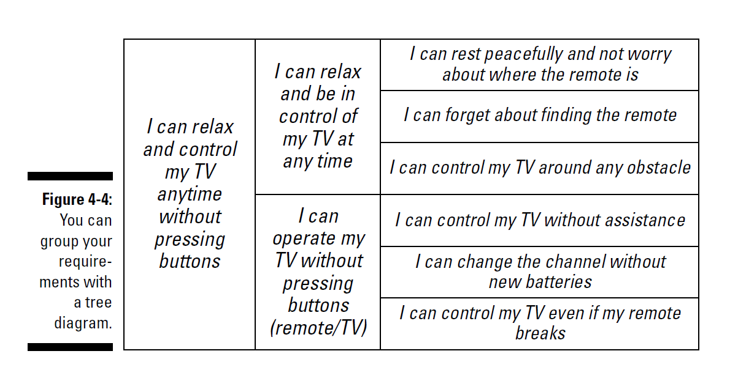

Slide 61
4.6 Quantifying the Results of the Customer Visit Program

Slide 62
Intro
Before your product development team depends too heavily on the research you’ve done with customers — known as qualitative research — you should do quantitative checks. You want to make sure that a sufficiently large number of customers value the customer requirements you’ve identified to make it worthwhile to design products to accomplish them. You also want to know which of the identified requirements are most important to your customers.
Your company’s marketing or market research department should be able to help your visit team conduct research that’s statistically valid. Here are a couple approaches we’ve used:

Slide 63
Intro
Before your product development team depends too heavily on the research you’ve done with customers — known as qualitative research — you should do quantitative checks. You want to make sure that a sufficiently large number of customers value the customer requirements you’ve identified to make it worthwhile to design products to accomplish them. You also want to know which of the identified requirements are most important to your customers.
Your company’s marketing or market research department should be able to help your visit team conduct research that’s statistically valid. Here are a couple approaches we’ve used:

Slide 64
Assessing the relative importance of requirements: Your team can do a quick sanity check by asking customers how important a particular requirement is to them. One way to quantify this is by asking, “If you had $100 (or $1,000 or $10,000, depending on the product), how much of that money would you spend for . . .?”
Assessing whether a requirement is a “must have,” a “pleaser,” or a “delighter”: Noriaki Kano, a Japanese quality expert, found that require- ments fall into three categories:
• Things a product must have: The wheels on a car, for example
• Things that make a product more attractive: Better gas mileage, for example
• Things that make a product delightful but that aren’t expected: Built-in televisions in the back seat, for example

