Slide 1
Chapter 05
Banking Service

Slide 2
Checking Account
(in Indonesian = GIRO or REKENING GIRO)

Slide 3
Description
Checking accounts are among the most useful and common banking services available today.
They provide a detailed record of monetary transactions, and are used by most businesses and individuals to purchase goods and services and to pay bills.
When a checking account is opened, banks often require an initial minimum deposit of $50 or $100. Certain. (For example, BCA or Mandiri determine that required initial minimum deposit of Rp1.000.000.)

Slide 4
Description
Checking account transactions are processed in our banking system using a combination of paper checks and electronic options such as automated teller machines (ATMs), debit cards, SMS, internet, call, automatic bill paying, and electronic funds transfer (EFTs).
Online banking uses today’s technology to give account holders the option of bypassing some of the time consuming, paper-based aspects of traditional banking.

Slide 5

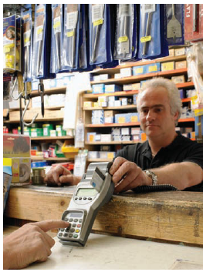
Debit Card

Slide 6
Definition
Deposits, is funds added to a checking account.
Depositor, is a person who deposits money in a checking account.
Check or draft, a written order to a bank by a depositor to pay the amount specified on the check from funds on deposit in a checking account.
Payee the person or business named on the check to receive the money.
Payor the person or business issuing the check.

Slide 7
Definition
Deposit slip printed forms with the depositor’s name, address, account number, and space for the details of the deposit. Used to record money, both cash and checks, being added to the checking account.
Check stub a bound part of the checkbook, attached by perforation to checks. Used to keep track of the checks written, deposits, and current account balance of a checking account.
Check register a separate booklet of blank forms used to keep track of all checking account activity. An alternative to the check stub.

Slide 8
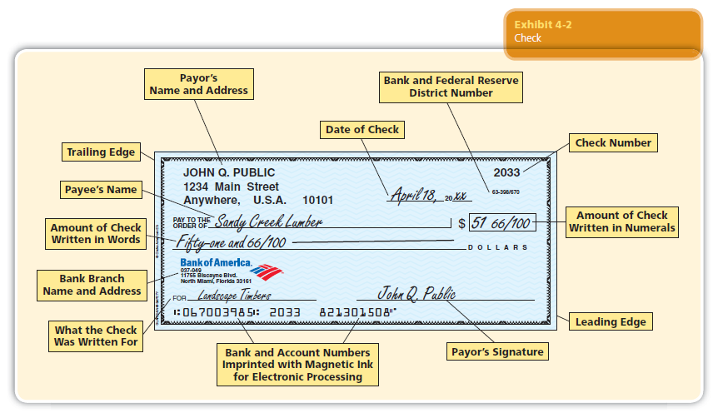
PART OF A CHECK

Slide 9
Service Charge
Service charge for business checking account are based on the average balance for the period covered by the statement.
This average balance determines the maintenance charge per month, to which a per debit charge (per check charge) is added.

Slide 10
Table 1. Typical Bank Charges for A Business Checking Account
Average Balance | Maintenance Charge per Month | Per Check Charge
Less than $500 | $12.00 | $0.20
$500-$1999 | $ 7.50 | $0.20
$2000-$4999 | $ 5.00 | $0.10
$5000 or more | $ 0.00 | $0.00

Slide 11
Example
Find the monthly service charge for the following business accounts using above Table 1.
  Pittsburgh Glass, 38 checks written, average balance $833
  Fargo Western Auto, 87 checks written, average balance $2367

Slide 12
Answer
An account with an average balance between $500-$1999 has a maintenance charge of $7.50 per month plus a debit (check) charge of $0.20 each.
Monthly charge = maintenance charge + number of checks x per check charge
= $7.50 + 38 x $0.50
= $15.10

Slide 13
Answer
An account with an average balance between $xxxx-$xxxx has a maintenance charge of $x.xx per month plus a debit (check) charge of $x.xx each.
Monthly charge = maintenance charge + number of checks x per check charge
= $ + x $
= $

Slide 14
Definition
Deposit slip printed forms with the depositor’s name, address, account number, and space for the details of the deposit. Used to record money, both cash and checks, being added to the checking account.
Check stub a bound part of the checkbook, attached by perforation to checks. Used to keep track of the checks written, deposits, and current account balance of a checking account.
Check register a separate booklet of blank forms used to keep track of all checking account activity. An alternative to the check stub.

Slide 15
Deposit Slip
Deposit slip is printed forms with the depositor’s name, address, account number, and space for the details of the deposit. Used to record money, both cash and checks, being added to the checking account.

Slide 16
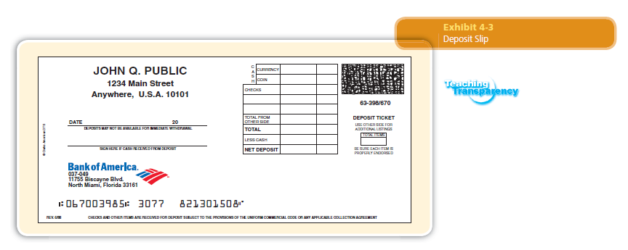

Slide 18
Check Stub and Check Register
Check stub a bound part of the checkbook, attached by perforation to checks. Used to keep track of the checks written, deposits, and current account balance of a checking account.
Check register a separate booklet of blank forms used to keep track of all checking account activity. An alternative to the check stub

Slide 19
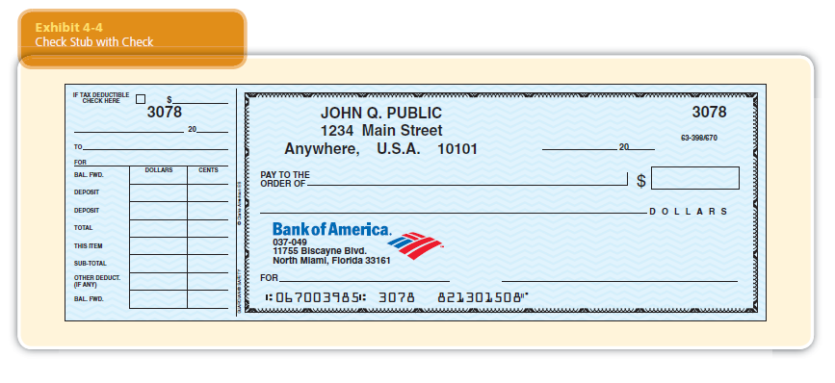

Slide 21
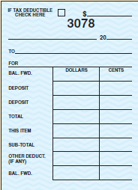

Slide 22
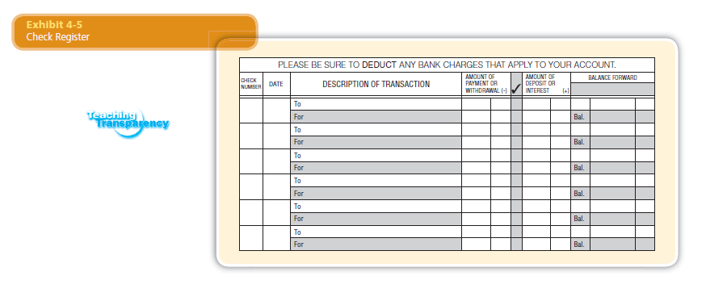

Slide 25
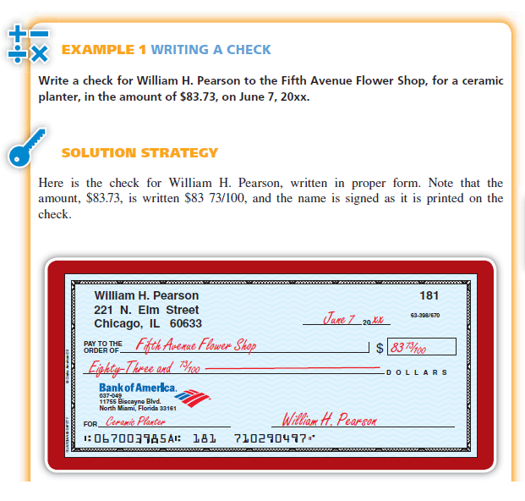
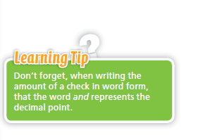

Slide 28
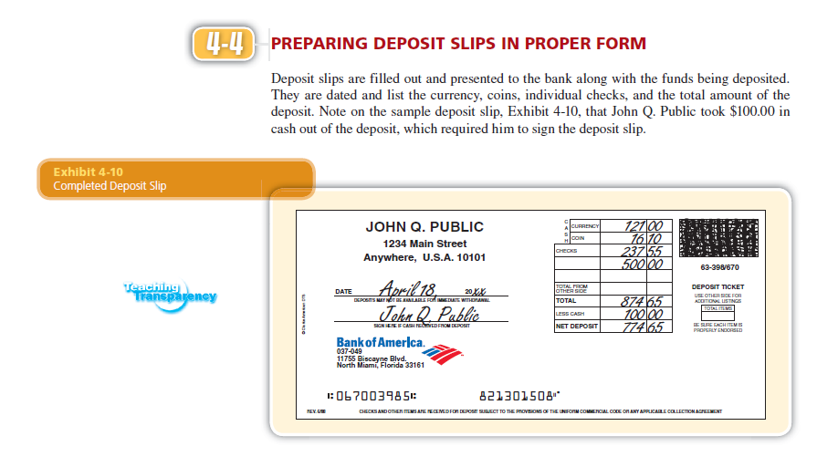

Slide 29
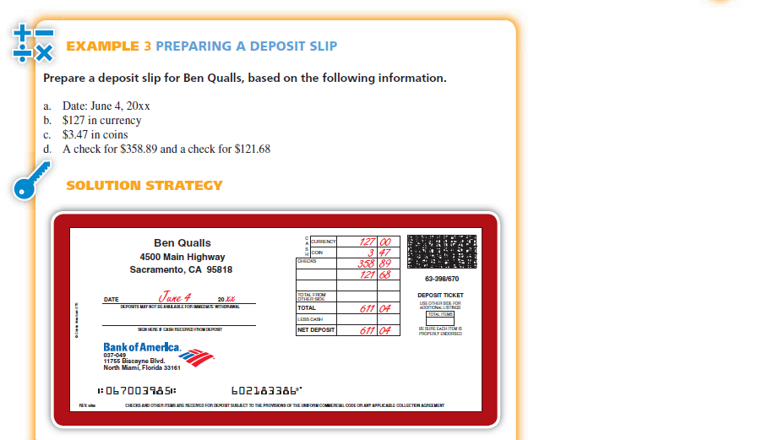

Slide 30
Check Endorsement
Is the signature and instructions on the back of a check instructing the bank on what to do with that check.

Slide 31
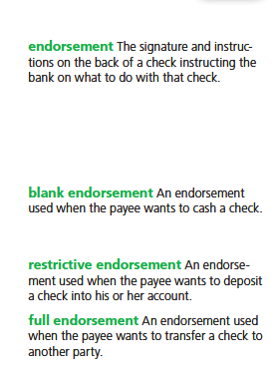

Slide 32
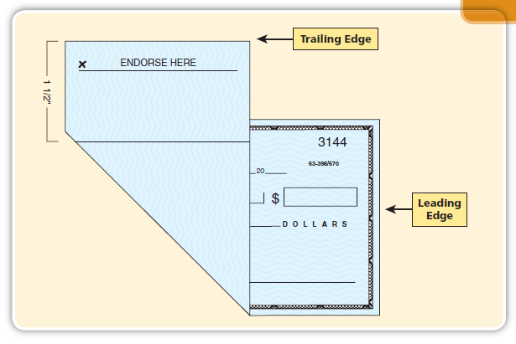

Slide 33
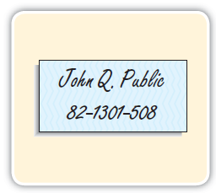

Slide 34
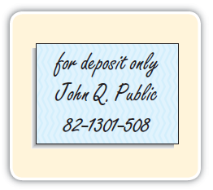

Slide 35
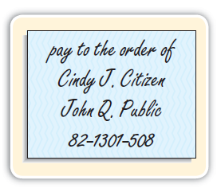

Slide 36
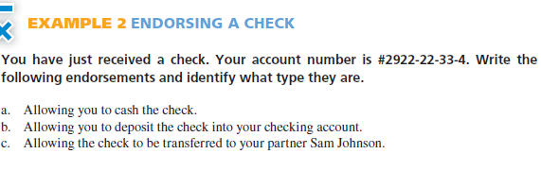
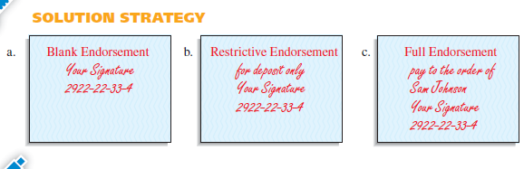

Slide 37
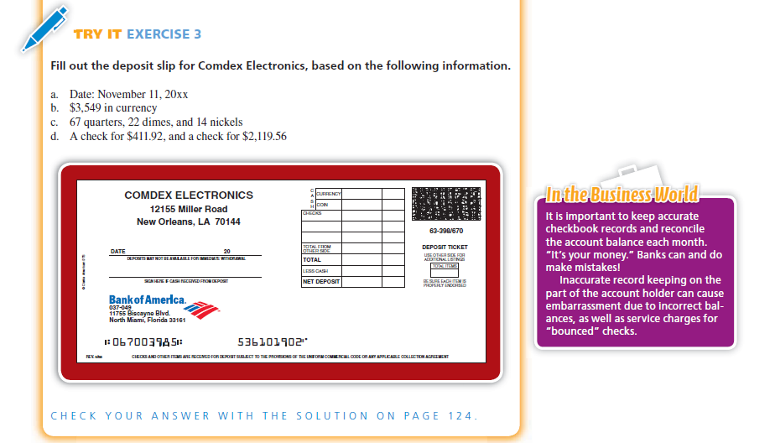

Slide 38
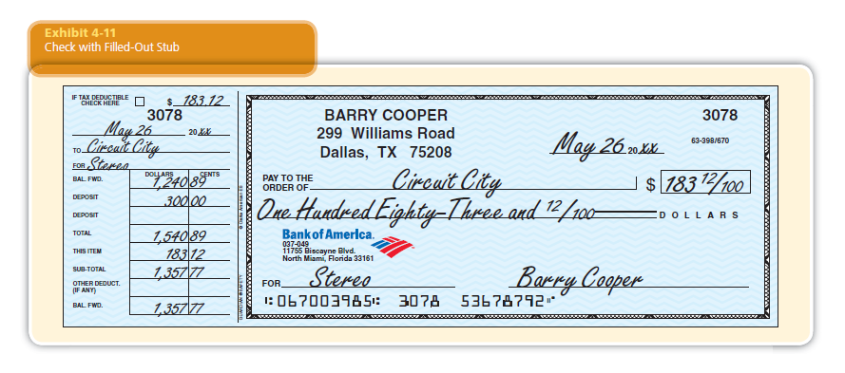

Slide 39
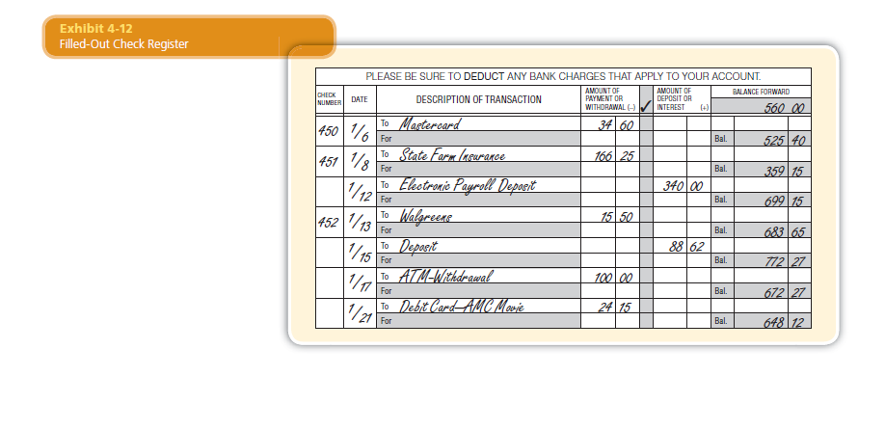

Slide 42
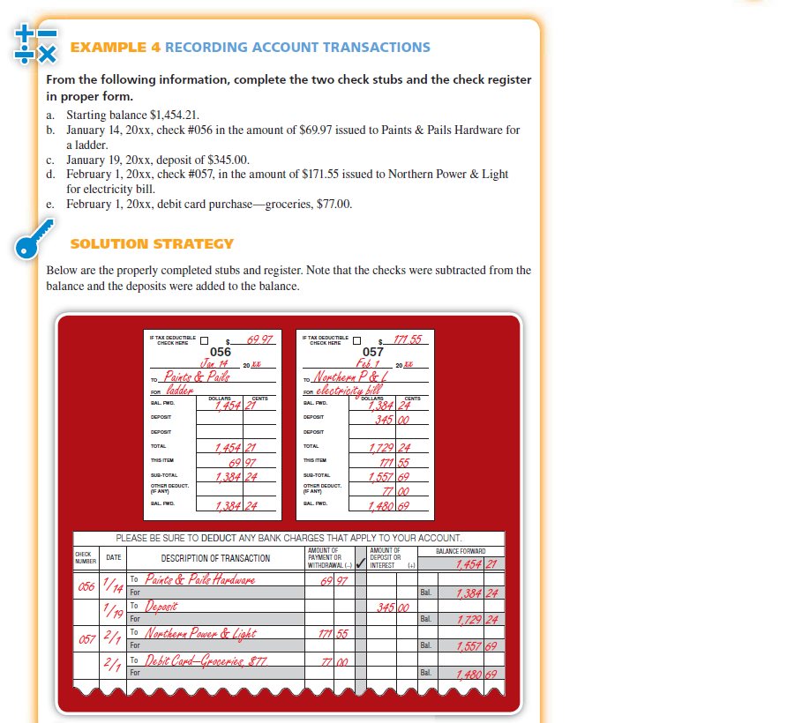

Slide 46
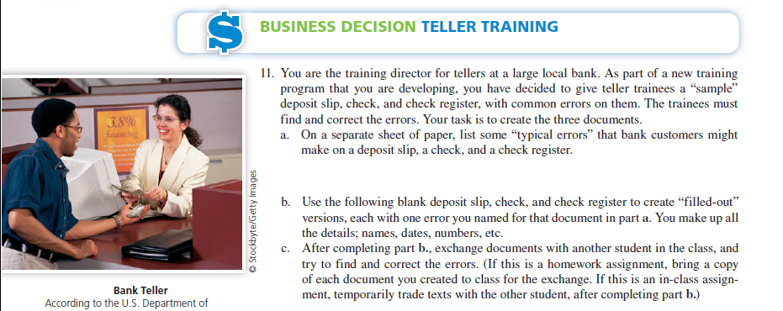

Slide 47
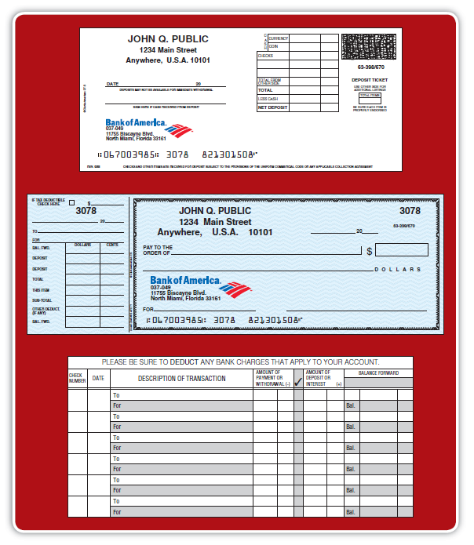

Slide 48
Bank statement A monthly summary of the activities in a checking account, including debits, credits, and beginning and ending balance. Sent by the bank to the account holder.
Credits Additions to a checking account, such as deposits and interest earned.
Debits Subtractions from a checking account, such as service charges.

Slide 49
Nonsufficient fund (NSF) fees A fee charged by the bank when a check is written without sufficient funds in the account to cover the amount of that check.
Returned item A check that you deposited but was returned to your bank unpaid because the person or business issuing the check had insufficient funds to cover the check.

Slide 50
Bank statement reconciliation The process of adjusting the bank and checkbook balances to reflect the actual current balance of the checking account.
Outstanding checks Checks that have been written but have not yet reached the bank and therefore do not appear on the current bank statement.
Deposits in transit Deposits made close to the statement date, or by mail, which do not clear in time to appear on the current bank statement.

Slide 51
Adjusted checkbook balance The checkbook balance minus service charges and other debits plus interest earned and other credits.
Adjusted bank balance The bank balance minus outstanding checks plus deposits in transit.

Slide 52
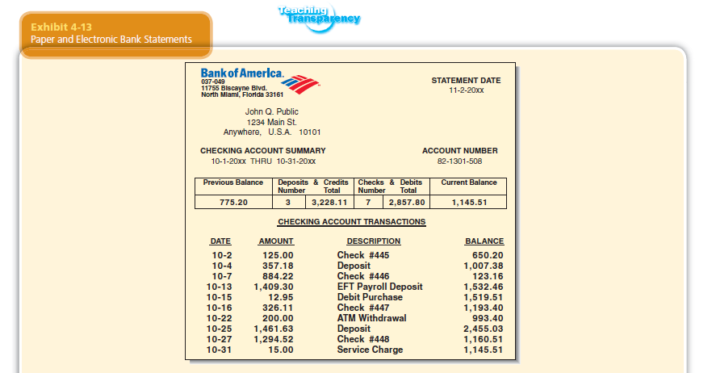

Slide 53
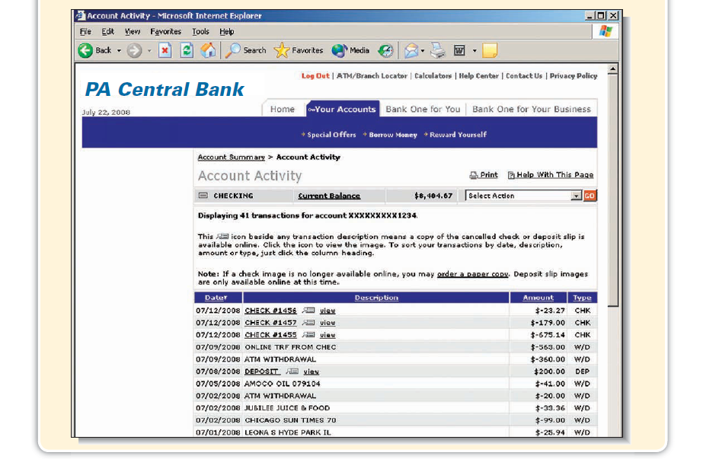

Slide 54
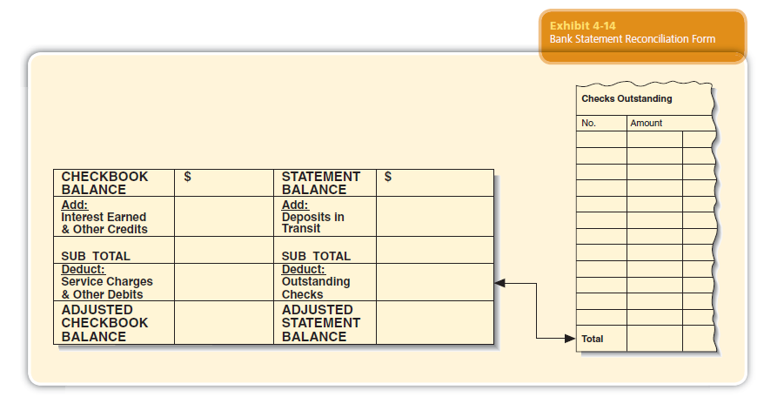

Slide 55
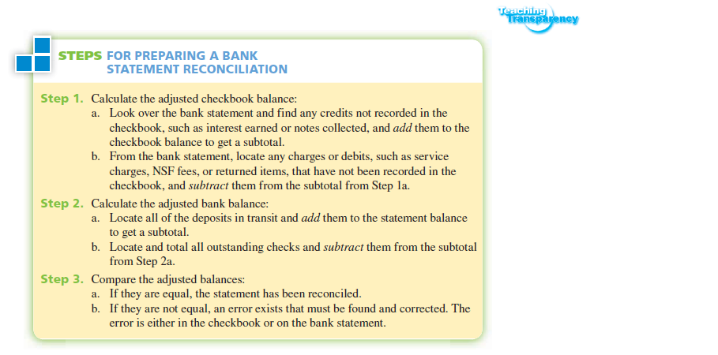

Slide 56
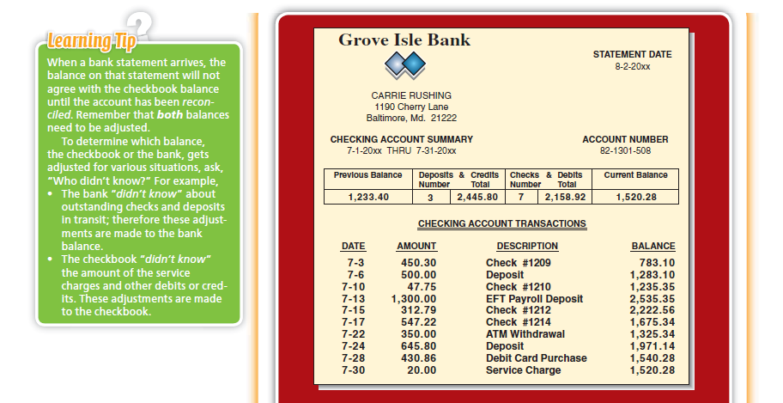

Slide 57
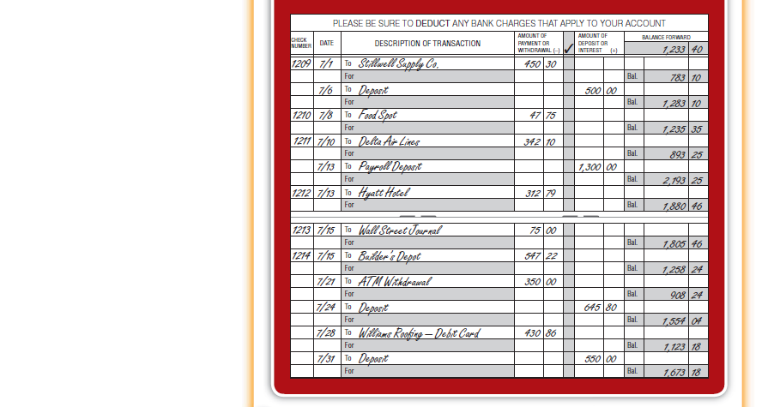

Slide 58
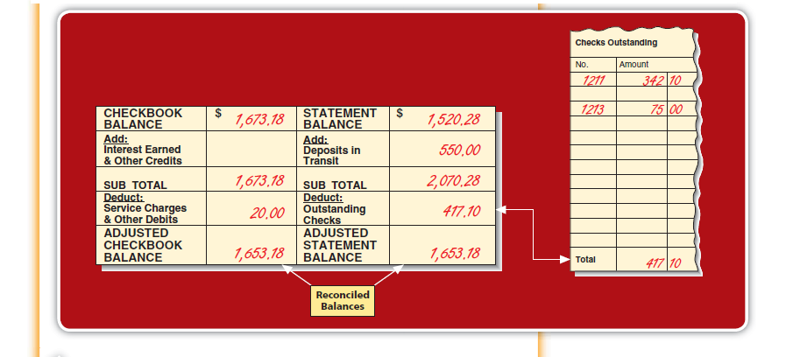

Slide 59
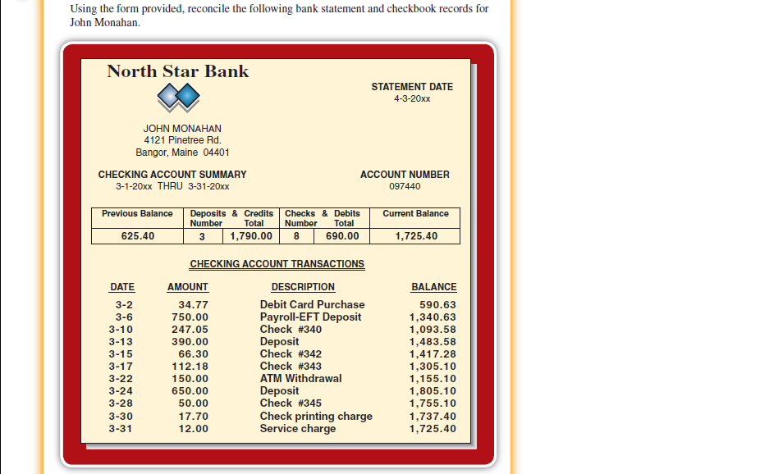

Slide 60
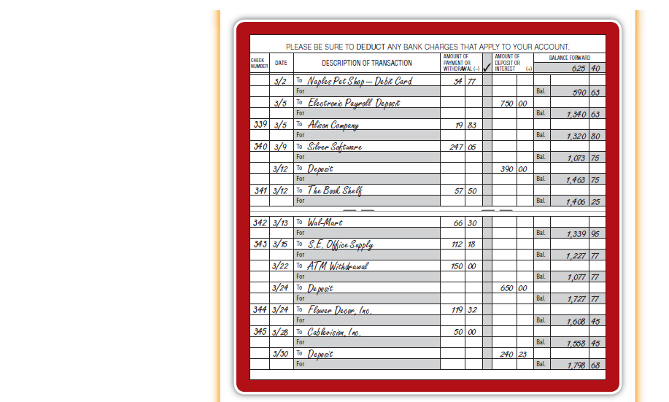

Slide 61
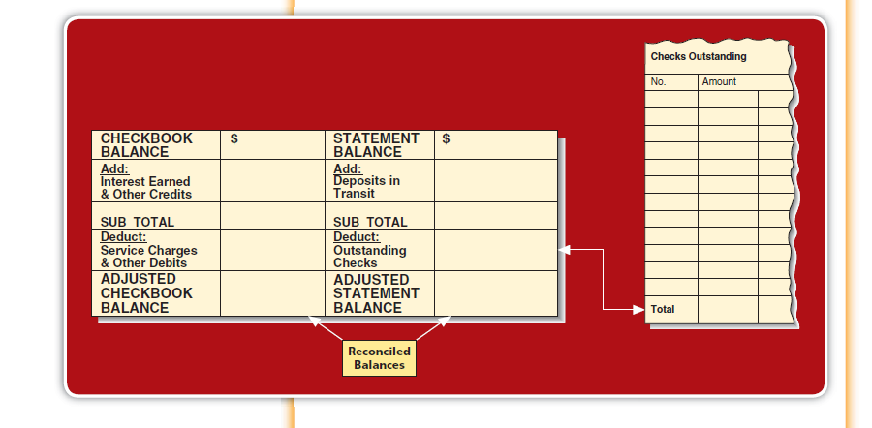

Slide 62
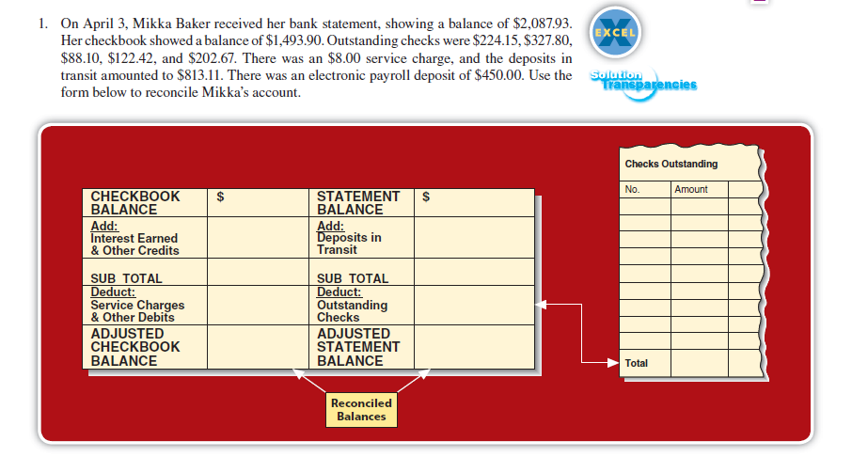

Slide 63
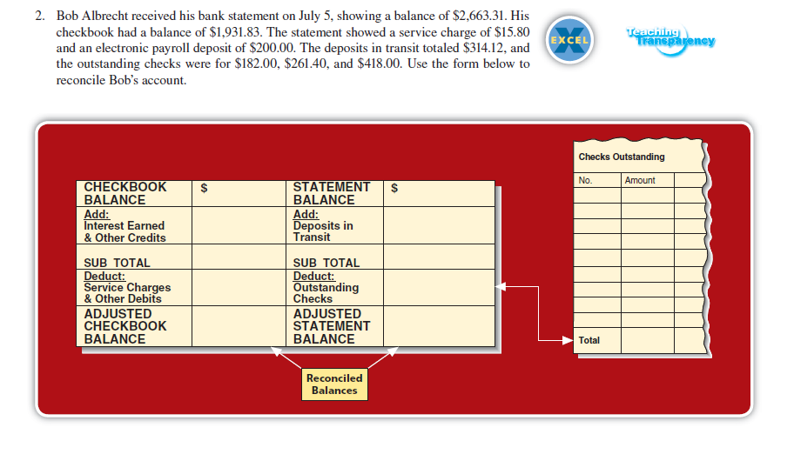

Slide 64
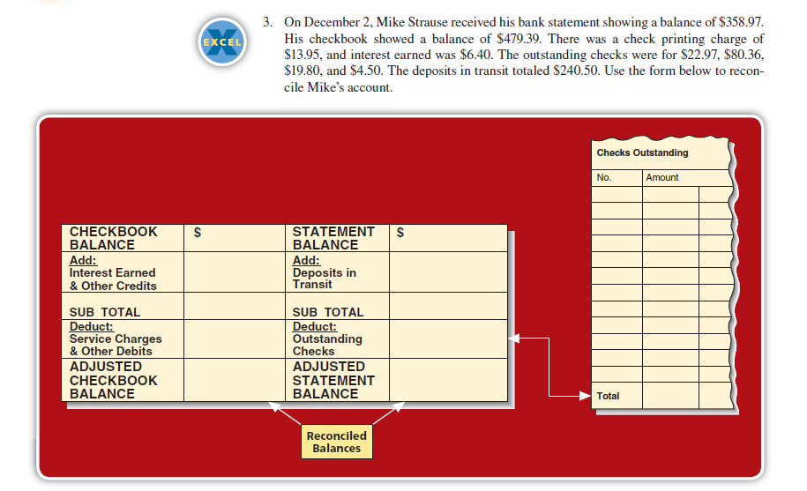

Slide 65
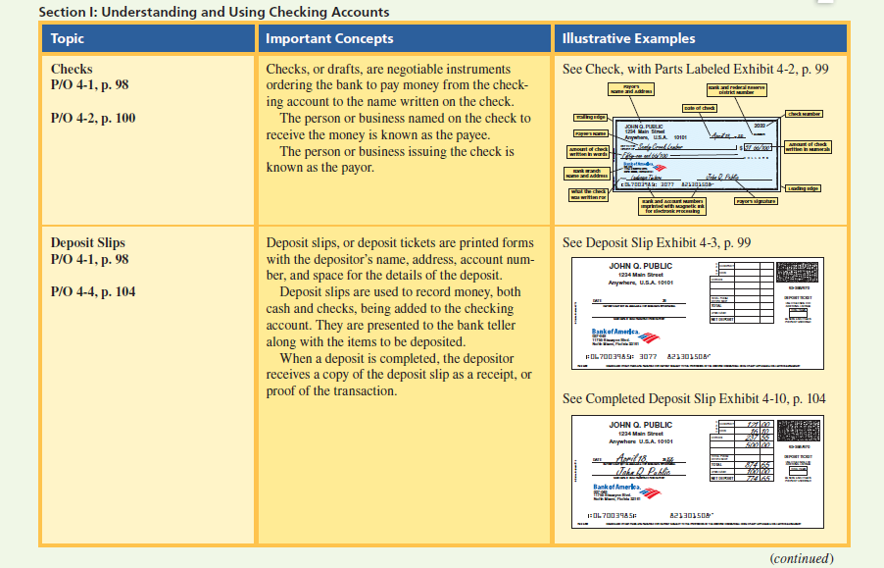

Slide 66
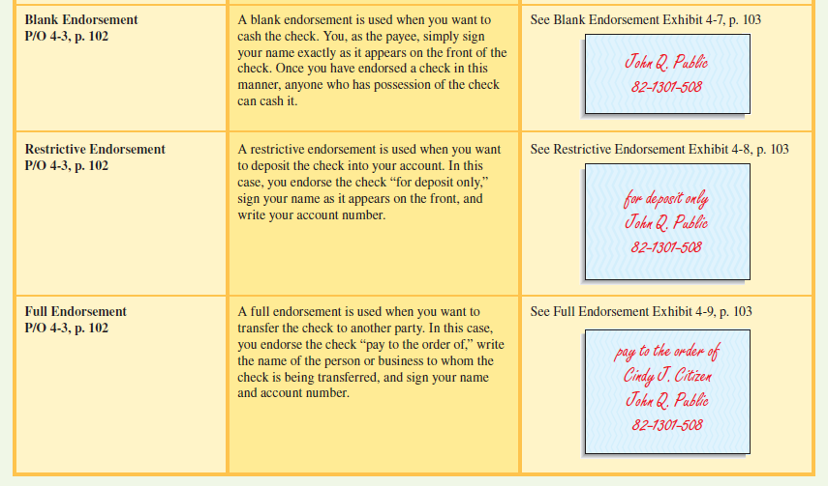

Slide 67
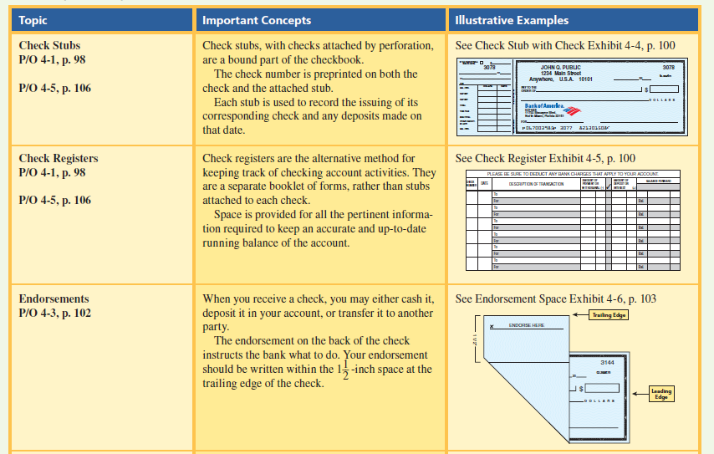

Slide 68
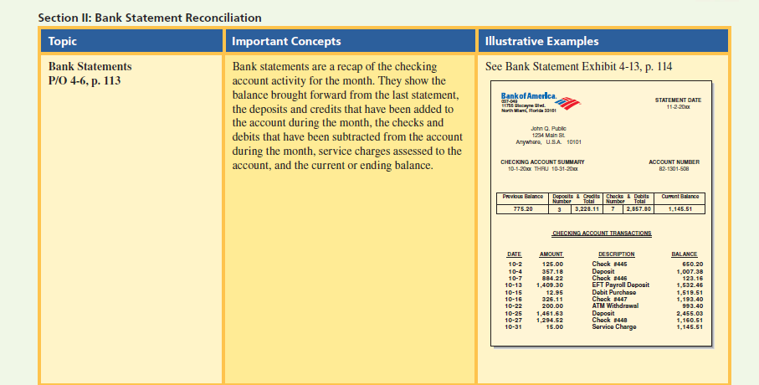

Slide 69
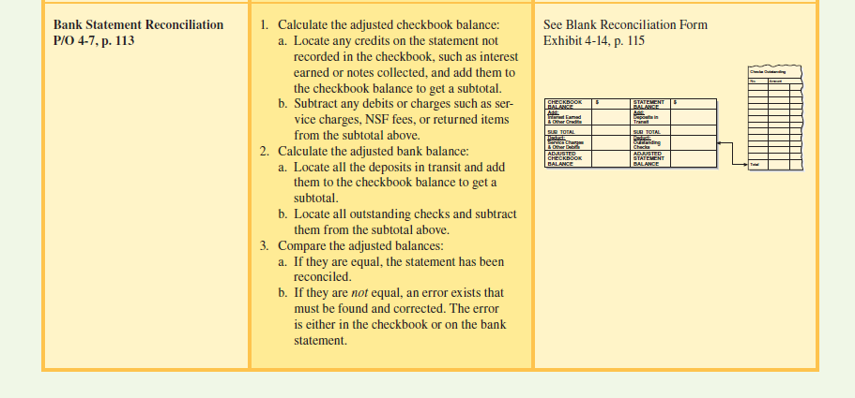

Slide 70
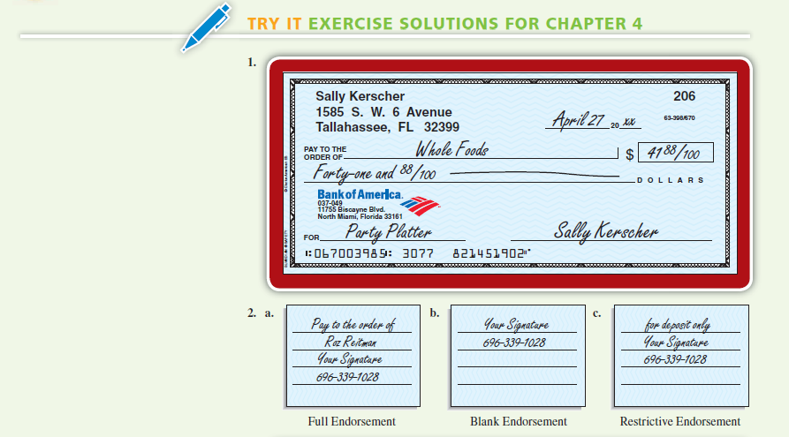

Slide 71
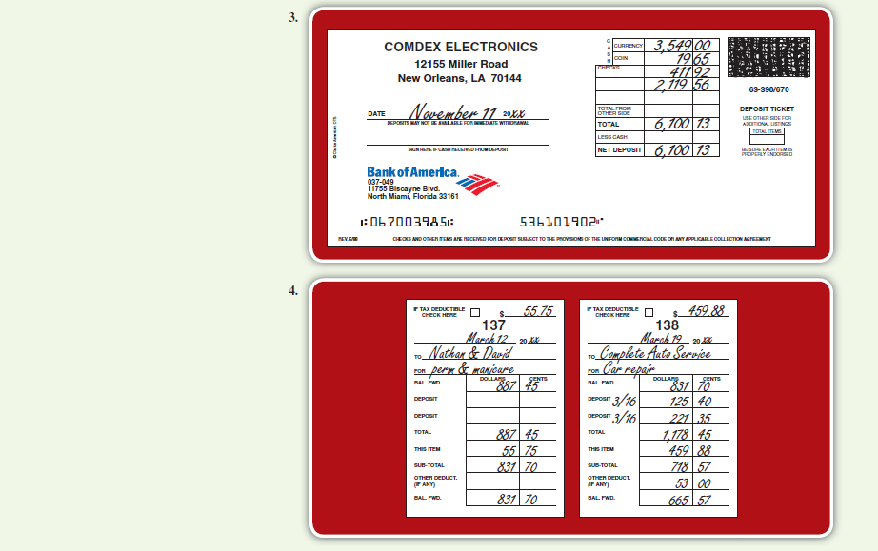

Slide 72
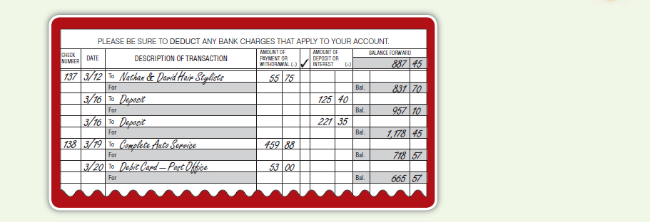

Slide 73
