Slide 1
Picking Winners and Losing Losers
Chapter 6

Slide 2

Chapter 6 Outline
6.1 Filtering your product options with an Idea Screen
6.2 Taking your ideas to the next level
6.3 Finding value even in the “losing” product ideas

Slide 3
6.1 Screening Your Ideas and Developing New Concepts

Slide 4
Intro
We hope you come up with plenty of ideas for products. We also hope that many of your ideas are cockeyed or impossible, or incompatible with your business. No, we’re not being sadists. What we’re saying is that when you come up with ideas, you should be creative and open-minded. If you try to get it right the first time, you’ll get it wrong — that is, you’ll stay too close to home and be too conservative.
When you brainstorm with an open mind, you give your company a chance to come up with a great idea that changes your industry, your business, or the way your customers do their jobs. (Take a look at Chapter 5 to find out more about being creative and open-minded when brainstorming ideas for new products.)

Slide 5
Intro
After you’ve come up with bunches of ideas, you have to screen all these ideas and pick a small handful to pass on to the executive team, whose job it is to make the decisions about which new projects to fund. You want to make the executives’ jobs easier by screening the ideas, turning the best ideas into concepts, and giving the executives the ones that look the most promising.
In the following sections, we explain how to screen your initial ideas, using an Idea Form to help identify the best ones. We then show you how portfolio views of these ideas can help you select a varied group of the most promising ideas to turn into Concept Briefs. The Concept Briefs give decision makers enough information to decide which concepts should be passed into the river of development.

Slide 6
Narrowing the field with an Idea Screen
After each idea-generation session that your company conducts, or whenever you collect a number of ideas for new products, you can hold an idea screen- ing session so that your company can focus on the most important ideas. We often include the screening process we describe here as part of the schedule for generating ideas. That way, a team can review its ideas while they’re still fresh in their minds, and its members can be sure that the job won’t get pushed aside and left undone.
An Idea Screen consists of three steps:
  1. Describe the ideas.
  2. Select the winning ideas.
  3. Create an idea portfolio to display the winning ideas.

Slide 7
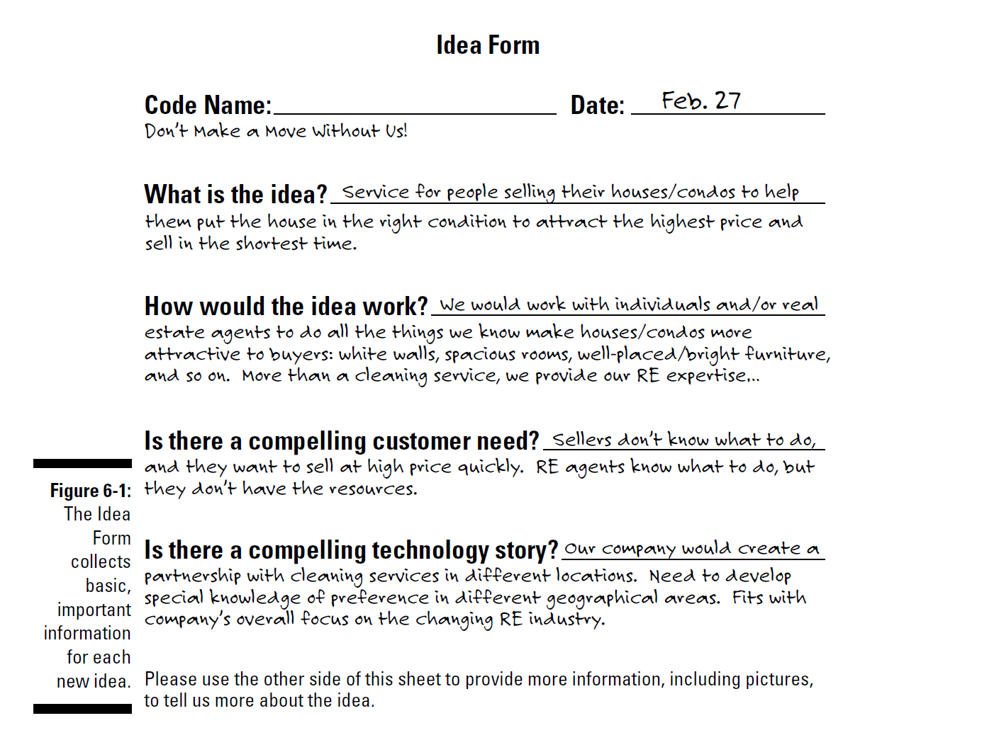

Slide 8
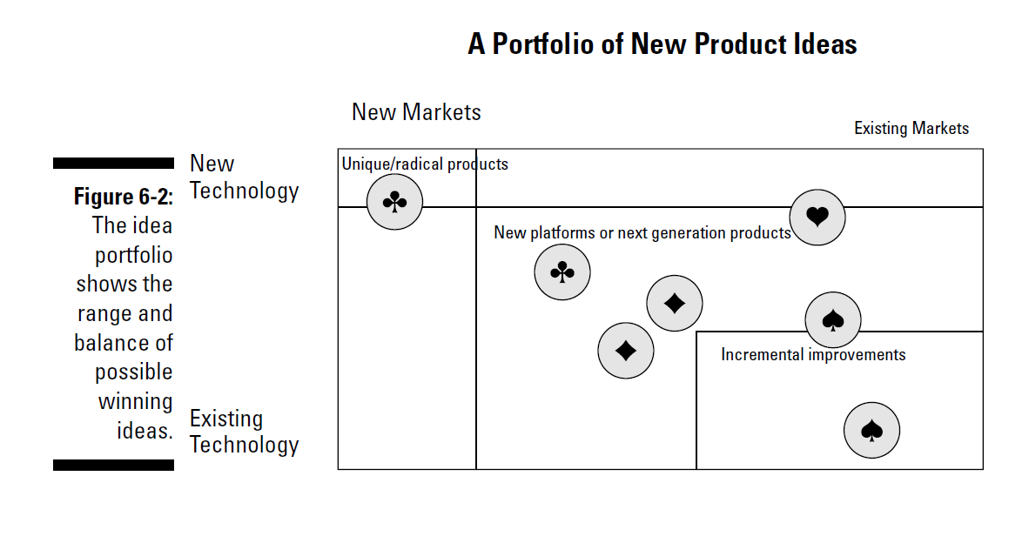

Slide 9
Turning winning ideas into concepts
With your team’s idea portfolio on hand to refer to, your next job is to select a handful of ideas that the team will turn into concepts for your executives to review. Usually, a team chooses a range of ideas, from incremental to platform to radical. Your team should also take into account any other dimensions that add diversity to the ideas they choose — for example, which market the idea relates to or which product line it would be a part of. A simple process for making these decisions is to ask the team members to vote for ones they want to keep. Usually, a handful are obvious keepers and a handful are obvious losers. The team can debate the others and come to a final tally.

Slide 10
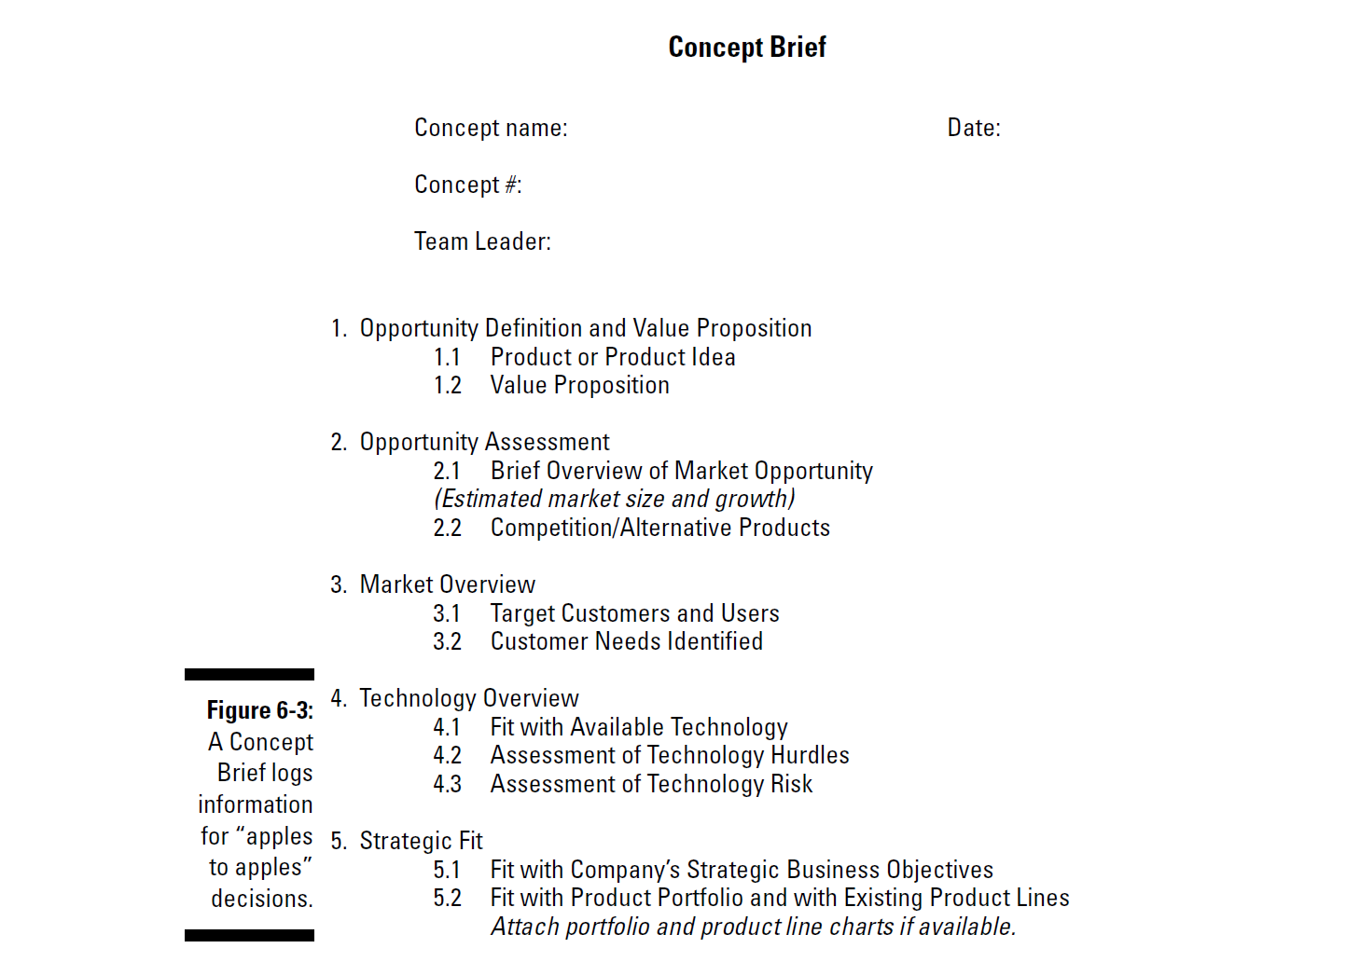

Slide 11
6.2 Improving Your Concepts with Quality Function Deployment

Slide 12
Intro
You have one more trick up your team’s sleeve that you can use to improve a concept and narrow the field for the decision makers at your company. The technique is called Quality Function Deployment, or QFD. Stuart Pugh came up with the specific process we use here
The following list explains how you can use QFD, and Pugh’s process in par- ticular, to improve your concepts before submitting them to decision makers:

Slide 13
Intro
Set aside a day or more to do this work.
Set up the meeting room with your teamwork supplies: large wall charts, a ruler for drawing, sticky notes, felt-tip pens, and tape.
Select groups of concepts that focus on similar customer needs
Make a two-dimensional matrix and draw in the columns and rows. You’ll write the customer requirements along the Y-axis (the vertical line on the left side), assigning one requirement per row, and then put the concepts along the X-axis, assigning one concept per column. You can use a catchy name, a cartoon or sketch, or any other moniker to help your team remember which concept you’re working with. Just don’t use more than ten or so requirements, and focus on fewer than eight concepts.
In the first column of the matrix, enter a concept or product that already exists in the market and does a pretty good job of meeting this set of customer requirements. The product may be yours, or it may be a competitor’s. This concept will be your point of reference.

Slide 14
Intro
Choose symbols that represent “better,” “worse,” and “same.” The numbers 1, 2, and 3 will do, but you can use more meaningful symbols, such as smiley, frown, and neutral faces. These are more fun and help keep the team interested.
Fill in each of the squares (formed by the rows and columns) with a symbol that shows whether the concept does a better, worse, or similar job as the reference concept with regard to the customer requirement in the row.
Strengthen each concept by stealing bits and pieces from other concepts. For example, if Concept A meets five requirements well and looks like a winner, can you make it even better by creating a hybrid A/D Concept? Can you blend in a bit of E and G?
Select the best concepts. You’ll need to write up new Concept Briefs for the hybrid, improved concepts. Now you have a smaller number of better concepts to pass along to your executives.

Slide 15
6.2 Turning Losing Concepts into Assets

Slide 16
Intro
Just because an idea for a new product project gets dropped onto the cutting room floor doesn’t mean that it has no value. A good idea may not work for your company because you don’t have the technology capability. Or perhaps the project seems risky, and your organization already has too much invested in risk and not enough in sure bets. In other cases, a good idea may not fit your company’s business model — the way it goes about making money (see Chapters 3 and 12).
Before you dump an idea, examine it to see whether it deserves some kind of special attention. Smart companies always look for ways to turn their rejected options into valuable assets.

Slide 17
Intro
The following list presents some options you may explore:
  Some companies assign employees to look for ways to create value from technology developments that the organizations won’t use. For example, if the company patents its technologies, it can sell or license them, and the company profits from the royalties.
  Some ideas are big and bold enough to warrant the creation of new business units if they don’t fit existing business models. Questioning and expanding a company’s business models is becoming more and more important in this age of open innovation (see Chapter 16).
  If your company can’t pursue a promising opportunity within your exist- ing business model, you may decide to allow employees to launch a new business with the idea as the focus.
  You can offer “losing” concepts on Web sites that allow inventors and companies to search for different patents, ideas, and technologies.

