Slide 1
risk management
Chapter 08

Slide 2


Slide 3




Slide 4
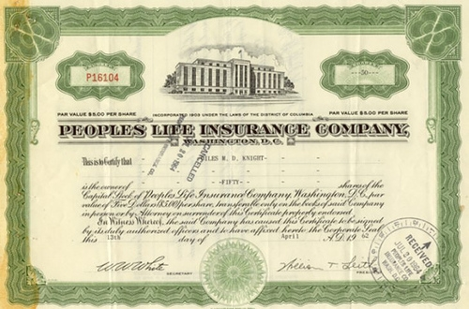

Slide 5
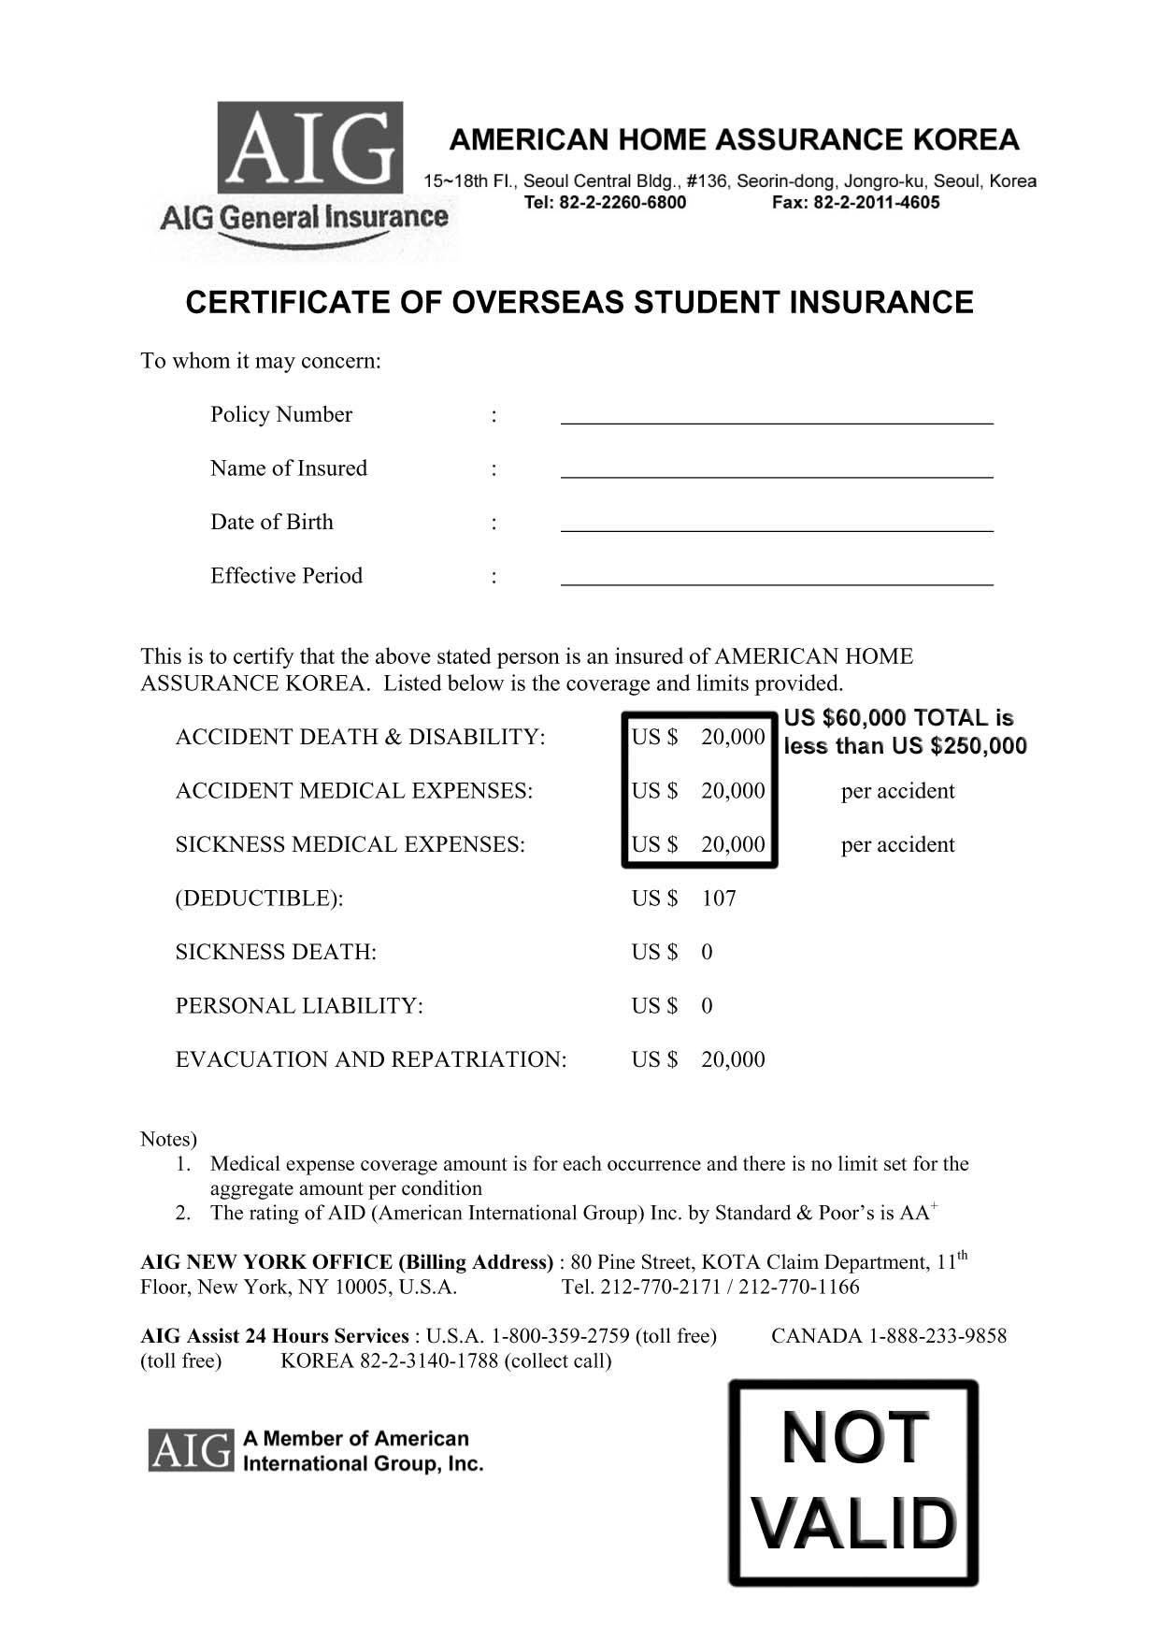

Slide 8
Definition
Insurance A mechanism for reducing financial risk and spreading financial loss due to unexpected events.
Shared Risk. The theory on which insurance is based; protection is purchased by many whose total payments are pooled together to pay off those few who actually incur a particular loss.

Slide 9
Definition
Actuaries. Statisticians employed by insurance companies who calculate the probability or chance of a certain insurable event occurring.
Insurer, Carrier, or Underwriter. The company offering the insurance protection and assuring payment in the event of a loss.

Slide 10
Definition
Insured, or Policyholder. The person or business purchasing the insurance protection.
Policy. The document stipulating the terms of the contract between the insurer and the insured.
Face Value. The amount of protection provided by the policy.

Slide 11
Definition
Premium. The amount paid at regular intervals to purchase insurance protection.
Beneficiary. The person or institution to whom the proceeds of the policy are paid in the event that a loss occurs.

Slide 12
UNDERSTANDING LIFE INSURANCE AND CALCULATING TYPICAL PREMIUMS FOR VARIOUS TYPES OF POLICIES

Slide 13
Definition
Life Insurance. A type of insurance that guarantees a specified sum of money to the surviving beneficiaries upon the death of the person who is insured.
Term Insurance. A type of life insurance that offers pure insurance protection, paying the face value of the policy to the beneficiaries upon the death of the insured.
Permanent Insurance. A type of insurance that combines an investment component with risk protection in order to provide the policyholder with both a death benefit and attractive investment returns.

Slide 14
Type of Life Insurance
Term Insurance
Whole Life Insurance.
Limited Payment Life Insurance.
Endowment Insurance.
Nontraditional Insurance.

Slide 15
CALCULATING
THE VALUE OF VARIOUS NONFORFEITURE OPTIONS

Slide 16
Calculating Premiums

Slide 17
Description
Life insurance is purchased in increments of $1,000 of face value. The actuaries at insurance companies generate comprehensive rate tables, listing the premiums per $1,000 of insurance for males and females of all ages.
Look at the table below:

Slide 18
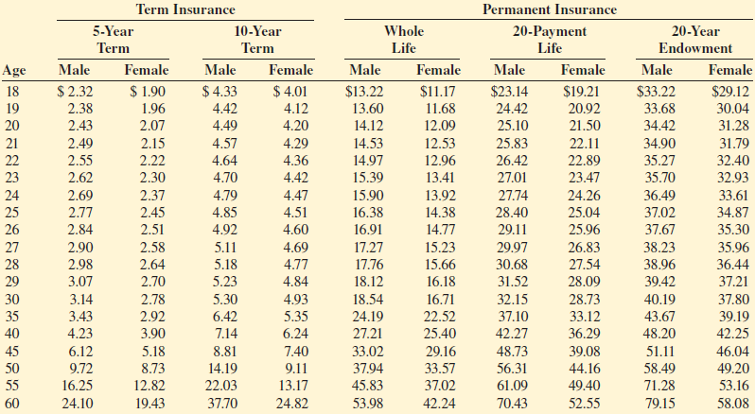

Slide 19
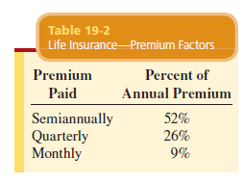
Premium Factor
Premium Factor. A small surcharge added to the cost of insurance policies when the insured chooses to pay the premiums more frequently than annually; takes into account the increased cost of billing, handling, and bookkeeping.

Slide 20
Annual life insurance premiums are calculated by first determining the number of $1,000 of insurance desired and then multiplying the number of $1,000 by the rate per $1,000 found in Table 19-1. When the insured desires to pay the premiums more frequently than annually, such as semiannually, quarterly, or monthly, a small surcharge is added to account for the increased cost of billing, handling, and bookkeeping. Table 19-2 illustrates typical premium factors used by insurance companies for this purpose.

Slide 21
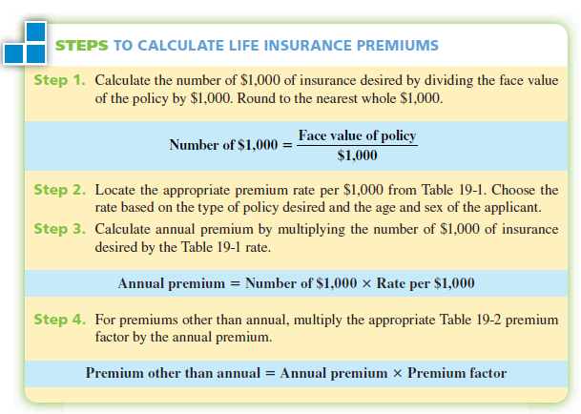

Slide 22
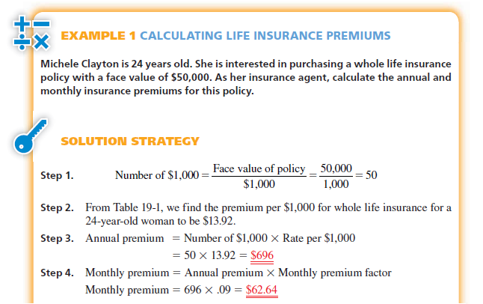

Slide 23
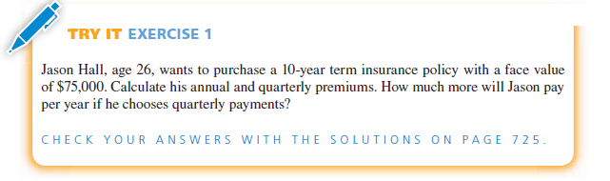

Slide 24
Description
Insurance premiums are based on the age and sex of the insured as well as the type of policy being purchased.
Premiums are less expensive for younger people because their probability of dying is lower than for older people.
Females pay lower rates than males of the same age because they have a longer life expectancy than males.

Slide 25
Definition
Cash Value The amount of money that begins to build up in a permanent life insurance policy after the first 2 or 3 years.
Ownership Rights The rights of life insurance policyholders, including the right to change beneficiaries, designate how the death benefits will be paid, borrow money against the policy, assign ownership to someone else, or cancel the policy.
Lapse Allowing an insurance policy to terminate by failing to make the required premium payments within 31 days of the due date.

Slide 26
Definition
Nonforfeiture Options The options available to the policyholder upon termination of a permanent life insurance policy with accumulated cash value; these include receiving the cash value, using the cash value to purchase a reduced paid-up insurance policy of the same type, or purchasing term insurance with the same face value as the original policy, for as long a time period as the cash value will purchase.

Slide 27
Option 1—Cash Value or Cash Surrender Option. Once a policy has accumulated cash value, the policyowner may choose to surrender (give up) the policy to the company and receive its cash value. At this point, the policy is terminated. If the insured wants to maintain the insurance coverage, the amount of the cash value may be borrowed and later repaid with interest.
Option 2—Reduced Paid-Up Insurance. The second option is that the available cash value is used to purchase a reduced level of paid-up insurance. This policy is of the same type as the original and continues for the life of the policyowner, with no further premiums due.
Option 3—Extended Term Insurance. With this option, the policyholder elects to use the cash value to purchase a term policy with the same face value as the original policy. The new policy will last for as long a time period as the cash value will purchase. When a policyowner simply stops paying on a policy and does not choose a nonforfeiture option, the insurance company automatically implements this extended term option.

Slide 28
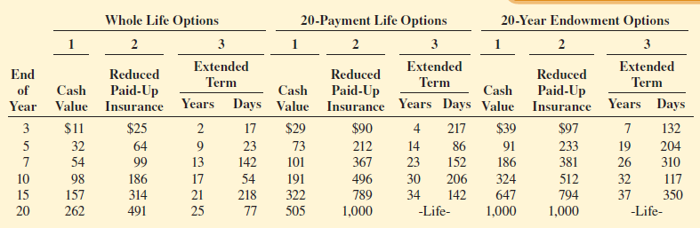
Table 19-3 illustrates typical nonforfeiture options per $1,000 of face value, for a policy issued to a woman at age 20.
Table 19-3

Slide 29
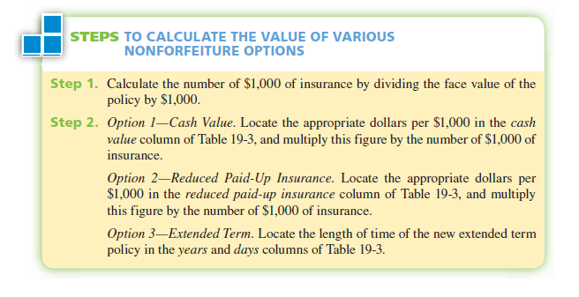

Slide 30
Example
Evelyn Butcher purchased a $30,000 whole life insurance policy when she was 20 years old. She is now 35 years old and wants to investigate her nonforfeiture options. As her insurance agent, use Table 19-3 to calculate the value of Evelyn’s
three options.

Slide 31
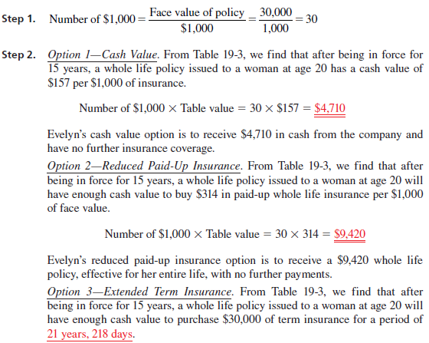

Slide 32
Exercise
Sarah Hurley purchased a $100,000 20-payment life insurance policy when she was 20 years old. She is now 30 years old and wants to investigate her nonforfeiture options. As her insurance agent, use Table 19-3 to determine the value of Sarah’s three options.

Slide 33
CALCULATING THE AMOUNT OF LIFE INSURANCE NEEDED TO COVER DEPENDENTS’ INCOME SHORTFALL

Slide 34
Definition
Income Shortfall The difference between the total living expenses and the total income of a family in the event of the death of the insured; used as an indicator of how much life insurance to purchase.

Slide 35
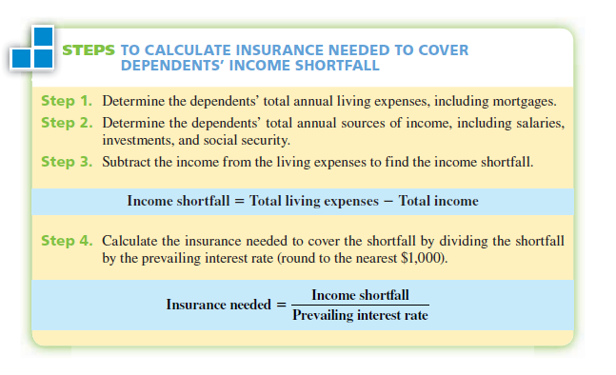

Slide 36
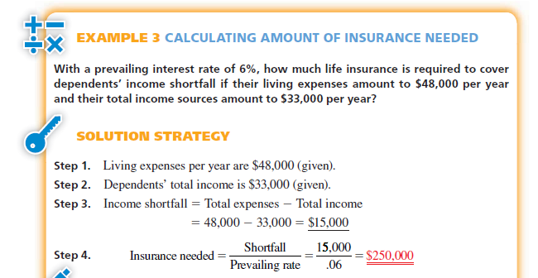

Slide 37
