Slide 1
One Foot in Front of The Other:
The Product Development Process
Chapter 09

Slide 2
Outline
Recognizing the parts of the product development process
Tailoring the process to work for you
Getting the company working together
Building knowledge and managing risk

Slide 3
Connecting Research to Development: The Fuzzy Front End

Slide 4
Connecting Research to Development: The Fuzzy Front End
Phase 1 Navigating from the Ocean to the River
Phase 2 The Business Case Phase
Phase 3 The Development Phase
Phase 4 Launch and Commercialization

Slide 5
Phase 1:
Navigating from the Ocean to the River
Before an idea can really enter the product developent process, it has to go through several hoops.
We call these the Idea Screen and the Concept Review.
These hoops begin to take the “fuzziness” out of the initial idea and help the idea to stack up against the business criteria that are all-important to NPD success.

Slide 6
The Idea Screen and the Concept Brief
The Idea Screen is the initial review in the new product development process.
The purpose of the Idea Screen is to reduce the large number of ideas for potential projects to a manageable number.
Sometimes new product teams narrow down the choices, and sometimes management makes these choices.

Slide 7
The Idea Screen and the Concept Brief
In the Concept Brief, the team needs to show how the concept will meet customer needs.
You may have gaps in your customer information.
For example, if you haven’t visited an important market segment, be sure to note that in the brief.
The Concept Brief should outline what technology the concept requires and indicate what technologies are available and which need to be developed

Slide 8
The Concept Review
After completing the Concept Brief, the NPD team is ready to hold a Concept Review, at which it presents a preliminary business case to the project’s reviewers.
The Concept Review is the first time that reviewers will judge an idea for a product against the same criteria that they’ll use at every review between now and launch.
In this early review, you use ranges and estimates because you still don’t have much information.
However, pulling the information together in this form allows you to update and revise the business case as you move through the product development process.

Slide 9
At the Concept Review, and at every review after the Concept Review, review- ers do one of three things:
Pass the project into the next phase.
If the project looks promising, if reviewers believe it will contribute to the company’s goals, and if reviewers can provide the needed resources, the reviewers pass it on to the next phase, where the team will draft the complete business case
Recycle the project to give the NPD team a chance to develop more information.
If the reviewers aren’t sure whether the project meets the criteria to pass, they may choose to recycle the project. A recycle decision gives reviewers an opportunity to tell the team members what else they need to know and gives the team a chance to develop the needed information.
Stop the project altogether.
If the project doesn’t meet the criteria, it’s easy and cheap to stop it early before a team has done much work.

Slide 10
Phase 2:
The Business Case Phase
An important part of the NPD team’s work in the second phase of the development process is preparing a potential product’s full business case.
Ohmigosh, you got into product development because you wanted to invent stuff, and we’re telling you to act like an MBA! Yup, and here’s the reason.
If your new products don’t earn good returns on your investments, you won’t be able to develop any more later on.

Slide 11
Phase 2:
The Business Case Phase
The product development process provides a format for the NPD team and members of management to hold meaningful conversations about the business merit of projects.
When reviews are done well, they cultivate an environment where everyone has a chance to shine — in other words, to contribute based on expertise and knowledge — and to work together to create a complete picture of a project’s merits and risks.

Slide 12
Preparing the business case
Most business cases include a Project Overview and Business Strategy section early on. Here’s what you include in this section:
  What the team is planning to develop: The team describes the new product and the customer needs the new product will fulfill.
  Rationale for the project: How the project is aligned with the company’s business, market, and technology strategies.
  Resources the team will need to develop the product: The team esti-mates what employee resources it will need
Notes:
Business case is a justification for a proposed project or undertaking on the basis of its expected commercial benefit

Slide 13
Preparing the business case
The following list presents some of the other pieces of information that most executives ask for in a business case:
Who are the target customers for the new product, and how will the product benefit customers after it hits the marketplace?
What’s the new product’s market potential? Include how stiff the com- petition is in the proposed market.
What are the details of the technical development and manufacture of the product? Include as much as you know now. For example, is the necessary technology ready, or do you need to develop the technology? Will you manufacture the product in-house or contract/partner on it? What changes to your existing manufacturing processes will the product require? Will these changes require facility or capital investment?

Slide 14
Conducting the Feasibility Review
The time has come for the team to present the project’s business case to the reviewers.
Companies often call this the Feasibility Review because what the team and the reviewers must establish is that the project is feasible: that the technology exists or can be developed; that the product will meet customer needs; and that there’s a sufficient market for the product to ensure a good return on the company’s investment.

Slide 15
Phase 3:
The Development Phase
These next three stages of the product development process take the product from concept to the market.
You must define and design the product, test it, and manufacture enough of it to be sure you can ramp up production, all in an effort to prepare for launch.
Often, companies overlap these stages instead of carrying them out totally sequentially.
The development phase of the product development process is the most vari- able of all the phases. It depends a lot on the industry and on the kind of prod- uct you’re developing.

Slide 16
There are five stage of the Development Phase
Defining the product
Designing the product
Developing the product
Testing the product
Reviewing from development to launch

Slide 17
a. Defining the product
Good product definition starts with a clear understanding of customer needs.
The product concept should meet those needs, and every aspect of the prod- uct should contribute to that effort.

Slide 18
a. Defining the product
You may need to include other requirements in addition to customer needs:
The product may have to come in at a particular price point in order to fill out a product line.
The product may have to hit a seasonal market or meet other “window of opportunity” timing (for example, launching ahead of a competitor product).
The product may have to include technology that works for an entire platform of products.
The product may need to meet regulatory requirements.
The product (and processes) may have to meet environmental require- ments (such as a specified percent of recycled material, or certain chem- icals being eliminated from the manufacturing process).

Slide 19
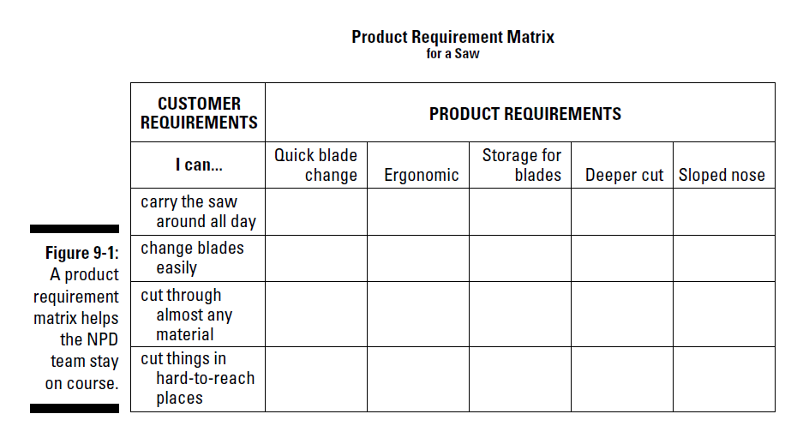
Notes:
One of the best ways to nail down a product definition is by generating a product requirement matrix

Slide 20
b. Designing the product
To turn the concept that your executives have approved into a real product, you need to bridge the gap between idea and reality.
Good product design starts with understanding your customers and their needs.
Product designers bring an understanding of the required materials and technologies, combined with artistic and creative approaches.

Slide 21
b. Designing the product
The design phase of development requires drafting and modeling.
It requires that your team move through iterations. If possible, you should create prototypes at this point in the process and test them with customers

Slide 22
c. Developing the product
Developing the product, as you may figure, is the heart of the “product development” process.
If you’ve done your homework, developed an understanding of customer needs, assembled a cross-functional team, faced and resolved technology hurdles, and so on, the development stage should go smoothly.
On the other hand, if you have to answer preparatory questions late in the process, you create a rework cycle that pushes your product beyond schedule and budget and sets it up for failure in the market.

Slide 23
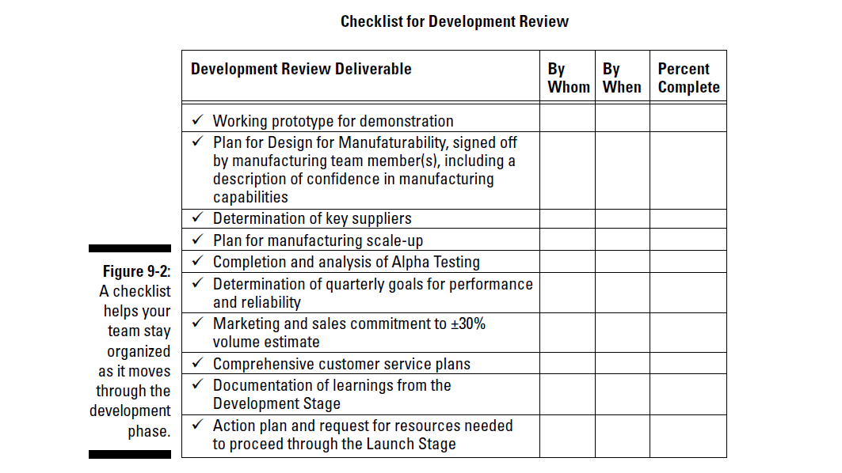

Slide 24
c. Developing the product
A good way to check team progress during the phase is to review the check- list at team meetings, assess how much of a task is complete, and make sure that team members have the resources they need to complete the work in time for the review.
In the development phase, the team has to reconfirm its marketing and sales estimates and assure the reviewers that the team can commit to the numbers in the business case (see the earlier section “Phase 2: The Business Case Phase”).
This deliverable usually requires further market research on the part of the marketing members of the team.

Slide 25
d. Testing the product
Performance and reliability criteria form the basis for product testing.
In the checklist in Figure 9-2, you can see that the NPD team is expected to accomplish Alpha Tests before the next review. In an Alpha Test, you give a small number of products to friendly testers — usually company employees — to use.
You ask them to report any problems. Better yet, you observe them using the product so you can discover what happens.

Slide 26
d. Testing the product
Alpha Tests enable you to get the bugs out of a product. During this stage, it’s okay if the product doesn’t perform perfectly.
Your friends will help you by letting you know, perfectly frankly, what works and what doesn’t. Later in the process (after you’re as sure as you can be that the product is working well), you move to Beta Tests — tests with actual customers.
At that point, your product better be working close to perfectly. Beta Tests aren’t looking for bugs, just opportunities to make a good product even better.

Slide 27
d. Testing the product
Alpha and Beta Tests help the team to make sure that the product is meeting its performance goals — in other words, that it performs as expected in the customers’ hands.
Teams also have to run tests to make sure that the product won’t break if dropped or that it will withstand normal use over time. Most companies have experts who can help the teams with this. (You can

Slide 28
e. Reviewing from development to launch
The product development process should look like a funnel: More projects should show up at the beginning than at the end.
Reviewers have a chance at every review to weed out projects that don’t perform as well as expected or that no longer meet the company’s strategic objectives.
However, after the Feasibility Review, the “funnel” should straighten out.

Slide 29
e. Reviewing from development to launch
Reviewers should still be on the lookout for projects that don’t measure up or projects that meet unexpected market or technical hurdles.
However, in most cases, as the project moves from development and testing to launch, the team and the review- ers have enough information to “see” from here to the market.
The team should concentrate on moving from development to market as fast and as efficiently as possible.

Slide 30
Phase 4:
Launch and Commercialization
The launch and commercialization phase is the last phase in the product development process.
After all, you can’t launch a product into the market until you’ve designed it, developed it, tested it, and figured out how you’re going to produce it.
Ideally, you should be thinking of prospective markets, of your target customers, and of how you’ll get the product to your markets and customers from the very beginning of the process.
Too many NPD teams leave launch planning until the end of the process. This is a mistake. You should have a launch subteam working with your NPD team from the get-go.

Slide 31
Making the Product Development Process Work for You

Slide 32
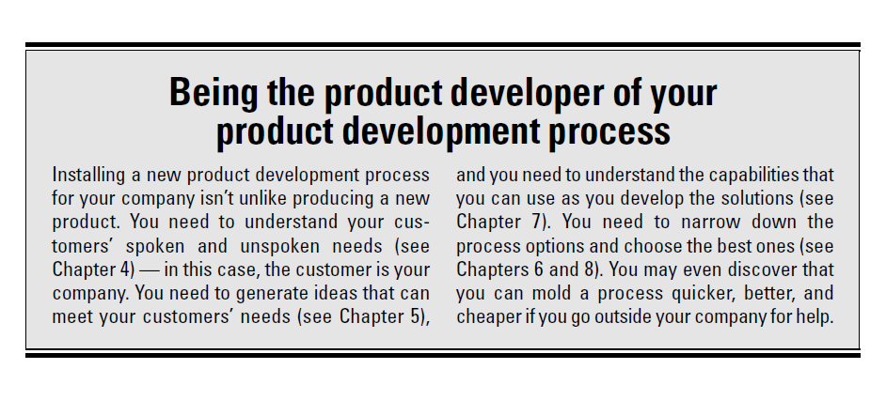

Slide 33
Right-sizing the process for your company
The right number of phases for your company’s product development process equals the number of phases you need to divide the workflow into logical chunks.
Well, how many is that? Most product development processes have between four and seven phases.

Slide 34
Right-sizing the process for your company
At a minimum, no matter what kind of products you produce or what industry you do business in, you need the fol- lowing basic phases in your process:
  A front end or concept phase: The front end phase is where you develop ideas or concepts.
  A business case phase: The product development process allows man- agement to make business decisions about how to invest the company’s resources..
  A development and testing phase: The NPD team has to get its work done to design, develop, and test the product concept.
A commercialization or launch phase: Every product that gets all the way through the development process needs to end up in a phase that precedes its entry into the market — the launch or commercialization phase.

Slide 35
Right-sizing the process for your company
At a minimum, no matter what kind of products you produce or what industry you do business in, you need the fol- lowing basic phases in your process:
  A front end or concept phase: The front end phase is where you develop ideas or concepts. Many companies now have a Phase Zero, because years ago, when they designed their product development processes, they didn’t appreciate the importance of the earliest phases. The front end is where a company’s leaders select from a large variety of product development options. You need a front end phase; without it, your company will probably end up with few development options.
  A business case phase: The product development process allows man- agement to make business decisions about how to invest the company’s resources. The business case phase provides executives with critical information so that they can get their jobs done. No matter what type of product you develop — chemicals, crackers, software, or services — your company’s leaders must have business case information.
  A development and testing phase: The NPD team has to get its work done to design, develop, and test the product concept. This basic phase is where the greatest variability comes in with respect to the phases:

Slide 36
Right-sizing the process for your company
  This basic phase is where the greatest variability comes in with respect to the phases:
If your product is fairly straightforward (for example, an improve- ment to a product or product line that’s already in the market), 181 Chapter 9: One Foot in Front of the Other: The PDP Process
Being the product developer of your product development process Installing a new product development process for your company isn’t unlike producing a new product. You need to understand your cus- tomers’ spoken and unspoken needs (see Chapter 4) — in this case, the customer is your company. You need to generate ideas that can meet your customers’ needs (see Chapter 5), and you need to understand the capabilities that you can use as you develop the solutions (see Chapter 7). You need to narrow down the process options and choose the best ones (see Chapters 6 and 8). You may even discover that you can mold a process quicker, better, and cheaper if you go outside your company for help.
you may need only one phase to lay out the deliverables for this stage of the process. • If your product is complex, needs to be manufactured, or requires the development of processes, it may be a good idea to add dis- tinct phases or subphases. An example of this kind of product would be a new product, such as the iPod, that requires new tech- nology to be developed and that meets new customer needs. • If your product requires extensive testing to meet regulatory or other requirements, you may include phases that tie directly to that requirement. Pharmaceutical development processes, for example, usually include a phase called “Clinical Trials” because conducting clinical trials is such a major issue in getting a drug into the market. • If you’re producing software, your process needs to allow for the iterative “design/test/design” process that typically goes with soft- ware development. On the other hand, your process doesn’t have to specify a manufacturing phase, because after you design, develop, and test your product, it’s good to go.

Slide 37
Deciding how many reviews to hold
As long as you complete those reviews, many projects can proceed to market without other reviews — as long as the projects continue to meet the objectives in the business cases. The following list points out when you should have more reviews:
You’ve built a business case, but the project has major uncertainties.
The project will cost significantly more as development proceeds.
The project must pass outside hurdles.
The project breaks new ground.

Slide 38
Involving the Functions in the NPD Process

Slide 39
Intro
The product development process doesn’t come equipped with its own resources. You must draw on resources that typically are “owned” by the business functions in your company: R&D, marketing, manufacturing, customer service, and so on.

Slide 40
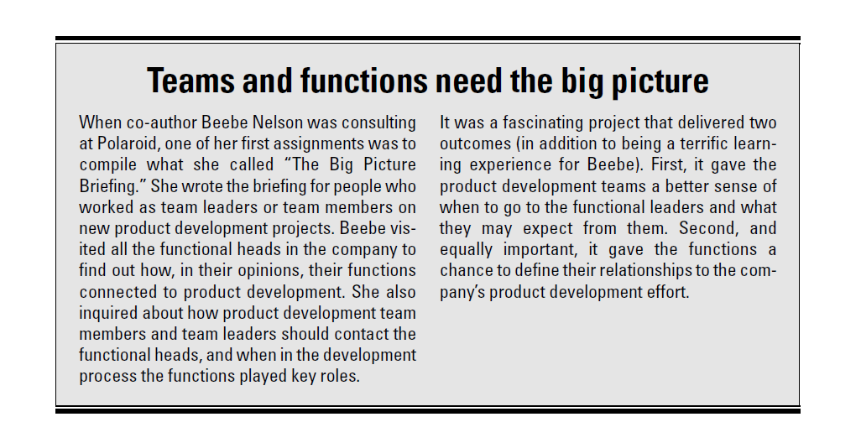

Slide 41
“How will my function benefit?”
Why should a functional leader provide valuable resources for a cross-functional NPD activity?
Functional heads always have important things to do to achieve functional goals, after all, and no one has extra resources to give away.
  The members of the management team need to make the necessity and value of supporting the development of new products absolutely clear to the functional heads.
  Your company’s executives must measure the contribution of the functions to its new product development objectives and assess the func- tions (and the functional heads) based on that evaluation (see Chapter 18 for more on NPD metrics).
  In addition, executives should tie the ability of the functions to grow and thrive — to get needed resources — to the contributions the functions make to new product development. (For more on obtaining resources from the functions, see Chapter 11.)

Slide 42
Tailoring functional processes to support NPD
Each function has its own processes —ones probably designed years ago— that fit its culture and its business needs quite well. You can’t just go to a function and ask politely whether the function heads would mind changing everything just to develop a new product. For sure, the functional leader would mind!
You need to involve the functions in the design and creation of the product development process. You should get their suggestions to tailor the develop- ment process to fit their needs as well as it can and to tailor the functional processes to support NPD.

Slide 43
Tailoring functional processes to support NPD
You’ll run into some pitfalls when you address the relationship of the func- tional processes to new product development. With each pitfall, however, comes an opportunity to put the functions and the NPD efforts on the same page.

Slide 44
Tailoring functional processes to support NPD
Here are a few pitfalls, along with opportunities to fix them:
Pitfall: Human resources (HR) has no career path or reward system for employees who participate in new product development.
Opportunity: Help HR design ways to recognize and reward employees who contribute to this important enterprise.
Pitfall: The finance department has no tools to track numbers that are important to product developers (such as time spent by functional mem- bers on new product teams).

Slide 45
Tailoring functional processes to support NPD
Opportunity: Work with finance to develop accounting systems that are in sync with product development.
Pitfall: Information Technology (IT) doesn’t have a flexible Intranet system designed to allow new product team members to communicate and share their data.
Opportunity: Introduce IT to some of the many Intranet systems that professionals are developing to work with their existing information processes. (See Chapter 14 for more information about IT’s role in prod- uct development.)
Pitfall: Your budgets are locked for the year, so projects that manage- ment approves for development outside of the designated fiscal year have to beg, borrow, and steal to get resources.
Opportunity: Work with the finance department to find a creative way to store resources so that you can allocate them as projects make their way into and through the NPD process.

Slide 46
You’ll run into some pitfalls when you address the relationship of the func- tional processes to new product development. With each pitfall, however, comes an opportunity to put the functions and the NPD efforts on the same page.

Slide 47
Relating to Management during the NPD Process

Slide 48
Intro
In this next section, you read about how to recognize the political activities in NPD.
Part of managing the politics is including the voices of all the functions in designing the product development processes.
In this way, more of the people involved have a chance to discuss, bargain, and negotiate in ways that encourage them to identify and work toward similar goals.

Slide 49
How do I manage the politics of NPD?
Of course you don’t have politics in your company. You’re running a business, after all, and each employee is focused on improving the business, not on jockeying for position. Really? If so, please give us a call; we want to do a research paper on your unique firm!
Remember this: If people are gathered together, politics is involved. This statement is especially true in product development because the process involves so many different groups and interests, and a business has to spend scarce resources that functions may want to keep for their own purposes.
The more the processes take the functional differences into account, the better the functions will be able to work together.

Slide 50
How do I manage the politics of NPD?
Markham and Holahan describe the following places where product develop- ment tends to be politicized. It’s in these critical areas that management and product developers need to be alert in order to manage the politics:
  Differences in goals between the business functions, the new product development enterprise as a whole, and the individual NPD teams
  The scarcity of resources that management can allocate to achieve the different goals
  The interdependency of the functions, the NPD enterprise, and the NPD teams, which can cause conflict over resources
  The ambiguity of product development efforts, which can put leaders and employees in the position of arguing over opinions rather than facts
  The vulnerability of the product development process, and of product development projects, to organizational change Understanding and managing these critical aspects within

Slide 51
Tailoring business processes to support NPD
The business processes that provide a structure in which companies make decisions — the budgeting process, the strategy process, and so on — can support product development or get in its way. In order to support product development, business processes must accommodate the way in which new product projects create their own time frames, and they must have an urgency for getting work done and making decisions so that products can get to market on time and on budget.

Slide 52
Tailoring business processes to support NPD
The companies that successfully support product development provide for the eccentricity of new product decision-making by making time for reviews and decisions that fall outside the “normal” calendar.

Slide 53
Understanding and Managing NPD Risk

Slide 54
Intro
The development of new products is one of the riskiest (and most rewarding) activities that a company can take on.
Of course, it’s not really as risky as not developing new products, but the risk entailed in NPD happens today, while falling behind competitors and becoming a nonentity in markets the company used to own happens slowly — maybe even on someone else’s watch.
In this section, we look at how the product development process helps companies manage and mitigate the risk of developing new products.

Slide 55
Preparing for risk
Here’s a paradox: As a new product team, you want to write the best busi- ness case you can for management’s review.
You want to do the best job you can to produce the best product you can.
But you also have another very important job: Being aware of the uncertainties and the risks of the project. You have to let management know about the risks to the project that you foresee and how you plan to mitigate those risks.
If you come to the conclusion that you can’t drive them down sufficiently, you may have to recommend that management stop the project.

Slide 56
The simple method for a product development team to get a handle on risk.
It entails a team meeting, a facilitator, a big wall chart, sticky notes, and felt-tip pens!
Brainstorm a list of the possible sources of risk in your new product project. Here’s a short sample list:
  Technology not ready when needed
  Key resources missing
  Prototype unable to meet customer needs
  Product cost too high to meet desired price point
Group and label the sources of risk. For example, you may have a category called “technology risk” and another called “possible competitor moves.”
Through a group discussion, give each source group a ranking: How likely is this to happen, and how serious would the consequences be?
Usually, the best approach is to use a simple scale.

Slide 57
Using the NPD process to increase knowledge and decrease risk
In its simplest form, the new product development process is a way to get from a point where you know nothing except that you want to develop a new product to a point where you’ve designed, developed, tested, and marketed a product and can now sit back and count the cash.
The process takes you from a place of near total uncertainty to the relative certainties of market share, cash flows, margins, and profits — that is, until you decide that the product line needs refreshing or the model needs to be updated, and then there you go again.

