Slide 1
Markdown and Inventory Control
Chapter 11

Slide 2
DEFINITION
Markdown. A price reduction from the original selling price of merchandise.
Markdown Cancellation. Raising prices back to the original selling price after a sale is over.
Sale Price. The promotional price of merchandise, after a markdown.

Slide 3
DETERMINING THE AMOUNT OF MARKDOWN AND
THE MARKDOWN PERCENT
A markdown is a reduction from the original selling price of an item to a new sale price. To determine the amount of a markdown, we use the formula:
Markdown = Original selling price - Sale price

Slide 4
For example, if a sweater was originally marked at $89.95 and then was sale priced at $59.95, the amount of the markdown would be $30.00 ($89.95 - $59.95 = $30.00).
To find the markdown percent, we use the percentage formula once again, Rate = Portion ÷ Base, where the markdown percent is the rate, the amount of the markdown is the portion, and the original selling price is the base:

Slide 5
Markdown
Markdown percent = --------------------------------
Original selling Price

Slide 6
DETERMINING THE MARKDOWN AND
MARKDOWN PERCENT
A picture frame that originally sold for $60 was marked down and sold for $48. What is the amount of the markdown and the markdown percent?

Slide 7
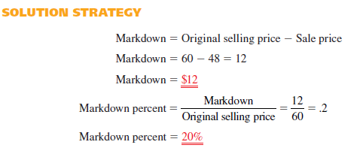

Slide 8

EXERCISE

Slide 9
DETERMINING THE SALE PRICE AFTER A MARKDOWN
AND THE ORIGINAL PRICE BEFORE A MARKDOWN
In markdown calculations, the original selling price is the base, or 100%. After a markdown is subtracted from that price, the new price represents (100% Markdown percent) of the original price. For example, if a chair is marked down 30%, the sale price would be 70% (100% 30%) of the original price.
To find the new sale price after a markdown, we use the familiar percentage formula, Portion Rate Base, where the sale price is the portion, the original price is the base, and (100% Markdown percent) is the rate.
Sale price = Original selling price(100% - Markdown percent)

Slide 10
DETERMINING THE SALE PRICE
Fernando’s Hideaway, a men’s clothing store, originally sold a line of ties for $55 each. If the manager decides to mark them down 40% for a clearance sale, what is the sale price of a tie?
Sulution strategy: Remember, if the markdown is 40%, the sale price must be 60% (100% - 40%) of the original price.
Sale price = Original selling price (100% - Markdown percent)
Sale price = $55 (100% - 40%) = 55 (.6) = 33
Sale price = $33

Slide 11
EXERCISE
Craftsman’s Village originally sold paneling for $27.50 per sheet. When the stock was almost depleted, the price was marked down 60% to make room for incoming merchandise. What was the sale price per sheet of paneling?

Slide 12
FINDING THE ORIGINAL PRICE BEFORE A MARKDOWN
To find the original selling price before a markdown, we use the sale price formula solved for the original selling price. The original selling price is isolated to one side by dividing both sides of the equation by (100% Markdown percent). Note: This is actually the percentage formula Base Portion Rate, with the original selling price as the base.

Slide 13
FINDING THE ORIGINAL PRICE BEFORE A MARKDOWN
Sale price
Original selling price = -------------------------------------------------
100% - Markdown percent

Slide 14

DETERMINING THE ORIGINAL SELLING PRICE
What was the original selling price of a backpack, currently on sale for $99 after a 25% markdown?
Reasoning: $99 = 75% (100% - 25%) of the original price. Solve for the original price.

Slide 15
COMPUTING THE FINAL SELLING PRICE AFTER A SERIES OF MARKUPS AND MARKDOWNS

Slide 16
DEFINITION
Staple Goods. Products, considered basic and routinely purchased, that do not undergo seasonal fluctuations in sales, such as food, tools, and furniture.
Seasonal Goods. Products that undergo seasonal fluctuations in sales, such as fashion apparel and holiday merchandise.

Slide 17
COMPUTING A SERIES OF MARKUPS AND
MARKDOWNS
In March, Swim and Sport purchased designer bathing suits for $50 each. The original markup was 60% based on the selling price. In May, the shop took a 25% markdown by having a sale. After three weeks, the sale was over and all merchandise was marked up 15%. By July, many of the bathing suits were still in stock, so the shop took a 30% markdown to stimulate sales. At the end of August, the balance of the bathing suits were put on clearance sale, with a final markdown of another 25%. Compute the intermediate prices and the final selling price of the bathing suits. Round to the nearest cent.

Slide 18
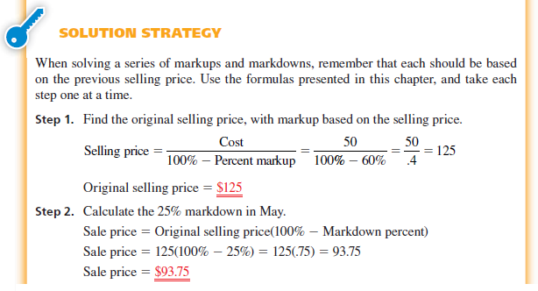

Slide 19
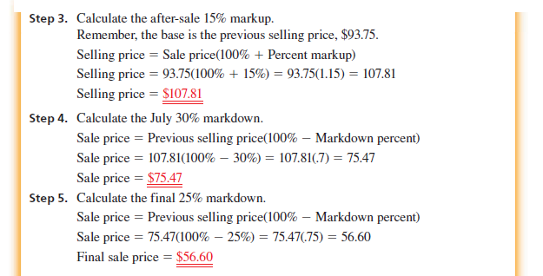

Slide 20
In September, Tire Depot in C hicago purchased snow tires from a distributor for $48.50 each. The original markup was 55% based on the selling price. In November, the tires were marked down 30% and put on sale. In December, they were marked up 20%. In February, the tires were again on sale at 30% off, and in March were cleared out with a final 25% markdown. What was the final selling price of the tires? Round to the nearest cent.

Slide 21
CALCULATING THE SELLING PRICE OF PERISHABLE GOODS
Out-of-season merchandise still has some value, whereas perishable goods (such as fruits, vegetables, flowers, and dairy products) have a certain shelf life and then no value at all. For sellers of this type of merchandise to achieve their intended markups, the selling price must be based on the quantity of products sold at the original price. The quantity sold is calculated as total items less spoilage. For example, if a tomato vendor anticipates a 20% spoilage rate, the selling price of the tomatoes should be calculated based on 80% of the original stock. To calculate the selling price of perishables, use the formula:

Slide 22
Total expected selling price
Selling price of perishables = ⎯⎯⎯⎯⎯⎯⎯⎯⎯⎯⎯⎯⎯⎯⎯⎯⎯ Total quantity - Anticipated spoilage

Slide 23
CALCULATING THE SELLING PRICE OF
PERISHABLE GOODS
The Farmer’s Market buys 1,500 pounds of fresh peaches at a cost of $.60 a pound. If a 15% spoilage rate is anticipated, at what price per pound should the peaches be sold to achieve a 50% markup based on selling price? Round to the nearest cent.

Slide 24
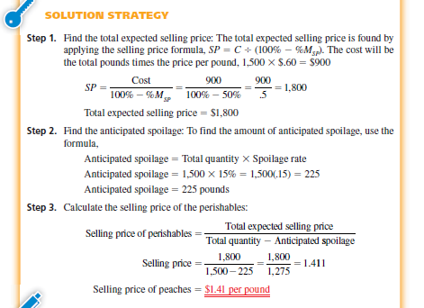

Slide 25

Exercise

