Slide 1
Managing Your Corporation’s
NPD Resources
Chapter 11

Slide 2
Outline
In This Chapter
Assessing how well your company uses its resources
Developing your product portfolio
Supporting the projects in your development pipeline
Reducing the cycle time of NPD
Stretching your resources by becoming Lean

Slide 3
Intro
You may think that coming up with good product ideas, developing products that customers want, and getting those products to markets where customers can buy them are the main ingredients you need to bake up an impressive piece of the profit pie. All those ingredients certainly are important, but they aren’t enough.
Too many companies fail at the new product development game because they don’t manage their resources well. Product development resources are mostly people, and people provide the needed skills and experience. Resources also include financial outlay — for people, of course, but also for equipment and infrastructure.
Some projects require capital outlays — for example, when a new product requires new manufacturing facilities.

Slide 4
Is Your Company a Well-Oiled Machine or a Herd of Cats?

Slide 5
Like A Well-oiled Machine
The companies that have the most new product development (NPD) success set themselves up to produce new products like a well-oiled machine.
Like a machine, all the parts of the process work together to produce the desired result.
These companies have the following characteristics:

Slide 6
These companies have the following characteristics:
They understand their new product goals, and they make sure that all their new product projects, taken together, can achieve those goals. (See Chapters 3 and 8 for more on setting new product goals.)
They know what resources they need and can tell you what resources they have.
They have plans in place to develop or acquire resources they need but don’t have. In Chapter 7, you can find out how companies plan to develop technology resources; in Chapters 8 and 16, you can read about partnering to acquire needed resources.

Slide 7
These companies have the following characteristics:
They look for synergies among projects, sometimes building technology or product platforms (see Chapter 3) that will produce many individual products.
They try to optimize the output of their product development pipelines instead of sacrificing speed and efficiency to gain short-term advantages.
They select methods to shorten NPD cycle time with great care, knowing that shortcuts can lead to disaster; however, they use every trick in the book to get as much from their pipelines as they can (see the final sec- tion of this chapter for cycle-shortening tips).

Slide 8
Questions
Our engineers and new product developers work on between 1.5 and 2.0 projects at a time.
Most of our projects don’t change significantly between Concept Review and commercialization (see Chapter 9). If a change does occur, it happens for a good, and documented, reason (for example, because the market changes or a competitor comes out with a better product).
We change or stop projects that aren’t meeting business goals. 212 Part III: Navigating the River of Product Development
We can see a clear connection between our resourced technology pro- jects (see Chapter 7) and product development projects.
Every project has a well-defined place in our product portfolio (see the following section).
The strategic criteria for making decisions about what we should include in our new product portfolio are clear and well understood (see Chapter 3).
We know what resources we need for NPD, now and in the future, and we have a plan to obtain those resources.
We use outsourcing, acquisition, partnering, and other means

Slide 9
Filling and Balancing Your NPD Portfolio

Slide 10
Filling and Balancing Your NPD Portfolio
In the good old days, the resources needed for product innovation seemed less constrained. For example, Edwin Land at Polaroid used to commission several projects to work on the same idea to see which would come out on top.
Companies like 3M and GE used to have huge internal budgets for R&D. Today, every company is resource-constrained. Businesses must try to make the most of every dollar spent on innovation and product development. What this means is that every company needs to make tough choices about what projects to fund and what to dump, shelve, or sell

Slide 11
Focusing your portfolio with disciplined portfolio management processes

Slide 12
Intro
Your organization needs to have many new product options to choose from if you want to be a successful new product developer.
If you don’t have more ideas for projects than you can resource, you’re putting yourself in the guaranteed-to-fail situation of sticking whatever projects you have hanging around into your NPD pipeline.
Have you ever been in a brainstorming ses- sion where desperate people are saying things like the following: “Maybe we could dye it red and sell it at Christmas!” “Maybe we could turn our sippy cup into a device for the medical market?”
These kinds of ideas are the NPD equivalent of “Let’s run it up the flagpole.”

Slide 13
Here are some of the areas of your NPD portfolio you should discuss with the portfolio implementation team:
What criteria are important for making decisions about what you’ll include in your product portfolio? Portfolio criteria usually include financial, strategic, and balance targets (see the following section).
Who will make the decisions about what goes in? What level of man-agement is appropriate? For example, will you make decisions at the business unit or the corporate level?
What’s the right calendar for portfolio review and decision making? How often will you review the portfolio? How will your portfolio deci- sions be tied to your strategic and budget calendars? The portfolio review calendar sets the timing for “regular” reviews. Your company also must track the portfolio in real time and call reviews if you notice any significant changes in, for example, the market or technology.
How will you link portfolio decisions to decisions about resourcing projects in the pipeline? It isn’t enough to decide what collection of pro- jects will deliver on your company’s goals. The portfolio decision makers have to know what resources they have so that they can resource the projects they select. And they have to monitor the use of resources as the projects move through the pipeline.
How will you get the data you need for making portfolio decisions? What form will the data be in? How detailed does it need to be? The information you gather about your customers (see Chapter 4), about technology (see Chapter 7), and about markets and competitors (see Chapter 3) will be important in making portfolio decisions.
What tools can you use for gathering and organizing the data? How can you support portfolio decision-making? How can you streamline the collection of data? (In Chapters 3, 4, and 7, you can read about

Slide 14
Using different criteria to shape your portfolio

Slide 15
Intro
Companies use a variety of tools and approaches to shape and manage their product portfolios. The key to successful portfolio management is under- standing how these different approaches work and finding the best fit for your company. In the following sections, we outline the approaches available to your organization.

Slide 16
Mixing and Matching the Tools
The most successful new product developers don’t settle for just one approach; they use a hybrid approach, mixing and matching the tools we describe in this section.
Financial targets
Balance of product types
  Balancing risk and reward
Strategic buckets

Slide 17
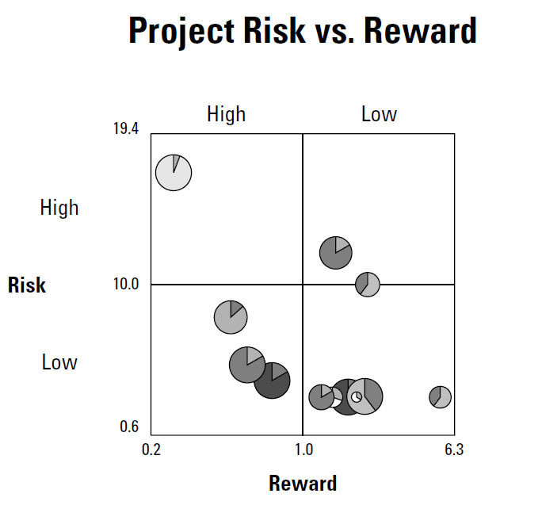

Slide 18
Resourcing New Product Projects in the Development Pipeline

Slide 19
Intro
A product portfolio represents the combination of projects a company’s management wants to see developed in order to meet the organization’s strategic objectives (see Chapter 3). The projects in the portfolio go into the company’s development pipeline, which is where the rubber meets the road. However, too many companies separate portfolio management from pipeline management. In these companies, executives and senior managers make the “strategic” decisions and leave others to make the “tactical” ones. The result is often that the actual work being done does not accomplish the strategic goals.

Slide 20
Managing the product development pipeline

Slide 21
Intro
The following list presents the main tasks that lead to successful project resourcing. Some of these tasks are the responsibility of the team members, and some fall under the executives’ watch. But in the age-old recipe for success — “manage up and manage down” — make sure you’re doing your part, and make sure the people you report to or who report to you are doing their parts, too.

Slide 22
The main tasks that lead to successful project resourcing.
Estimate the people resources needed to support each new product project. The resources include the number of full-time employees with specific skill sets who will work on the project, as well as the time frame in which they’re needed. They also include people outside the company with needed skills that the company may not have.
Review resource allocations monthly, and make the necessary adjust- ments to keep your pipeline running smoothly. No matter how well you’ve estimated resource requirements at the beginning of a project, as the work progresses the needs will change. The resource manager should make sure that teams use a standard template and report vari- ances on a regular basis.

Slide 23
Understanding a project’s resource needs

Slide 24
Project’s resource need
Each approved project that enters into the product development pipeline must have a clear outline of its resource needs.
Projects require both normal resources — people with adequate but widely available skills — and special resources — people or other resources that are in short supply.

Slide 25
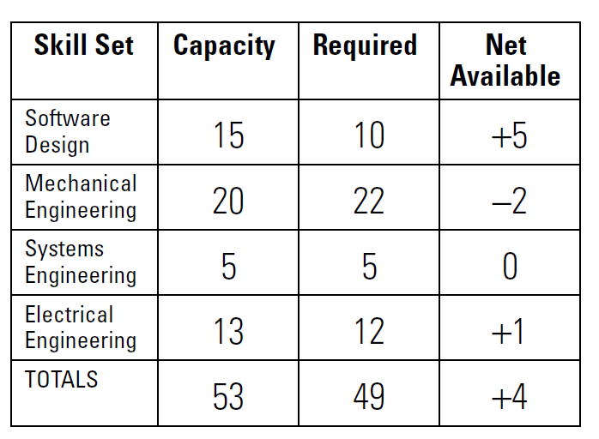
a simple matrix that you can use to plot the resource needs of each project
Notes:
If the manager asks teams to use this matrix, the information will come in a form that he or she can easily compare and aggregate. Of course, you aren’t going to know everything right at the beginning. But by predicting resource needs as accurately as possible early on and updating your predictions as sit- uations change, you can avoid a lot of headaches.

Slide 26
Resource Need Matrix
If the manager asks teams to use this matrix, the information will come in a form that he or she can easily compare and aggregate.
Of course, you aren’t going to know everything right at the beginning. But by predicting resource needs as accurately as possible early on and updating your predictions as situations change, you can avoid a lot of headaches.

Slide 27
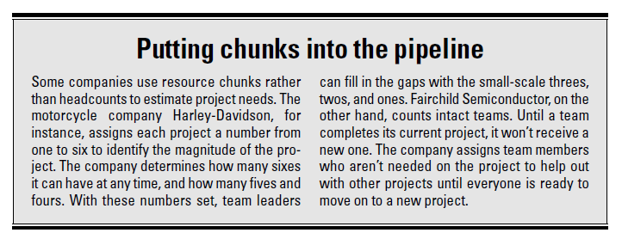

Slide 28
Securing functional resources

Slide 29
Securing functional resources
NPD team members come from the business functions within the company. The team comes together depending on whose expertise needs to be involved, from the fuzzy front end through the launch into market (see Chapters 9 and 10).
The team members must assess the resource needs for a project — resources that come from many of the company’s functions — and make those needs very clear to the managers who will give the project the green light — or put on the brakes. (See Chapter 12 for more on the relationship between the NPD team and the managers who sit on the review boards.)

Slide 30
Securing functional resources
Securing functional resources is complex. It isn’t like going to your boss and requesting an extra week or three more rolls of tape to complete a project.
The members of the NPD team — having formed a clear idea of the resources they need and when they’ll need them — must negotiate with the functions. (Take a look at Chapter 9 for some advice on how team members can negoti- ate successfully with their functions and for more on the politics of NPD.)

Slide 31
One of three things will happen:
The team can’t carry out the project because of a lack of resources.
The project gets delayed.
The managers will go to the functions and strengthen the requests for resources with more information and data.

Slide 32
Going outside for resource help

Slide 33
Going outside for resource help
If your NPD team can show your company that spending on resources now will increase revenue later (see the previous section), you may be able to argue for and obtain outside help. Timely use of external resources can do a world of good to help your team meet or exceed its schedule predictions, with little additional cost and the same or better quality.

Slide 34
Keeping the product development pipeline flowing

Slide 35
Keeping the product development pipeline flowing
The product development pipeline works like a highway. At 10 a.m. on a high- way that surrounds a major city, you won’t see very many cars. Every car can go the speed limit, and most are going faster. If an online directions service says that it will take an hour for your trip, you may be able to complete it in 50 minutes.
These driving conditions are pleasant, but if you always drive at 10 a.m., you may think that the state’s transportation department built too many highways and didn’t make good use of its resources.

Slide 36
Shortening Cycle Time

Slide 37
Intro
One of the most obvious and widely measured results of implementing a disciplined phase/review process (see Chapter 9) is that the process can shorten the time it takes for teams to get new products into the market, or the cycle time. Shortening cycle time has many benefits:
Projects tend to absorb fewer resources (contrary to common belief, which is that shortening cycle time requires more resources).
Companies can deploy resources to other projects more quickly.
Products get into the market quickly, where they’ll (hopefully)

Slide 38
Getting to profits within the window of opportunity

Slide 39
Intro
When you introduce a new product to the market, be aware that the product has a lifecycle (see Chapter 3). Much as you may want it to, the product won’t continue to produce profits forever (unless you have the equivalent of Classic Coke or a commodity product such as bottled hydrogen, in which case the revenue stream may last — at least until you retire).

Slide 40
Intro
For most products, teams really need to time their launches for what many call the window of opportunity — when the products will bring in the best returns. The more time products spend in development, the more time they lose in the window of opportunity, and after this time is lost, it can’t be regained.

Slide 41
Seasonal Products
For seasonal products such as ski jackets or bathing suits, the window may be the holiday season or summertime. For other products, the window may depend on the following:
Trends or fads (like hula hoops or fad diets)
How quickly a competitor can launch a product that could steal a part of your market The pace of product development is so fast now that even breakthrough products like digital cameras or the iPod find competitors breathing down their necks.
The length of time patents will protect your product This is critically important for the pharmaceutical industry, which mea- sures its returns on how long a drug will stay on patent.

Slide 42
Spending more time upfront to reduce rework later

Slide 43
Intro
It may seem paradoxical, but spending more time upfront in the development process may shorten the time it takes to get to market. Companies that take the time to thoroughly understand their customers and come up with solu- tions that meet their customers needs, instead of hurrying through the early parts of the product development cycle, not only get to market with products that customers will buy, but also often get there quicker (see Chapter 4 for more on understanding customers).

Slide 44
Intro
When teams rush into the projects, they often misunderstand their cus- tomers’ needs. In addition, they often do things wrong — use the wrong tech- nologies, design parts that don’t fit with other parts, design products that are hard or impossible to manufacture, and so on. These kinds of mistakes send the teams into a rework loop where they have to fix things that they could’ve avoided with better planning.

Slide 45
Planning makes perfect. Team leaders shouldn’t push their teams to jump into developing products until they’ve spent enough time working on their project plans. If team mem- bers find gaps, they should go back and get better information. Time spent in preparation should surface assumptions, uncover risks, and help the team members become a focused group.
Working on back-end issue. NPD teams shouldn’t be tempted to leave the later parts of projects for later. And they can be tempted if the culture of new product development at their companies doesn’t include a deep understanding of the importance of plan- ning and upfront work. Even though the work of developing new products is linear — it starts at the beginning with an idea, goes through the phase/ review process, and ends up, hopefully, with a product in the market — the planning is not. s during the front end.

Slide 46
Knowing when fast becomes too fast

Slide 47
Intro
The following list presents some of the speed traps that NPD teams can fall into:
Pushing people or teams with extrinsic rewards or threats. Most new product team members —and most people in general— respond to the intrinsic reward of doing work they consider worthwhile. Realistic goals to shorten cycle time can motivate NPD teams, but carrots and sticks rarely do.
Skipping steps to save time. You often can skip steps in a phase/review process, but you should think this out carefully in advance. You can’t skip reviews if you foresee important questions popping up about the technical or business viability of a project, for instance. For many projects, setting out-of-bounds criteria is an appropriate way to speed up a product’s cycle time. You can find out more about these in Chapter 12.
Compromising quality. Many speedsters are tempted to cut corners. We’ve known teams that have eliminated features in a rush to the market, only to find that without those features, the products weren’t attractive to customers. Another temptation is to make the product less robust, but that may come back to haunt you when warranty claims skyrocket.

Slide 48
Intro
To avoid the speed traps, do the upfront work so you don’t waste time cor- recting mistakes you could’ve anticipated, set conditions that may let teams move quickly through reviews, and, most importantly, value product quality over a senseless rush to get to market.

Slide 49
Practicing the Discipline of No Waste

Slide 50
Intro
Many companies want to cut the waste out of their product development processes and capitalize on the resources they have (or can easily obtain). The approaches most discussed today include Lean development and Six Sigma. This section won’t give you the last word on these strategies, but we want you to see how they connect to developing new products.

Slide 51
Lean development

Slide 52
Lean development
Lean development is a discipline that has emerged from the quality movement. The quality movement has enabled companies to make impressive improvements in efficiency and quality in their manufacturing enterprises. Although product development differs in many ways from manufacturing, many companies have successfully eliminated waste from their product development processes by using Lean processes.

Slide 53
Lean development
Follow these steps to follow their lead:
Identify the sources of waste in your new product development efforts. Assign a team to observe your new product teams and processes to see where they’re taking unnecessary steps or doing work that could be avoided. Examples could include hand-offs (for example, from engineer- ing to manufacturing), scatter (in other words, making your team members scatter-brained by giving them too many projects — see “Understanding a project’s resource needs”), and wishful thinking.
Eliminate waste wherever possible.

Slide 54
Lean development
Eliminate waste wherever possible.
Here are some methods you can use for the examples in Step 1:
  To eliminate hand-offs, use a team approach; make sure team mem- bers make decisions about the project together (“no decisions out- side of this room”); and make a detailed plan for the steps needed to develop the product. You can find more on planning in the prod- uct development process in the section “Planning makes perfect” and in Chapter 9.
  To eliminate scatter, be realistic about the projects you can resource, and don’t have a team spend too much time fixing a product that you launched six months ago. Yes, too often people who should be working on new product development are the ones who are diverted to fix problems that should’ve been taken care of earlier.
  To eliminate wishful thinking, get serious about what you can accomplish, and don’t add more projects until you’ve completed the most important ones in your pipeline.

Slide 55
Six Sigma

Slide 56
Six Sigma
Like other quality movements, Six Sigma was originally introduced to improve the quality of existing products and processes — manufacturing in particular.
Design for Six Sigma (DFSS), however, is a process that seeks to prevent quality problems by focusing on upfront design. Upfront work helps to reduce the number of changes to design as projects move forward. DFSS focuses on developing product requirements by understanding customer needs, using a process similar to the one we describe in Chapter 4.
DFSS also focuses on system design in order to identify critical interfaces. This attention to system design reduces rework and frustration later in the process.

