Slide 1
Simple Interest
Chapter 12

Slide 2
Simple Interest
The easiest type of loan interest to calculate so-called simple interest. The calculations are the same, both for loans and credit purchases.
The interest rate is the percent of the loan principal for a certain period.
Mention percent usually is the annual interest rate. Rate of 10% means that the interest payments during the year amounted to 10% of the loan principal.
To calculate simple interest on the loan amount one year, simply by multiplying the principal with interest rate.

Slide 3
EXAMPLE 1
Stan McSwain borrow $ 1000 for a period of 1 (one) year with an interest rate of 8% (simple interest). Calculate how much interest the loan.
SOLUTION:
  Principal of the loan is $ 1,000. The amount of interest for 1 year is 8% of $ 1,000, or
  0:08 x $ 1,000 = $ 80.

Slide 4
FORMULAS
Most of the loan, not exactly for a period of 1 year.
Loans for longer periods of time will result in the borrower to pay a lot more interest. Likewise, loans for short-term will require less interest.
To calculate simple interest on the loan each period, multiply the loan principal and the interest rate and then multiply that by the time (expressed in years or in fractions of years).

Slide 5

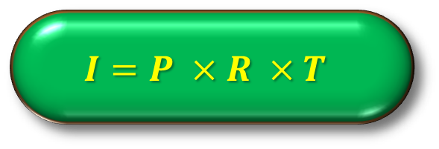

FORMULA
The basic formula of Simple Interest is:
OR
More Simple
$$Interest=Principal×Rate ×Time$$
$$I=P ×R ×T$$
$$I=PRT$$

Slide 6
EXAMPLE 2
Calculate the simple interest on a loan amount of $ 1,200 if the interest rate is 6% and 4 year loan term.
ANSWER:
  Interest = Principal x Rate x Time
  Interest = $ 1,200 x 0.06 x 4
  Interest = $ 288
How much interest, if the ¾-year loan term?

Slide 7
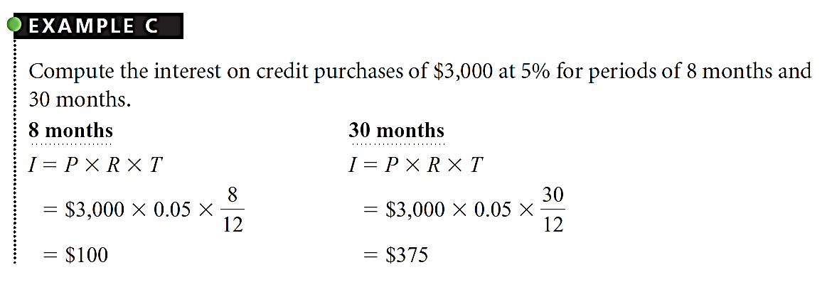

Slide 8
ORDINARY INTEREST
If the term of the loan expressed as a certain number of days, interest computation involves dividing the number of days by the number of days in 1 year -both 360 or 365.
Before the advent of computers and calculators, easier to calculate interest on the assumption that each year has 360 days and that every month has 30 days.
360-day method, called the method of ordinary interest, is still used by some companies and individuals.

Slide 9
EXACT INTEREST
Banks, savings and loan institutions, credit unions, and the federal government to use the 365 days (366 days for leap years) to calculate interest.
This method is called exact interest method. The same calculation as for ordinary simple interest, except that 365 days is used instead of 360 days.

Slide 10
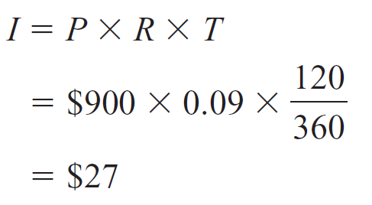
EXAMPLE
Calculate the ordinary simple interest to the principal loan of $ 900 with a 9% interest rate for a period of 120 days.
SOLUTION:

Slide 11
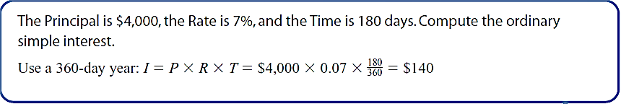

Slide 12
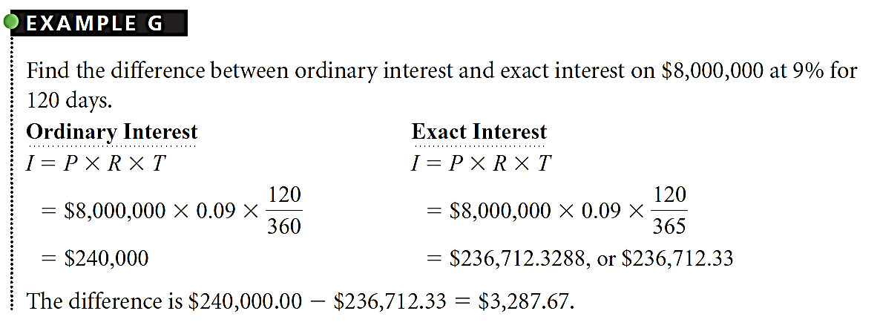

Slide 13
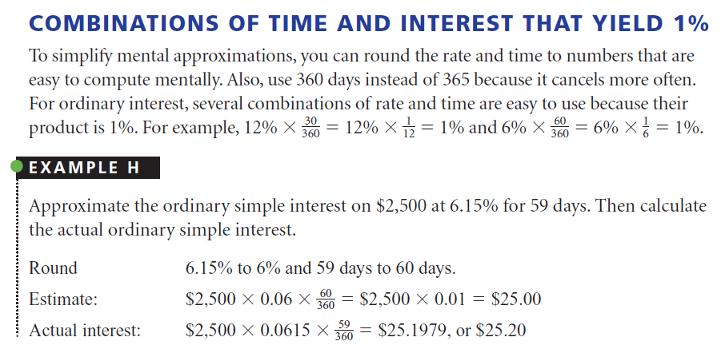

Slide 14
Actual Exact Interest
The objective in the approach just to get an estimate. Although the exact interest requires 365 days of the year, you can make a reasonable estimate by assuming that the number of days in a year is 360.

Slide 15
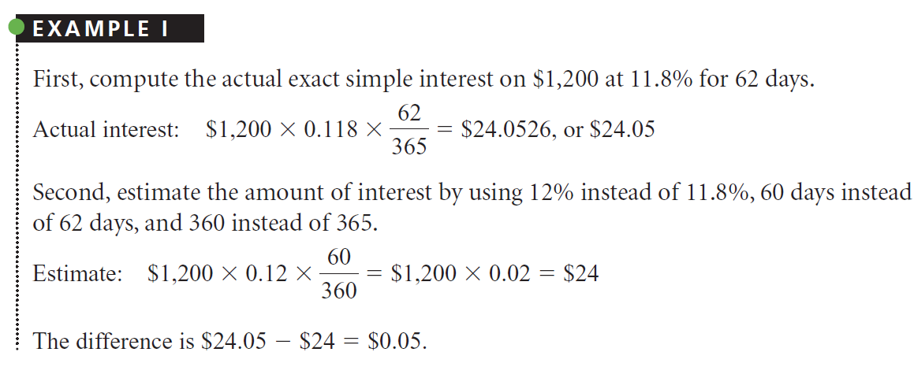

Slide 16
Calculating the Interest Variables
Each simple flower has four variables: Interest (I), Principal (P), Rate (R), and Time (T). So far, you have to solve for the amount of interest (I) when the Principal (P), Interest Rate (R), and time (T) is known. However, as long as there are three variables are given, you can always count fourth variable by simply changing the formula I = P x R x T became one of the possible variations, as shown in Table 13-2.

Slide 17
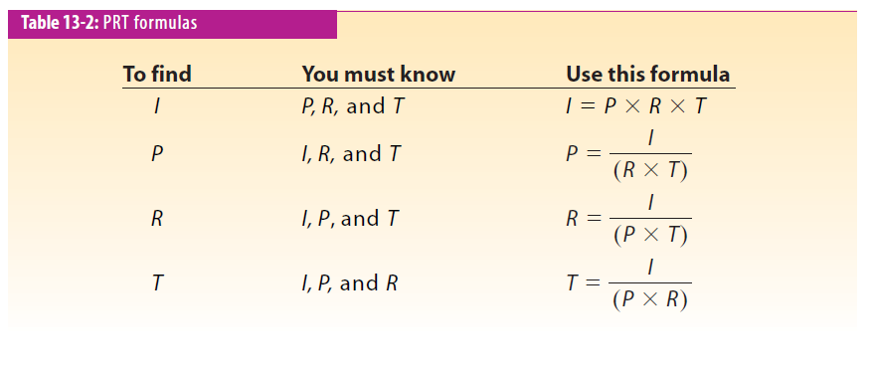

Slide 18
Magic
Triangle
I
P
R
T

Slide 19
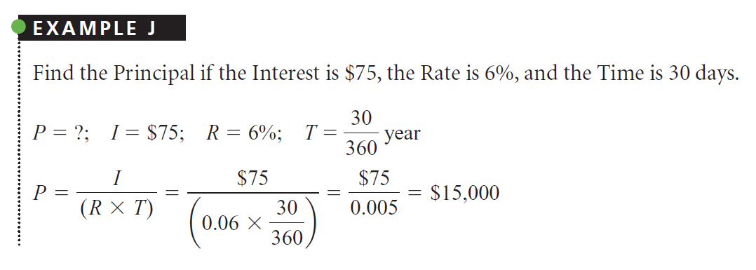

Slide 20
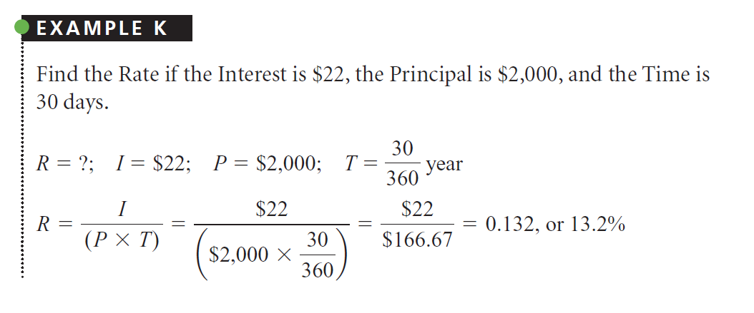

Slide 21
