Slide 1
Illycaffe Case Study:
Sustaining Quality from
Green Coffee to the Cup:
Logistics as a Competitive Weapon
CHAHPTER 11
Linking business strategy with international supply chain management and pursuing product quality using specific managerial practices throughout the whole supply chain

Slide 2
Supply Chain Management (SCM)
The term Supply Chain Management (SCM) refers to an integrated management of a network of entities that begins with the suppliers of the suppliers (second-tier suppliers) and ends with the customers of the customers (end customers)

Slide 3
Supply Chain Dynamics
The 1980s registered a vertical realignment between operations and business strategy (Hayes and Wheelwright, 1984),
while in the 1990s, focus was mainly on the horizontal alignment between operations and processes (Ghoshal and Bartlett, 1995).
In the last decade, interest has moved to the integration between internal and external supplier and customer processes in a unique supply chain (Frohlich and Westbrook, 2001).
According to Christopher (1992), 'Leading-edge companies are not companies against companies, but rather supply chain against supply chain.'

Slide 4
Supply Chain Dynamics
In fact, as described by Lambert and Cooper (2000), the Global Supply Chain Forum describes a successful SCM as demanding change in the management of functions: a move from an individual perspective to the integration of the activities associated with the key processes of the supply chain.

Slide 5
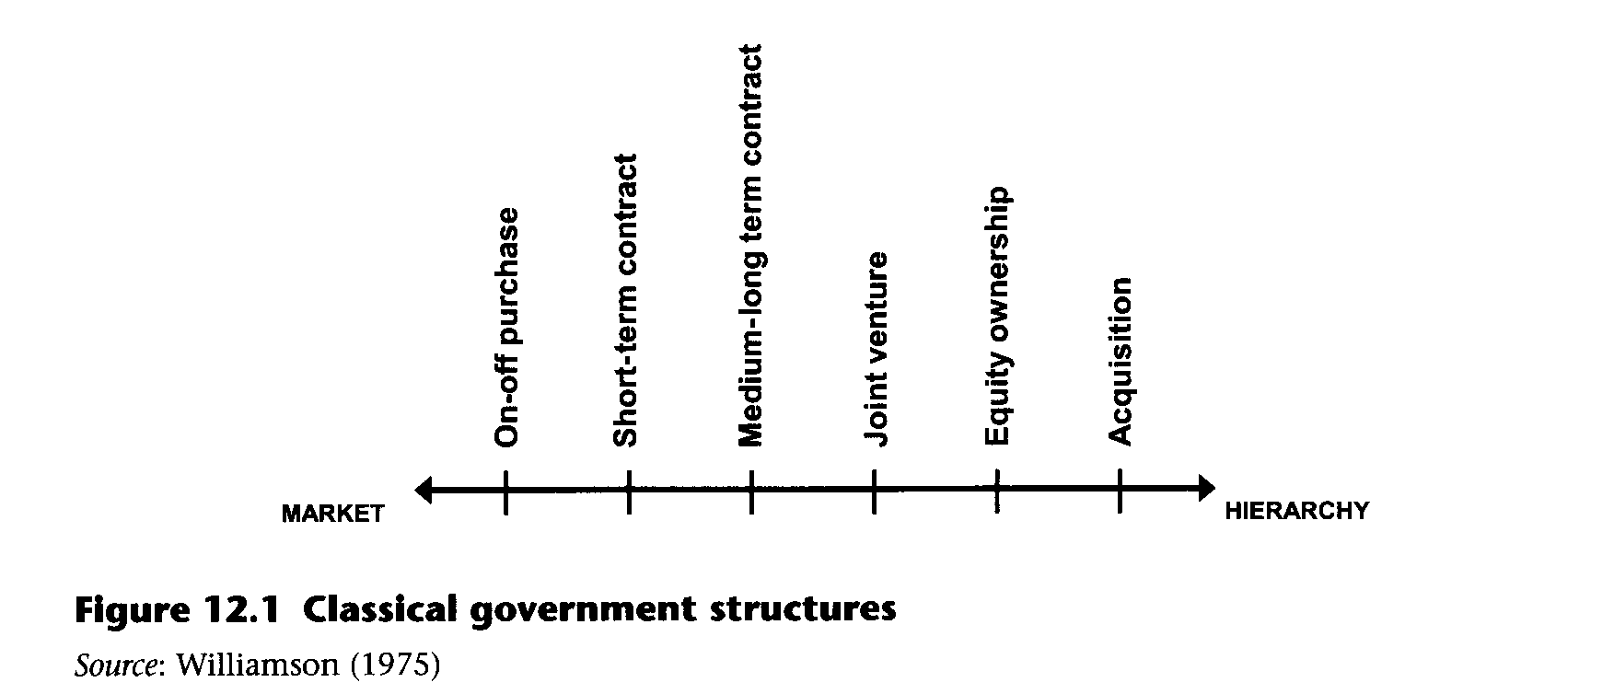

Slide 6
Government Structure
Vertical integration (hierarchy) and supply from external sources (market) therefore represent the extremes of this wide spectrum of alternatives in which management has to define the company's positioning and its consequent relational structure within the supply network.

Slide 7
As noted by Romano and Danese (2006), vertical integration means an extension of possession of the supply network by an organisation for two reasons:
To increase profit margins based on 'make or buy' decisions to reduce logistics costs and eliminate the cost of purchase and possession of the customers' or suppliers' profit margin; and
To expand control over part of the competitive environment and thus limit the uncertainty associated with trade relations between independent corporations.

Slide 8
In general, the decisions regarding vertical integration must define the following:
The direction of vertical integration: downstream to suppliers or upstream to customers;
The degree of integration: how much to integrate upstream or downstream; and
The balance between the vertically integrated activities: the amount of capacity of each stage that must be dedicated to the next.

Slide 9
The intermediate forms between hierarchy and market are joining or even replacing the traditional conflicting forms.
There are also empirical evidences suggesting that a higher level of integration between suppliers and customers allows greater advantages for both (Stevens, 1989; Lee et al., 1997; Metters, 1997; Narasimhan and Jayaram, 1998; Lummus et al., 1998; Anderson and Katz, 1998; Hines et al., 1998).
In accordance with this approach, the enterprises do not opportunistically follow a given strategy despite the other components of the supply chain.
Rather, they tend to make the overall supply chain more competitive (Romano and Vinelli, 2001), adopting initiatives based on collaboration, integration and transfer to obtain strategic advantage (Scott and Westbrook, 1991; De Maio and Maggiore, 1992; Kanter, 1994; Bowersox et al., 2000).

Slide 10
Collaborative Relationship
The creation of collaborative relationships is a very complex process, requiring an investment in resources that gradually increases in line with the increase in the intensity of the relationship and the number of players in the supply network with which it is established.
The grid of relations between customers and suppliers (Figure 12.2) shows how, given the limited availability of natural resources available to businesses, they tend to implement a rigorous partner selection process and develop different kinds of relationships with those partners.

Slide 12
De Maio and Maggiore (1992) propose classification of the relationship between customer and supplier based on two dimensions:
Operational integration, which describes the customer and the supplier as integrated in the management of orders, delivery, quality and, in general, all the logistical aspects related to the management and movement of materials;
Technological integration, which refers instead to how the customer and the supplier cooperate and exchange information during design and product development.

Slide 13
Combining the two dimensions with their levels of integration (high/low), the authors identify four types of supplier—customer relationships:
The traditional relationship regulated by price;
The just-in-time relationship, which is typical of those companies that have exceeded the traditional logic of supply to seek greater operational-logistics integration with suppliers. The characteristics of this relationship are the regularity of deliveries, small lots, high shipping frequency, quality and continuous improvement;
A technological alliance, suitable for producers/assemblers who require strong cooperation with suppliers to design components; and
Co-makership, a type of relationship that includes all of the characteristics of just-in­time but in addition implies a high degree of technological integration, namely joint efforts to engage in product and production process co-design.

Slide 14
PARTNERSHIP AS AN EVOLVED CUSTOMER—SUPPLIER RELATIONSHIP IN THE SUPPLY CHAINS

Slide 15
Definition
In general terms, a 'partnership' is an evolved type of customer—supplier relationship that is predominantly non-equity-based and characterised by the parties' mutual commitment to improve productivity and quality and then create competitive advantage.

Slide 16
Definition
The numerous existing definitions in the literature emphasise the need to personalise the relationship based on the characteristics and needs of the parties involved.
This approach defines the partnership as a tailored, packaged business relationship based on mutual trust, openness, and risk- and benefit-sharing, which lead to competitive advantage and result in a higher level of performance than companies could achieve individually.

Slide 17
Partnership may include a variety of configurations depending on:
the processes involved;
the degree of involvement of customer and supplier organisational structures; and
the time horizon for the collaboration.

Slide 18
The authors have identified four possible forms of cooperation for the implementation of supply chain management:
dyadic relationships;
channel integration;
keiretsu; and
analytical optimisation.

Slide 19
Keiretsu
Keiretsu adalah kata dalam bahasa Jepang yang mengidentifikasi sebuah 'masyarakat bisnis dengan berbagai tingkat, dengan perusahaan pusat (pemimpin) dan pemasok dibagi menjadi kelompok pemasok lapis, yang langsung melayani pemimpin, dan pemasok lapis kedua, kelompok pelanggan terstruktur dengan cara yang sama.
Dalam keiretsu, kerjasama dijamin melalui kepemilikan pemimpin saham di berbagai pemain dalam jaringan pasokan. Integrasi juga diimplementasikan melalui link horisontal dalam setiap level (tingkatan) dari jaringan pasokan melalui mekanisme yang disebut kyoryouku kai, yang secara harfiah berarti lingkaran koperasi.
Ini lingkaran koperasi dapat dilihat sebagai alat untuk komunikasi, koordinasi dan pengembangan dan telah berhasil berkat pelaksanaannya dalam jaringan pemasok perusahaan mobil Jepang selama sepuluh tahun terakhir. Selain itu, kolaborasi dengan optimasi analitis mengharapkan adanya pemimpin jaringan pasokan. Bentuk kolaborasi menggunakan perangkat lunak dan teknologi komunikasi dan pengolahan data untuk mengoptimalkan pengelolaan proses tertentu dalam jaringan pasokan.

Slide 20
Quality management and knowledge/know-how diffusion toward supply chain learning

Slide 21
It is fundamental to consider two more aspects to best develop SCM in organisations: quality and knowledge management in the supply network.
SCM can provide sustainable competitive advantage, improving product/service quality and reducing costs at the same time (Davis, 1993). In this case the main operations to have a strategic role in achieving quality (a competitive priority) are integrated logistics and purchasing.
In fact, the high quality of the product and service at every level of the supply network can be obtained through, for example, integrated logistics, recognised as essential to obtaining a successful SCM (Johnson and Wood, 1996; Choi and Rungtusanatham, 1999).

Slide 22
As regards knowledge, a new managerial approach is the so-called Supply Chain Learning (SCL) method. Bessant and Francis (1999) point out the necessity of focusing research and managerial practices not only on intra-organisational learning but also on inter-organisational learning as a potential lever for competitive advantage among small-to medium-sized enterprises.
Subsequently, Bessant and colleagues (2003) demonstrate that the competitive performance of the value stream depends on the learning and development of the whole system, not just that of the leading players, and provide empirical evidence of the benefits of SCL at both the individual firm and the inter-firm level.
For the Supply Chain Coordinator (SCC), the coordinating or central firms that take the lead, benefits accrue in terms of an increase in sales and improvement in the quality and the delivery time for materials, which leads to cost savings and cost reductions. Benefits for first-tier and second-tier suppliers emerge in terms of increasing profit margins, decreasing costs and improvements in product quality.

Slide 23
SCL is of a voluntary and participative nature (Kaplinsky and Morris, 2001), and it proceeds most effectively when a leading partner acts as supply chain coordinator, ensuring that a learning process occurs throughout the chain.
Nevertheless this requires a strong effort and a high use of SCC resources, as the learning process must be sustained due to the many risks of failure. Among the factors enabling SCL are trust and strong efforts by the SCC — while, for instance, low-cost culture creates destructive preconceptions or cultural differences among companies and within parts of the same companies that can inhibit SCL.
Consequently, the diffusion of a shared culture may sustain SCL. Krause and colleagues (2007) demonstrated the benefit of SCL in terms of buyer performance improvements when the buying firms perceive themselves as sharing values and goals with key suppliers.

