Slide 1
Chapter 14
Compound Interest

Slide 2
Definition
In business, another common way of calculating interest is by using a method known as compounding, or compound interest, in which the interest calculation is applied a number of times during the term of the loan or investment.
With compound interest, the interest earned for each period is reinvested or added to the previous principal before the next calculation or compounding. The previous principal plus interest then becomes the new principal for the next period.

Slide 3

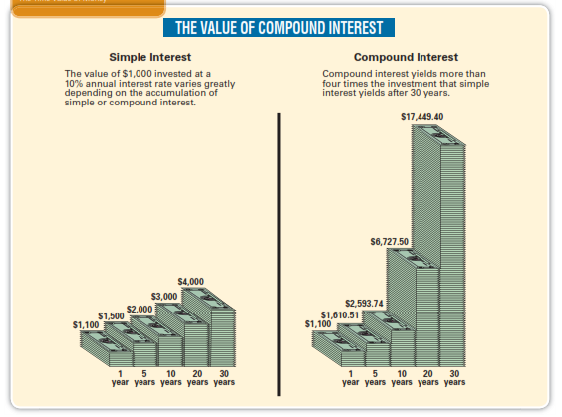

Slide 4
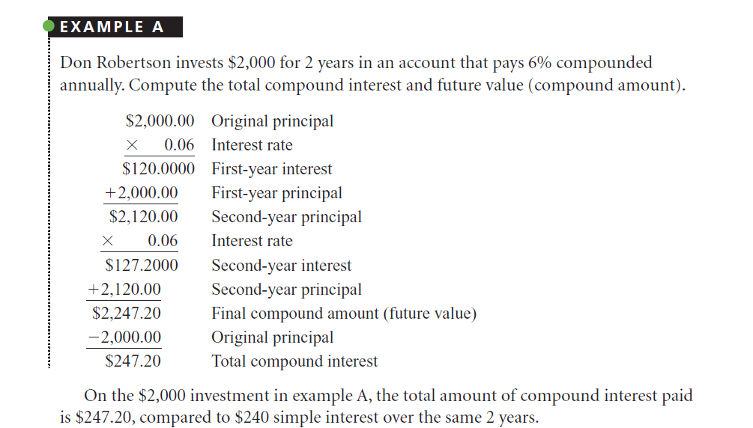

Slide 5
Time Value of Money
This chapter also introduces you to an all-important business concept, the time value of money.
Consider this: If you were owed $1,000, would you rather have it now or one year from now? If you answered “now,” you already have a feeling for the concept. Money “now,” or in the present, is more desirable than the same amount of money in the future because it can be invested and earn interest as time goes by.

Slide 6
In this chapter, you learn to calculate the compound amount (future value) of an investment at compound interest when the present amount (present value) is known. You also learn to calculate the present value that must be deposited now at compound interest to yield a known future amount.

Slide 7
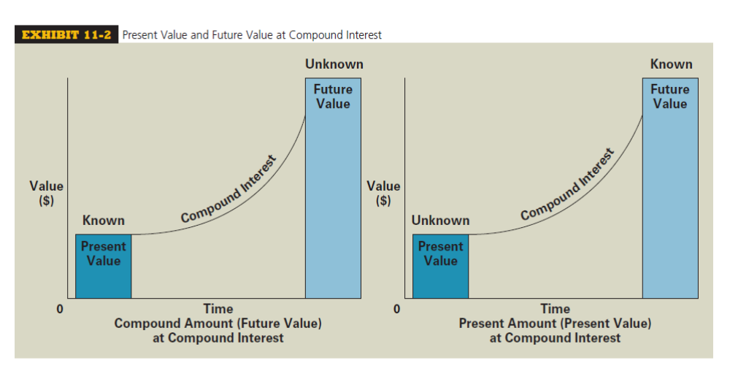

Slide 8
MANUALLY CALCULATING COMPOUND AMOUNT
(FUTURE VALUE) AND COMPOUND INTEREST

Slide 9
MANUALLY CALCULATING COMPOUND AMOUNT
(FUTURE VALUE) AND COMPOUND INTEREST
Compounding divides the time of a loan or an investment into compounding periods or simply periods.
To manually calculate the compound amount or future value of an investment, we must compound or calculate the interest as many times as there are compounding periods at the interest rate per period.

Slide 10
EXAMPLE
For example, an investment made for 5 years at 12% compounded annually (once per year) would have five compounding periods (5 years ×1 period per year), each at 12%. If the same investment was compounded semiannually (two times per year), there would be 10 compounding periods (5 years × 2 periods per year), each at 6% (12% annual rate ÷ 2 periods per year).
The amount of compound interest is calculated by subtracting the principal from the compound amount.

Slide 11
MANUALLY CALCULATING
COMPOUND INTEREST
Katie Trotta invested $5,000 in a passbook savings account at 10% interest compounded annually for 2 years. Manually calculate the compound amount of the investment and the total amount of compound interest Katie earned.
To solve this compound interest problem manually, we must apply the simple interest formula twice because there are two compounding periods (2 years × 1 period per year). Note how the interest from the first period is reinvested or added to the original principal to earn interest in the second period.

Slide 12
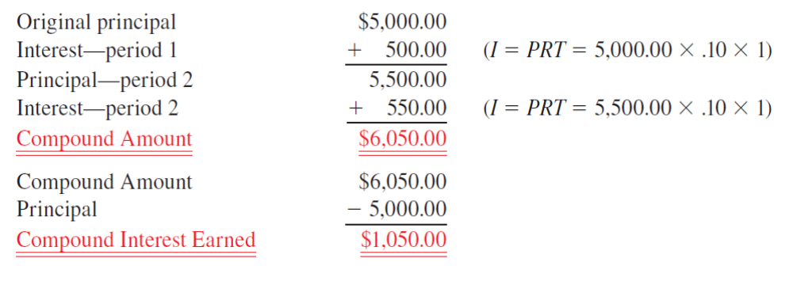
MANUALLY CALCULATING
COMPOUND INTEREST

Slide 13
MANUALLY CALCULATING
COMPOUND INTEREST
Manually recalculate the compound amount and compound interest from the previous example by using semiannual compounding (two times per year). How much more interest would Katie earn if the bank offered semiannual compounding?

Slide 14
Exercise
Gail Parker invested $10,000 at 12% interest compounded semiannually for 3 years. Manually calculate the compound amount and the compound interest of Gail’s investment.

Slide 15
Future Value or Future Amount or Compound Amount
The future value using compound interest can be found by multiplying the principal times the quantity (1+Rate) once for each period the investment is to be compounded. Rate is the annual interest rate. Therefore, the future value of $1000 invested at 8% compounded annually for 3 years is shown as follows.
Future value = $1000 x (1 + 0.08) x (1 + 0.08) x (1 + 0.08)
= $1000 x 1.08 x 1.08 x 1.08
= $1000 x 1.08³
= $1259.71

Slide 16
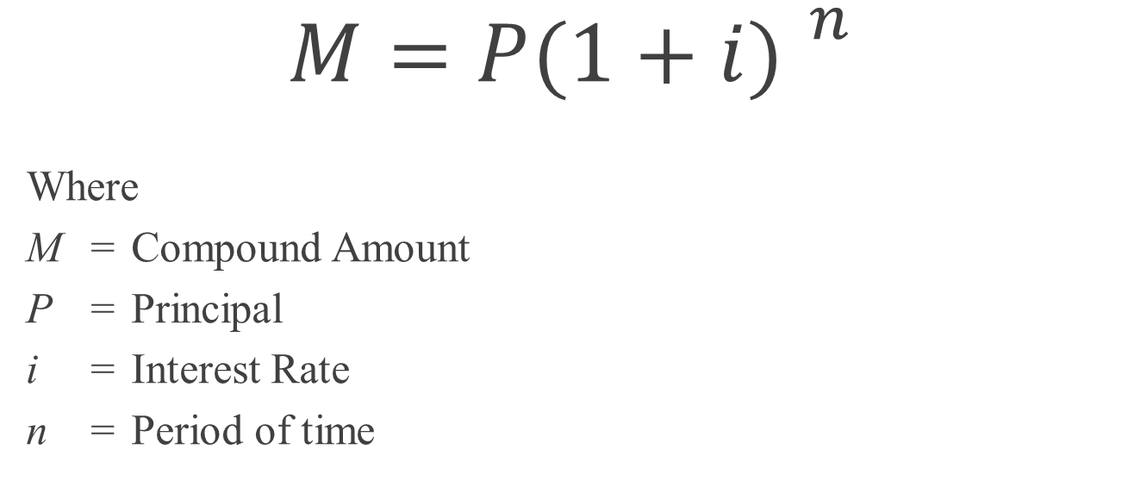
Future Value Formula
$$M={P(1+i) }^{n}$$
Where
M = Compound Amount
P = Principal
i = Interest Rate
n = Period of time

Slide 17
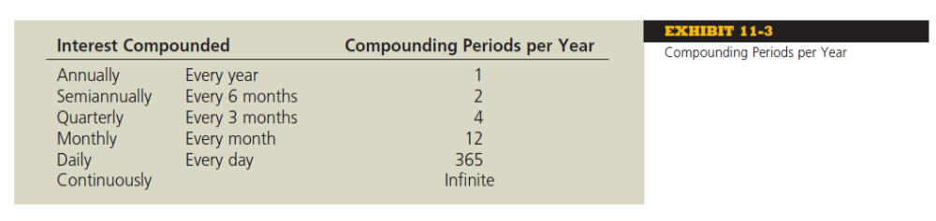
Determine the Number of Periods

Slide 18
Finding Compound Interest
Jonathan Simons invests $2500 in an account paying 4% compounded semiannually for 5 years. (a) Estimate the future value using simple interest. Then find (b) the compound amount. (c) the compound interest, and (d) the amount by which simple interst calculations underestimate the compound interest that is earned.
Simple interst = IRT
= $2500 x 0.02 x 10 = $500
(b) Compound amount = P(1+i)^{n}
= $2500 x (1 + 0.02)¹⁰
= $3047.49
(c) Compound interst = M – P = $3047 - $2500 = $547.49
(d) Underestimation when simple interest is used = $547.49 - $500 = $47.49

Slide 19
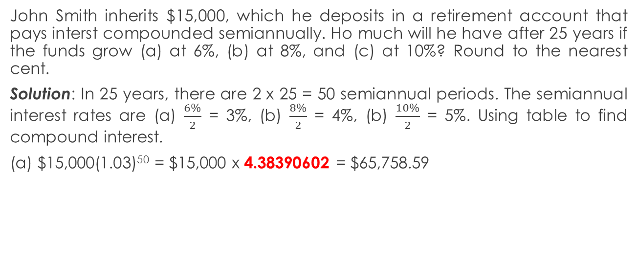
Find Values in the Interest Table
John Smith inherits $15,000, which he deposits in a retirement account that pays interst compounded semiannually. Ho much will he have after 25 years if the funds grow (a) at 6%, (b) at 8%, and (c) at 10%? Round to the nearest cent.
Solution: In 25 years, there are 2 x 25 = 50 semiannual periods. The semiannual interest rates are (a) $\frac{6\%}{2}$ = 3%, (b) $\frac{8\%}{2}$ = 4%, (b) $\frac{10\%}{2}$ = 5%. Using table to find compound interest.
$15,000(1.03)⁵⁰ = $15,000 x 4.38390602 = $65,758.59

Slide 20
Compound Interest Table (Future Value of $1 at Compound Interest)
Periods | 0.50% | 1.00% | 1.50% | 2.00% | 3.00% | 4.00% | 5.00% | 6.00% | 7.00% | 8.00% | Periods
1 | 1.00500000 | 1.01000000 | 1.01500000 | 1.02000000 | 1.03000000 | 1.04000000 | 1.05000000 | 1.06000000 | 1.07000000 | 1.08000000 | 1
2 | 1.01002500 | 1.02010000 | 1.03022500 | 1.04040000 | 1.06090000 | 1.08160000 | 1.10250000 | 1.12360000 | 1.14490000 | 1.16640000 | 2
3 | 1.01507513 | 1.03030100 | 1.04567838 | 1.06120800 | 1.09272700 | 1.12486400 | 1.15762500 | 1.19101600 | 1.22504300 | 1.25971200 | 3
4 | 1.02015050 | 1.04060401 | 1.06136355 | 1.08243216 | 1.12550881 | 1.16985856 | 1.21550625 | 1.26247696 | 1.31079601 | 1.36048896 | 4
5 | 1.02525125 | 1.05101005 | 1.07728400 | 1.10408080 | 1.15927407 | 1.21665290 | 1.27628156 | 1.33822558 | 1.40255173 | 1.46932808 | 5
6 | 1.03037751 | 1.06152015 | 1.09344326 | 1.12616242 | 1.19405230 | 1.26531902 | 1.34009564 | 1.41851911 | 1.50073035 | 1.58687432 | 6
7 | 1.03552940 | 1.07213535 | 1.10984491 | 1.14868567 | 1.22987387 | 1.31593178 | 1.40710042 | 1.50363026 | 1.60578148 | 1.71382427 | 7
8 | 1.04070704 | 1.08285671 | 1.12649259 | 1.17165938 | 1.26677008 | 1.36856905 | 1.47745544 | 1.59384807 | 1.71818618 | 1.85093021 | 8
9 | 1.04591058 | 1.09368527 | 1.14338998 | 1.19509257 | 1.30477318 | 1.42331181 | 1.55132822 | 1.68947896 | 1.83845921 | 1.99900463 | 9
10 | 1.05114013 | 1.10462213 | 1.16054083 | 1.21899442 | 1.34391638 | 1.48024428 | 1.62889463 | 1.79084770 | 1.96715136 | 2.15892500 | 10
11 | 1.05639583 | 1.11566835 | 1.17794894 | 1.24337431 | 1.38423387 | 1.53945406 | 1.71033936 | 1.89829856 | 2.10485195 | 2.33163900 | 11
12 | 1.06167781 | 1.12682503 | 1.19561817 | 1.26824179 | 1.42576089 | 1.60103222 | 1.79585633 | 2.01219647 | 2.25219159 | 2.51817012 | 12
13 | 1.06698620 | 1.13809328 | 1.21355244 | 1.29360663 | 1.46853371 | 1.66507351 | 1.88564914 | 2.13292826 | 2.40984500 | 2.71962373 | 13
14 | 1.07232113 | 1.14947421 | 1.23175573 | 1.31947876 | 1.51258972 | 1.73167645 | 1.97993160 | 2.26090396 | 2.57853415 | 2.93719362 | 14
15 | 1.07768274 | 1.16096896 | 1.25023207 | 1.34586834 | 1.55796742 | 1.80094351 | 2.07892818 | 2.39655819 | 2.75903154 | 3.17216911 | 15
16 | 1.08307115 | 1.17257864 | 1.26898555 | 1.37278571 | 1.60470644 | 1.87298125 | 2.18287459 | 2.54035168 | 2.95216375 | 3.42594264 | 16
17 | 1.08848651 | 1.18430443 | 1.28802033 | 1.40024142 | 1.65284763 | 1.94790050 | 2.29201832 | 2.69277279 | 3.15881521 | 3.70001805 | 17
18 | 1.09392894 | 1.19614748 | 1.30734064 | 1.42824625 | 1.70243306 | 2.02581652 | 2.40661923 | 2.85433915 | 3.37993228 | 3.99601950 | 18
19 | 1.09939858 | 1.20810895 | 1.32695075 | 1.45681117 | 1.75350605 | 2.10684918 | 2.52695020 | 3.02559950 | 3.61652754 | 4.31570106 | 19
20 | 1.10489558 | 1.22019004 | 1.34685501 | 1.48594740 | 1.80611123 | 2.19112314 | 2.65329771 | 3.20713547 | 3.86968446 | 4.66095714 | 20
21 | 1.11042006 | 1.23239194 | 1.36705783 | 1.51566634 | 1.86029457 | 2.27876807 | 2.78596259 | 3.39956360 | 4.14056237 | 5.03383372 | 21
22 | 1.11597216 | 1.24471586 | 1.38756370 | 1.54597967 | 1.91610341 | 2.36991879 | 2.92526072 | 3.60353742 | 4.43040174 | 5.43654041 | 22
23 | 1.12155202 | 1.25716302 | 1.40837715 | 1.57689926 | 1.97358651 | 2.46471554 | 3.07152376 | 3.81974966 | 4.74052986 | 5.87146365 | 23
24 | 1.12715978 | 1.26973465 | 1.42950281 | 1.60843725 | 2.03279411 | 2.56330416 | 3.22509994 | 4.04893464 | 5.07236695 | 6.34118074 | 24
25 | 1.13279558 | 1.28243200 | 1.45094535 | 1.64060599 | 2.09377793 | 2.66583633 | 3.38635494 | 4.29187072 | 5.42743264 | 6.84847520 | 25

Slide 21
Compound Interest Table (Future Value of $1 at Compound Interest)
Periods | 0.50% | 1.00% | 1.50% | 2.00% | 3.00% | 4.00% | 5.00% | 6.00% | 7.00% | 8.00% | Periods
26 | 1.13845955 | 1.29525631 | 1.47270953 | 1.67341811 | 2.15659127 | 2.77246978 | 3.55567269 | 4.54938296 | 5.80735292 | 7.39635321 | 26
27 | 1.14415185 | 1.30820888 | 1.49480018 | 1.70688648 | 2.22128901 | 2.88336858 | 3.73345632 | 4.82234594 | 6.21386763 | 7.98806147 | 27
28 | 1.14987261 | 1.32129097 | 1.51722218 | 1.74102421 | 2.28792768 | 2.99870332 | 3.92012914 | 5.11168670 | 6.64883836 | 8.62710639 | 28
29 | 1.15562197 | 1.33450388 | 1.53998051 | 1.77584469 | 2.35656551 | 3.11865145 | 4.11613560 | 5.41838790 | 7.11425705 | 9.31727490 | 29
30 | 1.16140008 | 1.34784892 | 1.56308022 | 1.81136158 | 2.42726247 | 3.24339751 | 4.32194238 | 5.74349117 | 7.61225504 | 10.06265689 | 30
31 | 1.16720708 | 1.36132740 | 1.58652642 | 1.84758882 | 2.50008035 | 3.37313341 | 4.53803949 | 6.08810064 | 8.14511290 | 10.86766944 | 31
32 | 1.17304312 | 1.37494068 | 1.61032432 | 1.88454059 | 2.57508276 | 3.50805875 | 4.76494147 | 6.45338668 | 8.71527080 | 11.73708300 | 32
33 | 1.17890833 | 1.38869009 | 1.63447918 | 1.92223140 | 2.65233524 | 3.64838110 | 5.00318854 | 6.84058988 | 9.32533975 | 12.67604964 | 33
34 | 1.18480288 | 1.40257699 | 1.65899637 | 1.96067603 | 2.73190530 | 3.79431634 | 5.25334797 | 7.25102528 | 9.97811354 | 13.69013361 | 34
35 | 1.19072689 | 1.41660276 | 1.68388132 | 1.99988955 | 2.81386245 | 3.94608899 | 5.51601537 | 7.68608679 | 10.67658148 | 14.78534429 | 35
36 | 1.19668052 | 1.43076878 | 1.70913954 | 2.03988734 | 2.89827833 | 4.10393255 | 5.79181614 | 8.14725200 | 11.42394219 | 15.96817184 | 36
37 | 1.20266393 | 1.44507647 | 1.73477663 | 2.08068509 | 2.98522668 | 4.26808986 | 6.08140694 | 8.63608712 | 12.22361814 | 17.24562558 | 37
38 | 1.20867725 | 1.45952724 | 1.76079828 | 2.12229879 | 3.07478348 | 4.43881345 | 6.38547729 | 9.15425235 | 13.07927141 | 18.62527563 | 38
39 | 1.21472063 | 1.47412251 | 1.78721025 | 2.16474477 | 3.16702698 | 4.61636599 | 6.70475115 | 9.70350749 | 13.99482041 | 20.11529768 | 39
40 | 1.22079424 | 1.48886373 | 1.81401841 | 2.20803966 | 3.26203779 | 4.80102063 | 7.03998871 | 10.28571794 | 14.97445784 | 21.72452150 | 40
41 | 1.22689821 | 1.50375237 | 1.84122868 | 2.25220046 | 3.35989893 | 4.99306145 | 7.39198815 | 10.90286101 | 16.02266989 | 23.46248322 | 41
42 | 1.23303270 | 1.51878989 | 1.86884712 | 2.29724447 | 3.46069589 | 5.19278391 | 7.76158756 | 11.55703267 | 17.14425678 | 25.33948187 | 42
43 | 1.23919786 | 1.53397779 | 1.89687982 | 2.34318936 | 3.56451677 | 5.40049527 | 8.14966693 | 12.25045463 | 18.34435475 | 27.36664042 | 43
44 | 1.24539385 | 1.54931757 | 1.92533302 | 2.39005314 | 3.67145227 | 5.61651508 | 8.55715028 | 12.98548191 | 19.62845959 | 29.55597166 | 44
45 | 1.25162082 | 1.56481075 | 1.95421301 | 2.43785421 | 3.78159584 | 5.84117568 | 8.98500779 | 13.76461083 | 21.00245176 | 31.92044939 | 45
46 | 1.25787892 | 1.58045885 | 1.98352621 | 2.48661129 | 3.89504372 | 6.07482271 | 9.43425818 | 14.59048748 | 22.47262338 | 34.47408534 | 46
47 | 1.26416832 | 1.59626344 | 2.01327910 | 2.53634352 | 4.01189503 | 6.31781562 | 9.90597109 | 15.46591673 | 24.04570702 | 37.23201217 | 47
48 | 1.27048916 | 1.61222608 | 2.04347829 | 2.58707039 | 4.13225188 | 6.57052824 | 10.40126965 | 16.39387173 | 25.72890651 | 40.21057314 | 48
49 | 1.27684161 | 1.62834834 | 2.07413046 | 2.63881179 | 4.25621944 | 6.83334937 | 10.92133313 | 17.37750403 | 27.52992997 | 43.42741899 | 49
50 | 1.28322581 | 1.64463182 | 2.10524242 | 2.69158803 | 4.38390602 | 7.10668335 | 11.46739979 | 18.42015427 | 29.45702506 | 46.90161251 | 50

Slide 22
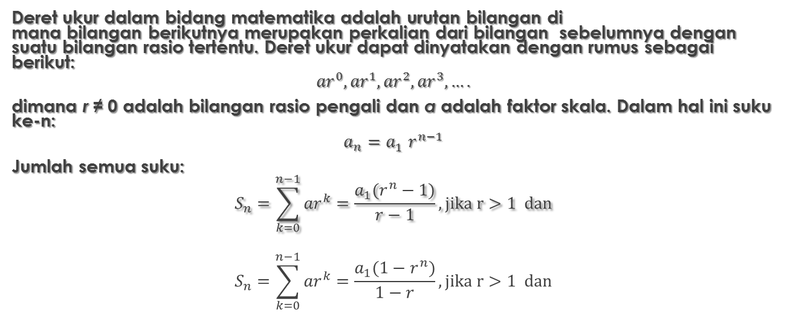
Konsep Deret
Deret ukur dalam bidang matematika adalah urutan bilangan di mana bilangan berikutnya merupakan perkalian dari bilangan sebelumnya dengan suatu bilangan rasio tertentu. Deret ukur dapat dinyatakan dengan rumus sebagai berikut:
$${ar}^{0},{ar}^{1},{ar}^{2},{ar}^{3},….$$
dimana r ≠ 0 adalah bilangan rasio pengali dan a adalah faktor skala. Dalam hal ini suku ke-n:
$$a_{n}={a_{1}^{}r}^{n−1}$$
Jumlah semua suku:
$$S_{n}=\sum_{k=0}^{n−1}{{ar}^{k}}=\frac{a_{1}(r^{n}−1)}{r−1}, jika r>1 dan$$
$$S_{n}=\sum_{k=0}^{n−1}{{ar}^{k}}=\frac{a_{1}(1−r^{n})}{1−r}, jika r>1 dan$$

Slide 23
Konsep Deret pada Bunga Majemuk
Konsep Deret
Jika a₁ = 1000; r = 1,01; berapa a₂, a₃, a₄, dan a₅
dengan forumula a_{n} = a₁r^{(n-1)}
a₁ = 1000 x 1,10⁰ = 1000
a₂ = 1000 x 1,10¹ = 1100
a₃ = 1000 x 1,10² = 1210
a₄ = 1000 x 1,10³ = 1331
a₅ = 1000 x 1,10⁴ = 1464
Jadi deret menjadi
1000, 1100, 1210, 1331, 1464

Slide 24
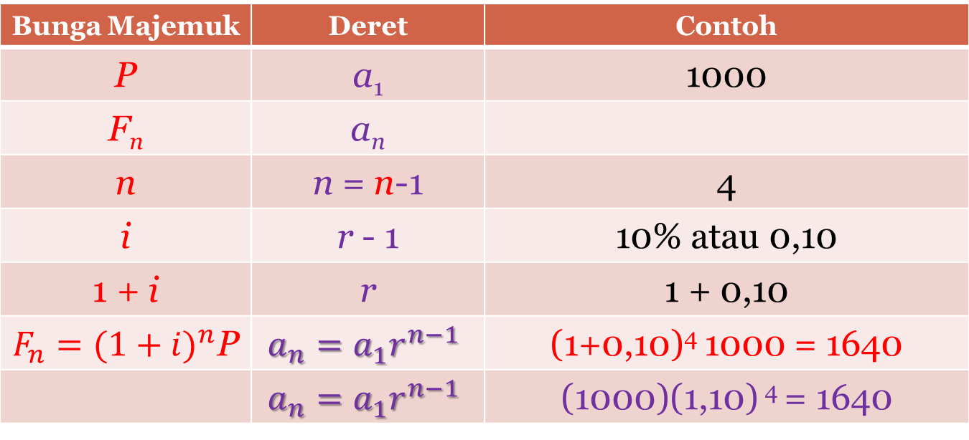
Analogi Bunga Majemuk vs Deret Ukur
Bunga Majemuk | Deret | Contoh
P | a₁ | 1000
F_{n} | a_{n}
n | n = n-1 | 4
i | r - 1 | 10% atau 0,10
1 + i | r | 1 + 0,10
$F_{n}={(1+i)}^{n}$P | $$a_{n}={a_{1}^{}r}^{n−1}$$ | (1+0,10)⁴ 1000 = 1640
 | $$a_{n}={a_{1}^{}r}^{n−1}$$ | (1000)(1,10) ⁴ = 1640

Slide 25
Analogi Bunga Majemuk vs Deret Ukur
JIKA a1 = 1000; r = 1,10; dan n = 5
Maka a₁= 1000, a₂= 1100, a₃= 1210, a₄= 1331, a₅= 1464
JIKA P = 1000; i = 0,10; dan n = 4
Maka P= 1000, F₁= 1100, F₂= 1210, F₃= 1331, F₄= 1464

Slide 26
FUTURE VALUE FACTOR
(Faktor nilai YAD)

Slide 27
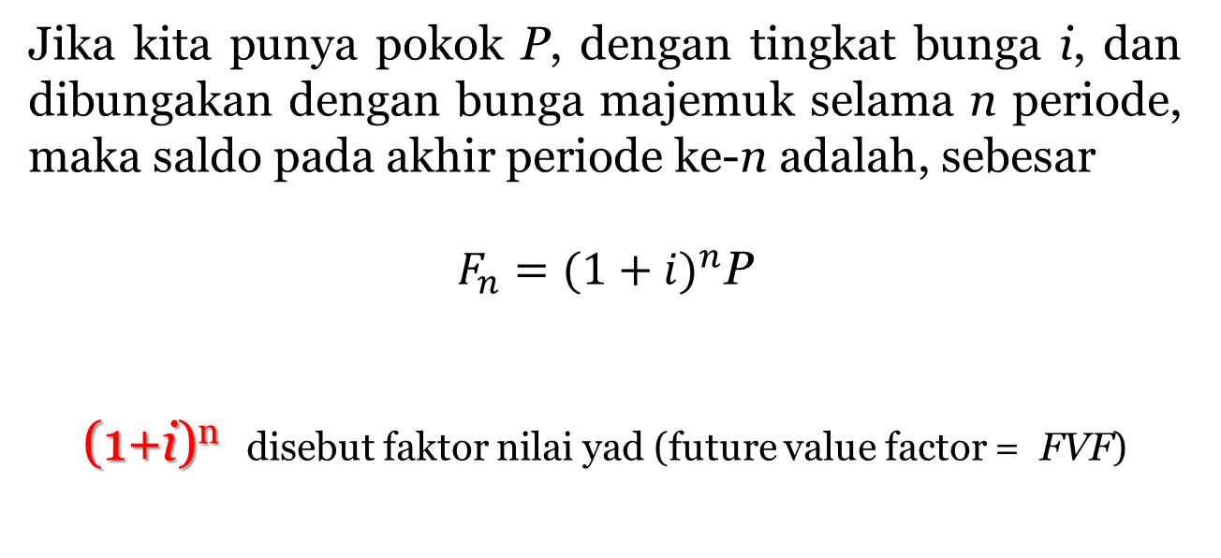
Jika kita punya pokok P, dengan tingkat bunga i, dan dibungakan dengan bunga majemuk selama n periode, maka saldo pada akhir periode ke-n adalah, sebesar
$F_{n}={(1+i)}^{n}$P
(1+i)^{n} disebut faktor nilai yad (future value factor = FVF)

Slide 28
Jadi
F_{n} = P x FVF_{(i,n)}
di mana FVF(i,n) = (1+i)^{n}

Slide 29
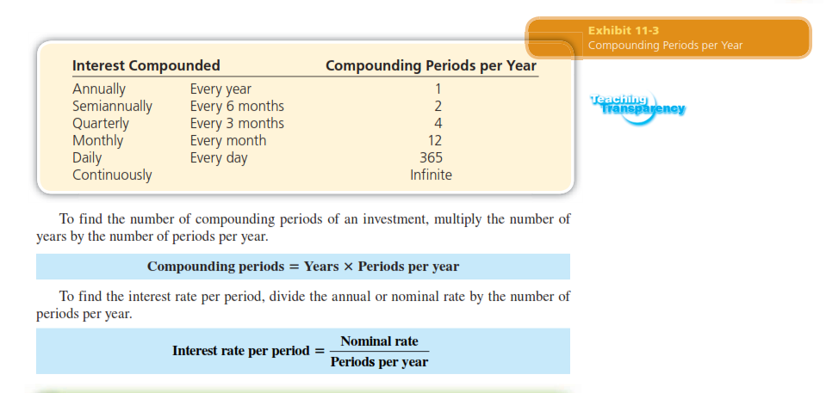

Slide 30
Annual Percentage Yield (APY)
The annual percentage yield (APY), or effective rate, reflects the real rate of return on an investment.
APY is calculated by finding the total compound interest earned in 1 year and dividing by the principal.

Slide 31
Calculating APY or Efective Rate of Interest
What is the compound amount, compound interest, and annual percentage yield of $4,000 invested for 1 year at 8% compounded semiannually?

Slide 32
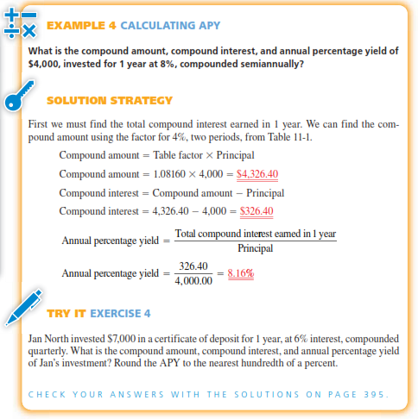

Slide 34
Present Value

Slide 35
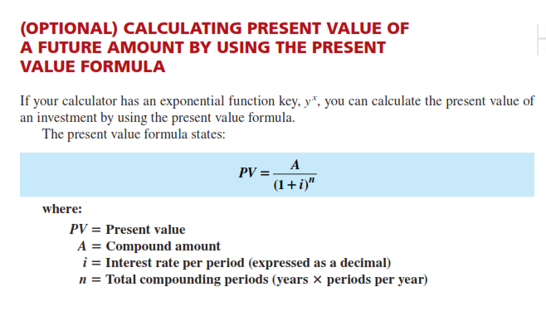

Slide 36
Daily and Continuous Compounding

Slide 37
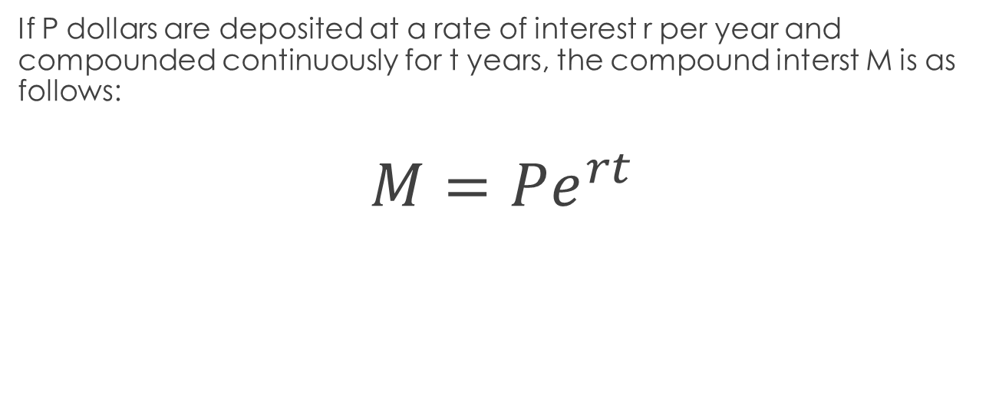
Continuous Compounding
If P dollars are deposited at a rate of interest r per year and compounded continuously for t years, the compound interst M is as follows:
$$M=Pe^{rt}$$

Slide 38
example
Find the compound amount for the following deposits
$1000 at 6% compounded continuously for 10 years
$45000 at 5% compounded continuously for 3 years
M = Pe^{rt}
= 1000 e^{0.06x10}
= 1000 e^{0.6}
= $1822.12

