Slide 1
Annuities, and Sinking Funds
Chapter 15

Slide 2
Chapter 15 Outline
15.1 Amount of an Annuity
Identify the types of annuities
Find the amount of an annuity
Find the amount of an annuity payment
Finde the number of payments
Find the amount of an annuity due
Find the value of an individual retirement account (IRA)
15.2 Present Value of an Annuity
Calculate the present value of an annuity
Use the formula for the present value of an annuity
Find the equivalent cash price
15.3 Sinking Funds
Find the amount of a sinking fund payment
Set up a sinking fund table

Slide 3
DEFINITION
An annuity is a sequence of equal payments. It can be used to accumulate money for the future or to pay off a debt.
Eamples of annuities include car payments, mortgage payments on a home, and a regular contribution to a retirement plan.
Another example of an annuity is the regular payments of the life insurance benefits from an insurance company to the spouse of the deceased person.

Slide 4
DEFINITION
Payment Period. Is the time between the payments of an annuity.
Term of the annuity. Is time from the beginning of the first payment period to the end of the last.
Amount of The Annuity or Future Value of The Annuity. Is the total amount accumulated at the end of the annuity. It is the sum of all payments along with compound interest on each payment to the end of the term.

Slide 5
15.1 amount of an annuity

Slide 6
Type of annuities
Contingent annuity has variable beginning or ending dates.
Annuity certain has a specified beginning date and a specified ending date
Ordinary annuity has a payments made at the end of each period
Annuity Due has a payments made at the beginning of each period.
Simple Annuity has payment dates matching the compounding period.

Slide 7
How an annuity works

Slide 8
Suppose each end of the year to save $ 1,000 over five years, how much money savings plus interest compounded at the end of the fifth year if the bank gives of10% interest rate per year?
Look for the timeline bellow
year
1 2 3 4 5
1000
1000
1000
1000
1000
1000
A(1+i)⁰
1100
A(1+i)¹
1210
A(1+i)²
1331
A(1+i)³
1464.1
A(1+i)⁴
+
6105.1
F₅
F_{n} = A(1+i)⁰ + A(1+i)¹ + A(1+i)² + A(1+i)³ + ….+ A(1+i)^{n-1}

Slide 9
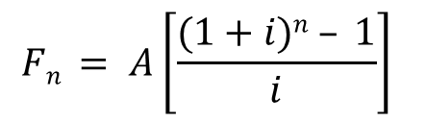
F_{n} = A(1+i)⁰ + A(1+i)¹ + A(1+i)² + A(1+i)³ + ….+ A(1+i)^{n-2} + A(1+i)^{n-1}
F_{n} = A[ 1 + (1+i)¹ + (1+i)² + (1+i)³ + ….+ (1+i)^{n-2} + (1+i)^{n-1} ]
I
(1+i)F_{n} = A[(1+i)¹ + (1+i)² + (1+i)³ + (1+i)⁴ + ….+ (1+i)^{n-1} + (1+i)^{n} ]
II
(-)
(1+i)F_{n} - F_{n} = A[(1+i)^{n} – 1]
II - I
(1+i)F_{n} - F_{n} = A[(1+i)^{n} – 1]
F_{n} + iF_{n} - F_{n} = A[(1+i)^{n} – 1]
iF_{n} = A[(1+i)^{n} – 1]
F_{n} = A[(1+i)^{n} – 1] / i
$$Fn = A\left[\frac{(1+i)n – 1}{i}\right]$$
Or we can write as

Slide 10
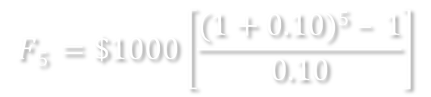
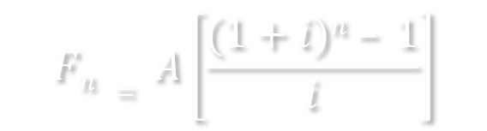

Suppose each end of the year to save $ 1,000 over five years, how much money savings plus interest compounded at the end of the fifth year if the bank gives of10% interest rate per year?
It is given that:
A = $ 1,000
i = 10% = 0.10
n = 5 years
$$Fn = A\left[\frac{(1+i)n – 1}{i}\right]$$
$$F5 =\$1000\left[\frac{(1+0.10)5 – 1}{0.10}\right]$$
$$F5 =\$6,105.10$$

Slide 11
THE FORMULAS OF
PRESENT VALUE,
FUTURE VALUE,
ANNUITY,
PRESENT VELUE OF ANNUITY,
FUTURE VALUE OF ANNUITY

Slide 12
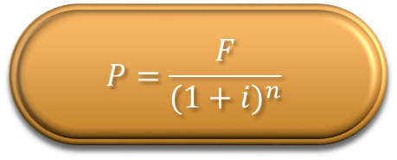
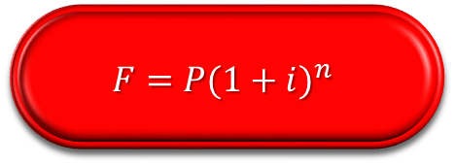
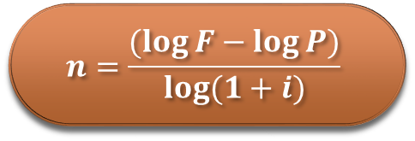
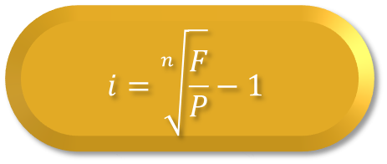
$$F=P{(1+i)}^{n}$$
Finding the Future Value (Compound Amount) if it is given P, i, and n
Future Value
Present Value
Interest Rate
Discounting Period
$$P=\frac{F}{{(1+i)}^{n}}$$
Finding the Present Value if it is given F, i, and n
$$i=\sqrt[n]{\frac{F}{P}}−1$$
Calculating Interest Rate (Discount Rate) if it is given F, P, and n
$$n=\frac{(\log{F−\log{P)}}}{\log{(1+i)}}$$
Calculating the Discounting Period if it is given F, P, and i

Slide 13
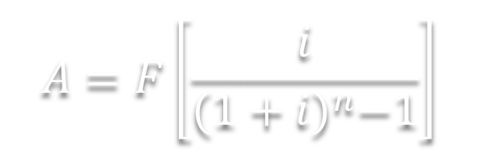
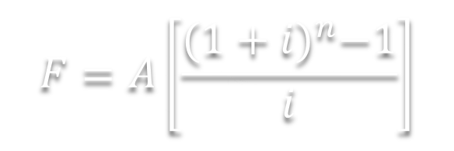


$$F=A\left[\frac{{(1+i)}^{n}−1}{i}\right]$$
Finding the Future Value if its A, i, and n are given
Future Value of Annuity
Annuity of Future Value
$$A=F\left[\frac{i}{{(1+i)}^{n}−1}\right]$$
Finding the Annuity (Serial Payment) if its F, i, and n are given
$$A=P\left(1+i\right)n\left[\frac{i}{{(1+i)}^{n}−1}\right]$$
According to formula #1,
F = P(1+i)^{n}, then
$$A=P\left[\frac{i\left(1+i\right)n}{{(1+i)}^{n}−1}\right]$$
or

Slide 14
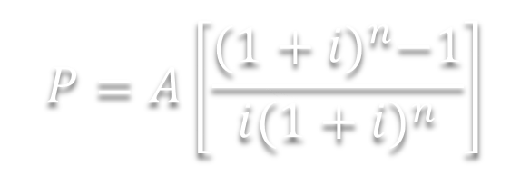
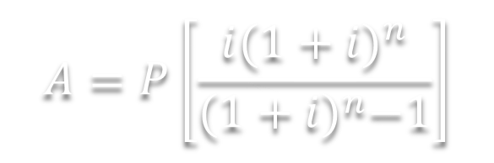
$$A=P\left[\frac{i{(1+i)}^{n}}{{(1+i)}^{n}−1}\right]$$
Calculating the Annuity if it is given P, i, and n
Annuity of Present Value
Present Value of Annuity
$$P=A\left[\frac{{(1+i)}^{n}−1}{i{(1+i)}^{n}}\right]$$
Calculating the Present Value if it is given A, i, and n

Slide 15
FIND THE AMOUNT OF AN ANNUITY
The hospital where Tish Baker works as an aide pays $600 at the end of each quarter into her retirement plan. If she chooses an investment that yields 6% per year compounded quarterly, how much will she have in 10 years? How much interest will she have earned?
Solution:
Baker’s payments from an ordinary annuity, with A = $600, n = 10 x 4 = 40 compounding periods (quarters), and i = 6% ÷ 4 = 1.5% per compounding period (per quarter). The amount or future value of the annuity is found as follows.

Slide 16
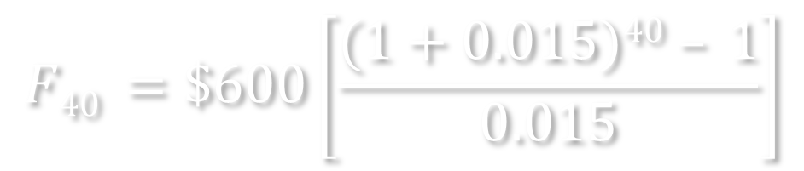
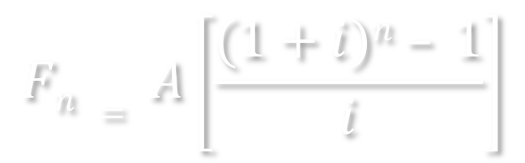
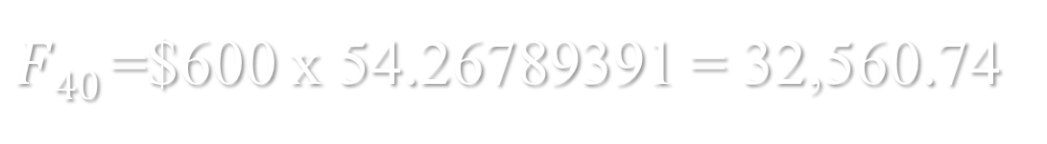
$$Fn = A\left[\frac{(1+i)n – 1}{i}\right]$$
$$F40 =\$600\left[\frac{(1+0.015)40 – 1}{0.015}\right]$$
$F40$=$600 x 54.26789391 = 32,560.74

Slide 17
The future value of the annuity is $32,560.74
The interest earned is the future amount less all payments,
i = $32,560.74 – 40 x $600 = $8560.74

Slide 18
exercise
At the birth of her grandson, Junella Smith decides to help pay for his college education. She commits to making deposits of $600 into an accout at the end of each 6 month for 18 years. Smith has narrowed her choices to an annuity at an insurance company paying 6% compounded semiannualy, a CD at a bank paying 5% compounded semiannually, or a savings account at a credit union paying 3½% compounded semiannually.
Find the amount of the annuity in each case.
Which is preferred if all three options are safe?

Slide 19
Finding the amount of an annuity payment
Fast Copy, Inc. will need several new commercial printers in 3 years and the owner wants to make end-of-quarter payments now toward that goal. She estimates that the equipment will cost $70,000. If funds earn 6% compounded quarterly, find the payment of the annuity needed to accumulate this amount.
Solution:
This is an ordinary annuity with F = 70,000, i = 1.5%, and n = 12. The unknown in the formula for the amount of an annuity is the size of each payment, or A

Slide 20
EXERCISE
Find the periodic payment that will amount to the following sums under the given conditions.
F = $20,000, interest at 7½% compounded annually, payments made at the end of each year for 10 years
F = $30,000, interest is 5% compounded semiannyally, payments made at the end of each 6-month period for 8 years.
F = $50,000, interest is 12% compounded quarterly, payments made at the end of each quarter for 8 years.
F = $24,000, interest is 9% compounded monthly, payments are made at the edn of each month for 3¼ years.

Slide 21
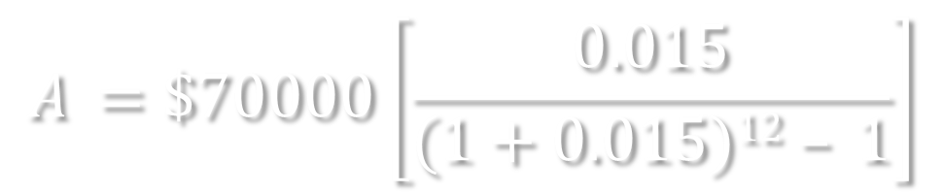
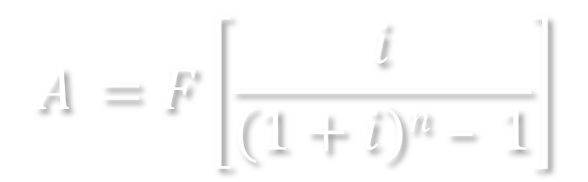
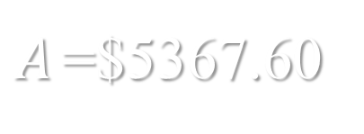
$$A =F\left[\frac{i}{(1+i)n – 1}\right]$$
$$A =\$70000\left[\frac{0.015}{(1+0.015)12 – 1}\right]$$
$A$=$5367.60
Each end-of-quarter payment must be $5367.60

Slide 22
Finding the number of payments
The Dunlaps want to purchase their first home and need $12.000 for a down payment. They can save $825 per quarter. If they deposit this amount in an account paying 3% interest compounded quarterly, how long will it be before they can purchase a home?

Slide 23
SOLUTION:
Here the amountof the annuity (S),the amount of each payment (R), and the interest rate per period (i) are known. The unknown is n, the number of quarters for which deposits must be made. Start with the formula for the amount of an annuity and substitute $12,000 for S, $825 for R, and ¾% (3% ÷ 4) for i.
S = R ⋅ S_{n i}
$12,000 = $825 S_{n |0.0075}
$14.54545455 = S_{n |0.0075}
Find the interest table, and go to the ¾%. Look down column C for the first number larger than 14.54545455. The first number that is larger is 14.70340370, which corresponds to 14 quarters.
The family must save for 14 quarters, or 3½ years.

Slide 24
Finding the amount of an annuity due
With annuities due the payment are made at the beginning of the time period.
The difference between an ordinary annuity and an annuity due is subtle, but both are used in the financial services industry.
Ordinary annuity payment are at the nd of each year
| | | | |
Annuity due payments are at the beginning of each year
| | | | |

Slide 25
Finding the amount of an annuity due
To find the amount of an annuity due, treat each payment as if it were made at the end of the preceding period. Then follow these steps.
Step 1 Add 1 to the number of periods
Step 2 Use this number of periods to find amount of the annuity
Step 3 Subtract one payment from the amount found in Step 2

Slide 26
Finding the amount of an annuity due
Mr. and Mrs. Thompson set up an investment program using an annuity due with payments of $500 at the beginning of each quarter. Find the amount of the annuity if they make payments for 7 years in a mutual fund paying 6% compound quarterly.
SOLUTION: There are 7 x 4 = 28 compounding periods
Step 1 Add 1 to the number of periods: 28 + 1 = 29
Setp 2 Use the 6% ÷ 4 = 1,5% interest with 29 periods to find Amount = 500 x {(1.015²⁹ -1)/0.015} = $17,999.35
Step 3 Subtract one payment
Future Value = $17,999.35 – 500 = $17,499.35

Slide 27
FIND THE VALUE OF AN
INDIVIDUAL RETIREMENT ACCOUNT (IRA)
A really great investment vehicle that working people can use to save for retirement is an Individual Retirement Account, also called an IRA. There are two common types of IRA accounts, regular IRAs and Roth IRAs.
Deposit to a regular IRA account are often excluded from federal income taxes in the current year. Therefore, a contribution to a regular IRA may reduce the amount of income taxes that you must pay this year. Interest earned in a regular IRA is not subject to income taxes in the year earned. At retirement, the account holder withdraws funds from the regular IRA and pays taxes at that time. As a result, a regular IRA may allow you to save for retirement without having to pay taxes on the savings for years or even decades!

Slide 28
FIND THE VALUE OF AN
INDIVIDUAL RETIREMENT ACCOUNT (IRA)
Deposit to a Roth IRA are not excluded from federal taxes in the year paid, so they do not reduce current income taxes. Howefer, the deposit and intersst do grow tax-free. In addition, one huge advantage is that the withdrawals from the Roth IRA at retirement are not subject to income taxes. This offers you a great opportunity to save money for retirement without having to pay taxes when you withdraw the funds.

Slide 29
Finding the value of an ira
At 27, Joann Gretz sets up an IRA with Merrill Lynch where she plans to deposit $2000 at the end of each year until age 60. find the amount of the annuity if she invests in (a) a Treasury-bill fund, which has historically yielded 6% compounded annually versus (b) a stock fund, which has historically yielded 10% compounded annually. Although past performance is no guarantee of the future, assume that future yields equal historical yields.

Slide 30
Finding the value of an ira
SOLUTION. Age 60 is 60 – 27 = 33 years away.
(a) Treasury-bill fund: Calculate amount with n = 33, and i = 6% ; Amount = $2000 x 97.34316471 = $194,686.33
(b) Stock fund: Calculate amount with n = 33, and i = 10%; Amount = $2000 x 222.25154420 = $444,503.09

Slide 31
Saving for retirement
At age 20, Tom Jones begin saving for retirement by making end-of-year payments of %400 into an IRA account, until age 65 (a total of 45 years). Becky Smith doesn’t begin saving for retirement until age 40, at which time she deposits $1000 at the end of each year until age 65 (a total of 25 years). Assume that each account earns 7% compounded annually and find the amount available at age 65 to each individual.
SOLUTION
Tom Jones saves $400 at the end of each year for 45 years at 7% compounded annually. FUTURE AMOUNT = $400 x 285.74931084 = $114,299.72
Becky Smith save $1000 at the end of each year for 25 years also earn 7% compounded annually. FUTURE AMOUNT = $1000 x 63.24903772 = $63,249.04

Slide 32
15.2 present value of an annuity

Slide 33
DEFINITION
The present value of an annuity is a lump sum that can be deposited today that will emount to the same future amount as would the periodic payments into an annuity
The present value of an annuity is a lump sum that can be deposited today that is needed to generate the payments from an annuity.

Slide 34
Example
Dion Martinez has decided to make annual payments of $1200 at the end of each year for 15 years into an investment that she thinks will yield 8% compounded annually. What lump sum deposited today at 8% compounded annually will result in the same future value?
Fred and Sara Zhao recently divorced. As one part of the divorce settlement, Fred must pay Sara $2000 at the end of each year for 10 years. If money can be deposited at 6% compounded annually, find the lump sum he could deposit today to have enough money, with principal and interest, to make the payments.

Slide 35
Example
Bill Jones wishes to retire at age 65 and withdraw $25.000 at the end of each year until age 90. (a) If money earns 8% per year compounded annually, how much will he need at age 65? (b) If Jones starts an IRA at age 32 by depositing $2000 per year in an account paying 8% per year compounded annually, will the IRA account contain enough money?
Julia Smithers is an attorney trying to settle an estate. The estate owns a piece of property that is desired by two different developers. Delton properties offers $140.000 in cash, today, for the land. Stoneybrook offers $50.000 now as a down payment, with payments of $8000 at the end of each quarter for 4 years. Money may be invested at 12% compounded quarterly. Stoneybrook offers a bank guarantee that the payment will be made, making each offer equally safe. Which bid should the attourney accept?

Slide 36
15.3 sinking funds

Slide 37
definition
A sinking fund is a fund that is set up to receive these periodic payments. The periodic payments plus the interest produce the necessary lump sum needed in the future.
Sinking funds are set up to provide money to build new factories, buy equipment, and purchase other companies.
Also, many corporations and governmental agencies set up sinking funds to cover the face value of bonds or other debt that must be paid off at some time in the future

Slide 38
example
Arctic Drilling, Inc. borrowed money by selling bonds with a maturity value in 15 years totaling $10.000.000. Find the mount of each payment into a sinking fund needed to build the required amount in 15 years to pay off the bonds. Assume 9% compounded annually.
Arctic Drilling, Inc. in Example 1 depolited $340.588,80 at the end of each year in a sninking fund earning 9% compounded annually. Set up a sinking fund table for the first 8 years.
Children’s Hospital plans to purchase a new MRI machine in 3 years. The machine currently sells for $2.100.000, but the price is expected to increase at 8% per year compounded semiannually. The hospital decides to set up a sinking fund to purchase the machine. Find the amount of each year-end payment into the fund if annual payments are made and the money is expected to earn 6% compounded annually. Round each to the nearest dollar.

Slide 39
SINKING FUND TABLE
 | Beginning of Period |  | End of period
Period | Accumulated Amount | Periodic Deposit | Interest Earned | Accumulated Amount
1 |  | $ 340,588.80 |  | $ 340,588.80
2 | $ 340,588.80 | $ 340,588.80 | $ 30,652.99 | $ 711,830.59
3 | $ 711,830.59 | $ 340,588.80 | $ 64,064.75 | $ 1,116,484.15
4 | $ 1,116,484.15 | $ 340,588.80 | $ 100,483.57 | $ 1,557,556.52
5 | $ 1,557,556.52 | $ 340,588.80 | $ 140,180.09 | $ 2,038,325.41
6 | $ 2,038,325.41 | $ 340,588.80 | $ 183,449.29 | $ 2,562,363.49
7 | $ 2,562,363.49 | $ 340,588.80 | $ 230,612.71 | $ 3,133,565.01
8 | $ 3,133,565.01 | $ 340,588.80 | $ 282,020.85 | $ 3,756,174.66

Slide 40
EXERCISES
FUTURE VALUE. In 4 years, Tony and Lynn Jameson will need $8000 for a down payment on a manufactured home. They have $5500 that they invest in an account earning 5% per year compounded annually. Find (a) the future amount in 4 years, (b) the amount of compound interest earned, (c) the excess of compound interest over simple interest for the 4 years, and (d) the additional amount needed to achieve their goal.
FUTURE VALUE (COMPOUND AMOUNT). Ben Fitzgerald is comparing two different investment options. Find the compund amount (future value) on a deposit of $8000 for 3 years at (a) 6% compounded quarterly and (b) 6% compounded monthly.

Slide 41
EXERCISES
FUTURE VALUE. In 4 years, Tony and Lynn Jameson will need $8000 for a down payment on a manufactured home. They have $5500 that they invest in an account earning 5% per year compounded annually. Find (a) the future amount in 4 years, (b) the amount of compound interest earned, (c) the excess of compound interest over simple interest for the 4 years, and (d) the additional amount needed to achieve their goal.
FUTURE VALUE (COMPOUND AMOUNT). Ben Fitzgerald is comparing two different investment options. Find the compund amount (future value) on a deposit of $8000 for 3 years at (a) 6% compounded quarterly and (b) 6% compounded monthly.

Slide 42
Beberapa Soal Latihan
FUTURE VALUE. Untuk persiapan event penting tertentu pada 12 tahun yang akan datang, Saudara merasa perlu untuk menabung dalam bentuk Deposito Berjangka. Jika Saudara menyimpan uang sebesar Rp500 juta, dan bank memberikan bunga deposito 5,5% per tahun, berapa uang Saudara pada saat event penting itu dilaksanakan?
FUTURE VALUE. In 4 years, Tony and Lynn Jameson will need $8000 for a down payment on a manufactured home. They have $5500 that they invest in an account earning 5% per year compounded annually. Find (a) the future amount in 4 years, (b) the amount of compound interest earned, (c) the excess of compound interest over simple interest for the 4 years, and (d) the additional amount needed to achieve their goal.
FUTURE VALUE (COMPOUND AMOUNT). Ben Fitzgerald is comparing two different investment options. Find the compund amount (future value) on a deposit of $8000 for 3 years at (a) 6% compounded quarterly and (b) 6% compounded monthly.

Slide 43
Beberapa Soal Latihan
PRESENT VALUE. Rasyid Sidhek menandatangani surat hutang dengan maturity value sebesar RM67.291 untuk membeli 1 hektar lahan di dekat sungai kecil di Kuching, negara bagian Sarawak, Malaysia. Surat berbarga tersebut memiliki bunga majemuk (compound interset) sebesar 9% per tahun dan jangka waktu surat hutang adalah 5 tahun. Berapa present value (nilai sekarang) yang diterima oleh Rasyid Sidhek?
COMPOUND INTEREST. John Smith inherits $15.500, which he deposits in a retirement account that pays interest compounded semiannually. How much will he have after 25 years if the funds grow (a) at 6%, (b) at 8%, and (c) at 10%? Round to the nearest cent.
INTEREST RATE. Jonathan Simons menginvestasikan $2500 pada pada rekening Deposito Berjangka yang memberikan bunga majemuk semesteran selama 5 tahun. Saldo pada akhir tahun ke-5 diketahui sebesar $3047,49. Berapa tingkat bunga per semester yang diberikan bank? Begitu juga, berapa tingkat bunga tahunannya?

Slide 44
Beberapa Soal Latihan
PRESENT VALUE. Shin Bun Niang adalah seorang pengusaha di Beijing. Ia suatu waktu menyimpan uangnya di Bank ICBC sebesar CN¥1.600.000.000. Jika diketahui Bank ICBC memberikan bunga majemuk tahunan 15%, dan saldo bank setelah sekian periode menjadi CN¥3.700.897.225, berapa lama Shin Bun Niang menyimpan uangnya?
EFECTIVE RATE OF INTEREST. James Suhr is comparing two loans. Loan A has a nominal rate of 10% compounded quarterly and Loan B has a nominal rate of 9% compounded monthly. Find the effective rate of interest for each loan.
FUTURE AMOUNT OF ANNUITY. At the birth of her grandson, Junella Smith decides to help pay for his college education. She commits to making deposits of $600 into an account at the end of each 6 months for 18 years. Smith has narrowed her choices to an annuity at an insurance company paying 6% compounded semiannually, a CD at a bank paying 5% compounded semiannually, or a savings account at a credit union paying 3½% compounded semiannualy. (a) Find the future amount of the annuity in each case. (b) which is preferred if all three options are safe?

Slide 45
Beberapa Soal Latihan
ANNUITY OF FUTURE VALUE. Galaxy Digital Inc. adalah pusat fotokopi (copy center) di Jln HR Bunjamin Purwokerto. Galaxy perlu beberapa mesin fotokopi digital tiga tahun yang akan datang, oleh karena itu pemiliknya, Dewi Percik, ingin menabung pada tiap akhir triwulan sejak sekarang selama 3 tahun ke depan. Dewi Percik memprediksi investasi pada peralatan mesin fotokopi digital dan pendukungnya seharga Rp700 juta. Jika bank di mana ia menabung memberi bunga 6% dengan pembungaan triwulanan (quarterly), berapa besar tabungan tiap kali yang diperlukan pada tiap akhir triwulan agar jumlah akumulasi sebesar Rp700 juta dapat tercapai pada akhir tahun ke tiga?
BESAR ANGSURAN (ANNUITY OF GIVEN PRESENT VALUE). Sebuah real estate seharga Rp2 milyar ditawarkan dengan fasilitas Kredit Pemilikan Rumah dari Bank BTN. Jika salah satu pembeli mendapatkan fasilitas tersebut, tanpa uang muka, tanpa biaya administrasi, dengan bunga 14%, dan tenor 15 tahun. Berapa angsuran per bulan jika anuitas dihitung tahunan (annully). Catatan: Angsuran perbulan adalah angsuran per tahun dibagi 12?

Slide 46
Beberapa Soal Latihan
BESAR ANGSURAN. Anthony wants to buy a boat which costs $17.000. He has saved $5.000, which he will use as a deposit. And he will finance the rest of it by taking out a loan to be paid back in equal monthly installments, amortized over 5 years at an annual interest rate of 12%. What will his payment be?.
CAPITAL BUDGETING. Frank wants to buy a car. The dealer tells him that he can pay $500 a month for 36 month for 36 months, or he can pay $15.000 cash for the car. Assuming that the prevailing interest rate is 9% monthly, which is a better deal for Frank?

