Slide 1
Business and Consumer Loans
Chapter 16

Slide 2
INTRODUCTION
“Buy now, pay later” is a concept that has become an everyday part of the way individuals and businesses purchase goods and services.
Merchants in all categories, as well as lending institutions, encourage us to just say “charge it!”

Slide 3
OPEN-END CREDIT
LOAN
CLOSED-END CREDIT

Slide 4
OPEN-END CREDIT
Revolving Charge Account
Credit Card
Lines of Credit

Slide 5
DEFINITION
Open-end Credit. A loan arrangement in which there is no set number of payments. As the balance of the loan is reduced, the borrower can renew the amount of the loan up to a pre-approved credit limit. A form of revolving credit. (Brechner, 2012)
A common way of buying on credit, called open-end credit, has no fixed payments. The customer continues making payments until no outstanding balance is owed. With open-end credit, additional credit is often extended before the initial amount is paid off. (Salzman, 2011)

Slide 6
1. charge ACCOUNT
Individuals may open credit accounts at certain stores.
This allows the customer to make frequent purchases from that store during the month without having to pay cash or write a check. Such accounts are often never paid off, although a minimum amount must be paid each month.
Since the account may never be paid off, it is called a revolving charge account.

Slide 7
2. CREDIT card
A credit card is a payment card issued to users as a system of payment.
It allows the cardholder to pay for goods and services based on the holder's promise to pay for them. The issuer of the card creates a revolving account and grants a line of credit to the consumer (or the user) from which the user can borrow money for payment to a merchant or as a cash advance to the user.
Credit card such as MasterCard and Visa are accepted by most store and restaurants worldwide. Sometimes there is an annual membership fee or a minimum monthly charge for the use of this service.
Credit cards are a convenient way to make purchases and track expenses since they provide a monthly statement. Part of their convenience is due to the fact that they are so widely accepted and can also be used at ATM machines for cash.

Slide 8
3. LINE OF CREDIT
Line of Credit, is pre-approved amount of open-end credit based on borrower’s ability to pay. A line of credit is an important tool for ongoing businesses and responsible individuals.
A line of credit is any credit source extended to a government, business or individual by a bank or other financial institution. A line of credit may take several forms, such as overdraft protection, demand loan, special purpose, export packing credit, term loan, discounting, purchase of commercial bills, traditional revolving credit card account, etc.
It is effectively a source of funds that can readily be tapped at the borrower's discretion. Interest is paid only on money actually withdrawn. (However, the borrower may be required to pay an unused line fee, often an annualized percentage fee on the money not withdrawn.) Lines of credit can be secured by collateral, or may be unsecured.

Slide 9

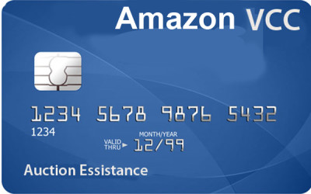
EXAMPLE
Examples of open-end credit include most department store credit accounts and credit cards, as well as MasterCard and Visa. Individuals are given a credit limit on these accounts based on their income and other factors. They are then allowed to charge up to this amount.

Slide 10

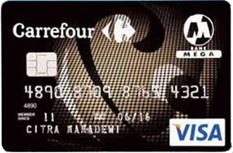
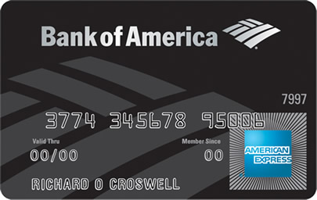


Slide 11
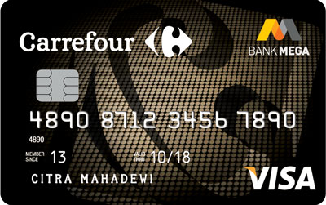
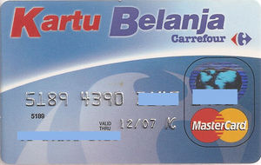

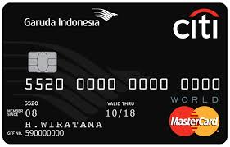

Slide 12
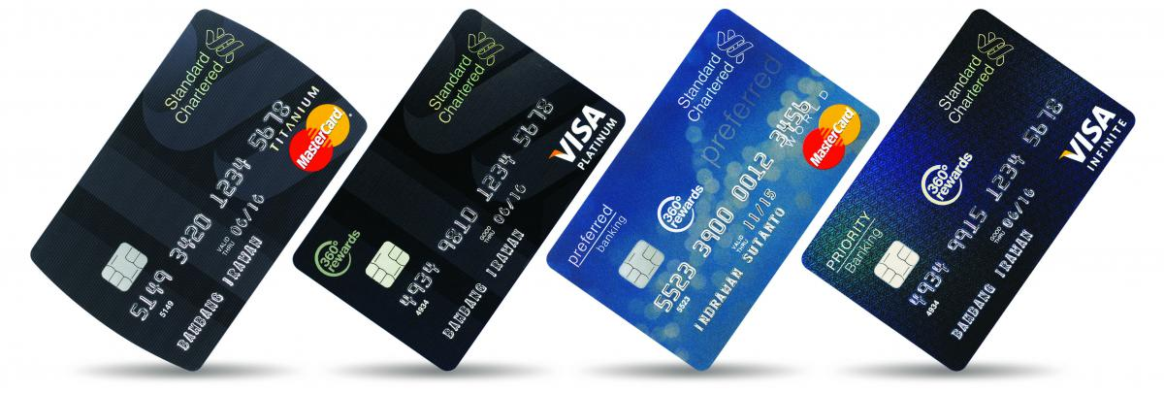

Slide 13
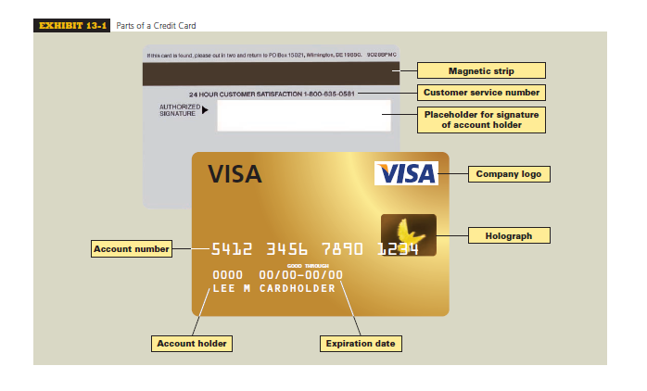

Slide 14
DEFINITION
Finance Charge. At the end of a monthly billing period, the customer receives an itemized billing. Charges over and above the combined cost of the various charges are called finance charge. They include interest, credit life insurance, and international transaction fees.
Late Fee. Many lenders charge late fees for payents that are received after the due date and over-the-limit fees in the event the debt exceeds the amount authorized by the issuer of the card. Both late fees and over-the-limit fees tend to be high, so avoid them if you can. Lenders also typically charge a late fee if the payment made is less than the minimum payment requested by the lender.

Slide 15
DEFINITION
Annual Percentage Rate (APR) is Effective or True Annual Interest Rate being charged for credit. Must be revealed to borrowers under the Truth in Lending Act.
Billing Cycles is time periods, usually 28 to 31 days, used in billing revolving credit accounts. Account statements are sent to the borrower after each billing cycle

Slide 16
CALCULATING
THE FINANCE CHARGE AND NEW BALANCE
BY USING
THE AVERAGE DAILY BALANCE METHOD

Slide 17
CALCULATING THE FINANCE CHARGE AND NEW BALANCE BY USING THE AVERAGE DAILY BALANCE METHOD
In business today, the method most widely used to calculate the finance charge on a revolving credit account is known as the average daily balance.
This method precisely tracks the activity in an account on a daily basis. Each day’s balance of a billing cycle is totaled and then divided by the number of days in that cycle.
This gives an average of all the daily balances. For accounts in which many charges are made each month, the average daily balance method results in much higher interest than the unpaid balance method because interest starts accruing on the day purchases are made or cash advances are taken.

Slide 18
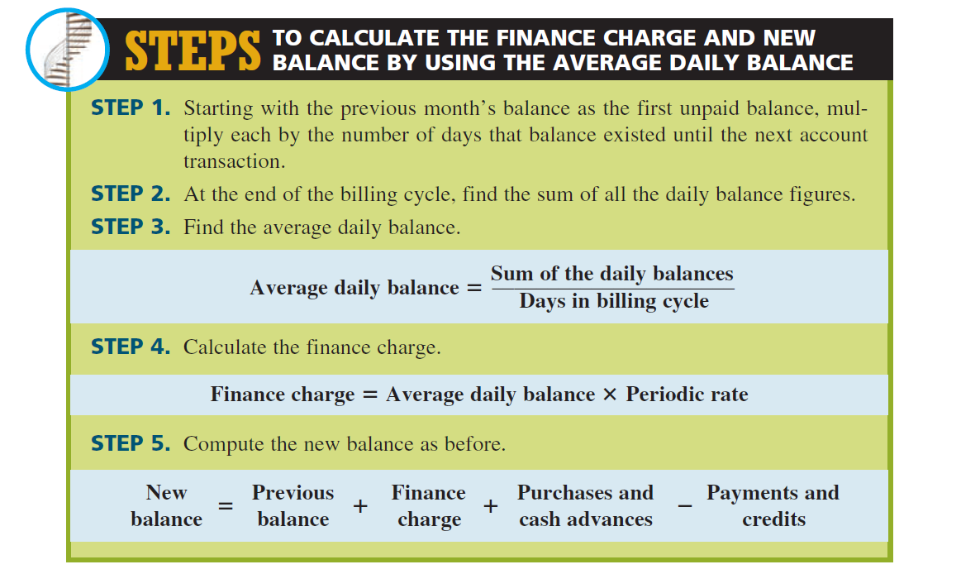

Slide 19
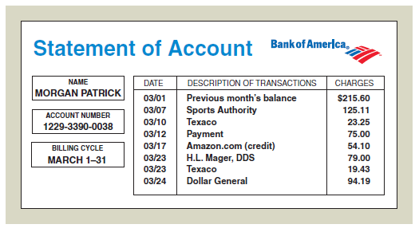
EXAMPLE 1
Morgan Patrick has a Bank of America revolving credit account with a 15% annual percentage rate. The finance charge is calculated by using the average daily balance method. The billing date is the first day of each month, and the billing cycle is the number of days in that month. During the month of March, Morgan’s account showed the following activity.
What is the finance charge for March,
and what is Morgan’s new balance?

Slide 20
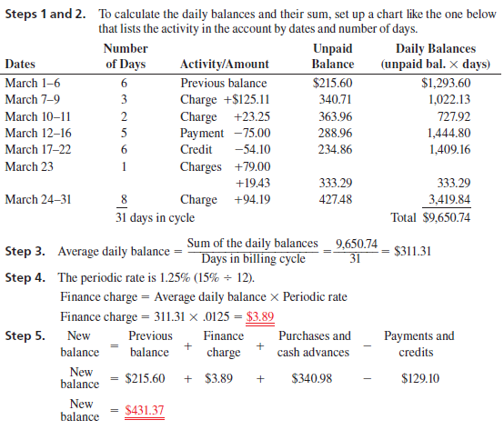
Beg. Date | End Date | Number of Days | Description | Unpaid Balance | Daily Balances (unpaid bal. x days)
March 1 | March 7 | 6 | Previous balance | 215.60 | $ 1,293.60
March 7 | March 10 | 3 | Charge +$125.11 | 340.71 | $ 1,022.13
March 10 | March 12 | 2 | Charge +$23.25 | 363.96 | $ 727.92
March 125 | March 17 | 5 | Payment -75.00 | 288.96 | $ 1,444.80
March 17 | March 23 | 6 | Credit -54.10 | 234.86 | $ 1,409.16
March 23 | March 24 | 1 | Charges +79.00 + 19.43 | 333.29 | $ 333.29
March 24 | April 1 | 8 | Charges +94.19 | 427.48 | $ 3,419.84
 |  | 31 |  |  | $ 9,650.74

Slide 21
CALCULATING
THE FINANCE CHARGE AND NEW BALANCE
BY USING
THE UNPAID BALANCE METHOD

Slide 22
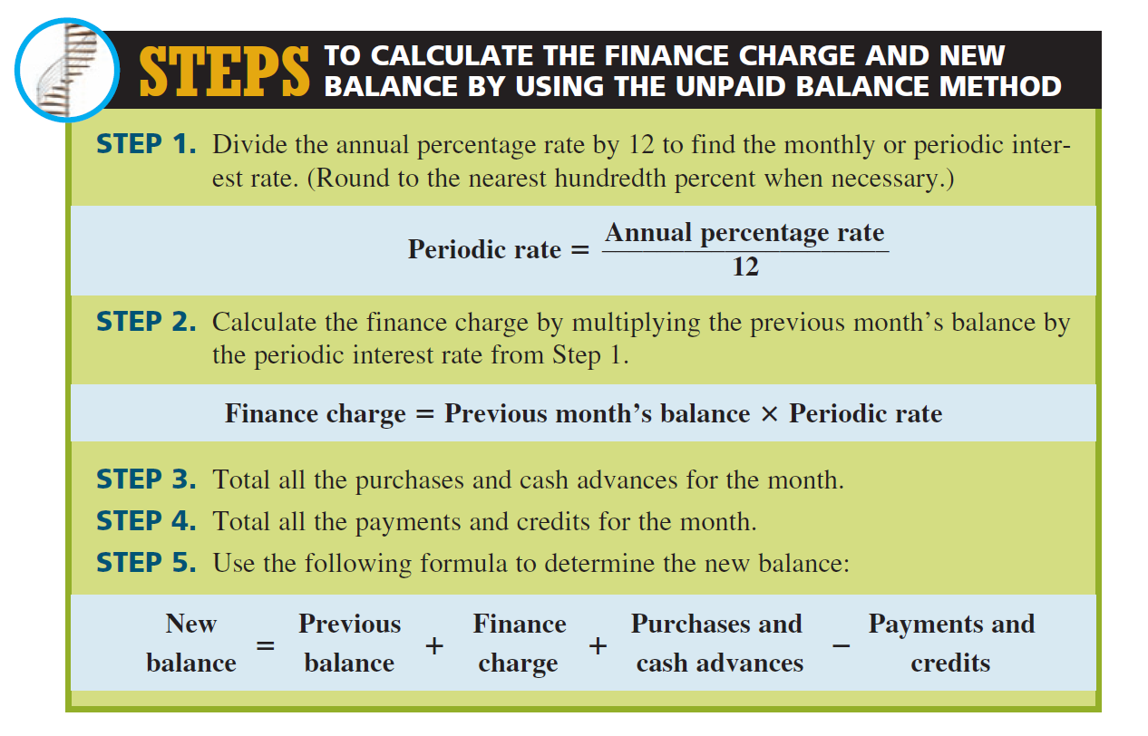

Slide 23
EXAMPLE 1
Jake Morrison has a revolving department store credit account with an annual percentage rate of 18%. His balance from last month is $322.40. During the month, he purchased shirts for $65.60 and a baseball bat for $43.25. He returned a tie for a credit of $22.95 and made a $50 payment. If the department store uses the unpaid balance method, what is the finance charge on the account and what is Jake’s new balance?

Slide 24
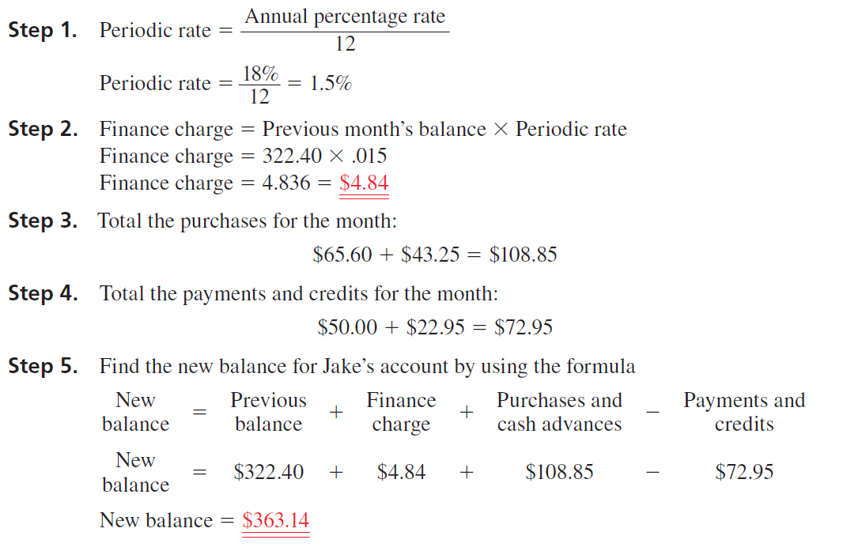

Slide 25
TRY IT EXERCISE 3
Angler Marine has a $75,000 line of credit with Harborside Bank. The annual percentage rate is the current prime rate plus 4.5%. The balance on November 1 was $12,300. On November 7, Angler borrowed $16,700 to pay for a shipment of fishing equipment, and on November 21, it borrowed another $8,800. On November 26, a $20,000 payment was made on the account. The billing cycle for November has 30 days. If the current prime rate is 8.5%, what is the finance charge on the account and what is Angler’s new balance?

Slide 26
CALCULATING THE FINANCE CHARGE AND NEW BALANCE OF BUSINESS AND PERSONAL LINES OF CREDIT

Slide 27
CALCULATING FINANCE CHARGE
Like the calculation of finance charges and new balances on credit cards, the finance charge on a line of credit is based on average daily balance and is calculated by
Finance charge = Average daily balance X Periodic rate

Slide 28
CALCULATING NEW BALANCE
This means that interest begins as soon as you write a check for a loan. Typically, the loan is paid back on a flexible schedule. In most cases, balances of $100 or less must be paid in full. Larger balances require minimum monthly payments of $100 or 2% of the outstanding balance, whichever is greater. As you repay, the line of credit renews itself. The new balance of the line of credit is calculated by
New balance = Previous balance + Finance charge + Loans - Payments

Slide 29
EXAMPLE 3
Shari’s Chocolate Shop has a $20,000 line of credit with the Shangri-La National Bank. The annual percentage rate charged on the account is the current prime rate plus 4%. There is a minimum APR on the account of 10%. The starting balance on April 1 was $2,350. On April 9, Shari borrowed $1,500 to pay for a shipment of assorted gift items. On April 20, she made a $3,000 payment on the account. On April 26, she borrowed another $2,500 to pay for air conditioning repairs. The billing cycle for April has 30 days. If the current prime rate is 8%, what is the finance charge on the account and what is Shari’s new balance?

Slide 30
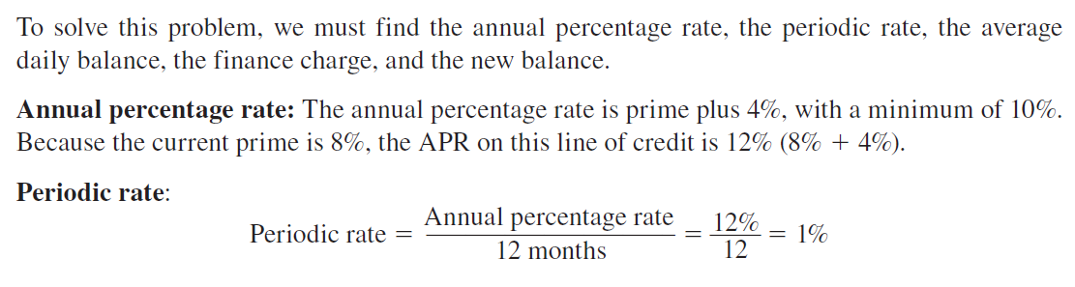
EXAMPLE 3
SOLUTION:

Slide 31
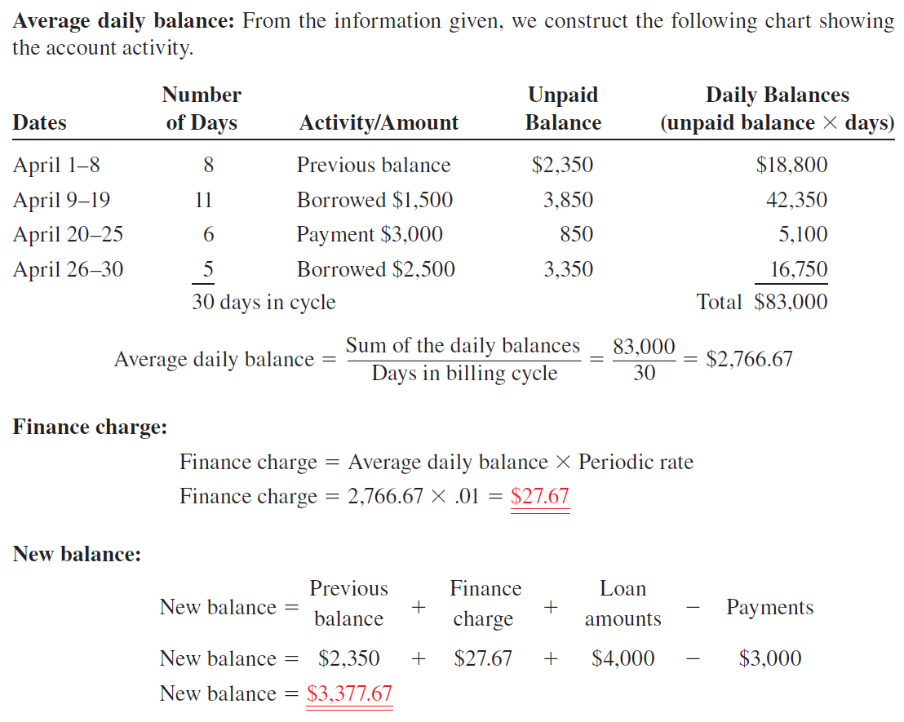
Beg. Date | End. Date
April 1 | April 9
April 9 | April 20
April 20 | April 26
April 26 | May 1

Slide 32
CLOSED-END CREDIT
Installment Loan

Slide 33
INSTALLMENT LOANS
Closed-end credit in the form of installment loans is used extensively today for the purchase of durable goods such as cars, boats, electronic equipment, furniture, and appliances, as well as services such as vacations and home improvements.
An installment loan is a lump-sum loan whereby the borrower repays the principal plus interest in a specified number of equal monthly payments. These loans generally range from 6 months to 10 years depending on what is being financed.
When a home or another real estate property is financed, the installment loan is known as a mortgage. A mortgage may be for as long as 30 years on a home and even longer on commercial property such as an office building or a factory.

Slide 34
INSTALLMENT LOANS
An additional form of security for the lending institution is that borrowers are often asked to make a down payment as part of the loan agreement.
A down payment is a percentage of the purchase price that the buyer must pay in a lump sum at the time of purchase.
Down payments on installment loans vary by category of merchandise and generally range from between 0% to 30% of the price of the item.
Sometimes the amount of the down payment is based on the credit rating of the borrower. Usually, the better the credit, the lower the down payment.

Slide 35

Until the loan on this vehicle is repaid, the
lending institution is technically the owner.

Slide 36
CALCULATING THE TOTAL DEFERRED PAYMENT PRICE AND THE AMOUNT OF THE FINANCE CHARGE OF AN INSTALLMENT LOAN
Notes:
MENGHITUNG TOTAL HARGA PEMBAYARAN TERTUNDA DAN JUMLAH BIAYA KEUANGAN DARI KREDIT
ANGSURAN

Slide 37
FORMULA
Let’s take a look at some of the terminology of installment loans. When a consumer buys goods or services without any financing, the price paid is known as the cash price or purchase price. When financing is involved, the amount financed is found by subtracting the down payment from the cash or purchase price. Sometimes the down payment will be listed as a dollar amount, and other times it will be expressed as a percent of the purchase price.
Amount financed = Purchase price - Down payment

Slide 38
FORMULA
When the down payment is listed as a percent of the purchase price, it can be found by using
Total amount of installment payments =Amount financed + Finance charge
The finance charge can be found by subtracting the amount financed from the total amount of installment payments.
Finance charge = Total amount of installment payments - Amount financed

Slide 39
FORMULA
When the amount of the monthly payments is known, the total amount of installment payments can be found by multiplying the monthly payment amount by the number of payments.
The total deferred payment price is the total amount of installment payments plus the down payment. This represents the total out-of-pocket expenses incurred by the buyer for an installment purchase.
Total deferred payment price = Total of installment payments + Down payment
Total amount of installment payment
Monthly Payment Amount
Number of Montly Payment
=
x

Slide 40
EXAMPLE 4
Tracy Hall is interested in buying a computer. At Radio Shack, she picks out a computer and a printer for a total cash price of $2,550. The salesperson informs her that if she qualifies for an installment loan, she may pay 20% now as a down payment and finance the balance with payments of $110 per month for 24 months.
a. What is the finance charge on this loan?
b. What is the total deferred payment price of Tracy’s computer?

Slide 41
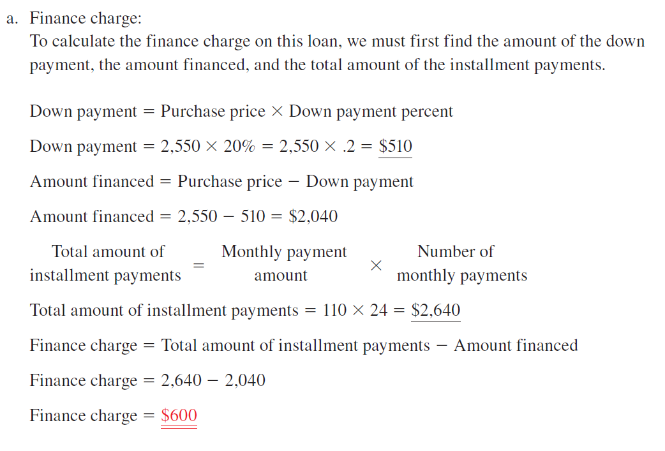

Slide 42
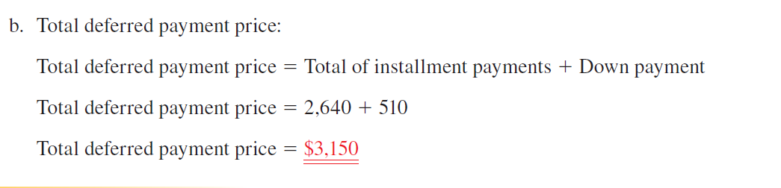

Slide 43
CALCULATING THE AMOUNT OF THE REGULAR
MONTHLY PAYMENTS OF AN INSTALLMENT
LOAN BY THE ADD-ON INTEREST METHOD

Slide 44
One of the most common methods of calculating the finance charge on an installment loan is known as add-on
The term gets its name from the fact that the simple interest is computed and then added on to the amount financed to get the total of installment payments. The interest or finance charge is computed by using the simple interest formula interest.

Slide 45
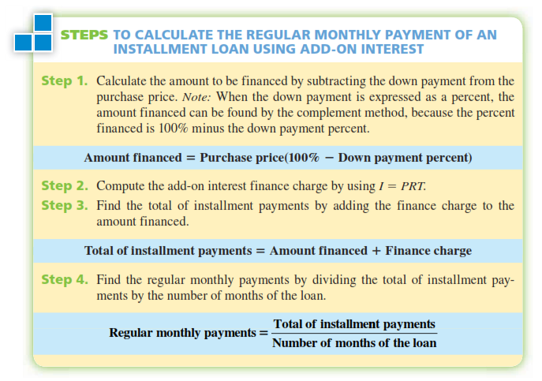

Slide 46
examples
Lee Childs bought a new boat with a 7% add-on interest installment loan from his credit union. The purchase price of the boat was $19,500. The credit union required a 20% down payment and equal monthly payments for 5 years (60 months). How much are Lee’s monthly payments?
Lee Childs membeli kapal baru dengan pinjaman angsuran add-on interest 7% dari serikat kredit. Harga beli perahu adalah $ 19.500. Serikat kredit mensyaratkan uang muka 20% dan pembayaran bulanan selama 5 tahun (60 bulan). Berapa banyak pembayaran bulanan Lee?

Slide 47
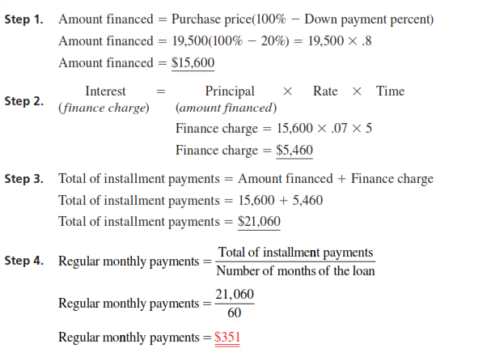

Slide 48
CALCULATING THE ANNUAL PERCENTAGE
RATE OF AN INSTALLMENT LOAN BY
APR TABLES AND BY FORMULA

Slide 49
Description
As we learned in Objective 13-5, the add-on interest calculation for an installment loan is the same as the procedure we used on the simple interest promissory note.
Although the interest is calculated the same way, the manner in which the loans are repaid is different. With promissory notes, the principal plus interest is repaid at the end of the loan period. The borrower has the use of the principal for the full time period of the loan. With an installment loan, the principal plus interest is repaid in equal regular payments. Each month in which a payment is made, the borrower has less and less use of the principal. For this reason, the effective or true interest rate on an installment loan is considerably higher than the simple add-on rate. As we learned in Section I of this chapter, the effective or true annual interest rate being charged on open- and closed-end credit is known as the APR.

Slide 50
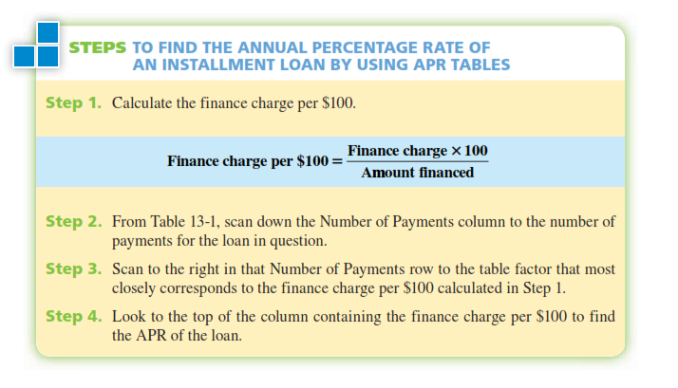

Slide 51
EXAMPLE 6
Jeff Gordon purchased a used motorcycle for $7,000. He made a down payment of $1,000 and financed the remaining $6,000 for 36 months. With monthly payments of $200 each, the total finance charge on the loan was $1,200 ($200 X 36 = $7,200 - $6,000 = $1,200). Use Table 13-1 to find what annual percentage rate was charged on Jeff’s loan.

Slide 52
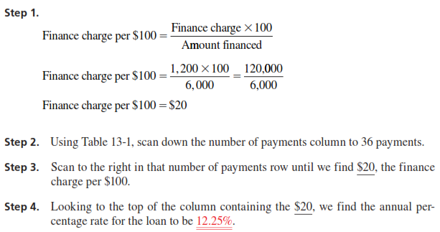

Slide 53
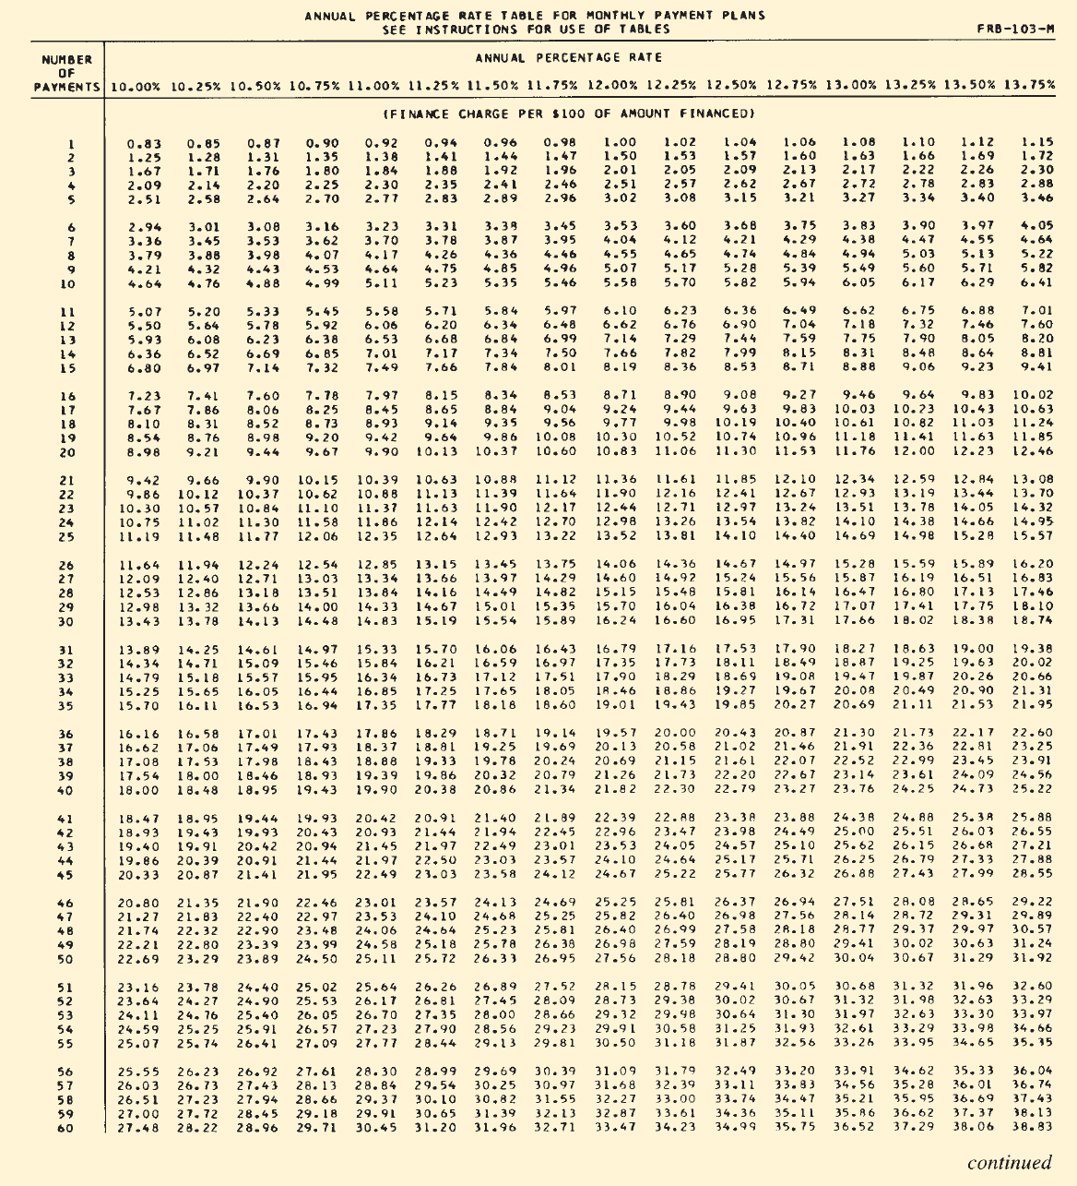

Slide 55
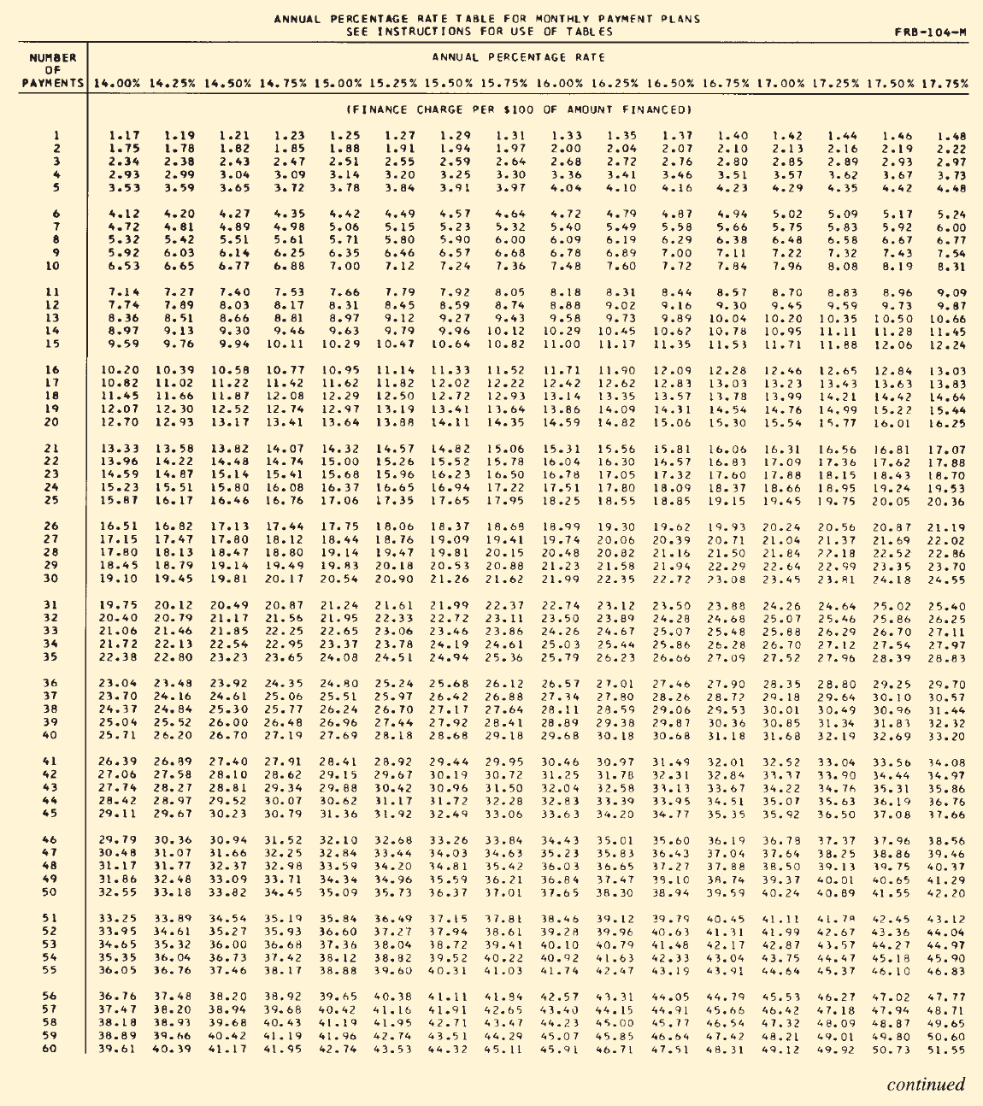

Slide 57
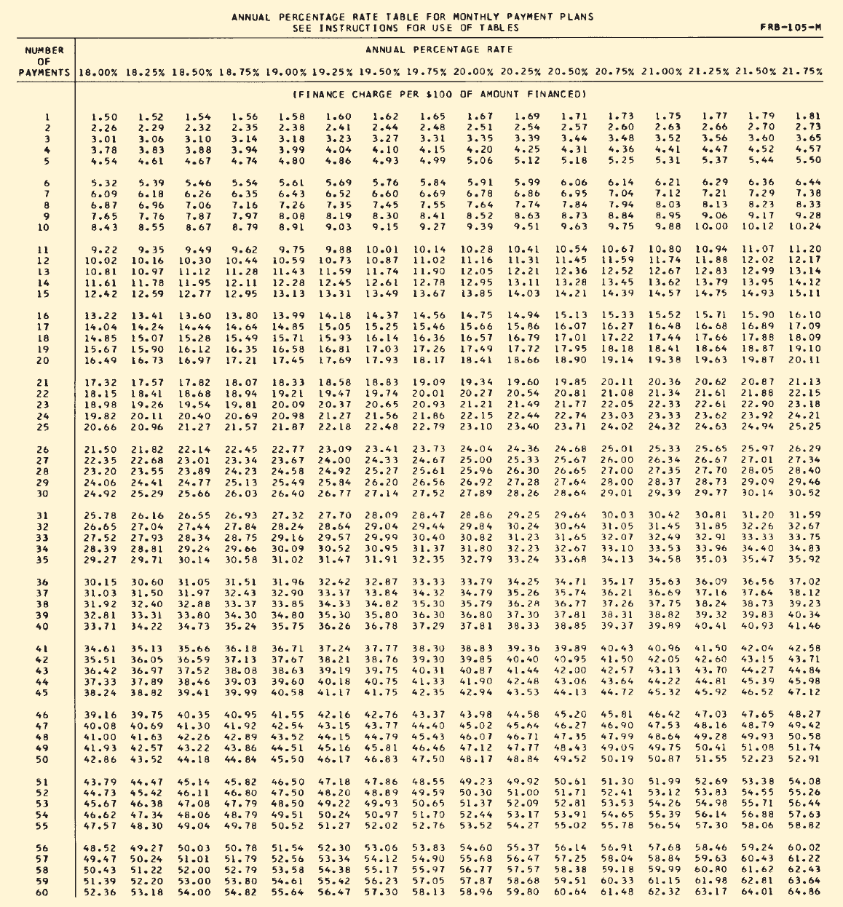

Slide 59
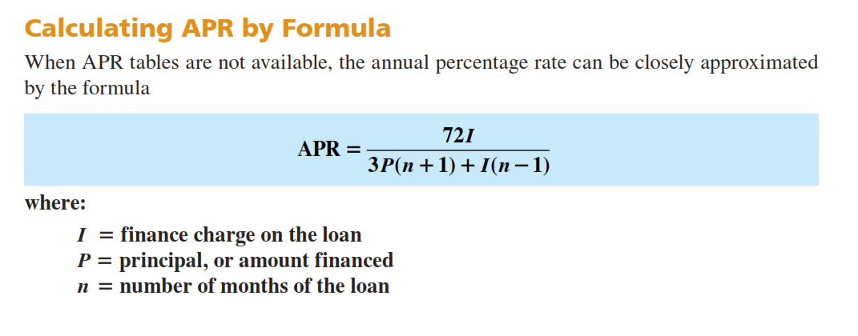

Slide 60
EXAMPLE 7
Refer to Example 6, Jeff Gordon’s motorcycle purchase. This time use the APR formula to find the annual percentage rate. How does it compare with the APR from the table?

Slide 61
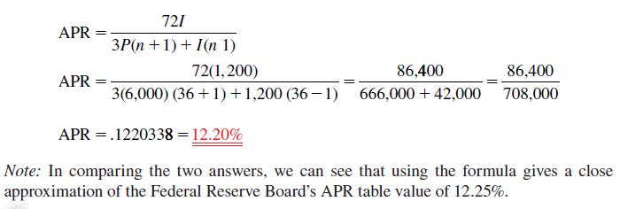

Slide 62
CALCULATING THE FINANCE CHARGE AND
MONTHLY PAYMENT OF AN INSTALLMENT LOAN BY USING
THE APR TABLES

Slide 63
When the annual percentage rate and number of months of an installment loan are known, the APR tables can be used in reverse to find the amount of the finance charge. Once the finance charge is known, the monthly payment required to amortize the loan can be calculated as before.

Slide 64
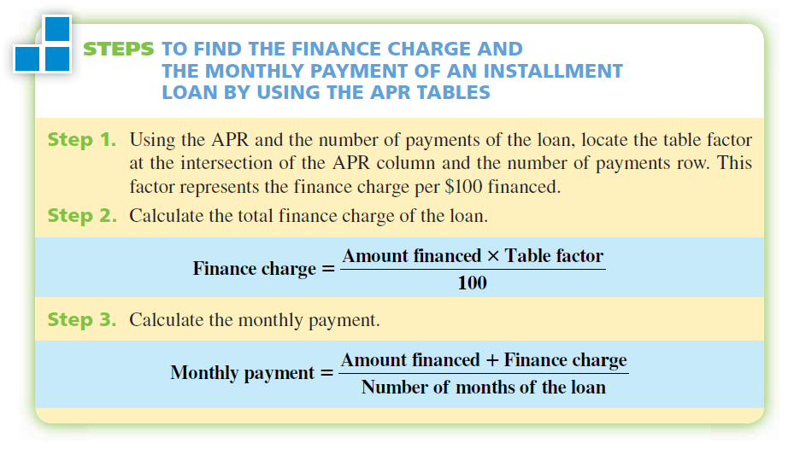

Slide 65
EXAMPLE 8
Classic Motors uses Regal Bank to finance automobile and truck sales. This month Regal is offering up to 48-month installment loans with an APR of 15.5%. For qualified buyers, no down payment is required. If Ron Wiser wants to finance a new truck for $17,500, what are the finance charge and the amount of the monthly payment on Ron’s loan?

Slide 66
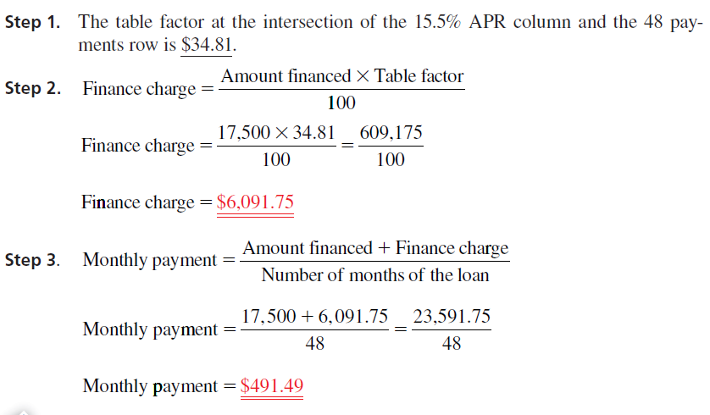

Slide 67
CALCULATING THE FINANCE CHARGE REBATE AND
THE AMOUNT OF THE PAYOFF WHEN A LOAN IS PAID OFF
EARLY BY USING THE SUM-OF-THE-DIGITS METHOD

Slide 68
Description
Frequently, borrowers choose to repay installment loans before the full time period of the loan has elapsed. When loans are paid off early, the borrower is entitled to a finance charge rebate, because the principal was not kept for the full amount of time on which the finance charge was calculated. At payoff, the lender must return or rebate to the borrower any unearned portion of the finance charge.
A widely accepted method for calculating the finance charge rebate is known as the sumof-the-digits method, or Rule of 78.

Slide 69
Description
This method is based on the assumption that the lender earns more interest in the early months of a loan, when the borrower has the use of much of theprincipal, than in the later months, when most of the principal has already been paid back.
When using this method, the finance charge is assumed to be divided in parts equal to the sum of the digits of the months of the loan. Because the sum of the digits of a 12-month loan is 78, the technique has become known as the Rule of 78.

Slide 70
Description
This method is based on the assumption that the lender earns more interest in the early months of a loan, when the borrower has the use of much of theprincipal, than in the later months, when most of the principal has already been paid back.
When using this method, the finance charge is assumed to be divided in parts equal to the sum of the digits of the months of the loan. Because the sum of the digits of a 12-month loan is 78, the technique has become known as the Rule of 78.
Sum of the digits of 12 = 1 + 2 + 3 + 4 + 5 + 6 + 7 + 8 + 9 + 10 + 11 + 12 = 78

Slide 71
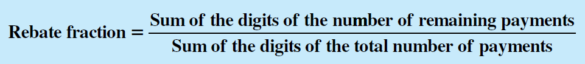
Description
With the sum-of-the-digits method, a rebate fraction is established based on when a loan is paid off. The numerator of the rebate fraction is the sum-of-the-digits of the number of remaining payments and the denominator is the sum of the digits of the total number of payments.

Slide 72

Description
Although the sum of the digits is easily calculated by addition, it can become tedious for loans of 24, 36, or 48 months. For this reason, we shall use the sum-of-the-digits formula to find the numerator and denominator of the rebate fraction. In the formula, n represents the number of payments.

Slide 73
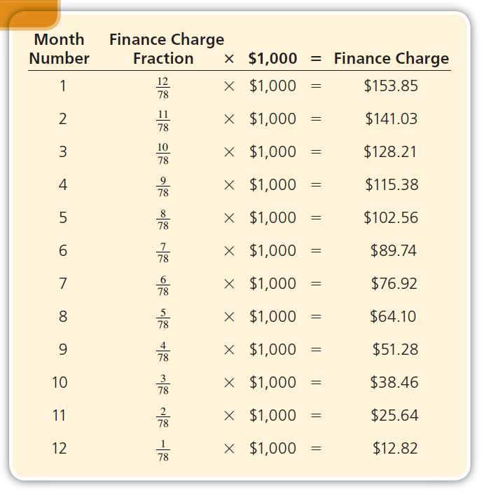

Slide 74
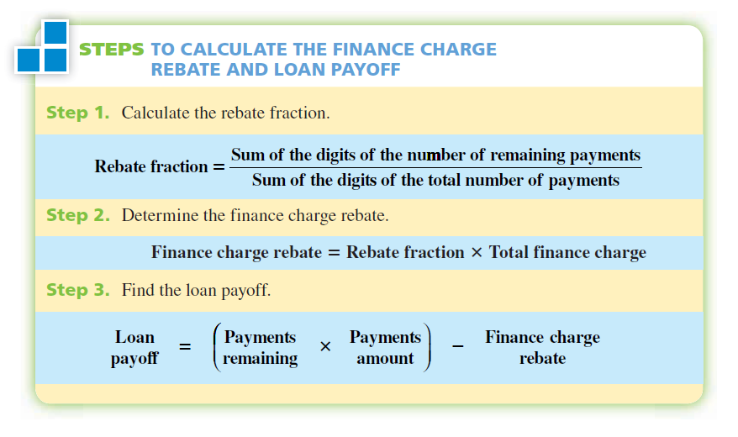

Slide 75
EXAMPLE 9
Sandy Lane financed a $1,500 health club membership with an installment loan for 12 months. The payments were $145 per month, and the total finance charge was $240. After 8 months, she decided to pay off the loan. How much is the finance charge rebate and what is her loan payoff?

Slide 76
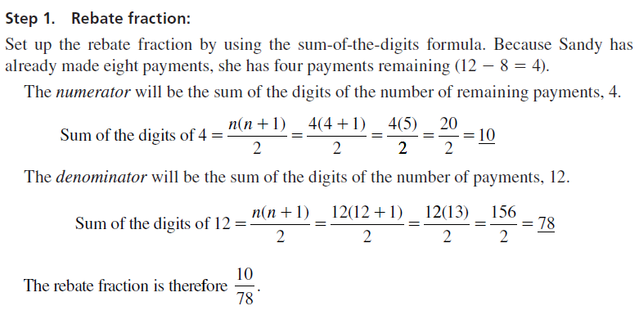

Slide 77
