Slide 1
Chapter 17
Depreciation
Notes:
cia

Slide 2
Intro
This chapter deals with the valuation of the long-term or long-lived assets of the firm: the property, plant, and equipment.
Companies acquire these relatively fixed or permanent assets in the course of building and operating a business. Some examples of these assets would be land, buildings, equipment, machinery, vehicles, furniture, fixtures, and tools.

Slide 3
Depreciation concept
A business finds its net income (profit) by subtracting all expenses from the amount of money received by th business (revenue). Major expenses include the cost of goods sold, salaries, rent, and utilities. Other expenses include the cost of assets such as machines, buildings, and fixtures.
This assets usually last several years, so it would not show the true income of the business if the entire cost of an asset were considered an expense in the year of purchase. Instead, a method called depreciation is used to spread the cost of the asset over the length of its useful life, which is measured in year.
Depreciation is used with assets having a useful life of more than one year. The asset to be depreciated must have a predictable life: a truck can be depreciated because its useful life can be estimated, but land cannot be depreciated because its life is indefinite.

Slide 4
BOOK VALUE
On the balance sheet, it is used to determine the current book value of an asset, whereby
Book value = Original cost - Accumulated depreciation

Slide 5
Four important factors
The total cost, or original basis of the asset. This amount includes such items as shipping, handling, and set-up charges.
The asset’s estimated residual value at the time that it is taken out of service. This is also known as scrap value, salvage value, or trade-in value.
An estimate of the useful life of the asset or the length of time it is expected to generate revenue. To be depreciated, an asset must have a life greater than 1 year.
The method of calculating depreciation must match the way in which the asset will depreciate. Some assets depreciate evenly over the years (straight-line depreciation), whereas others depreciate more quickly at first and then slow down in the later years (accelerated depreciation). Regardless of which method a company chooses, at the end of the useful life of an asset, the total amount of depreciation expense write-off will be the same.

Slide 6
DEPRECIATION METHODS
This chapter examines the various methods used to depreciate assets. In Section I, we learn to calculate depreciation by the four traditional methods:
  straight-line method;
  declining-balance method;
  sum-of-the-years’ digits method; and
  units-of-production method and Partial-Year Depreciation.
Any of these methods may be used for financial statement reporting. However, once a method has been implemented, it cannot be changed.
Frequently, the amount of depreciation reported by a company on its financial statements will differ from the amount reported to the IRS (Internal Revenue Service) for income tax purposes, because the IRS allows additional options for calculating depreciation expense. Today, the most widely used method for tax purposes is known as the Modified Accelerated Cost Recovery System (MACRS).

Slide 7
17.1
Straight-Line Method

Slide 8
CALCULATING DEPRECIATION BY
THE STRAIGHT-LINE METHOD
The straight-line depreciation method is by far the most widely used in business today. It provides for equal periodic charges to be written off over the estimated useful life of the asset.
Once the annual depreciation has been determined, we can set up a depreciation schedule. The depreciation schedule is a chart illustrating the depreciation activity of the asset for each year of its useful life.

Slide 9
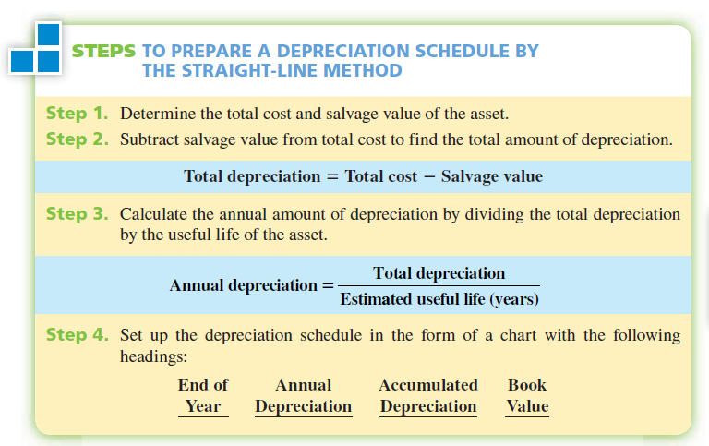

Slide 10
Example 1
Cascade Enterprises purchased a computer system for $9,000. Shipping charges were $125, and setup and programming amounted to $375. The system is expected to last 4 years and has a residual value of $1,500. If Cascade elects to use the straight-line method of depreciation for the computer, calculate the total cost, total depreciation, and annual depreciation. Prepare a depreciation schedule for its useful life.

Slide 11
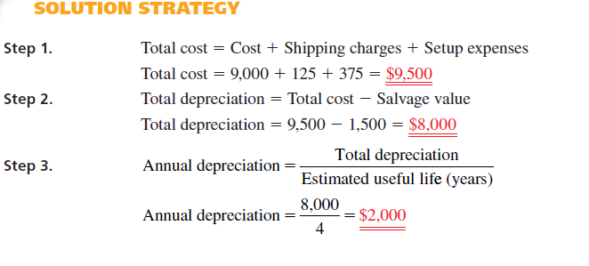

Slide 12
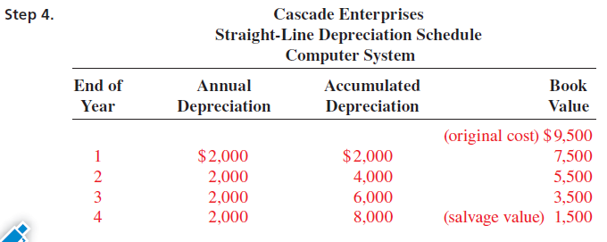

Slide 13
Exercise
Commercial Fisheries purchased some navigation equipment at a cost of $2,650. The estimated life of the equipnet is 5 years, with a salvage value of $350. Find the (a) annual rate of depreciation. (b) annual amount of depreciation, (c) book value at the end of the first year, (d) prepare a depreciation schedule using the straight-line method of depreciation.

Slide 14
17.2
Declining-Balance Method

Slide 15
CALCULATING DEPRECIATION BY
THE DECLINING-BALANCE METHOD
The sum-of-the-years’ digits and the declining-balance methods of calculating depreciation are the two accelerated depreciation methods. These methods assume that an asset depreciates more in the early years of its useful life than in the later years. The first widely accepted method of accelerated depreciation in business is known as the declining-balance method. This method uses a multiple of the straight-line rate to calculate depreciation. The most frequently used multiples are 1.25, 1.5, and 2. When 1.25 is used, it is known as the 125% declining balance; when 1.5 is used, it is known as the 150% declining balance. When 2 is the multiple, the method is known as the double-declining balance.
To calculate the declining-balance rate, we first determine the straight-line rate by dividing 1 by the number of years of useful life, then multiplying by the appropriate decliningbalance multiple.

Slide 16

FORMULA
The following formula should be used for this calculation:

Slide 17
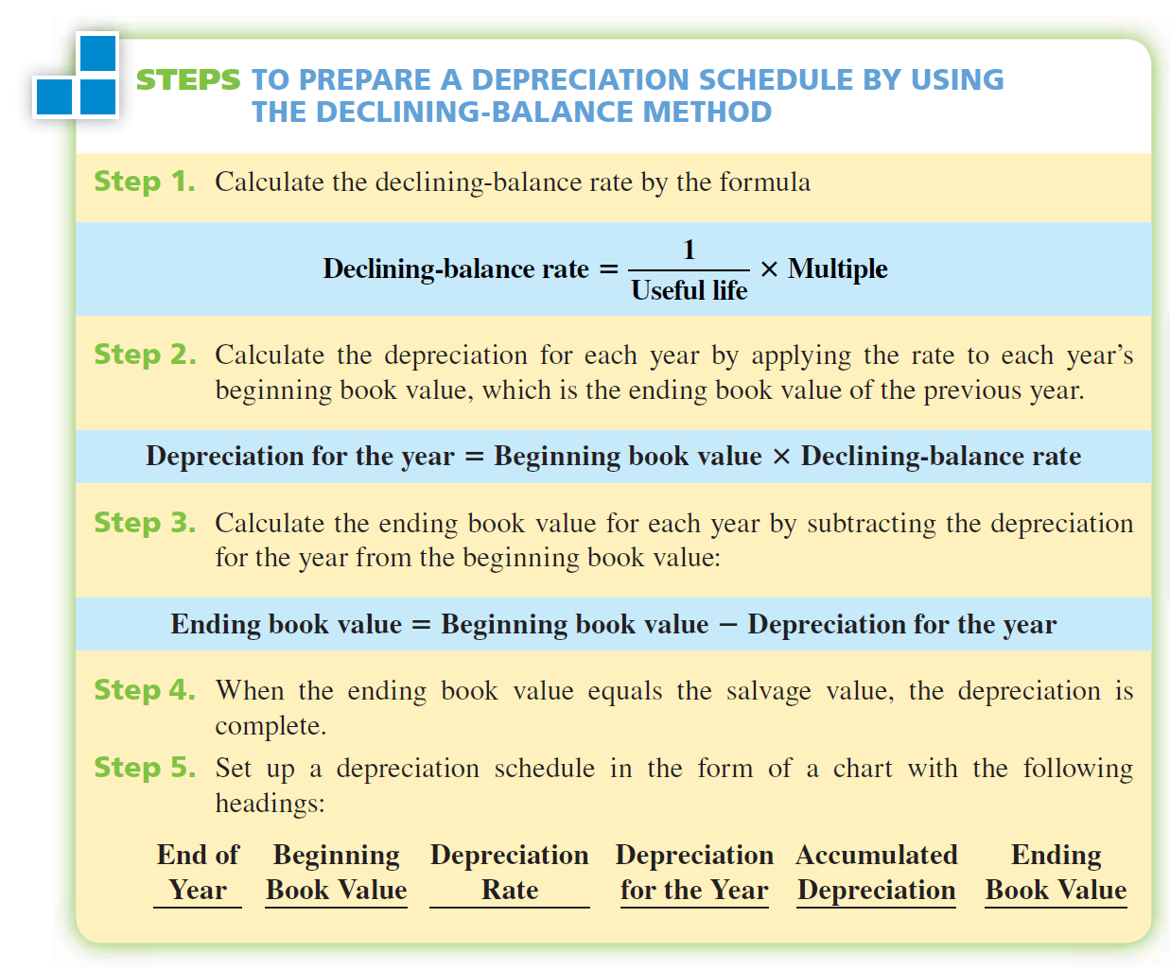

Slide 18
Example 2
Allstate Shipping bought a forklift for $20,000. It is expected to have a 5-year useful life and a trade-in value of $2,000. Prepare a depreciation schedule for this asset by using the double-declining balance method.

Slide 19
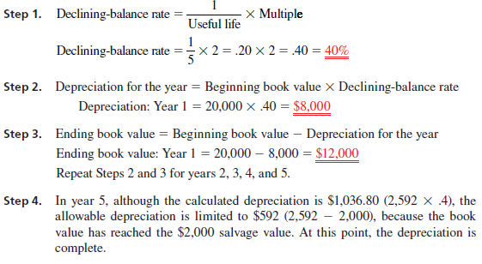

Slide 20
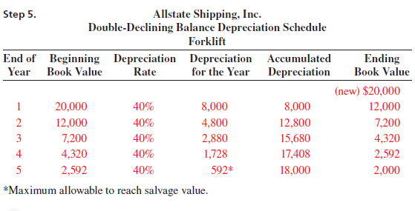

Slide 21
17.3
Sum-of-The-Years’- Digit Method

Slide 22
CALCULATING DEPRECIATION BY
THE SUM-OF-THE-YEARS’ DIGITS METHOD
The second widely accepted method of accelerated depreciation in business is known as the sum-of-the-years’ digits method. Under the sum-of-theyears’ digits method, the yearly charge for depreciation declines steadily over the estimated useful life of the asset because a successively smaller fraction is applied each year to the total depreciation (total cost salvage value).
This fraction is known as the sum-of-the-years’ digits fraction. The denominator of the fraction is the sum of the digits of the estimated life of the asset.

Slide 23


CALCULATING DEPRECIATION BY
THE SUM-OF-THE-YEARS’ DIGITS METHOD
This sum-of-the-years’ digits depreciation rate fraction can be expressed as
The denominator (the sum of the years’ digits) can be calculated by adding all the digits of the years, or by the following formula:

Slide 24
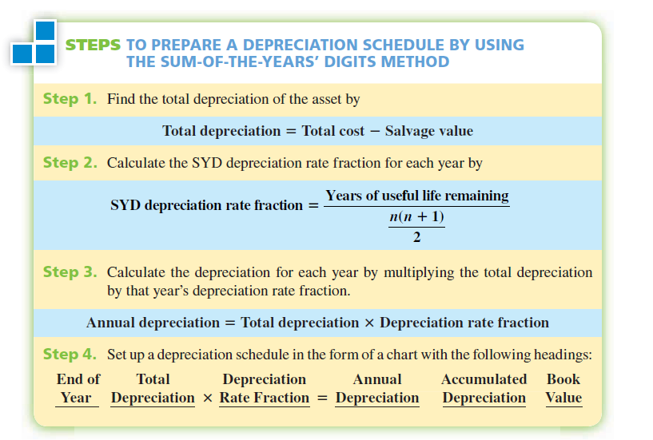

Slide 25
Example 3
Spectrum Industries purchased a delivery truck for $35,000. The truck is expected to have a useful life of 5 years and a trade-in value of $5,000. Using the sum-of-the-years’ digits method, prepare a depreciation schedule for Spectrum.

Slide 26
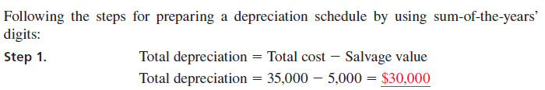
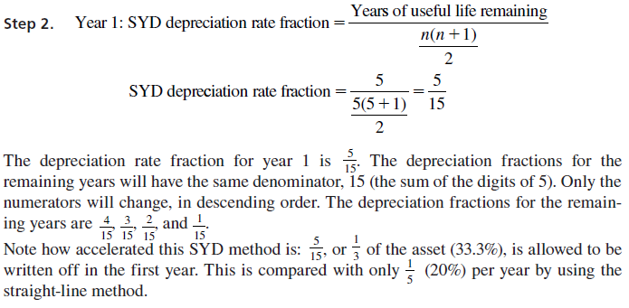

Slide 27
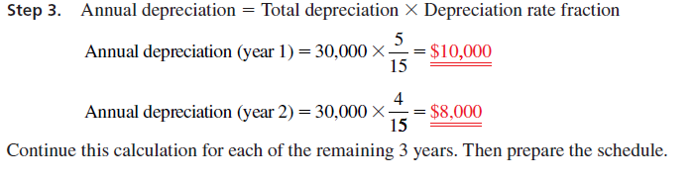

Slide 28
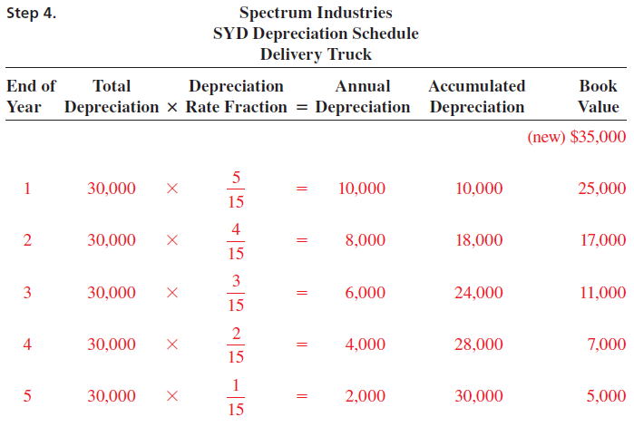

Slide 29
Exercise
A Ditch Witch 1220 Trencher is purchased by Village Nursery and Landscaping at a cost of $8,940. It has a useful life of 8 years and an estimated salvage value of $1,200. Find the first and second years’ depreciation using the sum-of-the-years-digits method.

Slide 30
17.4
Unit-of-Production Method

Slide 31
CALCULATING DEPRECIATION BY
THE UNITS-OF-PRODUCTION METHOD
When the useful life of an asset is more accurately defined in terms of how much it is used rather than the passage of time, we may use the units-of-production method to calculate depreciation.
To apply this method, the life of the asset is expressed in productive capacity, such as miles driven, units produced, or hours used. Some examples of assets typically depreciated by using this method would be cars, trucks, airplanes, production-line machinery, engines, pumps, and electronic equipment.
To calculate depreciation by using this method, we begin by determining the depreciation per unit.

Slide 32
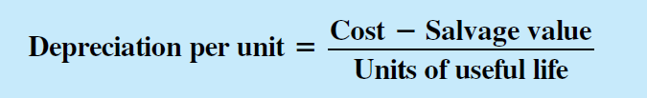
FORMULA
This number is found by dividing the amount to be depreciated (cost - salvage value) by the estimated units of useful life:

Slide 33
FORMULA
Once we have determined the depreciation per unit, we can find the annual depreciation by multiplying the depreciation per unit by the number of units produced each year.

Slide 34
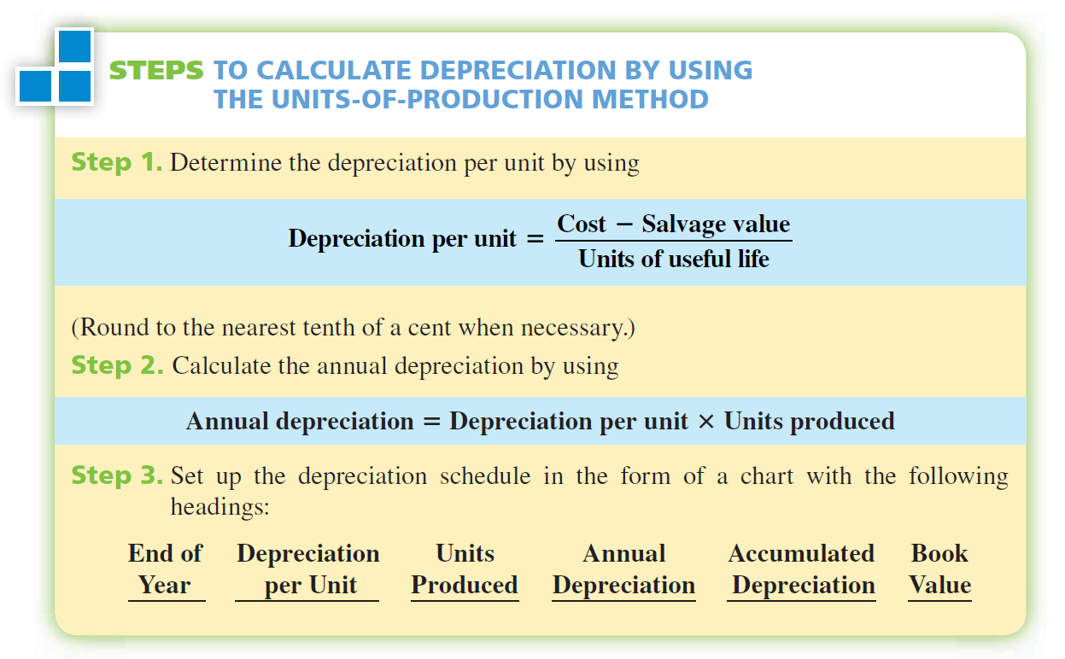

Slide 35
EXAMPLE
Colorcraft Printing purchased a new printing press for $8,500 with a salvage value of $500. For depreciation purposes, the press is expected to have a useful life of 5,000 hours. From the following estimate of hours of use, prepare a depreciation schedule for the printing press by using the units-of-production method.
Year | Hours of Use
1 | 1,500
2 | 1,200
3 | 2,000
4 | 500

Slide 36
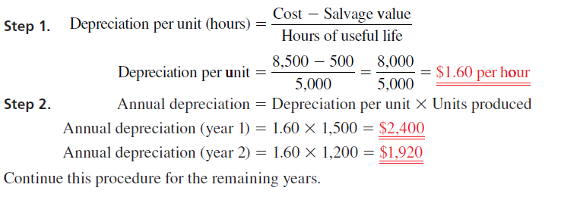

Slide 37
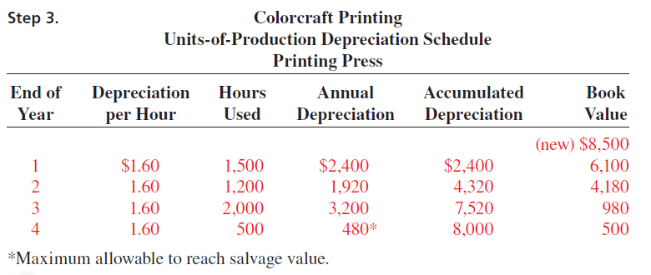

Slide 38
ASSET COST RECOVERY SYSTEMS-
IRS PRESCRIBED METHODS FOR INCOME TAX REPORTING

Slide 39
ACRS vs MACRS
As part of the Economic Recovery Act of 1981, the IRS introduced a depreciation method known as the Accelerated Cost Recovery System (ACRS), which allowed businesses to depreciate assets more quickly than they could with traditional methods. Faster write-offs encouraged businesses to invest in new equipment and other capital assets more frequently, thereby sparking needed economic growth. Essentially, ACRS discarded the concepts of estimated useful life and residual value. In their place, it required that business compute a cost recovery allowance.
After the ACRS was modified by the Tax Equity and Fiscal Responsibility Act of 1982 and the Tax Reform Act of 1984, it was significantly overhauled by the Tax Reform Act of 1986. The resulting method was known as the Modified Accelerated Cost Recovery System (MACRS). This is the system we shall use to calculate depreciation for federal income tax purposes.

Slide 40
CALCULATING DEPRECIATION BY USING THE MODIFIED
ACCELERATED COST RECOVERY SYSTEM (MACRS)
According to the IRS (Internal Revenue Services), the modified accelerated cost recovery system (MACRS) is the name given to tax rules for getting back or recovering through depreciation deductions the cost of property used in a trade or business or to produce income. These rules generally apply to tangible property placed into service after 1986.

Slide 41
CLASSES OF MACRS
Before we can calculate the amount of depreciation for a particular asset, we must determine the basis for depreciation, or “cost” of that asset, for depreciation purposes. Sometimes the basis for depreciation is the original cost of the asset; however, in many cases the original cost (original basis) is “modified” by various IRS rules, section 179 deductions, and special depreciation allowances. Once the basis for depreciation has been established, the MACRS depreciation deduction can be calculated for each year and the depreciation schedule can be prepared.
Table 17-1 exhibits the eight main property classes of MACRS, with some examples of assets included in each class. Once the property class for the asset has been identified, the amount of depreciation each year can be manually calculated or found by using percentage tables. As a general rule, the 3-, 5-, 7-, and 10-year property class assets are depreciated by using the 200% declining-balance method; the 15- and 20-year classes use the 150% declining-balance method; and the 31.5- and 39-year classes use straight-line depreciation.

Slide 42
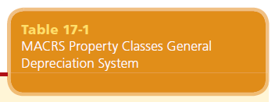
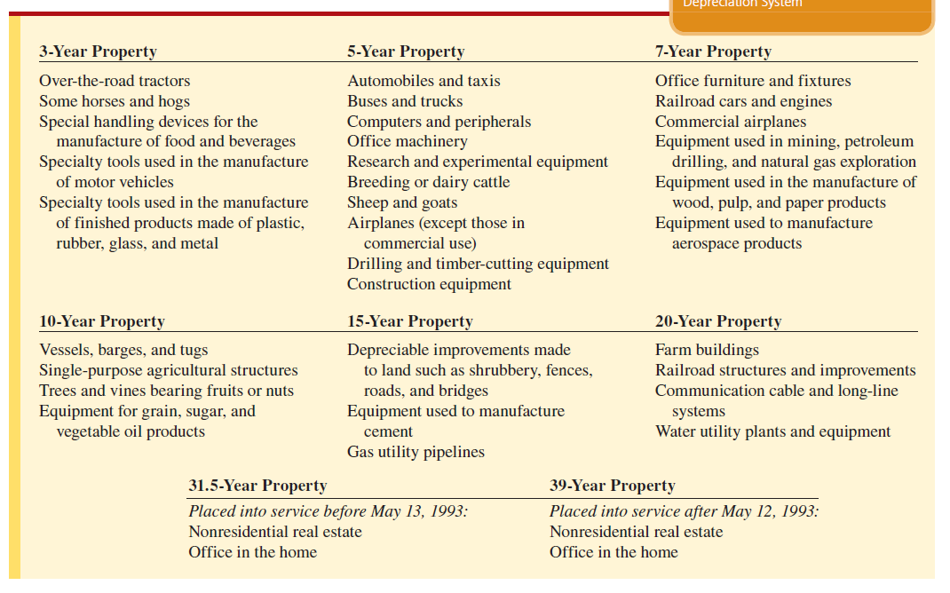

Slide 43
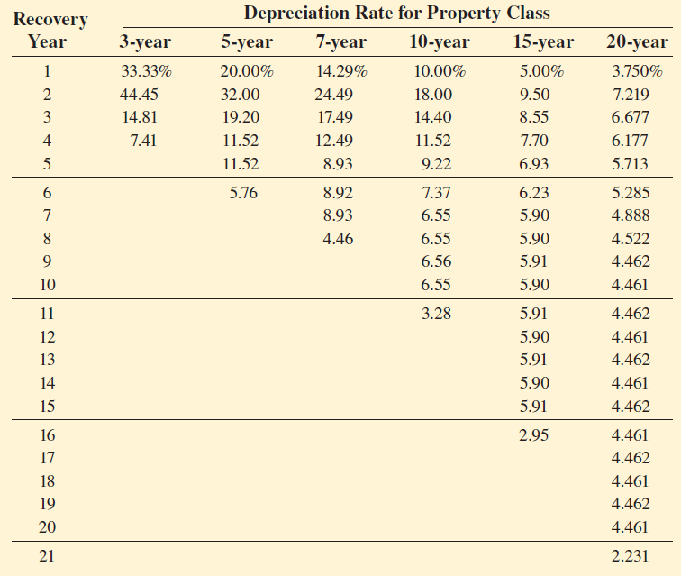


Slide 44
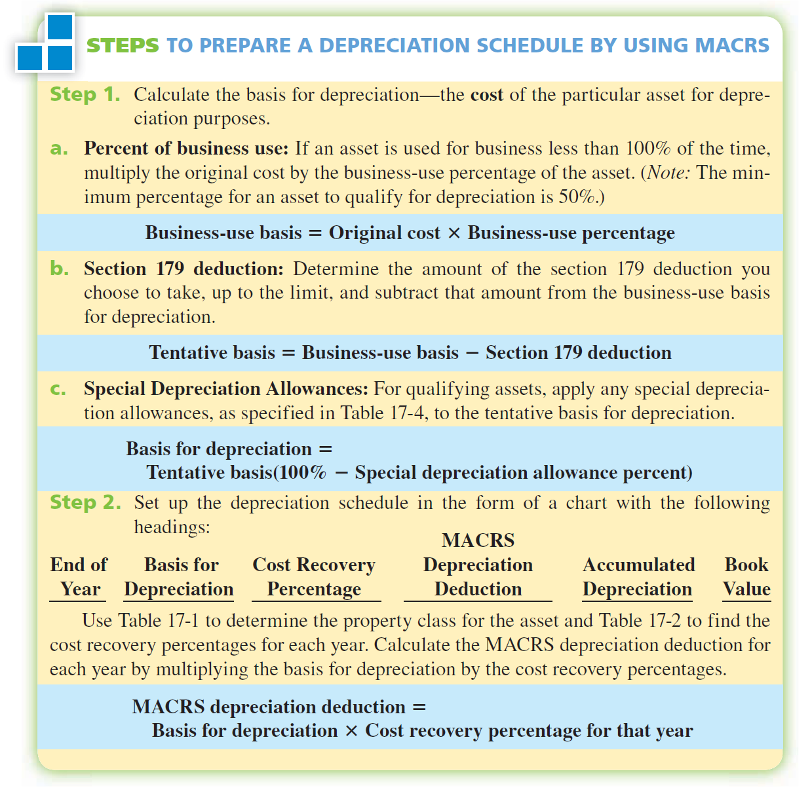

Slide 45
EXAMPLE 5
On July 27, 2003, Utopia Industries purchased and placed into service new office and computer equipment costing $400,000. This equipment will be used for business 100% of the time. The accountants have elected to take a $30,000 section 179 deduction. Prepare a depreciation schedule for the new asset by using MACRS.

Slide 46
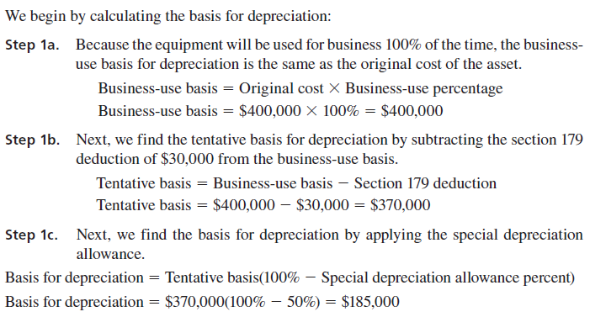

Slide 47
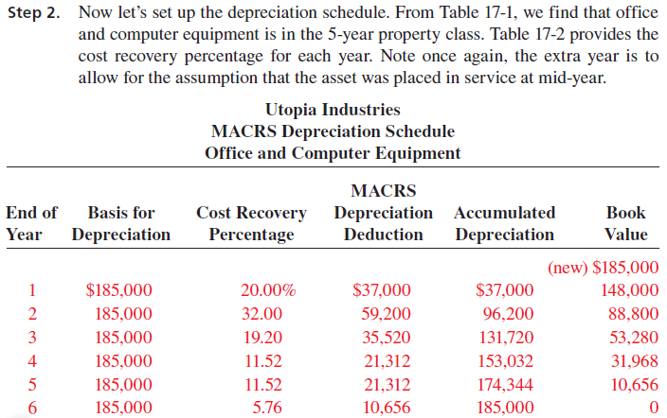

Slide 48
CALCULATING THE PERIODIC DEPLETION
COST OF NATURAL RESOURCES

Slide 49
CALCULATING THE PERIODIC DEPLETION
COST OF NATURAL RESOURCES
Just as depreciation is used to write off the useful life of plant assets such as trucks, equipment, and buildings, depletion is used to account for the consumption of natural resources such as coal, petroleum, timber, natural gas, and minerals. Depletion is the proportional allocation of the cost of natural resources to the units used up or depleted per accounting period. In accounting, natural resources are also known as wasting assets, because they are considered to be exhausted or to be used up as they are converted into inventory by mining, pumping, or cutting.

Slide 50
CALCULATING DEPLETION
Depletion of natural resources is calculated in the same way as the units-of-production method of depreciation for plant assets. To calculate the depletion allocation, we must determine the following:
Total cost of the natural resource package, including the original purchase price, exploration expenses, and extraction or cutting expenses.
Residual or salvage value of the property after resources have been exhausted.
Estimated total number of units (tons, barrels, board feet) of resource available.

Slide 51
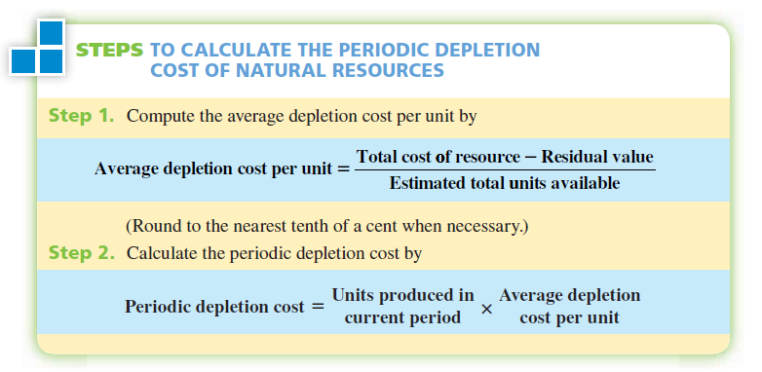

Slide 52
EXAMPLE 6
Black Gold Oil, Inc., purchased a parcel of land containing an estimated 2 million barrels of crude oil for $850,000. Two oil wells were drilled at a cost of $340,000. The residual value of the property and equipment is $50,000. Calculate the periodic depletion cost for the first year of operation if 325,000 barrels were extracted.

Slide 53
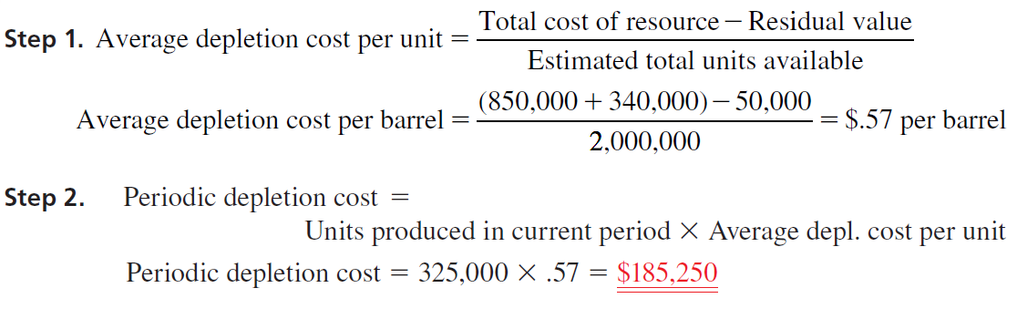
SOLUTION:

Slide 54
Calculate Partial-Year Depreciation

Slide 55
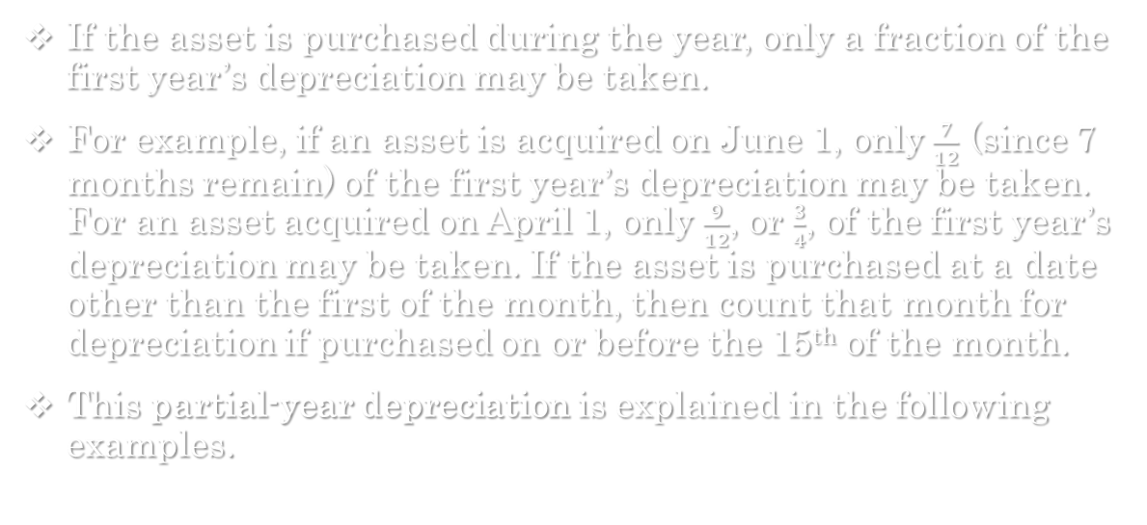
Definition
If the asset is purchased during the year, only a fraction of the first year’s depreciation may be taken.
For example, if an asset is acquired on June 1, only $\frac{7}{12}$ (since 7 months remain) of the first year’s depreciation may be taken. For an asset acquired on April 1, only $\frac{9}{12}$, or $\frac{3}{4}$, of the first year’s depreciation may be taken. If the asset is purchased at a date other than the first of the month, then count that month for depreciation if purchased on or before the 15th of the month.
This partial-year depreciation is explained in the following examples.

Slide 56
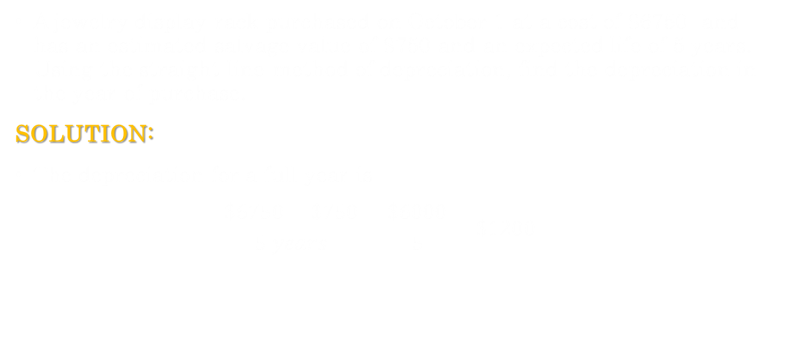
Finding Partial-Year Depreciation with Straight-Line
A jewelry display rack purchased on October 1 at a cost of $6750 and has an estimated salvage value of $750 and an expected life of 5 years. Using the straight-line method of depreciation, find the depreciation in the year of purchase.
SOLUTION:
The depreciation for a full year is
  $$\frac{\$6750−\$750}{5 years}=\frac{\$6000}{5}=\$1200$$

Slide 57

Finding Partial-Year Depreciation with Straight-Line
Since the purchase date is October 1, 3 months remain in the year. This means that only $\frac{3}{12}$, or $\frac{1}{4}$, or the $1200 may be taken in the year of purchase
$\$1200×\frac{1}{4}=\$300$ Depreciation allowed in the year of purchase
The next 4 years are depreciated at the full $1200 per year and the last 9 months $(\frac{3}{4})$ of deprecation, figured as follows, are reported in the sixth calendar year.
$\$1200×\frac{3}{4}=\$900$ Partial-year depreciation
As before, the total depreciation over all the years is the depreciable amount, or $6000

Slide 58
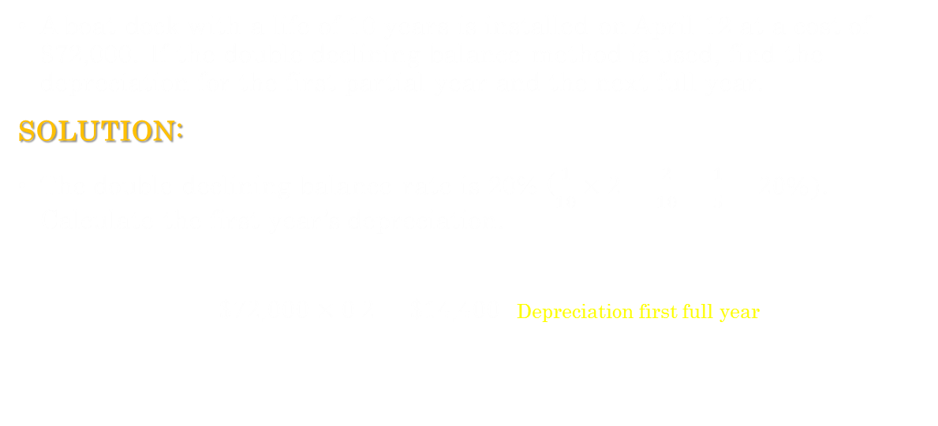
Finding Partial-Year Depreciation with Double-Declining Balance
A boat dock with a life of 10 years is installed on April 12 at a cost of $72,000. If the double declining-balance method is used, find the depreciation for the first partial year and the next full year.
SOLUTION:
The double-declining-balance rate is 20% ($\frac{1}{10}×2=\frac{2}{10}=\frac{1}{5}=20\%)$. Calculate the first year’s depreciation.
  $\$72,000×0.2=\$14,400$ Depreciation first full year

Slide 59
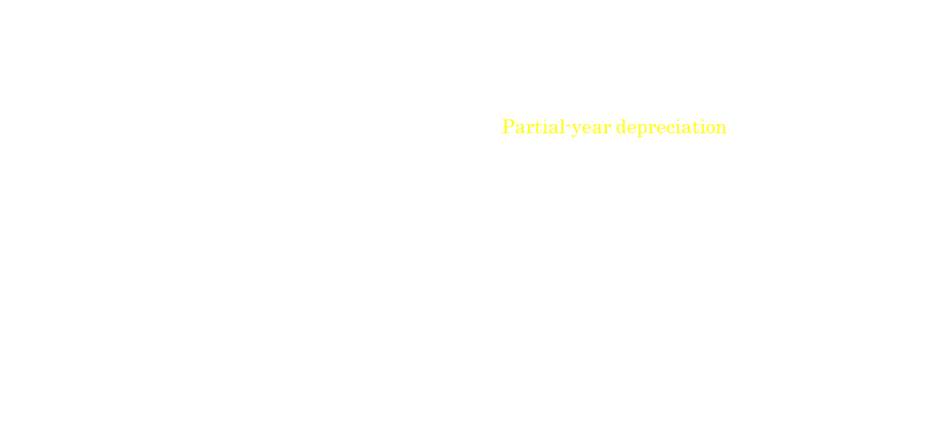
Finding Partial-Year Depreciation with Double-Declining Balance
Now find the depreciation for 9 months, or $\frac{3}{4}$ year. (Since April 12 is on or before April 15, count all of April.)
  $\$14,400×\frac{3}{4}=\$10,800$ Partial-year depreciation
The book value (declining balance) is $61,200 ($72,000-$10,800). Use this book value to find the first full-year depreciation.
$61,200 declining balance × 0.2 = $12,240
The depreciation for the first full year is $12,240. Depreciation for the following years would be calculated as usual. (Make sure that book value does not go below any scrap value.)

Slide 60
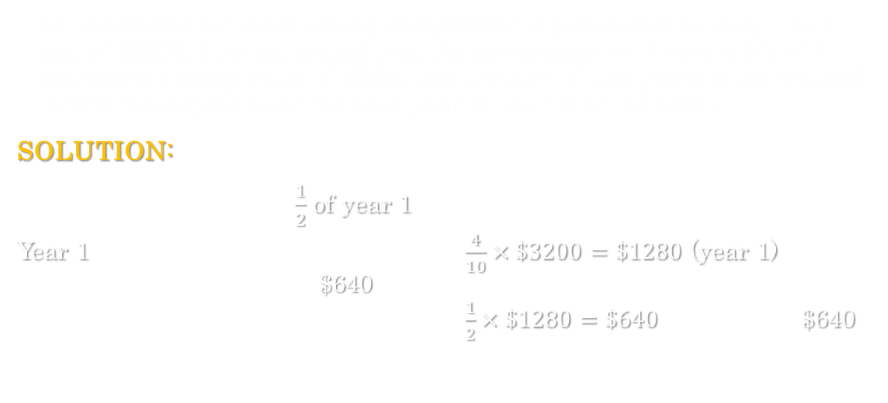
Finding Partial-Year Depreciation with Sum-of-the-Years’-Digit Method
An industrial air-conditioning compressor is purchased on July 1 at a cost of $3800. It is estimated that the compressor will have a life of 4 years and a scrap value of $600. Use the sum-of-the-years’-ditig method to find the depreciation for each year of the life of the asset.
SOLUTION:
$\frac{1}{2}$ of year 1
Year 1 $\frac{4}{10}×\$3200=\$1280$ (year 1)
$640
$\frac{1}{2}×\$1280=\$640$ $640

Slide 61
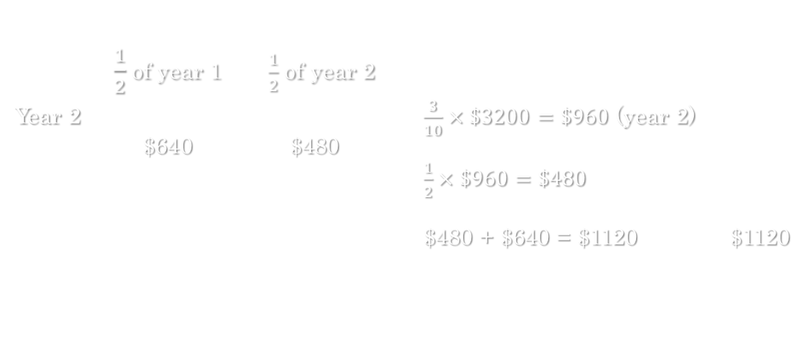
Finding Partial-Year Depreciation with Sum-of-the-Years’-Digit Method
$\frac{1}{2}$ of year 1 $\frac{1}{2}$ of year 2
Year 2 $\frac{3}{10}×\$3200=\$960$ (year 2)
$640 $480
$\frac{1}{2}×\$960=\$480$
$480 + $640 = $1120 $1120

Slide 62
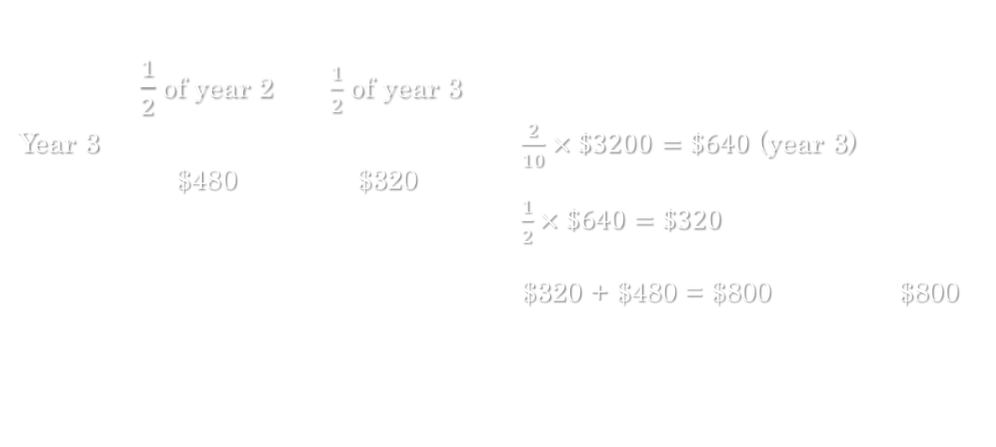
Finding Partial-Year Depreciation with Sum-of-the-Years’-Digit Method
$\frac{1}{2}$ of year 2 $\frac{1}{2}$ of year 3
Year 3 $\frac{2}{10}×\$3200=\$640$ (year 3)
$480 $320
$\frac{1}{2}×\$640=\$320$
$320 + $480 = $800 $800

Slide 63

Finding Partial-Year Depreciation with Sum-of-the-Years’-Digit Method
$\frac{1}{2}$ of year 3 $\frac{1}{2}$ of year 4
Year 4 $\frac{1}{10}×\$3200=\$320$ (year 4)
$320 $160
$\frac{1}{2}×\$320=\$160$
$160 + $320 = $480 $480

Slide 64
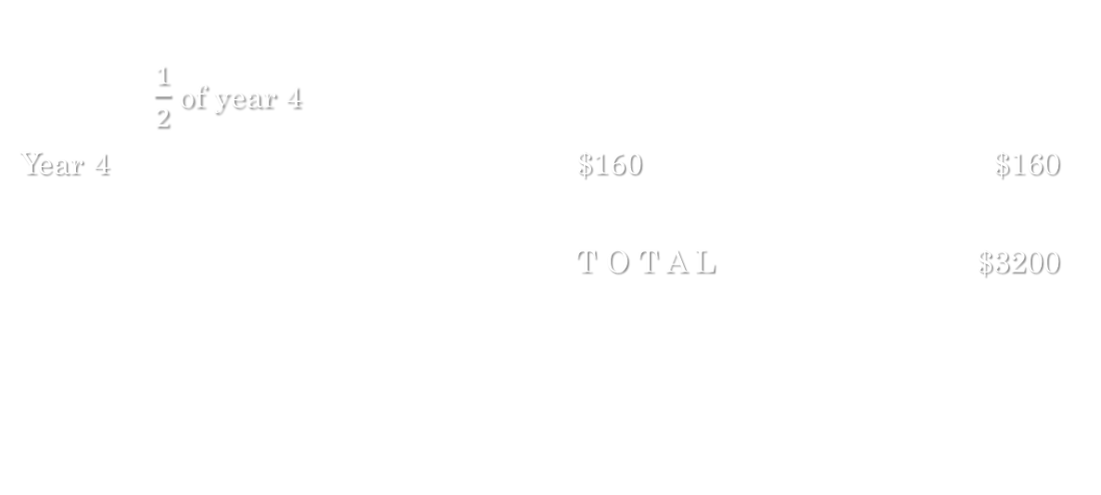
Finding Partial-Year Depreciation with Sum-of-the-Years’-Digit Method
$\frac{1}{2}$ of year 4
Year 4 $$160$ $160
T O T A L $3200

Slide 65
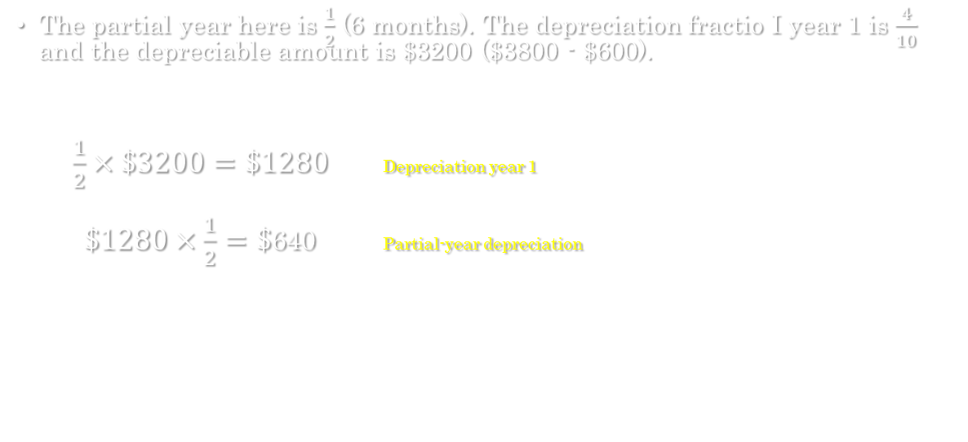
Finding Partial-Year Depreciation with Sum-of-the-Years’-Digit Method
The partial year here is $\frac{1}{2}$ (6 months). The depreciation fractio I year 1 is $\frac{4}{10}$ and the depreciable amount is $3200 ($3800 - $600).
$\frac{1}{2}×\$3200=\$1280$ Depreciation year 1
$\$1280×\frac{1}{2}=\$$640 Partial-year depreciation

