Slide 1
Chapter 18
Financial Statement and Ratios

Slide 2
Definition
Financial statements are the periodic report cards of how a business is doing from a monetary perspective. After all, money is the primary way in which the score is kept in the competitive arena of business.
These important statements are a summary of a company’s financial data compiled from business activity over a period of time. The four major financial statements used in business today are the balance sheet, the income statement, the owner’s equity statement, and the cash flow statement. Together, they tell a story about how a company has performed in the past and is likely to perform in the near future.

Slide 3
Financial Analysis
Financial analysis is the assessment of a company’s past, present, and anticipated future financial condition based on the information found on the financial statements.
Financial ratios are the primary tool of this analysis. These ratios are a way of standardizing financial data so that they may be compared with ratios from previous operating periods of the same firm or from other similar-size firms in the same industry.

Slide 4
Balance sheet

Slide 5
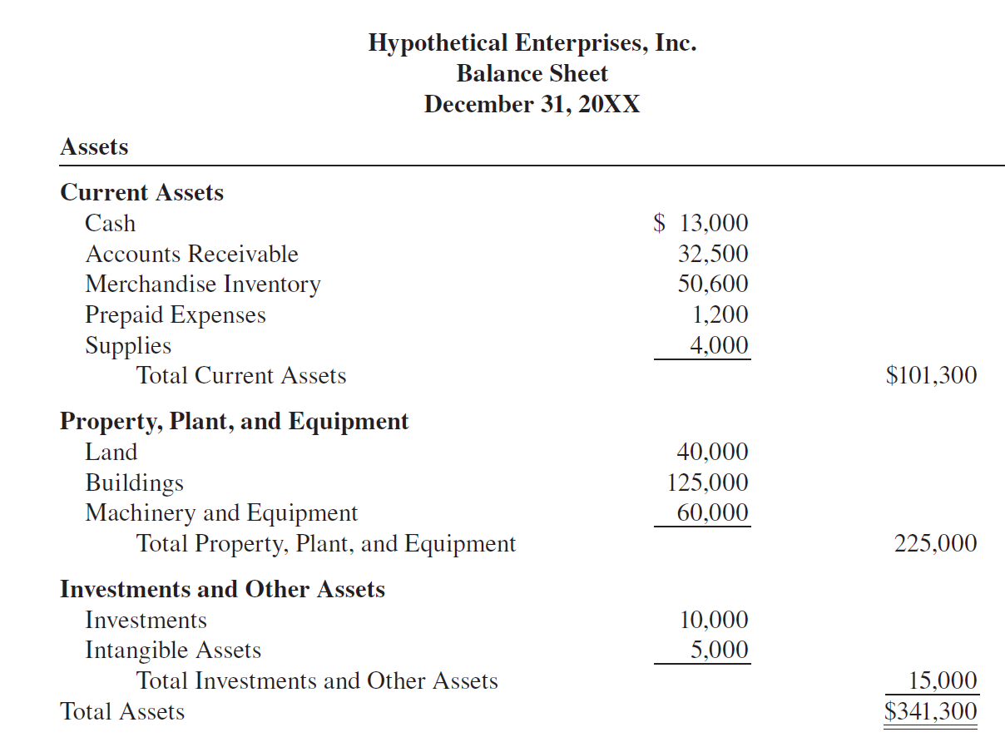

Slide 6
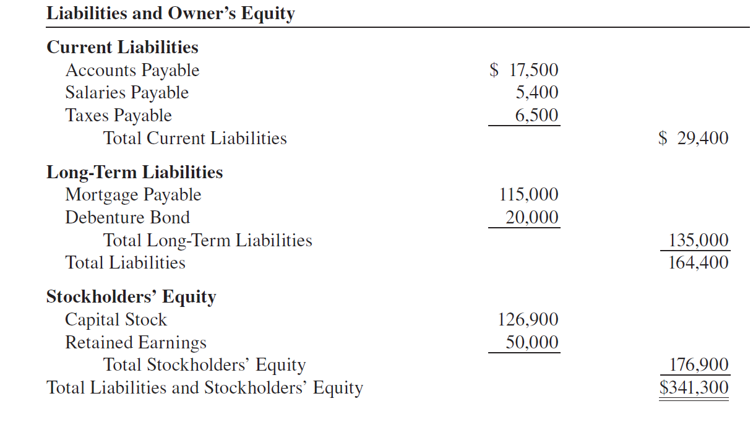

Slide 7
Balance sheet
COMPONENTS

Slide 8
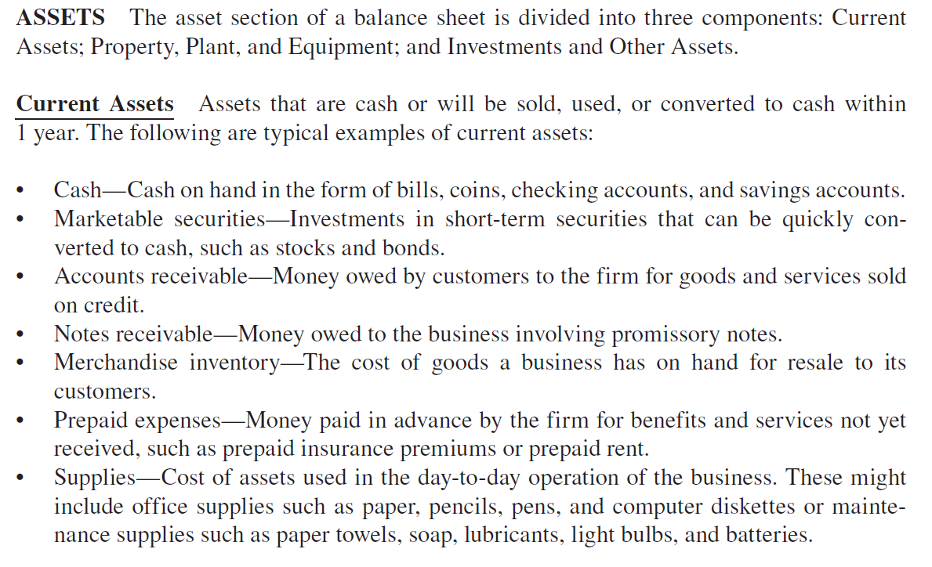

Slide 9
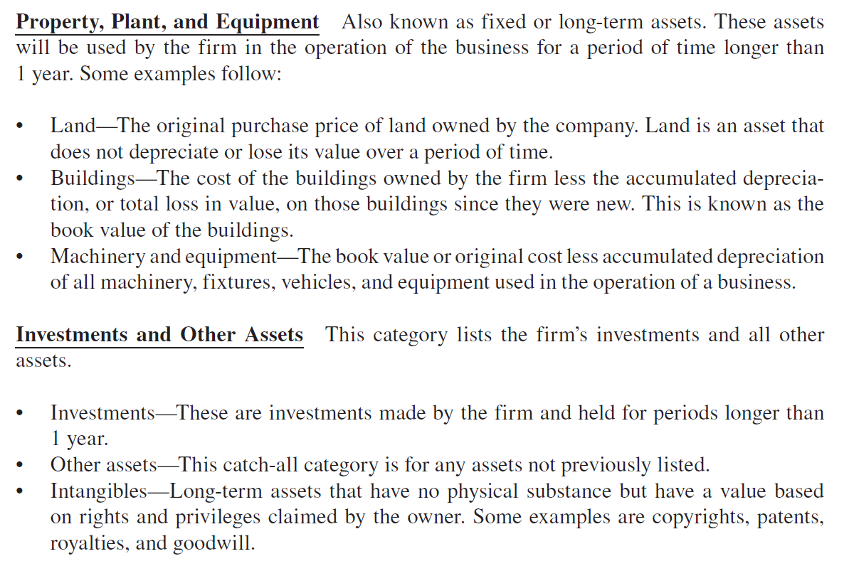

Slide 10
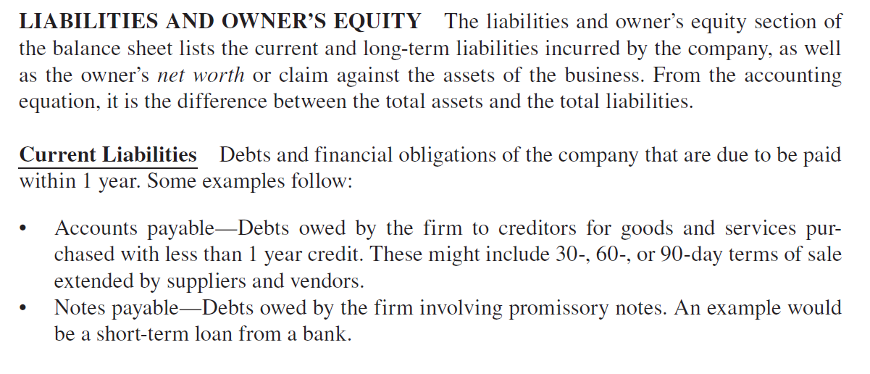

Slide 11
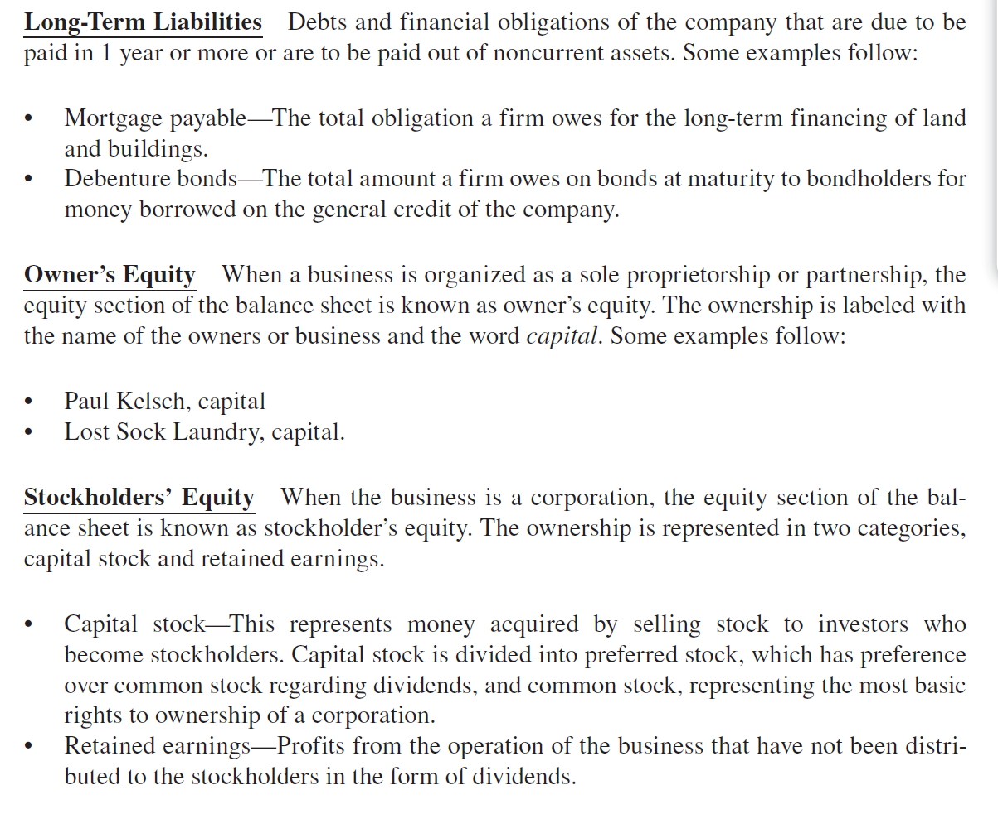

Slide 13
STEPS TO PREPAIR A BALANCE SHEET

Slide 14
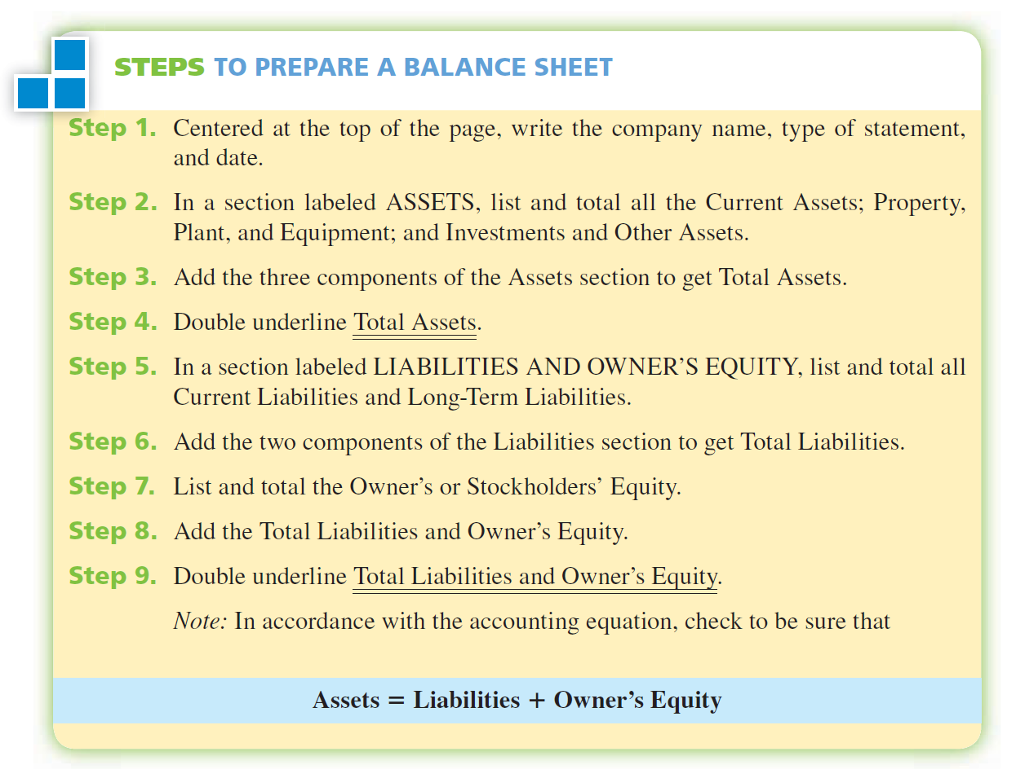

Slide 15
EXAMPLE 1
Use the following financial information to prepare a balance sheet for Royal Equipment Supply, Inc., as of June 30, 2008: cash, $3,400; accounts receivable, $5,600; merchandise inventory, $98,700; prepaid insurance, $455; supplies, $800; land and building, $147,000; fixtures, $8,600; delivery vehicles, $27,000; forklift, $7,000; goodwill, $10,000; accounts payable, $16,500; notes payable, $10,000; mortgage payable, $67,000; common stock, $185,055; and retained earnings, $30,000.

Slide 16
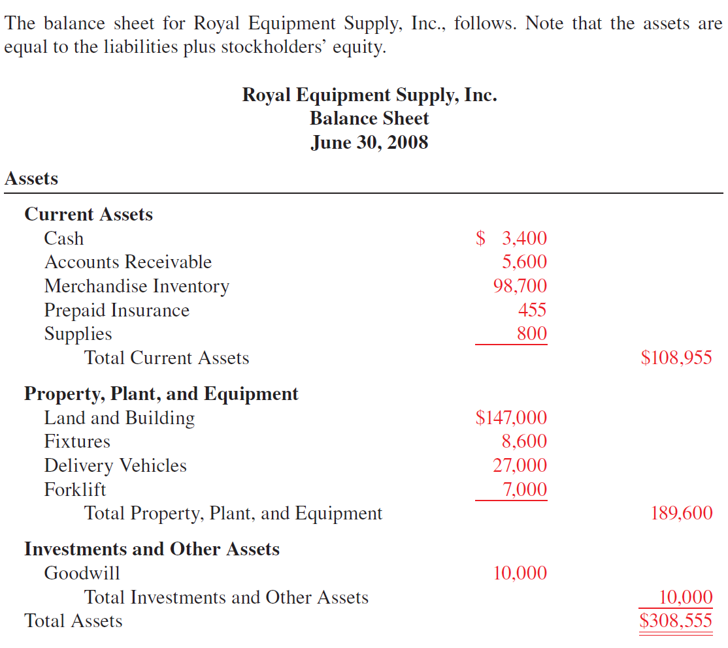

Slide 17
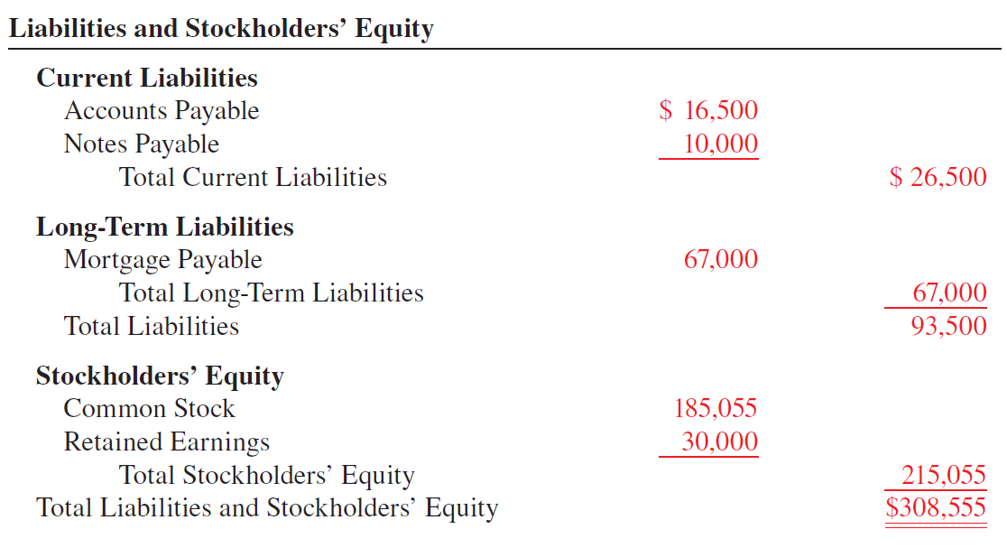

Slide 18
Vertical Analysis,
Horizontal Analysis, &
Common Size Analysis

Slide 19
Definition
Vertical Analysis is a percentage method of analyzing financial statements whereby each item on the statement is expressed as a percent of a base amount.
On balance sheet analysis, the base is total assets; on income statement analysis, the base is net sales.

Slide 20
Definition
Common-size Balance Sheets: Is the special forms of balance sheets that list only the vertical analysis percentages, not the dollar figures. All items are expressed as a percent of total assets.

Slide 21
Definition
Comparative Balance Sheet: Is if the balance sheet prepared with the data from the current year or operating period side by side with the figures from one or more previous periods.

Slide 22
Definition
Horizontal Analysis: Is the method of analyzing financial statements whereby each item of the current period is compared in dollars and percent with the corresponding item from a previous period.

Slide 23
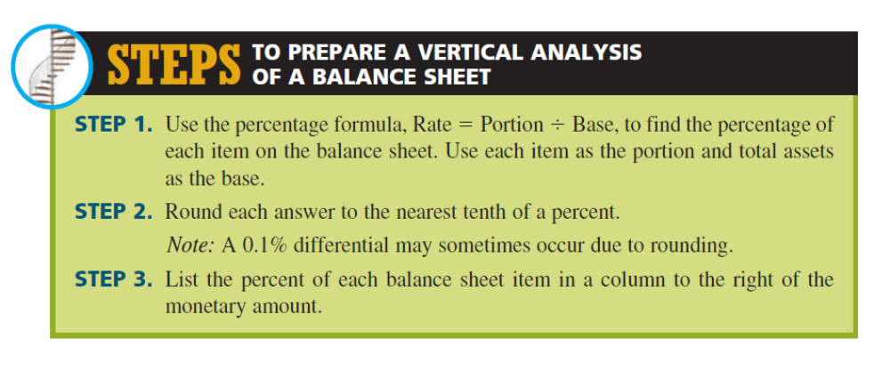

Slide 24
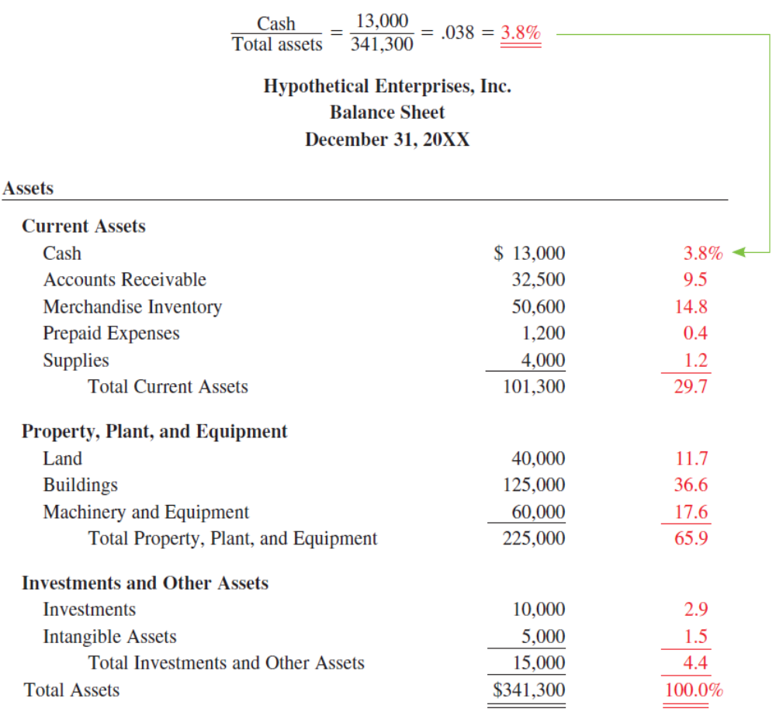

Slide 25
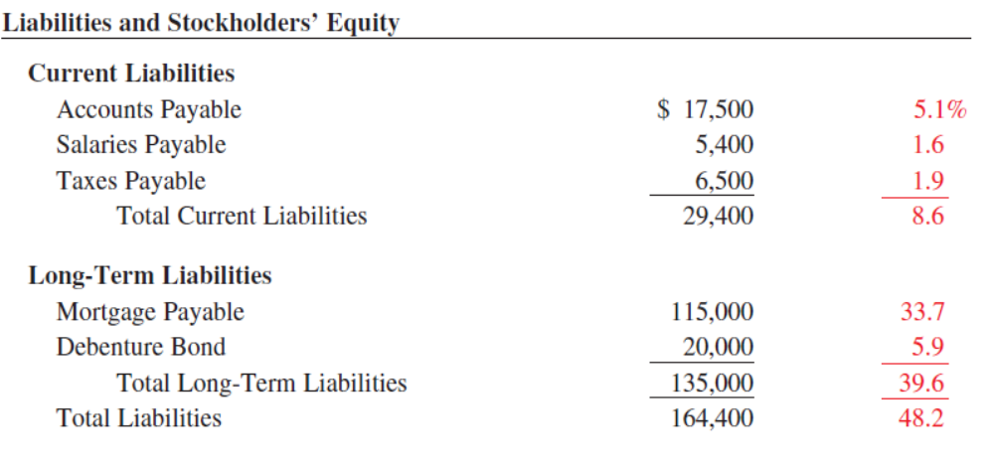

Slide 26
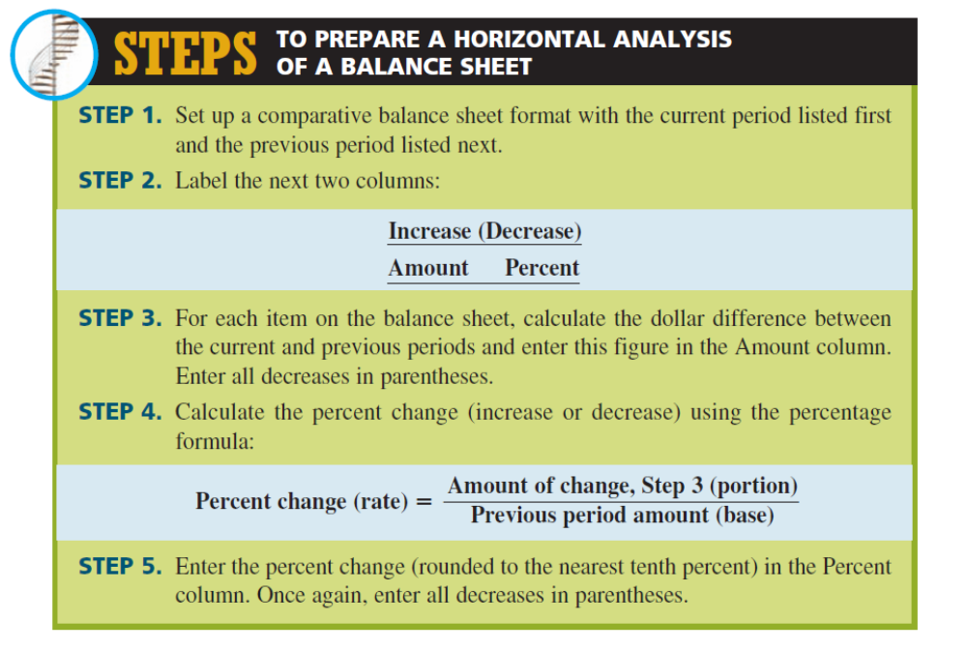

Slide 27
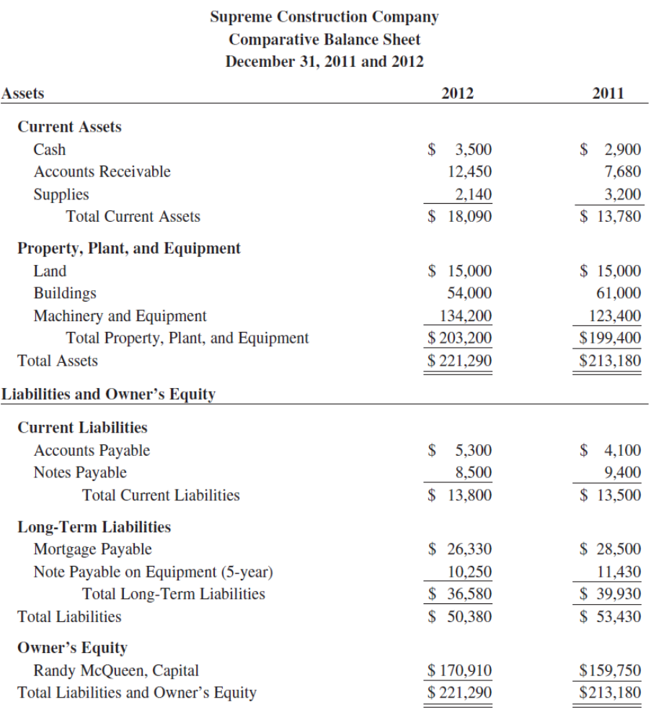

Slide 28


Slide 29
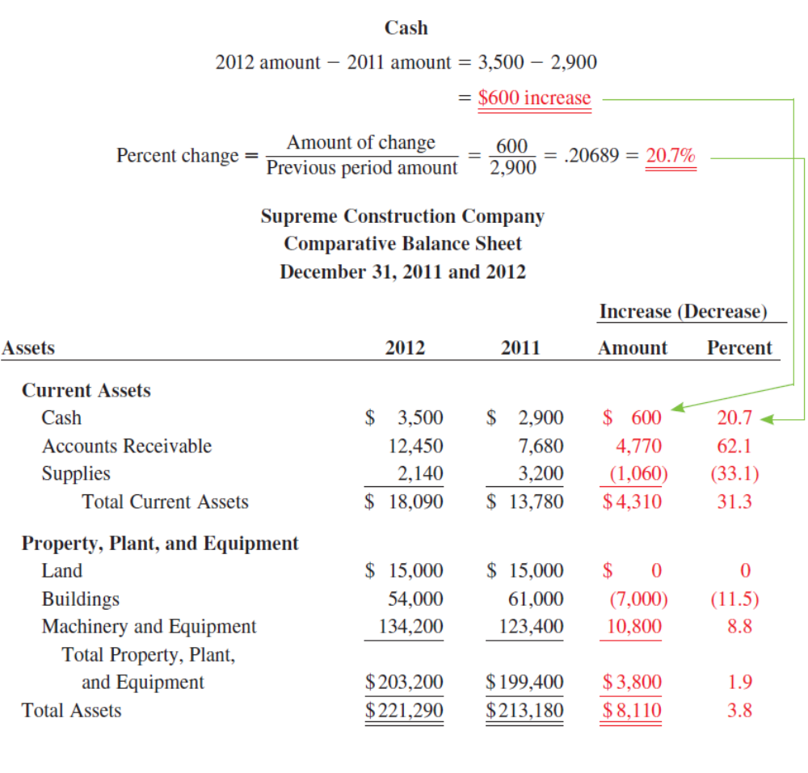

Slide 30
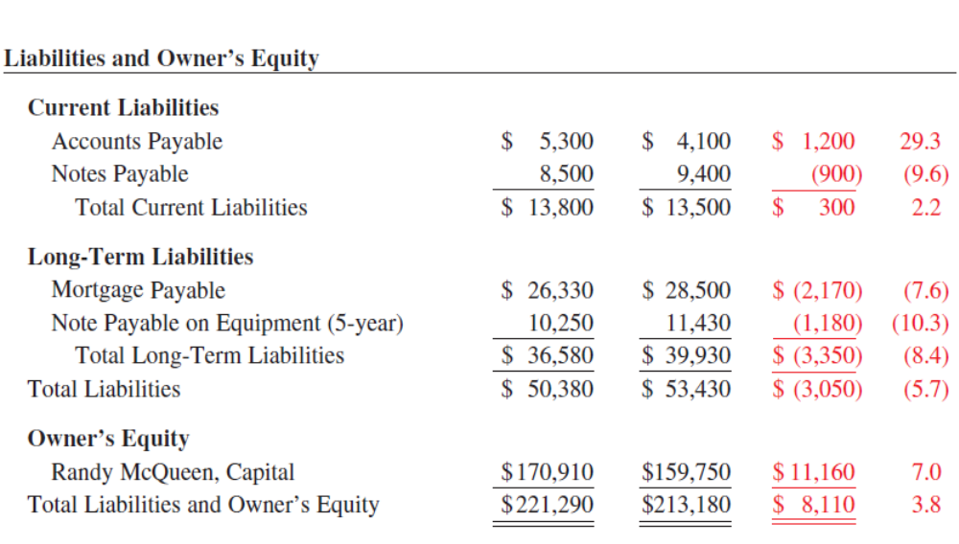

Slide 31
INCOME STATEMENT

Slide 32
Definition
When all is said and done, the question is how well did the business do. The real score is found on the income statement.
An income statement, also known as an operating statement or profit and loss statement, is a summary of the operations of a business over a period of time—usually a month, a quarter, or a year. For any business to exist, it must have earnings as well as expenses in the form of either cash or credit.
The income statement shows the revenue, or earnings, of the business from the sale of goods and services; the expenses, the costs incurred to generate that revenue; and the bottom line profit or loss, the difference between revenue and expenses.

Slide 33
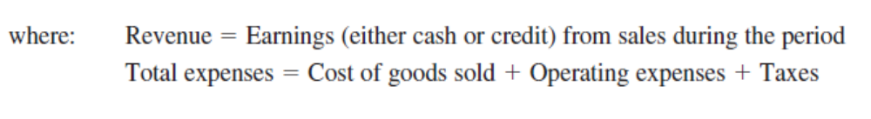
Definition

Slide 34
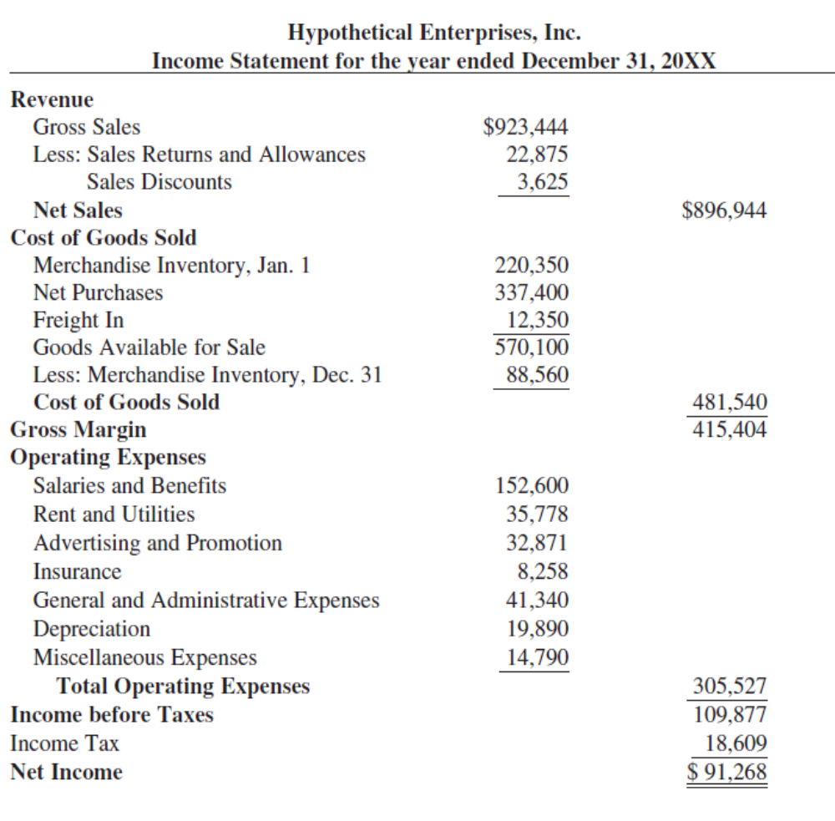

Slide 35
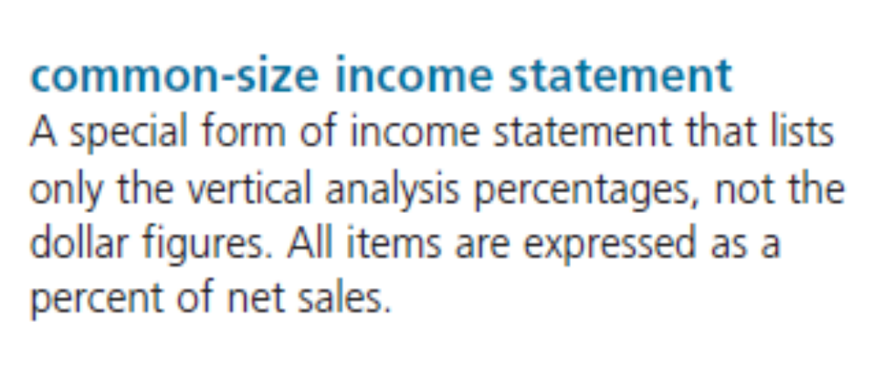

Slide 36
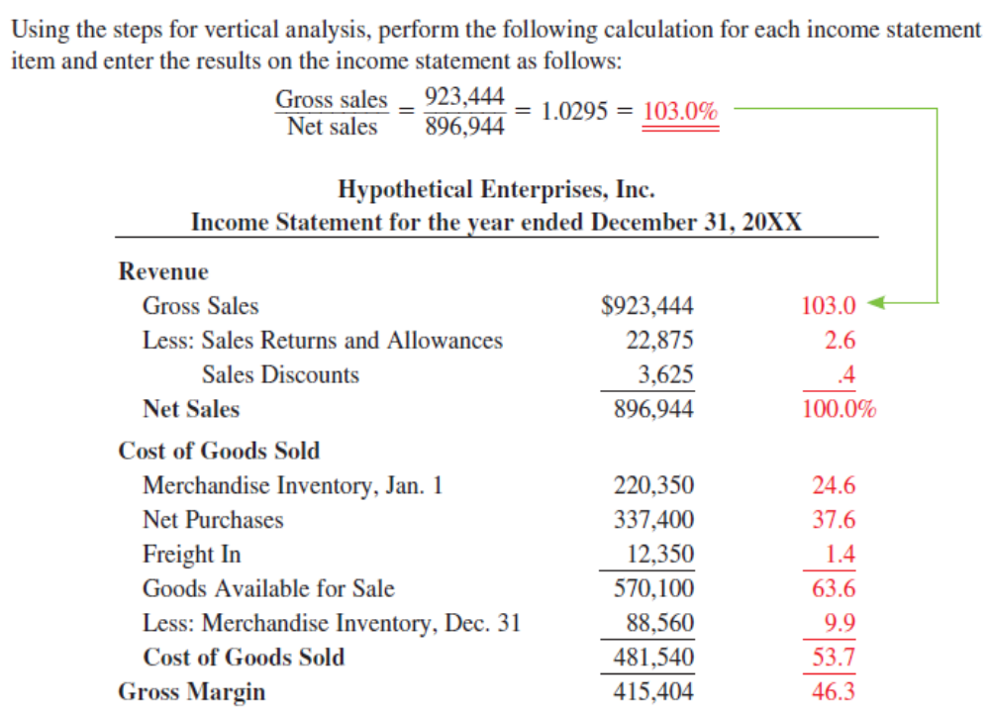

Slide 37
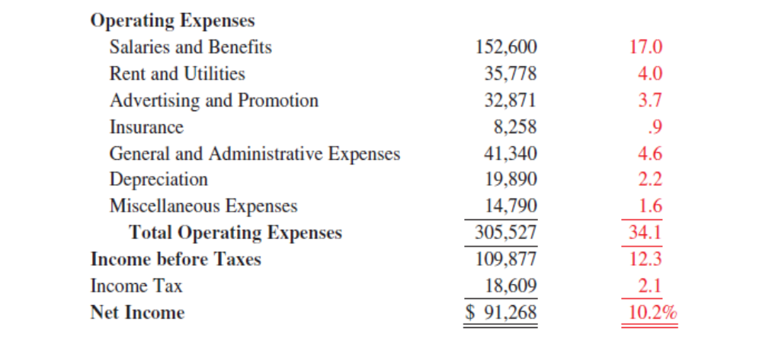

Slide 38
Horizontal Analysis

Slide 39
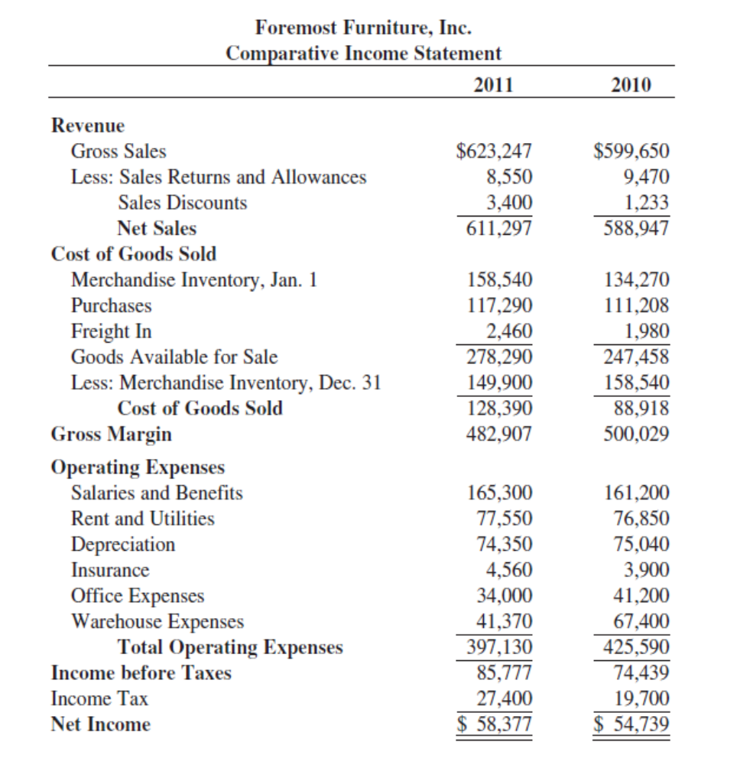

Slide 40
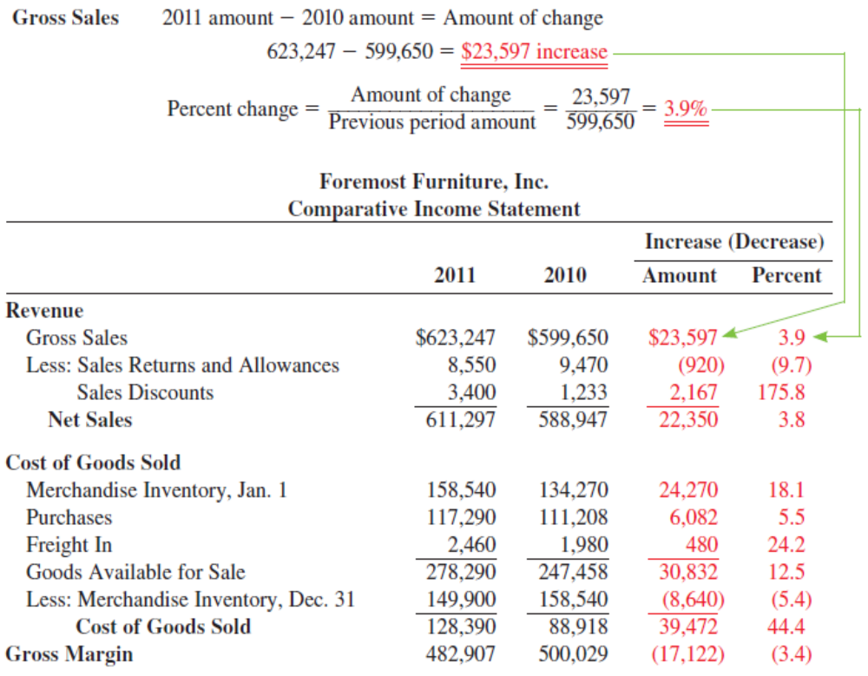

Slide 41
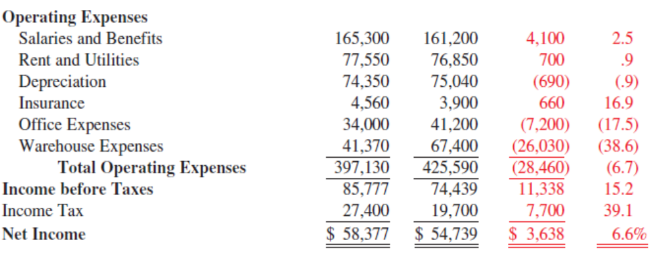

Slide 42
RATIO ANALYSIS

Slide 43
FINANCIAL RATIO
LIQUIDITY RATIO
ASSET MANAGEMENT RATIO
DEBT MANAGEMENT RATIO
PROFITABILITY RATIO
MARKET VALUE RATIO

Slide 44
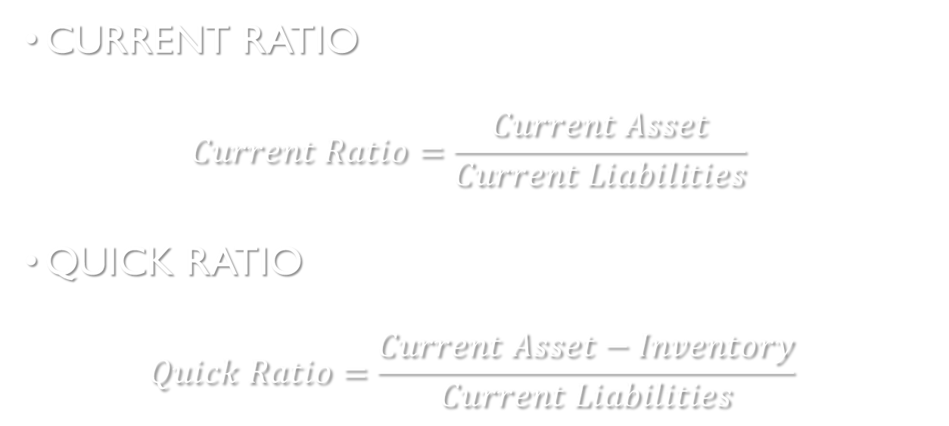
1. RASIO LIKUIDITAS
CURRENT RATIO
  $$Current Ratio=\frac{Current Asset}{Current Liabilities}$$
QUICK RATIO
  $$Quick Ratio=\frac{Current Asset−Inventory}{Current Liabilities}$$

Slide 45
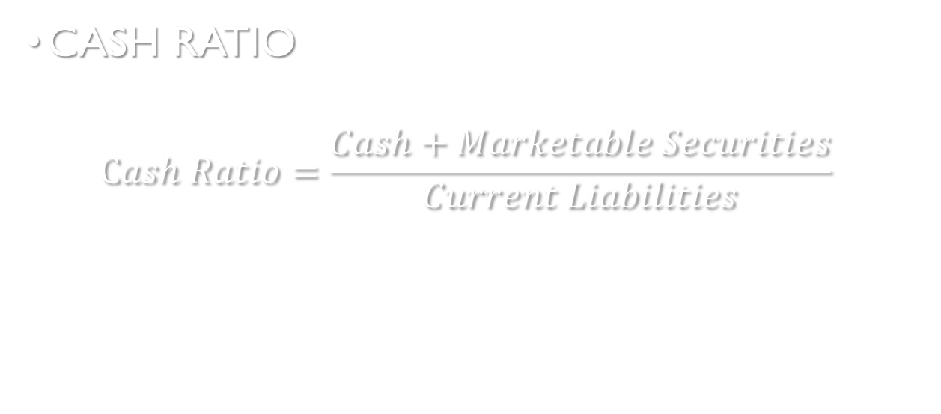
1. RASIO LIKUIDITAS
CASH RATIO
  $$Cash Ratio=\frac{Cash+Marketable Securities}{Current Liabilities}$$

Slide 46
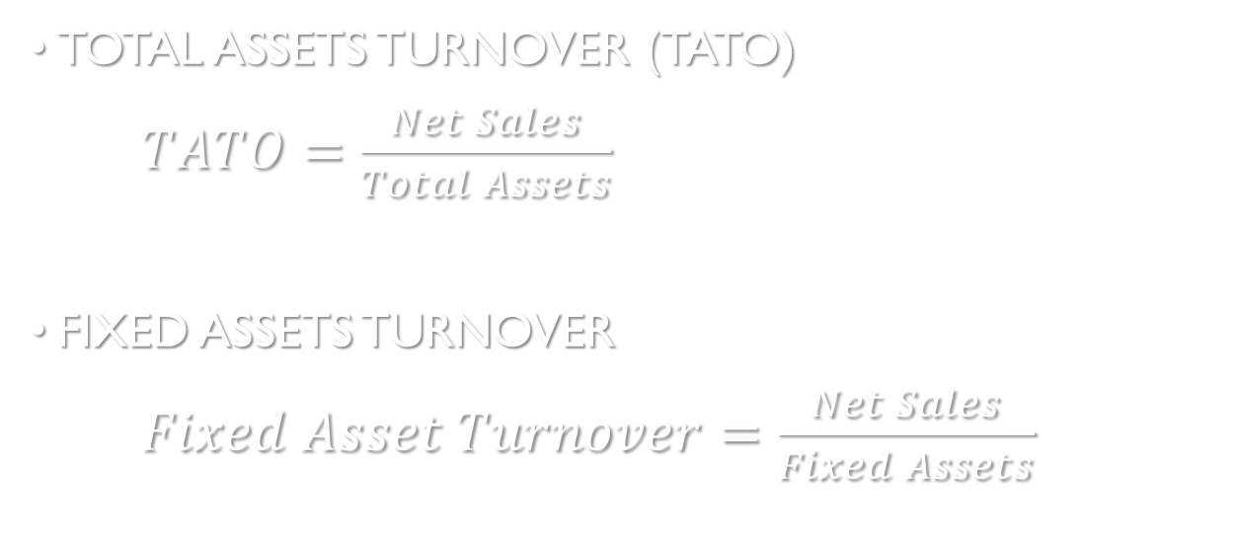
2. ASSETS MANAGEMENT RATIO
TOTAL ASSETS TURNOVER (TATO)
$TATO=\frac{Net Sales}{Total Assets}$
FIXED ASSETS TURNOVER
$Fixed Asset Turnover=\frac{Net Sales}{Fixed Assets}$

Slide 47
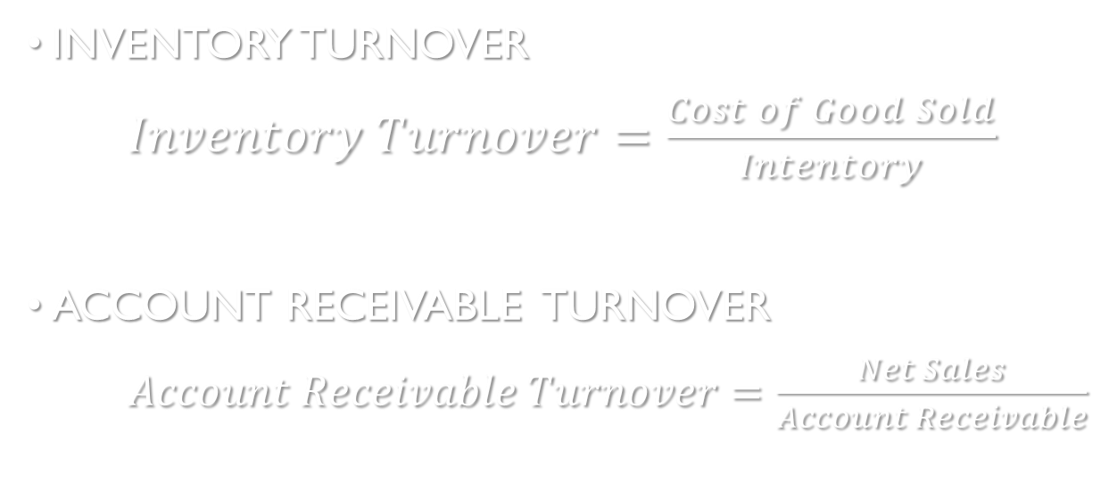
2. ASSETS MANAGEMENT RATIO
INVENTORY TURNOVER
$Inventory Turnover=\frac{Cost of Good Sold}{Intentory}$
ACCOUNT RECEIVABLE TURNOVER
$Account Receivable Turnover=\frac{Net Sales}{Account Receivable}$

Slide 48
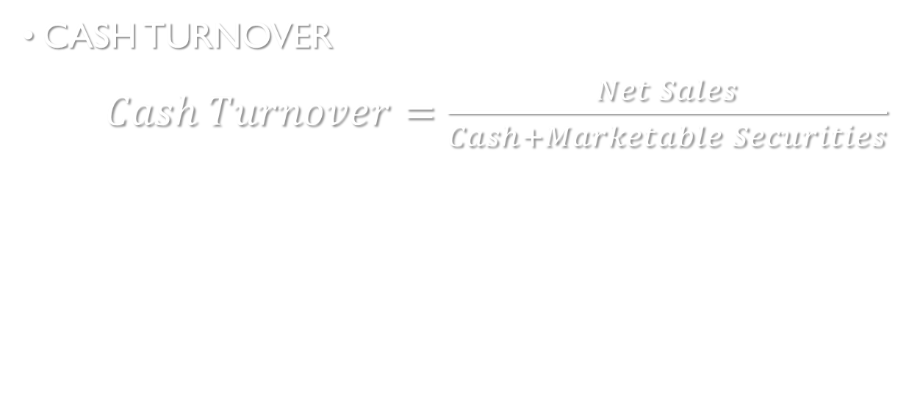
2. ASSETS MANAGEMENT RATIO
CASH TURNOVER
$Cash Turnover=\frac{Net Sales}{Cash+Marketable Securities}$

Slide 49
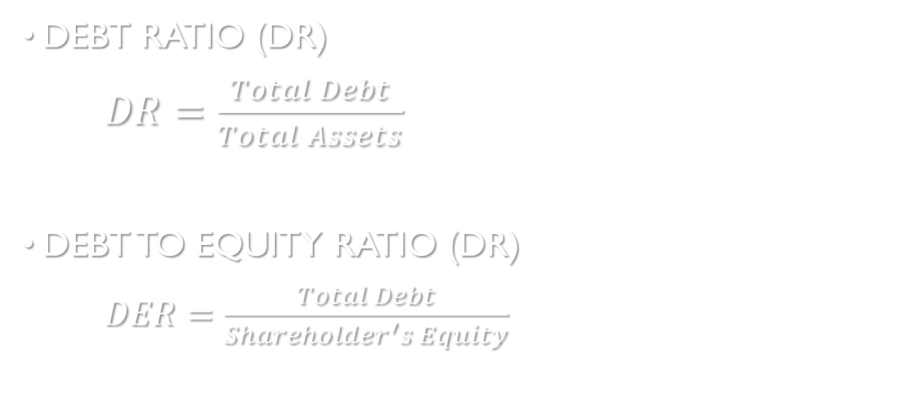
3. DEBT MANAGEMENT RATIO
DEBT RATIO (DR)
$DR=\frac{Total Debt}{Total Assets}$
DEBT TO EQUITY RATIO (DR)
$DER=\frac{Total Debt}{Shareholder^{′}s Equity}$

Slide 50

3. DEBT MANAGEMENT RATIO
TIME INTEREST EARN (TIE)
$TIE=\frac{Interest Expenses}{Net Income}$

Slide 51
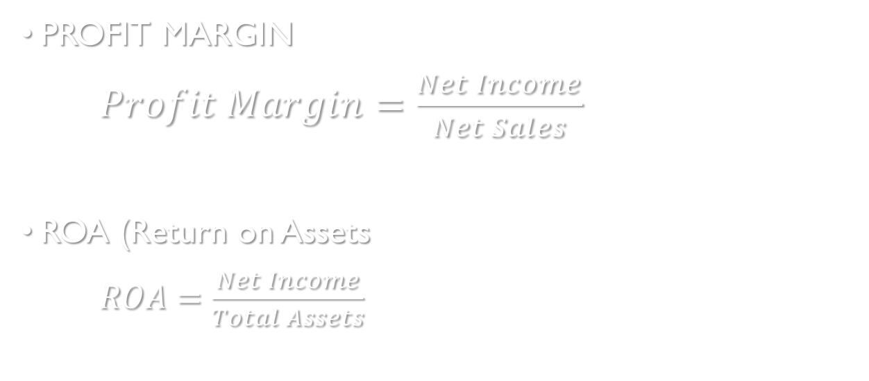
4. PROFITABILITY RATIO
PROFIT MARGIN
$Profit Margin=\frac{Net Income}{Net Sales}$
ROA (Return on Assets
$ROA=\frac{Net Income}{Total Assets}$

Slide 52
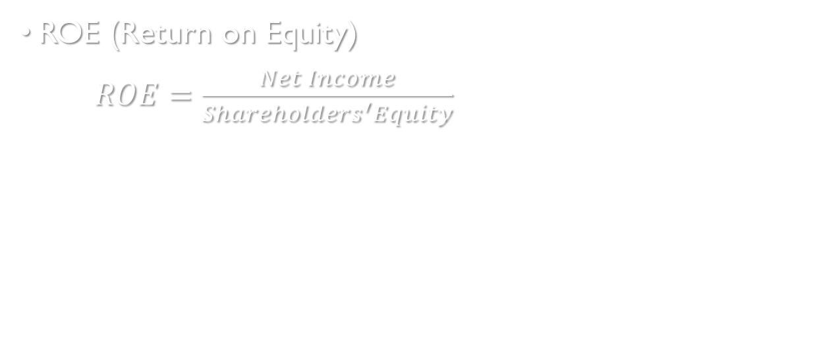
4. PROFITABILITY RATIO
ROE (Return on Equity)
$ROE=\frac{Net Income}{Shareholders^{′}Equity}$

Slide 53
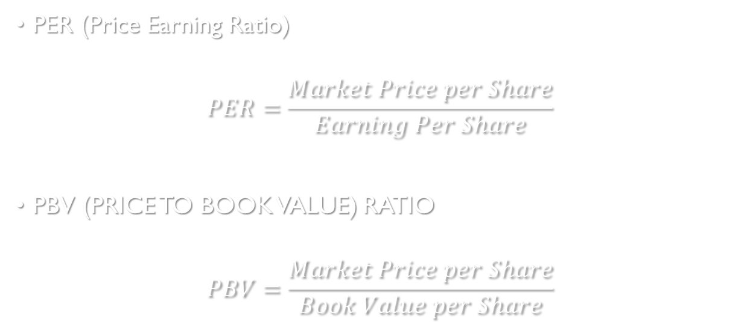
5. MARKET VALUE RATIO
PER (Price Earning Ratio)
$$PER=\frac{Market Price per Share}{Earning Per Share}$$
PBV (PRICE TO BOOK VALUE) RATIO
$$PBV=\frac{Market Price per Share}{Book Value per Share}$$

Slide 54
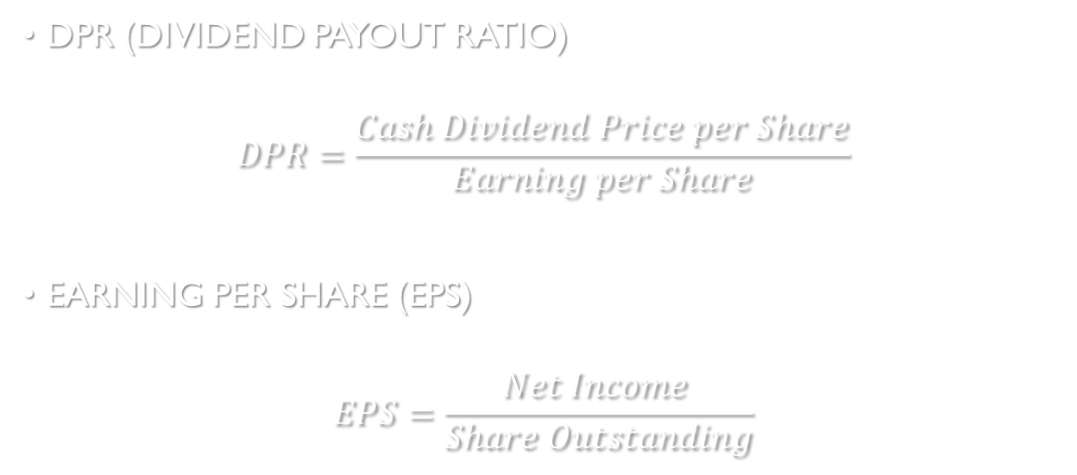
5. MARKET VALUE RATIO
DPR (DIVIDEND PAYOUT RATIO)
$$DPR=\frac{Cash Dividend Price per Share}{Earning per Share}$$
EARNING PER SHARE (EPS)
$$EPS=\frac{Net Income }{Share Outstanding}$$

