Slide 1
FINANCIAL STATEMENT AND RATIOS
CHAPTER 18

Slide 2
DEFINITION
Laporan keuangan adalah laporan berkala tentang bagaimana bisnis dijalankan dilihat dari perspektif moneter.
Laporan Keuangan merupakan ringkasan dari data keuangan perusahaan, disusun dari kegiatan usaha periode waktu atau saat tertentu.
Empat laporan keuangan utama yang digunakan dalam bisnis saat ini adalah neraca, laporan laba rugi, laporan ekuitas pemilik (sering disebut laporan perubahan modal), dan laporan arus kas. Bersama-sama, mereka bercerita tentang bagaimana sebuah perusahaan telah dilakukan di masa lalu dan kemungkinan akan dilakukan dalam waktu dekat.

Slide 3
FINANCIAL ANALYSIS
Analisis keuangan adalah penilaian masa lalu perusahaan, sekarang, dan antisipasi kondisi keuangan masa depan berdasarkan informasi yang ditemukan pada laporan keuangan. Rasio keuangan adalah alat utama dari analisis laporan keuangan ini.
Rasio keuangan adalah cara standardisasi data keuangan sehingga hal ini dapat dibandingkan dengan rasio dari periode operasi sebelumnya dari perusahaan yang sama atau rasio dari perusahaan yang berbeda dalam industri yang sama pada waktu sama.

Slide 4


Slide 5
Balance sheet
(neraca)

Slide 6
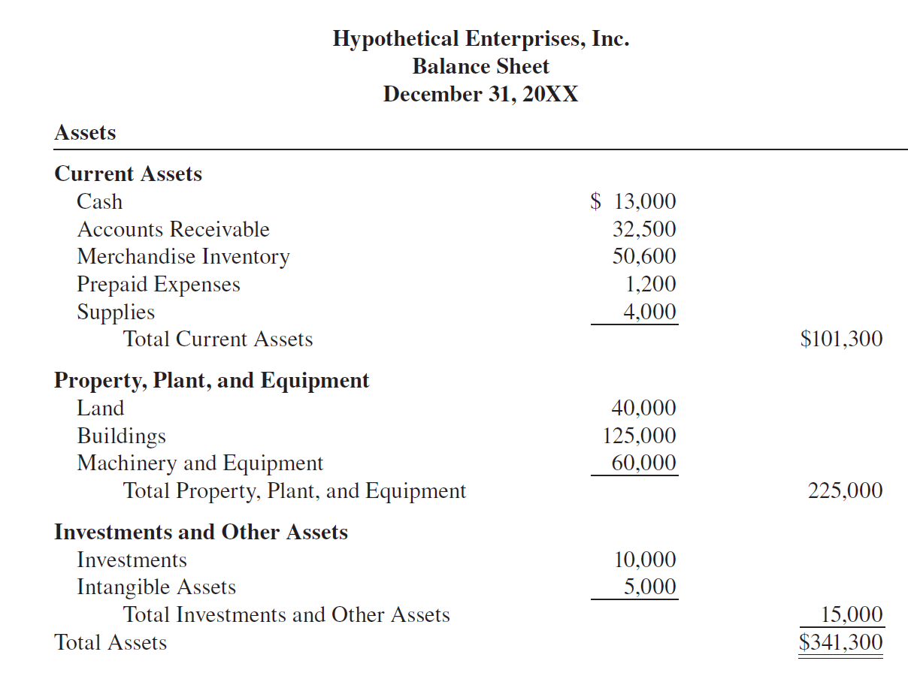

Slide 7
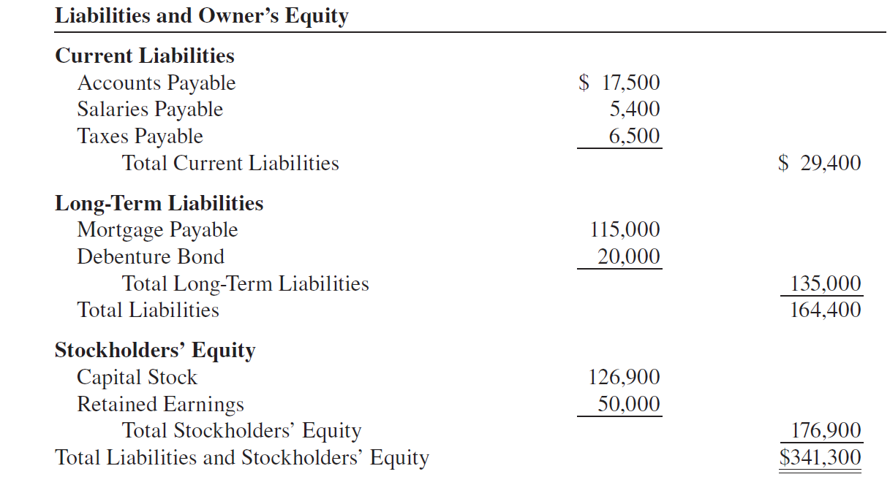

Slide 8
Balance sheet
COMPONENTS

Slide 9
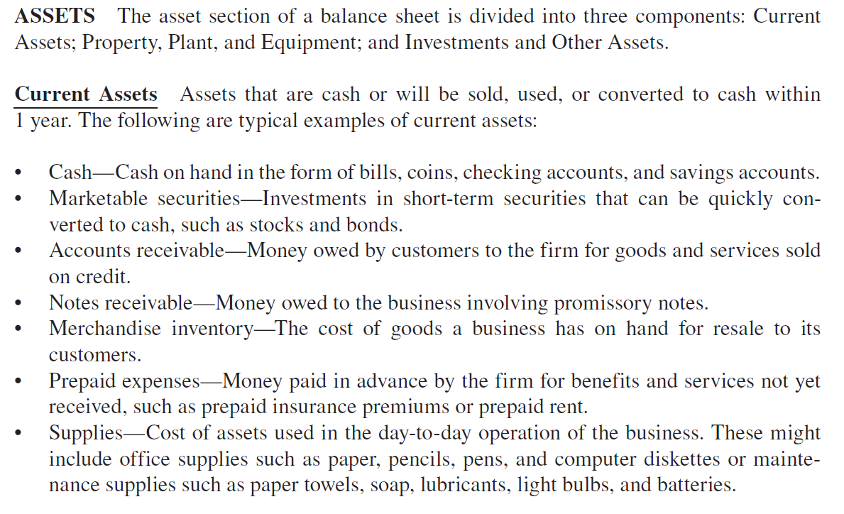

Slide 10
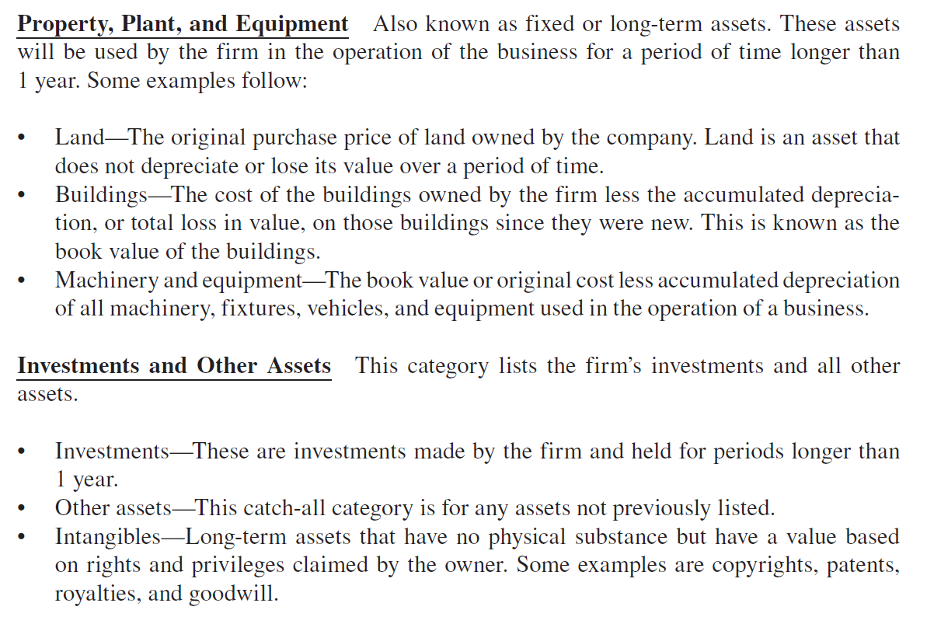

Slide 11
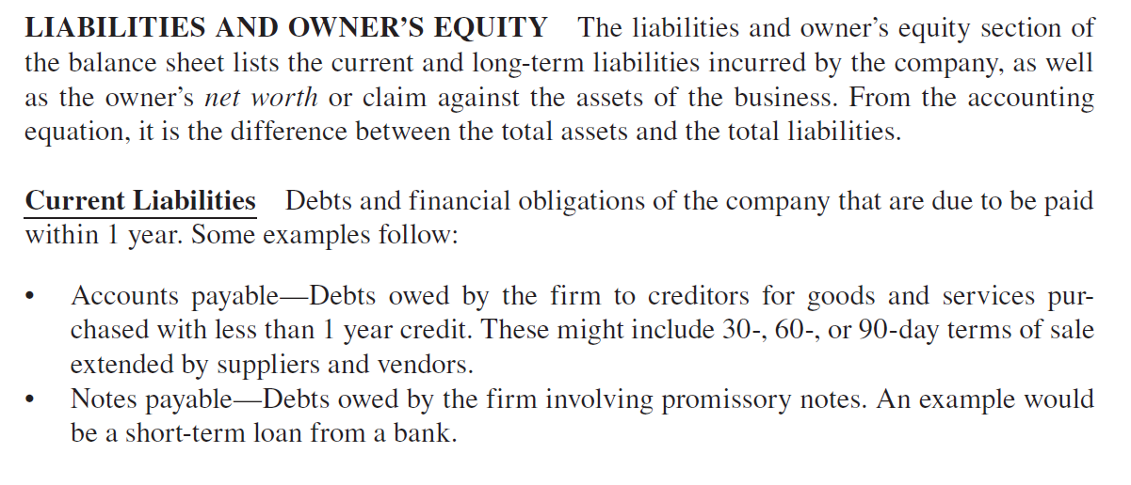

Slide 12
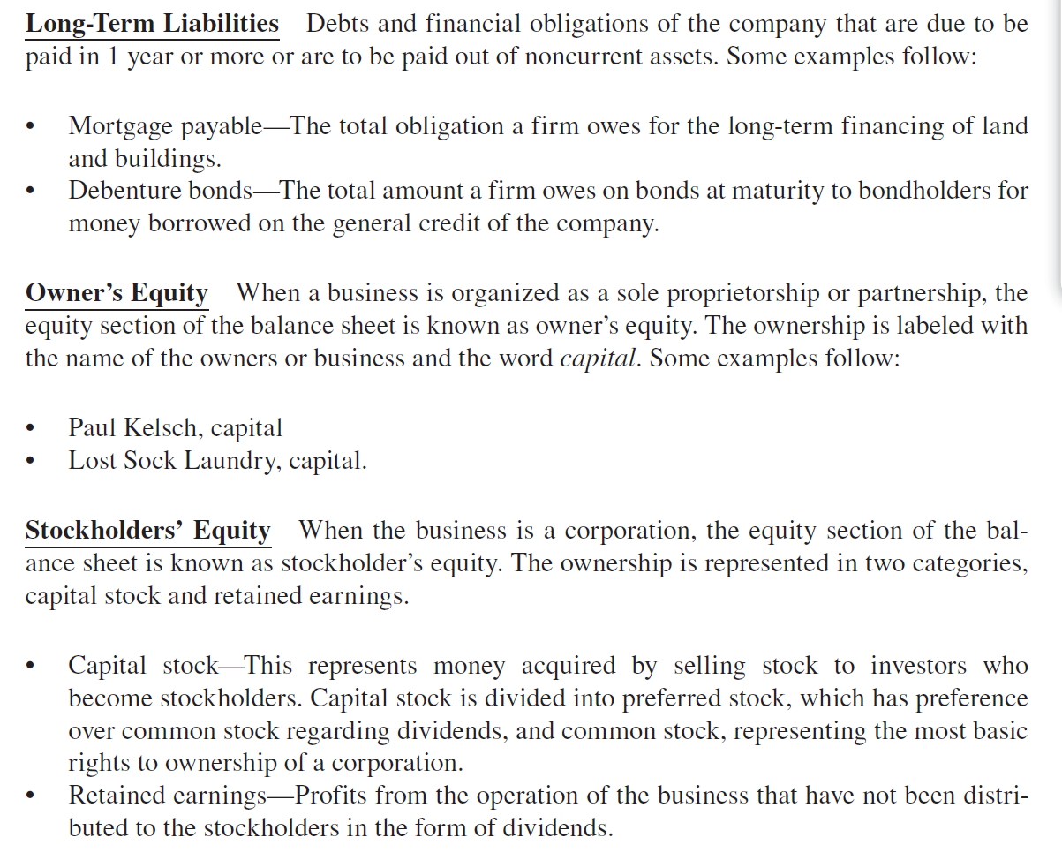

Slide 14
STEPS TO PREPAIR A BALANCE SHEET

Slide 15
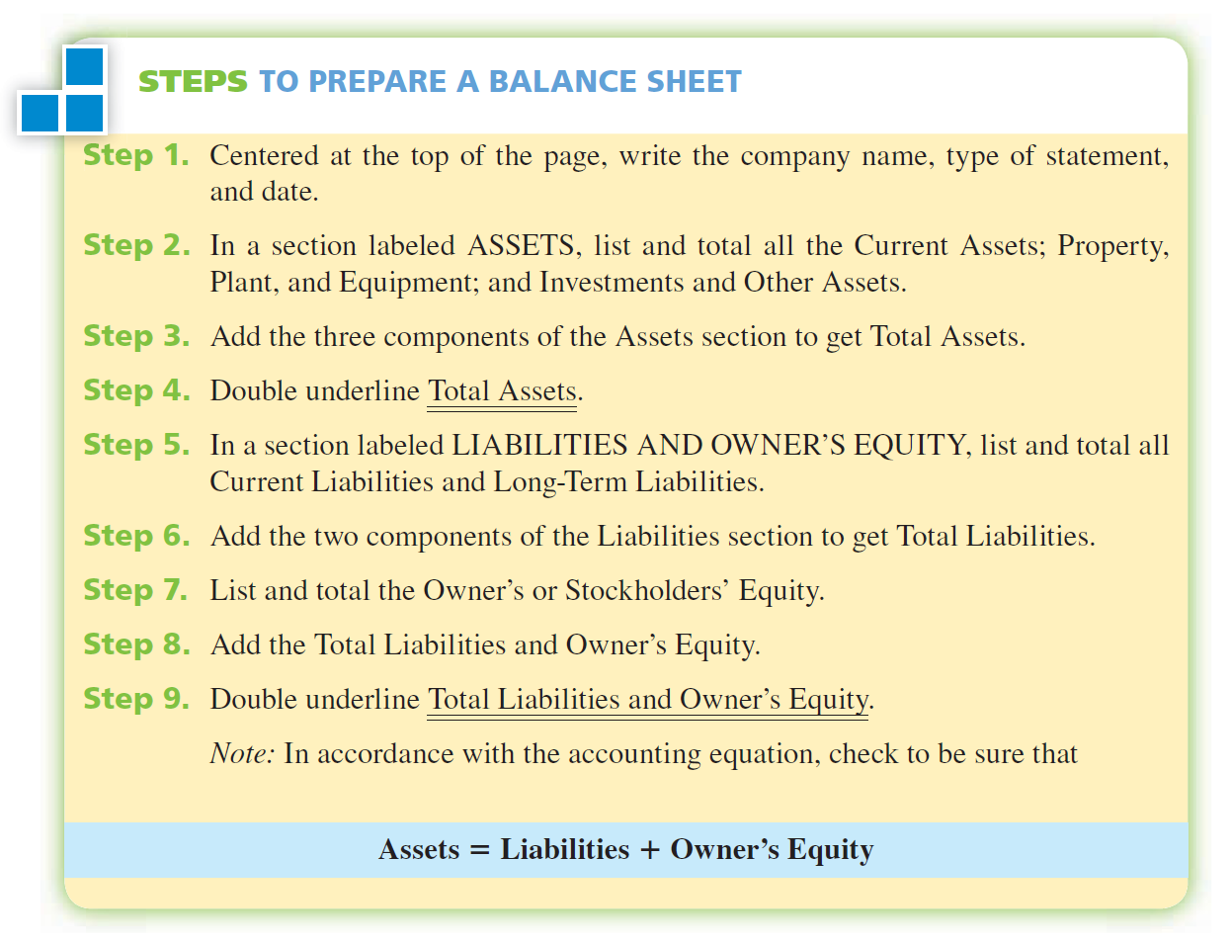

Slide 16
EXAMPLE 1
Gunakan informasi keuangan berikut ini untuk menyusun neraca Royal Equipment Supply, Inc, dari informasi pada tanggal 30 Juni 2008 sbb: tunai, $3400, piutang, $5600, persediaan barang dagangan, $98.700, asuransi dibayar di muka, $455, perlengkapan, $800; tanah dan bangunan, $147,000, perlengkapan, $8600, kendaraan, $27.000, forklift, $7000, goodwill, $10.000, utang dagang, $16.500 rekening, utang wesel (wesel bayar), $10.000; utang hipotik, $67.000, saham biasa, $185.055, dan laba ditahan, $30.000.

Slide 17
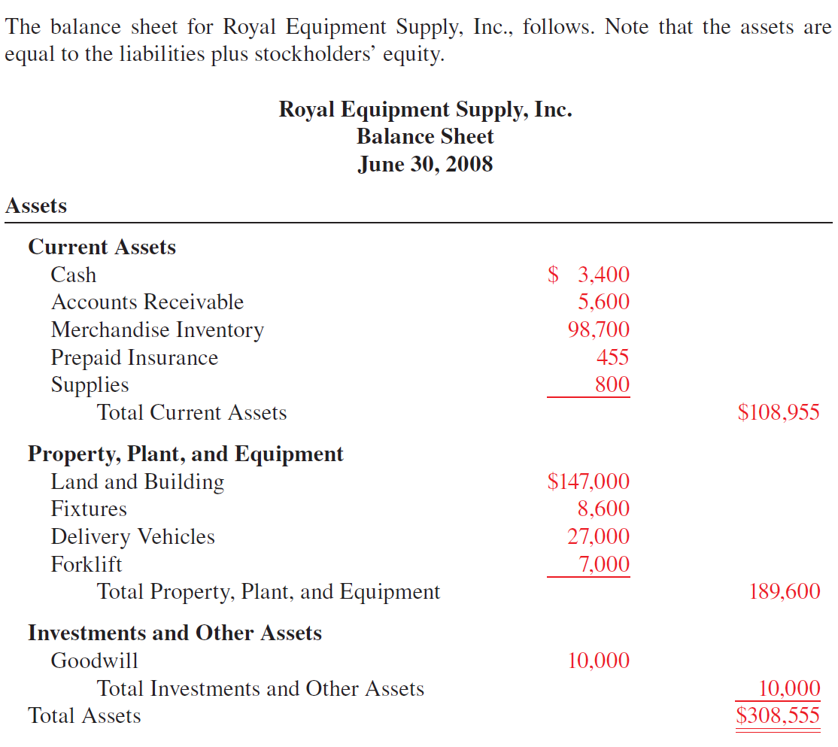

Slide 18
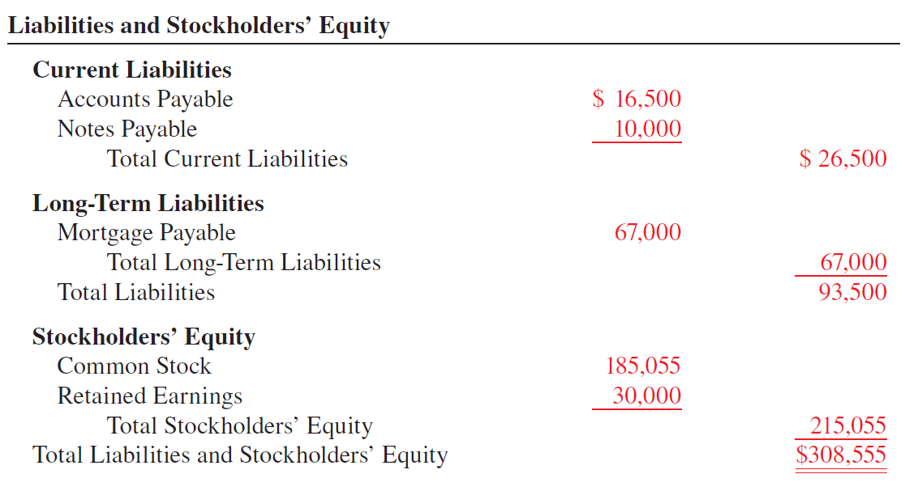

Slide 19
VERTICAL ANALYSIS

Slide 20
Vertical Analysis
Vertical Analysis A percentage method of analyzing financial statements whereby each item on the statement is expressed as a percent of a base amount. On balance sheet analysis, the base is total assets; on income statement analysis, the base is net sales.
Common-Size Balance Sheets Special forms of balance sheets that list only the vertical analysis percentages, not the dollar figures. All items

Slide 21
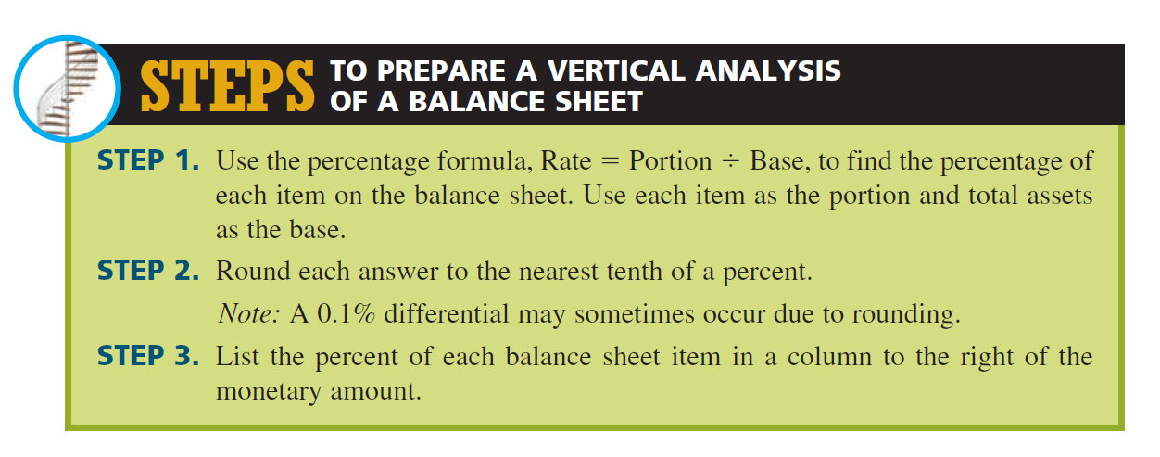

Slide 22
EXAMPLE 2
Prepare a vertical analysis of the balance sheet for Hypothetical Enterprises, Inc., on pages 491–492.

Slide 23
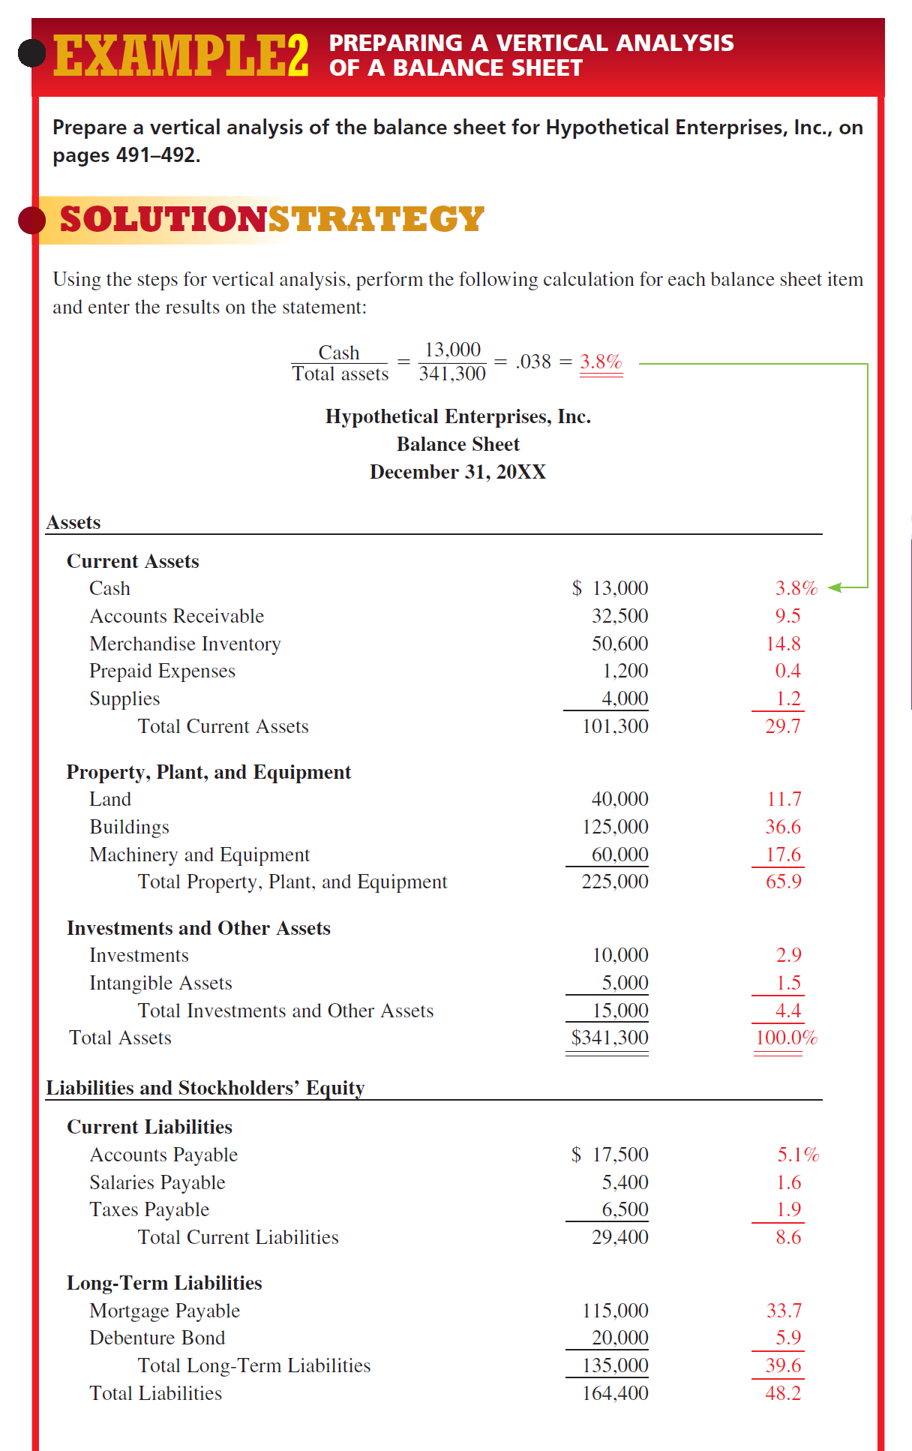

Slide 25
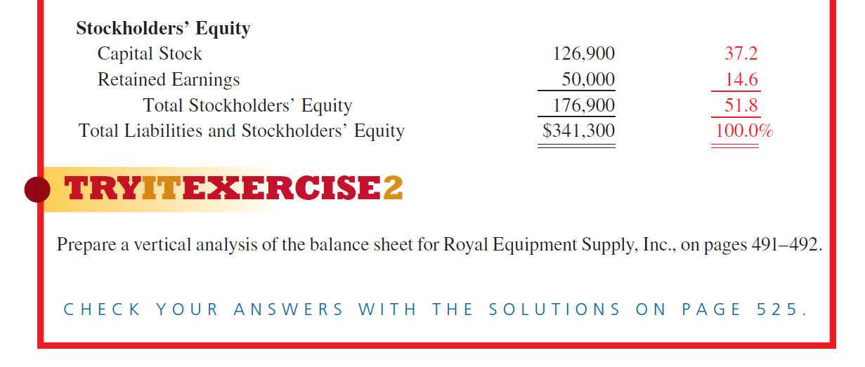

Slide 26
HORIZONTAL ANALYSIS OF BALANCE SHEET
(ANALISIS HORISONTAL DARI NERACA)

Slide 27
HORIZONTAL ANALYSIS
Frequently, balance sheets are prepared with the data from the current year or operating period side by side with the figures from one or more previous periods. This type of presentation is known as a comparative balance sheet because the data from different periods can be readily compared. This information provides managers, creditors, and investors with important data concerning the progress of the company over a period of time, financial trends that may be developing, and the likelihood of future success.
Comparative balance sheets use horizontal analysis to measure the increases and decreases that have taken place in the financial data between two operating periods. In horizontal analysis, each item of the current period is compared in dollars and percent with the corresponding item from a previous period.

Slide 28
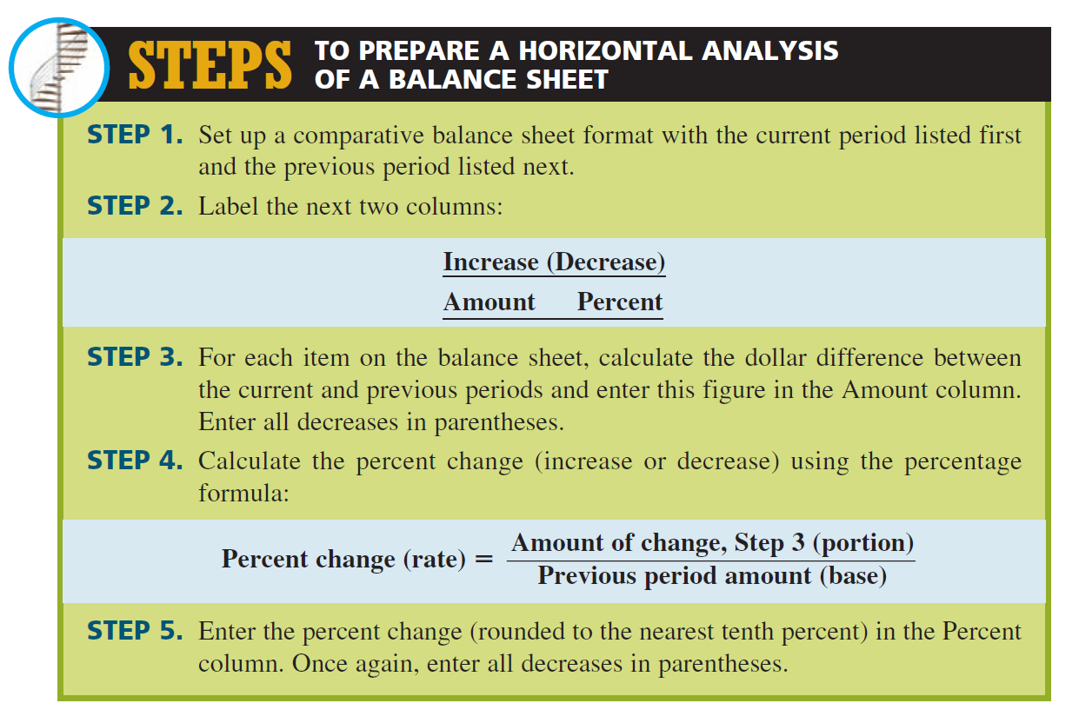

Slide 29
CONTOH 3
Using the following comparative balance sheet for the Supreme Construction Company as of December 31, 2011 and 2012, prepare a horizontal analysis of this balance sheet for the owner, Randy McQueen.
(Menggunakan neraca perbandingan Agung Construction Company pada tanggal 31 Desember 2011 dan 2012, susunlah analisis horizontal neraca ini atau pemiliknya, Randy McQueen.)

Slide 30
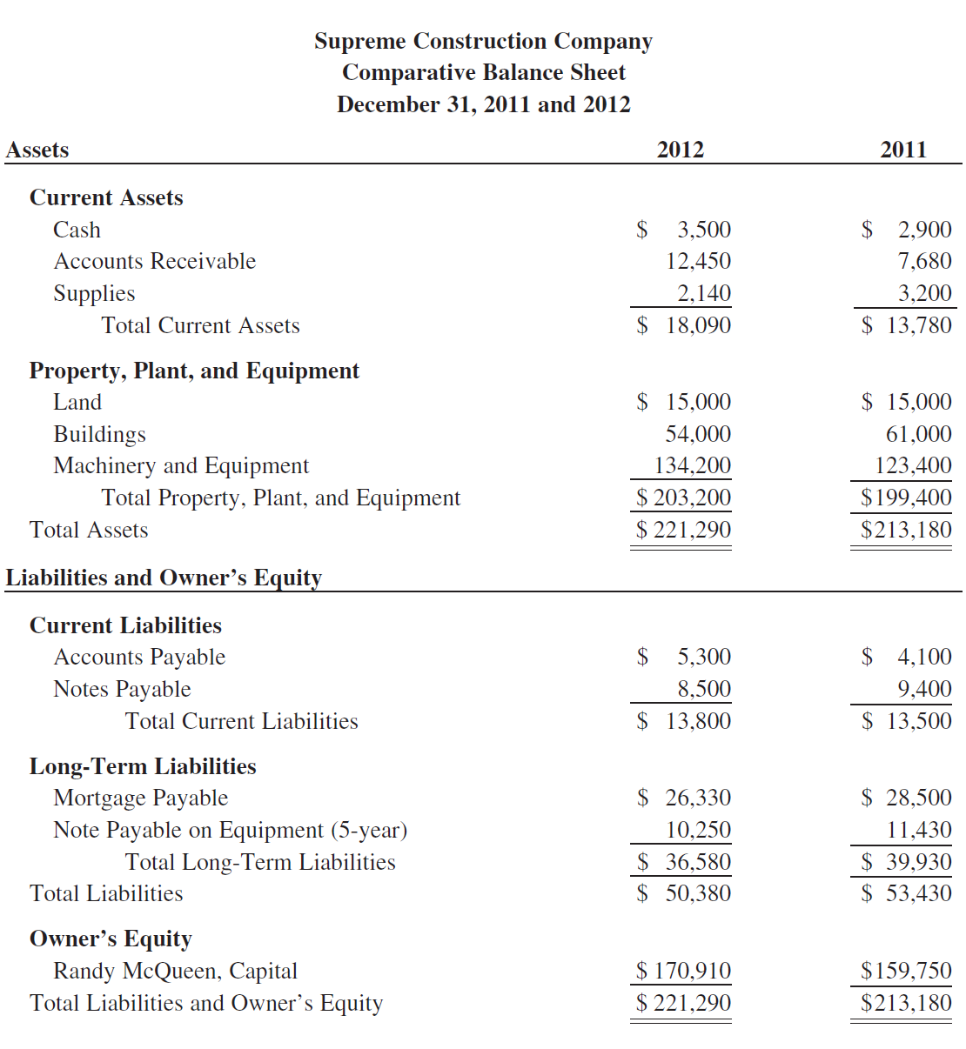

Slide 32
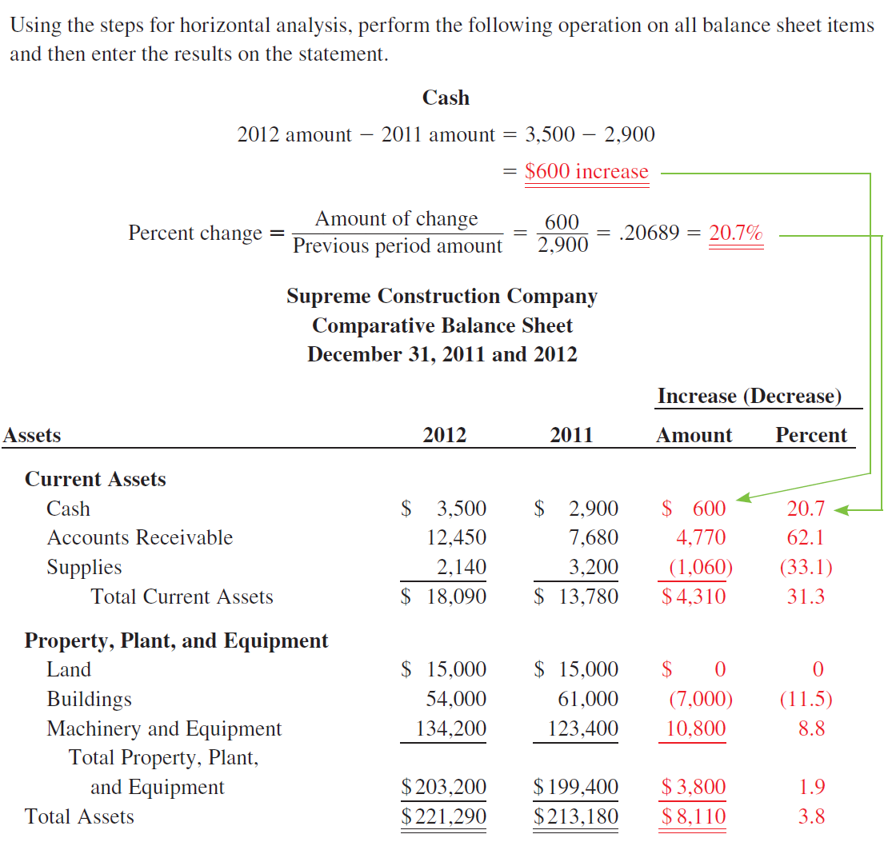

Slide 34
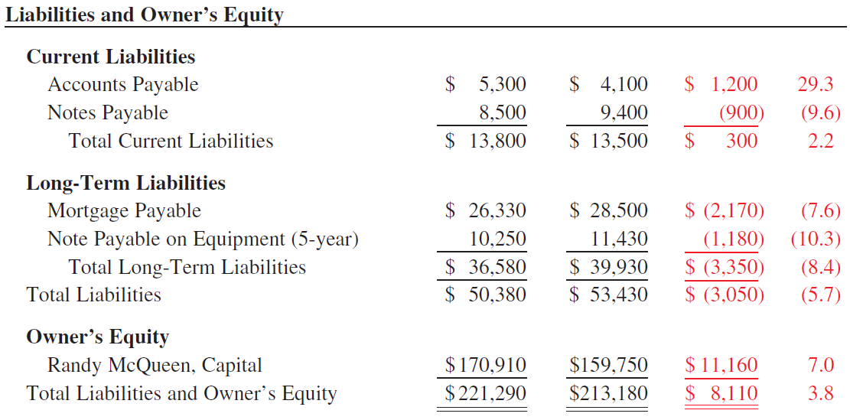

Slide 35


Slide 36
THE BOTTOM LINE
When all is said and done, the question is how well did the business do. The real score is found on the income statement. An income statement, also known as an operating statement or profit and loss statement, is a summary of the operations of a business over a period of time—usually a month, a quarter, or a year. For any business to exist, it must have earnings as well as expenses in the form of either cash or credit. The income statement shows the revenue, or earnings, of the business from the sale of goods and services; the expenses, the costs incurred to generate that revenue; and the bottom line profit or loss, the difference between revenue and expenses.

Slide 37
where:
Revenue = Earnings (either cash or credit) from sales during the period
Total expenses = Cost of goods sold + Operating expenses + Taxes

Slide 38
PREPARING AN INCOME STATEMENT
Once again, let’s begin by looking at a typical income statement. As before, we will use Hypothetical Enterprises, Inc., to illustrate. Carefully look over the following income statement and then read the descriptions of each section and its components.

Slide 39
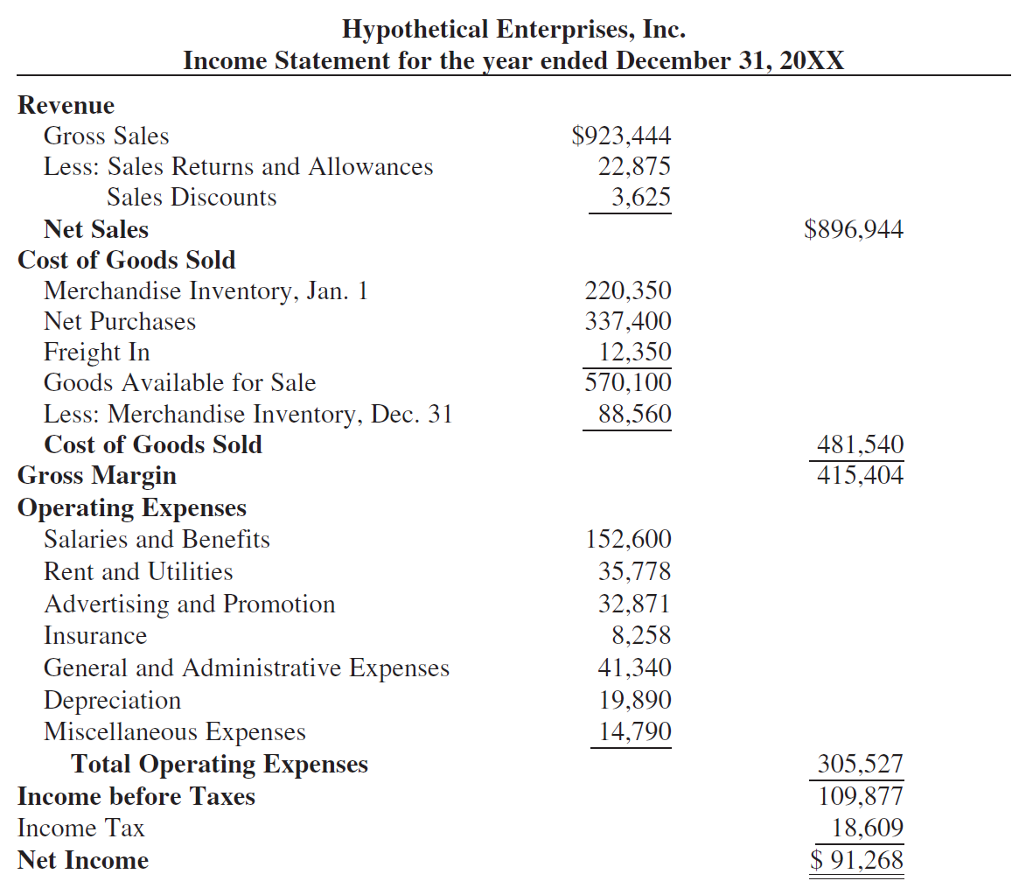

Slide 41
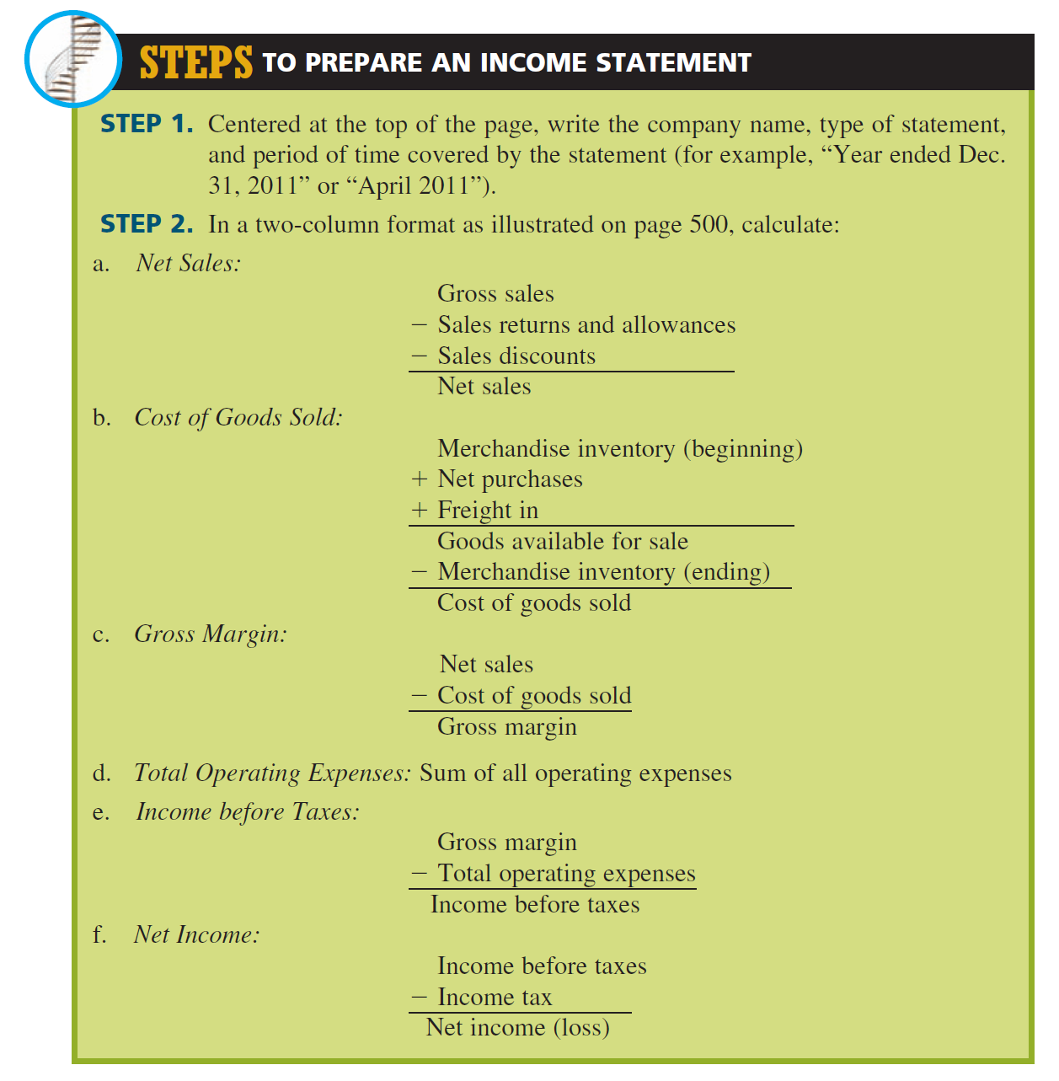

Slide 43
EXAMPLE 4
Use the following financial information to prepare an income statement for Royal Equipment Supply, Inc., for the year ended December 31, 2011: gross sales, $458,400; sales returns and allowances, $13,200; sales discounts, $1,244; merchandise inventory, Jan. 1, 2011, $198,700; merchandise inventory, Dec. 31, 2011, $76,400; net purchases, $86,760; freight in, $875; salaries, $124,200; rent, $21,000; utilities, $1,780; advertising, $5,400; insurance, $2,340; administrative expenses, $14,500; miscellaneous expenses, $6,000; and income tax, $17,335.

Slide 44
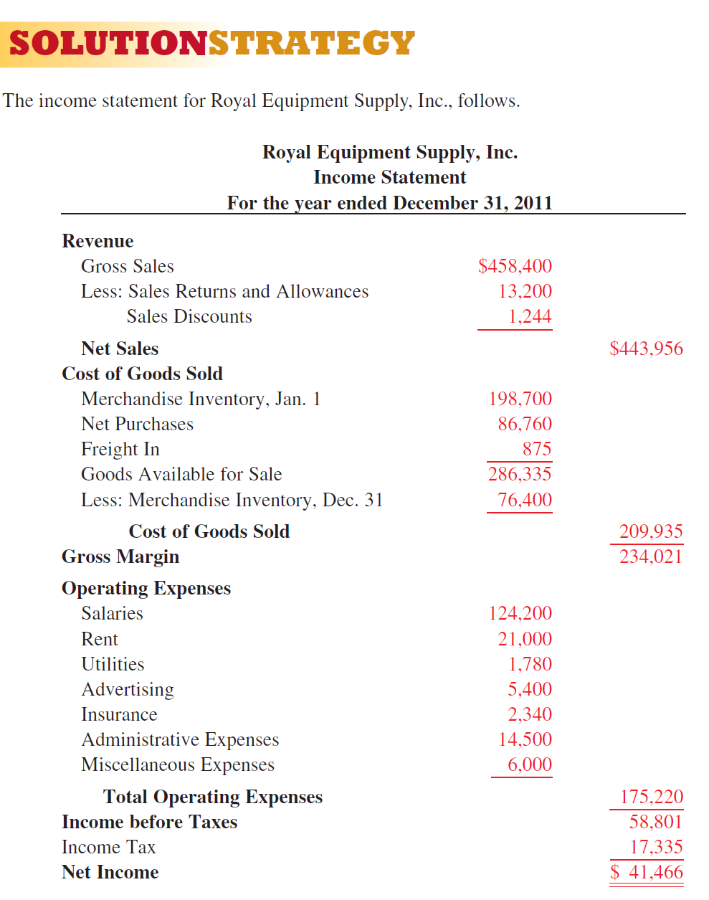

Slide 46
PREPARING A VERTICAL ANALYSIS
OF AN INCOME STATEMENT

Slide 47
PREPARING A VERTICAL ANALYSIS
OF AN INCOME STATEMENT
Vertical analysis can be applied to the income statement just as it was to the balance sheet. Each figure on the income statement is expressed as a percent of net sales (net sales 5 100%). The resulting figures describe how net sales were distributed among the expenses and what percent was left as net profit. For analysis purposes, this information can then be compared with the figures from previous operating periods for the company, with competitors’ figures, or with published industry averages for similar-size companies.
As with balance sheets, income statements with vertical analysis can be displayed in the format known as common-size, in which all figures on the statement appear as percentages.

Slide 48
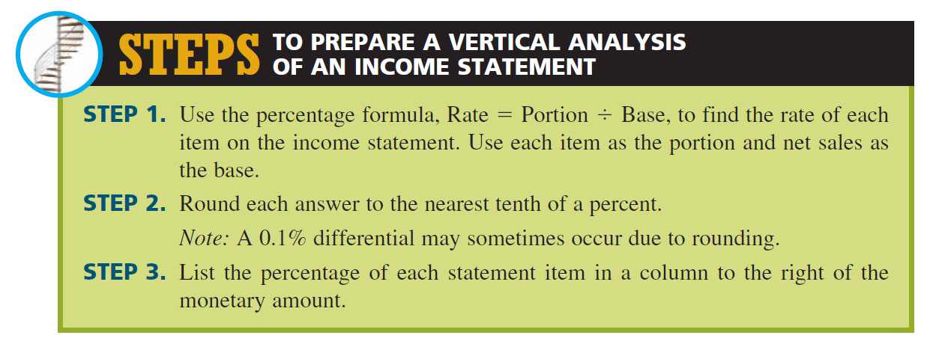

Slide 49
EXAMPLE 5
Prepare a vertical analysis of the income statement for Hypothetical Enterprises, Inc., on page 500.

Slide 50
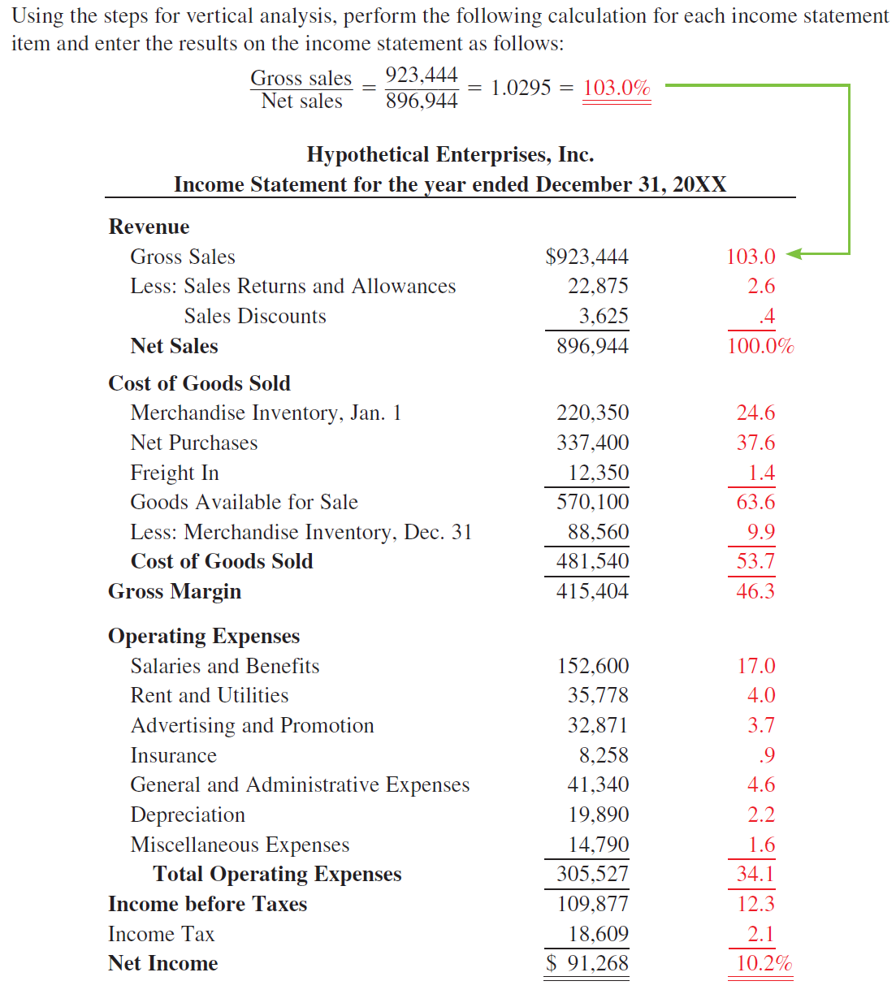

Slide 52
PREPARING A HORIZONTAL ANALYSIS
OF AN INCOME STATEMENT

Slide 53
PREPARING A HORIZONTAL ANALYSIS
OF AN INCOME STATEMENT
As with the balance sheet, the income statement can be prepared in a format that compares the financial data of the business from one operating period to another. This horizontal analysis provides percent increase or decrease information for each item on the income statement.
Such information provides a useful progress report of the company. As before, the previous or original period figure is the base.

Slide 54
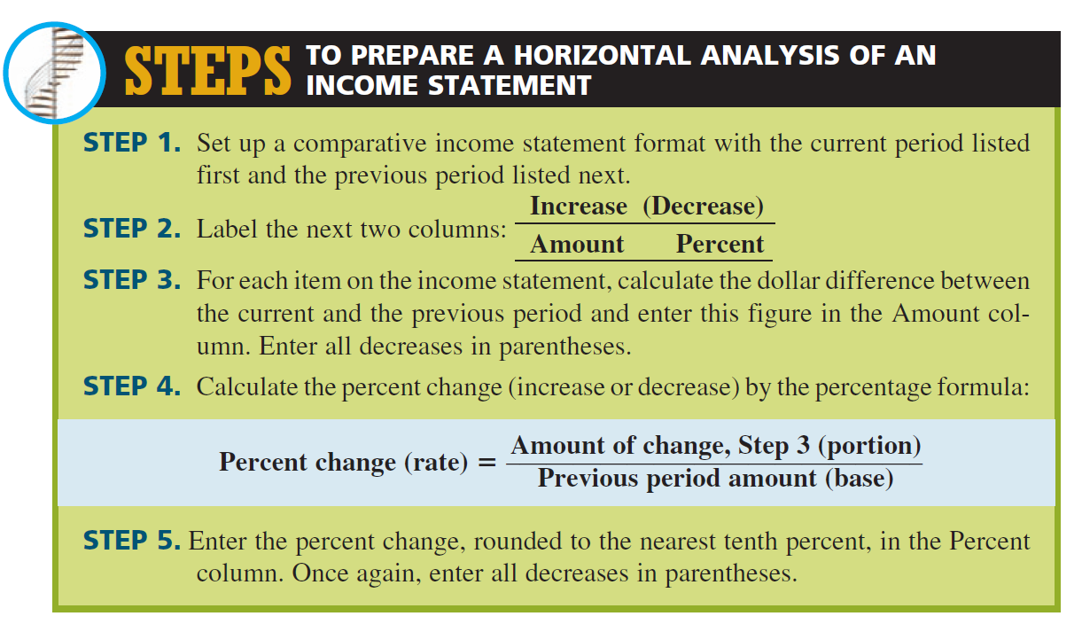

Slide 55
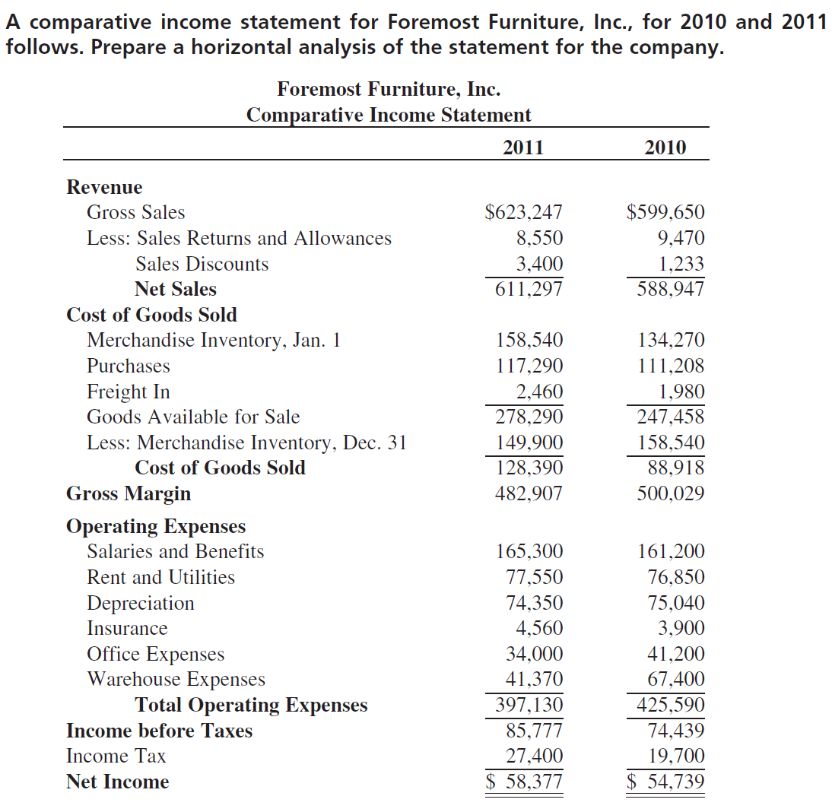
EXAMPLE6

Slide 56
EXAMPLE6

Slide 57
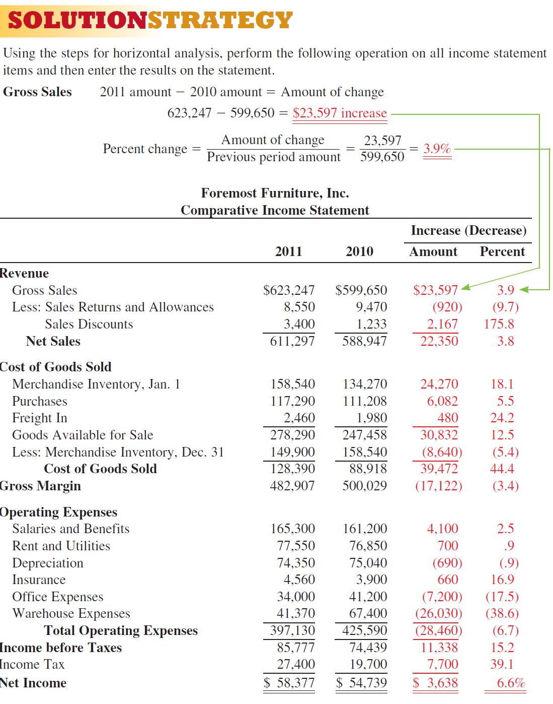

Slide 59


Slide 60
DEFINITION
In addition to vertical and horizontal analysis of financial statements, managers, creditors, and investors also study comparisons among various components on the statements. These comparisons are expressed as ratios and are known as financial ratios. Basically, financial ratios represent an effort by analysts to standardize financial information, which in turn makes comparisons more meaningful. The fundamental purpose of ratio analysis is to indicate areas requiring further investigation. Think of them as signals indicating areas of potential strength or weakness of the firm. Frequently, financial ratios have to be examined more closely to discover their true meaning. A high ratio, for example, might indicate that the numerator figure is too high or the denominator figure is too low.

Slide 61
Financial ratios fall into five major categories:
Liquidity Ratios tell how well a company can pay off its short-term debts and meet unexpected needs for cash.
Efficiency Ratios indicate how effectively a company uses its resources to generate sales. Also called as Activity Ratio or Asset Management Ratio
Leverage Ratios show how and to what degree a company has financed its assets. Also called as Debt Management Ratio.
Profitability Ratios tell how much of each dollar of sales, assets, and stockholders’ investment resulted in bottom-line net profit.
Market Price Ratio, do investors like what they see as reflected in P/E and M/B ratios?

Slide 62
EXAMPLE 7
Calculate the financial ratios for Hypothetical Enterprises, Inc., using the data from the financial statements presented on pages 489 and 500.

Slide 63
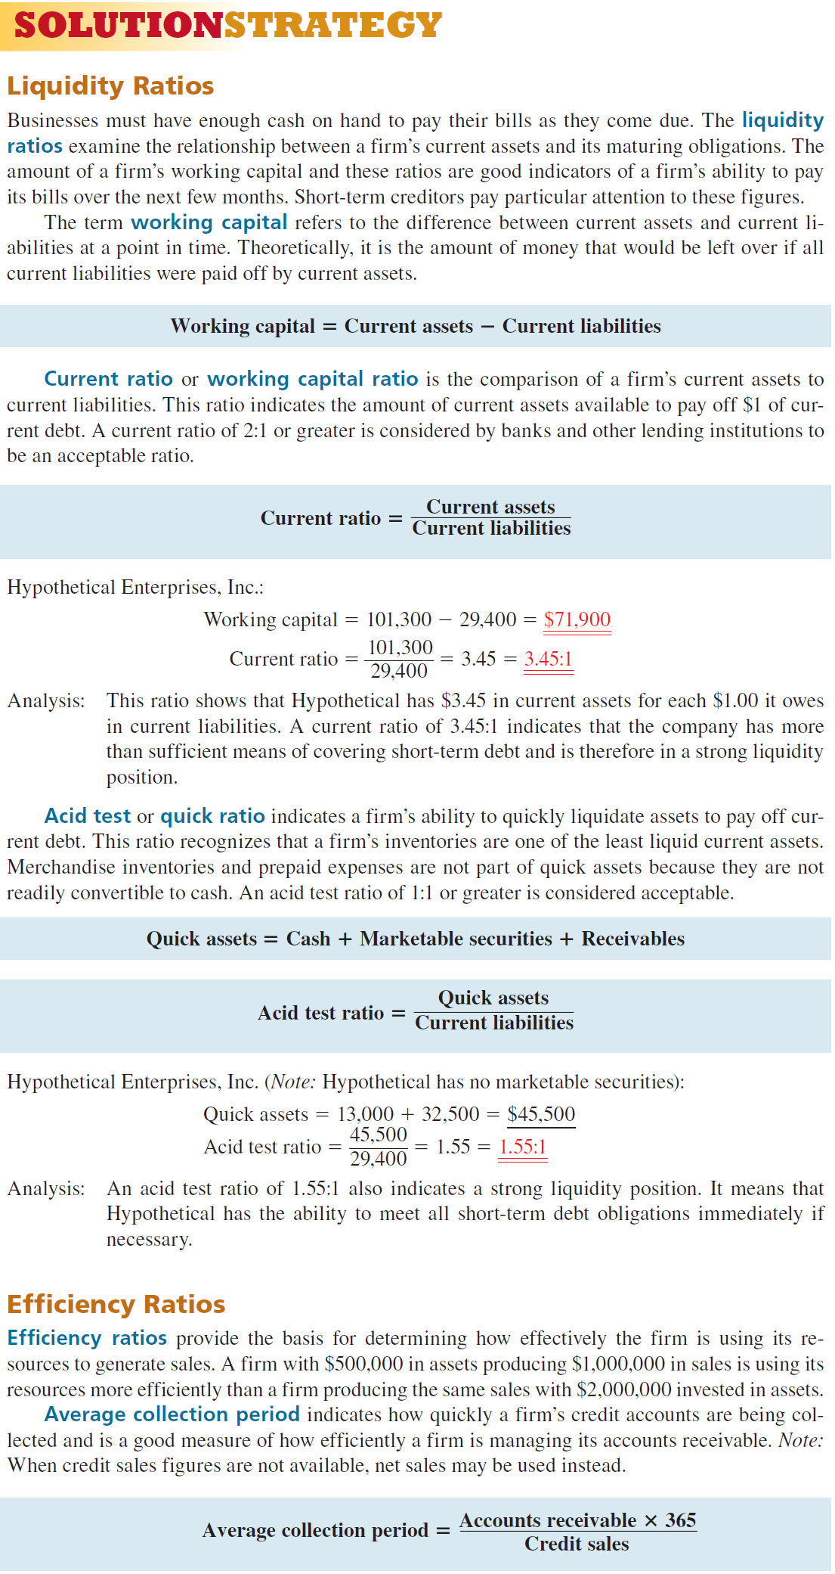

Slide 66
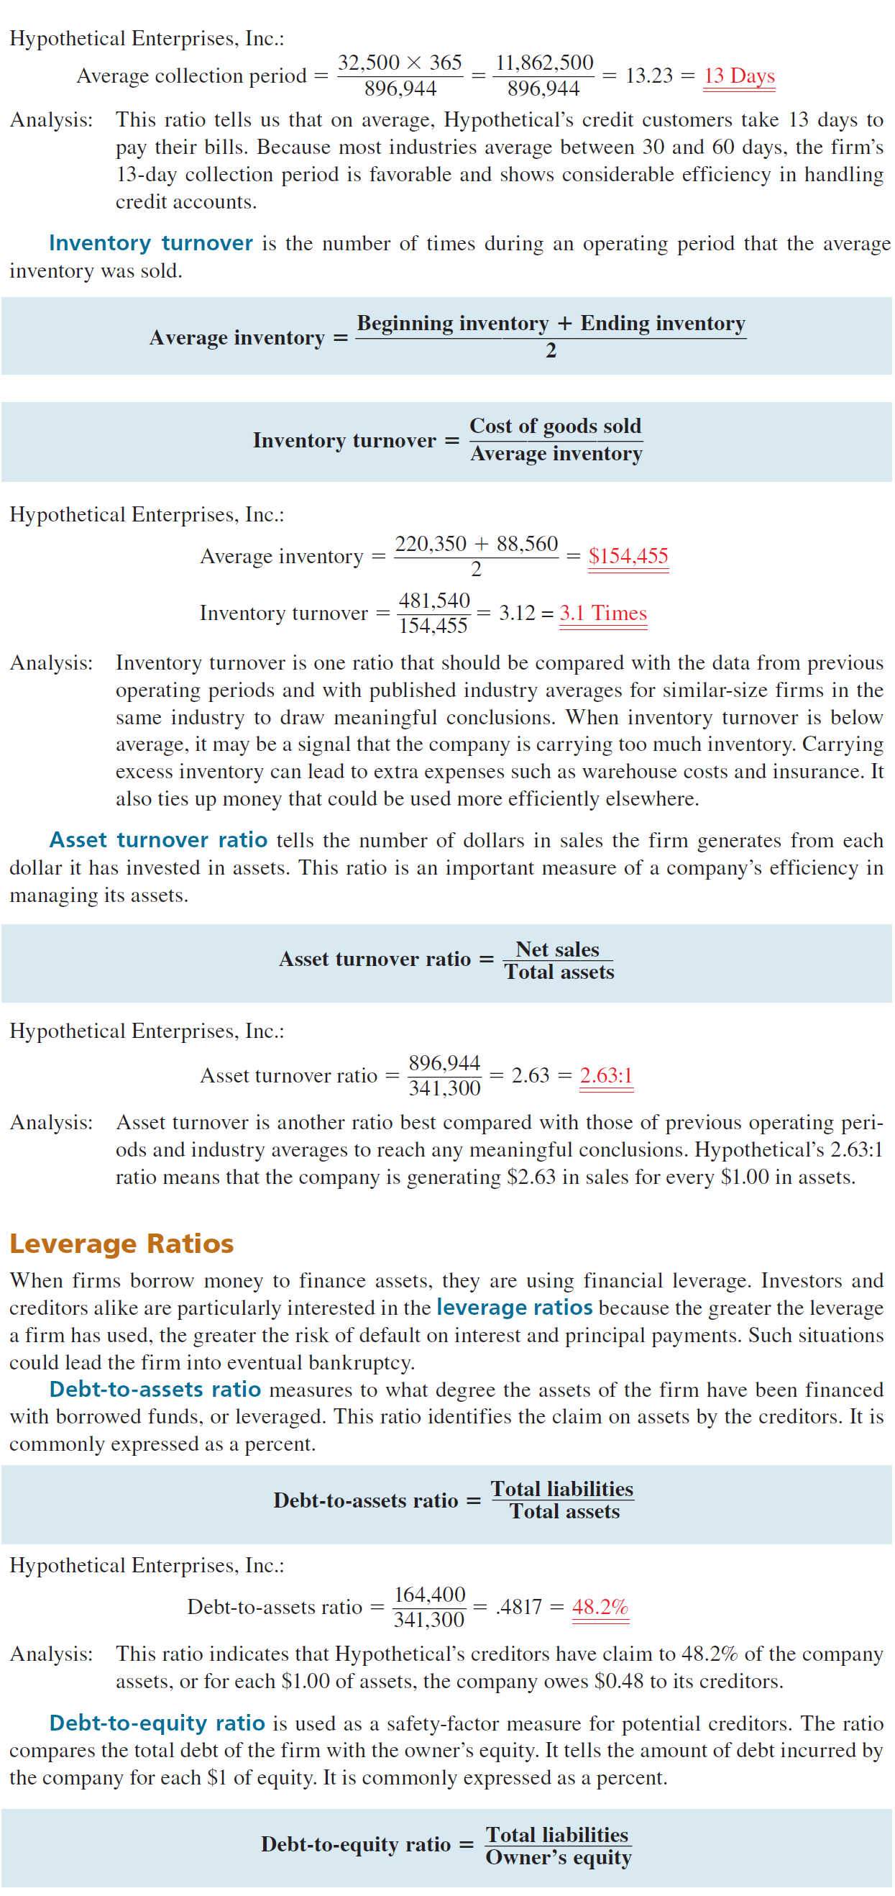

Slide 70
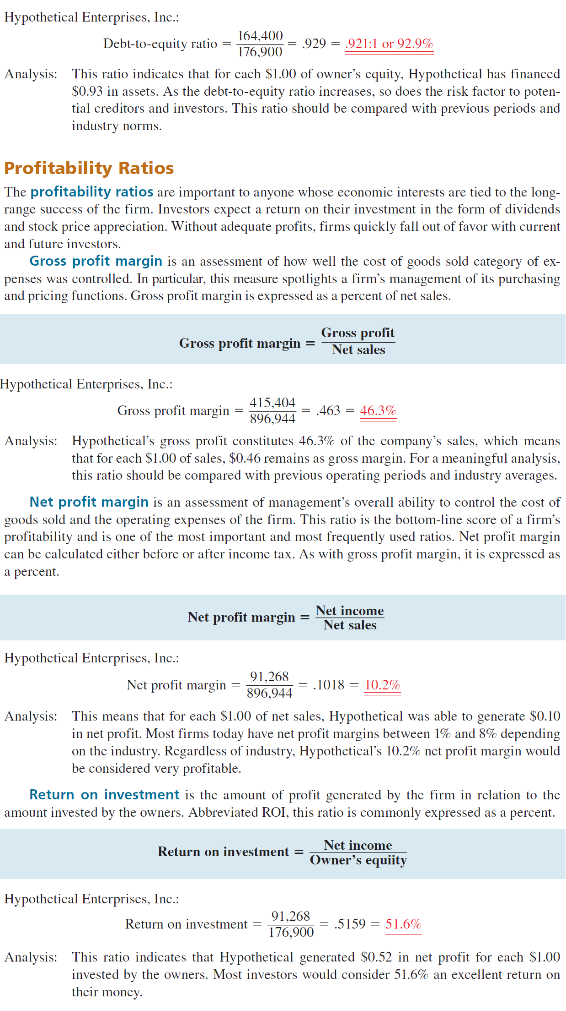

Slide 73
PREPARING A TREND ANALYSIS OF FINANCIAL DATA

Slide 74
TREND ANALYSIS
In Sections I and II of this chapter, we used horizontal analysis to calculate and report the amount and percent change in various balance sheet and income statement items from one operating period to another. When these percentage changes are tracked for a number of successive periods, it is known as trend analysis. Trend analysis introduces the element of time into financial analysis. Whereas data from one statement gives a firm’s financial position at a given point in time, trend analysis provides a dynamic picture of the firm by showing its financial direction over a period of time.

Slide 75
TREND ANALYSIS
Index numbers are used in trend analysis to show the percentage change in various financial statement items. With index numbers, a base year is chosen and is equal to 100%. All other years’ figures are measured as a percentage of the base year. Once again, we encounter the now familiar percentage formula Rate = Portion : Base. The index number should be expressed as a percent rounded to the nearest tenth.

Slide 76
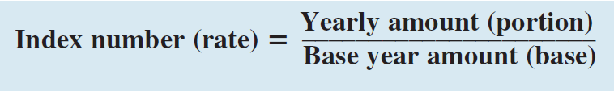
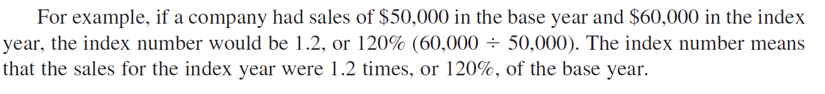

Slide 77
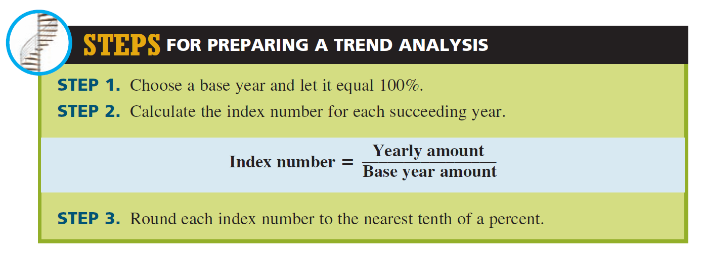

Slide 78
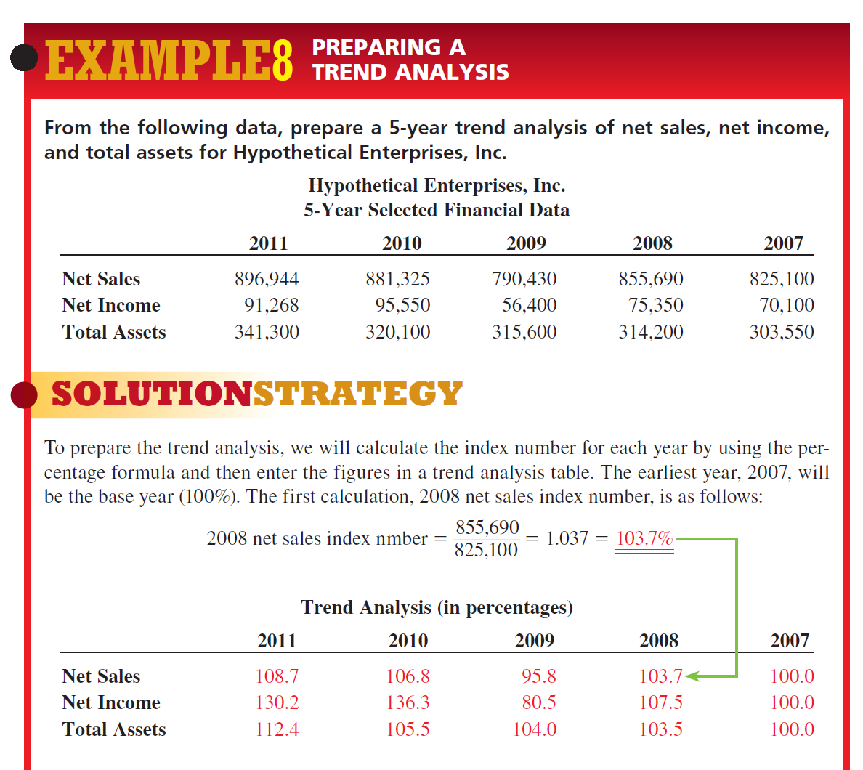

Slide 79
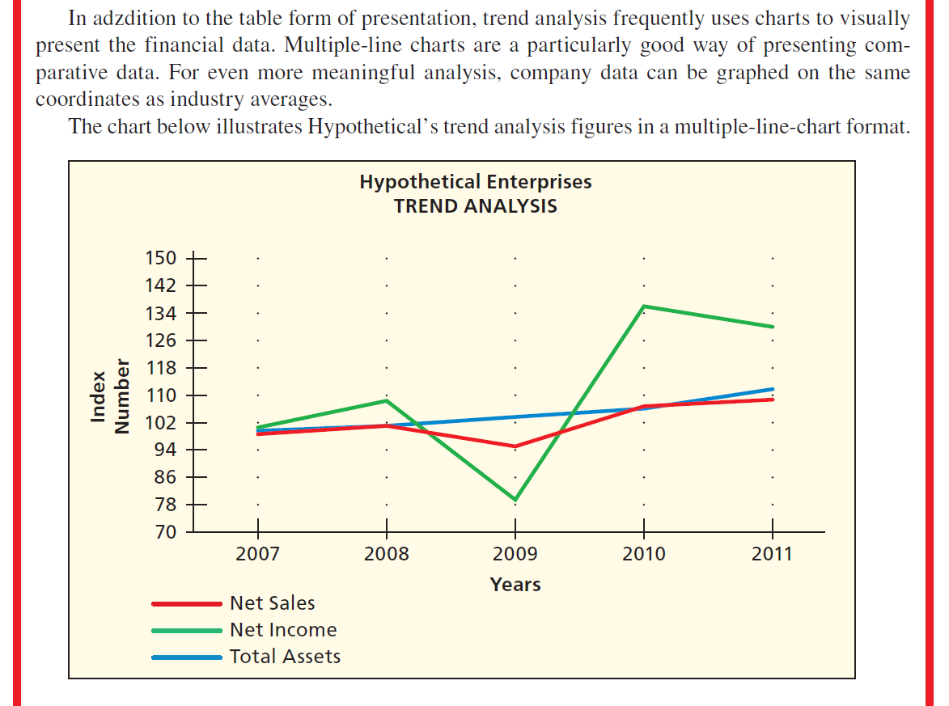

Slide 80
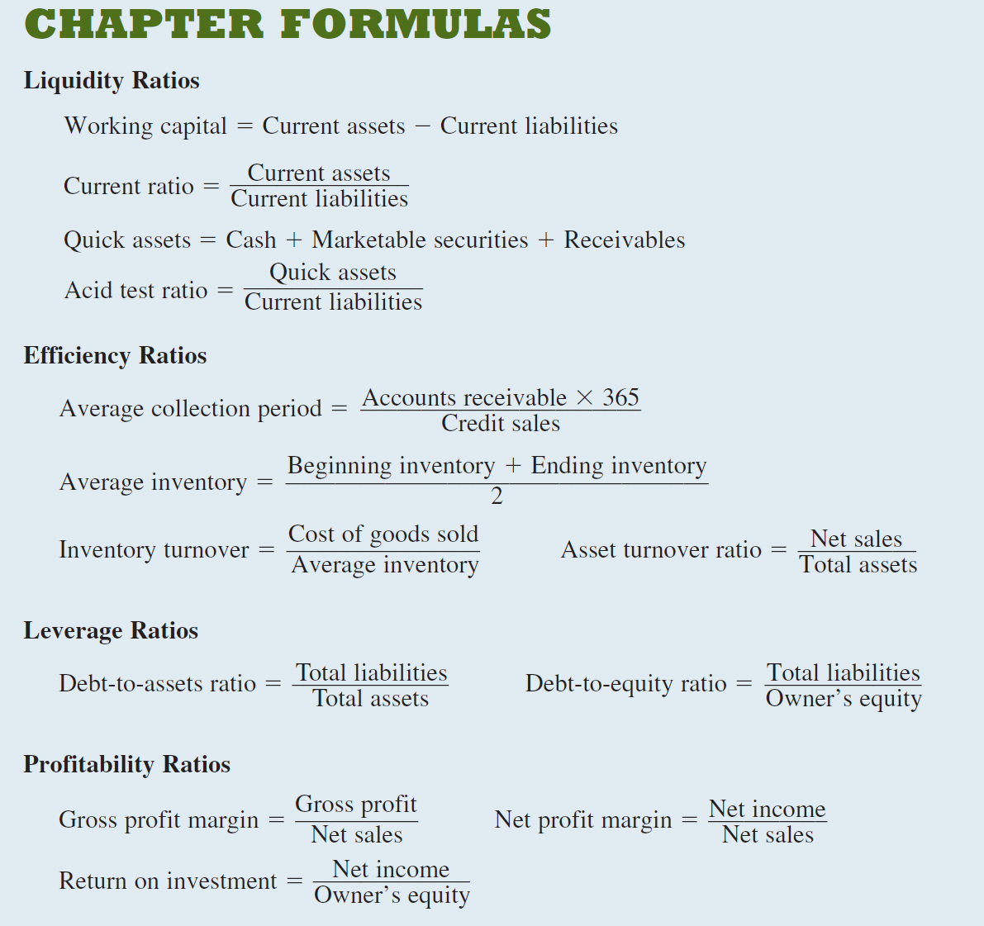

Slide 81
Balance Sheet: Assets
 |  | 2002E |  | 2001
Cash |  | 14,000 |  | 7,282
ST investments |  | 71,632 |  | 0
AR |  | 878,000 |  | 632,160
Inventories |  | 1,716,480 |  | 1,287,360
Total CA |  | 2,680,112 |  | 1,926,802
Gross FA |  | 1,197,160 |  | 1,202,950
Less: Accum. Deprec. |  | 380,120 |  | 263,160
Net FA |  | 817,040 |  | 939,790
Total assets |  | 3,497,152 |  | 2,866,592
18

Slide 82
Liabilities and Equity
 |  | 2002E |  | 2001
Accounts payable |  | 436,800 |  | 524,160
Notes payable |  | 600,000 |  | 720,000
Accruals |  | 408,000 |  | 489,600
Total CL |  | 1,444,800 |  | 1,733,760
Long-term debt |  | 500,000 |  | 1,000,000
Common stock |  | 1,680,936 |  | 460,000
Retained earnings |  | (128,584) |  | (327,168)
Total equity |  | 1,552,352 |  | 132,832
Total L&E |  | 3,497,152 |  | 2,866,592
18

Slide 83
Income Statement
 |  | 2002E |  | 2001
Sales |  | 7,035,600 |  | 5,834,400
COGS |  | 6,100,000 |  | 5,728,000
Other expenses |  | 312,960 |  | 680,000
Depreciation |  | 120,000 |  | 116,960
Tot. op. costs |  | 6,532,960 |  | 6,524,960
EBIT |  | 502,640 |  | (690,560)
Interest exp. |  | 80,000 |  | 176,000
EBT |  | 422,640 |  | (866,560)
Taxes (40%) |  | 169,056 |  | (346,624)
Net income |  | 253,584 |  | (519,936)

Slide 84
Other Data
 |  | 2002E |  | 2001
Shares out. |  | 250,000 |  | 100,000
EPS |  | $1.014 |  | ($5.199)
DPS |  | $0.220 |  | $0.110
Stock price |  | $12.17 |  | $2.25
Lease pmts |  | $40,000 |  | $40,000
19

Slide 85
Why are ratios useful?
Standardize numbers; facilitate comparisons
Used to highlight weaknesses and strengths

Slide 86
What are the five major categories of ratios, and what questions do they answer?
Liquidity: Can we make required payments as they fall due?
Asset management: Do we have the right amount of assets for the level of sales?
(More…)

Slide 87
Debt management: Do we have the right mix of debt and equity?
Profitability: Do sales prices exceed unit costs, and are sales high enough as reflected in PM, ROE, and ROA?
Market value: Do investors like what they see as reflected in P/E and M/B ratios?

Slide 88
Calculate the firm’s forecasted current and quick ratios for 2002.
CA
CL
$2,680
$1,445
CR₀₂ = = = 1.85x.
CA - Inv.
CL
QR₀₂ =
$2,680 - $1,716
$1,445
= = 0.67x.

Slide 89
Comments on CR and QR
 | 2002E | 2001 | 2000 | Ind.
CR | 1.85x | 1.1x | 2.3x | 2.7x
QR | 0.67x | 0.4x | 0.8x | 1.0x
Expected to improve but still below the industry average.
Liquidity position is weak.

Slide 90
What is the inventory turnover ratio as compared to the industry average?
Sales
Inventories
Inv. turnover =
= = 4.10x.
$7,036
$1,716
 | 2002E | 2001 | 2000 | Ind.
Inv. T. | 4.1x | 4.5x | 4.8x | 6.1x

Slide 91
Comments on Inventory Turnover
Inventory turnover is below industry average.
Firm might have old inventory, or its control might be poor.
No improvement is currently forecasted.

Slide 92
DSO is the average number of days after making a sale before receiving cash.
Receivables
Average sales per day
DSO =
= =
= 44.9 days.
Receivables
Sales/360
$878
$7,036/360

Slide 93
Appraisal of DSO
 | 2002E | 2001 | 2000 | Ind.
DSO | 44.9 | 39.0 | 36.8 | 32.0
Firm collects too slowly, and situation is getting worse.
Poor credit policy.

Slide 94
Fixed Assets and Total Assets
Turnover Ratios
Fixed assets
turnover
Sales
Net fixed assets
=
= = 8.61x.
$7,036
$817
Total assets
turnover
Sales
Total assets
=
= = 2.01x.
$7,036
$3,497
(More…)

Slide 95
 | 2002E | 2001 | 2000 | Ind.
FA TO | 8.6x | 6.2x | 10.0x | 7.0x
TA TO | 2.0x | 2.0x | 2.3x | 2.5x
FA turnover is expected to exceed industry average. Good.
TA turnover not up to industry average. Caused by excessive current assets (A/R and inventory).

Slide 96
Calculate the debt, TIE, and EBITDA coverage ratios.
Total debt
Total assets
Debt ratio =
= = 55.6%.
$1,445 + $500
$3,497
EBIT
Int. expense
TIE =
= = 6.3x.
$502.6
$80
(More…)

Slide 97
EBITDA coverage
= EC
EBIT + Depr. & Amort. + Lease payments
Interest Lease Loan pmt.
expense pmt.
= = 5.5x.
+ +
$502.6 + $120 + $40
$80 + $40 + $0
All three ratios reflect use of debt, but focus on different aspects.

Slide 98
How do the debt management ratios compare with industry averages?
 | 2002E | 2001 | 2000 | Ind.
D/A | 55.6% | 95.4% | 54.8% | 50.0%
TIE | 6.3x | -3.9x | 3.3x | 6.2x
EC | 5.5x | -2.5x | 2.6x | 8.0x
Too much debt, but projected to improve.

Slide 99
Profit Margin (PM)
NI
Sales
$253.6
$7,036
PM = = = 3.6%.
 | 2002E | 2001 | 2000 | Ind.
PM | 3.6% | -8.9% | 2.6% | 3.6%
Very bad in 2001, but projected to
meet industry average in 2002. Looking good.

Slide 100
Basic Earning Power (BEP)
EBIT
Total assets
BEP =
= =
14.4%.
$502.6
$3,497
(More…)

Slide 101
 | 2002E | 2001 | 2000 | Ind.
BEP | 14.4% | -24.1% | 14.2% | 17.8%
BEP removes effect of taxes and financial leverage. Useful for comparison.
Projected to be below average.
Room for improvement.

Slide 102
Return on Assets (ROA)
and Return on Equity (ROE)
Net income
Total assets
ROA =
= = 7.3%.
$253.6
$3,497
(More…)

Slide 103
Net income
Common equity
ROE =
= = 16.3%.
$253.6
$1,552
 | 2002E | 2001 | 2000 | Ind.
ROA | 7.3% | -18.1% | 6.0% | 9.0%
ROE | 16.3% | -391.0% | 13.3% | 18.0%
Both below average but improving.

Slide 104
Effects of Debt on ROA and ROE
ROA is lowered by debt-interest expense lowers net income, which also lowers ROA.
However, the use of debt lowers equity, and if equity is lowered more than net income, ROE would increase.

Slide 105
Calculate and appraise the
P/E, P/CF, and M/B ratios.
Price = $12.17.
EPS = = = $1.01
P/E = = = 12x.
NI
Shares out.
$253.6
250
$12.17
$1.01
Price per share
EPS

Slide 106
Typical industry average P/E ratios
Industry | P/E ratio
Banking | 17.15
Computer Software Services | 33.01
Drug | 41.81
Electric Utilities (Eastern U.S.) | 19.40
Internet Services* | 290.35
Semiconductors | 78.41
Steel | 12.71
Tobacco | 11.59
Water Utilities | 21.84
* Because many internet companies have negative earnings and no P/E, there was only a small sample of internet companies.

Slide 107
CASH FLOW PER SHARE =
NI + Depr.
Shares out.
CF per share =
= = $1.49.
$253.6 + $120.0
250
PRICE PER CASH FLOW =
Price per share
Cash flow per share
P/CF =
= = 8.2x.
$12.17
$1.49

Slide 108
BOOK VALUE PER SHARE =
Com. equity
Shares out.
BVPS =
= = $6.21.
$1,552
250
MARKET PER BOOK VALUE=
Mkt. price per share
Book value per share
M/B =
= = 2.0x.
$12.17
$6.21
(More…)

Slide 109
 | 2002E | 2001 | 2000 | Ind.
P/E | 12.0x | -0.4x | 9.7x | 14.2x
P/CF | 8.2x | -0.6x | 8.0x | 7.6x
M/B | 2.0x | 1.7x | 1.3x | 2.9x
P/E: How much investors will pay for $1 of earnings. High is good.
M/B: How much paid for $1 of book value. Higher is good.
P/E and M/B are high if ROE is high, risk is low.

