Slide 1
Securities and Distribution of Profit and Overhead
CHAPTER 19
Notes:
Note jajalan

Slide 2
DEFINITION
A corporation is a body that is granted a charter by a state legally recognizing it as a separate entity, having its own rights, privileges, and liabilities distinct from those of its owners. A corporation acquires assets, enters into contracts, sues or is sued, and pays taxes in its own name. Two primary reasons for forming a corporation are to limit liability and facilitate broadening the ownership base. A corporation raises capital by selling shares of ownership, which increases its assets without increasing its debt.
The general term applied to the shares of a corporation is capital stock. Each share of capital stock is a share of the ownership of the company’s net assets (assets minus liabilities). The number of shares that a corporation is authorized to issue, or offer for sale, is set forth in its charter, the basic approval document issued by the state, under which the corporation operates. Ownership of stock is evidenced by a stock certificate.

Slide 3
DEFINITION
Broker commissions may be a flat rate per transaction, a percent of the value of the stock, an amount per share traded, or an amount negotiated between the client and the broker. Generally, commissions for brokers are less than 1% of the value of the stock, ranging from $0.02 to $0.50 per share bought or sold.

Slide 4
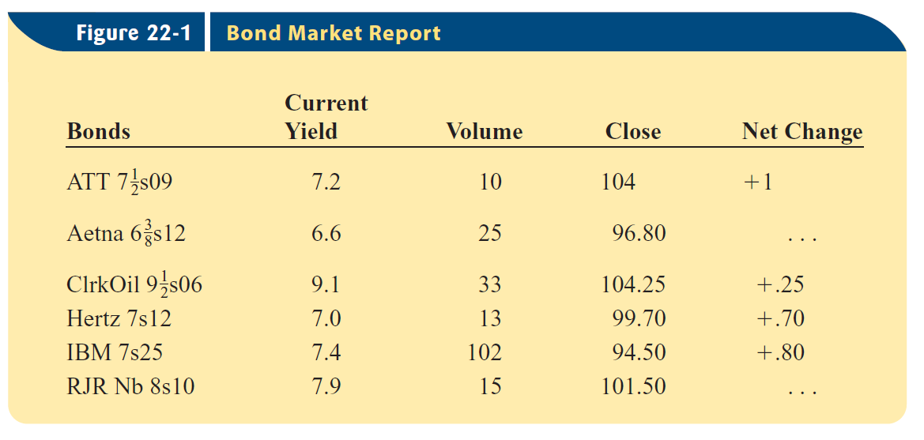

Slide 5
TOTAL COST AND PROCEED OF STOCK
Both the buyer and the seller of stock pay commissions to the stockbroker. The total amount paid by a buyer to purchase a stock includes the market price of the stock and the stockbroker’s commission (charge). The total cost paid by the purchaser is equal to the purchase price plus a broker’s commission. The proceeds received by the seller are equal to the selling price minus the commission.

Slide 6
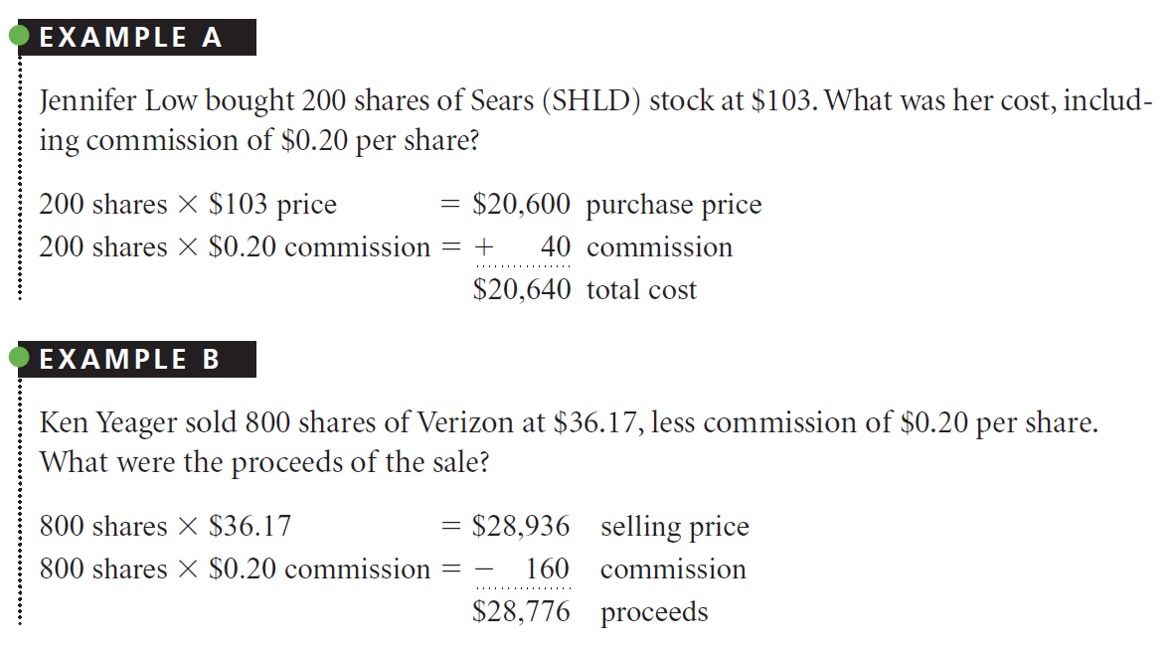

Slide 7
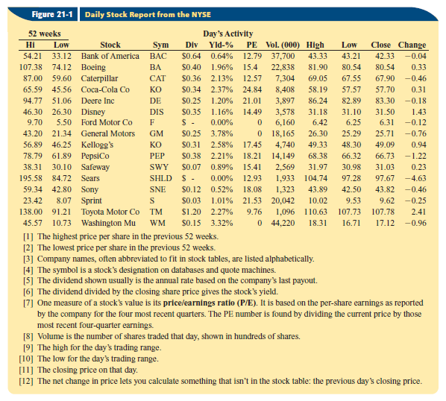

Slide 8
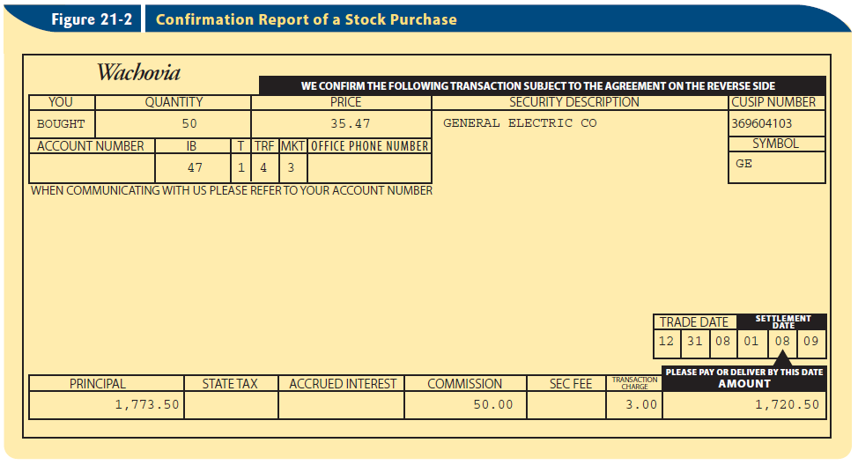

Slide 9
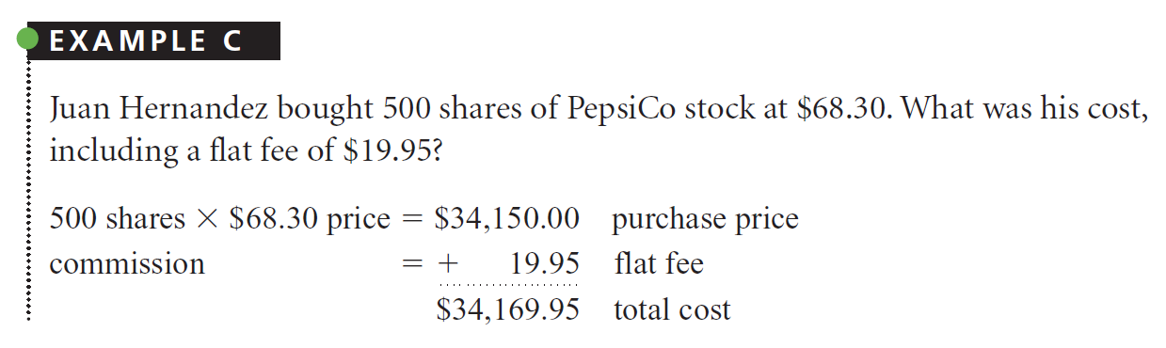

Slide 10
Capital Gain and Capital Loss
The par value may differ from the market price. In the marketplace, stock may be sold for any amount agreed upon by the buyer and seller.
After purchasing stock, a buyer may sell that stock at any price on the open market,regardless of the par value. Stocks are usually bought and sold on stock exchanges, the formal marketplaces set up for the purpose of trading stocks.
If no transaction cost, and selling price exeed the purchasing price, then the buyer get a capital gain. If selling price less than purchasing price (and if no transaction cost), then the buyer get a capital loss.

Slide 11
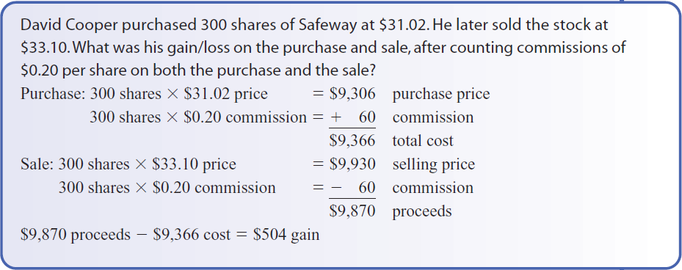

Slide 12
Computing the Costs and Proceeds of Round and Odd Lots

Slide 13
ROUND LOT vs. ODD LOT
Stocks are sold in round lots, odd lots, or a combination of the two. A round lot usually is 100 shares. An odd lot consists of any number of shares less than 100 (1 to 99 shares is an odd lot for a stock with a 100-share round lot).When odd lots are purchased, a small extra charge, or odd-lot differential, is commonly added to the round-lot price. The differential is added to the price for a purchaser and deducted from the price for the seller. In this book, we use a differential of 12.5 cents as the odd-lot rate.

Slide 14
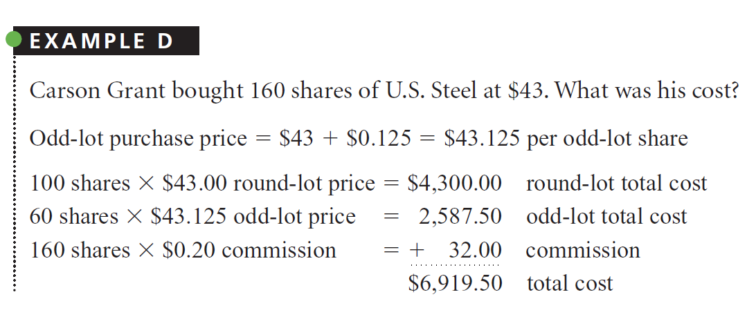

Slide 15
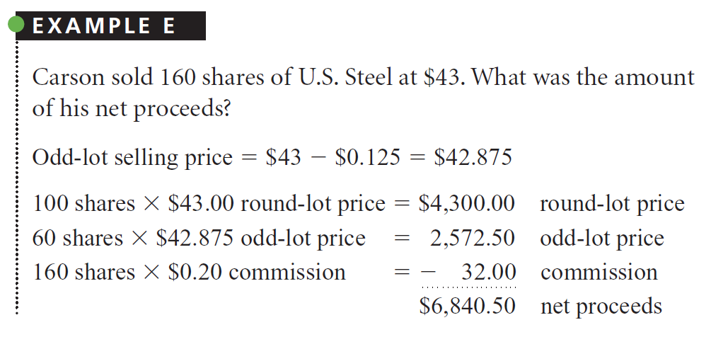

Slide 16
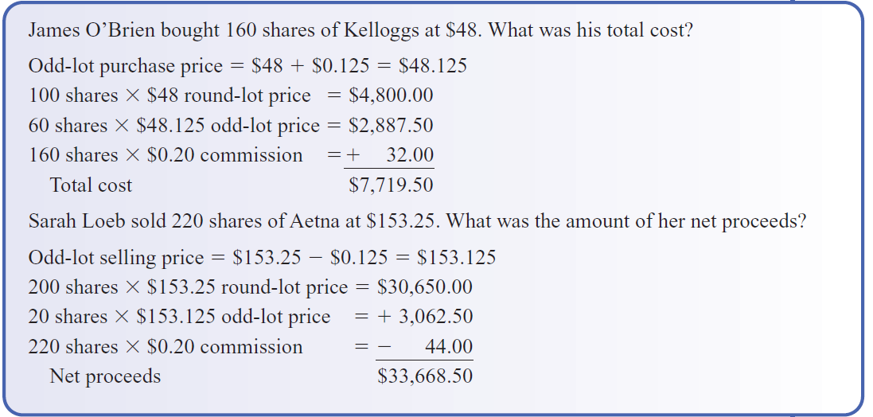

Slide 17
Computing the Rate of Yield and Gains or Losses

Slide 18
DEFINITION
The board of directors is a group of people elected by shareholders to oversee the operations of the corporation. The board has sole authority to distribute earnings to shareholders.When such action is taken, the directors are said to declare a dividend.
The rate of dividend is either a certain percent of the par value of the stock or a flat amount of money per share. Thus, a dividend of 8% on a stock with a par value of $100 would be $8.00 per share.Most large corporations pay dividends quarterly.
The rate of yield from an investment in stock is the ratio of the dividend to the total cost of the stock.

Slide 19
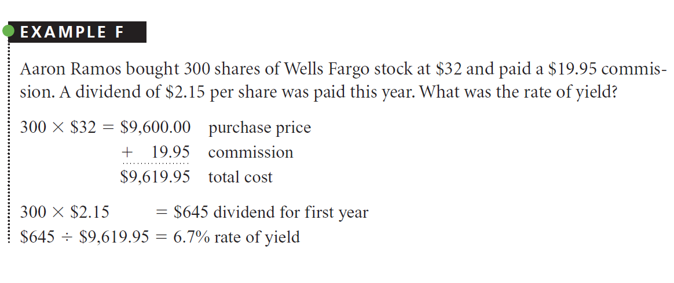

Slide 20
GAIN OR LOSS ON SALE OF STOCK
For income tax and accounting purposes, the amount of gain or loss on a sale of stock is determined by comparing the sale proceeds to the total cost.

Slide 21
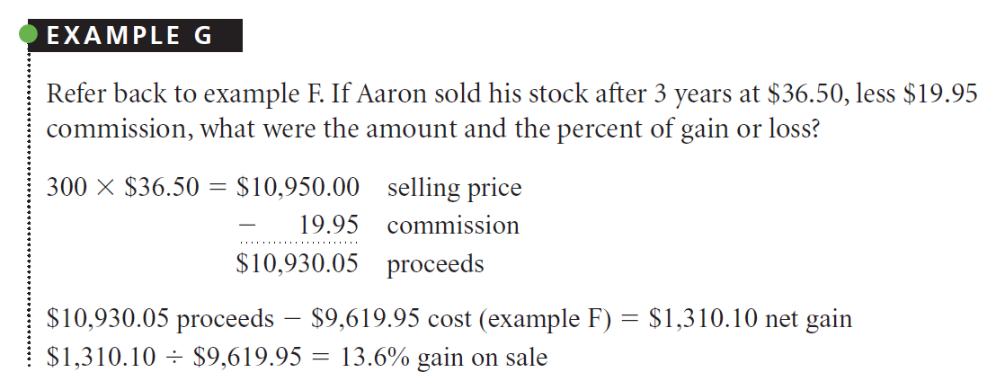

Slide 22
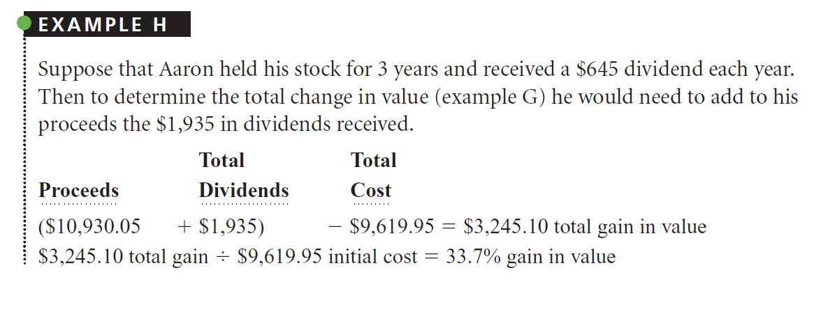

Slide 23
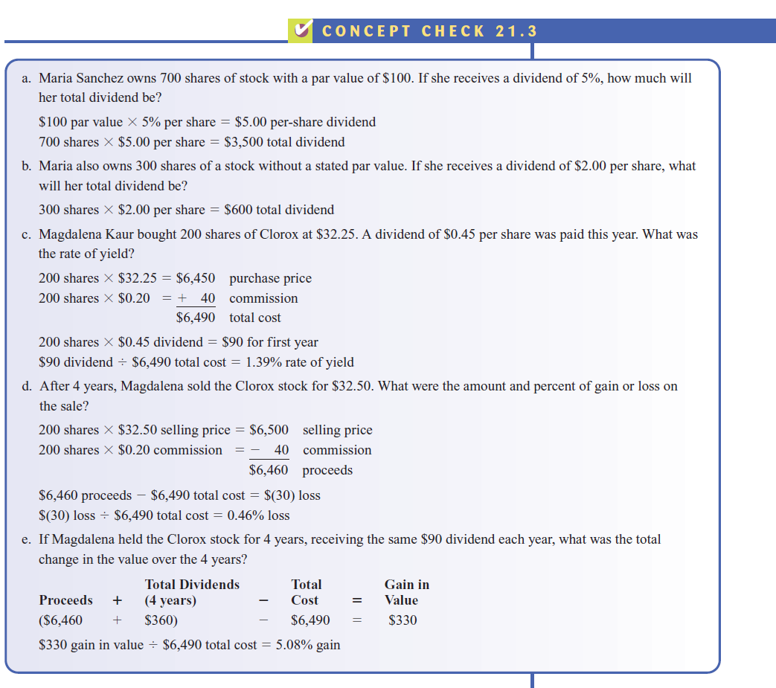

Slide 24
Computing Comparative Earning Potential

Slide 25
DEFINITION
Common stock is the usual type of stock issued by a corporation. Another type frequently issued, preferred stock, gives holders a right to share in earnings and liquidation before common shareholders do. For example, a company that has a 7% preferred stock must first pay dividends of 7% of the par value to the holders of preferred stock before anything is paid to the holders of common stock.
Preferred stock may be designated as cumulative—that is, if the corporation doesn’t pay the specified percentage, the unpaid amount, called a dividend in arrears, carries over to the following year or years. If dividends aren’t paid on noncumulative preferred stock during one year, the unpaid amount doesn’t carry over to the next year.

Slide 26
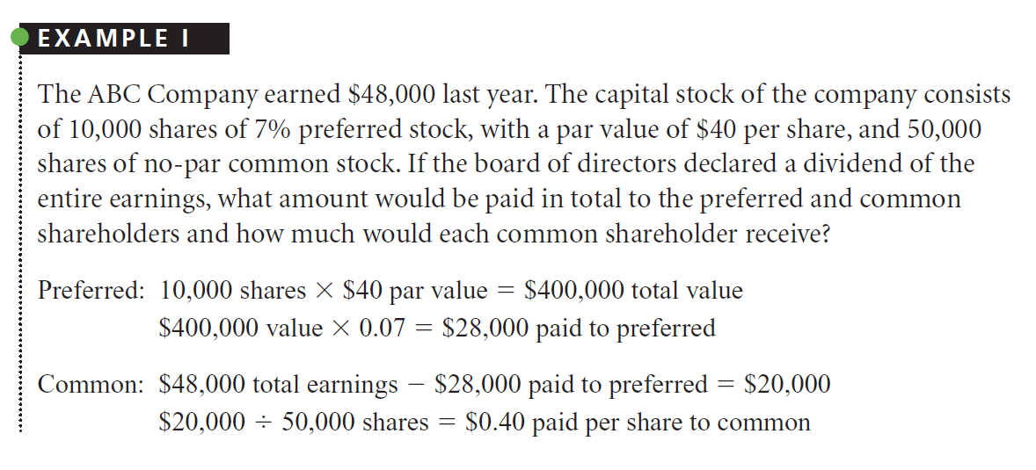

Slide 27
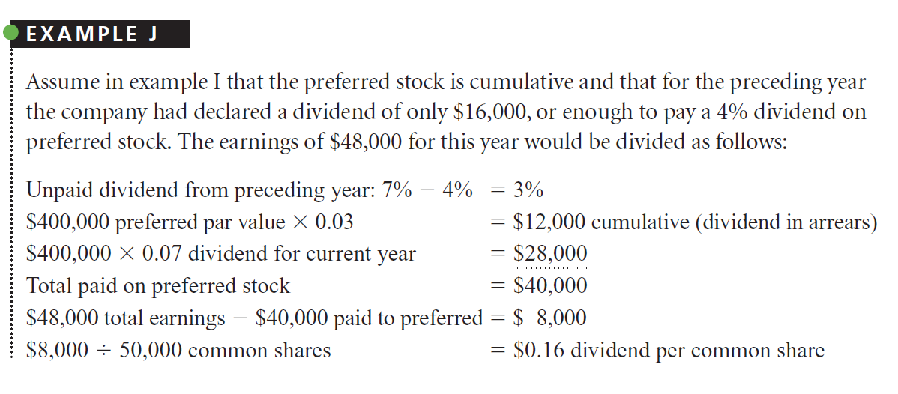

Slide 28
CONVERTIBLE PREFERRED STOCK
Another feature that sometimes makes preferred stock an attractive investment is the possibility of converting the preferred stock into common stock.
Convertible preferred stock gives the owner the option of converting those preferred shares into a stated number of common shares. For example, a stated conversion of 1 to 3 means that 1 share of preferred stock could be changed into 3 shares of common stock.
The conversion feature combines the safety of preferred stock with the possibility of growth through conversion to common stock.

Slide 29
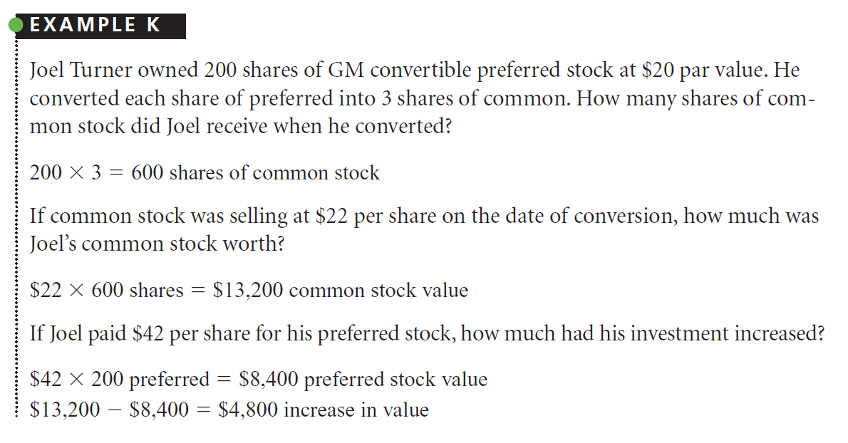

Slide 30
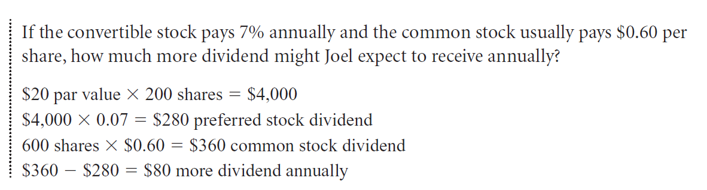

Slide 31
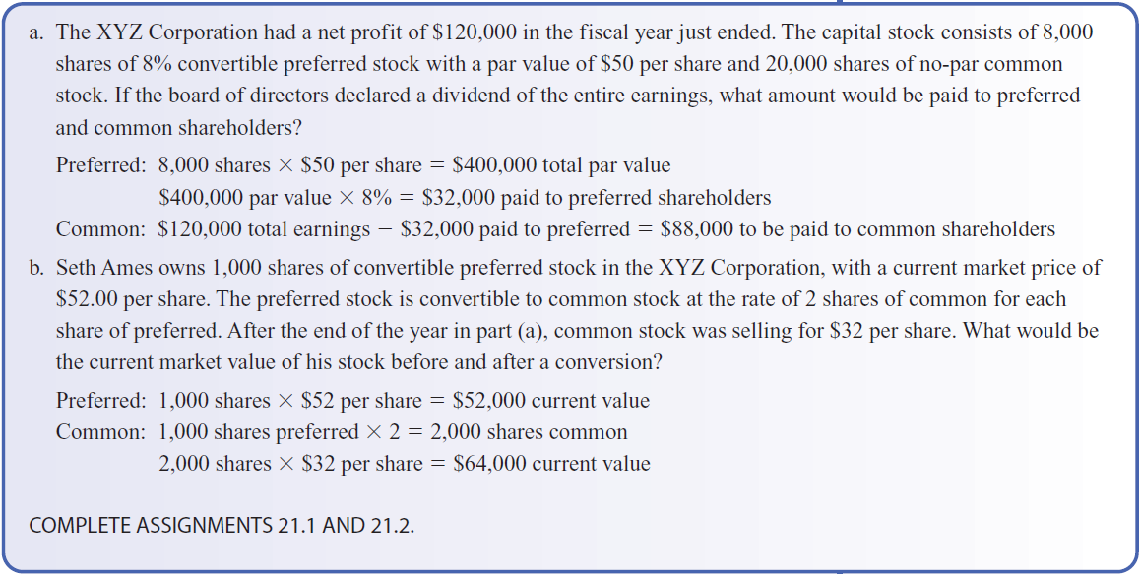

Slide 32
Corporate and Government Bonds

Slide 33
DEFINITION
When a corporation or government entity needs cash for a long period of time, usually 10 years or more, it often will issue long-term notes known as bonds. Bonds are bought and sold on the open market,much like stocks.
Two main types of government bonds are treasury bonds and municipal bonds. Treasury bonds are issued by the United States government. These bonds are fully guaranteed by the full faith and credit of the United States government. Bondholders are protected against default unless the federal government becomes insolvent.
Municipal bonds are issued by states, cities, school districts, and other public entities. Unlike treasury bonds,municipal bonds pose a risk that the issuer might fail to repay the principal. Interest paid on municipal bonds generally is exempt from federal and state income taxes.

Slide 34
DEFINITION
There are many kinds of corporate bonds, two of which are convertible bonds and callable bonds. Convertible bonds have a provision that they may be converted to a designated number of shares or a designated value of the corporation’s stock.
Callable bonds have a provision that the issuer can repurchase, or call in, the bonds at specified dates if the board of directors authorizes the retirement (payoff) of the bonds before their maturity date. Such action by the board of directors would be appropriate if interest rates fell significantly below the interest rate of the callable bond.

Slide 35
Computing Gains and Losses on Corporate Bonds

Slide 36
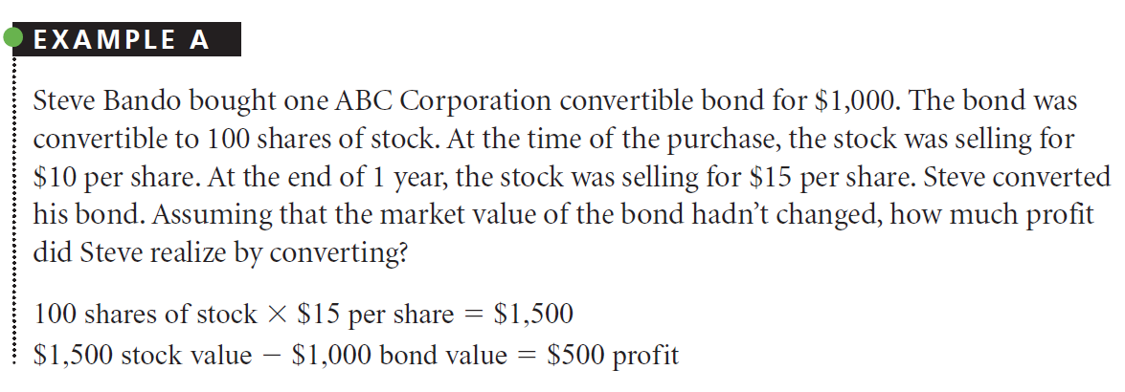

Slide 37
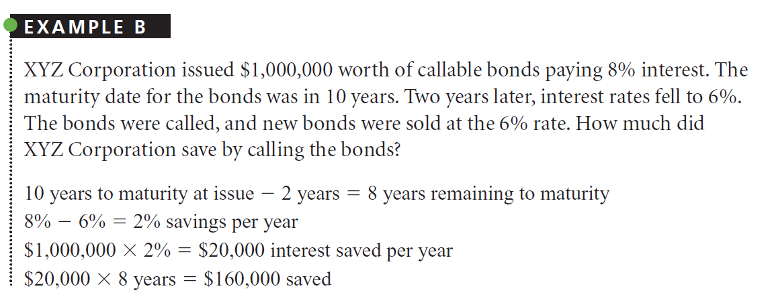

Slide 38
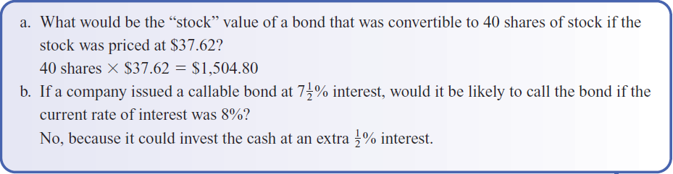

Slide 39
Computing Annual Interest on Corporate and Government Bonds

Slide 40
DEFINITION
When first issued, bonds are sold either through brokerage houses or directly to investors at or near the price of $1,000, called face value.
Face value represents the amount that will be paid to the holder when the bonds are redeemed at maturity. If the market value becomes less than the face value, the bond sells at a discount. If the market value becomes more than the face value, the bond sells at a premium. (The discount or premium amount is the difference between the market value and the face value.)
Bonds are rated. By checking a bond’s rating, buyers can have some indication of how safe their bond investment is. Bond ratings are information based on experience and research; they are not a guarantee. One major firm rating bonds is Standard & Poor’s. In Standard & Poor’s system, the ratings include AAA (the highest rating), AA, A, BBB, BB, B, CCC, CC, C, and D. A bond with a low rating is a higher-risk bond and sometimes is known as a junk bond. The lower a bond’s rating, the higher are its yield and its risk.

Slide 41
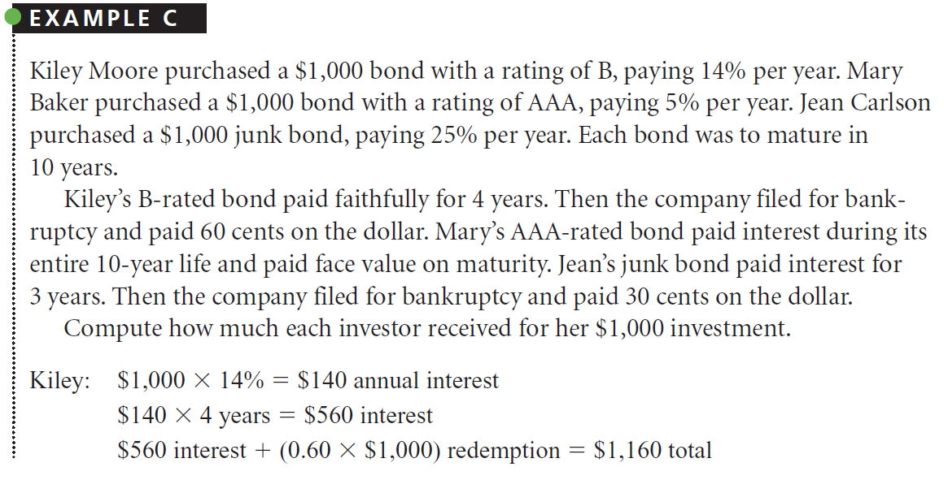

Slide 42
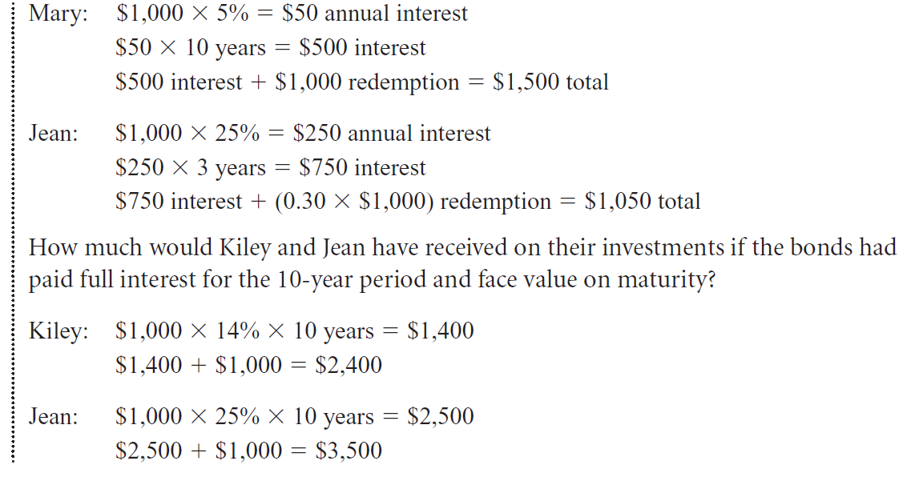

Slide 43
BOND PRICE AND INFORMATION ON NEWSPAPER
Information about the market value and sale of bonds on the major exchanges is reported daily in financial newspapers. Figure 22-1 shows information usually included in a bond report.
Prices of bonds are quoted in percents of face value. For example, a $1,000 bond quoted at 104 would sell at a premium price of $1,040 ($1,000 3 104%). If quoted at 87, the bond would sell at a discounted price of $870 ($1,000 3 87%).
Rule: Prices over 100 (100%) include a premium. Those under 100 (100%) include a discount.

Slide 44
BOND PRICE AND INFORMATION ON NEWSPAPER
The two main factors that influence the market price are the interest rate and the bond rating. For example, if a bond pays 8% interest and the current market rate of interest is greater than 8% for similarly rated bonds, the bonds will sell at a discount sufficient to make up for the difference in interest rates over the term of the bond.
Printed bond reports generally give a letter abbreviation for the company, the interest rate, a small s to designate semiannual (every 6 months) interest payments, and the maturity date, followed by the current yield, the number of bonds sold that day, the closing price of the bond, and the net change in price from the prior day.

Slide 45
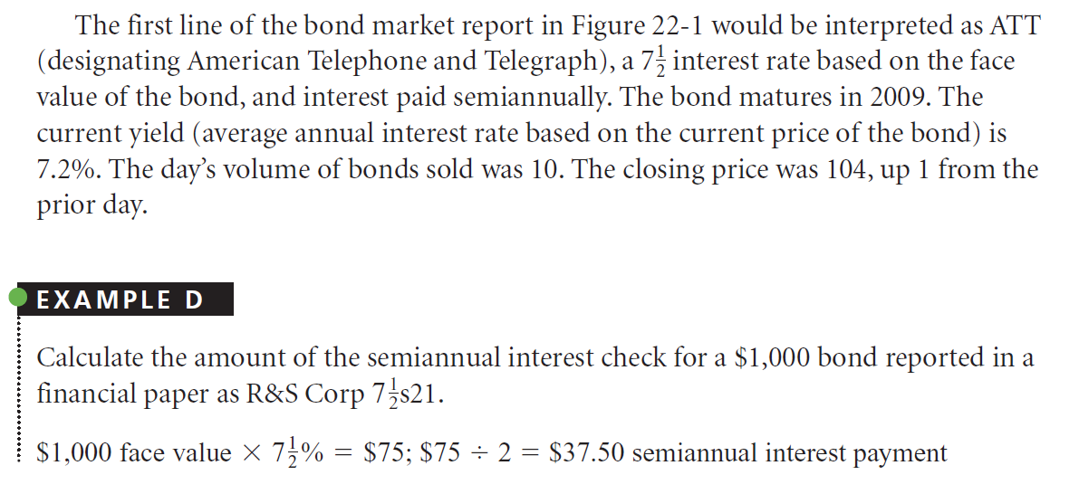

Slide 46
COMMISSIONS FOR BUYING AND SELLING BONDS

Slide 47
DEFINITION
The charge for buying and selling bonds varies among brokers, but there is no standard commission. Commissions are very small and thus comprise only a negligible part of the bond transaction.We do not use commission costs for problems in this textbook.

Slide 48
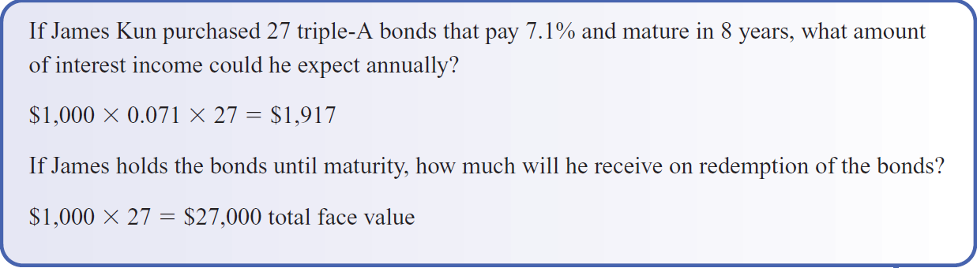

Slide 49
Computing Accrued Interest on Bond Transactions

Slide 50
ACCRUED INTEREST
Most bonds specify that interest is payable quarterly, semiannually, or annually. The interest payment dates—such as January 1 (for interest through December 31) and July 1 (for interest through June 30)—are stated on the bond.When a bond is purchased between these dates, it is customary to add the accrued interest (interest earned from the last payment date to the purchase date). This interest is calculated by finding the number of days from the day on which interest was last paid through the day before the purchase and dividing this number by 360.
The buyer pays the seller for the interest accumulated or accrued on the bond since the last interest payment date. On the next regular interest payment date, the new owner receives the interest for the full interest period. This procedure allocates the interest correctly between the buyer and the seller for the split interest period because the corporation that issued the bond will pay the entire amount to whomever owns the bond as of each interest date.

Slide 51
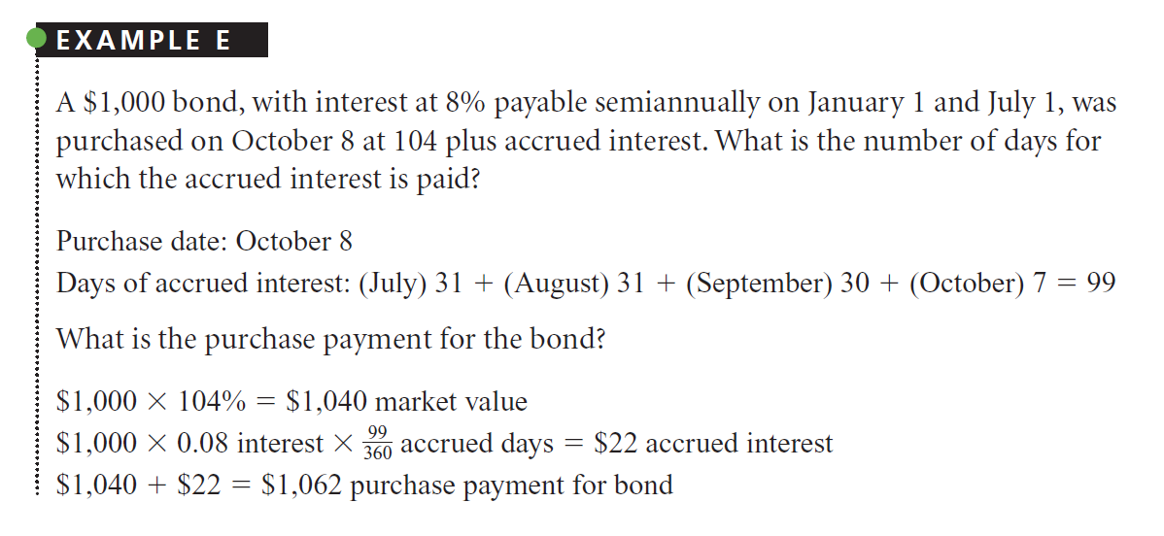
Notes:
In example E, although the accrued interest is an additional payment by the buyer, the
buyer will get it back in the $40 ($1,000 X 8% X 1/2 ) interest payment on January 1.

Slide 52
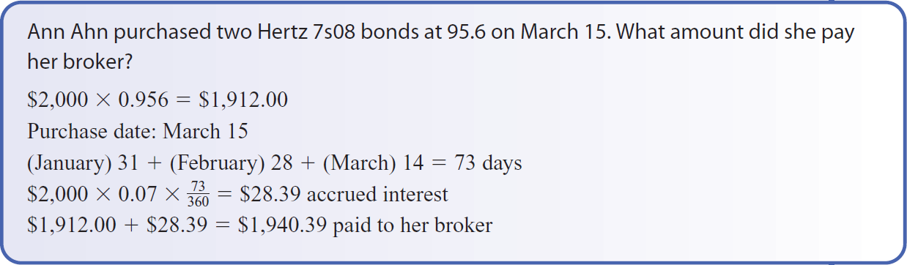

Slide 53
Computing the Rate of Yield for Bonds

Slide 54
YIELD
Interest on bonds provides income to bondholders. This income is referred to as yield. Newspapers and bond brokers refer to the annual yield of a bond as its current yield. Many newspaper bond reports include a column showing current yield. To calculate the current yield from an investment in bonds, use the following formula:

Slide 55
YIELD
When a bond is purchased at a discount, the current yield is greater than the face rate. For example, a $1,000 bond, purchased at 90, pays 7% interest and matures in 10 years. Interest of $70 ($1,000 3 7%) is paid annually, but as the bond was purchased for $900 ($1,000 3 90%), the effective rate, or yield, as a percent of cost is 7.8% ($70 4 $900).
When a bond is purchased at a premium, the current yield is less than the face rate. The reason is that the interest paid is calculated on the face value, and the yield is based on the higher market price.

Slide 56
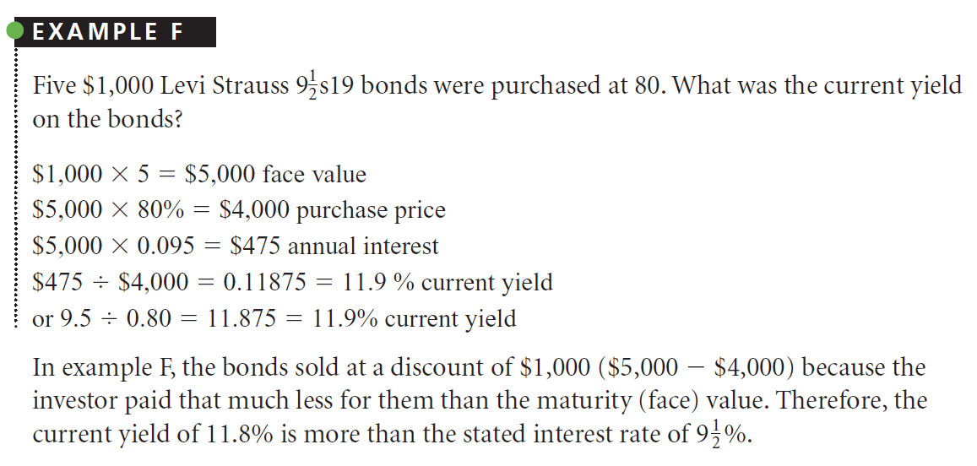

Slide 57
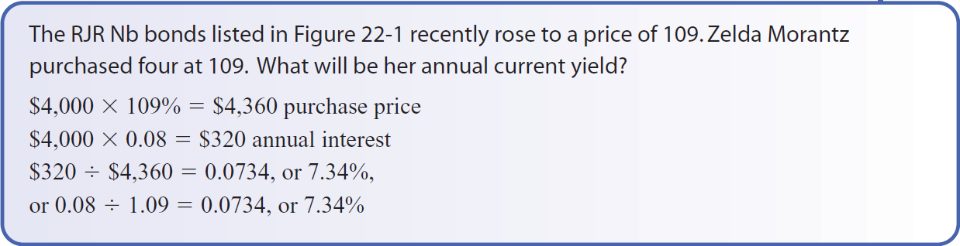

Slide 58
Computing the Rate of Yield to Maturity

Slide 59
DEFINITION
Careful investors calculate the rate of yield to maturity, or the rate of interest they will earn if they hold the bond to its maturity date. The yield to maturity calculation involves use of the true annual interest by adding a part of the discount or subtracting a part of the premium and basing the rate on the average principal invested (the average of the investor’s purchase price and the bond’s maturity value).

Slide 60
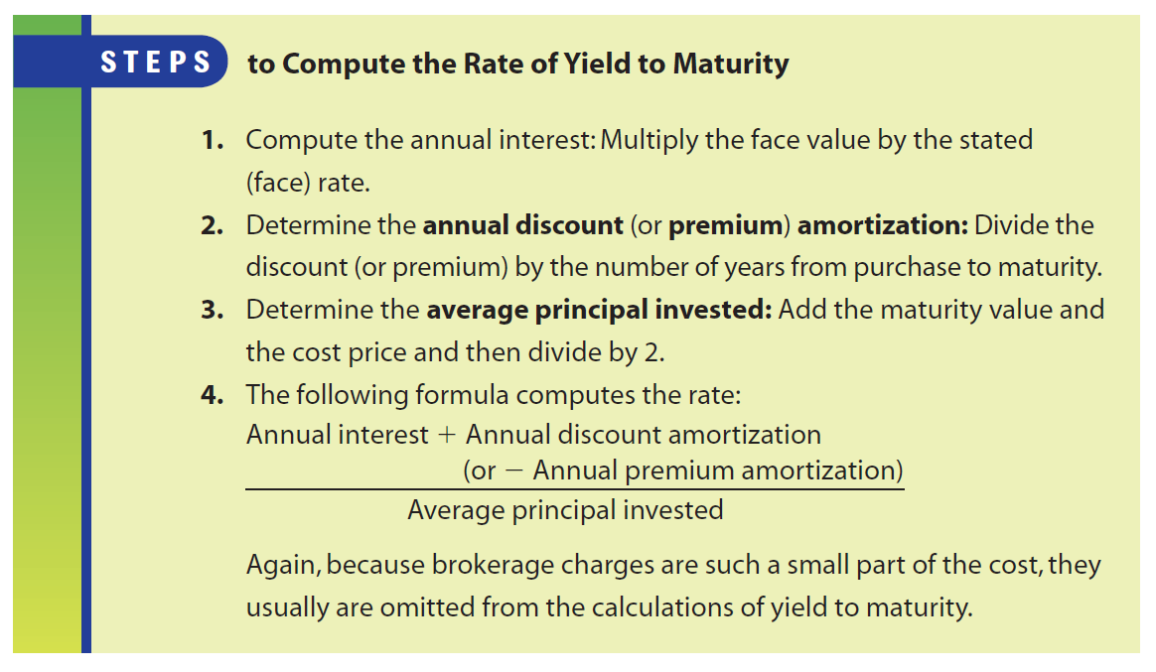

Slide 61
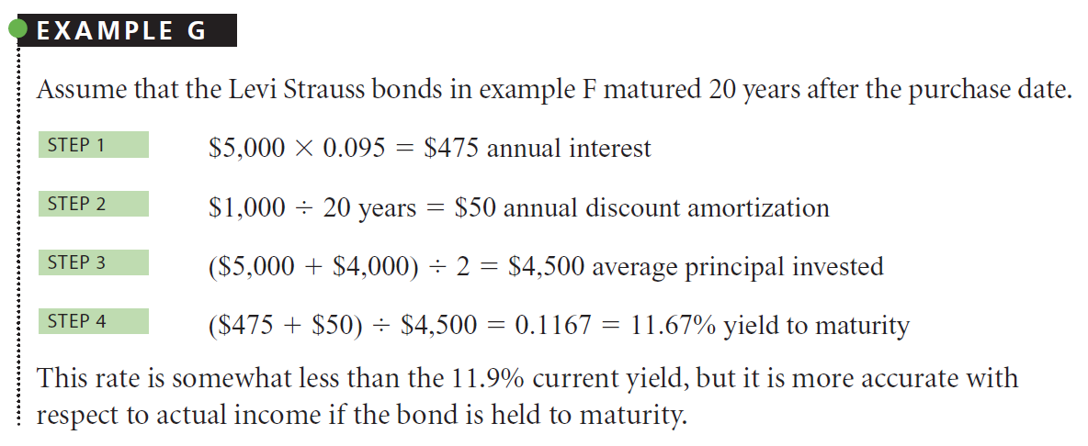

Slide 62
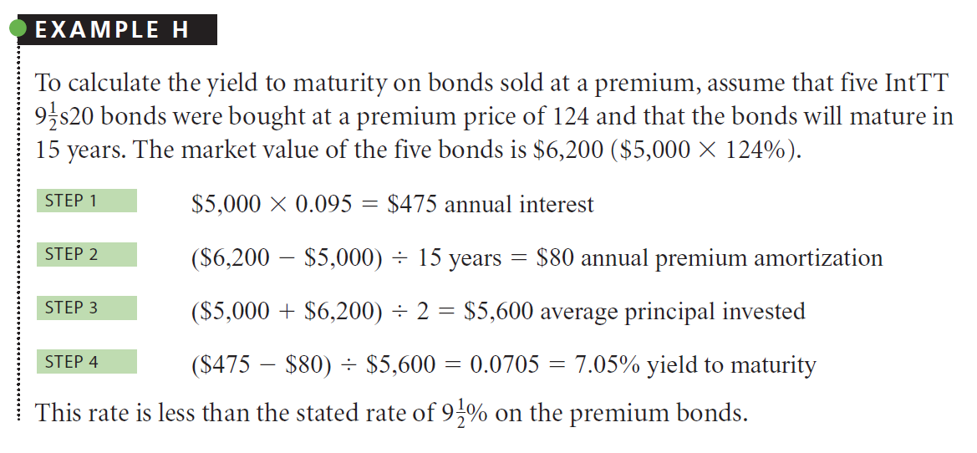

Slide 63
