Slide 1
11
Supply Chain Management

Slide 2
Outline
Global Company Profile:
Darden Restaurants
The Supply Chain’s Strategic Importance
Sourcing Issues: Make-or-Buy vs. Outsourcing
Six Sourcing Strategies

Slide 3
Outline - Continued
Supply Chain Risk
Managing the Integrated Supply Chain
Building the Supply Base
Logistics Management
Distribution Management

Slide 4
Outline - Continued
Ethics and Sustainable Supply Chain Management
Measuring Supply Chain Performance

Slide 5
Learning Objectives
When you complete this chapter you should be able to:
Explain the strategic importance of the supply chain
Identify six sourcing strategies
Explain issues and opportunities in the supply chain
Describe the steps in supplier selection

Slide 6
Learning Objectives
When you complete this chapter you should be able to:
Explain major issues in logistics management
Compute percent of assets committed to inventory and inventory turnover

Slide 7
Darden’s Supply Chain
Largest publicly traded casual dining company in the world
Serves over 400 million meals annually in more than 1,900 restaurants in the US and Canada
Annual sales of flagship brands totals $6 billion
Operations is the strategy
© 2014 Pearson Education, Inc.

Slide 8
Darden’s Supply Chain
Sources food from five continents and thousands of suppliers
Four distinct supply chains
Over $2 billion spent annually in supply chains
Competitive advantage achieved through superior supply chain
© 2014 Pearson Education, Inc.

Slide 9
Supply-Chain Management
The objective of supply chain management is to coordinate activities within the supply chain to maximize the supply chain’s competitive advantage and benefits to the ultimate consumer

Slide 10
The Supply Chain’s Strategic Importance
The coordination of all supply chain activities, starting with raw materials and ending with a satisfied customer
Includes suppliers, manufacturers and/or service providers, distributors, wholesalers, retailers, and final customer

Slide 11
The Supply Chain’s Strategic Importance
Large portion of sales dollars spent on purchases
Supplier relationships increasingly integrated and long term
  Improve innovation, speed design, reduce costs
Managing supplier relationships has added emphasis

Slide 12
Supply Chain Costs
TABLE 11.1
Supply Chain Costs as a Percentage of Sales
INDUSTRY |  | % PURCHASED
Automobiles |  | 67
Beverages |  | 52
Chemical |  | 62
Food |  | 60
Lumber |  | 61
Metals |  | 65
Paper |  | 55
Petroleum |  | 79
Restaurants |  | 35
Transportation |  | 62

Slide 13
Supply Chain vs.
Sales Strategy
Hau Lee Furniture
60% of sales $ in supply chain
Current gross profit = $10,000
Increase profits to $15,000 (50%)
 | CURRENT SITUATION | SUPPLY CHAIN STRATEGY | SALES STRATEGY
Sales | $100,000 | $100,000 | $125,000
Cost of materials | $60,000 (60%) | $55,000 (55%) | $75,000 (60%)
Production costs | $20,000 (20%) | $20,000 (20%) | $25,000 (20%)
Fixed costs | $10,000 (10%) | $10,000 (10%) | $10,000 (8%)
Profit | $10,000 (10%) | $15,000 (15%) | $15,000 (12%)

Slide 14
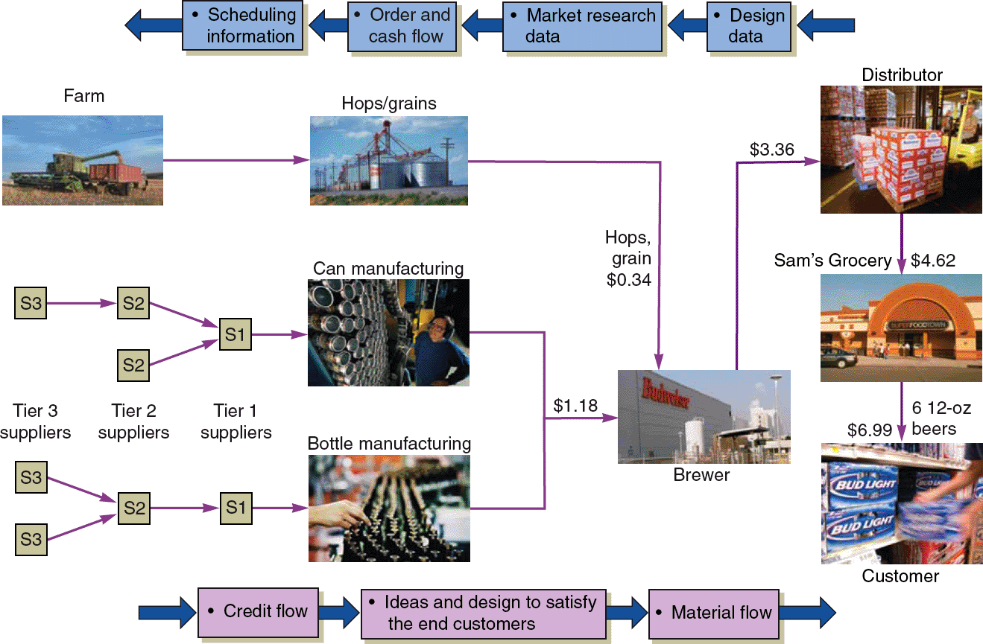
A Supply Chain for Beer
Figure 11.1

Slide 15
Supply Chain Management
TABLE 11.2 | How Corporate Strategy Impacts Supply Chain Decisions
 |  | LOW COST STRATEGY | RESPONSE STRATEGY | DIFFERENTIATION STRATEGY
Primary supplier selection criteria |  | Cost | Capacity Speed Flexibility | Product development skills Willing to share information Jointly and rapidly develop products
Supply chain inventory |  | Minimize inventory to hold down costs | Use buffer stocks to ensure speedy supply | Minimize inventory to avoid product obsolescence
Distribution network |  | Inexpensive transportation Sell through discount distributors/retailers | Fast transportation Provide premium customer service | Gather and communicate market research data Knowledgeable sales staff
Product design characteristics |  | Maximize performance Minimize cost | Low setup time Rapid production ramp-up | Modular design to aid product differentiation

Slide 16
Sourcing Issues
Make-or-buy vs. outsourcing
  Choosing between obtaining products and services externally as opposed to producing them internally
Outsourcing
  Transfer traditional internal activities and resources to outside vendors
  Efficiency in specialization
  Focus on core competencies

Slide 17
Six Sourcing Strategies
Many suppliers
Few suppliers
Vertical integration
Joint ventures
Keiretsu networks
Virtual companies

Slide 18
Many Suppliers
Commonly used for commodity products
Purchasing is typically based on price
Suppliers compete with one another
Supplier is responsible for technology, expertise, forecasting, cost, quality, and delivery

Slide 19
Few Suppliers
Buyer forms longer term relationships with fewer suppliers
Create value through economies of scale and learning curve improvements
Suppliers more willing to participate in JIT programs and contribute design and technological expertise
Cost of changing suppliers is huge
Trade secrets and other alliances

Slide 20
Vertical Integration
Vertical Integration Examples of Vertical Integration
Raw material (suppliers) |  |  | Tree Harvesting
Backward integration |  | Chipmakers | Pulpmaking
Current transformation | Pepsi | Apple | International Paper
Forward integration | Bottling | Retail stores | End-User Paper Conversion
Finished goods (customers)
Figure 11.2

Slide 21
Vertical Integration
Developing the ability to produce goods or service previously purchased
Integration may be forward, towards the customer, or backward, towards suppliers
Can improve cost, quality, and inventory but requires capital, managerial skills, and demand
Risky in industries with rapid technological change

Slide 22
Joint Ventures
Formal collaboration
  Enhance skills
  Secure supply
  Reduce costs
Cooperation without diluting brand or conceding competitive advantage

Slide 23
Keiretsu Networks
A middle ground between few suppliers and vertical integration
Supplier becomes part of the company coalition
Often provide financial support for suppliers through ownership or loans
Members expect long-term relationships and provide technical expertise and stable deliveries
May extend through several levels of the supply chain

Slide 24
Virtual Companies
Rely on a variety of supplier relationships to provide services on demand
Fluid organizational boundaries that allow the creation of unique enterprises to meet changing market demands
Relationships may be short- or long-term
Exceptionally lean performance, low capital investment, flexibility, and speed

Slide 25
Supply Chain Risk
More reliance on supply chains means more risk
Fewer suppliers increase dependence
Compounded by globalization and logistical complexity
Vendor reliability and quality risks
Political and currency risks

Slide 26
Risk and Mitigation Tactics
Research and assess possible risks
Innovative planning
Reduce potential disruptions
Prepare responses for negative events
Flexible, secure supply chains
Diversified supplier base

Slide 27
Risk and Mitigation Tactics
TABLE 11.3 |  | Supply Chain Risks and Tactics
RISK | RISK REDUCTION TACTICS |  | EXAMPLE
Supplier failure to deliver | Use multiple suppliers; effective contracts with penalties; subcontractors on retainer; pre-planning |  | McDonald’s planned its supply chain 6 years before its opening in Russia. Every plant—bakery, meat, chicken, fish, and lettuce—is closely monitored to ensure strong links.
Supplier quality failure | Careful supplier selection, training, certification, and monitoring |  | Darden Restaurants has placed extensive controls, including third-party audits, on supplier processes and logistics to ensure constant monitoring and reduction of risk.

Slide 28
Risk and Mitigation Tactics
TABLE 11.3 |  | Supply Chain Risks and Tactics
RISK | RISK REDUCTION TACTICS |  | EXAMPLE
Logistics delays or damage | Multiple/redundant transportation modes and warehouses; secure packaging; effective contracts with penalties |  | Walmart, with its own trucking fleet and numerous distribution centers located throughout the U.S., finds alternative origins and delivery routes bypassing problem areas.
Distribution | Careful selection, monitoring, and effective contracts with penalties |  | Toyota trains its dealers around the world, invoking principles of the Toyota Production System to help dealers improve customer service, used-car logistics, and body and paint operations.

Slide 29
Risk and Mitigation Tactics
TABLE 11.3 |  | Supply Chain Risks and Tactics
RISK | RISK REDUCTION TACTICS |  | EXAMPLE
Information loss or distortion | Redundant databases; secure IT systems; training of supply chain partners on the proper interpretations and uses of information |  | Boeing utilizes a state-of-the-art international communication system that transmits engineering, scheduling, and logistics data to Boeing facilities and suppliers worldwide.
Political | Political risk insurance; cross-country diversification; franchising and licensing |  | Hard Rock Café reduces political risk by franchising and licensing, rather than owning, when the political and cultural barriers seem significant.

Slide 30
Risk and Mitigation Tactics
TABLE 11.3 |  | Supply Chain Risks and Tactics
RISK | RISK REDUCTION TACTICS |  | EXAMPLE
Economic | Hedging to combat exchange rate risk; purchasing contracts that address price fluctuations |  | Honda and Nissan are moving more manufacturing out of Japan as the exchange rate for the yen makes Japanese-made autos more expensive.
Natural catastrophes | Insurance; alternate sourcing; cross-country diversification |  | Toyota, after its experience with fires, earthquakes, and tsunamis, now attempts to have at least two suppliers, each in a different geographical region, for each component.

Slide 31
Risk and Mitigation Tactics
TABLE 11.3 |  | Supply Chain Risks and Tactics
RISK | RISK REDUCTION TACTICS |  | EXAMPLE
Theft, vandalism, and terrorism | Insurance; patent protection; security measures including RFID and GPS; diversification |  | Domestic Port Radiation Initiative: The U.S. government has set up radiation portal monitors that scan nearly all imported containers for radiation.

Slide 32
Security and JIT
Shipments get misrouted, stolen, damaged, or excessively delayed
Technological innovations are improving security and inventory management
  Location, motion sensors, broken seals, temperature
Tracking can help expedite shipments

Slide 33
Managing the Integrated Supply Chain
Bullwhip effect occurs when orders are relayed through the supply chain increasing at each step
Issues
  Local optimization can magnify fluctuations
  Incentives push merchandise into the supply chain for sales that have not occurred
  Large lots reduce shipping costs but increase inventory holding and do not reflect actual sales

Slide 34
Managing the Integrated Supply Chain
Opportunities
  Accurate “pull” data, shared information
  Lot size reduction, shipping, discounts, reduced ordering costs
  Single stage control of replenishment
    Single supply chain member responsible for ordering
  Vendor managed inventory (VMI)

Slide 35
Managing the Integrated Supply Chain
Opportunities
  Collaborative planning, forecasting, and replenishment (CPFR) through the supply chain
  Blanket orders against which actual orders are released
  Standardization

Slide 36
Managing the Integrated Supply Chain
Opportunities
  Postponement withholds modification as long as possible
  Electronic ordering and funds transfer speed transactions and reduce paperwork
  Drop shipping and special packaging bypasses the seller and reduces costs

Slide 37
Building the Supply Base
Supplier evaluation
  Finding potential suppliers
  Determine likelihood of their becoming good suppliers
  Supplier certification
    Qualification
    Education
    Certification

Slide 38
Building the Supply Base
Supplier development
  Integrate the supplier into the system
    Quality requirements
    Product specifications
    Schedules and delivery
    Procurement policies
    Training
    Engineering and production help
    Information transfer procedures

Slide 39
Building the Supply Base
Negotiation
  A significant element in purchasing
  Highly valued skills
    Cost-based price model
      Supplier opens books
    Market-based price model
      Based on published, auction, or indexed prices
    Competitive bidding
      Common policy for many purchases
      Does not generally foster long-term relationships

Slide 40
Building the Supply Base
Contracting
  Share risks, benefits, create incentives
Centralized purchasing
  Leverage volume
  Develop specialized staff
  Develop supplier relationships
  Maintain professional control
  Devote resources to selection and negotiation
  Reduce duplication of tasks
  Promote standardization

Slide 41
Building the Supply Base
E-Procurement
    Speeds purchasing, reduces costs, integrates supply chain
  Online catalogs and exchanges
    Standard items or industry-specific web sites
  Online auctions
    Low barriers to entry
    Reverse auctions for buyers
    Price not always the most important factor

Slide 42
Logistics Management
Objective is to obtain efficient operations through the integration of all material acquisition, movement, and storage activities
Is a frequent candidate for outsourcing
Allows competitive advantage to be gained through reduced costs and improved customer service

Slide 43
Shipping Systems
Trucking
  Moves the vast majority of manufactured goods
  Chief advantage is flexibility
Railroads
  Capable of carrying large loads
  Little flexibility though containers and piggybacking have helped with this

Slide 44
Shipping Systems
Airfreight
  Fast and flexible for light loads
  May be expensive
Waterways
  Typically used for bulky, low-value cargo
  Used when shipping cost is more important than speed

Slide 45
Shipping Systems
Pipelines
  Used for transporting oil, gas, and other chemical products
Multimodal
  Combines shipping methods
  Common, especially in international shipments
  Aided by standardized containers

Slide 46
Cost and Speed of Shipments
Faster shipping is generally more expensive than slower shipping
Faster methods tend to involve smaller shipment sizes while slower methods involve very large shipment sizes

Slide 47
Warehousing
May be expensive, but alternatives may be more so
Fundamental purpose is to store goods
May provide other functions
  Consolidation
  Break-bulk
  Cross-docking
  Channel assembly

Slide 48
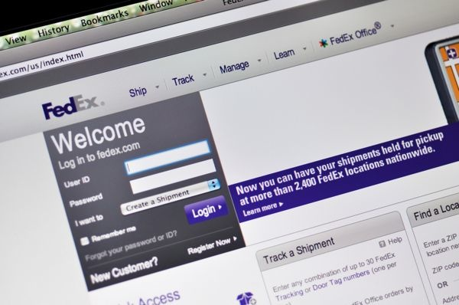
Third-Party Logistics (3PL)
Outsourcing logistics can reduce inventory, costs, and improve delivery reliability and speed
Coordinate supplier inventory with delivery services
May provide
warehousing,
assembly, testing,
shipping, customs

Slide 49
Distribution Management
The outbound flow of products
  Rapid response
  Product choice
  Service
Increasing the number of facilities generally improves response time and customer satisfaction
Total costs are important

Slide 50
Distribution Management
Figure 11.3
(a) Response Time
(b) Cost $
Response time
Lowest cost
Total logistics cost
Time
$
Facility costs
Inventory costs
Transportation costs
1 2 3 4 5
1 2 3 4 5
Number of facilities
Number of facilities

Slide 51
Distribution Management
(c) Cost, Revenue, and Profit
Figure 11.3
Revenue
Max profit
Total logistics cost
$
1 2 3 4 5
Number of facilities

Slide 52
Distribution Management
Facilities, packaging, and logistics
Selection and development of dealers or retailers
Downstream management as important as upstream management

Slide 53
Ethics and Sustainable Supply Chain Management
Personal ethics
  Critical to long term success of an organization
  Supply chains particularly susceptible
Ethics within the supply chain
Ethical behavior regarding the environment

Slide 54
Institute for Supply Management Principles and Standards
Promote and uphold responsibilities to one’s employer; positive supplier and customer relationships; sustainability and social responsibility; protection of confidential and proprietary information; applicable laws, regulations, and trade agreements; and development of professional competence
Avoid perceived impropriety; conflicts of interest; behaviors that negatively influence supply chain decisions; and improper reciprocal agreements

Slide 55
ISM Ethical Standards
PERCEIVED IMPROPRIETY. Prevent the intent and appearance of unethical or compromising conduct in relationships, actions and communications
CONFLICTS OF INTEREST. Ensure that any personal, business or other activity do not conflict with the lawful interests of your employer
ISSUES OF INFLUENCE. Avoid behaviors or actions that may negatively influence, or appear to influence, supply management decisions

Slide 56
ISM Ethical Standards
RESPONSIBILITIES TO YOUR EMPLOYER. Uphold fiduciary and other responsibilities using reasonable care and granted authority to deliver value to your employer
SUPPLIER AND CUSTOMER RELATIONSHIPS. Promote positive supplier and customer relationships
SUSTAINABILITY AND SOCIAL RESPONSIBILITY. Champion social responsibility and sustainability practices in supply management

Slide 57
ISM Ethical Standards
CONFIDENTIAL AND PROPRIETARY INFORMATION. Protect confidential and proprietary information
RECIPROCITY. Avoid improper reciprocal agreements
APPLICABLE LAWS, REGULATIONS AND TRADE AGREEMENTS. Know and obey the letter and spirit of laws, regulations and trade agreements applicable to supply management

Slide 58
ISM Ethical Standards
PROFESSIONAL COMPETENCE. Develop skills, expand knowledge and conduct business that demonstrates competence and promotes the supply management profession

Slide 59
Establishing Sustainability in Supply Chains
Return or reverse logistics
  Sending returned products back up the supply chain for resale, repair, reuse, remanufacture, recycling, or disposal
Closed-loop supply chain
  Proactive design of a supply chain that tries to optimize all forward and reverse flows
  Prepares for returns prior to product introduction

Slide 60
Establishing Sustainability in Supply Chains
TABLE 11.4 | Management Challenges of Reverse Logistics
ISSUE |  | FORWARD LOGISTICS | REVERSE LOGISTICS
Forecasting |  | Relatively straightforward | More uncertain
Product quality |  | Uniform | Not uniform
Product packaging |  | Uniform | Often damaged
Pricing |  | Relatively uniform | Dependent on many factors
Speed |  | Often very important | Often not a priority
Distribution costs |  | Easily visible | Less directly visible
Inventory management |  | Consistent | Not consistent

Slide 61
Measuring Supply-Chain Performance
Assets committed to inventory
Percentage invested in inventory
Total inventory investment
Total assets
= x 100
Home Depot had $11.4b inventory, total assets of $44.4b
Percentage invested in inventory
11.4
44.4
= x 100 = 25.7%

Slide 62
Measuring Supply-Chain Performance
TABLE 11.5
Inventory as Percentage of Total Assets (with examples of exceptional performance)
Manufacturer (Toyota 5%) |  | 15%
Wholesale (Coca-Cola 2.9%) |  | 34%
Restaurants (McDonald’s .05%) |  | 2.9%
Retail (Home Depot 25.7%) |  | 28%

Slide 63
Measuring Supply-Chain Performance
Inventory turnover
Inventory
turnover
Cost of goods sold
Inventory investment
=
Inventory investment
  Average of several periods
  (beginning plus ending)/2
  Ending inventory

Slide 64
Measuring Supply-Chain Performance
From PepsiCo, Inc. Annual Report
Net revenue |  |  |  | $32.5
Cost of goods sold |  |  |  | $14.2
Inventory:
Raw material inventory |  | $.74
Work-in-process inventory |  | $.11
Finished goods inventory |  | $.84
Total inventory investment |  |  |  | $1.69
Inventory
turnover
14.2
1.69
= = 8.4

Slide 65
Measuring Supply-Chain Performance
TABLE 11.6 | Examples of Annual Inventory Turnover
FOOD, BEVERAGE, RETAIL
Anheuser Busch |  | 15
Coca-Cola |  | 15
Home Depot |  | 5
McDonald’s |  | 112
MANUFACTURING
Dell Computer |  | 90
Johnson controls |  | 22
Toyota (overall) |  | 13
Nissan (assembly) |  | 150

Slide 66
Measuring Supply-Chain Performance
Weeks of supply
Weeks of supply
Inventory investment
Annual cost of goods sold
52 weeks
=
For PepsiCo
Inventory investment = $1.69b
Average weekly cost of goods sold = $14.2b / 52 = $.273b
Weeks of supply = 1.69 / .273 = 6.19 weeks

Slide 67
Benchmarking the Supply Chain
Comparison with benchmark firms
TABLE 11.7 | Supply Chain Metrics in the Consumer Packaged Goods Industry
 |  | TYPICAL FIRMS | BENCHMARK FIRMS
Order fill rate |  | 71% | 98%
Oder fulfillment lead time (days) |  | 7 | 3
Cash-to-cash cycle time (days) |  | 100 | 30
Inventory days of supply |  | 50 | 20

Slide 68
The SCOR Model
Processes, metrics and best practices
Figure 11.4
Plan: Demand/Supply planning and Management
Source: Identify, select, manage, and assess sources
Make: Manage production execution, testing and packaging
Deliver: Invoice, warehouse, transport and install
Return: Raw material
Return: Finished goods

Slide 69
The SCOR Model
TABLE 11.8 | SCOR Model Metrics to Help Firms Benchmark Performance Against the Industry
PERFORMANCE ATTRIBUTE |  | SAMPLE METRIC | CALCULATION
Supply chain reliability |  | Perfect order fulfillment | (Total perfect orders) / (Total number of orders)
Supply chain responsiveness |  | Average order fulfillment cycle time | (Sum of actual cycle times for all orders delivered) / (Total number of orders delivered)
Supply chain agility |  | Upside supply chain flexibility | Time required to achieve an unplanned 20% increase in delivered quantities
Supply chain costs |  | Supply chain management costs | Cost to plan + Cost to source + Cost to deliver + Cost to return
Supply chain asset management |  | Cash-to-cash cycle time | Inventory days of supply + Days of receivables outstanding – Days of payables outstanding

Slide 70
Benchmarking the Supply Chain
Benchmarking useful
May not be adequate
Audits may be necessary
  Continuing communication, Understanding, Trust, Performance, Corporate strategy
Foster a mutual belief that “we are in this together”

Slide 71
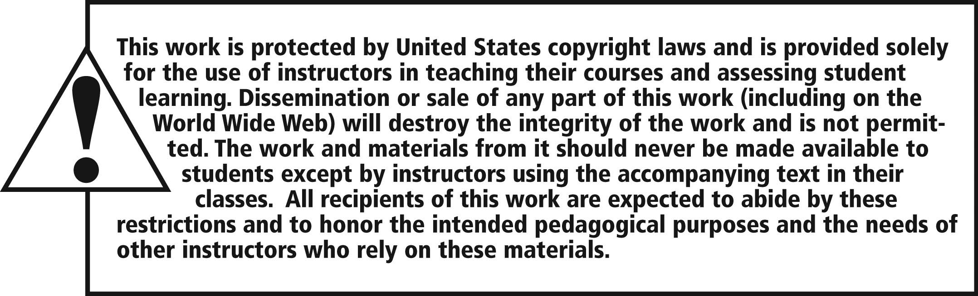
All rights reserved. No part of this publication may be reproduced, stored in a retrieval system, or transmitted, in any form or by any means, electronic, mechanical, photocopying, recording, or otherwise, without the prior written permission of the publisher.
Printed in the United States of America.

