Slide 1
11
SUPPLEMENT
Supply Chain Management Analytics

Slide 2
Outline
Techniques for Evaluating Supply Chains
Evaluating Disaster Risk in the Supply Chain
Managing the Bullwhip Effect
Supplier Selection Analysis
Transportation Mode Analysis

Slide 3
Learning Objectives
When you complete this supplement you should be able to:
Use a decision tree to determine the best number of suppliers to manage disaster risk
Explain and measure the bullwhip effect
Describe the factor weighting approach to supplier evaluation
Evaluate cost-of-shipping alternatives

Slide 4

Evaluating Disaster Risk
Many forms of potential disruptions
For a given supply cycle, the probability of n suppliers being disrupted is
S = the probability of a “super-event” that would disrupt all suppliers simultaneously
U = the probability of a “unique-event” that would disrupt only one supplier
L = the financial loss incurred in a supply cycle if all suppliers were disrupted
C = the marginal cost of managing a supplier

Slide 5
How Many Suppliers?
Portfolio of suppliers to balance costs and risks
Evaluate one, two, or three suppliers using a decision tree
S = 0.5%, U = 4%, C = $10,000, L = $10,000,000
P(1) = 0.005 + (1 – 0.005)0.04 = 0.005 + 0.0398
= 0.044800, or 4.4800%
P(2) = 0.005 + (1 – 0.005)0.04² = 0.005 + 0.001592
= 0.006592, or 0.6592%
P(3) = 0.005 + (1 – 0.005)0.04³ = 0.005 + 0.000064
= 0.005064, or 0.5064%

Slide 6
How Many Suppliers?
One supplier
$458,000
1 – P(1) = .955200
No failure
1C = (1)$10,000 = $10,000
P(1) = .044800
Failure
L + 1C = $10,000,000 + (1)$10,000
= $10,010,000
Two suppliers
$85,920
1 – P(2) = .993408
≤ 1 Fail
2C = (2)$10,000 = $20,000
P(2) = .006592
Both fail
L + 2C = $10,000,000 + (2)$10,000
= $10,020,000
1 – P(3) = .994936
≤ 2 Fail
3C = (3)$10,000 = $30,000
P(3) = .005064
All three fail
L + 3C = $10,000,000 + (3)$10,000
= $10,030,000
Three suppliers
$80,640
Figure S11.1

Slide 7
The Bullwhip Effect
The tendency for larger order size fluctuations as orders are relayed through the supply chain
Creates unstable production schedules, expensive capacity change costs, longer lead times, obsolescence
Damage can be minimized with supplier coordination and planning

Slide 8
The Bullwhip Effect
60 –
50 –
40 –
30 –
20 –
10 –
0 –
Figure S11.2
Suppliers believe sales are huge and respond accordingly
Wholesalers order even more to be sure retailers can be adequately supplied
Suppliers
Wholesalers
Retailers
Consumers
Retailers respond by ordering more
Order Quantity
A short-term increase in consumer demand
| | | | | | | | | | | |
1 2 3 4 5 6 7 8 9 10 11
Day

Slide 9
Managing the Bullwhip Effect
TABLE S11.1 | The Bullwhip Effect
CAUSE |  | REMEDY
Demand forecast errors (cumulative uncertainty in the supply chain) |  | Share demand information throughout the supply chain
Order batching (large, infrequent orders leading suppliers to order even larger amounts) |  | Channel coordination: Determine lot sizes as though the full supply chain was one company
Price fluctuations (buying in advance of demand to take advantage of low prices, discounts, or sales) |  | Price stabilization (everyday low prices)
Shortage gaming (hoarding supplies for fear of a supply shortage) |  | Allocate orders based on past demand

Slide 10
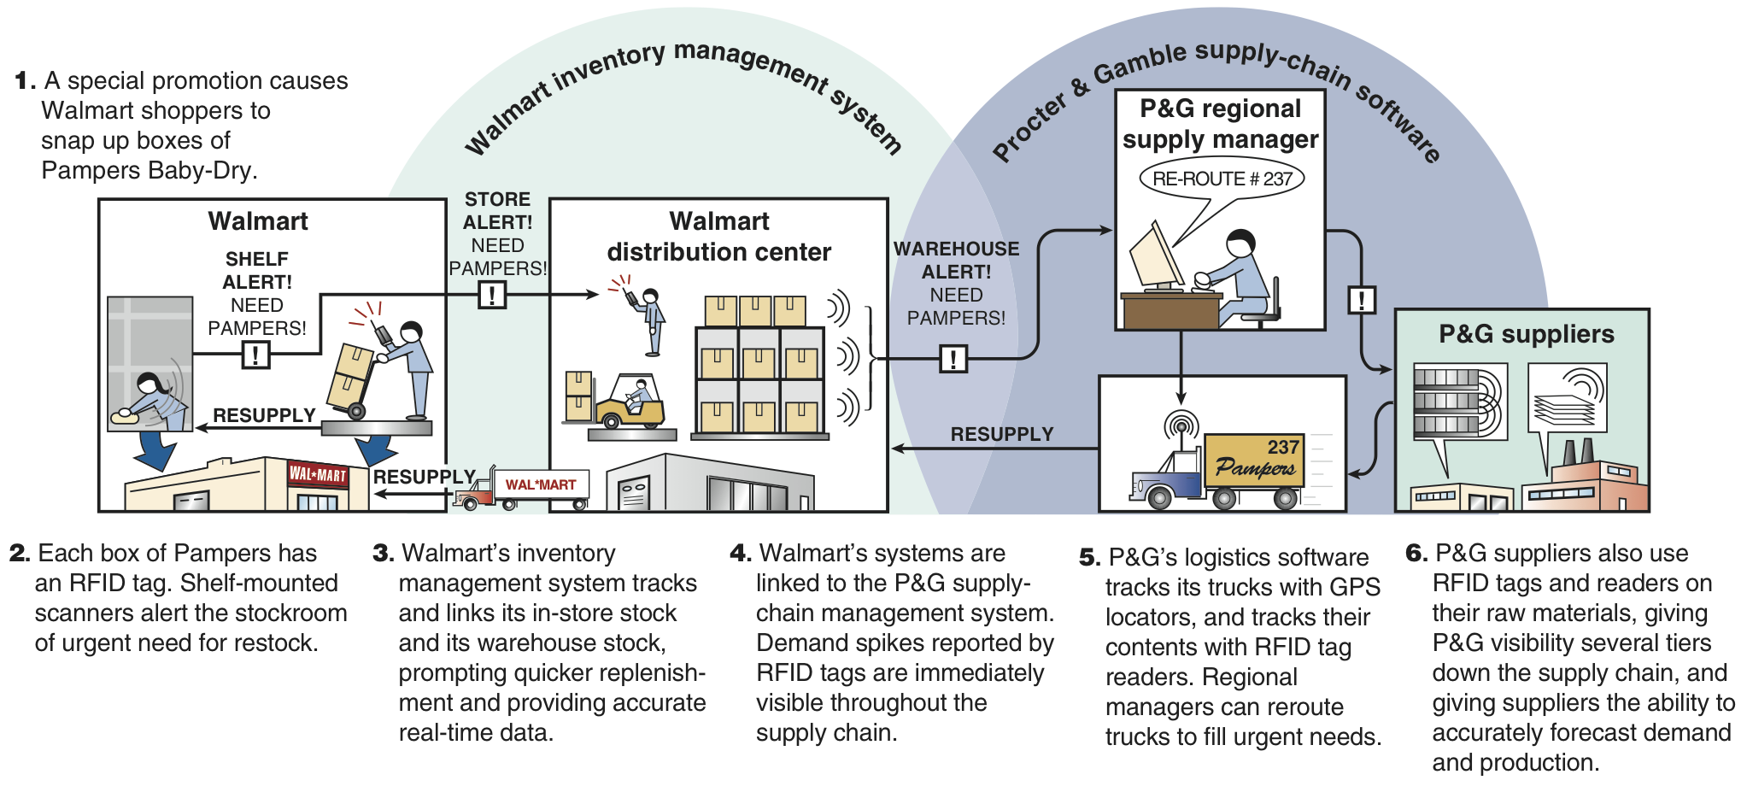
RFID Helps Control Bullwhip

Slide 11
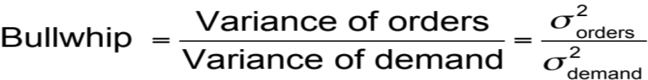
The Bullwhip Effect Measure
If measure is:
> 1 – Variance amplification is present
= 1 – No amplification is present
< 1 – Smoothing or dampening is occurring

Slide 12
Calculating the Bullwhip Effect
Transform sheet steel to tabletops
Each firm in the supply chain has one supplier and one customer
FIRM | VARIANCE OF DEMAND | VARIANCE OF ORDERS | BULLWHIP MEASURE
Furniture Mart, Inc. | 100 | 110 | 110/100 = 1.10
Furniture Distributors, Inc. | 110 | 180 | 180/110 = 1.64
Furniture Makers of America | 180 | 300 | 300/180 = 1.67
Chieh Lee Metals, Inc. | 300 | 750 | 750/300 = 2.50
Metal Suppliers Ltd. | 750 | 2000 | 2000/750 = 2.67

Slide 13
Supplier Selection Analysis
Many factors play a role
Choosing lowest bid is becoming rare
Factor weighting techniques consider multiple criteria
  Each factor is assigned a weight and a score
  Choose the supplier with the best weighted score

Slide 14
Factor Weighting Approach
 |  |  |  | FABER PAINT |  |  |  | SMITH DYE
CRITERION | WEIGHT |  |  | SCORE (1-5) (5 HIGHEST) | WEIGHT x SCORE |  |  | SCORE (1-5) (5 HIGHEST) | WEIGHT x SCORE
Engineering/innovation skills |  | .20 |  | 5 |  | 1.0 |  | 5 |  | 1.0
Production process capability |  | .15 |  | 4 |  | 0.6 |  | 5 |  | 0.75
Distribution capability |  | .05 |  | 4 |  | 0.2 |  | 3 |  | 0.15
Quality performance |  | .10 |  | 2 |  | 0.2 |  | 3 |  | 0.3
Facilities/location |  | .05 |  | 2 |  | 0.1 |  | 3 |  | 0.15
Financial strength |  | .15 |  | 4 |  | 0.6 |  | 5 |  | 0.75
Information systems |  | .10 |  | 2 |  | 0.2 |  | 5 |  | 0.5
Integrity |  | .20 |  | 5 |  | 1.0 |  | 3 |  | 0.6
Total |  | 1.00 |  |  |  | 3.9 |  |  |  | 4.2

Slide 15
Transportation Mode Analysis
Evaluate holding verses shipping options
  Ship connectors from San Jose to Singapore
  Value of connectors = $1,750
  Holding cost = 40% per year
  One carrier is 1 day faster but $20 more expensive
$1.92 < $20.00
Choose slower shipping
Daily cost of holding the product
Annual holding cost
Product value
= x
= (.40 x $1,750)/365
= $1.92

Slide 16

All rights reserved. No part of this publication may be reproduced, stored in a retrieval system, or transmitted, in any form or by any means, electronic, mechanical, photocopying, recording, or otherwise, without the prior written permission of the publisher.
Printed in the United States of America.

