Slide 1
Chapter 13
Aggregate Planning and S&OP
© 2014 Pearson Education, Inc.

Slide 2
Outline
Global Company Profile:
Frito-Lay
The Planning Process
Sales and Operations Planning
The Nature of Aggregate Planning
Aggregate Planning Strategies

Slide 3
Outline - Continued
Methods for Aggregate Planning
Aggregate Planning in Services
Revenue Management

Slide 4
Learning Objectives
When you complete this chapter you should be able to:
Define sales and operations planning
Define aggregate planning
Identify optional strategies for developing an aggregate plan

Slide 5
Learning Objectives
When you complete this chapter you should be able to:
Prepare a graphical aggregate plan
Solve an aggregate plan via the transportation method
Understand and solve a revenue management problem

Slide 6
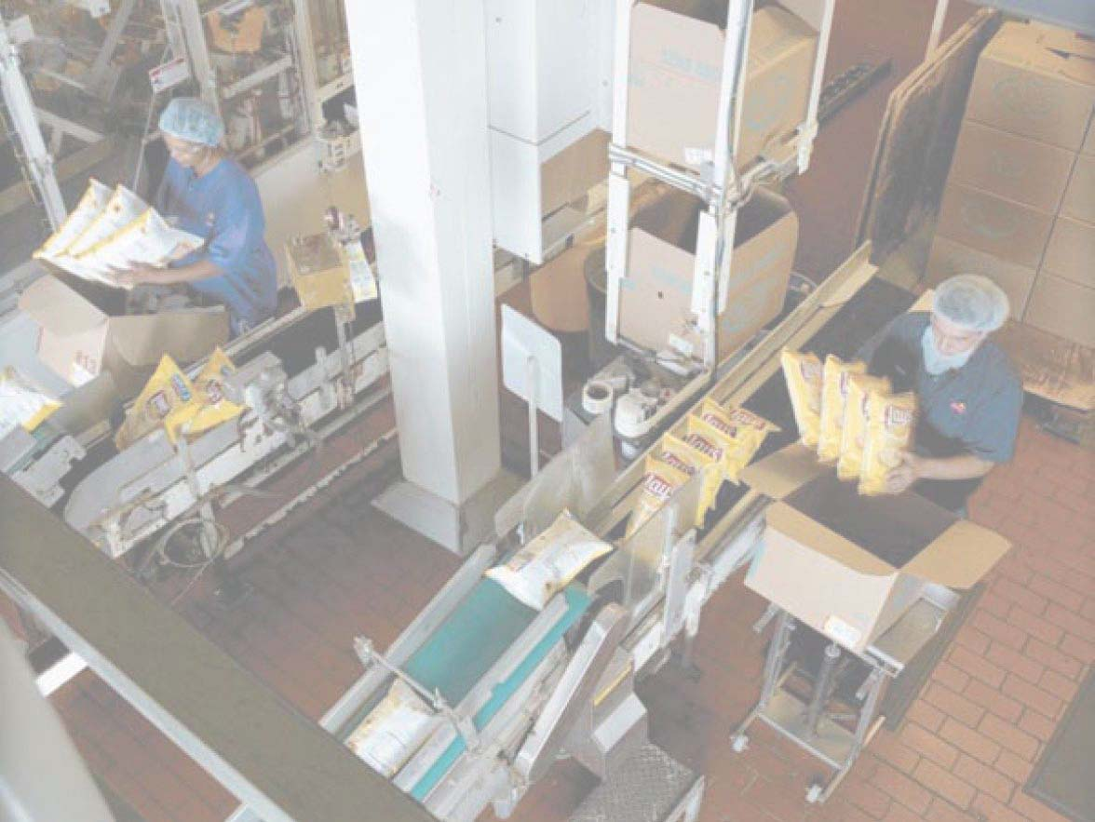
Aggregate Planning at
Frito-Lay
More than three dozen brands, 15 brands sell more than $100 million annually, 7 sell over $1 billion
Planning processes covers 3 to 18 months
Unique processes and specially designed equipment
High fixed costs require high volumes and high utilization
© 2014 Pearson Education, Inc.

Slide 7
Aggregate Planning at
Frito-Lay
Demand profile based on historical sales, forecasts, innovations, promotion, local demand data
Match total demand to capacity, expansion plans, and costs
Quarterly aggregate plan goes to 36 plants in 17 regions
Each plant develops 4-week plan for product lines and production runs
© 2014 Pearson Education, Inc.

Slide 8
The Planning Process
Figure 13.1
Long-range plans (over one year)
Capacity decisions critical to long range plans
Issues:
Research and Development
New product plans
Capital investments
Facility location/expansion
Top
executives
Intermediate-range plans (3 to 18 months)
Issues:
Sales and operations planning
Production planning and budgeting
Setting employment, inventory,
subcontracting levels
Analyzing operating plans
Operations managers with sales and operations planning team
Short-range plans (up to 3 months)
Scheduling techniques
Issues:
Job assignments
Ordering
Job scheduling
Dispatching
Overtime
Part-time help
Operations managers, supervisors, foremen
Responsibility
Planning tasks and time horizons

Slide 9
Sales and Operations Planning
Coordination of demand forecasts with functional areas and the supply chain
Typically done by cross-functional teams
Determine which plans are feasible
Limitations must be reflected
Provides warning when resources do not match expectations
Output is an aggregate plan

Slide 10
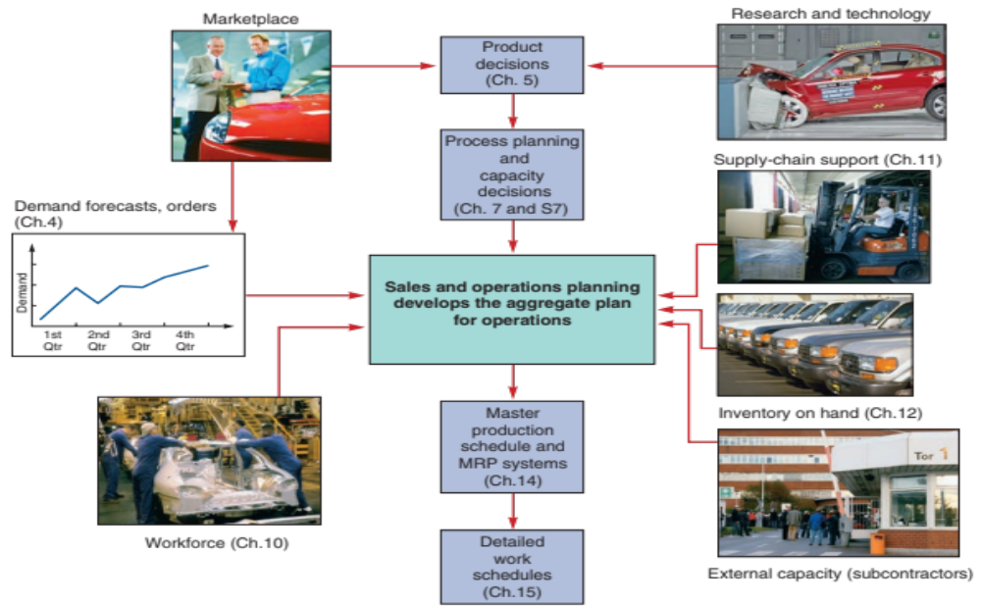
S&OP and the
Aggregate
Plan
Figure 13.2

Slide 11
Sales and Operations Planning
Decisions must be tied to strategic planning and integrated with all areas of the firm over all planning horizons
S&OP is aimed at
  The coordination and integration of the internal and external resources necessary for a successful aggregate plan
  Communication of the plan to those charged with its execution

Slide 12
Sales and Operations Planning
Requires
  A logical overall unit for measuring sales and output
  A forecast of demand for an intermediate planning period in these aggregate terms
  A method for determining relevant costs
  A model that combines forecasts and costs so that scheduling decisions can be made for the planning period

Slide 13
Aggregate Planning
The objective of aggregate planning is usually to meet forecast demand while minimizing cost over the planning period

Slide 14
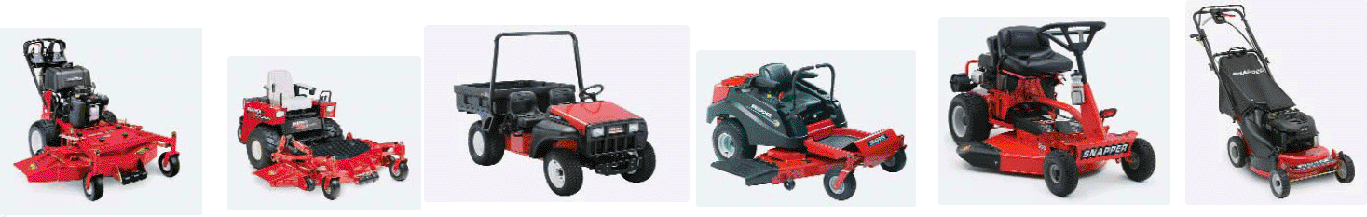
Aggregate Planning
QUARTER 1
Jan. | Feb. | March
150,000 | 120,000 | 110,000
QUARTER 2
April | May | June
100,000 | 130,000 | 150,000
QUARTER 3
July | Aug. | Sept.
180,000 | 150,000 | 140,000

Slide 15
Aggregate Planning
Combines appropriate resources into general terms
Part of a larger production planning system
Disaggregation breaks the plan down into greater detail
Disaggregation results in a master production schedule

Slide 16
Aggregate Planning Strategies
Should inventories be used to absorb changes in demand?
Should changes be accommodated by varying the size of the workforce?
Should part-timers, overtime, or idle time be used to absorb changes?
Should subcontractors be used and maintain a stable workforce?
Should prices or other factors be changed to influence demand?

Slide 17
Capacity Options
Changing inventory levels
  Increase inventory in low demand periods to meet high demand in the future
  Increases costs associated with storage, insurance, handling, obsolescence, and capital investment
  Shortages may mean lost sales due to long lead times and poor customer service

Slide 18
Capacity Options
Varying workforce size by hiring or layoffs
  Match production rate to demand
  Training and separation costs for hiring and laying off workers
  New workers may have lower productivity
  Laying off workers may lower morale and productivity

Slide 19
Capacity Options
Varying production rates through overtime or idle time
  Allows constant workforce
  May be difficult to meet large increases in demand
  Overtime can be costly and may drive down productivity
  Absorbing idle time may be difficult

Slide 20
Capacity Options
Subcontracting
  Temporary measure during periods of peak demand
  May be costly
  Assuring quality and timely delivery may be difficult
  Exposes your customers to a possible competitor

Slide 21
Capacity Options
Using part-time workers
  Useful for filling unskilled or low skilled positions, especially in services

Slide 22
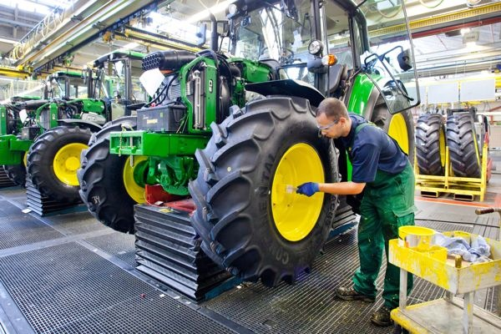
Demand Options
Influencing demand
  Use advertising or promotion to increase demand in low periods
  Attempt to shift
  demand to slow
  periods
  May not be
  sufficient to
  balance demand
  and capacity

Slide 23
Demand Options
Back ordering during high-demand periods
  Requires customers to wait for an order without loss of goodwill or the order
  Most effective when there are few if any substitutes for the product or service
  Often results in lost sales

Slide 24
Demand Options
Counterseasonal product and service mixing
  Develop a product mix of counterseasonal items
  May lead to products or services outside the company’s areas of expertise

Slide 25
Aggregate Planning Options
TABLE 13.1 | Aggregate Planning Options
OPTION | ADVANTAGES | DISADVANTAGES | COMMENTS
Changing inventory levels | Changes in human resources are gradual or none; no abrupt production changes. | Inventory holding cost may increase. Shortages may result in lost sales. | Applies mainly to production, not service, operations.
Varying workforce size by hiring or layoffs | Avoids the costs of other alternatives. | Hiring, layoff, and training costs may be significant. | Used where size of labor pool is large.

Slide 26
Aggregate Planning Options
TABLE 13.1 | Aggregate Planning Options
OPTION | ADVANTAGES | DISADVANTAGES | COMMENTS
Varying production rates through overtime or idle time | Matches seasonal fluctuations without hiring/ training costs. | Overtime premiums; tired workers; may not meet demand. | Allows flexibility within the aggregate plan.
Sub-contracting | Permits flexibility and smoothing of the firm’s output. | Loss of quality control; reduced profits; loss of future business. | Applies mainly in production settings.

Slide 27
Aggregate Planning Options
TABLE 13.1 | Aggregate Planning Options
OPTION | ADVANTAGES | DISADVANTAGES | COMMENTS
Using part-time workers | Is less costly and more flexible than full-time workers. | High turnover/ training costs; quality suffers; scheduling difficult. | Good for unskilled jobs in areas with large temporary labor pools.
Influencing demand | Tries to use excess capacity. Discounts draw new customers. | Uncertainty in demand. Hard to match demand to supply exactly. | Creates marketing ideas. Overbooking used in some businesses.

Slide 28
Aggregate Planning Options
TABLE 13.1 | Aggregate Planning Options
OPTION | ADVANTAGES | DISADVANTAGES | COMMENTS
Back ordering during high-demand periods | May avoid overtime. Keeps capacity constant. | Customer must be willing to wait, but goodwill is lost. | Many companies back order.
Counter-seasonal product and service mixing | Fully utilizes resources; allows stable workforce. | May require skills or equipment outside the firm’s areas of expertise. | Risky finding products or services with opposite demand patterns.

Slide 29
Mixing Options to Develop a Plan
A mixed strategy may be the best way to achieve minimum costs
There are many possible mixed strategies
Finding the optimal plan is not always possible

Slide 30
Mixing Options to Develop a Plan
Chase strategy
  Match output rates to demand forecast for each period
  Vary workforce levels or vary production rate
  Favored by many service organizations

Slide 31
Mixing Options to Develop a Plan
Level strategy
  Daily production is uniform
  Use inventory or idle time as buffer
  Stable production leads to better quality and productivity
Some combination of capacity options, a mixed strategy, might be the best solution

Slide 32
Methods for Aggregate Planning
Graphical Methods
Popular techniques
  Easy to understand and use
  Trial-and-error approaches that do not guarantee an optimal solution
  Require only limited computations

Slide 33
Graphical Methods
Determine the demand for each period
Determine the capacity for regular time, overtime, and subcontracting each period
Find labor costs, hiring and layoff costs, and inventory holding costs
Consider company policy on workers and stock levels
Develop alternative plans and examine their total cost

Slide 34
Roofing Supplier Example 1
TABLE 13.2 |  | Monthly Forecasts
MONTH | EXPECTED DEMAND |  | PRODUCTION DAYS | DEMAND PER DAY (COMPUTED)
Jan | 900 |  | 22 | 41
Feb | 700 |  | 18 | 39
Mar | 800 |  | 21 | 38
Apr | 1,200 |  | 21 | 57
May | 1,500 |  | 22 | 68
June | 1,100 |  | 20 | 55
 | 6,200 |  | 124
Total expected demand
Number of production days
Average requirement
=
6,200
124
= = 50 units per day

Slide 35
Roofing Supplier Example 1
Forecast demand
Figure 13.3
70 –
60 –
50 –
40 –
30 –
0 –
Level production using average monthly forecast demand
Production rate per working day
Jan Feb Mar Apr May June = Month
⬇ ⬇ ⬇ ⬇ ⬇ ⬇
22 18 21 21 22 20 = Number of
working days

Slide 36
Roofing Supplier Example 2
TABLE 13.3 | Cost Information
Inventory carrying cost |  | $ 5 per unit per month
Subcontracting cost per unit |  | $20 per unit
Average pay rate |  | $10 per hour ($80 per day)
Overtime pay rate |  | $17 per hour (above 8 hours per day)
Labor-hours to produce a unit |  | 1.6 hours per unit
Cost of increasing daily production rate (hiring and training) |  | $300 per unit
Cost of decreasing daily production rate (layoffs) |  | $600 per unit
Plan 1 – constant workforce

Slide 37
Roofing Supplier Example 2
MONTH | PRODUCTION DAYS | PRODUCTION AT 50 UNITS PER DAY | DEMAND FORECAST | MONTHLY INVENTORY CHANGE | ENDING INVENTORY
Jan | 22 | 1,100 | 900 | +200 |  | 200
Feb | 18 | 900 | 700 | +200 |  | 400
Mar | 21 | 1,050 | 800 | +250 |  | 650
Apr | 21 | 1,050 | 1,200 | –150 |  | 500
May | 22 | 1,100 | 1,500 | –400 |  | 100
June | 20 | 1,000 | 1,100 | –100 |  | 0
 |  |  |  |  |  | 1,850
Total units of inventory carried over from one
month to the next = 1,850 units
Workforce required to produce 50 units per day = 10 workers

Slide 38
Roofing Supplier Example 2
COST |  | CALCULATIONS
Inventory carrying | $9,250 | (= 1,850 units carried x $5 per unit)
Regular-time labor | 99,200 | (= 10 workers x $80 per day x 124 days)
Other costs (overtime, hiring, layoffs, subcontracting) | 0
Total cost | $108,450
MONTH | PRODUCTION DAYS | PRODUCTION AT 50 UNITS PER DAY | DEMAND FORECAST | MONTHLY INVENTORY CHANGE | ENDING INVENTORY
Jan | 22 | 1,100 | 900 | +200 |  | 200
Feb | 18 | 900 | 700 | +200 |  | 400
Mar | 21 | 1,050 | 800 | +250 |  | 650
Apr | 21 | 1,050 | 1,200 | –150 |  | 500
May | 22 | 1,100 | 1,500 | –400 |  | 100
June | 20 | 1,000 | 1,100 | –100 |  | 0
 |  |  |  |  |  | 1,850
Total units of inventory carried over from one
month to the next = 1,850 units
Workforce required to produce 50 units per day = 10 workers

Slide 39
Roofing Supplier Example 3
In-house production = 38 units per day
x 124 days
= 4,712 units
Subcontract units = 6,200 – 4,712
= 1,488 units
COST |  | CALCULATIONS
Regular-time labor | $75,392 | (= 7.6 workers x $80 per day x 124 days)
Subcontracting | 29,760 | (= 1,488 units x $20 per unit)
Total cost | $105,152

Slide 40
Roofing Supplier Example 3
Forecast demand
70 –
60 –
50 –
40 –
30 –
0 –
Level production using lowest monthly forecast demand
Production rate per working day
Jan Feb Mar Apr May June = Month
⬇ ⬇ ⬇ ⬇ ⬇ ⬇
22 18 21 21 22 20 = Number of
working days

Slide 41
Roofing Supplier Example 4
TABLE 13.4 |  | Cost Computations for Plan 3
MONTH | FORECAST (UNITS) |  | DAILY PROD RATE | BASIC PRODUCTION COST (DEMAND X 1.6 HRS/UNIT X $10/HR) |  |  | EXTRA COST OF INCREASING PRODUCTION (HIRING COST) |  |  | EXTRA COST OF DECREASING PRODUCTION (LAYOFF COST) |  |  | TOTAL COST
Jan | 900 |  | 41 |  | $ 14,400 |  |  | — |  |  | — |  | $ 14,400
Feb | 700 |  | 39 |  | 11,200 |  |  | — |  |  | $1,200 (= 2 x $600) |  | 12,400
Mar | 800 |  | 38 |  | 12,800 |  |  | — |  |  | $600 (= 1 x $600) |  | 13,400
Apr | 1,200 |  | 57 |  | 19,200 |  |  | $5,700 (= 19 x $300) |  |  | — |  | 24,900
May | 1,500 |  | 68 |  | 24,000 |  |  | $3,300 (= 11 x $300) |  |  | — |  | 24,300
June | 1,100 |  | 55 |  | 17,600 |  |  | — |  |  | $7,800 (= 13 x $600) |  | 25,400
 |  |  |  |  | $99,200 |  |  | $9,000 |  |  | $9,600 |  | $117,800

Slide 42
Roofing Supplier Example 4
Forecast demand and monthly production
70 –
60 –
50 –
40 –
30 –
0 –
Production rate per working day
Jan Feb Mar Apr May June = Month
⬇ ⬇ ⬇ ⬇ ⬇ ⬇
22 18 21 21 22 20 = Number of
working days

Slide 43
Comparison of Three Plans
TABLE 13.5 | Comparison of the Three Plans
COST |  | PLAN 1 |  |  | PLAN 2 |  |  | PLAN 3
Inventory carrying |  |  | $ 9,250 |  |  | $ 0 |  |  | $ 0
Regular labor |  |  | 99,200 |  |  | 75,392 |  |  | 99,200
Overtime labor |  |  | 0 |  |  | 0 |  |  | 0
Hiring |  |  | 0 |  |  | 0 |  |  | 9,000
Layoffs |  |  | 0 |  |  | 0 |  |  | 9,600
Subcontracting |  |  | 0 |  |  | 29,760 |  |  | 0
Total cost |  |  | $108,450 |  |  | $105,152 |  |  | $117,800
Plan 2 is the lowest cost option

Slide 44
Mathematical Approaches
Useful for generating strategies
  Transportation Method of Linear Programming
    Produces an optimal plan
    Works well for inventories, overtime, subcontracting
    Does not work when nonlinear or negative factors are introduced
Other Models
  General form of linear programming
  Simulation

Slide 45
Transportation Method
TABLE 13.6 | Farnsworth’s Production, Demand, Capacity, and Cost Data
 |  | SALES PERIOD
 |  | MAR. |  | APR. | MAY
Demand |  | 800 |  | 1,000 | 750
Capacity:
Regular |  | 700 |  | 700 | 700
Overtime |  | 50 |  | 50 | 50
Subcontracting |  | 150 |  | 150 | 130
Beginning inventory |  | 100 | tires
COSTS
Regular time | $40 per tire
Overtime | $50 per tire
Subcontracting | $70 per tire
Carrying cost | $ 2 per tire per month

Slide 46
Transportation Example
Important points
Carrying costs are $2/tire/month. If goods are made in one period and held over to the next, holding costs are incurred.
Supply must equal demand, so a dummy column called “unused capacity” is added.
Because back ordering is not viable in this example, cells that might be used to satisfy earlier demand are not available.

Slide 47
Transportation Example
  Quantities in each column designate the levels of inventory needed to meet demand requirements
  In general, production should be allocated to the lowest cost cell available without exceeding unused capacity in the row or demand in the column

Slide 48
Transportation Example
SUPPLY FROM |  | DEMAND FOR |  |  |  |  |  |  |  | TOTAL CAPACITY AVAILABLE (supply)
 |  | Period 1 (Mar) |  | Period 2 (Apr) |  | Period 3 (May) |  | Unused Capacity (dummy)
Beginning inventory |  |  | 0 |  | 2 |  | 4 |  | 0 | 100
 |  | 100
Period 1 | Regular time |  | 40 |  | 42 |  | 44 |  | 0 | 700
 |  | 700
 | Overtime |  | 50 |  | 52 |  | 54 |  | 0 | 50
 |  |  |  | 50
 | Subcontract |  | 70 |  | 72 |  | 74 |  | 0 | 150
 |  |  |  | 150
Period 2 | Regular time |  |  |  | 40 |  | 42 |  | 0 | 700
 |  | X
 | Overtime |  |  |  | 50 |  | 52 |  | 0 | 50
 |  | X
 | Subcontract |  |  |  | 70 |  | 72 |  | 0 | 150
 |  | X
Period 3 | Regular time |  |  |  |  |  | 40 |  | 0 | 700
 |  | X |  | X
 | Overtime |  |  |  |  |  | 50 |  | 0 | 50
 |  | X |  | X
 | Subcontract |  |  |  |  |  | 70 |  | 0 | 130
 |  | X |  | X
TOTAL DEMAND |  | 800 |  | 1,000 |  | 750 |  | 230 |  | 2,780
 |  |  |  | 700
 |  |  |  | 50
 |  |  |  | 50 |  |  |  | 100
 |  |  |  |  |  | 700
 |  |  |  |  |  | 50
 |  |  |  |  |  |  |  | 130
Table 13.7

Slide 49
Aggregate Planning in Services
Most services use combination strategies and mixed plans
Controlling the cost of labor is critical
  Accurate scheduling of labor-hours to assure quick response to customer demand
  An on-call labor resource to cover unexpected demand
  Flexibility of individual worker skills
  Flexibility in rate of output or hours of work

Slide 50
Five Service Scenarios
Restaurants
  Smoothing the production process
  Determining the optimal workforce size
Hospitals
  Responding to patient demand
National Chains of Small Service Firms
  Planning done at national level and at local level

Slide 51
Five Service Scenarios
Miscellaneous Services
  Plan human resource requirements
  Manage demand
Airline industry
  Extremely complex planning problem
  Involves number of flights, number of passengers, air and ground personnel, allocation of seats to fare classes
  Resources spread through the entire system

Slide 52
Revenue Management
Allocating resources to customers at prices that will maximize revenue
  Service or product can be sold in advance of consumption
  Demand fluctuates
  Capacity is relatively fixed
  Demand can be segmented
  Variable costs are low and fixed costs are high

Slide 53
Revenue Management Example
Room sales
Demand Curve
Figure 13.5
Potential customers exist who are willing to pay more than the $15 variable cost of the room, but not $150
100
Passed-up contribution
Some customers who paid $150 were actually willing to pay more for the room
50
Total
$ contribution
= (Price) x (50
rooms)
= ($150 - $15)
x (50)
= $6,750
Money left on the table
$15
Variable cost
of room
$150
Price charged for room
Price

Slide 54
Revenue Management Example
Room sales
Demand Curve
Total $ contribution =
(1st price) x 30 rooms + (2nd price) x 30 rooms =
($100 - $15) x 30 + ($200 - $15) x 30 =
$2,550 + $5,550 = $8,100
100
Figure 13.6
60
30
$15
Variable cost
of room
$100
Price 1
for room
$200
Price 2
for room
Price

Slide 55
Revenue Management Approaches
Airlines, hotels, rental cars, etc.
  Tend to have predictable duration of service and use variable pricing to control availability and revenue
Movies, stadiums, performing arts centers
  Tend to have predicable duration and fixed prices but use seating locations and times to manage revenue

Slide 56
Revenue Management Approaches
Restaurants, golf courses, ISPs
  Generally have unpredictable duration of customer use and fixed prices, may use “off-peak” rates to shift demand and manage revenue
Health care businesses, etc.
  Tend to have unpredictable duration of service and variable pricing, often attempt to control duration of service

Slide 57
Making Revenue Management Work
Multiple pricing structures must be feasible and appear logical to the customer
Forecasts of the use and duration of use
Changes in demand

