Slide 1
Chapter 14
Material Requirements Planning (MRP)
and ERP

Slide 2
Outline
Global Company Profile:
Wheeled Coach
Dependent Demand
Dependent Inventory Model Requirements
MRP Structure
MRP Management

Slide 3
Outline - Continued
Lot-Sizing Techniques
Extensions of MRP
MRP In Services
Enterprise Resource Planning (ERP)

Slide 4
Learning Objectives
When you complete this chapter you should be able to:
Develop a product structure
Build a gross requirements plan
Build a net requirements plan
Determine lot sizes for lot-for-lot, EOQ, and POQ

Slide 5
Learning Objectives
When you complete this chapter you should be able to:
Describe MRP II
Describe closed-loop MRP
Describe ERP

Slide 6
MRP for Wheeled Coach
Largest manufacturer of ambulances in the world
International competitor
12 major ambulance designs
  18,000 different inventory items
  6,000 manufactured parts
  12,000 purchased parts
© 2014 Pearson Education, Inc.

Slide 7
MRP for Wheeled Coach
Four Key Tasks
  Material plan must meet both the requirements of the master schedule and the capabilities of the production facility
  Plan must be executed as designed
  Minimize inventory investment
  Maintain excellent record integrity
© 2014 Pearson Education, Inc.

Slide 8
Dependent Demand
For any product for which a schedule can be established, dependent demand techniques should be used

Slide 9
Dependent Demand
Benefits of MRP
Better response to customer orders
Faster response to market changes
Improved utilization of facilities and labor
Reduced inventory levels

Slide 10
Dependent Demand
The demand for one item is related to the demand for another item
Given a quantity for the end item, the demand for all parts and components can be calculated
In general, used whenever a schedule can be established for an item
MRP is the common technique

Slide 11
Dependent Inventory Model Requirements
Effective use of dependent demand inventory models requires the following
  Master production schedule
  Specifications or bill of material
  Inventory availability
  Purchase orders outstanding
  Lead times

Slide 12
Master Production Schedule (MPS)
Specifies what is to be made and when
Must be in accordance with the aggregate production plan
Inputs from financial plans, customer demand, engineering, supplier performance
As the process moves from planning to execution, each step must be tested for feasibility
The MPS is the result of the production planning process

Slide 13
Master Production Schedule (MPS)
MPS is established in terms of specific products
Schedule must be followed for a reasonable length of time
The MPS is quite often fixed or frozen in the near term part of the plan
The MPS is a rolling schedule
The MPS is a statement of what is to be produced, not a forecast of demand

Slide 14
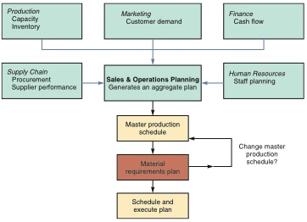
The Planning Process
Figure 14.1

Slide 15
The Planning Process
Figure 14.1
Production
Capacity
Inventory
Marketing
Customer
demand
Finance
Cash flow
Supply Chain
Procurement
Supplier
performance
Sales & Operations Planning
Generates an aggregate plan
Human Resources
Staff planning
Master production schedule

Slide 16
The Planning Process
Figure 14.1
Master production schedule
Change master production schedule?
Material requirements plan
Schedule and execute plan

Slide 17
Aggregate
Production Plan
Figure 14.2
Months January February
Aggregate Plan 1,500 1,200
(Shows the total
quantity of amplifiers)
Weeks 1 2 3 4 5 6 7 8
Master Production Schedule
(Shows the specific type and
quantity of amplifier to be
produced
240-watt amplifier 100 100 100 100
150-watt amplifier 500 500 450 450
75-watt amplifier 300 100

Slide 18
Master Production Schedule (MPS)
Can be expressed in any of the following terms:
A customer order in a job shop (make-to-order) company
Modules in a repetitive (assemble-to-order or forecast) company
An end item in a continuous (stock-to-forecast) company

Slide 19
MPS Example
TABLE 14.1 |  | Master Production Schedule for Chef John’s Buffalo Chicken Mac & Cheese
GROSS REQUIREMENTS FOR CHEF JOHN’S BUFFALO MAC & CHEESE
Day | 6 | 7 | 8 | 9 | 10 | 11 | 12 | 13 | 14 | And so on
Quantity | 450 |  | 200 | 350 | 525 |  | 235 | 375

Slide 20
Bills of Material
List of components, ingredients, and materials needed to make product
Provides product structure
  Items above given level are called parents
  Items below given level are called components or children

Slide 21

BOM Example
Level
Product structure for “Awesome” (A)
0
A
1
B₍₂₎
C₍₃₎
2
E₍₂₎
E₍₂₎
F₍₂₎
3
D₍₂₎
G₍₁₎
D₍₂₎

Slide 22
BOM Example
For an order of 50 Awesome speaker kits
Level
Product structure for “Awesome” (A)
Part B: 2 x number of As = (2)(50) = 100
Part C: 3 x number of As = (3)(50) = 150
Part D: 2 x number of Bs
+ 2 x number of Fs = (2)(100) + (2)(300) = 800
Part E: 2 x number of Bs
+ 2 x number of Cs = (2)(100) + (2)(150) = 500
Part F: 2 x number of Cs = (2)(150) = 300
Part G: 1 x number of Fs = (1)(300) = 300
0
A
1
B₍₂₎
C₍₃₎
2
E₍₂₎
E₍₂₎
F₍₂₎
3
D₍₂₎
G₍₁₎
D₍₂₎

Slide 23
Bills of Material
Modular Bills
  Modules are not final products but components that can be assembled into multiple end items
  Can significantly simplify planning and scheduling

Slide 24
Bills of Material
Planning Bills
  Also called “pseudo” or super bills
  Created to assign an artificial parent to the BOM
  Used to group subassemblies to reduce the number of items planned and scheduled
  Used to create standard “kits” for production

Slide 25
Bills of Material
Phantom Bills
  Describe subassemblies that exist only temporarily
  Are part of another assembly and never go into inventory
Low-Level Coding
  Item is coded at the lowest level at which it occurs
  BOMs are processed one level at a time

Slide 26
Accurate Inventory Records
Accurate inventory records are absolutely required for MRP (or any dependent demand system) to operate correctly
Generally MRP systems require more than 99% accuracy

Slide 27
Purchase Orders Outstanding
A by-product of well-managed purchasing and inventory control department
Outstanding purchase orders must accurately reflect quantities and scheduled receipts

Slide 28
Lead Times for Components
The time required to purchase, produce, or assemble an item
  For production – the sum
  of the move, setup, and
  assembly or run times
  For purchased items –
  the time between the
  recognition of a need
  and when its available
  for production
TABLE 14.2
Lead Times for Awesome Speaker Kits (As)
COMPONENT |  | LEAD TIME
A |  | 1 week
B |  | 2 weeks
C |  | 1 week
D |  | 1 week
E |  | 2 week
F |  | 3 weeks
G |  | 2 weeks

Slide 29
Time-Phased Product Structure
Figure 14.3
Start production of D
Must have D and E completed here so production can begin on B
1 week
2 weeks to produce
D
B
2 weeks
E
A
2 weeks
1 week
E
2 weeks
1 week
G
C
3 weeks
F
1 week
D
| | | | | | | |
1 2 3 4 5 6 7 8
Time in weeks

Slide 30
MRP Structure
Figure 14.4
Data Files
Output Reports
BOM
MRP by period report
Master
production schedule
MRP by date report
Lead times
(Item master file)
Planned order report
Inventory data
Material requirement planning programs (computer and software)
Purchase advice
Purchasing data
Exception reports
Order early or late or not needed
Order quantity too small or too large

Slide 31
Determining Gross Requirements
Starts with a production schedule for the end item – 50 units of Item A in week 8
Using the lead time for the item, determine the week in which the order should be released – a 1 week lead time means the order for 50 units should be released in week 7
This step is often called “lead time offset” or “time phasing”

Slide 32
Determining Gross Requirements
From the BOM, every Item A requires 2 Item Bs – 100 Item Bs are required in week 7 to satisfy the order release for Item A
The lead time for the Item B is 2 weeks – release an order for 100 units of Item B in week 5
The timing and quantity for component requirements are determined by the order release of the parent(s)

Slide 33
Determining Gross Requirements
The process continues through the entire BOM one level at a time – often called “explosion”
By processing the BOM by level, items with multiple parents are only processed once, saving time and resources and reducing confusion
Low-level coding ensures that each item appears at only one level in the BOM

Slide 34
Gross Requirements Plan
TABLE 14.3 | Gross Material Requirements Plan for 50 Awesome Speaker Kits (As) with Order Release Dates Also Shown
 |  | WEEK |  |  |  |  |  |  |  | LEAD TIME
 |  | 1 | 2 | 3 | 4 | 5 | 6 | 7 | 8
A. Required date |  |  |  |  |  |  |  |  | 50 | 1 week
Order release date |  |  |  |  |  |  |  | 50
B. Required date |  |  |  |  |  |  |  | 100 |  | 2 weeks
Order release date |  |  |  |  |  | 100
C. Required date |  |  |  |  |  |  |  | 150 |  | 1 week
Order release date |  |  |  |  |  |  | 150
E. Required date |  |  |  |  |  | 200 | 300 |  |  | 2 weeks
Order release date |  |  |  | 200 | 300
F. Required date |  |  |  |  |  |  | 300 |  |  | 3 weeks
Order release date |  |  |  | 300
D. Required date |  |  |  | 600 |  | 200 |  |  |  | 1 week
Order release date |  |  | 600 |  | 200
G. Required date |  |  |  | 300 |  |  |  |  |  | 2 weeks
Order release date |  | 300

Slide 35
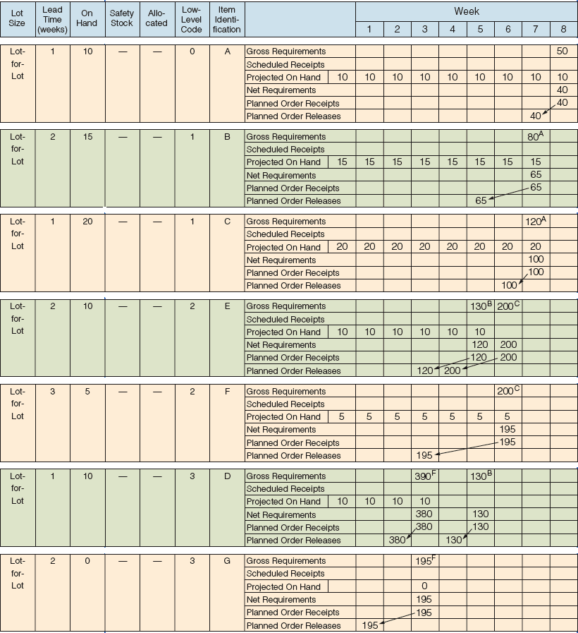
Net Requirements Plan
ITEM | ON HAND | ITEM | ON HAND
A | 10 | E | 10
B | 15 | F | 5
C | 20 | G | 0
D | 10

Slide 36
Net Requirements Plan

Slide 37
Determining Net Requirements
Starts with a production schedule for the end item – 50 units of Item A in week 8
Because there are 10 Item As on hand, only 40 are actually required – (net requirement) = (gross requirement – on-hand inventory)
The planned order receipt for Item A in week 8 is 40 units – 40 = 50 – 10

Slide 38
Determining Net Requirements
Following the lead time offset procedure, the planned order release for Item A is now 40 units in week 7
The gross requirement for Item B is now 80 units in week 7
There are 15 units of Item B on hand, so the net requirement is 65 units in week 7
A planned order receipt of 65 units in week 7 generates a planned order release of 65 units in week 5

Slide 39
Determining Net Requirements
A planned order receipt of 65 units in week 7 generates a planned order release of 65 units in week 5
The on-hand inventory record for Item B is updated to reflect the use of the 15 items in inventory and shows no on-hand inventory in week 8
This is referred to as the Gross-to-Net calculation and is the third basic function of the MRP process

Slide 40
Gross Requirements Schedule
Figure 14.5
A
S
B
C
B
C
Master schedule
for B
sold directly
Lead time = 4 for A
Master schedule for A
Lead time = 6 for S
Master schedule for S
Periods
5
6
7
8
9
10
11
8
9
10
11
12
13
1
2
3
40
50
15
40
20
30
10
10
Periods
1
2
3
4
5
6
7
8
40+10
15+30
Therefore, these are the gross requirements for B
Gross requirements: B
10
=50
40
50
20
=45

Slide 41
Net Requirements Plan
The logic of net requirements
Gross requirements
+
Allocations
Total requirements
–
On hand
+
Scheduled receipts
=
Net requirements
Available inventory

Slide 42
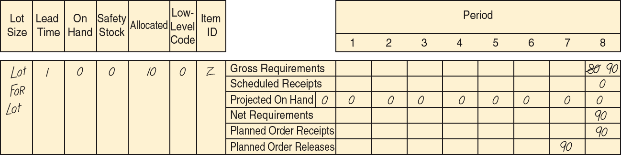
MRP Planning Sheet
Figure 14.6

Slide 43
Safety Stock
BOMs, inventory records, purchase and production quantities may not be perfect
Consideration of safety stock may be prudent
Should be minimized and ultimately eliminated
Typically built into projected on-hand inventory

Slide 44
MRP Management
MRP dynamics
  Facilitates replanning when changes occur
  System nervousness can result from too many changes
  Time fences put limits on replanning
  Pegging links each item to its parent allowing effective analysis of changes

Slide 45
MRP Management
MRP limitations
  MRP does not do detailed scheduling–it plans
  Works best in product-focused, repetitive environments
  Requires fixed lead time and infinite size time buckets

Slide 46
Lot-Sizing Techniques
Lot-for-lot techniques order just what is required for production based on net requirements
  May not always be feasible
  If setup costs are high, lot-for-lot can be expensive
Economic order quantity (EOQ)
  EOQ expects a known constant demand and MRP systems often deal with unknown and variable demand

Slide 47
Lot-Sizing Techniques
Periodic order quantity (POQ) orders quantity needed for a predetermined time period
  Interval = EOQ / average demand per period
  Order quantity set to cover the interval
  Order quantity calculated when order is released
  No extra inventory

Slide 48
Lot-Sizing Techniques
Dynamic lot sizing techniques
  Balance lot size and setup costs
  Part period balancing (least total cost)
  Least unit cost
  Least period cost (Silver-Meal)
Dynamic programming approach
  Wagner-Whitin

Slide 49
Lot-for-Lot Example
WEEK |  | 1 | 2 | 3 | 4 | 5 | 6 | 7 | 8 | 9 | 10
Gross requirements |  | 35 | 30 | 40 | 0 | 10 | 40 | 30 | 0 | 30 | 55
Scheduled receipts
Projected on hand | 35 | 35 | 0 | 0 | 0 | 0 | 0 | 0 | 0 | 0 | 0
Net requirements |  | 0 | 30 | 40 | 0 | 10 | 40 | 30 | 0 | 30 | 55
Planned order receipts |  |  | 30 | 40 |  | 10 | 40 | 30 |  | 30 | 55
Planned order releases |  | 30 | 40 |  | 10 | 40 | 30 |  | 30 | 55
Holding cost = $1/week; Setup cost = $100; Lead time = 1 week

Slide 50
Lot-for-Lot Example
No on-hand inventory is carried through the system
Total holding cost = $0
There are seven setups for this item in this plan
Total ordering cost = 7 x $100 = $700
WEEK |  | 1 | 2 | 3 | 4 | 5 | 6 | 7 | 8 | 9 | 10
Gross requirements |  | 35 | 30 | 40 | 0 | 10 | 40 | 30 | 0 | 30 | 55
Scheduled receipts
Projected on hand | 35 | 35 | 0 | 0 | 0 | 0 | 0 | 0 | 0 | 0 | 0
Net requirements |  | 0 | 30 | 40 | 0 | 10 | 40 | 30 | 0 | 30 | 55
Planned order receipts |  |  | 30 | 40 |  | 10 | 40 | 30 |  | 30 | 55
Planned order releases |  | 30 | 40 |  | 10 | 40 | 30 |  | 30 | 55
Holding cost = $1/week; Setup cost = $100; Lead time = 1 week

Slide 51
EOQ Lot Size Example
WEEK |  | 1 | 2 | 3 | 4 | 5 | 6 | 7 | 8 | 9 | 10
Gross requirements |  | 35 | 30 | 40 | 0 | 10 | 40 | 30 | 0 | 30 | 55
Scheduled receipts
Projected on hand | 35 | 35 | 0 | 43 | 3 | 3 | 66 | 26 | 69 | 69 | 39
Net requirements |  | 0 | 30 | 0 | 0 | 7 | 0 | 4 | 0 | 0 | 16
Planned order receipts |  |  | 73 |  |  | 73 |  | 73 |  |  | 73
Planned order releases |  | 73 |  |  | 73 |  | 73 |  |  | 73
Holding cost = $1/week; Setup cost = $100; Lead time = 1 week
Average weekly gross requirements = 27; EOQ = 73 units

Slide 52
EOQ Lot Size Example
Annual demand D = 1,404
Holding cost = 375 units x $1 (including 57 units on hand at end of week 10)
Ordering cost = 4 x $100 = $400
Total cost = $375 + $400 = $775
WEEK |  | 1 | 2 | 3 | 4 | 5 | 6 | 7 | 8 | 9 | 10
Gross requirements |  | 35 | 30 | 40 | 0 | 10 | 40 | 30 | 0 | 30 | 55
Scheduled receipts
Projected on hand | 35 | 35 | 0 | 43 | 3 | 3 | 66 | 26 | 69 | 69 | 39
Net requirements |  | 0 | 30 | 0 | 0 | 7 | 0 | 4 | 0 | 0 | 16
Planned order receipts |  |  | 73 |  |  | 73 |  | 73 |  |  | 73
Planned order releases |  | 73 |  |  | 73 |  | 73 |  |  | 73
Holding cost = $1/week; Setup cost = $100; Lead time = 1 week
Average weekly gross requirements = 27; EOQ = 73 units

Slide 53
POQ Lot Size Example
WEEK |  | 1 | 2 | 3 | 4 | 5 | 6 | 7 | 8 | 9 | 10
Gross requirements |  | 35 | 30 | 40 | 0 | 10 | 40 | 30 | 0 | 30 | 55
Scheduled receipts
Projected on hand | 35 | 35 | 0 | 40 | 0 | 0 | 70 | 30 | 0 | 0 | 55
Net requirements |  | 0 | 30 | 0 | 0 | 10 | 0 |  | 0 | 55 | 0
Planned order receipts |  |  | 70 |  |  | 80 |  | 0 |  | 85 | 0
Planned order releases |  | 70 |  |  | 80 |  |  |  | 85
EOQ = 73 units; Average weekly gross requirements = 27;
POQ interval = 73/27 ≅ 3 weeks

Slide 54
POQ Lot Size Example
Setups = 3 x $100 = $300
Holding cost = (40 + 70 + 30 + 55) units x $1 = $195
Total cost = $300 + $195 = $495
WEEK |  | 1 | 2 | 3 | 4 | 5 | 6 | 7 | 8 | 9 | 10
Gross requirements |  | 35 | 30 | 40 | 0 | 10 | 40 | 30 | 0 | 30 | 55
Scheduled receipts
Projected on hand | 35 | 35 | 0 | 40 | 0 | 0 | 70 | 30 | 0 | 0 | 55
Net requirements |  | 0 | 30 | 0 | 0 | 10 | 0 |  | 0 | 55 | 0
Planned order receipts |  |  | 70 |  |  | 80 |  | 0 |  | 85 | 0
Planned order releases |  | 70 |  |  | 80 |  |  |  | 85
EOQ = 73 units; Average weekly gross requirements = 27;
POQ interval = 73/27 ≅ 3 weeks

Slide 55
Lot-Sizing Summary
For these three examples
 | COSTS
 | SETUP | HOLDING | TOTAL
Lot-for-lot | $700 | $0 | $700
EOQ | $400 | $375 | $775
POQ | $300 | $195 | $495
Wagner-Whitin would have yielded a plan with a total cost of $455

Slide 56

Lot-Sizing Summary
In theory, lot sizes should be recomputed whenever there is a lot size or order quantity change
In practice, this results in system nervousness and
instability
Lot-for-lot should
be used when
low-cost setups can
be achieved

Slide 57
Lot-Sizing Summary
Lot sizes can be modified to allow for scrap, process constraints, and purchase lots
Use lot-sizing with care as it can cause considerable distortion of requirements at lower levels of the BOM
When setup costs are significant and demand is reasonably smooth, POQ or EOQ should give reasonable results

Slide 58
Extensions of MRP
MRP II
Closed-Loop MRP
Capacity Planning

Slide 59
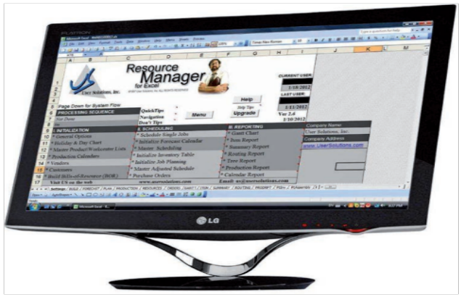
Material Requirements
Planning II
Requirement data can be
enriched by other resources
Generally called MRP II or
Material Resource Planning
Outputs can include scrap,
packaging waste, effluent,
carbon emissions
Data used by purchasing, production scheduling, capacity planning, inventory, warehouse management

Slide 60
Material Resource Planning
TABLE 14.4 | Material Resource Planning (MRP II)
 |  |  | Weeks
 |  | LT | 5 |  | 6 | 7 |  | 8
Computer |  | 1 |  |  |  |  |  | 100
Labor Hrs: .2 each |  |  |  |  |  |  |  | 20
Machine Hrs: .2 each |  |  |  |  |  |  |  | 20
Scrap: 1 ounce fiberglass each |  |  |  |  |  |  |  | 6.25 | lb
Payables: $0 each |  |  |  |  |  |  |  | $0
PC Board (1 each) |  | 2 |  |  |  | 100
Labor Hrs: .15 each |  |  |  |  |  | 15
Machine Hrs: .1 each |  |  |  |  |  | 10
Scrap: .5 ounces copper each |  |  |  |  |  | 3.125 | lb
Payables: raw material at $5 each |  |  |  |  |  | $500
Processors (5 each) |  | 4 | 500
Labor Hrs: .2 each |  |  | 100
Machine Hrs: .2 each |  |  | 100
Scrap: .01 ounces of acid waste each |  |  | 0.3125 | lb
Payables: processors at $10 each |  |  | $5,000

Slide 61
Closed-Loop MRP System
Figure 14.7
Aggregate Plan
OK?
NO
Priority Management
Capacity Management
Develop Master Production
Schedule
Prepare Materials
Requirements Pan
Detailed Production
Activity Control
(Shop Scheduling/Dispatching)
Evaluate Resource Availability
(Rough Cut)
Determine Capacity Availability
Implement Input/Output Control
OK?
NO
OK? YES
Planning
OK? YES
Execution
(in repetitive systems JIT techniques are used)

Slide 62
Capacity Planning
Feedback from the MRP system
Load reports show resource requirements for work centers
Work can be moved between work centers to smooth the load or bring it within capacity

Slide 63
Smoothing Tactics
Overlapping
  Sends part of the work to following operations before the entire lot is complete
  Reduces lead time
Operations splitting
  Sends the lot to two different machines for the same operation
  Shorter throughput time but increased setup costs
Order or lot splitting
  Breaking up the order into smaller lots and running part earlier (or later) in the schedule

Slide 64
Order Splitting
Develop a capacity plan for a work cell at Wiz Products
There are 12 hours available each day
Each order requires 1 hour
Day | 1 | 2 | 3 | 4 | 5
Orders | 10 | 14 | 13 | 10 | 14

Slide 65
Order Splitting
DAY | UNITS ORDERED |  |  | CAPACITY REQUIRED (HOURS) | CAPACITY AVAILABLE (HOURS) | UTILIZATION: OVER/ (UNDER) (HOURS) | PRODUCTION PLANNER’S ACTION | NEW PRODUCTION SCHEDULE
1 |  | 10 |  | 10 | 12 | (2) |  | 12
2 |  | 14 |  | 14 | 12 | 2 | Split order: move 2 units to day 1 | 12
3 |  | 13 |  | 13 | 12 | 1 | Split order: move one unit to day 6 or request overtime | 13
4 |  | 10 |  | 10 | 12 | (2) |  | 12
5 |  | 14 |  | 14 | 12 | 2 | Split order: move 2 units to day 4 | 12
 |  | 61

Slide 66
Order Splitting
Figure 14.8
2 orders moved to day 1 from day 2 (a day early)
1 order forced to overtime
or to day 6
2 orders moved to
day 4 (a day early)
Capacity exceeded on days 2, 3, and 5
Available capacity
14 –
12 –
10 –
8 –
6 –
4 –
2 –
0 –
14 –
12 –
10 –
8 –
6 –
4 –
2 –
0 –
Standard labor-Hours
Standard labor-Hours
1
2
3
4
5
1
2
3
4
5
Days
(a)
Days
(b)

Slide 67
MRP in Services
Some services or service items are directly linked to demand for other services
These can be treated as dependent demand services or items
  Restaurants
  Hospitals
  Hotels

Slide 68
MRP in Services
Figure 14.9
(a) PRODUCT STRUCTURE TREE
Buffalo Chicken Mac & Cheese
Garnish with Buffalo Chicken mix, Blue Cheese, Scallions
Baked Buffalo Chicken Mac & Cheese
Unbaked Buffalo Chicken Mac & Cheese
Buffalo Chicken Mix
Buffalo Sauce
Smoked Pulled Chicken
Blue Cheese Crumbles
Cooked Elbow Macaroni
Grated Pepper Jack Cheese
Chopped Scallions
Mac & Cheese Base
Milk

Slide 69
MRP in Services
(b) BILL OF MATERIALS
Production Specifications | Buffalo Chicken Mac & Cheese (6 portions)
Ingredients | Quantity | Measure | Unit Cost | Total Cost | Labor Hrs.
Elbow Macaroni (large, uncooked) | 20.00 | oz. | $ 0.09 | $ 1.80
Cheese-Pepper Jack (grated) | 10.00 | oz. | 0.17 | 1.70
Mac and Cheese Base (from refrigerator) | 32.00 | oz. | 0.80 | 25.60
Milk | 4.00 | oz. | 0.03 | 0.12
Smoked Pulled Chicken | 2.00 | lb. | 2.90 | 5.80
Buffalo Sauce | 8.00 | oz. | 0.09 | 0.72
Blue Cheese Crumbles | 4.00 | oz. | 0.19 | 0.76
Scallions | 2.00 | oz. | 0.18 | 0.36
 |  |  |  |  | 0.2 hrs

Slide 70
Distribution Resource Planning (DRP)
Using dependent demand techniques through the supply chain
Expected demand or sales forecasts become gross requirements
All other levels are computed
DRP pulls inventory through the system
Small and frequent replenishments

Slide 71
Enterprise Resource Planning (ERP)
An extension of the MRP system to tie in customers and suppliers
  Allows automation and integration of many business processes
  Shares common data bases and business practices
  Produces information in real time
Coordinates business from supplier evaluation to customer invoicing

Slide 72
Enterprise Resource Planning (ERP)
ERP modules include
  Basic MRP
  Finance
  Human resources
  Supply chain management (SCM)
  Customer relationship management (CRM)
  Sustainability

Slide 73
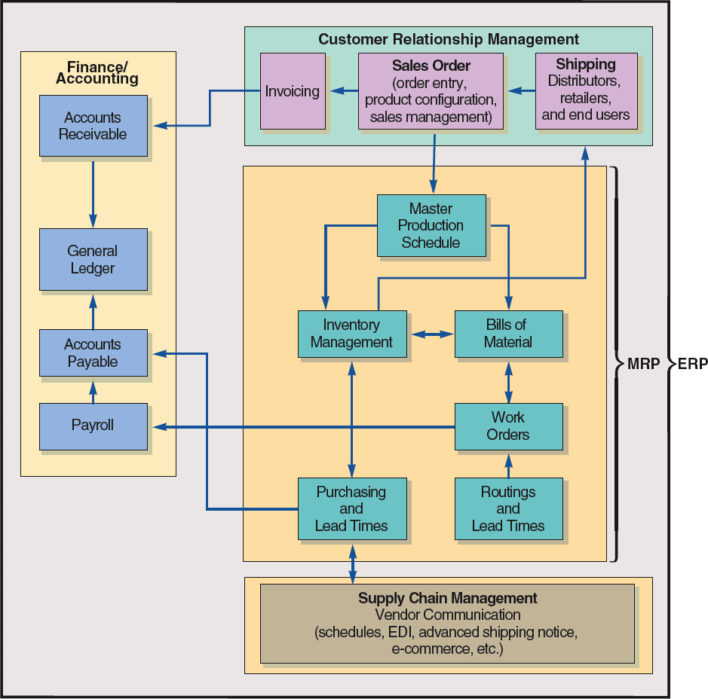
ERP and MRP
Figure 14.10

Slide 74
ERP and MRP
Figure 14.10
Customer Relationship Management
Sales Order
(order entry,
product configuration,
sales management)
Shipping
Distributors, retailers,
and end users
Invoicing

Slide 75
ERP and MRP
Figure 14.10
Master Production Schedule
Inventory Management
Bills of Material
MRP
Work Orders
Purchasing
and
Lead Times
Routings
and
Lead Times
Table 13.6

Slide 76
ERP and MRP
Figure 14.10
Supply-Chain Management
Vendor Communication
(schedules, EDI, advanced shipping notice,
e-commerce, etc.)

Slide 77
ERP and MRP
Figure 14.10
Finance/
Accounting
Accounts Receivable
General Ledger
Accounts Payable
Payroll
Table 13.6

Slide 78
Enterprise Resource Planning (ERP)
ERP systems have the potential to
  Reduce transaction costs
  Increase the speed and accuracy of information
Facilitates a strategic emphasis on JIT systems and supply chain integration
Can be expensive and time-consuming to install

Slide 79
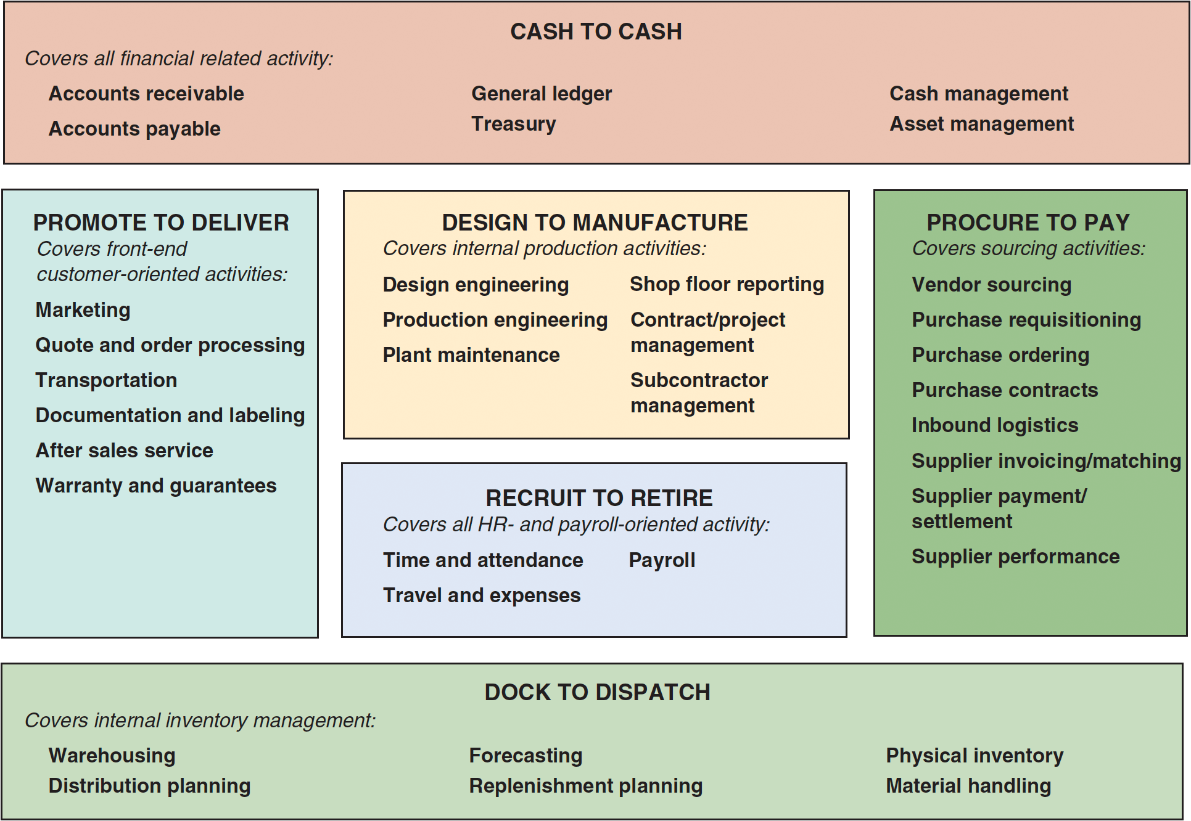
SAP’s ERP Modules
Figure 14.11

Slide 80
ERP in the Service Sector
ERP systems have been developed for health care, government, retail stores, hotels, and financial services
Also called efficient consumer response (ECR) systems
Objective is to tie sales to buying, inventory, logistics, and production

