Slide 1
Persen
Ch 03 Salzman
Ch 06 Brenchner

Slide 2
Definition
Percent, is a way of representing the parts of a whole. Percent means per hundred or parts per hundred.
Percent sign, is the symbol, %, used to represent percents. For example, 1 percent would be written 1%.

Slide 3
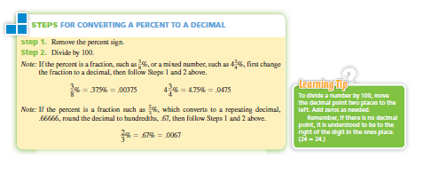
Converting percent to decimal, or vice versa

Slide 4
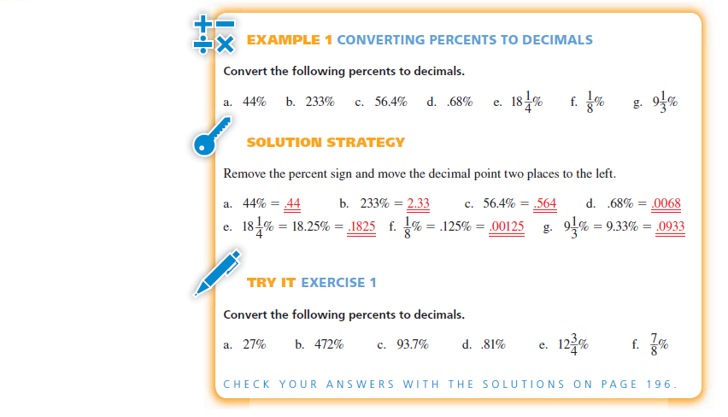
Convert Percent to Decimals

Slide 5
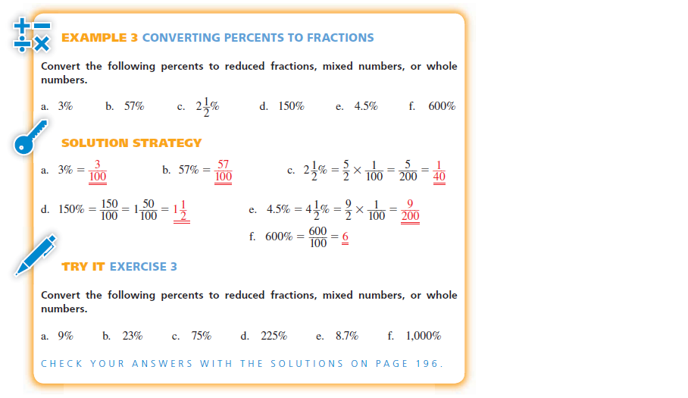
Converting Percents to Fraction

Slide 6
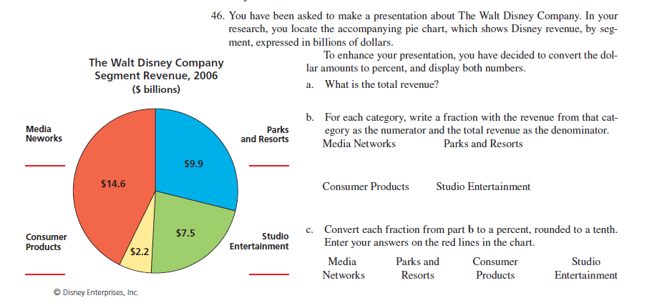

Slide 7
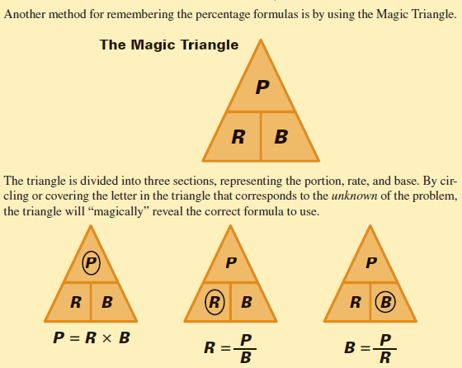
The Magic Triangle

Slide 8
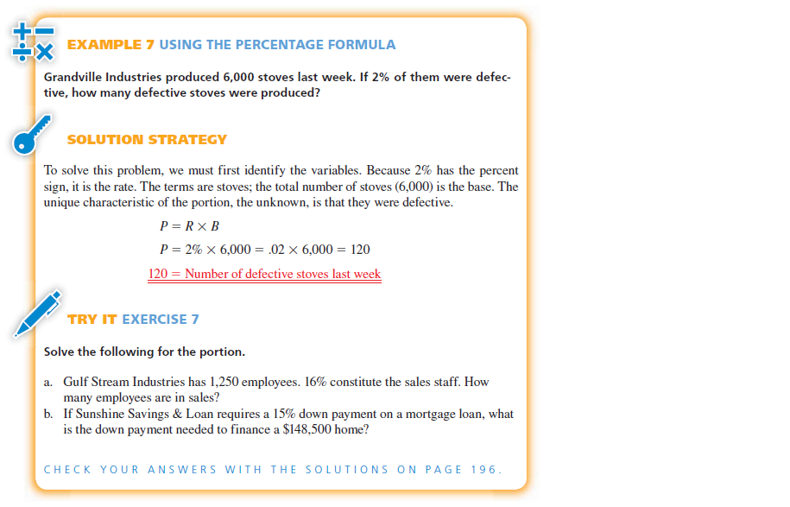

Slide 9
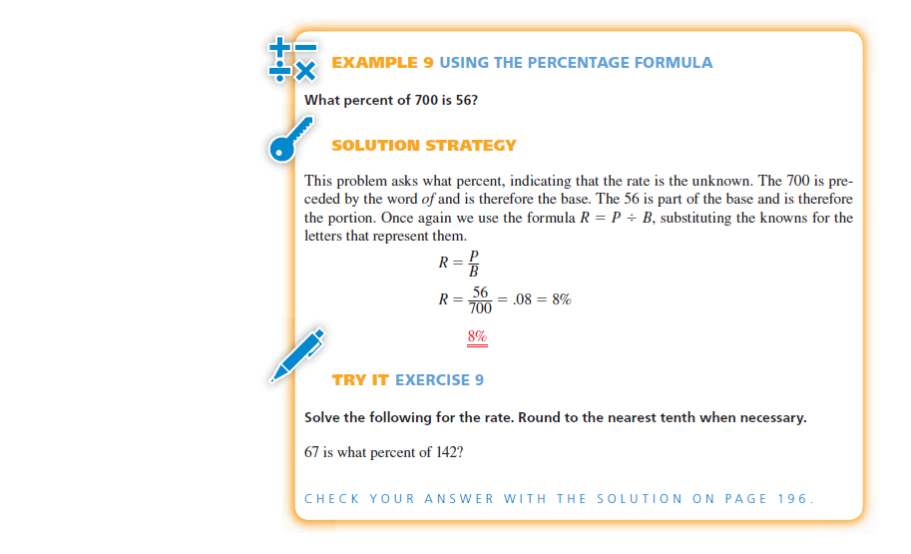

Slide 10
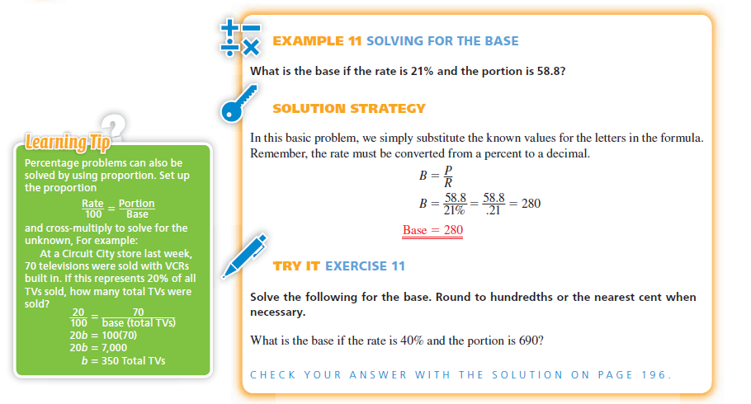

Slide 11
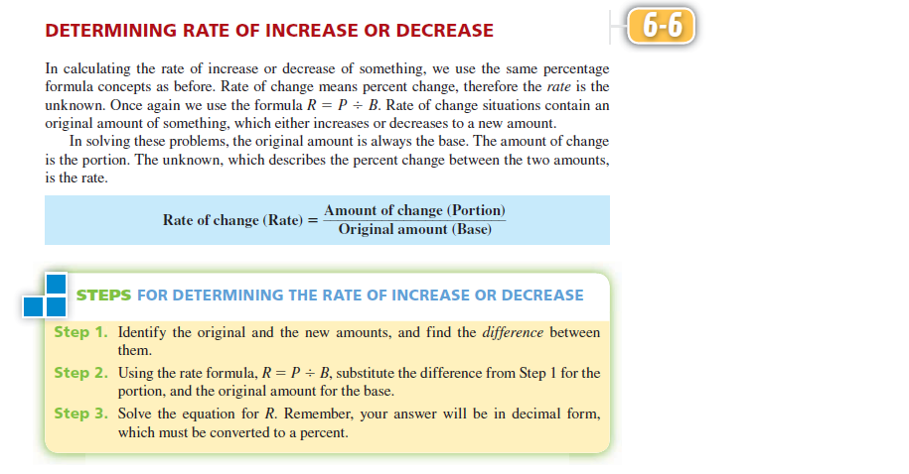

Slide 12
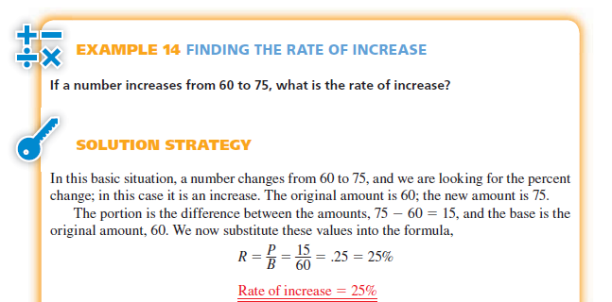
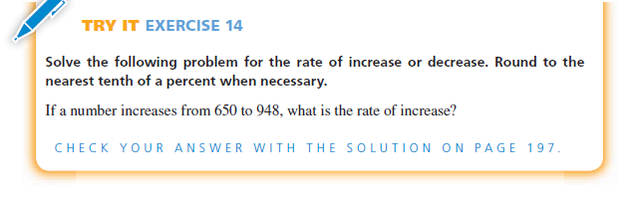

Slide 13
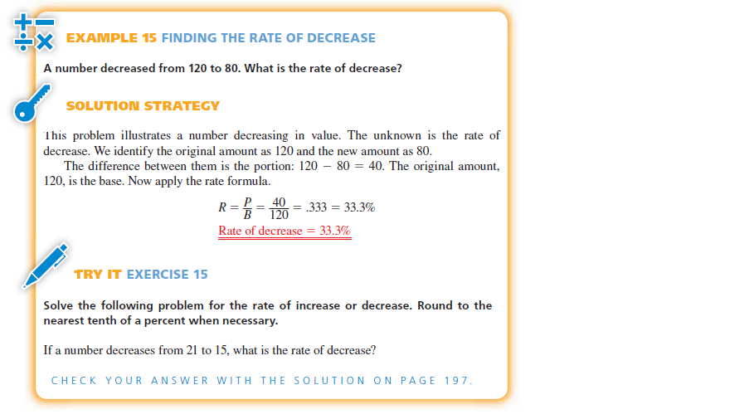

Slide 14
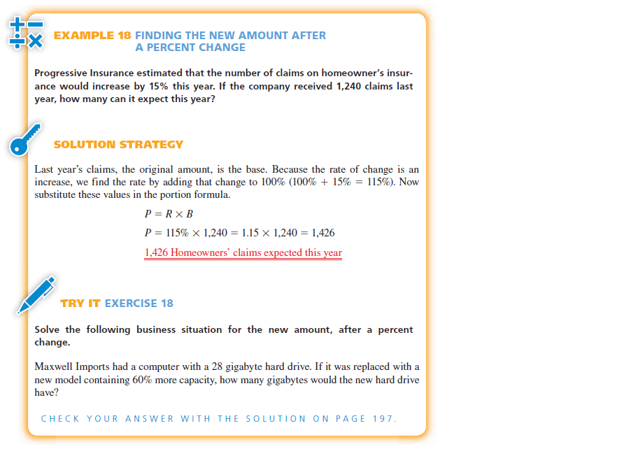

Slide 15
