Slide 1


Chapter 12
Linear Programming
I. Simplex Method
Ding-Zhu Du

Slide 2
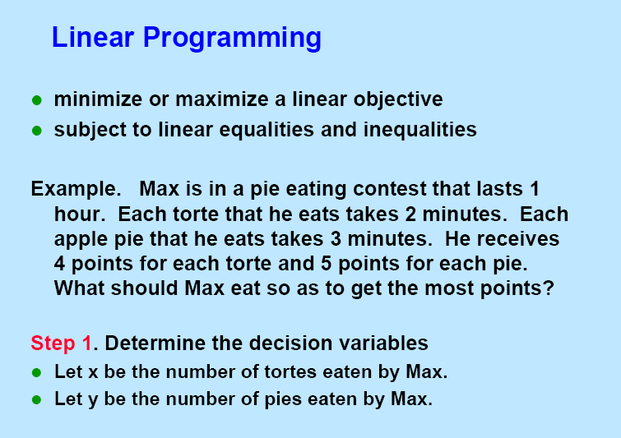

Slide 3
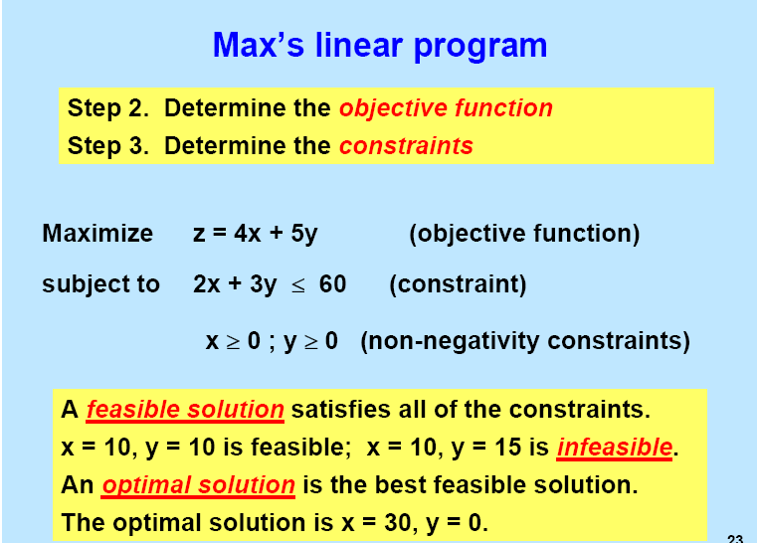

Slide 4
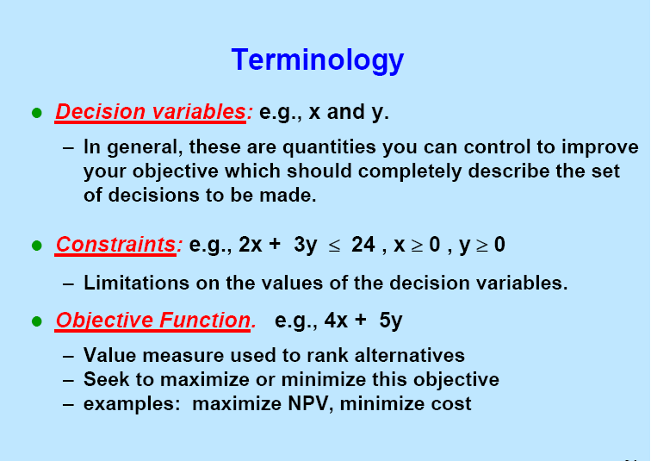

Slide 5
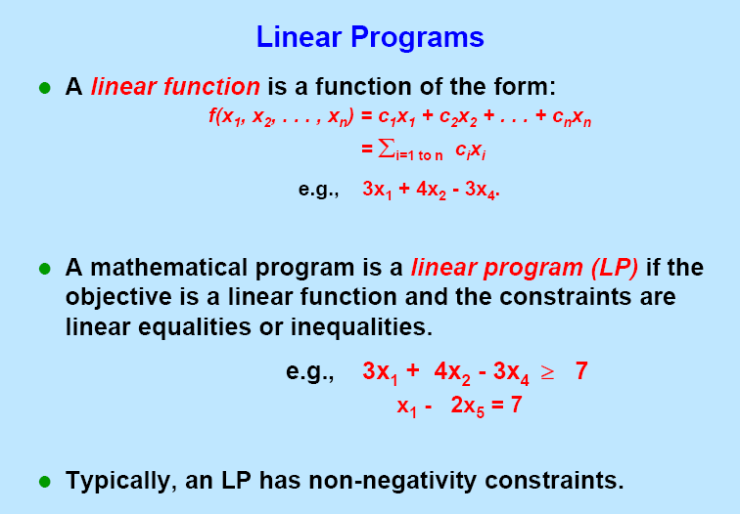

Slide 6
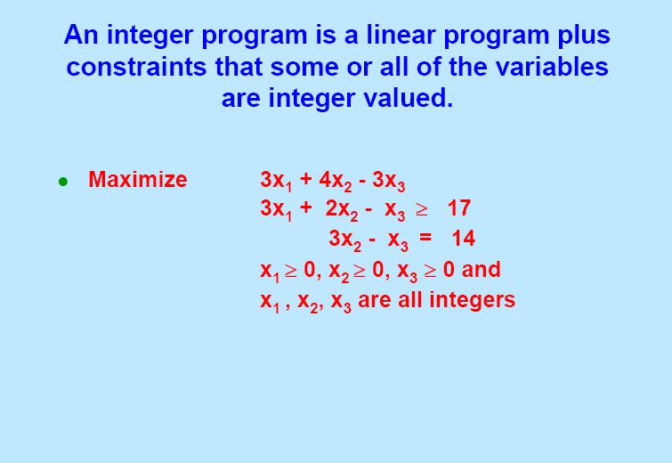

Slide 7
LP examples
A post office requires different numbers of full-time employees on different days of the week. The number of full-time employees required on each day is given in the table. Union rules state that each full-time employee must work five consecutive days and then receive two days off. The post office wants to meet its daily requirements using only full-time employees. Formulate an LP that the post office can use to minimize the number of full-time employees that must be hired.

Slide 8
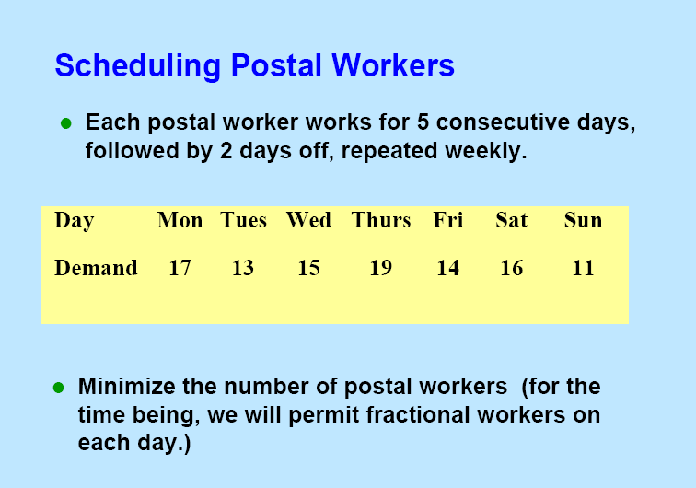

Slide 9
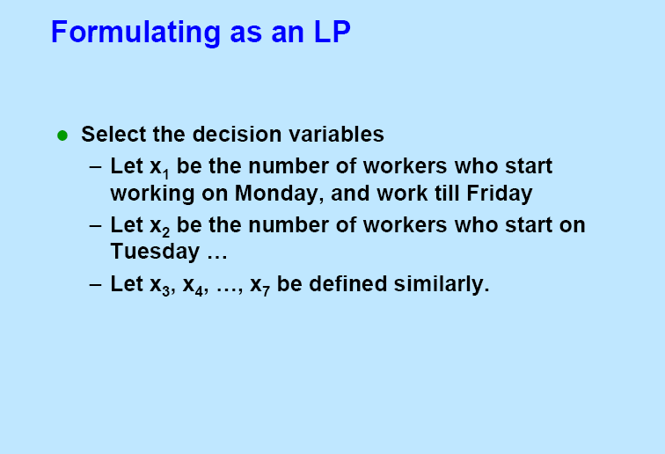

Slide 10
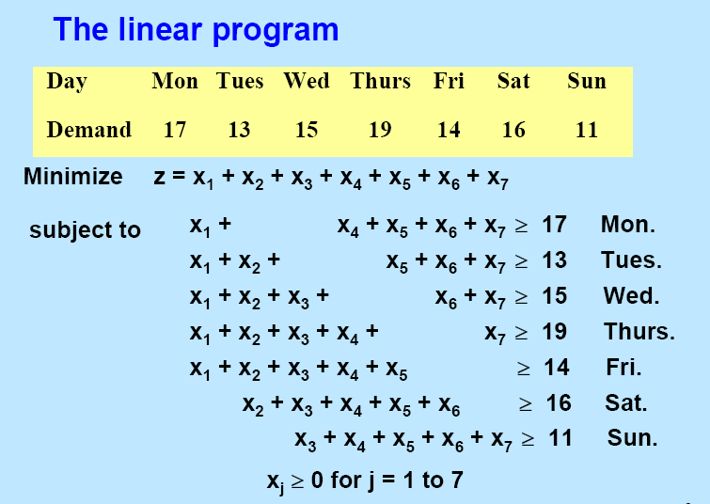

Slide 12


Optimal occurs at a vertex!!!
Feasible domain

Slide 13
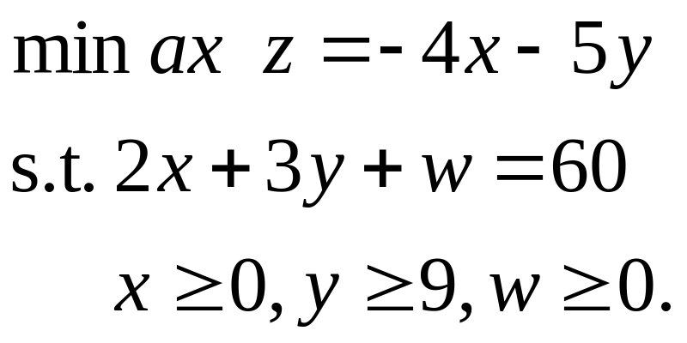
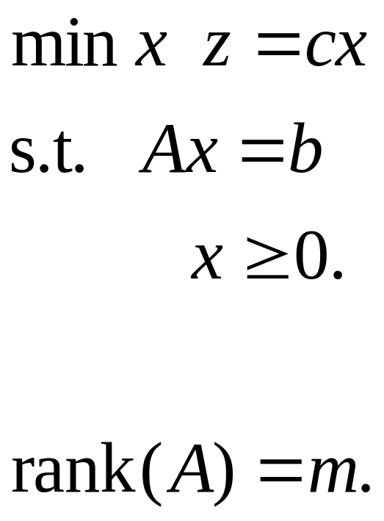
Slack Form

Slide 14
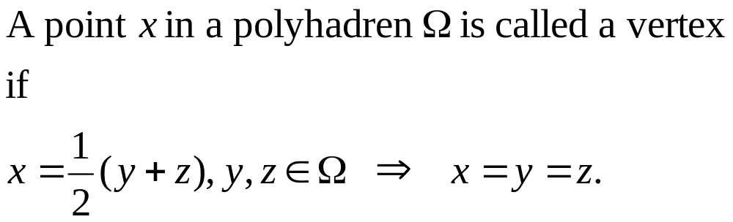
What’s a vertex?

Slide 15
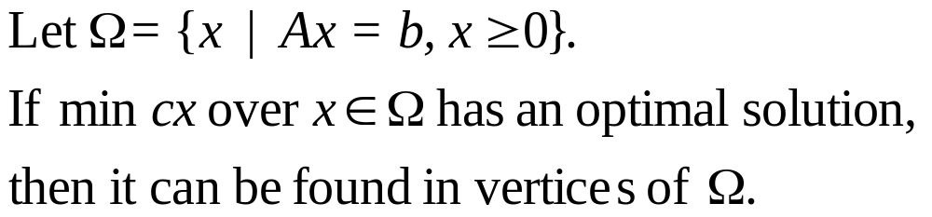
Fundamental Theorem

Slide 16
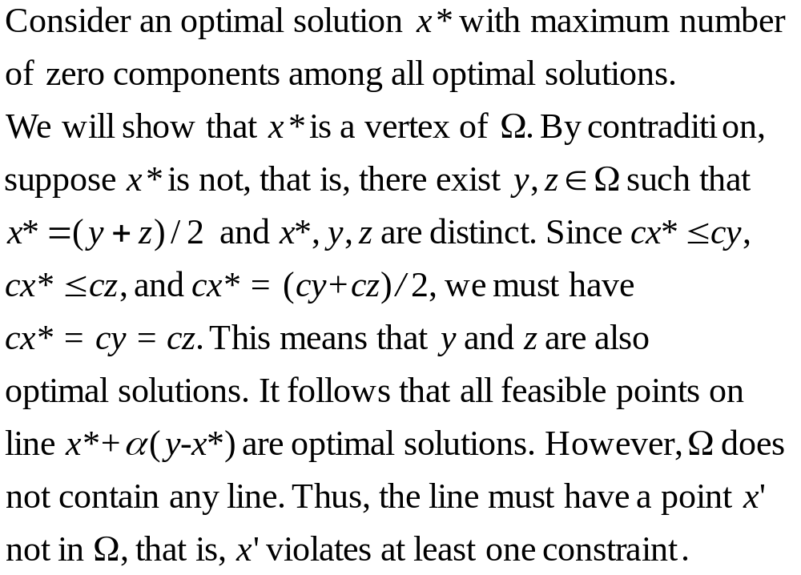
Proof.

Slide 17
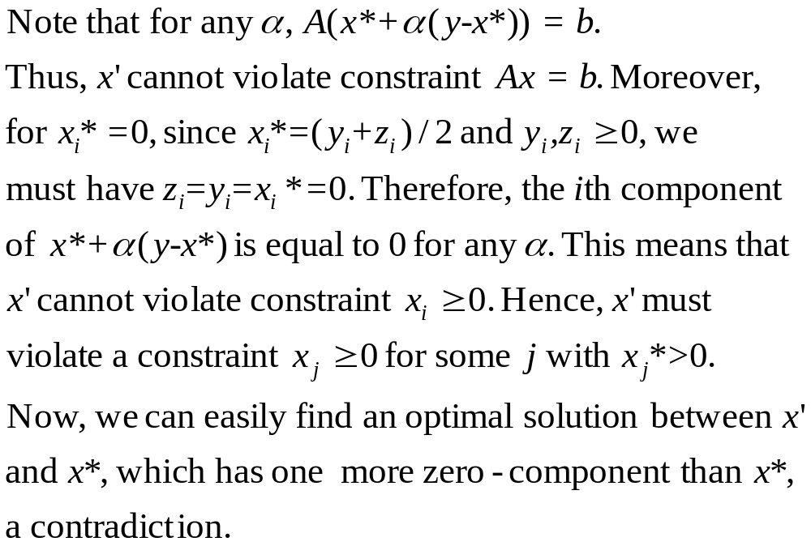
Proof (cont’s).

Slide 18
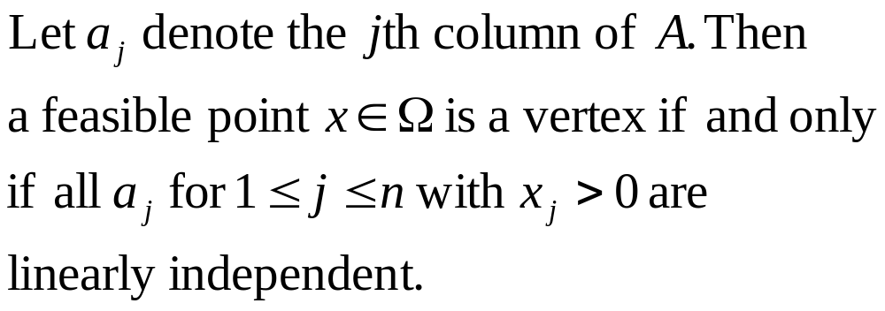
Characterization of Vertex

Slide 19
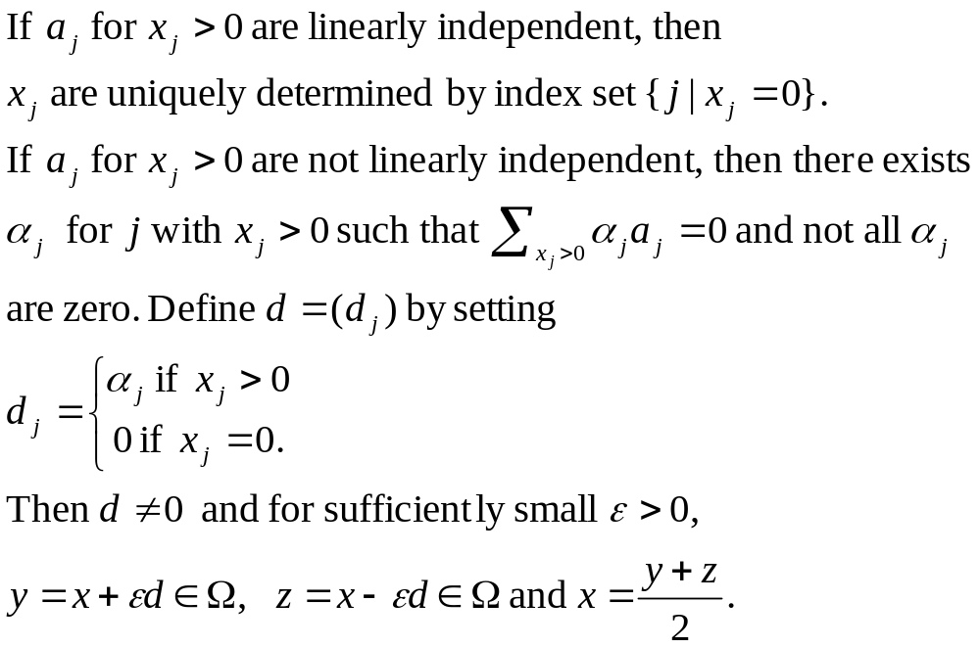
Proof

Slide 20

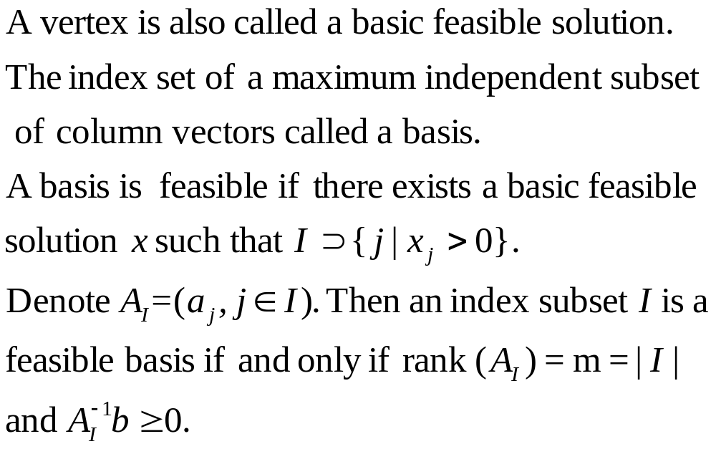
Basic Feasible Solution

Slide 21
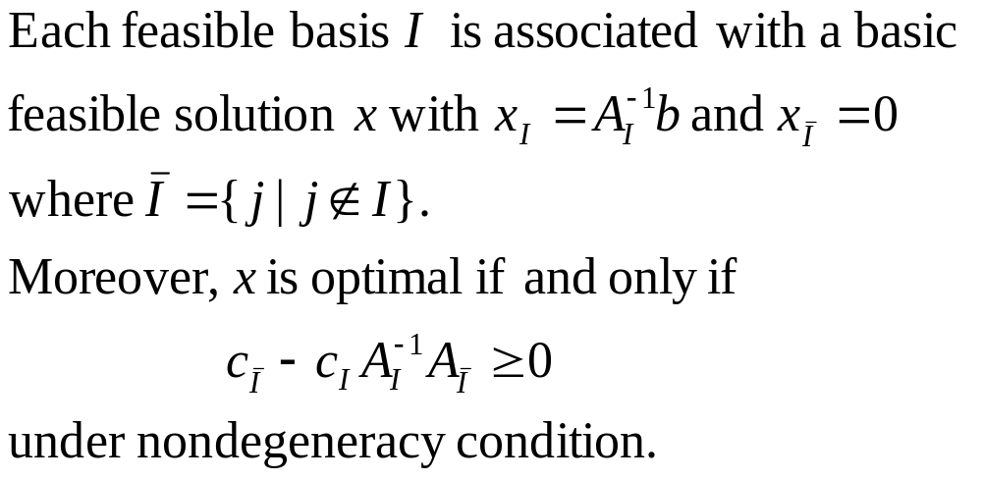
Optimality Condition

Slide 22
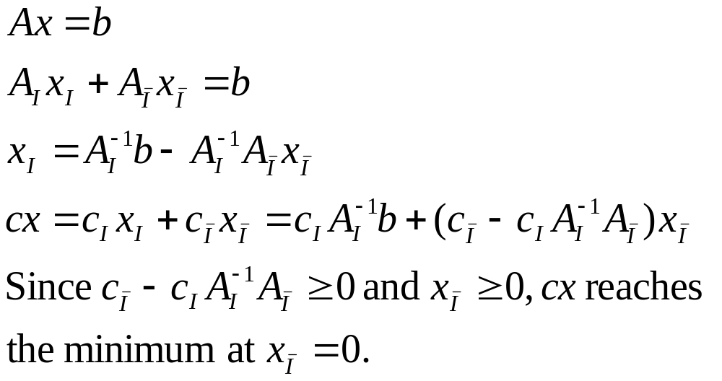
Sufficiency

Slide 23
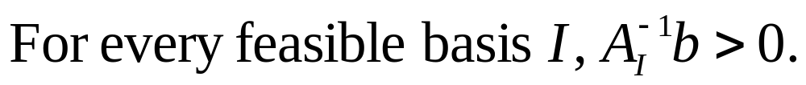
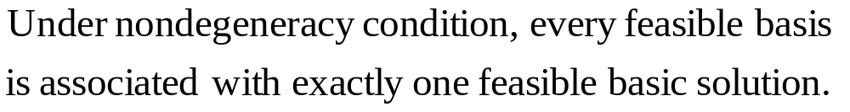
Nondegeneracy Assumption
Remark

Slide 24
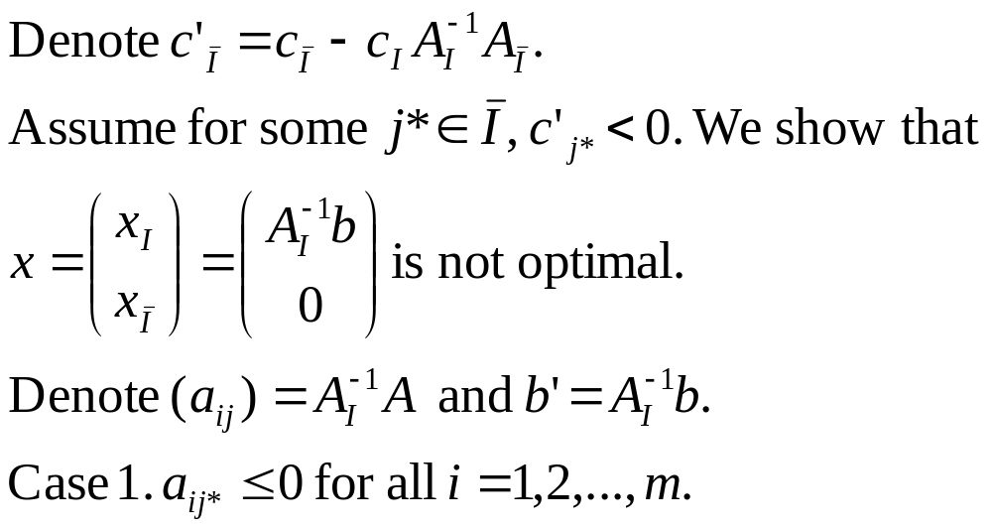
Necessary

Slide 25
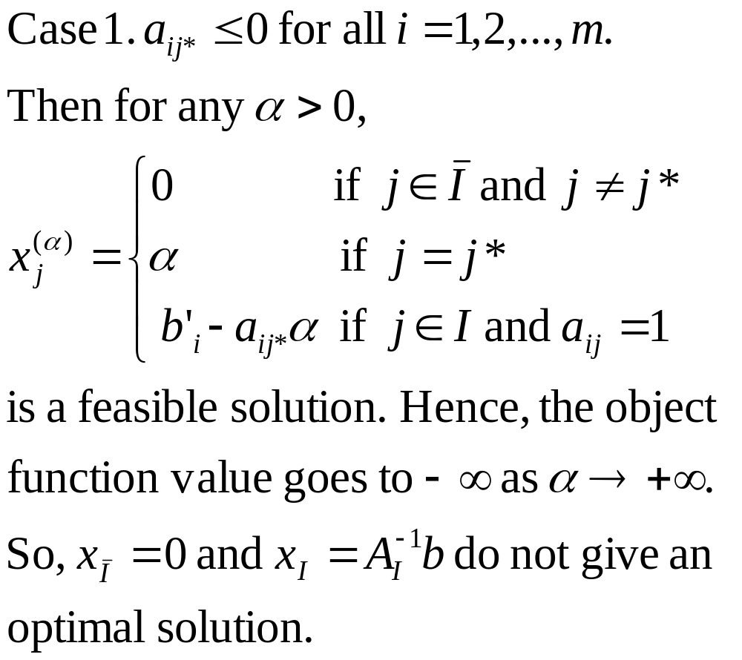

Slide 26
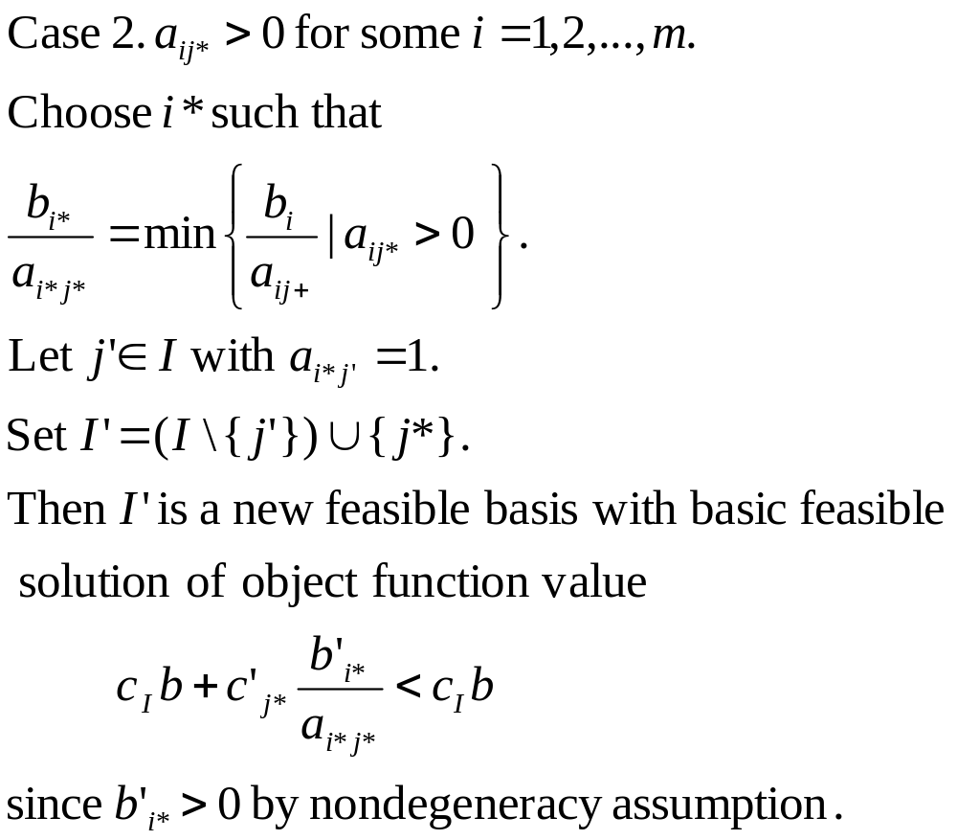
(pivoting)

Slide 27
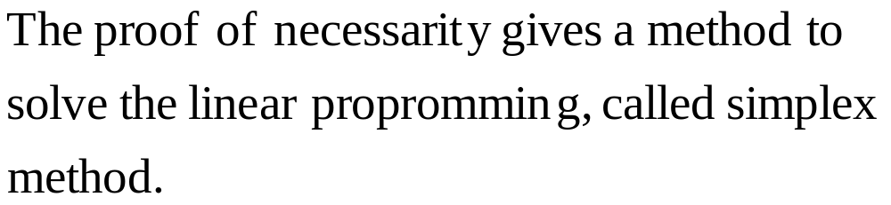
Simplex Method

Slide 28
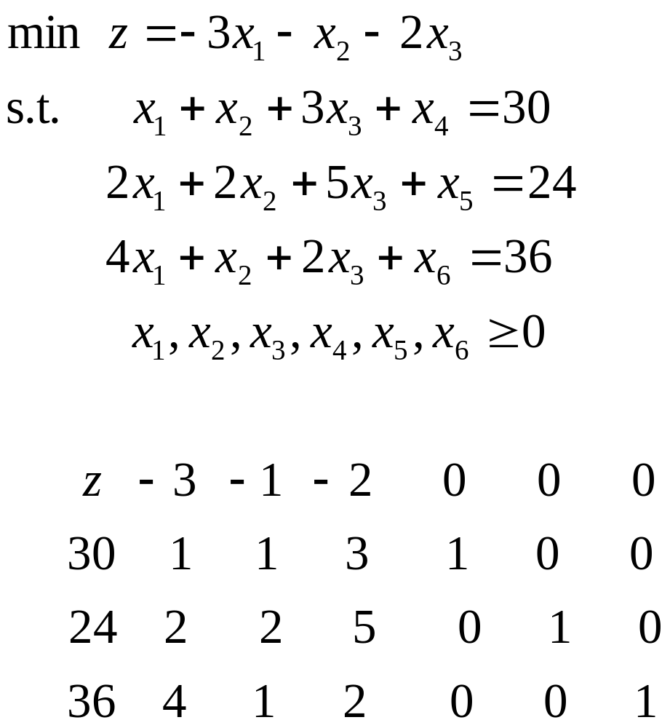
Simplex Table

Slide 29
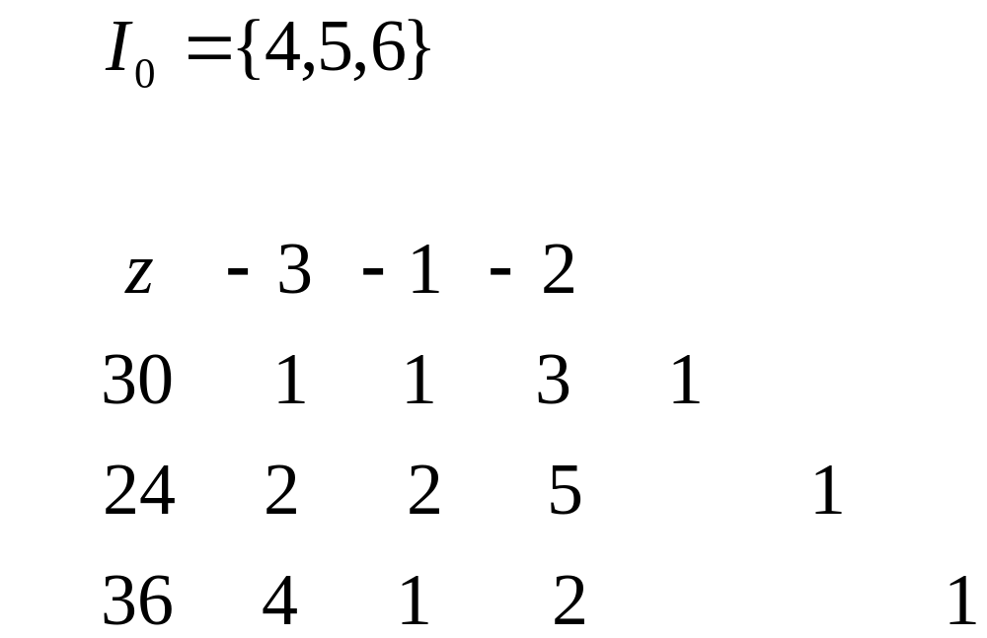

Slide 30
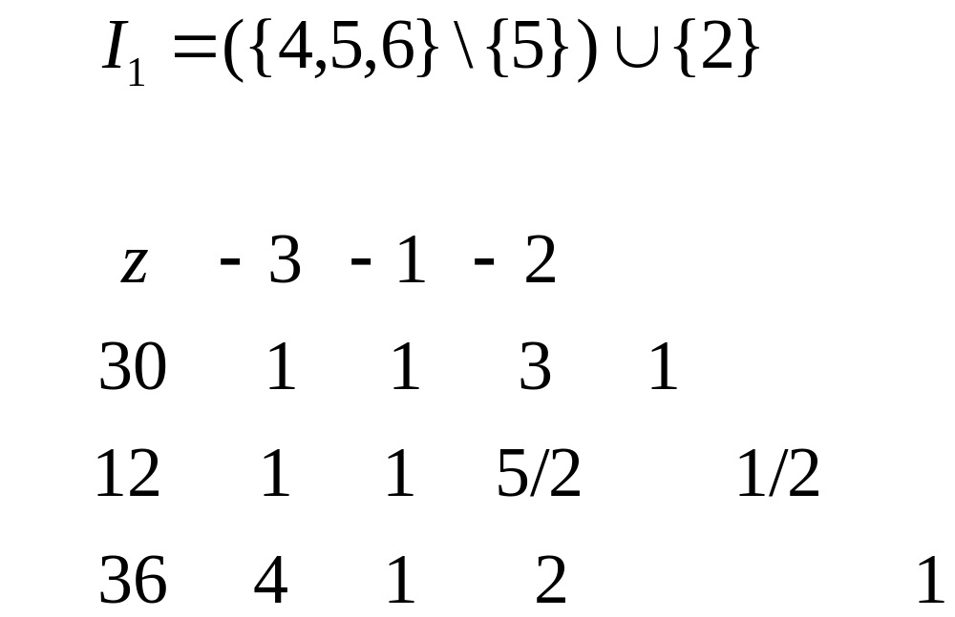

Slide 31
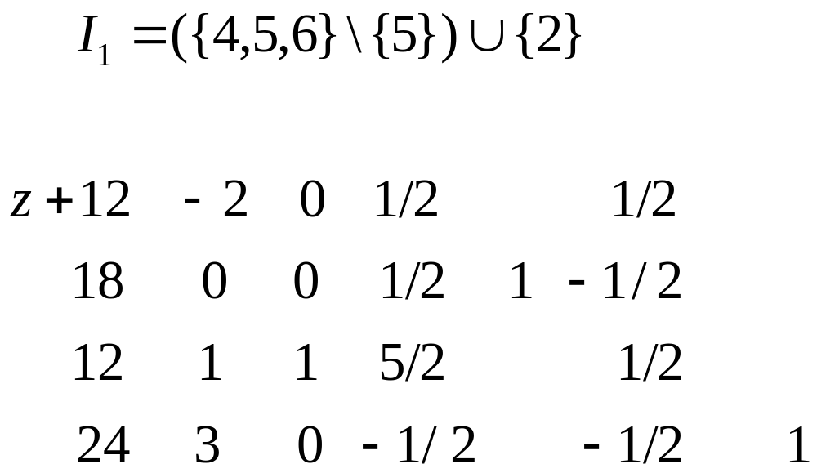

Slide 32
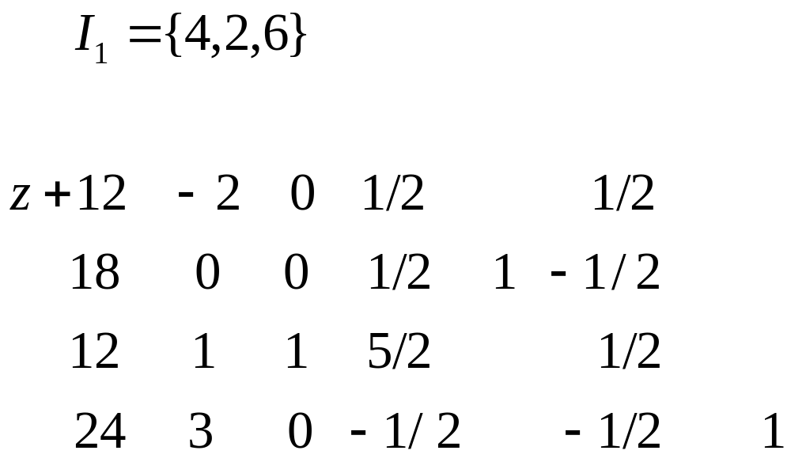

Slide 33
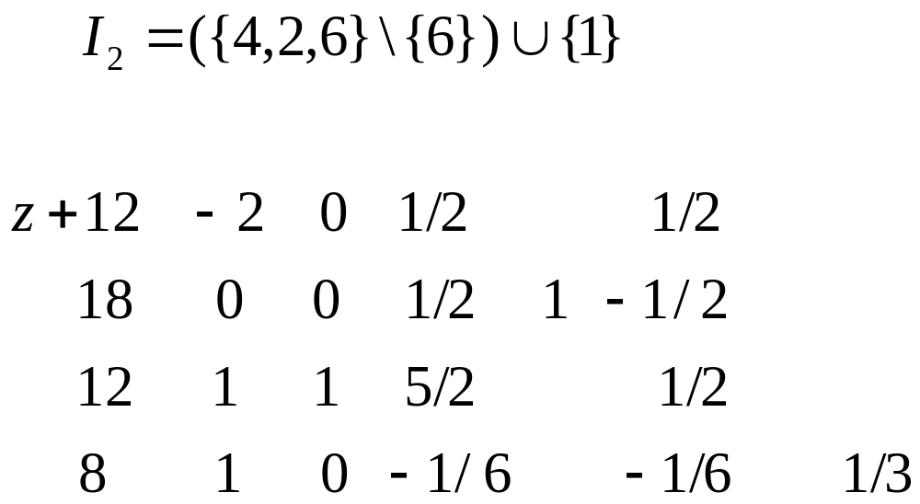

Slide 34
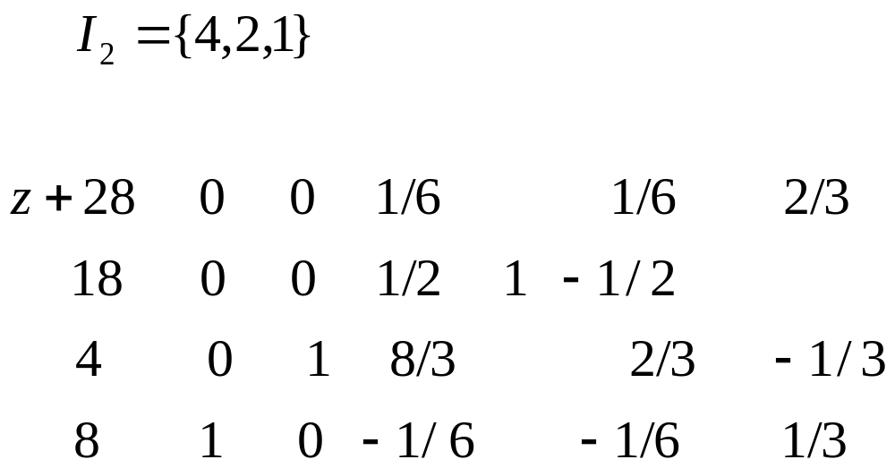

Slide 35
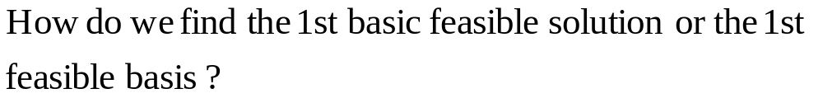
Puzzle 1

Slide 36
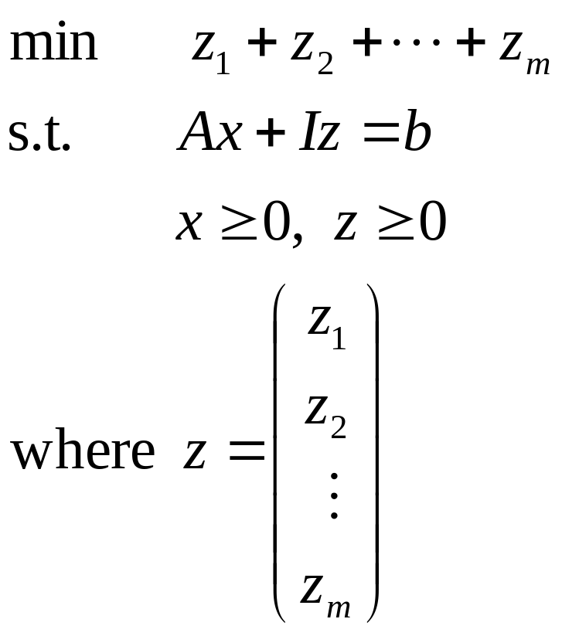
Artificial Feasible Basis

Slide 37
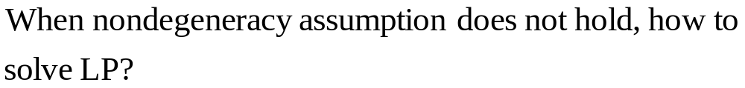
Puzzle 2

Slide 38
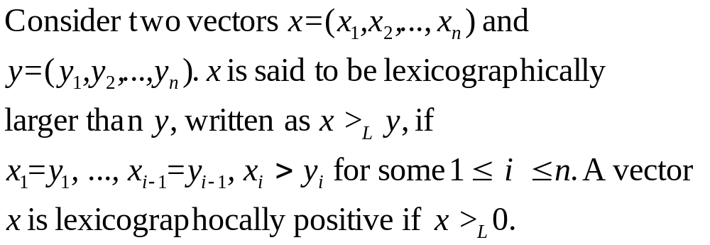
lexicographical ordering

Slide 39
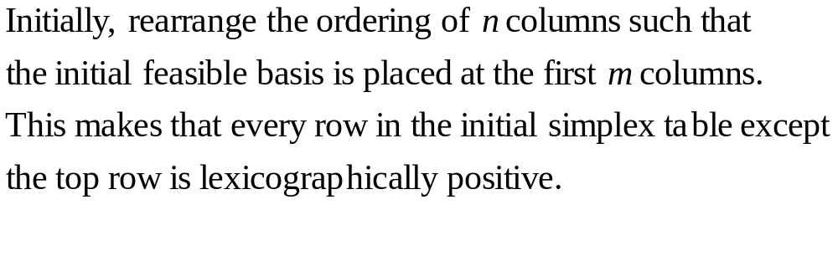
Method

Slide 40
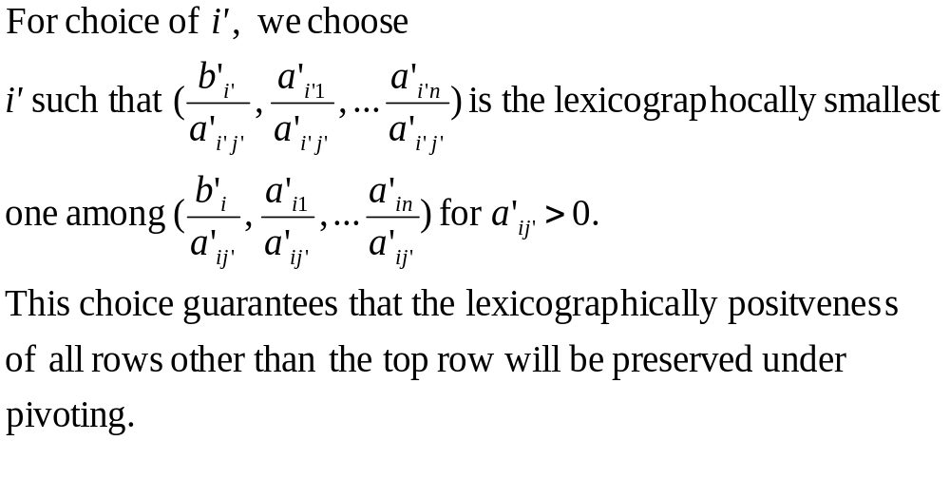
Method(cont’)

Slide 41
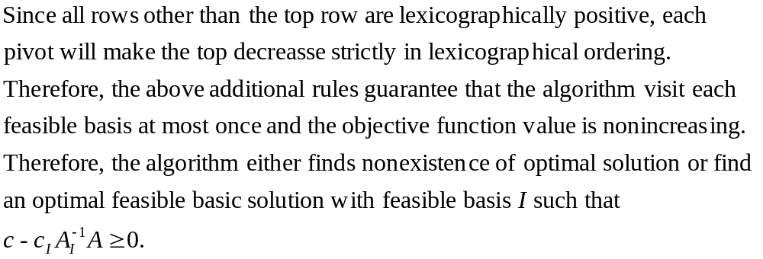
Method (cont’)

Slide 42
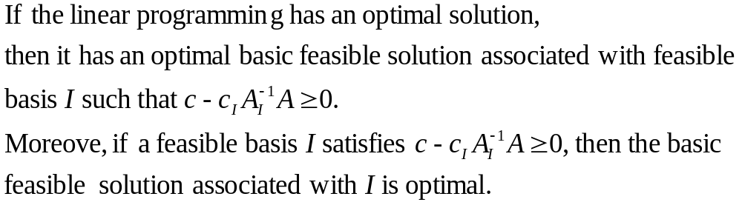
Theorem

Slide 43
Puzzle 3

Slide 44
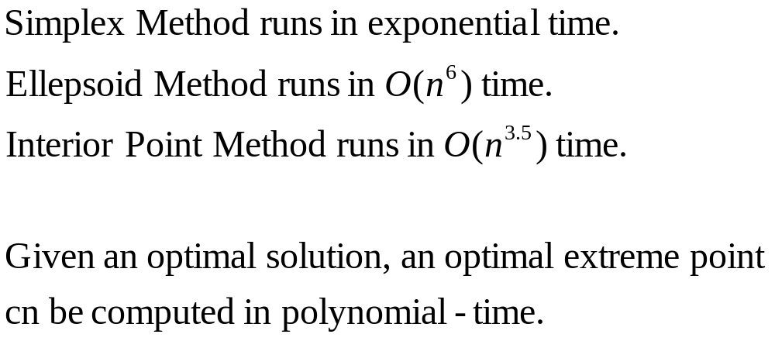
Complexity of LP

Slide 45

Thanks, End

