Slide 1
Chapter 01
Introduction
Notes:
cia

Slide 2
1.1 THE ORIGINS OF OPERATIONS RESEARCH
The roots of OR can be traced back many decades, when early attempts were made to use a scientific approach in the management of organizations. However, the beginning of the activity called operations research has generally been attributed to the military services early in World War II. Because of the war effort, there was an urgent need to allocate scarce resources to the various military operations and to the activities within each operation in an effective manner.
Therefore, the British and then the U.S. military management called upon a large number of scientists to apply a scientific approach to dealing with this and other strategic and tactical problems. In effect, they were asked to do research on (military) operations.

Slide 3
1.1 THE ORIGINS OF OPERATIONS RESEARCH
These teams of scientists were the first OR teams. By developing effective methods of using the new tool of radar, these teams were instrumental in winning the Air Battle of Britain. Through their research on how to better manage convoy and antisubmarine operations, they also played a major role in winning the Battle of the North Atlantic. Similar efforts assisted the Island Campaign in the Pacific.

Slide 4
1.2 THE NATURE OF OPERATIONS RESEARCH
As its name implies, operations research involves “research on operations.” Thus, operations research is applied to problems that concern how to conduct and coordinate the operations (i.e., the activities) within an organization.
The nature of the organization is essentially immaterial, and in fact, OR has been applied extensively in such diverse areas as manufacturing, transportation, construction, telecommunications, financial planning, health care, the military, and public services, to name just a few. Therefore, the breadth of application is unusually wide.

Slide 5
OR MODEL
Imagine that you have a 5-week business commitment between Fayetteville (FYV) and Denver (DEN). You fly out of Fayetteville on Mondays and return on Wednesdays.
A regular round-trip ticket costs $400, but a 20% discount is granted if the dates of the ticket span a weekend. A one-way ticket in either direction costs 75% of the regular price. How should you buy the tickets for the 5-week period?

Slide 6
OR MODEL
We can look at the situation as a decision-making problem whose solution requires answering three questions:
What are the decision alternatives?
Under what restrictions is the decision made?
What is an appropriate objective criterion for evaluating the alternati-ves?

Slide 7
OR MODEL
Three alternatives are considered:
Buy five regular FYV-DEN-FYV for departure on Monday and return on Wednesday of the same week.
Buy one FYV-DEN, four DEN-FYV-DEN that span weekends, and one DENFYV.
Buy one FYV-DEN-FYV to cover Monday of the first week and Wednesday of the last week and four DEN-FYV-DEN to cover the remaining legs. All tickets in this alternative span at least one weekend.
The restriction on these options is that you should be able to leave FYV on Monday and return on Wednesday of the same week.

Slide 8
OR MODEL
An obvious objective criterion for evaluating the proposed alternative is the price of the tickets. The alternative that yields the smallest cost is the best. Specifically, we have
Alternative 1 cost = 5 X 400 = $2000
Alternative 2 cost = .75 X 400 + 4 X (.8 X 400) + .75 X 400 = $1880
Alternative 3 cost = 5 X (.8 X 400) = $1600
Thus, you should choose alternative 3.

Slide 9
OR MODEL
Though the preceding example illustrates the three main components of an OR model-alternatives, objective criterion, and constraints-situations differ in the details of how each component is developed and constructed.

Slide 10
Forming a maximum-area rectangle out of a piece of wire of length L inches

Slide 11
OR MODEL 2
To illustrate this point, consider forming a maximum-area rectangle out of a piece of wire of length L inches. What should be the width and height of the rectangle?
In contrast with the tickets example, the number of alternatives in the present example is not finite; namely, the width and height of the rectangle can assume an infinite number of values. To formalize this observation, the alternatives of the problem are identified by defining the width and height as continuous (algebraic) variables.
Let
w = width of the rectangle in inches
h = height of the rectangle in inches

Slide 12
OR MODEL 2
Based on these definitions, the restrictions of the situation can be expressed verbally as
  Width of rectangle + Height of rectangle = Half the length of the wire
  Width and height cannot be negative
These restrictions are translated algebraically as
2(w + h) = L
w ≥ 0, h ≥ 0

Slide 13
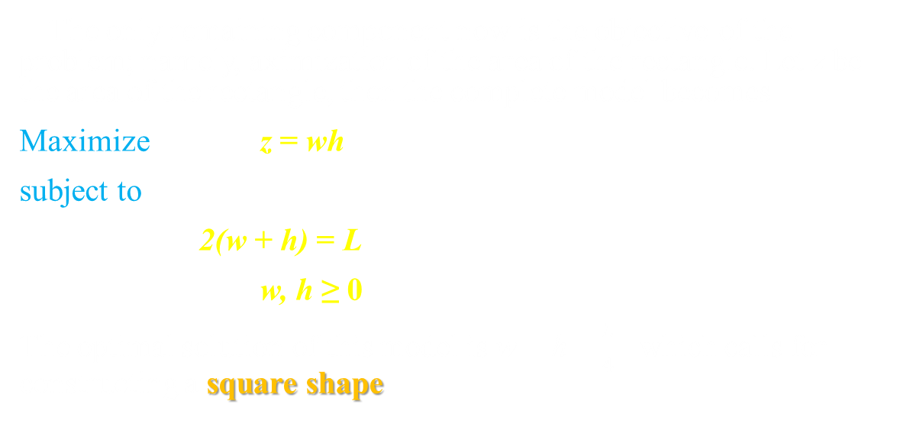
OR MODEL 2
The only remaining component now is the objective of the problem; namely, aximization of the area of the rectangle. Let z be the area of the rectangle, then the complete model becomes
Maximize z = wh
subject to
2(w + h) = L
w, h ≥ 0
The optimal solution of this model is w = h = $\frac{L}{4}$ which calls for constructing a square shape.

Slide 14
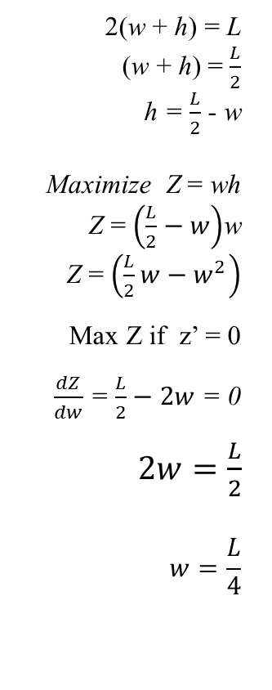
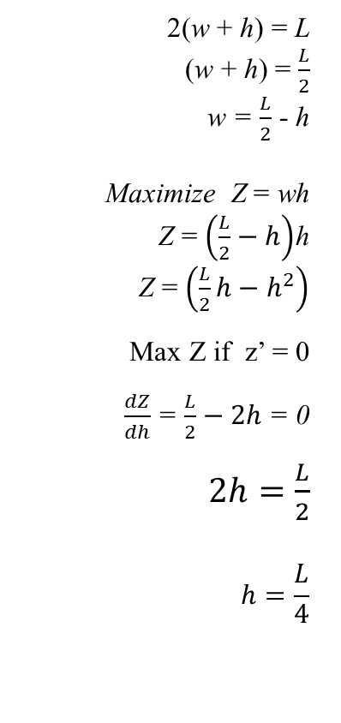
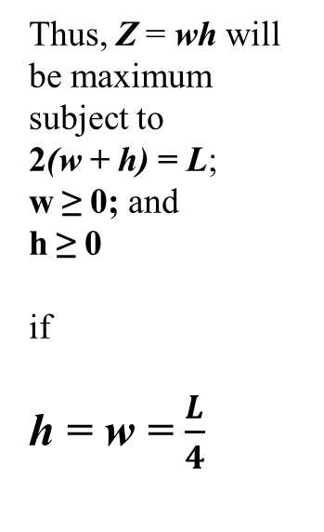
2(w + h) = L
(w + h) = $\frac{L}{2}$
w = $\frac{L}{2}$ - h
Maximize Z = wh
Z = $\left(\frac{L}{2}−h\right)$h
Z = $\left(\frac{L}{2}h−h^{2}\right)$
Max Z if z’ = 0
$\frac{dZ}{dh}$ = $\frac{L}{2}−2h$ = 0
$2h=\frac{L}{2}$
$$h=\frac{L}{4}$$
2(w + h) = L
(w + h) = $\frac{L}{2}$
h = $\frac{L}{2}$ - w
Maximize Z = wh
Z = $\left(\frac{L}{2}−w\right)$w
Z = $\left(\frac{L}{2}w−w^{2}\right)$
Max Z if z’ = 0
$\frac{dZ}{dw}$ = $\frac{L}{2}−2w$ = 0
$2w=\frac{L}{2}$
$$w=\frac{L}{4}$$
Thus, Z = wh will be maximum subject to
2(w + h) = L;
w ≥ 0; and
h ≥ 0
if
h = w = $\frac{L}{4}$

Slide 15
General OR Model
Based on the preceding two examples, the general OR model can be organized in the following general format:
Maximize or minimize Objective Function
subject to
Constraints

Slide 16
OTHER EXAMPLE:
Reddy Mikks Example

Slide 17
