Slide 1
Modeling With Linear Programming
Chapter 02

Slide 2
Example: Reddy Mikks
Reddy Mikks produces both interior and exterior paints from two raw materials, Ml and M2. The following table provides the basic data of the problem:
A market survey indicates that the daily demand for interior paint cannot exceed that for exterior paint by more than 1 ton. Also, the maximum daily demand for interior paint is 2 tons.
Reddy Mikks wants to determine the optimum (best) product mix of interior and exterior paints that maximizes the total daily profit.
 | Tons of raw material per ton of |  | Maximum daily availability (tons)
 | Exterior paint | Interior paint
Raw material, M1 | 6 | 4 | 24
Raw material M2 | 1 | 2 | 6
Profit per ton ($1000) | 5 | 4

Slide 3
The LP model, as in any OR model, has three basic components.
1. Decision variables that we seek to determine.
2. Objective (goal) that we need to optimize (maximize or minimize).
3. Constraints that the solution must satisfy.

Slide 4
1. Variables that we seek to determine
For the Reddy Mikks problem, we need to determine the daily amounts to be produced of exterior and interior paints. Thus the variables of the model are defined as
    Xl = Tons produced daily of exterior paint
    X2 = Tons produced daily of interior paint

Slide 5
2. Objective (goal) that we need to optimize (maximize or minimize).
Given that the profits per ton of exterior
and interior paints are 5 and 4 (thousand) dollars, respectively, it follows that
  Total profit from exterior paint = 5xl (thousand) dollars
  Total profit from interior paint = 4X2 (thousand) dollars
Letting z represent the total daily profit (in thousands of dollars), the objective of the company is
Maximize z = 5Xl + 4X2

Slide 6
3. Constraints that the solution must satisfy.
The daily usage of raw material MI is 6 tons per ton of exterior paint and 4 tons per ton of interior paint.
Thus
Usage of raw material Ml by exterior paint = 6X_{l} tons/day
Usage of raw material Ml by interior paint = 4X₂ tons/day
Hence
Usage of raw material Ml by both paints = 6X₁ + 4x₂ tons/day
In a similar manner,
Usage of raw material M2 by both paints = X_{l} + 2X₂ tons/day
Because the daily availabilities of raw materials Ml and M2 are limited to 24 and 6 tons, respectively,
the associated restrictions are given as
6x₁ + 4x₂ ≤ 24 (Raw material M1)
x₁ + 2x₂ ≤ 6 (Raw Material M2)

Slide 7
3. Constraints that the solution must satisfy.
The first demand restriction stipulates that the excess of the daily production of interior over exterior paint, x₂ - x_{l}, should not exceed 1 ton, which translates to
x₂ - x₁ ≤ 1
The second demand restriction stipulates that the maximum daily demand of interior paint is limited to 2 tons, which translates to
x₂ ≤ 2 (Demand limit)
An implicit (or "understood-to-be") restriction is that variables Xl and X2 cannot assume negative values. The nonnegativity restrictions, X_{l} > 0, X₂ > 0, account for this requirement.

Slide 8
The complete Reddy Mikks model is
Maximize z = 5x₁ + 4x₂
subject to
6x₁ + 4x2 = 24
x₁ + 2x₂ = 6
-x₁+ x₂ = 1
x₂ = 2
x_{l}, x₂ > 0

Slide 9
Graphical solution

Slide 10
GRAPHICAL LP SOLUTION
The graphical procedure includes two steps:
1. Determination of the feasible solution space.
2. Determination of the optimum solution from among all the feasible points in the solution space.
The procedure uses two examples to show how maximization and minimization objective functions are handled.

Slide 11
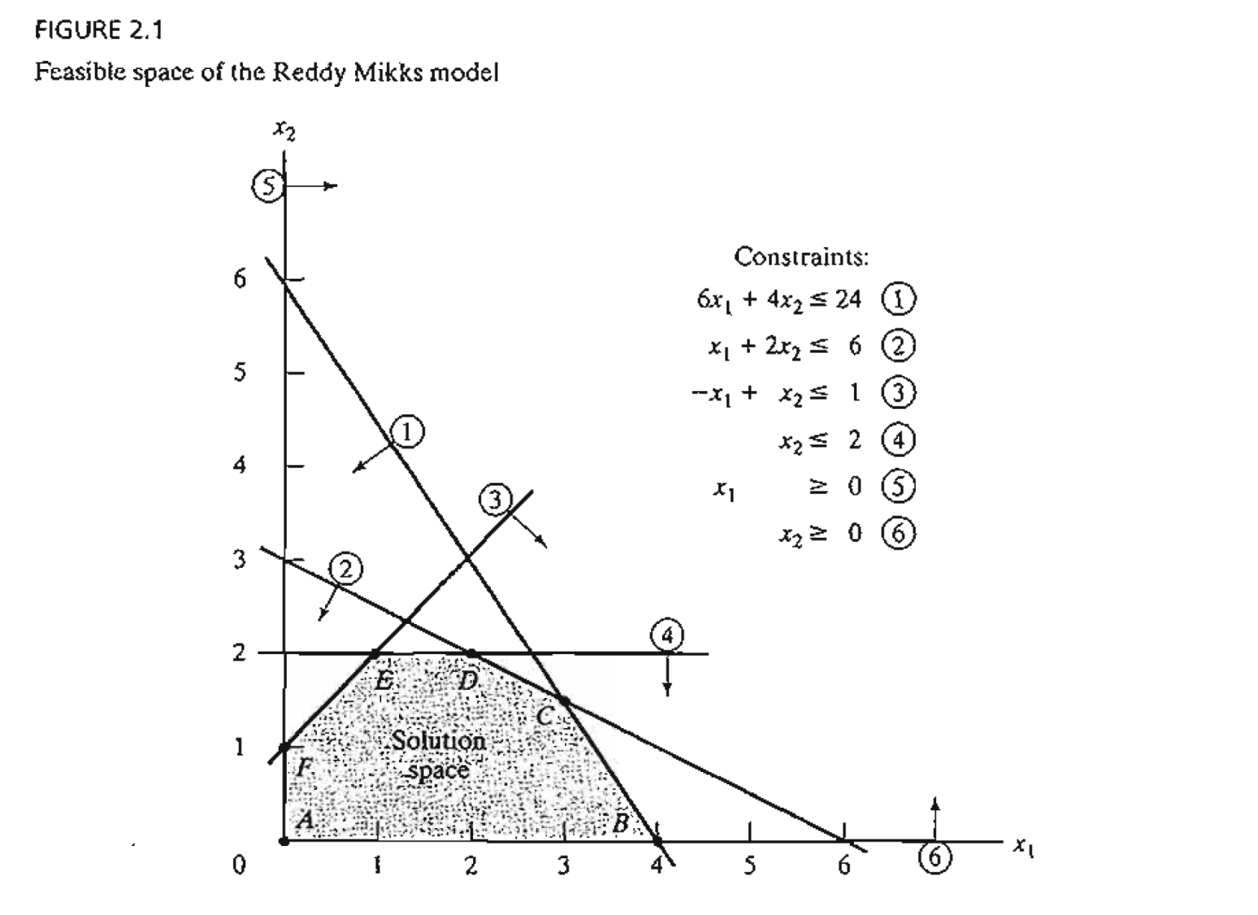

Slide 12
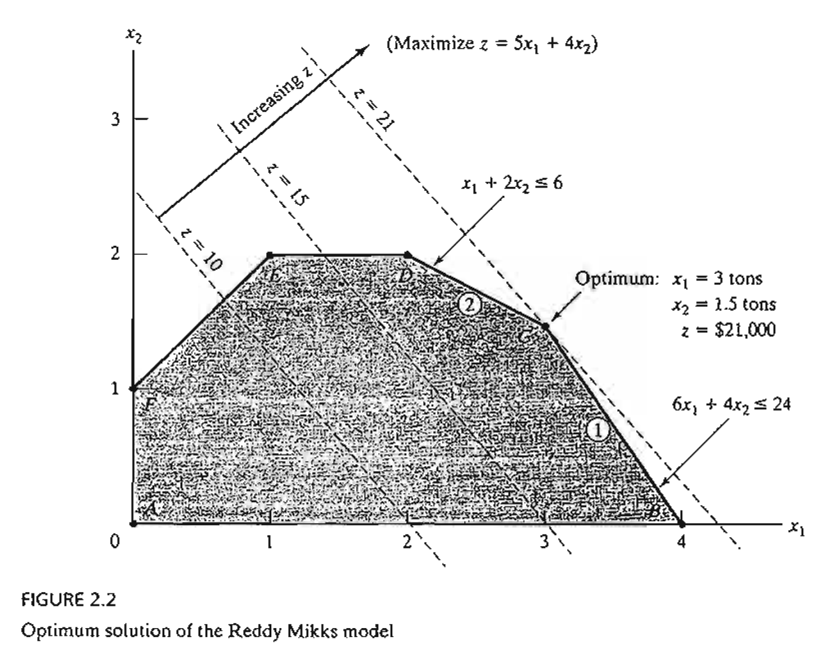

Slide 13
Other example

Slide 14
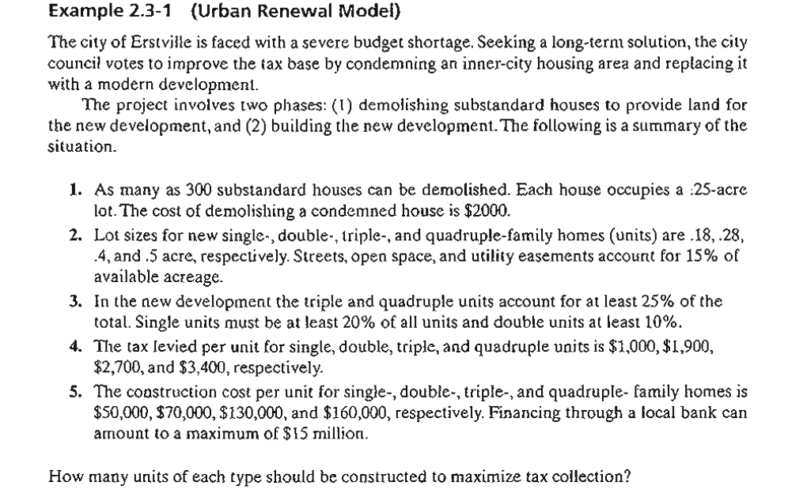

Slide 15
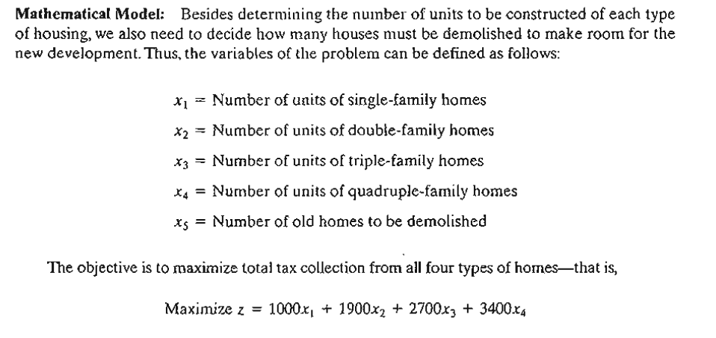

Slide 16
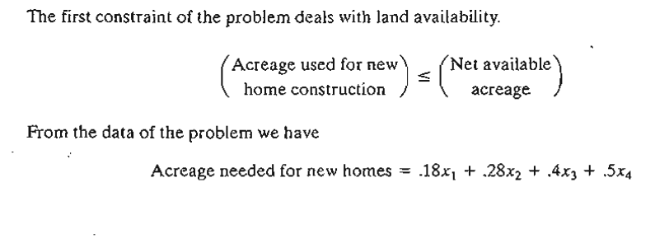

Slide 17
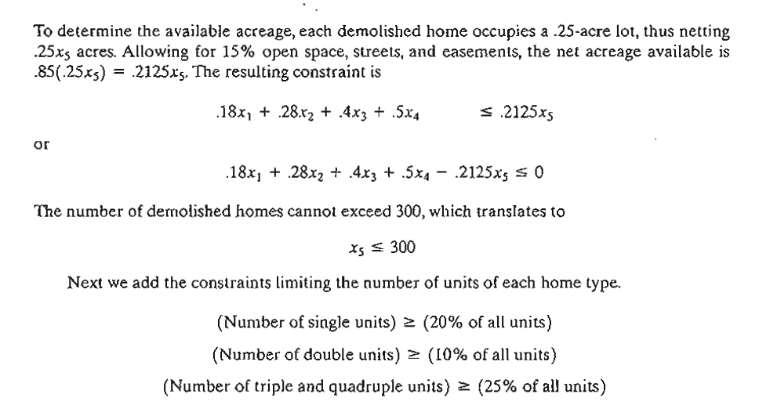

Slide 18
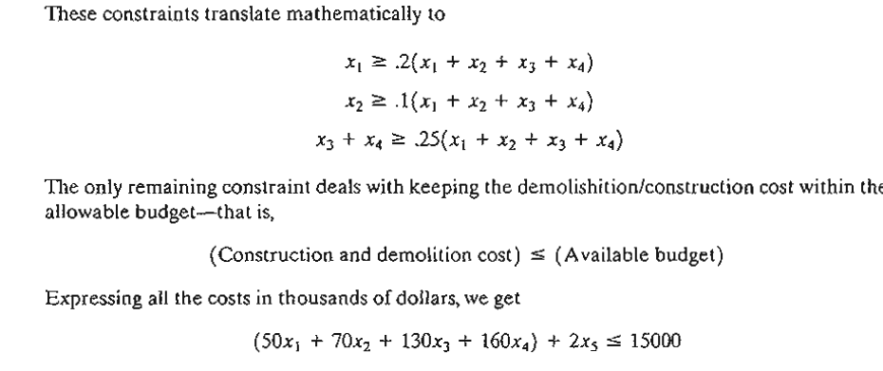

Slide 19
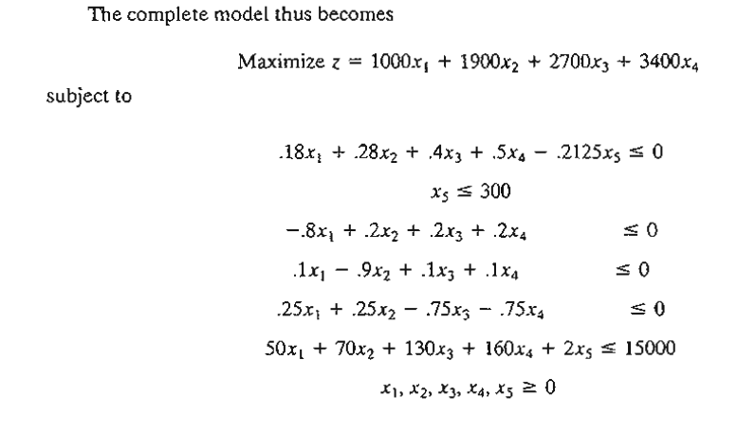

Slide 20
MORE THAN JUST MATHEMATICS

Slide 21
MORE THAN JUST MATHEMATICS
Because of the mathematical nature of OR models, one tends to think that an OR study is always rooted in mathematical analysis. Though mathematical modeling is a cornerstone of OR, simpler approaches should be explored first.
In some cases, a "common sense" solution may be reached through simple observations. Indeed, since the human element invariably affects most decision problems, a study of the psychology of people may be key to solving the problem.

Slide 22
Three illustrations are presented here to support this argument.
Responding to complaints of slow elevator service in a large office building, the OR team initially perceived the situation as a waiting-line problem that might require the use of mathematical queuing analysis or simulation. After studying the behavior of the people voicing the complaint, the psychologist on the team suggested installing full-length mirrors at the entrance to the elevators. Miraculously the complaints disappeared, as people were kept occupied watching themselves and others while waiting for the elevator.

Slide 23
Three illustrations are presented here to support this argument.
In a study of the check-in facilities at a large British airport, a United StatesCanadian consulting team used queuing theory to investigate and analyze the situation. Part of the solution recommended the use of well-placed signs to urge passengers who were within 20 minutes from departure time to advance to the head of the queueand request immediate service. The solution was not successful, because the passengers, being mostly British, were "conditioned to very strict queuing behavior" and hence were reluctant to move ahead of others waiting in the queue.

Slide 24
Three illustrations are presented here to support this argument.
In a steel mill, ingots were first produced from iron ore and then used in the manufacture of steel bars and beams. The manager noticed a long delay between the ingots production and their transfer to the next manufacturing phase (where end products were manufactured). Ideally, to reduce the reheating cost, manufacturing should start soon after the ingots left the furnaces. Initially the problem was perceived as a line-balancing situation, which could be resolved either by reducing the output of ingots or by increasing the capacity of the manufacturing process. The OR team used simple charts to summarize the output of the furnaces during the three shifts of the day. They discovered that, even though the third shift started at 11:00 PM., most of the ingots were produced between 2:00 and 7:00 A.M. Further investigation revealed that third-shift operators preferred to get long periods of rest at the start of the shift and then make up for lost production during morning hours. The problem was solved by "leveling out" the production of ingots throughout the shift.

Slide 25
Three conclusions can be drawn from these illustrations
Before embarking on sophisticated mathematical modeling, the OR team should explore the possibility of using "aggressive" ideas to resolve the situation.
Solutions are rooted in people and not in technology. Any solution that does not take human behavior into account is apt to fail. Even though the mathematical solution of the British airport problem may have been sound, the fact that the consulting team was not aware of the cultural differences between the United States and Britain (Americans and Canadians tend to be less formal) resulted in an unimplementable recommendation.
An OR study should never start with a bias toward using a specific mathematical tool before its use can be justified. For example, because linear programming is a successful technique, there is a tendency to use it as the tool of choice for modeling "any" situation. Such an approach usually leads to a mathematical model that is far removed from the real situation. It is thus imperative that we first analyze available data, using the simplest techniques where possible (e.g., averages, charts, and histograms), with the objective of pinpointing the source of the problem.

Slide 26
PHASES OF AN OR STUDY
The principal phases for implementing OR in practice include
    Definition of the problem.
    Construction of the model.
    Solution of the model.
    Validation of the model.
    Implementation of the solution.

