Slide 1
Duality and Post Optimal Analysis
CH 04

Slide 2
4.1 DEFINITION OF THE DUAL PROBLEM

Slide 3
4.1 DEFINITION OF THE DUAL PROBLEM
The dual problem is an LP defined directly and systematically from the primal (or original) LP model.
The two problems are so closely related that the optimal solution of one problem automatically provides the optimal solution to the other.

Slide 4
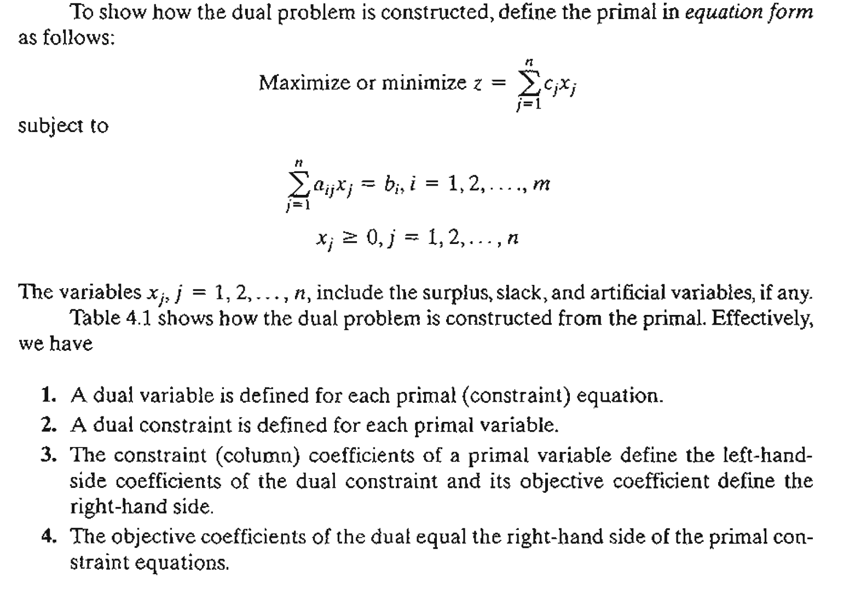

Slide 5
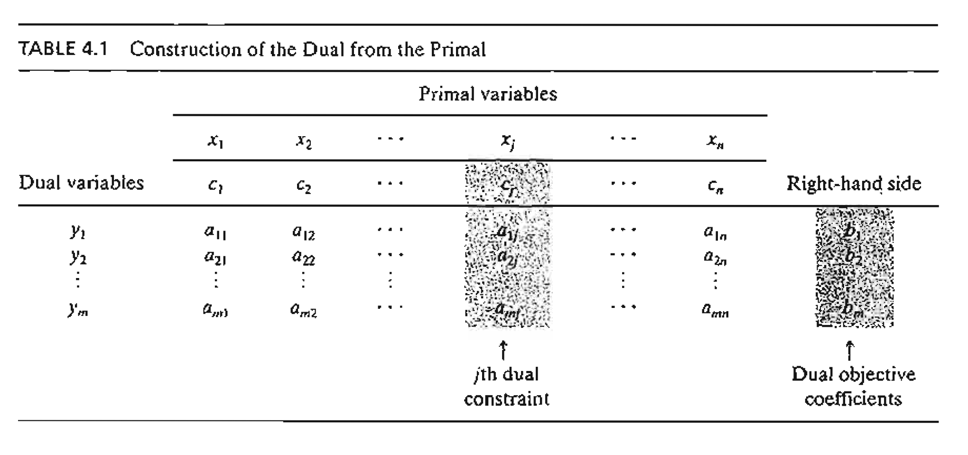

Slide 6
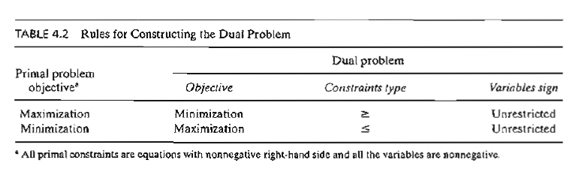

Slide 7
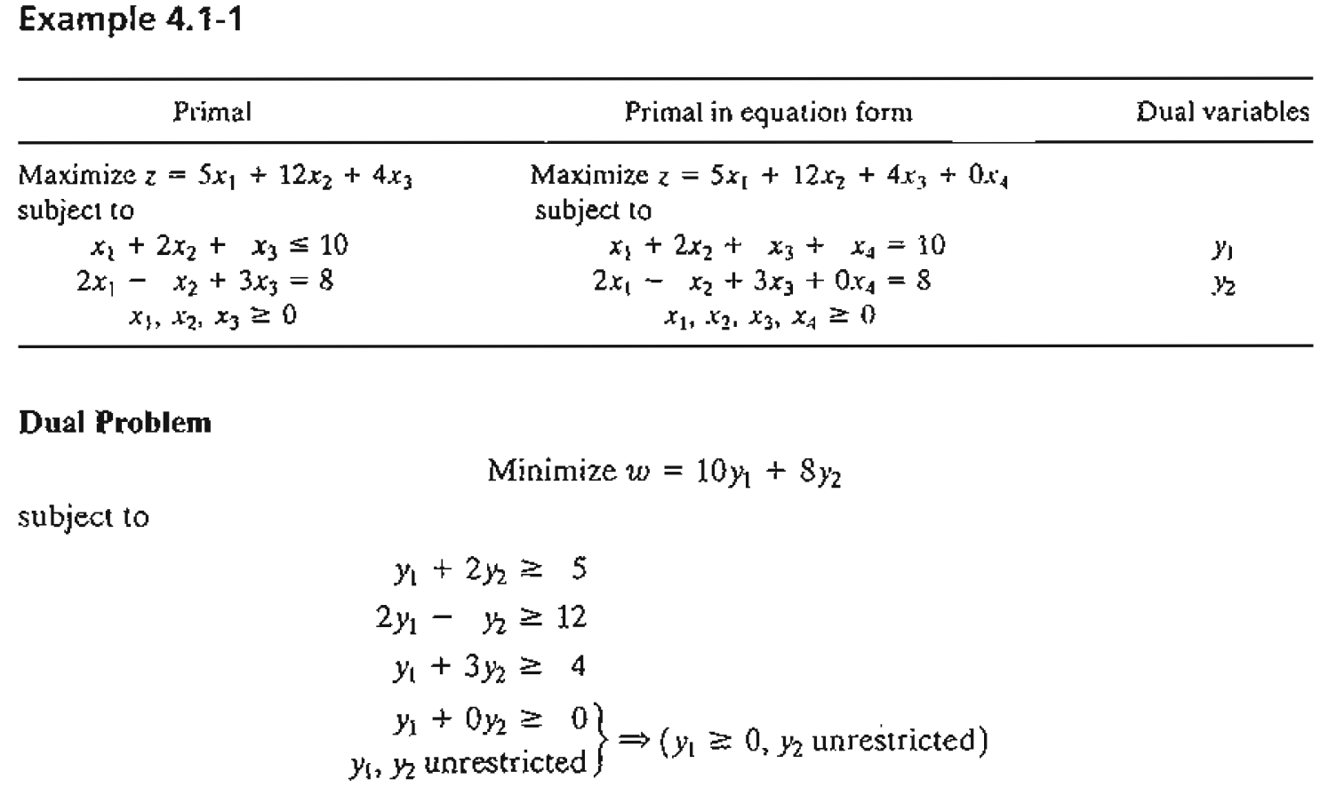

Slide 8
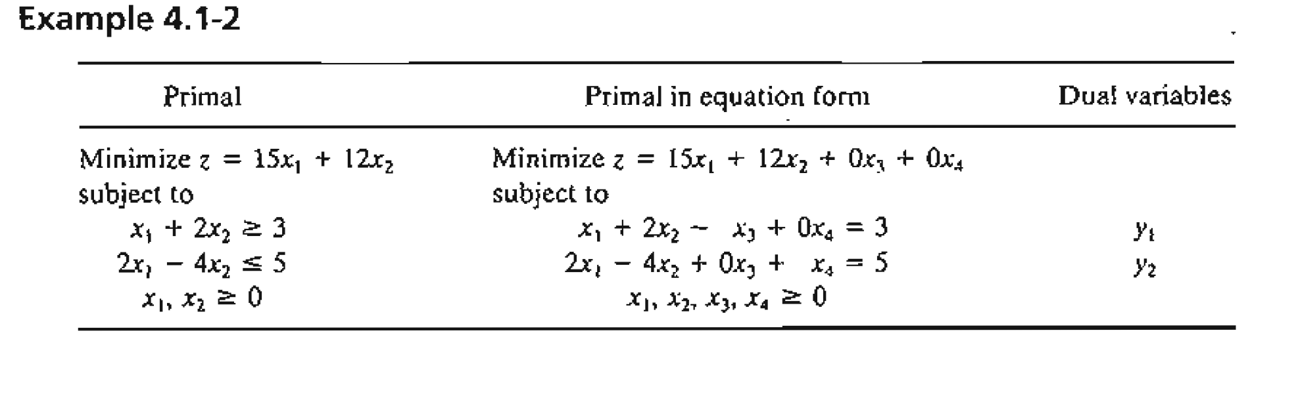
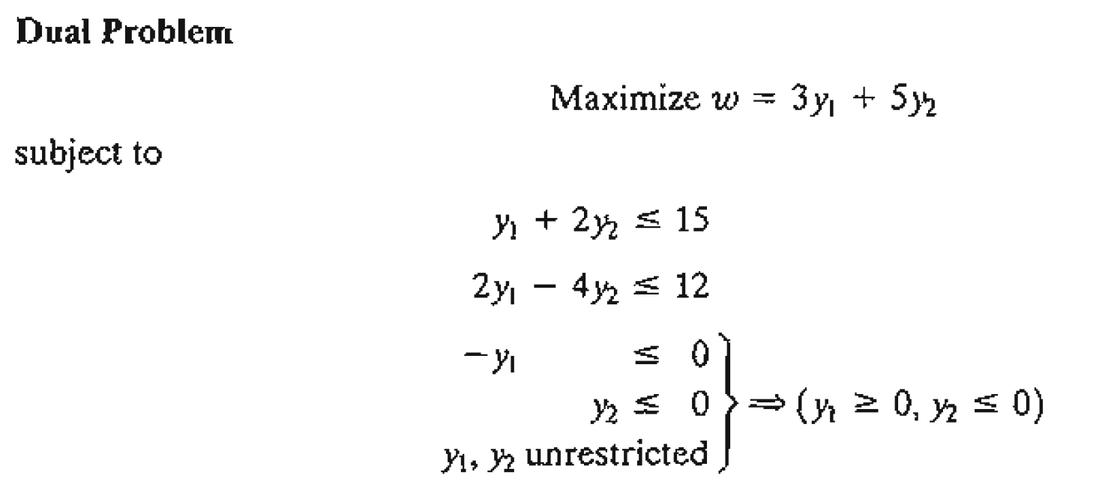

Slide 9
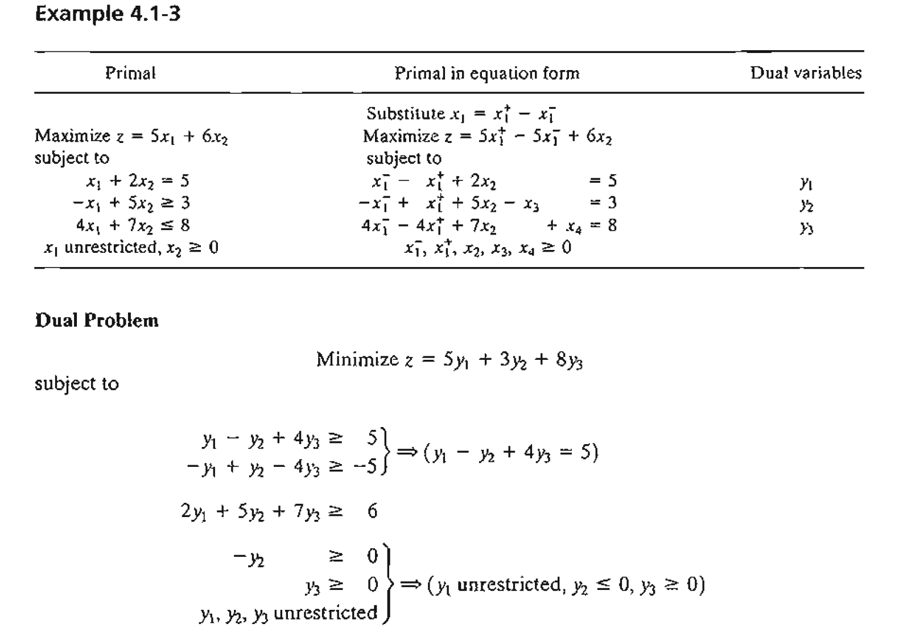

Slide 10
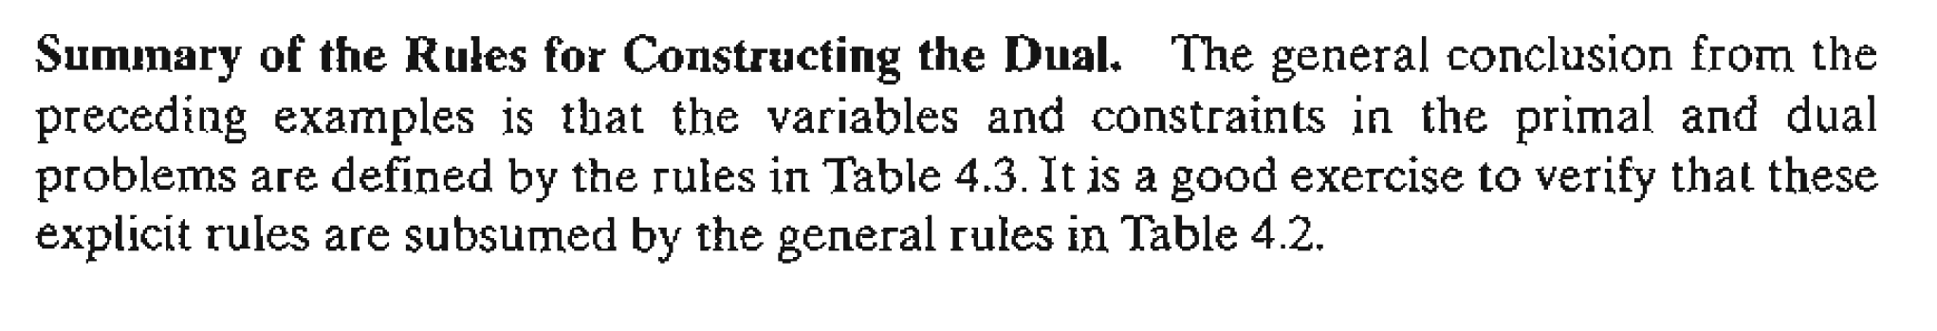
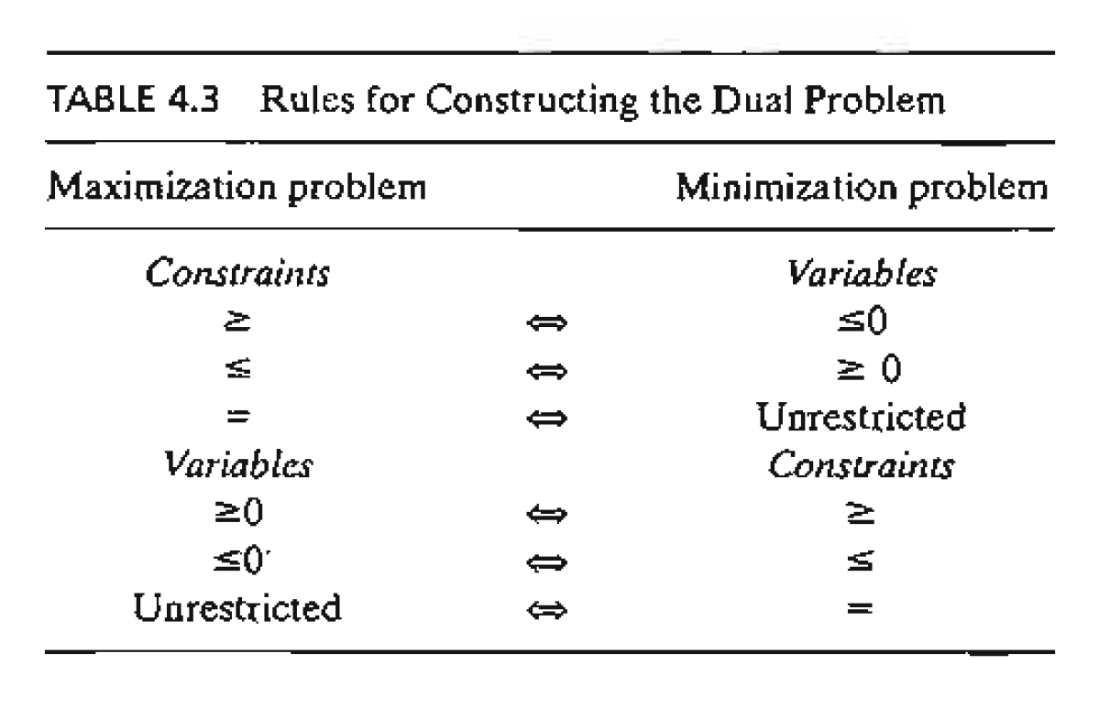

Slide 11
Optimal Dual Solution
TIle primal and dual solutions are so closely related that the optimal solution of either problem directly yields (with little additional computation) the optimal solution to the other.
Thus, in an LP model in which the number of variables is considerably smaller than the number of constraints, computational savings may be realized by solving the dual, from which the primal solution is determined automatically. This result follows because the amount of simplex computation depends largely (though not totally) on the number of constraints.

Slide 12
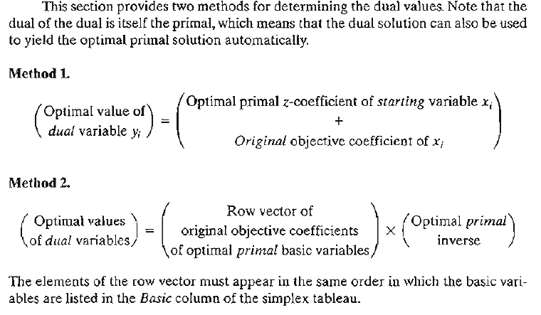

Slide 13
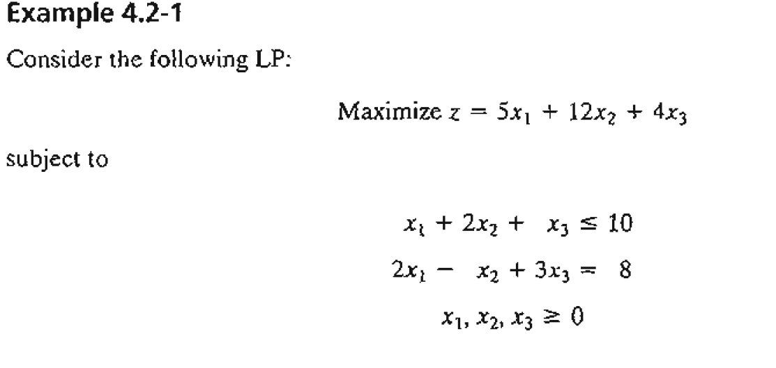

Slide 14
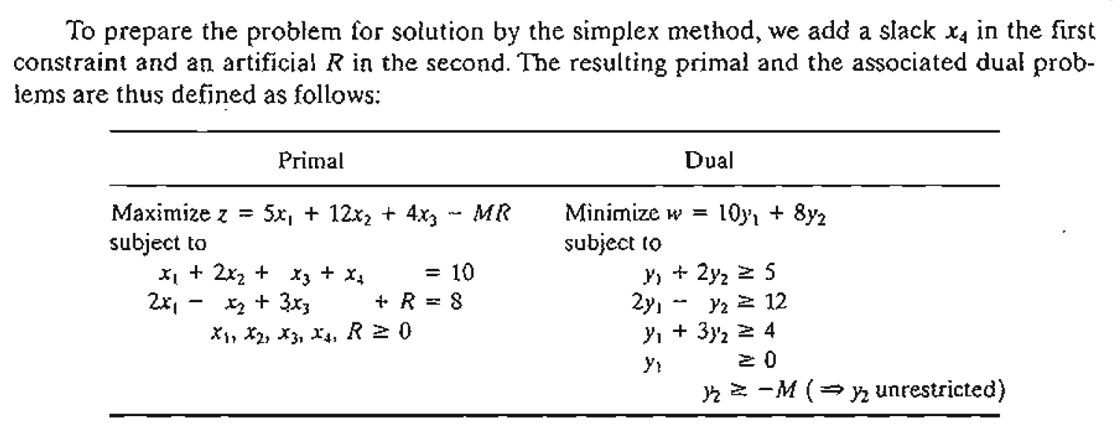

Slide 16
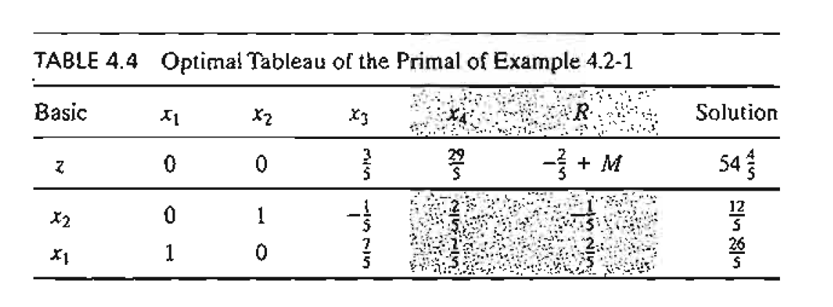

Slide 17
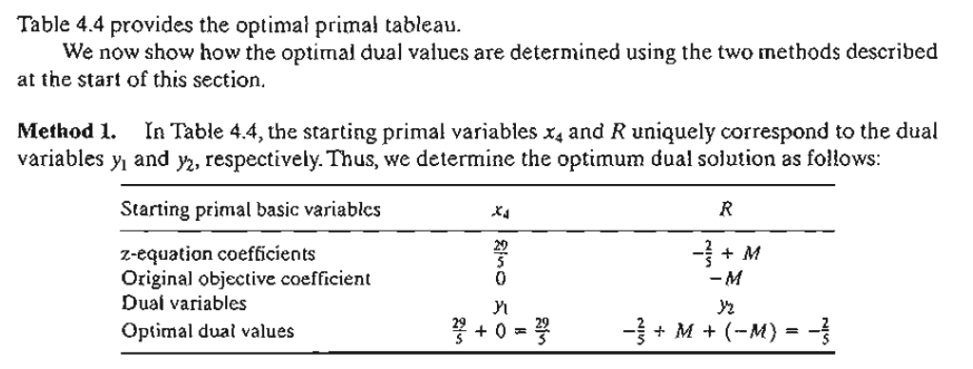

Slide 18
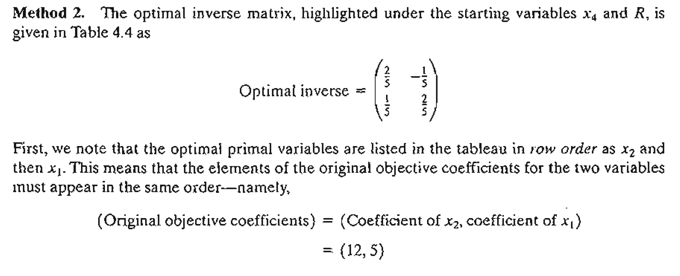

Slide 19
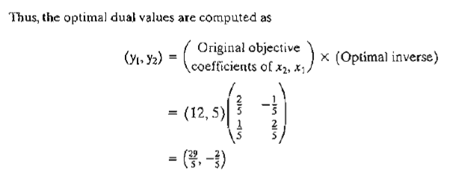

Slide 20
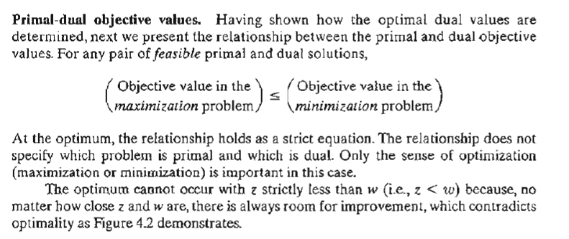

Slide 21
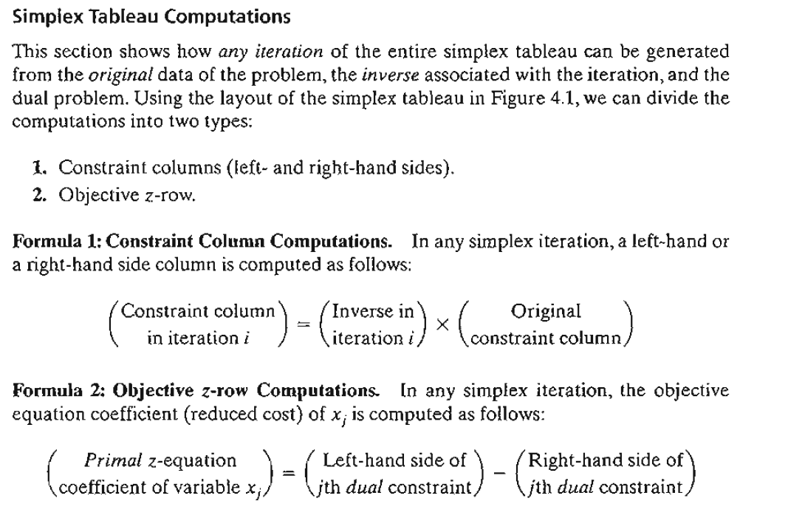

Slide 22
4.3 ECONOMIC INTERPRETATION OF DUALITY

Slide 23
ECONOMIC INTERPRETATION OF DUALITY
The linear programming problem can be viewed as a resource allocation model in which the objective is to maximize revenue subject to the availability of limited resources.
Looking at the problem from this standpoint, the associated dual problem offers interesting economic interpretations of the LP resource allocation model.

Slide 24
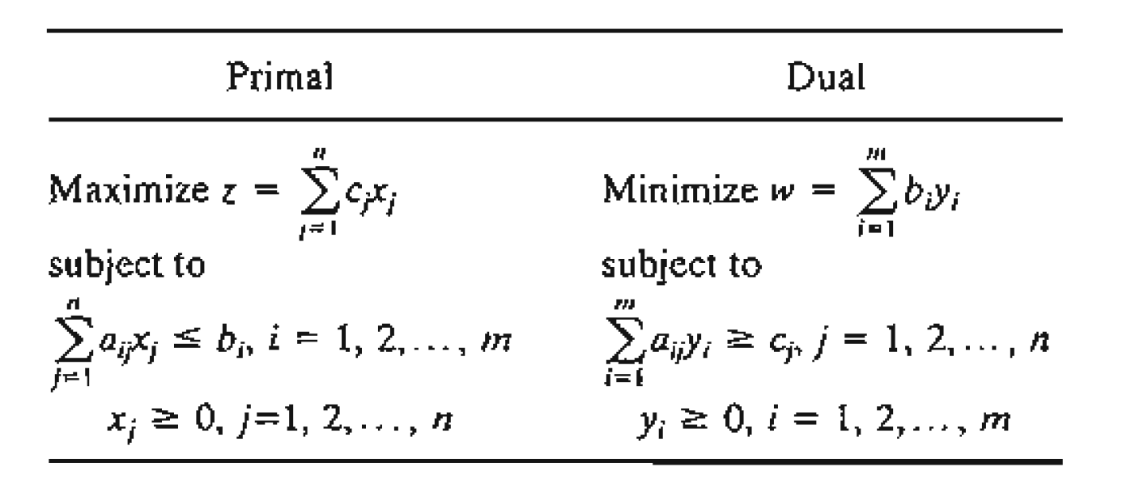
To formalize the discussion, we consider the following representation of the general primal and dual problems:
Viewed as a resource allocation model, the primal problem has n economic activities and m resources. The coefficient Cj in the primal represents the revenue per unit ofactivity j. Resource i, whose maximum availability is bi , is consumed at the rate aij units per unit of activity j.

Slide 25
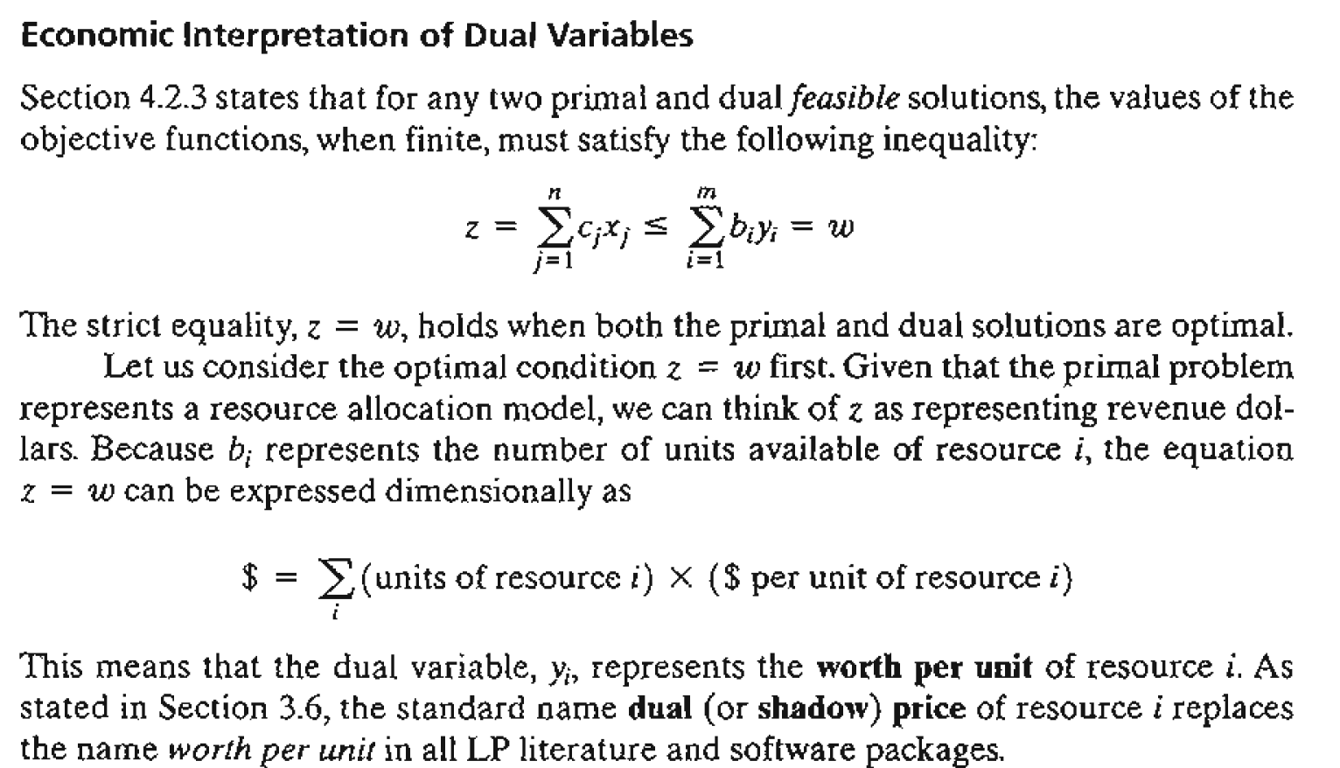

Slide 26
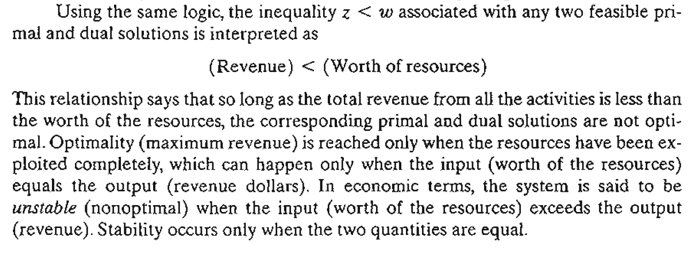

Slide 27
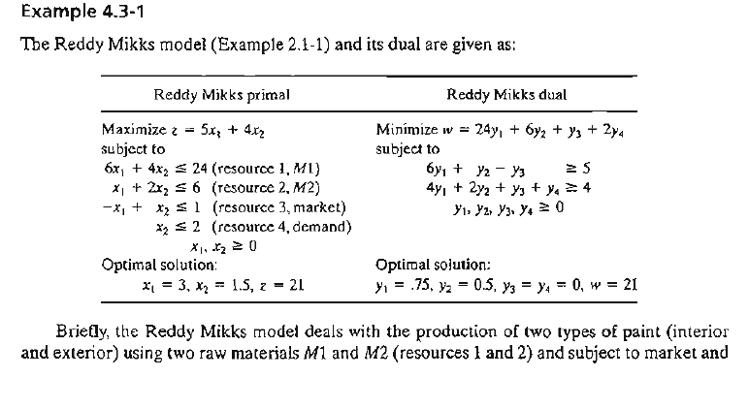

Slide 28
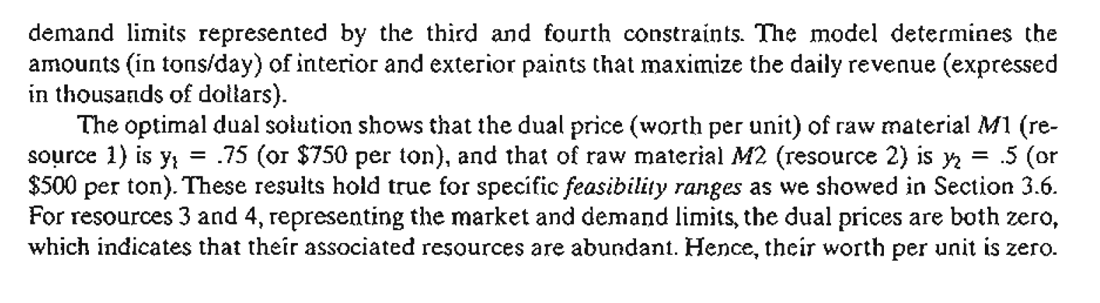

Slide 30
3.3.1 Iterative Nature of the Simplex Method

Slide 31
Iterative Nature
Normally, the simplex method starts at the origin where x_{l} = x₂ = 0.
At this starting point, the value of the objective function, z, is zero, and the logical question is whether an increase in nonbasic X_{l} and/or X₂ above their current zero values can improve (increase) the value of z. We answer this question by investigating the objective function:
Z = 5x₁ + 4x₂

Slide 32
Iterative Nature
The function shows that an increase in either X_{l} or X₂ (or both) above their current zero values will improve the value of z.
The design of the simplex method calls for increasing one variable at a time, with the selected variable being the one with the largest rate of improvement in z.

Slide 33
Iterative Nature
In the present example, the value of z will increase by 5 for each unit increase in X_{l} and by 4 for each unit increase in X_{2.} This means that the rate of improvement in the value of z is 5 for X_{l} and 4 for X₂.
We thus elect to increase X₁, the variable with the largest rate of improvement. Because the X_{l} is the most positive coefficient, then it was selected as the entering variable.

Slide 34
Iterative Nature
Equivalently, because the simplex tableau expresses the objective function as z - 5x₁ - 4x₂ = 0, the entering variable will correspond to the variable with the most negative coefficient in the objective equation. This rule is referred to as the optimality condition.

Slide 35
Iterative Nature
The mechanics of determining the leaving variable from the simplex tableau calls for computing the nonnegative ratios of the right-hand side of the equations (Solution column) to the corresponding constraint coefficients under the entering variable, X_{l} as the following table shows.

Slide 36
Iterative Nature
The minimum nonnegative ratio automatically identifies the current basic variable S_{I} as the leaving variable and assigns the entering variable X_{l} the new value of 4.

Slide 37
3.3.2 Computational Details of the Simplex Algorithm

Slide 38
intro
This section provides the computational details of a simplex iteration, including the rules for determining the entering and leaving variables as well as for stopping the computations when the optimum solution has been reached. The vehicle of explanation is a numerical example.

Slide 39

Algebraic Determination of Corner Points
In a set of m × n equations (m < n), if we set n - m variables equal to zero and then solve the m equations for the remaining m variables, the resulting solution, if unique, is called a basic solution and must correspond to a (feasible or infeasible) corner point of the solution space.
This means that the maximum number of corner points is
$$C_{m}^{n}=\frac{n!}{m!\left(n−m\right)!}$$

Slide 40
3.2 The steps of the simplex method are
The steps of the simplex method are
Step 1. Determine a starting basic feasible solution.
Step 2. Select an entering variable using the optimality condition. Stop if there is no entering variable; the last solution is optimal. Else, go to step 3.
Step 3 Select a leaving variabLe using the feasibility condition.
Step 4. Determine the new basic solution by using the appropriate Gauss-Jordan computations. Go to step 2.

Slide 41
computation

Slide 42
System description

Slide 43
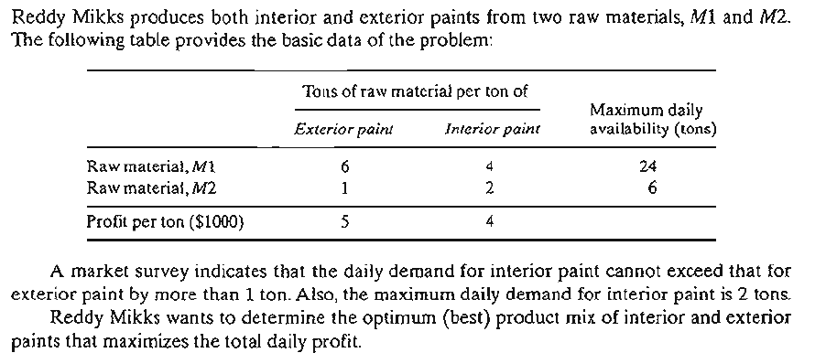

Slide 44
System modeling

Slide 45
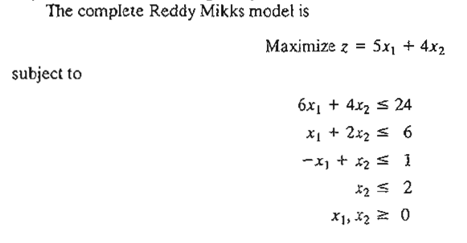

Slide 46
Converting Inequalities into Equations with Nonnegative Right-Hand Side

Slide 47
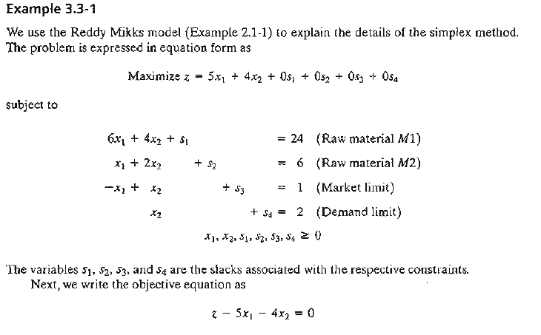

Slide 48
Make simplex tableau from the equations coeficient

Slide 49
In this manner, the starting simplex tableau can be represented as follows:
Basic | z | x₁ | x₂ | s₁ | s₂ | s₃ | s₄ | Solution
z | 1 | −5 | −4 | 0 | 0 | 0 | 0 | 0 | z-row
s₁ | 0 | 6 | 4 | 1 | 0 | 0 | 0 | 24 | s₁-row
s₂ | 0 | 1 | 2 | 0 | 1 | 0 | 0 | 6 | s₂-row
s₃ | 0 | −1 | 1 | 0 | 0 | 1 | 0 | 1 | s₃-row
s₄ | 0 | 0 | 1 | 0 | 0 | 0 | 1 | 2 | s₄-row

Slide 50
determine the entering variable

Slide 51
Select ENTERING VARIABLE, by selecting the most negative coeficient in the z-row, in this example is -5, and X1 as a ENTERING VARIABLE
Basic | z | x₁ | x₂ | s₁ | s₂ | s₃ | s₄ | Solution
z | 1 | −5 | −4 | 0 | 0 | 0 | 0 | 0 | z-row
s₁ | 0 | 6 | 4 | 1 | 0 | 0 | 0 | 24 | s₁-row
s₂ | 0 | 1 | 2 | 0 | 1 | 0 | 0 | 6 | s₂-row
s₃ | 0 | −1 | 1 | 0 | 0 | 1 | 0 | 1 | s₃-row
s₄ | 0 | 0 | 1 | 0 | 0 | 0 | 1 | 2 | s₄-row

Slide 52
determine the leaving variable

Slide 53
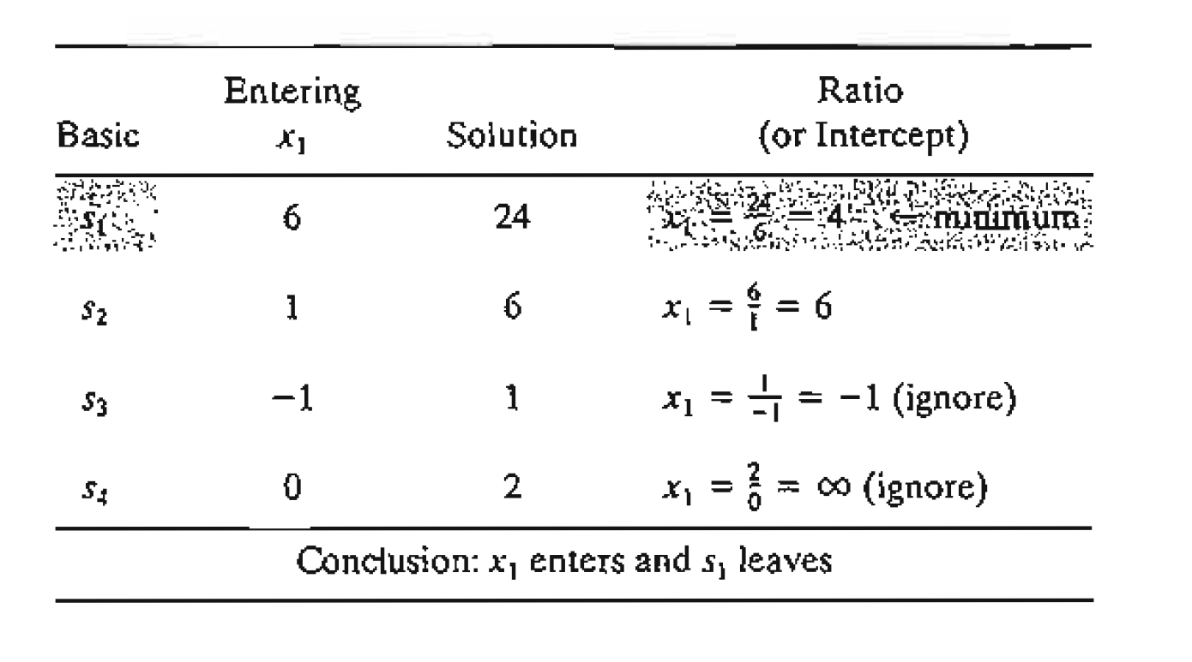
Select LEAVING VARIABLE, by selecting the minimum nonnegative ratio, in this case is 4. Thus, s₁ is as a LEAVING VARIABLE.

Slide 54
Select ENTERING VARIABLE, by selecting most negative coeficient in the z-row, that is -5
S₁ LEAVE
X₁ ENTER
PIVOT ROW
Basic | z | x₁ | x₂ | s₁ | s₂ | s₃ | s₄ | Solution
z | 1 | −5 | −4 | 0 | 0 | 0 | 0 | 0 | z-row
s₁ | 0 | 6 | 4 | 1 | 0 | 0 | 0 | 24 | s₁-row
s₂ | 0 | 1 | 2 | 0 | 1 | 0 | 0 | 6 | s₂-row
s₃ | 0 | −1 | 1 | 0 | 0 | 1 | 0 | 1 | s₃-row
s₄ | 0 | 0 | 1 | 0 | 0 | 0 | 1 | 2 | s₄-row
PIVOT COLUMN

Slide 55
Produce new basic solution

Slide 56
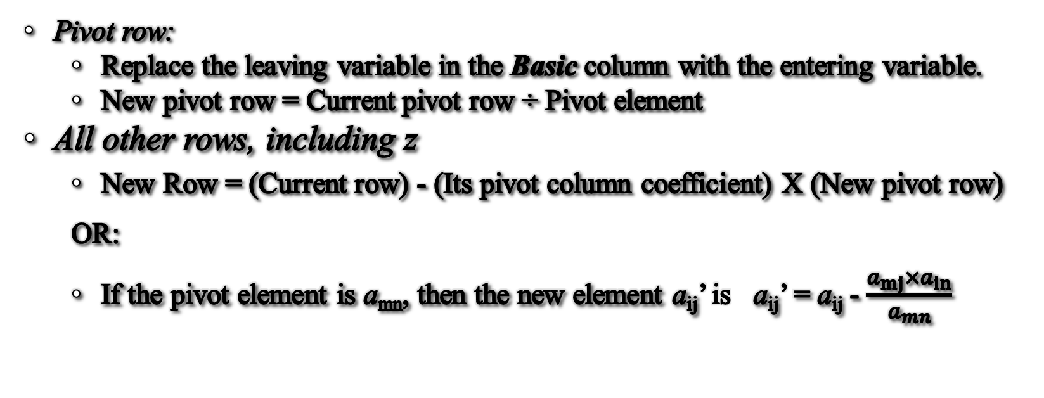
TIle Gauss-Jordan computations needed to produce the new basic solution include two types
Pivot row:
  Replace the leaving variable in the Basic column with the entering variable.
  New pivot row = Current pivot row ÷ Pivot element
All other rows, including z
  New Row = (Current row) - (Its pivot column coefficient) X (New pivot row)
  OR:
  If the pivot element is a_{mn}, then the new element a_{ij}’ is a_{ij}’ = a_{ij} - $\frac{a_{mj}×a_{in}}{a_{mn}}$

Slide 57
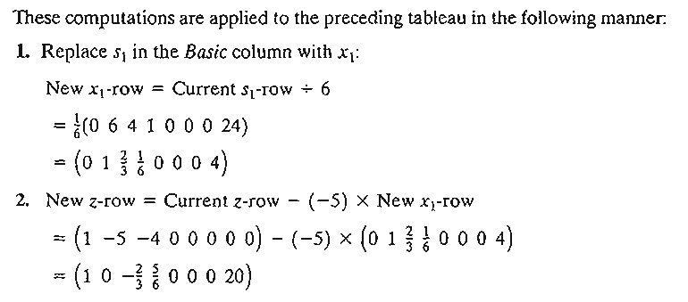

Slide 58
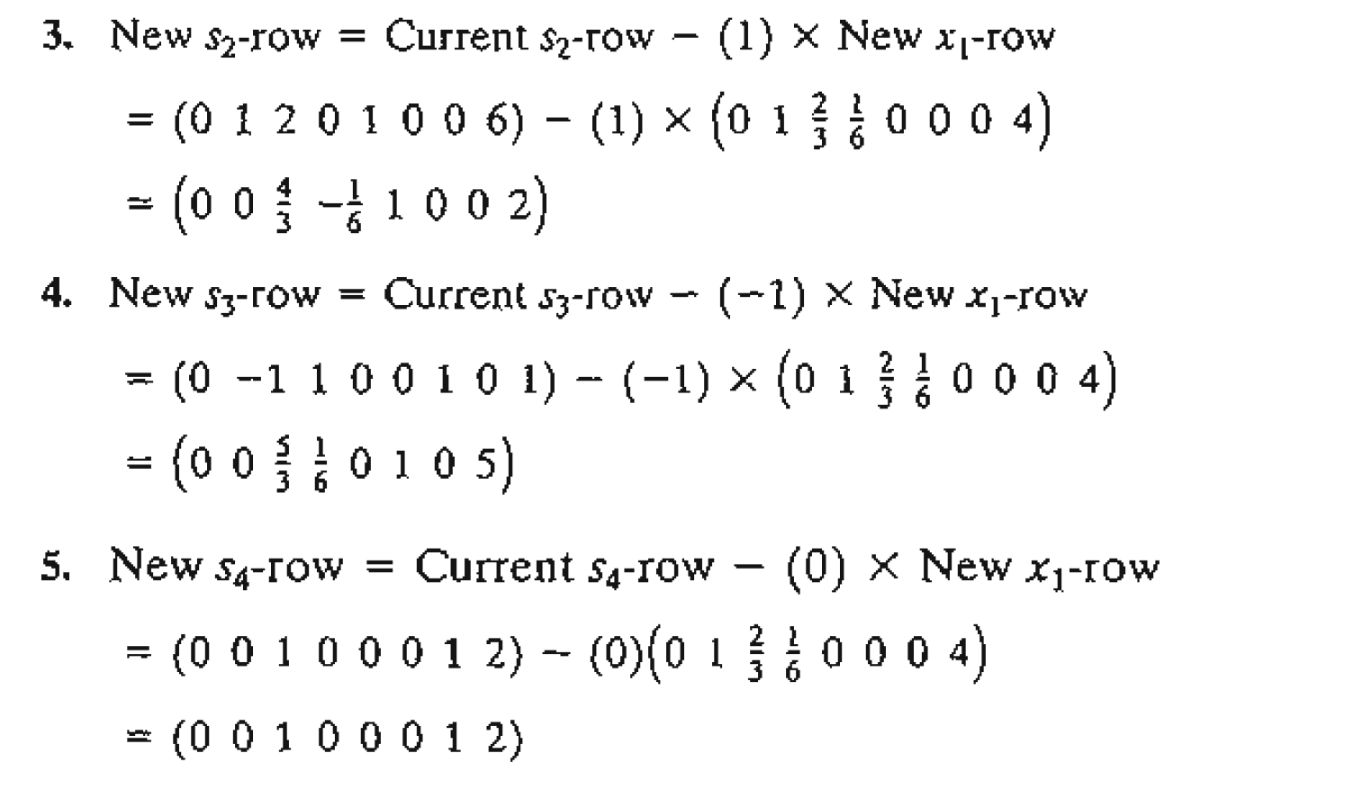

Slide 59
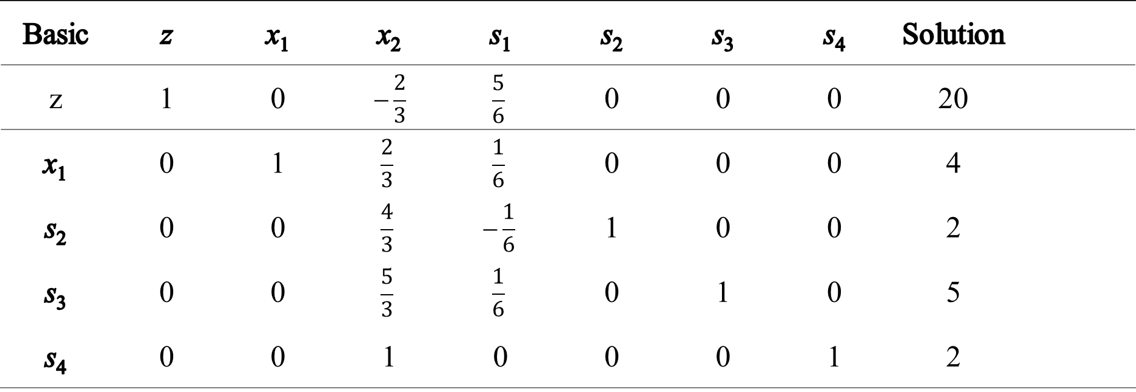
New Tableau become
Basic | z | x₁ | x₂ | s₁ | s₂ | s₃ | s₄ | Solution
z | 1 | 0 | $$−\frac{2}{3}$$ | $$\frac{5}{6}$$ | 0 | 0 | 0 | 20
x₁ | 0 | 1 | $$\frac{2}{3}$$ | $$\frac{1}{6}$$ | 0 | 0 | 0 | 4
s₂ | 0 | 0 | $$\frac{4}{3}$$ | $$−\frac{1}{6}$$ | 1 | 0 | 0 | 2
s₃ | 0 | 0 | $$\frac{5}{3}$$ | $$\frac{1}{6}$$ | 0 | 1 | 0 | 5
s₄ | 0 | 0 | 1 | 0 | 0 | 0 | 1 | 2

Slide 60
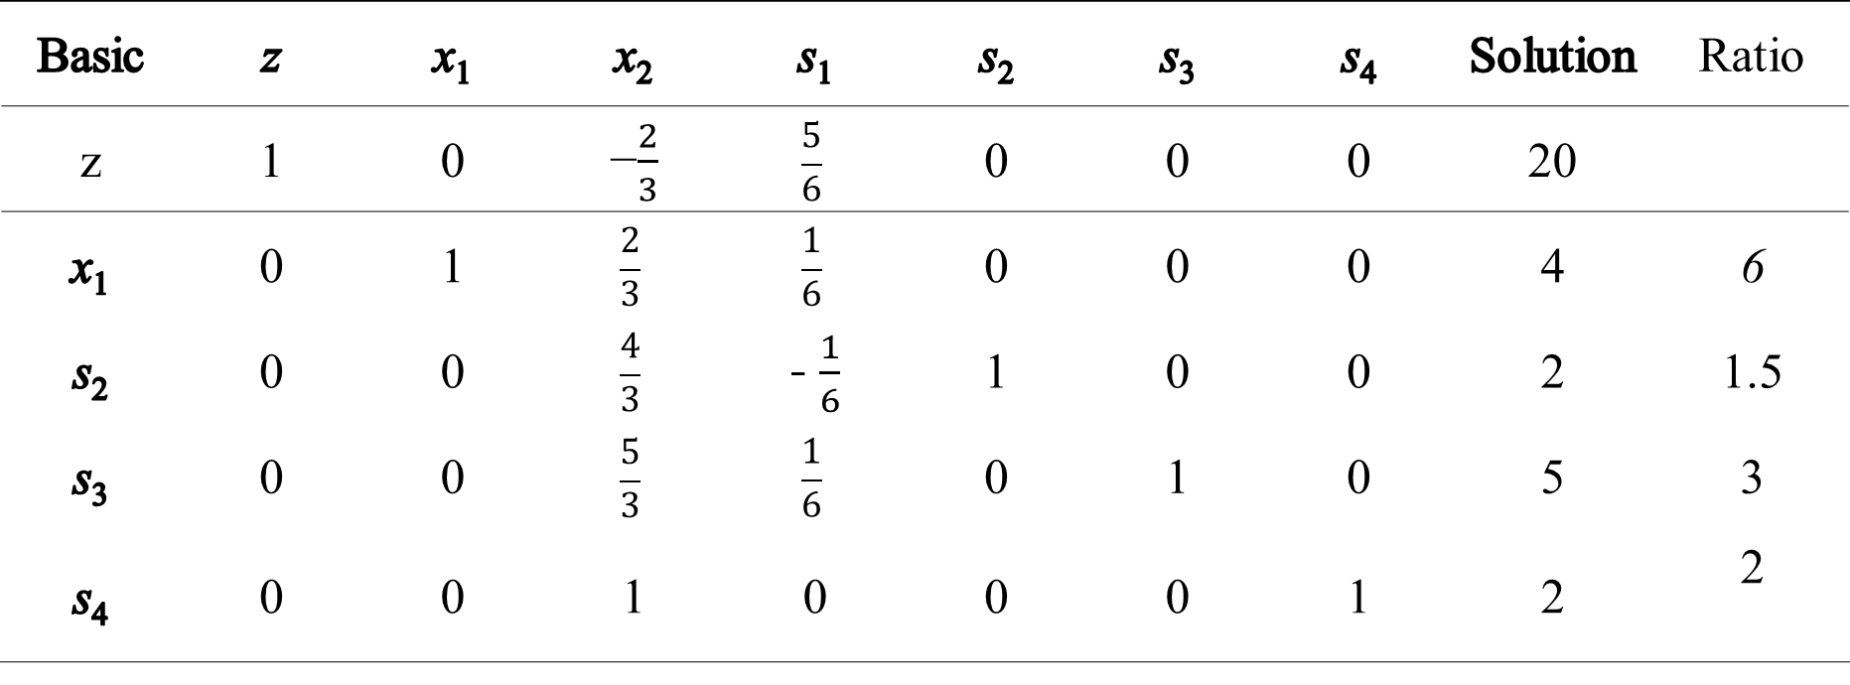
New Tableau become
Basic | z | x₁ | x₂ | s₁ | s₂ | s₃ | s₄ | Solution | Ratio
z | 1 | 0 | −$\frac{2}{3}$ | $$\frac{5}{6}$$ | 0 | 0 | 0 | 20
x₁ | 0 | 1 | $$\frac{2}{3}$$ | $$\frac{1}{6}$$ | 0 | 0 | 0 | 4 | 6
s₂ | 0 | 0 | $$\frac{4}{3}$$ | - $\frac{1}{6}$ | 1 | 0 | 0 | 2 | 1.5
s₃ | 0 | 0 | $$\frac{5}{3}$$ | $$\frac{1}{6}$$ | 0 | 1 | 0 | 5 | 3
s₄ | 0 | 0 | 1 | 0 | 0 | 0 | 1 | 2 | 2

Slide 61
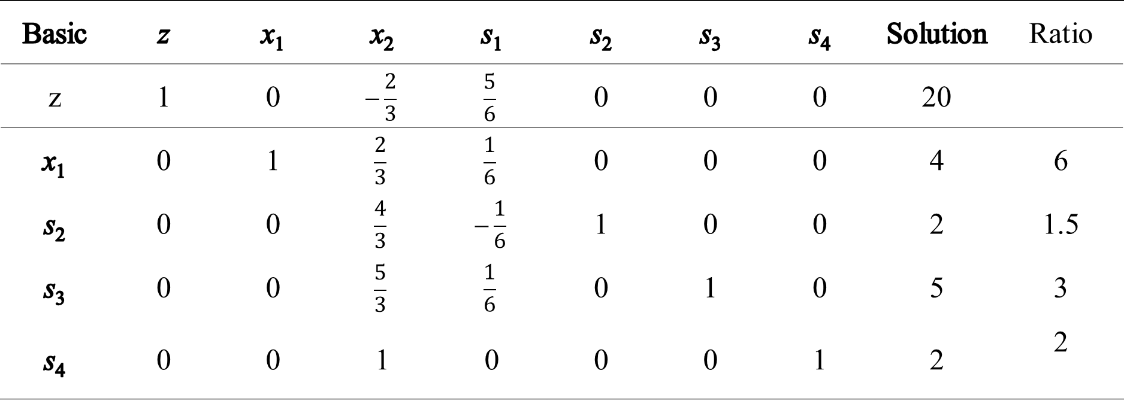
New Tableau become
PIVOT ROW
Basic | z | x₁ | x₂ | s₁ | s₂ | s₃ | s₄ | Solution | Ratio
z | 1 | 0 | $$−\frac{2}{3}$$ | $$\frac{5}{6}$$ | 0 | 0 | 0 | 20
x₁ | 0 | 1 | $$\frac{2}{3}$$ | $$\frac{1}{6}$$ | 0 | 0 | 0 | 4 | 6
s₂ | 0 | 0 | $$\frac{4}{3}$$ | $$−\frac{1}{6}$$ | 1 | 0 | 0 | 2 | 1.5
s₃ | 0 | 0 | $$\frac{5}{3}$$ | $$\frac{1}{6}$$ | 0 | 1 | 0 | 5 | 3
s₄ | 0 | 0 | 1 | 0 | 0 | 0 | 1 | 2 | 2
PIVOT COLUMN

Slide 62
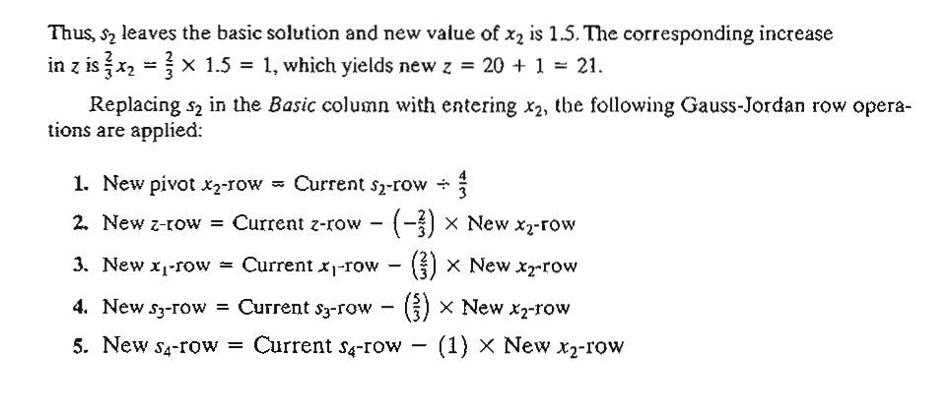

Slide 63
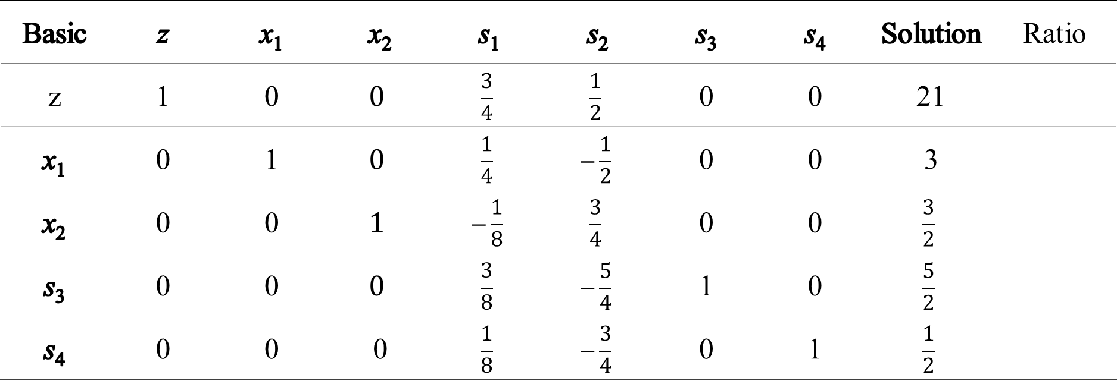
New Tableau become
Basic | z | x₁ | x₂ | s₁ | s₂ | s₃ | s₄ | Solution | Ratio
z | 1 | 0 | $$0$$ | $$\frac{3}{4}$$ | $$\frac{1}{2}$$ | 0 | 0 | 21
x₁ | 0 | 1 | $$0$$ | $$\frac{1}{4}$$ | $$−\frac{1}{2}$$ | 0 | 0 | 3
x₂ | 0 | 0 | $$1$$ | $$−\frac{1}{8}$$ | $$\frac{3}{4}$$ | 0 | 0 | $$\frac{3}{2}$$
s₃ | 0 | 0 | $$0$$ | $$\frac{3}{8}$$ | $$−\frac{5}{4}$$ | 1 | 0 | $$\frac{5}{2}$$
s₄ | 0 | 0 | 0 | $$\frac{1}{8}$$ | $$−\frac{3}{4}$$ | 0 | 1 | $$\frac{1}{2}$$
Based on the optimality condition, none of the z-row coefficients associated with the nonbasic variables, s_{l} and s₂, are negative. Hence, the last tableau is optimal.

Slide 64
Interprete the optimal soluintion

Slide 65


The optimum solution can be read from the simplex tableau in the following manner. The optimal values of the variables in the Basic column are given in the right-hand-side Solution column and can be interpreted as
Decision variable | Optimum value | Recommendation
x1 | 3 | Produce 3 tons of exterior paint daily
X2 | $$\frac{3}{2}$$ | Produce 1.5 tons of inerior paint daily
z | 21 | Daily profit is $21,000
You can verify that the values s₁ = s₂ = 0, s₃ = $\frac{5}{2}$, s₄ = $\frac{1}{2}$ are consistent with the given values of X_{l} and X₂ by substituting out the values of X_{I} and X₂ in the constraints.

Slide 66
Thank you

