Slide 1
Transportation Model and Its Variance
CH 05

Slide 2
5.1 DEFINITION OF THE TRANSPORTATION MODEL

Slide 3
definition
The transportation model is a special class of linear programs that deals with shipping a commodity from sources (e.g., factories) to destinations (e.g., warehouses). The objective is to determine the shipping schedule that minimizes the total shipping cost while satisfying supply and demand limits. The application of the transportation model can be extended to other areas of operation, including inventory control, employment scheduling, and personnel assignment.

Slide 4
definition
The general problem is represented by the network in Figure 5.1. There are m sources and n destinations, each represented by a node. The arcs represent the routes linking the sources and the destinations. Arc (i, j) joining source i to destination j carries two pieces of information: the transportation cost per unit, c_{ij}, and the amount shipped, x_{ij}. The amount of supply at source i is ai and the amount of demand at destinationj is b_{j} • The objective ofthe model is to determine the unknowns x_{ij} that will minimize the total transportation cost while satisfying all the supply and demand restrictions.

Slide 5
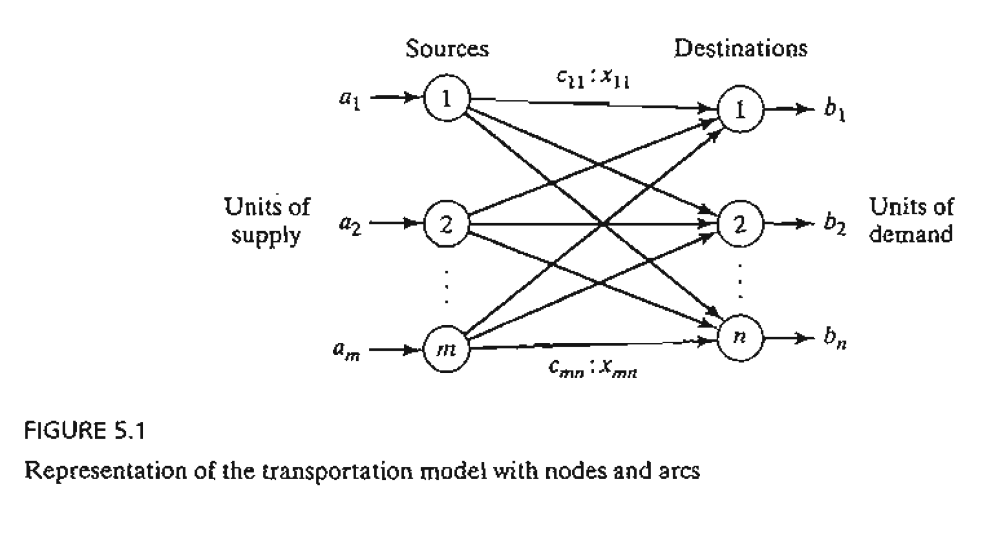

Slide 6
Example 5.1-1
MGAuto has three plants in Los Angeles, Detroit, and New Orleans, and two major distribution centers in Denver and Miami. The capacities of the three plants during the next quarter are 1000, 1500, and 1200 cars. The quarterly demands at the two distribution centers are 2300 and 1400 cars. The mileage chart between the plants and the distribution centers is given in Table 5.l.
The trucking company in charge of transporting the cars charges 8 cents per mile per car. The transportation costs per car on the different routes, rounded to the closest dollar, are given in Table 5.2.
The LP model of the problem is given as

Slide 7
Table 5.1 Mileage Chart
 | Denver | Miami
Los Angeles | 1000 | 2690
Detroit | 1250 | 1350
New Orleans | 1275 | 850
Table 5.2 Transportation Cost per Car
 | Denver (1) | Miami (2)
Los Angeles (1) | 80 | 215
Detroit (2) | 100 | 108
New Orleans (3) | 102 | 68

Slide 8
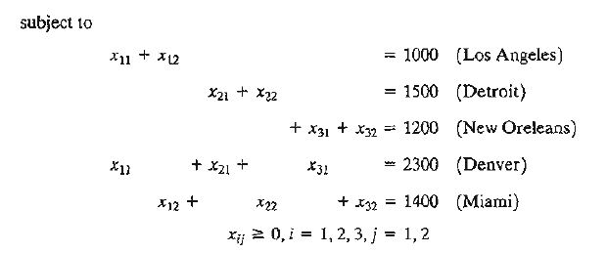
Minimize z = 80x₁₁ + 215x₁₂ + l00x₂₁ + l08x₂₂ + l02x₃₁ + 68x₃₂

Slide 9
These constraints are all equations because the total supply from the three sources (= 1000 + 1500 + 1200 = 3700 cars) equals the total demand at the two destinations (= 2300 + 1400 = 3700 cars).
The LP model can be solved by the simplex method. However, with the special structure of the constraints we can solve the problem more conveniently using the transportation tableau shown in Table 5.3.

Slide 10
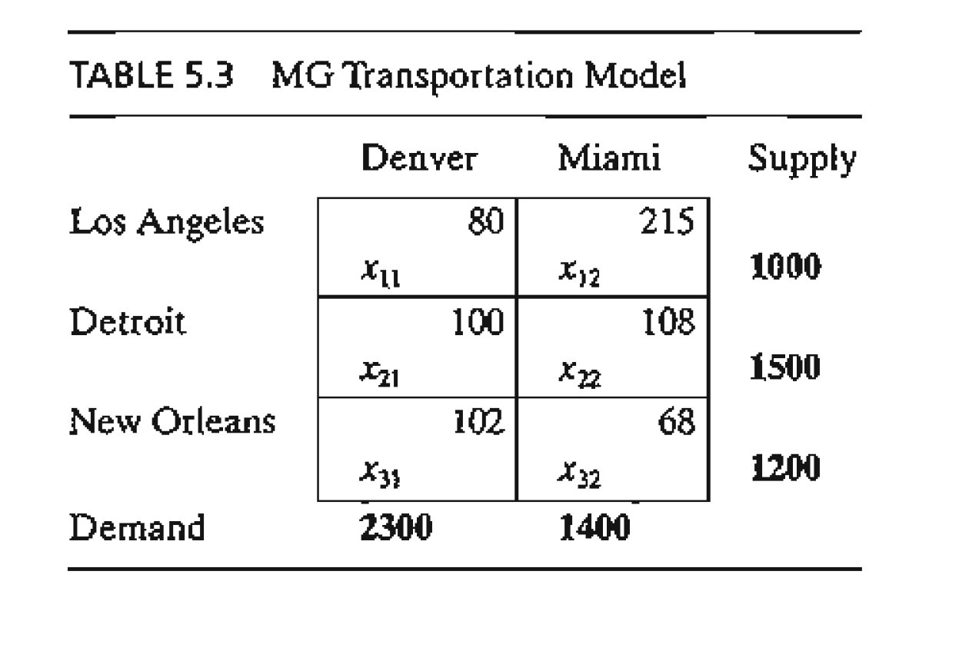

Slide 11
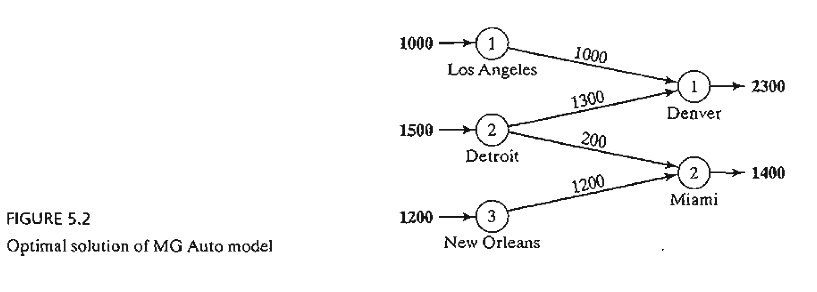
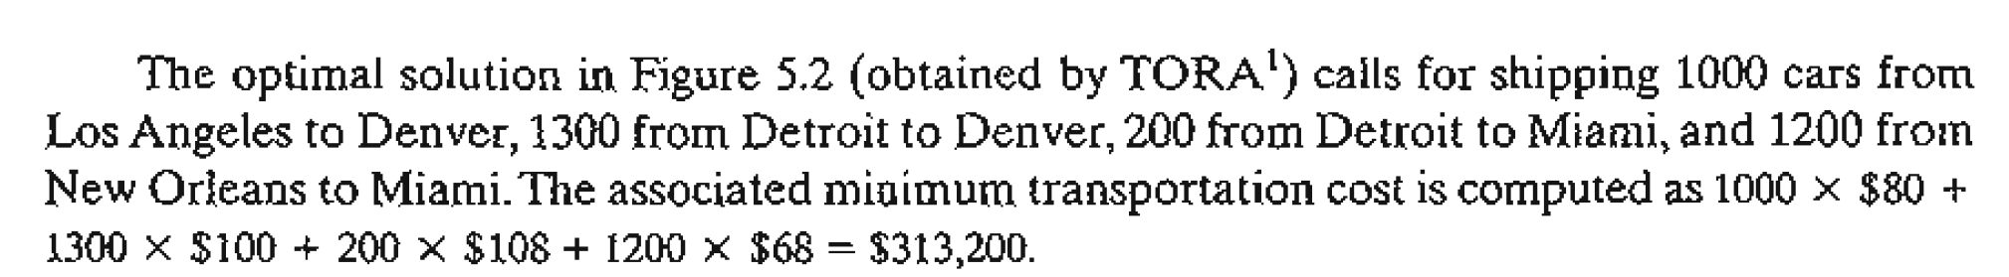

Slide 12
Balancing the Transportation Model. The transportation algorithm is based on the assumption that the model is balanced, meaning that the total demand equals the total supply. If the model is unbalanced, we can always add a dummy source or a dummy destination to restore balance.
Example 5.1-2
In the MG model, suppose that the Detroit plant capacity is 1300 cars (instead of 1500).The total supply (= 3500 cars) is less than the total demand (= 3700 cars), meaning that part of the demand at Denver and Miami will not be satisfied.
Because the demand exceeds the supply, a dummy source (plant) with a capacity of 200 cars (= 3700 - 3500) is added to balance the transportation model. The unit transportation costs from the dummy plant to the two destinations are zero because the plant does not exist.
Table 5.4 gives the balanced model together with its optimum solution. The solution shows that the dummy plant ships 200 cars to Miami, which means that Miami will be 200 cars short of satisfying its demand of 1400 cars.

Slide 13
We can make sure that a specific destination does not experience shortage by assigning a very high unit transportation cost from the dummy source to that destination. For example, a penalty of $1000 in the dummy-Miami cell will prevent shortage at Miami. Of course, we cannot use this "trick" with all the destinations, because shortage must occur somewhere in the system.
The case where the supply exceeds the demand can be demonstrated by assuming that the demand at Denver is 1900 cars only. In this case, we need to add a dummy distribution center to "receive" the surplus supply. Again, the unit transportation costs to the dummy distribution center are zero, unless we require a factory to "ship out" completely. In this case, we must assign a high unit transportation cost from the designated factory to the dummy destination.

Slide 14
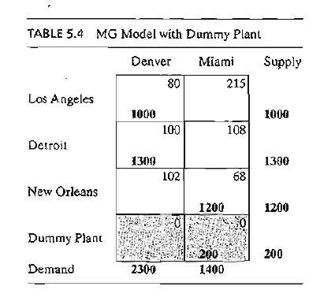
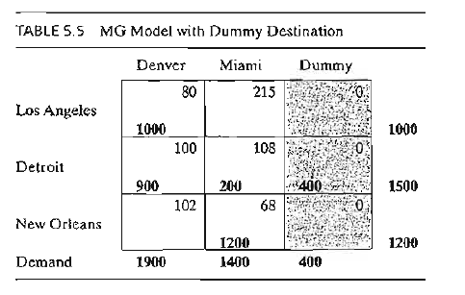

Slide 15
5.2 NONTRADITIONAL TRANSPORTATION MODELS

Slide 16
NONTRADITIONAL TRANSPORTATION MODELS
The application of the transportation model is not limited to transporting commodities between geographical sources and destinations. This section presents two applications in the areas of production-inventory control and tool sharpening service.

Slide 17
Example 5.2-1
(Production-Inventory Control)
Boralis manufactures backpacks for serious hikers. The demand for its product occurs during March to June of each year. Boralis estimates the demand for the four months to be 100, 200, 180, and 300 units, respectively. The company uses part-time labor to manufacture the backpacks and, accordingly, its production capacity varies monthly. It is estimated that Boralis can produce 50, 180,280, and 270 units in March through June. Because the production capacity and demand for the different months do not match, a current month's demand may be satisfied in one of three ways.

Slide 18
Example 5.2-1
(Production-Inventory Control)
1. Current month's production.
2. Surplus production in an earlier month.
3. Surplus production in a later month (backordering).
In the first case, the production cost per backpack is $40. The second case incurs an additional holding cost of $.50 per backpack per month. In the third case, an additional penalty cost of $2.00 per backpack is incurred for each month delay. Boralis wishes to determine the optimal production schedule for the four months.

Slide 19
Example 5.2-1
(Production-Inventory Control)
The situation can be modeled as a transportation model by recognizing the following parallels between the elements of the production-inventory problem and the transportation model:
Transportation | Production-inventory
1. Source i | 1. Production period i
2. Destination j | 2. Demand period j
3. Supply amount at source I | 3. Production capacity of period i
4. Demand at destination j | 4. Demand for period j
5. Unit transportation cost from source i to destination j | 5. Unit cost (production + inventory + penalty) in period i for period j

Slide 20
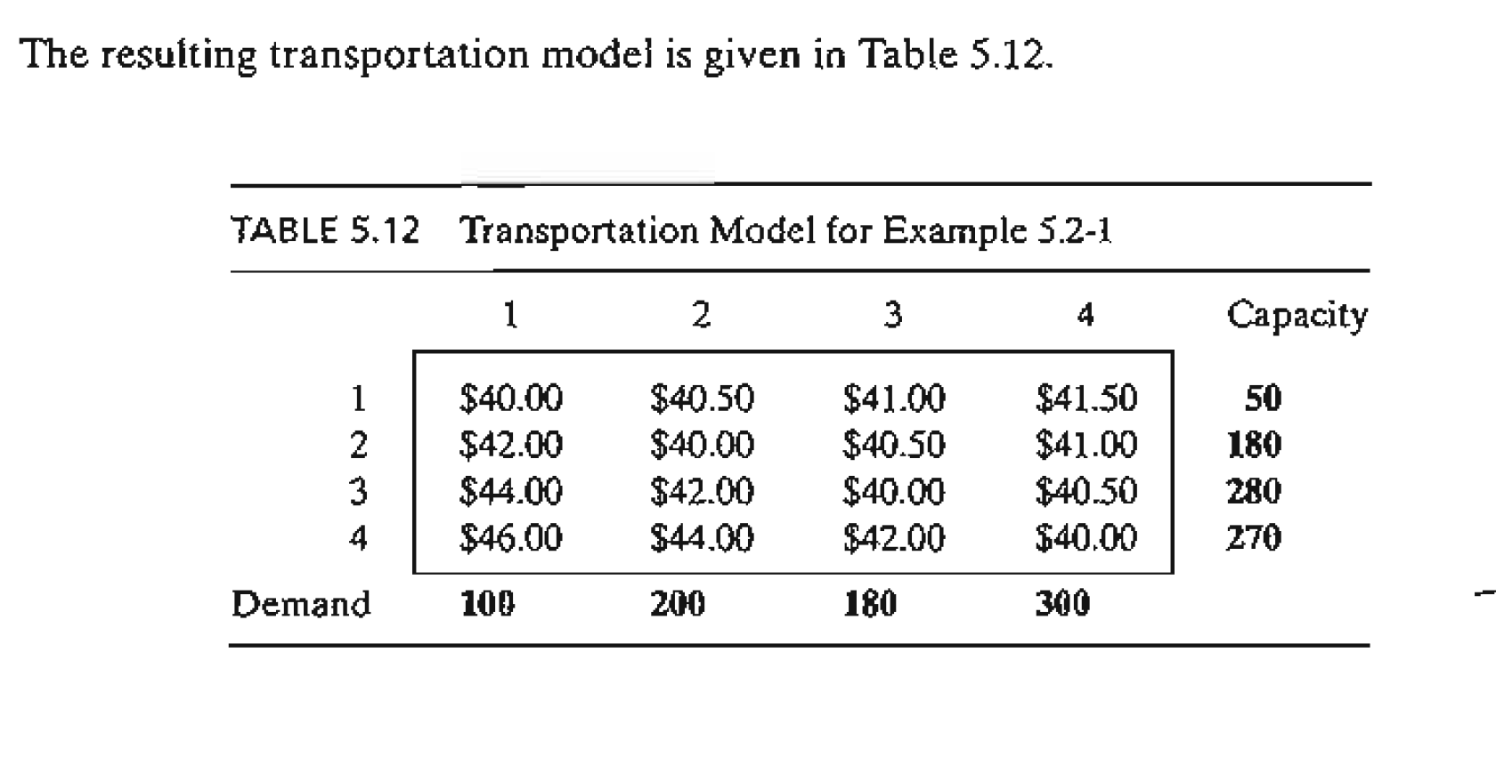

Slide 21
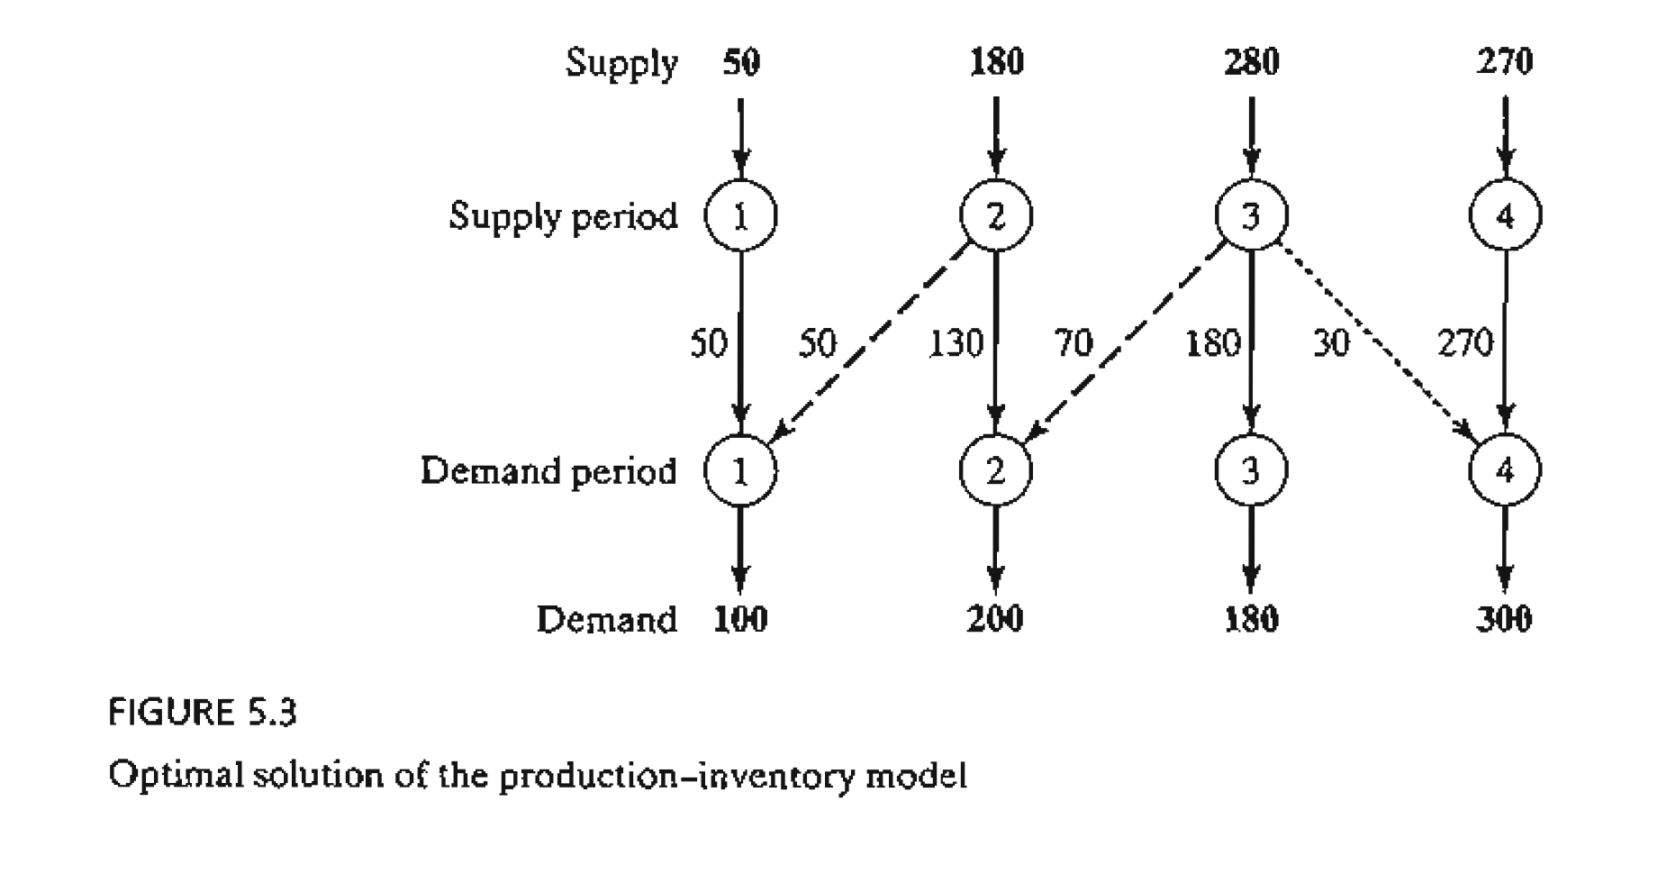

Slide 22
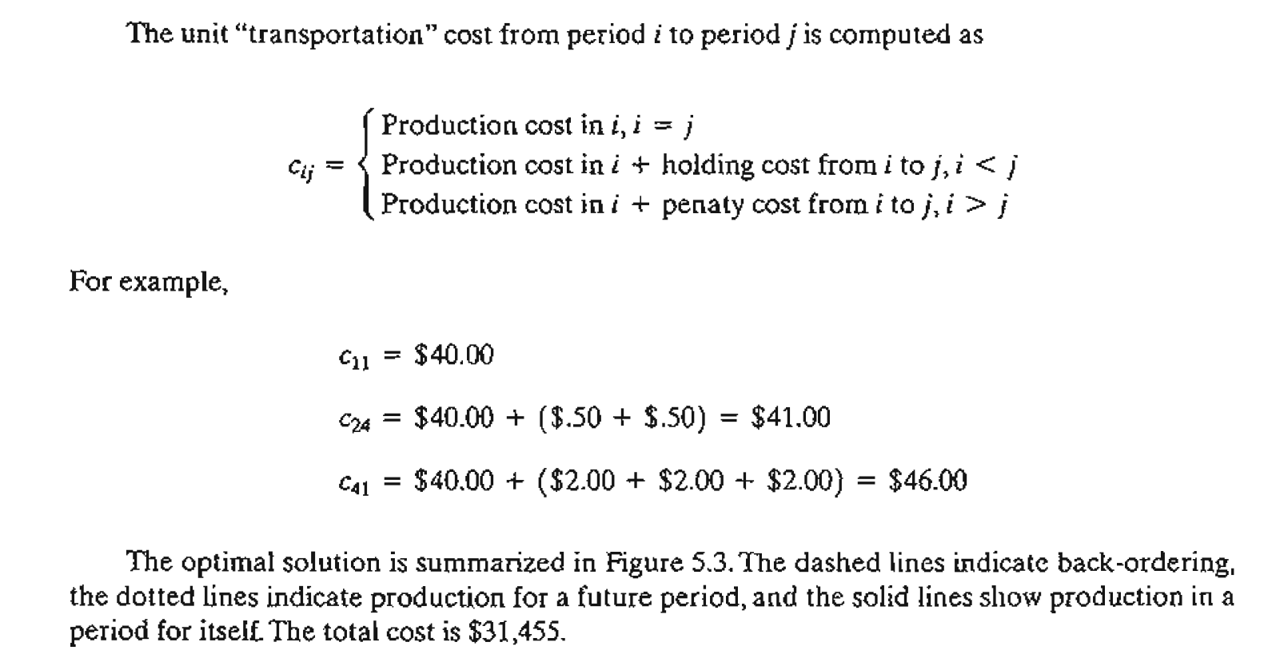

Slide 23
Example 5.2-2
(Tool Sharpening)
Arkansas Pacific operates a medium-sized saw mill. The mill prepares different types of wood that range from soft pine to hard oak according to a weekly schedule. Depending on the type of wood being milled, the demand for sharp blades varies from day to day according to the following I-week (7-day) data:
Day | Mon. | Tue. | Wed. | Thu. | Fri. | Sat. | Sun.
Demand (blades) | 24 | 12 | 14 | 20 | 18 | 14 | 22

Slide 24
Example 5.2-2
(Tool Sharpening)
The mill can satisfy the daily demand in the following manner
1. Buy new blades at the cost of $12 a blade.
2. Use an overnight sharpening service at the cost of $6 a blade.
3. Use a slow 2-day sharpening service at the cost of $3 a blade.
The situation can be represented as a transportation model with eight sources and seven destinations. The destinations represent the 7 days of the week. The sources of the model are defined as follows:

Slide 25
Example 5.2-2
(Tool Sharpening)
Source 1 corresponds to buying new blades, which, in the extreme case, can provide sufficient supply to cover the demand for all 7 days (= 24 + 12 + 14 + 20 + 18 + 14 + 22 = 124). Sources 2 to 8 correspond to the 7 days of the week. The amount of supply for each of these sources equals the number of used blades at the end of the associated day. For example, source 2 (i.e., Monday) will have a supply of used blades equal to the demand for Monday. The unit "transportation cost" for the model is $12, $6, or $3, depending on whether the blade is supplied from new blades, overnight sharpening, or 2-day sharpening. Notice that the overnight service means that used blades sent at the end of day i will be available for use at the start of day i + 1 or day i + 2, because the slow 2-day service will not be available until the start of day i + 3. The "disposal" column is a dummy destination needed to balance the model. TIle complete model and its solution are given in Table 5.13.

Slide 26
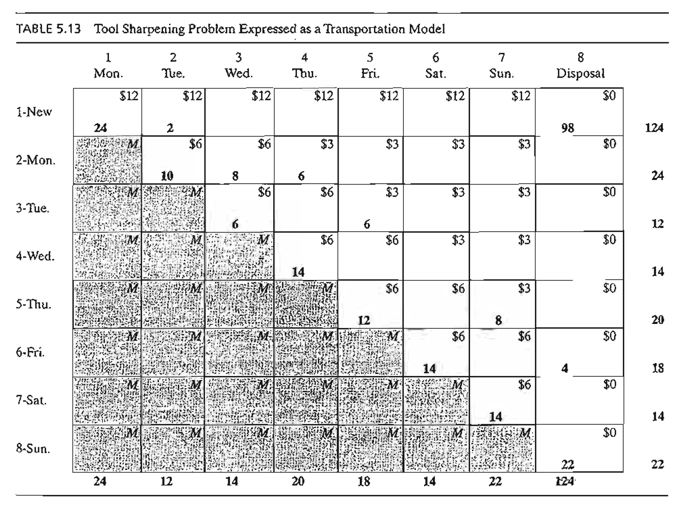

Slide 27
5.3 THE TRANSPORTATION ALGORITHM

Slide 28
THE TRANSPORTATION ALGORITHM
The transportation algorithm follows the exact steps of the simplex method (Chapter 3). However, instead of using the regular simplex tableau, we take advantage of the special structure of the transportation model to organize the computations in a more convenient form.

Slide 29
THE TRANSPORTATION ALGORITHM
Step 1. Determine a starting basic feasible solution, and go to step 2.
Step 2. Use the optimality condition of the simplex method to determine the entering variable from among all the nonbasic variables. If the optimality condition is satisfied, stop. Otherwise, go to step 3.
Step 3. Use the feasibility condition of the simplex method to determine the leaving variable from among all the current basic variables, and find the new basic solution. Return to step 2.

Slide 30
THE TRANSPORTATION ALGORITHM
The special structure of the transportation problem allows securing a nonartificiaI starting basic solution using one of three methods
1. Northwest-corner method
2. Least-cost method
3. Vogel approximation method

Slide 31
THE TRANSPORTATION ALGORITHM
The three methods differ in the "quality" of the starting basic solution they produce, in the sense that a better starting solution yields a smaller objective value. In general, though not always, the Vogel method yields the best starting basic solution, and the northwest-corner method yields the worst. The tradeoff is that the northwest-corner method involves the least amount of computations.

Slide 32
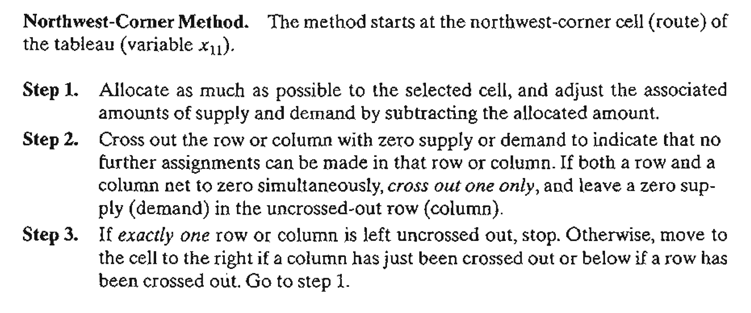

Slide 33
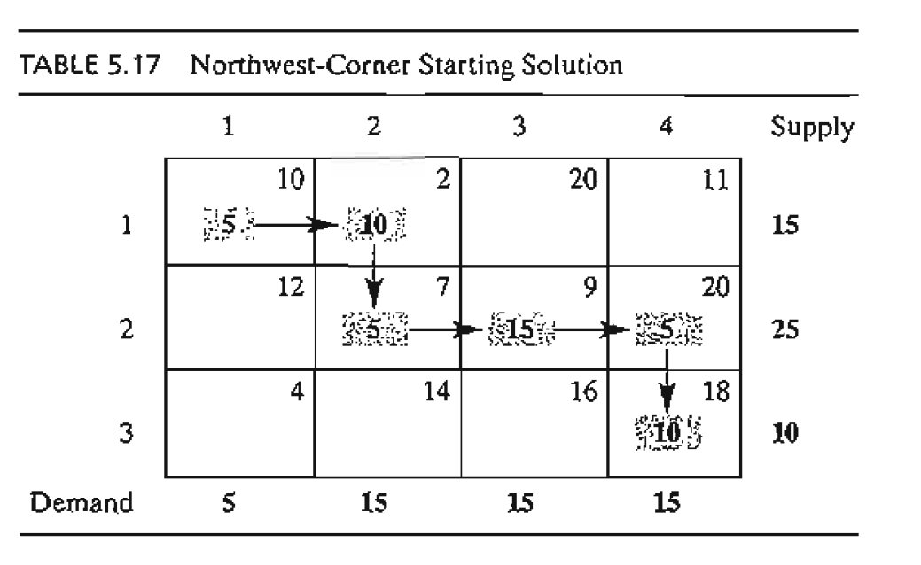

Slide 34
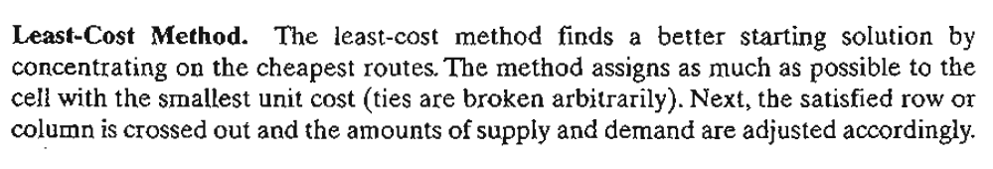
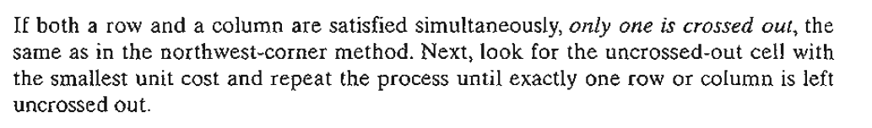

Slide 35
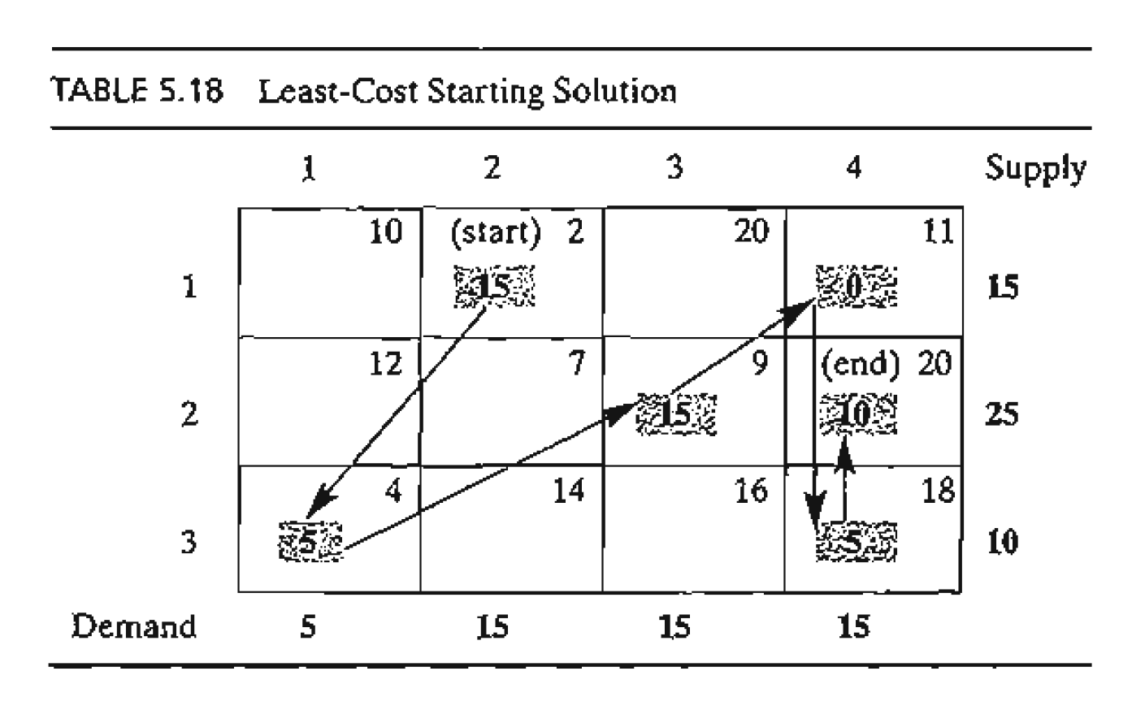

Slide 36
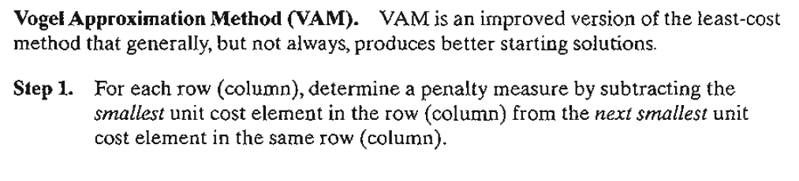
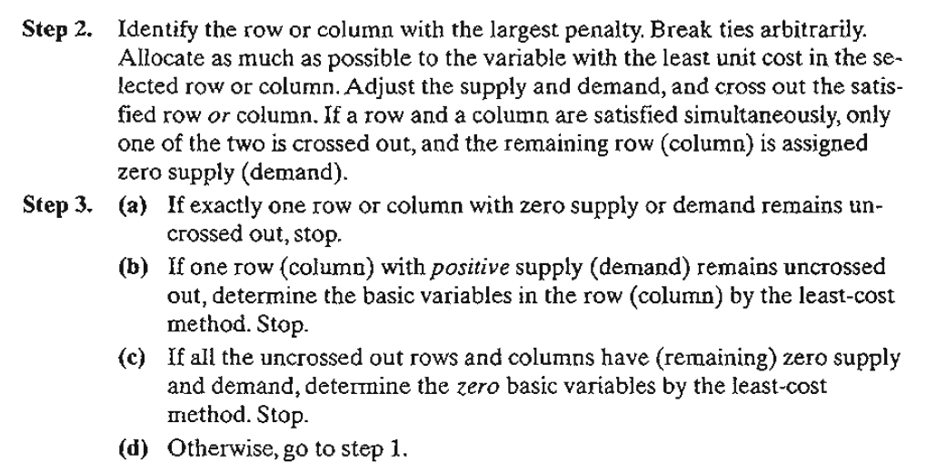

Slide 38
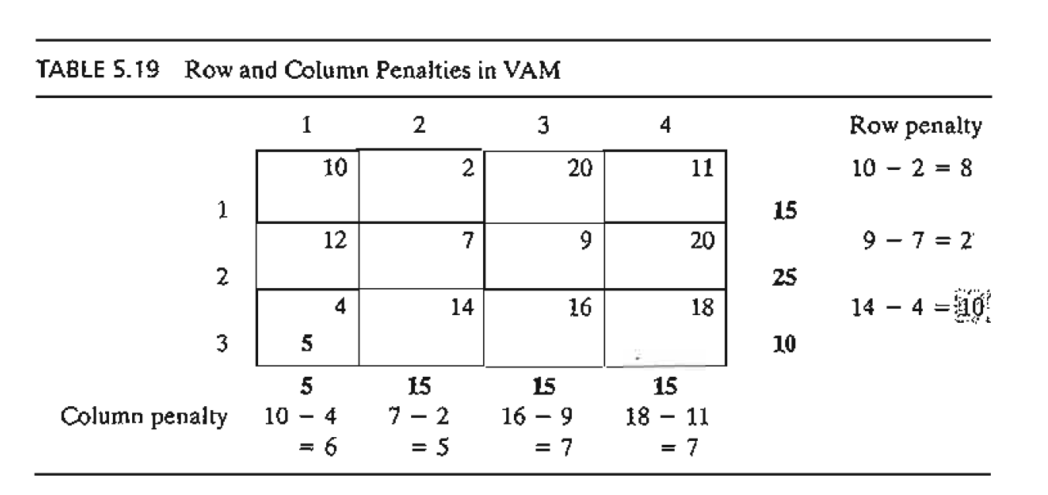

Slide 39
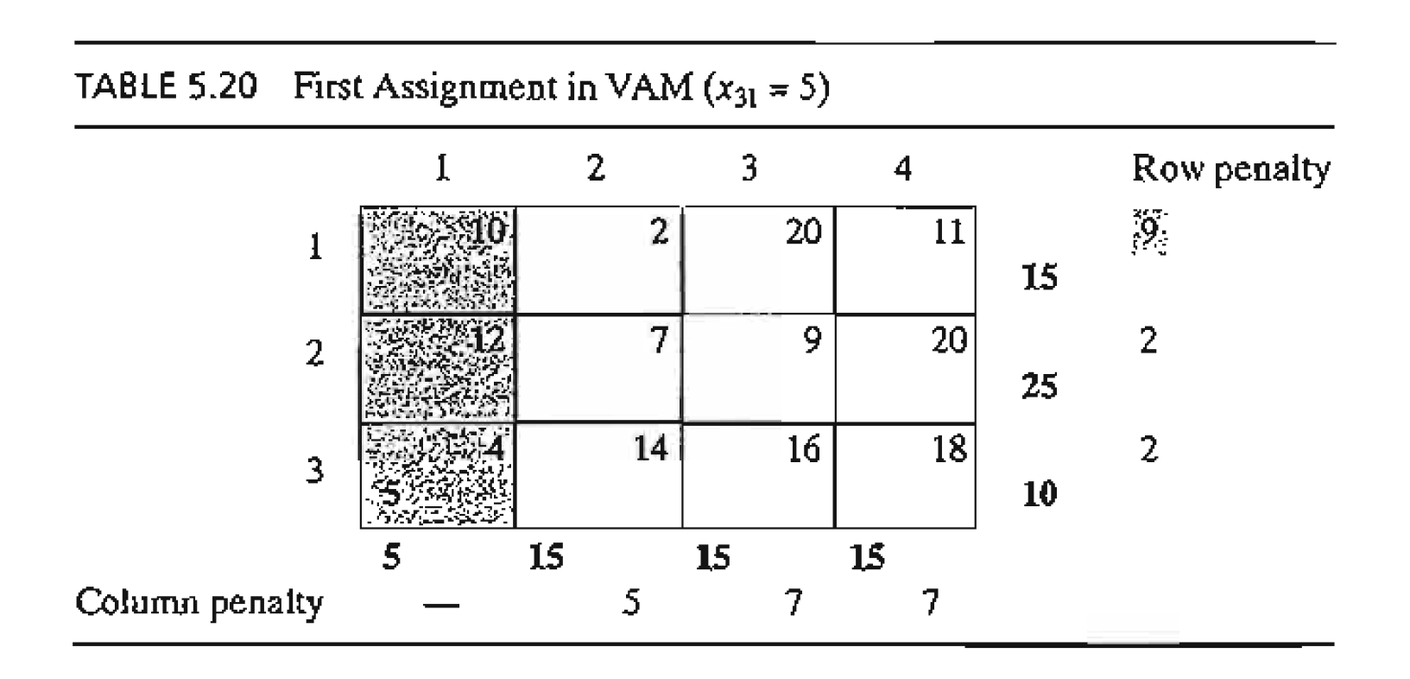

Slide 40
Iterative Computations of the Transportation Algorithm
After determining the starting solution (using any of the three methods in Section 5.3.1), we use the following algorithm to determine the optimum solution:
Step 1. Use the simplex optimality condition to determine the entering variable as the current nonbasic variable that can improve the solution. If the optimality condition is satisfied, stop. Otherwise, go to step 2.
Step 2. Determine the leaving variable using the simplex feasibility condition. Change the basis, and return to step 1.
The optimality and feasibility conditions do not involve the familiar row operations used in the simplex method. Instead, the special structure of the transportation model allows simpler computations.

Slide 41
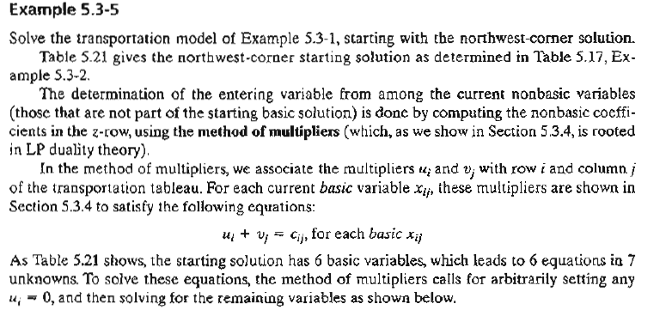

Slide 42
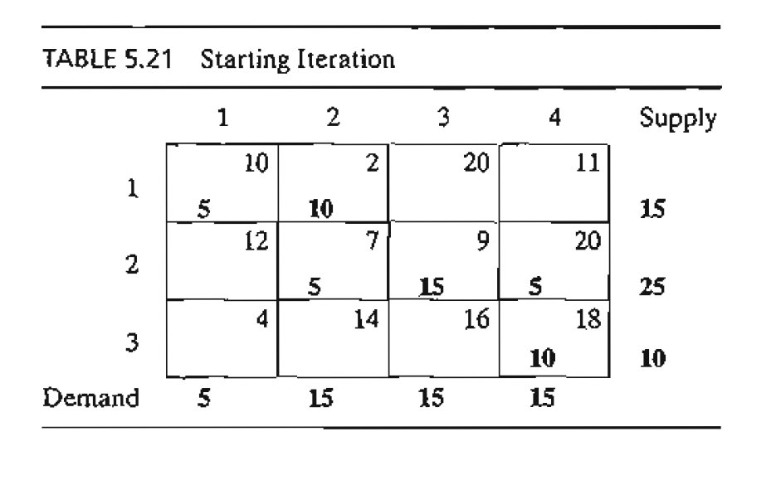

Slide 43
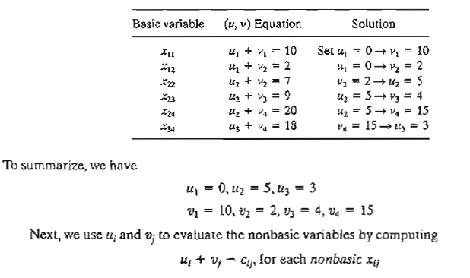

Slide 44
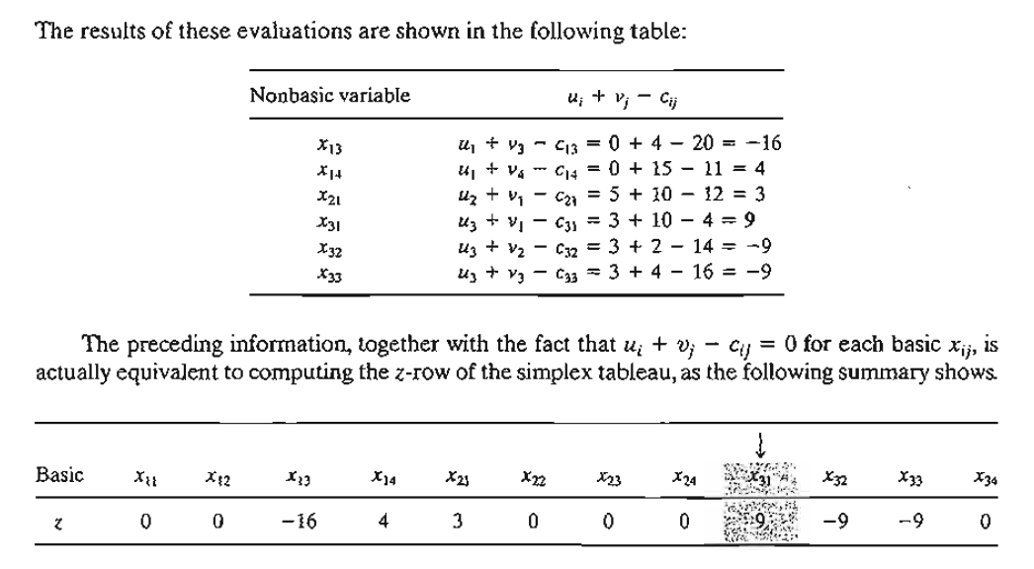

Slide 45
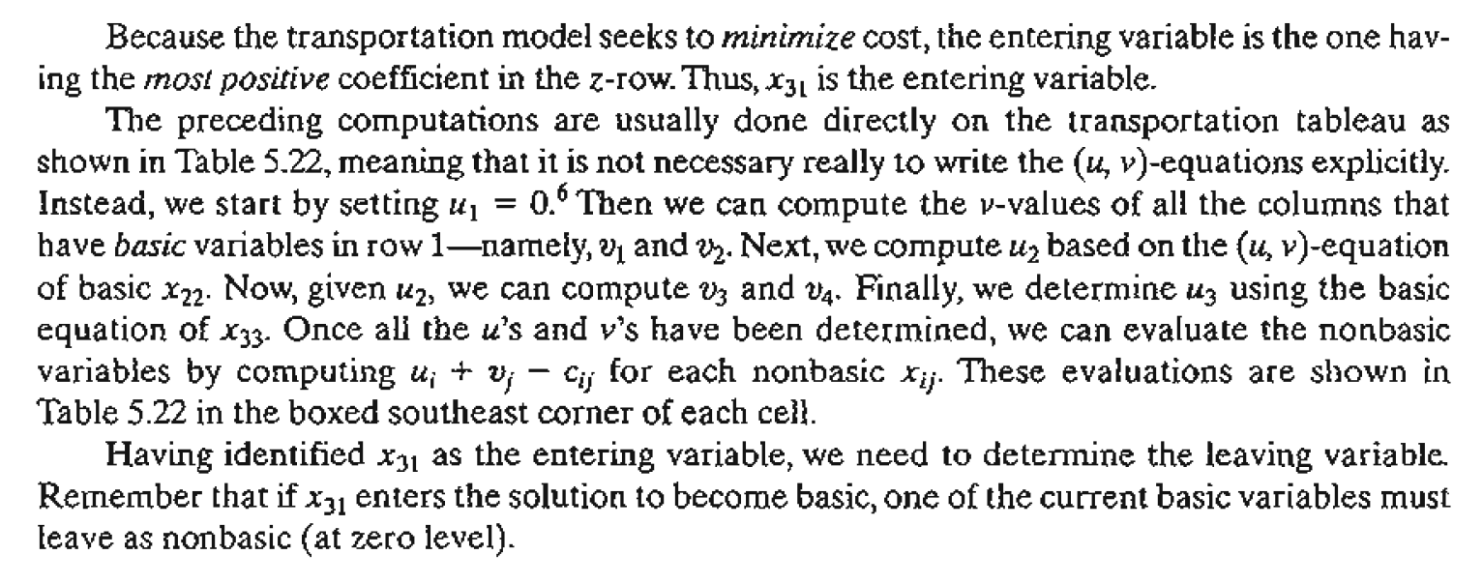

Slide 46
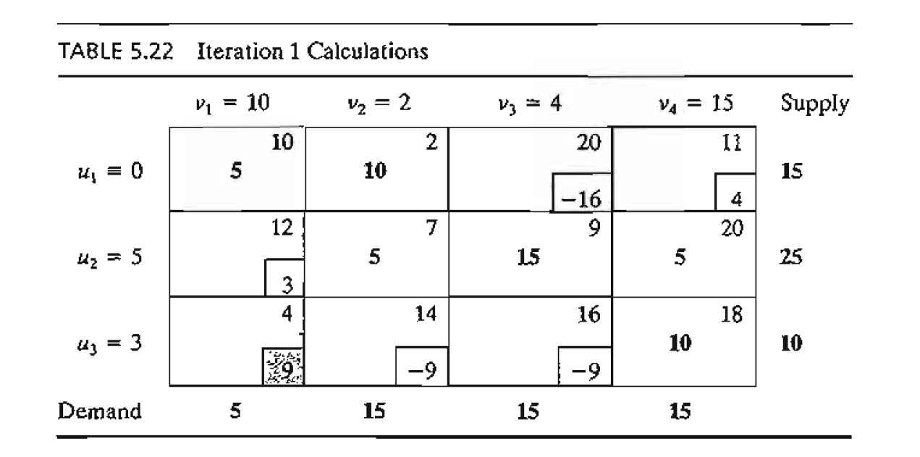

Slide 47
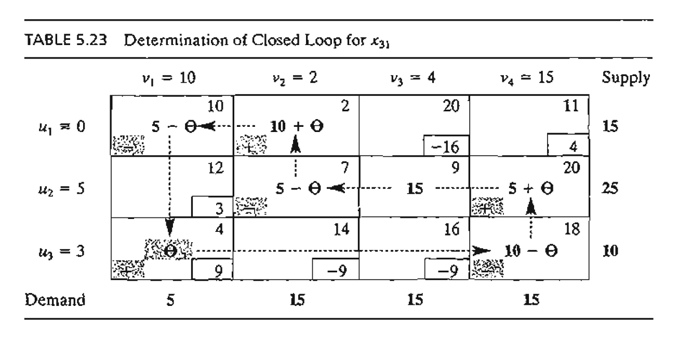

Slide 48
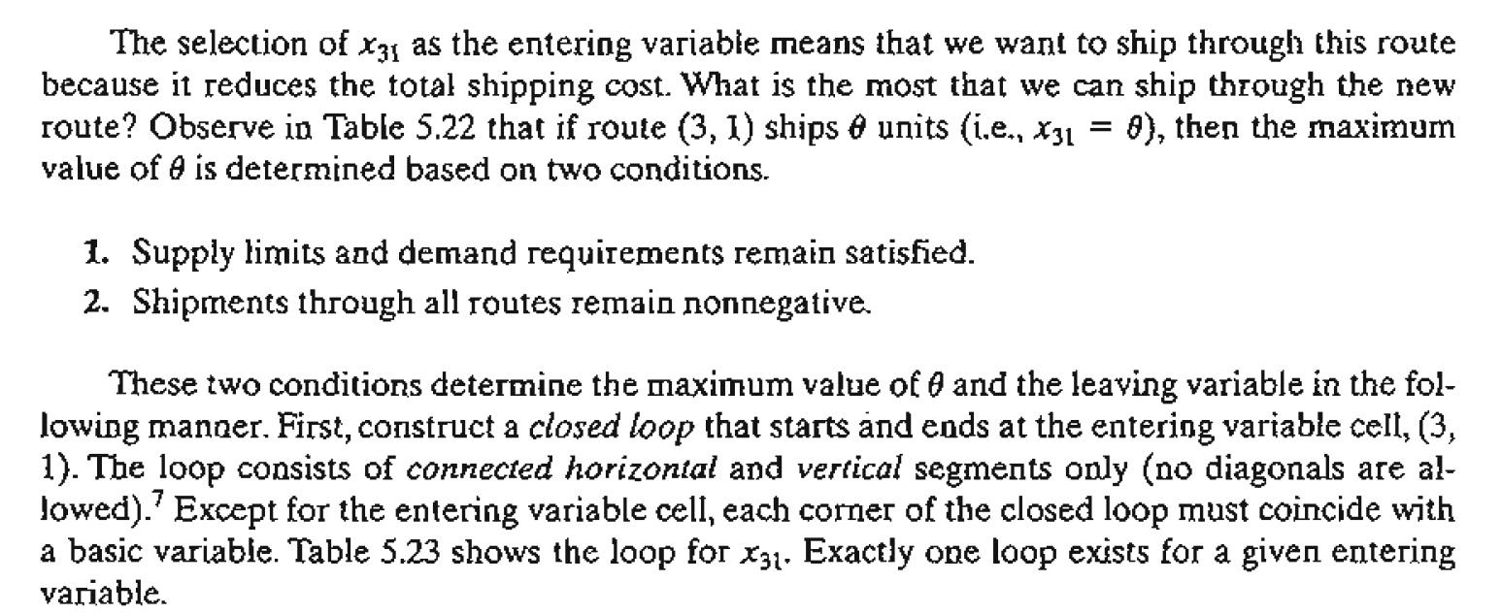

Slide 49
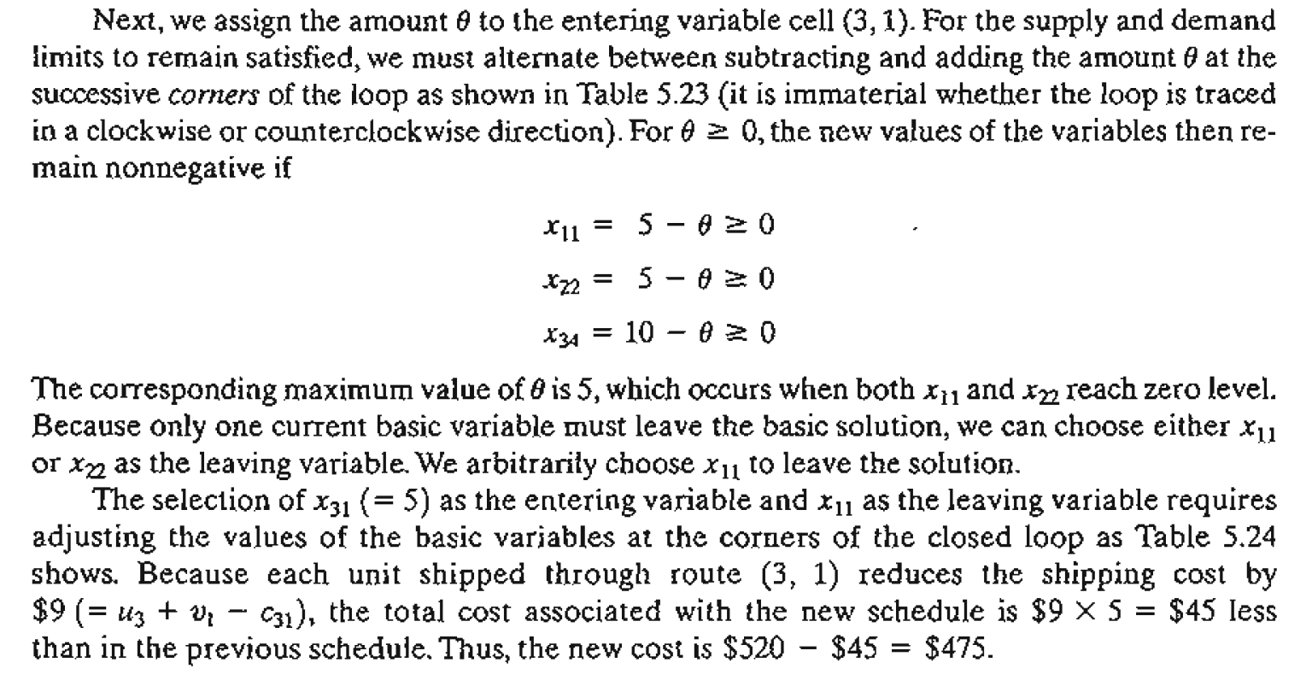

Slide 50
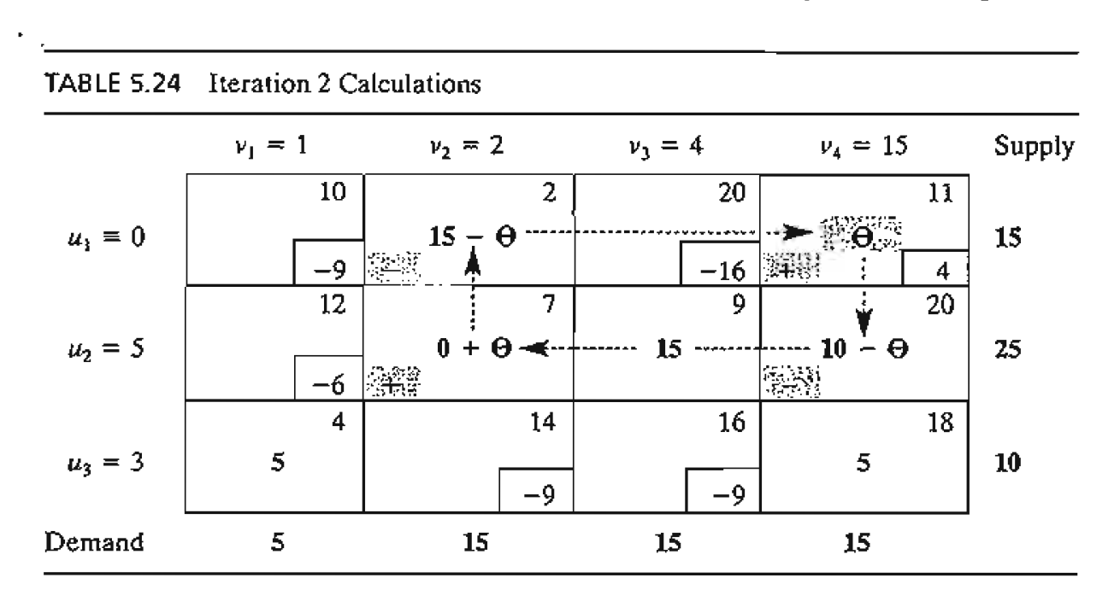

Slide 51
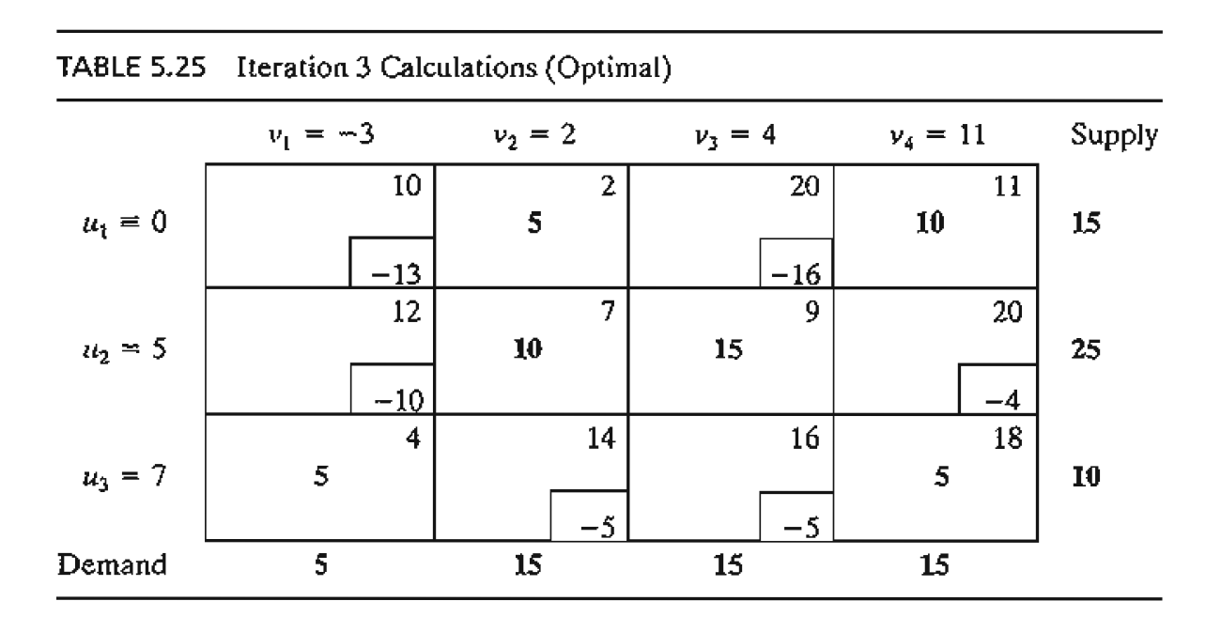

Slide 52
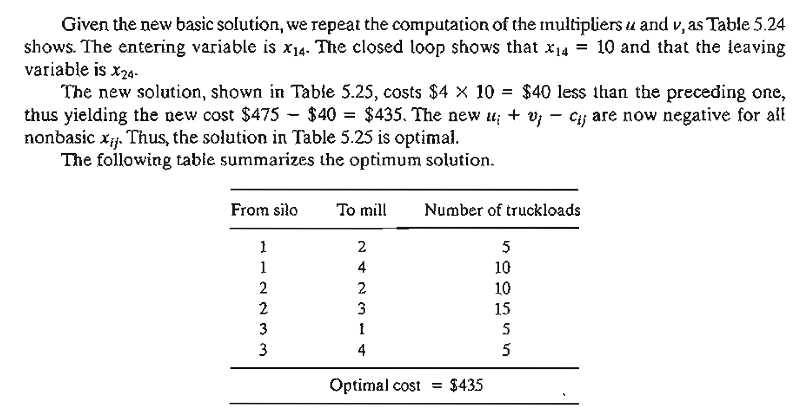

Slide 53
5.4 THE ASSIGNMENT MODEL

Slide 54
THE ASSIGNMENT MODEL
"The best person for the job" is an apt description of the assignment model. The situation can be illustrated by the assignment of workers with varying degrees of skill to jobs. A job that happens to match a worker's skill costs less than one in which the operator is not as skillful. The objective of the model is to determine the minimum-cost assignment of workers to jobs. The general assignment model with n workers and n jobs is represented in Table 5.31
The element Cij represents the cost of assigning worker i to job j (i, j = 1, 2, ... , n). There is no loss of generality in assuming that the number of workers always equals the number of jobs, because we can always add fictitious workers or fictitious jobs to satisfy this assumption

Slide 55
THE ASSIGNMENT MODEL
The assignment model is actually a special case of the transportation model in which the workers represent the sources, and the jobs represent the destinations.
The supply (demand) amount at each source (destination) exactly equals 1. The cost of "transporting" worker i to job j is Cij' In effect, the assignment model can be solved directly as a regular transportation modeL Nevertheless, the fact that all the supply and demand amounts equal 1 has led to the development of a simple solution algorithm called the Hungarian method. Although the new solution method appears totally unrelated to the transportation model, the algorithm is actually rooted in the simplex method,just as the transportation model is.

Slide 56
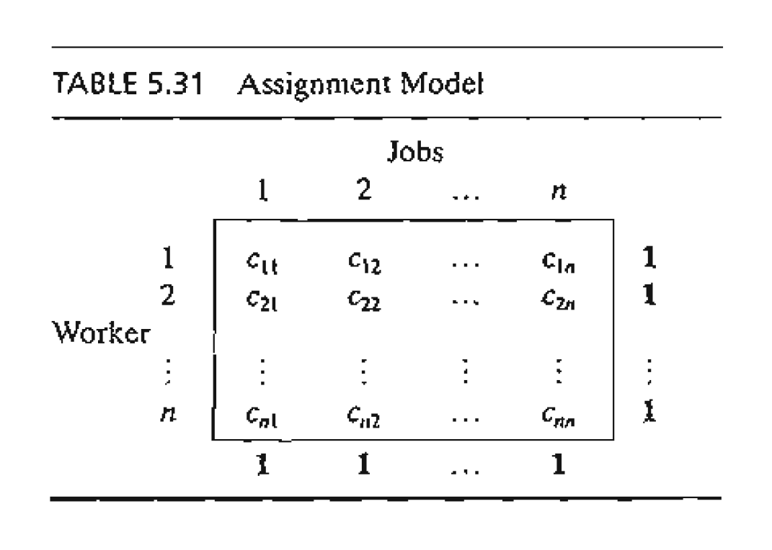

Slide 57
The Hungarian MethodS
The assignment problem will be solved by the Hungarian method.
Step 1. For the original cost matrix, identify each row's minimum, and subtract it from all the entries of the row.
Step 2. For the matrix resulting from step 1, identify each column's minimum, and subtract it from all the entries of the column.
Step 3. Identify the optimal solution as the feasible assignment associated with the zero elements of the matrix obtained in step 2.

Slide 58
Example 5.4-1
Joe Klyne's three children, John, Karen, and Terri, want to earn some money to take care of personal expenses during a school trip to the local zoo. Mr. Klyne has chosen three chores for his children: mowing the lawn, painting the garage door, and washing the family cars. To avoid anticipated sibling competition, he asks them to submit (secret) bids for what they feel is fair pay for each of the three chores. The understanding is that aU three children will abide by their father's decision as to who gets which chore. Table 5.32 summarizes the bids received. Based on this information, how should Mr. Klyne assign the chores?

Slide 59
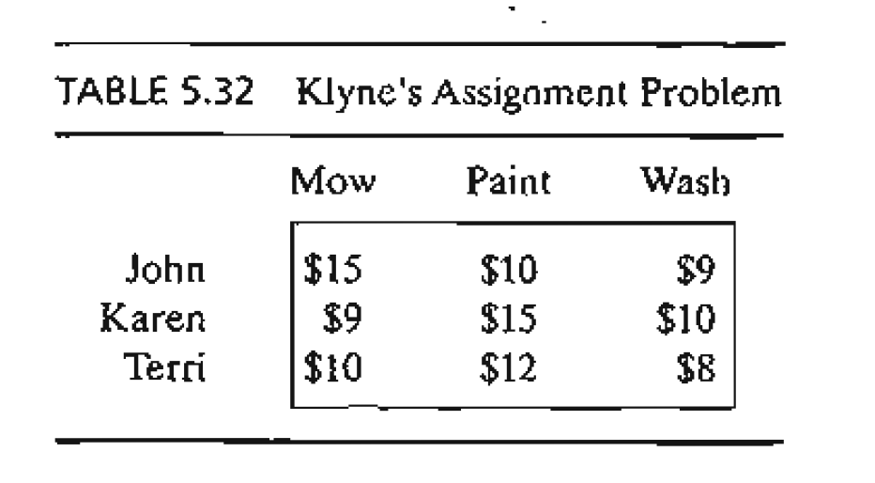

Slide 60
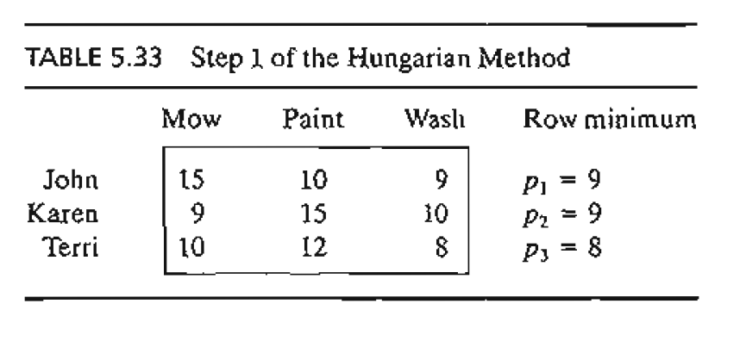

Slide 61
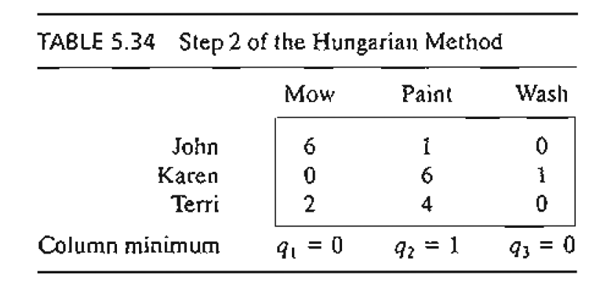

Slide 62
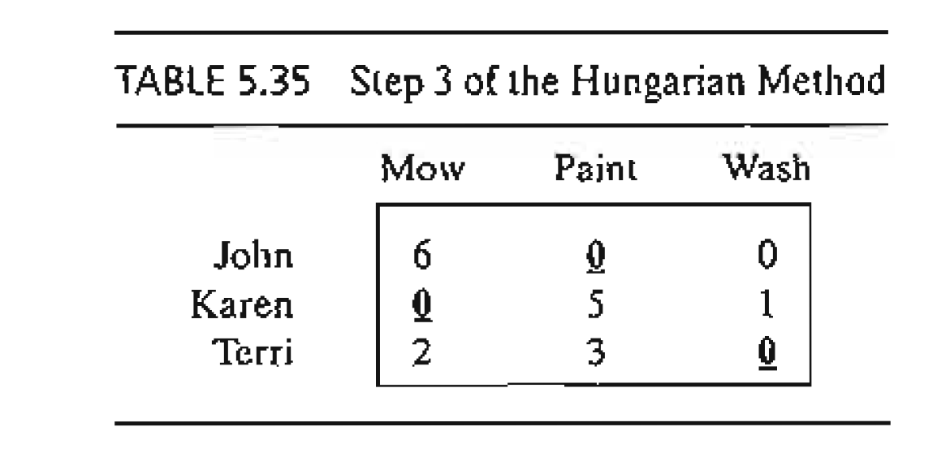

Slide 63
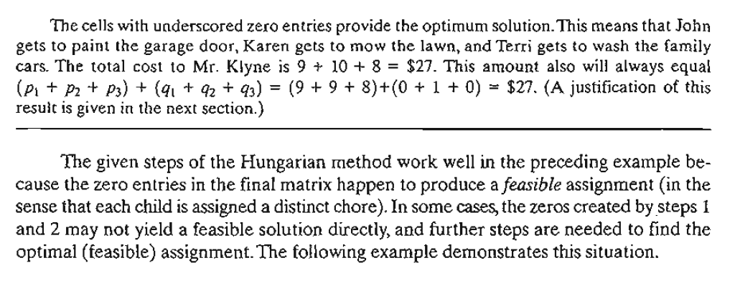

Slide 64
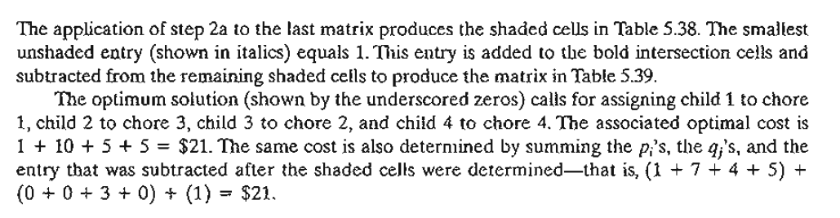

Slide 65
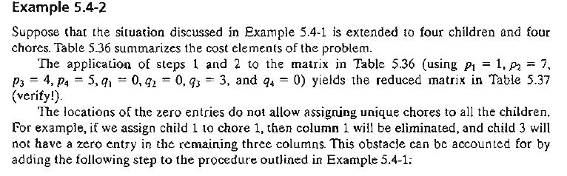
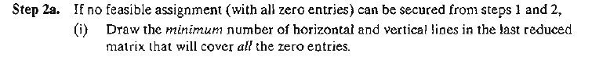

Slide 66
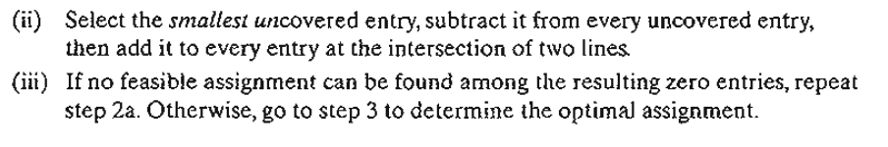

Slide 67
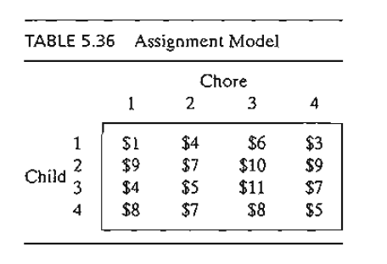

Slide 68
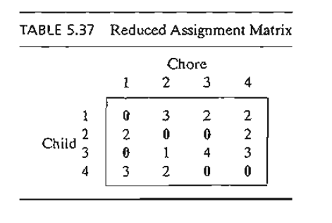

Slide 69
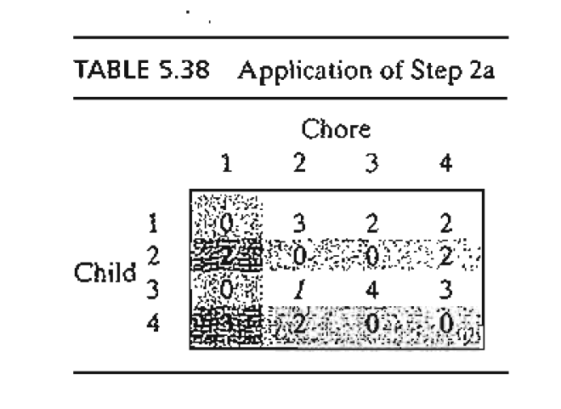

Slide 70
