Slide 1
BAB 2
Lingkungan Global dan Strategi Operasi

Slide 2
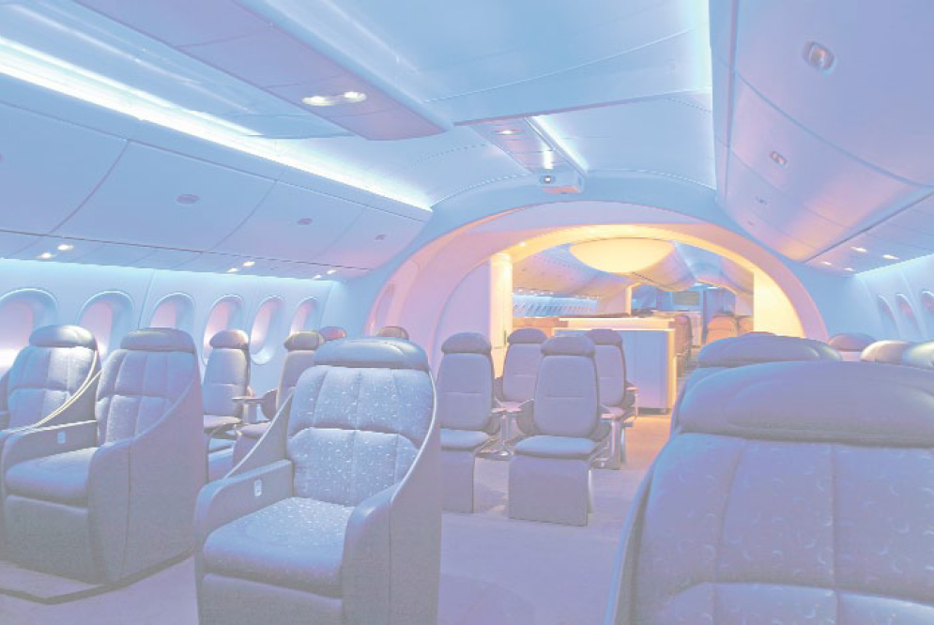
Boeing’s Global Supply-Chain Strategy
 | Beberapa Pemasok Internasional Komponen Boeing 787
PEMASOK |  | KANTOR PUSAT | KOMPONEN
Latecoere |  | France | Pintu Penumpang
Labinel |  | France | Pengkabelan
Dassault |  | France | Desain
Messier-Bugatti |  | France | Rem elektrik
Thales |  | France | Sistem konversi tenaga elektrik dan display penerbangan standby terintegrasi
Messier-Dowty |  | France | Struktur perkakas pendaratan
Diehl |  | Germany | Penerangan interior
© 2014 Pearson Education, Inc.

Slide 3
Boeing’s Global Supply-Chain Strategy
 | Beberapa Pemasok Internasional Komponen Boeing 787
PEMASOK |  | KANTOR PUSAT | KOMPONEN
Cobham |  | UK | Pompa dan Katup Bahan Bakar
Rolls-Royce |  | UK | Mesin
Smiths Aerospace |  | UK | Sistem Komputer
BAE Systems |  | UK | Elektronik
Alenia Aeronautica |  | Italy | Bagian atas badan pesawat dan stabilisator horisontal
Toray Industries |  | Japan | Serat karbon untuk unit sayap dan ekor
Fuji Heavy Industries |  | Japan | Kotak sayap sentral
© 2014 Pearson Education, Inc.

Slide 4
Boeing’s Global Supply-Chain Strategy
 | Beberapa Pemasok Internasional Komponen Boeing 787
PEMASOK |  | KANTOR PUSAT | KOMPONEN
Kawasaki Heavy Industries |  | Japan | Badan pesawat, Sayap fixed, roda pendaratan
Teijin Seiki |  | Japan | Aktuator hidraulik
Mitsubishi Heavy Industries |  | Japan | Kotak sayap
Chengdu Aircraft Group |  | China | Kemudi
Hafei Aviation |  | China | Komponen
Korean Airlines |  | South Korea | Ujung sayap
Saab |  | Sweden | Pintu akses dan kargo
© 2014 Pearson Education, Inc.

Slide 5
Strategi Global
Boeing – penjualan dan rantai pasokan adalah worldwide
Benetton – memindahkan persediaan ke toko di selurh dunia lebih cepat daripada para pesaingnya dengan membangun fleksibilitas dalam desain, produksi dan distribusi
Sony – membeli komponen dari suplier di Thailand, Malaysia, dan seluruh dunia

Slide 6
Strategi Global
Volvo – mempertimbangkan perusahaan milik orang Swedia, kini dibeli oleh perusahaan milik orang China, Geely. Saat ini, Volvo S40 dirakit di Belgia, Afrika Selatan, Malaysia, dan China dalam berbagi platform dengan Mazda 3 yang dibuat di Jepang dan Ford Focus dibangun di Eropa
Haier – Sebuah perusahaan milik orang China, memrpoduksi lemari pendingin kecil (ini menguasai 1/3 pasar Amerika) dan lemari anggur (menguasai ½ pasar Amerika) South Carolina

Slide 7
Pertumbuhan Perdagangan Dunia
Gambar 2.1
60 –
55 –
50 –
45 –
40 –
35 –
30 –
25 –
20 –
15 –
10 –
Persen
| | | | | | | | |
1970 1975 1980 1985 1990 1995 2000 2005 2010
Tahun

Slide 8
6 Alasan Globalisasi
Memperbaiki rantai pasokan
Mengurangi biaya (tenaga kerja, pajak, bea masuk, dsb.)
Memperbaiki operasi
Memahami pasar
Memperbaiki produk
Menarik dan membertahankan bakat global

Slide 9
Memperbaiki rantai pasokan
Menempatkan fasilitas produksi di dekat sumberdaya unik
  Mobil didesain di California
  Produksi sepatu olahraga di China
  Pabrikasi parfum di Perancis

Slide 10
Mengurangi Biaya
Lokasi luar negeri dengan tarip upah lebih rendah dapat menurunkan biaya langsung dan biaya tak langsung
Perjanjian perdagangan dapat menurunkan tarip
  Maquiladoras
  World Trade Organization (WTO)
  North American Free Trade Agreement (NAFTA)
  APEC, SEATO, MERCOSUR, CAFTA
  European Union (EU)
Notes:
Maquiladoras is a manufacturing operation, where factories import certain material and equipment on a duty-free and tariff-free basis for assembly, processing, or manufacturing and then export the assembled, processed and/or manufactured products, sometimes back to the raw materials' country of origin.

Slide 11
Memperbaiki Operasi
Memahami perbedaan antara bagaimana bisnis ditangani di negara lain
  Japanese – manajemen persediaan
  Scandinavians – ergonom
Operasi internasional dapat memperbaiki waktu respon dan layanan pelanggan

Slide 12
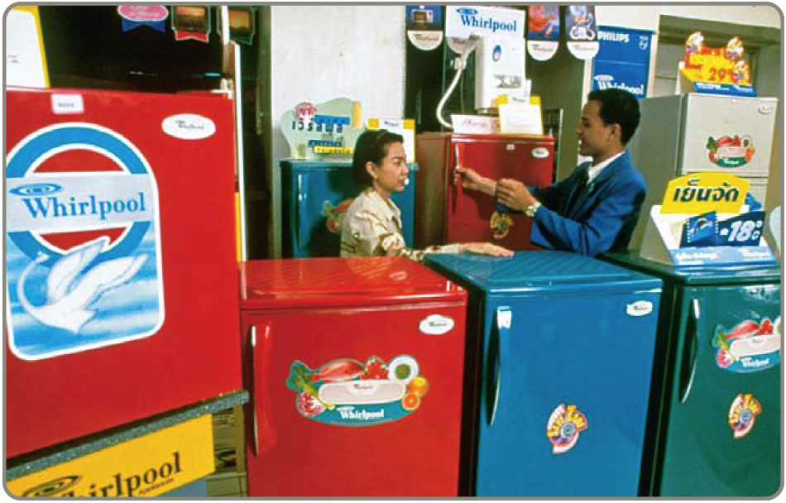
Memahami Pasar
Berinteraksi dengan pelanggan, pemasok, persaingan di luar negeri dapat memunculkan peluang baru
  Desain ponsel
    pindah dari
    Eropa ke
    Jepang
  Memperluas
    Daur hidup
    produk

Slide 13
Memperbaiki Produk
Mempertahankan keterbukaan pada aliran ide-ide dengan leluasa
Toyota dan BMW memanaje “joint research and development”
  Menurunkan risiko, desain state-of-the-art, biaya lebih rendah
Samsung dan Bosch kerjasama memproduksi batere

Slide 14
Menarik/merekrut dan mempertahankan Bakat Global
Menawarkan peluang kerja lebih baik
  Peluang pertumbuhan dan isolasi lebih baik melawan pengangguran
  Relokasi personil yang tidak dibutuhkan ke tempat yang lebih makmur

Slide 15
Isu Budaya dan Etika
Budaya bisa sangat berbeda
Sikap bisa sangat berbeda
Ketepatan waktu
Istirahat makan siang
Lingkungan Hidup
Hak kekayaan intelektual
Pencurian
Penyuapan
Pekerja anak

Slide 16
Perusahaan mempertimbangkan
Tingkat melek huruf nasional
Tingkat inovasi
Tingkat perubahan teknologi
Jumlah pekerja terampil
Stabilitas politik
Hukum pertanggungjawaban produk
Pembatasan ekspor
Variasi dalam bahasa
Etos kerja
Tarif pajak
Inflasi
Ketersediaan bahan baku
Suku bunga
Populasi
Jumlah mil dari jalan rayaPhone system

Slide 17
Menyesuaikan Produk dan Parent
Braun Household Appliances
Firestone Tires
Godiva Chocolate
Haagen-Dazs Ice Cream
Jaguar Autos
MGM Movies
Lamborghini Autos
Alpo Petfoods
Volkswagen
Bridgestone
Campbell Soup
Tata Motors Limited
Proctor and Gamble
Nestlé
Pillsbury
Sony

Slide 18
Match Product & Country
Braun Household Appliances
Firestone Tires
Godiva Chocolate
Haagen-Dazs Ice Cream
Jaguar Autos
MGM Movies
Lamborghini Autos
Alpo Petfoods
Great Britain
Germany
Japan
United States
Switzerland
India

Slide 19
Match Product & Country
Braun Household Appliances
Firestone Tires
Godiva Chocolate
Haagen-Dazs Ice Cream
Jaguar Autos
MGM Movies
Lamborghini Autos
Alpo Petfoods
Great Britain
Germany
Japan
United States
Switzerland
India

Slide 20
Mengembangkan Misi dan Strategi
Misi pernyataan sebuah organisasi kemana akan pergi
Strategi perkataan organisasi bagaimana mendapatkan

Slide 21
Misi
Misi – ke mana organisasi menuju?
  Tujuan organisasi untuk menjadi apa
  Menjawab pertanyaan ‘Apa yang kita sumbangkan kepada masyarakat?’
  Memberikan batas-batas dan fokus

Slide 22
Merck
Misi Merck adalah Untuk memberi masyarakat produk dan layanan unggulan Inovasi dan solusi yang meningkatkan kualitas hidup dan memenuhi kebutuhan pelanggan Untuk memberi kesempatan kerja dan kesempatan kerja bagi para karyawan dan peluang dengan tingkat pengembalian yang superior.
Figure 2.2

Slide 23
PespsiCo
Misi kami adalah Menjadi perusahaan produk konsumen utama di dunia yang berfokus pada makanan dan minuman yang nyaman. Kami berusaha menghasilkan penghargaan finansial bagi investor karena kami memberikan kesempatan untuk pertumbuhan dan pengayaan kepada karyawan, mitra bisnis dan komunitas tempat kami beroperasi. Dan dalam segala hal yang kita lakukan, kita berusaha untuk kejujuran, keadilan dan integritas.
Figure 2.2

Slide 24
Arnold Palmer Hospital
Rumah Sakit Arnold Palmer untuk Anak-anak memberikan perawatan kesehatan, berpusat pada keluarga dan berfokus pada pemulihan anak-anak di lingkungan kasih sayang, penyembuhan, dan harapan.
Figure 2.2

Slide 25
Faktor yang mempengaruhi misi
Filosofi dan Nilai-nilai
Profitabilitas dan Pertumbuhan
Lingkungan
Misi
Pelanggan
Citr Publik
Manfaat untuk Masyarakat

Slide 26
Proses Strategik
Misi Organisasi
Misi Area Funsional
Keuangan/
Akunting
Pemasaran
Operasi

Slide 27
Contoh Misi
Contoh Misi Perusahaan
Untuk memproduksi dan melayani bisnis komunikasi microwave inovatif, tumbuh, dan menguntungkan di seluruh dunia yang melebihi harapan pelanggan kami.
Contoh Misi Manajemen Operasi
Untuk menghasilkan produk yang konsisten dengan misi perusahaan sebagai produsen harga murah di seluruh dunia.
Figure 2.3

Slide 28
Sample Missions
Contoh Misi Departemen Manajemen Operasi
Desain Produk | Untuk mendesain dan memproduksi barang dan jasa dengan kualitas baik dan nilai pelanggan
Manajemen Kualitas | To attain the exceptional value that is consistent with our company mission and marketing objectives by close attention to design, procurement, production, and field service operations
Desain Proses | To determine, design, and produce the production process and equipment that will be compatible with low-cost product, high quality, and good quality of work life at economical cost.
Figure 2.3

Slide 29
Sample Missions
Sample OM Department Missions
Location | To locate, design, and build efficient and economical facilities that will yield high value to the company, its employees, and the community.
Layout design | To achieve, through skill, imagination, and resourcefulness in layout and work methods, production effectiveness and efficiency while supporting a high quality of work life.
Human resources | To provide a good quality of work life, with well-designed, safe, rewarding jobs, stable employment, and equitable pay, in exchange for outstanding individual contribution from employees at all levels.
Figure 2.3

Slide 30
Sample Missions
Sample OM Department Missions
Supply-chain management | To collaborate with suppliers to develop innovative products from stable, effective, and efficient sources of supply.
Inventory | To achieve low investment in inventory consistent with high customer service levels and high facility utilization.
Scheduling | To achieve high levels of throughput and timely customer delivery through effective scheduling.
Maintenance | To achieve high utilization of facilities and equipment by effective preventive maintenance and prompt repair of facilities and equipment.
Figure 2.3

Slide 31

Strategi
Rencana aksi untuk mencapai misi
Area Fungsional memiliki strategi
Strategi mengekploitasi peluang dan kekuatan, menetralkan hambatan, dan menghilangkan kelemahan

Slide 32
Strategi untuk Keunggulan Bersaing
Diferensiasi — lebih baik, atau minimial berbeda dari pesaing
Kepemimpinan harga – Lebih murah
Response – lebih responsive

Slide 33
Bersaing melalui Diferensiasi
Keunikan dapat diluar karakteristik fisik dan atribut layanan untuk menerobos setiap yang mempengaruhi persepsi nilai pelanggan
Safeskin gloves – leading edge products
Walt Disney Magic Kingdom – experience differentiation
Hard Rock Cafe – dining experience

Slide 34
Bersaing melalui harga
Menyediakan nilai maksimum yang dipersepsikan oleh konsumen. Tidak berpengaruh pada kualitas
Southwest Airlines – secondary airports, no frills service, efficient utilization of equipment
Walmart – small overhead, shrinkage, and distribution costs
Franz Colruyt – no bags, no bright lights, no music, and doors on freezers

Slide 35
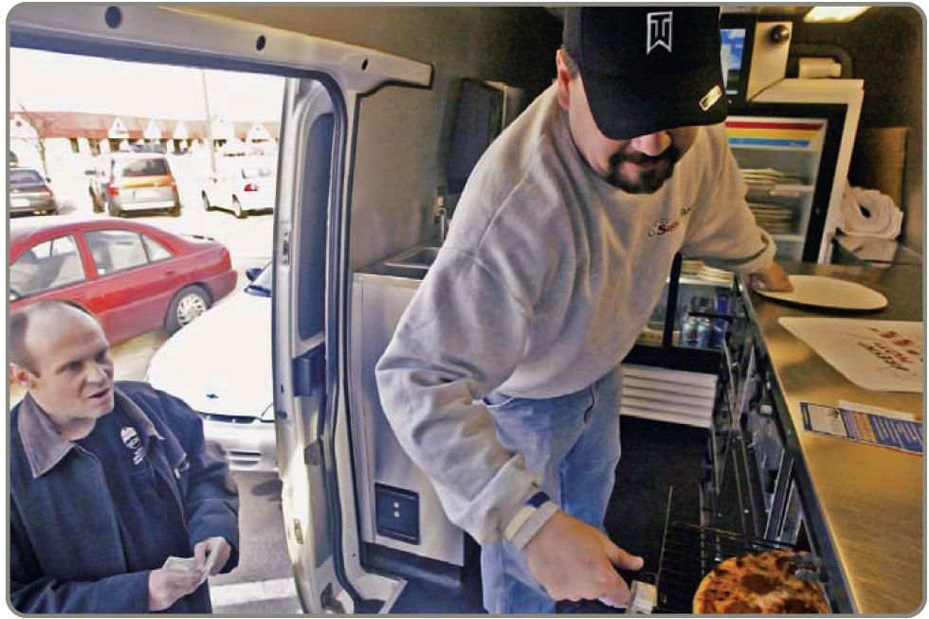
Bersaing melalui Respon
Flexibility is matching market changes in design innovation and volumes
  A way of life at Hewlett-Packard
Reliability is meeting schedules
  German machine industry
Timeliness is quickness
in design, production,
and delivery
  Johnson Electric,
  Pizza Hut, Motorola

Slide 36
OM’s Contribution to Strategy
10 Operations Competitive
Decisions Strategy Example Advantage
Product
Quality
Process
Location
Layout
Human
resource
Supply chain
Inventory
Scheduling
Maintenance
DIFFERENTIATION:
Innovative design Safeskin’s innovative gloves
Broad product line Fidelity Security’s mutual funds
After-sales service Caterpillar’s heavy equipment service
Experience Hard Rock Café’s dining experience
COST LEADERSHIP:
Low overhead Franz-Colruyt’s warehouse-type stores
Effective capacity Southwest Airline’s
use aircraft utilization
Inventory Walmart’s sophisticated
management distribution system
RESPONSE:
Flexibility Hewlett-Packard’s response to volatile world market
Reliability FedEx’s “absolutely, positively, on time”
Quickness Pizza Hut’s 5-minute guarantee
at lunchtime
Differentiation
(better)
Response
(faster)
Cost leadership
(cheaper)
Gambar 2.4

Slide 37
Isu-isu Strategi Operasi
Pandangan sumberdaya
Analisis Rantai Pasokan
Model Porter’s Five Forces
Operasi di sistem dengan banyak faktor eksternal
Perubahan konstan

Slide 38
Product Life Cycle
Introduction Growth Maturity Decline
Best period to increase market share
R&D engineering is critical
Practical to change price or quality image
Strengthen niche
Poor time to change image, price, or quality
Competitive costs become critical
Defend market position
Cost control critical
Company Strategy/Issues
Internet search engines
Drive-through restaurants
Xbox 360
DVDs
iPods
Boeing 787
Sales
3D printers
3-D game players
Electric vehicles
Analog TVs
Figure 2.5

Slide 39
Product Life Cycle
Introduction Growth Maturity Decline
Product design and development critical
Frequent product and process design changes
Short production runs
High production costs
Limited models
Attention to quality
Forecasting critical
Product and process reliability
Competitive product improvements and options
Increase capacity
Shift toward product focus
Enhance distribution
Standardization
Fewer product changes, more minor changes
Optimum capacity
Increasing stability of process
Long production runs
Product improvement and cost cutting
Little product differentiation
Cost minimization
Overcapacity in the industry
Prune line to eliminate items not returning good margin
Reduce capacity
OM Strategy/Issues
Figure 2.5

Slide 40
Analisis SWOT
Misi
Internal: Kekuatan
External: Peluang
Analysis
Interna;:
Kelemahan
External : Tantangan
STRATEGI

Slide 41
Proses Pengembangan Strategi
Analyze the Environment
Identify the strengths, weaknesses, opportunities, and threats. Understand the environment, customers, industry, and competitors.
Determine the Corporate Mission
State the reason for the firm’s existence and identify the value it wishes to create.
Form a Strategy
Build a competitive advantage, such as low price, design, or volume flexibility, quality, quick delivery, dependability, after-sale service, broad product lines.
Figure 2.6

Slide 42
Pengembangan dan Implementasi Strategi
Identifikasi Faktor Kunci Keberhasilan (KSF)
Mengintegrasikan MO denagn kegiatan lain
Membentuk dan staffing organisasi
Pekerjaan manajer operasi adalah mengimplementasi strategi MO, menghasilkan keunggulan bersaing, dan meningkatkan produktivitas

Slide 43
Faktor Kunci Keberhasilan
Mendukung Kompetensi Inti dan Mengimplementasi Strategi dengan Mengidentifikasi dan Melaksanakan Faktor Kunci Keberhasilan dalam Area Funsional
Pemasaran
Layanan Distribusi Promosi Saluran distribusi Posisioning Produk (citra, fungsi)
Keuangan/Akunting
Leverage Biaya modal Modal Kerja Piutang Utang Pengendalian keuangan Lines of credit
Produksi/Operasi
10 Keputusan MO | Sample Options | Chapter
Product Quality Process Location Layout Human resource Supply chain Inventory Schedule Maintenance | Customized, or standardized; sustainability Define customer expectations and how to achieve them Facility size, technology, capacity, automation Near supplier or near customer Work cells or assembly line Specialized or enriched jobs Single or multiple suppliers When to reorder, how much to keep on hand Stable or fluctuating production rate Repair as required or preventive maintenance | 5, S5 6, S6 7, S7 8 9 10 11, S11 12, 14, 16 13, 15 17
Figure 2.7

Slide 44
Activity Mapping at
Southwest Airlines
Courteous, but Limited Passenger Service
Lean, Productive Employees
Short Haul, Point-to-Point Routes, Often to Secondary Airports
Competitive Advantage:
Low Cost
High Aircraft Utilization
Frequent, Reliable Schedules
Standardized Fleet of Boeing 737 Aircraft
Figure 2.8

Slide 45
Activity Mapping at
Southwest Airlines
Courteous, but Limited Passenger Service
Lean, Productive Employees
Short Haul, Point-to-Point Routes, Often to Secondary Airports
Automated ticketing machines
No seat assignments
No baggage transfers
No meals (peanuts)
Competitive Advantage:
Low Cost
High Aircraft Utilization
Frequent, Reliable Schedules
Standardized Fleet of Boeing 737 Aircraft
Figure 2.8

Slide 46
Activity Mapping at
Southwest Airlines
Courteous, but Limited Passenger Service
No meals (peanuts)
Lower gate costs at secondary airports
High number of flights reduces employee idle time between flights
Lean, Productive Employees
Short Haul, Point-to-Point Routes, Often to Secondary Airports
Competitive Advantage:
Low Cost
High Aircraft Utilization
Frequent, Reliable Schedules
Standardized Fleet of Boeing 737 Aircraft
Figure 2.8

Slide 47
Activity Mapping at
Southwest Airlines
Courteous, but Limited Passenger Service
Lean, Productive Employees
Short Haul, Point-to-Point Routes, Often to Secondary Airports
High number of flights reduces employee idle time between flights
Saturate a city with flights, lowering administrative costs (advertising, HR, etc.) per passenger for that city
Pilot training required on only one type of aircraft
Reduced maintenance inventory required because of only one type of aircraft
Competitive Advantage:
Low Cost
High Aircraft Utilization
Frequent, Reliable Schedules
Standardized Fleet of Boeing 737 Aircraft
Figure 2.8

Slide 48
Activity Mapping at
Southwest Airlines
Courteous, but Limited Passenger Service
Pilot training required on only one type of aircraft
Reduced maintenance inventory required because of only one type of aircraft
Excellent supplier relations with Boeing has aided financing
Lean, Productive Employees
Short Haul, Point-to-Point Routes, Often to Secondary Airports
Competitive Advantage:
Low Cost
High Aircraft Utilization
Frequent, Reliable Schedules
Standardized Fleet of Boeing 737 Aircraft
Figure 2.8

Slide 49
Activity Mapping at
Southwest Airlines
Courteous, but Limited Passenger Service
Lean, Productive Employees
Short Haul, Point-to-Point Routes, Often to Secondary Airports
Reduced maintenance inventory required because of only one type of aircraft
Flexible employees and standard planes aid scheduling
Maintenance personnel trained only one type of aircraft
20-minute gate turnarounds
Flexible union contracts
Competitive Advantage:
Low Cost
High Aircraft Utilization
Frequent, Reliable Schedules
Standardized Fleet of Boeing 737 Aircraft
Figure 2.8

Slide 50
Activity Mapping at
Southwest Airlines
Courteous, but Limited Passenger Service
Automated ticketing machines
Empowered employees
High employee compensation
Hire for attitude, then train
High level of stock ownership
High number of flights reduces employee idle time between flights
Lean, Productive Employees
Short Haul, Point-to-Point Routes, Often to Secondary Airports
Competitive Advantage:
Low Cost
High Aircraft Utilization
Frequent, Reliable Schedules
Standardized Fleet of Boeing 737 Aircraft
Figure 2.8

Slide 51
Implementing Strategic Decisions
TABLE 2.1 | Operations Strategies of Two Drug Companies
COMPETITIVE ADVANTAGE | BRAND NAME DRUGS, INC. | GENERIC DRUGS CORP.
 | PRODUCT DIFFERENTIATION STRATEGY | LOW COST STRATEGY
Product selection and design | Heavy R&D investment; extensive labs; focus on development in a broad range of drug categories | Low R&D investment; focus on development of generic drugs
Quality | Quality is major priority, standards exceed regulatory requirements | Meets regulatory requirements on a country-by-country basis, as necessary
Process | Product and modular production process; tries to have long product runs in specialized facilities; builds capacity ahead of demand | Process focused; general production processes; “job shop” approach, short-run production; focus on high utilization
Location | Still located in city where it was founded | Recently moved to low-tax, low-labor-cost environment

Slide 52
Implementing Strategic Decisions
TABLE 2.1 | Operations Strategies of Two Drug Companies
COMPETITIVE ADVANTAGE | BRAND NAME DRUGS, INC. | GENERIC DRUGS CORP.
 | PRODUCT DIFFERENTIATION STRATEGY | LOW COST STRATEGY
Layout | Layout supports automated product-focused production | Layout supports process-focused “job shop” practices
Human resources | Hire the best; nationwide searches | Very experienced top executives provide direction; other personnel paid below industry average
Supply chain | Long-term supplier relationships | Tends to purchase competitively to find bargains
Inventory | Maintains high finished goods inventory primarily to ensure all demands are met | Process focus drives up work-in-process inventory; finished goods inventory tends to be low
Scheduling | Centralized production planning | Many short-run products complicate scheduling
Maintenance | Highly trained staff; extensive parts inventory | Highly trained staff to meet changing demands

Slide 53
Strategic Planning, Core Competencies, and Outsourcing
Outsourcing – transferring activities that traditionally been internal to external suppliers
Accelerating due to
  Increased technological expertise
  More reliable and cheaper transportation
  Rapid development and deployment of advancements in telecommunications and computers

Slide 54
Strategic Planning, Core Competencies, and Outsourcing
Subcontracting - contract manufacturing
Outsourced activities
  Legal services
  Travel services
  Payroll
  Production
  Surgery

Slide 55
Theory of Comparative Advantage
If an external provider can perform activities more productively than the purchasing firm, then the external provider should do the work
Purchasing firm focuses on core competencies
Drives outsourcing

Slide 56
Risks of Outsourcing
TABLE 2.2 | Potential Advantages and Disadvantages of Outsourcing
ADVANTAGES |  | DISADVANTAGES
Cost savings |  | Increased logistics and inventory costs
Gaining outside expertise |  | Loss of control (quality, delivery, etc.)
Improving operations and service |  | Potential creation of future competition
Maintaining a focus on core competencies |  | Negative impact on employees
Accessing outside technology |  | Risks may not manifest themselves for years

Slide 57
Rating Outsourcing Providers
Insufficient analysis most common reason for failure
Factor rating method
Points and weights assigned for each factor to each

Slide 58
Rating Provider Selection Criteria
TABLE 2.3 | Factor Ratings Applied to National Architects’s Potential IT Outsourcing Providers
 |  | IMPORTANCE WEIGHTS |  |  | OUTSOURCING PROVIDERS
FACTOR (CRITERION) |  |  |  |  | BIM (U.S.) |  |  | S.P.C. (INDIA) |  |  | TELCO (ISRAEL)
1. Can reduce operating costs |  |  | .2 |  |  | 3 |  |  | 3 |  |  | 5
2. Can reduce capital investment |  |  | .2 |  |  | 4 |  |  | 3 |  |  | 3
3. Skilled personnel |  |  | .2 |  |  | 5 |  |  | 4 |  |  | 3
4. Can improve quality |  |  | .1 |  |  | 4 |  |  | 5 |  |  | 2
5. Can gain access to technology not in company |  |  | .1 |  |  | 5 |  |  | 3 |  |  | 5
6. Can create additional capacity |  |  | .1 |  |  | 4 |  |  | 2 |  |  | 4
7. Aligns with policy/philosophy/culture |  |  | .1 |  |  | 2 |  |  | 3 |  |  | 5
Totals |  |  | 1.0 |  |  | 3.9 |  |  | 3.3 |  |  | 3.8
Score for BIM = (.2 * 3) + (.2 * 4) + (.2 * 5) + (.1 * 4) + (.1 * 5) + (.1 * 4) + (.1 * 2) = 3.9

Slide 59
Global Operations Strategy Options
High
Figure 2.9
International strategy
(eg, Harley-Davidson
U.S. Steel)
Cost Reduction
Import/export or license existing product
Low
Low
High
Local Responsiveness
(Quick Response and/or Differentiation)

Slide 60
Global Operations Strategy Options
High
Figure 2.9
Cost Reduction
International
strategy
(eg, Harley-Davidson
U.S. Steel)
Import/export or license existing product
Low
Low
High
Local Responsiveness
(Quick Response and/or Differentiation)

Slide 61
Global Operations Strategy Options
High
Figure 2.9
Global strategy
(eg, Caterpillar
Texas Instruments
Otis Elevator)
Cost Reduction
International
strategy
(eg, Harley-Davidson
U.S. Steel)
Standardize product
Economies of scale
Cross-cultural learning
Import/export or license existing product
Low
Low
High
Local Responsiveness
(Quick Response and/or Differentiation)

Slide 62
Global Operations Strategy Options
High
Global strategy
(eg, Caterpillar
Texas Instruments
Otis Elevator)
Figure 2.9
Standardize product
Economies of scale
Cross-cultural learning
Cost Reduction
International
strategy
(eg, Harley-Davidson
U.S. Steel)
Import/export or license existing product
Low
Low
High
Local Responsiveness
(Quick Response and/or Differentiation)

Slide 63
Global Operations Strategy Options
High
Global strategy
(eg, Caterpillar
Texas Instruments
Otis Elevator)
Figure 2.9
Multidomestic
strategy
(eg, Heinz, McDonald’s
The Body Shop
Hard Rock Cafe)
Standardize product
Economies of scale
Cross-cultural learning
Cost Reduction
Use existing domestic model globally
Franchise, joint ventures, subsidiaries
International
strategy
(eg, Harley-Davidson
U.S. Steel)
Import/export or license existing product
Low
Low
High
Local Responsiveness
(Quick Response and/or Differentiation)

Slide 64
Global Operations Strategy Options
High
Global strategy
(eg, Caterpillar
Texas Instruments
Otis Elevator)
Figure 2.9
Standardize product
Economies of scale
Cross-cultural learning
Cost Reduction
International
strategy
(eg, Harley-Davidson
U.S. Steel)
Multidomestic
strategy
(eg, Heinz, McDonald’s
The Body Shop
Hard Rock Cafe)
Import/export or license existing product
Use existing domestic model globally
Franchise, joint ventures,
subsidiaries
Low
Low
High
Local Responsiveness
(Quick Response and/or Differentiation)

Slide 65
Global Operations Strategy Options
High
Global strategy
(eg, Caterpillar
Texas Instruments
Otis Elevator)
Transnational
strategy
(eg, Coca-Cola, Nestlé)
Figure 2.9
Standardize product
Economies of scale
Cross-cultural learning
Move material, people, ideas across national boundaries
Economies of scale
Cross-cultural learning
Cost Reduction
International
strategy
(eg, Harley-Davidson
U.S. Steel)
Multidomestic
strategy
(eg, Heinz, McDonald’s
The Body Shop
Hard Rock Cafe)
Import/export or license existing product
Use existing domestic model globally
Franchise, joint ventures,
subsidiaries
Low
Low
High
Local Responsiveness
(Quick Response and/or Differentiation)

Slide 66
Global Operations Strategy Options
High
Global strategy
(eg, Caterpillar
Texas Instruments
Otis Elevator)
Transnational
strategy
(eg, Coca-Cola, Nestlé)
Figure 2.9
Move material, people, ideas across national boundaries
Economies of scale
Cross-cultural learning
Standardize product
Economies of scale
Cross-cultural learning
Cost Reduction
International
strategy
(eg, Harley-Davidson
U.S. Steel)
Multidomestic
strategy
(eg, Heinz, McDonald’s
The Body Shop
Hard Rock Cafe)
Import/export or license existing product
Use existing domestic model globally
Franchise, joint ventures,
subsidiaries
Low
Low
High
Local Responsiveness
(Quick Response and/or Differentiation)

Slide 67
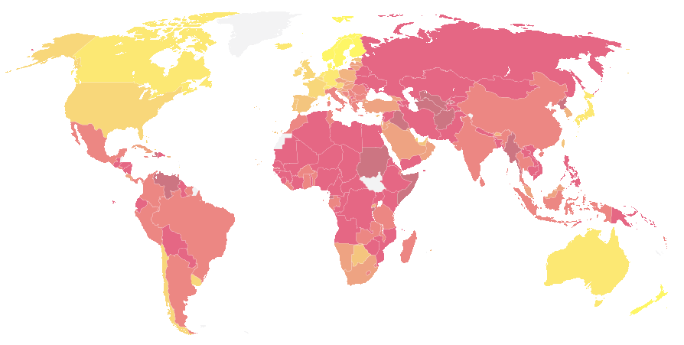

Ranking Corruption
Rank Country 2012 CPI Score (out of 100)
1 Demark, Finland, New Zealand 90
4 Sweden 88
5 Singapore 87
6 Switzerland 86
7 Australia, Norway 85
9 Canada, Netherlands 84
13 Germany 79
14 Hong Kong 77
17 Japan, UK 74
19 USA 73
37 Taiwan 61
39 Israel 60
45 South Korea 56
80 China 39
123 Vietnam 31
133 Russia 28
Least Corrupt
Most Corrupt
Notes:
67
CPI is the Corrupt Perceptions Index calculated by Transparency International, an organization dedicated to fighting business corruption. The Index is calculated from up to 13 different individual scores. For details and the methodology, see www.transparency.org.
In 2012 they changed their scoring system from “out of 10” to “out of 100”.
In case students are interested, three countries tied for the lowest score in the 2012 survey with a score of 8 out of 100 – Afghanistan, North Korea, and Somalia.

Slide 68
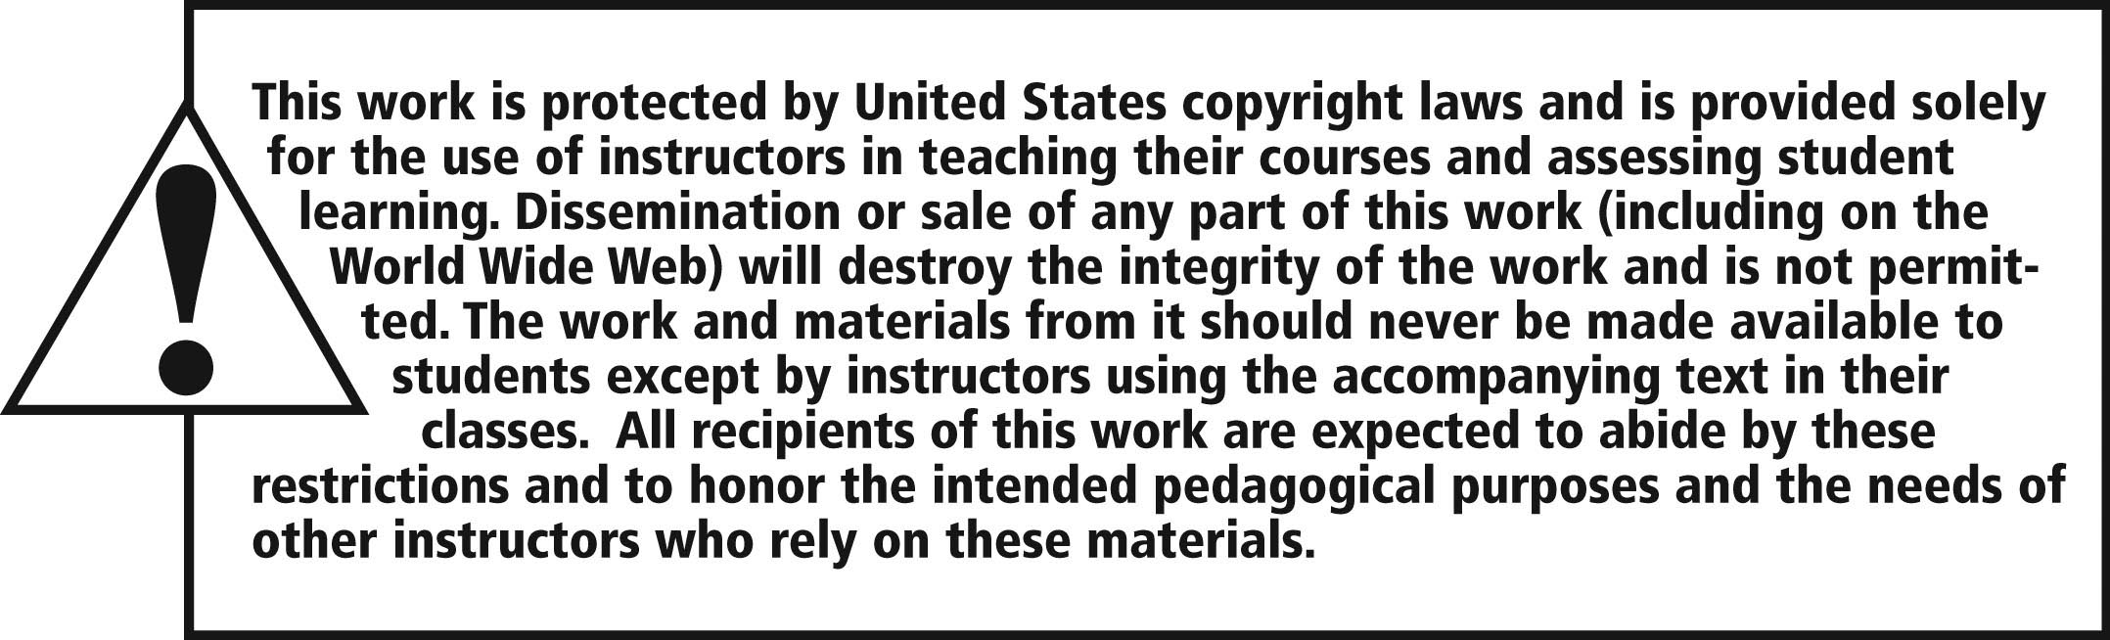
All rights reserved. No part of this publication may be reproduced, stored in a retrieval system, or transmitted, in any form or by any means, electronic, mechanical, photocopying, recording, or otherwise, without the prior written permission of the publisher.
Printed in the United States of America.

