Slide 1
Manajemen
Proyek
Bab 03

Slide 2
Outline
Global Company Profile:
Bechtel Group
Visit: http://www.bechtel.com

Slide 3
Outline
The Importance of Project Management
Project Planning
Project Scheduling
Project Controlling
Project Management Techniques: PERT and CPM
Determining the Project Schedule
Variability in Activity Times
Cost-Time Trade-offs and Project Crashing
A Critique of PERT and CPM
Using Microsoft Project to Manage Projects

Slide 4
Learning Objectives
When you complete this chapter you should be able to:
Use a Gantt Chart for scheduling
Draw AOA and AON networks
Complete forward and backward passes for a project
Determine a critical path

Slide 5
Learning Objectives
When you complete this chapter you should be able to:
Calculate the variance of activity times
Crash a project

Slide 6
Bechtel Projects
Constructing 30 high-security data centers worldwide for Equinix, Inc. ($1.2 billion)
Building and running a rail line between London and the Channel Tunnel ($4.6 billion)
Developing an OIL PIPELINE from the Caspian Sea region to Russia ($850 million)
Expanding the Dubai Airport in the UAE ($600 million), and the Miami Airport in Florida ($2 billion)

Slide 7
Bechtel Projects
Building liquid natural gas plants in Yemen ($2 billion) and in Trinidad, West Indies ($1 billion)
Building a new subway for Athens, Greece ($2.6 billion)
Constructing a natural gas pipeline in Thailand ($700 million)
Building 30 plants for iMotors.com, a company that sells refurbished autos online ($300 million)
Building a highway to link the north and south of Croatia ($303 million)

Slide 8
Importance of
Project Management
Bechtel Project Management
  International workforce, construction professionals, cooks, medical personnel, security
  Strategic value of time-based competition
  Quality mandate for continual improvement

Slide 9
Importance of
Project Management
Organizing Chaos
Managing Risk
Managing Quality
Managing Integration
Managing Change
Clearing Issues
Retaining and Using Knowledge
Learning From Failure

Slide 10
Karakteristik Proyek
Unit tunggal
Terdiri dari banyak kegiatan yang saling berhubungan
Sulit utk direncanakan dan mengendalikan persediaan
Perlatannya bisa dipakai untuk berbagai tujuan
Memerlukan tenaga berketrampilan tinggi

Slide 11
Project Characteristics
Waktu mulainya jelas
Waktu berkhirnya jelas
Memerlukan waktu panjang (dlm bulan atau tahun)
Kualitas produk sangat rendah
Variasi tugas sangat tinggi
Berbagai tugas sering saling terkait kinerjanya

Slide 12
Project Characteristics
Organisasinya bersifat sementara
Sering merupakan bagian dari proyek besar
Tujuan dan karakteristik produk bisa jadi didefinisikan dan dicapai secara progresif
Hasilnya bisa jadi merupakan hasil dari beberapa unit proyek
Saling keterkaitan antara kegiatan yang satu dan lainnya mungkin rumit

Slide 13
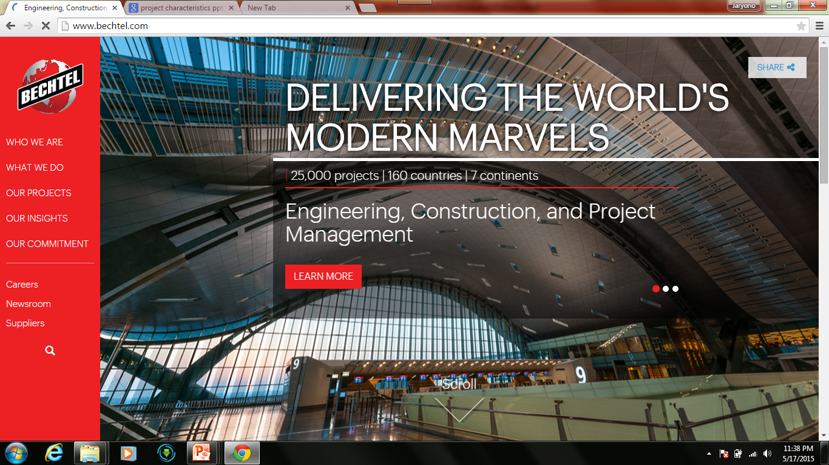

Slide 14


Slide 15


Slide 16
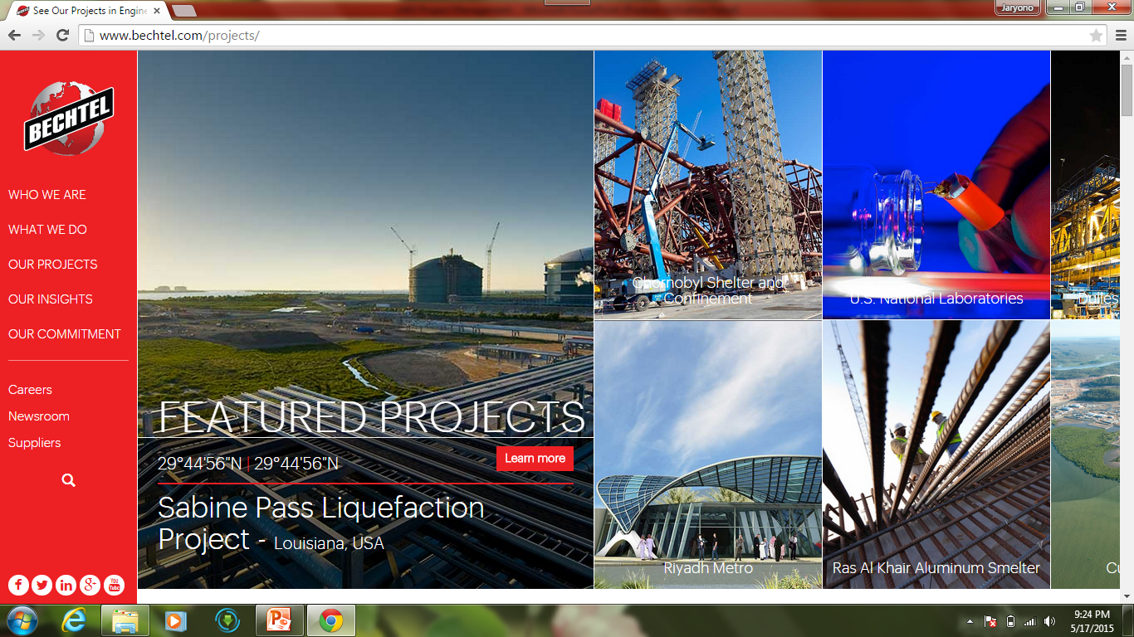
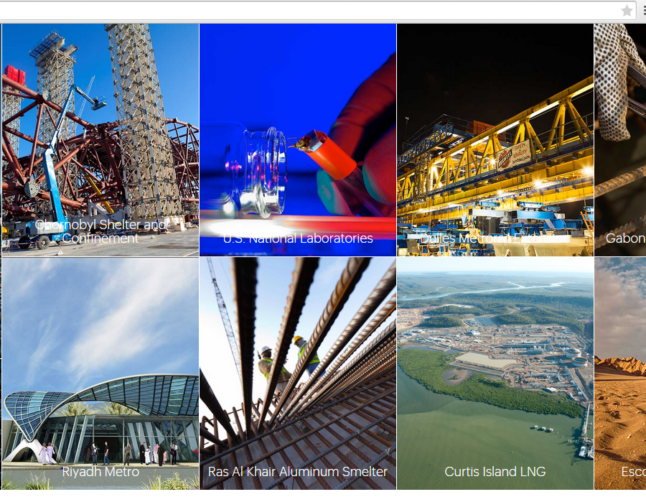

Slide 18
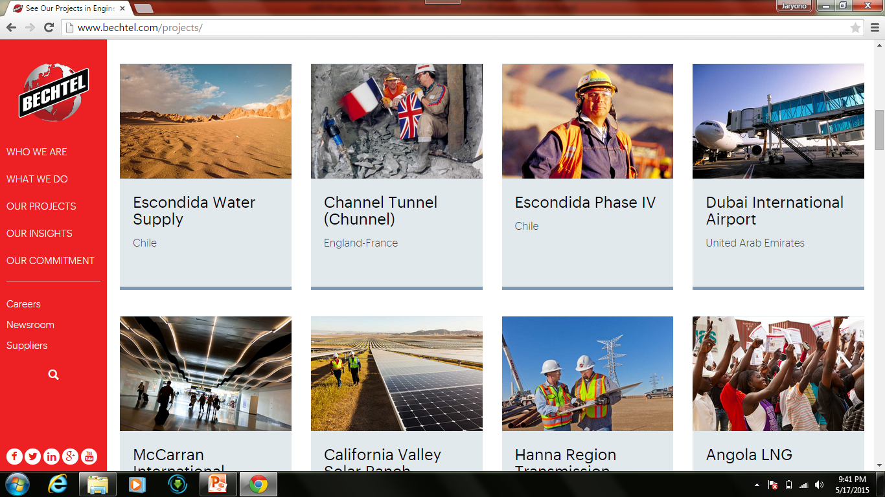

Slide 19
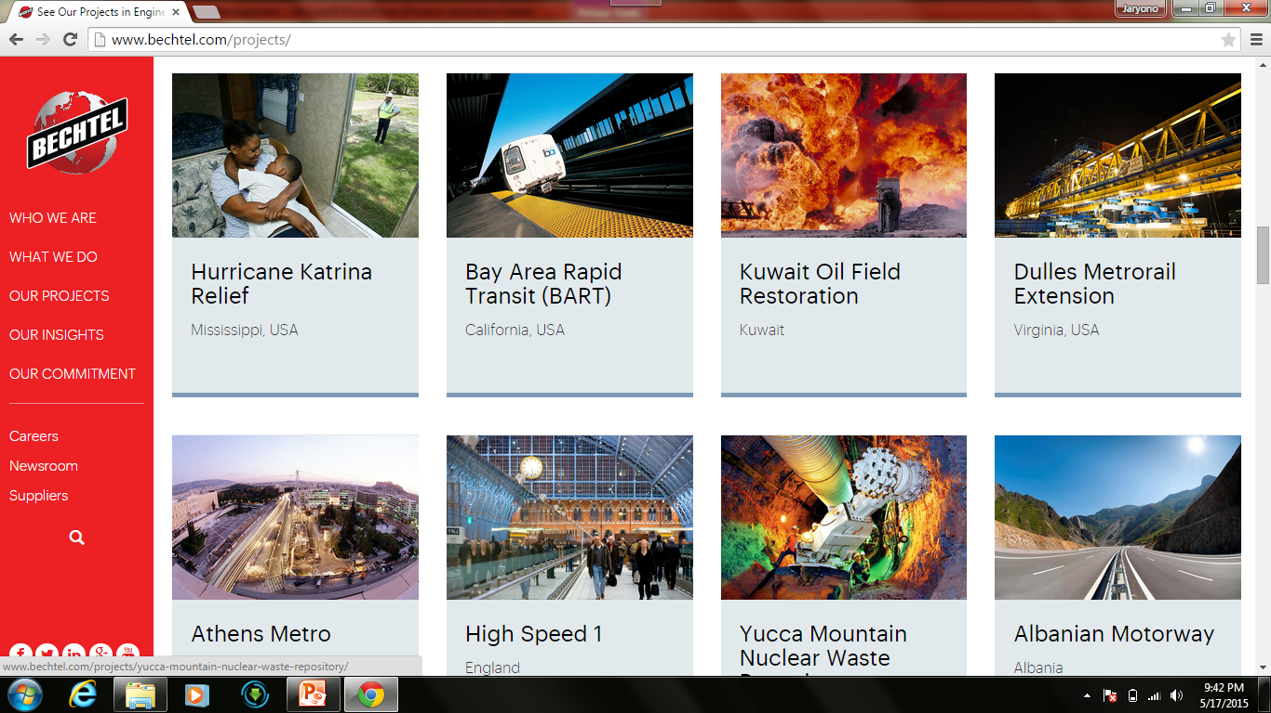

Slide 20


Slide 21
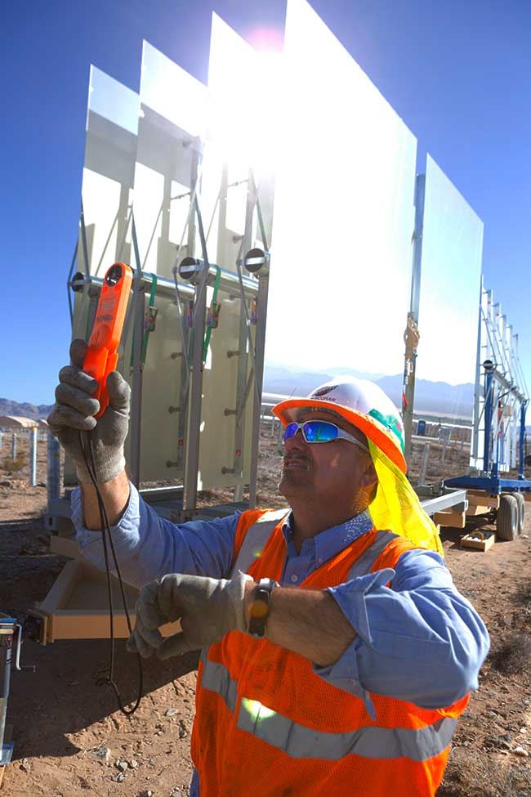

Slide 22


Slide 23
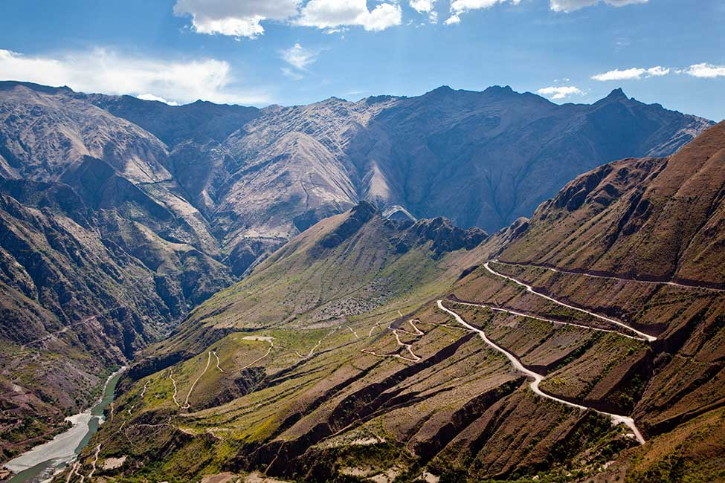

Slide 24
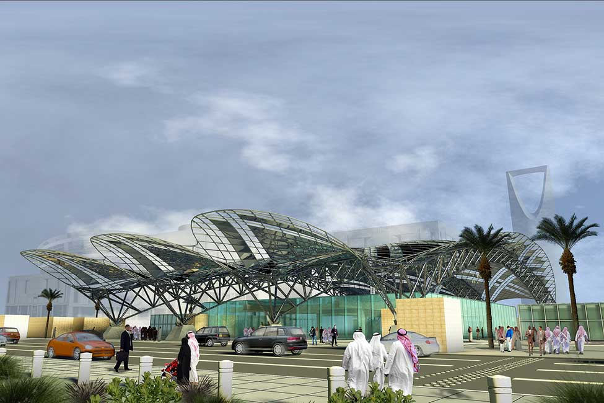

Slide 25
Project Definition
Proyek dapat didefinisikan sebagai serangkain kegiatan yang saling terkait yang diatur untuk mencapai hasil utama tertentu.
Proyek adalah kegiatan atau upaya yang unik dan dioperasikan sekali saja
Project adalah entitas sementara yang dibuat untuk mencapai output tertentu (biasanya berujud) sesuai dengan batasan-batasan waktu, biaya dan kualitas yang ditentukan terlebih dahulu.

Slide 26
Activity Definition
Activity is an individual job or work effort requiring labor, resources and time, and is subject to management control.

Slide 27
Program Definition
A program is a portfolio comprised of multiple projects that are managed and coordinated as one unit with the objective of achieving (often intangible) outcomes and benefits for the organization.

Slide 28
Different between Project and Program
 | Project | Program
Objectives | Outputs – tangible; relatively easy to describe, define and measure; tending towards objective. | Outcomes – often intangible; difficult to quantify; benefits often based on changes to organizational culture and behaviors; introducing new capabilities into the organization; tending towards subjective.
Scope | Strictly limited; tightly defined; not likely to be subject to material change during the life of the project. | Not tightly defined or bounded; likely to change during the life cycle of the program.
Duration | Relatively short term; typically three to six months. | Relatively long term typically eighteen months to three years.
Risk profile | Project risk is relatively easy to identify and manage. The project failure would result in relatively limited impact on the organization relative to program risk. | Program risk is more complex and potentially the impact on the organization if a risk materializes will be greater relative to project risk. Programme failure could result in material financial, reputational or operational loss.
Nature of the problem | Clearly defined. | Ill-defined; often disagreement between key stakeholders on the nature and definition of the problem.
Nature of the solution | A relatively limited number of potential solutions. | A significant number of potential solutions with often with disagreement between stakeholders as to the preferred solution.
Stakeholders | A relatively limited number of stakeholders. | A significant number of diverse stakeholders; probable disagreement between them as to the definition of the problem & the preferred solution.
Relationship to environment | Environment within which the project takes place is understood and relatively stable. | Environment is dynamic; and programme objectives need to be managed in the context of the changing environment within which the organization operates.
Resources | Resources to deliver the project can be reasonably estimated in advance. | Resources are constrained and limited; there is competition for resources between projects.

Slide 29
Different between Project and Program
 | Project | Program
Objectives | Outputs – tangible; relatively easy to describe, define and measure; tending towards objective. | Outcomes – often intangible; difficult to quantify; benefits often based on changes to organizational culture and behaviors; introducing new capabilities into the organization; tending towards subjective.
Scope | Strictly limited; tightly defined; not likely to be subject to material change during the life of the project. | Not tightly defined or bounded; likely to change during the life cycle of the program.
Duration | Relatively short term; typically three to six months. | Relatively long term typically eighteen months to three years.
Risk profile | Project risk is relatively easy to identify and manage. The project failure would result in relatively limited impact on the organization relative to program risk. | Program risk is more complex and potentially the impact on the organization if a risk materializes will be greater relative to project risk. Programme failure could result in material financial, reputational or operational loss.
Nature of the problem | Clearly defined. | Ill-defined; often disagreement between key stakeholders on the nature and definition of the problem.
Nature of the solution | A relatively limited number of potential solutions. | A significant number of potential solutions with often with disagreement between stakeholders as to the preferred solution.
Stakeholders | A relatively limited number of stakeholders. | A significant number of diverse stakeholders; probable disagreement between them as to the definition of the problem & the preferred solution.
Relationship to environment | Environment within which the project takes place is understood and relatively stable. | Environment is dynamic; and programme objectives need to be managed in the context of the changing environment within which the organization operates.
Resources | Resources to deliver the project can be reasonably estimated in advance. | Resources are constrained and limited; there is competition for resources between projects.

Slide 30
Different between Project and Program
 | Project | Program
Objectives | Outputs – tangible; relatively easy to describe, define and measure; tending towards objective. | Outcomes – often intangible; difficult to quantify; benefits often based on changes to organizational culture and behaviors; introducing new capabilities into the organization; tending towards subjective.
Scope | Strictly limited; tightly defined; not likely to be subject to material change during the life of the project. | Not tightly defined or bounded; likely to change during the life cycle of the program.
Duration | Relatively short term; typically three to six months. | Relatively long term typically eighteen months to three years.
Risk profile | Project risk is relatively easy to identify and manage. The project failure would result in relatively limited impact on the organization relative to program risk. | Program risk is more complex and potentially the impact on the organization if a risk materializes will be greater relative to project risk. Programme failure could result in material financial, reputational or operational loss.
Nature of the problem | Clearly defined. | Ill-defined; often disagreement between key stakeholders on the nature and definition of the problem.
Nature of the solution | A relatively limited number of potential solutions. | A significant number of potential solutions with often with disagreement between stakeholders as to the preferred solution.
Stakeholders | A relatively limited number of stakeholders. | A significant number of diverse stakeholders; probable disagreement between them as to the definition of the problem & the preferred solution.
Relationship to environment | Environment within which the project takes place is understood and relatively stable. | Environment is dynamic; and programme objectives need to be managed in the context of the changing environment within which the organization operates.
Resources | Resources to deliver the project can be reasonably estimated in advance. | Resources are constrained and limited; there is competition for resources between projects.

Slide 31


Examples of Projects
Building Construction
Research Project

Slide 32
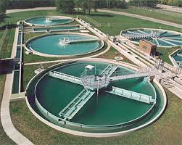

Examples of Projects
IT Dev Project
Water Treatment Project

Slide 33
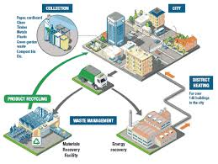
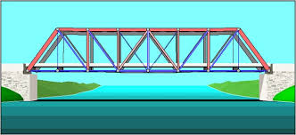
Examples of Projects
Waste Mgt Project
Bridge Construction Project

Slide 34
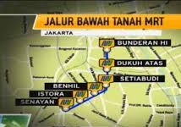
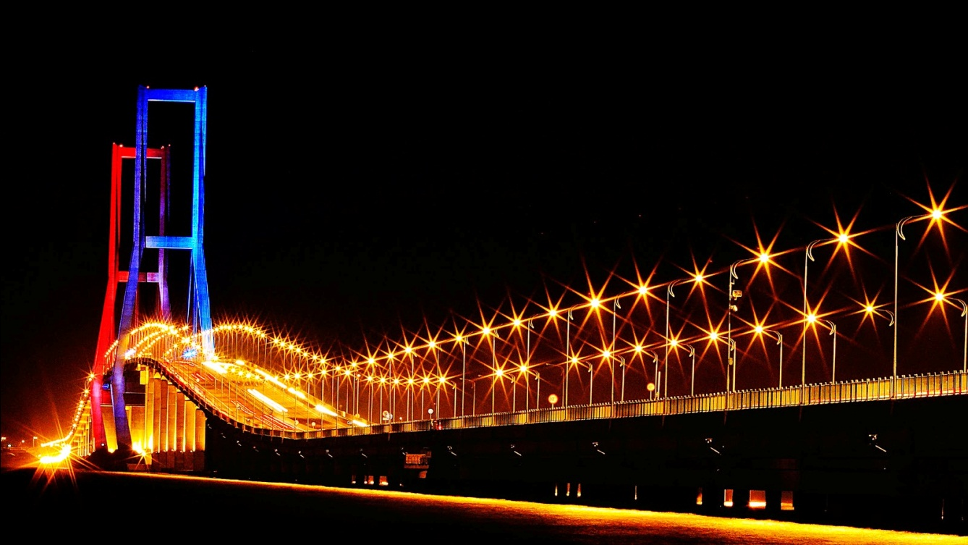
Examples of Projects
Jakarta MRT Tunnel Project
Suramadu Bridge Construction Project

Slide 35
Management of Projects
Planning - goal setting, defining the project, team organization
Scheduling - relate people, money, and supplies to specific activities and activities to each other
Controlling - monitor resources, costs, quality, and budgets; revise plans and shift resources to meet time and cost demands

Slide 36
Project Management Activities
Planning
  Objectives
  Resources
  Work break-down structure
  Organization
Scheduling
  Project activities
  Start & end times
  Network
Controlling
  Monitor, compare, revise, action

Slide 37
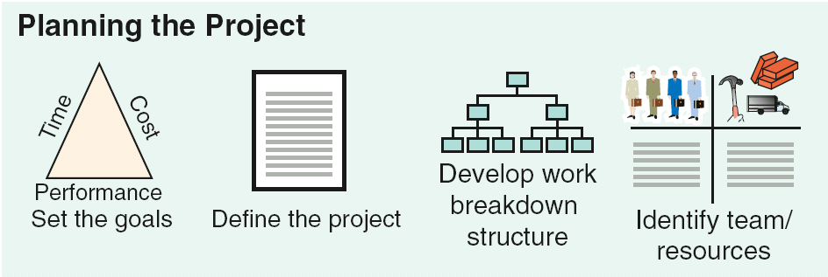
Project Planning, Scheduling, and Controlling
Figure 3.1

Slide 38
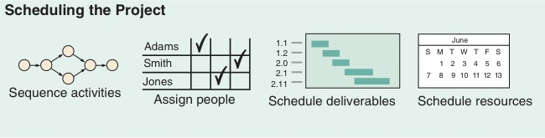
Project Planning, Scheduling, and Controlling
Figure 3.1

Slide 39
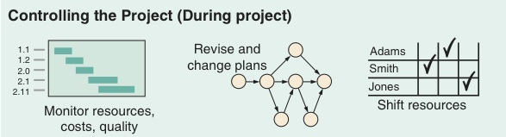
Project Planning, Scheduling, and Controlling
Figure 3.1

Slide 40
Project Planning, Scheduling, and Controlling
Figure 3.1

Slide 41
Project Planning, Scheduling, and Controlling
Time/cost estimates
Budgets
Engineering diagrams
Cash flow charts
Material availability details
Budgets
Delayed activities report
Slack activities report
CPM/PERT
Gantt charts
Milestone charts
Cash flow schedules
Figure 3.1

Slide 42

Project Planning
Establishing objectives
Defining project
Creating work breakdown structure
Determining
resources
Forming organization

Slide 43
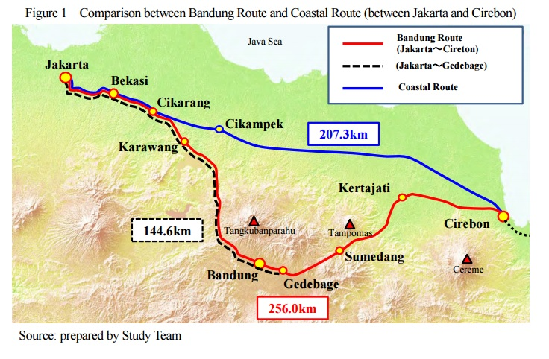
JAKARTA – BANDUNG FAST TRAIN

Slide 44
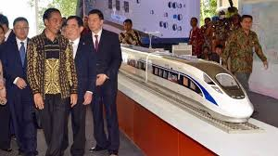
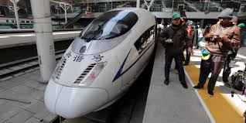
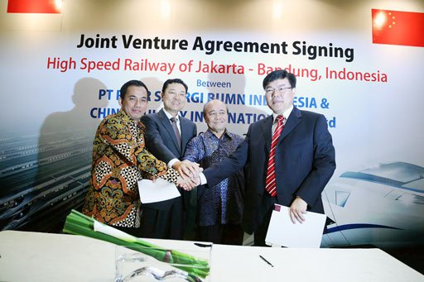

Slide 45
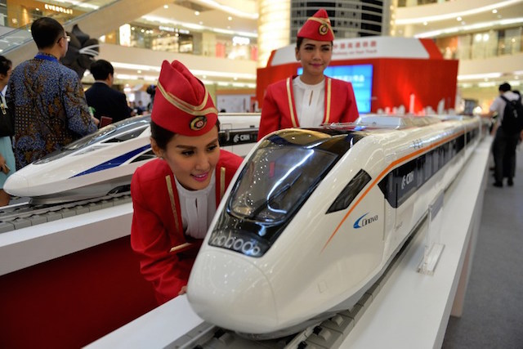

Slide 46

Project Organization
Often temporary structure
Uses specialists from entire company
Headed by project manager
  Coordinates activities
  Monitors schedule
  and costs
Permanent
structure called
‘matrix organization’

Slide 47
Project Organization
Works Best When
Work can be defined with a specific goal and deadline
The job is unique or somewhat unfamiliar to the existing organization
The work contains complex interrelated tasks requiring specialized skills
The project is temporary but critical to the organization
The project cuts across organizational lines

Slide 48
A Sample Project Organization
President
Human
Resources
Marketing
Finance
Design
Quality
Mgt
Production
Project No. 1
Project
Manager
Mechanical
Engineer
Test
Engineer
Technician
Project No. 2
Project
Manager
Electrical
Engineer
Computer
Engineer
Technician
Figure 3.2

Slide 49




Matrix Organization
Marketing Operations Engineering Finance
Project 1
Project 2
Project 3
Project 4

Slide 50
The Role of the Project Manager
Highly visible
Responsible for making sure that:
All necessary activities are finished in order and on time
The project comes in within budget
The project meets quality goals
The people assigned to the project receive motivation, direction, and information

Slide 51
The Role of the Project Manager
Highly visible
Responsible for making sure that:
Project managers should be:
All necessary activities are finished in order and on time
The project comes in within budget
The project meets quality goals
The people assigned to the project receive motivation, direction, and information
Good coaches
Good communicators
Able to organize activities from a variety of disciplines

Slide 52
Ethical Issues
Project managers face many ethical decisions on a daily basis
The Project Management Institute has established an ethical code to deal with problems such as:
Offers of gifts from contractors
Pressure to alter status reports to mask delays
False reports for charges of time and expenses
Pressure to compromise quality to meet schedules

Slide 53
Work Breakdown Structure
Level
1. Project
2. Major tasks in the project
3. Subtasks in the major tasks
4. Activities (or “work packages”)
to be completed

Slide 54
Work Breakdown Structure
Level 1
Develop Windows 8 Operating System
1.0
Level 2
Software Design
1.1
Cost Management Plan
1.2
System Testing
1.3
Level 3
Develop GUIs
1.1.1
Design Cost Tracking Reports
1.2.1
Module
Testing
1.3.1
Ensure Compatibility with Earlier Versions
1.1.2
Develop Cost/Schedule Interface
1.2.2
Defect
Testing
1.3.2
Level 4
Compatible with Windows 7
1.1.2.1
(Work packages)
Compatible with Windows Vista
1.1.2.2
Compatible with Windows XP
1.1.2.3
Figure 3.3
Notes:
GUIs = Graphical User Interfaces

Slide 55

Project Scheduling Techniques
Ensure that all activities
are planned for.
Their order of
performance is
accounted for.
The activity time
estimates are recorded.
The overall project time is developed.

Slide 56
Purposes of Project Scheduling
Shows the relationship of each activity to others and to the whole project
Identifies the precedence relationships among activities
Encourages the setting of realistic time and cost estimates for each activity
Helps make better use of people, money, and material resources by identifying critical bottlenecks in the project

Slide 57

Project Management Techniques
Gantt chart
Critical Path Method (CPM)
Program Evaluation and Review Technique (PERT)

Slide 58
A Simple Gantt Chart
Time
J F M A M J J A S
Design
Prototype
Test
Revise
Production

Slide 59
Service For a Delta Jet
Passengers
Baggage
Fueling
Cargo and mail
Galley servicing
Lavatory servicing
Drinking water
Cabin cleaning
Cargo and mail
Flight services
Operating crew
Baggage
Passengers
Deplaning
Baggage claim
Container offload
Pumping
Engine injection water
Container offload
Main cabin door
Aft cabin door
Aft, center, forward
Loading
First-class section
Economy section
Container/bulk loading
Galley/cabin check
Receive passengers
Aircraft check
Loading
Boarding
0 10 20 30 40
Time, Minutes
Figure 3.4

Slide 60
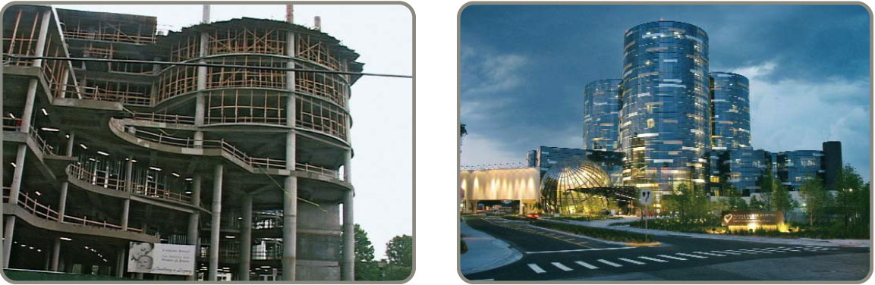
Project Controlling
Close monitoring of resources, costs, quality, budgets
Feedback enables revising the project plan and shift resources
Computerized tools produce extensive reports

Slide 61
Project Management Software
There are several popular packages for managing projects
  Primavera https://www.oracle.com/applications/primavera/
  MacProject http://www.mac512.com
  MindView http://www.matchware.com
  HP Project http://www8.hp.com
  Fast Track http://www.aecsoftware.com
  Microsoft Project http://www.microsoft.com

Slide 62
Project Control Reports
Detailed cost breakdowns for each task
Total program labor curves
Cost distribution tables
Functional cost and hour summaries
Raw materials and expenditure forecasts
Variance reports
Time analysis reports
Work status reports

Slide 63
PERT and CPM
Network techniques
Developed in 1950s
  CPM by DuPont for chemical plants (1957)
  PERT by Booz, Allen & Hamilton with the U.S. Navy, for Polaris missile (1958)
Consider precedence relationships and interdependencies
Each uses a different estimate of activity times

Slide 64
Six Steps PERT & CPM
Define the project and prepare the work breakdown structure
Develop relationships among the activities - decide which activities must precede and which must follow others
Draw the network connecting all of the activities

Slide 65
Six Steps PERT & CPM
Assign time and/or cost estimates to each activity
Compute the longest time path through the network – this is called the critical path
Use the network to help plan, schedule, monitor, and control the project

Slide 66
Questions PERT & CPM
Can Answer
When will the entire project be completed?
What are the critical activities or tasks in the project?
Which are the noncritical activities?
What is the probability the project will be completed by a specific date?

Slide 67
Questions PERT & CPM
Can Answer
Is the project on schedule, behind schedule, or ahead of schedule?
Is the money spent equal to, less than, or greater than the budget?
Are there enough resources available to finish the project on time?
If the project must be finished in a shorter time, what is the way to accomplish this at least cost?

Slide 68
A Comparison of AON and AOA Network Conventions
Activity on Activity Activity on
Node (AON) Meaning Arrow (AOA)
(a)
A
B
C
A comes before B, which comes before C
A
B
C
A
A
C
A and B must both be completed before C can start
(b)
B
C
B
B
A
B and C cannot begin until A is completed
B
(c)
A
C
C

Slide 69
A Comparison of AON and AOA Network Conventions
Activity on Activity Activity on
Node (AON) Meaning Arrow (AOA)
A
C
C and D cannot begin until both A and B are completed
A
C
(d)
B
D
B
D
C cannot begin until both A and B are completed
D cannot begin until B is completed
A dummy activity is introduced in AOA
A
C
A
C
(e)
Dummy activity
B
D
B
D

Slide 70
A Comparison of AON and AOA Network Conventions
Activity on Activity Activity on
Node (AON) Meaning Arrow (AOA)
B and C cannot begin until A is completed
D cannot begin until both B and C are completed
A dummy activity is again introduced in AOA
A
B
D
A
B
D
(f)
Dummy activity
C
C

Slide 71
AON Example
Table 3.1 | Milwaukee Paper Manufacturing’s Activities and Predecessors
ACTIVITY |  | DESCRIPTION | IMMEDIATE PREDECESSORS
A |  | Build internal components | —
B |  | Modify roof and floor | —
C |  | Construct collection stack | A
D |  | Pour concrete and install frame | A, B
E |  | Build high-temperature burner | C
F |  | Install pollution control system | C
G |  | Install air pollution device | D, E
H |  | Inspect and test | F, G

Slide 72
AON Network for Milwaukee Paper
Activity A
(Build Internal Components)
A
C
Start
B
Activity B
(Modify Roof and Floor)
Start Activity
D
Figure 3.5

Slide 73
AON Network for Milwaukee Paper
Activity A Precedes Activity C
A
C
Start
B
D
Activities A and B Precede Activity D
Figure 3.6

Slide 74
AON Network for Milwaukee Paper
F
A
C
E
Start
H
B
D
G
Arrows Show Precedence Relationships
Figure 3.7

Slide 75
AOA Network for Milwaukee Paper
C
(Construct Stack)
2
4
F
(Install Controls)
A
(Build Internal Components)
E
(Build Burner)
H
(Inspect/ Test)
1
Dummy Activity
6
7
B
(Modify Roof/Floor)
G
(Install Pollution Device)
D
(Pour Concrete/ Install Frame)
3
5
Figure 3.8

Slide 76
Determining the Project Schedule
Perform a Critical Path Analysis
The critical path is the longest path through the network
The critical path is the shortest time in which the project can be completed
Any delay in critical path activities delays the project
Critical path activities have no slack time

Slide 77
Determining the Project Schedule
KEGIATAN | PENJELASAN | WAKTU (MINGGU) | KEG YG MENDAHULUI
A | Membantun komponen internal | 2 | —
B | Modifikasi atap dan lantai | 3 | —
C | Membangun stak pengumpul | 2 | A
D | Cor beton | 4 | A, B
E | Membangun tungku pembakaran temmperatur tinggi | 4 | C
F | Memasang sistem pengendalian polusi | 3 | C
G | Memasang alat polusi udara | 5 | D, E
H | Pengawasan dan pengujian | 2 | F, G
 | Total waktu (minggu) | 25

Slide 78
Determining the Project Schedule
Perform a Critical Path Analysis
Earliest start (ES) = earliest time at which an activity can start, assuming all predecessors have been completed
Earliest finish (EF) = earliest time at which an activity can be finished
Latest start (LS) = latest time at which an activity can start so as to not delay the completion time of the entire project
Latest finish (LF) = latest time by which an activity has to be finished so as to not delay the completion time of the entire project

Slide 79
Determining the Project Schedule
Activity Format
Figure 3.9
Activity Name or Symbol
A
Earliest Finish
Earliest Start
ES
EF
Latest Start
LS
LF
Latest Finish
2
Activity Duration

Slide 80
Forward Pass
Begin at starting event and work forward
Earliest Start Time Rule:
If an activity has only a single immediate predecessor, its ES equals the EF of the predecessor
If an activity has multiple immediate predecessors, its ES is the maximum of all the EF values of its predecessors
ES = Max {EF of all immediate predecessors}

Slide 81
Forward Pass
Begin at starting event and work forward
Earliest Finish Time Rule:
The earliest finish time (EF) of an activity is the sum of its earliest start time (ES) and its activity time
EF = ES + Activity time

Slide 82
ES/EF Network for Milwaukee Paper
ES
EF = ES + Activity time
Start
0
0
0

Slide 83
ES/EF Network for Milwaukee Paper
EF of A =
ES of A + 2
ES
of A
A
2
0
2
0
Start
0
0

Slide 84
ES/EF Network for Milwaukee Paper
A
2
0
2
EF of B =
ES of B + 3
ES
of B
0
Start
0
B
3
0
3
0

Slide 85
ES/EF Network for Milwaukee Paper
A
2
C
2
0
2
2
4
0
Start
0
0
B
3
0
3

Slide 86
ES/EF Network for Milwaukee Paper
A
2
C
2
0
2
2
4
0
Start
0
= Max (2, 3)
D
4
0
3
7
B
3
0
3

Slide 87
ES/EF Network for Milwaukee Paper
A
2
C
2
0
2
2
4
0
Start
0
0
B
3
D
4
0
3
3
7

Slide 88
ES/EF Network for Milwaukee Paper
A
2
C
2
F
3
0
2
2
4
4
7
Start
0
E
4
H
2
0
4
8
13
15
0
B
3
D
4
G
5
0
3
3
7
8
13
Figure 3.10

Slide 89
Backward Pass
Begin with the last event and work backwards
Latest Finish Time Rule:
If an activity is an immediate predecessor for just a single activity, its LF equals the LS of the activity that immediately follows it
If an activity is an immediate predecessor to more than one activity, its LF is the minimum of all LS values of all activities that immediately follow it
LF = Min {LS of all immediate following activities}

Slide 90
Backward Pass
Begin with the last event and work backwards
Latest Start Time Rule:
The latest start time (LS) of an activity is the difference of its latest finish time (LF) and its activity time
LS = LF – Activity time

Slide 91
LS/LF Times for
Milwaukee Paper
A
2
C
2
F
3
0
2
2
4
4
7
Start
0
E
4
H
2
0
4
8
13
15
13
15
0
LS = LF – Activity time
B
3
D
4
G
5
0
3
3
7
8
13
LF = EF
of Project

Slide 92
LS/LF Times for
Milwaukee Paper
A
2
C
2
F
3
0
2
2
4
4
7
10
13
Start
0
E
4
H
2
0
LF = Min(LS of following activity)
4
8
13
15
13
15
0
B
3
D
4
G
5
0
3
3
7
8
13

Slide 93
LS/LF Times for
Milwaukee Paper
LF = Min(4, 10)
A
2
C
2
F
3
0
2
2
4
4
7
2
4
10
13
Start
0
E
4
H
2
0
4
8
13
15
4
8
13
15
0
B
3
D
4
G
5
0
3
3
7
8
13
8
13

Slide 94
LS/LF Times for
Milwaukee Paper
A
2
C
2
F
3
0
2
2
4
4
7
0
2
2
4
10
13
Start
0
E
4
H
2
0
4
8
13
15
0
0
4
8
13
15
0
B
3
D
4
G
5
0
3
3
7
8
13
1
4
4
8
8
13

Slide 95
Computing Slack Time
After computing the ES, EF, LS, and LF times for all activities, compute the slack or free time for each activity
Slack is the length of time an activity can be delayed without delaying the entire project
Slack = LS – ES or Slack = LF – EF

Slide 96
Computing Slack Time
TABLE 3.3 | Milwaukee Paper’s Schedule and Slack Times
ACTIVITY | EARLIEST START ES | EARLIEST FINISH EF | LATEST START LS | LATEST FINISH LF | SLACK LS – ES | ON CRITICAL PATH
A | 0 | 2 | 0 | 2 | 0 | Yes
B | 0 | 3 | 1 | 4 | 1 | No
C | 2 | 4 | 2 | 4 | 0 | Yes
D | 3 | 7 | 4 | 8 | 1 | No
E | 4 | 8 | 4 | 8 | 0 | Yes
F | 4 | 7 | 10 | 13 | 6 | No
G | 8 | 13 | 8 | 13 | 0 | Yes
H | 13 | 15 | 13 | 15 | 0 | Yes

Slide 97
Critical Path for
Milwaukee Paper
A
2
C
2
F
3
0
2
2
4
4
7
0
2
2
4
10
13
Start
0
E
4
H
2
0
4
8
13
15
0
0
4
8
13
15
0
B
3
D
4
G
5
0
3
3
7
8
13
1
4
4
8
8
13

Slide 98
ES – EF Gantt Chart for Milwaukee Paper
1 2 3 4 5 6 7 8 9 10 11 12 13 14 15 16
A Build internal components
B Modify roof and floor
C Construct collection stack
D Pour concrete and install frame
E Build high-temperature burner
F Install pollution control system
G Install air pollution device
H Inspect and test

Slide 99
LS – LF Gantt Chart for Milwaukee Paper
1 2 3 4 5 6 7 8 9 10 11 12 13 14 15 16
A Build internal components
B Modify roof and floor
C Construct collection stack
D Pour concrete and install frame
E Build high-temperature burner
F Install pollution control system
G Install air pollution device
H Inspect and test

Slide 100
Variability in Activity Times
CPM assumes we know a fixed time estimate for each activity and there is no variability in activity times
PERT uses a probability distribution for activity times to allow for variability

Slide 101
Variability in Activity Times
Three time estimates are required
  Optimistic time (a) – if everything goes according to plan
  Pessimistic time (b) – assuming very unfavorable conditions
  Most likely time (m) – most realistic estimate

Slide 102
Variability in Activity Times
Estimate follows βeta distribution
Expected time:
Variance of times:
t = (a + 4m + b)/6
v = [(b – a)/6]²

Slide 103
Variability in Activity Times
Figure 3.11
Estimate follows beta distribution
Expected time:
Variance of times:
t = (a + 4m + b)/6
v = [(b − a)/6]2
Probability of 1 in 100 of
< a occurring
Probability of 1 in 100 of > b occurring
Probability
Activity Time
Optimistic Time (a)
Most Likely Time (m)
Pessimistic Time (b)

Slide 104
Computing Variance
TABLE 3.4 |  | Time Estimates (in weeks) for Milwaukee Paper’s Project
ACTIVITY | OPTIMISTIC a |  | MOST LIKELY m | PESSIMISTIC b | EXPECTED TIME t = (a + 4m + b)/6 | VARIANCE [(b – a)/6]²
A | 1 |  | 2 | 3 | 2 | .11
B | 2 |  | 3 | 4 | 3 | .11
C | 1 |  | 2 | 3 | 2 | .11
D | 2 |  | 4 | 6 | 4 | .44
E | 1 |  | 4 | 7 | 4 | 1.00
F | 1 |  | 2 | 9 | 3 | 1.78
G | 3 |  | 4 | 11 | 5 | 1.78
H | 1 |  | 2 | 3 | 2 | .11

Slide 105
Probability of Project Completion
Project variance is computed by summing the variances of critical activities
σ² = Project variance
= ∑(variances of activities
on critical path)
p

Slide 106
Probability of Project Completion
Project variance is computed by summing the variances of critical activities
Project variance
σ² = .11 + .11 + 1.00 + 1.78 + .11 = 3.11
Project standard deviation
σ_{p} = Project variance
= 3.11 = 1.76 weeks
p

Slide 107
Probability of Project Completion
PERT makes two more assumptions:
Total project completion times follow a normal probability distribution
Activity times are statistically independent

Slide 108
Probability of Project Completion
Figure 3.12
Standard deviation = 1.76 weeks
15 Weeks
(Expected Completion Time)

Slide 109
Probability of Project Completion
What is the probability this project can be completed on or before the 16 week deadline?
Z = – /σ_{p}
= (16 weeks – 15 weeks)/1.76
= 0.57
Due Expected date
date of completion
Where Z is the number of standard deviations the due date or target date lies from the mean or expected date

Slide 110
Probability of Project Completion
From Appendix I
What is the probability this project can be completed on or before the 16 week deadline?
.00 .01 .07 .08
.1 .50000 .50399 .52790 .53188
.2 .53983 .54380 .56749 .57142
.5 .69146 .69497 .71566 .71904
.6 .72575 .72907 .74857 .75175
Z = – /σ_{p}
= (16 weeks – 15 weeks)/1.76
= 0.57
Due Expected date
date of completion
Where Z is the number of standard deviations the due date or target date lies from the mean or expected date

Slide 111
Probability of Project Completion
Figure 3.13
0.57 Standard deviations
Probability
(T ≤ 16 weeks)
is 71.57%
15 16
Weeks Weeks
Time

Slide 112
Determining Project Completion Time
Probability of 0.99
Probability of 0.01
2.33 Standard deviations
Z
From Appendix I
0
2.33
Figure 3.14

Slide 113
Variability of Completion Time for Noncritical Paths
Variability of times for activities on noncritical paths must be considered when finding the probability of finishing in a specified time
Variation in noncritical activity may cause change in critical path

Slide 114
What Project Management Has Provided So Far
The project’s expected completion time is 15 weeks
There is a 71.57% chance the equipment will be in place by the 16 week deadline
Five activities (A, C, E, G, and H) are on the critical path
Three activities (B, D, F) are not on the critical path and have slack time
A detailed schedule is available

Slide 115
Cost–Time Trade-Offs and Project Crashing
It is not uncommon to face the following situations:
The project is behind schedule
The completion time has been moved forward
Shortening the duration of the project is called project crashing

Slide 116
Factors to Consider When Crashing a Project
The amount by which an activity is crashed is, in fact, permissible
Taken together, the shortened activity durations will enable us to finish the project by the due date
The total cost of crashing is as small as possible

Slide 117
Steps in Project Crashing
Compute the crash cost per time period. If crash costs are linear over time:
(Crash cost – Normal cost)
(Normal time – Crash time)
Crash cost
per period
=
Using current activity times, find the critical path and identify the critical activities

Slide 118
Steps in Project Crashing
If there is only one critical path, then select the activity on this critical path that (a) can still be crashed, and (b) has the smallest crash cost per period. If there is more than one critical path, then select one activity from each critical path such that (a) each selected activity can still be crashed, and (b) the total crash cost of all selected activities is the smallest. Note that the same activity may be common to more than one critical path.

Slide 119
Steps in Project Crashing
Update all activity times. If the desired due date has been reached, stop. If not, return to Step 2.

Slide 120
Crashing The Project
TABLE 3.5 |  | Normal and Crash Data for Milwaukee Paper Manufacturing
ACTIVITY | TIME (WEEKS) |  |  | COST ($) |  | CRASH COST PER WEEK ($) | CRITICAL PATH ?
 | NORMAL |  | CRASH | NORMAL | CRASH
A | 2 |  | 1 | 22,000 | 22,750 | 750 | Yes
B | 3 |  | 1 | 30,000 | 34,000 | 2,000 | No
C | 2 |  | 1 | 26,000 | 27,000 | 1,000 | Yes
D | 4 |  | 2 | 48,000 | 49,000 | 1,000 | No
E | 4 |  | 2 | 56,000 | 58,000 | 1,000 | Yes
F | 3 |  | 2 | 30,000 | 30,500 | 500 | No
G | 5 |  | 2 | 80,000 | 84,500 | 1,500 | Yes
H | 2 |  | 1 | 16,000 | 19,000 | 3,000 | Yes

Slide 121
Crash and Normal Times and Costs for Activity B
Activity Cost
Crash
$34,000 —
$33,000 —
$32,000 —
$31,000 —
$30,000 —
—
Crash Cost – Normal Cost
Normal Time – Crash Time
Crash Cost/Wk =
Crash Cost
$34,000 – $30,000
3 – 1
=
$4,000
2 Wks
= = $2,000/Week
Normal
Normal Cost
| | |
1 2 3 Time (Weeks)
Figure 3.15
Crash Time
Normal Time

Slide 122
Critical Path and Slack Times for Milwaukee Paper
Figure 3.16
A
2
C
2
F
3
0
2
2
4
4
7
0
2
2
4
10
13
Start
Slack = 0
Slack = 0
E
4
Slack = 6
H
2
0
0
4
8
13
15
0
0
4
8
13
15
0
B
3
D
4
Slack = 0
G
5
Slack = 0
0
3
3
7
8
13
1
4
4
8
8
13
Slack = 1
Slack = 1
Slack = 0

Slide 123
Advantages of PERT/CPM
Especially useful when scheduling and controlling large projects
Straightforward concept and not mathematically complex
Graphical networks help highlight relationships among project activities
Critical path and slack time analyses help pinpoint activities that need to be closely watched

Slide 124
Advantages of PERT/CPM
Project documentation and graphics point out who is responsible for various activities
Applicable to a wide variety of projects
Useful in monitoring not only schedules but costs as well

Slide 125
Limitations of PERT/CPM
Project activities have to be clearly defined, independent, and stable in their relationships
Precedence relationships must be specified and networked together
Time estimates tend to be subjective and are subject to fudging by managers
There is an inherent danger of too much emphasis being placed on the longest, or critical, path

Slide 126
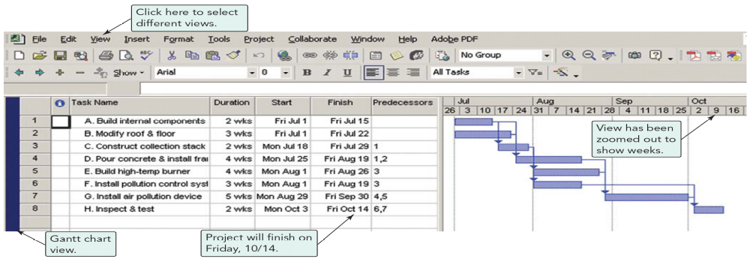
Using Microsoft Project
Program 3.1

Slide 127
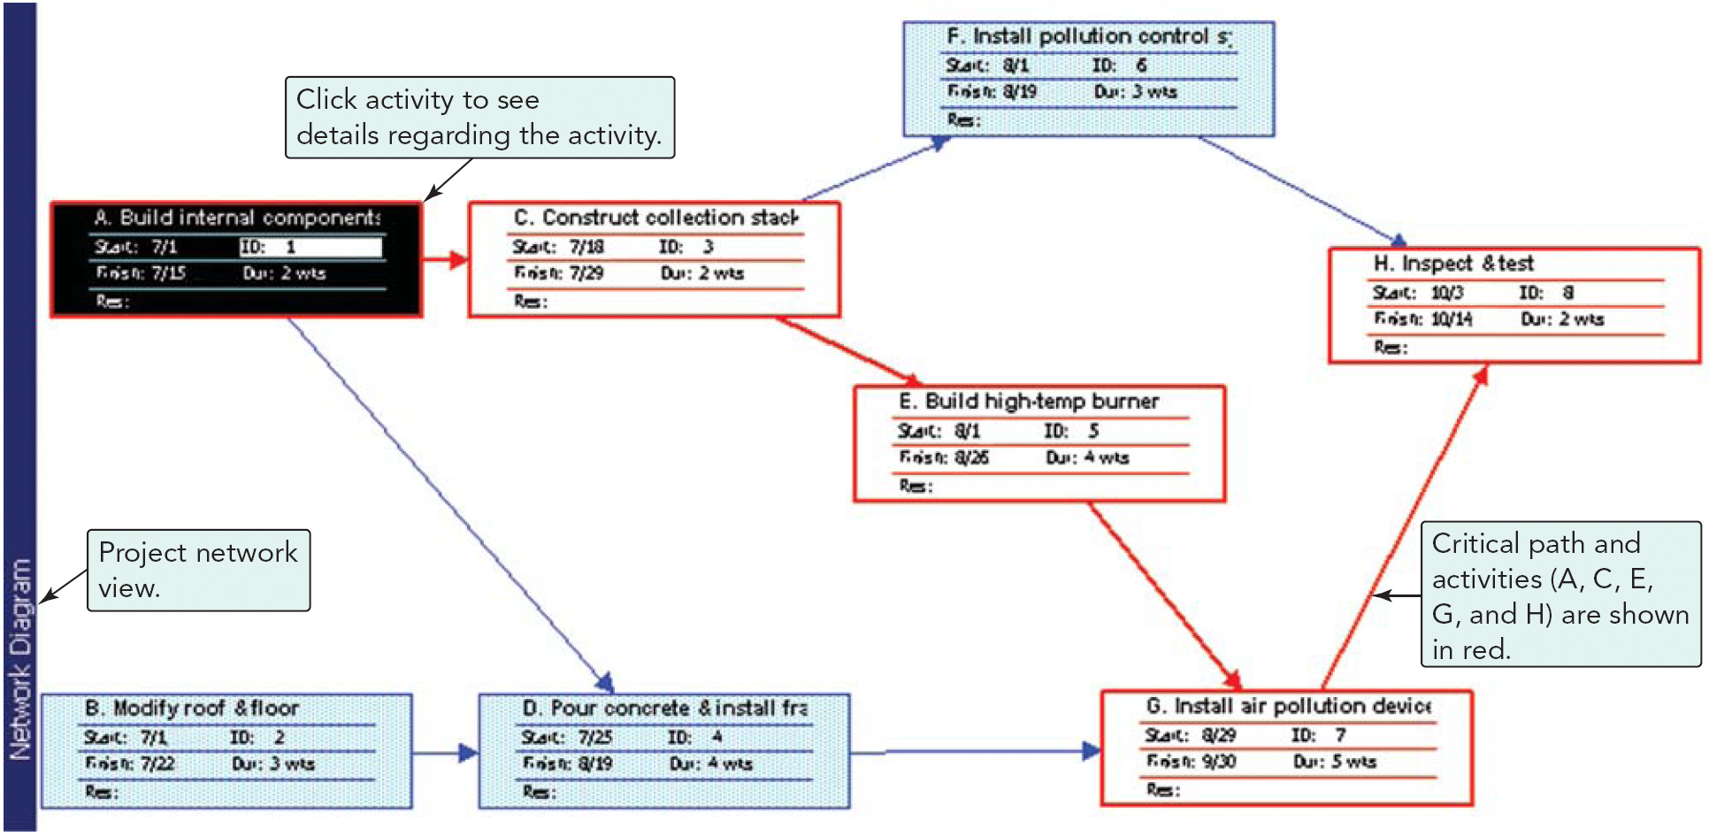
Using Microsoft Project
Program 3.2

Slide 128
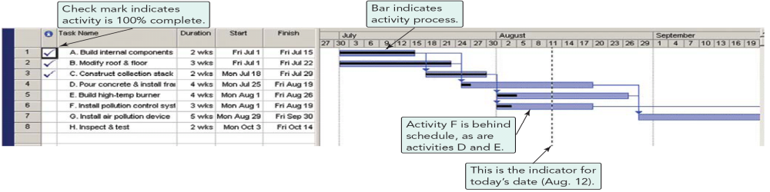
Using Microsoft Project
Pollution Project Percentage Completed on Aug. 12
ACTIVITY | COMPLETED
A | 100
B | 100
C | 100
D | 10
E | 20
F | 20
G | 0
H | 0
Program 3.3

Slide 129
Thank You so Much

Slide 130
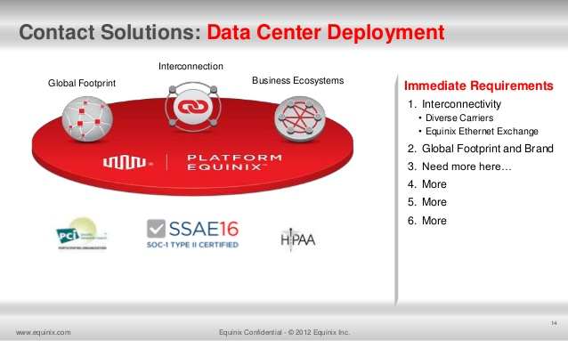

Slide 131
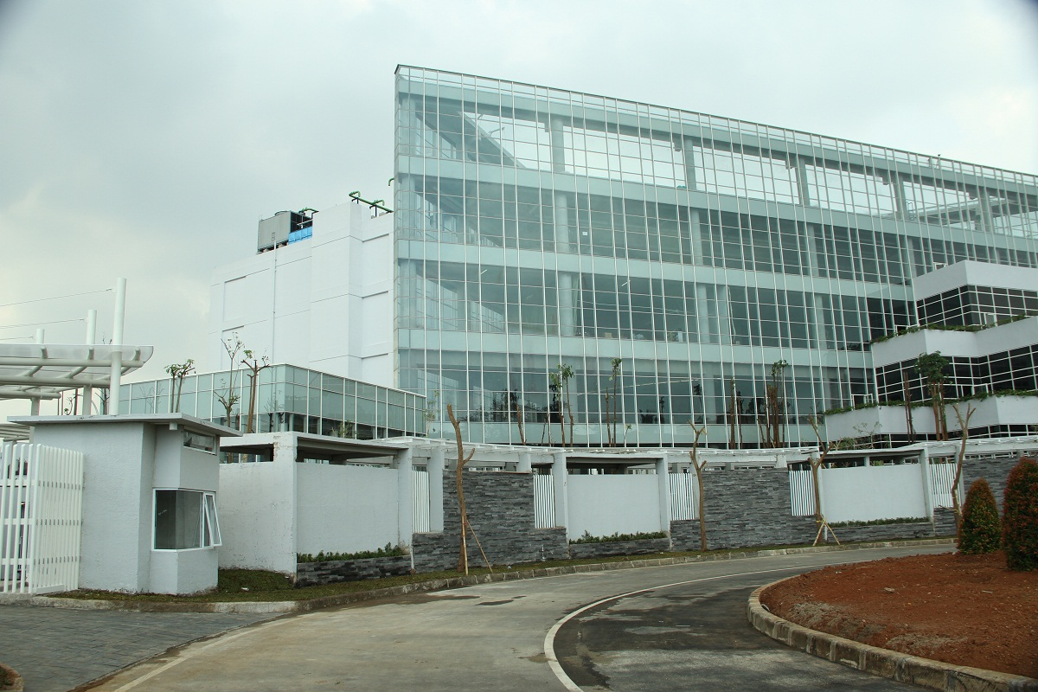

Slide 132
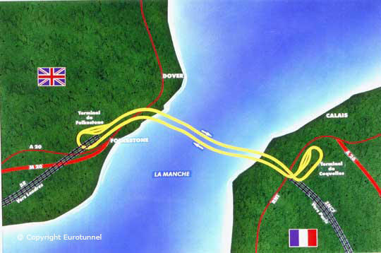

Slide 133
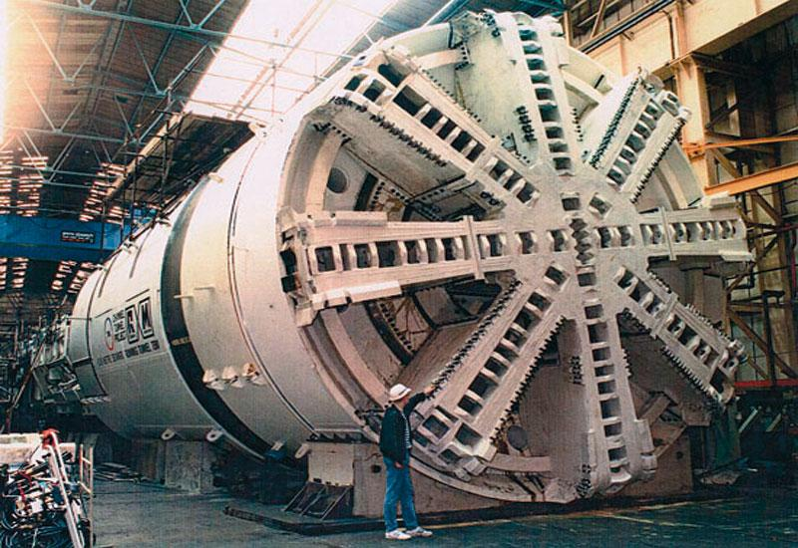

Slide 134
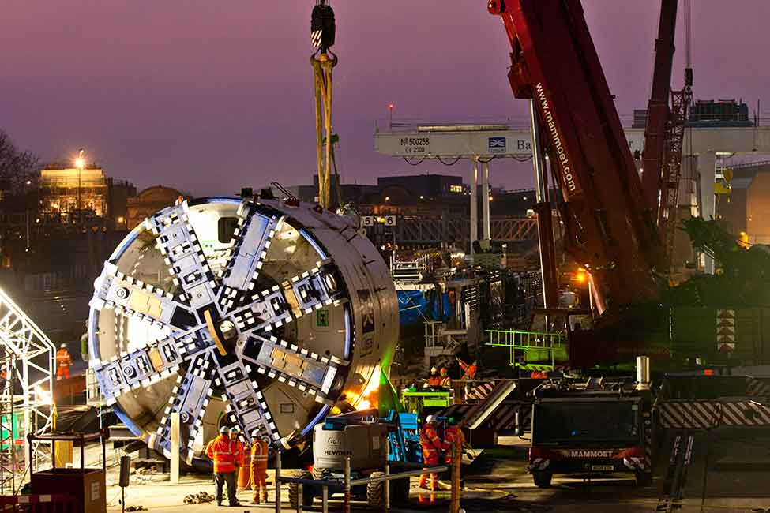

Slide 135
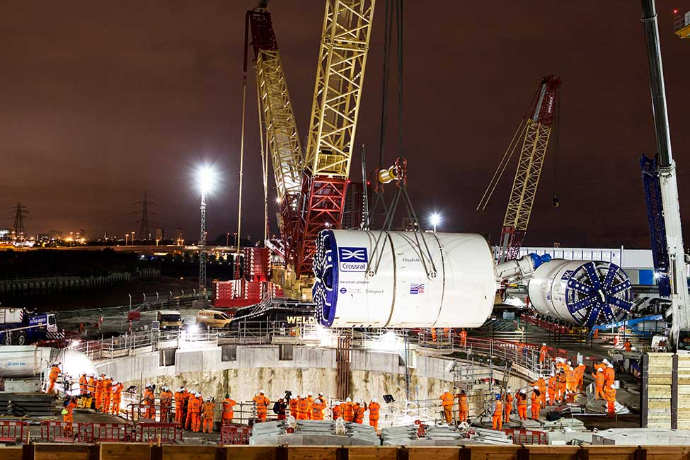

Slide 136
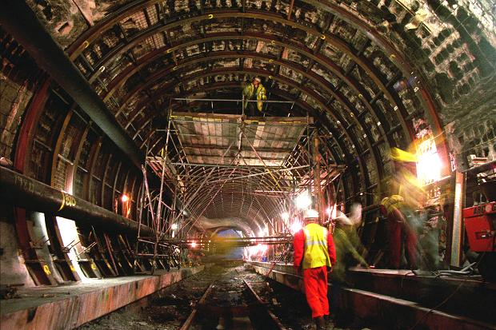

Slide 137
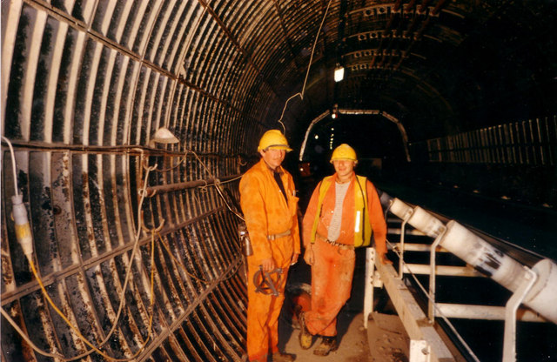

Slide 138
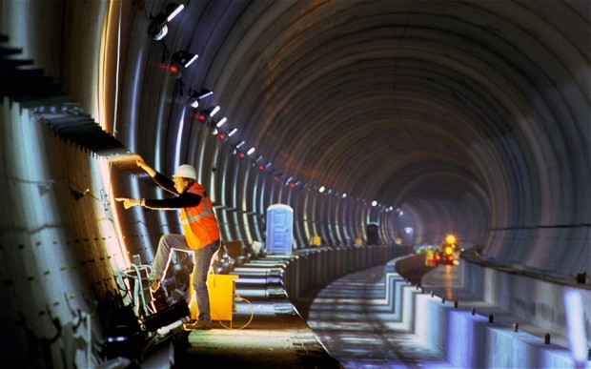

Slide 139
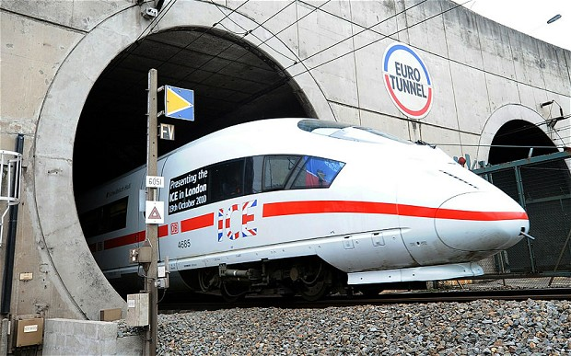

Slide 140
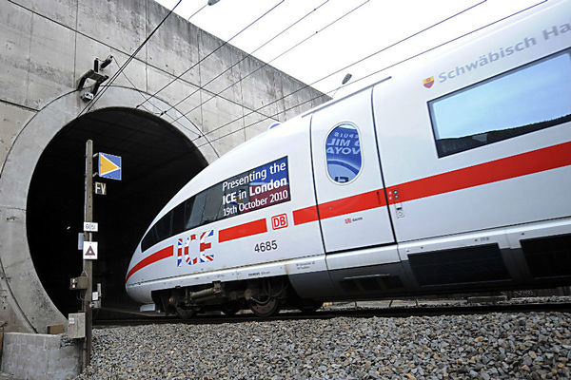

Slide 141
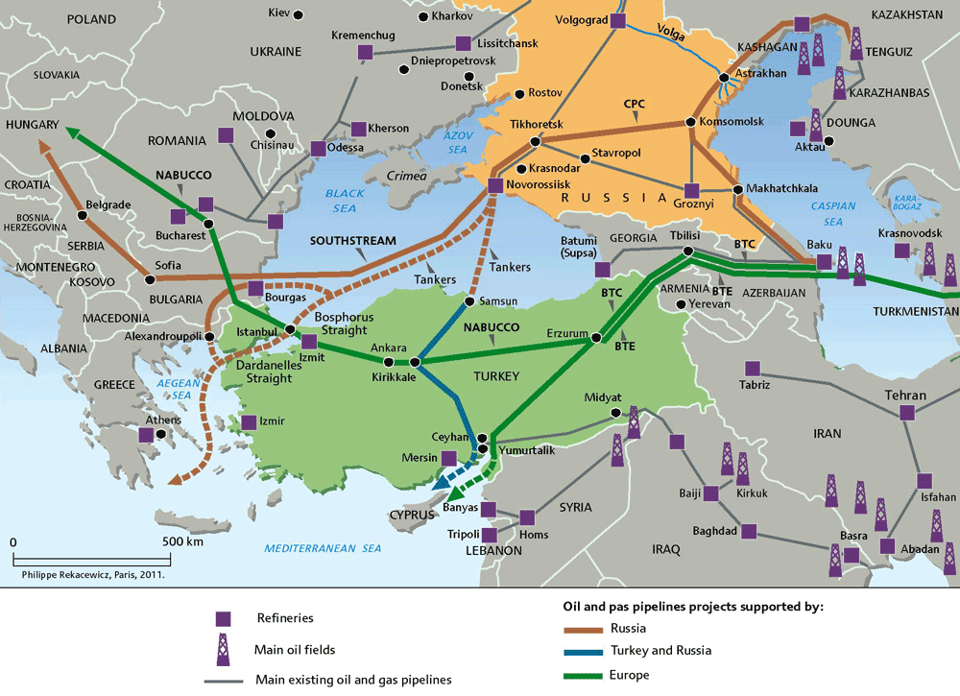

Slide 142
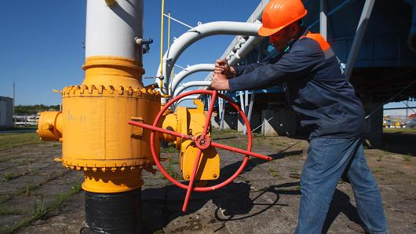

Slide 143
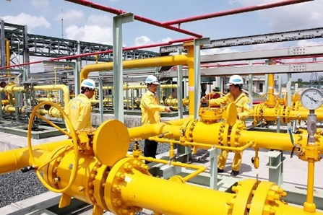

Slide 144
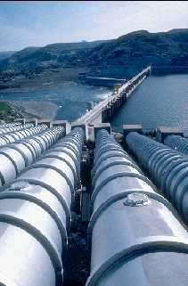
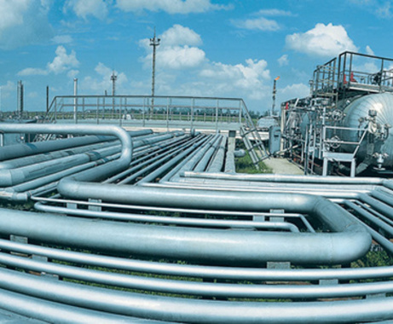

Slide 145
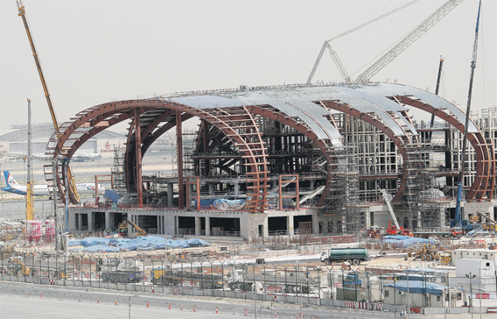

Slide 146
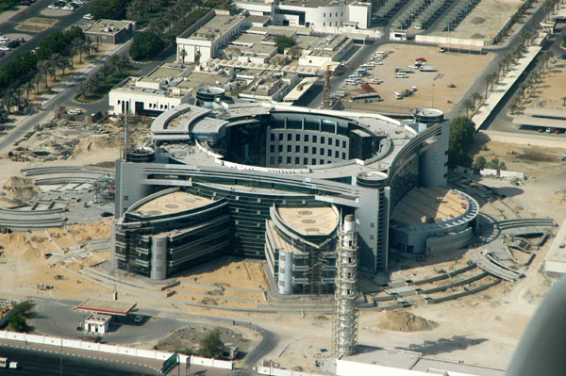

Slide 147
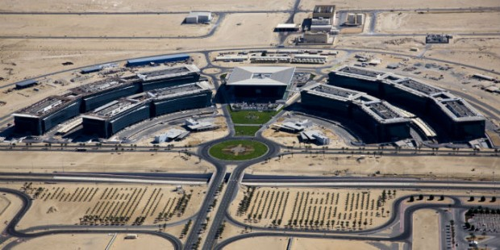

Slide 148
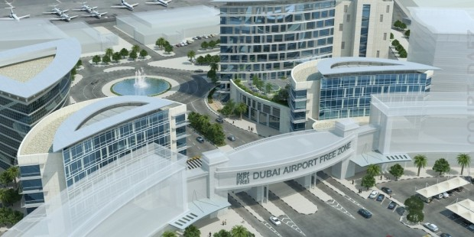

Slide 149
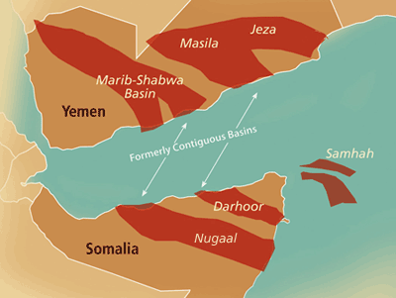

Slide 150
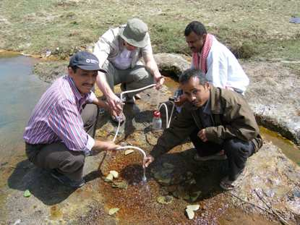

Slide 151
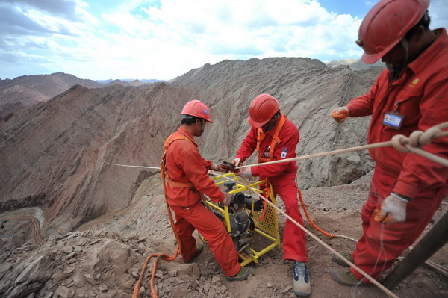

Slide 152
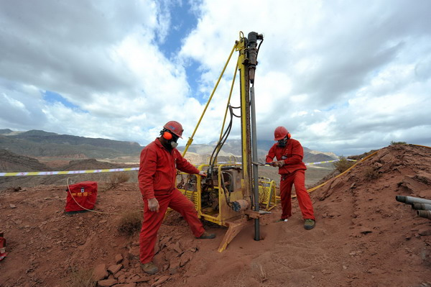

Slide 153
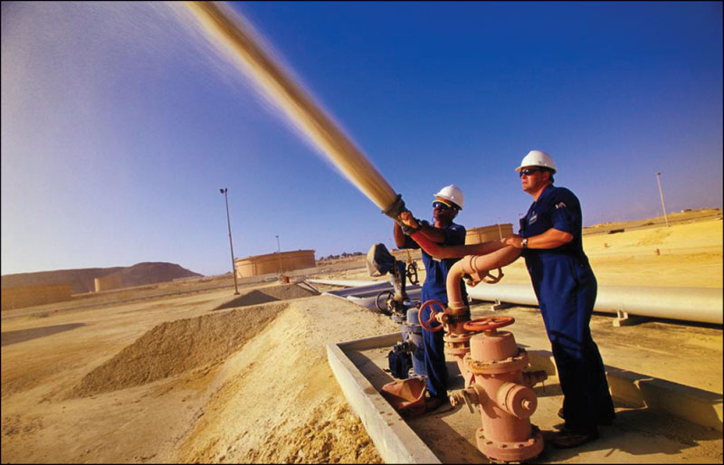

Slide 154


Slide 155


Slide 156


