Slide 1
4
Peramalan

Slide 2
Outline
Global Company Profile:
Walt Disney Parks & Resorts
What Is Forecasting?
The Strategic Importance of Forecasting
Seven Steps in the Forecasting System
Forecasting Approaches

Slide 3
Outline - Continued
Time-Series Forecasting
Associative Forecasting Methods: Regression and Correlation Analysis
Monitoring and Controlling Forecasts
Forecasting in the Service Sector

Slide 4
Learning Objectives
When you complete this chapter you should be able to :
Understand the three time horizons and which models apply for each use
Explain when to use each of the four qualitative models
Apply the naive, moving average, exponential smoothing, and trend methods

Slide 5
Learning Objectives
When you complete this chapter you should be able to :
Compute three measures of forecast accuracy
Develop seasonal indices
Conduct a regression and correlation analysis
Use a tracking signal

Slide 6
Forecasting Provides a Competitive Advantage for Disney
Global portfolio includes parks in Hong Kong, Paris, Tokyo, Orlando, and Anaheim
Revenues are derived from people – how many visitors and how they spend their money
Daily management report contains only the forecast and actual attendance at each park
© 2014 Pearson Education, Inc.

Slide 7
Forecasting Provides a Competitive Advantage for Disney
Disney generates daily, weekly, monthly, annual, and 5-year forecasts
Forecast used by labor management, maintenance, operations, finance, and park scheduling
Forecast used to adjust opening times, rides, shows, staffing levels, and guests admitted
© 2014 Pearson Education, Inc.

Slide 8
Forecasting Provides a Competitive Advantage for Disney
20% of customers come from outside the USA
Economic model includes gross domestic product, cross-exchange rates, arrivals into the USA
A staff of 35 analysts and 70 field people survey 1 million park guests, employees, and travel professionals each year
© 2014 Pearson Education, Inc.

Slide 9
Forecasting Provides a Competitive Advantage for Disney
Inputs to the forecasting model include airline specials, Federal Reserve policies, Wall Street trends, vacation/holiday schedules for 3,000 school districts around the world
Average forecast error for the 5-year forecast is 5%
Average forecast error for annual forecasts is between 0% and 3%
© 2014 Pearson Education, Inc.

Slide 10
Apa itu peramalan?
Proses memprediksi kejadian yang akan datang
Sebagai dasar kegiatan bisnis
  Produksi
  Persediaan
  Personalia
  Fasilitas
??

Slide 11
Time Horizons (Horison Waktu)
Peramalan jangka pendek
  Paling lama 1 tahun, biasanya kurang dari 3 bulan
  Pembelian, Penjadwalan kerja, tingakt tenaga kerja, penugasan, tingkat produksi
Peramalan jangka menengah
  3 bulan sampai 3 tahun
  Perencanaan penjualan dan produksi, penanggaran (budgeting)
Permalan jangka panjang
  3⁺ tahun
  Perencanaan produk baru, lokasi fasilitas, penelitian dan pengembangan

Slide 12
Perbedaan horison waktu
Peramalan jangka menengah/panjang terkait dengan isu komprehensif dan mendukung keputusan manajemen terkait perencanaan dan produk, pabrik, dan proses
Peramalan jangka pendek biasanya menggunakan metodoloti yang berbeda dibandingkan peramalan jangka panjang
Peramalan jangka pendek cenderung lebih akurat dibandingkan perencanaan jangka panjang

Slide 13
Influence of Product Life Cycle
Introduction – Growth – Maturity – Decline
Introduction and growth require longer forecasts than maturity and decline
As product passes through life cycle, forecasts are useful in projecting
  Staffing levels
  Inventory levels
  Factory capacity

Slide 14
Product Life Cycle
Introduction Growth Maturity Decline
Best period to increase market share
R&D engineering is critical
Practical to change price or quality image
Strengthen niche
Poor time to change image, price, or quality
Competitive costs become critical
Defend market position
Cost control critical
Drive-through restaurants
Company Strategy/Issues
Internet search engines
Xbox 360
DVDs
iPods
Boeing 787
Sales
3D printers
3-D game players
Electric vehicles
Analog TVs
Figure 2.5

Slide 15
Product Life Cycle
Introduction Growth Maturity Decline
Product design and development critical
Frequent product and process design changes
Short production runs
High production costs
Limited models
Attention to quality
Forecasting critical
Product and process reliability
Competitive product improvements and options
Increase capacity
Shift toward product focus
Enhance distribution
Standardization
Fewer product changes, more minor changes
Optimum capacity
Increasing stability of process
Long production runs
Product improvement and cost cutting
Little product differentiation
Cost minimization
Overcapacity in the industry
Prune line to eliminate items not returning good margin
Reduce capacity
OM Strategy/Issues
Figure 2.5

Slide 16
Jenis Peramalan
Peramalan ekonomi
  Diarahkan pada siklus bisnis → inflasi, penawaran uang beredar, perumahan, dll
Peramalan teknologi
  Pemprediksi kemajuan teknologi
  Pengaruh kepada produk baru
Peramalan permintaan
  Memprediksi penjualan dari produk yang ada sekarang

Slide 17
Strategic Importance of Forecasting
Supply-Chain Management – Good supplier relations, advantages in product innovation, cost and speed to market
Human Resources – Hiring, training, laying off workers
Capacity – Capacity shortages can result in undependable delivery, loss of customers, loss of market share

Slide 18
Seven Steps in Forecasting
Menentukan kegunaan peramalan
Memilih item yang diramal
Menetapkan waktu horison
Memilih model peramalan
Mengumpulkan data yang diperlukan untuk membuat peramalan
Membuat peramalan
Validasi dan menerapkan hasil peramalan

Slide 19
Seven Steps in Forecasting
Determine the use of the forecast: Disney uses park attendance forecasts to drive decisions about staffing, opening times, ride availability, and food supplies.
Select the items to be forecasted: For Disney World, them are six main parks. A forecast of daily attendance at each is the main number that determines labor, maintenance, and scheduling.
Determine the time horizon of the forecast: Is it short, medium, or long term? Disney develops daily, weekly, monthly, annual, and 5-year forecasts.
Select the forecasting models): Disney uses a variety of statistical models that we shall dis­cuss, including moving averages, econometrics, and regression analysis. It also employs judgmental, or nonquantitative, models.

Slide 20
Seven Steps in Forecasting
Gather the data needed to make the forecast: Disney's forecasting team employs 35 analysts and 70 field personnel to survey 1 million people/businesses every year. Disney also uses a firm called Global Insights for travel industry forecasts and gathers data on exchange rates, arrivals into the U.S., airline specials, Wall Street trends, and school vacation schedules.
Make the forecast.
Validate and implement the results: At Disney, forecasts are reviewed daily at the highest levels to make sure that the model, assumptions, and data are valid. Error measures are applied; then the forecasts are used to schedule personnel down to 15-minute intervals.

Slide 21
The Realities!
Forecasts are seldom perfect, unpredictable outside factors may impact the forecast
Most techniques assume an underlying stability in the system
Product family and aggregated forecasts are more accurate than individual product forecasts

Slide 22
Pendekatan peramalan
Metode Kualitatif
Used when situation is vague and little data exist
  New products
  New technology
Involves intuition, experience
  e.g., forecasting sales on Internet

Slide 23
Forecasting Approaches
Metode kuantitatif
Used when situation is ‘stable’ and historical data exist
  Existing products
  Current technology
Involves mathematical techniques
  e.g., forecasting sales of color televisions

Slide 24
Overview of Qualitative Methods
Jury of executive opinion
  Pool opinions of high-level experts, sometimes augment by statistical models
Delphi method
  Panel of experts, queried iteratively

Slide 25
Overview of Qualitative Methods
Sales force composite
  Estimates from individual salespersons are reviewed for reasonableness, then aggregated
Market Survey
  Ask the customer

Slide 26

Jury of Executive Opinion
Involves small group of high-level experts and managers
Group estimates demand by working together
Combines managerial experience with statistical models
Relatively quick
‘Group-think’
disadvantage

Slide 27
Delphi Method
Iterative group process, continues until consensus is reached
3 types of participants
  Decision makers
  Staff
  Respondents
Decision Makers
(Evaluate responses and make decisions)
Staff
(Administering survey)
Respondents
(People who can make valuable judgments)

Slide 28
Sales Force Composite
Each salesperson projects his or her sales
Combined at district and national levels
Sales reps know customers’ wants
May be overly optimistic

Slide 29
Market Survey
Ask customers about purchasing plans
Useful for demand and product design and planning
What consumers say, and what they actually do may be different
May be overly optimistic

Slide 30
Pendekatan kuantitatif
Untuk peramalan

Slide 31
Overview of Quantitative Approaches
Naive approach (Pendekatan naif)
Moving averages (Rata2 bergerak)
Exponential smoothing (pemulusan eksponensial)
Trend projection (proyeksi tren / kecenderungan)
Linear regression (regresi linier)
Model Runtut Waktu
Model
Asosiatif

Slide 32
TIME SERIES MODEL

Slide 33
Time-Series Forecasting
Set of Evenly Spaced Numerical Data
  Obtained by observing response variable at regular time periods
Forecast based only on past values, no other variables important
  Assumes that factors influencing past and present will continue influence in future

Slide 34
Time-Series Components
Trend
Cyclical
Seasonal
Random
Notes:
TREND = a general direction in which something is developing or changing
SEASONAL =of, relating to, or characteristic of a particular season of the year.
CYCLICAL = occurring in cycles; regularly repeated.
RANDOM = made, done, happening, or chosen without method or conscious decision.

Slide 35
Components of Demand
Trend component
Seasonal peaks
Actual demand line
Demand for product or service
Average demand over 4 years
Random variation
| | | |
1 2 3 4
Time (years)
Figure 4.1

Slide 36
Trend Component
Persistent, overall upward or downward pattern
Changes due to population, technology, age, culture, etc.
Typically several years duration
Notes:
Persistent = continuing firmly or obstinately in a course of action in spite of difficulty or opposition.

Slide 37
Seasonal Component
Regular pattern of up and down fluctuations
Due to weather, customs, etc.
Occurs within a single year
PERIOD LENGTH | “SEASON” LENGTH | NUMBER OF “SEASONS” IN PATTERN
Week | Day | 7
Month | Week | 4 – 4.5
Month | Day | 28 – 31
Year | Quarter | 4
Year | Month | 12
Year | Week | 52

Slide 38
Cyclical Component
Repeating up and down movements
Affected by business cycle, political, and economic factors
Multiple years duration
Often causal or
associative
relationships
0 5 10 15 20

Slide 39
Random Component
Erratic, unsystematic, ‘residual’ fluctuations
Due to random variation or unforeseen events
Short duration
and nonrepeating
M T W T F
Notes:
unforeseen events = not anticipated or predicted EVENTS

Slide 40
1. NAIVE APPROACH

Slide 41

Naive Approach
Menganggap permintaan periode yad sama dengan permintaan masa lampau
  contoh., Jika pada bulan Januari permintaan sebesar 68, maka bulan Februari juga sebesar 68
Metode ini lebih efektif dan efisin
Dapat digunakan sebagai titik awal yang baik
Notes:
Naïve = (of a person or action) showing a lack of experience, wisdom, or judgment.

Slide 42
2. Metode rata-rata bergerak

Slide 43
Moving Average Method
MA adalah sekumpulan rata-rata hitung
Digunakan jika tidak ada atau sedikit tren
Sering digunakan untuk pemulusan
  Provides overall impression of data over time
$$Rata−rata bergerak=\frac{\sum{permintaan n periode yg lalu}}{n}$$

Slide 44
CONTOH RATA-RATA BERGERAK
BULAN | PENJUALAN SEBENARNYA | RATA-RATA BERGERAK 3-BULAN
Januari | 10
Februari | 12
Maret | 13
April | 16
Mei | 19
Juni | 23
Juli | 26
Agustus | 30
September | 28
Oktober | 18
November | 16
Desember | 14
10
12
13
+
+
10
12
13
(10 + 12 + 13)/3 = 11 ²/₃
(12 + 13 + 16)/3 = 13 ²/₃
(13 + 16 + 19)/3 = 16
(16 + 19 + 23)/3 = 19 ¹/₃
(19 + 23 + 26)/3 = 22 ²/₃
(23 + 26 + 30)/3 = 26 ¹/₃
(29 + 30 + 28)/3 = 28
(30 + 28 + 18)/3 = 25 ¹/₃
(28 + 18 + 16)/3 = 20 ²/₃

Slide 45
Weighted Moving average

Slide 46
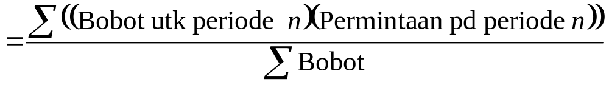
Rata-rata bergerak tertimbang
Digunakan jika terjadi beberapa kecenderungan (tren)
  Menganggap data masa lampu dianggap kurang penting dibanding data terbaru
Bobot didasarkan pada pengalaman dan intuisi (filling)
Rata-rata bergerak tertimbang

Slide 47
Weighted Moving Average
MONTH | ACTUAL SHED SALES | 3-MONTH WEIGHTED MOVING AVERAGE
January | 10
February | 12
March | 13
April | 16
May | 19
June | 23
July | 26
August | 30
September | 28
October | 18
November | 16
December | 14
10
12
13
[(3 x 13) + (2 x 12) + (10)]/6 = 12 ¹/₆
WEIGHTS APPLIED |  |  |  | PERIOD
 |  | 3 |  | Last month
 |  | 2 |  | Two months ago
 |  | 1 |  | Three months ago
 |  | 6 |  | Sum of the weights
Forecast for this month =
3 x Sales last mo. + 2 x Sales 2 mos. ago + 1 x Sales 3 mos. ago
 | Sum of the weights

Slide 48
Weighted Moving Average
MONTH | ACTUAL SHED SALES | 3-MONTH WEIGHTED MOVING AVERAGE
January | 10
February | 12
March | 13
April | 16
May | 19
June | 23
July | 26
August | 30
September | 28
October | 18
November | 16
December | 14
10
12
13
[(3 x 13) + (2 x 12) + (10)]/6 = 12 ¹/₆
[(3 x 16) + (2 x 13) + (12)]/6 = 14 ¹/₃
[(3 x 19) + (2 x 16) + (13)]/6 = 17
[(3 x 23) + (2 x 19) + (16)]/6 = 20 ¹/₂
[(3 x 26) + (2 x 23) + (19)]/6 = 23 ⁵/₆
[(3 x 30) + (2 x 26) + (23)]/6 = 27 ¹/₂
[(3 x 28) + (2 x 30) + (26)]/6 = 28 ¹/₃
[(3 x 18) + (2 x 28) + (30)]/6 = 23 ¹/₃
[(3 x 16) + (2 x 18) + (28)]/6 = 18 ²/₃

Slide 49
Potential Problems With
Moving Average
Increasing n smooths the forecast but makes it less sensitive to changes
Does not forecast trends well
Requires extensive historical data

Slide 50
Graph of Moving Averages
Weighted moving average
30 –
25 –
20 –
15 –
10 –
5 –
Sales demand
Actual sales
Moving average
| | | | | | | | | | | |
J F M A M J J A S O N D
Month
Figure 4.2

Slide 51
3. Exponential smoothing

Slide 52
Exponential Smoothing
Form of weighted moving average
  Weights decline exponentially
  Most recent data weighted most
Requires smoothing constant (α)
  Ranges from 0 to 1
  Subjectively chosen
Involves little record keeping of past data

Slide 53
Exponential Smoothing
New forecast = Last period’s forecast
+ α (Last period’s actual demand
– Last period’s forecast)
F_{t} = F_{t – 1} + α(A_{t – 1} - F_{t – 1})
where F_{t} = new forecast
F_{t – 1} = previous period’s forecast
α = smoothing (or weighting) constant (0 ≤ α ≤ 1)
A_{t – 1} = previous period’s actual demand

Slide 54
Exponential Smoothing Example
Predicted demand = 142 Ford Mustangs
Actual demand = 153
Smoothing constant a = .20

Slide 55
Exponential Smoothing Example
Predicted demand = 142 Ford Mustangs
Actual demand = 153
Smoothing constant a = .20
New forecast = 142 + .2(153 – 142)

Slide 56
Exponential Smoothing Example
Predicted demand = 142 Ford Mustangs
Actual demand = 153
Smoothing constant a = .20
New forecast = 142 + .2(153 – 142)

Slide 57
Exponential Smoothing Example
Predicted demand = 142 Ford Mustangs
Actual demand = 153
Smoothing constant a = .20
New forecast = 142 + .2(153 – 142)

Slide 58
Exponential Smoothing Example
Predicted demand = 142 Ford Mustangs
Actual demand = 153
Smoothing constant a = .20
New forecast = 142 + .2(153 – 142)
= 142 + 2.2
= 144.2 ≈ 144 cars

Slide 59
Effect of Smoothing Constants
Smoothing constant generally .05 ≤ α ≤ .50
As α increases, older values become less significant
WEIGHT ASSIGNED TO
SMOOTHING CONSTANT | MOST RECENT PERIOD (α) | 2ND MOST RECENT PERIOD α(1 – α) | 3RD MOST RECENT PERIOD α(1 – α)² | 4th MOST RECENT PERIOD α(1 – α)³ | 5th MOST RECENT PERIOD α(1 – α)⁴
α = .1 | .1 | .09 | .081 | .073 | .066
α = .5 | .5 | .25 | .125 | .063 | .031

Slide 60
Impact of Different α
225 –
200 –
175 –
150 –
Actual demand
α = .5
Demand
α = .1
| | | | | | | | |
1 2 3 4 5 6 7 8 9
Quarter

Slide 61
Impact of Different α
225 –
200 –
175 –
150 –
Chose high values of α when underlying average is likely to change
Choose low values of α when underlying average is stable
Actual demand
α = .5
Demand
α = .1
| | | | | | | | |
1 2 3 4 5 6 7 8 9
Quarter

Slide 62
Choosing α
The objective is to obtain the most accurate forecast no matter the technique
We generally do this by selecting the model that gives us the lowest forecast error
Forecast error = Actual demand – Forecast value
= A_{t} – F_{t}

Slide 63
Common measure of error

Slide 64
Ukuran umum tingkat kesalahan
Mean Absolute Deviation (MAD)
Mean Square Error (MSE)
Mean Absolute Percent Error (MAPE)

Slide 65
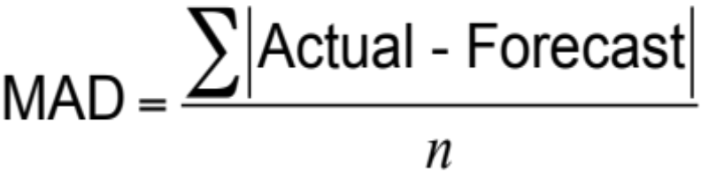
Common Measures of Error
1) Mean Absolute Deviation (MAD)

Slide 66
Determining the MAD
QUARTER | ACTUAL TONNAGE UNLOADED | FORECAST WITH α = .10 | FORECAST WITH α = .50
1 | 180 | 175 | 175
2 | 168 | 175.50 = 175.00 + .10(180 – 175) | 177.50
3 | 159 | 174.75 = 175.50 + .10(168 – 175.50) | 172.75
4 | 175 | 173.18 = 174.75 + .10(159 – 174.75) | 165.88
5 | 190 | 173.36 = 173.18 + .10(175 – 173.18) | 170.44
6 | 205 | 175.02 = 173.36 + .10(190 – 173.36) | 180.22
7 | 180 | 178.02 = 175.02 + .10(205 – 175.02) | 192.61
8 | 182 | 178.22 = 178.02 + .10(180 – 178.02) | 186.30
9 | ? | 178.59 = 178.22 + .10(182 – 178.22) | 184.15

Slide 67
Menghitung MAD
Kuartal | Sebenarnya | Peramalan | Deviasi Absolut
1 | 180 | 175 |  | 5.00
2 | 168 | 175.50 |  | 7.50
3 | 159 | 174.75 |  | 15.75
4 | 175 | 173.18 |  | 1.82
5 | 190 | 173.36 |  | 16.64
6 | 205 | 175.02 |  | 29.98
7 | 180 | 178.02 |  | 1.98
8 | 182 | 178.22 |  | 3.78
Jumlah dari deviasi absolut: |  |  |  | 82.45
MAD = |  | Σ|Deviasi| | 82.45 | 10.31
 |  | n | 8

Slide 68
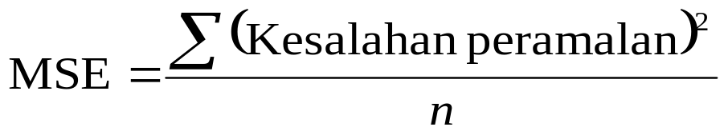
Common Measures of Error
2) Mean Squared Error (MSE)

Slide 69
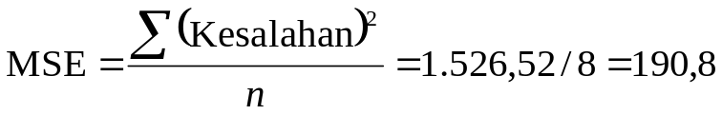
Determining the MSE
QUARTER | AKTUAL | PERAMALAN |  | KESALAHAN KUADRAT
1 | 180 | 175 |  | 5² = 25
2 | 168 | 175.50 |  | (–7.5)² = 56,25
3 | 159 | 174.75 |  | (–15.75)² = 248,06
4 | 175 | 173.18 |  | (1.82)² = 3,31
5 | 190 | 173.36 |  | (16.64)² = 276,89
6 | 205 | 175.02 |  | (29.98)² = 898,80
7 | 180 | 178.02 |  | (1.98)² = 3,92
8 | 182 | 178.22 |  | (3.78)² = 14,29
 |  | Jumlah kesalahan kuadrat = 1.526,52

Slide 70
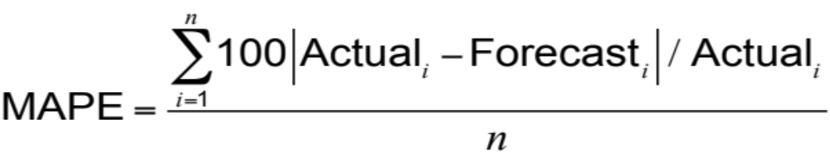
Common Measures of Error
3) Mean Absolute Percent Error (MAPE)

Slide 71
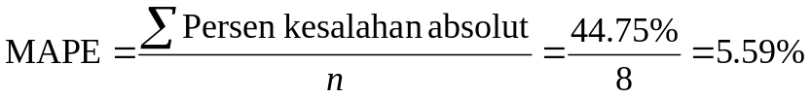
Determining the MAPE
KUARTAL | AKTUAL | PERAMALAN | PERSEN KESALAHAN AKTUAL = 100(|KESALAHAN|/AKTUAL)
1 | 180 | 175.00 |  | 100(5/180) = 2.78%
2 | 168 | 175.50 |  | 100(7.5/168) = 4.46%
3 | 159 | 174.75 |  | 100(15.75/159) = 9.90%
4 | 175 | 173.18 |  | 100(1.82/175) = 1.05%
5 | 190 | 173.36 |  | 100(16.64/190) = 8.76%
6 | 205 | 175.02 |  | 100(29.98/205) = 14.62%
7 | 180 | 178.02 |  | 100(1.98/180) = 1.10%
8 | 182 | 178.22 |  | 100(3.78/182) = 2.08%
 |  | Jumlah % kesalahan absolut = 44.75%

Slide 72
Comparison of forecast error
MAD vs MSE vs MAPE

Slide 73
Comparison of Forecast Error
Rounded Absolute Rounded Absolute
Actual Forecast Deviation Forecast Deviation
Tonnage with for with for
Quarter Unloaded α = .10 α = .10 α = .50 α = .50
1 180 175 5.00 175 5.00
2 168 175.5 7.50 177.50 9.50
3 159 174.75 15.75 172.75 13.75
4 175 173.18 1.82 165.88 9.12
5 190 173.36 16.64 170.44 19.56
6 205 175.02 29.98 180.22 24.78
7 180 178.02 1.98 192.61 12.61
8 182 178.22 3.78 186.30 4.30
82.45 98.62

Slide 74
Comparison of Forecast Error
∑ |deviations|
n
Rounded Absolute Rounded Absolute
Actual Forecast Deviation Forecast Deviation
Tonnage with for with for
Quarter Unloaded α = .10 α = .10 α = .50 α = .50
MAD =
For α = .10
1 180 175 5.00 175 5.00
2 168 175.5 7.50 177.50 9.50
3 159 174.75 15.75 172.75 13.75
4 175 173.18 1.82 165.88 9.12
5 190 173.36 16.64 170.44 19.56
6 205 175.02 29.98 180.22 24.78
7 180 178.02 1.98 192.61 12.61
8 182 178.22 3.78 186.30 4.30
82.45 98.62
= 82.45/8 = 10.31
For α = .50
= 98.62/8 = 12.33
MAD 10.31 12.33

Slide 75
Comparison of Forecast Error
∑ (forecast errors)²
n
Rounded Absolute Rounded Absolute
Actual Forecast Deviation Forecast Deviation
Tonnage with for with for
Quarter Unloaded α = .10 α = .10 α = .50 α = .50
MSE =
For α = .10
1 180 175 5.00 175 5.00
2 168 175.5 7.50 177.50 9.50
3 159 174.75 15.75 172.75 13.75
4 175 173.18 1.82 165.88 9.12
5 190 173.36 16.64 170.44 19.56
6 205 175.02 29.98 180.22 24.78
7 180 178.02 1.98 192.61 12.61
8 182 178.22 3.78 186.30 4.30
82.45 98.62
= 1,526.54/8 = 190.82
For α = .50
= 1,561.91/8 = 195.24
MAD 10.31 12.33
MSE 190.31 195.33

Slide 76
Comparison of Forecast Error
n
i = 1
∑100|deviation_{i}|/actual_{i}
n
Rounded Absolute Rounded Absolute
Actual Forecast Deviation Forecast Deviation
Tonnage with for with for
Quarter Unloaded α = .10 α = .10 α = .50 α = .50
MAPE =
For α = .10
1 180 175 5.00 175 5.00
2 168 175.5 7.50 177.50 9.50
3 159 174.75 15.75 172.75 13.75
4 175 173.18 1.82 165.88 9.12
5 190 173.36 16.64 170.44 19.56
6 205 175.02 29.98 180.22 24.78
7 180 178.02 1.98 192.61 12.61
8 182 178.22 3.78 186.30 4.30
82.45 98.62
= 44.75/8 = 5.59%
For α = .50
= 54.05/8 = 6.76%
MAD 10.31 12.33
MSE 190.31 195.33
MAPE 5.59% 6.76%

Slide 77
Comparison of Forecast Error
Rounded Absolute Rounded Absolute
Actual Forecast Deviation Forecast Deviation
Tonnage with for with for
Quarter Unloaded α = .10 α = .10 α = .50 α = .50
1 180 175 5.00 175 5.00
2 168 175.5 7.50 177.50 9.50
3 159 174.75 15.75 172.75 13.75
4 175 173.18 1.82 165.88 9.12
5 190 173.36 16.64 170.44 19.56
6 205 175.02 29.98 180.22 24.78
7 180 178.02 1.98 192.61 12.61
8 182 178.22 3.78 186.30 4.30
82.45 98.62
MAD 10.31 12.33
MSE 190.31 195.33
MAPE 5.59% 6.76%

Slide 78
Exponential smoothing WITH TREND ADJUSTMENT

Slide 79
Exponential Smoothing with Trend Adjustment
When a trend is present, exponential smoothing must be modified
MONTH | ACTUAL DEMAND | FORECAST (F_{t}) FOR MONTHS 1 – 5
1 | 100 | F_{t} = 100 (given)
2 | 200 | F_{t} = F₁ + α(A₁ – F₁) = 100 + .4(100 – 100) = 100
3 | 300 | F_{t} = F₂ + α(A₂ – F₂) = 100 + .4(200 – 100) = 140
4 | 400 | F_{t} = F₃ + α(A₃ – F₃) = 140 + .4(300 – 140) = 204
5 | 500 | F_{t} = F₄ + α(A₄ – F₄) = 204 + .4(400 – 204) = 282

Slide 80
Exponential Smoothing with Trend Adjustment
Forecast
including (FIT_{t}) =
trend
Exponentially Exponentially
smoothed (F_{t}) + smoothed (T_{t})
forecast trend
F_{t} = α(A_{t - 1}) + (1 - α)(F_{t - 1} + T_{t - 1})
T_{t} = β(F_{t} - F_{t - 1}) + (1 - β)T_{t - 1}
where F_{t} = exponentially smoothed forecast average
T_{t} = exponentially smoothed trend
A_{t} = actual demand
α = smoothing constant for average (0 ≤ α ≤ 1)
β = smoothing constant for trend (0 ≤ β ≤ 1)

Slide 81
Exponential Smoothing with Trend Adjustment
Step 1: Compute F_{t}
Step 2: Compute T_{t}
Step 3: Calculate the forecast FIT_{t} = F_{t} + T_{t}

Slide 82
Exponential Smoothing with Trend Adjustment Example
MONTH (t) | ACTUAL DEMAND (A_{t}) | MONTH (t) | ACTUAL DEMAND (A_{t})
1 | 12 | 6 | 21
2 | 17 | 7 | 31
3 | 20 | 8 | 28
4 | 19 | 9 | 36
5 | 24 | 10 | ?
α = .2 β = .4

Slide 83
Exponential Smoothing with Trend Adjustment Example
TABLE 4.1 |  | Forecast with α - .2 and β = .4
MONTH | ACTUAL DEMAND |  | SMOOTHED FORECAST AVERAGE, F_{t} | SMOOTHED TREND, T_{t} | FORECAST INCLUDING TREND, FIT_{t}
1 | 12 |  | 11 | 2 | 13.00
2 | 17
3 | 20
4 | 19
5 | 24
6 | 21
7 | 31
8 | 28
9 | 36
10 | —
12.80
Step 1: Average for Month 2
F₂ = αA₁ + (1 – α)(F₁ + T₁)
F₂ = (.2)(12) + (1 – .2)(11 + 2)
= 2.4 + (.8)(13) = 2.4 + 10.4
= 12.8 units

Slide 84
Exponential Smoothing with Trend Adjustment Example
TABLE 4.1 |  | Forecast with α - .2 and β = .4
MONTH | ACTUAL DEMAND |  | SMOOTHED FORECAST AVERAGE, F_{t} | SMOOTHED TREND, T_{t} | FORECAST INCLUDING TREND, FIT_{t}
1 | 12 |  | 11 | 2 | 13.00
2 | 17 |  | 12.80
3 | 20
4 | 19
5 | 24
6 | 21
7 | 31
8 | 28
9 | 36
10 | —
1.92
Step 2: Trend for Month 2
T₂ = β(F₂ - F₁) + (1 - b)T₁
T₂ = (.4)(12.8 - 11) + (1 - .4)(2)
= .72 + 1.2 = 1.92 units

Slide 85
Exponential Smoothing with Trend Adjustment Example
TABLE 4.1 |  | Forecast with α - .2 and β = .4
MONTH | ACTUAL DEMAND |  | SMOOTHED FORECAST AVERAGE, F_{t} | SMOOTHED TREND, T_{t} | FORECAST INCLUDING TREND, FIT_{t}
1 | 12 |  | 11 | 2 | 13.00
2 | 17 |  | 12.80 | 1.92
3 | 20
4 | 19
5 | 24
6 | 21
7 | 31
8 | 28
9 | 36
10 | —
14.72
Step 3: Calculate FIT for Month 2
FIT₂ = F₂ + T₂
FIT₂ = 12.8 + 1.92
= 14.72 units

Slide 86
Exponential Smoothing with Trend Adjustment Example
TABLE 4.1 |  | Forecast with a - .2 and b = .4
MONTH | ACTUAL DEMAND |  | SMOOTHED FORECAST AVERAGE, F_{t} | SMOOTHED TREND, T_{t} | FORECAST INCLUDING TREND, FIT_{t}
1 | 12 |  | 11 | 2 | 13.00
2 | 17 |  | 12.80 | 1.92 | 14.72
3 | 20 |  | 15.18 | 2.10 | 17.28
4 | 19 |  | 17.82 | 2.32 | 20.14
5 | 24 |  | 19.91 | 2.23 | 22.14
6 | 21 |  | 22.51 | 2.38 | 24.89
7 | 31 |  | 24.11 | 2.07 | 26.18
8 | 28 |  | 27.14 | 2.45 | 29.59
9 | 36 |  | 29.28 | 2.32 | 31.60
10 | — |  | 32.48 | 2.68 | 35.16

Slide 87
Exponential Smoothing with Trend Adjustment Example
40 –
35 –
30 –
25 –
20 –
15 –
10 –
5 –
0 –
Figure 4.3
Actual demand (A_{t})
Product demand
Forecast including trend (FIT_{t})
with α = .2 and β = .4
| | | | | | | | |
1 2 3 4 5 6 7 8 9
Time (months)

Slide 88
4. Proyeksi tren

Slide 89
Proyeksi tren
Menyesuaikan garis tren ke titik-titik data historis untuk memproyeksikan jangka menengah dan jangka panjang
Tren garis lurus dapat diperleh dengan teknik kuadrat terkecil
^
y = a + bx
^
di mana y = nilai yg dihitung dari variabel yang diprediksi (variabel terikat)
a = intersep sumbu y
b = kemiringan garis regresi
x = variabel bebas (periode waktu)

Slide 90
Least Squares Method
Figure 4.4
Least squares method minimizes the sum of the squared errors (deviations)
Actual observation
(y-value)
Deviation₇
Deviation₅
Deviation₆
Values of Dependent Variable (y-values)
Deviation₃
Deviation₄
Deviation₁
(error)
^
Deviation₂
Trend line, y = a + bx
| | | | | | |
1 2 3 4 5 6 7
Time period

Slide 91
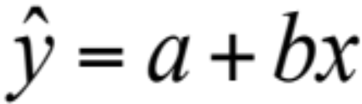
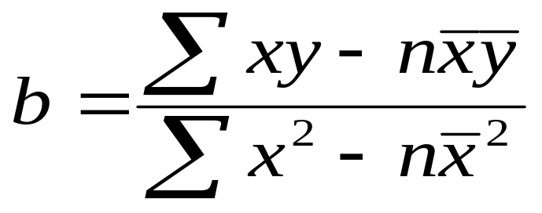

Least Squares Method
Equations to calculate the regression variables
19 Maret

Slide 92
Least Squares Example
YEAR | ELECTRICAL POWER DEMAND | YEAR | ELECTRICAL POWER DEMAND
1 | 74 | 5 | 105
2 | 79 | 6 | 142
3 | 80 | 7 | 122
4 | 90

Slide 93
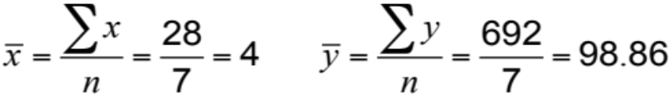
Least Squares Example
YEAR (x) |  |  | ELECTRICAL POWER DEMAND (y) |  |  | x² |  |  | xy
 | 1 |  |  | 74 |  |  | 1 |  |  | 74
 | 2 |  |  | 79 |  |  | 4 |  |  | 158
 | 3 |  |  | 80 |  |  | 9 |  |  | 240
 | 4 |  |  | 90 |  |  | 16 |  |  | 360
 | 5 |  |  | 105 |  |  | 25 |  |  | 525
 | 6 |  |  | 142 |  |  | 36 |  |  | 852
 | 7 |  |  | 122 |  |  | 49 |  |  | 854
Σx = 28 |  |  | Σy = 692 |  |  | Σx² = 140 |  |  | Σxy = 3,063

Slide 94
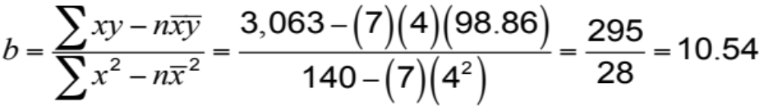

Least Squares Example
YEAR (x) |  |  | ELECTRICAL POWER DEMAND (y) |  |  | x² |  |  | xy
 | 1 |  |  | 74 |  |  | 1 |  |  | 74
 | 2 |  |  | 79 |  |  | 4 |  |  | 158
 | 3 |  |  | 80 |  |  | 9 |  |  | 240
 | 4 |  |  | 90 |  |  | 16 |  |  | 360
 | 5 |  |  | 105 |  |  | 25 |  |  | 525
 | 6 |  |  | 142 |  |  | 36 |  |  | 852
 | 7 |  |  | 122 |  |  | 49 |  |  | 854
Σx = 28 |  |  | Σy = 692 |  |  | Σx² = 140 |  |  | Σxy = 3,063
Demand in year 8 = 56.70 + 10.54(8)
= 141.02, or 141 megawatts

Slide 95
Least Squares Example
Trend line,
y = 56.70 + 10.54x
160 –
150 –
140 –
130 –
120 –
110 –
100 –
90 –
80 –
70 –
60 –
50 –
^
Power demand (megawatts)
| | | | | | | | |
1 2 3 4 5 6 7 8 9
Year
Figure 4.5

Slide 96
Least Squares Requirements
We always plot the data to insure a linear relationship
We do not predict time periods far beyond the database
Deviations around the least squares line are assumed to be random

Slide 97


Seasonal Variations In Data
The multiplicative seasonal model can adjust trend data for seasonal variations in demand

Slide 98
Seasonal Variations In Data
Steps in the process for monthly seasons:
Find average historical demand for each month
Compute the average demand over all months
Compute a seasonal index for each month
Estimate next year’s total demand
Divide this estimate of total demand by the number of months, then multiply it by the seasonal index for that month

Slide 99
Seasonal Index Example
 | DEMAND
MONTH | YEAR 1 | YEAR 2 | YEAR 3 | AVERAGE YEARLY DEMAND |  |  | AVERAGE MONTHLY DEMAND | SEASONAL INDEX
Jan | 80 | 85 | 105
Feb | 70 | 85 | 85
Mar | 80 | 93 | 82
Apr | 90 | 95 | 115
May | 113 | 125 | 131
June | 110 | 115 | 120
July | 100 | 102 | 113
Aug | 88 | 102 | 110
Sept | 85 | 90 | 95
Oct | 77 | 78 | 85
Nov | 75 | 82 | 83
Dec | 82 | 78 | 80
90
80
85
100
123
115
105
100
90
80
80
80
Total average annual demand = 1,128

Slide 100
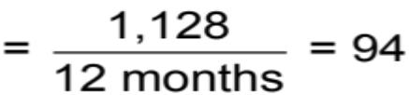
Seasonal Index Example
 | DEMAND
MONTH | YEAR 1 | YEAR 2 | YEAR 3 | AVERAGE YEARLY DEMAND |  |  | AVERAGE MONTHLY DEMAND | SEASONAL INDEX
Jan | 80 | 85 | 105 |  | 90 |  | 94
Feb | 70 | 85 | 85 |  | 80 |  | 94
Mar | 80 | 93 | 82 |  | 85 |  | 94
Apr | 90 | 95 | 115 |  | 100 |  | 94
May | 113 | 125 | 131 |  | 123 |  | 94
June | 110 | 115 | 120 |  | 115 |  | 94
July | 100 | 102 | 113 |  | 105 |  | 94
Aug | 88 | 102 | 110 |  | 100 |  | 94
Sept | 85 | 90 | 95 |  | 90 |  | 94
Oct | 77 | 78 | 85 |  | 80 |  | 94
Nov | 75 | 82 | 83 |  | 80 |  | 94
Dec | 82 | 78 | 80 |  | 80 |  | 94
Total average annual demand = |  |  |  |  | 1,128
Average monthly demand

Slide 101
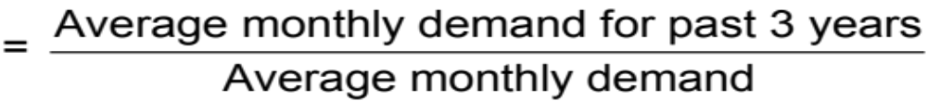
Seasonal Index Example
 | DEMAND
MONTH | YEAR 1 | YEAR 2 | YEAR 3 | AVERAGE YEARLY DEMAND |  |  | AVERAGE MONTHLY DEMAND | SEASONAL INDEX
Jan | 80 | 85 | 105 |  | 90 |  | 94
Feb | 70 | 85 | 85 |  | 80 |  | 94
Mar | 80 | 93 | 82 |  | 85 |  | 94
Apr | 90 | 95 | 115 |  | 100 |  | 94
May | 113 | 125 | 131 |  | 123 |  | 94
June | 110 | 115 | 120 |  | 115 |  | 94
July | 100 | 102 | 113 |  | 105 |  | 94
Aug | 88 | 102 | 110 |  | 100 |  | 94
Sept | 85 | 90 | 95 |  | 90 |  | 94
Oct | 77 | 78 | 85 |  | 80 |  | 94
Nov | 75 | 82 | 83 |  | 80 |  | 94
Dec | 82 | 78 | 80 |  | 80 |  | 94
Total average annual demand = |  |  |  |  | 1,128
.957( = 90/94)
Seasonal index

Slide 102
Seasonal Index Example
 | DEMAND
MONTH | YEAR 1 | YEAR 2 | YEAR 3 | AVERAGE YEARLY DEMAND |  |  | AVERAGE MONTHLY DEMAND | SEASONAL INDEX
Jan | 80 | 85 | 105 |  | 90 |  | 94 | .957( = 90/94)
Feb | 70 | 85 | 85 |  | 80 |  | 94 | .851( = 80/94)
Mar | 80 | 93 | 82 |  | 85 |  | 94 | .904( = 85/94)
Apr | 90 | 95 | 115 |  | 100 |  | 94 | 1.064( = 100/94)
May | 113 | 125 | 131 |  | 123 |  | 94 | 1.309( = 123/94)
June | 110 | 115 | 120 |  | 115 |  | 94 | 1.223( = 115/94)
July | 100 | 102 | 113 |  | 105 |  | 94 | 1.117( = 105/94)
Aug | 88 | 102 | 110 |  | 100 |  | 94 | 1.064( = 100/94)
Sept | 85 | 90 | 95 |  | 90 |  | 94 | .957( = 90/94)
Oct | 77 | 78 | 85 |  | 80 |  | 94 | .851( = 80/94)
Nov | 75 | 82 | 83 |  | 80 |  | 94 | .851( = 80/94)
Dec | 82 | 78 | 80 |  | 80 |  | 94 | .851( = 80/94)
Total average annual demand = |  |  |  |  | 1,128

Slide 103
Seasonal Index Example
Seasonal forecast for Year 4
MONTH | DEMAND |  |  | MONTH | DEMAND
Jan |  | 1,200 | x .957 = 96 | July |  | 1,200 | x 1.117 = 112
 |  | 12 |  |  |  | 12
Feb |  | 1,200 | x .851 = 85 | Aug |  | 1,200 | x 1.064 = 106
 |  | 12 |  |  |  | 12
Mar |  | 1,200 | x .904 = 90 | Sept |  | 1,200 | x .957 = 96
 |  | 12 |  |  |  | 12
Apr |  | 1,200 | x 1.064 = 106 | Oct |  | 1,200 | x .851 = 85
 |  | 12 |  |  |  | 12
May |  | 1,200 | x 1.309 = 131 | Nov |  | 1,200 | x .851 = 85
 |  | 12 |  |  |  | 12
June |  | 1,200 | x 1.223 = 122 | Dec |  | 1,200 | x .851 = 85
 |  | 12 |  |  |  | 12

Slide 104
Seasonal Index Example
Year 4 Forecast
Year 3 Demand
Year 2 Demand
Year 1 Demand
140 –
130 –
120 –
110 –
100 –
90 –
80 –
70 –
Demand
| | | | | | | | | | | |
J F M A M J J A S O N D
Time

Slide 105
San Diego Hospital
Figure 4.6
Trend Data
10,200 –
10,000 –
9,800 –
9,600 –
9,400 –
9,200 –
9,000 –
9702
9745
9616
9659
9530
9573
9724
9766
Inpatient Days
9680
9594
9637
9551
| | | | | | | | | | | |
Jan Feb Mar Apr May June July Aug Sept Oct Nov Dec
67 68 69 70 71 72 73 74 75 76 77 78
Month

Slide 106
San Diego Hospital
 | Seasonality Indices for Adult Inpatient Days at San Diego Hospital
MONTH | SEASONALITY INDEX | MONTH | SEASONALITY INDEX
January | 1.04 | July | 1.03
February | 0.97 | August | 1.04
March | 1.02 | September | 0.97
April | 1.01 | October | 1.00
May | 0.99 | November | 0.96
June | 0.99 | December | 0.98

Slide 107
San Diego Hospital
Figure 4.7
Seasonal Indices
1.06 –
1.04 –
1.02 –
1.00 –
0.98 –
0.96 –
0.94 –
0.92 –
1.04
1.04
1.03
1.02
1.01
1.00
0.99
Index for Inpatient Days
0.98
0.99
0.97
0.97
0.96
| | | | | | | | | | | |
Jan Feb Mar Apr May June July Aug Sept Oct Nov Dec
67 68 69 70 71 72 73 74 75 76 77 78
Month

Slide 108
San Diego Hospital
Period | 67 | 68 | 69 | 70 | 71 | 72
Month | Jan | Feb | Mar | Apr | May | June
Forecast with Trend & Seasonality | 9,911 | 9,265 | 9,164 | 9,691 | 9,520 | 9,542
Period | 73 | 74 | 75 | 76 | 77 | 78
Month | July | Aug | Sept | Oct | Nov | Dec
Forecast with Trend & Seasonality | 9,949 | 10,068 | 9,411 | 9,724 | 9,355 | 9,572

Slide 109
San Diego Hospital
Figure 4.8
Combined Trend and Seasonal Forecast
10,200 –
10,000 –
9,800 –
9,600 –
9,400 –
9,200 –
9,000 –
10068
9911
9949
9764
9724
9691
Inpatient Days
9572
9520
9542
9411
9265
9355
| | | | | | | | | | | |
Jan Feb Mar Apr May June July Aug Sept Oct Nov Dec
67 68 69 70 71 72 73 74 75 76 77 78
Month

Slide 110
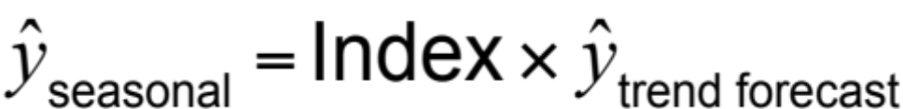
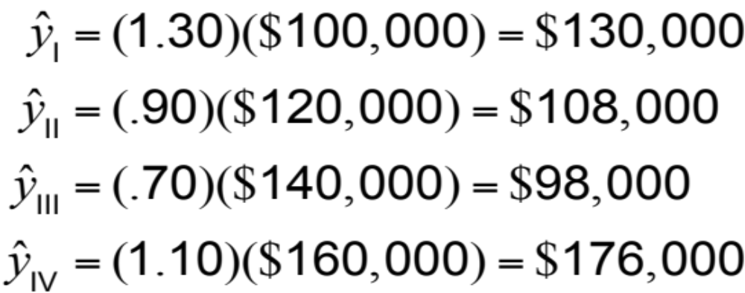
Adjusting Trend Data
Quarter I:
Quarter II:
Quarter III:
Quarter IV:

Slide 111
MODEL ASOSIATIF

Slide 112
Associative Forecasting
Used when changes in one or more independent variables can be used to predict the changes in the dependent variable
Most common technique is linear regression analysis
We apply this technique just as we did in the time-series example

Slide 113
Peramalan asosiatif
Hasil peramalan didasarkan pada variabel prediktor menggunakan teknik kuadrat terkecil
^
y = a + bx
^
di mana y = nilai variabel terikat (yang diramalkan)
a = intersep sumbu y
b = kemiringan garis regresi
x = variabel bebas (prediktor)

Slide 114
Associative Forecasting Example
NODEL’S SALES (IN $ MILLIONS), y | AREA PAYROLL (IN $ BILLIONS), x | NODEL’S SALES (IN $ MILLIONS), y | AREA PAYROLL (IN $ BILLIONS), x
2.0 | 1 | 2.0 | 2
3.0 | 3 | 2.0 | 1
2.5 | 4 | 3.5 | 7
4.0 –
3.0 –
2.0 –
1.0 –
Nodel’s sales
(in$ millions)
| | | | | | |
0 1 2 3 4 5 6 7
Area payroll (in $ billions)

Slide 115
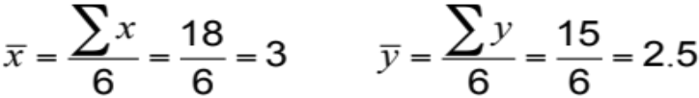
Associative Forecasting Example
SALES, y |  |  | PAYROLL, x |  |  |  | x² |  |  | xy
 | 2.0 |  |  | 1 |  |  | 1 |  |  | 2.0
 | 3.0 |  |  | 3 |  |  | 9 |  |  | 9.0
 | 2.5 |  |  | 4 |  |  | 16 |  |  | 10.0
 | 2.0 |  |  | 2 |  |  | 4 |  |  | 4.0
 | 2.0 |  |  | 1 |  |  | 1 |  |  | 2.0
 | 3.5 |  |  | 7 |  | 49 |  |  |  | 24.5
Σy = | 15.0 |  | Σx = | 18 |  | Σx² = | 80 |  | Σxy = | 51.5

Slide 116
Associative Forecasting Example
SALES, y |  |  | PAYROLL, x |  |  |  | x² |  |  | xy
 | 2.0 |  |  | 1 |  |  | 1 |  |  | 2.0
 | 3.0 |  |  | 3 |  |  | 9 |  |  | 9.0
 | 2.5 |  |  | 4 |  |  | 16 |  |  | 10.0
 | 2.0 |  |  | 2 |  |  | 4 |  |  | 4.0
 | 2.0 |  |  | 1 |  |  | 1 |  |  | 2.0
 | 3.5 |  |  | 7 |  | 49 |  |  |  | 24.5
Σy = | 15.0 |  | Σx = | 18 |  | Σx² = | 80 |  | Σxy = | 51.5

Slide 117
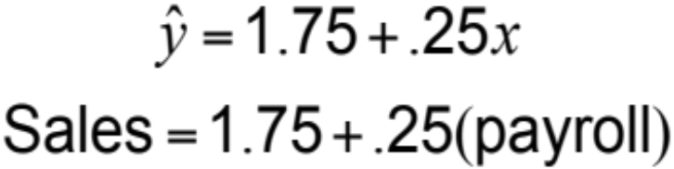
Associative Forecasting Example
SALES, y |  |  | PAYROLL, x |  |  |  | x² |  |  | xy
 | 2.0 |  |  | 1 |  |  | 1 |  |  | 2.0
 | 3.0 |  |  | 3 |  |  | 9 |  |  | 9.0
 | 2.5 |  |  | 4 |  |  | 16 |  |  | 10.0
 | 2.0 |  |  | 2 |  |  | 4 |  |  | 4.0
 | 2.0 |  |  | 1 |  |  | 1 |  |  | 2.0
 | 3.5 |  |  | 7 |  | 49 |  |  |  | 24.5
Σy = | 15.0 |  | Σx = | 18 |  | Σx² = | 80 |  | Σxy = | 51.5

Slide 118
Associative Forecasting Example
SALES, y |  |  | PAYROLL, x |  |  |  | x² |  |  | xy
 | 2.0 |  |  | 1 |  |  | 1 |  |  | 2.0
 | 3.0 |  |  | 3 |  |  | 9 |  |  | 9.0
 | 2.5 |  |  | 4 |  |  | 16 |  |  | 10.0
 | 2.0 |  |  | 2 |  |  | 4 |  |  | 4.0
 | 2.0 |  |  | 1 |  |  | 1 |  |  | 2.0
 | 3.5 |  |  | 7 |  | 49 |  |  |  | 24.5
Σy = | 15.0 |  | Σx = | 18 |  | Σx² = | 80 |  | Σxy = | 51.5
4.0 –
3.0 –
2.0 –
1.0 –
Nodel’s sales
(in$ millions)
| | | | | | |
0 1 2 3 4 5 6 7
Area payroll (in $ billions)

Slide 119
Associative Forecasting Example
If payroll next year is estimated to be $6 billion, then:
Sales (in $ millions) = 1.75 + .25(6)
= 1.75 + 1.5 = 3.25
Sales = $3,250,000

Slide 120
Associative Forecasting Example
4.0 –
3.0 –
2.0 –
1.0 –
If payroll next year is estimated to be $6 billion, then:
3.25
Nodel’s sales
(in$ millions)
Sales (in$ millions) = 1.75 + .25(6)
= 1.75 + 1.5 = 3.25
Sales = $3,250,000
| | | | | | |
0 1 2 3 4 5 6 7
Area payroll (in $ billions)

Slide 121

Standard Error of the Estimate
A forecast is just a point estimate of a future value
This point is
actually the
mean of a
probability
distribution
4.0 –
3.0 –
2.0 –
1.0 –
3.25
Regression line,
Nodel’s sales
(in$ millions)
| | | | | | |
0 1 2 3 4 5 6 7
Area payroll (in $ billions)
Figure 4.9

Slide 122
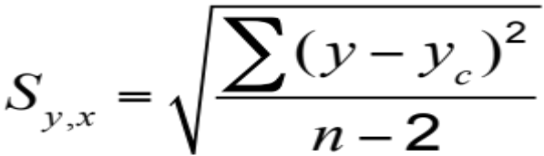
Standard Error of the Estimate
where y = y-value of each data point
y_{c} = computed value of the dependent variable, from the regression equation
n = number of data points

Slide 123
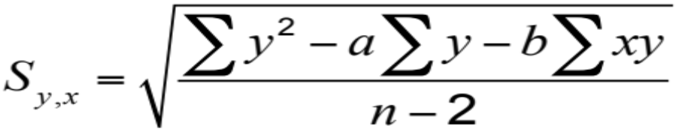
Standard Error of the Estimate
Computationally, this equation is considerably easier to use
We use the standard error to set up prediction intervals around the point estimate

Slide 124
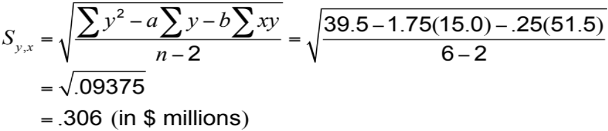
Standard Error of the Estimate
4.0 –
3.0 –
2.0 –
1.0 –
3.25
The standard error of the estimate is $306,000 in sales
Nodel’s sales
(in$ millions)
| | | | | | |
0 1 2 3 4 5 6 7
Area payroll (in $ billions)

Slide 125
Correlation
How strong is the linear relationship between the variables?
Correlation does not necessarily imply causality!
Coefficient of correlation, r, measures degree of association
  Values range from -1 to +1

Slide 126
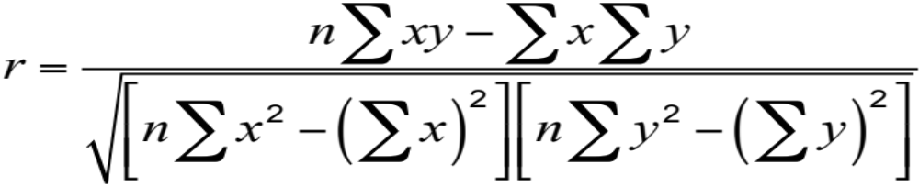
Correlation Coefficient

Slide 127
Correlation Coefficient
Figure 4.10
y
y
x
x
(a) Perfect negative correlation
(e) Perfect positive correlation
y
y
x
y
x
(b) Negative correlation
(d) Positive correlation
x
(c) No correlation
High
Moderate
Low
Low
Moderate
High
| | | | | | | | |
–1.0 –0.8 –0.6 –0.4 –0.2 0 0.2 0.4 0.6 0.8 1.0
Correlation coefficient values

Slide 128
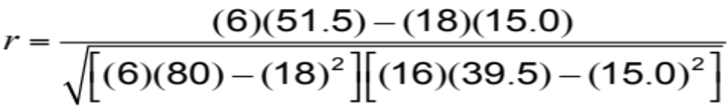
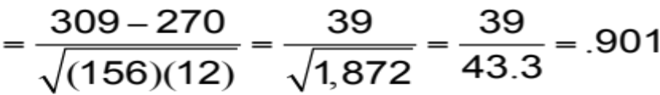
Correlation Coefficient
y |  |  | x |  |  |  | x² |  |  | xy |  |  | y²
 | 2.0 |  |  | 1 |  |  | 1 |  |  | 2.0 |  |  | 4.0
 | 3.0 |  |  | 3 |  |  | 9 |  |  | 9.0 |  |  | 9.0
 | 2.5 |  |  | 4 |  |  | 16 |  |  | 10.0 |  |  | 6.25
 | 2.0 |  |  | 2 |  |  | 4 |  |  | 4.0 |  |  | 4.0
 | 2.0 |  |  | 1 |  |  | 1 |  |  | 2.0 |  |  | 4.0
 | 3.5 |  |  | 7 |  | 49 |  |  |  | 24.5 |  |  | 12.25
Σy = | 15.0 |  | Σx = | 18 |  | Σx² = | 80 |  | Σxy = | 51.5 |  | Σy² = | 39.5

Slide 129
Correlation
Coefficient of Determination, r², measures the percent of change in y predicted by the change in x
  Values range from 0 to 1
  Easy to interpret
For the Nodel Construction example:
r = .901
r² = .81

Slide 130

Multiple-Regression Analysis
If more than one independent variable is to be used in the model, linear regression can be extended to multiple regression to accommodate several independent variables
Computationally, this is quite complex and generally done on the computer

Slide 131

Multiple-Regression Analysis
In the Nodel example, including interest rates in the model gives the new equation:
An improved correlation coefficient of r = .96 suggests this model does a better job of predicting the change in construction sales
Sales = 1.80 + .30(6) - 5.0(.12) = 3.00
Sales = $3,000,000

Slide 132
Monitoring and Controlling Forecasts
Tracking Signal
Measures how well the forecast is predicting actual values
Ratio of cumulative forecast errors to mean absolute deviation (MAD)
  Good tracking signal has low values
  If forecasts are continually high or low, the forecast has a bias error

Slide 133
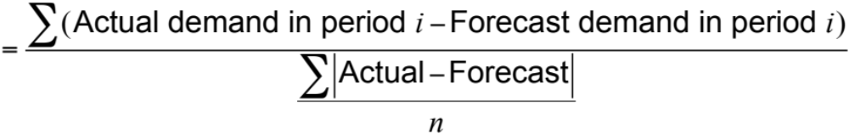
Monitoring and Controlling Forecasts
Tracking signal
Cumulative error
MAD
=

Slide 134
Tracking Signal
Figure 4.11
Signal exceeding limit
+
0 MADs
–
Tracking signal
Upper control limit
Acceptable range
Lower control limit
Time

Slide 135
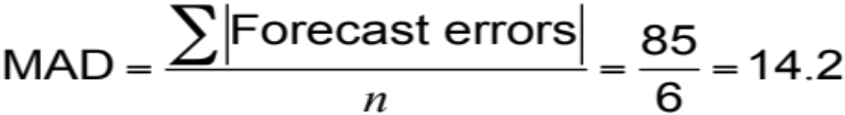
Tracking Signal Example
QTR | ACTUAL DEMAND | FORECAST DEMAND | ERROR | CUM ERROR | ABSOLUTE FORECAST ERROR | CUM ABS FORECAST ERROR | MAD | TRACKING SIGNAL (CUM ERROR/MAD)
1 | 90 | 100 | –10 | –10 | 10 | 10 | 10.0 | –10/10 = –1
2 | 95 | 100 | –5 | –15 | 5 | 15 | 7.5 | –15/7.5 = –2
3 | 115 | 100 | +15 | 0 | 15 | 30 | 10. | 0/10 = 0
4 | 100 | 110 | –10 | –10 | 10 | 40 | 10. | 10/10 = –1
5 | 125 | 110 | +15 | +5 | 15 | 55 | 11.0 | +5/11 = +0.5
6 | 140 | 110 | +30 | +35 | 30 | 85 | 14.2 | +35/14.2 = +2.5
At the end of quarter 6,

Slide 136
Adaptive Smoothing
It’s possible to use the computer to continually monitor forecast error and adjust the values of the a and b coefficients used in exponential smoothing to continually minimize forecast error
This technique is called adaptive smoothing

Slide 137
Focus Forecasting
Developed at American Hardware Supply, based on two principles:
Sophisticated forecasting models are not always better than simple ones
There is no single technique that should be used for all products or services
Uses historical data to test multiple forecasting models for individual items
Forecasting model with the lowest error used to forecast the next demand

Slide 138
Forecasting in the Service Sector
Presents unusual challenges
  Special need for short term records
  Needs differ greatly as function of industry and product
  Holidays and other calendar events
  Unusual events

Slide 139
Fast Food Restaurant Forecast
Figure 4.12
20% –
15% –
10% –
5% –
Percentage of sales by hour of day
11-12 1-2 3-4 5-6 7-8 9-10
12-1 2-3 4-5 6-7 8-9 10-11
(Lunchtime)
(Dinnertime)
Hour of day

Slide 140
FedEx Call Center Forecast
Figure 4.12
12% –
10% –
8% –
6% –
4% –
2% –
0% –
2
4
6
8
10
12
2
4
6
8
10
12
A.M.
P.M.
Hour of day

