Slide 1
Desain Barang dan Jasa
Bab 05

Slide 2
Outline
Global Company Profile: Regal Marine
Goods and Services Selection
Generating New Products
Product Development
Issues for Product Design
Product Development Continuum

Slide 3
Outline
Defining a Product
Documents for Production
Service Design
Application of Decision Trees to Product Design
Transition to Production

Slide 4
Learning Objectives
When you complete this chapter you should be able to :
Define product life cycle
Describe a product development system
Build a house of quality
Explain how time-based competition is implemented by OM

Slide 5
Learning Objectives
When you complete this chapter you should be able to :
Describe how products and services are defined by OM
Describe the documents needed for production
Explain how the customer participates in the design and delivery of services
Apply decision trees to product issues

Slide 6
Regal Marine
Visit: http://www.regalmarine.com.au
Global market
3-dimensional CAD system
  Reduced product development time
  Reduced problems with tooling
  Reduced problems in production
Assembly line production
JIT

Slide 7
ABOUT REGAL MARINE
Thirty years after its founding by potato farmer Paul Kuck, Regal Marine has become a powerful force on the waters of the world. The world's third-largest boat manufacturer (by global sales), Regal exports to 30 countries, including Russia and China. Almost one-third of its sales are overseas.
Product design is critical in the highly competitive pleasure boat business: "We keep in touch with our customers and we respond to the marketplace," says Kuck. "We're introducing six new models this year alone. I'd say we're definitely on the aggressive end of the spectrum."
With changing consumer tastes, compounded by material changes and ever-improving marine engineering, the design function is under constant pressure. Added to these pressures is the constant issue of cost competitiveness combined with the need to provide good value for customers.
Consequently, Regal Marine is a frequent user of Computer-Aided Design (CAD). New designs come to life via Regal's three-dimensional CAD system, borrowed from automotive technology. Regal's naval architects' goal is to continue to reduce the time from concept to prototype to production. The sophisticated CAD system not only has reduced product development time but also has reduced problems with tooling and production, resulting in a superior product.

Slide 8
ABOUT REGAL MARINE
All of Regal's products, from its $14,000 19-foot boat to the $500,000 44-foot Commodore Yacht, follow a similar production process. Hulls and decks are separately hand-produced by spraying preformed molds with three to five layers of a fiberglass laminate. The hulls and decks harden and are removed to become the lower and upper structure of the boat. As they move to the assembly line, they are joined and components added at each workstation.
Wooden components, precut in-house by computer-driven routers, are delivered on a just-in­time basis for installation at one station. Engines—one of the few purchased components—are installed at another. Racks of electrical wiring harnesses, engineered and rigged in-house, are then installed. An in-house upholstery department delivers customized seats, beds, dashboards, or other cushioned components. Finally, chrome fixtures are put in place, and the boat is sent to Regal's test tank for watertight, gauge, and system inspection.

Slide 9
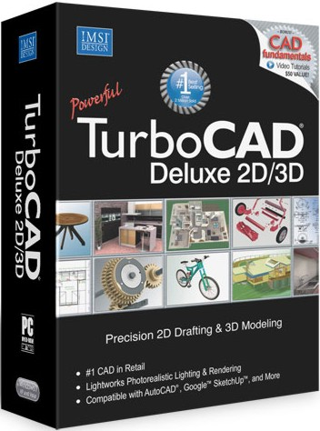
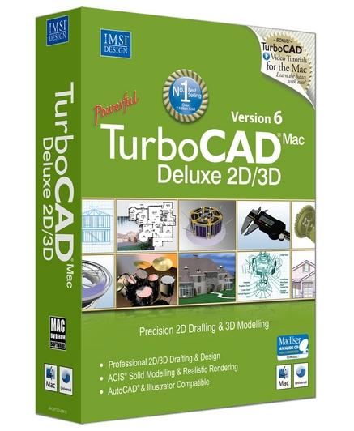

Slide 10
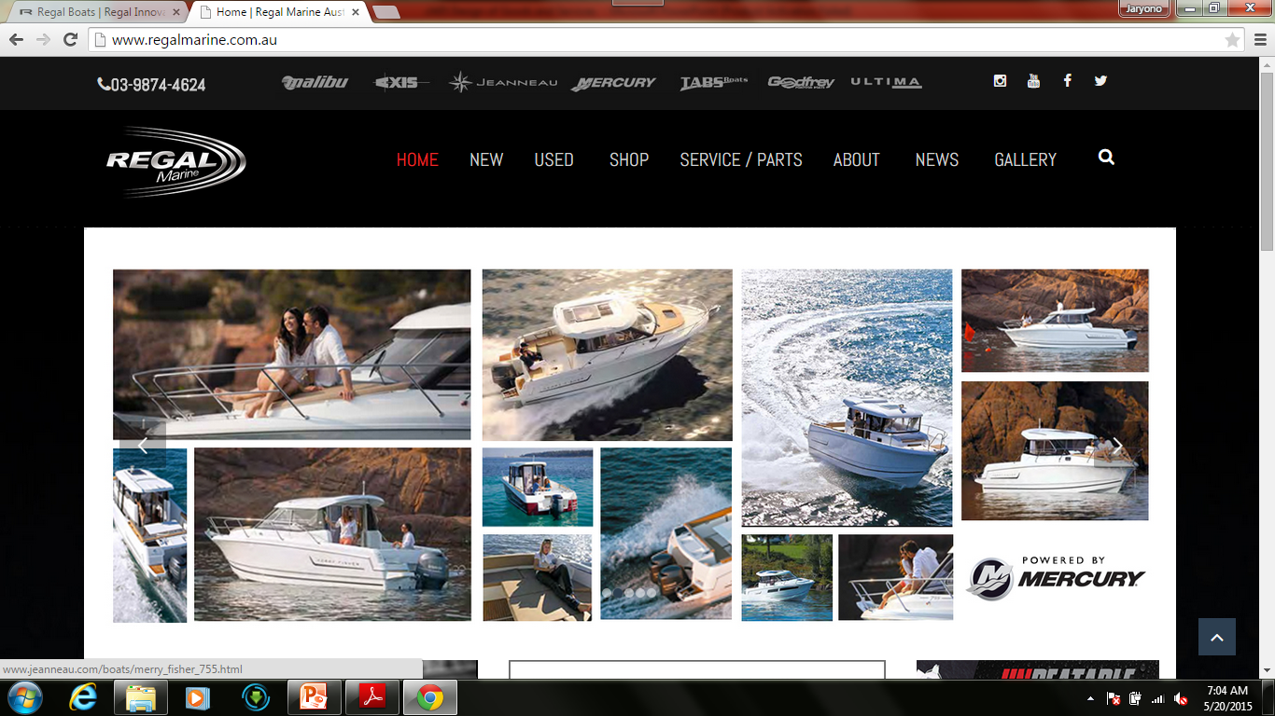

Slide 11
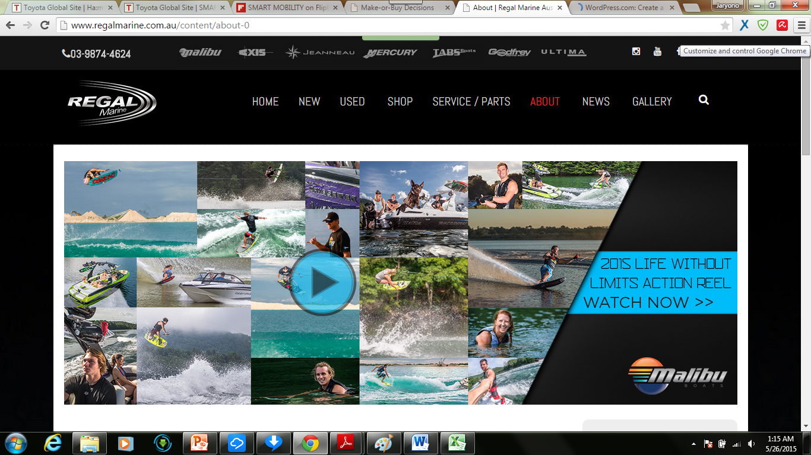

Slide 12
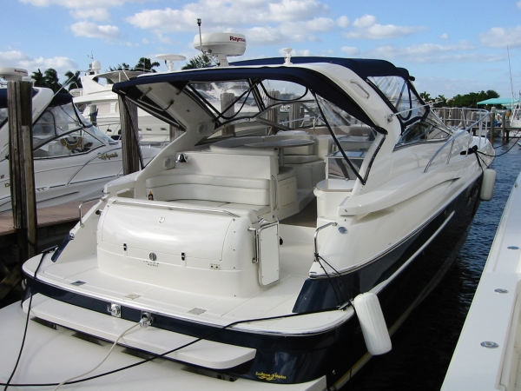

Slide 13


Slide 14
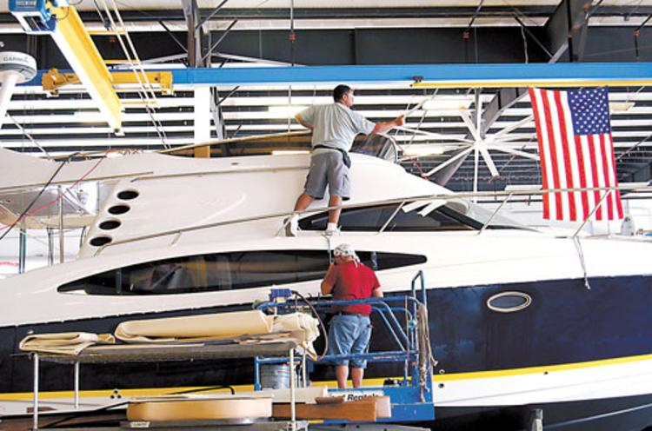

Slide 15
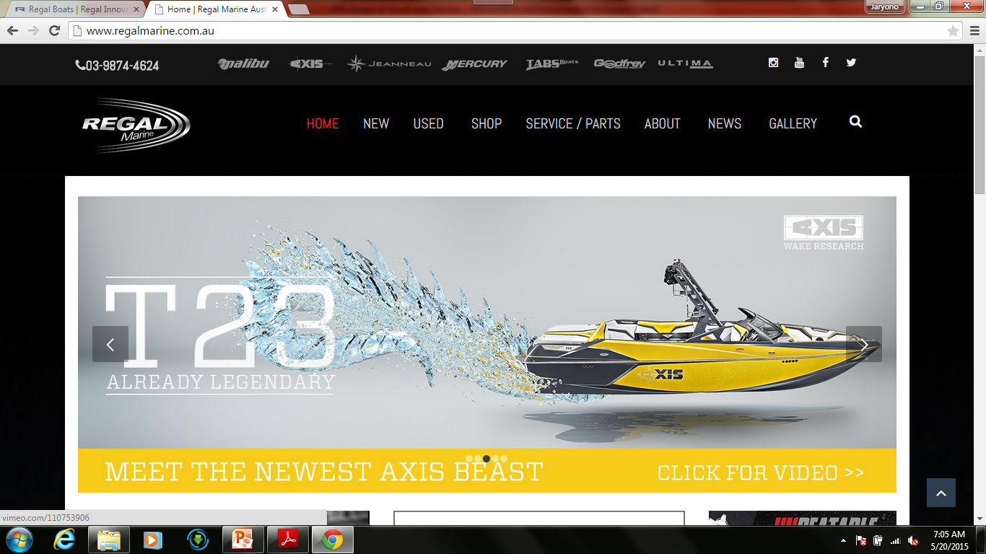

Slide 16


Slide 17



Slide 18
5.1 Goods and services selection

Slide 19
Goods and Services Selection
Organizations exist to provide goods or services to society
Great products are the key to success
Top organizations typically focus on core products
Customers buy satisfaction, not just a physical good or particular service
Fundamental to an organization's strategy with implications throughout the operations function

Slide 20
Goods and Services Selection
Goods or services are the basis for an organization's existence
Limited and predicable life cycles requires constantly looking for, designing, and developing new products
New products generate substantial revenue

Slide 21
Goods and Services Selection
50% –
40% –
30% –
20% –
10% –
0% –
The higher the percentage of sales from the last 5 years, the more likely the firm is to be a leader.
Percent of sales from new products
Industry leader
Top third
Middle third
Bottom third
Position of firm in its industry
Figure 5.1

Slide 22
Product Decision
The objective of the product decision is to develop and implement a product strategy that meets the demands of the marketplace with a competitive advantage

Slide 23
Product Strategy Options
Differentiation
  Shouldice Hospital http://www.shouldice.com
Low cost
  Taco Bell http://www.tacobell.com
Rapid response
  Toyota http://www.toyota-global.com/innovation/smart_mobility_society/

Slide 24

Founded in 1945, Shouldice Hospital is The global leader in hernia repair. Our 99.5% lifetime success rate for primary inguinal hernias sets the gold standard for medical professionals around the world. Shouldice specializes in external abdominal wall hernias.

Slide 25
About Shouldice Hospital
Over 65 years of clinical evidence clearly demonstrates that the Shouldice surgical procedure is exceptionally safe and the repair is secure and reliable. Our rate of infection, complications and recurrence is less than 0.5% for primary inguinal hernia repairs. This is the lowest recorded rate in the world.
If you think you have a hernia, we offer a walk-in clinic for your convenience. We always recommend that you come to the clinic for an examination, if at all possible. Our surgeons have years of specialized training and experience and are available during clinic hours to provide an expert diagnosis.
Our walk-in clinic is available at no direct cost to our patients. If you live more than 1 hour (100 km/60 miles) away from Shouldice, you can submit a medical questionnaire for our surgeons to review.

Slide 26
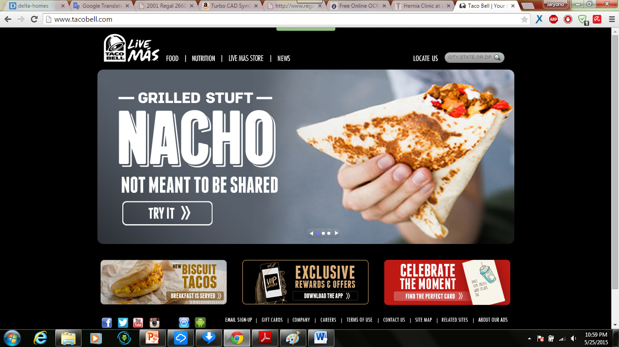

Slide 27
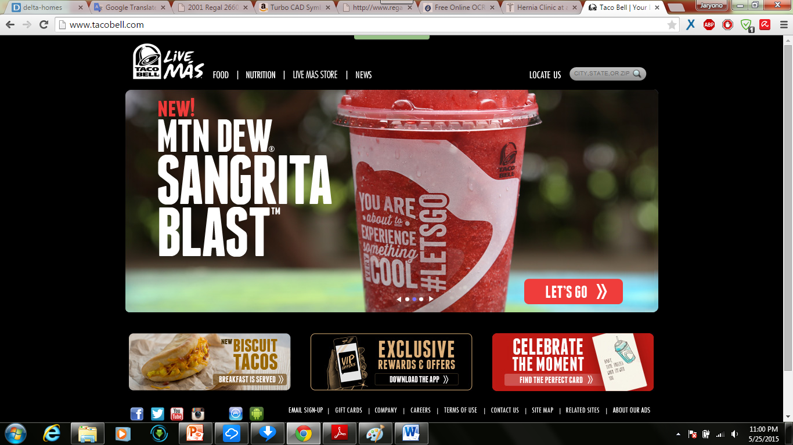

Slide 28
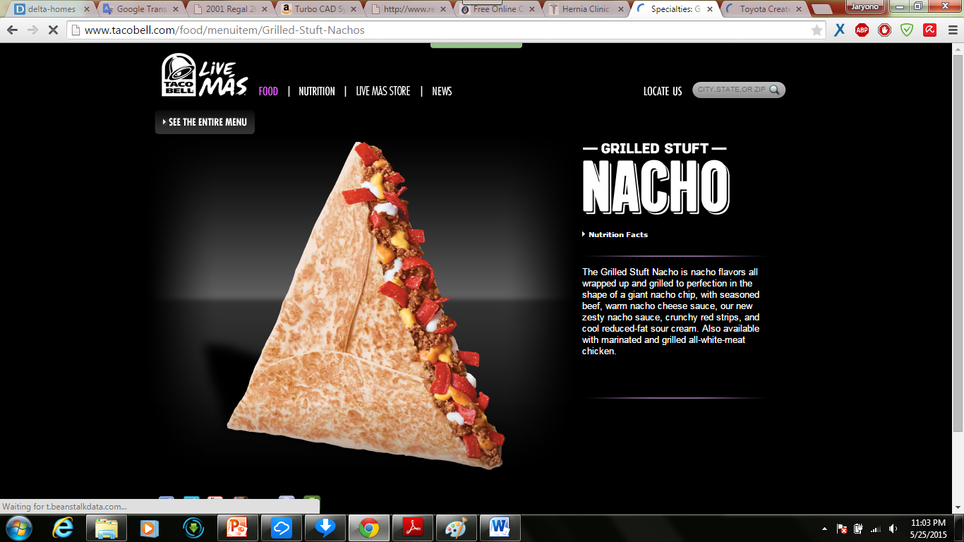

Slide 29
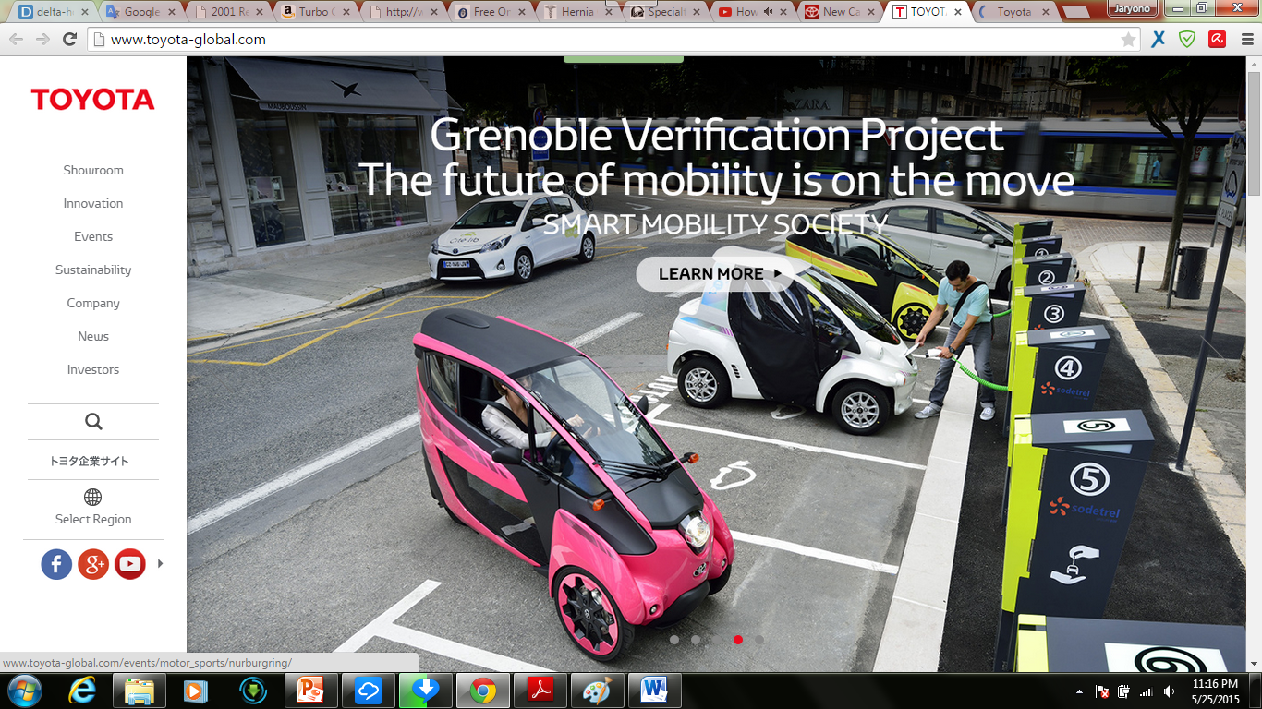

Slide 30
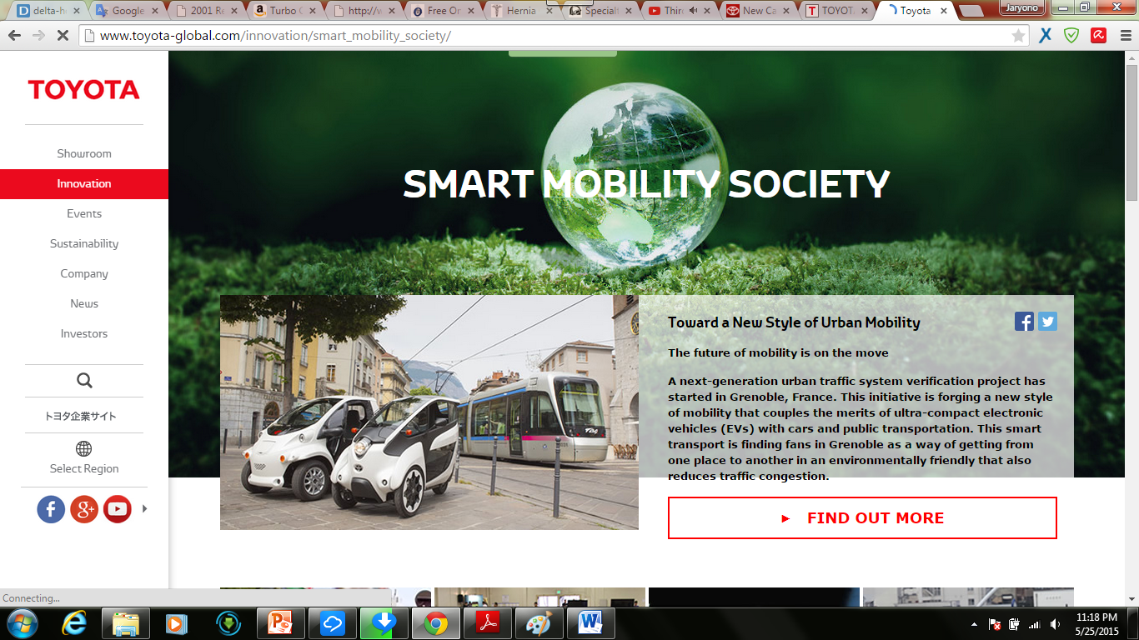

Slide 31
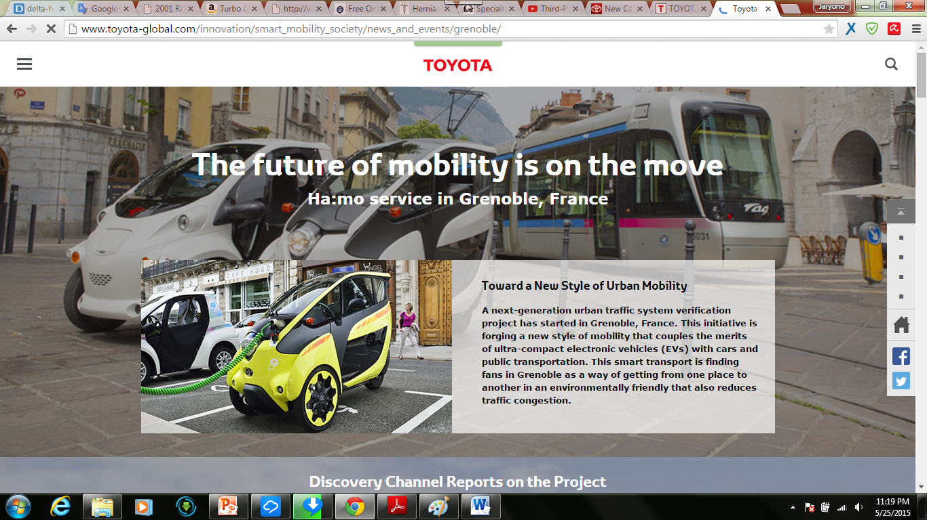

Slide 32
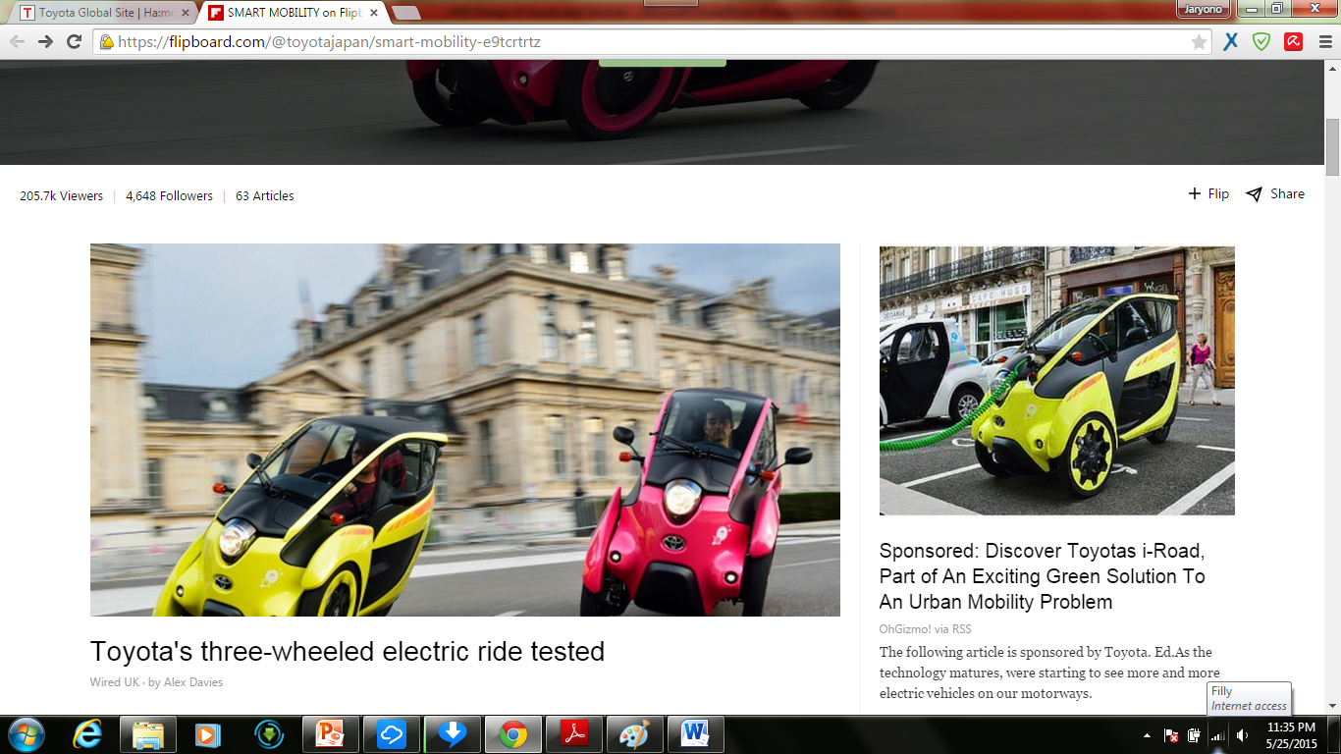

Slide 33
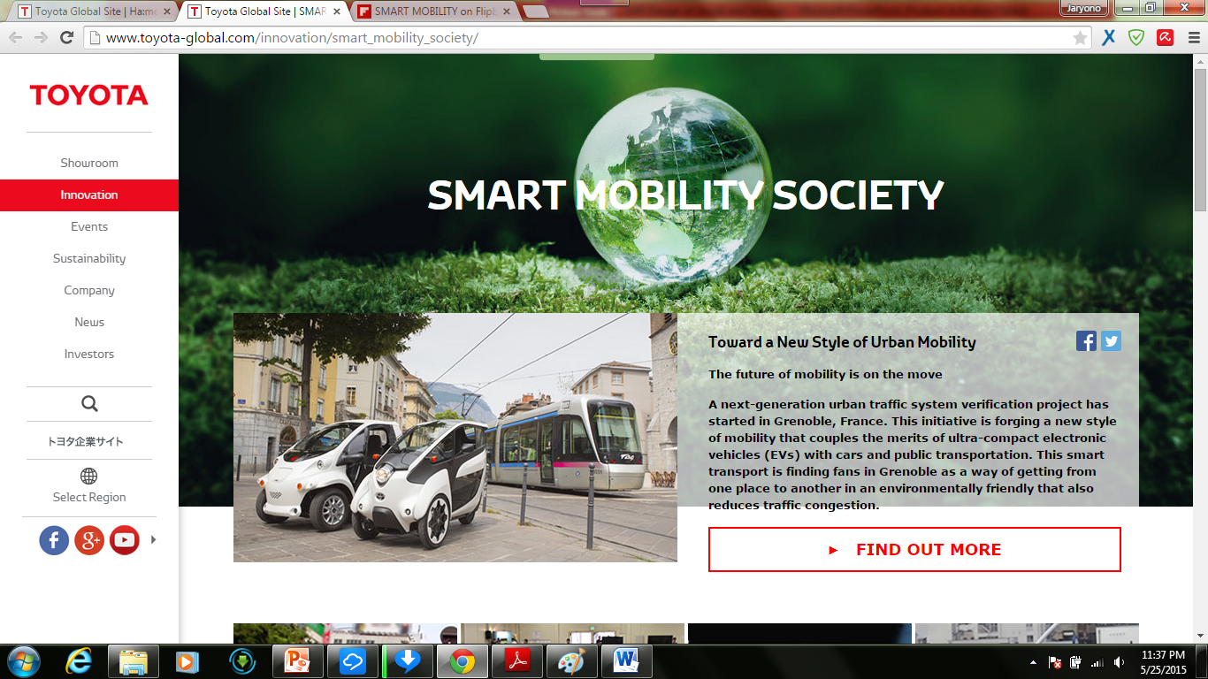

Slide 34
Product Life Cycles
May be any length from a few days to decades
The operations function must be able to introduce new products successfully

Slide 35
Product Life Cycles
Cost of development and production
Sales revenue
Net revenue (profit)
Sales, cost, and cash flow
Cash flow
Negative cash flow
Loss
Introduction Growth Maturity Decline
Figure 5.2

Slide 36
Life Cycle and Strategy
Introductory Phase
Fine tuning may warrant unusual expenses for
  Research
  Product development
  Process modification and enhancement
  Supplier development

Slide 37
Life Cycle and Strategy
Growth Phase
Product design begins to stabilize
Effective forecasting of capacity becomes necessary
Adding or enhancing capacity may be necessary

Slide 38
Life Cycle and Strategy
Maturity Phase
Competitors now established
High volume, innovative production may be needed
Improved cost control, reduction in options, paring down of product line

Slide 39
Life Cycle and Strategy
Decline Phase
Unless product makes a special contribution to the organization, must plan to terminate offering

Slide 40
Product-by-Value Analysis
Lists products in descending order of their individual dollar contribution to the firm
Lists the total annual dollar contribution of the product
Helps management evaluate alternative strategies

Slide 41
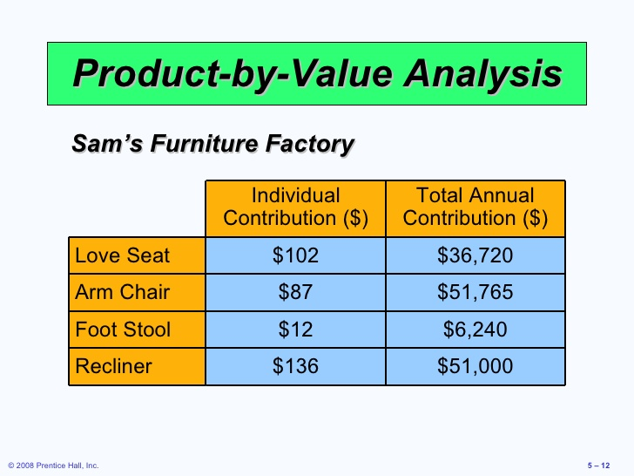

Slide 42
Generating New Products
Understanding the customer
Economic change
Sociological and demographic change
Technological change
Political and legal change
Market practice, professional standards, suppliers, distributors

Slide 43
Product Development Stages
Figure 5.3
Concept
Feasibility
Customer Requirements
Functional Specifications
Product Specifications
Scope of product development team
Scope for design and engineering teams
Design Review
Test Market
Introduction
Evaluation

Slide 44
Quality Function Deployment (QFD)
QFD is a process for determining customer requirements (customer ‘wants’) and translating them into the attributes (the ‘hows’) that each functional area can understand and act on.

Slide 45
Quality Function Deployment (QFD)
Identify customer wants
Identify how the good/service will satisfy customer wants
Relate customer wants to product hows
Identify relationships between the firm’s hows
Develop customer importance ratings
Evaluate competing products
Compare performance to desirable technical attributes

Slide 46
House of Quality
House of quality is a part of the Quality Function Deployment process that utilizes a planning matrix to relate customer “wants” to “how” the firm is going to meet those “wants.”

Slide 47
QFD House of Quality
Interrelationships
Customer importance ratings
How to satisfy
customer wants
What the customer
wants
Relationship
matrix
Competitive assessment
Target values
Weighted rating
Technical
evaluation
Notes:
1

Slide 48
House of Quality Example
Your team has been charged with designing a new camera for Great Cameras, Inc.
The first action is
to construct a
House of Quality

Slide 49
House of Quality Example
Interrelationships
How to Satisfy
Customer Wants
What the Customer
Wants
Relationship
Matrix
Analysis of
Competitors
Technical
Attributes and
Evaluation
What the customer wants
Customer
importance
rating
(5 = highest)
Lightweight 3
Easy to use 4
Reliable 5
Easy to hold steady 2
High resolution 1

Slide 50
House of Quality Example
Interrelationships
How to Satisfy
Customer Wants
What the Customer
Wants
Relationship
Matrix
Analysis of
Competitors
Technical
Attributes and
Evaluation
Low electricity requirements
Aluminum components
Auto focus
Auto exposure
High number of pixels
Ergonomic design
How to Satisfy
Customer Wants

Slide 51
House of Quality Example
Interrelationships
How to Satisfy
Customer Wants
What the Customer
Wants
Relationship
Matrix
Analysis of
Competitors
High relationship
Medium relationship
Low relationship
Technical
Attributes and
Evaluation
Lightweight 3
Easy to use 4
Reliable 5
Easy to hold steady 2
High resolution 1
Relationship matrix

Slide 52
House of Quality Example
Interrelationships
How to Satisfy
Customer Wants
What the Customer
Wants
Relationship
Matrix
Analysis of
Competitors
Technical
Attributes and
Evaluation
Relationships between the things we can do
Low electricity requirements
Aluminum components
Auto focus
Auto exposure
High number of pixels
Ergonomic design

Slide 53
House of Quality Example
Interrelationships
How to Satisfy
Customer Wants
What the Customer
Wants
Relationship
Matrix
Analysis of
Competitors
Technical
Attributes and
Evaluation
Lightweight 3
Easy to use 4
Reliable 5
Easy to hold steady 2
High resolution 1
Our importance ratings 22 9 27 27 32 25
Weighted rating

Slide 54
House of Quality Example
Interrelationships
How to Satisfy
Customer Wants
What the Customer
Wants
Relationship
Matrix
Analysis of
Competitors
Technical
Attributes and
Evaluation
Company A
Company B
How well do competing products meet customer wants
Lightweight 3
Easy to use 4
Reliable 5
Easy to hold steady 2
High resolution 1
G P
G P
F G
G P
P P
Our importance ratings 22 5

Slide 55
House of Quality Example
Interrelationships
How to Satisfy
Customer Wants
What the Customer
Wants
Relationship
Matrix
Analysis of
Competitors
Technical
Attributes and
Evaluation
2 circuits
Failure 1 per 10,000
Panel ranking
Target values
(Technical attributes)
75%
2’ to ∞
0.5 A
Company A 0.7 60% yes 1 ok G
Company B 0.6 50% yes 2 ok F
Us 0.5 75% yes 2 ok G
Technical evaluation

Slide 56
House of Quality Example
Low electricity requirements
Aluminum components
Auto focus
Auto exposure
High number of pixels
Ergonomic design
Company A
Company B
Lightweight 3
Easy to use 4
Reliable 5
Easy to hold steady 2
High resolution 1
Our importance ratings
G P
G P
F G
G P
P P
Completed House of Quality
22 9 27 27 32 25
0.5 A
75%
2’ to ∞
2 circuits
Failure 1 per 10,000
Panel ranking
Target values
(Technical attributes)
Company A 0.7 60% yes 1 ok G
Company B 0.6 50% yes 2 ok F
Us 0.5 75% yes 2 ok G
Technical evaluation

Slide 57
House of Quality Sequence
Deploying resources through the organization in response to customer requirements
Quality plan
Production process
Specific components
House 4
Production process
Design characteristics
House 3
Specific components
House 2
Design characteristics
House 1
Customer requirements
Figure 5.4

Slide 58
Organizing for Product Development
Traditionally – distinct departments
  Duties and responsibilities are defined
  Difficult to foster forward thinking
A Champion
  Product manager drives the product through the product development system and related organizations

Slide 59
Organizing for Product Development
Team approach
  Cross functional – representatives from all disciplines or functions
  Product development teams, design for manufacturability teams, value engineering teams
Japanese “whole organization” approach
  No organizational divisions

Slide 60
Manufacturability and
Value Engineering
Benefits:
  Reduced complexity of the product
  Reduction of environmental impact
  Additional standardization of components
  Improvement of functional aspects of the product
  Improved job design and job safety
  Improved maintainability (serviceability) of the product
  Robust design

Slide 61
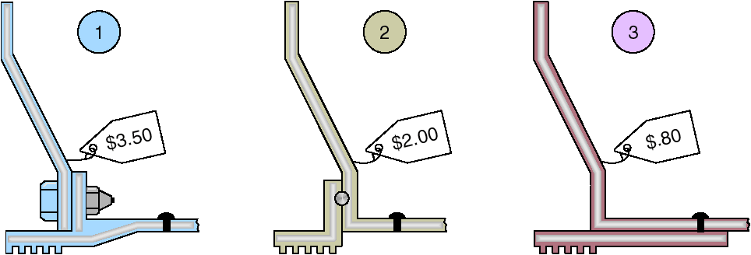
Cost Reduction of a Bracket via Value Engineering
Figure 5.5

Slide 62
ISSUE FOR
PRODUCT DESIGN

Slide 63
Issues for Product Design
Robust design
Modular design
Computer-aided design (CAD)
Computer-aided manufacturing (CAM)
Virtual reality technology
Value analysis
Sustainability and Life Cycle Assessment (LCA)

Slide 64
Robust Design
Robust design: A design that can be produced to requirement even with unfavorable conditions in the production process
Product is designed so that small variations in production or assembly do not adversely affect the product.
Typically results in lower cost and higher quality.

Slide 65
Modular Design
Modular design: A design in which parts or components of a product are subdivided into modules that are easily interchanged or replaced.
Products designed in easily segmented components
Adds flexibility to both production and marketing
Improved ability to satisfy customer requirements

Slide 66
Computer Aided Design (CAD)
CAD: Interactive use of a computer to develop and document a product.
Using computers to design products and prepare engineering documentation
Shorter development cycles, improved accuracy, lower cost
Information and designs can be deployed worldwide

Slide 67
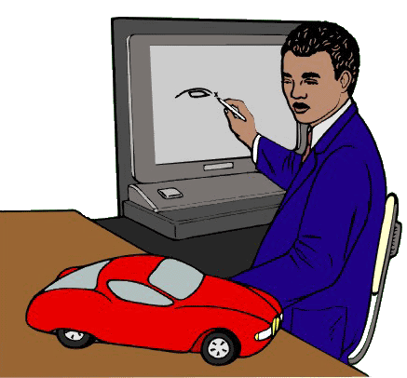
Computer Aided Design (CAD)
CAD: Interactive use of a computer to develop and document a product.
Using computers to design products and prepare engineering documentation
Shorter development cycles, improved accuracy, lower cost
Information and designs can be deployed worldwide

Slide 68
Extensions of CAD
Design for Manufacturing and Assembly (DFMA): Software that allows designers to look at the effect of design on manufacturing of the product.
  Solve manufacturing problems during the design stage
3-D Object Modeling: An extension of CAD that builds small prototype.
  Small prototype
  development
CAD through the
internet
International data
exchange through STEP

Slide 69
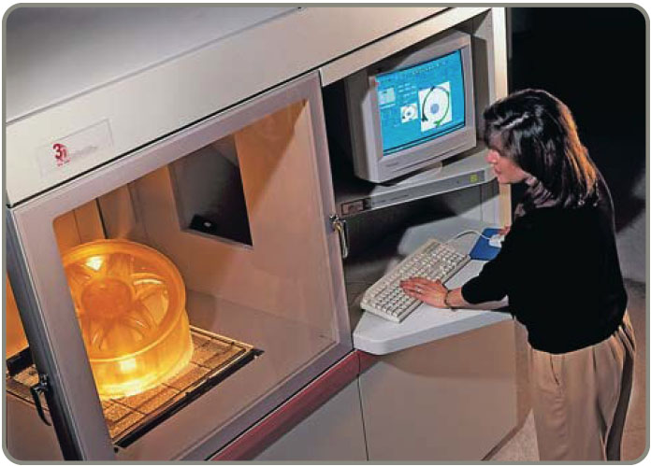
Extensions of CAD
Design for Manufacturing and Assembly (DFMA): Software that allows designers to look at the effect of design on manufacturing of the product.
  Solve manufacturing problems during the design stage
3-D Object Modeling: An extension of CAD that builds small prototype.
  Small prototype
  development
CAD through the
internet
International data
exchange through STEP

Slide 70
Computer-Aided Manufacturing (CAM)
CAM: The use of information technology to control machinery.
Utilizing specialized computers and program to control manufacturing equipment
Often driven by the CAD system (CAD/CAM)

Slide 71
Benefits of CAD/CAM
Product quality
Shorter design time
Production cost reductions
Database availability
New range of capabilities

Slide 72
Virtual Reality Technology
Virtual Reality Technology: A visual form of communication in which images substitute for reality and typically allow the user to respond interactively.
Computer technology used to develop an interactive, 3-D model of a product from the basic CAD data
Allows people to ‘see’ the finished design before a physical model is built
Very effective in large-scale designs such as plant layout

Slide 73

FORD USING VR DURING THE DESIGN PHASE
Published on Mar 19, 2012
Ford has been able to cut the car manufacturing process in half, from six years to three years, using virtual reality during the design phase. SmartPlanet correspondent Sumi Das gets outfitted with the virtual-reality gear and steps inside the machine for a preview.

Slide 74
Value Analysis
Value Analysis: A review of successful products that takes place during the production process.
Focuses on design improvement during production
Seeks improvements leading either to a better product or a product which can be produced more economically with less environmental impact

Slide 75
Sustainability and Life Cycle Assessment (LCA)
Life Cycle Assessment (LCA): Part of ISO 14000; assesses the environmental impact of a product, from material and energy inputs to disposal and environmental releases.
Sustainability means meeting the needs of the present without compromising the ability of future generations to meet their needs
LCA is a formal evaluation of the environmental impact of a product

Slide 76
Product Development Continuum
Product life cycles are becoming shorter and the rate of technological change is increasing
Developing new products faster can result in a competitive advantage
Time-Based Competition

Slide 77
Product Development Continuum
External Development Strategies
Alliances
Joint ventures
Purchase technology or expertise
by acquiring the developer
Figure 5.6
Internal Development Strategies
Migrations of existing products
Enhancements to existing products
New internally developed products
Internal Cost of product development Shared
Lengthy Speed of product development Rapid and/
or Existing
High Risk of product development Shared

Slide 78
Product Development Continuum
Purchasing technology by acquiring a firm
  Speeds development
  Issues concern the fit between the acquired organization and product and the host
Joint Ventures
  Both organizations learn
  Risks are shared

Slide 79
Product Development Continuum
Through Alliances
  Cooperative agreements between independent organizations
  Useful when technology is developing
  Reduces risks

Slide 80
Defining a Product
First definition is in terms of functions
Rigorous specifications are developed during the design phase
Manufactured products will have an engineering drawing
Bill of material (BOM) lists the components of a product

Slide 81

Monterey Jack Cheese
(a) U.S. grade AA. Monterey cheese shall conform to the following requirements:
(1) Flavor. Is fine and highly pleasing, free from undesirable flavors and odors. May possess a very slight acid or feed flavor.
(2) Body and texture. A plug drawn from the cheese shall be reasonably firm. It shall have numerous small mechanical openings evenly distributed throughout the plug. It shall not possess sweet holes, yeast holes, or other gas holes.
(3) Color. Shall have a natural, uniform, bright and attractive appearance.
(4) Finish and appearance—bandaged and
paraffin-dipped. The rind shall be sound,
firm, and smooth providing a good
protection to the cheese.
Code of Federal Regulation, Parts 53 to 109, General Service Administration

Slide 82
Product Documents
Engineering drawing
  Shows dimensions, tolerances, and materials
  Shows codes for Group Technology
Bill of Material
  Lists components, quantities and where used
  Shows product structure

Slide 83
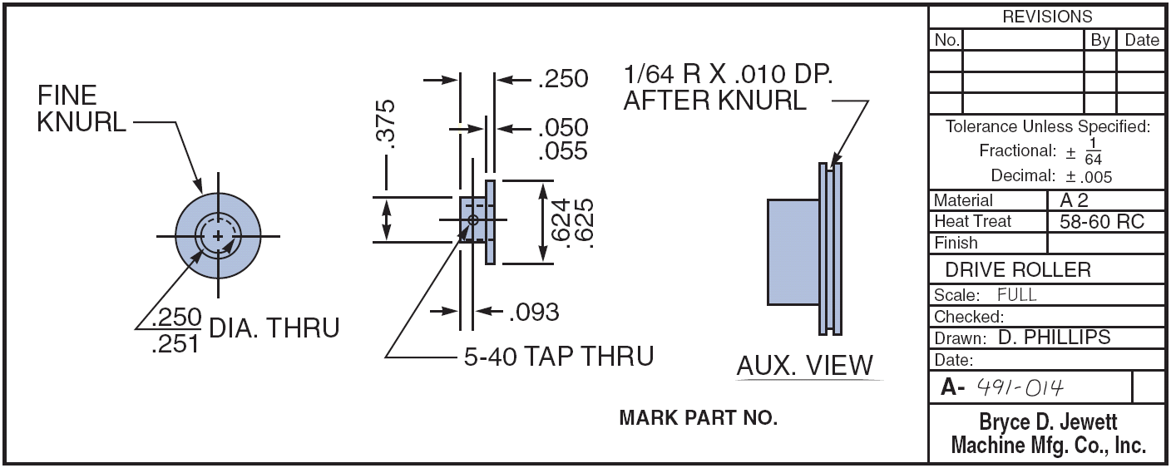
Engineering Drawings
Figure 5.8

Slide 84
Bills of Material
Figure 5.9 (a)
BOM for a Panel Weldment
NUMBER DESCRIPTION QTY
A 60-71 PANEL WELDM’T 1
A 60-7 LOWER ROLLER ASSM. 1
R 60-17 ROLLER 1
R 60-428 PIN 1
P 60-2 LOCKNUT 1
A 60-72 GUIDE ASSM. REAR 1
R 60-57-1 SUPPORT ANGLE 1
A 60-4 ROLLER ASSM. 1
02-50-1150 BOLT 1
A 60-73 GUIDE ASSM. FRONT 1
A 60-74 SUPPORT WELDM’T 1
R 60-99 WEAR PLATE 1
02-50-1150 BOLT 1

Slide 85
Bills of Material
Hard Rock Cafe’s Hickory BBQ Bacon Cheeseburger
DESCRIPTION QTY
Bun 1
Hamburger patty 8 oz.
Cheddar cheese 2 slices
Bacon 2 strips
BBQ onions 1/2 cup
Hickory BBQ sauce 1 oz.
Burger set
Lettuce 1 leaf
Tomato 1 slice
Red onion 4 rings
Pickle 1 slice
French fries 5 oz.
Seasoned salt 1 tsp.
11-inch plate 1
HRC flag 1
Figure 5.9 (b)

Slide 86
Group Technology
Parts grouped into families with similar characteristics
Coding system describes processing and physical characteristics
Part families can be produced
in dedicated manufacturing cells

Slide 87
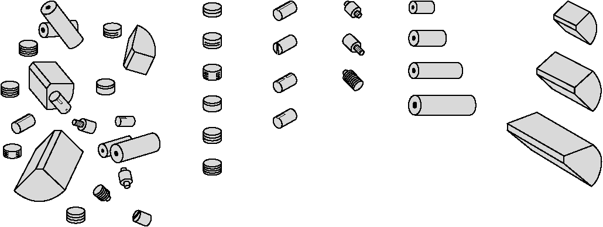
Group Technology Scheme
(b) Grouped Cylindrical Parts (families of parts)
(a) Ungrouped Parts
Grooved Slotted Threaded Drilled Machined
Figure 5.10

Slide 88
Group Technology Benefits
Improved design
Reduced raw material and purchases
Simplified production planning and control
Improved layout, routing, and machine loading
Reduced tooling setup time, work-in-process, and production time

Slide 89
Documents for Production
Assembly drawing
Assembly chart
Route sheet
Work order
Engineering change notices (ECNs)

Slide 90
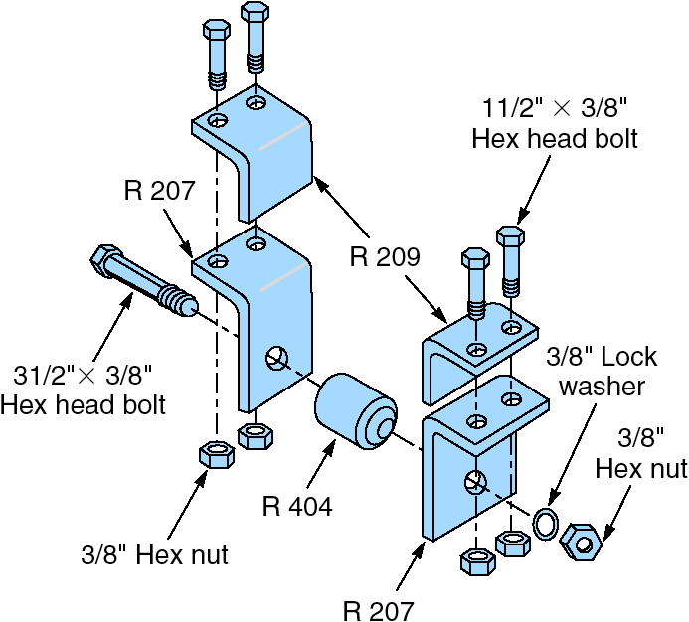
Assembly Drawing
Figure 5.11 (a)
Shows exploded view of product
Details relative locations to show how to assemble the product

Slide 91
Assembly Chart
1
R 209 Angle
R 207 Angle
Left
bracket
assembly
Identifies the point of production where components flow into subassemblies and ultimately into the final product
2
SA
1
A1
Bolts w/nuts (2)
3
R 209 Angle
4
R 207 Angle
Right
bracket
assembly
5
SA
2
A2
Bolts w/nuts (2)
6
Bolt w/nut
7
R 404 Roller
8
A3
Lock washer
Poka-yoke inspection
9
Part number tag
10
A4
Box w/packing material
Figure 5.11 (b)
11
A5

Slide 92
Route Sheet
Lists the operations and times required to produce a component
Setup Operation
Process Machine Operations Time Time/Unit
1 Auto Insert 2 Insert Component 1.5 .4
Set 56
2 Manual Insert Component .5 2.3
Insert 1 Set 12C
3 Wave Solder Solder all 1.5 4.1
components
to board
4 Test 4 Circuit integrity .25 .5
test 4GY

Slide 93
Work Order
Instructions to produce a given quantity of a particular item, usually to a schedule
Work Order
Item Quantity Start Date Due Date
Production Delivery
Dept Location
157C 125 5/2/08 5/4/08
F32 Dept K11

Slide 94
Engineering Change Notice (ECN)
A correction or modification to a product’s definition or documentation
  Engineering drawings
  Bill of material
Quite common with long product life cycles, long manufacturing lead times, or rapidly changing technologies

Slide 95
Configuration Management
The need to manage ECNs has led to the development of configuration management systems
A product’s planned and changing components are accurately identified and control and accountability for change are identified and maintained

Slide 96
Product Life-Cycle Management (PLM)
Integrated software that brings together most, if not all, elements of product design and manufacture
  Product design
  CAD/CAM, DFMA
  Product routing
  Materials
  Assembly
  Environmental

Slide 97
SERVICE DESIGN

Slide 98
Service Design
Service typically includes direct interaction with the customer
Process – Chain – Network (PCN) analysis focuses on the ways in which processes can be designed to optimize interaction between firms and their customers

Slide 99
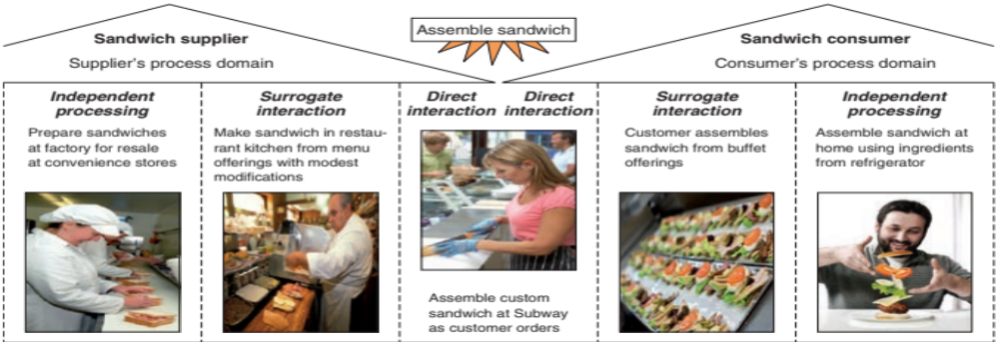
Process-Chain-Network (PCN) Analysis
Figure 5.12

Slide 100
Process-Chain-Network (PCN) Analysis
Direct interaction region includes process steps that involve interaction between participants
The surrogate (substitute) interaction region includes process steps in which one participant is acting on another participant’s resources
The independent processing region includes steps in which the supplier and/or the customer is acting on resources where each has maximum control

Slide 101
Process-Chain-Network (PCN) Analysis
All three regions have similar operating issues but the appropriate way of handling the issues differs across regions
Service operations exist only within the area of direct and surrogate interaction
PCN analysis provides insight to aid in positioning and designing processes that can achieve strategic objectives

Slide 102
Adding Service Efficiency
Service productivity is notoriously low partially because of customer involvement in the design or delivery of the service, or both
Complicates product design

Slide 103
Adding Service Efficiency
Limit the options
  Improves efficiency and ability to meet customer expectations
Delay customization
Modularization
  Eases customization of a service

Slide 104
Adding Service Efficiency
Automation
  Reduces cost, increases customer service
Moment of truth
  Critical moments between the customer and the organization that determine customer satisfaction

Slide 105
Documents for Services
High levels of customer interaction necessitates different documentation
Often explicit job instructions
Scripts and storyboards are other techniques

Slide 106
First Bank Corp. Drive-up Teller Service Guidelines
Be especially discreet when talking to the customer through the microphone.
Provide written instructions for customers who must fill out forms you provide.
Mark lines to be completed or attach a note with instructions.
Always say “please” and “thank you” when speaking through the microphone.
Establish eye contact with the customer if the distance allows it.
If a transaction requires that the customer park the car and come into the lobby, apologize for the inconvenience.

Slide 107
Application of Decision Trees to Product Design
Particularly useful when there are a series of decisions and outcomes which lead to other decisions and outcomes

Slide 108
Application of Decision Trees to Product Design
Procedure
Include all possible alternatives and states of nature - including “doing nothing”
Enter payoffs at end of branch
Determine the expected value of each branch and “prune” the tree to find the alternative with the best expected value

Slide 109
Decision Tree Example
(.4)
High sales
Purchase CAD
(.6) Low sales
Hire and train engineers
(.4)
High sales
(.6)
Low sales
Do nothing
Figure 5.13

Slide 110
Decision Tree Example
(.4)
High sales
$2,500,000 Revenue
– 1,000,000 Mfg cost ($40 x 25,000)
– 500,000 CAD cost
$1,000,000 Net
Purchase CAD
(.6) Low sales
$800,000 Revenue
– 320,000 Mfg cost ($40 x 8,000)
– 500,000 CAD cost
– $20,000 Net loss
Hire and train engineers
(.4)
High sales
EMV (purchase CAD system) = (.4)($1,000,000) + (.6)(– $20,000)
(EMV = Expected Monetary Value)
(.6)
Low sales
Do nothing
Figure 5.13

Slide 111
Decision Tree Example
(.4)
High sales
$2,500,000 Revenue
– 1,000,000 Mfg cost ($40 x 25,000)
– 500,000 CAD cost
$1,000,000 Net
Purchase CAD
$388,000
(.6) Low sales
$800,000 Revenue
– 320,000 Mfg cost ($40 x 8,000)
– 500,000 CAD cost
– $20,000 Net loss
Hire and train engineers
(.4)
High sales
EMV (purchase CAD system) = (.4)($1,000,000) + (.6)(– $20,000)
= $388,000
(EMV = Expected Monetary Value)
(.6)
Low sales
Do nothing
Figure 5.13

Slide 112
Decision Tree Example
(.4)
High sales
$2,500,000 Revenue
– 1,000,000 Mfg cost ($40 x 25,000)
– 500,000 CAD cost
$1,000,000 Net
Purchase CAD
$388,000
(.6) Low sales
$800,000 Revenue
– 320,000 Mfg cost ($40 x 8,000)
– 500,000 CAD cost
– $20,000 Net loss
Hire and train engineers
$365,000
(.4)
High sales
$2,500,000 Revenue
– 1,250,000 Mfg cost ($50 x 25,000)
– 375,000 Hire and train cost
$875,000 Net
(.6)
Low sales
$800,000 Revenue
– 400,000 Mfg cost ($50 x 8,000)
– 375,000 Hire and train cost
$25,000 Net
Do nothing $0
$0 Net
Figure 5.13

Slide 113
Transition to Production
Know when to move to production
  Product development can be viewed as evolutionary and never complete
  Product must move from design to production in a timely manner
Most products have a trial production period to insure producibility
  Develop tooling, quality control, training
  Ensures successful production

Slide 114
Transition to Production
Responsibility must also transition as the product moves through its life cycle
  Line management takes over from design
Three common approaches to managing transition
  Project managers
  Product development teams
  Integrate product development and manufacturing organizations

Slide 115
Thank you

