Slide 1
A Look Toward the Future of Information Technology
Part I. Managing the Value of Data and Information Technology
^{9th Edition}
^{Information}
^{Technology}
^{for Management}
^{Advancing Sustainable,}
^{Profitable Business Growth}
Chapter 1

Slide 2
Chapter 1 Outline
1.1 IT DAN MANAJEMEN, PELUANG DAN TANTANGAN
1.2 PERHATIAN MANAJEMEN UTAMA DAN IT YANG PALING BERPENGARUH
1.3 IT KELINCAHAN, KONSUMENISASI, DAN KEUNGGULAN BERSAING
1.4 PERENCANAAN STRATEGIK DAN MODEL PERSAINGAN
1.5 MENGAPA PENTING BAGI KARIR ANDA DAN KARIR IT

Slide 3
Chapter 1 Learning Objectives
Menjelaskan IT dan isu manajemen, peluang dan tantangan.
Mengidentifikasi perhatian utama manajemen dan IT paling berpengaruh
Mengakses peran kelincahan IT, konsumenisasi IT, dan perubahan dalam keunggulan bersaing pada bagian kedua dari era informasi.
Menjelaskan proses perencanaan strategik, analisis SWOT, dan model persaingan
Bagaimana pengaruh IT terhadap karir anda dan pandangan positif bagi karir manajemen

Slide 4
For Class Discussion & Debate
Crowdfunding—a Creative Integrated IT Solution
Crowdfunding—which is an integration of social networking, e-commerce, and financing and payment systems—clearly is responsive to the needs of the market. In tough economic times, Kickstarter and other crowdfunding platforms offer the ability to support economic growth by funding project creators worldwide.
Sources: Compiled from Kickstarter.com (2012), Pogue (2012), lumi.co (2012), and lunatik.com/ (2012).
Discuss
1. Visit Kickstarter.com and review the “Project of the Day.” What is the project? Review the offerings and number of backers in each level. Which two pledge levels ($1 through$1,000) have the highest number of backers? Which pledge levels are sold out, if any?
Do the answers to these questions suggest that backers are actually customers making purchases (pre-sales) rather than donors making selfless contributions?

Slide 5
Crowdfunding—a Creative Integrated IT Solution
2. Explain crowdfunding and its advantages to new entrepreneurs.
3. Compare Kickstarter and eBay.
4. What characteristics make Kickstarter a social commerce site?
Decide
5. Research how Kickstarter and two other crowdfunding sites manage or provide for the collection and transfer of pledges. Based on what you learn, is there a site that you would recommend? Explain why or why not.
Debate
6. Crowdfunding could be viewed as a technology that disrupts the financing industry. Or it could be viewed as so unique that it has created a new industry. Create two teams, and have each team select one of these views. Debate which view better reflects the impact of crowdfunding.

Slide 6
1.1 IT dan manajemen, peluang dan tantangan. LIKE, FOLLOW, FAN, SNAP, SHARE, JOIN,
SIGN UP, WATCH
Mengapa banyak bisnis meminta anda untuk: like, follow, fan, snap, share, sign up, watch, joint, atau download?
Jawabannya adalah, untuk mendapatkan akses ke konsumen dan data tentangnya untuk memperbaiki kinerja.

Slide 7
1.1 IT dan manajemen, peluang dan tantangan. LIKE, FOLLOW, FAN, SNAP, SHARE, JOIN,
SIGN UP, WATCH
Contoh:
1. Overstock.com. Jonathan Johnson, eksekutif ritel pada Overstock.com, menjelaskan: “We’re not trying to use social media as a sales piece as much as an information gathering piece. Finding out what our customers want; whether they like a product; how could we sell it better” (Jopson et al., 2011).
2. Best Buy. Pe-ritel barang elektronik Best Buy mempelajari bagaiana fee restocking tak populer melalui media sosial. Perusahaan ini merubah kebijakan produk retur, mengeliminasi fee penjuaan yang merugikan.
3. Starbucks. Peritel kopi, Starbucks bermaksud memonitor tweet pelanggan tentang rasa kopi baru pada hari kopi tersebut diperkenalkan. Manajer terkejut mengetahui bahwa sebagian besar tweet bukanlah tentang kuatnya rasa kopi, tetapi keluhan mereka justru tentang harga yang tinggi. Pada hari berikutnya, mereka telah menurunkan harganya.

Slide 8
1.1 IT and Management Opportunities and Challenges. LIKE, FOLLOW, FAN, SNAP, SHARE, JOIN, SIGN UP, WATCH
Examples:
1. Overstock.com. Jonathan Johnson, a retail executive at Overstock.com, explained: “We’re not trying to use social media as a sales piece as much as an information gathering piece. Finding out what our customers want; whether they like a product; how could we sell it better” (Jopson et al., 2011).
2. Best Buy. Electronics retailer Best Buy learned how unpopular its restocking fees were through social media. The company changed its product-return policies, eliminating those fees that were hurting sales.
3. Starbucks. Coffee retailer Starbucks prepared to monitor customers’ tweets about a new coffee flavor on the day it was introduced. Managers were surprised to learn that a huge majority of tweets were not about the coffee’s intense taste, but were complaints about the higher price. By the next day, they had dropped the price.

Slide 9
NEXT BIG TECH TRENDS FOCUSED ON COMPETITION, GROWTH, AND INNOVATION
Upaya Pembelajaran umum untuk memperbaiki kinerja:
Kampanye pasar yang paling dan kurang efektif, mengapa. What products to develop
Pelanggan mana yang suka dan tidak suka.
Bagaimana untuk menarik perhatian kelompok pelanggan kunci.
Bagaimana memilih dan menerapkan aplikasi terpadu yang membuat persaingan jadi berbeda.
Keistimewaan apa yang menguatkan loyalitas pelanggan paling efektif

Slide 10
DATA ANALYTICS— FIGURING OUT WHAT THE DATA MEANS
Data analytics refers to the specialized software, capabilities, and components all geared toward exploring huge volumes of data to provide greater insight and intelligence—and doing so quickly.
Data analytic processes include:
1. Locating and collecting reliable data from multiple sources that are in various formats.
2. Preparing the data for analysis. Collected data is not usable until it has been organized, standardized, duplicates are removed (called deduping), and other data cleansing processes are done.
3. Performing the correct analyses, verifying the analyses, and then reporting the findings in meaningful ways.

Slide 11
IT at Work 1.1
Watson Wins Jeopardy, Leaving Human Champions in its Silicon Dust
Data analytics have interesting applications. Here is one famous
example of data analytics in action.
Watson is a computer system created by a team of 25 IBM scientists over four years. In 2011, Watson competed against Ken Jennings on the game show Jeopardy (see Figure 1.5) in a three-day tournament and won. Watson received the clues as electronic texts at the same time they were made visible to Ken. Watson would then parse the clues into different keywords and sentence fragments in order to find statistically related phrases. Watson won by using its ability to quickly execute thousands of language analysis algorithms simultaneously to compile potential answers and determine its level of confidence in any given answer.

Slide 12
IT at Work 1.1
Watson Wins Jeopardy, Leaving Human Champions in its Silicon Dust
Questions
1. Explain how Watson figured out the most likely response to win the tournament.
2. View the IBM demo, “Turning insight into outcomes,” at
ibm.com/smarterplanet/us/en/business_analytics/article/
outperform_with_smarter_analytics.html.
3. Discuss how companies in various industries are using the
insights from analytics to achieve significant outcomes in customer satisfaction and retention, operational efficiency, financial processes, and/or risk, fraud, and compliance management

Slide 13
DATA ANALYTICS—FIGURING OUT WHAT
THE DATA MEANS
Analilis data dapat membantu perusahaan mencapai outcome bisnis berikut:
• Pertumbuhan berbasis pelanggannya
• Menjaga pelanggan yang menguntungkan.
• Perbaikan secara berkelanjutan pada efisiensi operasi operasional.
• Transformasi dan otomasi proses keuangan
• Mendeteksi dan mencegah penipuan

Slide 14
DATA ANALYTICS
Messy data is istilah yang digunakan untuk mengacu pada data (seperti: tweets, posts, clickstreams, images, including medical images) yang tidak dapat diorganisasi dengan cara yang mudah diproses dengan komputer.
Data sources include smartphones, jejaring sosial, microblogs, clickstreams from online activities, location-aware mobile devices, scanners, dan sensors yang secara otomatis mengumpulkan beraneka data dari transaksi.

Slide 15
BIG DATA ANALYTICS—THE NEXT FRONTIER OF OPPORTUNITIES
Big Data: Huge sets of messy data from sources such as multi-petabyte data warehouses, social media, and mobile devices. Sekumpulan besar data dari sumber-sumber seperti gudang multi-petabyte data, media sosial, dan perangkat mobile.
Data analytics adalah salah satu peluang dan tantangan terbesar yang dihadapi manajer yang berusaha untuk mendapatkan wawasan dan keunggulan kompetitif.

Slide 16
1.1 IT and Management Opportunities and Challenges: Discussion Questions
1. Why do businesses ask you to like, follow, fan, or interact with them via social networks or web sites?
2. Why is data analytics challenging for companies?
3. Explain messy data.
4. What are the sources of messy data?
5. Explain big data analytics.

Slide 17
BUSINESS PERFORMANCE DEPENDS ON QUALITY
INFORMATION AND IT CAPABILITIES
Business performance is directly related to the quality of information.
An important principle is that what a company can accomplish or achieve depends on what its ITs can do.
Business and technology teams need to work together and understand the benefits of smart, cost-effective, and collaborative data management, and the implementation of this knowledge is key.
Avoid the “paralysis of analysis.”
Managers should not lose agility and flexibility in the hope of gathering perfect data when making time-sensitive decisions.

Slide 18
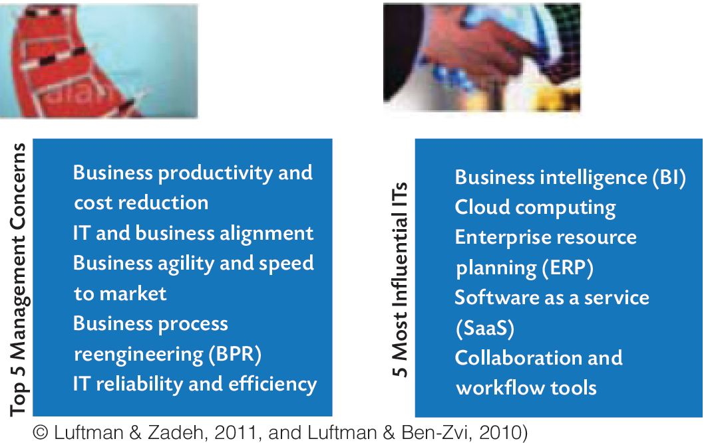
Figure 1.6 Top 5 Management Concerns and Five Most Influential ITs

Slide 19
Business Productivity and Cost Reduction
  Increasing output, while maintaining the same level of inputs
  Maintaining output, while reducing the level of inputs
  A combination of the above

Slide 20
IT and Business Alignment
Aligning IT with business means leveraging opportunities for IT to support business strategy and improve success. IT-business alignment depends on the IT department understanding strategy, risks, and opportunities—and the business understanding IT’s potential and limitations.

Slide 21
Business Agility and Speed to Market
As markets recover from a worldwide recession, managers are exploring new strategies to improve business performance or profitability.
Becoming an agile enterprise, which is one that has the ability to adapt and respond rapidly, has never been a greater advantage because of struggling economic recoveries and advances in mobile and social technologies.

Slide 22
Business Process Reengineering (BPR)
A business process is a series of tasks performed by people or systems that are designed to produce a specific output or achieve a predetermined outcome.
Examples: customer ordering process, credit approval and shipping a product.
The goal of BPR is to eliminate the unnecessary non–value added processes, then to simplify and automate the remaining processes to significantly reduce cycle time, labor, and costs.

Slide 23
IT Reliability and Efficiency
Managers need to know that they can trust the data—rely on the accuracy, availability, security, and accessibility of data and information systems.
Federal and state regulations have made data privacy and protection a legal requirement and impose huge fines for violations

Slide 24
5 MOST INFLUENTIAL ITs
Business Intelligence (BI)
Cloud Computing
Enterprise Resource Planning (ERP)
Software as a Service (SaaS)
Collaboration and Workflow Tools

Slide 25
Business Intelligence (BI)
BI technologies can help to run the business more efficiently, identify trends and relationships in organizational data, and create or take advantage of business opportunities
Implementing BI successfully is extremely challenging technically because it requires the integration, computation, and analysis of massive data repositories

Slide 26
Cloud Computing
The cloud is a term for networked computers, including the public Internet.
Often “cloud” means “Internet.”
Cloud computing (or cloud infrastructure or cloud services) does not refer to a specific arrangement, but rather to various computing and network arrangements.
Cloud computing makes it possible for almost anyone to deploy tools that can scale on demand to serve as many users as needed.

Slide 27
Enterprise Resource Planning (ERP)
ERP also refers to technology infrastructure and/or apps that support essential business processes and operations.
ERP systems are commercial software packages that are bought as modules.
Examples of modules are: accounting, inventory, budgeting, and sales.

Slide 28
Software as a Service (SaaS)
SaaS is a pay-per-use arrangement.
Software is available to users when they need it.
SaaS is an arrangement where instead of buying and installing enterprise apps, users access those apps from a SaaS vendor over a network via a browser.

Slide 29
Collaboration and Workflow Tools
These tools help people work together in an organized way and manage their tasks more effectively regardless of their location.
Examples include Google Docs, Group Chat, and Skype.

Slide 30
1.2 Top Management Concerns and Influential IT Questions
1. What are the top five concerns of management? Briefly explain each.
2. What are the five most influential ITs? Briefly explain each.
3. Describe a business process.
4. Explain the Internet of things.

Slide 31
1.3 IT Agility, Consumerization, and Competitive Advantage Agility
Agility means being able to respond quickly. A scalable cloud IT infrastructure can be more responsive to urgent agency needs.
Responsive means that IT capacity can be easily scaled up or down as needed.
Flexible means having the ability to quickly integrate new business functions or to easily reconfigure software or apps.

Slide 32
IT CONSUMERIZATION
IT consumerization is the migration of consumer technology into enterprise computing environments.
With mobile devices, apps, platforms, and social media becoming inseparable parts of work life and corporate collaboration and with more employees working from home, the result is the rapid consumerization of IT.
This shift has occurred because personally-owned IT is as capable and cost-effective as its enterprise equivalents.

Slide 33
COMPETITIVE ADVANTAGE
Key Components of Corporate Profitability:
1. Industry structure: An industry’s structure determines the range of profitability of the average competitor and can be very difficult to change.
2. Competitive advantage: The edge that enables a company to outperform its average competitor. Competitive advantage can be sustained only by continually pursuing new ways to compete.

Slide 34
COMPETITIVE ADVANTAGE
Competitive advantage is defined as a difference between a company and its competitors that matters to customers.

Slide 35
1.3 IT Agility, Consumerization, and Competitive Advantage Agility: Questions for Discussion
1. What are the characteristics of an agile organization?
2. Explain IT consumerization.
3. What are two key components of corporate profitability?
4. Define competitive advantage.
5. What is a business model?

Slide 36
1.4 Strategic Planning and Competitive Models
Strategy planning is critical for all organizations, including government agencies, health care, education, military, and other nonprofit and not-for-profits.
Strategic technologies are those with the potential for significant impact on the enterprise during the next three years.

Slide 37
WHAT IS STRATEGIC (SWOT) ANALYSIS?
Strategic analysis is the scanning and review of the political, social, economic, and technical environment of the organization.
SWOT analysis involves the evaluation of strengths and weaknesses, which are internal factors, and opportunities and threats, which are external factors.

Slide 38
STRATEGIC SWOT ANALYSIS
• Strengths: Reliable processes; agility; motivated workforce
• Weaknesses: Lack of expertise; competitors with better IT infrastructure
• Opportunities: A developing market; ability to create a new market or product
• Threats: Price wars or other fierce reaction by competitors; obsolescence

Slide 39
STRATEGIC SWOT ANALYSIS
Be realistic about the strengths and weaknesses of your organization
Be realistic about the size of the opportunities and threats
Be specific and keep the analysis simple, or as simple as possible
Evaluate your company’s strengths and weaknesses in relation to those of competitors (better than or worse than competitors)
Expect conflicting views because SWOT is subjective, forward-looking, and based on assumptions

Slide 40
WHAT IS STRATEGIC PLANNING?
Strategic planning is a series of processes in which an organization selects and arranges its businesses or services to keep the organization viable even when unexpected events disrupt one or more of its businesses, markets, products, or services.
Strategic planning involves environmental scanning and prediction.

Slide 41
WHAT IS STRATEGY?
Strategy defines the plan for how a business will achieve its mission, goals, and objectives.
What is the long-term direction of our business?
What is the overall plan for deploying our resources?
What trade-offs are necessary? What resources will it need to share?
What is our position compared to our competitors?
How do we achieve competitive advantage over rivals in order to achieve or maximize profitability?

Slide 42
PORTER’S COMPETITIVE FORCES MODEL
AND STRATEGIES
1. Threat of entry of new competitors.
2. Bargaining power of suppliers.
3. Bargaining power of customers or buyers.
4. Threat of substitute products or services.
5. Competitive rivalry among existing firms in the industry.

Slide 43
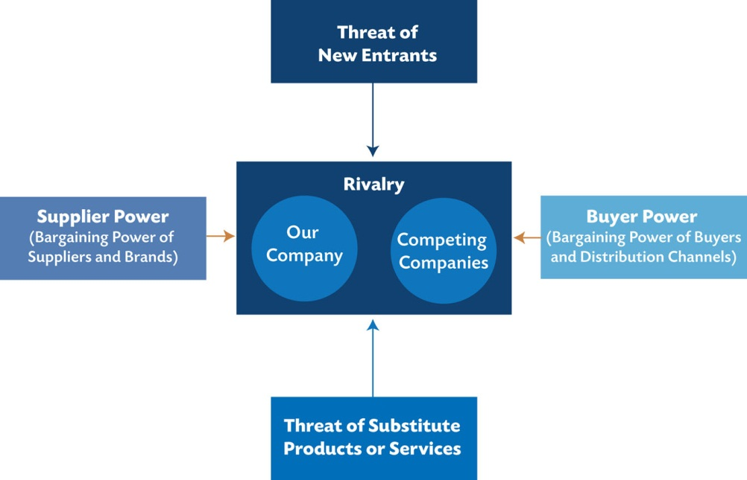
Fig 1.10 Porter’s competitive forces model

Slide 44
Porter’s Model
Primary activities are those business activities through which a company produces goods, thus creating value for which customers are willing to pay. Primary activities involve the purchase of materials, the processing of materials into products, and delivery of products to customers
1. Inbound logistics, or acquiring and receiving of raw materials and other inputs
2. Operations, including manufacturing and testing
3. Outbound logistics, which includes packaging, storage, delivery, and distribution
4. Marketing and sales to customers
5. Services, including customer service

Slide 45
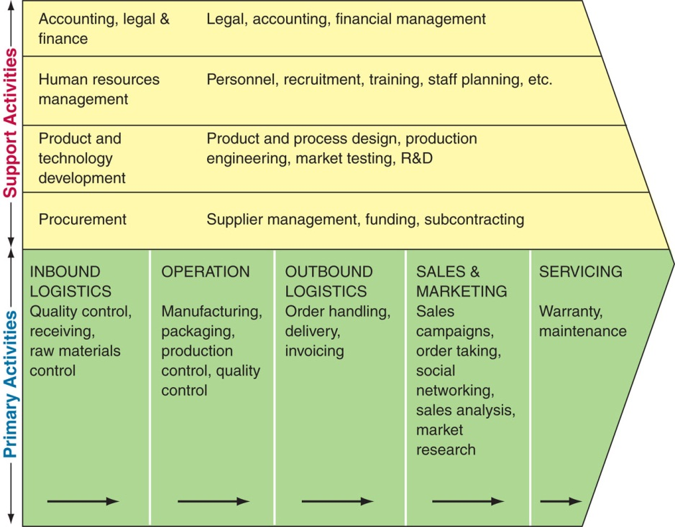
Fig 1.11 A firm’s value chain

Slide 46
Adaptive and Innovative Organizations
Competition not only takes place among products or services, but also among business models, customer service, and supply chains. The concept of value chain has been supplemented by the concepts of value system and value network.
A firm’s value chain is part of a larger stream of activities, which Porter calls a value system. A value system includes the suppliers that provide the inputs necessary to the firm and their value chains.
A value network is a complex set of social and technical resources. Value networks work together via relationships to create social goods (public goods) or economic value.

Slide 47
Real-Time, On-Demand IT Support
A real-time system is an IS that provides fast enough access to information or data so that a decision can be made before the data or situation changes.
Examples:
Salespeople can check to see whether a product is in inventory by looking directly into the inventory system.
Suppliers can ensure adequate supplies by checking the forecasting and inventory systems.
An online order payment by credit card is checked for the balance and the amount of the purchase is debited all in one second. This way authorization is given fast enough for both a seller and a buyer.

Slide 48
1.4 Strategic Planning and Competitive Models: Questions for Discussion
1. Describe strategic planning.
2. Describe SWOT analysis.
3. Explain Porters’ five forces model, and give an example of each force.
4. Describe adaptive organization.
5. Describe real-time business.

Slide 49
1.5 Why IT is Important to Your Career, and IT Careers
IT creates markets, businesses, products, and careers.
New technologies and IT-supported functions, such as the 4G networks, embedded sensors, on-demand work forces, and e-readers point to ground-breaking changes.

Slide 50
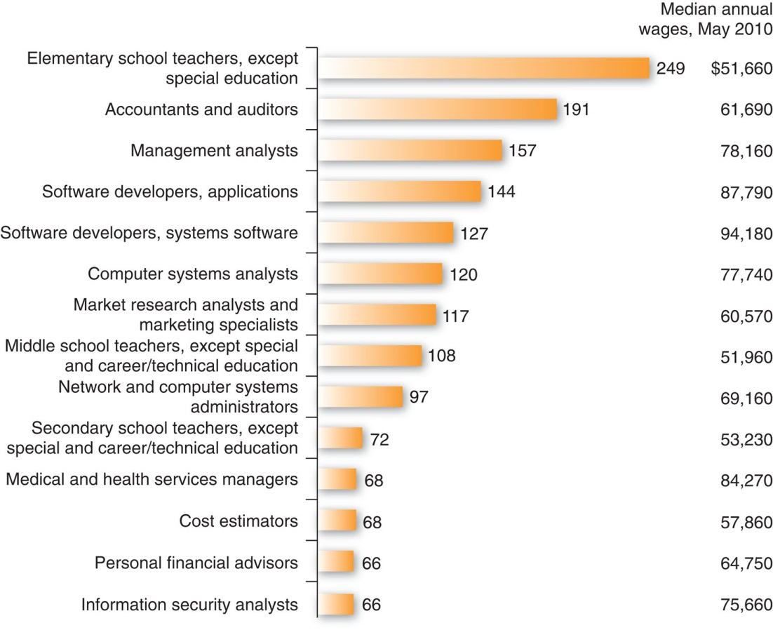
Fig 1.12 Top 13 growth occupations, 2010-2020

Slide 51
IT as a Career: The Nature of IS and IT Work
Chief technology officers (CTOs) evaluate the newest and most innovative technologies and determine how they can be applied for competitive advantage.
CTOs develop technical standards, deploy technology, and supervise workers who deal with the daily IT issues of the firm.

Slide 52
1.5 Why IT is Important to Your Career, and IT Careers: Questions for Discussion
1. Why is IT a major enabler of business performance and success?
2. Explain why it is beneficial to study IT today.
3. Why are IT job prospects so strong?

