Slide 1
Information Management and IT Architecture
(Manajemen Informasi dan Infrastruktur Teknologi Informasi)
Part I
Maximizing the Value of Data and Information Technology
^{9th Edition}
^{Information}
^{Technology}
^{for Management}
^{Advancing Sustainable,}
^{Profitable Business Growth}
Chapter 2

Slide 2
Chapter 2 Outline
2.1 Information Management in the 2010s
2.2 IT Architecture
2.3 Information Systems and IT Infrastructure
2.4 Cloud Computing and Services
2.5 Virtualization and VM (Virtual Machines)

Slide 3
Chapter 2 Learning Objectives
Identify current information management challenges and evaluate potential solutions.
Recognize the role of IT architecture and how it guides and governs IT growth and maintenance.
Map the functions of various types of information systems to the type of support needed by business operations and decision makers.
Evaluate cloud-computing solutions and services.
Explain the characteristics and assess the benefits of virtualization and virtual machines (VM).

Slide 4
For Class Discussion & Debate
Paul McCartney’s Artistic Legacy (and Its IT Architecture)
IT Architecture Supports Paul’s Vision
McCartney wanted to “make it something really exciting.” A really exciting portal was made possible by the IT architecture that powers his media business, making it simpler and more efficient for fans to identify, locate, and use assets in the huge collection. See the book for the full explanation of McCartney’s vision.

Slide 5
For Class Discussion & Debate
Paul McCartney’s Artistic Legacy (and Its IT Architecture)
IT Architecture Supports Paul’s Vision
McCartney ingin "membuat sesuatu yang benar-benar menarik." Sebuah portal yang benar-benar menarik dimungkinkan oleh arsitektur TI yang mendukung bisnis medianya, sehingga lebih sederhana dan lebih efisien untuk para penggemar untuk mengidentifikasi, menemukan, dan menggunakan aset dalam koleksinya.

Slide 6
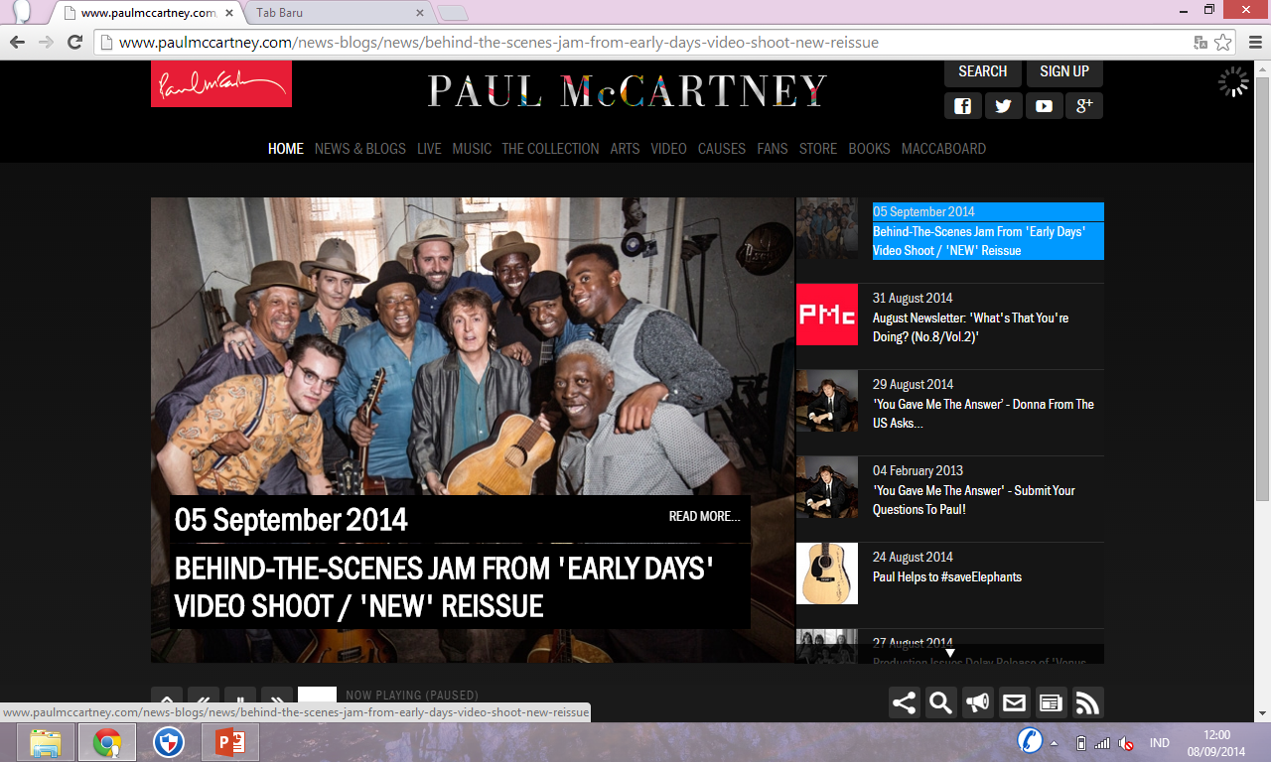

Slide 7
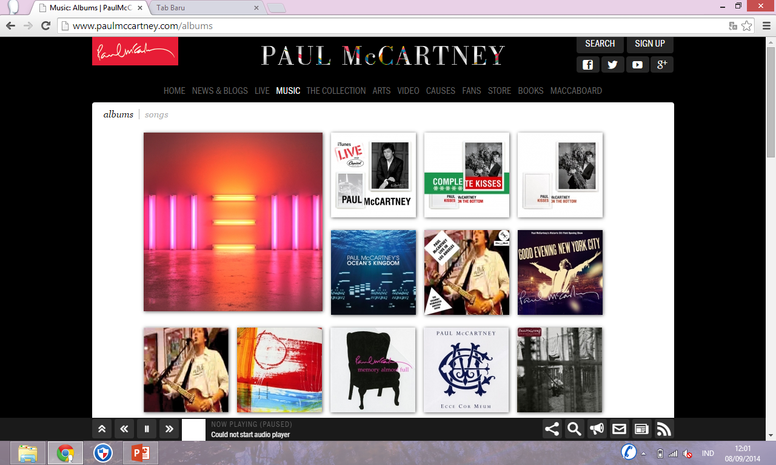

Slide 8
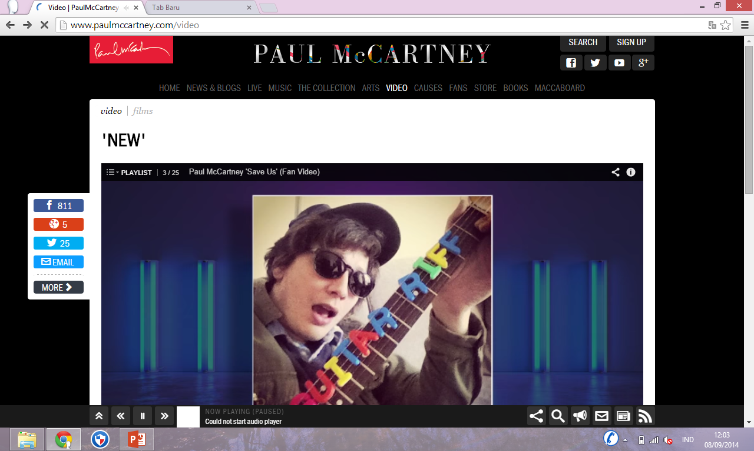

Slide 9
TUGAS UNTUK DISKUSI
Kunjungi dan buat review fitur http://www.paulmccartney.com . Jelaskan apa yang dikatakan Jan Zadak, (wakil presiden eksekutif HP) : “Para penggemar mengharapkan pengalaman yang lebih kaya dan lebih dalam dari sebelumnya“. Apakah Anda setuju dengan pernyataan ini? Jelaskan. Apa fitur portal menciptakan lebih kaya dan lebih dalam pengalaman para penggemar?
Siapa Paul McCartney?
Apa yang dikerjaan dalam visioner project-nya pada tahun 2011?

Slide 10
Diskusi
1. Jelaskan keadaan atau kondisi koleksi pribadi McCartney sebelum proyek visioner ini dimulai pada tahun 2011.
2. Menggunakan jawaban Anda pada no # 1, apa yang harus dilakukan untuk mendapatkan koleksi McCartney di perpustakaan digital?
3. Apa manfaat untuk penggemar portal paulmccartney.com baru?
4. Mengapa penting untuk dapat menawarkan konten real-time dari konser McCartney atau peristiwa lain di portal?
5. Sebagai konten baru diciptakan, bagaimana hal itu sampai ke portal?

Slide 11
Sebelum pembuatan PaulMcCarney.com McCartney memiliki banyak sekali koleksi rekaman, video pertunjukan live, salinan asli lirik, foto, lukisan dan memorabilia lainnya. Banyak barang-barang tersebut belum pernah terlihat oleh penggemar McCartney. Hampir semua koleksi lebih dari satu juta artefak tidak dalam format digital. Sebagian besar berada di kertas atau bentuk analog.
McCartney Productions Ltd. bermitra dengan HP untuk menciptakan sistem manajemen konten yang state-of-the-art untuk menampilkan artefak online. Setelah perpustakaan diciptakan HP mengumpulkan artefak dari beberapa gudang dan dikonversi ke format digital. Setelah artefak yang didigitalkan, lalu diorganisir dan dibuat katalog.
Salah satu manfaat dari portal ini adalah jumlah besar artefak yang sebelumnya tak terlihat dari koleksi Paulus. Juga penggemar McCartney dapat melihat semua konten ini di satu tempat, bukan mencari internet untuk berbagai klip video, lagu dan konten lainnya.

Slide 12
Discuss
1. Explain the state or condition of McCartney’s private collection before this visionary project began in 2011.
2. Using your answer to #1, what had to be done to get McCartney’s collection ready for the digital library?
3. What are the benefits to fans of the new paulmccartney.com portal?
4. Why is it important to be able to offer real-time content from McCartney’s concerts or other events on the portal?
5. As new content was created, how did it get to the portal?

Slide 13
Decide and Debate
Decide
6. Visit and review the features of paulmccartney.com. Consider what Jan Zadak, an HP executive vice president, said: “Fans expect a richer and deeper experience than ever before.” Do you agree with this statement? Explain. What features of the portal created a richer and deeper fan experience?
Debate
7. According to MPL, the online music player Jukebox is unique. Not only can fans listen to songs and build their own playlists, but they can gain access to all information related to any particular song or album. Fans can listen to full tracks, buy albums, make dedications, and download Jukebox to their desktops. To encourage return visits, the site lets fans create a custom personal page with their profile, playlists, blogs, private messaging, and videos. Based on these features, debate whether or not the paulmccartney.com portal is a competitor of Facebook. Your debate should include the issue of whether or not it is a social media site.

Slide 14
2.1 Information Management in the 2010s

Slide 15
2.1 Information Management in the 2010s
How information is stored and organized, and the speed at which it is captured, analyzed, and reported. (Bagaimana informasi disimpan dan terorganisir, serta kecepatan di mana ia ditangkap, dianalisis, dan dilaporkan.)
Enterprise mashups, also referred to as business mashups, combine data from multiple internal and public sources and publish the results to enterprise portals, dashboards, or the cloud (juga disebut sebagai mashup bisnis, menggabungkan data dari berbagai sumber internal dan publik dan mempublikasikan hasilnya kepada portal perusahaan, dashboard, atau awan.)

Slide 16
INFORMATION MANAGEMENT FOR
HIGH PERFORMANCE
Tujuan keseluruhan dari manajemen informasi adalah desain dan implementasi arsitektur TI yang sudah direncanakan dengan baik, kebijakan, dan prosedur yang diperlukan untuk secara efektif dan efisien mendukung informasi dan pengambilan kebutuhan organisasi.
Isu akses informasi, manajemen, dan keamanan juga harus berurusan dengan degradasi informasi dan gangguan-mana orang-orang tidak mengerti apa arti dari data atau bagaimana hal itu dapat bermanfaat.

Slide 17
INFORMATION MANAGEMENT FOR
HIGH PERFORMANCE
The overall goal of information management is the design and implementation of a well–planned out IT architecture, policies, and procedures needed to effectively and efficiently support the information and decision needs of an organization.
Issues of information access, management, and security must also deal with information degradation and disorder—where people do not understand what data means or how it can be useful.

Slide 18
REASONS FOR INFORMATION DEFICIENCIES
1. Data silos
2. Lost or bypassed data
3. User-fierce formats
4. Nonstandardized data formats
5. Moving targets

Slide 19
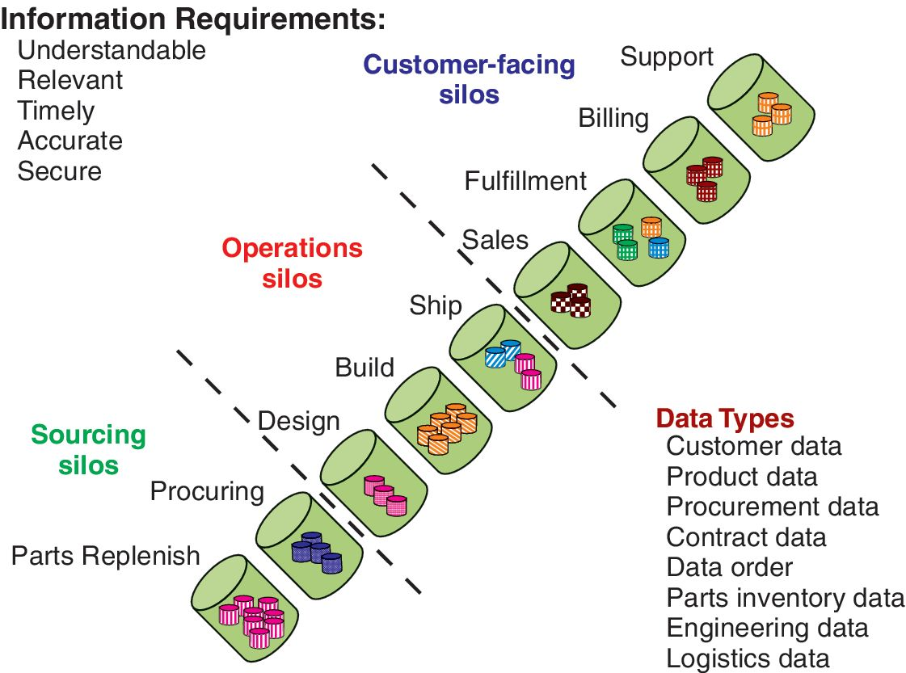
Fig 2.3 Data (or information) silos are ISs that do not have the capability to exchange data with other ISs making timely coordination and communication across functions or departments difficult.

Slide 20
FACTORS DRIVING THE SHIFT FROM SILOS TO SHARING AND COLLABORATION
1. Global, mobile workforce. An estimated 62 percent of the workforce works outside an office at some point.
2. Mobility-driven consumerization. There is a growing number of cloud-based collaboration solutions that make it easier to collaborate and share from anywhere.
3. Principle of “any.” There is growing need to connect any body, any time, and any where on any device.

Slide 21
IT at Work 2.1
When ISs Fail, The Problem May Be the IT Architecture
1. IT architecture was not designed for customized reporting.
2. Complicated user interface.
Questions
1. What problems did executives have with the EIS?
2. What were the two reasons for those EIS problems?
3. How did the CIO improve the EIS?
4. What are the benefits of the new IT architecture?

Slide 22
MANFAAT INFORMATION MANAGEMENT
1 Meningkatkan kualitas keputusan. Meningkatkan ketepatan waktu dan kualitas pengambilan keputusan melalui akses yang lebih komprehensif dari sumber informasi.
2 Meningkatkan prediksi. Kemampuan untuk memprediksi peluang baru atau tantangan melalui pola mencari, pencocokan, dan penemuan.
3 Mengurangi resiko. Meningkatkan kepatuhan perusahaan dengan peraturan dan kebijakan melalui peningkatan kualitas informasi dan tata kelola.
4. Mengurangi biaya dengan mengurangi jumlah repositori dan waktu yang dihabiskan menemukan dan menumbuk (mengintegrasikan) informasi.

Slide 23
BENEFITS OF INFORMATION MANAGEMENT
1. Improves decision quality. Improving the timeliness and quality of decision making through access to a more comprehensive set of information sources.
2. Improves predictions. The ability to predict new opportunities or challenges through pattern seeking, matching, and discovery.
3. Reduces risk. Improving enterprise compliance with regulations and policies through improved information quality and governance.
4. Reduces cost by reducing the number of repositories and time spent locating and mashing (integrating) information.

Slide 24
2.2 IT Architecture

Slide 25
2.2 IT Architecture
NEED FOR LONG-TERM PLANNING TO MANAGE GROWTH
1. Business productivity and cost reduction
2. IT and business alignment
3. Business agility and speed to market
4. Business process reengineering (BPR)
5. IT reliability and efficiency

Slide 26
IT ARCHITECTURE: THE PLAN TO MAINTAIN
IT-BUSINESS ALIGNMENT
1. The organization’s mission, business functions, and future direction
2. Information and information flows needed to perform the mission
3. Processes for implementing new ITs in response to business changes
4. The current baseline architecture
5. The desired target architecture
6. The sequencing plan, which consists of the short- and long-term strategies for managing the change from baseline to target architecture

Slide 27
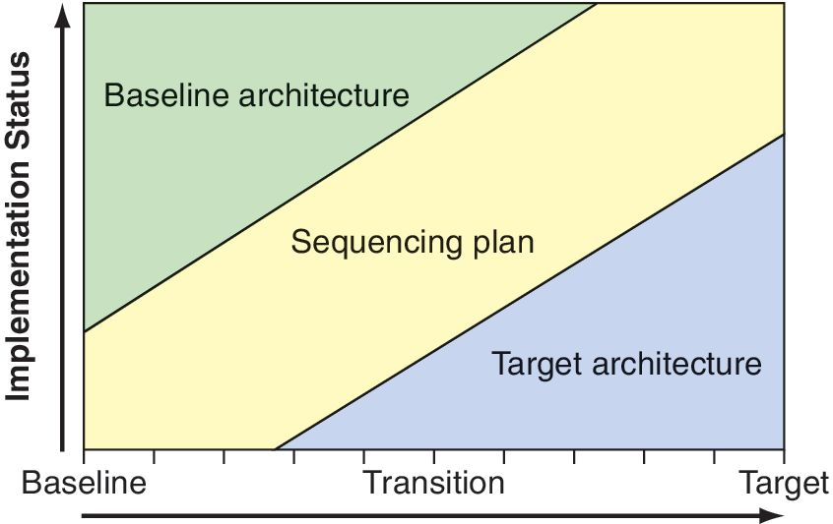
POSSIBLE CONFLICT
Fig 2.4. IT architecture transition plan to maintain the IT-business alignment. Changes in priorities and business are reflected in the target architecture to help keep IT aligned with them.

Slide 28
IT at Work 2.2
Gartner’s View of Enterprise Architecture
Starts with a shared vision of the future.
Focus is on strategy.
Questions
1. Explain the relationship between complexity and planning. Give an example.
2. Explain IT architecture.
3. What are the four components of IT architecture?
4. What are the uses and benefits of IT architecture?
5. How are baseline architecture, sequencing plan, and target architecture related?
6. Why should the organization’s target architecture never be achieved?

Slide 29
2.3 Information Systems and IT Infrastructure
DATA, INFORMATION, AND KNOWLEDGE
Data, or raw data, refers to a basic description of products, customers, events, activities, and transactions that are recorded, classified, and stored.
Information is data that has been processed, organized, or put into context so that it has meaning and value to the person receiving it.
Knowledge consists of data and/or information that have been processed.

Slide 30
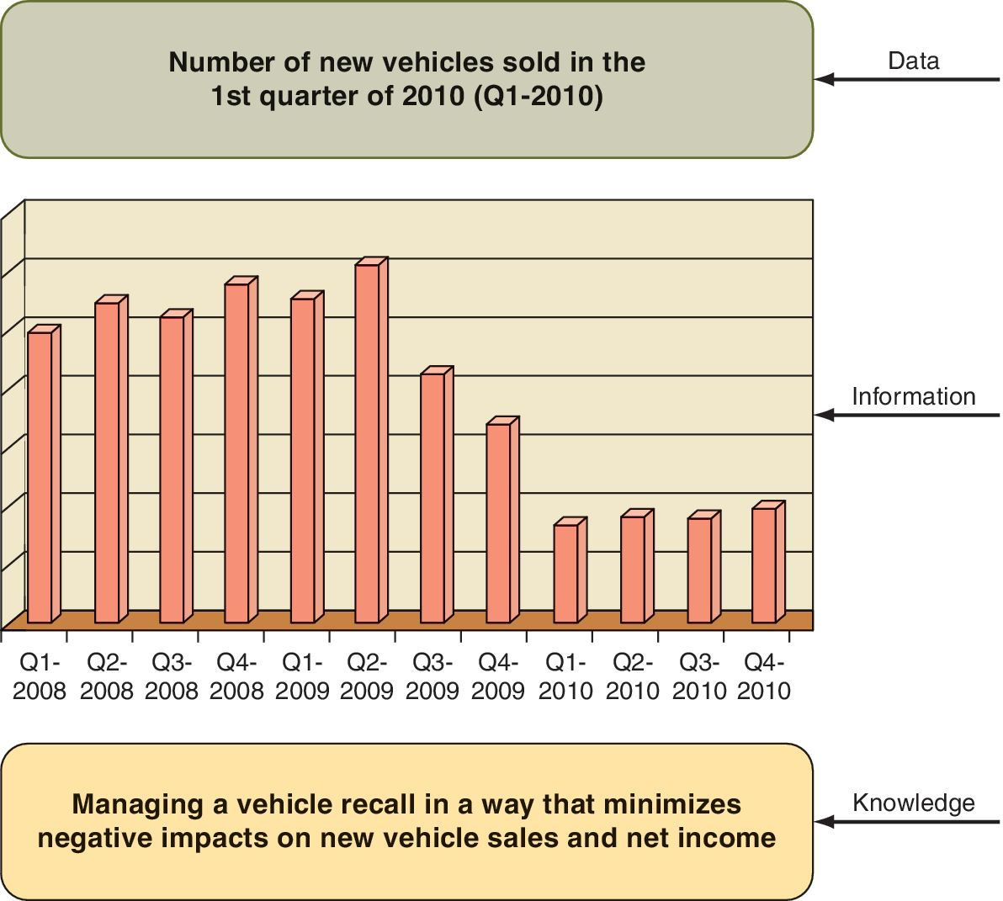
DATA, INFORMATION, AND KNOWLEDGE
Figure 2.5 Examples of data, information, and knowledge

Slide 31
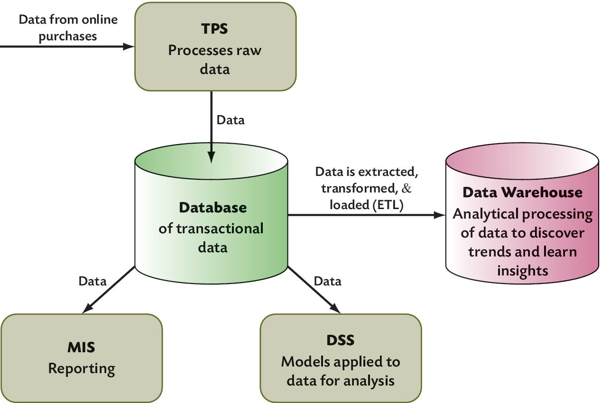
DATA, INFORMATION,AND KNOWLEDGE
Figure 2.7 Diagram showing the flow of data from the point of sale (POS) through processing, storage, reporting, decision support, and analysis. Also shows the relationships among information systems.

Slide 32
DATA, INFORMATION, AND KNOWLEDGE
Transaction Processing Systems (TPS) are designed to process specific types of data input from ongoing transactions.
Batch vs. Online Real-Time Processing. Data captured by a TPS are processed and stored in a database, and then are available for use by other systems.
Data Quality. The more efficiently and thoroughly an organization gathers, stores, processes, retrieves, and uses its data, the more productive it is.

Slide 33
MANAGEMENT INFORMATION SYSTEMS (MIS)
MIS systems are designed for their particular reporting needs. Their objective is to provide reports to managers for tracking operations, monitoring, and control.
Periodic reports are created or run according to a pre-set schedule.
Exception reports are generated only when something is outside the norm, either higher or lower than expected.
Ad hoc reports are generated on request to learn more about a situation, problem, or opportunity.

Slide 34
DECISION SUPPORT SYSTEMS (DSS)
Decision support systems are interactive applications that support decision making.
Three Defining DSS Characteristics:
1. An easy-to-use interactive interface.
2. Models or formulas that enable sensitivity analysis, what if analysis, goal seeking, and risk analysis.
3. Data from multiple sources—internal and external sources plus data added by the decision maker who may have insights relevant to the decision situation.

Slide 35
DATABASE VOLATILITY AND DATA
WAREHOUSING
Given the huge number of transactions, the data in databases are constantly in use and/or undergoing change. This characteristic of databases—referred to as volatility—makes it impossible to use them for complex decision making and problem-solving tasks.
For this reason, data are extracted, transformed, and loaded (ETL) into a warehouse where it is better formatted for simple to advanced analyses.

Slide 36
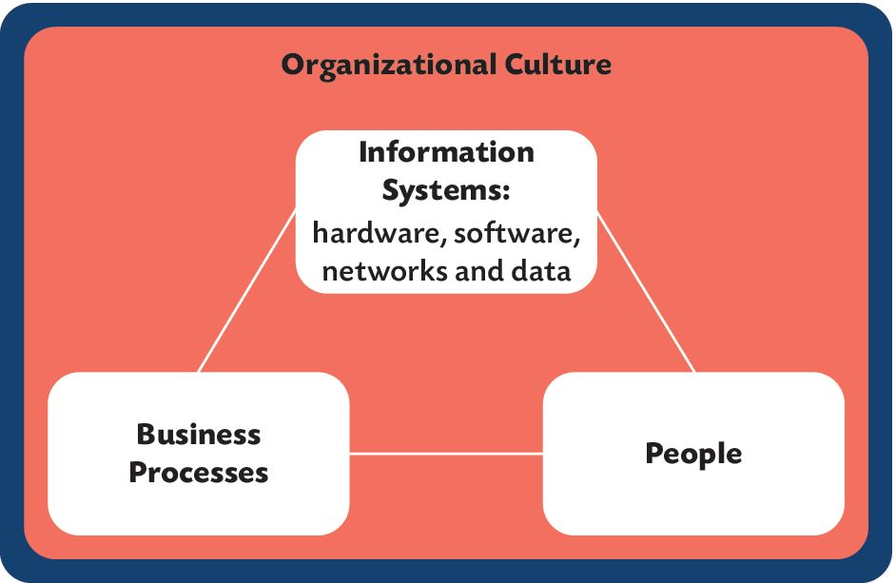
ISs EXIST WITHIN A CULTURE
Figure 2.10 Organizational culture plays a significant role in the use and benefits of information systems.

Slide 37
IT at Work 2.3
Feedback and Incentives Improve Performance at 1-800-Contacts
New Reporting Systems Needed by Call Center Managers and Operators
Dashboard Reporting Tools
Operators’ and Business Performance Increased
Questions
1. What were the information and reporting problems the company
faced?
2. How did business analysts get the data they needed?
3. What was the effect of linking operators’ pay to business performance? That is, how did feedback at the operator’s level
lead to improved performance at the organizational level?
4. Why do you think the dashboards updated frequently (every
15 minutes) instead of only at the end of the operator’s workday?

Slide 38
IT INFRASTRUCTURE
The role of the IT department is to insure the reliability of the enterprise’s IT infrastructure. 1. Hardware
2. Software
3. Networks and communication facilities, including the Internet and intranets
4. Databases and data workers
5. Information management personnel

Slide 39
ACQUIRING INFRASTRUCTURE COMPONENTS
When making decisions about how to acquire hardware, software, or any of these five components, the following four characteristics of an IT infrastructure need to be considered.
Dependable
Manageable
Adaptable
Affordable

Slide 40
2.4 Cloud Computing and Services
Cloud computing is the general term for infrastructures that use the Internet and private networks to access, share, and deliver computing resources, as shown in Figure 2.12.

Slide 41
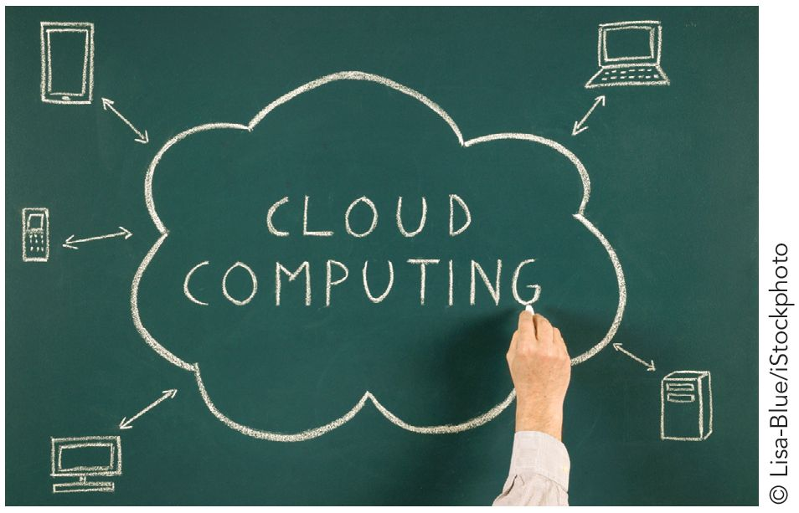
Figure 2.12 Cloud computing using the Internet and private networks to access, share, and deliver computing resources.

Slide 42
MOVE TO ENTERPRISE CLOUDS
Managing software and their licenses involves deploying, provisioning, and updating them—all of which are time consuming and expensive.
Cloud computing overcomes these problems. Procuring a physical machine can take days or weeks, but a VM can be provisioned in one business day.

Slide 43
Moving to the Cloud Raises Questions
Which workloads should be exported to the cloud?
Which set of standards should be followed for cloud computing?
How to resolve issues of privacy and security as things move out to the cloud?
How will departments or business units get new IT resources? Should they help themselves, or should IT remain a gatekeeper?

Slide 44
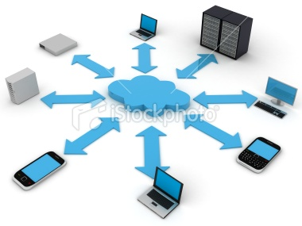
What Services are Available in the Cloud?
Software-as-a-Service (SaaS): popular IT model in which software is available to users as needed.
Other terms for SaaS:
  on-demand computing
  utility computing
  hosted services
Basic idea: instead of buying and installing expensive packaged enterprise applications, users access software apps over a network.
See Table 2.3 on page 48

Slide 45
IT at Work 2.4
Cloud Pro Leverages iPad’s touch: Benefits Start-Ups
Questions
1. Consider this statement: Cloud computing is about the flexible
delivery of services at the point of need. Explain how Cloud
Pro offers flexible delivery of network management (the service).
Explain how it offers that service to network admins at the
point of need (e.g., while on vacation or away from the office).
2. Discuss one benefit and one disadvantage of Cloud Pro for
network admins.
3. Search and view a video demo of Rackspace’s Cloud Pro for
the iPad. Does the app have amazing features, as Mike Mayo
described?

Slide 46
2.5 Virtualization and VM (Virtual Machines)
A virtual machine is a software layer (virtualization layer) that runs its own OS and apps as if it were a physical computer as shown in Figure 2.13.

Slide 47
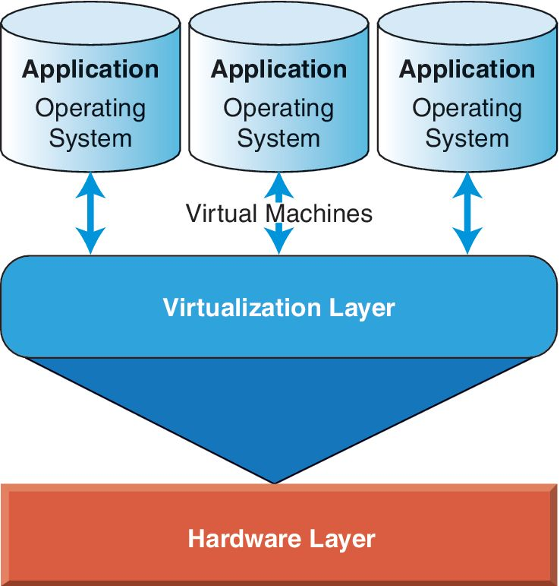
Figure 2.13 Virtual machines running on a simple hardware layer (computer).

Slide 48
WHAT IS A VIRTUAL MACHINE?
Storage virtualization is the pooling of physical storage from multiple network storage devices into what appears to be a single storage device that is managed from a central console.
Network virtualization combines the available resources in a network by splitting the network load into manageable parts, each of which can be assigned (or reassigned) to a particular server on the network.
Hardware virtualization is the use of software to emulate hardware or a total computer environment other than the one the software is actually running in. It allows a piece of hardware to run multiple operating system images at once. This kind of software is sometimes known as a virtual machine.

Slide 49
Cloud Computing Limitations and Trade-Offs
Cloud computing runs on a shared infrastructure so the arrangement is less customized to a specific company’s requirements.
It’s more difficult to get to the root of performance problems, like the unplanned outages that occurred with Google's Gmail & Workday's human resources apps.
The tradeoff is cost vs. control.

Slide 50
VIRTUALIZATION CHARACTERISTICS
AND BENEFITS
1. Memory-intensive. VMs need a huge amount of memory.
2. Energy-efficient. Minimizes energy consumed running and cooling servers in the data center—up to a 95 percent reduction in energy use per server.
3. Scalability and load balancing.

Slide 51
IT at Work 2.5
Liberty Wines Improves Business Continuity with Virtualization
IT Problems and Business Needs
Virtualized Solution
Questions
1. What business risks had Liberty Wines faced?
2. How does Liberty Wines’ IT infrastructure impact its competitive advantage?
3. How did server virtualization benefit Liberty Wines and the environment?

