Slide 1
Database, Data Warehouse, and Data Mining
Part I. Managing the Value of Data and Information Technology
^{9th Edition}
^{Information}
^{Technology}
^{for Management}
^{Advancing Sustainable,}
^{Profitable Business Growth}
Chapter 3

Slide 2
Outline
3.1 Teknologi Database
3.2 Teknologi Gudang Data dan Data Mart
3.3 Data Mining dan Text Mining
3.4 Business Intelligence (BI) dan Analisis
3.5 Manajeen Dokumen Digital dan Fisik

Slide 3
Chapter 3 Learning Outcomes
Describe the functions of database technology, the differences between centralized and distributed database architecture, how data quality impacts performance, and the role of a master reference file in creating accurate and consistent data across the enterprise.
Evaluate the tactical and strategic benefits of data warehouses, data marts, and data centers; describe their data volatility and decision-support characteristics; and understand the process of building and using a data warehouse.
Describe data and text mining, and give examples of mining applications to find patterns, correlations, trends, or other meaningful relationships in organizational data stores.

Slide 4
Chapter 3 Learning Outcomes - 2
Explain the operational benefits and competitive advantages of business intelligence and analytics, and how forecasting can be improved.
Describe digital and physical data and document management, and how it helps companies meet their compliance, regulatory, and legal obligations.

Slide 5
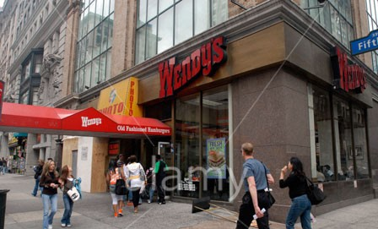
For Class Discussion & Debate
Zero-Downtime at BNP Paribas
Discuss (see book for full text)
1. Explain the importance of fault tolerant information systems.
2. What does IT downtime impact?
3. Who manages the database hardware and the software? Why is this arrangement helpful to BNP Paribas?
4. What technology transforms data to knowledge at BNP Paribas?
5. How does a query differ from a report?
6. Why is it important for the bank to be able to process in near real time or within one day? Refer to Figure 3.2 for your answer.
7. What are the operational and strategic benefits of the new database platform?

Slide 6
For Class Discussion & Debate
Zero-Downtime at BNP Paribas
Decide
8. Visit oracle.com/Exadata. Click on Resources to access the video BNP Paribas Improves Performance by 17x with Oracle Exadata (1:34). Which was considered more important to BNP Paribas—the cost savings or time savings? Explain why. Is there a predictable relationship between these two types of savings? Explain.
Debate
9. Does BNP Paribas’ investment in Oracle Exadata, data warehousing, and BI provide the global bank with a strategic advantage? Or was the investment necessary for operational survival—in effect, the cost of continuing to do business?

Slide 7
3.1 Database Technology
Today’s computing hardware is capable of crunching through huge datasets that were considered impossible a few years back. And data management vendors, such as Oracle, IBM, Microsoft, and Teradata, have been responding with more powerful software and hardware.

Slide 8
3.1 TEKNOLOGI DATABASE
Teknologi Manajemen Data yang dibahas di bab ini adalah:
Databases store data generated by business apps, sensors, and transaction processing systems (TPS).
Data warehouses integrate data from multiple databases and data silos and organize them for complex analysis, knowledge discovery, and to support decision making.
Data marts are small-scale data warehouses that support a single function or department. Organizations that are unable to invest in data warehousing may start with one or more data marts.
Business intelligence (BI) tools and techniques process data and do statistical analysis for insight and discovery—that is, to discover meaningful relationships in the data, keep informed of real time, gain insight, detect trends, and identify opportunities and risks.

Slide 9
Teknologi Database
Online Transaction Process (OLTP)
When most business transactions occur—for instance, an item is sold or returned, an order is sent or cancelled, a payment or deposit is made—changes are made immediately to the database. See Figure 3.3.
These online changes are additions, updates, or deletions. Database management systems (DBMS) record and process transactions in the database, and support queries and reporting.
Given their functions, DBMSs are referred to as online transaction processing (OLTP) systems. OLTP is a design that breaks down complex information into simple data tables.
This design is very efficient for analyzing and reporting captured transactional data. OLTP databases are capable of processing millions of transactions every second.

Slide 10
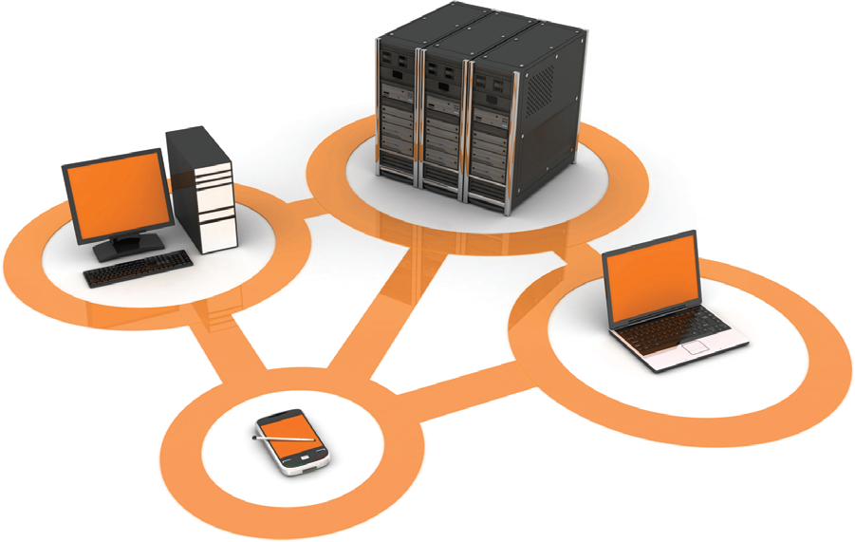
Teknologi Database
Figure 3.3 Data dihasilkan dari transaksi melalui computers, handhelds, dan input devices lainnya disimpan di database. DBMS mendukung data queries dan laporan dengan menekstrak data dari database dan mengirimnya ke layar atau alat output lainnya.

Slide 11
Centralized and Distributed Database Architecture
Ada dua jenis database: centralized and distributed. Pada kedua jenis database, For both types of databases, multiple backups atau data archives dijaga baik in-site maupun off-site.

Slide 12
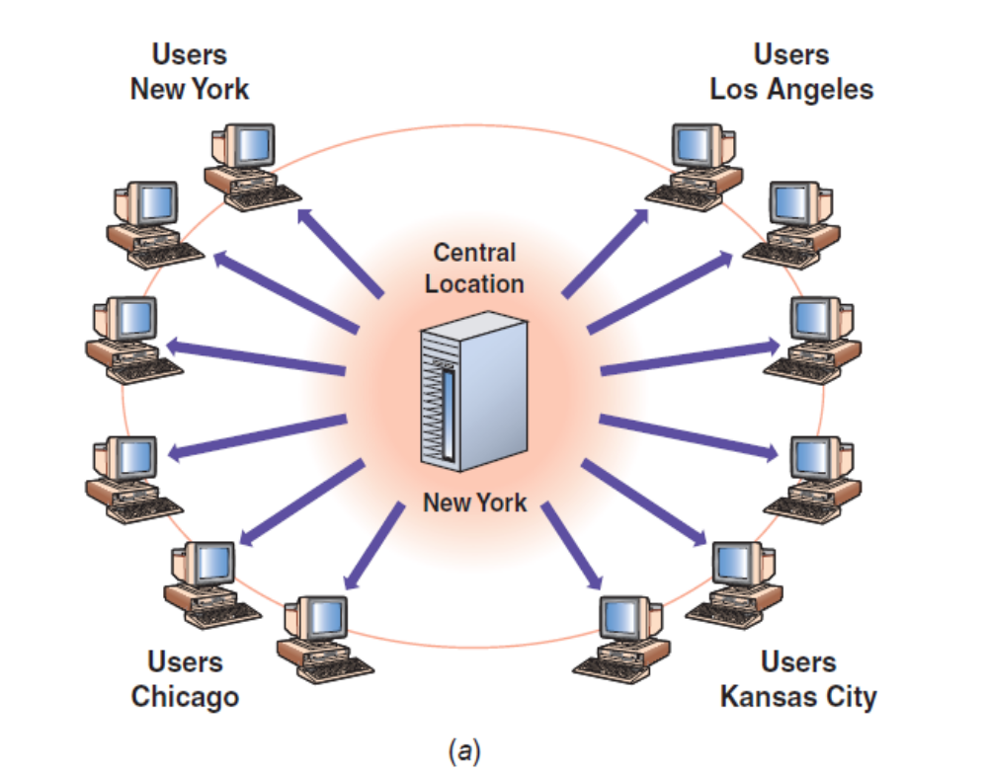
Centralized Database Architecture
A centralized database menyimpan semua file terkait pada lokasi fisik pusat seperti pada gambar sebelah

Slide 13
Centralized and Distributed Database Architecture
1. Better quality. Konsistensi data menjadi lebih mudah jika secara fisik tersimpan dalam satu lokasi, sebab penambahan data, update data, dan hapus data dapat dibuat dalam sesuai pengawasan dan pesanan.
Better security. Data diakses via komputer host terpusat, di mana ini dapat melindungi dengan lebih mudah dari akses dan modifikasi oleh orang yang tidak berhak.

Slide 14
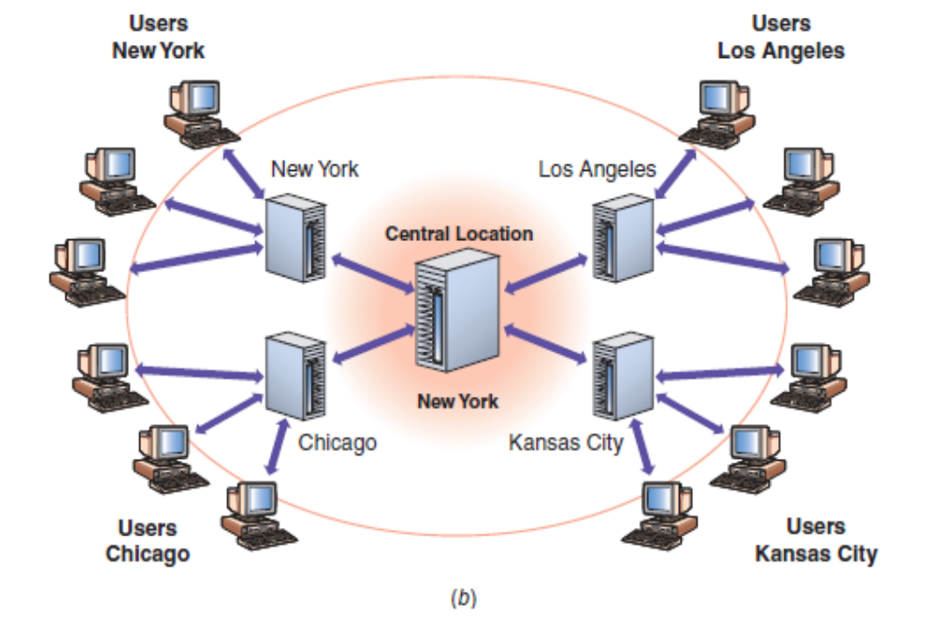
Distributed Database Architecture
Sistem Database Terdistribusi (distributed database system) mempungkinkan aplikasi dalam komputer dan mobile device untuk mengakses data dari database lokal maupun remote, seperti diagram berikut:

Slide 15
FUNGSI-FUNGSI Data Management Systems (DBMS)
Fungsi data utama yang dihasilkan DBMS meliputi:
Data filtering and profiling: Inspeksi kesalahan data, data tidak konsisten, data dobel, dan informasi tidak lengkap.
Data integrity: Koreksi, standardizing, dan verifikasi keterpaduan (integrity) data.
Data synchronization: Integrasikan, mencocokkan, dan mengkaitkan data dari berbagai sumber.
Data enrichment: Peningkatan data menggunakan informasi dari sumber data internal dan eksternal.
Data maintenance: Checking dan controlling integritas data sepanjang waktu.

Slide 16
Biaya Pengumpulan Data (Data Collection)
Garbage in/garbage out.
Data collection adalah proses yang sangat rumit, yang dapat menimbulkan masalah berkaitan kualitas data yang dikumpulkan.
Terkait bagaimana data dikumpulkan, ini perlu divalidasi sehingga pengguna tahu data tersebut dapat dipercaya.
Dalam situasi ini, penentu keputusan menghadapi terlalu banyak ketidakpastian untuk membuat intelligent business decisions. Biaya data kualitas rendah bisa dinyatakan dengan rumus:
Cost of poor data = lost business value + cost to prevent errors + cost to correct errors

Slide 17
Data Ownership and Organizational Politics
The source of the problem is data ownership. That is, who owns or is responsible for the data. Data ownership problems exist when there are no policies defining responsibility and accountability for managing data.
The tendency to delegate data quality responsibilities to the technical teams, who have no control over data quality, as opposed to business users who do have such control, is another common pitfall that stands in the way of accumulating high-quality data.

Slide 18
Data Ownership and Organizational Politics
Data life cycle. The data life cycle is a model that illustrates the way data travel:
Through an organization, as shown in Figure 3.8. The data life cycle begins with storage
2. In a database, to being loaded into a data warehouse for analysis, then reported
3. To knowledge workers or used in business apps.

Slide 19
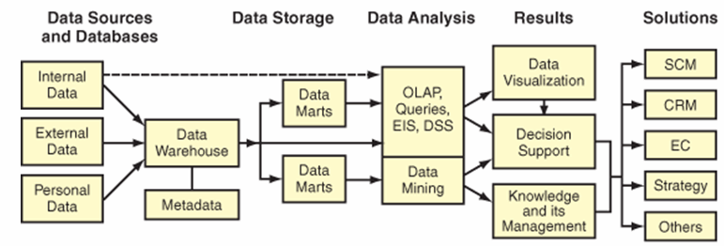
Data management is a structured approach for capturing, storing, processing, integrating, distributing, securing, and archiving data effectively throughout their life cycle.
Figure 3.8 Data life cycle

Slide 20
MASTER DATA AND MASTER DATA MANAGEMENT (MDM)
Master data management (MDM) adalah sekumpulan proses untuk mengintegrasikan data dari berbagai sumber atau aplikasi enterprise untuk menciptakan dan menjaga lebih banyak tampilan pelanggan, produk, atau entitas inti lainnya yang di-share ke antar sistem.

Slide 21
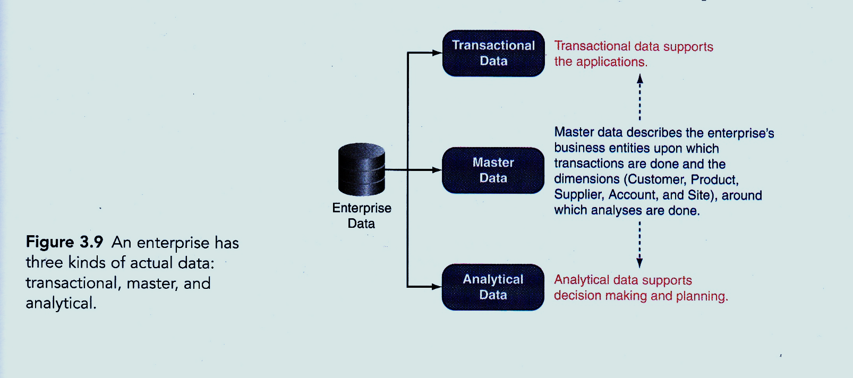

Slide 22
IT at Work 3.1 – Healthcare Sector
Data Errors Cost Billions of Dollars and Put Lives at Risk
Every day, healthcare administrators and others throughout the healthcare supply chain waste 24%-30% of their time correcting data errors.
Each incorrect transaction costs $60 to $80 to correct.
About 60% of all invoices among supply chain partners have errors, and each invoice error costs $40 to $400 to reconcile.
Each year, billions of dollars are wasted in the healthcare supply chain because of supply chain data disconnects.

Slide 23
IT at Work 3.1 (continued)
Data Errors Cost Billions of Dollars and Put Lives at Risk
Benefits from data synchronization in the healthcare sector and supply chair:
  Easier and faster product sourcing because of accurate and consistent item information
  Significantly reduces the amount of fraud or unauthorized purchasing
  Reduces unnecessary inventories
  Lowers prices because purchase volumes became apparent
  Improves patient safety

Slide 24
3.2 Data Warehouse dan Data Mart
DUKUNGAN REAL-TIME DARI ACTIVE DATA WAREHOUSE (ADW)
Data warehouse adalah database khusus yang berisi data yan diringkas dengan berbagai cara sehingga hal ini siap untuk reaksi cepat pada inquiries. Data sarehouse yang mengintegrasikan data dari database antar seluruh perusahaan disebut Enterprise Data Warehouses (EDW).
A data mart adalah data warehouse yang lebih kecil, serta melayani departemen khusus atau fungsi khusus, seperti keuangan, pemasaran, atau operasi.
Tak seperti databases, data di gudang tidaklah berubah-ubah. Oleh karenanya, data warehouses didesain sebagai sisitem Online Analytical Processing (OLAP), artinya bahwa data dapat dibutuhkan dan dianalisis lebih efisien daripada aplikasi database Online Transaction Processing (OLTP).
Kecenderungannya adalah ke real-time data warehousing and analytics—yakni, sebuah active data warehouse (ADW).

Slide 25
INTELLIGENT AND SELECTIVE CUSTOMER SERVICE MADE POSSIBLE WITH ADW
Consider, for example, the case of Charles, a dissatisfied customer who calls the customer service center because of frequent dropped cell calls. Through the call center application attached to the ADW, the CSR accesses not only the complete history of Charles’s calls to the company but also a full view of all the services to which he subscribes—TV, video on-demand, Internet, and cell—along with his customer profitability score, which lets the CSR know how profitable he is to the company. Intelligent and selective customer service is possible because all service lines and calls to customer service are stored in the ADW. The CSR uses the data to determine the best action or offer to resolve this issue to Charles’s satisfaction.

Slide 26
MANFAAT DATA WAREHOUSING
Banyak organisasi membangun gudang data, sebab mereka frustasi dengan data pendukung keputusan yang tidak konsisten, atau mereka membutuhkan perbaikan pada aplikasi pelaporan, atau pemahaman yang lebih baik tentang bisnis. Dilihat dari perspektif ini, gudang data merupakan investasi infrastruktur yang membuat perusahaan mendukung operasi yang sedang berjalan maupun yang akan datan, seperti: Pemasaran dan Penjualan; Penentuan harga dan kontrak penjualan; Forecasting; Sales performance; financing
support ongoing and future operations, such as:
Marketing and sales. A data warehouse keeps everyone informed of the status of products, marketing program effectiveness, and product line profitability; and helps managers make intelligent decisions to maximize per-customer profitability.

Slide 27
MANFAAT DATA WAREHOUSING
Marketing and sales. Gudang data menjaga siapa saja yang telah menginformasikan status produk tertentu, program pemasaran yang efektif, dan line produk yang menguntungkan, dan membantu manajemen membuat keputusan intelligent untuk memaksimemkan profitabilitas per pelanggan

Slide 28
MANFAAT DATA WAREHOUSING
Pricing and contracts. Data digunakan untuk menghitung biaya secara lebih akurat dalam rangka mengopimasikanhargu suatu kontrak. Tanpa data biaya yang akurat, harga boleh jadi terlalu rendah sehingga dibawah biaya atau dekat dengan biaya produksi, atau harga yang tidak yang tidak kompetitif sebab terlalu tinggi.
Forecasting. Mendukung permintaan pelanggan.
Sales performance. Gudang data digunakan untuk menentukan profitabliitas penjualan dan produktivitas untuk seluruh wilayah teritorial; dapat mencari dan menganalisis hasil berdasasrkan geografis, produk, kelompok sales, atau individual.
Financial. Manajemen keuangan bergantung pada data real-time terbaru.

Slide 29
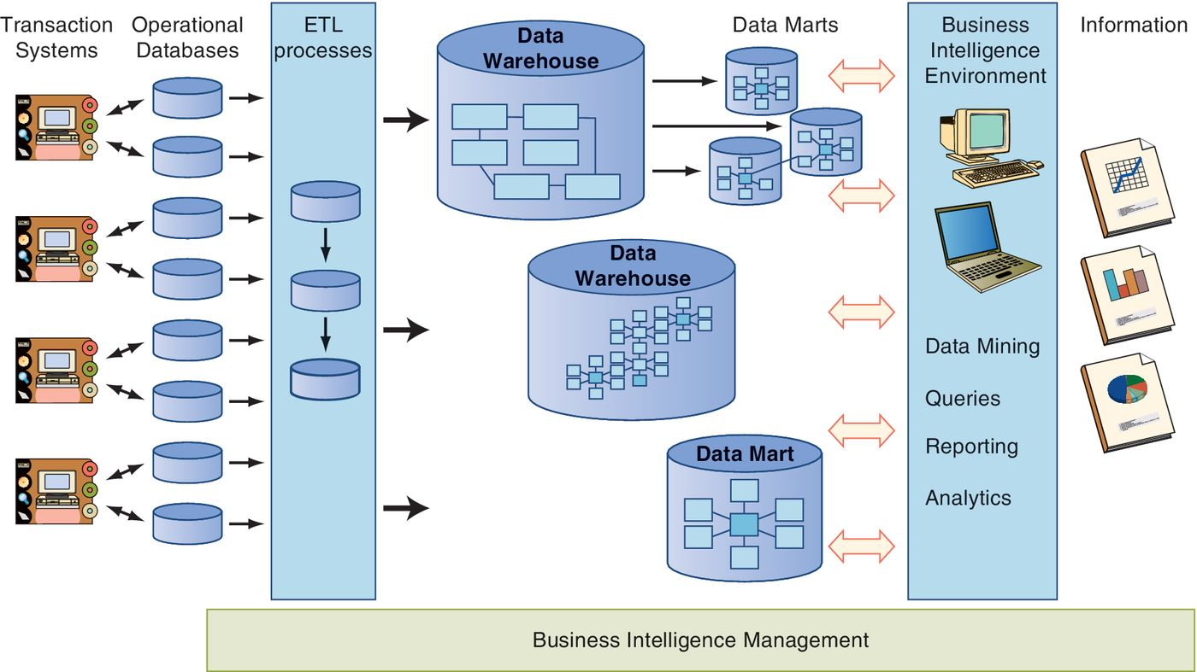
BUILDING A DATA WAREHOUSE
Figure 3.10. Database, data warehouse and marts, and BI architecture

Slide 30
DATA MARTS, OPERATIONAL DATA STORES, TEXT MINING
Data Marts. The high costs of data warehouses can make them too expensive for a company to implement. As an alternative, many firms create a lower-cost, scaled down version of a data warehouse called a data mart. Data marts are designed for a strategic business unit (SBU) or a single department.
Operational Data Stores. An operational data store is a database for transaction processing systems that uses data warehouse concepts to provide clean data. It brings the concepts and benefits of the data warehouse to the operational portions of the business at a lower cost.
Up to 75 percent of an organization’s data are non-structured word processing documents, social media, text messages, audio, video, images and diagrams, fax and memos, call center or claims notes, and so on. Text mining is a broad category that involves interpreting words and concepts in context.

Slide 31
IT at Work 3.2: U.S. Military Uses Data Mining Spy Machine for Cultural Intelligence
Nexus 7, Data Mining System
Nexus 7 is a massive new data mining system put into use by the
U.S. military in Afghanistan to understand Afghan society, and to
look for signs of weakness or instability. The classified program ties together “everything from spy radars to fruit prices” in order to read the Afghan social situation.
Questions
1. What is Nexus 7?
2. How does data mining help I2O achieve its mission?
3. What are Nexus 7’s data sources?
4. According to DARPA, what benefit does Nexus 7 provide that could not be realized without it?

Slide 33
Data and Text Mining
Data mining, which is also called data discovery, is the process of analyzing data from different prerspectives and summarizing it into information that can be used to increse revenues, decrease costs, or both.
Data mining software allows usert to analyze data from various dimensions or angles, categorieze it, and find correlations or patterns among fields in the data warehouse.

Slide 34
Data and Text Mining
Data mining, yang juga disebut penemuan data, adalah proses menganalisis data dari prerspectives berbeda dan meringkas menjadi informasi yang dapat digunakan untuk meningkatkan pendapatan, mengurangi biaya, atau keduanya.
Software Data mining memungkinkan pengguna untuk menganalisis data dari berbagai dimensi atau sudut, mengkategorikan, dan menemukan korelasi atau pola antara bidang dalam data warehouse.

Slide 35
Data and Text Mining
Text mining adalah kategori yang luas yang melibatkan penafsiran kata-kata dan konsep sesuai konteks. Setiap pelanggan menjadi advokat merek atau musuh mengekspresikan pendapat dan sikap degan bebas, yang mencapai jutaan pelanggan saat ini atau calon pelanggan lainnya pada media sosial.

Slide 36
Text Analytics Procedure
With text analytics, information is extracted out of large quantities of various types of textual information. The basic steps involved in text analytics include:
1. Exploration. First, documents are explored. This might be in the form of simple word counts in a document collection, or manually creating topic areas to categorize documents by reading a sample of them. A challenge of the exploration effort is misspelled or abbreviated words, acronyms, or slang.

Slide 37
Text Analytics Procedure
2. Preprocessing. Before analysis or the automated categorization of the content, the text may need to be preprocessed to standardize it to the extent possible. As in traditional analysis, up to 80 percent of the time can be spent preparing and standardizing the data. Misspelled words, abbreviations, and slang may need to be transformed into consistent terms.
3. Categorizing and Modeling. Content is then ready to be categorized. Categorizing messages or documents from information contained within them can be achieved using statistical models and business rules. As with traditional model development, sample documents are examined to train the models. Additional documents are then processed to validate the accuracy and precision of the model, and finally new documents are evaluated using the final model (scored).

Slide 38
IT at Work 3.3: Are There Places Not to Use Analytics?
Between 2008 and 2011, an estimated 25 percent of all newsroom employees were laid off or accepted buyouts, and over 100 free local papers went out of business. Why? During that time,newspaper advertising revenues nose-dived. One exception was AOL, which had hired many journalists. According to the AOL’s CEO Tim Armstrong, the most valuable part of AOL is its collection of over 90 blogs and news sites that it manages. AOL relies much more on IT than traditional news-gathering organizations do. In 2010, AOL was using Seed to attract readers through search engines. See text for complete information.
For Debate
1. In your opinion, who might benefit from Seed and what are those benefits?
2. To what extent, if any, do you agree about the concern for reporting integrity?
3. To what extent, if any, do you agree about the concern for reporting quality?
4. Do you detect other new media organizations following a similar strategy to attract readers—and remain in business? Identify those organizations and their similarity to AOL’s use of Seed.

Slide 39
3.4 Business Intelligence(BI) dan Analytics
TRANSFORMASI DATA BI UNTUK KEPUTUSAN
Produk apa yang telah dibeli dalam enam bulan yang lalu? Siapa yang membelinya? Agen penjualan mana yang terlibat? Jenis cross-selling apakah yang potensial? Bagaimana break down kecenderungan penjualan menuruh kelompok produk selama lima tahun terakhir? Apakah penjualan sehari-hari nampak seperti dalam tiap area penjualan?
Perusahaan menggunakan solusi BI untuk mengetahui pertanyaan apa yang dikemukakan, dan mencari jawabannya. BI tool mengintegrasikan dan menkonsolidasi data dari berbagai sumber internal maupun eksternal dan kemudian memprosesnya kedalam informasi untuk membuat keputusan cerdas.

Slide 40
3.4 Business Intelligence(BI) dan Analytics
TRANSFORMASI DATA BI UNTUK KEPUTUSAN
Produk apa yang telah dibeli dalam enam bulan yang lalu? Siapa yang membelinya? Agen penjualan mana yang terlibat? Jenis cross-selling apakah yang potensial? Bagaimana break down kecenderungan penjualan menuruh kelompok produk selama lima tahun terakhir? Apakah penjualan sehari-hari nampak seperti dalam tiap area penjualan?
Perusahaan menggunakan solusi BI untuk mengetahui pertanyaan apa yang dikemukakan, dan mencari jawabannya. BI tool mengintegrasikan dan menkonsolidasi data dari berbagai sumber internal maupun eksternal dan kemudian memprosesnya kedalam informasi untuk membuat keputusan cerdas.
What started as a tool to support sales, marketing, and customer service departments has widely evolved into an enterprise-wide strategic platform. While BI systems are used in the operational management of divisions and business processes, they are also used to support strategic corporate decision making.

Slide 41
3.4 Business Intelligence(BI) and Analytics
BI TECHNOLOGICAL ADVANCES
BI architecture is undergoing technological advances in response to big data and the performance demands of end users (Watson, 2012).
One technology advance that can help handle big data is BI in the cloud. BI can be hosted on a public or private cloud.
The driver of the business analytics trend is the need to be able to use data to create not just business value, but also competitive advantage.

Slide 42
IT at Work 3.4: BI for Finance
CarMax, Inc. is the largest U.S. specialty retailer of used cars, with $9 billion in 2011 revenues. CarMax also sells vehicles that do not meet its retail standards to licensed dealers through on-site wholesale auctions, sells new vehicles under franchise agreements, and provides customers financing through its finance operation, CarMax Auto Finance. See text for complete information.
Questions
1. What value does BI offer organizations?
2. What is the value of business analytics?
3. What does it mean to drill down, and why is it important?
4. What were MIT and IBM’s key findings about analytics?
5. What ISs helped CarMax achieve record-setting growth?

Slide 43
DOCUMENT MANAGEMENT SYSTEM (DMS)

Slide 44
3.5 Digital and Physical Document Management
Semua perusahaan membuat catatan bisnis, dimana dokumen-dokumen merekam deal-deal bisnis, seperti kontrak, R&d, dokumen bukti akunting, memo, komunikasi klien, dan notulen rapat.
Document management adalah kontrol otomatis dokumen gambar dan elektronik, gambar laman, spreadsheet, pesan suara dan e-mail, dokuthe automated control of imaged and electronic documents, page images, spreadsheets, voice and e-mail messages, dokumen word, dan dokumen lain melalui siklus hidupnya dalam organisasi, dari penciptaan awal sampai pengarsipan atau penghancuran akhir.

Slide 45
3.5 Digital and Physical Document Management
Document management systems (DMS) terdiri dari hardware dan software yang memanaj dan mengarsipkan dokumen elektronik dan juga mengkonversi dokumen kertas ke e-document dan kemudian mengindeks dan menyimpannya untuk kebijakan perusahaan. DMS memiliki kemampuan query dan search sehingga dapat diidentifikasi dan diakses seperti data dalam sebuah database.

Slide 46
3.5 Digital and Physical Document Management
DOCUMENT MANAGEMENT SYSTEM
A DMS can help a business to become more efficient and productive by:
Enabling the company to access and use the content contained in the documents
Cutting labor costs by automating business processes
Reducing the time and effort required to locate information the business needs to support decision making
Improving the security of the content, thereby reducing the risk of intellectual property theft
Minimizing the costs associated with printing, storing, and searching for content.

Slide 47
3.5 Digital and Physical Document Management
MEETING COMPLIANCE REQUIREMENTS
Simply creating backups of records is not sufficient because the content is not organized in a way to make it accurately and easily retrieved. The requirement to manage records—regardless of whether they are physical or digital—is not new.
What is new is the volume that must be reviewed to determine whether they should be retained or destroyed. Properly managed, records are strategic assets. Improperly managed or destroyed, they are liabilities.
Companies need to be prepared to respond to an audit, federal investigation, lawsuit, or any other legal action against it. Types of lawsuits against companies include patent violations, product safety negligence, theft of intellectual property, breach of contract, wrongful termination, harassment, discrimination, and many more.

Slide 48
IT at Work 3.5: How Companies Use Document Management Systems
The Surgery Center of Baltimore stores all medical records electronically, providing instant patient information to doctors and nurses anywhere and at any time.
American Express (AMEX) uses TELEform, to collect and process more than 1 million customer satisfaction surveys every year.
The University of Cincinnati provides authorized access to the personnel files of 12,000 active employees and tens of thousands of retirees. See text for complete information.
Questions
1. What types of waste can DMS reduce?
2. How do DMS reduce waste?
3. What is the value of providing access to documents via the Internet or corporate network?

Slide 49
3.5 Digital and Physical Document Management
Discussion Questions
1. What are business records?
2. What is the difference between a document and a record?
3. What are document management systems (DMS)?
4. Why is creating backups an insufficient way to manage an organization’s documents?
5. With respect to documents, what must companies be prepared to respond to?

