Slide 1
Teknologi Mobile dan Commerce
BAB 7
7-1

Slide 2
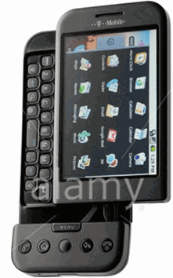
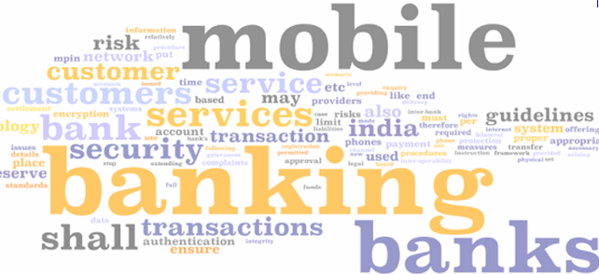
Chapter 7 Outline
7.1 Teknologi Komputasi Mobil
7.2 Mobile Commerce (m-Commerce)
7.3 Transaksi Mobile dan Layanan Finansial
7.4 Location-Based Services dan Commerce
7.5 Mobile Enterprise Applications

Slide 3
Chapter 7 Learning Objectives
Understand the three primary components of mobile technology: mobile devices, mobile operating systems and software, and wireless networks.
Describe how mobile technologies are creating opportunities for new forms of commerce in established industries.
Recognize how mobile payment methods benefit both consumers and retailers.
Describe how location-aware features of mobile devices create opportunities for new services, new approaches to advertising, and valuable benefits for mobile device users.
Identify ways that business organizations are using mobile technologies to become more efficient, productive, and profitable.

Slide 4

For Class Discussion & Debate
Macy’s Races Ahead with Mobile Retail Strategies
Scenario for Brainstorming & Discussion (see book for full text)
Perangkat Mobile, khususnya smart phones, telah menjadi alat utama dalam belanja modern. Menggunakan aplikasi barcode scanner, Pelanggan di toko Ritel semi modern dapat dengan cepat membandingkan harga dengan toko dan online retailers lain.
Mereka dapat akses informasi produk, check expert and consumer product reviews, dan bahkan beli produk dari online retailers.
Praktik ini, disebut showrooming, menjunjukkan kelemahan nyata Banyak ritel tradisional yang masih terus mengabaikan dampak perilaku konsumen mobile.

Slide 5
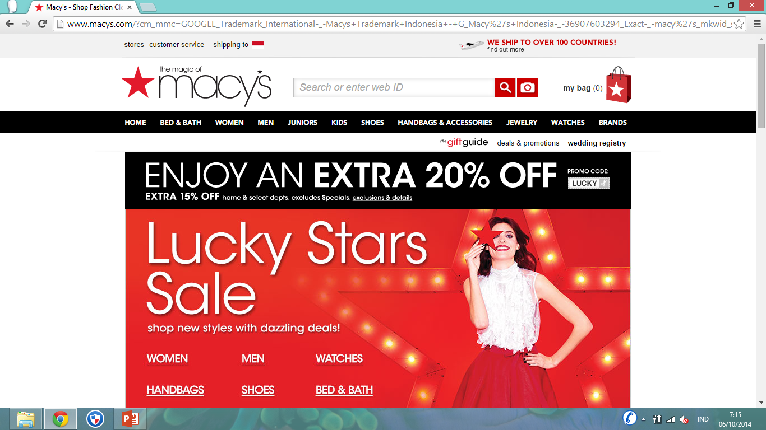
Figure 7.18. Smartphone with GPS in location-based commerce

Slide 6
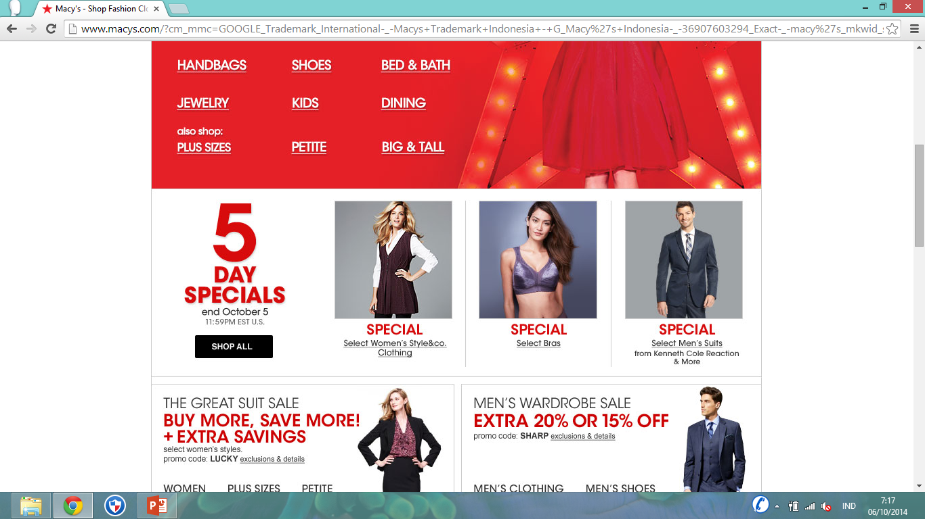
Figure 7.18. Smartphone with GPS in location-based commerce

Slide 7
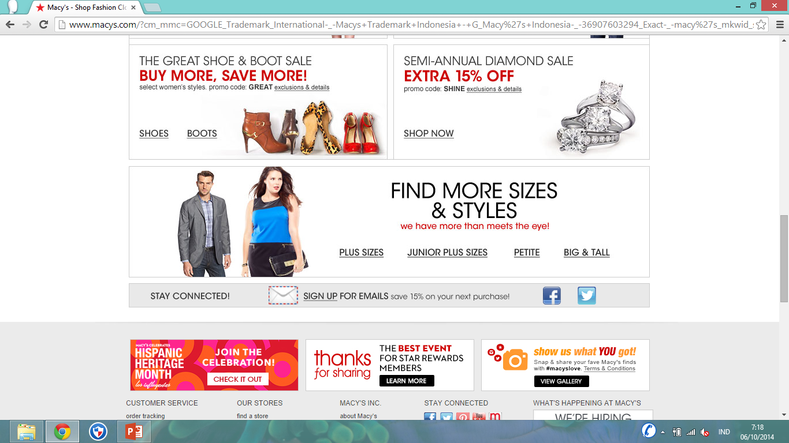

Slide 8
For Class Discussion & Debate
Macy’s Races Ahead with Mobile Retail Strategies
Discuss
Jelaskan bagaimana masing-masing mobile retail strategies-nya Macy menambah pengalaman berbelanja di-toko bagi konsumen
Apa yg akan konsumen pikirkan tentang sasaran terkait membuat perbandingan harga?
Apakah manfaat Macy dari menggunakan location-based apps seperti Foursquare dan Shopkick?
Mengapa penting bahwa Macy mendapatkan pelanggan untuk memilih ikut program mereka sebelum mengirim pesan teks promosi?
7-8
Notes:
8

Slide 9
For Class Discussion & Debate
Macy’s Races Ahead with Mobile Retail Strategies
Decide
5. Does Macy’s Backstage Pass Program really add value to the customer or is it just a gimmick with short-term benefits?
Debate
6. Traditional retailers spend a considerable amount of money to maintain an inventory of products and provide salespeople to service in-store customers. Is it unethical for customers to “showroom” these retailers, taking advantage of their services but then ultimately purchasing the product online from a retailer that doesn’t provide these services?
Notes:
9

Slide 10
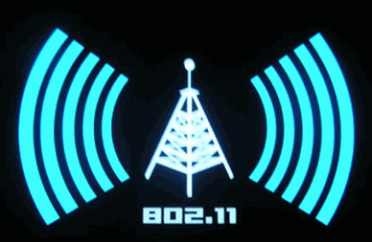
7.1 Mobile Computing Technology
Kenyataan adanya komputasi mobile telah berkembang pesat selama dua dekade terakhir.
Teknologi nirkabel membuat lokasi tidak relevan—membuat komputasi mobile dan komersial berpeluang besar untuk bisnis.
Pada 2010, ada lebih dari 4,6 miliar pengguna ponsel di seluruh dunia, yang merupakan 60,6% dari populasi penduduk dunia.

Slide 11
Mobile Computing Devices
Laptop, Notebook, Netbook, Tablet dan Mobilitas dimulai sejak adanya komputer portabel. Komputer laptop secara signifikan lebih ringan dan lebih praktis.
Smartphone. Ponsel modern pertama yang diciptakan oleh para peneliti di Motorola di pertengahan 1970-an. Sejak saat itu, ponsel telah berevolusi dari besar, perangkat sederhana yang digunakan untuk komunikasi dua-arah, sampai kecil tapi kuat sistem komputer berjaringan.
7-11
Notes:
11

Slide 12
Mobile Operating Systems (OSs) terpopuler saat ini:
Android (Google / Open Handset Alliance). Android adalah sistem operasi yang paling populer dengan pangsa pasar global 46%.
iOS (Apple). Digunakan di iPhone, iPod Touch dan iPad produk Apple.
Symbian OS (Symbian Foundation). Setelah dominan smartphone OS global, pangsa pasarnya saat ini sekitar 16% dan diabaikan di Amerika Serikat.
Blackberry OS (RIM). Ini adalah OS yang dominan di Amerika Serikat hanya beberapa tahun yang lalu. Sementara masih populer dengan pengguna bisnis Mei, sahamnya sekitar 15,9% sebagai konsumen bergeser ke arah produk Android dan Apple berbasis.
Windows Mobile OS (MS) Palm OS (Palm) Bada (Samsung). Masih ditemukan pada beberapa perangkat smartphone, meskipun mereka account hanya sebagian kecil dari pasar global.

Slide 13
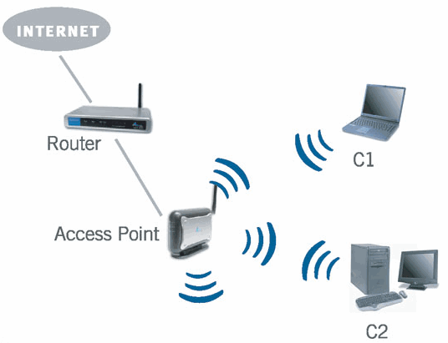
Network Access Points
Dari Bab 4: perangkat mobile harus dapat terhubung dengan jaringan berkecepatan tinggi. Lingkungan komputasi dan perdagangan mobile bergantung pada dua pendekatan dasar untuk konektivitas Internet: teknologi nirkabel jarak pendek seperti Wi-Fi dan jarak yang lebih luas dengan jaringan telekomunikasi 3G dan 4G.
Wireless Local Area Networks dan Wi-Fi. Jaringan area lokal nirkabel (WLAN) telah membuka jalan mereka ke era nirkabel. Secara bertahap, pemerintah kota, bandara, stasiun kereta api, restoran, kafe, dan pemilik tempat-tempat umum lainnya menyediakan akses Wi-Fi untuk umum secara gratis.
7-13
Notes:
13

Slide 14
7.1 Review Questions
1. What are the three technological foundations of mobile computing?
2. List the reasons why it can be difficult to categorize mobile devices.
3. What factors have led to the recent growth of the smartphone market?
4. Why is mobile computing now almost synonymous with wireless computing?
5. Why is developing mobile web sites more difficult than developing standard web sites?
Copyright 2013 John Wiley & Sons, Inc.
7-14
Notes:
14

Slide 15
7.2 mobile commerce
(m-commerce)

Slide 16
7.2 Mobile Commerce
Pada tahun 1997, dua mesin penjual Coca-Cola yang menerima pembayaran melalui pesan teks SMS dipasang di Helsinki Finlandia. Sejak saat itu, pakar industri dan pakar TI memperkirakan bahwa mobile commerce akan menjadi "hal besar berikutnya" dalam pemasaran dan penjualan barang-barang konsumsi.
Mobile Commerce, atau mCommerce, adalah membeli atau menjual barang dan jasa menggunakan perangkat genggam nirkabel seperti ponsel atau komputer tablet (slate).
7-16
Notes:
16

Slide 17
7.2 Mobile Commerce
eCommerce Mobile: Penggunaan perangkat genggam nirkabel untuk memesan dan / atau membayar barang dan jasa dari vendor online.
Ritel Mobile: Penggunaan teknologi mobile untuk mempromosikan, meningkatkan, dan dengan menambah nilai pengalaman belanja di toko.
Marketing mobile: Berbagai kegiatan yang digunakan oleh organisasi untuk terlibat, berkomunikasi, dan berinteraksi melalui Wi-Fi dan jaringan telekomunikasi dengan konsumen
7-17
Notes:
17

Slide 18
Berbelanja dari Perangkat Nirkabel (Wireless Devices)
Awalnya, mCommerce dibayangkan sebagai saluran yang terpisah dari operasi toko tradisional. Bahkan, banyak pengecer dan pelanggan melihat m-commerce sebagai pesaing saluran ritel tradisional.
Gambar 7.8 menggambarkan strategi perdagangan Mobile.
7-18
Notes:
18

Slide 19
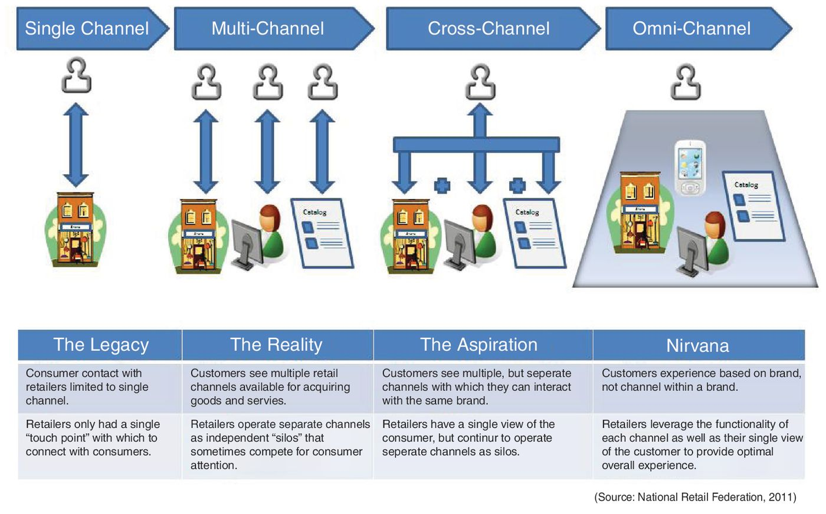
Figure 7.8. Trend in m-Commerce strategy is toward omni-channel approach.

Slide 20
7.2 Mobile Commerce…
Informasi: Keunggulan Kompetitif di Mobile Commerce. Mengintegrasikan teknologi mobile dengan strategi ritel dan merek eCommerce menyediakan manfaat lain yang penting untuk bisnis: informasi pelanggan dan identifikasi.
In-store Tracking. Di toko, pengalaman belanja dapat dioptimalkan melalui teknologi mobile yang dapat melacak gerakan pelanggan melalui toko ritel.
Quick Response (QR) Codes. Di Jepang, banyak produk yang dilengkapi dengan kode QR tag. Konsumen di negara tersebut memindai kode QR untuk mengakses informasi produk dari perangkat mobile. Menggunakan aplikasi barcode scanner dan kamera dari perangkat mobile, pelanggan memindai kode QR yang berisi link ke halaman web internet.
Mobile Visual Search (MVS) teknologi yang muncul sebagai alternatif untuk kode QR.
7-20
Notes:
20

Slide 21
7.2 Mobile Commerce…
Information: Competitive Advantage in Mobile Commerce. Integrating mobile technology with a brand’s retail and eCommerce strategy provides another important benefit to business: customer information and identification.
In-store Tracking. In-store shopping experiences can be optimized through mobile technology that can track a customer’s movement through a retail store.
Quick Response (QR) Codes. In Japan, many products are tagged with QR codes. Consumers in that country scan QR codes to access product information from a mobile device. Using a barcode scanner app and camera of a mobile device, customers scan the QR code containing a link to an Internet web page.
Mobile Visual Search (MVS) technology is emerging as an alternative to QR codes.
Copyright 2013 John Wiley & Sons, Inc.
7-21
Notes:
21

Slide 22
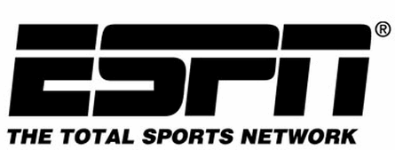
Mobile Entertainment
Penggemar olahraga menikmati sejumlah besar aplikasi dan layanan pada perangkat mobile mereka.
ESPN Sport Center, dalam kemitraan dengan Sanyo, menawarkan ponsel yang didedikasikan untuk olahraga.
Perusahaan seperti theChanner.com dan program televisi FLO TV menawarkan ke ponsel.
iTunes Store terus menjadi pemimpin dalam membuat musik digital, film, dan podcast.
Food Network memiliki genggam dengan tips dan resep untuk fine dining dan menghibur.
Sementara masih relatif kecil, industri perjudian mobile diperkirakan akan tumbuh secara substansial dalam beberapa tahun ke depan. Beberapa memprediksi jenis mobile commerce bisa menghasilkan sebanyak $ 20 myd dalam waktu dekat.
7-22
Notes:
22

Slide 23
Mobile Entertainment
Sports enthusiasts enjoy a large number of apps and services on their mobile devices.
ESPN’s Sport Center, in partnership with Sanyo, offers a cell phone dedicated to sports.
Companies like theChanner.com and FLO TV offer television programming to mobiles.
iTunes Store continues to be a leader in making digital music, movies, and podcasts.
Food Network has a handheld with tips and recipes for fine dining and entertaining.
While still relatively small, the mobile gambling industry is expected to grow substantially in the next few years. Some predict this type of mobile commerce could generate as much as $20 billion in the near future.
Copyright 2013 John Wiley & Sons, Inc.
7-23
Notes:
23

Slide 24
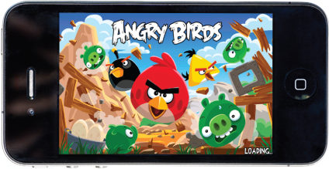
IT at Work 7.1: Angry Birds Make Mobile Game Developers Happy
Figure 7.11
Have you ever played popular mobile games like Angry Birds (Figure 7.11), Draw Something, or The Sims FreePlay? Media research firm Nielsen (2011) reports that games are the most popular mobile apps in the United States.
While many apps in this category are free, 93 percent of app downloaders are willing to pay for game apps, compared to 76 percent for news apps, another popular category.
Flurry, a mobile app analytics firm estimates that downloads for iOS and Android phones alone produced revenue of $800 million and $1.9 billion in 2010 and 2011, respectively—an increase of 137% in one year.
Copyright 2013 John Wiley & Sons, Inc.
7-24
Notes:
24

Slide 25

IT at Work 7.1: Angry Birds Make Mobile Game Developers Happy
Figure 7.11
Questions
1. Why did established companies like Nintendo and Sony fail to gain an early position in the growing mobile gaming market?
2. How are mobile games different from traditional video games? What advantages do mobile game apps have over traditional game makers?
3. Gaming is the most popular mobile app category in the United States. Social Media apps are the third-largest category. What do you think this says about the role of mobile devices in the lives of U.S. consumers?
4. Since most gaming apps are free, how do developers make money in this category?
Copyright 2013 John Wiley & Sons, Inc.
7-25
Notes:
25

Slide 26
Travel and Social Networking Go Wireless
Layanan Hotel and Travel. Dalam beberapa tahun terakhir, smartphone dan perangkat mobile lainnya telah menjadi alat bantu wisata penting. Kebanyakan maskapai besar, jaringan hotel, dan agen perjalanan internet memiliki aplikasi mobile untuk membantu wisatawan mengelola pengaturan mereka. Maskapai sering memberikan penumpang pilihan untuk menerima informasi up-to-date tentang penerbangan mereka melalui pesan teks SMS. Google Maps merupakan salah satu aplikasi yang paling populer digunakan oleh wisatawan, terutama mereka yang bepergian dengan mobil.
Mobile Social Networking. Orang-orang semakin menggunakan perangkat mobile dengan situs jejaring sosial seperti Facebook dan Twitter. Menurut Nielsen (2011) aplikasi media sosial adalah jenis ketiga paling populer mobile app-setelah permainan dan aplikasi cuaca.
7-26
Notes:
26

Slide 27
Travel and Social Networking Go Wireless
Hotel Services and Travel. In recent years, smartphones and other mobile devices have become essential travel aids. Most major airlines, hotel chains, and Internet travel agencies have mobile apps to help travelers manage their arrangements. Airlines frequently give passengers the option of receiving up-to-date information about their flights via SMS text messaging. Google Maps is one of the most popular apps used by travelers, particularly those traveling by automobile.
Mobile Social Networking. People are increasingly using mobile devices with social networking sites like Facebook and Twitter. According to Nielsen (2011) social media apps are the third-most popular kind of mobile app—after games and weather apps.
Copyright 2013 John Wiley & Sons, Inc.
7-27
Notes:
27

Slide 28
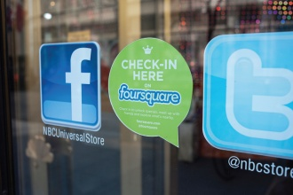
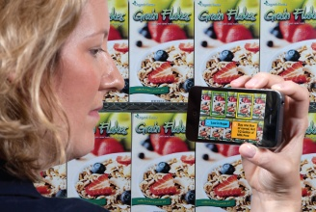
IT at Work 7.2: Wireless Marketing and Advertising in Action
Industry analysts expect advertising in the mobile channel to heat up. The following are a few examples:
Location-Based Marketing. Foursquare.com is one of the most popular apps in the growing field of mobile advertising (see Figure 7.13).
Flurry, Augmented Reality (AR) apps utilize a special technology that will become more commonplace in the future (see Figure 7.14).
Mobile Directories. Hoping to become the king of location based web domains, Go2Online (go2.com) helps travelers with mobile devices find everything from lodging to automobile repair shops.
Figure 7.13
Figure 7.14
Copyright 2013 John Wiley & Sons, Inc.
7-28
Notes:
28

Slide 29
IT at Work 7.2: Wireless Marketing and Advertising in Action
Questions
1. Describe some ways in which people are using mobile devices to shop for products and services.
2. What are some ways in which traditional brick-and-mortar retailers can use mobile technology to enhances a customer’s in-store shopping experience?
3. List types of mobile entertainment available to consumers.
4. List some ways that travelers and travel-related businesses are using mobile technology.
5. How are companies using QR codes to promote products and services to mobile consumers? Why are QR codes not as popular in the United States as they are in Asia and other parts of the world?
6. Explain why the mobile gaming market represents such a lucrative market opportunity.
Copyright 2013 John Wiley & Sons, Inc.
7-29
Notes:
29

Slide 30
7.3 transaksi mobile dan layanan keuangan

Slide 31
7.3 Mobile Transactions and Financial Services
Konsumen menggunakan perangkat mobile untuk belanja secara luas atau aktivitas komersial (mobile transactions):
Charge to phone bill with SMS confirmation.
Near Field Communications (NFC)
Phone displays barcode that retailer scans
Credit card + web form
Transfer funds from payment account using SMS
Mobile phone card reader
User scans 2D tags generated by retailer
“Bumping” iPhones with payment applications
Mobile bill payments
7-31
Notes:
31

Slide 32
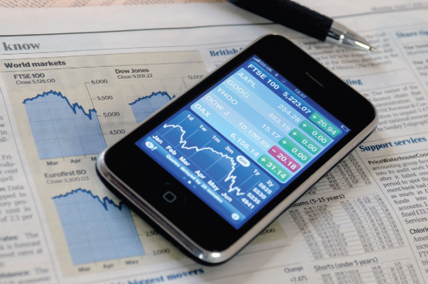
7.3 Mobile Transactions and Financial Services
Mobile Financial Services
Mobile banking adalah pengembangan dari online banking
Layanan keuangan perangkat genggam menggunakan kode singkat for sending SMS texts (misal kode SAL untuk melihat saldo rekening), Sekali perusahaan telah menyewa kode singkat, ini dapat digunakan untuk promosi dan interaksi dengan konsumen.
  Voting di acara TV American Idol dilakukan dengan menggunakan short codes. Tiap kontestan menerapkan kode singkat dan menampilkan pesan teks menggambarkan penampilan terbaik yang disukai
Figure 7.16. Mobile banking,
stock trading, and payment
services have increased in
recent years.
7-32
Notes:
32

Slide 33
Risiko Keamanan Mobile Banking
Cloning – Duplicating the Electronic Serial Number (ESM) of one phone and using it in a second phone, the clone.
Phishing – Using a fraudulent communication, such as an email, to trick the receiver into revealing confidential information.
Smishing – Similar to phishing, but the fraudulent communication comes as an SMS message.
Vishing – Similar to phishing, but the fraudulent communication is voice or voicemail message.
Lost or Stolen Phone – Lost or stolen cell phones can be used to conduct financial transactions without the owner’s permission.
7-33
Notes:
33

Slide 34
7.4 layanan dan komersial berbasis lokasi
(Location-Based services and commerce)

Slide 35
7.4 Location-Based Services and Commerce
Location-based commerce (l-commerce): delivery of ads, products, or services to customers whose locations are known at a given time; also called location-based services (LBSs).
5 key concepts:
  1. Location: MENUNJUKKAN POSISI
  2. Navigation: MENGGAMBAR RUTE
  3. Tracking: MEMONITOR GERAKAN SEPANJANG RUTE
  4. Mapping: MEMBUAT PETA DIGITAL
  5. Timing: MENUNJUKKAN WAKTU DAN LOKASI TERTENTU
Notes:
35

Slide 36
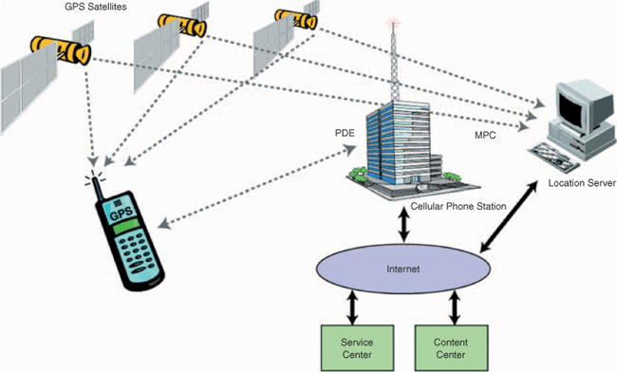
7.4 Location-Based Services and Commerce
L-COMMERCE TECHNOLOGIES
  Position Determining Equipment (PDE)
  Mobile Positioning Center (MPC)
  Location-based technology
  Geographic content
  Location-specific content
Figure 7.18. Smartphone with GPS in location-based commerce
7-36
Notes:
36

Slide 37
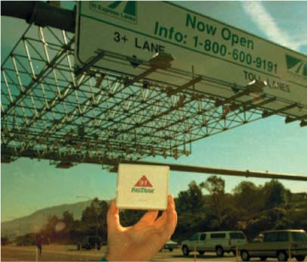
IT at Work 7.3: The Highway 91 Project
RFID sensors in the pavement let the tollway computer know that a car has entered. Only prepaid subscribers can drive on the 91.
Figure 7.17.
Highway 91 Project
7-37
Notes:
37

Slide 38
7.4 Questions
  1. What are location-based services?
  2. What are some examples of location-based commerce?
  3. Describe GPS. What is it used for?
  4. Describe GIS and its advantages.
  5. Describe how advertisers may take advantage of GIS and GPS information to make their advertising and promotional campaigns more effective.
Copyright 2012 John Wiley & Sons, Inc.
7-38
Notes:
38

Slide 39
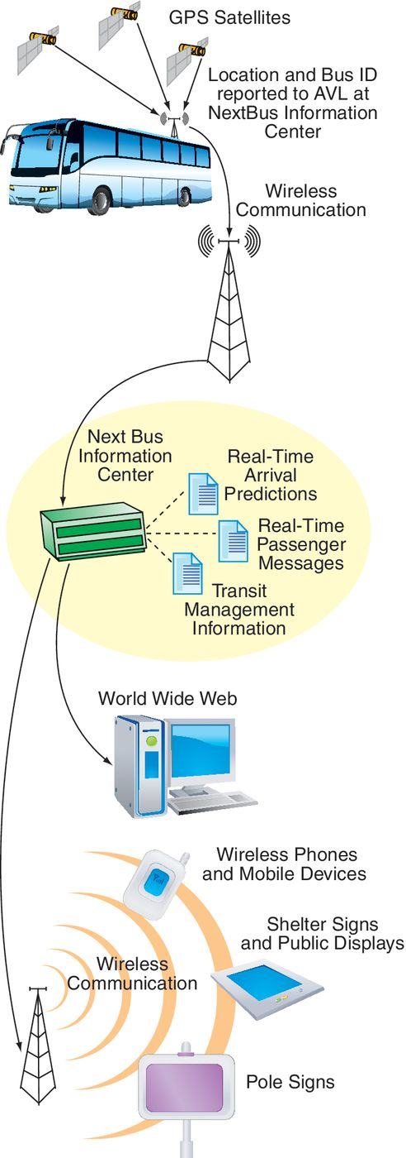
IT at Work 7.4: NextBus: Superb Customer Service
Figure 7.20. NextBus
operational model
San Francisco bus riders carrying a mobile can quickly find out when a bus is likely to arrive at a bus stop.
The NextBus system tracks public transportation buses in real time.
Knowing where each bus is and factoring in traffic patterns and weather reports, NextBus dynamically calculates the ETA of the bus to each bus stop on the route.
Questions
1. How can NextBus generate revenue?
2. Who might be good sponsors of the service?
7-39
Notes:
39

Slide 40
7.5 aplikasi enterprise mobile

Slide 41
7.5 Mobile Enterprise Applications
Organisasi menciptakan aplikasi FULL-RANGE—dari aplikasi back-office sampai consumer-centric
Organisasi membangun strategi pemasaran dan penjualan yang terkoneksi dengan pelanggannya melalui mobile
Keterbatasan smart-phone dengan layar sempitnya, dapat diatasi dengan menggunakan penrangkat tablet dan dengan mengambah kemampuan aplikasi komputasi mobile dan mobile enterprise.
7-41
Notes:
41

Slide 42
Mobile Apps
Mendukung salesman yang sedang menunggu pelanggan
Mendukung karyawan lapangan melakukan perbaikan atau perawatan di tempat perusahaan atau untuk klien.
Mendukung perjalanan atau kunjungan luar perusahaan bagi para eksekutif, manajer, atau karyawan lainnya.
Mendukung karyawan sementara mereka bekerja di dalam perusahaan, tetapi di mana tidak ada akses yang mudah ke komputer desktop, misalnya, di gudang, fasilitas outdoor, atau toko ritel besar.
Mendukung karyawan yang terlibat dalam operasi logistik seperti mengemudi truk atau kendaraan pengiriman, atau bekerja di gudang terpencil atau fasilitas penyimpanan
7-42
Notes:
42

Slide 43
7.5 Questions
1. Describe how mobile devices and apps are being used inside organizations.
2. Describe some ways that salespeople are benefiting from mobile technology.
3. Describe how retailers improve the shopping experience for their customers using mobile technology.
4. How is mobile technology being used to improve inventory management within companies?
5. Describe some benefits to companies using Mobile Supply Chain Management (MSCM) programs.
Copyright 2013 John Wiley & Sons, Inc.
7-43
Notes:
43

