Slide 1
Manajemen Kualitas
Bab 6

Slide 2
Outline
Profil Perusahaan Global :
Rumah sakit Arnold Palmer
Kualitas dan Strategi
Definisi Kualitas
Manajemen Kualitas Total (Manjemen Mutu Terpadu)
Alat-alat Manajemen Kualitas Total
Peran Inspeksi
Manajemen Kualitas Total bidang Jasa

Slide 3
Tujuan Pembelajaran
Setelah mengikuti bab ini, Anda diharapkan mampu untuk:
Mendefinisikan Kualitas dan TQM (MKT)
Menjelaskan Standar Kualitas Internasional ISO
Menjelaskan apa itu Six Sigma (Enam Sigma)
Menjelaskan bagaimana benchmarking (patok duga) digunakan dalam TQM
Menjelaskan kualiatas produk robust (tegar) dan konsep Taguchi
Menggunakan tujuh alat TQM

Slide 4


Slide 5
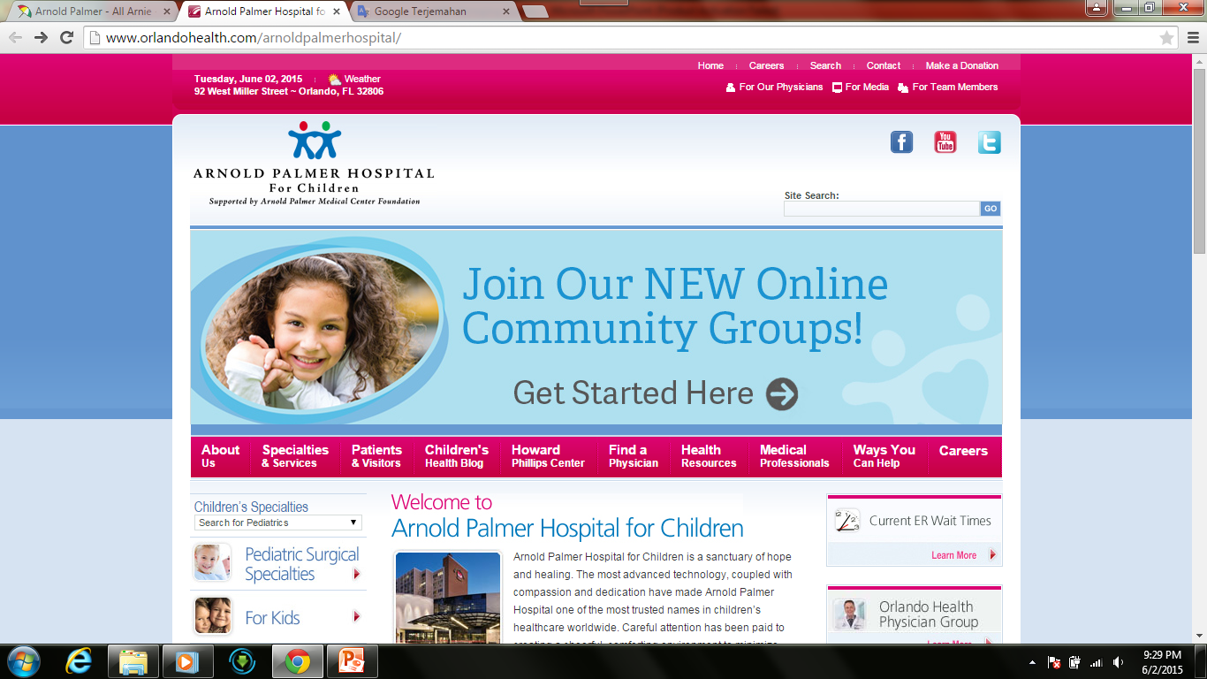

Slide 6
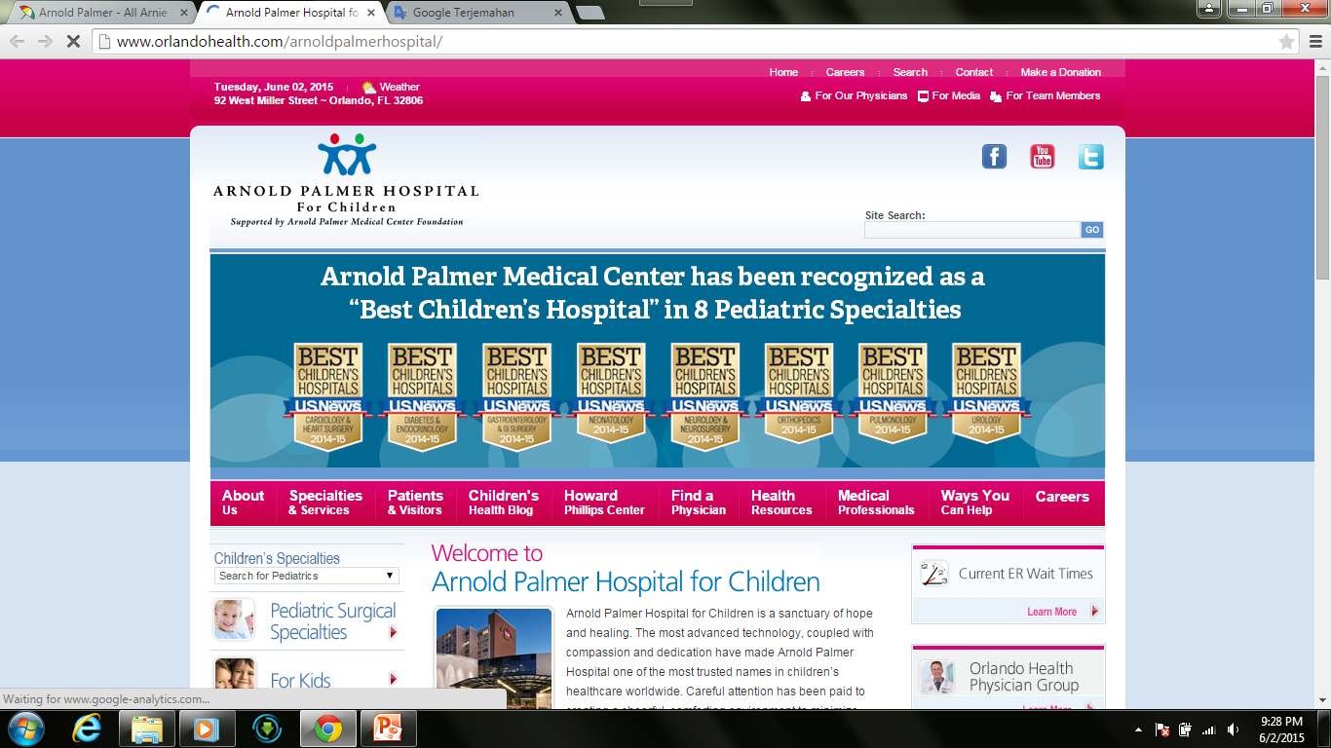

Slide 7
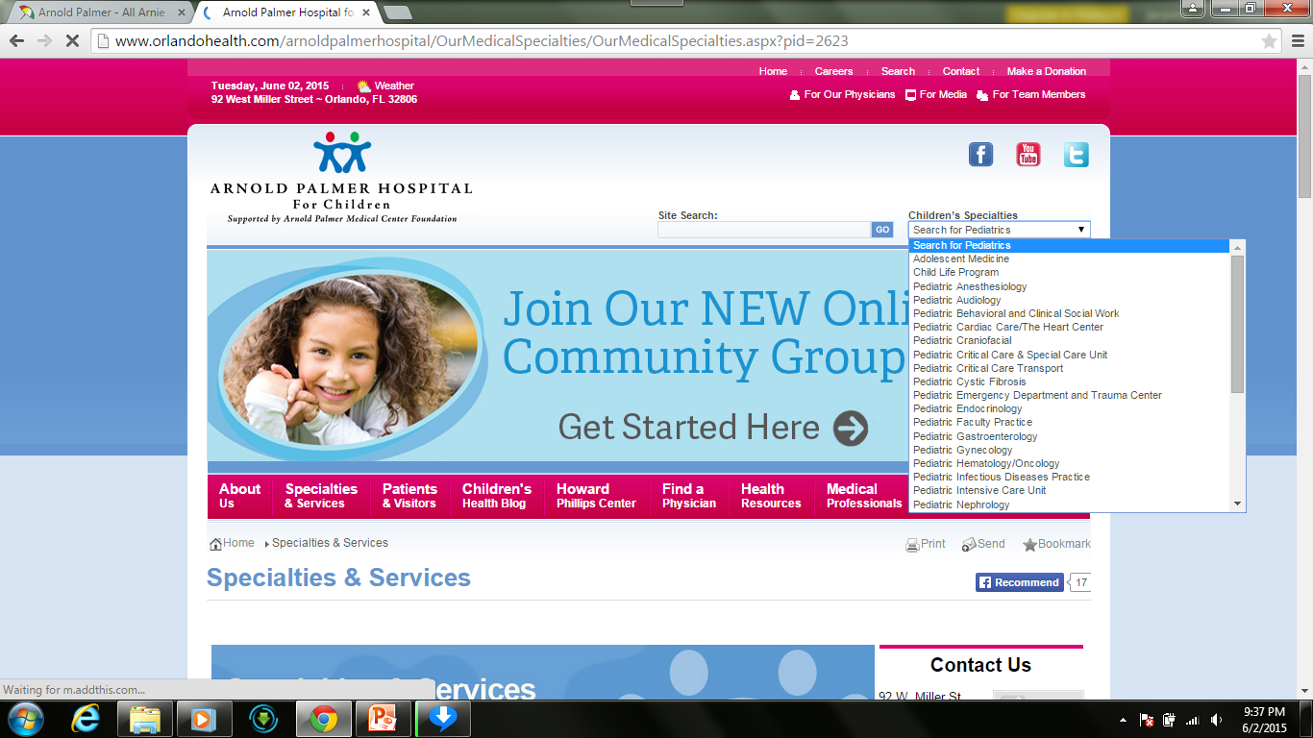

Slide 8
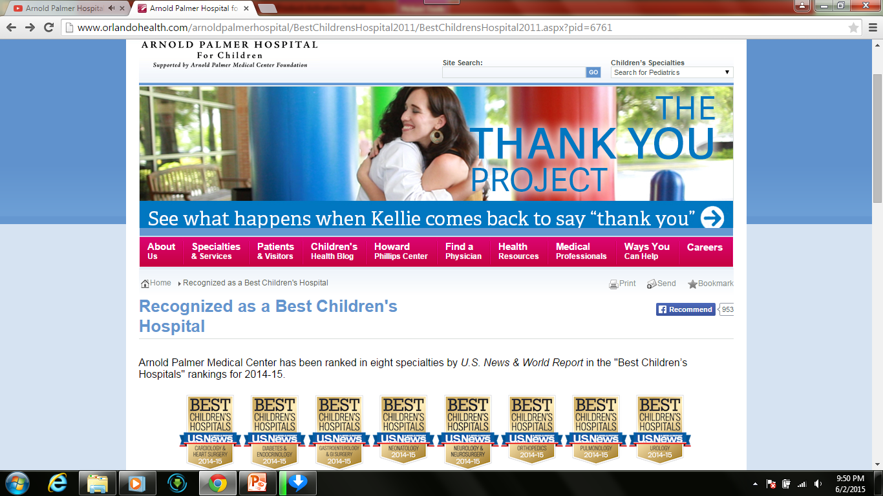

Slide 9
Memanaj Kualitas memberikan Keunggulan Bersaing
Rumah sakit Arnold Palmer
Menangani lebih dari 12,000 kelahiran bayi per tahun
Secara virtual, setiap jenis alat kualitas diterapkan
  Continuous improvement (perbaikan terus menerus)
  Employee empowerment (pemberdayaan karyawan)
  Benchmarking (patok duga)
  Just-in-time (JIT)
  Quality tools (alat-alat kualitas)

Slide 10
Kualitas dan Strategi
Memanaj kualitas mendorong strategi differentiation, low cost, dan response
Kualitas membantu perusahaan meningkatkan penjualan dan menurunkan biaya
Membangun organisasi berkualitas adalah tuntutan tugas

Slide 11
Dua Cara Kualitas memperbaiki Profitabilitas
Melalui Penerimaan Penjualan
Memperbaiki respon
Penentuan harga yang fleksibel
Perbaikan reputasi
Memperbaiki
Kualitas
Meningkatnya
Laba
Melalui Penurunan Biaya
Meningkatnya produktivitas
Pengerjaan ulang dan pembatala lebih rendah
Biaya garansi yang lebih rendah
Figure 6.1

Slide 12
The Flow of Activities
Organizational Practices
Leadership, Mission statement, Effective operating procedures, Staff support, Training
Yields: What is important and what is to be
accomplished
Quality Principles
Customer focus, Continuous improvement, Benchmarking, Just-in-time, Tools of TQM
Yields: How to do what is important and to be
accomplished
Employee Fulfillment
Empowerment, Organizational commitment
Yields: Employee attitudes that can accomplish
what is important
Customer Satisfaction
Winning orders, Repeat customers
Yields: An effective organization with
a competitive advantage
Figure 6.2

Slide 13
Definisi Kualitas
Tujuan seorang manajer operasi adalah untuk membangun sistem Manajemen Kualitas Total yang mengidentifikasi dan memuaskan kebutuhan pelanggan

Slide 14
Definisi Kualitas
Totalitas fitur dan karakteristik produk atau jasa yang yang berhubungan dengan kemampuannya untuk memenuhi kebutuhan baik yang tersurat maupun tersirat.
The totality of features and characteristics of a product or service that bears on its ability to satisfy stated or implied needs
American Society for Quality

Slide 15
Definisi Kualitas
DEFINISI SEDERHANA
Kualitas adalah kemampuan sebuah produk atau jasa untuk memenuhi kebutuhan pelanggan
Quality is the ability of a product or service to meet customer needs

Slide 16
Dari sudut pandang berbeda:
User-based: kinerja lebih baik, lebih banyak fitur
Manufacturing-based: kesesuaian dengan standar, membuatnya benar pada kali pertama
Product-based: atribut spesifik dan terukur dari suatu produk

Slide 17
Implikasi dari Kualitas
Reputasi Perusahaan
  Persepsi produk baru
  Praktik kerja
  Hubungan suplier
Jaminan Produk
  Mengurangi risiko
Implikasi Global
  Memperbaiki kemampuan untuk bersaing

Slide 18
Malcolm Baldrige National Quality Award (MBNQA)
Didirikan pada tahun 1988 oleh Pemerintah AS
Didesain untuk memajukan praktik TQM
Pemenang saat ini meliputi
Lockheed Martin Missiles and Fire Control, MESA Products Inc., North Mississippi Health Services, City of Irving, Concordia Publishing House, Henry Ford Health System, MEDRAD, Nestlé Purina PetCare Co., Montgomery County Public Schools

Slide 19

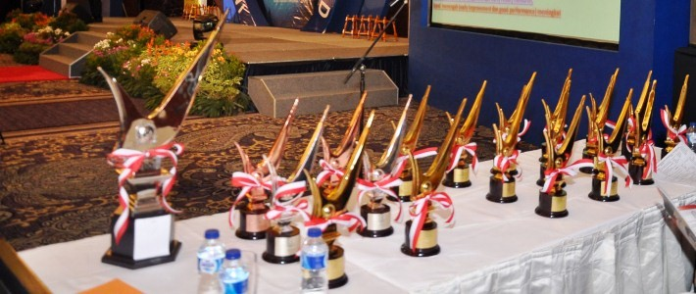
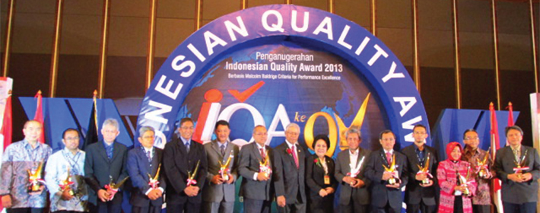
IQAF (Indonesia Quality Award Foundation)

Slide 20
Kriteria Baldrige
Pengusul dievaluasi mengenai:
KATEGORI | POIN
Kepemimpinan (Leadership) | 120
Rencana Strategik (Strategic Planning) | 85
Fokus pada Pelanggan (Customer Focus) | 85
Manajemen Pengukuran, Analisis dan Pengetahuan (Measurement, Analysis, and Knowledge Management) | 90
Fokus pada Karyawan (Workforce Focus) | 85
Fokus pada Operasi (Operations Focus) | 85
HASIL (Results) | 450

Slide 21
Standar Kualitas Internasional ISO 9000
Pengakuan Internasional
Mendorong prosedur manajemen mutu, dokumentasi rinci, instruksi kerja, dan pencatatan
Revisi 2009 menekankan kesuksesan berkelanjutan
Labih dari satu juta sertifikasi di 178 negara
Penting sekali untuk bisnis global

Slide 22
Standar Kualitas Internasional ISO 9000
Prinsip-prinsip Manajemen
  Kepemimpinan manajemen puncak (Top management leadership)
  Kepuasan pelanggan (Customer satisfaction)
  Perbaikan terus-menerus (Continual improvement )
  Keterlibatan manusia (Involvement of people)
  Analisis proses (Process analysis)
  Menggunakan pengambilan keputusan bersasarkan data (data-driven decision making)
  Pendekatan sistem untuk manajemen (A systems approach to management)
  Hubungan pemasok yang saling menguntungkan (Mutually beneficial supplier relationships)

Slide 23
ISO 9000 International Quality Standards
Management principles
  Top management leadership
  Customer satisfaction
  Continual improvement
  Involvement of people
  Process analysis
  Use of data-driven decision making
  A systems approach to management
  Mutually beneficial supplier relationships

Slide 24
Biaya Kualitas
Biaya pencegahan (Prevention costs) – mengurangi potensi cacat
Biaya penilaian (Appraisal costs) – mengevaluasi produk, komponen, dan layanan
Biaya kegagalan internal (Internal failure costs) - memproduksi komponen atau layanan yang rusak sebelum pengiriman
Biaya kegagalan eksternal (External failure costs) - cacat ditemukan setelah pengiriman

Slide 25
Biaya Kualitas
Total Cost
Total Cost
External Failure
Internal Failure
Prevention
Appraisal
Quality Improvement

Slide 26

Takumi
Huruf Jepang yang melambangkan dimensi yang lebih luas daripada kualitas, proses yang lebih dalam daripada pendidikan, dan metode yang lebih sempurna daripada ketekunan
(A Japanese character that symbolizes a broader dimension than quality, a deeper process than education, and a more perfect method than persistence)

Slide 27
Pemimpin di bidang Kualitas
TABLE 6.1 | Pemimpin di bidang Manajemen Kualitas
PEMIMPIN |  | FILOSOFI/KONTRIBUSI
W. Edwards Deming |  | Deming insisted management accept responsibility for building good systems. The employee cannot produce products that on average exceed the quality of what the process is capable of producing. His 14 points for implementing quality improvement are presented in this chapter.
Joseph M. Juran |  | A pioneer in teaching the Japanese how to improve quality, Juran believed strongly in top-management commitment, support, and involvement in the quality effort. He was also a believer in teams that continually seek to raise quality standards. Juran varies from Deming somewhat in focusing on the customer and defining quality as fitness for use, not necessarily the written specifications.

Slide 28
Pemimpin di bidang Kualitas
TABLE 6.1 | Pemimpin di bidang Manajemen Kualitas
PEMIMPIN |  | FILOSOFI/KONTRIBUSI
W. Edwards Deming |  | Deming insisted management accept responsibility for building good systems. The employee cannot produce products that on average exceed the quality of what the process is capable of producing. His 14 points for implementing quality improvement are presented in this chapter.
Joseph M. Juran |  | A pioneer in teaching the Japanese how to improve quality, Juran believed strongly in top-management commitment, support, and involvement in the quality effort. He was also a believer in teams that continually seek to raise quality standards. Juran varies from Deming somewhat in focusing on the customer and defining quality as fitness for use, not necessarily the written specifications.

Slide 29
Leaders in Quality
TABLE 6.1 | Leaders in the Field of Quality Management
LEADER |  | PHILOSOPHY/CONTRIBUTION
Amarnd Feigenbaum |  | His 1961 book Total Quality Control laid out 40 steps to quality improvement processes. He viewed quality not as a set of tools but as a total field that integrated the processes of a company. His work in how people learn from each other’s successes led to the field of cross-functional teamwork.
Philip B. Crosby |  | Quality Is Free was Crosby’s attention-getting book published in 1979. Crosby believed that in the traditional trade-off between the cost of improving quality and the cost of poor quality, the cost of poor quality is understated. The cost of poor quality should include all of the things that are involved in not doing the job right the first time. Crosby coined the term zero defects and stated, “There is absolutely no reason for having errors or defects in any product or service.”

Slide 30
Ethics and Quality Management
Operations managers must deliver healthy, safe, quality products and services
Poor quality risks injuries, lawsuits, recalls, and regulation
Ethical conduct must dictate response to problems
All stakeholders much be considered

Slide 31
Total Quality Management
Encompasses entire organization from supplier to customer
Stresses a commitment by management to have a continuing companywide drive toward excellence in all aspects of products and services that are important to the customer

Slide 32
Deming’s Fourteen Points
TABLE 6.2 | Deming’s 14 Points for Implementing Quality Improvement
1. Create consistency of purpose
2. Lead to promote change
3. Build quality into the product; stop depending on inspections to catch problems
4. Build long-term relationships based on performance instead of awarding business on price
5. Continuously improve product, quality, and service
6. Start training
7. Emphasize leadership

Slide 33
Deming’s Fourteen Points
TABLE 6.2 | Deming’s 14 Points for Implementing Quality Improvement
8. Drive out fear
9. Break down barriers between departments
10. Stop haranguing workers
11. Support, help, and improve
12. Remove barriers to pride in work
13. Institute a vigorous program of education and self-improvement
14. Put everyone in the company to work on the transformation

Slide 34
Seven Concepts of TQM
Continuous Improvement
Six Sigma
Employee Empowerment
Benchmarking
Just-in-time (JIT)
Taguchi Concepts
Knowledge of TQM Tools

Slide 35
1. Continuous Improvement
Never-ending process of continual improvement
Covers people, equipment, materials, procedures
Every operation can be improved

Slide 36
Shewhart’s PDCA Model
Figure 6.3
4. Act
Implement the plan, document
Plan
Identify the pattern and make a plan
3. Check
Is the plan working?
2. Do
Test the plan

Slide 37
Continuous Improvement
Kaizen describes the ongoing process of unending improvement
TQM and zero defects also used to describe continuous improvement

Slide 38
2. Six Sigma
Two meanings
  Statistical definition of a process that is 99.9997% capable, 3.4 defects per million opportunities (DPMO)
  A program designed to reduce defects, lower costs, save time, and improve customer satisfaction
A comprehensive system for achieving and sustaining business success

Slide 39
2. Six Sigma
Lower limits
Upper limits
Two meanings
  Statistical definition of a process that is 99.9997% capable, 3.4 defects per million opportunities (DPMO)
  A program designed to reduce defects, lower costs, save time, and improve customer satisfaction
A comprehensive system for achieving and sustaining business success
2,700 defects/million
3.4 defects/million
Mean
±3σ
±6σ
Figure 6.4

Slide 40
Six Sigma Program
Originally developed by Motorola, adopted and enhanced by Honeywell and GE
Highly structured approach to process improvement
    A strategy
    A discipline – DMAIC
    A set of 7 tools
6σ

Slide 41
Six Sigma
Defines the project’s purpose, scope, and outputs, identifies the required process information keeping in mind the customer’s definition of quality
Measures the process and collects data
Analyzes the data ensuring
repeatability and reproducibility
Improves by modifying or
redesigning existing
processes and procedures
Controls the new process
to make sure performance
levels are maintained
DMAIC Approach

Slide 42
Implementing Six Sigma
Emphasize defects per million opportunities as a standard metric
Provide extensive training
Focus on corporate sponsor support (Champions)
Create qualified process improvement experts (Black Belts, Green Belts, etc.)
Set stretch objectives
This cannot be accomplished without a major commitment from top level management

Slide 43

3. Employee Empowerment
Getting employees involved in product and process improvements
  85% of quality problems are due
  to process and material
Techniques
  Build communication networks
  that include employees
  Develop open, supportive supervisors
  Move responsibility to employees
  Build a high-morale organization
  Create formal team structures

Slide 44
Quality Circles
Group of employees who meet regularly to solve problems
Trained in planning, problem solving, and statistical methods
Often led by a facilitator
Very effective when done properly

Slide 45
4. Benchmarking
Selecting best practices to use as a standard for performance
Determine what to benchmark
Form a benchmark team
Identify benchmarking partners
Collect and analyze benchmarking information
Take action to match or exceed the benchmark

Slide 46
Best Practices for Resolving Customer Complaints
Table 6.3
BEST PRACTICE |  | JUSTIFICATION
Make it easy for clients to complain |  | It is free market research
Respond quickly to complaints |  | It adds customers and loyalty
Resolve complaints on first contact |  | It reduces cost
Use computers to manage complaints |  | Discover trends, share them, and align your services
Recruit the best for customer service jobs |  | It should be part of formal training and career advancement

Slide 47
Internal Benchmarking
When the organization is large enough
Data more accessible
Can and should be established in a variety of areas

Slide 48
5. Just-in-Time (JIT)
Relationship to quality:
JIT cuts the cost of quality
JIT improves quality
Better quality means less inventory and better, easier-to-employ JIT system

Slide 49
5. Just-in-Time (JIT)
‘Pull’ system of production scheduling including supply management
  Production only when signaled
Allows reduced inventory levels
  Inventory costs money and hides process and material problems
Encourages improved process and product quality

Slide 50
6. Taguchi Concepts
Engineering and experimental design methods to improve product and process design
  Identify key component and process variables affecting product variation
Taguchi Concepts
  Quality robustness
  Quality loss function
  Target-oriented quality

Slide 51
Quality Robustness
Ability to produce products uniformly in adverse manufacturing and environmental conditions
  Remove the effects of adverse conditions
  Small variations in materials and process do not destroy product quality

Slide 52
Quality Loss Function
Shows that costs increase as the product moves away from what the customer wants
Costs include customer dissatisfaction, warranty
and service, internal
scrap and repair, and costs to society
Traditional conformance specifications are too simplistic
Target-oriented quality

Slide 53
Quality Loss Function
High loss
L = D²C
Unacceptable
where
L = loss to society
D² = square of the distance from target value
C = cost of deviation
Loss (to producing organization, customer, and society)
Poor
Fair
Good
Low loss
Best
Target-oriented quality yields more product in the “best” category
Target-oriented quality brings product toward the target value
Frequency
Conformance-oriented quality keeps products within 3 standard deviations
Lower
Target
Upper
Specification
Figure 6.5

Slide 54
7. TQM Tools
Tools for Generating Ideas
  (1) Check Sheet
  (2) Scatter Diagram
  (3) Cause-and-Effect Diagram
Tools to Organize the Data
  (4) Pareto Chart
  (5) Flowchart (Process Diagram)

Slide 55
7. TQM Tools
Tools for Identifying Problems
  (6) Histogram
  (7) Statistical Process Control Chart

Slide 56
Seven Tools of TQM
(a) Check Sheet: An organized method of recording data
Hour
Defect 1 2 3 4 5 6 7 8
A
B
C
/
/
/
/
/
/
/
/
/
/
/
/
/
/
/
/
/
/
/
/
/
/
/
/
/
/
/
/
/
/
Figure 6.6

Slide 57
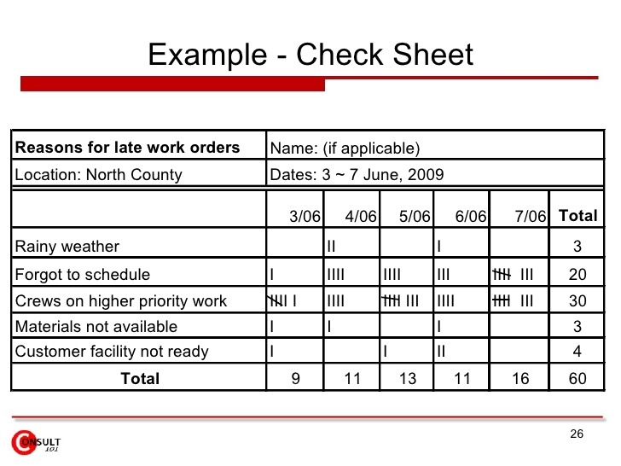
Seven Tools of TQM

Slide 58
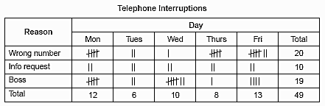
Seven Tools of TQM

Slide 59
Seven Tools of TQM
(b) Scatter Diagram: A graph of the value of one variable vs. another variable
Productivity
Absenteeism
Figure 6.6

Slide 60
Seven Tools of TQM
(c) Cause-and-Effect Diagram: A tool that identifies process elements (causes) that might effect an outcome
Cause
Materials
Methods
Effect
Manpower
Machinery
Figure 6.6

Slide 61
Seven Tools of TQM
(d) Pareto Chart: A graph to identify and plot problems or defects in descending order of frequency
Frequency
Percent
A B C D E
Figure 6.6

Slide 62
Seven Tools of TQM
(e) Flowchart (Process Diagram): A chart that describes the steps in a process
Figure 6.6

Slide 63
Seven Tools of TQM
(f) Histogram: A distribution showing the frequency of occurrences of a variable
Distribution
Frequency
Repair time (minutes)
Figure 6.6

Slide 64
Seven Tools of TQM
(g) Statistical Process Control Chart: A chart with time on the horizontal axis to plot values of a statistic
Upper control limit
Target value
Lower control limit
Time
Figure 6.6

Slide 65
Cause-and-Effect Diagrams
Material
(ball)
Method
(shooting process)
Grain/Feel (grip)
Aiming point
Size of ball
Bend knees
Air pressure
Hand position
Lopsidedness
Balance
Follow-through
Missed
free-throws
Training
Rim size
Conditioning
Motivation
Rim height
Consistency
Rim alignment
Backboard stability
Concentration
Manpower
(shooter)
Machine
(hoop &
backboard)
Figure 6.7

Slide 66
Pareto Charts
Data for October
70 –
60 –
50 –
40 –
30 –
20 –
10 –
0 –
– 100
– 93
– 88
– 72
54
Frequency (number)
Number of occurrences
Cumulative percent
12
4
3
2
Room svc Check-in Pool hours Minibar Misc.
72% 16% 5% 4% 3%
Causes and percent of the total

Slide 67
Flow Charts
MRI Flowchart
Physician schedules MRI
Patient taken to MRI
Patient signs in
Patient is prepped
Technician carries out MRI
Technician inspects film
If unsatisfactory, repeat
Patient taken back to room
MRI read by radiologist
MRI report transferred to physician
Patient and physician discuss
8
80%
1
2
3
4
5
6
7
11
9
10
20%

Slide 68
Statistical Process Control (SPC)
Uses statistics and control charts to tell when to take corrective action
Drives process improvement
Four key steps
  Measure the process
  When a change is indicated, find the assignable cause
  Eliminate or incorporate the cause
  Restart the revised process

Slide 69
Control Charts
Figure 6.8
Plot the percent of free throws missed
40%
20%
0%
Upper control limit
Coach’s target value
| | | | | | | | |
1 2 3 4 5 6 7 8 9
Lower control limit
Game number

Slide 70
Inspection
Involves examining items to see if an item is good or defective
Detect a defective product
  Does not correct deficiencies in process or product
  It is expensive
Issues
  When to inspect
  Where in process to inspect

Slide 71
When and Where to Inspect
At the supplier’s plant while the supplier is producing
At your facility upon receipt of goods from your supplier
Before costly or irreversible processes
During the step-by-step production process
When production or service is complete
Before delivery to your customer
At the point of customer contact

Slide 72
Inspection
Many problems
  Worker fatigue
  Measurement error
  Process variability
Cannot inspect quality into a product
Robust design, empowered employees, and sound processes are better solutions

Slide 73
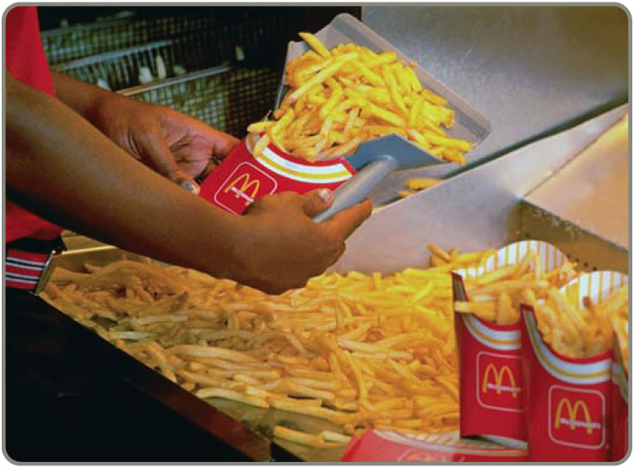
Source Inspection
Also known as source control
The next step in the process is your customer
Ensure perfect
product to your
customer

Slide 74

Source Inspection
Poka-yoke is the concept of foolproof devices or techniques designed to pass only acceptable product
Checklists ensure
consistency and
completeness

Slide 75
Service Industry Inspection
TABLE 6.4 | Examples of Inspection in Services
ORGANIZATION |  | WHAT IS INSPECTED | STANDARD
Jones Law Office |  | Receptionist performance Billing Attorney | Phone answered by the second ring Accurate, timely, and correct format Promptness in returning calls
Hard Rock Hotel |  | Reception desk Doorman Room Minibar | Use customer’s name Greet guest in less than 30 seconds All lights working, spotless bathroom Restocked and charges accurately posted to bill

Slide 76
Service Industry Inspection
TABLE 6.4 | Examples of Inspection in Services
ORGANIZATION |  | WHAT IS INSPECTED | STANDARD
Arnold Palmer Hospital |  | Billing Pharmacy Lab Nurses Admissions | Accurate, timely, and correct format Prescription accuracy, inventory accuracy Audit for lab-test accuracy Charts immediately updated Data entered correctly and completely
Olive Garden Restaurant |  | Busboy Busboy Waiter | Serves water and bread within 1 minute Clears all entrée items and crumbs prior to dessert Knows and suggest specials, desserts

Slide 77
Service Industry Inspection
TABLE 6.4 | Examples of Inspection in Services
ORGANIZATION |  | WHAT IS INSPECTED | STANDARD
Nordstrom Department Store |  | Display areas Stockrooms Salesclerks | Attractive, well-organized, stocked, good lighting Rotation of goods, organized, clean Neat, courteous, very knowledgeable

Slide 78
Attributes Versus Variables
Attributes
  Items are either good or bad, acceptable or unacceptable
  Does not address degree of failure
Variables
  Measures dimensions such as weight, speed, height, or strength
  Falls within an acceptable range
Use different statistical techniques

Slide 79
TQM In Services
Service quality is more difficult to measure than the quality of goods
Service quality perceptions depend on
  Intangible differences between products
  Intangible expectations customers have of those products

Slide 80
Service Quality
The Operations Manager must recognize:
The tangible component of services is important
The service process is important
The service is judged against the customer’s expectations
Exceptions will occur

Slide 81
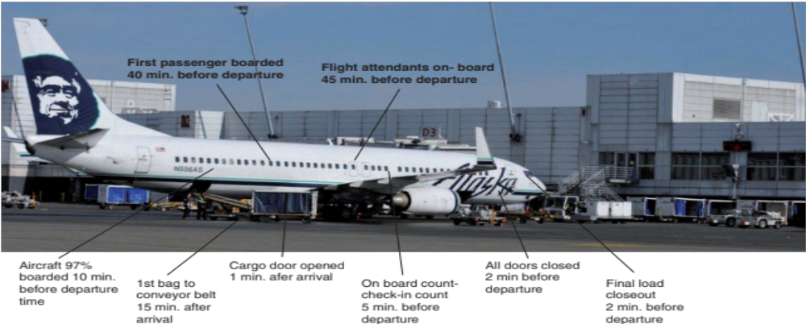
Service Specifications

Slide 82
Determinants of Service Quality
Table 6.5
Reliability involves consistency of performance and dependability
Responsiveness concerns the willingness or readiness of employees to provide service
Competence means possession of the required skills and knowledge to perform the service
Access involves approachability and ease of contact
Courtesy involves politeness, respect, consideration, and friendliness
Communication means keeping customers informed and listening to them
Credibility involves trustworthiness, believability, and honesty
Security is the freedom from danger, risk, or doubt
Understanding/knowing the customer involves making the effort to understand the customer’s needs
Tangibles include the physical evidence of the service

Slide 83
Service Recovery Strategy
Managers should have a plan for when services fail
Marriott’s LEARN routine
  Listen
  Empathize
  Apologize
  React
  Notify

