Slide 1
BAB 4
Peramalan

Slide 2
Apa itu peramalan?
Proses memprediksi kejadian yang akan datang
Sebagai dasar kegiatan bisnis
  Produksi
  Persediaan
  Personalia
  Fasilitas
??

Slide 3
Time Horizons (Horison Waktu)
Peramalan jangka pendek
  Paling lama 1 tahun, biasanya kurang dari 3 bulan
  Pembelian, Penjadwalan kerja, tingakt tenaga kerja, penugasan, tingkat produksi
Peramalan jangka menengah
  3 bulan sampai 3 tahun
  Perencanaan penjualan dan produksi, penanggaran (budgeting)
Permalan jangka panjang
  3⁺ tahun
  Perencanaan produk baru, lokasi fasilitas, penelitian dan pengembangan

Slide 4
Perbedaan horison waktu
Peramalan jangka menengah/panjang terkait dengan isu komprehensif dan mendukung keputusan manajemen terkait perencanaan dan produk, pabrik, dan proses
Peramalan jangka pendek biasanya menggunakan metodoloti yang berbeda dibandingkan peramalan jangka panjang
Peramalan jangka pendek cenderung lebih akurat dibandingkan perencanaan jangka panjang

Slide 5
Pengaruh Product Life Cycle
Introduction – Growth – Maturity – Decline
Pendahuluan dan pertumbuhan membutuhkan prakiraan yang lebih lama daripada kematangan dan kemunduran
Ketika produk melewati siklus hidup, perkiraan berguna dalam memproyeksikan
  Tingkat kepegawaian
  Tingkat persediaan
  Kapasitas pabrik

Slide 6
Product Life Cycle
Introduction Growth Maturity Decline
Best period to increase market share
R&D engineering is critical
Practical to change price or quality image
Strengthen niche
Poor time to change image, price, or quality
Competitive costs become critical
Defend market position
Cost control critical
Drive-through restaurants
Company Strategy/Issues
Internet search engines
Xbox 360
DVDs
iPods
Boeing 787
Sales
3D printers
3-D game players
Electric vehicles
Analog TVs
Figure 2.5

Slide 7
Product Life Cycle
Introduction Growth Maturity Decline
Product design and development critical
Frequent product and process design changes
Short production runs
High production costs
Limited models
Attention to quality
Forecasting critical
Product and process reliability
Competitive product improvements and options
Increase capacity
Shift toward product focus
Enhance distribution
Standardization
Fewer product changes, more minor changes
Optimum capacity
Increasing stability of process
Long production runs
Product improvement and cost cutting
Little product differentiation
Cost minimization
Overcapacity in the industry
Prune line to eliminate items not returning good margin
Reduce capacity
OM Strategy/Issues
Figure 2.5

Slide 8
Jenis Peramalan
Peramalan ekonomi
  Diarahkan pada siklus bisnis → inflasi, penawaran uang beredar, perumahan, dll
Peramalan teknologi
  Pemprediksi kemajuan teknologi
  Pengaruh kepada produk baru
Peramalan permintaan
  Memprediksi penjualan dari produk yang ada sekarang

Slide 9
Pentingnya Peramalan
Supply-Chain Management – Hubungan pemasok yang baik, keunggulan dalam inovasi produk, biaya dan kecepatan ke pasar
Human Resources – Mempekerjakan, melatih, merumahkan pekerja
Capacity – Kekurangan kapasitas dapat mengakibatkan pengiriman yang tidak dapat diandalkan, kehilangan pelanggan, hilangnya pangsa pasar

Slide 10
Tahapan Peramalan
Menentukan kegunaan peramalan
Memilih item yang diramal
Menetapkan waktu horison
Memilih model peramalan
Mengumpulkan data yang diperlukan untuk membuat peramalan
Membuat peramalan
Validasi dan menerapkan hasil peramalan

Slide 11
Seven Steps in Forecasting
Determine the use of the forecast: Disney uses park attendance forecasts to drive decisions about staffing, opening times, ride availability, and food supplies.
Select the items to be forecasted: For Disney World, them are six main parks. A forecast of daily attendance at each is the main number that determines labor, maintenance, and scheduling.
Determine the time horizon of the forecast: Is it short, medium, or long term? Disney develops daily, weekly, monthly, annual, and 5-year forecasts.
Select the forecasting models): Disney uses a variety of statistical models that we shall dis­cuss, including moving averages, econometrics, and regression analysis. It also employs judgmental, or nonquantitative, models.

Slide 12
Seven Steps in Forecasting
Gather the data needed to make the forecast: Disney's forecasting team employs 35 analysts and 70 field personnel to survey 1 million people/businesses every year. Disney also uses a firm called Global Insights for travel industry forecasts and gathers data on exchange rates, arrivals into the U.S., airline specials, Wall Street trends, and school vacation schedules.
Make the forecast.
Validate and implement the results: At Disney, forecasts are reviewed daily at the highest levels to make sure that the model, assumptions, and data are valid. Error measures are applied; then the forecasts are used to schedule personnel down to 15-minute intervals.

Slide 13
The Realities!
Forecasts are seldom perfect, unpredictable outside factors may impact the forecast
Most techniques assume an underlying stability in the system
Product family and aggregated forecasts are more accurate than individual product forecasts

Slide 14
Pendekatan Peramalan
Metode Kualitatif
Digunakan ketika situasi tidak jelas dan hanya ada sedikit data
  Produk baru
  Teknologi baru
Melibatkan intuisi, pengalaman
  Misal: meramalkan penjualan di Internet

Slide 15
Pendekatan Peramalan
Metode kuantitatif
Digunakan ketika situasi 'stabil' dan data historis tersedia.
  Produk yang sekarang ada
  Teknologi saat ini
Melibatkan teknik matematika
  e.g., Peramalan penjualan tv warna

Slide 16
Metode Kualitatif
Jury of Executive Opinion
  Menggabungkan pendapat ahli-tingkat-tinggi, kadang-kadang ditambah dengan model statistik
Delphi method
  Panel ahli, bertanya secara berulang

Slide 17
Metode Kualitatif
Sales Force Composite
  Perkiraan dari penjual individu ditinjau untuk masuk akal, kemudian dikumpulkan
  Market Survey
  Tanyakan kepada pelanggan

Slide 18

Jury of Executive Opinion
Melibatkan sekelompok kecil ahli dan manajer tingkat tinggi
Kelompok memperkirakan permintaan dengan bekerja sama
Menggabungkan pengalaman manajerial dengan model statistik
Relatif cepat
‘Group-think’
disadvantage

Slide 19
Delphi Method
Proses grup berulang, berlanjut hingga konsensus tercapai
3 jenis peserta
    Pembuat keputusan
    Staf
    Responden
Decision Makers
(Evaluate responses and make decisions)
Staff
(Administering survey)
Respondents
(People who can make valuable judgments)

Slide 20
Sales Force Composite
Setiap salesperson memproyeksikan penjualannya
Dikombinasikan di tingkat kabupaten dan nasional
Staf penjualan tahu keinginan pelanggan
Mungkin terlalu optimis

Slide 21
Market Survey
Tanyakan kepada pelanggan tentang rencana pembelian
Berguna untuk desain dan perencanaan permintaan dan produk
Apa yang dikatakan konsumen, dan apa yang sebenarnya mereka lakukan mungkin berbeda
Mungkin terlalu optimis

Slide 22
Pendekatan Kuantitatif
untuk Peramalan

Slide 23
Sekilas Pendekatan Kuantitatif
Naive approach (Pendekatan naif)
Moving averages (Rata2 bergerak)
Exponential smoothing (pemulusan eksponensial)
Trend projection (proyeksi tren / kecenderungan)
Linear regression (regresi linier)
Model Runtut Waktu
Model
Asosiatif

Slide 24
TIME SERIES MODEL

Slide 25
Peramalan Time-Series
Sekumpulan Data Numerik dengan jarak waktu sama
  Diperoleh dengan mengamati variabel respon pada periode waktu yang teratur
Prakiraan hanya berdasarkan nilai lampau, tidak ada variabel lain yang penting
  Asumsikan bahwa faktor-faktor yang mempengaruhi masa lalu dan sekarang akan terus mempengaruhi di masa depan

Slide 26
Peramalan Time-Series
Set of Evenly Spaced Numerical Data
  Obtained by observing response variable at regular time periods
Forecast based only on past values, no other variables important
  Assumes that factors influencing past and present will continue influence in future

Slide 27
Komponen Time-Series
Trend
Cyclical (Siklus)
Seasonal
(Musiman)
Random (Acak)
Notes:
TREND = a general direction in which something is developing or changing
SEASONAL =of, relating to, or characteristic of a particular season of the year.
CYCLICAL = occurring in cycles; regularly repeated.
RANDOM = made, done, happening, or chosen without method or conscious decision.

Slide 28
Komponen Permintaan
Komponen Trend
Puncak Musiman
Garis Permintaan Aktual
Permintaan produk atau jasa
Rata-rata Permintaan selama 4 tahun
Variasi Acak
| | | |
1 2 3 4
Waktu (Tahun)
Figure 4.1

Slide 29
Komponen Trend (Kecenderungan)
Persisten (stabil), seluruhnya berpola ke atas atau ke bawah
Perubahan karena populasi, teknologi, usia, budaya, dll.
Biasanya beberapa tahun lamanya
Notes:
Persistent = continuing firmly or obstinately in a course of action in spite of difficulty or opposition.

Slide 30
Komponen Musiman
Pola fluktuasi naik turun secara teratur
Karena cuaca, adat istiadat, dll.
Terjadi dalam satu tahun
PERIOD LENGTH | “SEASON” LENGTH | NUMBER OF “SEASONS” IN PATTERN
Week | Day | 7
Month | Week | 4 – 4.5
Month | Day | 28 – 31
Year | Quarter | 4
Year | Month | 12
Year | Week | 52

Slide 31
Komponen Siklus (Cyclical)
Mengulangi gerakan naik turun
Dipengaruhi oleh siklus bisnis, politik, dan faktor ekonomi
Durasi beberapa tahun
Sering hubungan kausal atau hubungan asosiatif
0 5 10 15 20

Slide 32
Komponen Acak (Random)
Fluktuasi yang tidak menentu, tidak sistematis
Karena variasi acak atau kejadian tak terduga
Durasi pendek
dan tidak berulang
M T W T F
Notes:
unforeseen events = not anticipated or predicted EVENTS

Slide 33
1. NAIVE APPROACH

Slide 34

Naive Approach (Pendekatan Naif)
Menganggap permintaan periode yad sama dengan permintaan masa lampau
  contoh., Jika pada bulan Januari permintaan sebesar 68, maka bulan Februari juga sebesar 68
Metode ini lebih efektif dan efisien
Dapat digunakan sebagai titik awal yang baik
Notes:
Naïve = (of a person or action) showing a lack of experience, wisdom, or judgment.

Slide 35
2. Metode rata-rata bergerak

Slide 36
Moving Average Method
MA adalah sekumpulan rata-rata hitung
Digunakan jika tidak ada atau sedikit tren
Sering digunakan untuk pemulusan
  Provides overall impression of data over time
$$Rata−rata bergerak=\frac{\sum{permintaan n periode yg lalu}}{n}$$

Slide 37
CONTOH RATA-RATA BERGERAK
BULAN | PENJUALAN SEBENARNYA | RATA-RATA BERGERAK 3-BULAN
Januari | 10
Februari | 12
Maret | 13
April | 16
Mei | 19
Juni | 23
Juli | 26
Agustus | 30
September | 28
Oktober | 18
November | 16
Desember | 14
10
12
13
+
+
10
12
13
(10 + 12 + 13)/3 = 11 ²/₃
(12 + 13 + 16)/3 = 13 ²/₃
(13 + 16 + 19)/3 = 16
(16 + 19 + 23)/3 = 19 ¹/₃
(19 + 23 + 26)/3 = 22 ²/₃
(23 + 26 + 30)/3 = 26 ¹/₃
(29 + 30 + 28)/3 = 28
(30 + 28 + 18)/3 = 25 ¹/₃
(28 + 18 + 16)/3 = 20 ²/₃

Slide 38
Weighted Moving average

Slide 39
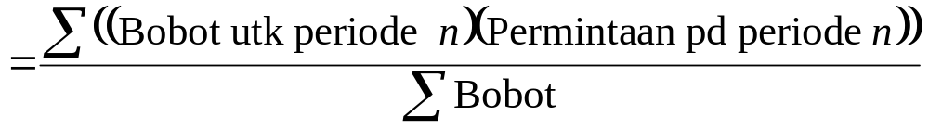
Rata-rata bergerak tertimbang
Digunakan jika terjadi beberapa kecenderungan (tren)
  Menganggap data masa lampu dianggap kurang penting dibanding data terbaru
Bobot didasarkan pada pengalaman dan intuisi (filling)
Rata-rata bergerak tertimbang

Slide 40
Weighted Moving Average
MONTH | ACTUAL SHED SALES | 3-MONTH WEIGHTED MOVING AVERAGE
January | 10
February | 12
March | 13
April | 16
May | 19
June | 23
July | 26
August | 30
September | 28
October | 18
November | 16
December | 14
10
12
13
[(3 x 13) + (2 x 12) + (10)]/6 = 12 ¹/₆
WEIGHTS APPLIED |  |  |  | PERIOD
 |  | 3 |  | Last month
 |  | 2 |  | Two months ago
 |  | 1 |  | Three months ago
 |  | 6 |  | Sum of the weights
Forecast for this month =
3 x Sales last mo. + 2 x Sales 2 mos. ago + 1 x Sales 3 mos. ago
 | Sum of the weights

Slide 41
Weighted Moving Average
MONTH | ACTUAL SHED SALES | 3-MONTH WEIGHTED MOVING AVERAGE
January | 10
February | 12
March | 13
April | 16
May | 19
June | 23
July | 26
August | 30
September | 28
October | 18
November | 16
December | 14
10
12
13
[(3 x 13) + (2 x 12) + (10)]/6 = 12 ¹/₆
[(3 x 16) + (2 x 13) + (12)]/6 = 14 ¹/₃
[(3 x 19) + (2 x 16) + (13)]/6 = 17
[(3 x 23) + (2 x 19) + (16)]/6 = 20 ¹/₂
[(3 x 26) + (2 x 23) + (19)]/6 = 23 ⁵/₆
[(3 x 30) + (2 x 26) + (23)]/6 = 27 ¹/₂
[(3 x 28) + (2 x 30) + (26)]/6 = 28 ¹/₃
[(3 x 18) + (2 x 28) + (30)]/6 = 23 ¹/₃
[(3 x 16) + (2 x 18) + (28)]/6 = 18 ²/₃

Slide 42
Potensi Masalah dengan
Moving Average
Meningkatkan n memperhalus ramalan tetapi membuatnya kurang sensitif terhadap perubahan
Tidak meramalkan tren dengan baik
Membutuhkan data historis yang luas

Slide 43
Grafik Moving Averages
Weighted moving average
30 –
25 –
20 –
15 –
10 –
5 –
Permintaan Penjualan
Actual sales
Moving average
| | | | | | | | | | | |
J F M A M J J A S O N D
Bulan
Figure 4.2

Slide 44
3. Exponential smoothing

Slide 45
Exponential Smoothing
Bentuk dari weighted moving average
  Bobot turun secara eksponensial
  Data sekarang diberi bobot lebih tinggi
Diperlukan smoothing constant (α)
  Berkisar dari 0 hingga 1
  Dipilih secara subjektif
Memerlukan sedikit catatan data masa lalu

Slide 46
Exponential Smoothing
Ramalan baru = Ramalan periode lalu
+ α (Permintaan actual periode lalu
– Ramalan periode lalu)
F_{t} = F_{t – 1} + α(A_{t – 1} - F_{t – 1})
Di mana F_{t} = ramalan baru
F_{t – 1} = ramalan periode sebelumnya
α = smoothing (atau bobot) constant (0 ≤ α ≤ 1)
A_{t – 1} = permintaan actual perode sebelumnya

Slide 47
Contoh Exponential Smoothing
Permintaan diperkirakan = 142 Ford Mustangs
Permintaan aktual = 153
Smoothing constant α = .20

Slide 48
Contoh Exponential Smoothing
Permintaan diperkirakan = 142 Ford Mustangs
Permintaan aktual = 153
Smoothing constant α = .20
Ramalan baru = 142 + .2(153 – 142)

Slide 49
Contoh Exponential Smoothing
Permintaan diperkirakan = 142 Ford Mustangs
Permintaan aktual = 153
Smoothing constant α = .20
Ramalan baru = 142 + .2(153 – 142)
= 142 + 2.2
= 144.2 ≈ 144 mobil

Slide 50
Exponential Smoothing Example
Predicted demand = 142 Ford Mustangs
Actual demand = 153
Smoothing constant a = .20
New forecast = 142 + .2(153 – 142)

Slide 51
Exponential Smoothing Example
Predicted demand = 142 Ford Mustangs
Actual demand = 153
Smoothing constant a = .20
New forecast = 142 + .2(153 – 142)

Slide 52
Exponential Smoothing Example
Predicted demand = 142 Ford Mustangs
Actual demand = 153
Smoothing constant a = .20
New forecast = 142 + .2(153 – 142)

Slide 53
Exponential Smoothing Example
Predicted demand = 142 Ford Mustangs
Actual demand = 153
Smoothing constant a = .20
New forecast = 142 + .2(153 – 142)
= 142 + 2.2
= 144.2 ≈ 144 cars

Slide 54
Effect Smoothing Constants
Smoothing constant umumnya .05 ≤ α ≤ .50
Jika α meningkat, nilai yang lebih lama menjadi kurang significant
WEIGHT ASSIGNED TO
SMOOTHING CONSTANT | MOST RECENT PERIOD (α) | 2ND MOST RECENT PERIOD α(1 – α) | 3RD MOST RECENT PERIOD α(1 – α)² | 4th MOST RECENT PERIOD α(1 – α)³ | 5th MOST RECENT PERIOD α(1 – α)⁴
α = .1 | .1 | .09 | .081 | .073 | .066
α = .5 | .5 | .25 | .125 | .063 | .031

Slide 55
Dampak Perbedaan α
225 –
200 –
175 –
150 –
Permintaan Aktual
α = .5
Permintaan
α = .1
| | | | | | | | |
1 2 3 4 5 6 7 8 9
Triwulan (Kuartal)

Slide 56
Dampak Perbedaan α
225 –
200 –
175 –
150 –
Memilih nilai α tinggi ketika rata-rata yang mendasarinya cenderung berubah
Memilih nilai α jika rata-rata yang mendasari stabil
Permintaan Aktual
α = .5
Permintaan
α = .1
| | | | | | | | |
1 2 3 4 5 6 7 8 9
Triwulan (Kuartal)

Slide 57
Impact of Different α
225 –
200 –
175 –
150 –
Chose high values of α when underlying average is likely to change
Choose low values of α when underlying average is stable
Actual demand
α = .5
Demand
α = .1
| | | | | | | | |
1 2 3 4 5 6 7 8 9
Quarter

Slide 58
Memilih α
Tujuannya adalah untuk mencari ramalan yang paling akurat tidak peduli tekniknya
Kita biasanya melakukannya dengan memilih model yang memberi kita kesalahan ramalan terendah
Kesalahan Ramalan = Permintaan aktual – Nilai ramalan
= A_{t} – F_{t}

Slide 59
Choosing α
The objective is to obtain the most accurate forecast no matter the technique
We generally do this by selecting the model that gives us the lowest forecast error
Forecast error = Actual demand – Forecast value
= A_{t} – F_{t}

Slide 60
Pengukuran kesalahan yang umum digunakan

Slide 61
Ukuran umum tingkat kesalahan
Mean Absolute Deviation (MAD)
Mean Square Error (MSE)
Mean Absolute Percent Error (MAPE)

Slide 62
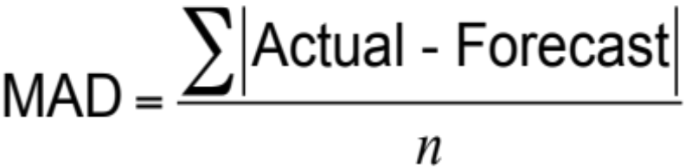
Ukuran umum tingkat kesalahan
1) Mean Absolute Deviation (MAD)

Slide 63
Menghitung MAD
QUARTER | ACTUAL TONNAGE UNLOADED | FORECAST WITH α = .10 | FORECAST WITH α = .50
1 | 180 | 175 | 175
2 | 168 | 175.50 = 175.00 + .10(180 – 175) | 177.50
3 | 159 | 174.75 = 175.50 + .10(168 – 175.50) | 172.75
4 | 175 | 173.18 = 174.75 + .10(159 – 174.75) | 165.88
5 | 190 | 173.36 = 173.18 + .10(175 – 173.18) | 170.44
6 | 205 | 175.02 = 173.36 + .10(190 – 173.36) | 180.22
7 | 180 | 178.02 = 175.02 + .10(205 – 175.02) | 192.61
8 | 182 | 178.22 = 178.02 + .10(180 – 178.02) | 186.30
9 | ? | 178.59 = 178.22 + .10(182 – 178.22) | 184.15

Slide 64
Menghitung MAD
Kuartal | Sebenarnya | Peramalan | Deviasi Absolut
1 | 180 | 175 |  | 5.00
2 | 168 | 175.50 |  | 7.50
3 | 159 | 174.75 |  | 15.75
4 | 175 | 173.18 |  | 1.82
5 | 190 | 173.36 |  | 16.64
6 | 205 | 175.02 |  | 29.98
7 | 180 | 178.02 |  | 1.98
8 | 182 | 178.22 |  | 3.78
Jumlah dari deviasi absolut: |  |  |  | 82.45
MAD = |  | Σ|Deviasi| | 82.45 | 10.31
 |  | n | 8

Slide 65
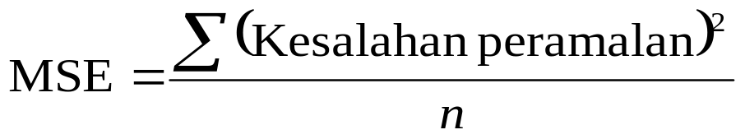
Ukuran umum tingkat kesalahan
2) Mean Squared Error (MSE)

Slide 66
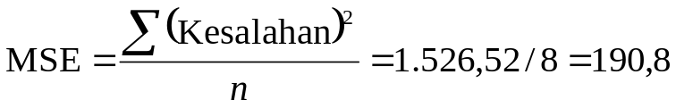
Menghitung MSE
QUARTER | AKTUAL | PERAMALAN |  | KESALAHAN KUADRAT
1 | 180 | 175 |  | 5² = 25
2 | 168 | 175.50 |  | (–7.5)² = 56,25
3 | 159 | 174.75 |  | (–15.75)² = 248,06
4 | 175 | 173.18 |  | (1.82)² = 3,31
5 | 190 | 173.36 |  | (16.64)² = 276,89
6 | 205 | 175.02 |  | (29.98)² = 898,80
7 | 180 | 178.02 |  | (1.98)² = 3,92
8 | 182 | 178.22 |  | (3.78)² = 14,29
 |  | Jumlah kesalahan kuadrat = 1.526,52

Slide 67
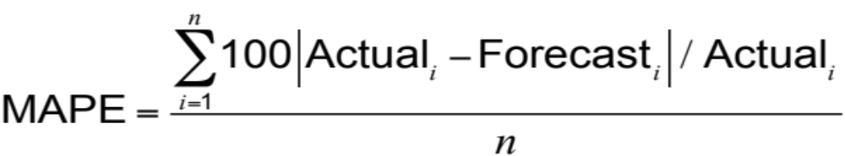
Ukuran umum tingkat kesalahan
3) Mean Absolute Percent Error (MAPE)

Slide 68
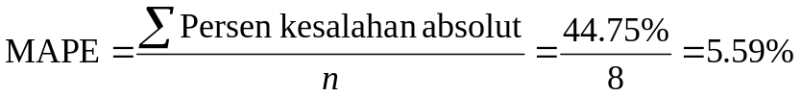
Menghitung MAPE
KUARTAL | AKTUAL | PERAMALAN | PERSEN KESALAHAN AKTUAL = 100(|KESALAHAN|/AKTUAL)
1 | 180 | 175.00 |  | 100(5/180) = 2.78%
2 | 168 | 175.50 |  | 100(7.5/168) = 4.46%
3 | 159 | 174.75 |  | 100(15.75/159) = 9.90%
4 | 175 | 173.18 |  | 100(1.82/175) = 1.05%
5 | 190 | 173.36 |  | 100(16.64/190) = 8.76%
6 | 205 | 175.02 |  | 100(29.98/205) = 14.62%
7 | 180 | 178.02 |  | 100(1.98/180) = 1.10%
8 | 182 | 178.22 |  | 100(3.78/182) = 2.08%
 |  | Jumlah % kesalahan absolut = 44.75%

Slide 69
Perbandingan kesalahan peramalan
MAD vs MSE vs MAPE

Slide 70
Perbandingan Kesalahan Peramalan
Rounded Absolute Rounded Absolute
Actual Forecast Deviation Forecast Deviation
Tonnage with for with for
Kuartal Unloaded α = .10 α = .10 α = .50 α = .50
1 180 175 5.00 175 5.00
2 168 175.5 7.50 177.50 9.50
3 159 174.75 15.75 172.75 13.75
4 175 173.18 1.82 165.88 9.12
5 190 173.36 16.64 170.44 19.56
6 205 175.02 29.98 180.22 24.78
7 180 178.02 1.98 192.61 12.61
8 182 178.22 3.78 186.30 4.30
82.45 98.62

Slide 71
Comparison of Forecast Error
∑ |deviations|
n
Rounded Absolute Rounded Absolute
Actual Forecast Deviation Forecast Deviation
Tonnage with for with for
Quarter Unloaded α = .10 α = .10 α = .50 α = .50
MAD =
For α = .10
1 180 175 5.00 175 5.00
2 168 175.5 7.50 177.50 9.50
3 159 174.75 15.75 172.75 13.75
4 175 173.18 1.82 165.88 9.12
5 190 173.36 16.64 170.44 19.56
6 205 175.02 29.98 180.22 24.78
7 180 178.02 1.98 192.61 12.61
8 182 178.22 3.78 186.30 4.30
82.45 98.62
= 82.45/8 = 10.31
For α = .50
= 98.62/8 = 12.33
MAD 10.31 12.33

Slide 72
Comparison of Forecast Error
∑ (forecast errors)²
n
Rounded Absolute Rounded Absolute
Actual Forecast Deviation Forecast Deviation
Tonnage with for with for
Quarter Unloaded α = .10 α = .10 α = .50 α = .50
MSE =
For α = .10
1 180 175 5.00 175 5.00
2 168 175.5 7.50 177.50 9.50
3 159 174.75 15.75 172.75 13.75
4 175 173.18 1.82 165.88 9.12
5 190 173.36 16.64 170.44 19.56
6 205 175.02 29.98 180.22 24.78
7 180 178.02 1.98 192.61 12.61
8 182 178.22 3.78 186.30 4.30
82.45 98.62
= 1,526.54/8 = 190.82
For α = .50
= 1,561.91/8 = 195.24
MAD 10.31 12.33
MSE 190.31 195.33

Slide 73
Comparison of Forecast Error
n
i = 1
∑100|deviation_{i}|/actual_{i}
n
Rounded Absolute Rounded Absolute
Actual Forecast Deviation Forecast Deviation
Tonnage with for with for
Quarter Unloaded α = .10 α = .10 α = .50 α = .50
MAPE =
For α = .10
1 180 175 5.00 175 5.00
2 168 175.5 7.50 177.50 9.50
3 159 174.75 15.75 172.75 13.75
4 175 173.18 1.82 165.88 9.12
5 190 173.36 16.64 170.44 19.56
6 205 175.02 29.98 180.22 24.78
7 180 178.02 1.98 192.61 12.61
8 182 178.22 3.78 186.30 4.30
82.45 98.62
= 44.75/8 = 5.59%
For α = .50
= 54.05/8 = 6.76%
MAD 10.31 12.33
MSE 190.31 195.33
MAPE 5.59% 6.76%

Slide 74
Comparison of Forecast Error
Rounded Absolute Rounded Absolute
Actual Forecast Deviation Forecast Deviation
Tonnage with for with for
Quarter Unloaded α = .10 α = .10 α = .50 α = .50
1 180 175 5.00 175 5.00
2 168 175.5 7.50 177.50 9.50
3 159 174.75 15.75 172.75 13.75
4 175 173.18 1.82 165.88 9.12
5 190 173.36 16.64 170.44 19.56
6 205 175.02 29.98 180.22 24.78
7 180 178.02 1.98 192.61 12.61
8 182 178.22 3.78 186.30 4.30
82.45 98.62
MAD 10.31 12.33
MSE 190.31 195.33
MAPE 5.59% 6.76%

Slide 75
Exponential smoothing WITH TREND ADJUSTMENT

Slide 76
Exponential Smoothing with Trend Adjustment
When a trend is present, exponential smoothing must be modified
MONTH | ACTUAL DEMAND | FORECAST (F_{t}) FOR MONTHS 1 – 5
1 | 100 | F_{t} = 100 (given)
2 | 200 | F_{t} = F₁ + α(A₁ – F₁) = 100 + .4(100 – 100) = 100
3 | 300 | F_{t} = F₂ + α(A₂ – F₂) = 100 + .4(200 – 100) = 140
4 | 400 | F_{t} = F₃ + α(A₃ – F₃) = 140 + .4(300 – 140) = 204
5 | 500 | F_{t} = F₄ + α(A₄ – F₄) = 204 + .4(400 – 204) = 282

Slide 77
Exponential Smoothing with Trend Adjustment
Forecast
including (FIT_{t}) =
trend
Exponentially Exponentially
smoothed (F_{t}) + smoothed (T_{t})
forecast trend
F_{t} = α(A_{t - 1}) + (1 - α)(F_{t - 1} + T_{t - 1})
T_{t} = β(F_{t} - F_{t - 1}) + (1 - β)T_{t - 1}
where F_{t} = exponentially smoothed forecast average
T_{t} = exponentially smoothed trend
A_{t} = actual demand
α = smoothing constant for average (0 ≤ α ≤ 1)
β = smoothing constant for trend (0 ≤ β ≤ 1)

Slide 78
Exponential Smoothing with Trend Adjustment
Step 1: Compute F_{t}
Step 2: Compute T_{t}
Step 3: Calculate the forecast FIT_{t} = F_{t} + T_{t}

Slide 79
Exponential Smoothing with Trend Adjustment Example
MONTH (t) | ACTUAL DEMAND (A_{t}) | MONTH (t) | ACTUAL DEMAND (A_{t})
1 | 12 | 6 | 21
2 | 17 | 7 | 31
3 | 20 | 8 | 28
4 | 19 | 9 | 36
5 | 24 | 10 | ?
α = .2 β = .4

Slide 80
Exponential Smoothing with Trend Adjustment Example
TABLE 4.1 |  | Forecast with α - .2 and β = .4
MONTH | ACTUAL DEMAND |  | SMOOTHED FORECAST AVERAGE, F_{t} | SMOOTHED TREND, T_{t} | FORECAST INCLUDING TREND, FIT_{t}
1 | 12 |  | 11 | 2 | 13.00
2 | 17
3 | 20
4 | 19
5 | 24
6 | 21
7 | 31
8 | 28
9 | 36
10 | —
12.80
Step 1: Average for Month 2
F₂ = αA₁ + (1 – α)(F₁ + T₁)
F₂ = (.2)(12) + (1 – .2)(11 + 2)
= 2.4 + (.8)(13) = 2.4 + 10.4
= 12.8 units

Slide 81
Exponential Smoothing with Trend Adjustment Example
TABLE 4.1 |  | Forecast with α - .2 and β = .4
MONTH | ACTUAL DEMAND |  | SMOOTHED FORECAST AVERAGE, F_{t} | SMOOTHED TREND, T_{t} | FORECAST INCLUDING TREND, FIT_{t}
1 | 12 |  | 11 | 2 | 13.00
2 | 17 |  | 12.80
3 | 20
4 | 19
5 | 24
6 | 21
7 | 31
8 | 28
9 | 36
10 | —
1.92
Step 2: Trend for Month 2
T₂ = β(F₂ - F₁) + (1 - b)T₁
T₂ = (.4)(12.8 - 11) + (1 - .4)(2)
= .72 + 1.2 = 1.92 units

Slide 82
Exponential Smoothing with Trend Adjustment Example
TABLE 4.1 |  | Forecast with α - .2 and β = .4
MONTH | ACTUAL DEMAND |  | SMOOTHED FORECAST AVERAGE, F_{t} | SMOOTHED TREND, T_{t} | FORECAST INCLUDING TREND, FIT_{t}
1 | 12 |  | 11 | 2 | 13.00
2 | 17 |  | 12.80 | 1.92
3 | 20
4 | 19
5 | 24
6 | 21
7 | 31
8 | 28
9 | 36
10 | —
14.72
Step 3: Calculate FIT for Month 2
FIT₂ = F₂ + T₂
FIT₂ = 12.8 + 1.92
= 14.72 units

Slide 83
Exponential Smoothing with Trend Adjustment Example
TABLE 4.1 |  | Forecast with a - .2 and b = .4
MONTH | ACTUAL DEMAND |  | SMOOTHED FORECAST AVERAGE, F_{t} | SMOOTHED TREND, T_{t} | FORECAST INCLUDING TREND, FIT_{t}
1 | 12 |  | 11 | 2 | 13.00
2 | 17 |  | 12.80 | 1.92 | 14.72
3 | 20 |  | 15.18 | 2.10 | 17.28
4 | 19 |  | 17.82 | 2.32 | 20.14
5 | 24 |  | 19.91 | 2.23 | 22.14
6 | 21 |  | 22.51 | 2.38 | 24.89
7 | 31 |  | 24.11 | 2.07 | 26.18
8 | 28 |  | 27.14 | 2.45 | 29.59
9 | 36 |  | 29.28 | 2.32 | 31.60
10 | — |  | 32.48 | 2.68 | 35.16

Slide 84
Exponential Smoothing with Trend Adjustment Example
40 –
35 –
30 –
25 –
20 –
15 –
10 –
5 –
0 –
Figure 4.3
Actual demand (A_{t})
Product demand
Forecast including trend (FIT_{t})
with α = .2 and β = .4
| | | | | | | | |
1 2 3 4 5 6 7 8 9
Time (months)

Slide 85
4. Proyeksi tren

Slide 86
Proyeksi tren
Menyesuaikan garis tren ke titik-titik data historis untuk memproyeksikan jangka menengah dan jangka panjang
Tren garis lurus dapat diperleh dengan teknik kuadrat terkecil
^
y = a + bx
^
di mana y = nilai yg dihitung dari variabel yang diprediksi (variabel terikat)
a = intersep sumbu y
b = kemiringan garis regresi
x = variabel bebas (periode waktu)

Slide 87
Least Squares Method
Figure 4.4
Least squares method minimizes the sum of the squared errors (deviations)
Actual observation
(y-value)
Deviation₇
Deviation₅
Deviation₆
Values of Dependent Variable (y-values)
Deviation₃
Deviation₄
Deviation₁
(error)
^
Deviation₂
Trend line, y = a + bx
| | | | | | |
1 2 3 4 5 6 7
Time period

Slide 88
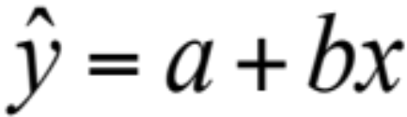
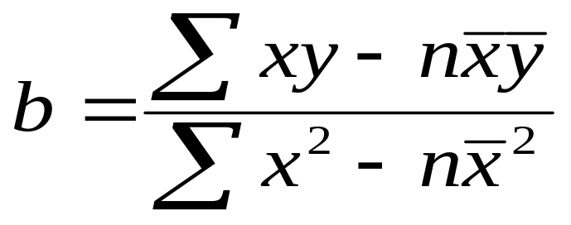

Least Squares Method
Equations to calculate the regression variables
19 Maret

Slide 89
Least Squares Example
YEAR | ELECTRICAL POWER DEMAND | YEAR | ELECTRICAL POWER DEMAND
1 | 74 | 5 | 105
2 | 79 | 6 | 142
3 | 80 | 7 | 122
4 | 90

Slide 90
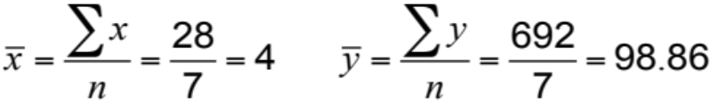
Least Squares Example
YEAR (x) |  |  | ELECTRICAL POWER DEMAND (y) |  |  | x² |  |  | xy
 | 1 |  |  | 74 |  |  | 1 |  |  | 74
 | 2 |  |  | 79 |  |  | 4 |  |  | 158
 | 3 |  |  | 80 |  |  | 9 |  |  | 240
 | 4 |  |  | 90 |  |  | 16 |  |  | 360
 | 5 |  |  | 105 |  |  | 25 |  |  | 525
 | 6 |  |  | 142 |  |  | 36 |  |  | 852
 | 7 |  |  | 122 |  |  | 49 |  |  | 854
Σx = 28 |  |  | Σy = 692 |  |  | Σx² = 140 |  |  | Σxy = 3,063

Slide 91
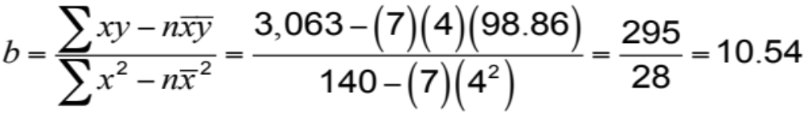

Least Squares Example
YEAR (x) |  |  | ELECTRICAL POWER DEMAND (y) |  |  | x² |  |  | xy
 | 1 |  |  | 74 |  |  | 1 |  |  | 74
 | 2 |  |  | 79 |  |  | 4 |  |  | 158
 | 3 |  |  | 80 |  |  | 9 |  |  | 240
 | 4 |  |  | 90 |  |  | 16 |  |  | 360
 | 5 |  |  | 105 |  |  | 25 |  |  | 525
 | 6 |  |  | 142 |  |  | 36 |  |  | 852
 | 7 |  |  | 122 |  |  | 49 |  |  | 854
Σx = 28 |  |  | Σy = 692 |  |  | Σx² = 140 |  |  | Σxy = 3,063
Demand in year 8 = 56.70 + 10.54(8)
= 141.02, or 141 megawatts

Slide 92
Least Squares Example
Trend line,
y = 56.70 + 10.54x
160 –
150 –
140 –
130 –
120 –
110 –
100 –
90 –
80 –
70 –
60 –
50 –
^
Power demand (megawatts)
| | | | | | | | |
1 2 3 4 5 6 7 8 9
Year
Figure 4.5

Slide 93
Least Squares Requirements
Kita selalu menempatkan data untuk memastikan hubungan linear
Kita tidak memprediksi periode waktu jauh melampaui database
Deviasi sekitar garis kuadrat terkecil diasumsikan acak

Slide 94


Seasonal Variations In Data
Model musiman multiplikatif dapat menyesuaikan data tren untuk variasi musiman dalam permintaan

Slide 95
Seasonal Variations In Data
Langkah-langkah dalam proses untuk musim bulanan :
Temukan permintaan historis rata-rata untuk setiap bulan
Hitung rata-rata permintaan selama semua bulan
Hitung indeks musiman untuk setiap bulan
Perkirakan total permintaan tahun depan
Bagilah perkiraan total permintaan ini dengan jumlah bulan, lalu kalikan dengan indeks musiman untuk bulan ituFind average historical demand for each month

Slide 96
Seasonal Index Example
 | DEMAND
MONTH | YEAR 1 | YEAR 2 | YEAR 3 | AVERAGE YEARLY DEMAND |  |  | AVERAGE MONTHLY DEMAND | SEASONAL INDEX
Jan | 80 | 85 | 105
Feb | 70 | 85 | 85
Mar | 80 | 93 | 82
Apr | 90 | 95 | 115
May | 113 | 125 | 131
June | 110 | 115 | 120
July | 100 | 102 | 113
Aug | 88 | 102 | 110
Sept | 85 | 90 | 95
Oct | 77 | 78 | 85
Nov | 75 | 82 | 83
Dec | 82 | 78 | 80
90
80
85
100
123
115
105
100
90
80
80
80
Total average annual demand = 1,128

Slide 97
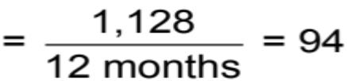
Seasonal Index Example
 | DEMAND
MONTH | YEAR 1 | YEAR 2 | YEAR 3 | AVERAGE YEARLY DEMAND |  |  | AVERAGE MONTHLY DEMAND | SEASONAL INDEX
Jan | 80 | 85 | 105 |  | 90 |  | 94
Feb | 70 | 85 | 85 |  | 80 |  | 94
Mar | 80 | 93 | 82 |  | 85 |  | 94
Apr | 90 | 95 | 115 |  | 100 |  | 94
May | 113 | 125 | 131 |  | 123 |  | 94
June | 110 | 115 | 120 |  | 115 |  | 94
July | 100 | 102 | 113 |  | 105 |  | 94
Aug | 88 | 102 | 110 |  | 100 |  | 94
Sept | 85 | 90 | 95 |  | 90 |  | 94
Oct | 77 | 78 | 85 |  | 80 |  | 94
Nov | 75 | 82 | 83 |  | 80 |  | 94
Dec | 82 | 78 | 80 |  | 80 |  | 94
Total average annual demand = |  |  |  |  | 1,128
Average monthly demand

Slide 98
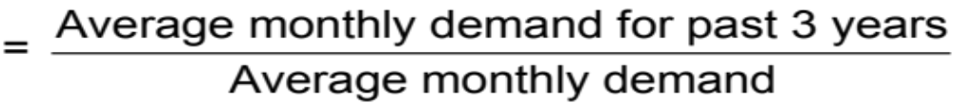
Seasonal Index Example
 | DEMAND
MONTH | YEAR 1 | YEAR 2 | YEAR 3 | AVERAGE YEARLY DEMAND |  |  | AVERAGE MONTHLY DEMAND | SEASONAL INDEX
Jan | 80 | 85 | 105 |  | 90 |  | 94
Feb | 70 | 85 | 85 |  | 80 |  | 94
Mar | 80 | 93 | 82 |  | 85 |  | 94
Apr | 90 | 95 | 115 |  | 100 |  | 94
May | 113 | 125 | 131 |  | 123 |  | 94
June | 110 | 115 | 120 |  | 115 |  | 94
July | 100 | 102 | 113 |  | 105 |  | 94
Aug | 88 | 102 | 110 |  | 100 |  | 94
Sept | 85 | 90 | 95 |  | 90 |  | 94
Oct | 77 | 78 | 85 |  | 80 |  | 94
Nov | 75 | 82 | 83 |  | 80 |  | 94
Dec | 82 | 78 | 80 |  | 80 |  | 94
Total average annual demand = |  |  |  |  | 1,128
.957( = 90/94)
Seasonal index

Slide 99
Seasonal Index Example
 | DEMAND
MONTH | YEAR 1 | YEAR 2 | YEAR 3 | AVERAGE YEARLY DEMAND |  |  | AVERAGE MONTHLY DEMAND | SEASONAL INDEX
Jan | 80 | 85 | 105 |  | 90 |  | 94 | .957( = 90/94)
Feb | 70 | 85 | 85 |  | 80 |  | 94 | .851( = 80/94)
Mar | 80 | 93 | 82 |  | 85 |  | 94 | .904( = 85/94)
Apr | 90 | 95 | 115 |  | 100 |  | 94 | 1.064( = 100/94)
May | 113 | 125 | 131 |  | 123 |  | 94 | 1.309( = 123/94)
June | 110 | 115 | 120 |  | 115 |  | 94 | 1.223( = 115/94)
July | 100 | 102 | 113 |  | 105 |  | 94 | 1.117( = 105/94)
Aug | 88 | 102 | 110 |  | 100 |  | 94 | 1.064( = 100/94)
Sept | 85 | 90 | 95 |  | 90 |  | 94 | .957( = 90/94)
Oct | 77 | 78 | 85 |  | 80 |  | 94 | .851( = 80/94)
Nov | 75 | 82 | 83 |  | 80 |  | 94 | .851( = 80/94)
Dec | 82 | 78 | 80 |  | 80 |  | 94 | .851( = 80/94)
Total average annual demand = |  |  |  |  | 1,128

Slide 100
Seasonal Index Example
Seasonal forecast for Year 4
MONTH | DEMAND |  |  | MONTH | DEMAND
Jan |  | 1,200 | x .957 = 96 | July |  | 1,200 | x 1.117 = 112
 |  | 12 |  |  |  | 12
Feb |  | 1,200 | x .851 = 85 | Aug |  | 1,200 | x 1.064 = 106
 |  | 12 |  |  |  | 12
Mar |  | 1,200 | x .904 = 90 | Sept |  | 1,200 | x .957 = 96
 |  | 12 |  |  |  | 12
Apr |  | 1,200 | x 1.064 = 106 | Oct |  | 1,200 | x .851 = 85
 |  | 12 |  |  |  | 12
May |  | 1,200 | x 1.309 = 131 | Nov |  | 1,200 | x .851 = 85
 |  | 12 |  |  |  | 12
June |  | 1,200 | x 1.223 = 122 | Dec |  | 1,200 | x .851 = 85
 |  | 12 |  |  |  | 12

Slide 101
Seasonal Index Example
Year 4 Forecast
Year 3 Demand
Year 2 Demand
Year 1 Demand
140 –
130 –
120 –
110 –
100 –
90 –
80 –
70 –
Demand
| | | | | | | | | | | |
J F M A M J J A S O N D
Time

Slide 102
San Diego Hospital
Figure 4.6
Trend Data
10,200 –
10,000 –
9,800 –
9,600 –
9,400 –
9,200 –
9,000 –
9702
9745
9616
9659
9530
9573
9724
9766
Inpatient Days
9680
9594
9637
9551
| | | | | | | | | | | |
Jan Feb Mar Apr May June July Aug Sept Oct Nov Dec
67 68 69 70 71 72 73 74 75 76 77 78
Month

Slide 103
San Diego Hospital
 | Seasonality Indices for Adult Inpatient Days at San Diego Hospital
MONTH | SEASONALITY INDEX | MONTH | SEASONALITY INDEX
January | 1.04 | July | 1.03
February | 0.97 | August | 1.04
March | 1.02 | September | 0.97
April | 1.01 | October | 1.00
May | 0.99 | November | 0.96
June | 0.99 | December | 0.98

Slide 104
San Diego Hospital
Figure 4.7
Seasonal Indices
1.06 –
1.04 –
1.02 –
1.00 –
0.98 –
0.96 –
0.94 –
0.92 –
1.04
1.04
1.03
1.02
1.01
1.00
0.99
Index for Inpatient Days
0.98
0.99
0.97
0.97
0.96
| | | | | | | | | | | |
Jan Feb Mar Apr May June July Aug Sept Oct Nov Dec
67 68 69 70 71 72 73 74 75 76 77 78
Month

Slide 105
San Diego Hospital
Period | 67 | 68 | 69 | 70 | 71 | 72
Month | Jan | Feb | Mar | Apr | May | June
Forecast with Trend & Seasonality | 9,911 | 9,265 | 9,164 | 9,691 | 9,520 | 9,542
Period | 73 | 74 | 75 | 76 | 77 | 78
Month | July | Aug | Sept | Oct | Nov | Dec
Forecast with Trend & Seasonality | 9,949 | 10,068 | 9,411 | 9,724 | 9,355 | 9,572

Slide 106
San Diego Hospital
Figure 4.8
Combined Trend and Seasonal Forecast
10,200 –
10,000 –
9,800 –
9,600 –
9,400 –
9,200 –
9,000 –
10068
9911
9949
9764
9724
9691
Inpatient Days
9572
9520
9542
9411
9265
9355
| | | | | | | | | | | |
Jan Feb Mar Apr May June July Aug Sept Oct Nov Dec
67 68 69 70 71 72 73 74 75 76 77 78
Month

Slide 107
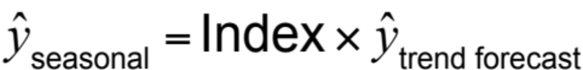
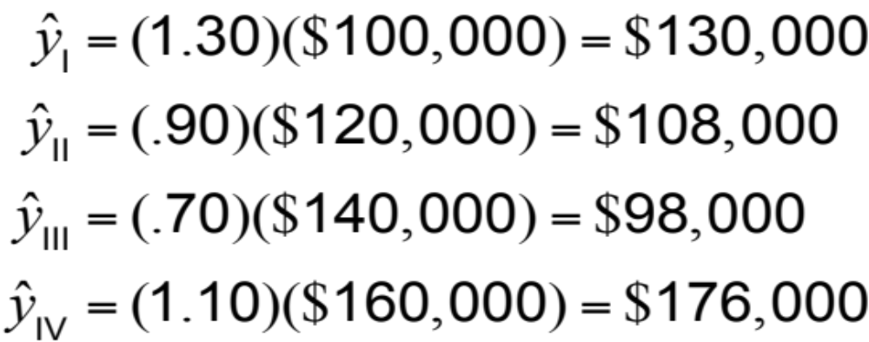
Adjusting Trend Data
Quarter I:
Quarter II:
Quarter III:
Quarter IV:

Slide 108
MODEL ASOSIATIF

Slide 109
Associative Forecasting
Digunakan ketika perubahan dalam satu atau lebih variabel independen dapat digunakan untuk memprediksi perubahan dalam variabel dependen
Teknik yang paling umum adalah analisis regresi linier
Kita menerapkan teknik ini seperti yang kita lakukan dalam contoh time-series

Slide 110
Peramalan asosiatif
Hasil peramalan didasarkan pada variabel prediktor menggunakan teknik kuadrat terkecil
^
y = a + bx
^
di mana y = nilai variabel terikat (yang diramalkan)
a = intersep sumbu y
b = kemiringan garis regresi
x = variabel bebas (prediktor)

Slide 111
Associative Forecasting Example
NODEL’S SALES (IN $ MILLIONS), y | AREA PAYROLL (IN $ BILLIONS), x | NODEL’S SALES (IN $ MILLIONS), y | AREA PAYROLL (IN $ BILLIONS), x
2.0 | 1 | 2.0 | 2
3.0 | 3 | 2.0 | 1
2.5 | 4 | 3.5 | 7
4.0 –
3.0 –
2.0 –
1.0 –
Nodel’s sales
(in$ millions)
| | | | | | |
0 1 2 3 4 5 6 7
Area payroll (in $ billions)

Slide 112
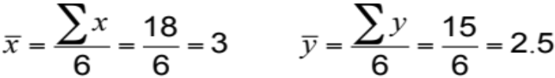
Associative Forecasting Example
SALES, y |  |  | PAYROLL, x |  |  |  | x² |  |  | xy
 | 2.0 |  |  | 1 |  |  | 1 |  |  | 2.0
 | 3.0 |  |  | 3 |  |  | 9 |  |  | 9.0
 | 2.5 |  |  | 4 |  |  | 16 |  |  | 10.0
 | 2.0 |  |  | 2 |  |  | 4 |  |  | 4.0
 | 2.0 |  |  | 1 |  |  | 1 |  |  | 2.0
 | 3.5 |  |  | 7 |  | 49 |  |  |  | 24.5
Σy = | 15.0 |  | Σx = | 18 |  | Σx² = | 80 |  | Σxy = | 51.5

Slide 113
Associative Forecasting Example
SALES, y |  |  | PAYROLL, x |  |  |  | x² |  |  | xy
 | 2.0 |  |  | 1 |  |  | 1 |  |  | 2.0
 | 3.0 |  |  | 3 |  |  | 9 |  |  | 9.0
 | 2.5 |  |  | 4 |  |  | 16 |  |  | 10.0
 | 2.0 |  |  | 2 |  |  | 4 |  |  | 4.0
 | 2.0 |  |  | 1 |  |  | 1 |  |  | 2.0
 | 3.5 |  |  | 7 |  | 49 |  |  |  | 24.5
Σy = | 15.0 |  | Σx = | 18 |  | Σx² = | 80 |  | Σxy = | 51.5

Slide 114
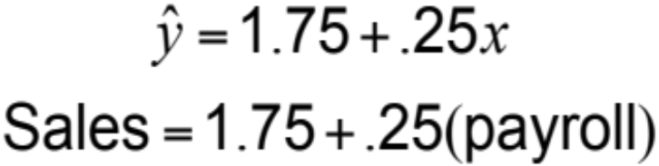
Associative Forecasting Example
SALES, y |  |  | PAYROLL, x |  |  |  | x² |  |  | xy
 | 2.0 |  |  | 1 |  |  | 1 |  |  | 2.0
 | 3.0 |  |  | 3 |  |  | 9 |  |  | 9.0
 | 2.5 |  |  | 4 |  |  | 16 |  |  | 10.0
 | 2.0 |  |  | 2 |  |  | 4 |  |  | 4.0
 | 2.0 |  |  | 1 |  |  | 1 |  |  | 2.0
 | 3.5 |  |  | 7 |  | 49 |  |  |  | 24.5
Σy = | 15.0 |  | Σx = | 18 |  | Σx² = | 80 |  | Σxy = | 51.5

Slide 115
Associative Forecasting Example
SALES, y |  |  | PAYROLL, x |  |  |  | x² |  |  | xy
 | 2.0 |  |  | 1 |  |  | 1 |  |  | 2.0
 | 3.0 |  |  | 3 |  |  | 9 |  |  | 9.0
 | 2.5 |  |  | 4 |  |  | 16 |  |  | 10.0
 | 2.0 |  |  | 2 |  |  | 4 |  |  | 4.0
 | 2.0 |  |  | 1 |  |  | 1 |  |  | 2.0
 | 3.5 |  |  | 7 |  | 49 |  |  |  | 24.5
Σy = | 15.0 |  | Σx = | 18 |  | Σx² = | 80 |  | Σxy = | 51.5
4.0 –
3.0 –
2.0 –
1.0 –
Nodel’s sales
(in$ millions)
| | | | | | |
0 1 2 3 4 5 6 7
Area payroll (in $ billions)

Slide 116
Associative Forecasting Example
If payroll next year is estimated to be $6 billion, then:
Sales (in $ millions) = 1.75 + .25(6)
= 1.75 + 1.5 = 3.25
Sales = $3,250,000

Slide 117
Associative Forecasting Example
4.0 –
3.0 –
2.0 –
1.0 –
If payroll next year is estimated to be $6 billion, then:
3.25
Nodel’s sales
(in$ millions)
Sales (in$ millions) = 1.75 + .25(6)
= 1.75 + 1.5 = 3.25
Sales = $3,250,000
| | | | | | |
0 1 2 3 4 5 6 7
Area payroll (in $ billions)

Slide 118

Standard Error of the Estimate
A forecast is just a point estimate of a future value
This point is
actually the
mean of a
probability
distribution
4.0 –
3.0 –
2.0 –
1.0 –
3.25
Regression line,
Nodel’s sales
(in$ millions)
| | | | | | |
0 1 2 3 4 5 6 7
Area payroll (in $ billions)
Figure 4.9

Slide 119
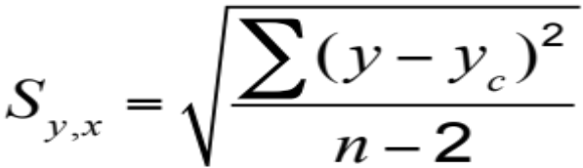
Standard Error of the Estimate
where y = y-value of each data point
y_{c} = computed value of the dependent variable, from the regression equation
n = number of data points

Slide 120
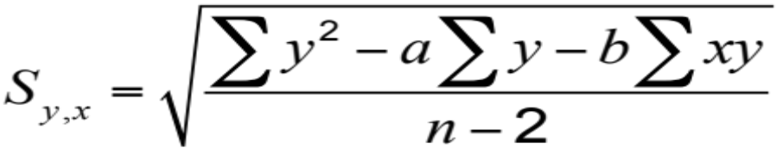
Standard Error of the Estimate
Computationally, this equation is considerably easier to use
We use the standard error to set up prediction intervals around the point estimate

Slide 121
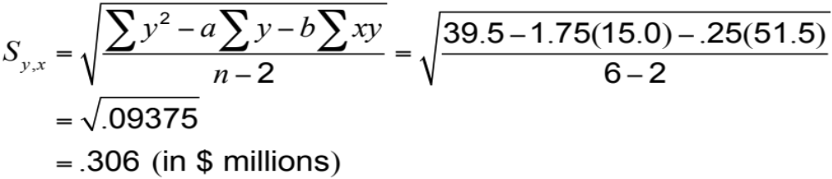
Standard Error of the Estimate
4.0 –
3.0 –
2.0 –
1.0 –
3.25
The standard error of the estimate is $306,000 in sales
Nodel’s sales
(in$ millions)
| | | | | | |
0 1 2 3 4 5 6 7
Area payroll (in $ billions)

Slide 122
Correlation
How strong is the linear relationship between the variables?
Correlation does not necessarily imply causality!
Coefficient of correlation, r, measures degree of association
  Values range from -1 to +1

Slide 123
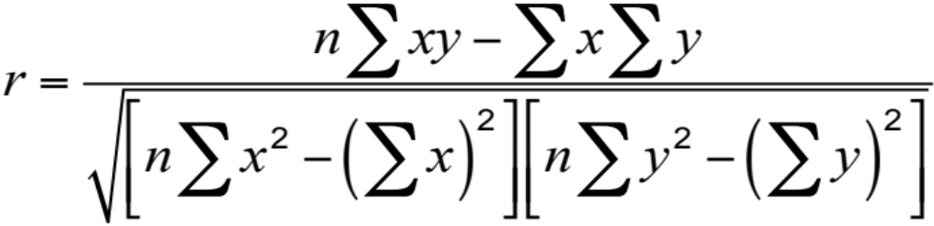
Correlation Coefficient

Slide 124
Correlation Coefficient
Figure 4.10
y
y
x
x
(a) Perfect negative correlation
(e) Perfect positive correlation
y
y
x
y
x
(b) Negative correlation
(d) Positive correlation
x
(c) No correlation
High
Moderate
Low
Low
Moderate
High
| | | | | | | | |
–1.0 –0.8 –0.6 –0.4 –0.2 0 0.2 0.4 0.6 0.8 1.0
Correlation coefficient values

Slide 125
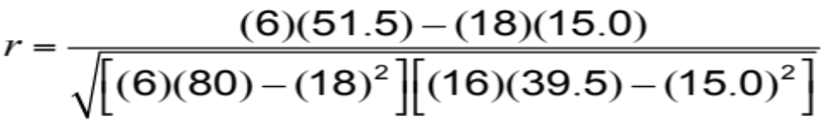
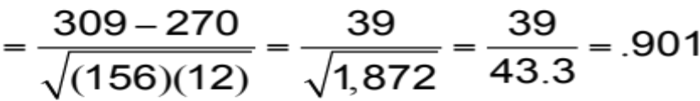
Correlation Coefficient
y |  |  | x |  |  |  | x² |  |  | xy |  |  | y²
 | 2.0 |  |  | 1 |  |  | 1 |  |  | 2.0 |  |  | 4.0
 | 3.0 |  |  | 3 |  |  | 9 |  |  | 9.0 |  |  | 9.0
 | 2.5 |  |  | 4 |  |  | 16 |  |  | 10.0 |  |  | 6.25
 | 2.0 |  |  | 2 |  |  | 4 |  |  | 4.0 |  |  | 4.0
 | 2.0 |  |  | 1 |  |  | 1 |  |  | 2.0 |  |  | 4.0
 | 3.5 |  |  | 7 |  | 49 |  |  |  | 24.5 |  |  | 12.25
Σy = | 15.0 |  | Σx = | 18 |  | Σx² = | 80 |  | Σxy = | 51.5 |  | Σy² = | 39.5

Slide 126
Correlation
Coefficient of Determination, r², measures the percent of change in y predicted by the change in x
  Values range from 0 to 1
  Easy to interpret
For the Nodel Construction example:
r = .901
r² = .81

Slide 127

Multiple-Regression Analysis
Jika lebih dari satu variabel independen akan digunakan dalam model, regresi linier dapat diperluas ke regresi ganda untuk mengakomodasi beberapa variabel independen
Secara komputasi, ini cukup kompleks dan umumnya dilakukan di komputer

Slide 128

Multiple-Regression Analysis
Dalam contoh Nodel, termasuk suku bunga dalam model memberikan persamaan baru:
Koefisien korelasi meningkat sebesar r = .96 menunjukkan model ini melakukan pekerjaan yang lebih baik dalam memprediksi perubahan dalam penjualan konstruksi
Sales = 1.80 + .30(6) - 5.0(.12) = 3.00
Sales = $3,000,000

Slide 129
Monitoring and Controlling Forecasts
Tracking Signal
Mengukur seberapa baik ramalan memprediksi nilai yang sebenarnya
Ratio of cumulative forecast errors to mean absolute deviation (MAD)
  Sinyal pelacakan yang baik memiliki nilai yang rendah
  Jika perkiraan terus-menerus tinggi atau rendah, ramalan memiliki kesalahan bias

Slide 130
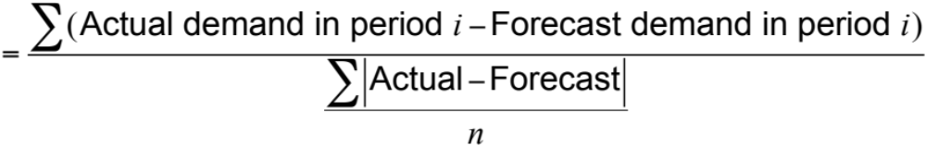
Monitoring and Controlling Forecasts
Tracking signal
Cumulative error
MAD
=

Slide 131
Tracking Signal
Figure 4.11
Signal exceeding limit
+
0 MADs
–
Tracking signal
Upper control limit
Acceptable range
Lower control limit
Time

Slide 132
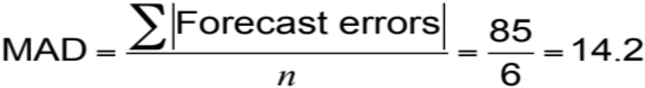
Tracking Signal Example
QTR | ACTUAL DEMAND | FORECAST DEMAND | ERROR | CUM ERROR | ABSOLUTE FORECAST ERROR | CUM ABS FORECAST ERROR | MAD | TRACKING SIGNAL (CUM ERROR/MAD)
1 | 90 | 100 | –10 | –10 | 10 | 10 | 10.0 | –10/10 = –1
2 | 95 | 100 | –5 | –15 | 5 | 15 | 7.5 | –15/7.5 = –2
3 | 115 | 100 | +15 | 0 | 15 | 30 | 10. | 0/10 = 0
4 | 100 | 110 | –10 | –10 | 10 | 40 | 10. | 10/10 = –1
5 | 125 | 110 | +15 | +5 | 15 | 55 | 11.0 | +5/11 = +0.5
6 | 140 | 110 | +30 | +35 | 30 | 85 | 14.2 | +35/14.2 = +2.5
At the end of quarter 6,

Slide 133
Adaptive Smoothing
Anda dapat menggunakan komputer untuk terus memantau kesalahan perkiraan dan menyesuaikan nilai koefisien a dan b yang digunakan dalam pemulusan eksponensial untuk terus meminimalkan kesalahan perkiraan
Teknik ini disebut smoothing adaptif

Slide 134
Focus Forecasting
Dikembangkan di American Hardware Supply, berdasarkan dua prinsip:
Model peramalan yang canggih tidak selalu lebih baik daripada model sederhana
Tidak ada teknik tunggal yang harus digunakan untuk semua produk atau layanan
Menggunakan data historis untuk menguji beberapa model perkiraan untuk masing-masing item
Model peramalan dengan kesalahan terendah digunakan untuk meramalkan permintaan berikutnya

Slide 135
Forecasting in the Service Sector
Menyajikan tantangan yang tidak biasa
  Kebutuhan khusus untuk catatan jangka pendek
  Kebutuhan sangat berbeda sebagai fungsi industri dan produk
  Liburan dan acara kalender lainnya
  Peristiwa yang tidak biasa

Slide 136
Fast Food Restaurant Forecast
Figure 4.12
20% –
15% –
10% –
5% –
Percentage of sales by hour of day
11-12 1-2 3-4 5-6 7-8 9-10
12-1 2-3 4-5 6-7 8-9 10-11
(Lunchtime)
(Dinnertime)
Hour of day

Slide 137
FedEx Call Center Forecast
Figure 4.12
12% –
10% –
8% –
6% –
4% –
2% –
0% –
2
4
6
8
10
12
2
4
6
8
10
12
A.M.
P.M.
Hour of day

