Slide 1
Manajemen
Kualitas
BAB 6

Slide 2
Outline
Global Company Profile:
Arnold Palmer Hospital
Quality and Strategy
Defining Quality
Total Quality Management
Tools of TQM
The Role of Inspection
TQM in Services

Slide 3
Learning Objectives
When you complete this chapter you should be able to:
Define quality and TQM
Describe the ISO international quality standards
Explain what Six Sigma is
Explain how benchmarking is used in TQM
Explain quality robust products and
Taguchi concepts
Use the seven tools of TQM

Slide 4
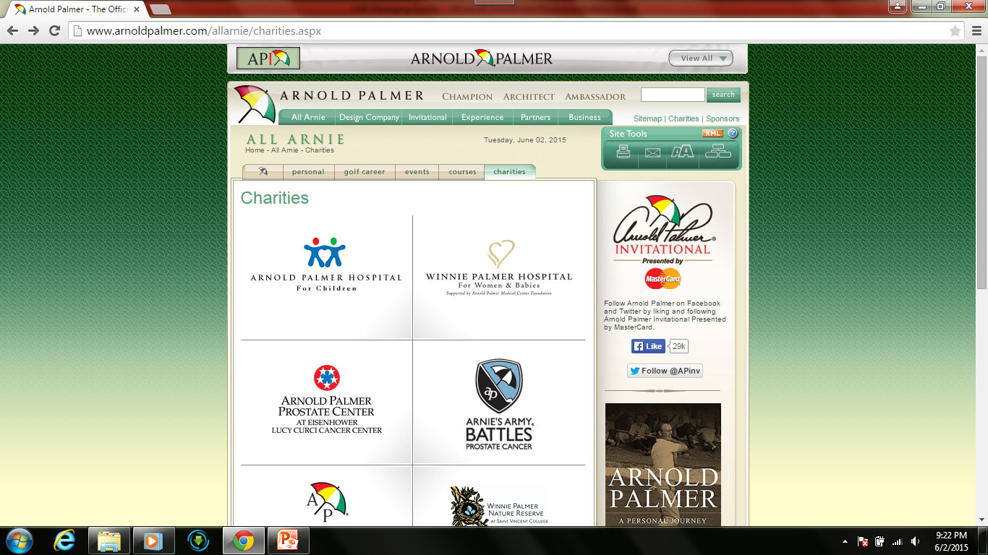

Slide 5
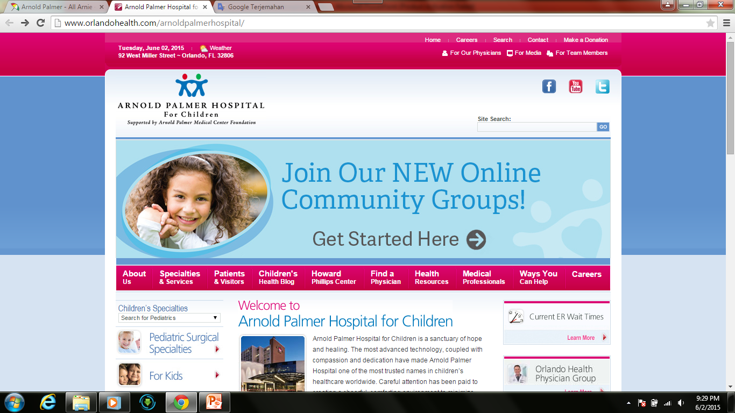

Slide 6
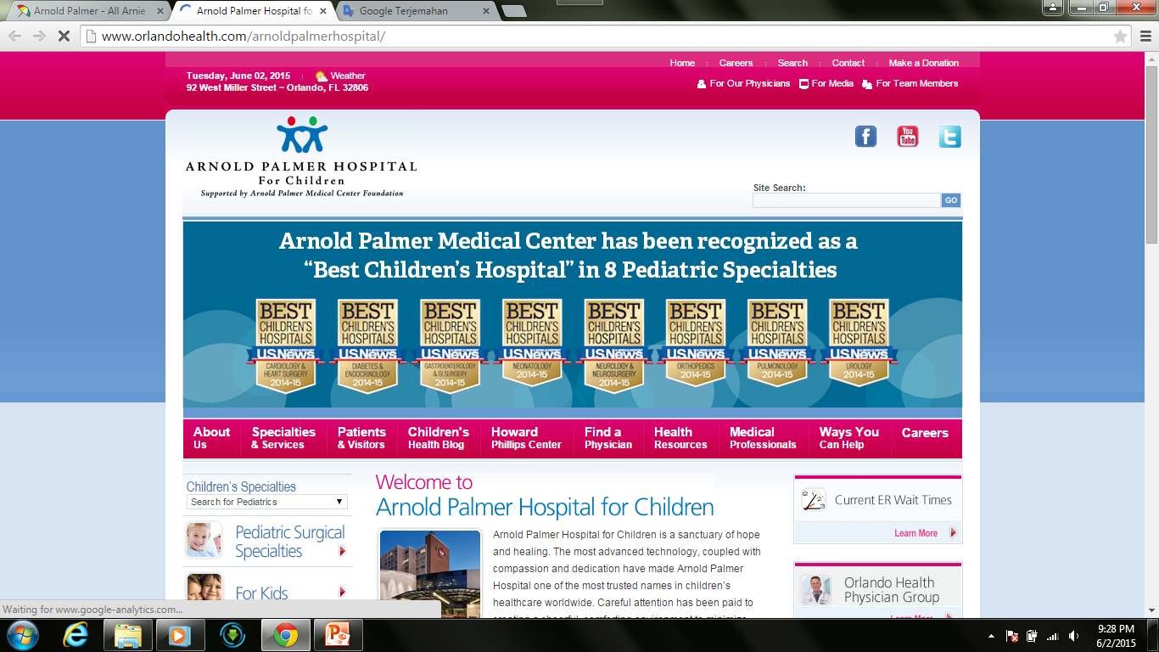

Slide 7
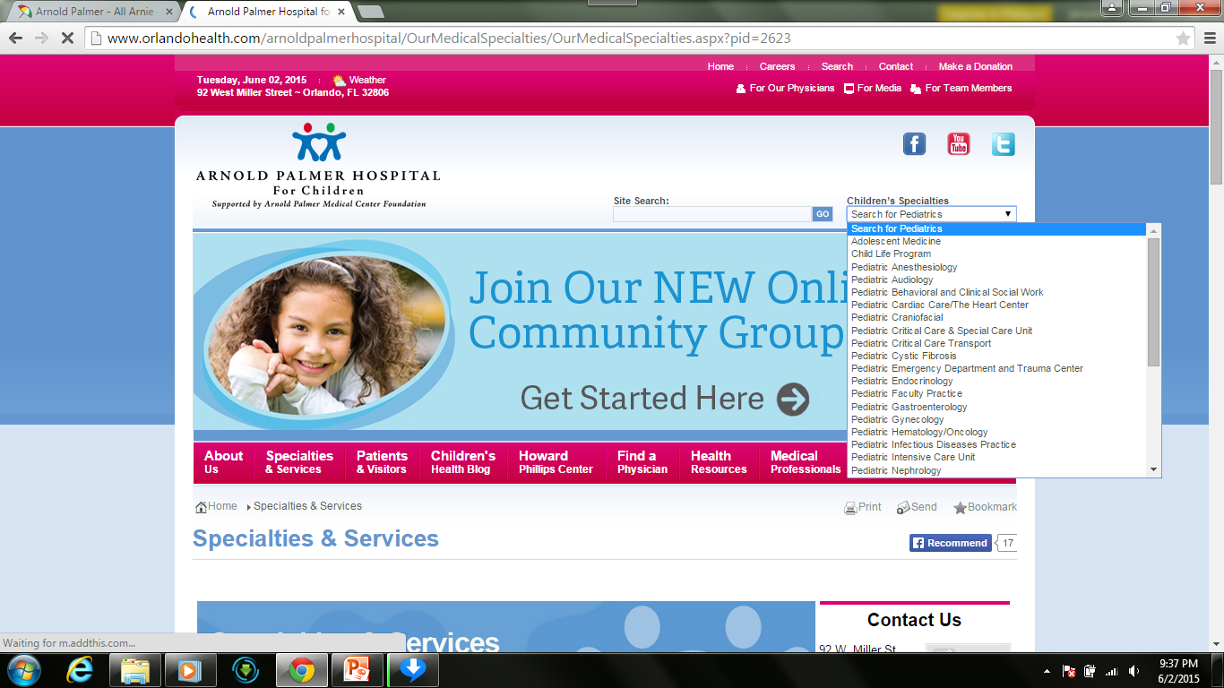

Slide 8
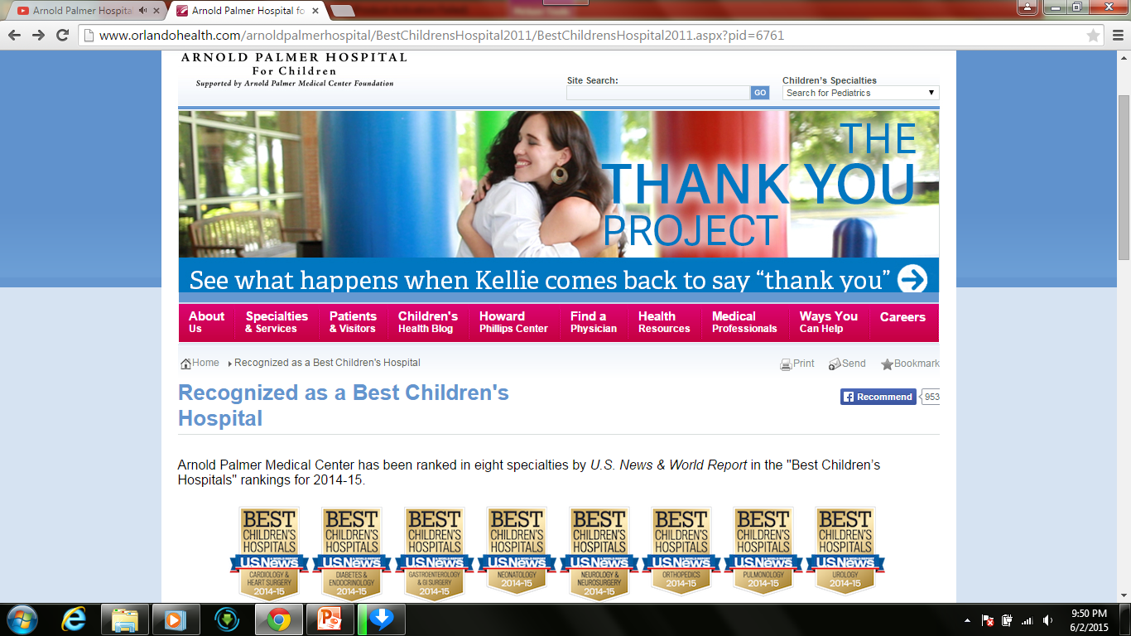

Slide 9
Managing Quality Provides a Competitive Advantage
Arnold Palmer Hospital
Deliver over 12,000 babies annually
Virtually every type of quality tool is employed
  Continuous improvement
  Employee empowerment
  Benchmarking
  Just-in-time
  Quality tools

Slide 10
Quality and Strategy
Managing quality supports differentiation, low cost, and response strategies
Quality helps firms increase sales and reduce costs
Building a quality organization is a demanding task

Slide 11
Two Ways Quality
Improves Profitability
Sales Gains via
Improved response
Flexible pricing
Improved reputation
Improved Quality
Increased Profits
Reduced Costs via
Increased productivity
Lower rework and scrap costs
Lower warranty costs
Figure 6.1

Slide 12
The Flow of Activities
Organizational Practices
Leadership, Mission statement, Effective operating procedures, Staff support, Training
Yields: What is important and what is to be
accomplished
Quality Principles
Customer focus, Continuous improvement, Benchmarking, Just-in-time, Tools of TQM
Yields: How to do what is important and to be
accomplished
Employee Fulfillment
Empowerment, Organizational commitment
Yields: Employee attitudes that can accomplish
what is important
Customer Satisfaction
Winning orders, Repeat customers
Yields: An effective organization with
a competitive advantage
Figure 6.2

Slide 13
Defining Quality
An operations manager’s objective is to build a total quality management system that identifies and satisfies customer needs

Slide 14
Defining Quality
The totality of features and characteristics of a product or service that bears on its ability to satisfy stated or implied needs
American Society for Quality

Slide 15
Defining Quality
SIMPLE DEFINITION
Quality is the ability of a product or service to meet customer needs

Slide 16
Different Views
User-based: better performance, more features
Manufacturing-based: conformance to standards, making it right the first time
Product-based: specific and measurable attributes of the product

Slide 17
Implications of Quality
Company reputation
  Perception of new products
  Employment practices
  Supplier relations
Product liability
  Reduce risk
Global implications
  Improved ability to compete

Slide 18
Malcolm Baldrige National Quality Award (MBNQA)
Established in 1988 by the U.S. Government
Designed to promote TQM practices
Recent winners include
Lockheed Martin Missiles and Fire Control, MESA Products Inc., North Mississippi Health Services, City of Irving, Concordia Publishing House, Henry Ford Health System, MEDRAD, Nestlé Purina PetCare Co., Montgomery County Public Schools

Slide 19

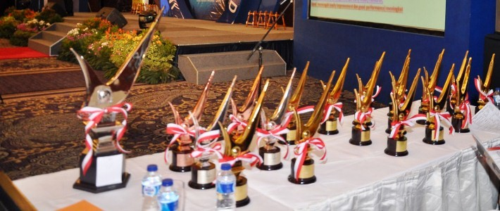
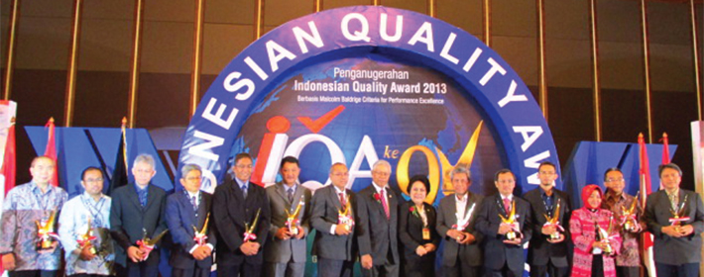
IQAF (Indonesia Quality Award Foundation)

Slide 20
Baldrige Criteria
Applicants are evaluated on:
CATEGORIES | POINTS
Leadership | 120
Strategic Planning | 85
Customer Focus | 85
Measurement, Analysis, and Knowledge Management | 90
Workforce Focus | 85
Operations Focus | 85
Results | 450

Slide 21
ISO 9000 International Quality Standards
International recognition
Encourages quality management procedures, detailed documentation, work instructions, and recordkeeping
2009 revision emphasized sustained success
Over one million certifications in 178 countries
Critical for global business

Slide 22
ISO 9000 International Quality Standards
Management principles
  Top management leadership
  Customer satisfaction
  Continual improvement
  Involvement of people
  Process analysis
  Use of data-driven decision making
  A systems approach to management
  Mutually beneficial supplier relationships

Slide 23
Costs of Quality
Prevention costs - reducing the potential for defects
Appraisal costs - evaluating products, parts, and services
Internal failure costs - producing defective parts or service before delivery
External failure costs - defects discovered after delivery

Slide 24
Costs of Quality
Total Cost
Total Cost
External Failure
Internal Failure
Prevention
Appraisal
Quality Improvement

Slide 25

Takumi
A Japanese character that symbolizes a broader dimension than quality, a deeper process than education, and a more perfect method than persistence

Slide 26
Leaders in Quality
TABLE 6.1 | Leaders in the Field of Quality Management
LEADER |  | PHILOSOPHY/CONTRIBUTION
W. Edwards Deming |  | Deming insisted management accept responsibility for building good systems. The employee cannot produce products that on average exceed the quality of what the process is capable of producing. His 14 points for implementing quality improvement are presented in this chapter.
Joseph M. Juran |  | A pioneer in teaching the Japanese how to improve quality, Juran believed strongly in top-management commitment, support, and involvement in the quality effort. He was also a believer in teams that continually seek to raise quality standards. Juran varies from Deming somewhat in focusing on the customer and defining quality as fitness for use, not necessarily the written specifications.

Slide 27
Leaders in Quality
TABLE 6.1 | Leaders in the Field of Quality Management
LEADER |  | PHILOSOPHY/CONTRIBUTION
Amarnd Feigenbaum |  | His 1961 book Total Quality Control laid out 40 steps to quality improvement processes. He viewed quality not as a set of tools but as a total field that integrated the processes of a company. His work in how people learn from each other’s successes led to the field of cross-functional teamwork.
Philip B. Crosby |  | Quality Is Free was Crosby’s attention-getting book published in 1979. Crosby believed that in the traditional trade-off between the cost of improving quality and the cost of poor quality, the cost of poor quality is understated. The cost of poor quality should include all of the things that are involved in not doing the job right the first time. Crosby coined the term zero defects and stated, “There is absolutely no reason for having errors or defects in any product or service.”

Slide 28
Ethics and Quality Management
Operations managers must deliver healthy, safe, quality products and services
Poor quality risks injuries, lawsuits, recalls, and regulation
Ethical conduct must dictate response to problems
All stakeholders much be considered

Slide 29
Total Quality Management
Encompasses entire organization from supplier to customer
Stresses a commitment by management to have a continuing companywide drive toward excellence in all aspects of products and services that are important to the customer

Slide 30
Deming’s Fourteen Points
TABLE 6.2 | Deming’s 14 Points for Implementing Quality Improvement
1. Create consistency of purpose
2. Lead to promote change
3. Build quality into the product; stop depending on inspections to catch problems
4. Build long-term relationships based on performance instead of awarding business on price
5. Continuously improve product, quality, and service
6. Start training
7. Emphasize leadership

Slide 31
Deming’s Fourteen Points
TABLE 6.2 | Deming’s 14 Points for Implementing Quality Improvement
8. Drive out fear
9. Break down barriers between departments
10. Stop haranguing workers
11. Support, help, and improve
12. Remove barriers to pride in work
13. Institute a vigorous program of education and self-improvement
14. Put everyone in the company to work on the transformation

Slide 32
Seven Concepts of TQM
Continuous Improvement
Six Sigma
Employee Empowerment
Benchmarking
Just-in-time (JIT)
Taguchi Concepts
Knowledge of TQM Tools

Slide 33
1. Continuous Improvement
Never-ending process of continual improvement
Covers people, equipment, materials, procedures
Every operation can be improved

Slide 34
Shewhart’s PDCA Model
Figure 6.3
4. Act
Implement the plan, document
Plan
Identify the pattern and make a plan
3. Check
Is the plan working?
2. Do
Test the plan

Slide 35
Continuous Improvement
Kaizen describes the ongoing process of unending improvement
TQM and zero defects also used to describe continuous improvement

Slide 36
2. Six Sigma
Two meanings
  Statistical definition of a process that is 99.9997% capable, 3.4 defects per million opportunities (DPMO)
  A program designed to reduce defects, lower costs, save time, and improve customer satisfaction
A comprehensive system for achieving and sustaining business success

Slide 37
2. Six Sigma
Lower limits
Upper limits
Two meanings
  Statistical definition of a process that is 99.9997% capable, 3.4 defects per million opportunities (DPMO)
  A program designed to reduce defects, lower costs, save time, and improve customer satisfaction
A comprehensive system for achieving and sustaining business success
2,700 defects/million
3.4 defects/million
Mean
±3σ
±6σ
Figure 6.4

Slide 38
Six Sigma Program
Originally developed by Motorola, adopted and enhanced by Honeywell and GE
Highly structured approach to process improvement
    A strategy
    A discipline – DMAIC
    A set of 7 tools
6σ

Slide 39
Six Sigma
Defines the project’s purpose, scope, and outputs, identifies the required process information keeping in mind the customer’s definition of quality
Measures the process and collects data
Analyzes the data ensuring
repeatability and reproducibility
Improves by modifying or
redesigning existing
processes and procedures
Controls the new process
to make sure performance
levels are maintained
DMAIC Approach

Slide 40
Implementing Six Sigma
Emphasize defects per million opportunities as a standard metric
Provide extensive training
Focus on corporate sponsor support (Champions)
Create qualified process improvement experts (Black Belts, Green Belts, etc.)
Set stretch objectives
This cannot be accomplished without a major commitment from top level management

Slide 41

3. Employee Empowerment
Getting employees involved in product and process improvements
  85% of quality problems are due
  to process and material
Techniques
  Build communication networks
  that include employees
  Develop open, supportive supervisors
  Move responsibility to employees
  Build a high-morale organization
  Create formal team structures

Slide 42
Quality Circles
Group of employees who meet regularly to solve problems
Trained in planning, problem solving, and statistical methods
Often led by a facilitator
Very effective when done properly

Slide 43
4. Benchmarking
Selecting best practices to use as a standard for performance
Determine what to benchmark
Form a benchmark team
Identify benchmarking partners
Collect and analyze benchmarking information
Take action to match or exceed the benchmark

Slide 44
Best Practices for Resolving Customer Complaints
Table 6.3
BEST PRACTICE |  | JUSTIFICATION
Make it easy for clients to complain |  | It is free market research
Respond quickly to complaints |  | It adds customers and loyalty
Resolve complaints on first contact |  | It reduces cost
Use computers to manage complaints |  | Discover trends, share them, and align your services
Recruit the best for customer service jobs |  | It should be part of formal training and career advancement

Slide 45
Internal Benchmarking
When the organization is large enough
Data more accessible
Can and should be established in a variety of areas

Slide 46
5. Just-in-Time (JIT)
Relationship to quality:
JIT cuts the cost of quality
JIT improves quality
Better quality means less inventory and better, easier-to-employ JIT system

Slide 47
5. Just-in-Time (JIT)
‘Pull’ system of production scheduling including supply management
  Production only when signaled
Allows reduced inventory levels
  Inventory costs money and hides process and material problems
Encourages improved process and product quality

Slide 48
6. Taguchi Concepts
Engineering and experimental design methods to improve product and process design
  Identify key component and process variables affecting product variation
Taguchi Concepts
  Quality robustness
  Quality loss function
  Target-oriented quality

Slide 49
Quality Robustness
Ability to produce products uniformly in adverse manufacturing and environmental conditions
  Remove the effects of adverse conditions
  Small variations in materials and process do not destroy product quality

Slide 50
Quality Loss Function
Shows that costs increase as the product moves away from what the customer wants
Costs include customer dissatisfaction, warranty
and service, internal
scrap and repair, and costs to society
Traditional conformance specifications are too simplistic
Target-oriented quality

Slide 51
Quality Loss Function
High loss
L = D²C
Unacceptable
where
L = loss to society
D² = square of the distance from target value
C = cost of deviation
Loss (to producing organization, customer, and society)
Poor
Fair
Good
Low loss
Best
Target-oriented quality yields more product in the “best” category
Target-oriented quality brings product toward the target value
Frequency
Conformance-oriented quality keeps products within 3 standard deviations
Lower
Target
Upper
Specification
Figure 6.5

Slide 52
7. TQM Tools
Tools for Generating Ideas
  (1) Check Sheet
  (2) Scatter Diagram
  (3) Cause-and-Effect Diagram
Tools to Organize the Data
  (4) Pareto Chart
  (5) Flowchart (Process Diagram)

Slide 53
7. TQM Tools
Tools for Identifying Problems
  (6) Histogram
  (7) Statistical Process Control Chart

Slide 54
Seven Tools of TQM
(a) Check Sheet: An organized method of recording data
Hour
Defect 1 2 3 4 5 6 7 8
A
B
C
/
/
/
/
/
/
/
/
/
/
/
/
/
/
/
/
/
/
/
/
/
/
/
/
/
/
/
/
/
/
Figure 6.6

Slide 55
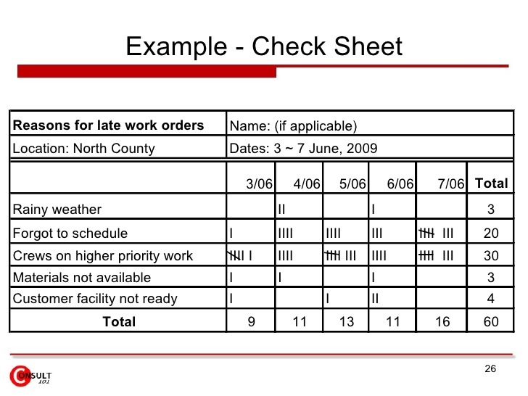
Seven Tools of TQM

Slide 56
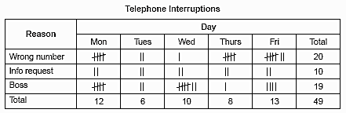
Seven Tools of TQM

Slide 57
Seven Tools of TQM
(b) Scatter Diagram: A graph of the value of one variable vs. another variable
Productivity
Absenteeism
Figure 6.6

Slide 58
Seven Tools of TQM
(c) Cause-and-Effect Diagram: A tool that identifies process elements (causes) that might effect an outcome
Cause
Materials
Methods
Effect
Manpower
Machinery
Figure 6.6

Slide 59
Seven Tools of TQM
(d) Pareto Chart: A graph to identify and plot problems or defects in descending order of frequency
Frequency
Percent
A B C D E
Figure 6.6

Slide 60
Seven Tools of TQM
(e) Flowchart (Process Diagram): A chart that describes the steps in a process
Figure 6.6

Slide 61
Seven Tools of TQM
(f) Histogram: A distribution showing the frequency of occurrences of a variable
Distribution
Frequency
Repair time (minutes)
Figure 6.6

Slide 62
Seven Tools of TQM
(g) Statistical Process Control Chart: A chart with time on the horizontal axis to plot values of a statistic
Upper control limit
Target value
Lower control limit
Time
Figure 6.6

Slide 63
Cause-and-Effect Diagrams
Material
(ball)
Method
(shooting process)
Grain/Feel (grip)
Aiming point
Size of ball
Bend knees
Air pressure
Hand position
Balance
Lopsidedness
Follow-through
Missed
free-throws
Training
Conditioning
Rim size
Motivation
Rim height
Consistency
Rim alignment
Backboard stability
Concentration
Figure 6.7
Machine
(hoop &
backboard)
Manpower
(shooter)

Slide 64
Pareto Charts
Data for October
70 –
60 –
50 –
40 –
30 –
20 –
10 –
0 –
– 100
– 93
– 88
– 72
54
Frequency (number)
Number of occurrences
Cumulative percent
12
4
3
2
Room svc Check-in Pool hours Minibar Misc.
72% 16% 5% 4% 3%
Causes and percent of the total

Slide 65
Flow Charts
MRI Flowchart
Physician schedules MRI
Patient taken to MRI
Patient signs in
Patient is prepped
Technician carries out MRI
Technician inspects film
If unsatisfactory, repeat
Patient taken back to room
MRI read by radiologist
MRI report transferred to physician
Patient and physician discuss
8
80%
1
2
3
4
5
6
7
11
9
10
20%

Slide 66
Statistical Process Control (SPC)
Uses statistics and control charts to tell when to take corrective action
Drives process improvement
Four key steps
  Measure the process
  When a change is indicated, find the assignable cause
  Eliminate or incorporate the cause
  Restart the revised process

Slide 67
Control Charts
Figure 6.8
Plot the percent of free throws missed
40%
20%
0%
Upper control limit
Coach’s target value
| | | | | | | | |
1 2 3 4 5 6 7 8 9
Lower control limit
Game number

Slide 68
Inspection
Involves examining items to see if an item is good or defective
Detect a defective product
  Does not correct deficiencies in process or product
  It is expensive
Issues
  When to inspect
  Where in process to inspect

Slide 69
When and Where to Inspect
At the supplier’s plant while the supplier is producing
At your facility upon receipt of goods from your supplier
Before costly or irreversible processes
During the step-by-step production process
When production or service is complete
Before delivery to your customer
At the point of customer contact

Slide 70
Inspection
Many problems
  Worker fatigue
  Measurement error
  Process variability
Cannot inspect quality into a product
Robust design, empowered employees, and sound processes are better solutions

Slide 71
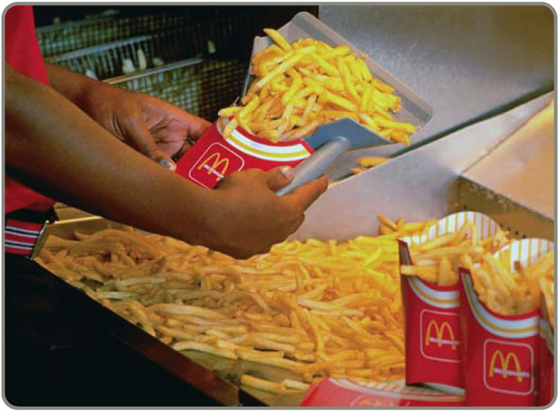
Source Inspection
Also known as source control
The next step in the process is your customer
Ensure perfect
product to your
customer

Slide 72

Source Inspection
Poka-yoke is the concept of foolproof devices or techniques designed to pass only acceptable product
Checklists ensure
consistency and
completeness

Slide 73
Service Industry Inspection
TABLE 6.4 | Examples of Inspection in Services
ORGANIZATION |  | WHAT IS INSPECTED | STANDARD
Jones Law Office |  | Receptionist performance Billing Attorney | Phone answered by the second ring Accurate, timely, and correct format Promptness in returning calls
Hard Rock Hotel |  | Reception desk Doorman Room Minibar | Use customer’s name Greet guest in less than 30 seconds All lights working, spotless bathroom Restocked and charges accurately posted to bill

Slide 74
Service Industry Inspection
TABLE 6.4 | Examples of Inspection in Services
ORGANIZATION |  | WHAT IS INSPECTED | STANDARD
Arnold Palmer Hospital |  | Billing Pharmacy Lab Nurses Admissions | Accurate, timely, and correct format Prescription accuracy, inventory accuracy Audit for lab-test accuracy Charts immediately updated Data entered correctly and completely
Olive Garden Restaurant |  | Busboy Busboy Waiter | Serves water and bread within 1 minute Clears all entrée items and crumbs prior to dessert Knows and suggest specials, desserts

Slide 75
Service Industry Inspection
TABLE 6.4 | Examples of Inspection in Services
ORGANIZATION |  | WHAT IS INSPECTED | STANDARD
Nordstrom Department Store |  | Display areas Stockrooms Salesclerks | Attractive, well-organized, stocked, good lighting Rotation of goods, organized, clean Neat, courteous, very knowledgeable

Slide 76
Attributes Versus Variables
Attributes
  Items are either good or bad, acceptable or unacceptable
  Does not address degree of failure
Variables
  Measures dimensions such as weight, speed, height, or strength
  Falls within an acceptable range
Use different statistical techniques

Slide 77
TQM In Services
Service quality is more difficult to measure than the quality of goods
Service quality perceptions depend on
  Intangible differences between products
  Intangible expectations customers have of those products

Slide 78
Service Quality
The Operations Manager must recognize:
The tangible component of services is important
The service process is important
The service is judged against the customer’s expectations
Exceptions will occur

Slide 79
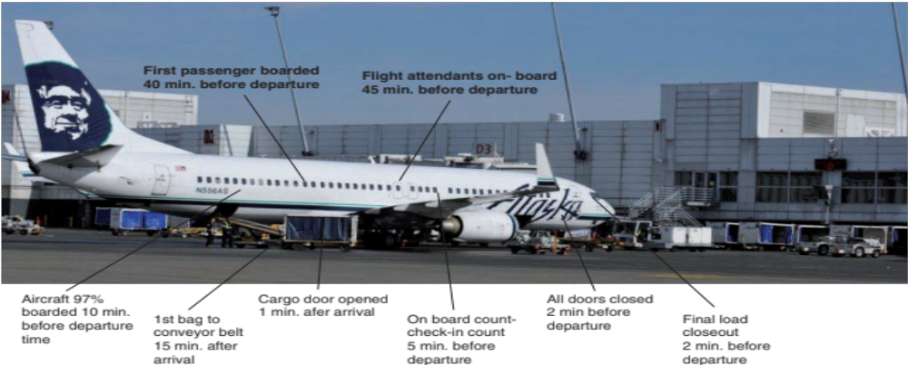
Service Specifications

Slide 80
Determinants of Service Quality
Table 6.5
Reliability involves consistency of performance and dependability
Responsiveness concerns the willingness or readiness of employees to provide service
Competence means possession of the required skills and knowledge to perform the service
Access involves approachability and ease of contact
Courtesy involves politeness, respect, consideration, and friendliness
Communication means keeping customers informed and listening to them
Credibility involves trustworthiness, believability, and honesty
Security is the freedom from danger, risk, or doubt
Understanding/knowing the customer involves making the effort to understand the customer’s needs
Tangibles include the physical evidence of the service

Slide 81
Service Recovery Strategy
Managers should have a plan for when services fail
Marriott’s LEARN routine
  Listen
  Empathize
  Apologize
  React
  Notify

