Slide 1
BAB 7
DESAIN PROSES

Slide 2
Outline
Global Company Profile:
Harley-Davidson (see: http://www.harley-davidson.com)
Four Process Strategies
Selection of Equipment
Process Analysis and Design
Special Consideration for Service Process Design

Slide 3
Outline
Production Technology
Technology in Services
Process Redesign

Slide 4
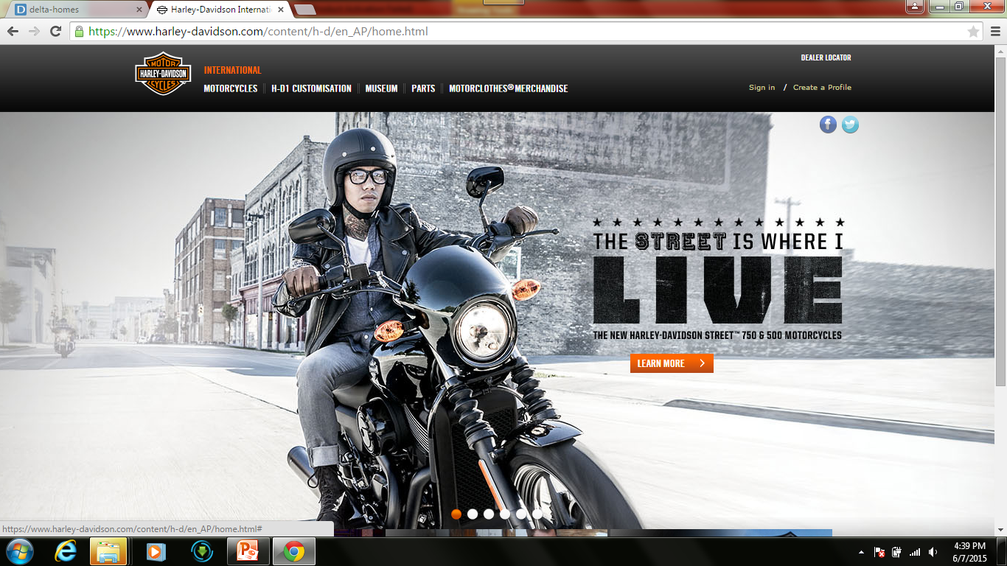

Slide 5
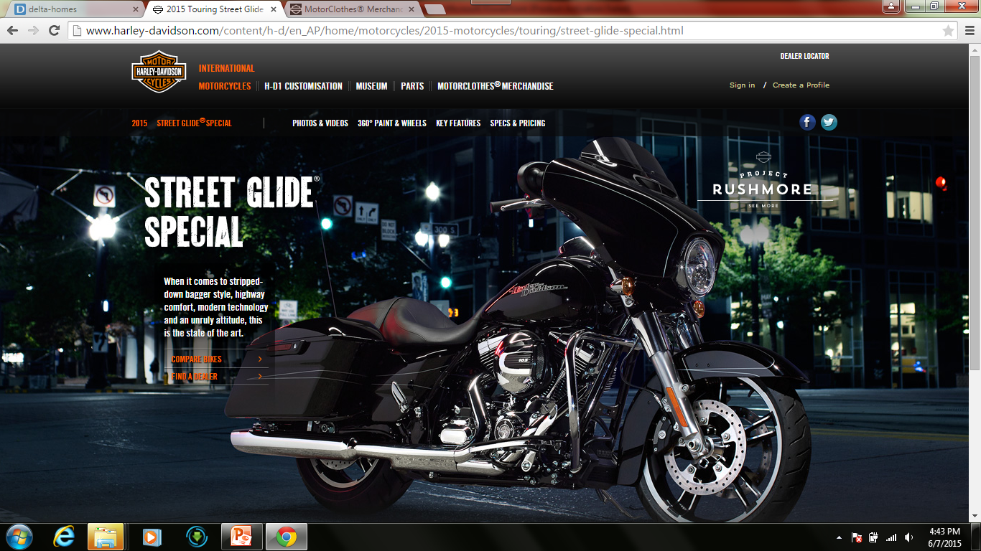

Slide 6
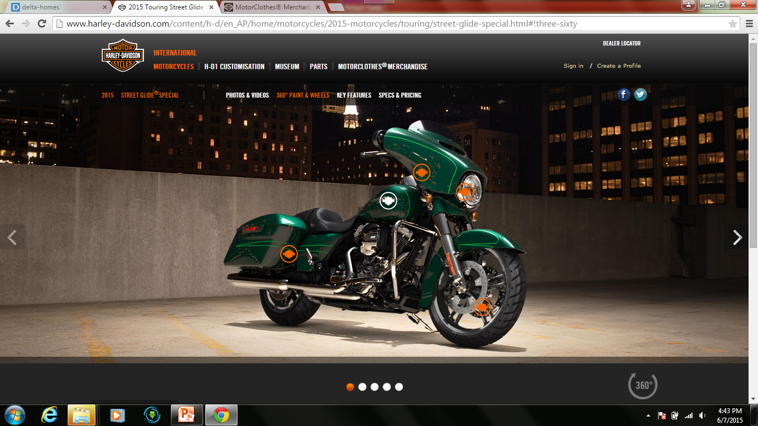

Slide 7
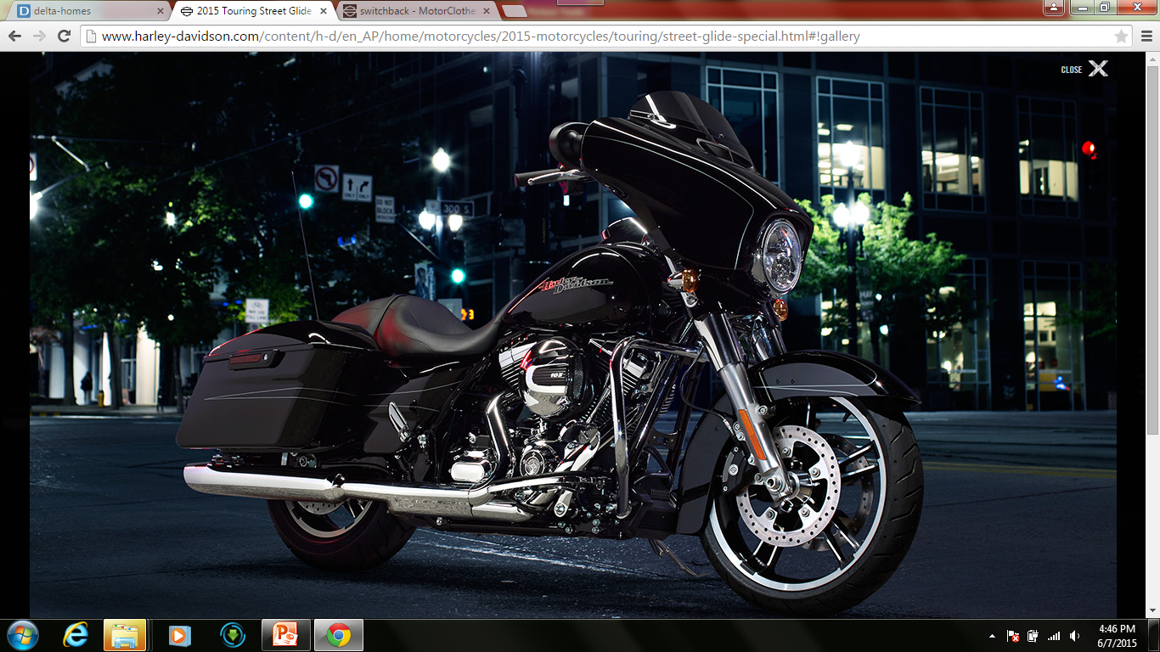

Slide 8
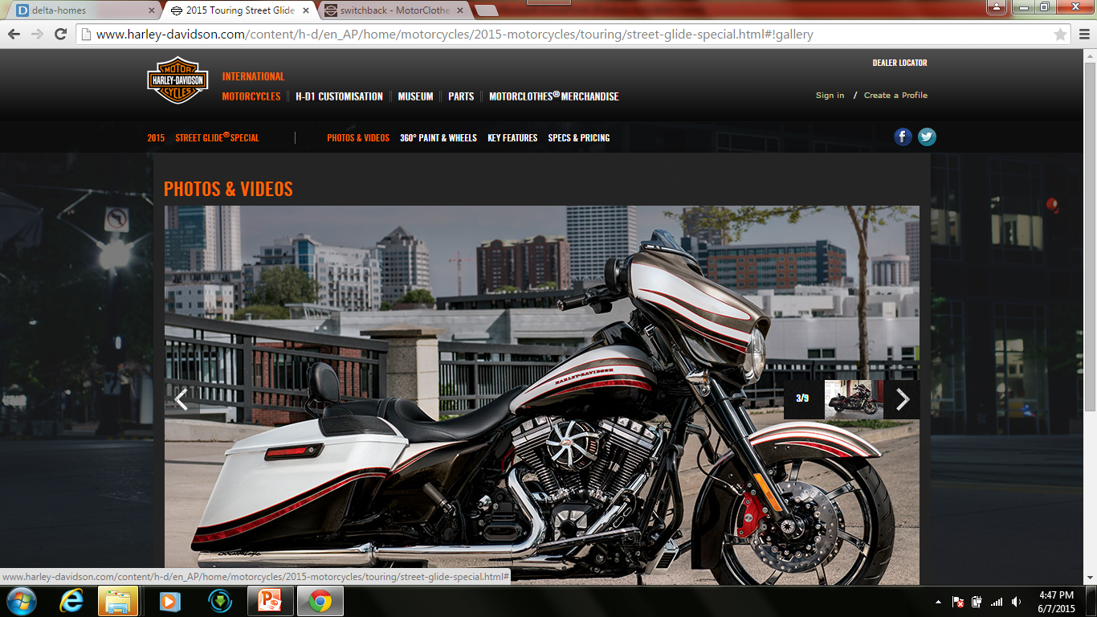

Slide 9
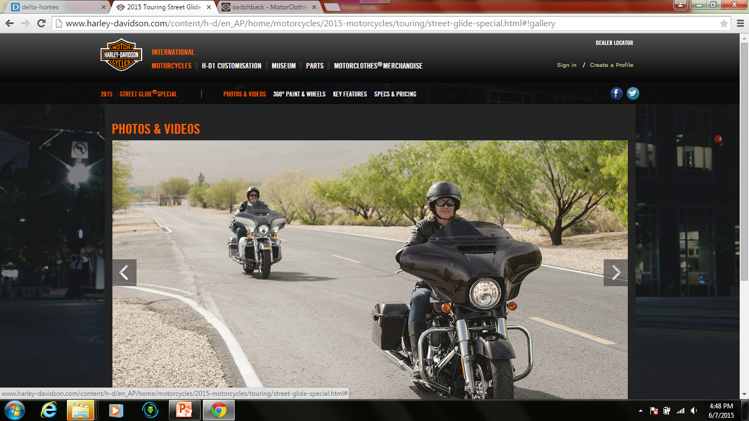

Slide 10
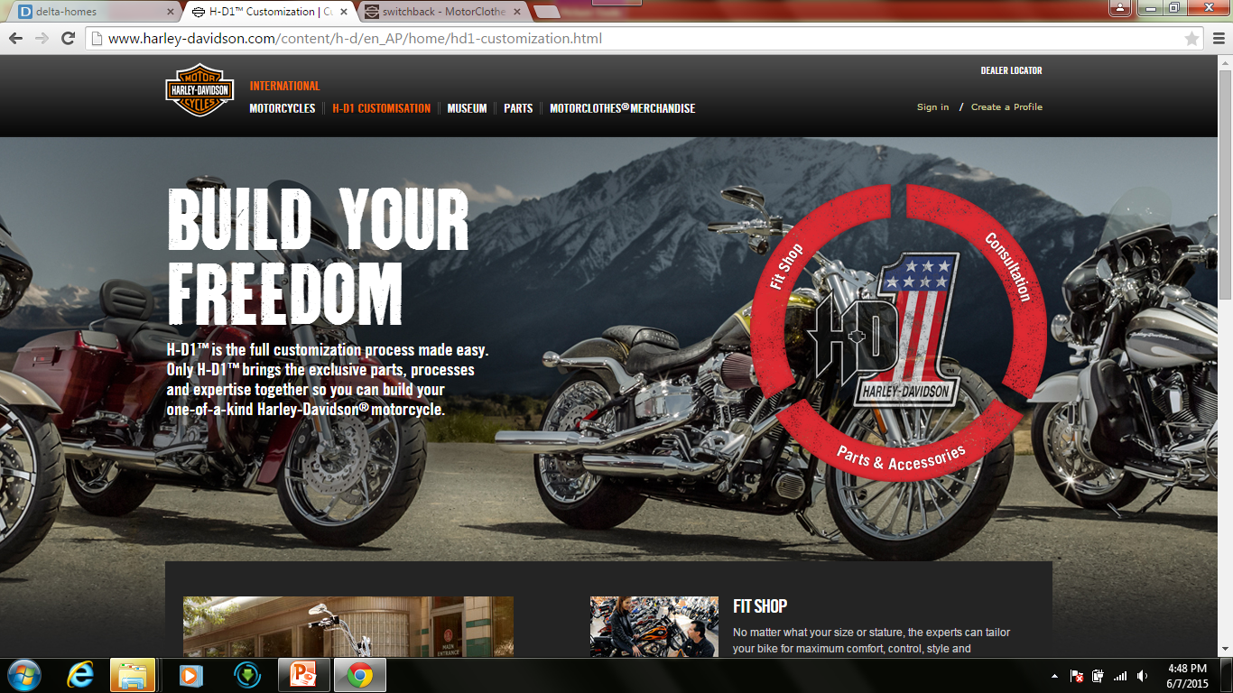

Slide 11

Courtesy of Youtube

Slide 12
Learning Objectives
When you complete this chapter you should be able to:
Describe four process strategies
Compute crossover points for different processes
Use the tools of process analysis
Describe customer interaction in service processes
Identify recent advances in production technology

Slide 13
Harley-Davidson
Repetitive manufacturing works
The only major U.S. motorcycle company
Emphasizes quality and lean manufacturing
Materials as Needed system
Many variations possible
Tightly scheduled repetitive production line

Slide 14
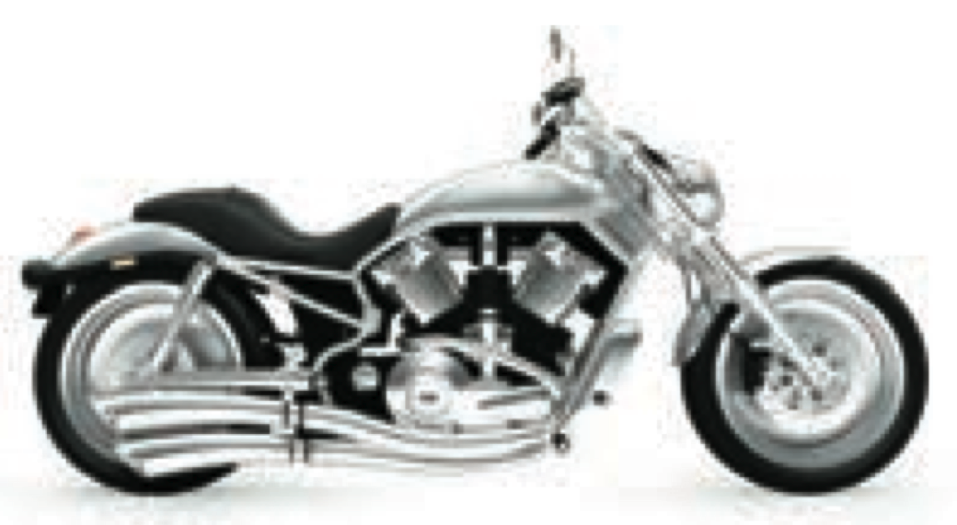
Process Flow Diagram
Frame tube bending
Frame-building work cells
Frame machining
Hot-paint
frame painting
THE ASSEMBLY LINE
TESTING
28 tests
Incoming parts
Engines and transmissions
Arrive on a JIT schedule from a 10-station work cell in Milwaukee
Air cleaners
Oil tank work cell
Fluids and mufflers
Shocks and forks
Fuel tank work cell
Handlebars
Wheel work cell
Fender work cell
Roller testing
Crating

Slide 15
Process Strategy
The objective is to create a process to produce products that meets customer requirements within cost and other managerial constraints

Slide 16
Process Strategies
How to produce a product or provide a service that
  Meets or exceeds customer requirements
  Meets cost and managerial goals
Has long term effects on
  Efficiency and production flexibility
  Costs and quality

Slide 17
Process, Volume, and Variety
Figure 7.1
Volume
Low Volume
Repetitive Process
High Volume
High Variety
one or few units per run,
(allows customization)
Process Focus
projects, job shops (machine, print, hospitals, restaurants)
Arnold Palmer Hospital
Mass Customization
(difficult to achieve, but huge rewards)
Dell Computer
Changes in Modules
modest runs, standardized modules
Repetitive
(autos, motorcycles, home appliances)
Harley-Davidson
Changes in Attributes (such as grade, quality, size, thickness, etc.)
long runs only
Poor Strategy (Both fixed and variable costs are high)
Product Focus
(commercial baked goods, steel, glass, beer)
Frito-Lay

Slide 18
Process Strategies
Four basic strategies
Process focus
Repetitive focus
Product focus
Mass customization
Within these basic strategies there are many ways they may be implemented

Slide 19
Process Focus
Facilities are organized around specific activities or processes
General purpose equipment and skilled personnel
High degree of product flexibility
Typically high costs and low equipment utilization
Product flows may vary considerably making planning and scheduling a challenge

Slide 20
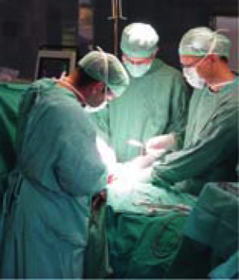
Process Focus
Many inputs
(surgeries, sick patients,
baby deliveries, emergencies)
(low-volume, high-variety, intermittent processes)
Arnold Palmer Hospital
Many departments and many routings
Figure 7.2(a)
Many different outputs
(uniquely treated patients)

Slide 21
Repetitive Focus
Facilities often organized as assembly lines
Characterized by modules with parts and assemblies made previously
Modules may be combined for many output options
Less flexibility than process-focused facilities but more efficient

Slide 22
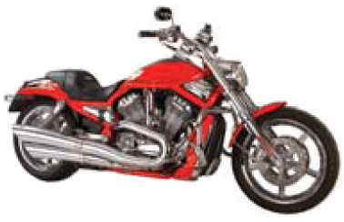
Repetitive Focus
Raw materials and module inputs
(multiple engine models, wheel modules)
Few modules
(modular)
Harley Davidson
Figure 7.2(b)
Modules combined for many
Output options
(many combinations of motorcycles)

Slide 23
Product Focus
Facilities are organized by product
High volume but low variety of products
Long, continuous production runs enable efficient processes
Typically high fixed cost but low variable cost
Generally less skilled labor

Slide 24
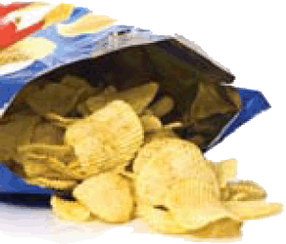
Product Focus
Few Inputs
(corn, potatoes, water, seasoning)
(high-volume, low-variety, continuous process)
Frito-Lay
Output variations in size, shape, and packaging
(3-oz, 5-oz, 24-oz package labeled for each material)
Figure 7.2(c)

Slide 25
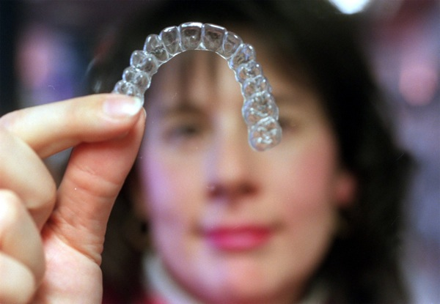
Mass Customization
The rapid, low-cost production of goods and service to satisfy increasingly unique customer desires
Combines the
flexibility of a
process focus
with the efficiency
of a product focus

Slide 26
Mass Customization
TABLE 7.1 | Mass Customization Provides More Choices Than Ever
 |  | NUMBER OF CHOICES
ITEM |  | 1970s | 21ST CENTURY
Vehicle styles |  | 18 | 1,212
Bicycle types |  | 8 | 211,000
Software titles |  | 0 | 400,000
Web sites |  | 0 | 255,000,000
Movie releases per year |  | 267 | 744
New book titles |  | 40,530 | 300,000
Houston TV channels |  | 5 | 185
Breakfast cereals |  | 160 | 340
Items (SKUs) in supermarkets |  | 14,000 | 150,000
LCD TVs |  | 0 | 102

Slide 27
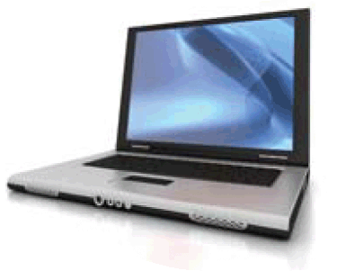
Mass Customization
Many parts and component inputs
(chips, hard drives, software, cases)
Many modules
(high-volume, high-variety)
Dell Computer
Figure 7.2(d)
Many output versions
(custom PCs and notebooks)

Slide 28
Mass Customization
Imaginative product design
Flexible process design
Tightly controlled inventory management
Tight schedules
Responsive supply-chain partners

Slide 29
Comparison of Processes
TABLE 7.2 | Comparison of the Characteristics of Four Types of Processes
PROCESS FOCUS (LOW-VOLUME, HIGH-VARIETY) |  | REPETITIVE FOCUS (MODULAR) | PRODUCT FOCUS (HIGH-VOLUME, LOW-VARIETY) | MASS CUSTOMIZATION (HIGH-VOLUME, HIGH-VARIETY)
Small quantity and large variety of products |  | Long runs, usually a standardized product from modules | Large quantity and small variety of products | Large quantity and large variety of products
Broadly skilled operators |  | Moderately trained employees | Less broadly skilled operators | Flexible operators

Slide 30
Comparison of Processes
TABLE 7.2 | Comparison of the Characteristics of Four Types of Processes
PROCESS FOCUS (LOW-VOLUME, HIGH-VARIETY) |  | REPETITIVE FOCUS (MODULAR) | PRODUCT FOCUS (HIGH-VOLUME, LOW-VARIETY) | MASS CUSTOMIZATION (HIGH-VOLUME, HIGH-VARIETY)
Instructions for each job |  | Few changes in the instructions | Standardized job instructions | Custom orders requiring many job instructions
High inventory |  | Low inventory | Low inventory | Low inventory relative to the value of the product

Slide 31
Comparison of Processes
TABLE 7.2 | Comparison of the Characteristics of Four Types of Processes
PROCESS FOCUS (LOW-VOLUME, HIGH-VARIETY) |  | REPETITIVE FOCUS (MODULAR) | PRODUCT FOCUS (HIGH-VOLUME, LOW-VARIETY) | MASS CUSTOMIZATION (HIGH-VOLUME, HIGH-VARIETY)
Finished goods are made to order and not stored |  | Finished goods are made to frequent forecasts | Finished goods are made to a forecast and stored | Finished goods are build-to-order (BTO)
Scheduling is complex |  | Scheduling is routine | Scheduling is routine | Sophisticated scheduling accommodates custom orders

Slide 32
Comparison of Processes
TABLE 7.2 | Comparison of the Characteristics of Four Types of Processes
PROCESS FOCUS (LOW-VOLUME, HIGH-VARIETY) |  | REPETITIVE FOCUS (MODULAR) | PRODUCT FOCUS (HIGH-VOLUME, LOW-VARIETY) | MASS CUSTOMIZATION (HIGH-VOLUME, HIGH-VARIETY)
Fixed costs are low and variable costs high |  | Fixed costs are dependent on flexibility of the facility | Fixed costs are high and variable costs low | Fixed costs tend to be high and variable costs low

Slide 33
Crossover Chart Example
Evaluate three different accounting software products
Calculate crossover points between software A and B and between software B and C
 | TOTAL FIXED COST | DOLLARS REQUIRED PER ACCOUNTING REPORT
Software A | $200,000 | $60
Software B | $300,000 | $25
Software C | $400,000 | $10

Slide 34
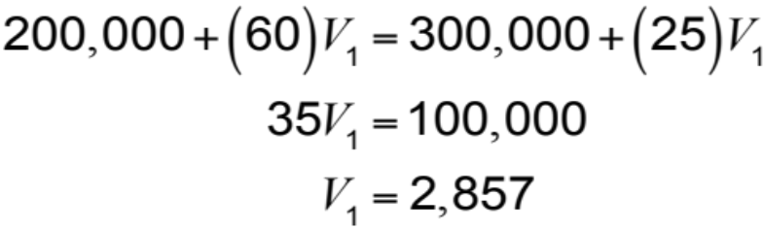
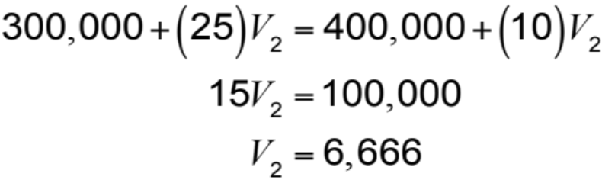
Crossover Chart Example
Software A is most economical from 0 to 2,857 reports
Software B is most economical from 2,857 to 6,666 reports

Slide 35
Crossover Charts
Variable costs
$
Variable costs
$
Variable costs
$
Fixed costs
Fixed costs
Fixed costs
Low volume, high variety
Process A
Repetitive
Process B
High volume, low variety
Process C
$
Total process B costs
Total process A costs
Total process C costs
400,000
300,000
200,000
Fixed cost Process C
Fixed cost Process B
Fixed cost Process A
Figure 7.3
(2,857)
V₁
V₂
(6,666)
Volume

Slide 36
Focused Processes
Focus brings efficiency
Focus on depth of product line rather than breadth
Focus can be
  Customers
  Products
  Service
  Technology

Slide 37
Selection of Equipment
Decisions can be complex as alternate methods may be available
Important factors may be
  Cost
  Cash flow
  Market stability
  Quality
  Capacity
  Flexibility

Slide 38
Equipment and Technology
Possible competitive advantage
Flexibility may be a competitive advantage
May be difficult and expensive and may require starting over
Important to get it right

Slide 39
Process Analysis and Design
Is the process designed to achieve a competitive advantage?
Does the process eliminate steps that do not add value?
Does the process maximize customer value?
Will the process win orders?

Slide 40
Process Analysis and Design
Flowcharts
  Shows the movement of materials
  Harley-Davidson flowchart
Time-Function Mapping
  Shows flows and time frame

Slide 41
“Baseline” Time-Function Map
Customer
Order product
Receive product
Sales
Process order
Production control
Order
Wait
Plant A
Order
Print
Product
Warehouse
WIP
Wait
Wait
Product
Wait
Plant B
WIP
WIP
WIP
Extrude
Product
Transport
Move
Move
12 days
13 days
1 day
4 days
1 day
10 days
1 day
0 day
1 day
Figure 7.4(a)
52 days

Slide 42
“Target” Time-Function Map
Customer
Order product
Receive product
Sales
Process order
Production control
Order
Wait
Product
WIP
Plant
Order
Print
Extrude
Warehouse
Product
Wait
Transport
Product
Move
1 day
2 days
1 day
1 day
1 day
6 days
Figure 7.4(b)

Slide 43
Process Analysis and Design
Value-Stream Mapping
  Where value is added in the entire production process, including the supply chain
  Extends from the customer back to the suppliers

Slide 44
Value-Stream Mapping
Begin with symbols for customer, supplier, and production to ensure the big picture
Enter customer order requirements
Calculate the daily production requirements
Enter the outbound shipping requirements and delivery frequency
Determine inbound shipping method and delivery frequency

Slide 45
Value-Stream Mapping
Add the process steps (i.e., machine, assemble) in sequence, left to right
Add communication methods, add their frequency, and show the direction with arrows
Add inventory quantities (shown with ) between every step of the entire flow
Determine total working time (value-added time) and delay (non-value-added time)
I

Slide 46
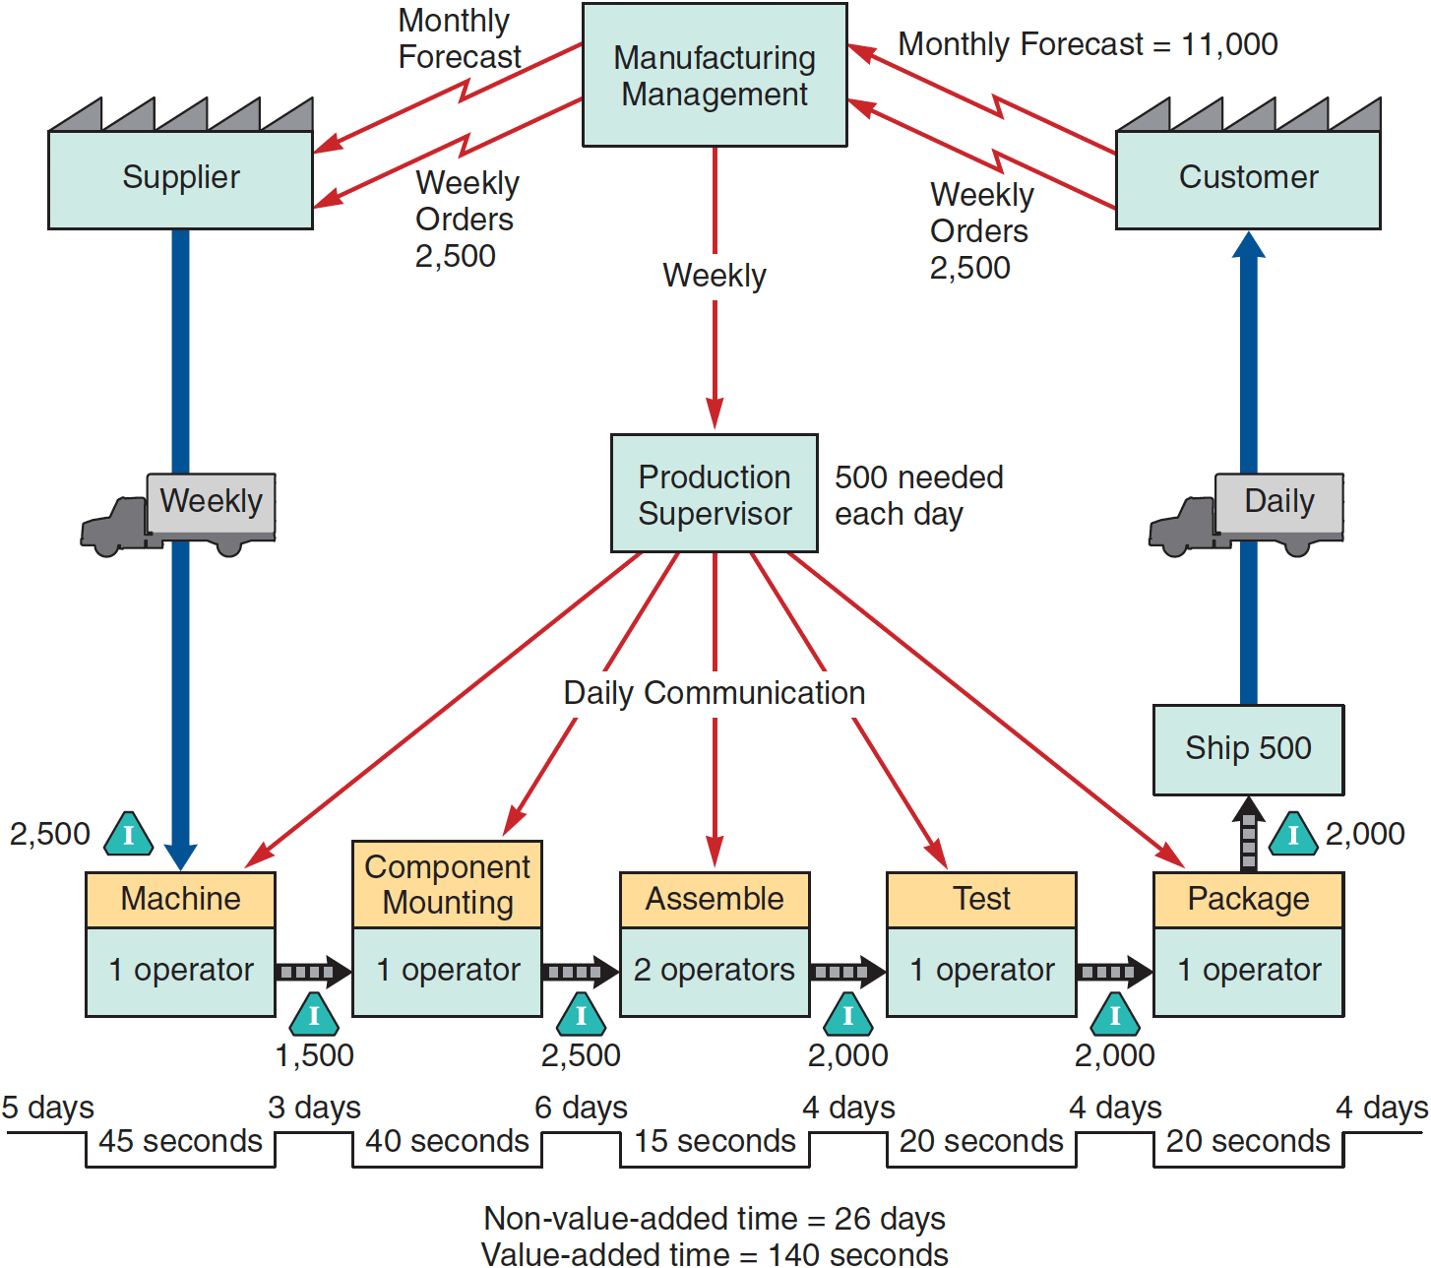
Value-Stream Mapping
Figure 7.5

Slide 47
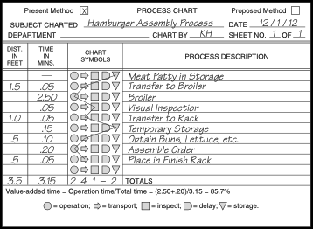
Process Chart
Figure 7.6

Slide 48
Service Blueprinting
Focuses on the customer and provider interaction
Defines three levels of interaction
Each level has different management issues
Identifies potential failure points

Slide 49
Service Blueprint
Personal Greeting
Service Diagnosis
Perform Service
Friendly Close
Level
#1
Customer arrives for service.
(3 min)
Customer departs
F
Determine specifics.
(5 min)
Notify
customer
and recommend
an alternative
provider.
(7 min)
Customer pays bill.
(4 min)
Warm greeting and obtain service request.
(10 sec)
No
F
Level
#2
Standard request.
(3 min)
Can
service be
done and does customer approve?
(5 min)
F
Direct customer to waiting room.
No
Notify customer the car is ready.
(3 min)
F
F
F
F
Yes
Yes
Level
#3
Perform required work.
(varies)
F
Prepare invoice.
(3 min)
Figure 7.7

Slide 50
Special Considerations for Service Process Design
Some interaction with customer is necessary, but this often affects performance adversely
The better these interactions are accommodated in the process design, the more efficient and effective the process
Find the right combination of cost and customer interaction

Slide 51
Service Process Matrix
Figure 7.8
Degree of Customization
Low
High
Mass Service
Professional Service
Private banking
Traditional orthodontics
Commercial banking
High
General-
purpose law firms
Full-service stockbroker
Boutiques
Digital orthodontics
Retailing
Degree of Labor
Service Factory
Service Shop
Law clinics
Limited-service stockbroker
Specialized hospitals
Warehouse and catalog stores
Fast-food restaurants
Fine-dining restaurants
Low
Hospitals
Airlines
No-frills airlines

Slide 52
Service Process Matrix
Mass Service and Professional Service
Labor involvement is high
Focus on human resources
Selection and training highly important
Personalized services
Low
Degree of Customization
High
Mass Service
Professional Service
Private banking
Traditional orthodontics
Commercial banking
High
General-
purpose law firms
Full-service stockbroker
Boutiques
Digital orthodontics
Degree of Labor
Retailing
Service Factory
Law clinics
Service Shop
Limited-service stockbroker
Specialized hospitals
Low
Warehouse and catalog stores
Fast-food restaurants
Fine-dining restaurants
Hospitals
Airlines
No-frills airlines

Slide 53
Service Process Matrix
Service Factory and Service Shop
Automation of standardized services
Restricted offerings
Low labor intensity responds well to process technology and
scheduling
Tight control required to
maintain standards
Low
Degree of Customization
High
Mass Service
Professional Service
Private banking
Traditional orthodontics
Commercial banking
High
General-
purpose law firms
Full-service stockbroker
Boutiques
Digital orthodontics
Degree of Labor
Retailing
Service Factory
Law clinics
Service Shop
Limited-service stockbroker
Specialized hospitals
Low
Warehouse and catalog stores
Fast-food restaurants
Fine-dining restaurants
Hospitals
Airlines
No-frills airlines

Slide 54
Improving Service Productivity
TABLE 7.3 | Techniques for Improving Service Productivity
STRATEGY |  | TECHNIQUE | EXAMPLE
Separation |  | Structuring service so customers must go where the service is offered | Bank customers go to a manager to open a new account, to loan officers for loans, and to tellers for deposits
Self-service |  | Self-service so customers examine, compare, and evaluate at their own pace | Supermarkets and department stores
Postponement |  | Customizing at delivery | Customizing vans at delivery rather than at production
Focus |  | Restricting the offerings | Limited-menu restaurant

Slide 55
Improving Service Productivity
TABLE 7.3 | Techniques for Improving Service Productivity
STRATEGY |  | TECHNIQUE | EXAMPLE
Modules |  | Modular selection of service Modular production | Investment and insurance selection Prepackaged food modules in restaurants
Automation |  | Separating services that may lend themselves to some type of automation | Automatic teller machines
Scheduling |  | Precise personnel scheduling | Scheduling ticket counter personnel at 15-minute intervals at airlines
Training |  | Clarifying the service options Explaining how to avoid problems | Investment counselor, funeral directors After-sale maintenance personnel

Slide 56
Production Technology
Machine Technology
Automatic Identification Systems (AISs) and RFID
Process control
Vision Systems
Robots
Automated Storage and Retrieval Systems (ASRSs)
Automated Guided Vehicles (AGVs)
Flexible Manufacturing Systems (FMSs)
Computer-Integrated Manufacturing (CIM)

Slide 57
Machine Technology
Computer numerical
control (CNC)
Increased precision
Increased productivity
Increased flexibility
Improved environmental impact
Reduced changeover time
Decreased size
Reduced power requirements

Slide 58
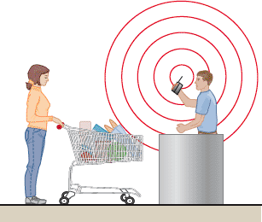
Automatic Identification Systems (AISs)
Improved data acquisition
Reduced data entry errors
Increased speed
Increased scope
of process
automation
Bar codes and RFID

Slide 59

Process Control
Real-time monitoring and control of processes
  Sensors collect data
  Devices read data
  on periodic basis
  Measurements translated into digital signals then sent to a computer
  Computer programs analyze the data
  Resulting output may take numerous forms

Slide 60
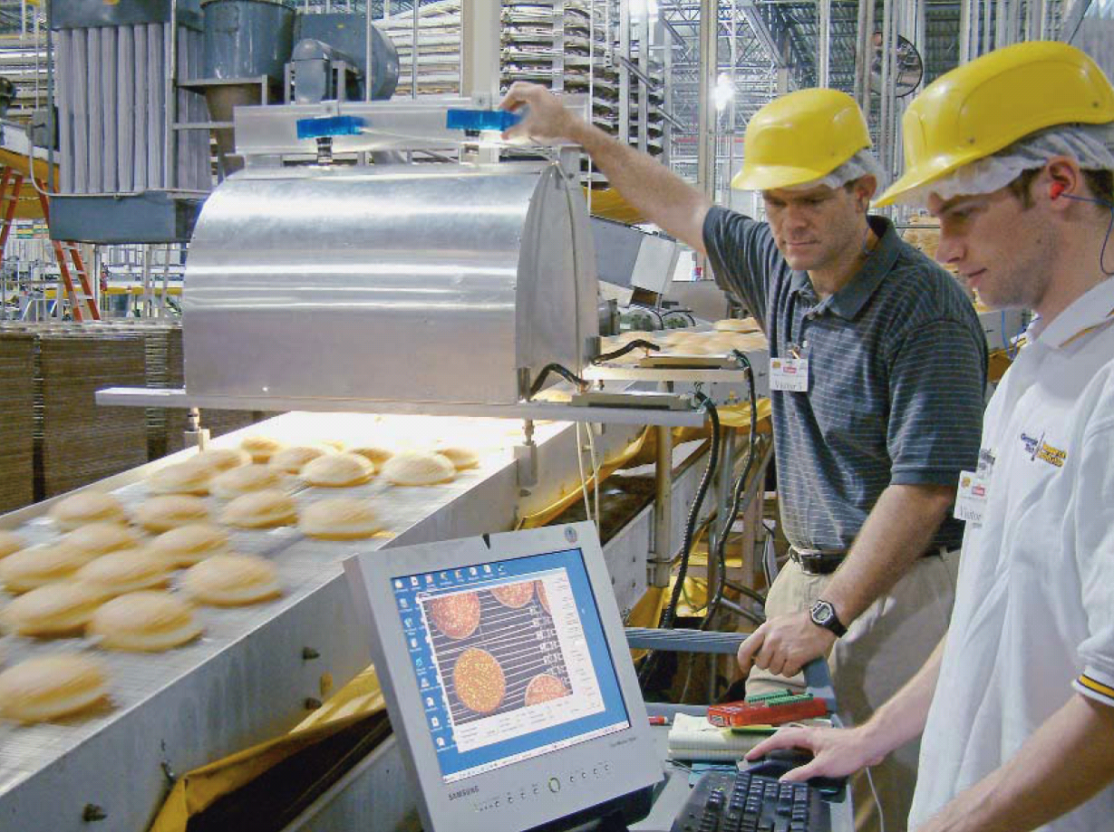
Vision Systems
Particular aid to inspection
Consistently
accurate
Never bored
Modest cost
Superior to
individuals performing the same tasks

Slide 61
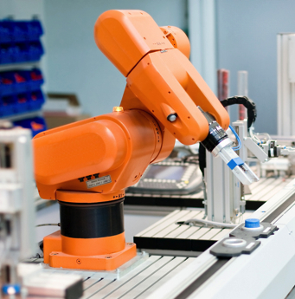
Robots
Perform monotonous or dangerous tasks
Perform tasks
requiring significant
strength or
endurance
Generally enhanced
consistency and
accuracy

Slide 62
Automated Storage and Retrieval Systems (ASRSs)
Automated placement and withdrawal of parts and products
Reduced errors and labor
Particularly useful in inventory and test areas of manufacturing firms

Slide 63
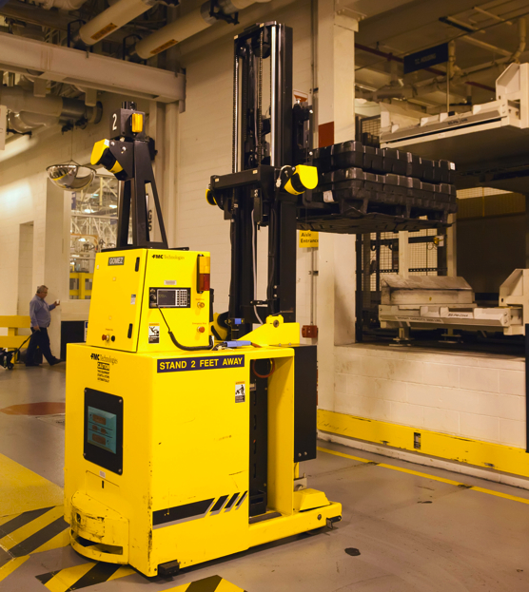
Automated Guided Vehicle (AGVs)
Electronically guided and controlled carts
Used for movement of products and/or individuals

Slide 64
Flexible Manufacturing Systems (FMSs)
Computer controls both the workstation and the material handling equipment
Enhance flexibility and reduced waste
Can economically produce low volume at high quality
Reduced changeover time and increased utilization
Stringent communication requirement between components

Slide 65
Computer-Integrated Manufacturing (CIM)
Extend flexible manufacturing
  Backwards to engineering and inventory control
  Forward into warehousing and shipping
  Can also include financial and customer service areas
  Reducing the distinction between low-volume/high-variety, and high-volume/low-variety production

Slide 66
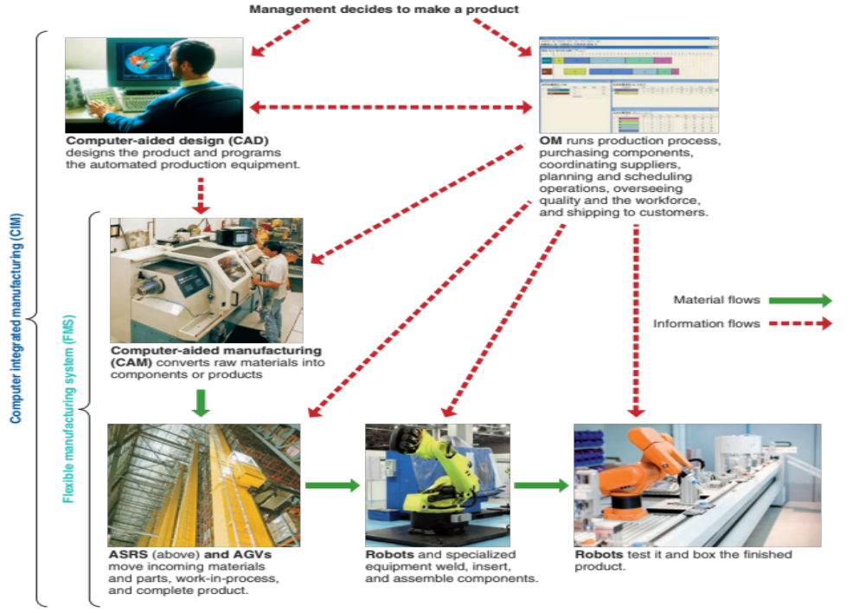
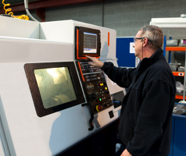

Computer-Integrated Manufacturing (CIM)
ASRS and AGVs
Figure 7.9

Slide 67
Technology in Services
TABLE 7.4 | Examples of Technology’s Impact on Services
SERVICE INDUSTRY |  | EXAMPLE
Financial Services |  | Debit cards, electronic funds transfer, ATMs, Internet stock trading, on-line banking via cell phone
Education |  | Electronic bulletin boards, on-line journals, WebCT, Blackboard, and smart phones
Utilities and government |  | Automated one-man garbage trucks, optical mail and bomb scanners, flood warning systems, meters allowing homeowners to control energy usage and costs
Restaurants and foods |  | Wireless orders from waiters to kitchen, robot butchering, transponders on cars that track sales at drive-throughs
Communications |  | Interactive TV, e-books via Kindle

Slide 68
Technology in Services
TABLE 7.4 | Examples of Technology’s Impact on Services
SERVICE INDUSTRY |  | EXAMPLE
Hotels |  | Electronic check-in/check-out, electronic key/lock systems, mobile Web bookings
Wholesale/retail trade |  | Point-of-sale (POS) terminals, e-commerce, electronic communication between store and supplier, bar-coded data, RFID
Transportation |  | Automatic toll booths, satellite-directed navigation systems, Wi-Fi in automobiles
Health care |  | Online patient-monitoring systems, online medical information systems, robotic surgery
Airlines |  | Ticketless travel, scheduling, Internet purchases, boarding passes downloaded as two-dimensional bar codes on smart phones

Slide 69
Process Redesign
The fundamental rethinking of business processes to bring about dramatic improvements in performance
Relies on reevaluating the purpose of the process and questioning both the purpose and the underlying assumptions
Requires reexamination of the basic process and its objectives
Focuses on activities that cross functional lines
Any process is a candidate for redesign

