Slide 1
Chapter 12
Inventory Management

Slide 2
Outline
Global Company Profile:
Amazon.com
The Importance of Inventory
Managing Inventory
Inventory Models
Inventory Models for Independent Demand

Slide 3
Outline
Probabilistic Models and Safety Stock
Single-Period Model
Fixed-Period (P) Systems

Slide 4
Learning Objectives
When you complete this chapter you should be able to:
Conduct an ABC analysis
Explain and use cycle counting
Explain and use the EOQ model for independent inventory demand
Compute a reorder point and safety stock

Slide 5
Learning Objectives
When you complete this chapter you should be able to:
Apply the production order quantity model
Explain and use the quantity discount model
Understand service levels and probabilistic inventory models

Slide 6
Inventory Management at Amazon.com
Amazon.com started as a “virtual” retailer – no inventory, no warehouses, no overhead; just computers taking orders to be filled by others
Growth has forced Amazon.com to become a world leader in warehousing and inventory management

Slide 7
Inventory Management at Amazon.com
Each order is assigned by computer to the closest distribution center that has the product(s)
A “flow meister” at each distribution center assigns work crews
Lights indicate products that are to be picked and the light is reset
Items are placed in crates on a conveyor, bar code scanners scan each item 15 times to virtually eliminate errors

Slide 8
Inventory Management at Amazon.com
Crates arrive at central point where items are boxed and labeled with new bar code
Gift wrapping is done by hand at 30 packages per hour
Completed boxes are packed, taped, weighed and labeled before leaving warehouse in a truck
Order arrives at customer within 1 - 2 days

Slide 9
Inventory Management
The objective of inventory management is to strike a balance between inventory investment and customer service

Slide 10
Importance of Inventory
One of the most expensive assets of many companies representing as much as 50% of total invested capital
Operations managers must balance inventory investment and customer service

Slide 11
Functions of Inventory
To provide a selection of goods for anticipated demand and to separate the firm from fluctuations in demand
To decouple or separate various parts of the production process
To take advantage of quantity discounts
To hedge against inflation

Slide 12
Types of Inventory
Raw material
  Purchased but not processed
Work-in-process (WIP)
  Undergone some change but not completed
  A function of cycle time for a product
Maintenance/repair/operating (MRO)
  Necessary to keep machinery and processes productive
Finished goods
  Completed product awaiting shipment

Slide 13
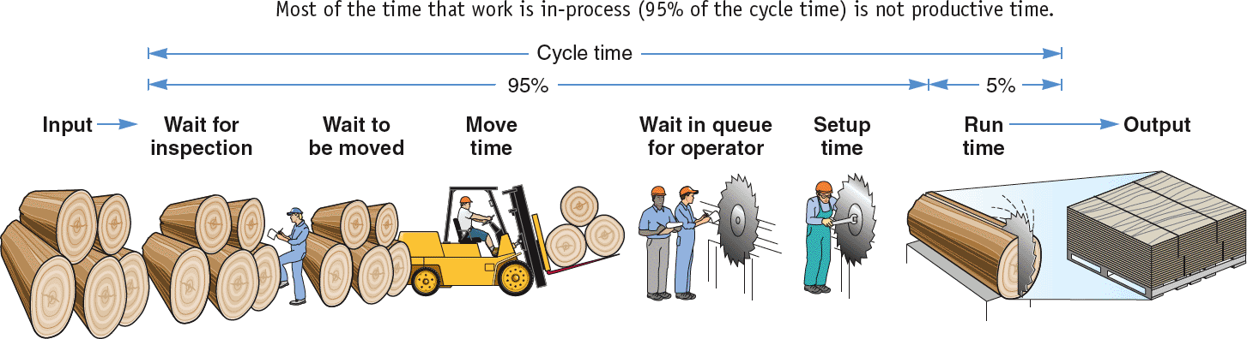
The Material Flow Cycle
Cycle time
95% 5%
Input Wait for Wait to Move Wait in queue Setup Run Output
inspection be moved time for operator time time
Figure 12.1

Slide 14
Managing Inventory
How inventory items can be classified (ABC analysis)
How accurate inventory records can be maintained

Slide 15
ABC Analysis
Divides inventory into three classes based on annual dollar volume
  Class A - high annual dollar volume
  Class B - medium annual dollar volume
  Class C - low annual dollar volume
Used to establish policies that focus on the few critical parts and not the many trivial ones

Slide 16
ABC Analysis
ABC Calculation
(1) | (2) | (3) |  | (4) |  | (5) |  | (6) |  |  | (7)
ITEM STOCK NUMBER | PERCENT OF NUMBER OF ITEMS STOCKED | ANNUAL VOLUME (UNITS) | x | UNIT COST | = | ANNUAL DOLLAR VOLUME |  | PERCENT OF ANNUAL DOLLAR VOLUME |  |  | CLASS
#10286 | 20% | 1,000 |  | $ 90.00 |  |  | $ 90,000 |  | 38.8% |  | A
#11526 |  | 500 |  | 154.00 |  |  | 77,000 |  | 33.2% |  | A
#12760 |  | 1,550 |  | 17.00 |  |  | 26,350 |  | 11.3% |  | B
#10867 | 30% | 350 |  | 42.86 |  |  | 15,001 |  | 6.4% |  | B
#10500 |  | 1,000 |  | 12.50 |  |  | 12,500 |  | 5.4% |  | B
#12572 |  | 600 |  | $ 14.17 |  |  | $ 8,502 |  | 3.7% |  | C
#14075 |  | 2,000 |  | .60 |  |  | 1,200 |  | .5% |  | C
#01036 | 50% | 100 |  | 8.50 |  |  | 850 |  | .4% |  | C
#01307 |  | 1,200 |  | .42 |  |  | 504 |  | .2% |  | C
#10572 |  | 250 |  | .60 |  |  | 150 |  | .1% |  | C
 |  | 8,550 |  |  |  |  | $232,057 |  | 100.0%
72%
23%
5%

Slide 17
ABC Analysis
80 –
70 –
60 –
50 –
40 –
30 –
20 –
10 –
0 –
A Items
Figure 12.2
Percentage of annual dollar usage
B Items
C Items
| | | | | | | | | |
10 20 30 40 50 60 70 80 90 100
Percentage of inventory items

Slide 18
ABC Analysis
Other criteria than annual dollar volume may be used
  High shortage or holding cost
  Anticipated engineering changes
  Delivery problems
  Quality problems

Slide 19
ABC Analysis
Policies employed may include
  More emphasis on supplier development for A items
  Tighter physical inventory control for A items
  More care in forecasting A items

Slide 20
Record Accuracy
Accurate records are a critical ingredient in production and inventory systems
  Periodic systems require regular checks of inventory
    Two-bin system
  Perpetual inventory tracks receipts and subtractions on a continuing basis
    May be semi-automated

Slide 21
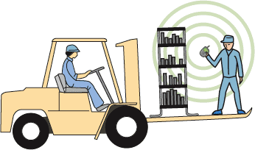
Record Accuracy
Incoming and outgoing
record keeping must be
accurate
Stockrooms should be secure
Necessary to make precise decisions about ordering, scheduling, and shipping

Slide 22
Cycle Counting
Items are counted and records updated on a periodic basis
Often used with ABC analysis
Has several advantages
  Eliminates shutdowns and interruptions
  Eliminates annual inventory adjustment
  Trained personnel audit inventory accuracy
  Allows causes of errors to be identified and corrected
  Maintains accurate inventory records

Slide 23
Cycle Counting Example
5,000 items in inventory, 500 A items, 1,750 B items, 2,750 C items
Policy is to count A items every month (20 working days), B items every quarter (60 days), and C items every six months (120 days)
ITEM CLASS | QUANTITY | CYCLE COUNTING POLICY | NUMBER OF ITEMS COUNTED PER DAY
A | 500 | Each month | 500/20 = | 25/day
B | 1,750 | Each quarter | 1,750/60 = | 29/day
C | 2,750 | Every 6 months | 2,750/120 = | 23/day
 |  |  |  | 77/day

Slide 24
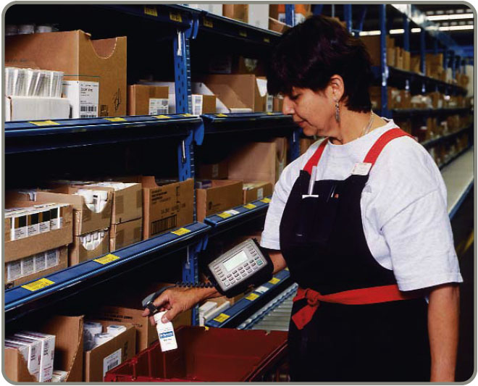
Control of Service Inventories
Can be a critical component
of profitability
Losses may come from
shrinkage or pilferage
Applicable techniques include
  Good personnel selection, training, and discipline
  Tight control of incoming shipments
  Effective control of all goods leaving facility

Slide 25
Inventory Models
Independent demand - the demand for item is independent of the demand for any other item in inventory
Dependent demand - the demand for item is dependent upon the demand for some other item in the inventory

Slide 26
Inventory Models
Holding costs - the costs of holding or “carrying” inventory over time
Ordering costs - the costs of placing an order and receiving goods
Setup costs - cost to prepare a machine or process for manufacturing an order
  May be highly correlated with setup time

Slide 27
Holding Costs
TABLE 12.1 | Determining Inventory Holding Costs
CATEGORY |  | COST (AND RANGE) AS A PERCENT OF INVENTORY VALUE
Housing costs (building rent or depreciation, operating costs, taxes, insurance) |  |  | 6% (3 - 10%)
Material handling costs (equipment lease or depreciation, power, operating cost) |  |  | 3% (1 - 3.5%)
Labor cost (receiving, warehousing, security) |  |  | 3% (3 - 5%)
Investment costs (borrowing costs, taxes, and insurance on inventory) |  |  | 11% (6 - 24%)
Pilferage, space, and obsolescence (much higher in industries undergoing rapid change like PCs and cell phones) |  |  | 3% (2 - 5%)
Overall carrying cost |  |  | 26%

Slide 28
Holding Costs
TABLE 12.1 | Determining Inventory Holding Costs
CATEGORY |  | COST (AND RANGE) AS A PERCENT OF INVENTORY VALUE
Housing costs (building rent or depreciation, operating costs, taxes, insurance) |  |  | 6% (3 - 10%)
Material handling costs (equipment lease or depreciation, power, operating cost) |  |  | 3% (1 - 3.5%)
Labor cost (receiving, warehousing, security) |  |  | 3% (3 - 5%)
Investment costs (borrowing costs, taxes, and insurance on inventory) |  |  | 11% (6 - 24%)
Pilferage, space, and obsolescence (much higher in industries undergoing rapid change like PCs and cell phones) |  |  | 3% (2 - 5%)
Overall carrying cost |  |  | 26%
Holding costs vary considerably depending on the business, location, and interest rates. Generally greater than 15%, some high tech and fashion items have holding costs greater than 40%.

Slide 29
Inventory Models for Independent Demand
Need to determine when and how much to order
Basic economic order quantity (EOQ) model
Production order quantity model
Quantity discount model

Slide 30
Basic EOQ Model
Important assumptions
Demand is known, constant, and independent
Lead time is known and constant
Receipt of inventory is instantaneous and complete
Quantity discounts are not possible
Only variable costs are setup (or ordering) and holding
Stockouts can be completely avoided

Slide 31
Inventory Usage Over Time
Figure 12.3
Total order received
Average inventory on hand
Q
2
Order quantity = Q (maximum inventory level)
Usage rate
Inventory level
Minimum inventory
0
Time

Slide 32
Minimizing Costs
Objective is to minimize total costs
Table 12.4(c)
Total cost of holding and setup (order)
Minimum total cost
Holding cost
Annual cost
Setup (order) cost
Optimal order quantity (Q*)
Order quantity

Slide 33
Minimizing Costs
By minimizing the sum of setup (or ordering) and holding costs, total costs are minimized
Optimal order size Q* will minimize total cost
A reduction in either cost reduces the total cost
Optimal order quantity occurs when holding cost and setup cost are equal

Slide 34
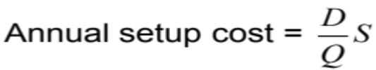
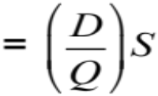
Minimizing Costs
Q = Number of pieces per order
Q* = Optimal number of pieces per order (EOQ)
D = Annual demand in units for the inventory item
S = Setup or ordering cost for each order
H = Holding or carrying cost per unit per year
Annual setup cost = (Number of orders placed per year)
x (Setup or order cost per order)
Annual demand
Number of units in each order
Setup or order cost per order
=

Slide 35

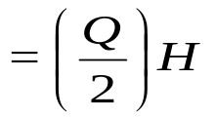
Minimizing Costs
Q = Number of pieces per order
Q* = Optimal number of pieces per order (EOQ)
D = Annual demand in units for the inventory item
S = Setup or ordering cost for each order
H = Holding or carrying cost per unit per year
Annual holding cost = (Average inventory level)
x (Holding cost per unit per year)
Order quantity
2
=
(Holding cost per unit per year)

Slide 36
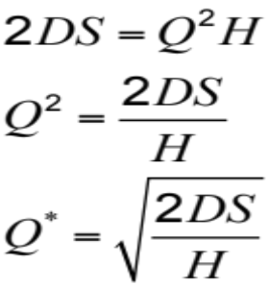
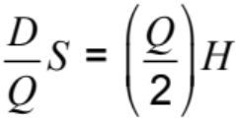
Minimizing Costs
Q = Number of pieces per order
Q* = Optimal number of pieces per order (EOQ)
D = Annual demand in units for the inventory item
S = Setup or ordering cost for each order
H = Holding or carrying cost per unit per year
Optimal order quantity is found when annual setup cost equals annual holding cost
Solving for Q*

Slide 37
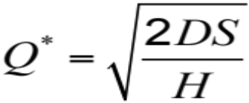
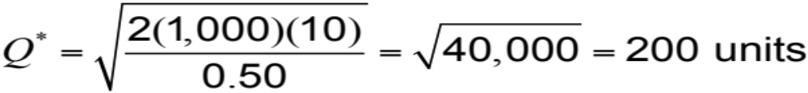
An EOQ Example
Determine optimal number of needles to order
D = 1,000 units
S = $10 per order
H = $.50 per unit per year

Slide 38

An EOQ Example
Determine expected number of orders
D = 1,000 units Q* = 200 units
S = $10 per order
H = $.50 per unit per year
Expected number of orders
Demand
Order quantity
= N = =
1,000
200
N = = 5 orders per year

Slide 39
An EOQ Example
Determine optimal time between orders
D = 1,000 units Q* = 200 units
S = $10 per order N = 5 orders/year
H = $.50 per unit per year
Expected time between orders
Number of working days per year
Expected number of orders
= T =
250
5
T = = 50 days between orders

Slide 40
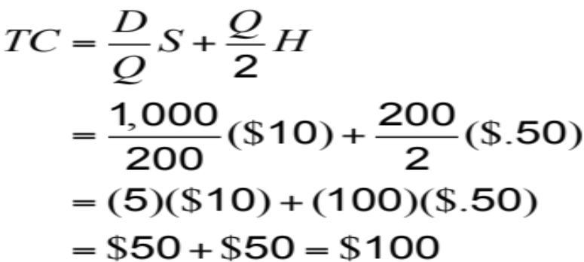
An EOQ Example
Determine the total annual cost
D = 1,000 units Q* = 200 units
S = $10 per order N = 5 orders/year
H = $.50 per unit per year T = 50 days
Total annual cost = Setup cost + Holding cost

Slide 41
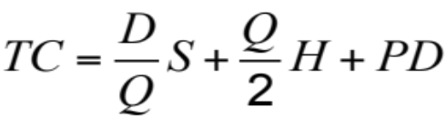
The EOQ Model
When including actual cost of material P
Total annual cost = Setup cost + Holding cost + Product cost

Slide 42
Robust Model
The EOQ model is robust
It works even if all parameters and assumptions are not met
The total cost curve is relatively flat in the area of the EOQ

Slide 43
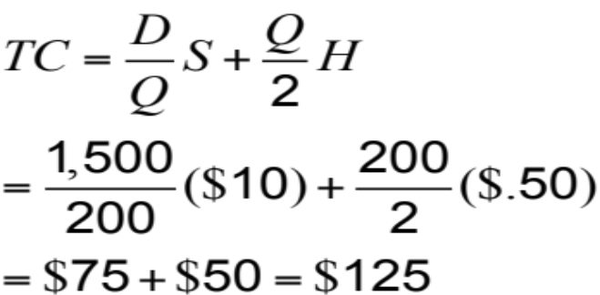
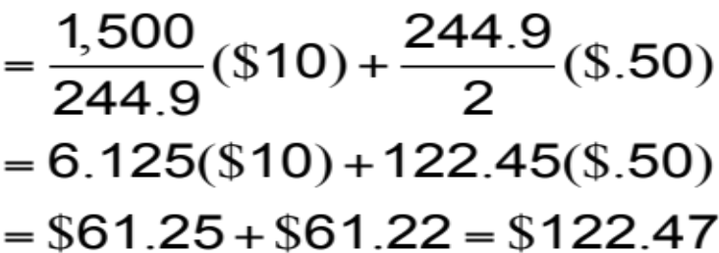
An EOQ Example
Only 2% less than the total cost of $125 when the order quantity was 200
Determine optimal number of needles to order
D = 1,000 units Q* = 200 units
S = $10 per order N = 5 orders/year
H = $.50 per unit per year T = 50 days
1,500 units

Slide 44
Reorder Points
EOQ answers the “how much” question
The reorder point (ROP) tells “when” to order
Lead time (L) is the time between placing and receiving an order
Demand per day
Lead time for a new order in days
ROP =
= d x L
D
Number of working days in a year
d =

Slide 45
Reorder Point Curve
Q*
Resupply takes place as order arrives
Slope = units/day = d
Inventory level (units)
ROP (units)
Time (days)
Figure 12.5
Lead time = L

Slide 46
Reorder Point Example
Demand = 8,000 iPods per year
250 working day year
Lead time for orders is 3 working days, may take 4
D
Number of working days in a year
d =
= 8,000/250 = 32 units
ROP = d x L
= 32 units per day x 3 days = 96 units
= 32 units per day x 4 days = 128 units

Slide 47
Production Order Quantity Model
Used when inventory builds up over a period of time after an order is placed
Used when units are produced and sold simultaneously
Figure 12.6
Part of inventory cycle during which production (and usage) is taking place
Demand part of cycle with no production (only usage)
Inventory level
Maximum inventory
t
Time

Slide 48
Production Order Quantity Model
Q = Number of pieces per order p = Daily production rate
H = Holding cost per unit per year d = Daily demand/usage rate
t = Length of the production run in days
Annual inventory holding cost
= (Average inventory level) x
Holding cost
per unit per year
Annual inventory level
= (Maximum inventory level)/2
Maximum inventory level
Total produced during the production run
Total used during the production run
= –
= pt – dt

Slide 49
Production Order Quantity Model
Q = Number of pieces per order p = Daily production rate
H = Holding cost per unit per year d = Daily demand/usage rate
t = Length of the production run in days
Maximum inventory level
Total produced during the production run
Total used during the production run
= –
= pt – dt
However, Q = total produced = pt ; thus t = Q/p
Maximum inventory level
Q
p
Q
p
d
p
= p – d = Q 1 –
Maximum inventory level
2
Q
2
d
p
Holding cost = (H) = 1 – H

Slide 50
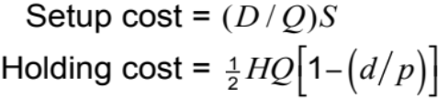
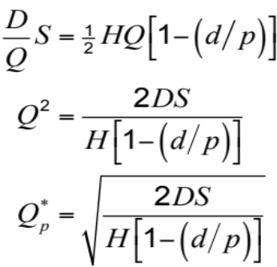
Production Order Quantity Model
Q = Number of pieces per order p = Daily production rate
H = Holding cost per unit per year d = Daily demand/usage rate
t = Length of the production run in days

Slide 51
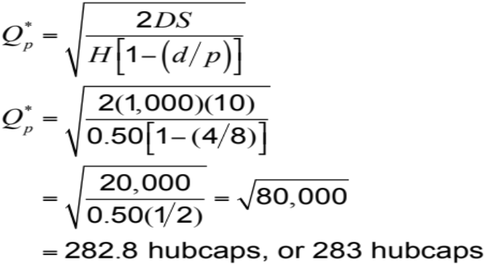
Production Order Quantity Example
D = 1,000 units p = 8 units per day
S = $10 d = 4 units per day
H = $0.50 per unit per year

Slide 52
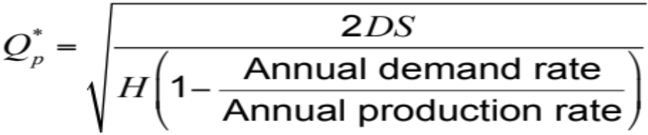
Production Order Quantity Model
Note:
D
Number of days the plant is in operation
1,000
250
d = 4 = =
When annual data are used the equation becomes

Slide 53
Quantity Discount Models
Reduced prices are often available when larger quantities are purchased
Trade-off is between reduced product cost and increased holding cost
TABLE 12.2 |  | A Quantity Discount Schedule
DISCOUNT NUMBER | DISCOUNT QUANTITY |  | DISCOUNT (%) | DISCOUNT PRICE (P)
1 | 0 to 999 |  | no discount | $5.00
2 | 1,000 to 1,999 |  | 4 | $4.80
3 | 2,000 and over |  | 5 | $4.75

Slide 54
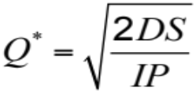
Quantity Discount Models
Total annual cost = Setup cost + Holding cost + Product cost
where Q = Quantity ordered P = Price per unit
D = Annual demand in units H = Holding cost per unit per year
S = Ordering or setup cost per order
Because unit price varies, holding cost (H) is expressed as a percent (I) of unit price (P)

Slide 55
Quantity Discount Models
Steps in analyzing a quantity discount
For each discount, calculate Q*
If Q* for a discount doesn’t qualify, choose the lowest possible quantity to get the discount
Compute the total cost for each Q* or adjusted value from Step 2
Select the Q* that gives the lowest total cost

Slide 56
Quantity Discount Models
Total cost curve for discount 2
Total cost curve for discount 1
Total cost $
Total cost curve for discount 3
b
a
Q* for discount 2 is below the allowable range at point a and must be adjusted upward to 1,000 units at point b
1st price break
2nd price break
0
1,000
2,000
Order quantity
Figure 12.7

Slide 57
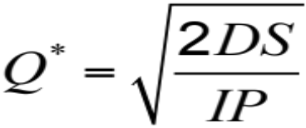
Quantity Discount Example
Calculate Q* for every discount
2(5,000)(49)
(.2)(5.00)
Q₁* = = 700 cars/order
2(5,000)(49)
(.2)(4.80)
Q₂* = = 714 cars/order
2(5,000)(49)
(.2)(4.75)
Q₃* = = 718 cars/order

Slide 58
Quantity Discount Example
Calculate Q* for every discount
2(5,000)(49)
(.2)(5.00)
Q₁* = = 700 cars/order
2(5,000)(49)
(.2)(4.80)
Q₂* = = 714 cars/order
1,000 — adjusted
2(5,000)(49)
(.2)(4.75)
Q₃* = = 718 cars/order
2,000 — adjusted

Slide 59
Quantity Discount Example
TABLE 12.3 |  | Total Cost Computations for Wohl’s Discount Store
DISCOUNT NUMBER | UNIT PRICE |  | ORDER QUANTITY | ANNUAL PRODUCT COST | ANNUAL ORDERING COST | ANNUAL HOLDING COST | TOTAL
1 | $5.00 |  | 700 | $25,000 | $350 | $350 | $25,700
2 | $4.80 |  | 1,000 | $24,000 | $245 | $480 | $24,725
3 | $4.75 |  | 2,000 | $23.750 | $122.50 | $950 | $24,822.50
Choose the price and quantity that gives the lowest total cost
Buy 1,000 units at $4.80 per unit

Slide 60
Probabilistic Models and
Safety Stock
Used when demand is not constant or certain
Use safety stock to achieve a desired service level and avoid stockouts
ROP = d x L + ss
Annual stockout costs = the sum of the units short x the probability x the stockout cost/unit
x the number of orders per year

Slide 61
Safety Stock Example
ROP = 50 units Stockout cost = $40 per frame
Orders per year = 6 Carrying cost = $5 per frame per year
NUMBER OF UNITS | PROBABILITY
30 |  | .2
40 |  | .2
ROP → 50 |  | .3
60 |  | .2
70 |  | .1
 |  | 1.0

Slide 62
Safety Stock Example
ROP = 50 units Stockout cost = $40 per frame
Orders per year = 6 Carrying cost = $5 per frame per year
SAFETY STOCK | ADDITIONAL HOLDING COST | STOCKOUT COST | TOTAL COST
20 | (20)($5) = $100 | $0 | $100
10 | (10)($5) = $ 50 | (10)(.1)($40)(6) = $240 | $290
0 | $ 0 | (10)(.2)($40)(6) + (20)(.1)($40)(6) = $960 | $960
A safety stock of 20 frames gives the lowest total cost
ROP = 50 + 20 = 70 frames

Slide 63
Probabilistic Demand
Figure 12.8
Minimum demand during lead time
Maximum demand during lead time
Inventory level
Mean demand during lead time
ROP = 350 + safety stock of 16.5 = 366.5
ROP →
Normal distribution probability of demand during lead time
Expected demand during lead time (350 kits)
Safety stock
16.5 units
0
Place order
Lead time
Time
Receive order

Slide 64
Probabilistic Demand
Use prescribed service levels to set safety stock when the cost of stockouts cannot be determined
ROP = demand during lead time + Zσ_{dLT}
where Z = Number of standard deviations
σ_{dLT} = Standard deviation of demand during lead time

Slide 65
Probabilistic Demand
Probability of
no stockout
95% of the time
Risk of a stockout (5% of area of normal curve)
Mean demand 350
ROP = ? kits
Quantity
Safety stock
0
z
Number of
standard deviations

Slide 66
Probabilistic Example
μ = Average demand = 350 kits
σ_{dLT} = Standard deviation of
demand during lead time = 10 kits
Z = 5% stockout policy (service level = 95%)
Using Appendix I, for an area under the curve of 95%, the Z = 1.65
Safety stock = Zσ_{dLT} = 1.65(10) = 16.5 kits
Reorder point = Expected demand during lead time + Safety stock
= 350 kits + 16.5 kits of safety stock
= 366.5 or 367 kits

Slide 67
Other Probabilistic Models
When data on demand during lead time is not available, there are other models available
  When demand is variable and lead time is constant
  When lead time is variable and demand is constant
  When both demand and lead time are variable

Slide 68
Other Probabilistic Models
Demand is variable and lead time is constant
ROP = (Average daily demand
x Lead time in days) + Zσ_{dLT}
where σ_{dLT} = σ_{d} Lead time
σ_{d} = standard deviation of demand per day

Slide 69
Probabilistic Example
Average daily demand (normally distributed) = 15
Lead time in days (constant) = 2
Standard deviation of daily demand = 5
Service level = 90%
Z for 90% = 1.28
From Appendix I
ROP = (15 units x 2 days) + Zσ_{dLT}
= 30 + 1.28(5)( 2)
= 30 + 9.02 = 39.02 ≈ 39
Safety stock is about 9 computers

Slide 70
Other Probabilistic Models
Lead time is variable and demand is constant
ROP = (Daily demand x Average lead time in days) + Z x (Daily demand) x σ_{LT}
where σ_{LT} = Standard deviation of lead time in days

Slide 71
Probabilistic Example
Daily demand (constant) = 10
Average lead time = 6 days
Standard deviation of lead time = σ_{LT} = 1
Service level = 98%, so Z (from Appendix I) = 2.055
ROP = (10 units x 6 days) + 2.055(10 units)(1)
= 60 + 20.55 = 80.55
Reorder point is about 81 cameras

Slide 72
Other Probabilistic Models
Both demand and lead time are variable
ROP = (Average daily demand
x Average lead time) + Zσ_{dLT}
where σ_{d} = Standard deviation of demand per day
σ_{LT} = Standard deviation of lead time in days
σ_{dLT} = (Average lead time x σ_{d}²)
+ (Average daily demand)²σ²_{LT}

Slide 73
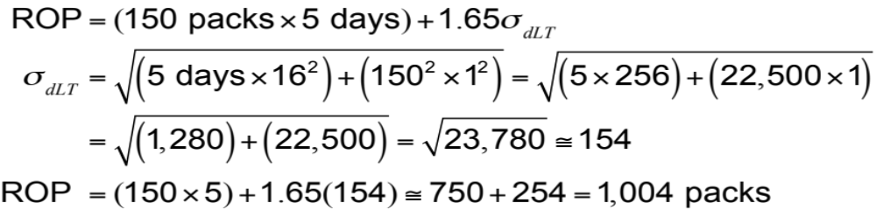
Probabilistic Example
Average daily demand (normally distributed) = 150
Standard deviation = σ_{d} = 16
Average lead time 5 days (normally distributed)
Standard deviation = σ_{LT} = 1 day
Service level = 95%, so Z = 1.65 (from Appendix I)

Slide 74
Single-Period Model
Only one order is placed for a product
Units have little or no value at the end of the sales period
C_{s} = Cost of shortage = Sales price/unit – Cost/unit
C_{o} = Cost of overage = Cost/unit – Salvage value
C_{s}
C_{s} + C_{o}
Service level =

Slide 75
Single-Period Example
Average demand = μ = 120 papers/day
Standard deviation = σ = 15 papers
C_{s} = cost of shortage = $1.25 – $.70 = $.55
C_{o} = cost of overage = $.70 – $.30 = $.40
C_{s}
C_{s} + C_{o}
Service level =
=
= = .579
.55
.55 + .40
Service level 57.9%
.55
.95
μ = 120
Optimal stocking level

Slide 76
Single-Period Example
From Appendix I, for the area .579, Z ≅ .20
The optimal stocking level
= 120 copies + (.20)(σ)
= 120 + (.20)(15) = 120 + 3 = 123 papers
The stockout risk = 1 – Service level
= 1 – .579 = .422 = 42.2%

Slide 77
Fixed-Period (P) Systems
Orders placed at the end of a fixed period
Inventory counted only at end of period
Order brings inventory up to target level
  Only relevant costs are ordering and holding
  Lead times are known and constant
  Items are independent of one another

Slide 78
Fixed-Period (P) Systems
Figure 12.9
Target quantity (T)
Q₂
Q₄
Q₁
P
Q₃
On-hand inventory
P
P
Time

Slide 79
Fixed-Period Systems
Inventory is only counted at each review period
May be scheduled at convenient times
Appropriate in routine situations
May result in stockouts between periods
May require increased safety stock

