Slide 1
CHAPTER 15
Short-Term Scheduling

Slide 2
Outline
Global Company Profile:
Delta Air Lines
The Importance of Short-Term Scheduling
Scheduling Issues
Scheduling Process-Focused Facilities

Slide 3
Outline
Loading Jobs
Scheduling Jobs
Finite Capacity Scheduling (FCS)
Scheduling Services

Slide 4
Learning Objectives
When you complete this chapter you should be able to:
Explain the relationship between short-term scheduling, capacity planning, aggregate planning, and a master schedule
Draw Gantt loading and scheduling charts
Apply the assignment method for loading jobs

Slide 5
Learning Objectives
When you complete this chapter you should be able to:
Name and describe each of the priority sequencing rules
Use Johnson’s rule
Define finite capacity scheduling
Use the cyclical scheduling technique

Slide 6
Delta Airlines
About 10% of Delta’s flights are disrupted per year, half because of weather
Cost is $440 million in lost revenue, overtime pay, food and lodging vouchers
The $33 million Operations Control Center adjusts to changes and keeps flights flowing
Saves Delta $35 million per year
© 2014 Pearson Education, Inc.

Slide 7


Slide 8


Slide 9


Slide 11
Short-Term Scheduling
The objective of scheduling is to allocate and prioritize demand (generated by either forecasts or customer orders) to available facilities

Slide 12
Importance of Short-Term Scheduling
Effective and efficient scheduling can be a competitive advantage
  Faster movement of goods through a facility means better use of assets and lower costs
  Additional capacity resulting from faster throughput improves customer service through faster delivery
  Good schedules result in more dependable deliveries

Slide 13
Scheduling Issues
Scheduling deals with the timing of operations
The task is the allocation and prioritization of demand
Significant factors are
  Forward or backward scheduling
  Finite or infinite loading
  The criteria for sequencing jobs

Slide 14
Scheduling Decisions
TABLE 15.1 | Scheduling Decisions
ORGANIZATION |  | MANAGERS SCHEDULE THE FOLLOWING
Delta Air Lines |  | Maintenance of aircraft Departure timetables Flight crews, catering, gate, ticketing personnel
Arnold Palmer Hospital |  | Operating room use Patient admissions Nursing, security, maintenance staffs Outpatient treatments
University of Alabama |  | Classrooms and audiovisual equipment Student and instructor schedules Graduate and undergraduate courses
Amway Center |  | Ushers, ticket takers, food servers, security personnel Delivery of fresh foods and meal preparation Orlando Magic games, concerts, arena football
Lockheed Martin Factory |  | Production of goods Purchases of materials Workers

Slide 15
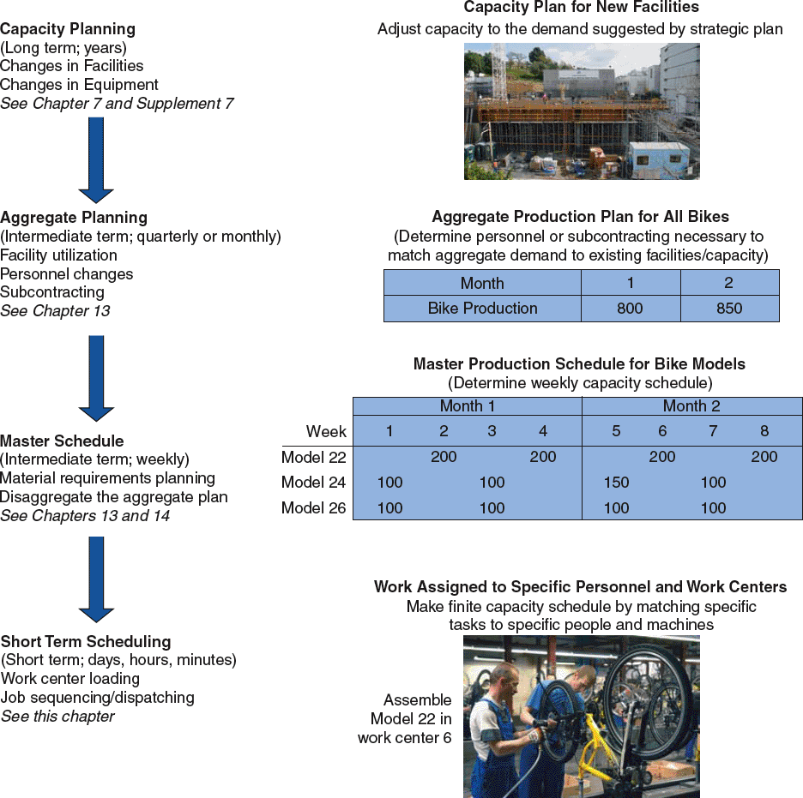
Scheduling Flow
Figure 15.1

Slide 16
Forward and Backward Scheduling
Forward scheduling starts as soon as the requirements are known
Produces a feasible schedule though it may not meet due dates
Frequently results in
buildup of work-in-
process inventory
Now
Due Date

Slide 17
Forward and Backward Scheduling
Backward scheduling begins with the due date and schedules the final operation first
Schedule is produced by working backwards though the processes
Resources may not
be available to
accomplish the
schedule
Now
Due Date

Slide 18
Forward and Backward Scheduling
Backward scheduling begins with the due date and schedules the final operation first
Schedule is produced by working backwards though the processes
Resources may not
be available to
accomplish the
schedule
Often these approaches are combined to develop a trade-off between capacity constraints and customer expectations
Now
Due Date

Slide 19
Finite and Infinite Loading
Assigning jobs to work stations
Finite loading assigns work up to the capacity of the work station
  All work gets done
  Due dates may be pushed out
Infinite loading does not consider capacity
  All due dates are met
  Capacities may have to be adjusted

Slide 20
Scheduling Criteria
Minimize completion time
Maximize utilization of facilities
Minimize work-in-process (WIP) inventory
Minimize customer waiting time

Slide 21
Different Processes/
Different Approaches
TABLE 15.2 | Different Processes Suggest Different Approaches to Scheduling
Process-focused facilities (job shops) Scheduling to customer orders where changes in both volume and variety of jobs/clients/patients are frequent Schedules are often due-date focused, with loading refined by finite loading techniques Examples: foundries, machine shops, cabinet shops, print shops, many restaurants, and the fashion industry
Repetitive facilities (assembly lines) Schedule module production and product assembly based on frequent forecasts Finite loading with a focus on generating a forward-looking schedule JIT techniques are used to schedule components that feed the assembly line Examples: assembly lines for washing machines at Whirlpool and automobiles at Ford.

Slide 22
Different Processes/
Different Approaches
TABLE 15.2 | Different Processes Suggest Different Approaches to Scheduling
Product-focused facilities (continuous) Schedule high volume finished products of limited variety to meet a reasonably stable demand within existing fixed capacity Finite loading with a focus on generating a forward-looking schedule that can meet known setup and run times for the limited range of products Examples: huge paper machines at International Paper, beer in a brewery at Anheuser-Busch, and potato chips at Frito-Lay

Slide 23
Focus for Different
Process Strategies
Process-focused
(job shops)
Repetitive facilities (assemble lines)
Product-focused
(continuous)
Number of inputs
Schedule orders
Typical focus of the master production schedule
Schedule modules
Number of end items
Schedule finished product
Examples: Print shop Motorcycles Steel, Beer, Bread
Machine shop Autos, TVs Lightbulbs
Fine-dining restaurant Fast-food restaurant Paper

Slide 24
Scheduling Process-Focused Facilities
High-variety, low volume
Production differ considerably
Schedule incoming orders without violating capacity constraints
Scheduling can be complex

Slide 25
Loading Jobs
Assign jobs so that costs, idle time, or completion time are minimized
Two forms of loading
    Capacity oriented
    Assigning specific jobs to work centers

Slide 26
Input-Output Control
Identifies overloading and underloading conditions
Prompts managerial action to resolve scheduling problems
Can be maintained using ConWIP cards that control the scheduling of batches

Slide 27
Input-Output Control Example
Figure 15.2
Work Center DNC Milling (in standard hours)
Week Ending | 6/6 | 6/13 | 6/20 | 6/27 | 7/4 | 7/11
Planned Input | 280 | 280 | 280 | 280 | 280
Actual Input | 270 | 250 | 280 | 285 | 280
Cumulative Deviation | –10 | –40 | –40 | –35
Planned Output | 320 | 320 | 320 | 320
Actual Output | 270 | 270 | 270 | 270
Cumulative Deviation | –50 | –100 | –150 | –200
Cumulative Change in Backlog | 0 | –20 | –10 | +5

Slide 28
Input-Output Control Example
Figure 15.2
Work Center DNC Milling (in standard hours)
Week Ending | 6/6 | 6/13 | 6/20 | 6/27 | 7/4 | 7/11
Planned Input | 280 | 280 | 280 | 280 | 280
Actual Input | 270 | 250 | 280 | 285 | 280
Cumulative Deviation | –10 | –40 | –40 | –35
Explanation:
270 input,
270 output implies
0 change
Planned Output | 320 | 320 | 320 | 320
Actual Output | 270 | 270 | 270 | 270
Cumulative Deviation | –50 | –100 | –150 | –200
Explanation:
250 input,
270 output implies
–20 change
Cumulative Change in Backlog | 0 | –20 | –10 | +5

Slide 29
Input-Output Control Example
Options available to operations personnel include:
Correcting performances
Increasing capacity
Increasing or reducing input to the work center

Slide 30
Gantt Charts
Load chart shows the loading and idle times of departments, machines, or facilities
Displays relative workloads over time
Schedule chart monitors jobs in process
All Gantt charts need to be updated frequently to account for changes

Slide 31
Gantt Load Chart Example
Figure 15.3
Work Center
Day
Monday
Tuesday
Wednesday
Thursday
Friday
Metalworks
Job 349
Job 350
Mechanical
Job 349
Job 408
Electronics
Job 408
Job 349
Painting
Job 295
Job 408
Job 349
Processing
Unscheduled
Center not available

Slide 32
Gantt Schedule Chart Example
Figure 15.4
Start of an activity
Job | Day 1 | Day 2 | Day 3 | Day 4 | Day 5 | Day 6 | Day 7 | Day 8
A
B
C
End of an activity
Scheduled activity time allowed
Maintenance
Actual work progress
Nonproduction time
Point in time when chart is reviewed
Now

Slide 33
Assignment Method
A special class of linear programming models that assigns tasks or jobs to resources
Objective is to minimize cost or time
Only one job (or worker) is assigned to one machine (or project)

Slide 34
Assignment Method
Build a table of costs or time associated with particular assignments
 | TYPESETTER
JOB | A | B | C
R-34 | $11 | $14 | $ 6
S-66 | $ 8 | $10 | $11
T-50 | $ 9 | $12 | $ 7

Slide 35
Assignment Method
Create zero opportunity costs by repeatedly subtracting the lowest costs from each row and column
Draw the minimum number of vertical and horizontal lines necessary to cover all the zeros in the table. If the number of lines equals either the number of rows or the number of columns, proceed to step 4. Otherwise proceed to step 3.

Slide 36
Assignment Method
Subtract the smallest number not covered by a line from all other uncovered numbers. Add the same number to any number at the intersection of two lines. Return to step 2.
Optimal assignments are at zero locations in the table. Select one, draw lines through the row and column involved, and continue to the next assignment.

Slide 37
Assignment Example
Typesetter
A B C
Job
R-34 $11 $14 $ 6
S-66 $ 8 $10 $11
T-50 $ 9 $12 $ 7
Step 1a - Rows
Step 1b - Columns
Typesetter
Typesetter
A B C
Job
R-34 $ 5 $ 8 $ 0
S-66 $ 0 $ 2 $ 3
T-50 $ 2 $ 5 $ 0
A B C
Job
R-34 $ 5 $ 6 $ 0
S-66 $ 0 $ 0 $ 3
T-50 $ 2 $ 3 $ 0

Slide 38
Assignment Example
Step 2 - Lines
The smallest uncovered number is 2 so this is subtracted from all other uncovered numbers and added to numbers at the intersection of lines
Typesetter
A B C
Job
R-34 $ 5 $ 6 $ 0
S-66 $ 0 $ 0 $ 3
T-50 $ 2 $ 3 $ 0
Step 3 - Subtraction
Typesetter
Smallest uncovered number
A B C
Job
R-34 $ 3 $ 4 $ 0
S-66 $ 0 $ 0 $ 5
T-50 $ 0 $ 1 $ 0
Because only two lines are needed to cover all the zeros, the solution is not optimal

Slide 39
Assignment Example
Step 2 - Lines
Start by assigning R-34 to worker C as this is the only possible assignment for worker C.
Typesetter
A B C
Job
R-34 $ 3 $ 4 $ 0
S-66 $ 0 $ 0 $ 5
T-50 $ 0 $ 1 $ 0
Job T-50 must go to worker A as worker C is already assigned. This leaves S-66 for worker B.
Step 4 - Assignments
Typesetter
Because three lines are needed, the solution is optimal and assignments can be made
A B C
Job
R-34 $ 3 $ 4 $ 0
S-66 $ 0 $ 0 $ 5
T-50 $ 0 $ 1 $ 0

Slide 40
Assignment Example
Typesetter
Typesetter
A B C
Job
R-34 $11 $14 $ 6
S-66 $ 8 $10 $11
T-50 $ 9 $12 $ 7
A B C
Job
R-34 $ 3 $ 4 $ 0
S-66 $ 0 $ 0 $ 5
T-50 $ 0 $ 1 $ 0
From the original cost table
Minimum cost = $6 + $10 + $9 = $25

Slide 41
Sequencing Jobs
Specifies the order in which jobs should be performed at work centers
Priority rules are used to dispatch or sequence jobs
  FCFS: First come, first served
  SPT: Shortest processing time
  EDD: Earliest due date
  LPT: Longest processing time

Slide 42
Sequencing Example
Apply the four popular sequencing rules to these five jobs
Job | Job Work (Processing) Time (Days) | Job Due Date (Days)
A | 6 | 8
B | 2 | 6
C | 8 | 18
D | 3 | 15
E | 9 | 23

Slide 43
Sequencing Example
FCFS: Sequence A-B-C-D-E
Job Sequence | Job Work (Processing) Time |  |  | Flow Time |  |  | Job Due Date | Job Lateness
A |  | 6 |  |  | 6 |  | 8 |  | 0
B |  | 2 |  |  | 8 |  | 6 |  | 2
C |  | 8 |  |  | 16 |  | 18 |  | 0
D |  | 3 |  |  | 19 |  | 15 |  | 4
E |  | 9 |  |  | 28 |  | 23 |  | 5
 |  | 28 |  |  | 77 |  |  |  | 11

Slide 44
Sequencing Example
FCFS: Sequence A-B-C-D-E
Sum of total flow time
Number of jobs
Average completion time = = 77/5 = 15.4 days
Total job work time
Sum of total flow time
Utilization metric = = 28/77 = 36.4%
Average number of jobs in the system
Sum of total flow time
Total job work time
= = 77/28 = 2.75 jobs
Total late days
Number of jobs
Average job lateness = = 11/5 = 2.2 days

Slide 45
Sequencing Example
SPT: Sequence B-D-A-C-E
Job Sequence | Job Work (Processing) Time |  |  | Flow Time |  |  | Job Due Date | Job Lateness
B |  | 2 |  |  | 2 |  | 6 |  | 0
D |  | 3 |  |  | 5 |  | 15 |  | 0
A |  | 6 |  |  | 11 |  | 8 |  | 3
C |  | 8 |  |  | 19 |  | 18 |  | 1
E |  | 9 |  |  | 28 |  | 23 |  | 5
 |  | 28 |  |  | 65 |  |  |  | 9

Slide 46
Sequencing Example
SPT: Sequence B-D-A-C-E
Sum of total flow time
Number of jobs
Average completion time = = 65/5 = 13 days
Total job work time
Sum of total flow time
Utilization metric = = 28/65 = 43.1%
Average number of jobs in the system
Sum of total flow time
Total job work time
= = 65/28 = 2.32 jobs
Total late days
Number of jobs
Average job lateness = = 9/5 = 1.8 days

Slide 47
Sequencing Example
EDD: Sequence B-A-D-C-E
Job Sequence | Job Work (Processing) Time |  |  | Flow Time |  |  | Job Due Date | Job Lateness
B |  | 2 |  |  | 2 |  | 6 |  | 0
A |  | 6 |  |  | 8 |  | 8 |  | 0
D |  | 3 |  |  | 11 |  | 15 |  | 0
C |  | 8 |  |  | 19 |  | 18 |  | 1
E |  | 9 |  |  | 28 |  | 23 |  | 5
 |  | 28 |  |  | 68 |  |  |  | 6

Slide 48
Sequencing Example
EDD: Sequence B-A-D-C-E
Sum of total flow time
Number of jobs
Average completion time = = 68/5 = 13.6 days
Total job work time
Sum of total flow time
Utilization metric = = 28/68 = 41.2%
Average number of jobs in the system
Sum of total flow time
Total job work time
= = 68/28 = 2.43 jobs
Total late days
Number of jobs
Average job lateness = = 6/5 = 1.2 days

Slide 49
Sequencing Example
LPT: Sequence E-C-A-D-B
Job Sequence | Job Work (Processing) Time |  |  | Flow Time |  |  | Job Due Date | Job Lateness
E |  | 9 |  |  | 9 |  | 23 |  | 0
C |  | 8 |  |  | 17 |  | 18 |  | 0
A |  | 6 |  |  | 23 |  | 8 |  | 15
D |  | 3 |  |  | 26 |  | 15 |  | 11
B |  | 2 |  |  | 28 |  | 6 |  | 22
 |  | 28 |  |  | 103 |  |  |  | 48

Slide 50
Sequencing Example
LPT: Sequence E-C-A-D-B
Sum of total flow time
Number of jobs
Average completion time = = 103/5 = 20.6 days
Total job work time
Sum of total flow time
Utilization metric = = 28/103 = 27.2%
Average number of jobs in the system
Sum of total flow time
Total job work time
= = 103/28 = 3.68 jobs
Total late days
Number of jobs
Average job lateness = = 48/5 = 9.6 days

Slide 51
Sequencing Example
Summary of Rules
Rule | Average Completion Time (Days) | Utilization Metric (%) | Average Number of Jobs in System | Average Lateness (Days)
FCFS | 15.4 | 36.4 | 2.75 | 2.2
SPT | 13.0 | 43.1 | 2.32 | 1.8
EDD | 13.6 | 41.2 | 2.43 | 1.2
LPT | 20.6 | 27.2 | 3.68 | 9.6

Slide 52
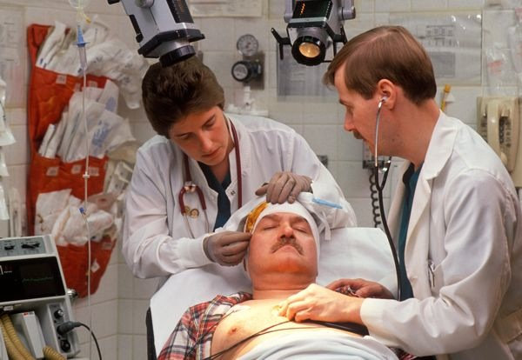
Comparison of
Sequencing Rules
No one sequencing rule excels on all criteria
SPT does well on minimizing flow time and number of jobs in the system
  But SPT moves long jobs to
  the end which may result
  in dissatisfied customers
FCFS does not do especially
well (or poorly) on any
criteria but is perceived
as fair by customers
EDD minimizes maximum
lateness

Slide 53
Critical Ratio (CR)
An index number found by dividing the time remaining until the due date by the work time remaining on the job
Jobs with low critical ratios are scheduled ahead of jobs with higher critical ratios
Performs well on average job lateness criteria
Time remaining
Workdays remaining
Due date – Today’s date
Work (lead) time remaining
CR = =

Slide 54
Critical Ratio Example
Currently Day 25
JOB | DUE DATE | WORKDAYS REMAINING
A | 30 | 4
B | 28 | 5
C | 27 | 2
JOB | CRITICAL RATIO | PRIORITY ORDER
A | (30 - 25)/4 = 1.25 | 3
B | (28 - 25)/5 = .60 | 1
C | (27 - 25)/2 = 1.00 | 2
With CR < 1, Job B is late. Job C is just on schedule and Job A has some slack time.

Slide 55
Critical Ratio Technique
Helps determine the status of specific jobs
Establishes relative priorities among jobs on a common basis
Adjusts priorities automatically for changes in both demand and job progress
Dynamically tracks job progress

Slide 56
Sequencing N Jobs on Two Machines: Johnson’s Rule
Works with two or more jobs that pass through the same two machines or work centers
Minimizes total production time and idle time
An N/2 problem, N number of jobs through 2 workstations

Slide 57
Johnson’s Rule
List all jobs and times for each work center
Choose the job with the shortest activity time. If that time is in the first work center, schedule the job first. If it is in the second work center, schedule the job last.
Once a job is scheduled, it is eliminated from the list
Repeat steps 2 and 3 working toward the center of the sequence

Slide 58
Johnson’s Rule Example
JOB | WORK CENTER 1 (DRILL PRESS) | WORK CENTER 2 (LATHE)
A | 5 | 2
B | 3 | 6
C | 8 | 4
D | 10 | 7
E | 7 | 12

Slide 59
Johnson’s Rule Example
JOB | WORK CENTER 1 (DRILL PRESS) | WORK CENTER 2 (LATHE)
A | 5 | 2
B | 3 | 6
C | 8 | 4
D | 10 | 7
E | 7 | 12
B
E
D
C
A

Slide 60
Johnson’s Rule Example
JOB | WORK CENTER 1 (DRILL PRESS) | WORK CENTER 2 (LATHE)
A | 5 | 2
B | 3 | 6
C | 8 | 4
D | 10 | 7
E | 7 | 12
B
E
D
C
A
Time 0 3 10 20 28 33
WC 1
B
E
D
C
A
Idle
WC 2
Job completed

Slide 61
Johnson’s Rule Example
JOB | WORK CENTER 1 (DRILL PRESS) | WORK CENTER 2 (LATHE)
A | 5 | 2
B | 3 | 6
C | 8 | 4
D | 10 | 7
E | 7 | 12
B
E
D
C
A
Time 0 3 10 20 28 33
WC 1
B
E
D
C
A
Idle
WC 2
B
E
D
C
A
Time➔ 0 1 3 5 7 9 10 11 12 13 17 19 21 22 23 25 27 29 31 33 35
Job completed
B
E
D
C
A

Slide 62
Limitations of Rule-Based Dispatching Systems
Scheduling is dynamic and rules need to be revised to adjust to changes
Rules do not look upstream or downstream
Rules do not look beyond due dates

Slide 63
Finite Capacity Scheduling
Overcomes disadvantages of rule-based systems by providing an interactive, computer-based graphical system
May include rules and expert systems or simulation to allow real-time response to system changes
FCS allows the balancing of delivery needs and efficiency

Slide 64
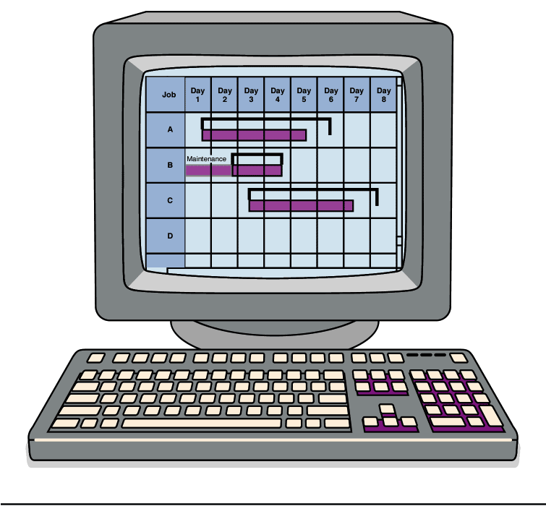
Finite Capacity Scheduling
Planning Data
Master schedule
BOM
Inventory
Interactive Finite Capacity Scheduling
Routing files
Work center information
Tooling and other resources
Priority rules
Expert systems
Simulation models
Setups and run time
Figure 15.5

Slide 65
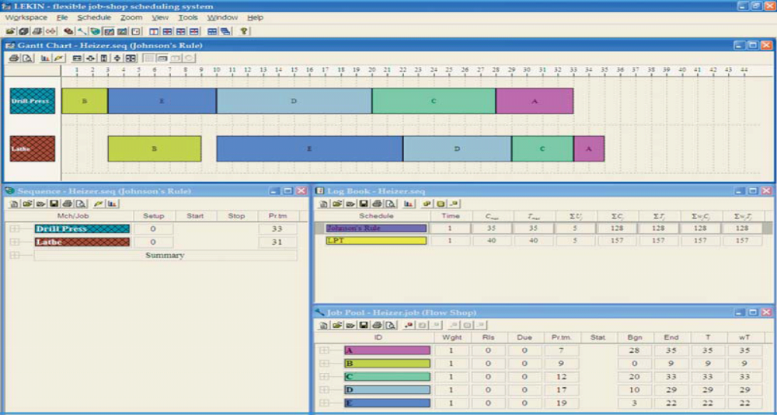
Finite Capacity Scheduling
Figure 15.6

Slide 66
Scheduling Services
Service systems differ from manufacturing
MANUFACTURING | SERVICES
Schedules machines and materials | Schedule staff
Inventories used to smooth demand | Seldom maintain inventories
Machine-intensive and demand may be smooth | Labor-intensive and demand may be variable
Scheduling may be bound by union contracts | Legal issues may constrain flexible scheduling
Few social or behavioral issues | Social and behavioral issues may be quite important

Slide 67
Scheduling Services
Hospitals have complex scheduling system to handle complex processes and material requirements
Banks use a cross-trained and flexible workforce and part-time workers
Retail stores use scheduling optimization systems that track sales, transactions, and customer traffic to create work schedules in less time and with improved customer satisfaction

Slide 68
Scheduling Services
Airlines must meet complex FAA and union regulations and often use linear programming to develop optimal schedules
24/7 operations like police/fire departments, emergency hot lines, and mail order businesses use flexible workers and variable schedules, often created using computerized systems

Slide 69
Scheduling Service Employees With Cyclical Scheduling
Objective is to meet staffing requirements with the minimum number of workers
Schedules need to be smooth and keep personnel happy
Many techniques exist from simple algorithms to complex linear programming solutions

Slide 70
Cyclical Scheduling Example
Determine the staffing requirements
Identify two consecutive days with the lowest total requirements and assign these as days off
Make a new set of requirements subtracting the days worked by the first employee
Apply step 2 to the new row
Repeat steps 3 and 4 until all requirements have been met

Slide 71
Cyclical Scheduling Example
DAY | M | T | W | T | F | S | S
Staff required | 5 | 5 | 6 | 5 | 4 | 3 | 3
 | M | T | W | T | F | S | S
Employee 1 | 5 | 5 | 6 | 5 | 4 | 3 | 3
Capacity (Employees)
Excess Capacity

Slide 72
Cyclical Scheduling Example
DAY | M | T | W | T | F | S | S
Staff required | 5 | 5 | 6 | 5 | 4 | 3 | 3
 | M | T | W | T | F | S | S
Employee 1 | 5 | 5 | 6 | 5 | 4 | 3 | 3
Employee 2 | 4 | 4 | 5 | 4 | 3 | 3 | 3
Capacity (Employees)
Excess Capacity

Slide 73
Cyclical Scheduling Example
DAY | M | T | W | T | F | S | S
Staff required | 5 | 5 | 6 | 5 | 4 | 3 | 3
 | M | T | W | T | F | S | S
Employee 1 | 5 | 5 | 6 | 5 | 4 | 3 | 3
Employee 2 | 4 | 4 | 5 | 4 | 3 | 3 | 3
Employee 3 | 3 | 3 | 4 | 3 | 2 | 3 | 3
Capacity (Employees)
Excess Capacity

Slide 74
Cyclical Scheduling Example
DAY | M | T | W | T | F | S | S
Staff required | 5 | 5 | 6 | 5 | 4 | 3 | 3
 | M | T | W | T | F | S | S
Employee 1 | 5 | 5 | 6 | 5 | 4 | 3 | 3
Employee 2 | 4 | 4 | 5 | 4 | 3 | 3 | 3
Employee 3 | 3 | 3 | 4 | 3 | 2 | 3 | 3
Employee 4 | 2 | 2 | 3 | 2 | 2 | 3 | 2
Capacity (Employees)
Excess Capacity

Slide 75
Cyclical Scheduling Example
DAY | M | T | W | T | F | S | S
Staff required | 5 | 5 | 6 | 5 | 4 | 3 | 3
 | M | T | W | T | F | S | S
Employee 1 | 5 | 5 | 6 | 5 | 4 | 3 | 3
Employee 2 | 4 | 4 | 5 | 4 | 3 | 3 | 3
Employee 3 | 3 | 3 | 4 | 3 | 2 | 3 | 3
Employee 4 | 2 | 2 | 3 | 2 | 2 | 3 | 2
Employee 5 | 1 | 1 | 2 | 2 | 2 | 2 | 1
Capacity (Employees)
Excess Capacity

Slide 76
Cyclical Scheduling Example
DAY | M | T | W | T | F | S | S
Staff required | 5 | 5 | 6 | 5 | 4 | 3 | 3
 | M | T | W | T | F | S | S
Employee 1 | 5 | 5 | 6 | 5 | 4 | 3 | 3
Employee 2 | 4 | 4 | 5 | 4 | 3 | 3 | 3
Employee 3 | 3 | 3 | 4 | 3 | 2 | 3 | 3
Employee 4 | 2 | 2 | 3 | 2 | 2 | 3 | 2
Employee 5 | 1 | 1 | 2 | 2 | 2 | 2 | 1
Employee 6 | 1 | 1 | 1 | 1 | 1 | 1 | 0
Capacity (Employees)
Excess Capacity

Slide 77
Cyclical Scheduling Example
DAY | M | T | W | T | F | S | S
Staff required | 5 | 5 | 6 | 5 | 4 | 3 | 3
 | M | T | W | T | F | S | S
Employee 1 | 5 | 5 | 6 | 5 | 4 | 3 | 3
Employee 2 | 4 | 4 | 5 | 4 | 3 | 3 | 3
Employee 3 | 3 | 3 | 4 | 3 | 2 | 3 | 3
Employee 4 | 2 | 2 | 3 | 2 | 2 | 3 | 2
Employee 5 | 1 | 1 | 2 | 2 | 2 | 2 | 1
Employee 6 | 1 | 1 | 1 | 1 | 1 | 1 | 0
Employee 7 |  |  |  |  |  | 1
Capacity (Employees) | 5 | 5 | 6 | 5 | 4 | 3 | 3
Excess Capacity | 0 | 0 | 0 | 0 | 0 | 1 | 0

