Slide 1
Chapter 16
JIT, TPS, and
Lean Operations

Slide 2
Outline
Global Company Profile:
Toyota Motor Corporation
Just-in-Time, the Toyota Production System, and Lean Operations
Just-in-Time (JIT)
Toyota Production System (TPS)
Lean Operations
Lean Operations in Services

Slide 3
Learning Objectives
When you complete this chapter you should be able to:
Define just-in-time, TPS, and lean operations
Define the seven wastes and the 5Ss
Explain JIT partnerships
Determine optimal setup time

Slide 4
Learning Objectives
When you complete this chapter you should be able to:
Define kanban
Compute the required number of kanbans
Explain the principles of the Toyota Production System

Slide 5
Toyota Motor Corporation
Largest vehicle manufacturer in the world with annual sales of over 9 million vehicles
Success due to two techniques, JIT and TPS
Continual problem solving is central to JIT
Eliminating excess inventory makes problems immediately evident

Slide 6
Toyota Motor Corporation
Central to TPS is employee learning and a continuing effort to produce products under ideal conditions
Respect for people is fundamental
Small building but high levels of production
Subassemblies are transferred to the assembly line on a JIT basis
High quality and low assembly time per vehicle

Slide 7
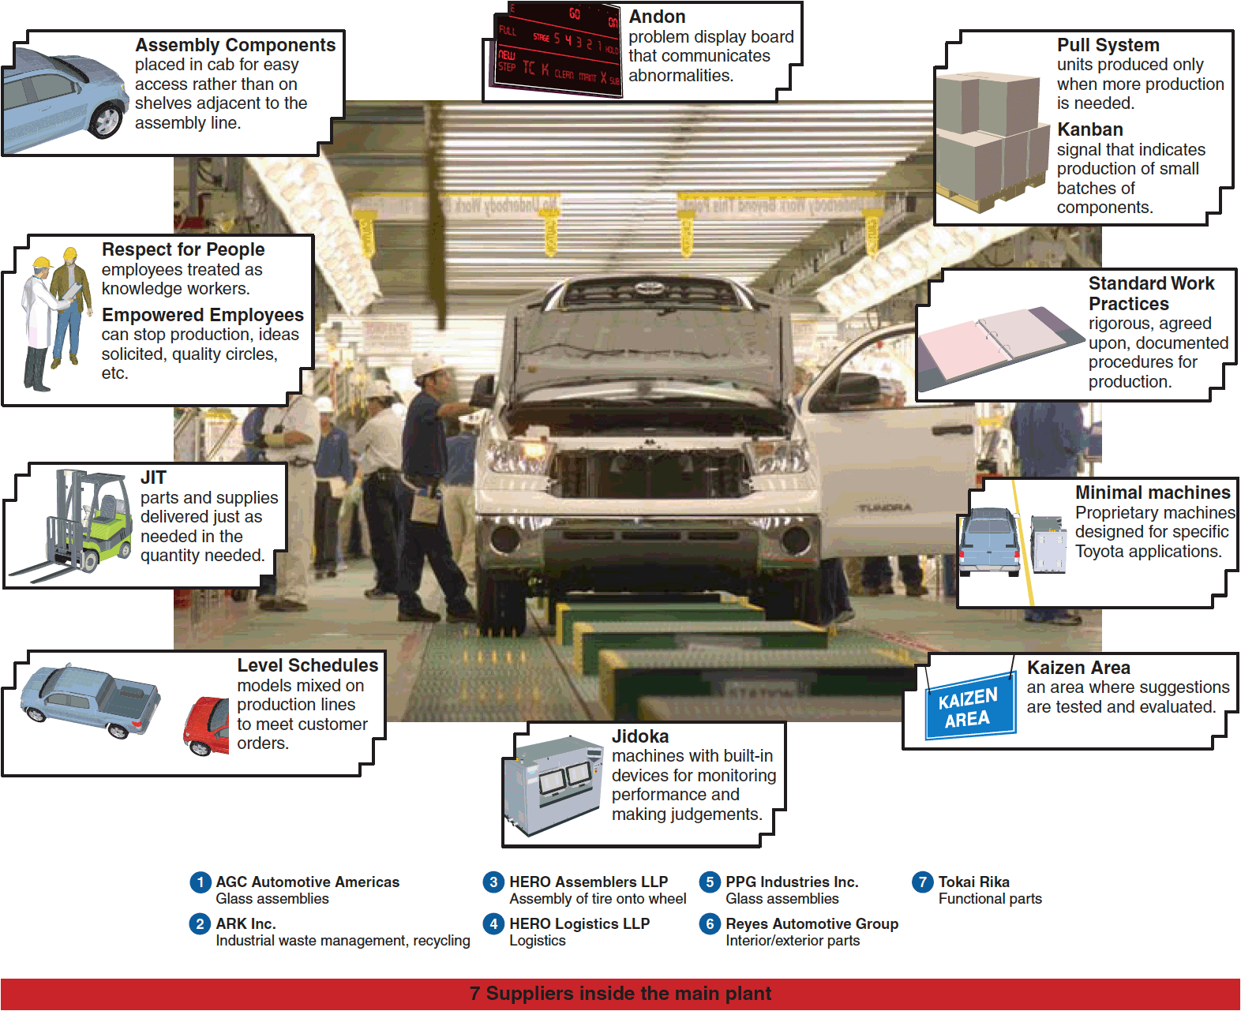
TPS Elements

Slide 8
JIT/TPS/Lean Operations
Good production systems require that managers address three issues that are pervasive and fundamental to operations management: eliminate waste, remove variability, and improve throughput

Slide 9
Just-In-Time, TPS, and
Lean Operations
JIT focuses on continuous forced problem solving
TPS emphasizes continuous improvement, respect for people, and standard work practices in an assembly-line environment
Lean operations emphasize understanding the customer

Slide 10
Eliminate Waste
Waste is anything that does not add value from the customer point of view
Storage, inspection, delay, waiting in queues, and defective products do not add value and are 100% waste

Slide 11
Ohno’s Seven Wastes
Overproduction
Queues
Transportation
Inventory
Motion
Overprocessing
Defective products

Slide 12
Eliminate Waste
Other resources such as energy, water, and air are often wasted
Efficient, sustainable production minimizes inputs, reduces waste
Traditional “housekeeping” has been expanded to the 5Ss

Slide 13
The 5Ss
Sort/segregate – when in doubt, throw it out
Simplify/straighten – methods analysis tools
Shine/sweep – clean daily
Standardize – remove variations from processes
Sustain/self-discipline – review work and recognize progress

Slide 14
The 5Ss
Sort/segregate – when in doubt, throw it out
Simplify/straighten – methods analysis tools
Shine/sweep – clean daily
Standardize – remove variations from processes
Sustain/self-discipline – review work and recognize progress
Two additional Ss
Safety – built in good practices
Support/maintenance – reduce variability and unplanned downtime

Slide 15
Remove Variability
JIT systems require managers to reduce variability caused by both internal and external factors
Variability is any deviation from the optimum process
Inventory hides variability
Less variability results in less waste

Slide 16
Sources of Variability
Poor production processes resulting in improper quantities, late, or non-conforming units
Unknown customer demands
Incomplete or inaccurate drawings, specifications, or bills of material

Slide 17
Sources of Variability
Poor production processes resulting in improper quantities, late, or non-conforming units
Unknown customer demands
Incomplete or inaccurate drawings, specifications, or bills of material
Both JIT and inventory reduction are effective tools in identifying causes of variability

Slide 18
Improve Throughput
The time it takes to move an order from receipt to delivery
The time between the arrival of raw materials and the shipping of the finished order is called manufacturing cycle time
A pull system increases throughput

Slide 19
Improve Throughput
By pulling material in small lots, inventory cushions are removed, exposing problems and emphasizing continual improvement
Manufacturing cycle time is reduced
Push systems dump orders on the downstream stations regardless of the need

Slide 20
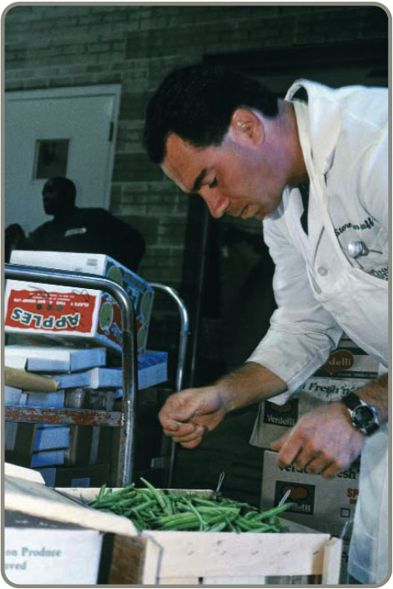
Just-In-Time (JIT)
Powerful strategy for improving operations
Materials arrive where they
are needed when they are
needed
Identifying problems and
driving out waste reduces
costs and variability and
improves throughput
Requires a meaningful
buyer-supplier relationship

Slide 21
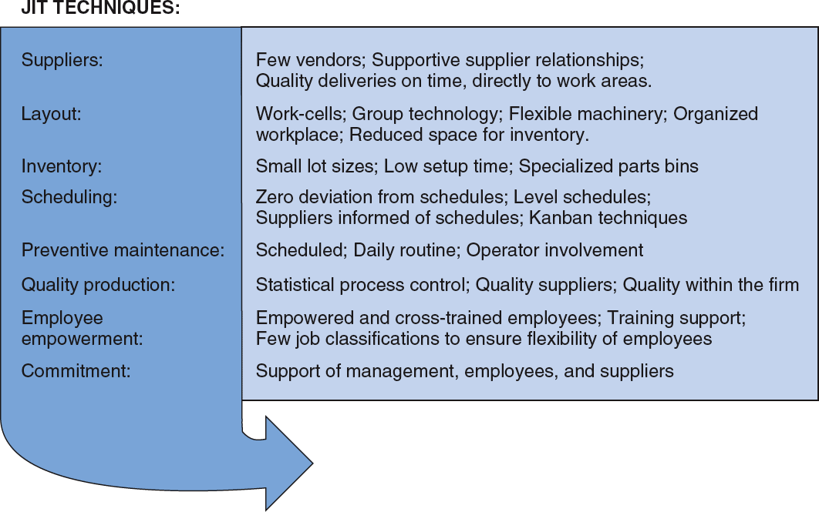
JIT and Competitive Advantage
Figure 16.1

Slide 22
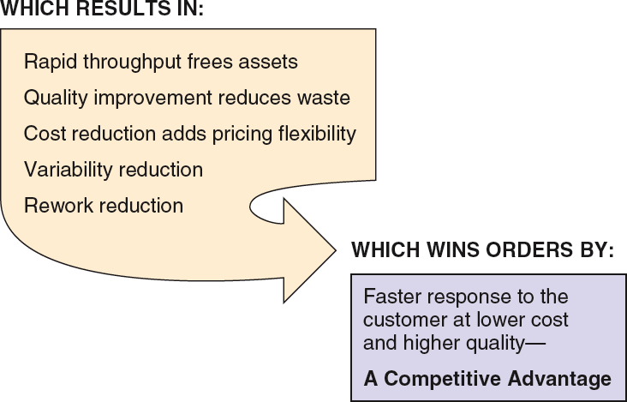
JIT and Competitive Advantage
Figure 16.1

Slide 23
JIT Partnerships
JIT partnerships exist when a supplier and purchaser work together to remove waste and drive down costs
Four goals of JIT partnerships are:
  Removal of unnecessary activities
  Removal of in-plant inventory
  Removal of in-transit inventory
  Improved quality and reliability

Slide 24
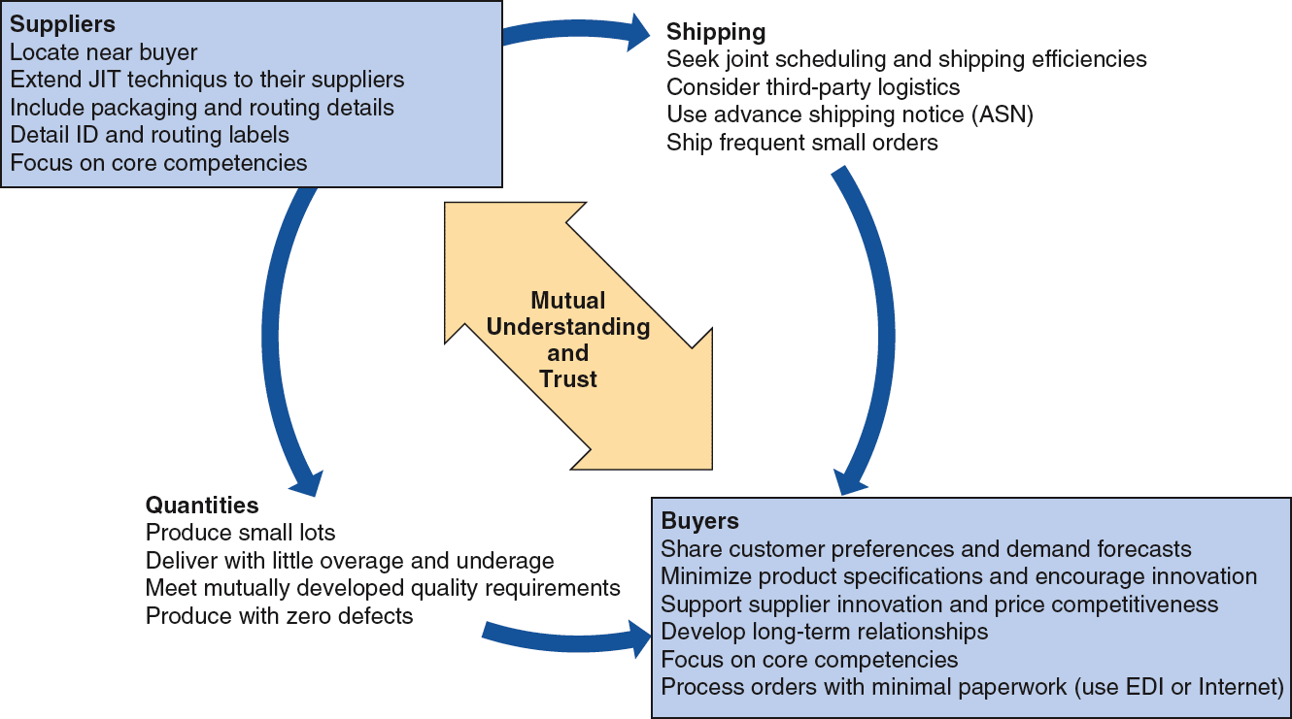
JIT Partnerships
Figure 16.2

Slide 25
Concerns of Suppliers
Diversification – ties to only one customer increases risk
Scheduling – don’t believe customers can create a smooth schedule
Lead time – short lead times mean engineering or specification changes can create problems
Quality – limited by capital budgets, processes, or technology
Lot sizes – small lot sizes may transfer costs to suppliers

Slide 26
JIT Layout
Reduce waste due to movement
TABLE 16.1
JIT LAYOUT TACTICS
Build work cells for families of products
Include a large number operations in a small area
Minimize distance
Design little space for inventory
Improve employee communication
Use poka-yoke devices
Build flexible or movable equipment
Cross-train workers to add flexibility

Slide 27
Distance Reduction
Large lots and long production lines with single-purpose machinery are being replaced by smaller flexible cells
Often U-shaped for shorter paths and improved communication
Often using group technology concepts

Slide 28
Increased Flexibility
Cells designed to be rearranged as volume or designs change
Applicable in office environments as well as production settings
Facilitates both product and process improvement

Slide 29
Impact on Employees
Employees may be cross trained for flexibility and efficiency
Improved communications facilitate the passing on of important information about the process
With little or no inventory buffer, getting it right the first time is critical

Slide 30
Reduced Space and Inventory
With reduced space, inventory must be in very small lots
Units are always moving because there is no storage

Slide 31
JIT Inventory
Inventory is at the minimum level necessary to keep operations running
TABLE 16.2
JIT INVENTORY TACTICS
Use a pull system to move inventory
Reduce lot sizes
Develop just-in-time delivery systems with suppliers
Deliver directly to point of use
Perform to schedule
Reduce setup time
Use group technology

Slide 32
Reduce Variability
Inventory level
Process downtime
Scrap
Setup time
Quality problems
Late deliveries
Figure 16.3

Slide 33
Reduce Variability
Inventory level
Process downtime
Scrap
Setup time
Quality problems
Late deliveries
Figure 16.3

Slide 34
Reduce Variability
Inventory level
No scrap
Quality problems removed
Setup time reduced
Process downtime removed
No late deliveries
Figure 16.3

Slide 35
Reduce Inventory
Reducing inventory uncovers the “rocks”
Problems are exposed
Ultimately there will
be virtually no
inventory and no
problems
Shingo says “Inventory is evil”
Inventory

Slide 36
Reduce Lot Sizes
Figure 16.4
200 –
100 –
Q₁ When average order size = 200
average inventory is 100
Inventory
Q₂ When average order size = 100
average inventory is 50
Time

Slide 37
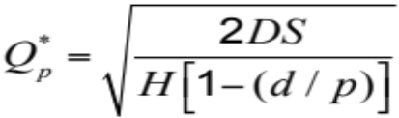
Reduce Lot Sizes
Ideal situation is to have lot sizes of one pulled from one process to the next
Often not feasible
Can use EOQ analysis to calculate desired setup time
Two key changes necessary
  Improve material handling
  Reduce setup time

Slide 38
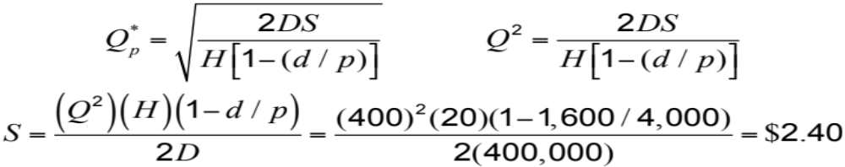
Lot Size Example
D = Annual demand = 400,000 units
d = Daily demand = 400,000/250 = 1,600 per day
p = Daily production rate = 4,000 units
Q = EOQ desired = 400
H = Holding cost = $20 per unit
S = Setup cost (to be determined)
Setup time = $2.40/($30/hour) = 0.08 hr = 4.8 minutes

Slide 39
Reduce Setup Costs
High setup costs encourage large lot sizes
Reducing setup costs reduces lot size and reduces average inventory
Setup time can be reduced through preparation prior to shutdown and changeover

Slide 40
Lower Setup Costs
Figure 16.5
Holding cost
Sum of ordering and holding costs
Cost
T₁
Setup cost curve (S₂)
T₂
Setup cost curve (S₁)
S₁
S₂
Lot size

Slide 41
Reduce Setup Costs
Figure 16.6
90 min —
Initial Setup Time
Separate setup into preparation and actual setup,
doing as much as possible while the
machine/process is operating
(save 30 minutes)
Step 1
60 min —
Move material closer and
improve material handling
(save 20 minutes)
Step 2
45 min —
Standardize and
improve tooling
(save 15 minutes)
Step 3
25 min —
Step 4
Use one-touch system to eliminate adjustments (save 10 minutes)
Training operators and standardizing work procedures (save 2 minutes)
15 min —
Step 5
13 min —
Step 6
Repeat cycle until subminute setup is achieved
—

Slide 42
JIT Scheduling
Schedules must be communicated inside and outside the organization
Level schedules
  Process frequent small batches
  Freezing the schedule helps stability
Kanban
  Signals used in a pull system

Slide 43
JIT Scheduling
Better scheduling improves performance
TABLE 16.3
JIT SCHEDULING TACTICS
Communicate schedules to suppliers
Make level schedules
Freeze part of the schedule
Perform to schedule
Seek one-piece-make and one-piece move
Eliminate waste
Produce in small lots
Use kanbans
Make each operation produce a perfect part

Slide 44
Level Schedules
Process frequent small batches rather than a few large batches
Make and move small lots so the level schedule is economical
Freezing the schedule closest to the due dates can improve performance

Slide 45
Scheduling Small Lots
Figure 16.7
JIT Level Material-Use Approach
A
A
B
B
B
C
A
A
B
B
B
C
Large-Lot Approach
A
A
A
A
A
A
B
B
B
B
B
B
B
B
B
C
C
C
Time

Slide 46
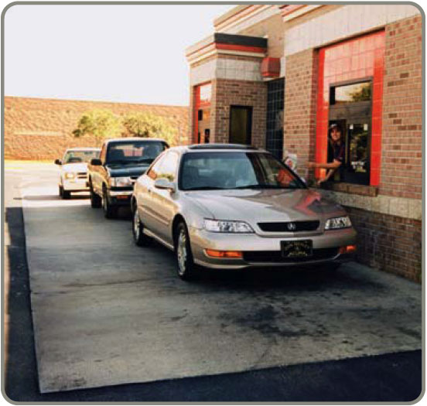
Kanban
Kanban is the Japanese word for card
The card is an authorization for the next container of material to be produced
A sequence of kanbans
pulls material through
the process
Many different sorts of
signals are used, but
the system is still called
a kanban

Slide 47
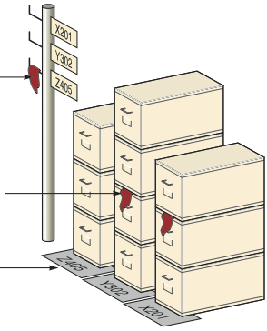
Kanban
Figure 16.8
Signal marker hanging on post for part Z405 shows that production should start for that part. The post is located so that workers in normal locations can easily see it.
Signal marker on stack of boxes
Part numbers mark location of specific part

Slide 48
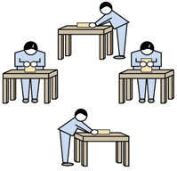
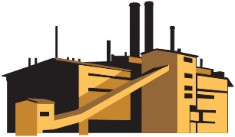
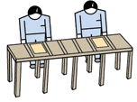


Kanban
Material/Parts Supplier
Final assembly
Finished goods
Customer order
Work cell
Kanban
Kanban
Kanban

Slide 49
More Kanban
When the producer and user are not in visual contact, a card can be used; otherwise, a light or flag or empty spot on the floor may be adequate
Usually each card controls a specific quantity or parts although multiple card systems may be used if there are several components or if the lot size is different from the move size

Slide 50
More Kanban
Kanban cards provide a direct control and limit on the amount of work-in-process between cells
If there is an intermediate storage area, a two-card system can be used with one card circulating between the user and storage area and the other between the storage area and the producing area

Slide 51
The Number of Kanban Cards or Containers
Need to know the lead time needed to produce a container of parts
Need to know the amount of safety stock needed
Demand during Safety
lead time + stock
Size of container
Number of kanbans
(containers)
=

Slide 52
Number of Kanbans Example
Daily demand = 500 cakes
Production lead time = 2 days
(Wait time +
Material handling time +
Processing time)
Safety stock = 1/2 day
Container size = 250 cakes
Demand during lead time = 2 days x 500 cakes = 1,000
Safety stock = ½ x Daily demand = 250
1,000 + 250
250
Number of kanbans = = 5

Slide 53
Advantages of Kanban
Small containers require tight schedules, smooth operations, little variability
Shortages create an immediate impact
Places emphasis on meeting schedules, reducing lead time and setups, and economic material handling
Standardized containers reduce weight, disposal costs, wasted space, and labor

Slide 54
JIT Quality
Strong relationship
  JIT cuts the cost of obtaining good quality because JIT exposes poor quality
  Because lead times are shorter, quality problems are exposed sooner
  Better quality means fewer buffers and allows simpler JIT systems to be used

Slide 55
JIT Quality Tactics
TABLE 16.4
JIT QUALITY TACTICS
Use statistical process control
Empower employees
Build fail-safe methods (poka-yoke, checklists, etc.)
Expose poor quality with small lot JIT
Provide immediate feedback

Slide 56
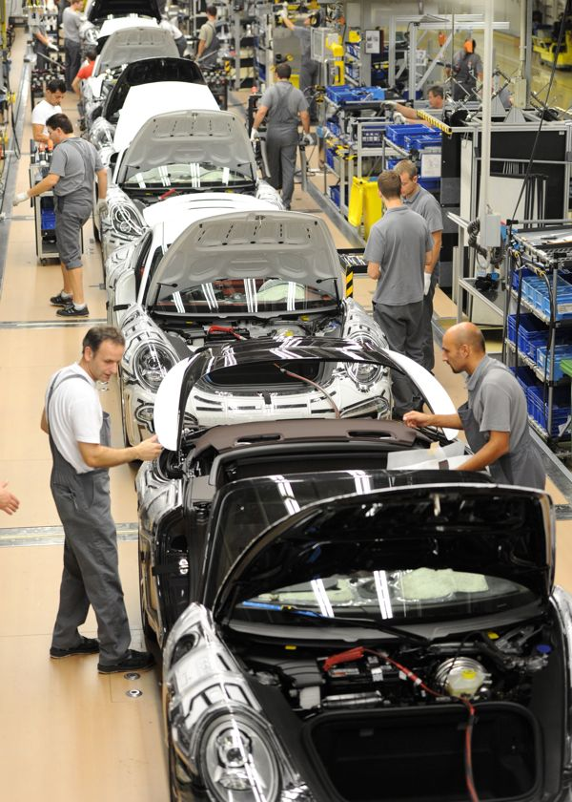
Toyota Production System
Continuous improvement
  Build an organizational culture and value system that stresses improvement of all processes, kaizen
  Part of everyone’s job
Respect for people
  People are treated as
  knowledge workers
  Engage mental and
  physical capabilities
  Empower employees

Slide 57
Toyota Production System
Continuous improvement
  Build an organizational culture and value system that stresses improvement of all processes, kaizen
  Part of everyone’s job
Respect for people
  People are treated as
  knowledge workers
  Engage mental and
  physical capabilities
  Empower employees

Slide 58
Toyota Production System
Standard work practice
  Work shall be completely specified as to content, sequence, timing, and outcome
  Internal and external customer-supplier connection are direct
  Product and service flows must be simple and direct
  Any improvement must be made in accordance with the scientific method at the lowest possible level of the organization

Slide 59
Lean Operations
Broader than JIT in that it is externally focused on the customer
Starts with understanding what the customer wants
Optimize the entire process from the customer’s perspective

Slide 60
Building a Lean Organization
Transitioning to a lean system can be difficult
Lean systems tend to have the following attributes
  Use JIT techniques
  Build systems that help employees produce perfect parts
  Reduce space requirements

Slide 61
Building a Lean Organization
Lean systems tend to have the following attributes
  Develop partnerships with suppliers
  Educate suppliers
  Eliminate all but value-added activities
  Develop employees
  Make jobs challenging
  Build worker flexibility

Slide 62
Lean Sustainability
Two sides of the same coin
Maximize resource use and economic efficiency
Focus on issues outside the immediate firm
Driving out waste is the common ground

Slide 63
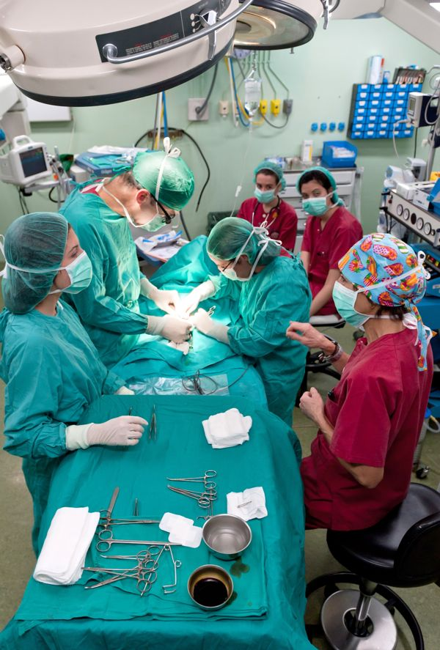
Lean Operations in Services
The JIT techniques
used in manufacturing
are used in services
  Suppliers
  Layouts
  Inventory
  Scheduling

