Slide 1
Understanding the Supply Chain
1

Slide 2
Course Code MGT 561
Supply Chain Management
Book: Supply Chain Management Strategy, Planning, and Operation
5th edition (Pearson Publishing)
Author: Sunil Chopra and Peter Meindl

Slide 3
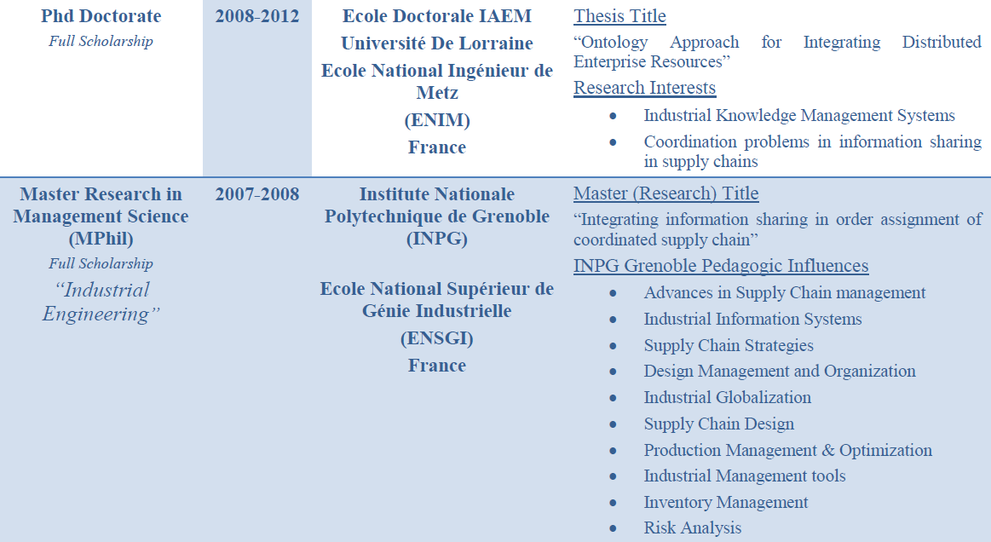

Slide 4
Course Strategic Outline
Building a strategic framework to analyze supply chains
Designing a supply chain networks
Planning and coordinating demand and supply in supply chain
Planning and managing inventories in a supply chain
Designing and planning transportation networks

Slide 5
Understanding the Supply Chain
1

Slide 6
Learning Objectives
Discuss the goal of a supply chain and explain the impact of supply chain decisions on the success of a firm.
Identify the three key supply chain decision phases and explain the significance of each one.
Describe the cycle and push/pull views of a supply chain.
Classify the supply chain macro processes in a firm.

Slide 7
What is a Supply Chain? (1/3)
All stages involved, directly or indirectly, in fulfilling a customer request
Includes manufacturers, suppliers, transporters, warehouses, retailers, and customers
Within each company, the supply chain includes all functions involved in fulfilling a customer request (product development, marketing, operations, distribution, finance, customer service)

Slide 8
What is a Supply Chain? (2/3)
Customer is an integral part of the supply chain
Includes movement of products from suppliers to manufacturers to distributors and information, funds, and products in both directions
May be more accurate to use the term “supply network” or “supply web”
Typical supply chain stages: customers, retailers, distributors, manufacturers, suppliers
All stages may not be present in all supply chains (e.g., no retailer or distributor for Dell)

Slide 9
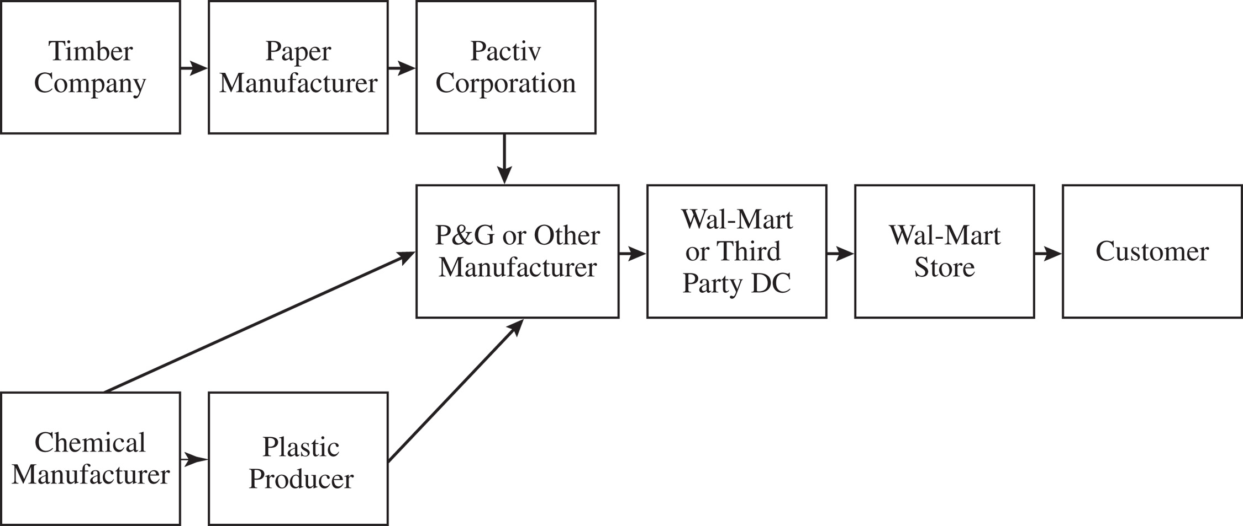
What is a Supply Chain? (3/3)
Figure 1-1 Stages of a detergent supply chain
Notes:
Notes:
Supply chain involves everybody, from the customer all the way to the last supplier.
Key flows in the supply chain are - information, product, and cash. It is through these flows that a supply chain fills a customer order. The management of these flows is key to the success or failure of a firm. Give Dell & Compaq example, Amazon & Borders example to bring out the fact that all supply chain interaction is through these flows.

Slide 10
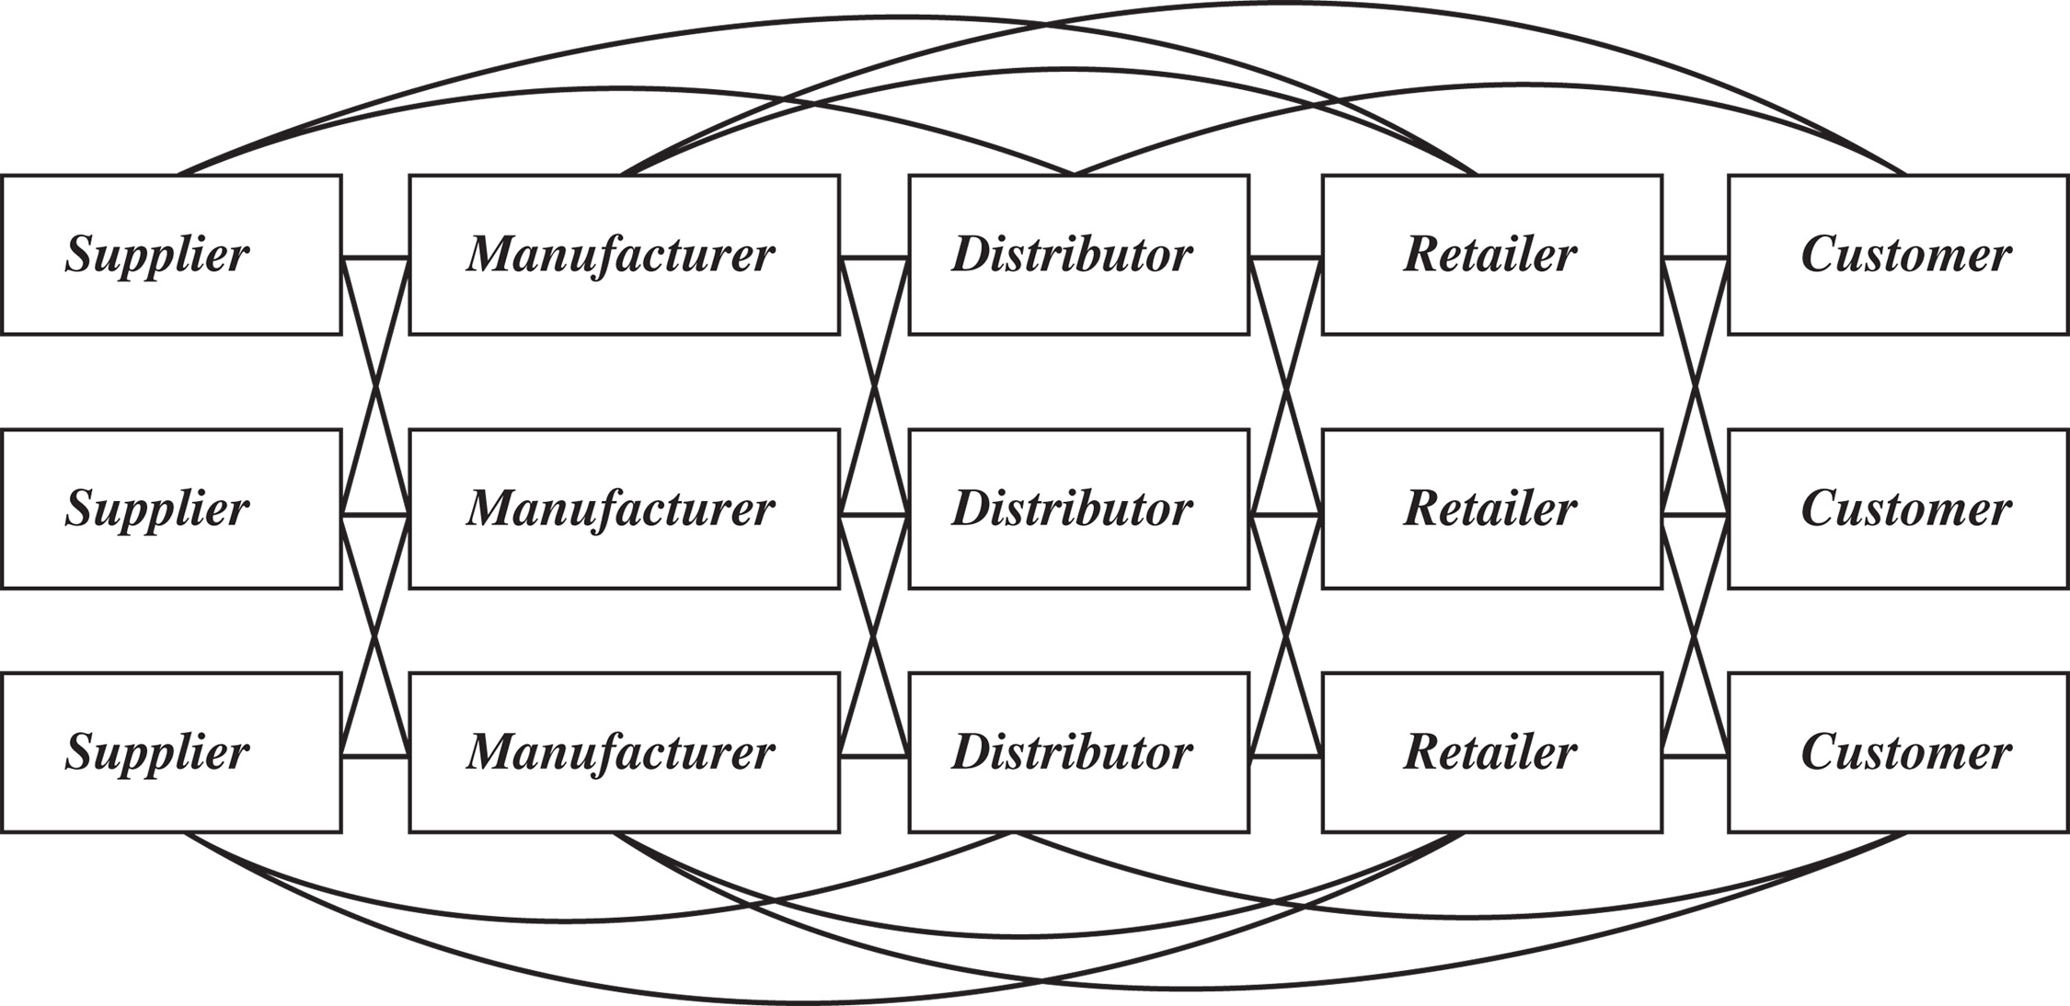
Flows in a Supply Chain
Figure 1-2 Supply chain stages

Slide 11
The Objective of a Supply Chain (1/3)
Maximize overall value created
Disaster supply chains
Supply Chain Surplus
= Customer Value – Supply Chain Cost

Slide 12
The Objective of a Supply Chain (2/3)
Example: a customer purchases a wireless router from Best Buy for $60 (revenue)
Supply chain incurs costs (information, storage, transportation, components, assembly, etc.)
Difference between $60 and the sum of all of these costs is the supply chain profit
Supply chain profitability is total profit to be shared across all stages of the supply chain
Success should be measured by total supply chain profitability, not profits at an individual stage

Slide 13
The Objective of a Supply Chain (3/3)
Customer the only source of revenue
Sources of cost include, flows of information, products, or funds between stages of the supply chain
Effective supply chain management is the management of flows between and among the supply chain stages to maximize total supply chain surplus

Slide 14
Importance of
Supply Chain Decisions – Cases
Wal-Mart, $1 billion sales in 1980 to $408 billion in 2010
Seven-Eleven Japan, ¥1 billion sales in 1974 to ¥3 trillion in 2009
Dell, $56 billion in 2006, adopted new supply chain strategies

Slide 15
Decision Phases of a Supply Chain
Supply chain strategy or design
  How to structure the supply chain over the next several years
Supply chain planning
  Decisions over the next quarter or year
Supply chain operation
  Daily or weekly operational decisions

Slide 16
Supply Chain Strategy or Design
Decisions about the structure of the supply chain and what processes each stage will perform
Strategic supply chain decisions
  Locations and capacities of facilities
  Products to be made or stored at various locations
  Modes of transportation
  Information systems
Supply chain design must support strategic objectives
Supply chain design decisions are long-term and expensive to reverse – must take into account market uncertainty

Slide 17
Supply Chain Planning (1/2)
Definition of a set of policies that govern short-term operations
Fixed by the supply configuration from previous phase
Starts with a forecast of demand in the coming year

Slide 18
Supply Chain Planning (2/2)
Planning decisions:
  Which markets will be supplied from which locations
  Planned buildup of inventories
  Subcontracting, backup locations
  Inventory policies
  Timing and size of market promotions
Must consider in planning decisions demand uncertainty, exchange rates, competition over the time horizon

Slide 19
Supply Chain Operation
Time horizon is weekly or daily
Decisions regarding individual customer orders
Supply chain configuration is fixed and operating policies are determined
Goal is to implement the operating policies as effectively as possible
Allocate orders to inventory or production, set order due dates, generate pick lists at a warehouse, allocate an order to a particular shipment, set delivery schedules, place replenishment orders
Much less uncertainty (short time horizon)

Slide 20
Process View of a Supply Chain
Cycle View: processes in a supply chain are divided into a series of cycles, each performed at the interfaces between two successive supply chain stages
Push/Pull View: processes in a supply chain are divided into two categories depending on whether they are executed in response to a customer order (pull) or in anticipation of a customer order (push)

Slide 21
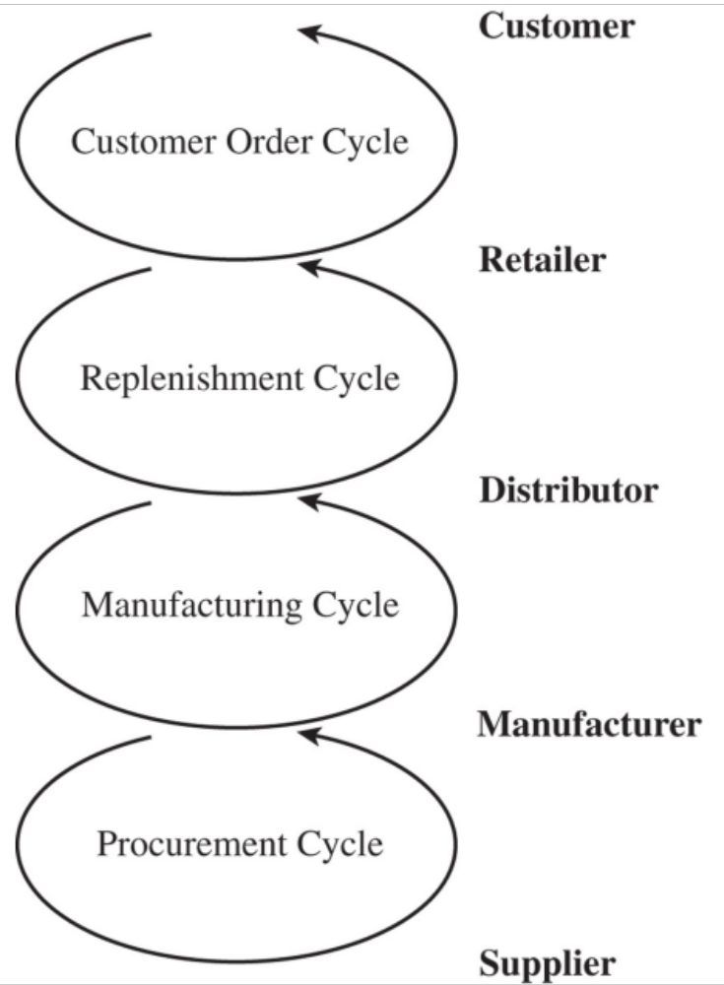
Cycle View of Supply
Chain Processes
Figure 1-3
Notes:
The supply chain is a concatenation of cycles with each cycle at the interface of two successive stages in the supply chain. Each cycle involves the customer stage placing an order and receiving it after it has been supplied by the supplier stage.
One difference is in size of order. Second difference is in predictability of orders - orders in the procurement cycle are predictable once manufacturing planning has been done.
This is the predominant view for ERP systems. It is a transaction level view and clearly defines each process and its owner.

Slide 22
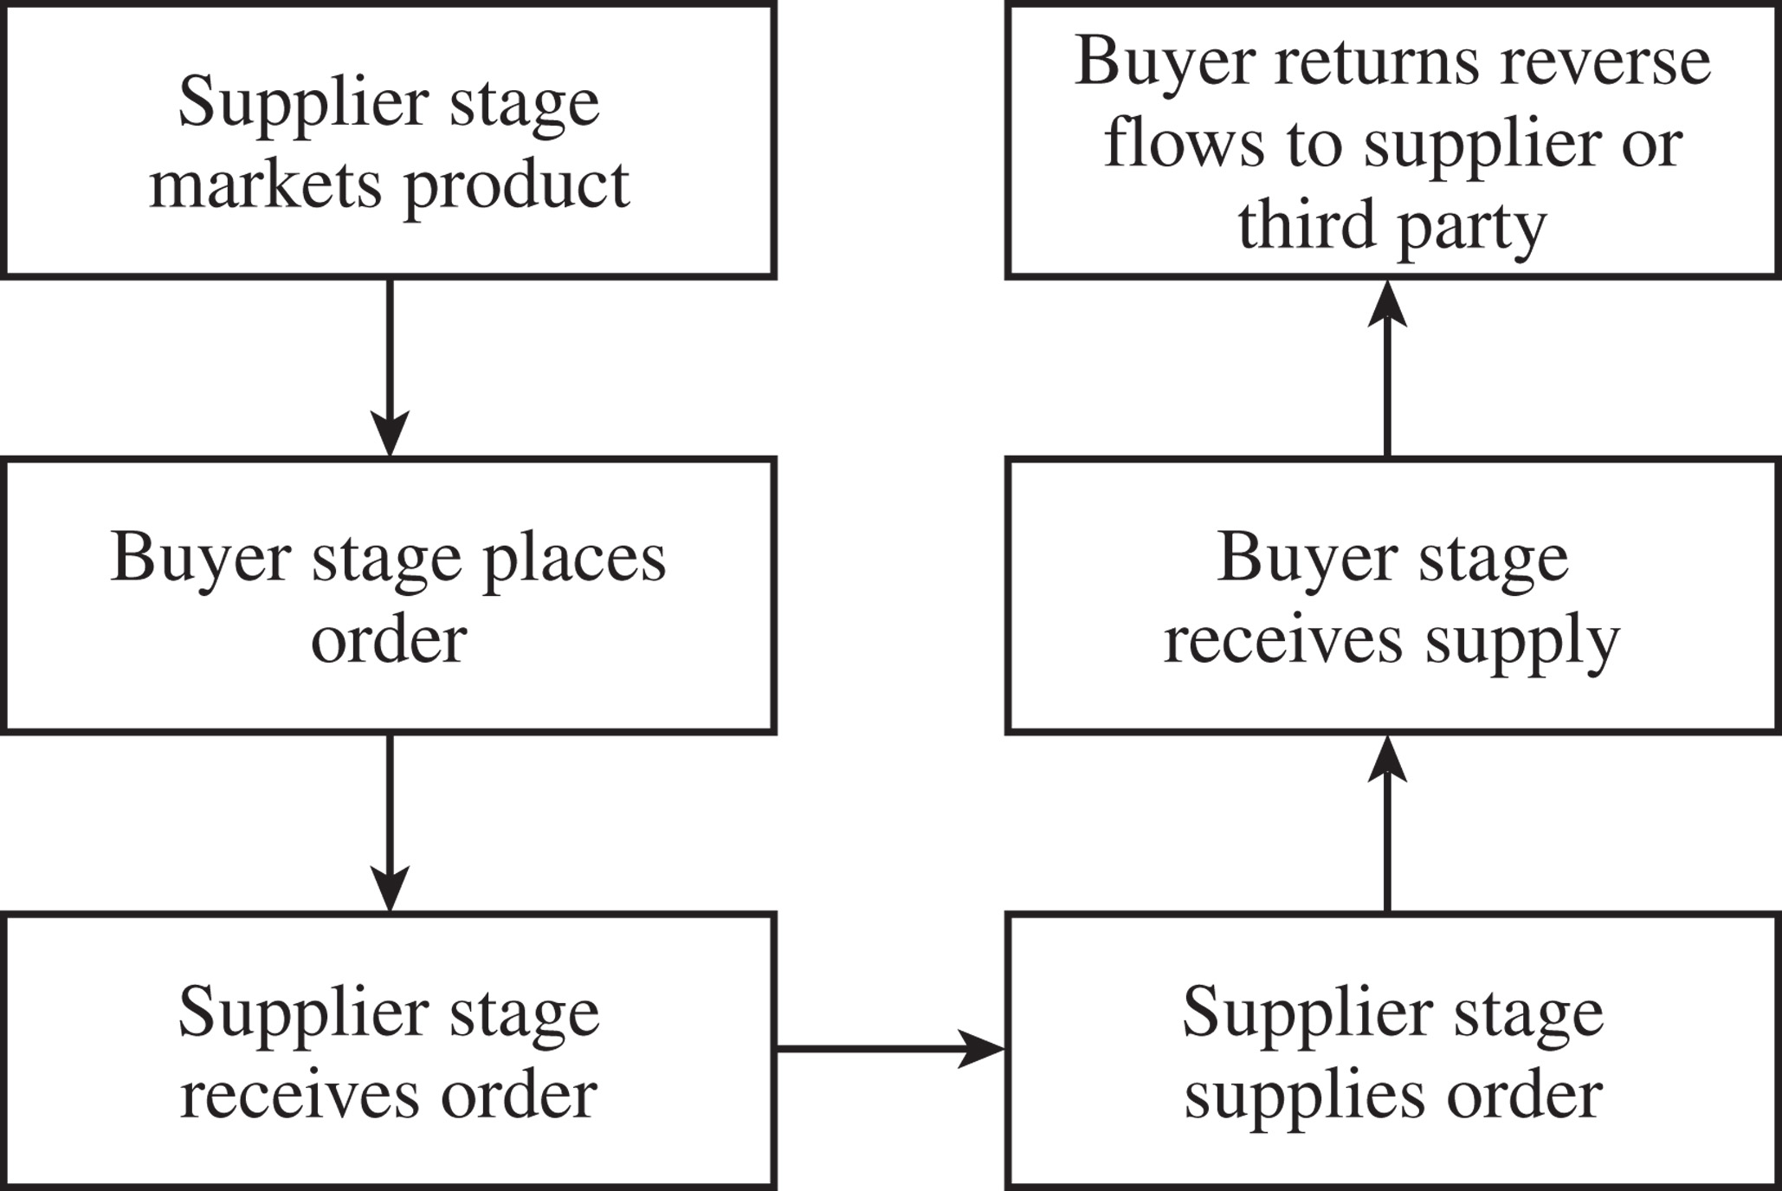
Cycle View of
Supply Chain Processes
Figure 1-4

Slide 23
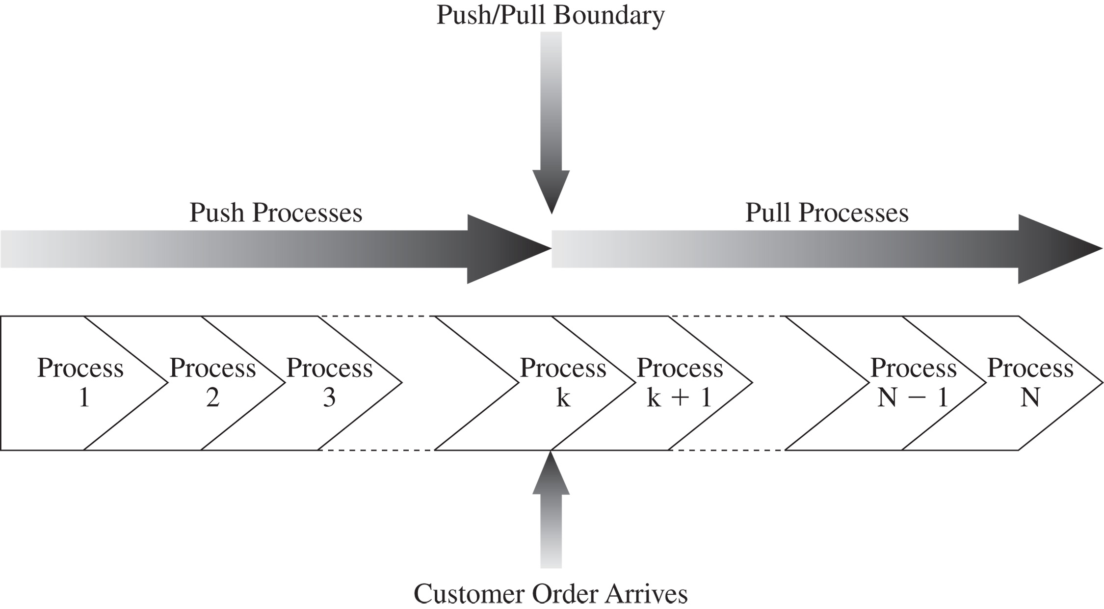
Push/Pull View of Supply Chains
Figure 1-5
Notes:
In this view processes are divided based on their timing relative to the timing of a customer order. Define push and pull processes.
They key difference is the uncertainty during the two phases.
Give examples at Amazon and Borders to illustrate the two views

Slide 24
Push/Pull View of
Supply Chain Processes
Supply chain processes fall into one of two categories depending on the timing of their execution relative to customer demand
Pull: execution is initiated in response to a customer order (reactive)
Push: execution is initiated in anticipation of customer orders (speculative)
Push/pull boundary separates push processes from pull processes

Slide 25
Push/Pull View of
Supply Chain Processes
Useful in considering strategic decisions relating to supply chain design – more global view of how supply chain processes relate to customer orders
The relative proportion of push and pull processes can have an impact on supply chain performance

Slide 26
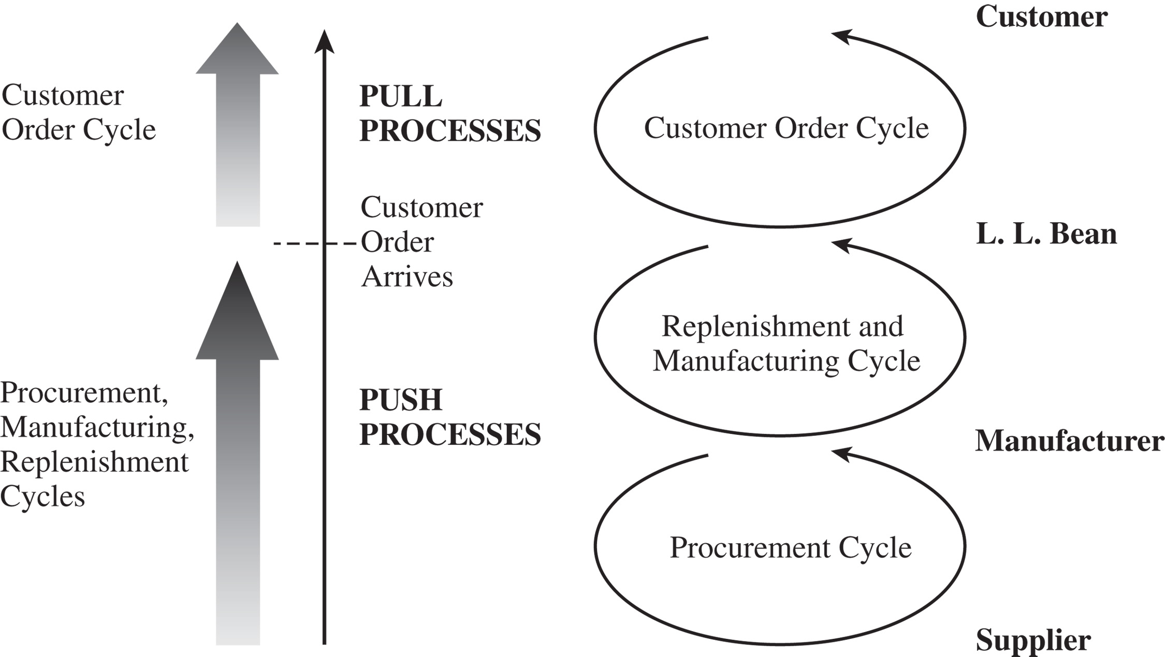
Push/Pull View of – L.L. Bean
Figure 1-6

Slide 27
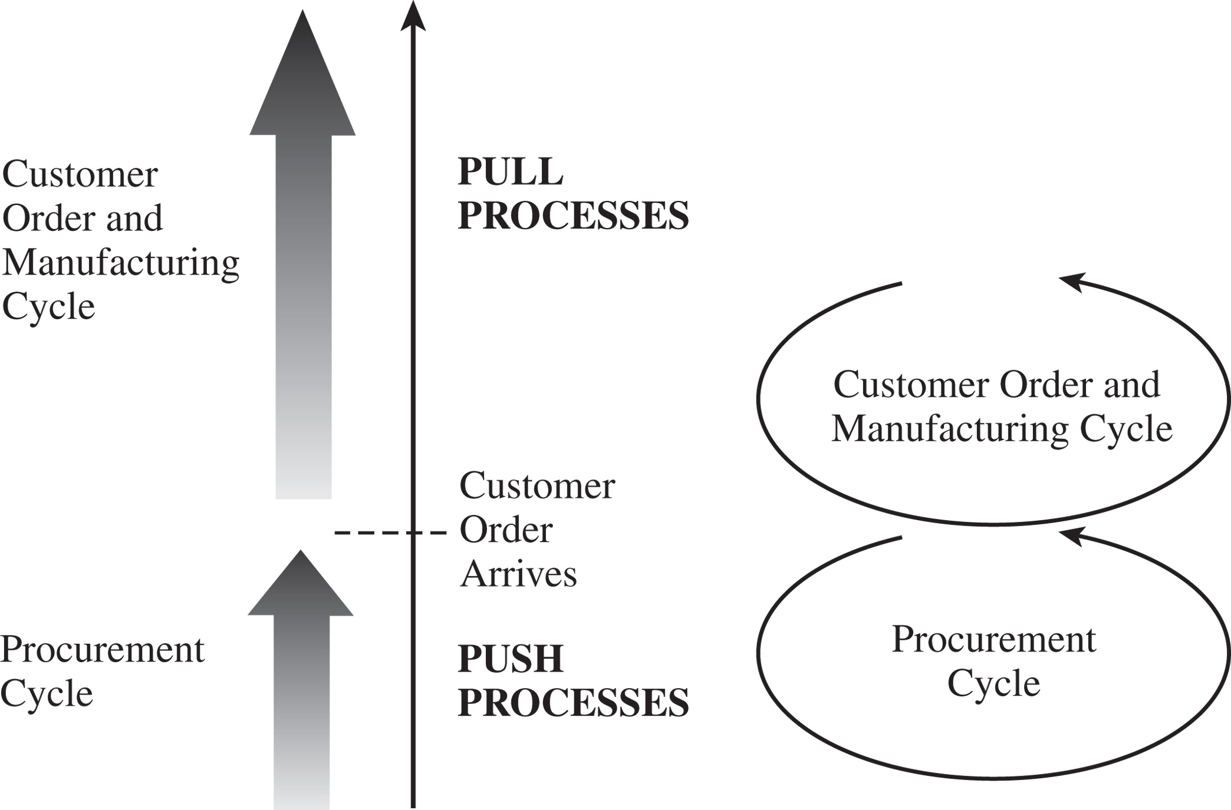
Push/Pull View – Dell
Figure 1-7

Slide 28
Supply Chain Macro Processes
Supply chain processes discussed in the two views can be classified into
  Customer Relationship Management (CRM)
  Internal Supply Chain Management (ISCM)
  Supplier Relationship Management (SRM)
Integration among the above three macro processes is critical for effective and successful supply chain management

Slide 29
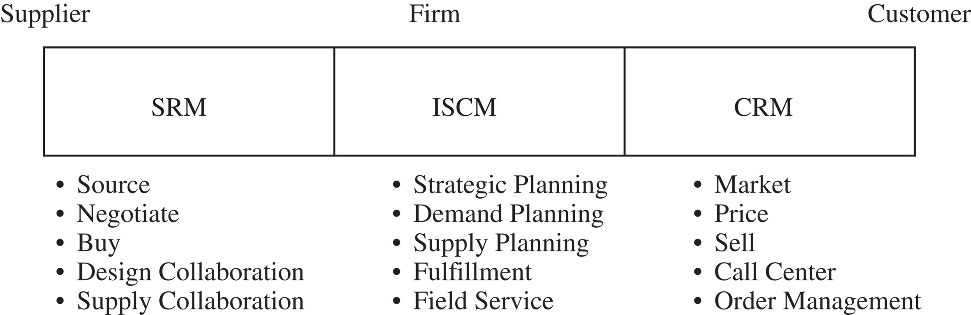
Supply Chain Macro Processes
Figure 1-8

Slide 30
Lecture Notes
The basic theme discussed in this chapter is the understanding of the what really supply chain management is, and what are the different decisional phases involved in any decision pertaining to supply chain management.
The different supply chain macro processes both within the supply chain and at the input and output of the supply chain have been identified.

Slide 31
Lecture Notes
After the introduction of the macro processes a classification approach have been introduced, in this classification approach the different processes can be either be classified as either push or pull.
The basic distinction between push and pull process is that push process is in the anticipation of the customer demand while the pull process is triggered after the arrival of the customer demand.

Slide 32
Lecture Notes
Definition:
Supply Chain Management is primarily concerned with the efficient integration of suppliers, factories, warehouses and stores so that merchandise is produced and distributed in the right quantities, to the right locations and at the right time, and so as to minimize total system cost subject to satisfying service requirements.
Notice: – Who is involved – Cost and Service Level – It is all about integration

Slide 33
Lecture Notes
Today’s Supply Chain Challenges
• Global supply chain with long lead times
• Rising and shifting customer expectations
• Increase in labor costs in developing countries Increase in labor costs in developing countries
• Increase in logistics costs
• Importance of sustainability
• Unprecedented Volatility

Slide 34
Lecture Notes
Conflicting Objectives in the Supply Chain
  1. Purchasing
  • Stable volume requirements
  • Flexible delivery time
  • Little variation in mix
  • Large quantities
  2. Manufacturing
  • Long run production
  • High quality
  • High productivity
  • Low production cost

Slide 35
Lecture Notes
  3. Warehousing Warehousing
  • Low inventory
  • Reduced transportation costs
  • Quick replenishment capability
  4. Customers
  • Shortorder leadtime
  • High in stock
  • Enormous variety of products
  • Low prices

