Slide 1
Supply Chain Performance: Achieving Strategic Fit and Scope
2

Slide 2
Course Code MGT 561
Supply Chain Management
Book: Supply Chain Management Strategy, Planning, and Operation
5th edition (Pearson Publishing)
Author: Sunil Chopra and Peter Meindl

Slide 3
Supply Chain Performance: Achieving Strategic Fit and Scope
2

Slide 4
Learning Objectives
Explain why achieving strategic fit is critical to a company’s overall success.
Describe how a company achieves strategic fit between its supply chain strategy and its competitive strategy.
Discuss the importance of expanding the scope of strategic fit across the supply chain.
Describe the major challenges that must be overcome to manage a supply chain successfully.

Slide 5
Competitive Strategies and Supply
Chain Strategies
Competitive strategy defines the set of customer needs a firm seeks to satisfy through its products and services
Product development strategy specifies the portfolio of new products that the company will try to develop
Marketing and sales strategy specifies how the market will be segmented and product positioned, priced, and promoted
Supply chain strategy determines the nature of material procurement, transportation of materials, manufacture of product or creation of service, distribution of product
All functional strategies must support one another and the competitive strategy
Notes:
Responsiveness , Cost, quality, variety – competitive strategy

Slide 6
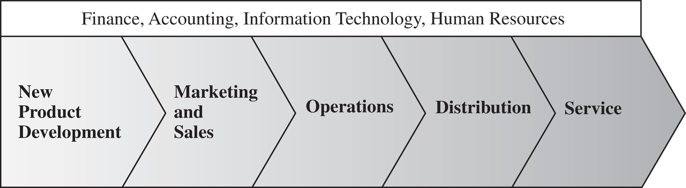
The Value Chain in a Company
Figure 2-1

Slide 7
Achieving Strategic Fit
Strategic fit – competitive and supply chain strategies have aligned goals
A company may fail because of a lack of strategic fit or because its processes and resources do not provide the capabilities to execute the desired strategy

Slide 8
Achieving Strategic Fit
The competitive strategy and all functional strategies must fit together to form a coordinated overall strategy.
The different functions in a company must appropriately structure their processes and resources to be able to execute these strategies successfully.
The design of the overall supply chain and the role of each stage must be aligned to support the supply chain strategy.

Slide 9
How is Strategic Fit Achieved?
Understanding the customer and supply chain uncertainty
Understanding the supply chain
Achieving strategic fit

Slide 10
Step 1: Understanding the Customer and Supply Chain Uncertainty
Quantity of product needed in each lot
Response time customers will tolerate
Variety of products needed
Service level required
Price of the product
Desired rate of innovation in the product

Slide 11
Step 1: Understanding the Customer and Supply Chain Uncertainty
Demand uncertainty – uncertainty of customer demand for a product
Implied demand uncertainty – resulting uncertainty for the supply chain given the portion of the demand the supply chain must handle and attributes the customer desires

Slide 12
Customer Needs and Implied Demand Uncertainty
Customer Need | Causes Implied Demand Uncertainty to …
Range of quantity required increases | Increase because a wider range of the quantity required implies greater variance in demand
Lead time decreases | Increase because there is less time in which to react to orders
Variety of products required increases | Increase because demand per product becomes more disaggregate
Number of channels through which product may be acquired increases | Increase because the total customer demand is now disaggregated over more channels
Rate of innovation increases | Increase because new products tend to have more uncertain demand
Required service level increases | Increase because the firm now has to handle unusual surges in demand
Table 2-1

Slide 13
Implied Uncertainty and Other Attributes
 | Low Implied Uncertainty | High Implied Uncertainty
Product margin | Low | High
Average forecast error | 10% | 40% to 100%
Average stockout rate | 1% to 2% | 10% to 40%
Average forced season-end markdown | 0% | 10% to 25%
Table 2-2

Slide 14
Implied Uncertainty and Other Attributes
Products with uncertain demand are often less mature and have less direct competition. As a result, margins tend to be high.
Forecasting is more accurate when demand has less uncertainty.
Increased implied demand uncertainty leads to increased difficulty in matching supply with demand. For a given product, this dynamic can lead to either a stockout or an oversupply situation.
Markdowns are high for products with greater implied demand uncertainty because oversupply often results.

Slide 15
Impact of Supply Source Capability
Supply Source Capability | Causes Supply Uncertainty to...
Frequent breakdowns | Increase
Unpredictable and low yields | Increase
Poor quality | Increase
Limited supply capacity | Increase
Inflexible supply capacity | Increase
Evolving production process | Increase
Table 2-3

Slide 16
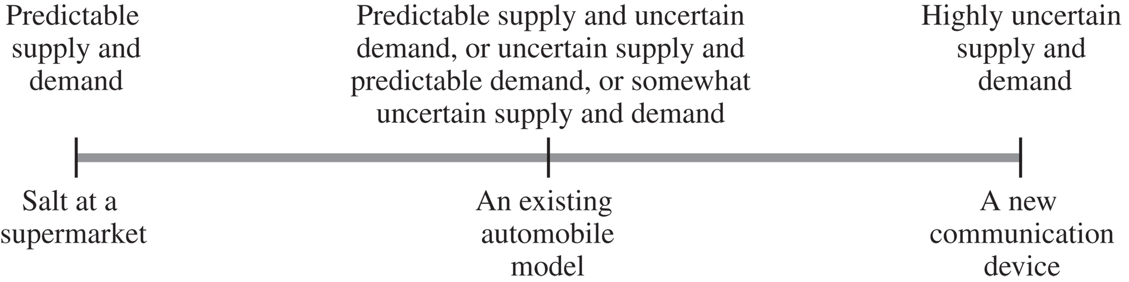
Levels of Implied Demand Uncertainty
Figure 2-2

Slide 17
Step 2: Understanding Supply Chain Capabilities
How does the firm best meet demand?
Supply chain responsiveness is the ability to
  Respond to wide ranges of quantities demanded
  Meet short lead times
  Handle a large variety of products
  Build highly innovative products
  Meet a very high service level

Slide 18
Step 2: Understanding Supply Chain Capabilities
Responsiveness comes at a cost
Supply chain efficiency is the inverse to the cost of making and delivering the product to the customer
The cost-responsiveness efficient frontier curve shows the lowest possible cost for a given level of responsiveness

Slide 19
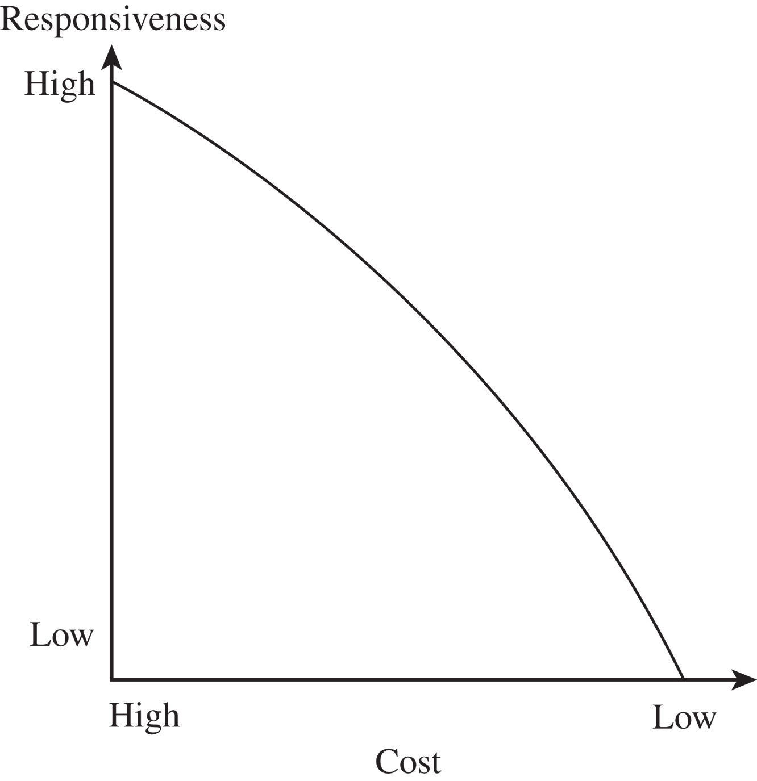
Cost-Responsiveness Efficient Frontier
Figure 2-3

Slide 20
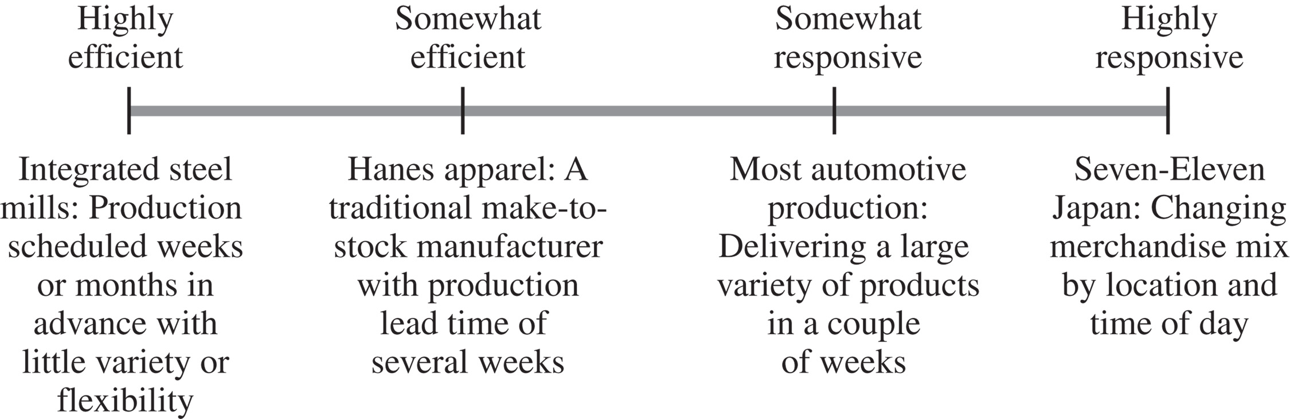
Responsiveness Spectrum
Figure 2-4

Slide 21
Step 3: Achieving Strategic Fit
Ensure that the degree of supply chain responsiveness is consistent with the implied uncertainty
Assign roles to different stages of the supply chain that ensure the appropriate level of responsiveness
Ensure that all functions maintain consistent strategies that support the competitive strategy

Slide 22
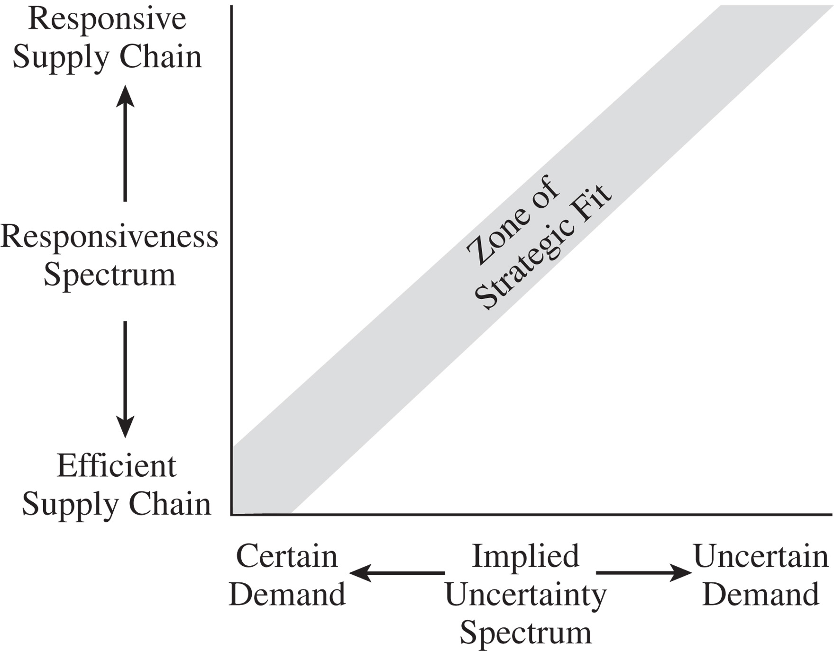
Zone of Strategic Fit
Figure 2-5

Slide 23
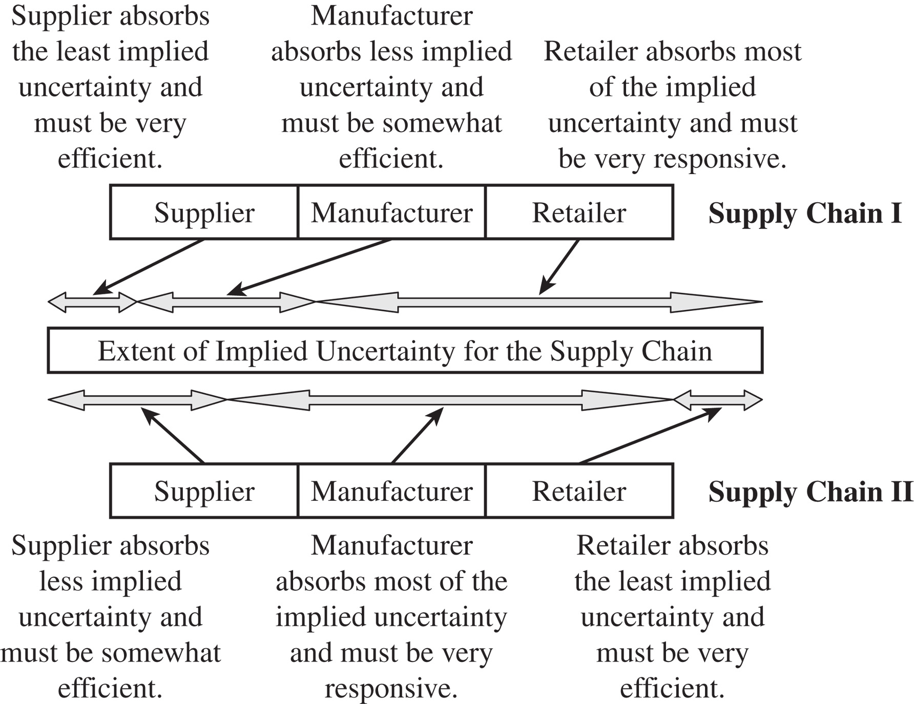
Roles and Allocations
Figure 2-6

Slide 24
Efficient and Responsive Supply Chains
 | Efficient Supply Chains | Responsive Supply Chains
Primary goal | Supply demand at the lowest cost | Respond quickly to demand
Product design strategy | Maximize performance at a minimum product cost | Create modularity to allow postponement of product differentiation
Pricing strategy | Lower margins because price is a prime customer driver | Higher margins because price is not a prime customer driver
Manufacturing strategy | Lower costs through high utilization | Maintain capacity flexibility to buffer against demand/supply uncertainty
Inventory strategy | Minimize inventory to lower cost | Maintain buffer inventory to deal with demand/supply uncertainty
Lead-time strategy | Reduce, but not at the expense of costs | Reduce aggressively, even if the costs are significant
Supplier strategy | Select based on cost and quality | Select based on speed, flexibility, reliability, and quality
Table 2-4

Slide 25
Tailoring the Supply Chain
Achieve strategic fit while serving many customer segments with a variety of products across multiple channels
Requires sharing some links in the supply chain with some products, while having separate operations for other links

Slide 26
Changes Over Product Life Cycle
Beginning stages
  Demand is very uncertain, and supply may be unpredictable
  Margins are often high, and time is crucial to gaining sales
  Product availability is crucial to capturing the market
  Cost is often a secondary consideration

Slide 27
Changes Over Product Life Cycle
Later stages
  Demand has become more certain, and supply is predictable
  Margins are lower as a result of an increase in competitive pressure
  Price becomes a significant factor in customer choice

Slide 28
Expanding Strategic Scope
Scope of strategic fit – the functions within the firm and stages across the supply chain that devise an integrated strategy with an aligned objective
  Intraoperation scope – minimize local cost view
  Each stage of the supply chain devises strategy independently

Slide 29
Expanding Strategic Scope
Intrafunctional view – minimize total functional cost
  Firms align all operations within a function
Interfunctional scope – maximize company profit
  Functional strategies are developed to align with one another and the competitive strategy

Slide 30
Expanding Strategic Scope
Intercompany scope – maximize supply chain surplus
  Supplier and customer work together and share information to reduce total cost and grow supply chain surplus
Agile intercompany scope – a firm’s ability to achieve strategic fit when partnering with supply chain stages that change over time

Slide 31
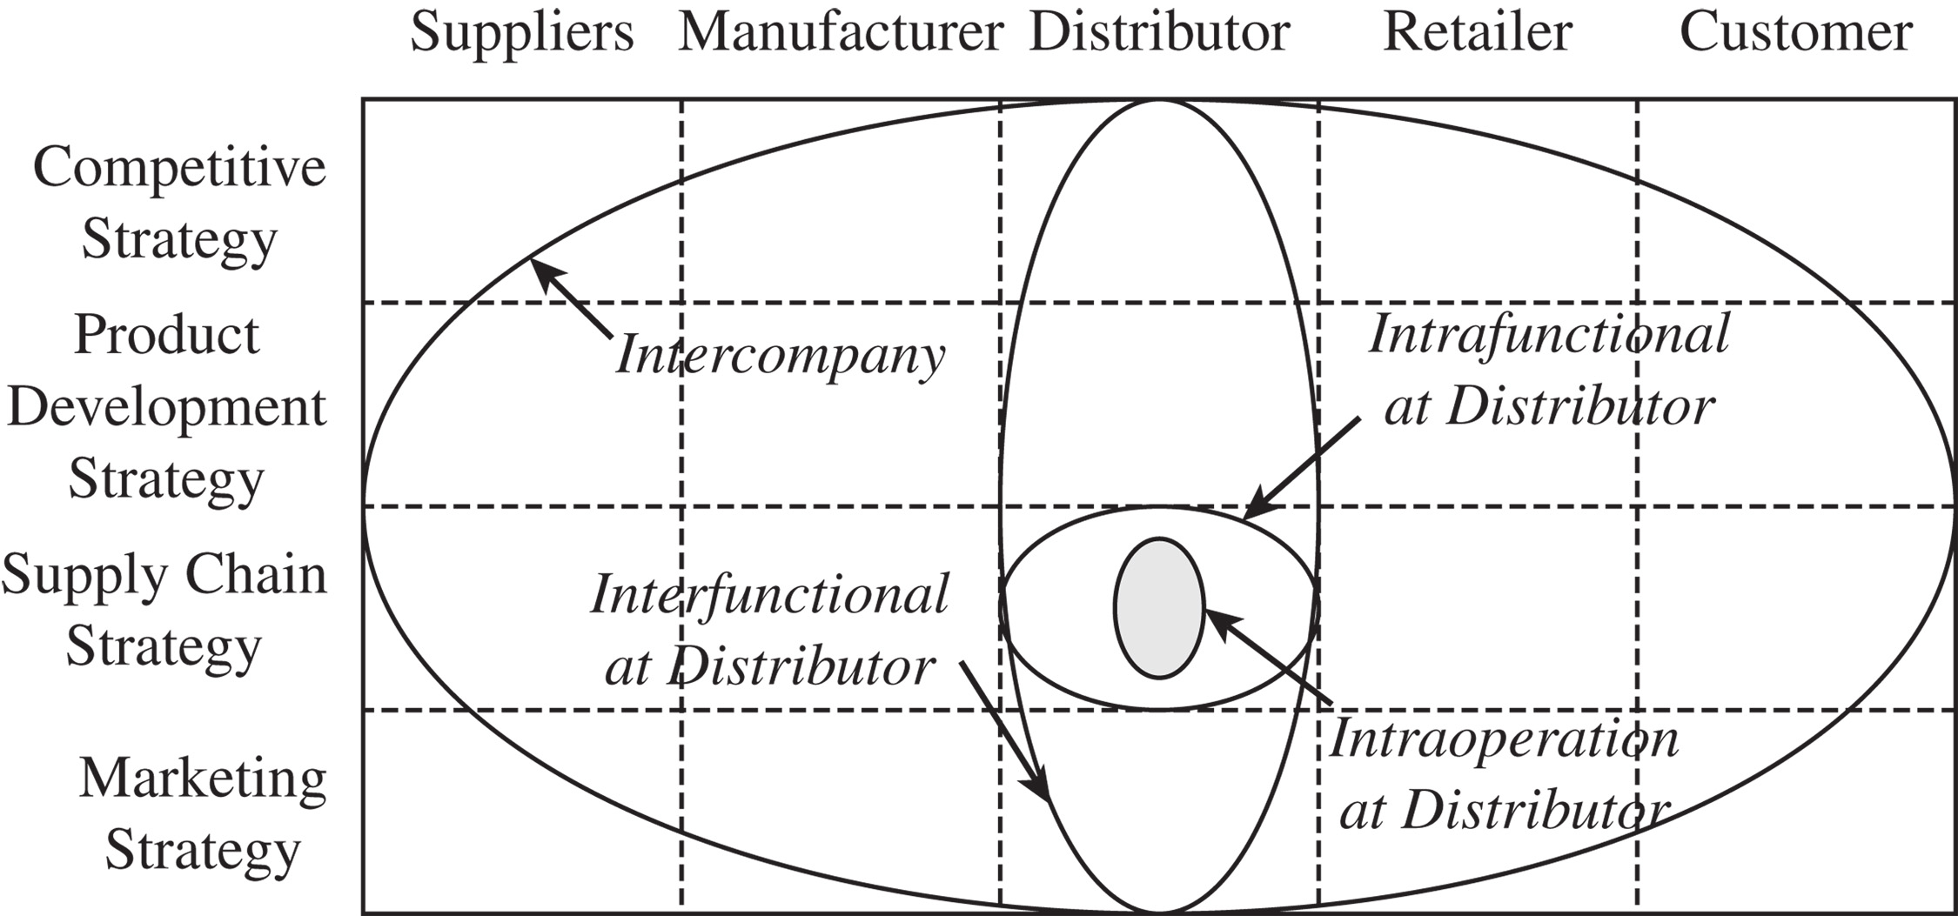
Different Scopes of Strategic Fit Across a Supply Chain
Figure 2-7

Slide 32
Challenges
Increasing product variety and shrinking life cycles
  Greater product variety and shorter life cycles increase uncertainty while reducing the window of opportunity within which the supply chain can achieve fit
Globalization and increasing uncertainty
  Significant fluctuations in exchange rates, global demand, and the price of crude oil

Slide 33
Challenges
Fragmentation of supply chain ownership
  Firms are less vertically integrated
  Take advantage of supplier and customer competencies they did not have
  New ownership structure makes aligning and managing the supply chain more difficult
  Aligning all members of a supply chain has become critical to achieving supply chain fit

Slide 34
Challenges
Changing technology and business environment
  Customer needs and technology change may force a firm to rethink their supply chain strategy
The environment and sustainability
  Growing in relevance and must be accounted for when designing supply chain strategy
  Opportunities may require coordination across different members of the supply chain

Slide 35
Summary of Learning Objectives
Explain why achieving strategic fit is critical to a company’s overall success
Describe how a company achieves strategic fit between its supply chain strategy and its competitive strategy
Discuss the importance of expanding the scope of strategic fit across the supply chain
Describe the major challenges that must be overcome to manage a supply chain successfully

Slide 36
Lecture Notes

