Slide 1
Supply Chain Drivers and Metrics
3

Slide 2
Learning Objectives
Identify the major drivers of supply chain performance.
Discuss the role of each driver in creating strategic fit between the supply chain strategy and the competitive strategy.
Define the key metrics that track the performance of the supply chain in terms of each driver.
Describe key financial measures of firm performance.

Slide 3
Drivers of Supply Chain Performance
Facilities
  The physical locations in the supply chain network where product is stored, assembled, or fabricated
Inventory
  All raw materials, work in process, and finished goods within a supply chain
Transportation
  Moving inventory from point to point in the supply chain

Slide 4
Drivers of Supply Chain Performance
Information
  Data and analysis concerning facilities, inventory, transportation, costs, prices, and customers throughout the supply chain
Sourcing
  Who will perform a particular supply chain activity
Pricing
  How much a firm will charge for the goods and services that it makes available in the supply chain

Slide 5
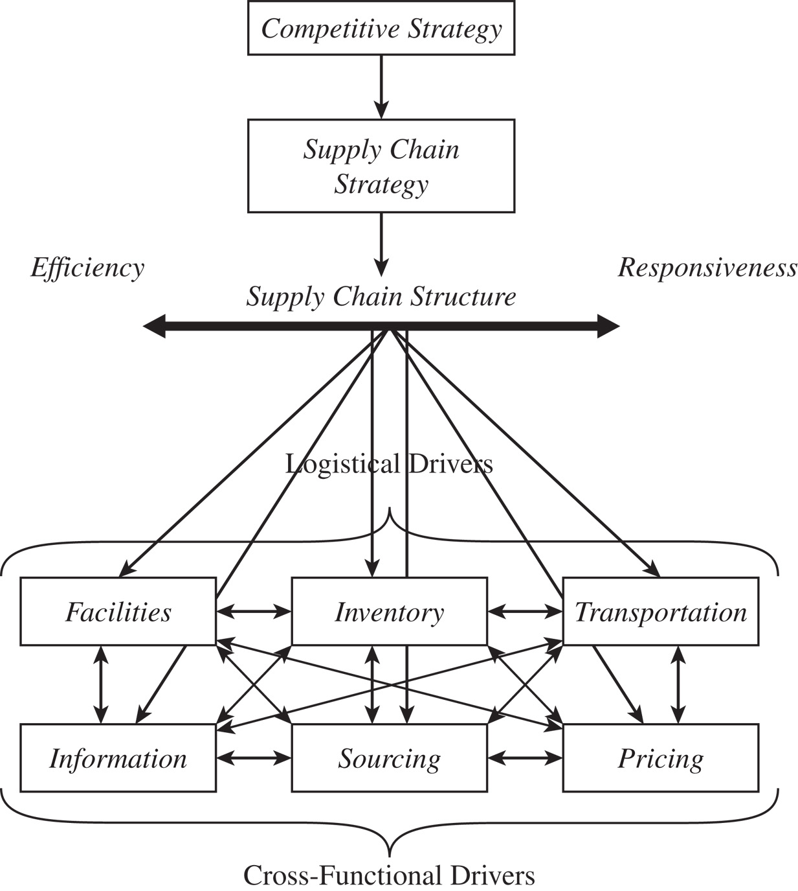
A Framework for
Structuring Drivers
Figure 3-1

Slide 6
Facilities
Role in the supply chain
  The “where” of the supply chain
  Manufacturing or storage (warehouses)
Role in the competitive strategy
  Economies of scale (efficiency priority)
  Larger number of smaller facilities (responsiveness priority)

Slide 7
Facilities
Components of facilities decisions
  Role
    Flexible, dedicated, or a combination of the two
    Product focus or a functional focus
  Location
    Where a company will locate its facilities
    Centralize/decentralize, macroeconomic factors, quality of workers, cost of workers and facility, availability of infrastructure, proximity to customers, location of other facilities, tax effects

Slide 8
Facilities
Components of facilities decisions
  Capacity
    A facility’s capacity to perform its intended function or functions
    Excess capacity – responsive, costly
    Little excess capacity – more efficient, less responsive

Slide 9
Facilities
Components of facilities decisions
  Facility-related metrics
    Capacity
    Utilization
    Processing/setup/down/idle time
    Production cost per unit
    Quality losses
    Theoretical flow/cycle time of production
    Actual average flow/cycle time

Slide 10
Facilities
Overall trade-off: Responsiveness versus efficiency
  Cost of the number, location, capacity, and type of facilities (efficiency) and the level of responsiveness
  Increasing the number of facilities increases facility and inventory costs but decreases transportation costs and reduces response time
  Increasing the flexibility or capacity of a facility increases facility costs but decreases inventory costs and response time

Slide 11
Overall Trade-Off
Responsiveness versus efficiency
  Cost of the number, location, capacity, and type of facilities (efficiency)
  Level of responsiveness
  Increasing number of facilities increases facility and inventory costs, decreases transportation costs and reduces response time
  Increasing the flexibility or capacity of a facility increases facility costs, decreases inventory costs and response time

Slide 12
Inventory
Role in the Supply Chain
  Mismatch between supply and demand
  Satisfy demand
  Exploit economies of scale
  Impacts assets, costs, responsiveness, material flow time

Slide 13
Inventory
  Material flow time, the time that elapses between the point at which material enters the supply chain to the point at which it exits
  Throughput, the rate at which sales occur
  Little’s law
I = DT
where
I = flow time, T = throughput, D = demand

Slide 14
Inventory
Role in Competitive Strategy
  Form, location, and quantity of inventory allow a supply chain to range from being very low cost to very responsive
  Objective is to have right form, location, and quantity of inventory that provides the right level of responsiveness at the lowest possible cost

Slide 15
Components of Inventory Decisions
Cycle inventory
  Average amount of inventory used to satisfy demand between shipments
  Function of lot size decisions
Safety inventory
  Inventory held in case demand exceeds expectations
  Costs of carrying too much inventory versus cost of losing sales

Slide 16
Components of Inventory Decisions
Seasonal inventory
  Inventory built up to counter predictable variability in demand
  Cost of carrying additional inventory versus cost of flexible production
Level of product availability
  The fraction of demand that is served on time from product held in inventory
  Trade off between customer service and cost

Slide 17
Components of Inventory Decisions
Inventory-related metrics
  Cash-to-cash cycle time
  Average inventory
  Inventory turns
  Products with more than a specified number of days of inventory
  Average replenishment batch size

Slide 18
Components of Inventory Decisions
Inventory-related metrics
  Average safety inventory
  Seasonal inventory
  Fill rate
  Fraction of time out of stock
  Obsolete inventory

Slide 19
Inventory
Overall trade-off: Responsiveness versus efficiency
  Increasing inventory generally makes the supply chain more responsive
  A higher level of inventory facilitates a reduction in production and transportation costs because of improved economies of scale
  Inventory holding costs increase

Slide 20
Transportation
Role in the Supply Chain
  Moves the product between stages in the supply chain
  Impact on responsiveness and efficiency
  Faster transportation allows greater responsiveness but lower efficiency
  Also affects inventory and facilities

Slide 21
Transportation
Role in the Competitive Strategy
  Allows a firm to adjust the location of its facilities and inventory to find the right balance between responsiveness and efficiency
Components of Transportation Decisions
  Design of transportation network
    Modes, locations, and routes
    Direct or with intermediate consolidation points
    One or multiple supply or demand points in a single run

Slide 22
Transportation
  Choice of transportation mode
    Air, truck, rail, sea, and pipeline
    Information goods via the Internet
    Different speed, size of shipments, cost of shipping, and flexibility

Slide 23
Transportation
  Transportation-related metrics
    Average inbound transportation cost
    Average income shipment size
    Average inbound transportation cost per shipment
    Average outbound transportation cost
    Average outbound shipment size
    Average outbound transportation cost per shipment
    Fraction transported by mode

Slide 24
Transportation
Overall trade-off: Responsiveness versus efficiency
  The cost of transporting a given product (efficiency) and the speed with which that product is transported (responsiveness)
  Using fast modes of transport raises responsiveness and transportation cost but lowers the inventory holding cost

Slide 25
Information
Role in the Supply Chain
  Improve the utilization of supply chain assets and the coordination of supply chain flows to increase responsiveness and reduce cost
  Information is a key driver that can be used to provide higher responsiveness while simultaneously improving efficiency

Slide 26
Information
Role in the Competitive Strategy
  Right information can help a supply chain better meet customer needs at lower cost
  Improves visibility of transactions and coordination of decisions across the supply chain
  Share the minimum amount of information required to achieve coordination

Slide 27
Components of Information Decisions
Push versus Pull
  Different information requirements and uses
Coordination and information sharing
  Supply chain coordination, all stages of a supply chain work toward the objective of maximizing total supply chain profitability based on shared information
Sales and operations planning (S&OP)
  The process of creating an overall supply plan (production and inventories) to meet the anticipated level of demand (sales)

Slide 28
Components of Information Decisions
Enabling technologies
  Electronic data interchange (EDI)
  The Internet
  Enterprise resource planning (ERP) systems
  Supply chain management (SCM) software
  Radio frequency identification (RFID)

Slide 29
Components of Information Decisions
Information-related metrics
  Forecast horizon
  Frequency update
  Forecast error
  Seasonal factors
  Variance from plan
  Ratio of demand variability to order variability

Slide 30
Information
Overall trade-off: Complexity versus value
  Good information helps a firm improve both efficiency and responsiveness
  More information is not always better
  More information increases complexity and cost of both infrastructure and analysis exponentially while marginal value diminishes
  Evaluate the minimum information required to accomplish the desired objectives

Slide 31
Sourcing
Role in the Supply Chain
  Set of business processes required to purchase goods and services
  Will tasks be performed by a source internal to the company or a third party
  Globalization creates many more sourcing options with both considerable opportunity and potential risk

Slide 32
Sourcing
Role in the Competitive Strategy
  Sourcing decisions are crucial because they affect the level of efficiency and responsiveness in a supply chain
  Outsource to responsive third parties if it is too expensive to develop their own
  Keep responsive process in-house to maintain control

Slide 33
Components of Sourcing Decisions
In-house or outsource
  Perform a task in-house or outsource it to a third party
Supplier selection
  Number of suppliers, evaluation and selection criteria, direct negotiations or auction
Procurement
  The supplier sends product in response to customer orders

Slide 34
Components of Sourcing Decisions
Sourcing-related metrics
  Days payable outstanding
  Average purchase price
  Range of purchase price
  Average purchase quantity
  Supply quality
  Supply lead time
  Fraction of on-time deliveries
  Supplier reliability

Slide 35
Sourcing
Overall trade-off: Increase the supply chain surplus
  Increase the size of the total surplus to be shared across the supply chain
  Impact of sourcing on sales, service, production costs, inventory costs, transportation costs, and information cost
  Outsource if it raises the supply chain surplus more than the firm can on its own
  Keep function in-house if the third party cannot increase the supply chain surplus or if the outsourcing risk is significant

Slide 36
Pricing
Role in the Supply Chain
  Pricing determines the amount to charge customers for goods and services
  Affects the supply chain level of responsiveness required and the demand profile the supply chain attempts to serve
  Pricing strategies can be used to match demand and supply

Slide 37
Pricing
Role in the Competitive Strategy
  Firms can utilize optimal pricing strategies to improve efficiency and responsiveness
  Pricing strategies vary to meet different customer responsiveness requirements

Slide 38
Components of Pricing Decisions
Pricing and economies of scale
  The provider of the activity must decide how to price it appropriately to reflect these economies of scale
Everyday low pricing versus high-low pricing
  Different pricing strategies lead to different demand profiles that the supply chain must serve

Slide 39
Components of Pricing Decisions
Fixed price versus menu pricing
  If marginal supply chain costs or the value to the customer vary significantly along some attribute, it is often effective to have a pricing menu
  Can lead to customer behavior that has a negative impact on profits

Slide 40
Components of Pricing Decisions
Pricing-related metrics
  Profit margin
  Days sales outstanding
  Incremental fixed cost per order
  Incremental variable cost per unit
  Average sale price
  Average order size
  Range of sale price
  Range of periodic sales

Slide 41
Pricing
Overall trade-off: Increase firm profits
  Understand of the cost structure of performing a supply chain activity and the value this activity brings to the supply chain
  Strategy may support efficiency in the supply chain, lower supply chain costs, defend market share, or steal market share
  Differential pricing may be used to attract customers with varying needs
  Strategy should help either increase revenues or shrink costs or preferably both

Slide 42
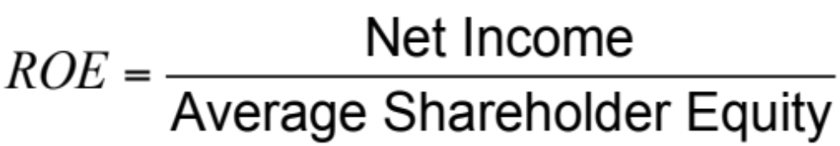
Financial Measures Of Performance
From a shareholder perspective, return on equity (ROE) is the main summary measure of a firm’s performance

Slide 43
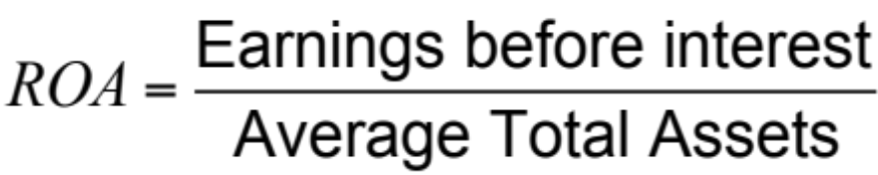
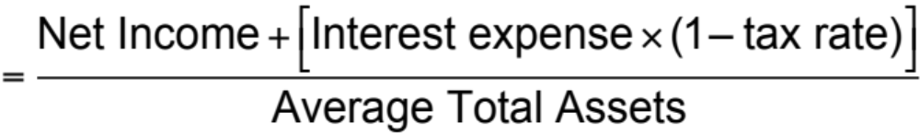
Financial Measures Of Performance
Return on assets (ROA) measures the return earned on each dollar invested by the firm in assets

Slide 44
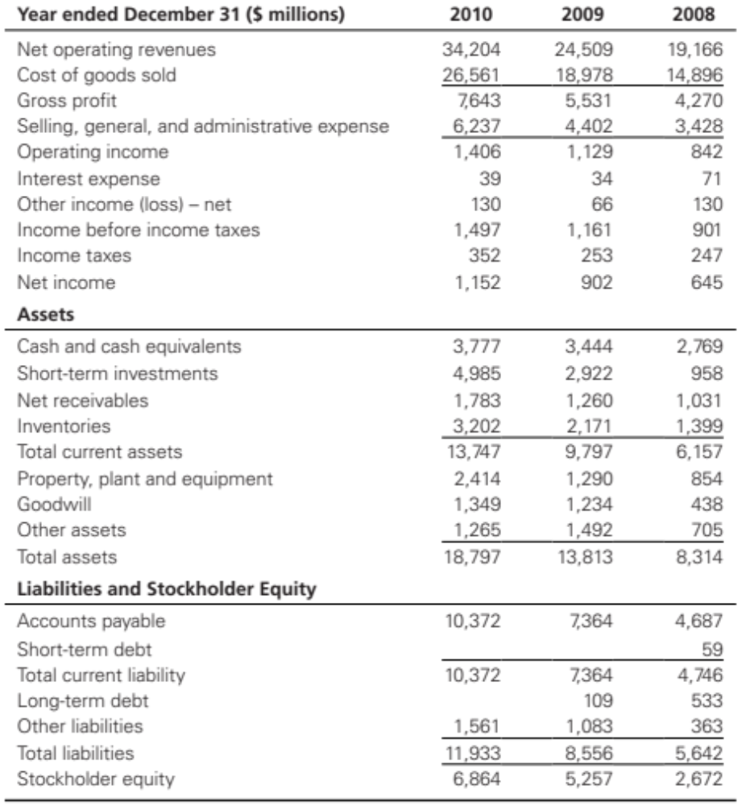
Financial Data for Amazon
Table 3-1

Slide 45
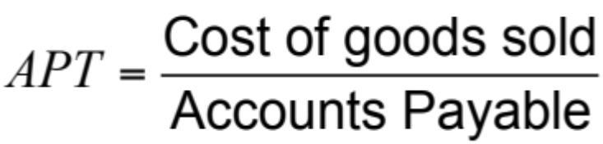
Financial Measures Of Performance
An important ratio that defines financial leverage is accounts payable turnover (APT)

Slide 46
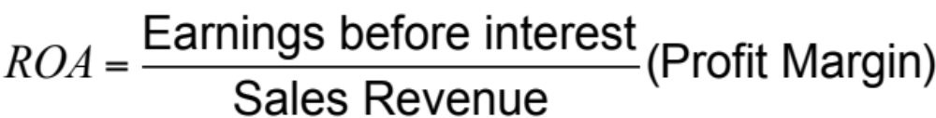
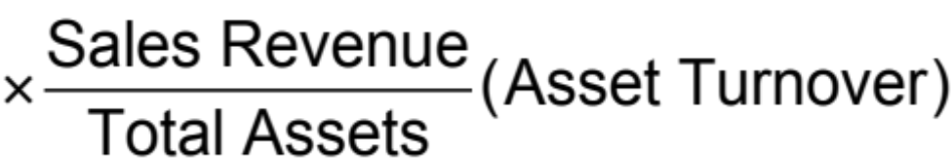
Financial Measures Of Performance
ROA can be written as the product of two ratios – profit margin and asset turnover

Slide 47
Financial Measures Of Performance
Cash-to-cash (C2C) cycle roughly measures the average amount time from when cash enters the process as cost to when it returns as collected revenue
C2C = – days payable (1/APT)
+ days in inventory (1/INVT)
+ days receivable (1/ART)

Slide 48
Summary of Learning Objectives
Describe key financial measures of firm performance
Identify the major drivers of supply chain performance
Discuss the role of each driver in creating strategic fit between the supply chain strategy and the competitive strategy
Define the key metrics that track the performance of the supply chain in terms of each driver

Slide 49

All rights reserved. No part of this publication may be reproduced, stored in a retrieval system, or transmitted, in any form or by any means, electronic, mechanical, photocopying, recording, or otherwise, without the prior written permission of the publisher.
Printed in the United States of America.

