Slide 1
Designing Distribution Networks and Applications to Online Sales
4

Slide 2
Learning Objectives
Identify the key factors to be considered when designing a distribution network
Discuss the strengths and weaknesses of various distribution options
Understand how online sales have affected the design of distribution networks in different industries

Slide 3
The Role of Distribution in the Supply Chain
Distribution – the steps taken to move and store a product from the supplier stage to the customer stage in a supply chain
Drives profitability by directly affecting supply chain cost and the customer experience
Choice of distribution network can achieve supply chain objectives from low cost to high responsiveness

Slide 4
Factors Influencing
Distribution Network Design
Distribution network performance evaluated along two dimensions
  Customer needs that are met
  Cost of meeting customer needs
Evaluate the impact on customer service and cost for different distribution network options
Profitability of the delivery network determined by revenue from met customer needs and network costs

Slide 5
Factors Influencing
Distribution Network Design
Elements of customer service influenced by network structure:
  Response time
  Product variety
  Product availability
  Customer experience
  Order visibility
  Returnability

Slide 6
Factors Influencing
Distribution Network Design
Supply chain costs affected by network structure:
  Inventories
  Transportation
  Facilities and handling
  Information

Slide 7
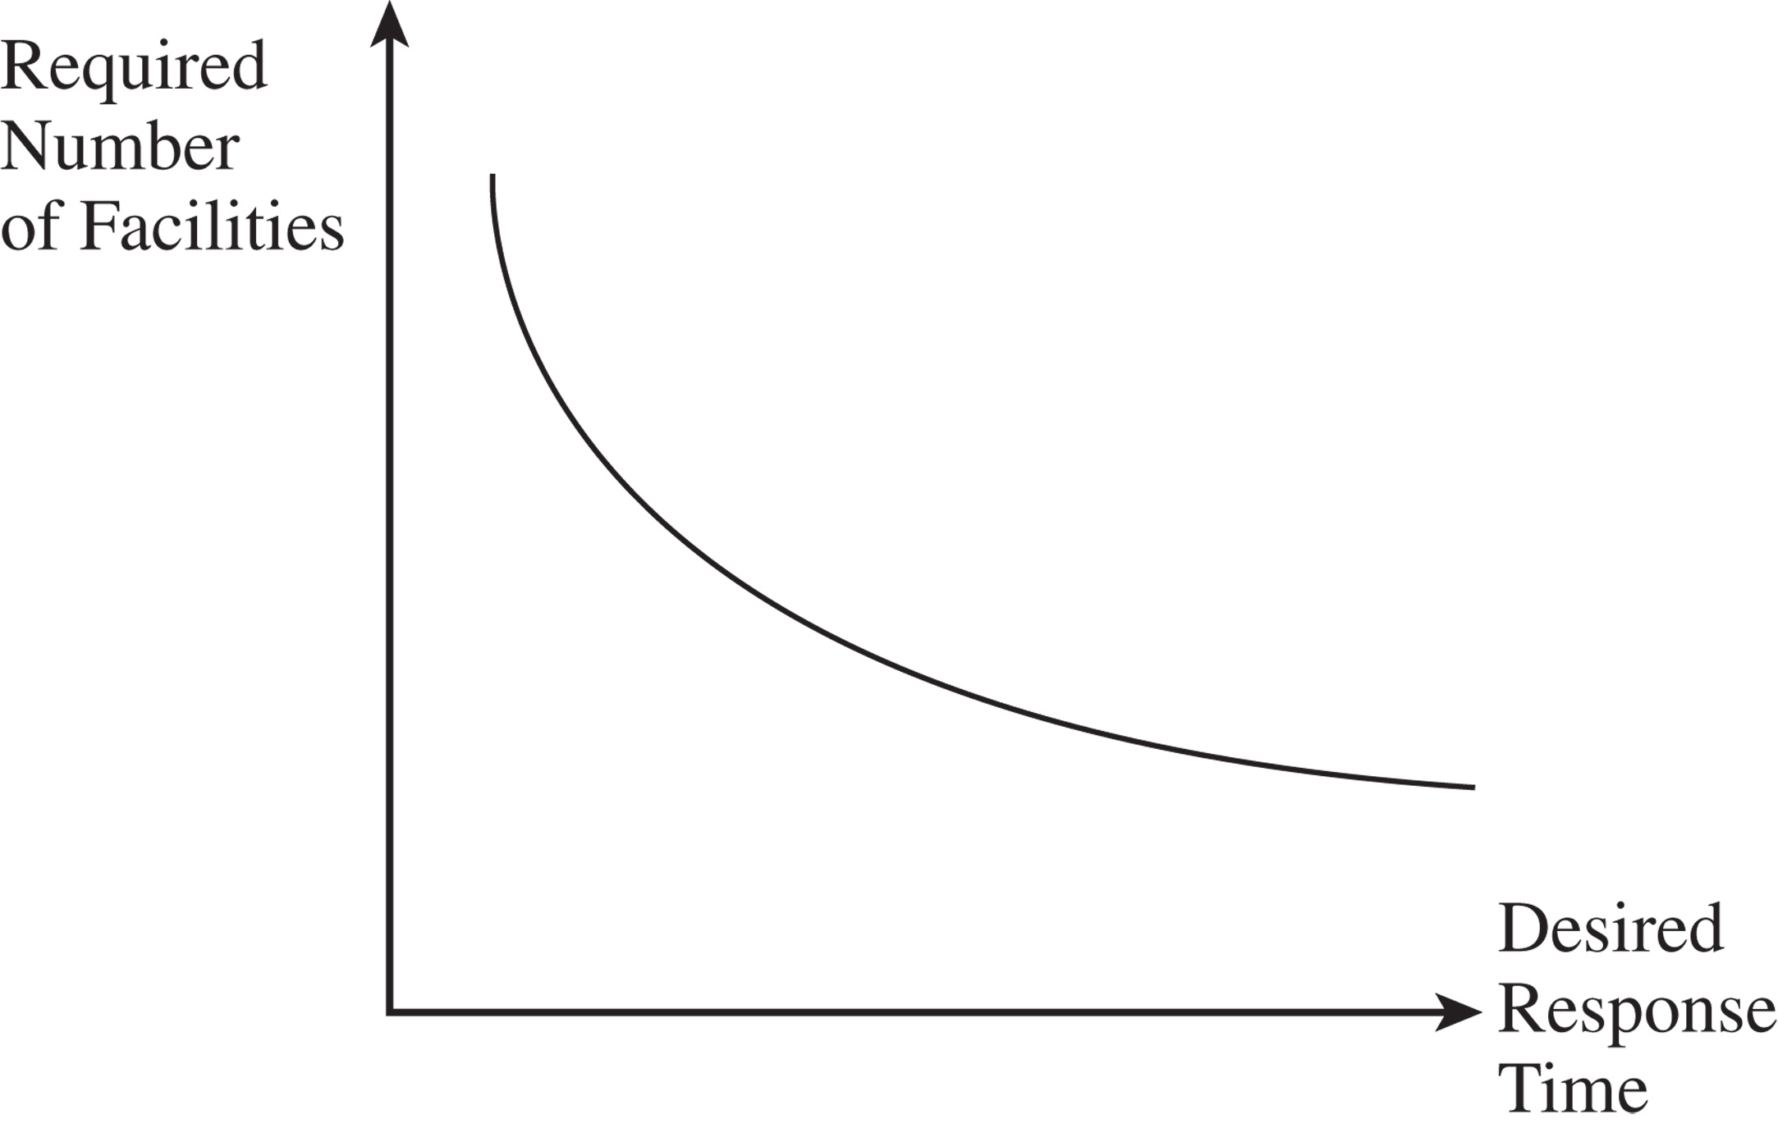
Desired Response Time and Number of Facilities
Figure 4-1
Notes:
Notes: Increasing the number of facilities moves them closer to the end consumer. This reduces the response time. As Amazon has built warehouses, the average time from the warehouse to the end consumer has decreased. McMaster-Carr provides 1-2 day coverage of most of the U.S from 6 facilities. W.W. Grainger is able to increase coverage to same day delivery using about 370 facilities.

Slide 8
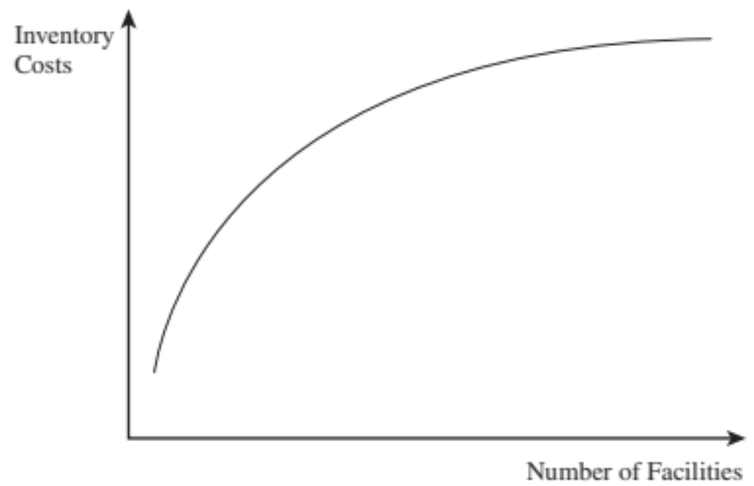
Inventory Costs and Number of Facilities
Figure 4-2
Notes:
Notes: Inventory costs increase, facility costs increase, and transportation costs decrease as we increase the number of facilities.

Slide 9
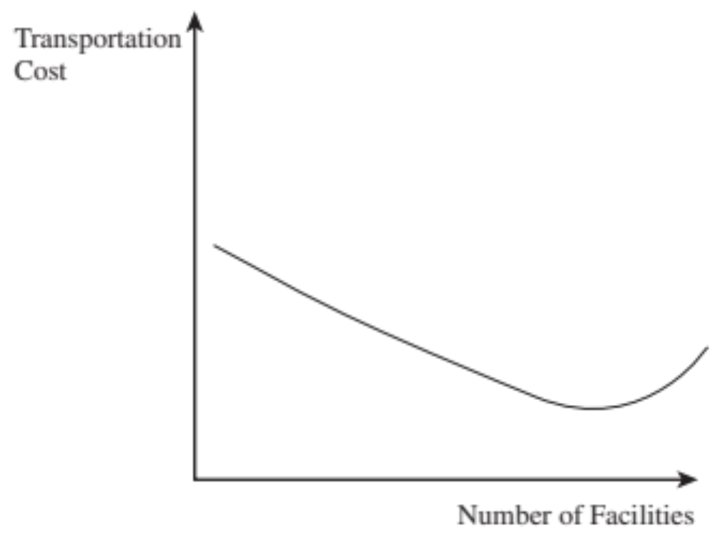
Transportation Costs and
Number of Facilities
Figure 4-3
Notes:
Notes: Inventory costs increase, facility costs increase, and transportation costs decrease as we increase the number of facilities.

Slide 10
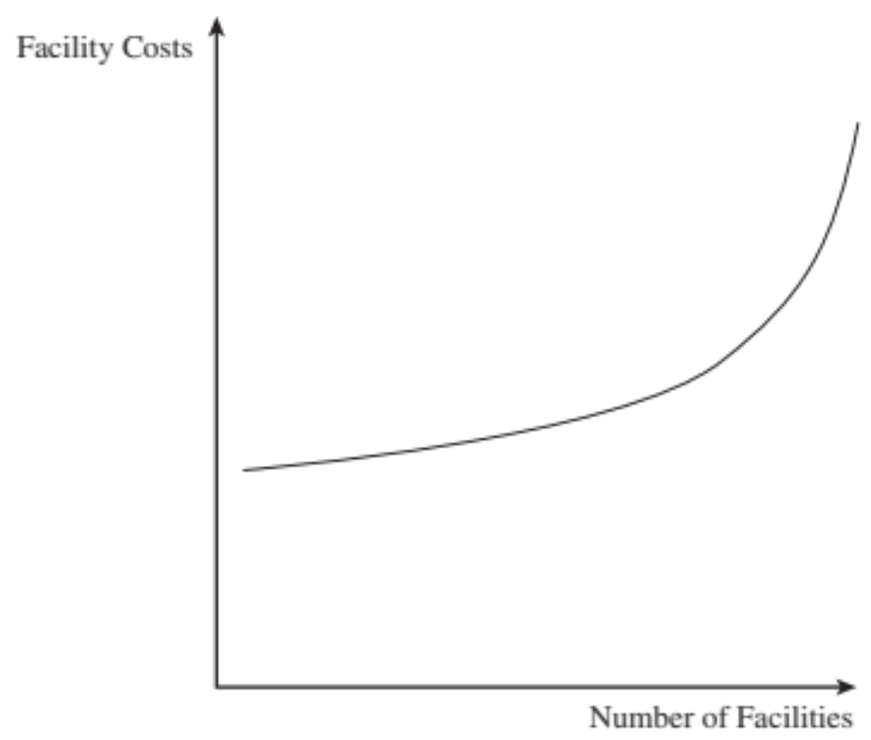
Facility Costs and Number of Facilities
Figure 4-4
Notes:
Notes: Inventory costs increase, facility costs increase, and transportation costs decrease as we increase the number of facilities.

Slide 11
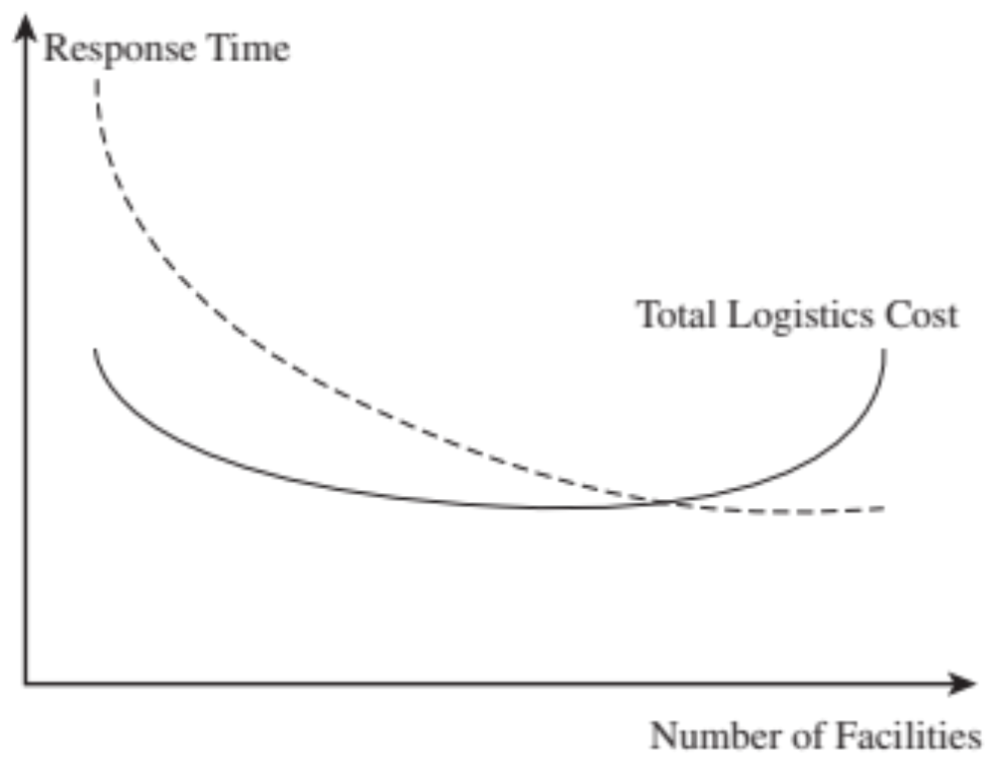
Logistics Cost, Response Time, and Number of Facilities
Figure 4-5

Slide 12
Design Options for a
Distribution Network
Distribution network choices from the manufacturer to the end consumer
Two key decisions
  Will product be delivered to the customer location or picked up from a prearranged site?
  Will product flow through an intermediary (or intermediate location)?

Slide 13
Design Options for a
Distribution Network
One of six designs may be used
  Manufacturer storage with direct shipping
  Manufacturer storage with direct shipping and in-transit merge
  Distributor storage with carrier delivery
  Distributor storage with last-mile delivery
  Manufacturer/distributor storage with customer pickup
  Retail storage with customer pickup

Slide 14
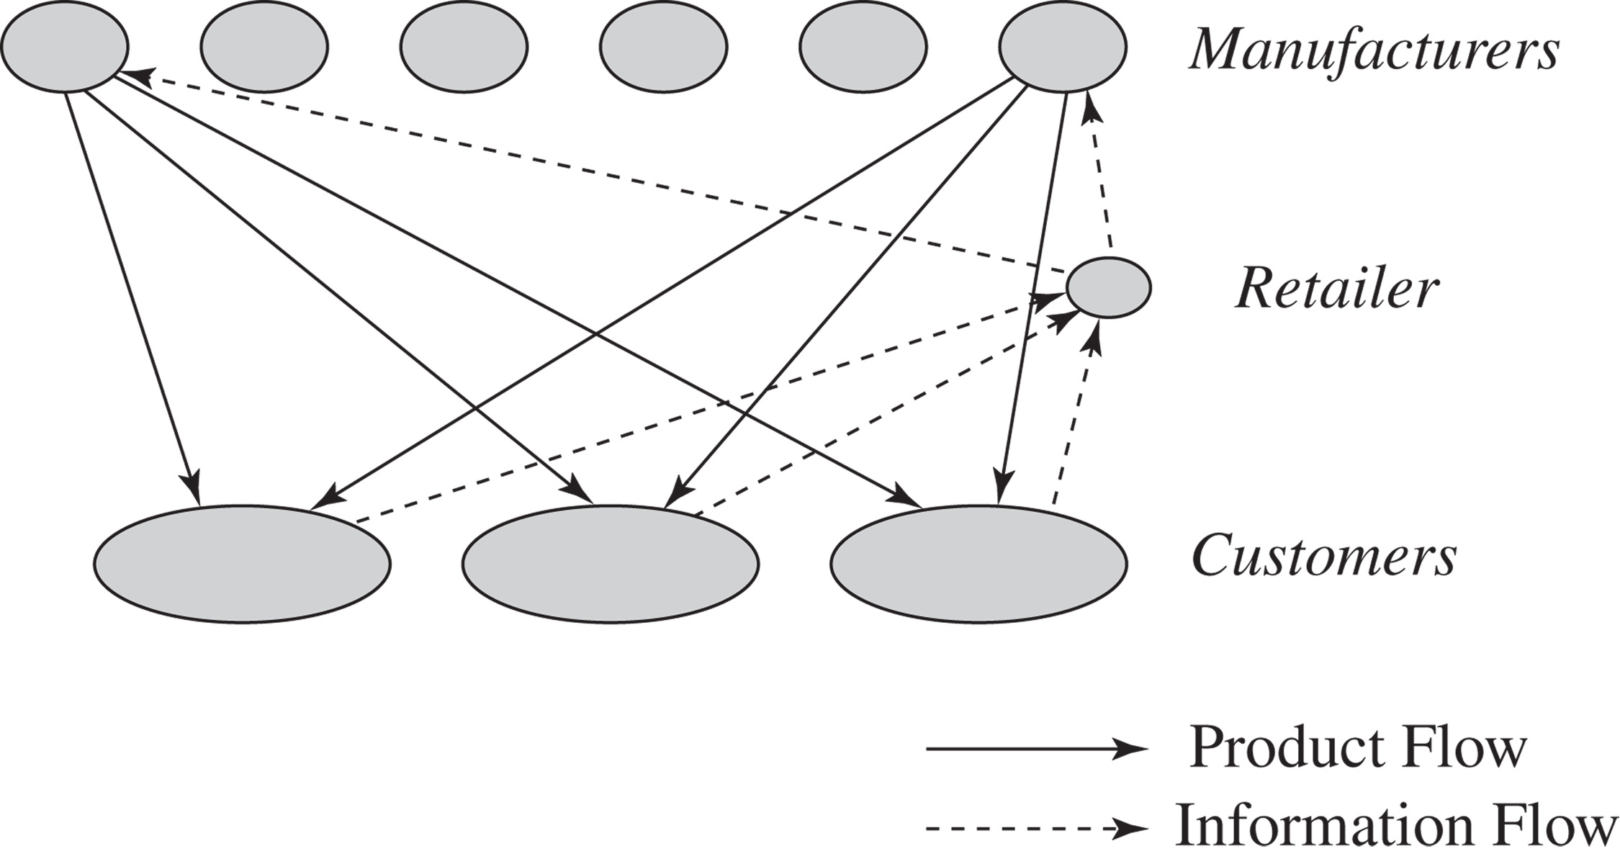
Manufacturer Storage with
Direct Shipping
Figure 4-6

Slide 15
Manufacturer Storage with Direct Shipping Network
Cost Factor | Performance
Inventory | Lower costs because of aggregation. Benefits of aggregation are highest for low-demand, high-value items. Benefits are large if product customization can be postponed at the manufacturer.
Transportation | Higher transportation costs because of increased distance and disaggregate shipping.
Facilities and handling | Lower facility costs because of aggregation. Some saving on handling costs if manufacturer can manage small shipments or ship from production line.
Information | Significant investment in information infrastructure to integrate manufacturer and retailer.
Table 4-1

Slide 16
Manufacturer Storage with Direct Shipping Network
Service Factor | Performance
Response time | Long response time of one to two weeks because of increased distance and two stages for order processing. Response time may vary by product, thus complicating receiving.
Product variety | Easy to provide a high level of variety.
Product availability | Easy to provide a high level of product availability because of aggregation at manufacturer.
Customer experience | Good in terms of home delivery but can suffer if order from several manufacturers is sent as partial shipments.
Time to market | Fast, with the product available as soon as the first unit is produced.
Order visibility | More difficult but also more important from a customer service perspective.
Returnability | Expensive and difficult to implement.
Table 4-1

Slide 17
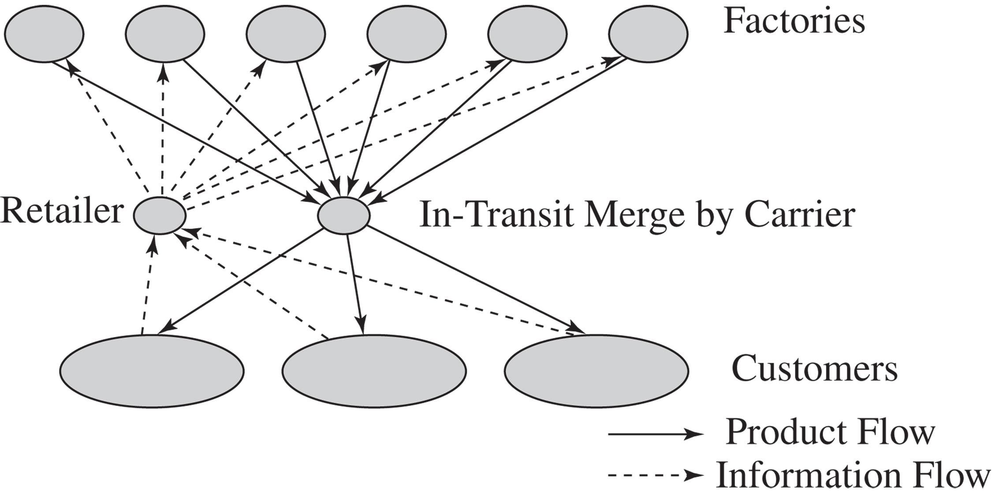
In-Transit Merge Network
Figure 4-7

Slide 18
In-Transit Merge
Cost Factor | Performance
Inventory | Similar to drop-shipping.
Transportation | Somewhat lower transportation costs than drop-shipping.
Facilities and handling | Handling costs higher than drop-shipping at carrier; receiving costs lower at customer.
Information | Investment is somewhat higher than for drop-shipping.
Table 4-2

Slide 19
In-Transit Merge
Service Factor | Performance
Response time | Similar to drop-shipping; may be marginally higher.
Product variety | Similar to drop-shipping.
Product availability | Similar to drop-shipping.
Customer experience | Better than drop-shipping because only a single delivery has to be received.
Time to market | Similar to drop-shipping.
Order visibility | Similar to drop-shipping.
Returnability | Similar to drop-shipping.
Table 4-2

Slide 20
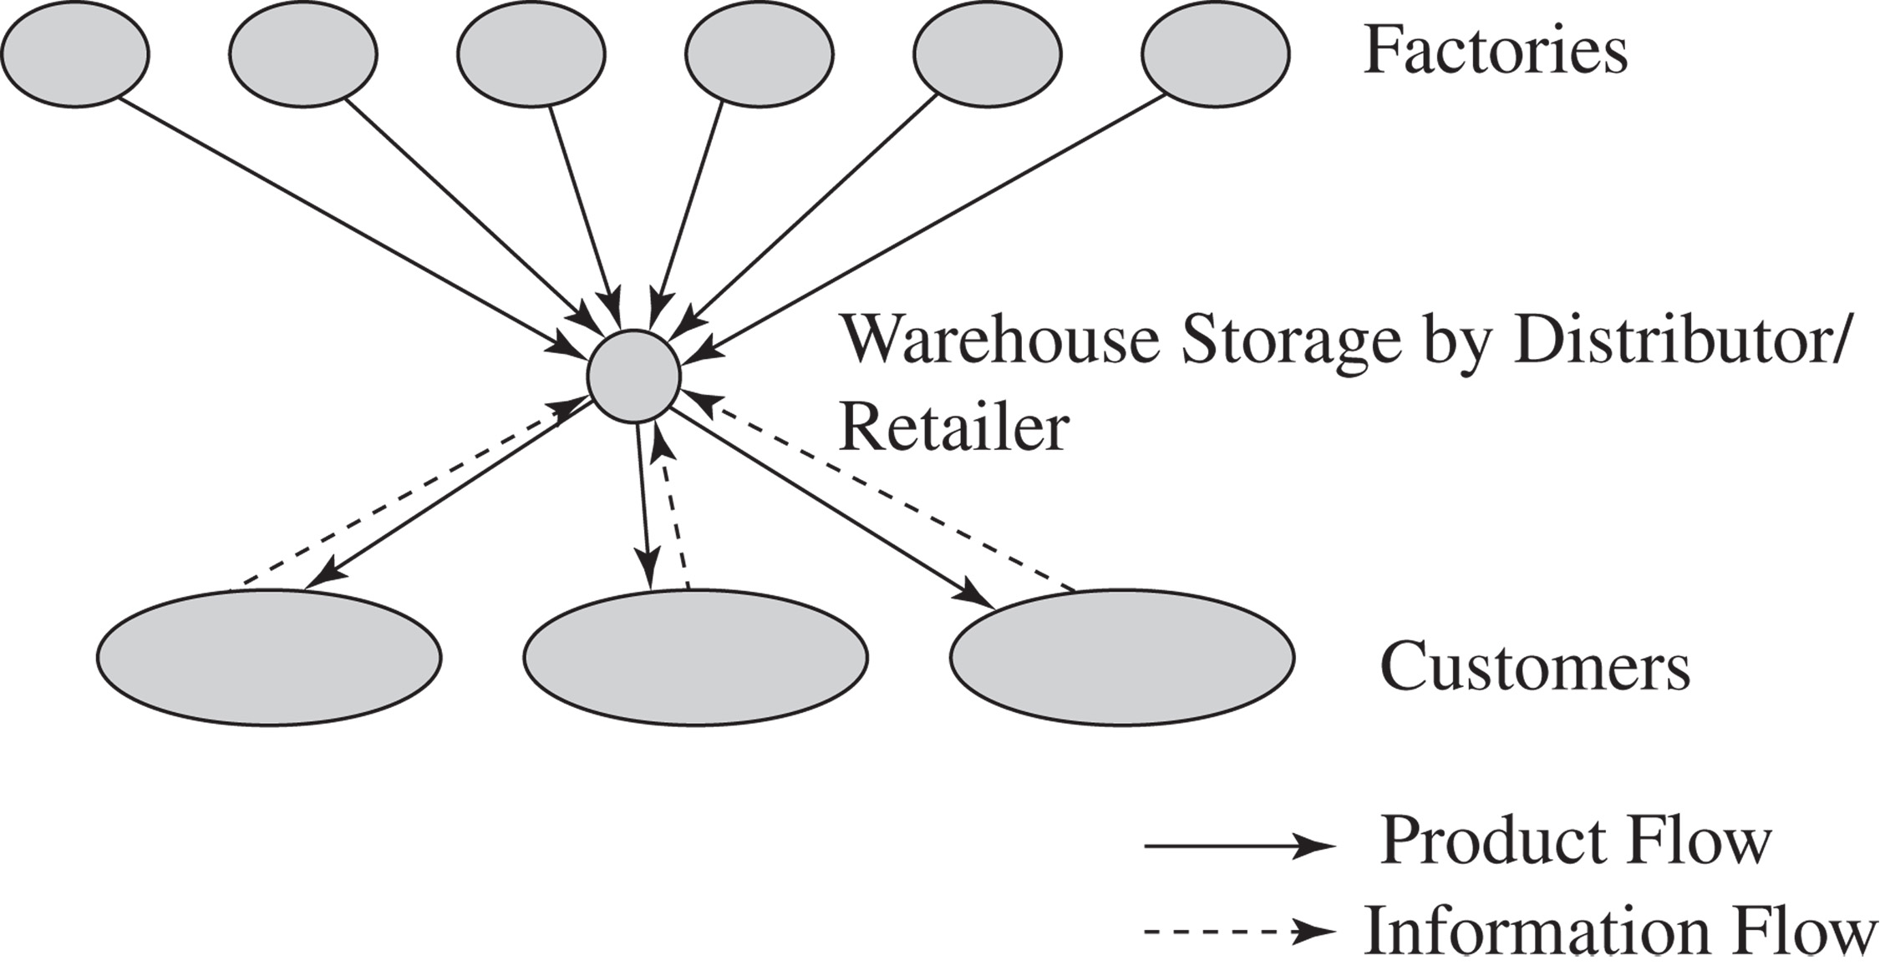
Distributor Storage with
Carrier Delivery
Figure 4-8

Slide 21
Distributor Storage with
Carrier Delivery
Cost Factor | Performance
Inventory | Higher than manufacturer storage. Difference is not large for faster moving items but can be large for very slow-moving items.
Transportation | Lower than manufacturer storage. Reduction is highest for faster moving items.
Facilities and handling | Somewhat higher than manufacturer storage. The difference can be large for very slow-moving items.
Information | Simpler infrastructure compared to manufacturer storage.
Table 4-3

Slide 22
Distributor Storage with
Carrier Delivery
Service Factor | Performance
Response time | Faster than manufacturer storage.
Product variety | Lower than manufacturer storage.
Product availability | Higher cost to provide the same level of availability as manufacturer storage.
Customer experience | Better than manufacturer storage with drop-shipping.
Time to market | Higher than manufacturer storage.
Order visibility | Easier than manufacturer storage.
Returnability | Easier than manufacturer storage.
Table 4-3

Slide 23
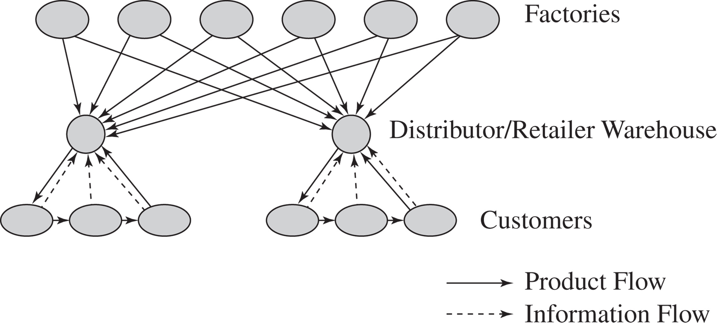
Distributor Storage with
Last Mile Delivery
Figure 4-9

Slide 24
Distributor Storage with
Last Mile Delivery
Cost Factor | Performance
Inventory | Higher than distributor storage with package carrier delivery.
Transportation | Very high cost given minimal scale economies. Higher than any other distribution option.
Facilities and handling | Facility costs higher than manufacturer storage or distributor storage with package carrier delivery, but lower than a chain of retail stores.
Information | Similar to distributor storage with package carrier delivery.
Table 4-4

Slide 25
Distributor Storage with
Last Mile Delivery
Service Factor | Performance
Response time | Very quick. Same day to next-day delivery.
Product variety | Somewhat less than distributor storage with package carrier delivery but larger than retail stores.
Product availability | More expensive to provide availability than any other option except retail stores.
Customer experience | Very good, particularly for bulky items. Slightly higher than distributor storage with package carrier delivery.
Time to market | Less of an issue and easier to implement than manufacturer storage or distributor storage with package carrier delivery.
Order visibility | Easier to implement than other previous options.
Returnability | Harder and more expensive than a retail network.
Table 4-4

Slide 26
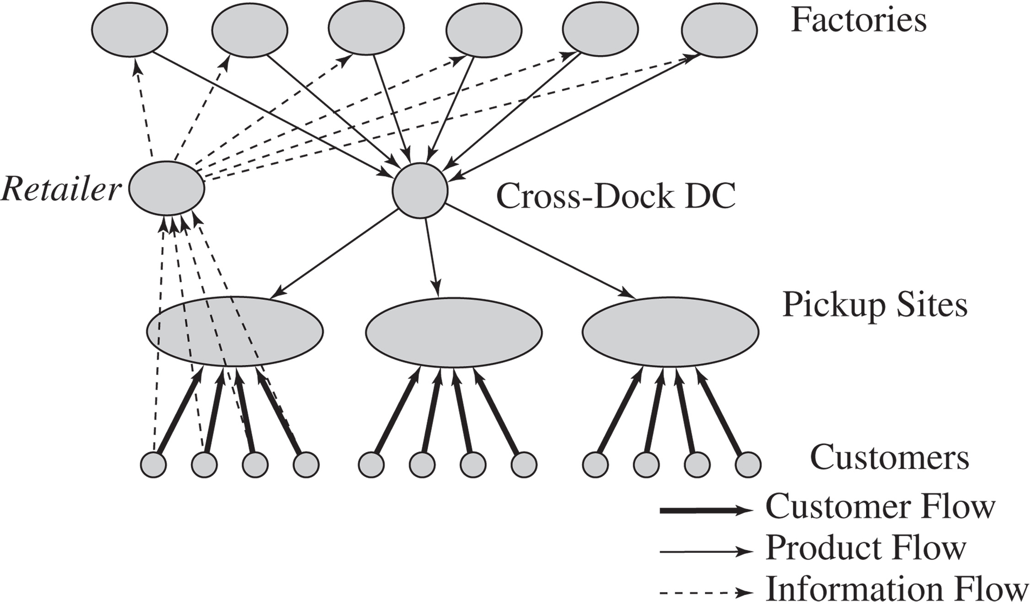
Manufacturer or Distributor Storage with Customer Pickup
Figure 4-10

Slide 27
Manufacturer or Distributor Storage with Customer Pickup
Cost Factor | Performance
Inventory | Can match any other option, depending on the location of inventory.
Transportation | Lower than the use of package carriers, especially if using an existing delivery network.
Facilities and handling | Facility costs can be high if new facilities have to be built. Costs are lower if existing facilities are used. The increase in handling cost at the pickup site can be significant.
Information | Significant investment in infrastructure required.
Table 4-5

Slide 28
Manufacturer or Distributor Storage with Customer Pickup
Service Factor | Performance
Response time | Similar to package carrier delivery with manufacturer or distributor storage. Same-day delivery possible for items stored locally at pickup site.
Product variety | Similar to other manufacturer or distributor storage options.
Product availability | Similar to other manufacturer or distributor storage options.
Customer experience | Lower than other options because of the lack of home delivery. Experience is sensitive to capability of pickup location.
Time to market | Similar to manufacturer storage options.
Order visibility | Difficult but essential.
Returnability | Somewhat easier given that pickup location can handle returns.
Table 4-5

Slide 29
Retail Storage with Customer Pickup
Cost Factor | Performance
Inventory | Higher than all other options.
Transportation | Lower than all other options.
Facilities and handling | Higher than other options. The increase in handling cost at the pickup site can be significant for online and phone orders.
Information | Some investment in infrastructure required for online and phone orders.
Table 4-6

Slide 30
Retail Storage with Customer Pickup
Service Factor | Performance
Response time | Same-day (immediate) pickup possible for items stored locally at pickup site.
Product variety | Lower than all other options.
Product availability | More expensive to provide than all other options.
Customer experience | Related to whether shopping is viewed as a positive or negative experience by customer.
Time to market | Highest among distribution options.
Order visibility | Trivial for in-store orders. Difficult, but essential, for online and phone orders.
Returnability | Easier than other options because retail store can provide a substitute.
Table 4-6

Slide 31
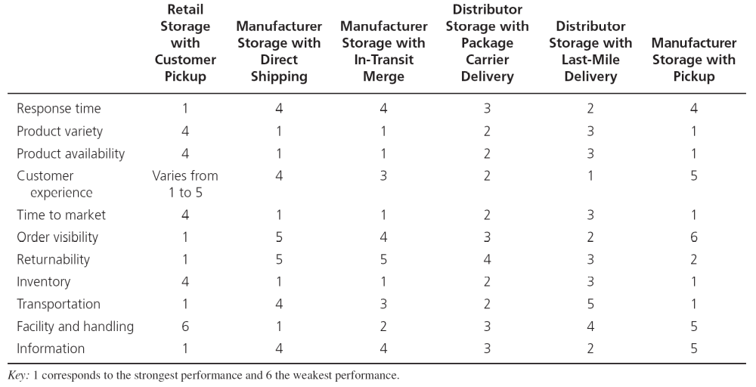
Comparative Performance of Delivery Network Designs
Table 4-7
Notes:
Identify the best and worst network along various dimensions.
Response time: (B) retail stores (W) Manufacturer storage with direct ship
Product variety: (W) retail stores (B) Manufacturer storage with direct ship
Product availability: (W) retail store (B) Manufacturer storage
Inventory: (W) retail store (B) manufacturer storage
Transportation: (B) retail store (W) last mile delivery
Facility: (W) retail store (B) manufacturer storage
Handling: (W) Distributor storage with last mile delivery (B)
Information: Retail stores may be less complex; manufacturer storage with pickup may be very complex

Slide 32
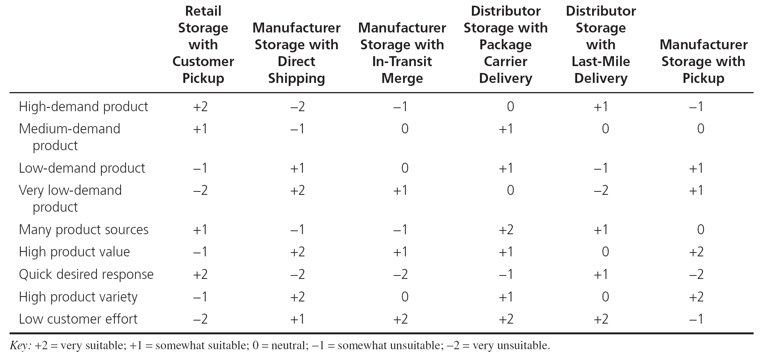
Delivery Networks for Different Product/ Customer Characteristics
Table 4-8
Notes:
When designing the delivery network we should account for product and market characteristics.
High demand products will have transportation cost play a significant role. Use network with good transportation cost (retail stores)
Very low demand products will have inventory play a significant role. Use network with low inventory costs (direct shipping)
Many product sources: transportation + information plays a role. Distributor storage with package carrier
Few product sources but high customization: manufacturer storage with merge in transit
High product variety: inventory cost will be significant. Use distributor storage
Low customer effort: Distributor storage with package carrier delivery or last mile delivery depending upon desired response time

Slide 33
Impact of Online Sales on Customer Service
Response time to customers
  Physical products take longer to fulfill than retail store
  No delay for information goods
Product variety
  Easier to offer larger selection
Product availability
  Aggregating inventory and better information on customer preferences improves product availability

Slide 34
Impact of Online Sales on Customer Service
Customer experience
  Improved access, customization, and convenience
Faster time to market
Order Visibility
Returnability
  Harder with online orders
  Proportion of returns likely to be much higher

Slide 35
Impact of Online Sales on Customer Service
Direct Sales to Customers
  Social networking channels allow firms to directly pitch products and promotion
Flexible Pricing, Product Portfolio, and Promotions
  Manage revenues from product portfolio more effectively than traditional channels
  Promotion information can be conveyed to customers quickly and inexpensively
Efficient Funds Transfer

Slide 36
Impact of Online Sales on Cost
Inventory
  Lower inventory levels if customers will wait
  Postpone variety until after the customer order is received
Facilities
  Costs related to the number and location of facilities in a network
  Costs associated with the operations in these facilities

Slide 37
Impact of Online Sales on Cost
Transportation
  Lower cost of “transporting” information goods in digital form
  For nondigital, aggregating inventories increases outbound transportation
Information
  Share demand, planning, and forecasting information throughout its supply chain
  Additional costs to build and maintain the information infrastructure

Slide 38
Online Sales Scorecard
Area | Impact
Response time
Product variety
Product availability
Customer experience
Time to market
Order visibility
Direct sales
Flexible pricing, portfolio, promotions
Efficient funds transfer
Inventory
Facilities
Transportation
Information
Key: +2 = very positive; +1 = positive; 0 = neutral; −1 = negative; −2 = very negative.
Table 4-9

Slide 39
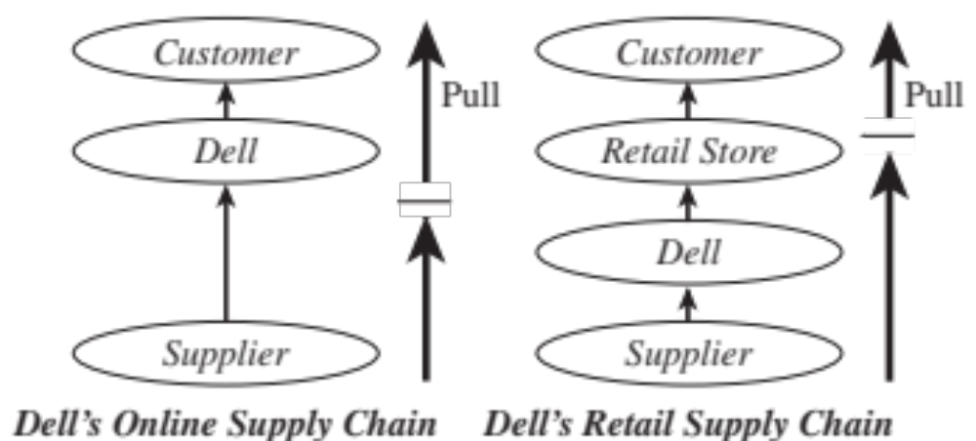
Using Online Sales to Sell Computer Hardware: Dell
Figure 4-11

Slide 40
Using Online Sales to Sell Computer Hardware: Dell
Impact of online sales on customer service
  Delay in fulfilling customer request
Impact of online sales on cost
  Reduced inventory costs
  Lower facility costs
  Higher total transportation costs
  Incremental increase in information costs

Slide 41
Impact of Online Sales on Performance
Table 4-10
Area | Impact for Customized Hardware | Impact for Standard Low-Cost Hardware
Response time | –1 | –2
Product variety | +2 | 0
Product availability | +1 | +1
Customer experience | +2 | +1
Time to market | +2 | +1
Order visibility | +1 | 0
Direct sales | +2 | +1
Flexible pricing, portfolio, promotions | +2 | +1
Efficient funds transfer | +2 | +2
Inventory | +2 | +1
Facilities | +2 | +1
Transportation | –1 | –2
Information | 0 | 0

Slide 42
Using Online Sales to Sell Computer Hardware: Dell
A tailored supply chain network
  A hybrid model can be very effective
  More significant as hardware becomes more of a commodity
  Take advantage of the strengths of both online sales and traditional retail and distribution channels

Slide 43
Using Online Sales to Sell Books: Amazon
Impact of online sales on customer service
  Internet has not shortened supply chains
  Increased selection, convenience
Impact of online sales on cost
  Reduced inventory costs
  Lower facility costs
  Higher total transportation costs
  Increase in information costs

Slide 44
Impact of Online Sales on Performance
Table 4-11
Area | Physical books | e-books
Response time | –1 | +1
Product variety | +2 | +2
Product availability | +1 | +2
Customer experience | +1 | +1
Time to market | +1 | +2
Order visibility | 0 | 0
Direct sales | 0 | +1
Flexible pricing, portfolio, promotions | +1 | +1
Efficient funds transfer | 0 | 0
Inventory | +1 | +2
Facilities | +1 | +1
Transportation | –2 | +1
Information | –1 | –1

Slide 45
Using Online Sales to Sell Books: Amazon
A supply chain network for books
  Traditional bookstores pressured from both ends
  Amazon more efficient

Slide 46
Using the Internet to Sell Groceries: Peapod
Impact of online sales on customer service
  Sell convenience and the time savings
  Offers less variety
  Creating a personalized shopping experience and customized advertising and promotions

Slide 47
Using the Internet to Sell Groceries: Peapod
Impact of online sales on cost
  Reduced inventory costs
  Higher facility costs due to picking operation
  Significantly higher total transportation costs
  Increase in information costs

Slide 48
Impact of Online Sales on Performance
Table 4-12
Area | Impact
Response time | –1
Product variety | 0
Product availability | 0
Customer experience | +1
Time to market | 0
Order visibility | –1
Direct sales | 0
Flexible pricing, portfolio, promotions | +1
Efficient funds transfer | 0
Inventory | 0
Facilities | –1
Transportation | –2
Information | –1

Slide 49
Using Internet to Sell Groceries: Peapod
Value of online sales to a traditional grocery chain
  Complement the strengths of their existing network
  Offer an entire array of services at differing prices based on the amount of work the customer does

Slide 50
Using the Internet to Rent Movies: Netflix
Impact of online sales on customer service
  Staggering selection and an excellent recommendation engine
  Video streaming through a variety of devices
  Customers received their DVDs within 24 hours of being shipped

Slide 51
Using the Internet to Rent Movies: Netflix
Impact of online sales on cost
  Reduced inventory costs
  Lower facility costs
  Considerably higher total transportation costs, increased streaming will reduce transportation costs
  Increase in information costs

Slide 52
Impact of Online Sales on Performance
Table 4-12
Area | Impact for DVDs | Impact for Digital Content
Response time | –1 | +2
Product variety | +2 | +2
Product availability | +1 | +2
Customer experience | +1 | +1
Time to market | –1 | –1
Order visibility | 0 | 0
Direct sales | 0 | 0
Flexible pricing, portfolio, promotions | +1 | +1
Efficient funds transfer | 0 | 0
Inventory | +2 | +2
Facilities | +1 | +1
Transportation | –2 | 0
Information | –1 | –1

Slide 53
Distribution Networks in Practice
The ownership structure of the distribution network can have as big as an impact as the type of distribution network
It is important to have adaptable distribution networks
Product price, commoditization, and criticality affect the type of distribution system preferred by customers
Integrate the Internet with the existing physical network

Slide 54
Distribution Networks in Practice
Consider whether an exclusive distribution strategy is advantageous
Product, price, commoditization, and criticality have an impact on the type of distribution system preferred by customers

Slide 55
Summary of Learning Objectives
Identify the key factors to be considered when designing a distribution network
Discuss the strengths and weaknesses of various distribution options
Understand how online sales have affected the design of distribution networks in different industries

Slide 56

All rights reserved. No part of this publication may be reproduced, stored in a retrieval system, or transmitted, in any form or by any means, electronic, mechanical, photocopying, recording, or otherwise, without the prior written permission of the publisher.
Printed in the United States of America.

