Slide 1
Network Design in the Supply Chain
5

Slide 2
Learning Objectives
Understand the role of network design in a supply chain.
Identify factors influencing supply chain network design decisions.
Develop a framework for making network design decisions.
Use optimization for facility location and capacity allocation decisions.
Notes:
Notes:

Slide 3
Network Design Decisions
Facility role
  What role, what processes?
Facility location
  Where should facilities be located?
Capacity allocation
  How much capacity at each facility?
Market and supply allocation
  What markets? Which supply sources?

Slide 4
Factors Influencing
Network Design Decisions
Strategic factors
Technological factors
Macroeconomic factors
  Tariffs and tax incentives
  Exchange-rate and demand risk
  Freight and fuel costs
Political

Slide 5
Factors Influencing
Network Design Decisions
Infrastructure factors
Competitive factors
  Positive externalities between firms
  Locating to split the market
Customer response time and local presence
Logistics and facility costs

Slide 6
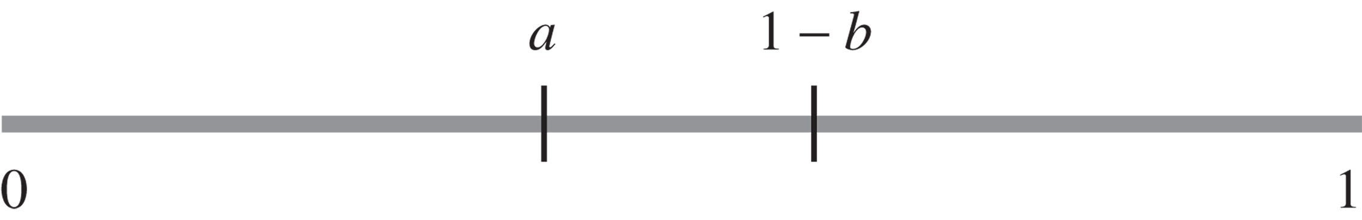
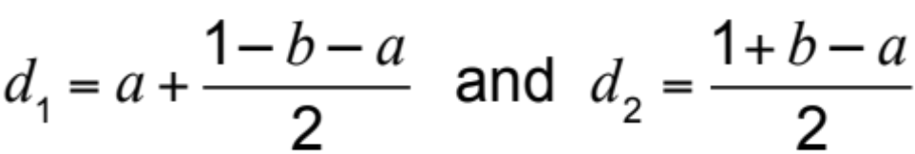
Competitive Factors
  Positive externalities between firms
    Collocation benefits all
Figure 5-1
  Locating to split the market
    Locate to capture largest market share

Slide 7
Framework for Network Design Decisions
Phase I: Define a Supply Chain Strategy/Design
  Clear definition of the firm’s competitive strategy
  Forecast the likely evolution of global competition
  Identify constraints on available capital
  Determine growth strategy

Slide 8
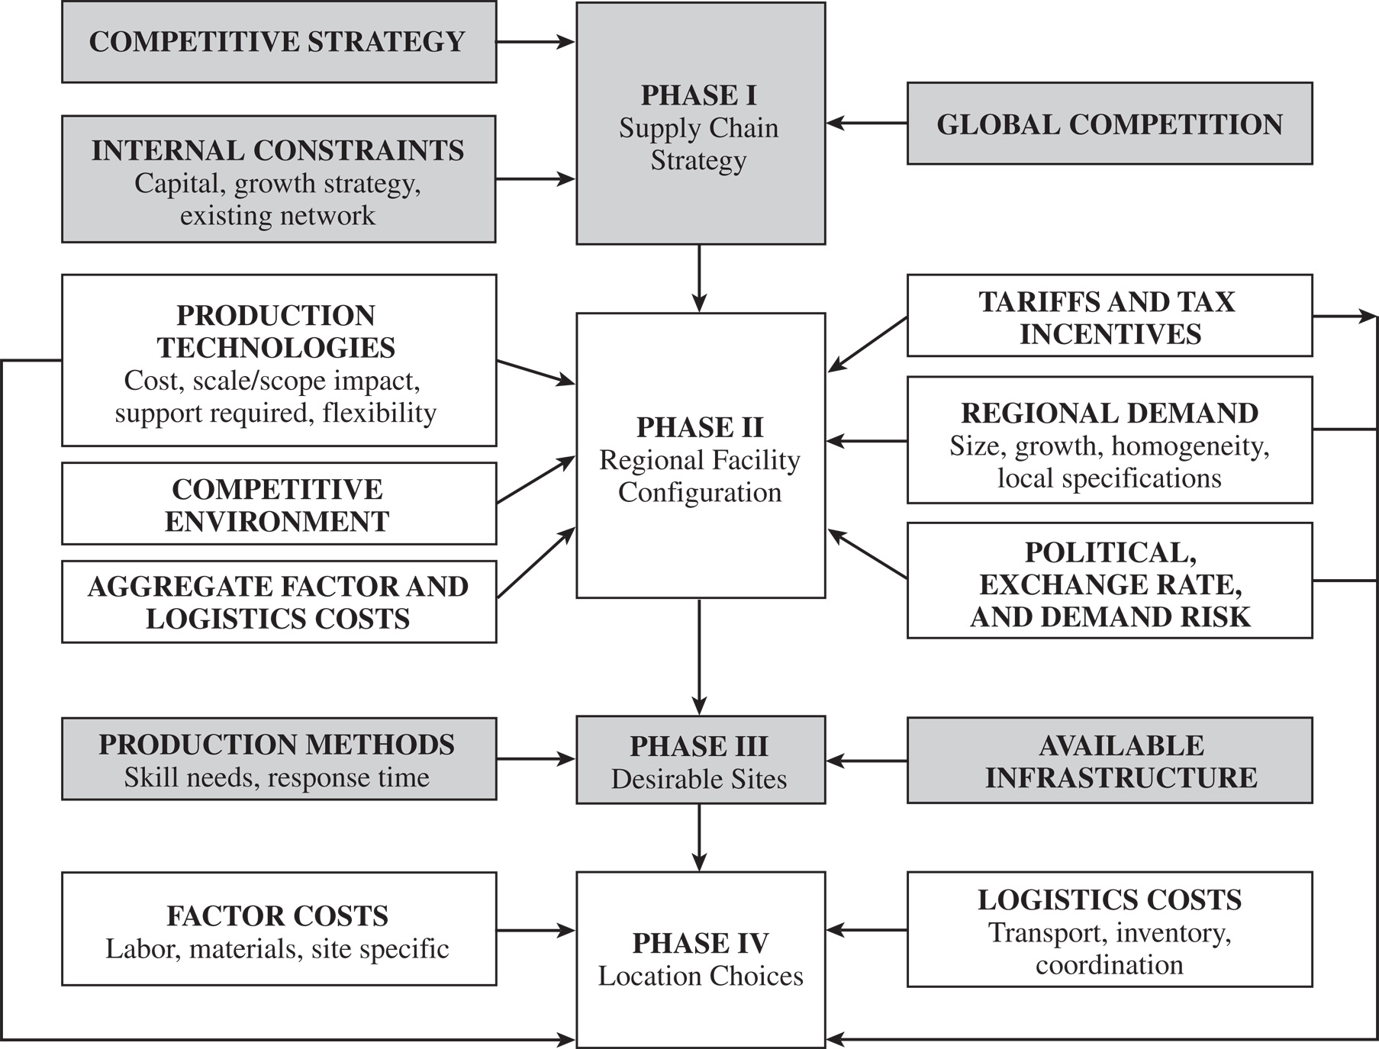
Framework for Network Design Decisions
Figure 5-2

Slide 9
Framework for Network Design Decisions
Phase II: Define the Regional Facility Configuration
  Forecast of the demand by country or region
  Economies of scale or scope
  Identify demand risk, exchange-rate risk, political risk, tariffs, requirements for local production, tax incentives, and export or import restrictions
  Identify competitors

Slide 10
Framework for Network Design Decisions
Phase III: Select a Set of Desirable Potential Sites
  Hard infrastructure requirements
  Soft infrastructure requirements
Phase IV: Location Choices

Slide 11
Models for Facility Location and Capacity Allocation
Maximize the overall profitability of the supply chain network while providing customers with the appropriate responsiveness
Many trade-offs during network design
Network design models used to decide on locations and capacities and to assign current demand to facilities

Slide 12
Models for Facility Location and Capacity Allocation
Important information
  Location of supply sources and markets
  Location of potential facility sites
  Demand forecast by market
  Facility, labor, and material costs by site
  Transportation costs between each pair of sites
  Inventory costs by site and as a function of quantity
  Sale price of product in different regions
  Taxes and tariffs
  Desired response time and other service factors

Slide 13
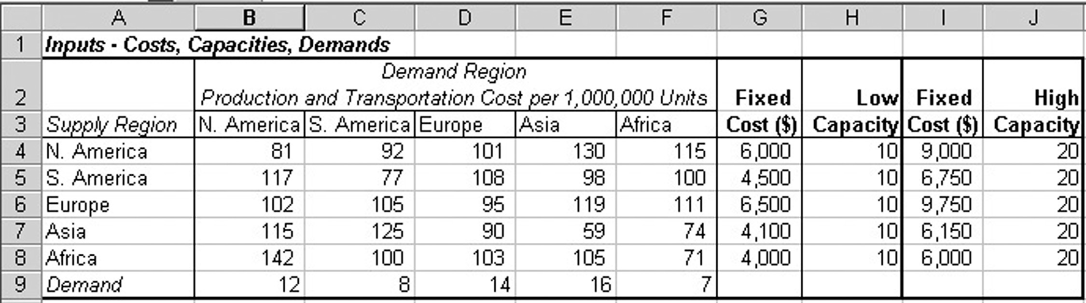
Phase II: Network Optimization Models
Figure 5-3

Slide 14


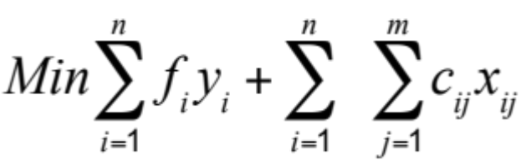
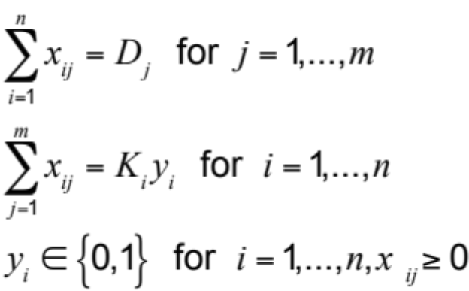
Capacitated Plant Location Model
= number of potential plant locations/capacity
= number of markets or demand points
= 1 if plant i is open, 0 otherwise
= annual demand from market j
= quantity shipped from plant i to market j
= potential capacity of plant i
= annualized fixed cost of keeping plant i open
= cost of producing and shipping one unit from plant i to market j (cost includes production, inventory, transportation, and tariffs)
subject to

Slide 15
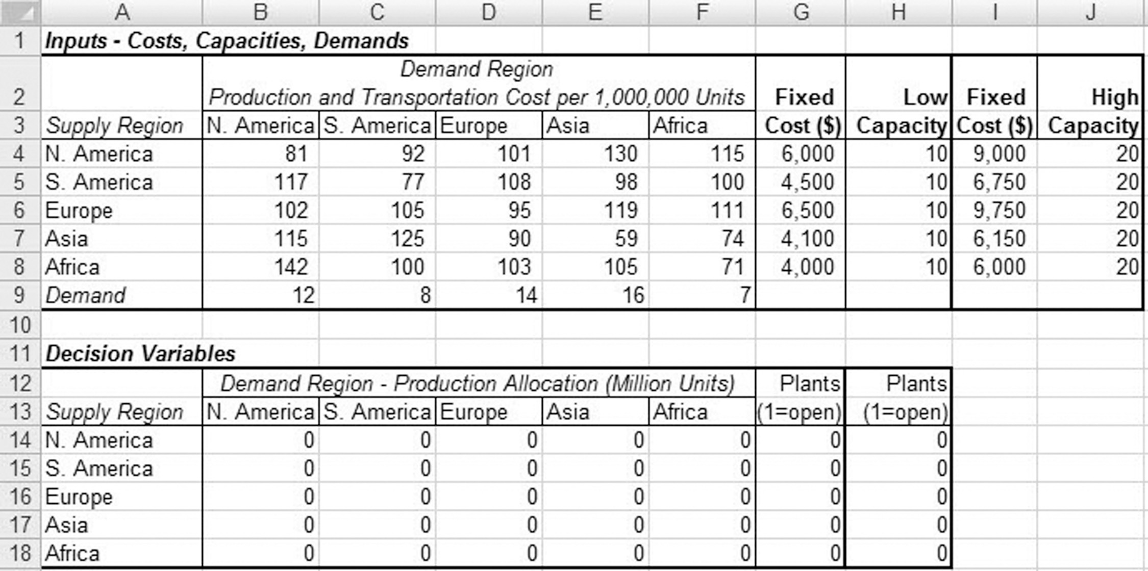
Capacitated Plant Location Model
Figure 5-4

Slide 16
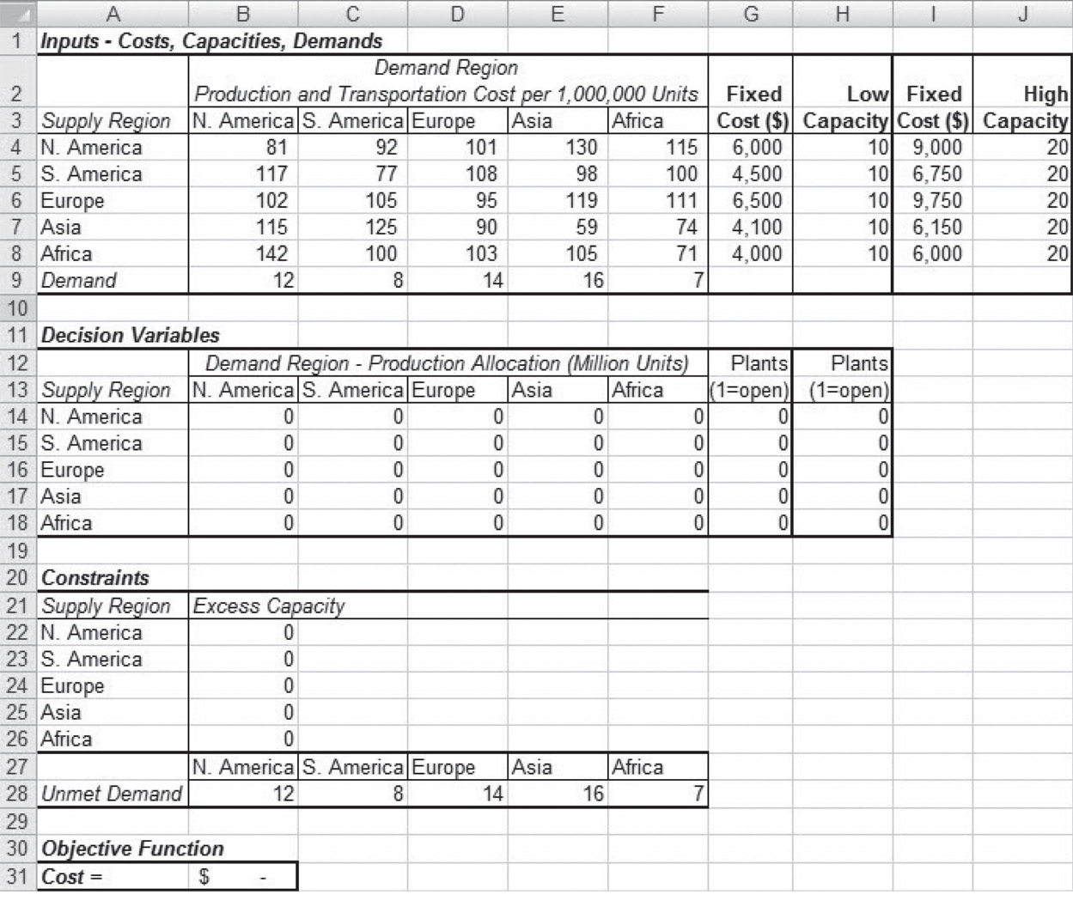
Capacitated Plant Location Model
Figure 5-5

Slide 17
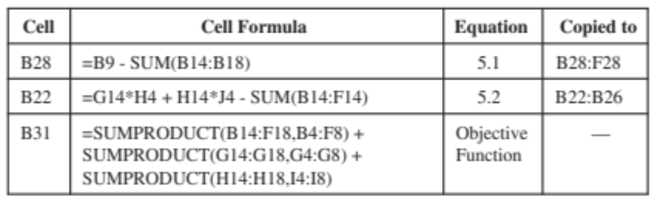
Capacitated Plant Location Model
Figure 5-5

Slide 18
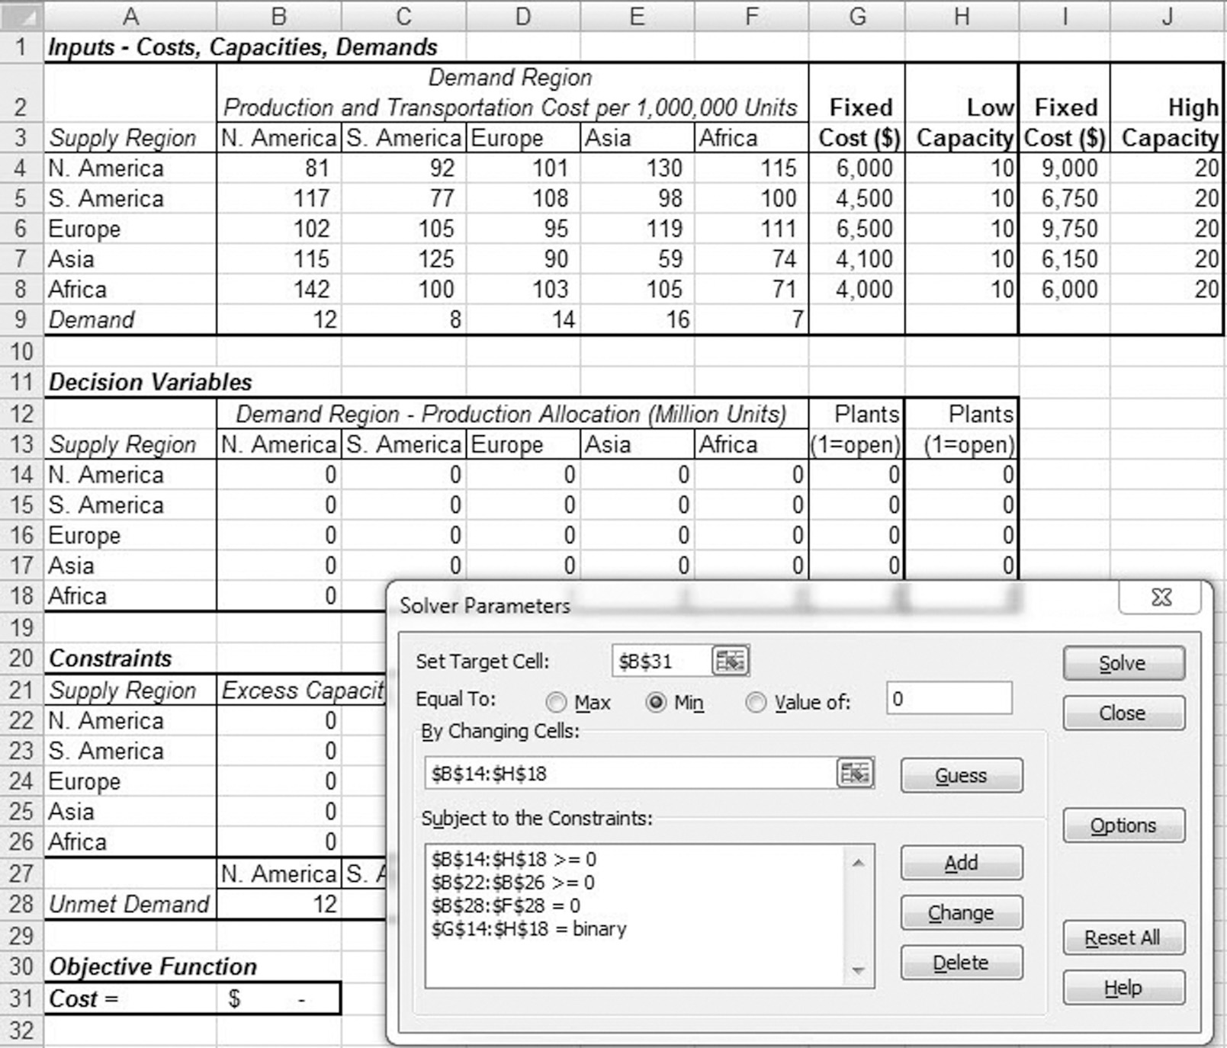
Phase III: Gravity Location Models
Figure 5-6

Slide 19
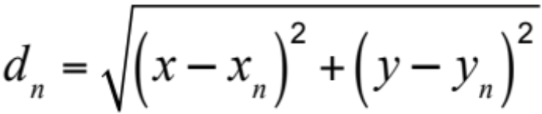
Gravity Location Model
x_{n}, y_{n}: coordinate location of either a market or supply source n
F_{n}: cost of shipping one unit for one mile between the facility and either market or supply source n
D_{n}: quantity to be shipped between facility and market or supply source n
(x, y) is the location selected for the facility, the distance d_{n} between the facility at location (x, y) and the supply source or market n is given by

Slide 20
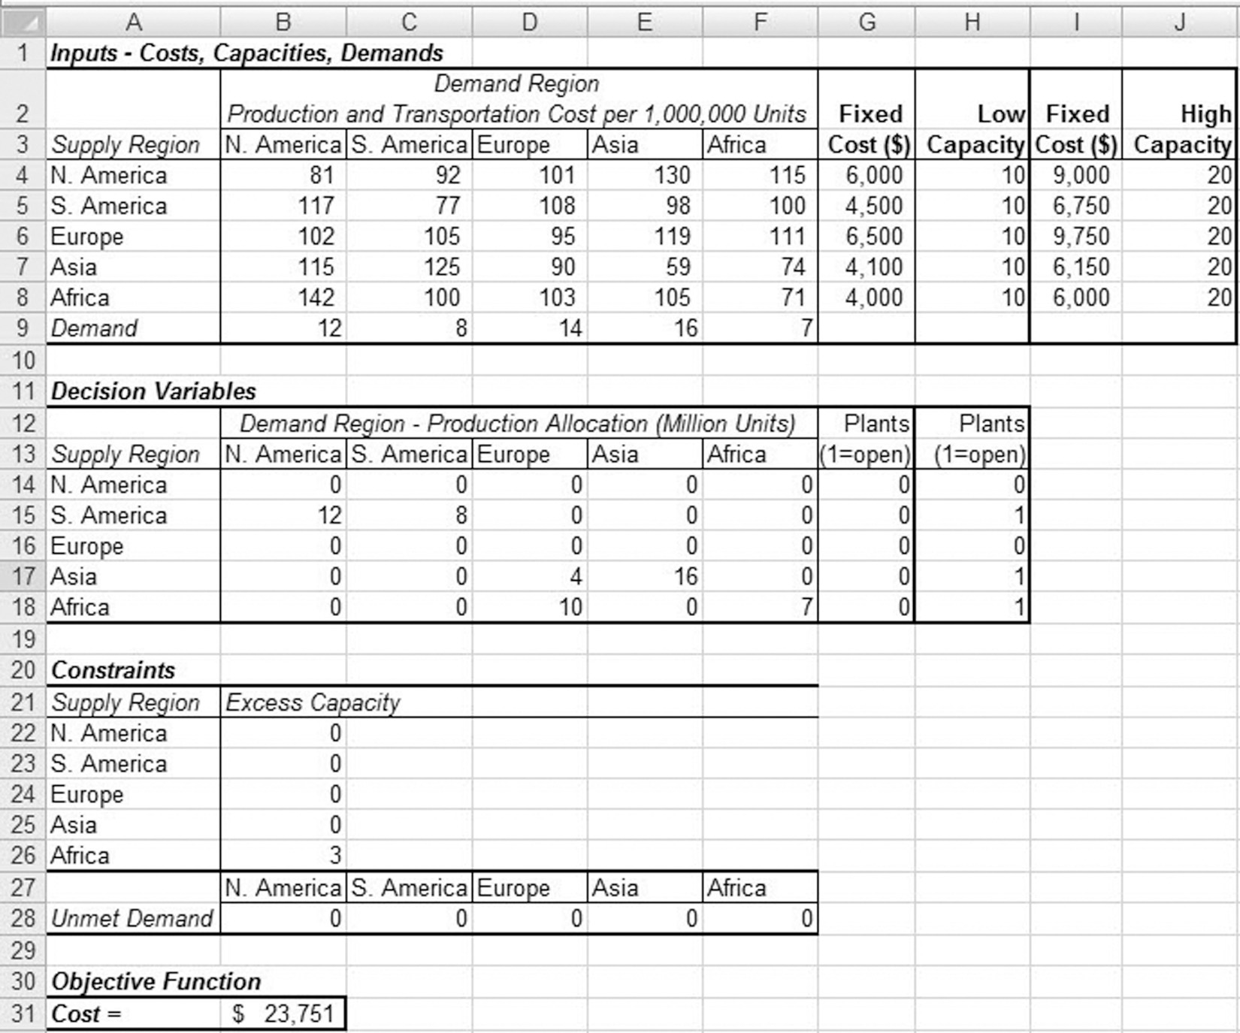
Gravity Location Model
Figure 5-7

Slide 21
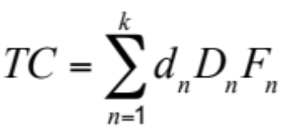
Gravity Location Model
Sources/Markets | Transportation Cost $/Ton Mile (F_{n}) | Quantity in Tons (D_{n}) | Coordinates
 |  |  | x_{n} | y_{n}
Supply sources
Buffalo | 0.90 | 500 | 700 | 1,200
Memphis | 0.95 | 300 | 250 | 600
St. Louis | 0.85 | 700 | 225 | 825
Markets
Atlanta | 1.50 | 225 | 600 | 500
Boston | 1.50 | 150 | 1,050 | 1,200
Jacksonville | 1.50 | 250 | 800 | 300
Philadelphia | 1.50 | 175 | 925 | 975
New York | 1.50 | 300 | 1,000 | 1,080
Table 5-1
Total transportation cost

Slide 22
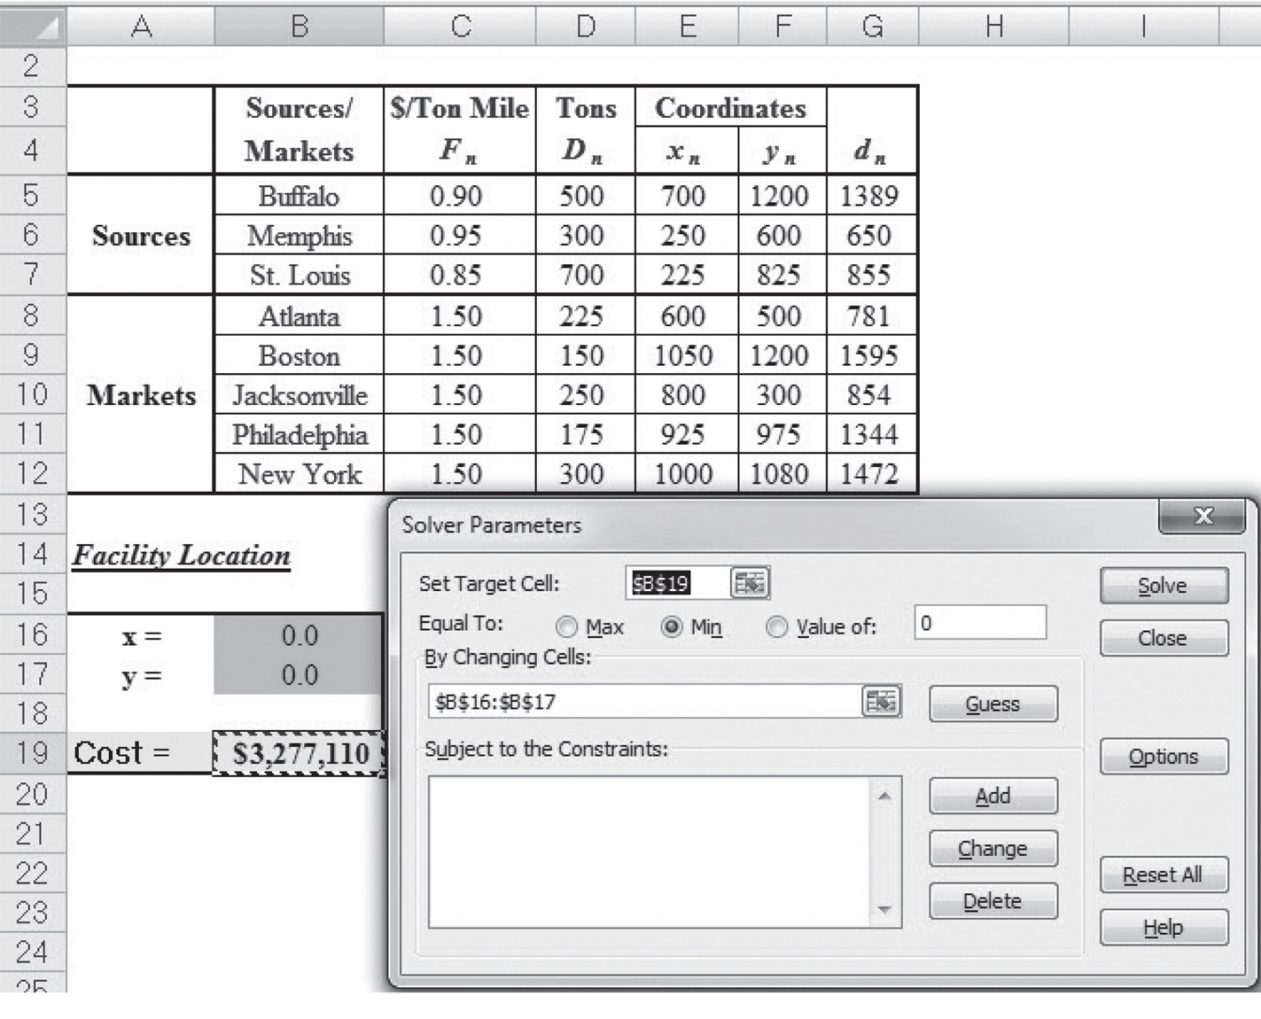
Gravity Location Model
Figure 5-8

Slide 23
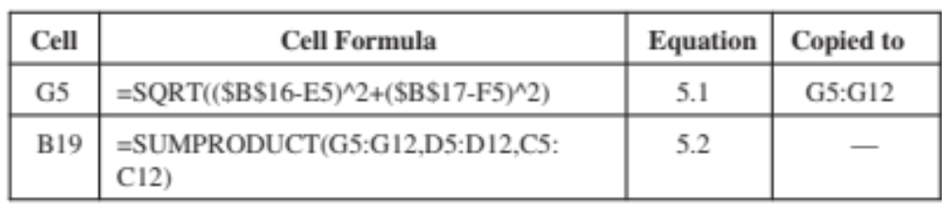
Gravity Location Model
Figure 5-8

Slide 24
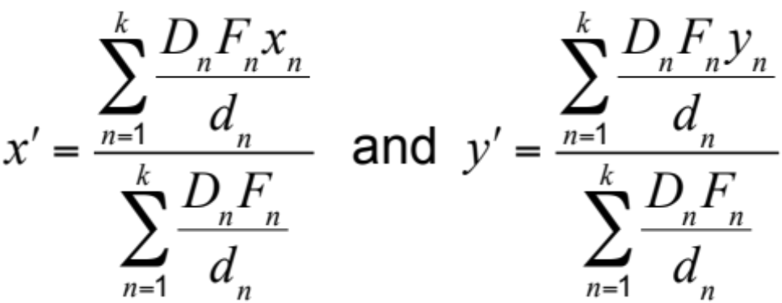
Gravity Location Model
For each supply source or market n, evaluate d_{n}
Obtain a new location (x’, y’) for the facility, where
If the new location (x’ , y’ ) is almost the same as
(x, y) stop. Otherwise, set (x, y) = (x’ , y’ ) and go to step 1

Slide 25
Phase IV: Network Optimization Models
Supply City | Demand City Production and Transportation Cost per Thousand Units (Thousand $) |  |  |  |  |  | Monthly Capacity (Thousand Units) K | Monthly Fixed Cost (Thousand $) f
 | Atlanta | Boston | Chicago | Denver | Omaha | Portland
Baltimore | 1,675 | 400 | 985 | 1,630 | 1,160 | 2,800 | 18 | 7,650
Cheyenne | 1,460 | 1,940 | 970 | 100 | 495 | 1,200 | 24 | 3,500
Salt Lake City | 1,925 | 2,400 | 1,450 | 500 | 950 | 800 | 27 | 5,000
Memphis | 380 | 1,355 | 543 | 1,045 | 665 | 2,321 | 22 | 4,100
Wichita | 922 | 1,646 | 700 | 508 | 311 | 1,797 | 31 | 2,200
Monthly demand (thousand units) D_{j} | 10 | 8 | 14 | 6 | 7 | 11
Table 5-2

Slide 26

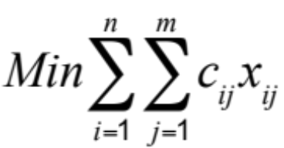
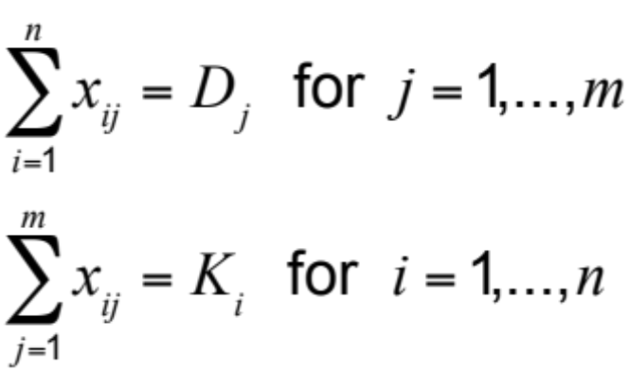
Network Optimization Models
Allocating demand to production facilities
= number of factory locations
= number of markets or demand points
x_{ij} = quantity shipped from factory i to market j
= annual demand from market j
= capacity of factory i
= cost of producing and shipping one unit from factory i to market j
subject to

Slide 27
Network Optimization Models
Optimal demand allocation
 |  | Atlanta | Boston | Chicago | Denver | Omaha | Portland
TelecomOne | Baltimore | 0 | 8 | 2
 | Memphis | 10 | 0 | 12
 | Wichita | 0 | 0 | 0
HighOptic | Salt Lake |  |  |  | 0 | 0 | 11
 | Cheyenne |  |  |  | 6 | 7 | 0
Table 5-3

Slide 28
Capacitated Plant Location Model
Merge the companies
Solve using location-specific costs
y_{i} = 1 if factory i is open, 0 otherwise
x_{ij} = quantity shipped from factory i to market j

Slide 29
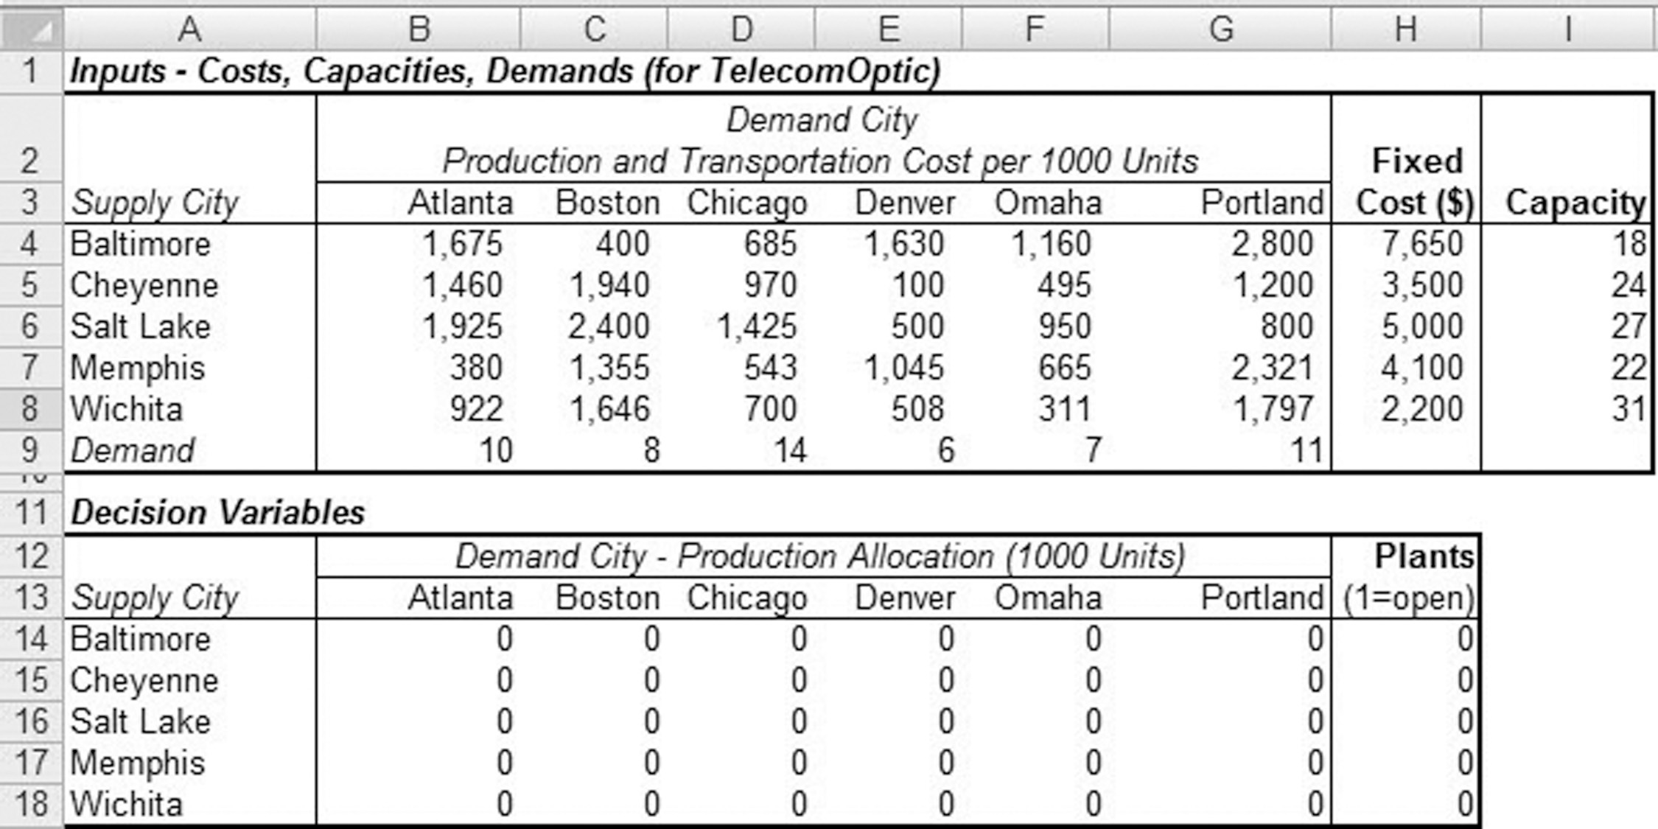
Capacitated Plant Location Model
Figure 5-9

Slide 30
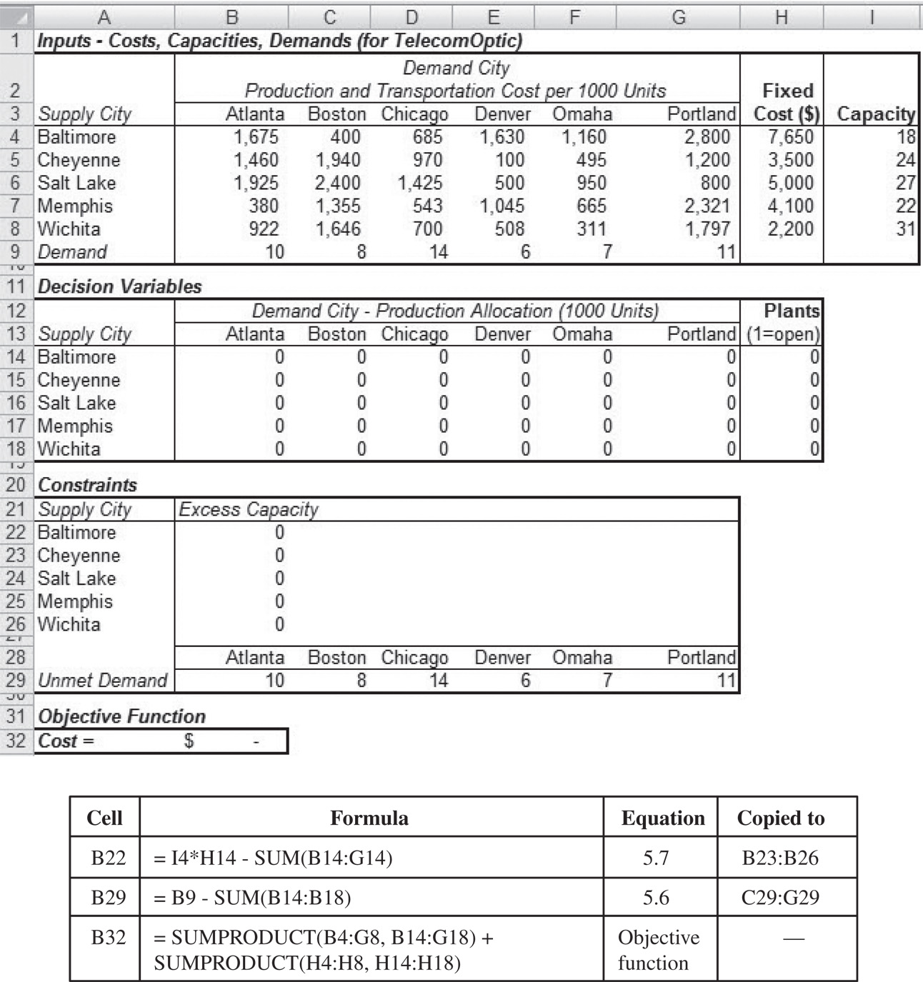
Capacitated Plant Location Model
Figure 5-10

Slide 31
Capacitated Plant Location Model
Figure 5-10

Slide 32
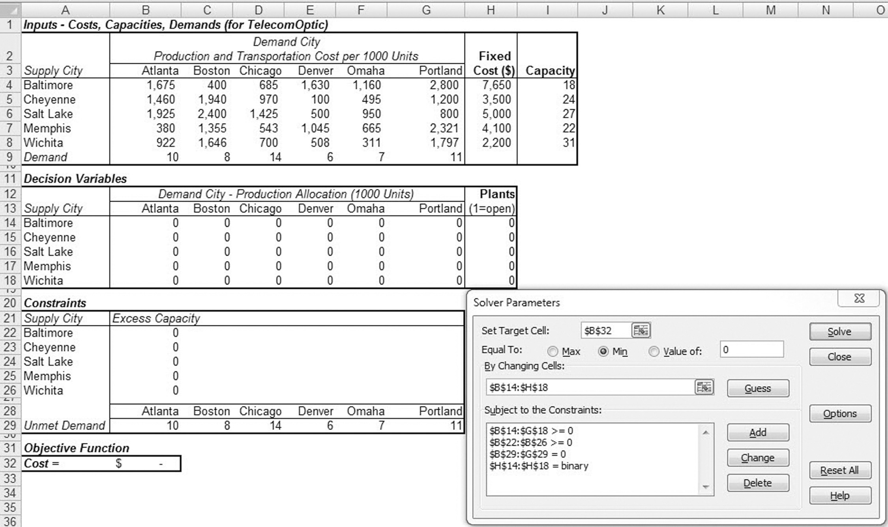
Capacitated Plant Location Model
Figure 5-11

Slide 33
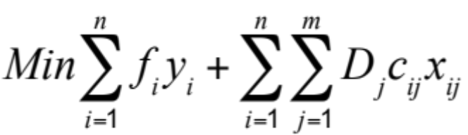
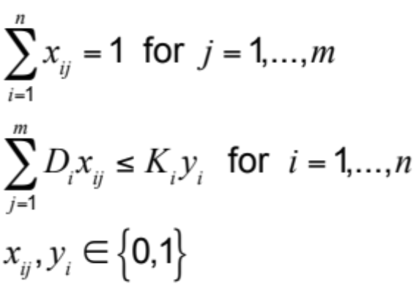
Capacitated Model With
Single Sourcing
Market supplied by only one factory
Modify decision variables
y_{i} = 1 if factory i is open, 0 otherwise
x_{ij} = 1 if market j is supplied by factory i, 0 otherwise
subject to

Slide 34
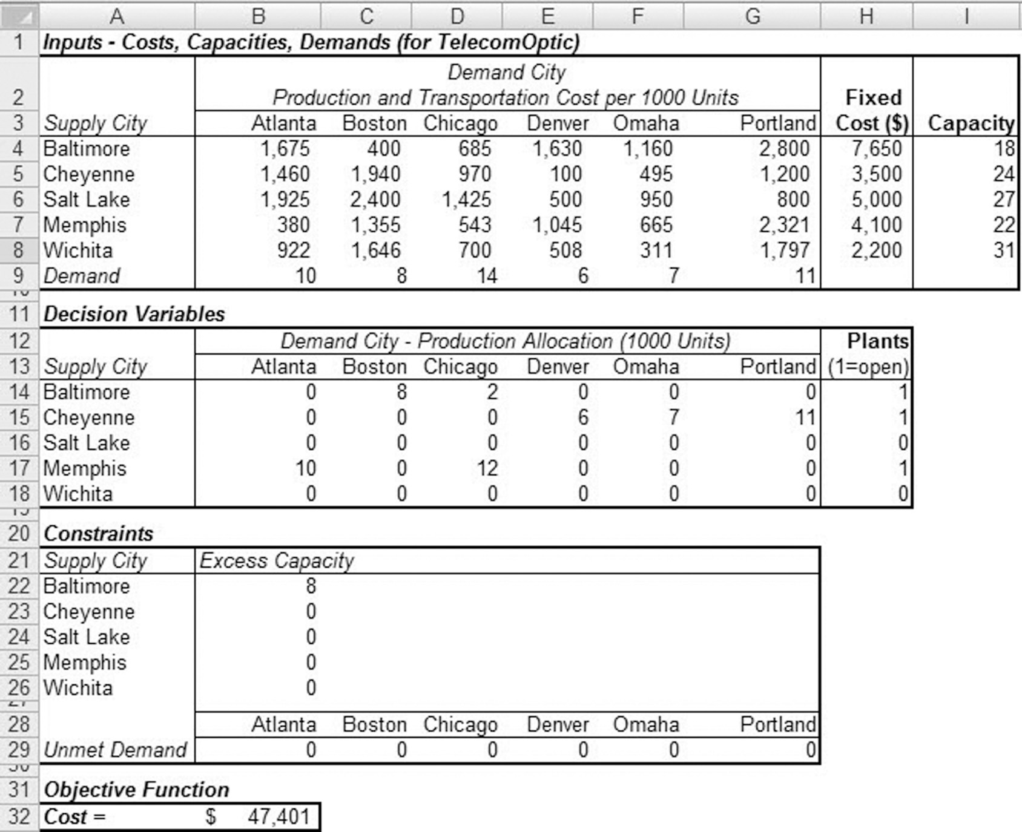
Capacitated Model With
Single Sourcing
Figure 5-12

Slide 35
Capacitated Model With
Single Sourcing
Optimal network configuration with single sourcing
 | Open/ Closed | Atlanta | Boston | Chicago | Denver | Omaha | Portland
Baltimore | Closed | 0 | 0 | 0 | 0 | 0 | 0
Cheyenne | Closed | 0 | 0 | 0 | 0 | 0 | 0
Salt Lake | Open | 0 | 0 | 0 | 6 | 0 | 11
Memphis | Open | 10 | 8 | 0 | 0 | 0 | 0
Wichita | Open | 0 | 0 | 14 | 0 | 7 | 0
Table 5-4

Slide 36
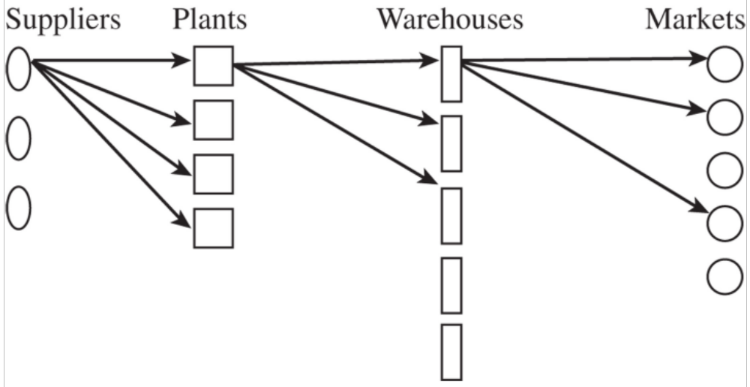
Locating Plants and Warehouses Simultaneously
Figure 5-13

Slide 37
Locating Plants and Warehouses Simultaneously
Model inputs
m = number of markets or demand points
n = number of potential factory locations
l = number of suppliers
t = number of potential warehouse locations
D_{j} = annual demand from customer j
K_{i} = potential capacity of factory at site i
S_{h} = supply capacity at supplier h
W_{e} = potential warehouse capacity at site e
F_{i} = fixed cost of locating a plant at site i
f_{e} = fixed cost of locating a warehouse at site e
c_{hi} = cost of shipping one unit from supply source h to factory i
c_{ie} = cost of producing and shipping one unit from factory i to warehouse e
c_{ej} = cost of shipping one unit from warehouse e to customer j

Slide 38
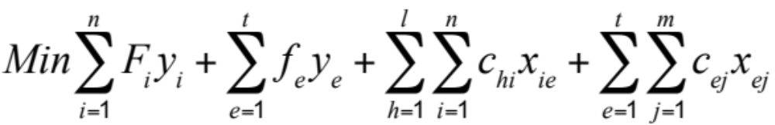
Locating Plants and Warehouses Simultaneously
Goal is to identify plant and warehouse locations and quantities shipped that minimize the total fixed and variable costs
Y_{i} = 1 if factory is located at site i, 0 otherwise
Y_{e} = 1 if warehouse is located at site e, 0 otherwise
x_{ej} = quantity shipped from warehouse e to market j
x_{ie} = quantity shipped from factory at site i to warehouse e
x_{hi} = quantity shipped from supplier h to factory at site i

Slide 39
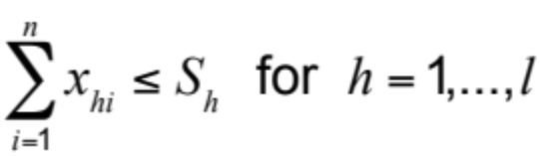
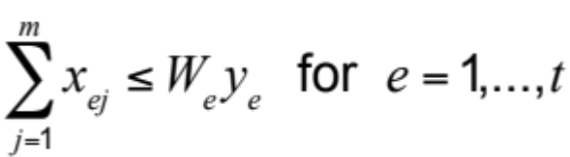
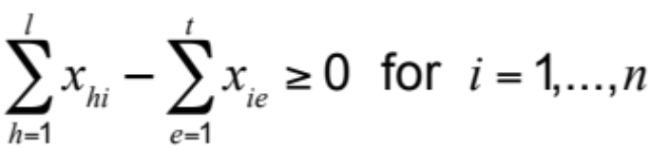
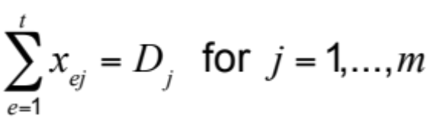
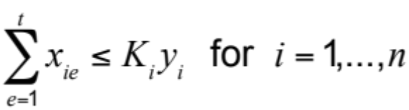

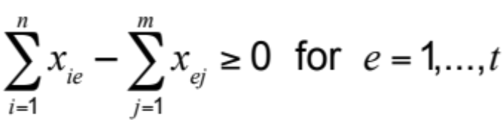
Locating Plants and Warehouses Simultaneously
subject to

Slide 40
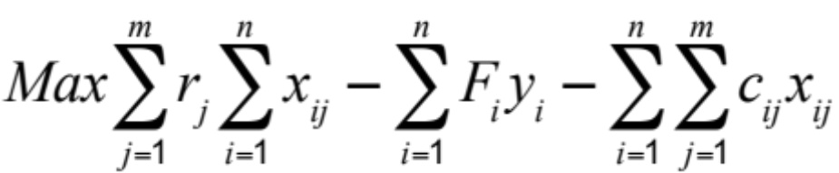
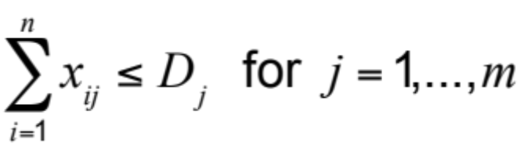
Accounting for Taxes, Tariffs, and Customer Requirements
A supply chain network should maximize profits after tariffs and taxes while meeting customer service requirements
Modified objective and constraint

Slide 41
Making Network Design Decisions In Practice
Do not underestimate the life span of facilities
Do not gloss over the cultural implications
Do not ignore quality-of-life issues
Focus on tariffs and tax incentives when locating facilities

Slide 42
Summary of Learning Objectives
Understand the role of network design in a supply chain
Identify factors influencing supply chain network design decisions
Develop a framework for making network design decisions
Use optimization for facility location and capacity allocation decisions
Notes:
Notes:

Slide 43

All rights reserved. No part of this publication may be reproduced, stored in a retrieval system, or transmitted, in any form or by any means, electronic, mechanical, photocopying, recording, or otherwise, without the prior written permission of the publisher.
Printed in the United States of America.

